Slide 1
PSB reference measurements
F. Asvesta, H. Bartosik, E. Koukovini-Platia, T. Rijoff, G. Rumolo, C. Zannini
Acknowledgments: F. Antoniou, G. Di Giovanni

Slide 2
Overview
Impedance reference measurements
  Tune shift measurements
  Horizontal instability measurements
Horizontal instability at the end of the 2 GeV cycle

Slide 3
Overview
Impedance reference measurements
  Tune shift measurements
  Horizontal instability measurements
Horizontal instability at the end of the 2 GeV cycle

Slide 4
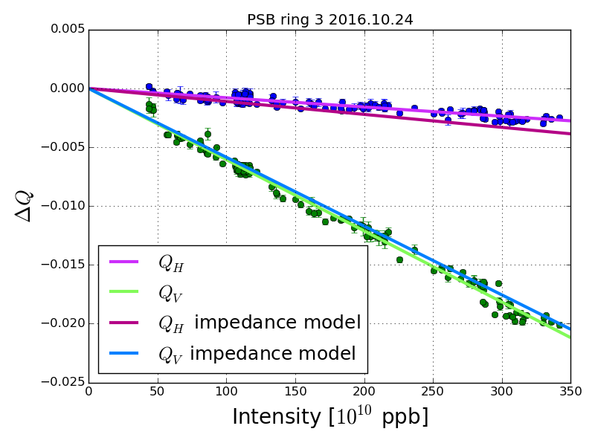
160 MeV pre-LS2
Latest pre-LS2 measurements performed by T. Rijoff
Model slightly overestimate horizontal impedance and underestimate vertical impedance
Good agreement between model and measurements
Notes:
8% diff. in x between DELPHI and theory, 9% in y

Slide 5
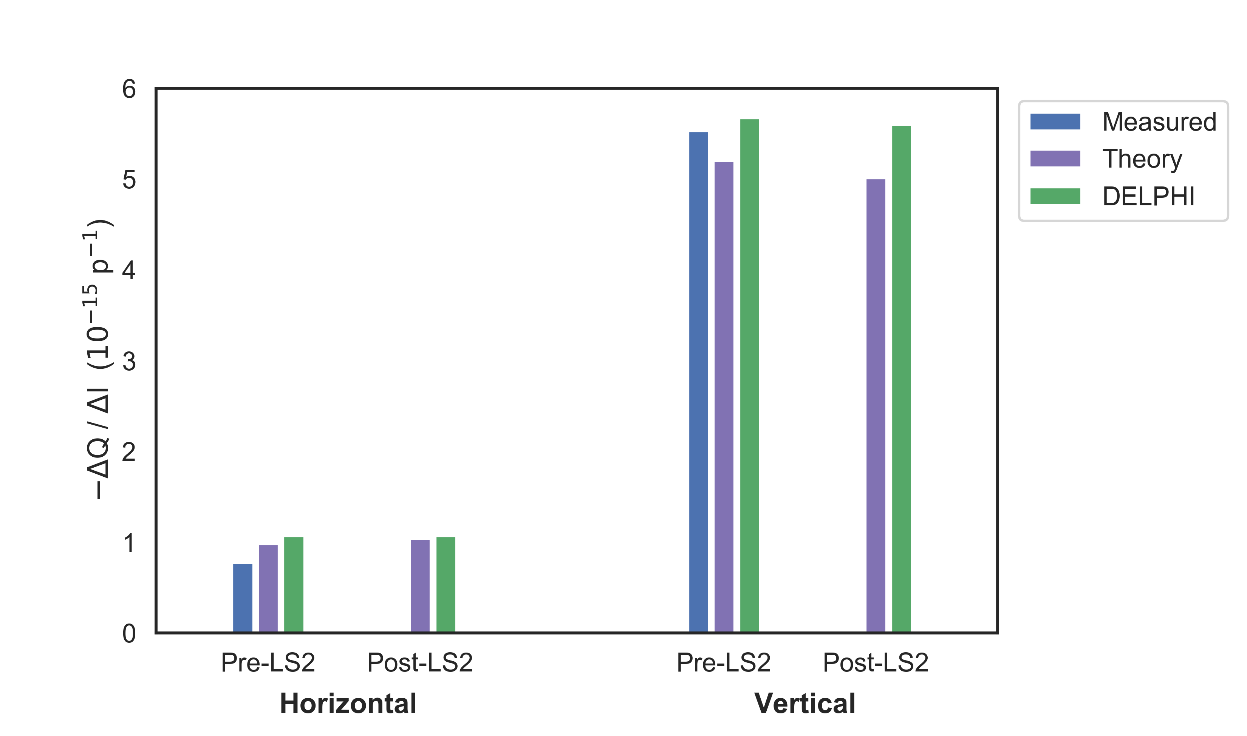
160 MeV pre-LS2
Model slightly overestimate horizontal impedance and underestimate vertical impedance
Pre and post-LS2 impedance variation below 5%
Good agreement between model and measurements
Notes:
8% diff. in x between DELPHI and theory, 9% in y

Slide 6
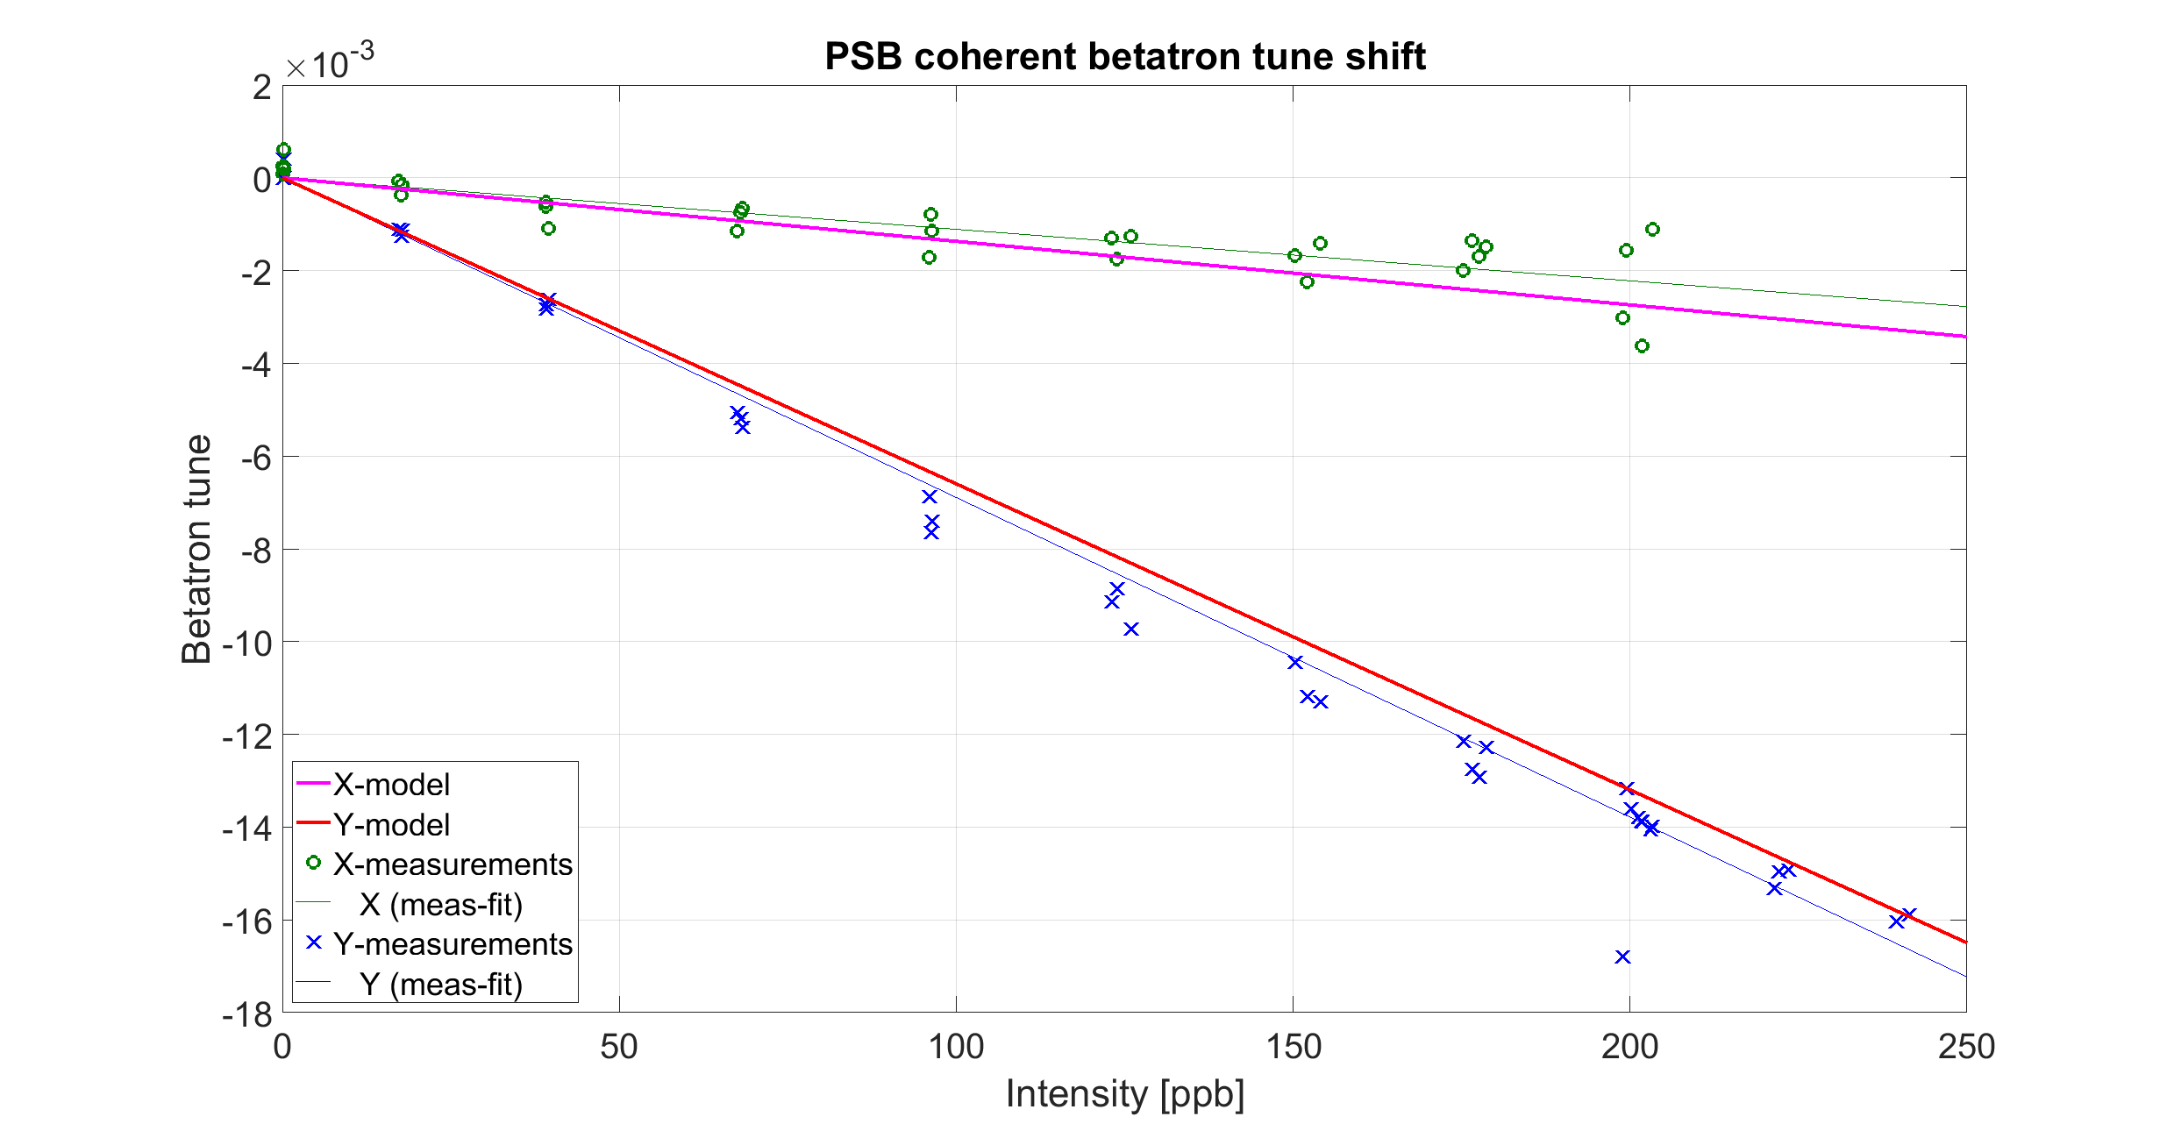
Tune shift reference measurements
2021 measurements at 160 MeV
Slight overestimation of the horizontal impedance and underestimation of the vertical impedance are also retrieved
Good agreement between model and measurements

Slide 7
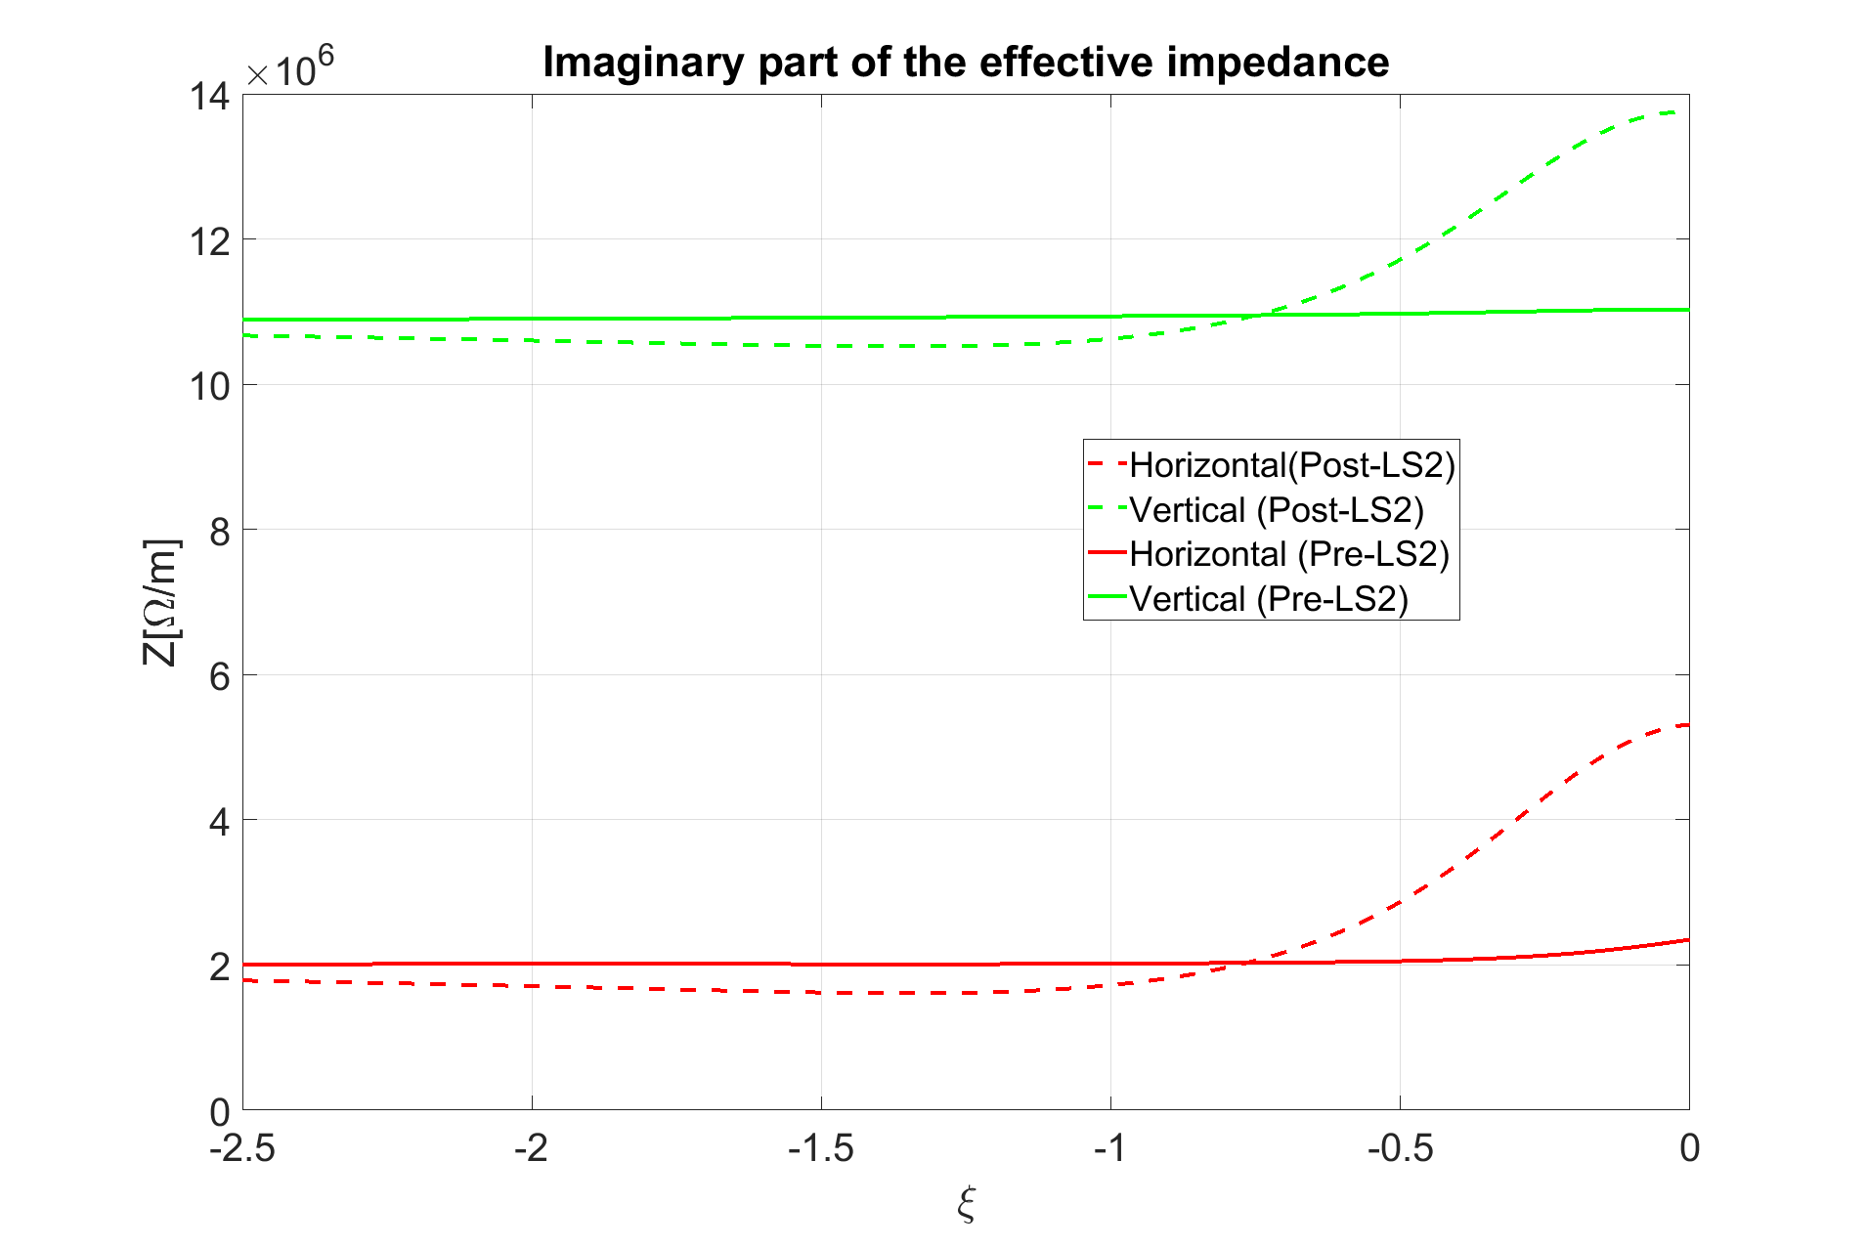
Dependence on chromaticity: 160 MeV
ξ_{y} = -1.66
The significant increase of the effective impedance moving towards zero chromaticity is attributed to FINEMET cavities. This is the reason why is not present in the pre-LS2 model
ξ_{x} = -0.73

Slide 8
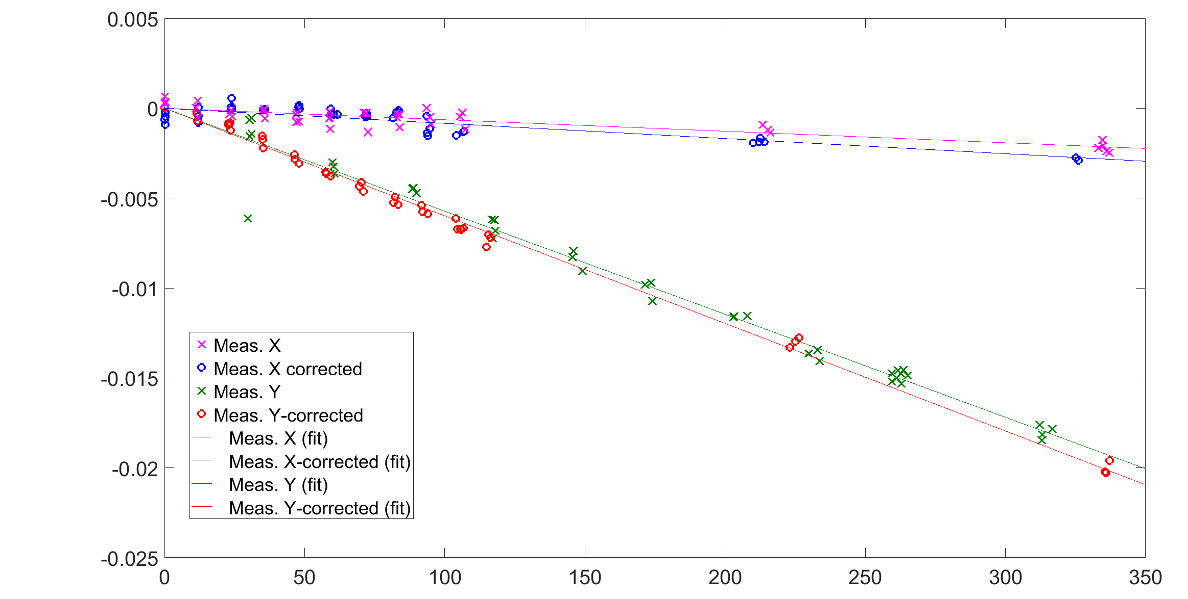
Tune shift reference measurements
2021 measurements at 160 MeV
Review model of FINEMET cavities
Model predict about factor 2 increase in the impedance in the horizontal plane and 20% increase in the vertical plane
Only 30% increase in the horizontal impedance and 5% in the vertical impedance has been observed

Slide 9
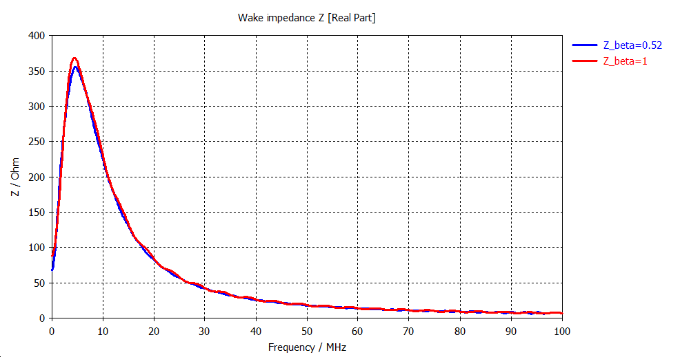
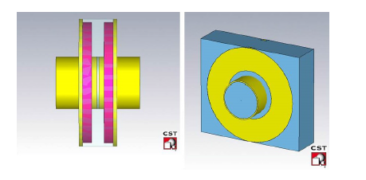
Finemet cavities
PS and PSB cell cavity
The impedance does not depend on the relativistic beta
S. Persichelli et al., Finemet cavities impedance studies, CERN-ACC-NOTE-2013-0033, 2013.

Slide 10
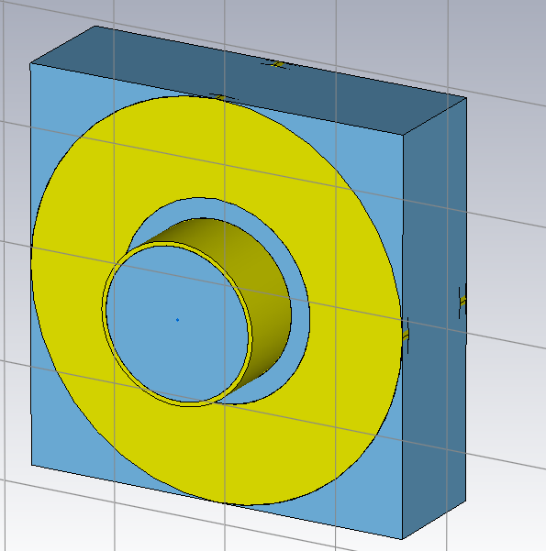
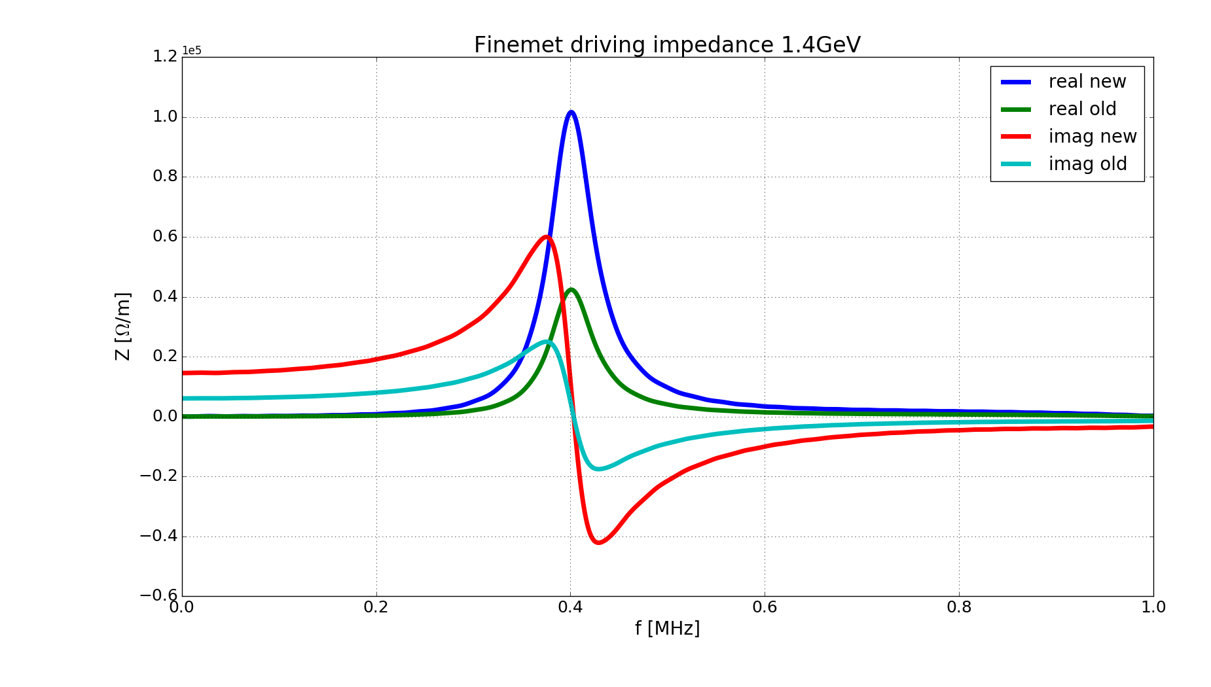
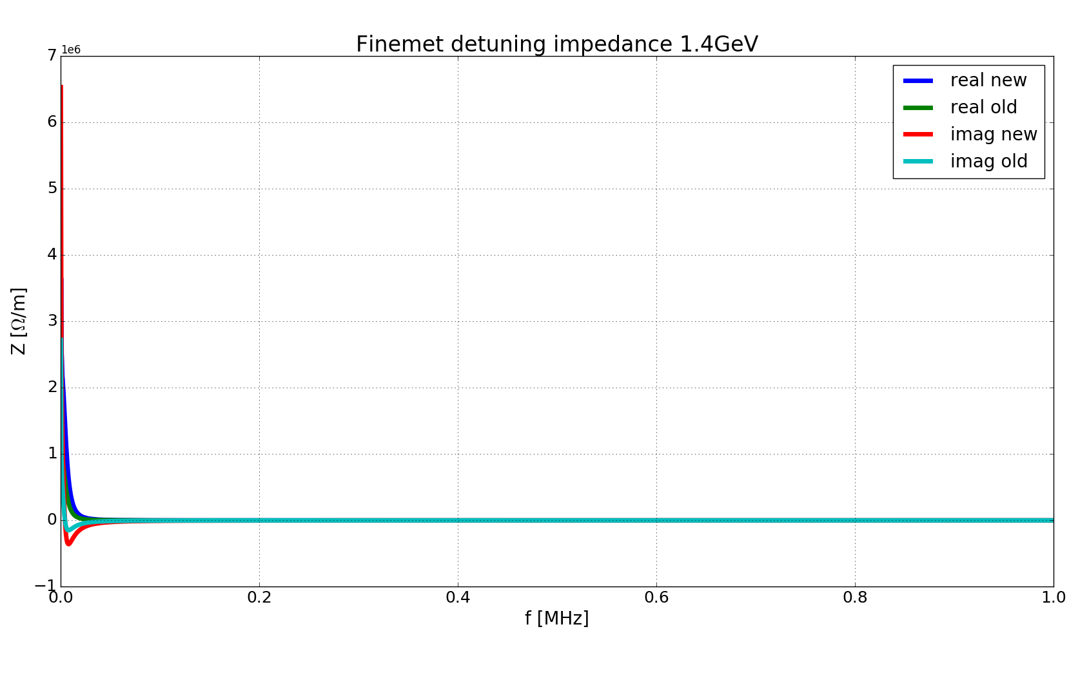
Present finemet cavity model developed by T. Rijoff
Latest model developed by T. Rijoff
The significant variation at low frequency of the detuning impedance is responsible of the significant dependence of the tune shift vs. chromaticity expected from the impedance model.
The low frequency impedance taken as output of CST simulations is more prone to numerical issue
f [GHz]
f [GHz]
Review of the model seems to be needed in order to explain the 2021 tune shift measurements versus chromaticity

Slide 11
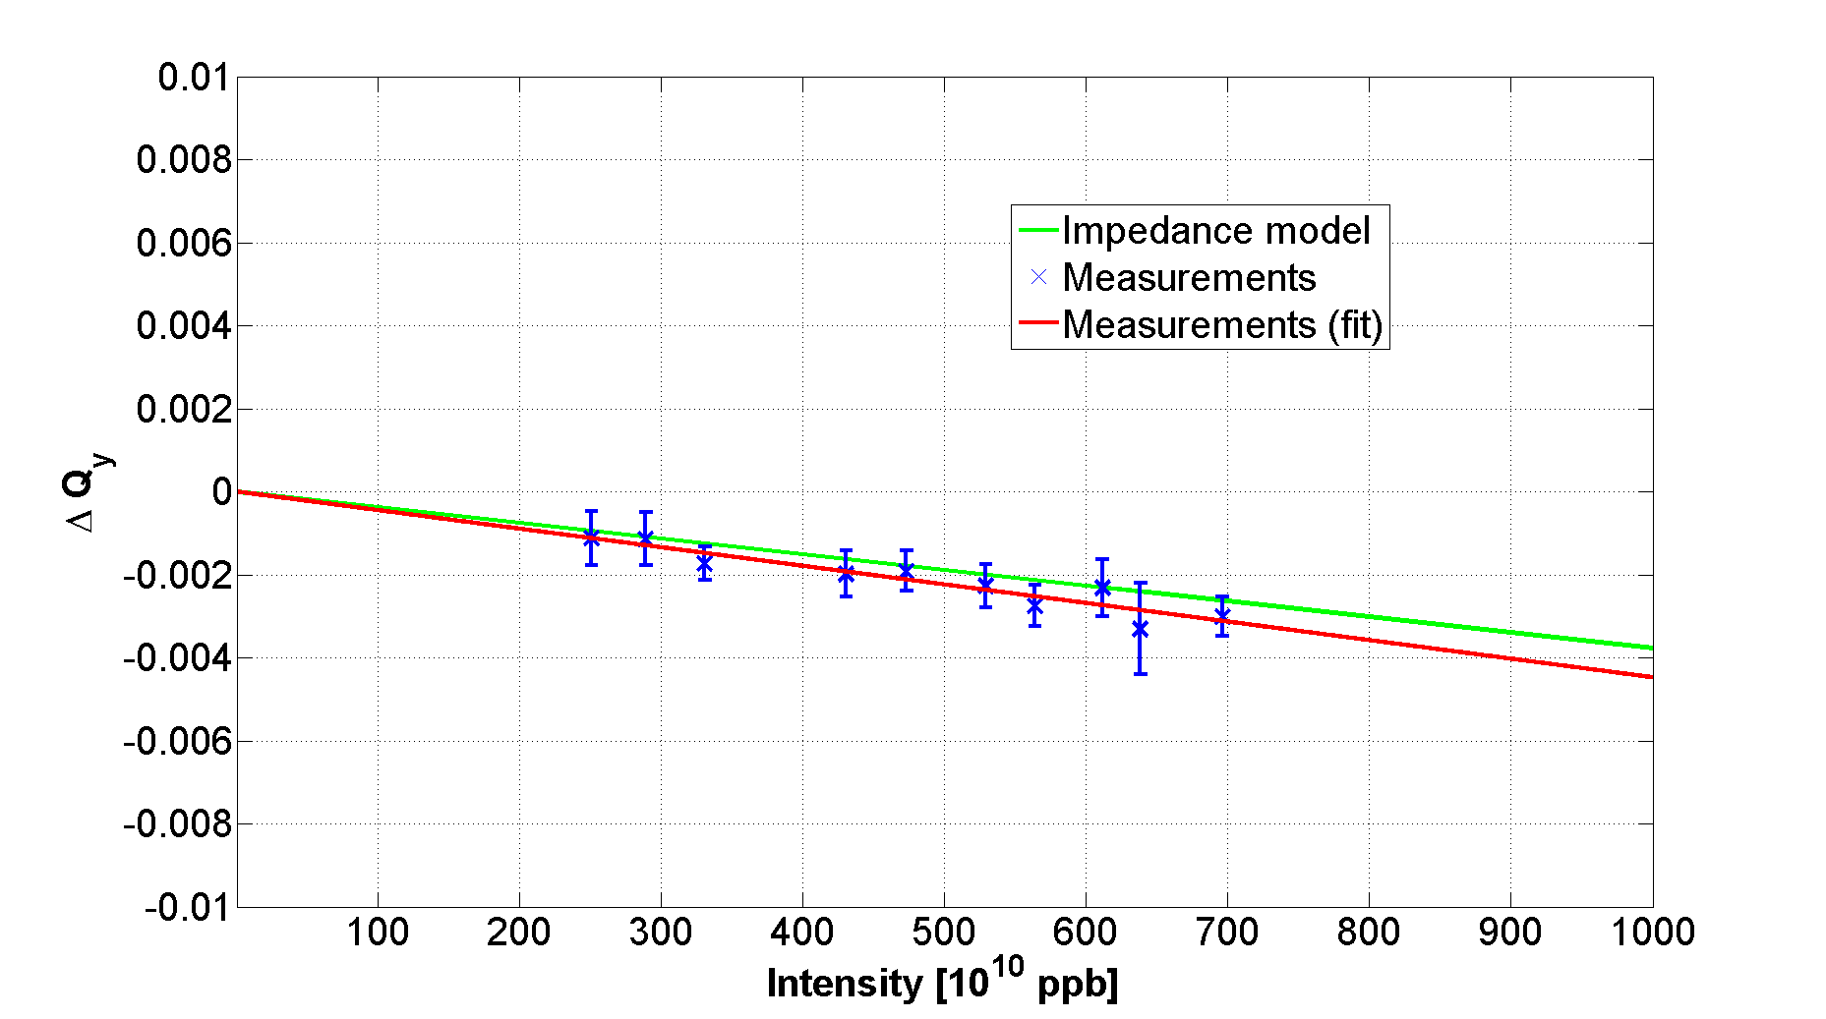
Measurements at higher energy
Measurements 2014 (week 48)
Tune shift at 1.4 GeV in ring 2
About 20% discrepancy between model and measurements appears consistently in all rings.
Indirect space charge decreases with energy contrary to the other impedance contributions.
The missing impedance has been estimated to be around 0.5 MΩ/m

Slide 12
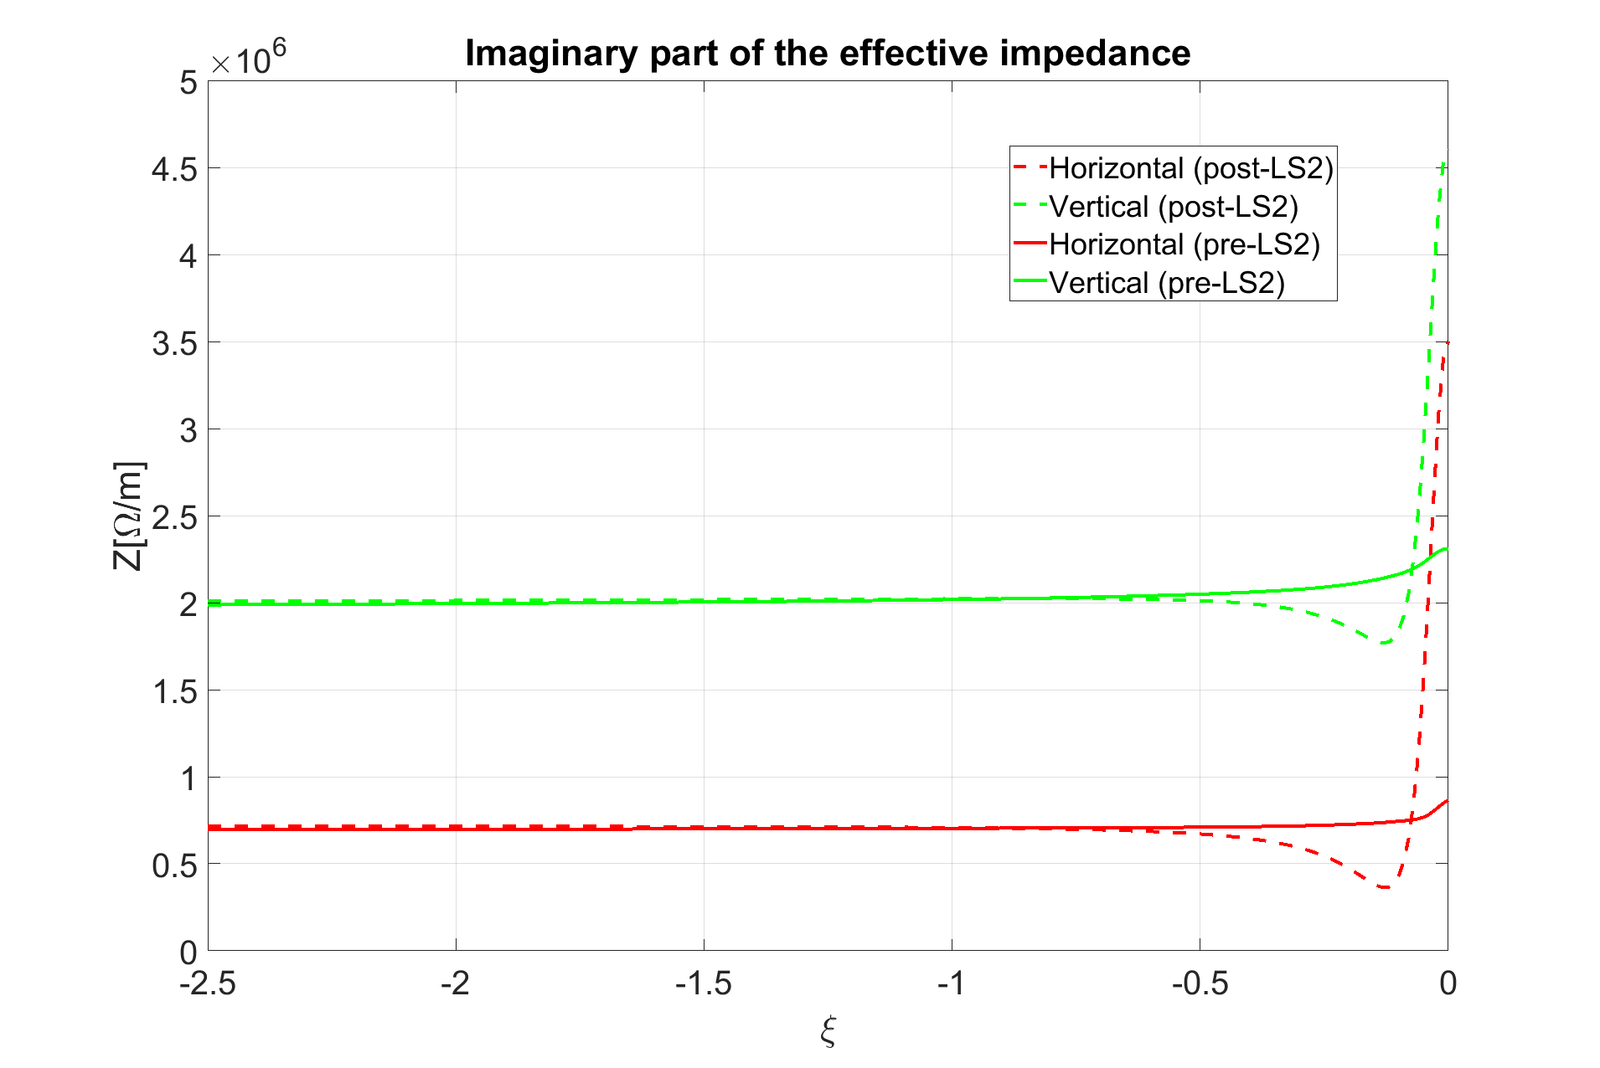
Dependence on chromaticity: 1.4 GeV
ξ_{y} = -1.66
ξ_{x} = -0.73

Slide 13
Overview
Impedance reference measurements
  Tune shift measurements
  Horizontal instability measurements
Horizontal instability at the end of the 2 GeV cycle

Slide 14
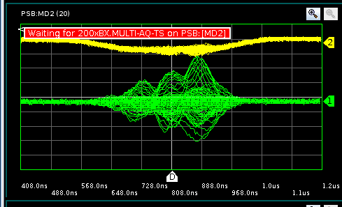
Measurements of the PSB horizontal instability

Slide 15
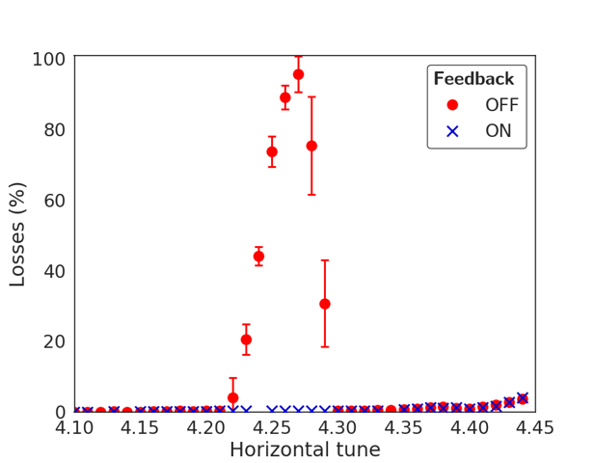
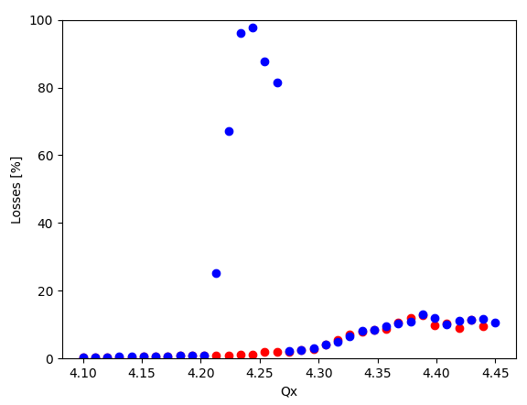
Instability before and after LS2
Pre-LS2
Post-LS2
Feedback OFF
Feedback ON
Slight variation of the tune at which the instability exhibits the maximum growth rate

Slide 16
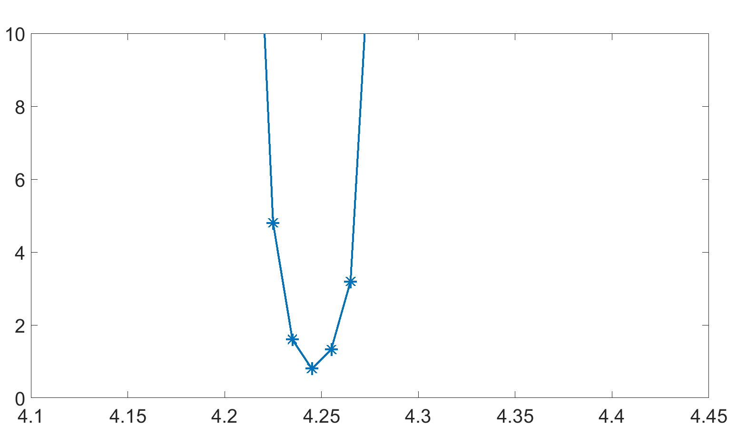
Instability before and after LS2
Pre-LS2
Post-LS2
Slight variation of the tune at which the instability exhibits the maximum growth rate
Slight reduction of the instability growth rate in the Post-LS2 measurements
The instability has been found to be consistent with the pre-LS2 observations

Slide 17
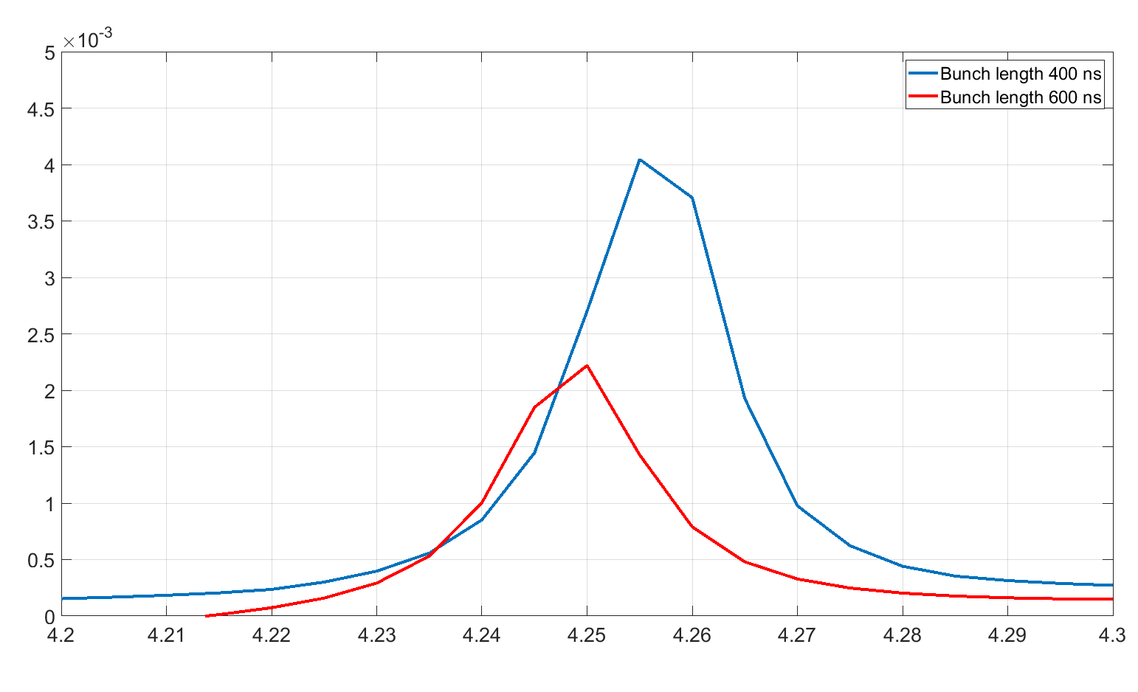
A possible explanation of the slight difference between pre- and post-LS2 measurements
Growth rates [1/#turns]
The ~ 0.01 shift to lower tune and the reduction of the growth rates observed in post-LS2 measurements with respect to the pre-LS2 case could be compatible with the effect of longer bunches
Measurements could be performed to test this dependence on bunch length
Horizontal tune

Slide 18
Overview
Impedance reference measurements
  Tune shift measurements
  Horizontal instability measurements
Horizontal instability at the end of the 2 GeV cycle

Slide 19
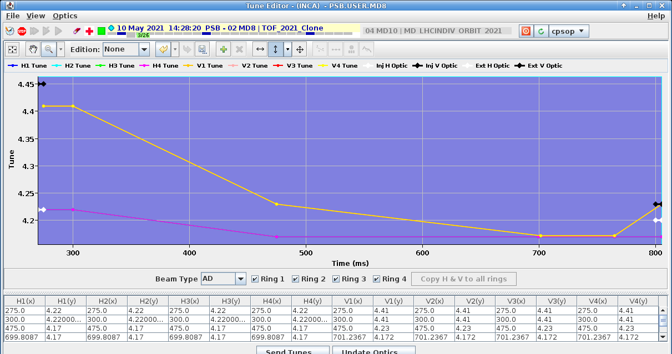
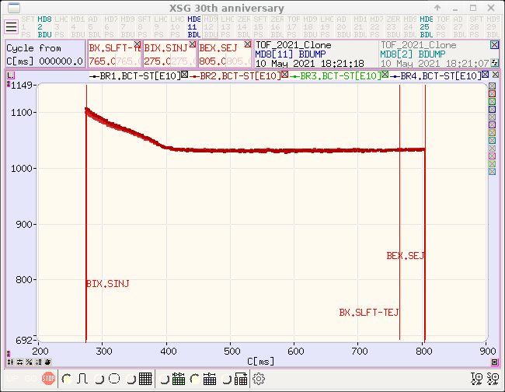
Instability with nTOF beam close to flat top
Instability observed around C720ms observed by F. Avesta.
At first it seemed longitudinal as it had characteristics of the microwave instability expected from simulations
Extra studies revealed that it was a transverse instability on the horizontal plane.
  TFB does not seem to be able to correct it entirely → being followed up with the experts
Mitigation strategy identified by F. Avesta
  Currently cured using the coupling resonance:
    Tunes pushed on the coupling resonance
  QSKHO quadrupoles are used to further enhance the coupling
Accelerated more than 1000e10 protons!

Slide 20
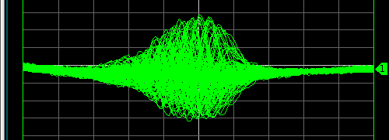
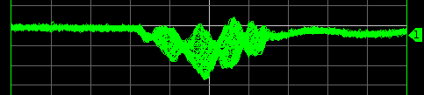
Instability with nTOF beam close to flat top
Instability observed for the first time for the TOF user (only R2) for intensities above 500e10.
Studies without the TFB show that the instability starts appearing at even lower intensity (~250e10 ppr) but is being cured by the TFB at lower intensities.
Studies on the AD user revealed that we have similar behaviour for all rings, but at intensities up to 450e10 (AD target) it is being cured by the TFB.
  Rings 1&2: The instability starts appearing for intensities ~250e10
  Rings 3&4: The instability starts appearing for intensities ~350e10
  Rings with lower thresholds are the rings with a known bad RF bypass

Slide 21
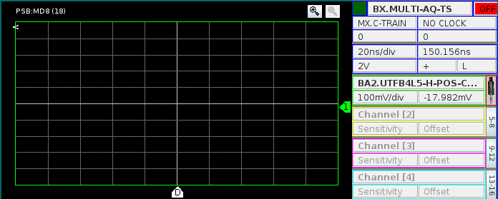
Instability with nTOF beam close to flat top
Instability observed for the first time for the TOF user (only R2) for intensities above 500e10.
Studies without the TFB show that the instability starts appearing at even lower intensity (~250e10 ppr) but is being cured by the TFB at lower intensities.
Studies on the AD user revealed that we have similar behaviour for all rings, but at intensities up to 450e10 (AD target) it is being cured by the TFB.
  Rings 1&2: The instability starts appearing for intensities ~250e10
  Rings 3&4: The instability starts appearing for intensities ~350e10
  Rings with lower thresholds are the rings with a known bad RF bypass

Slide 22
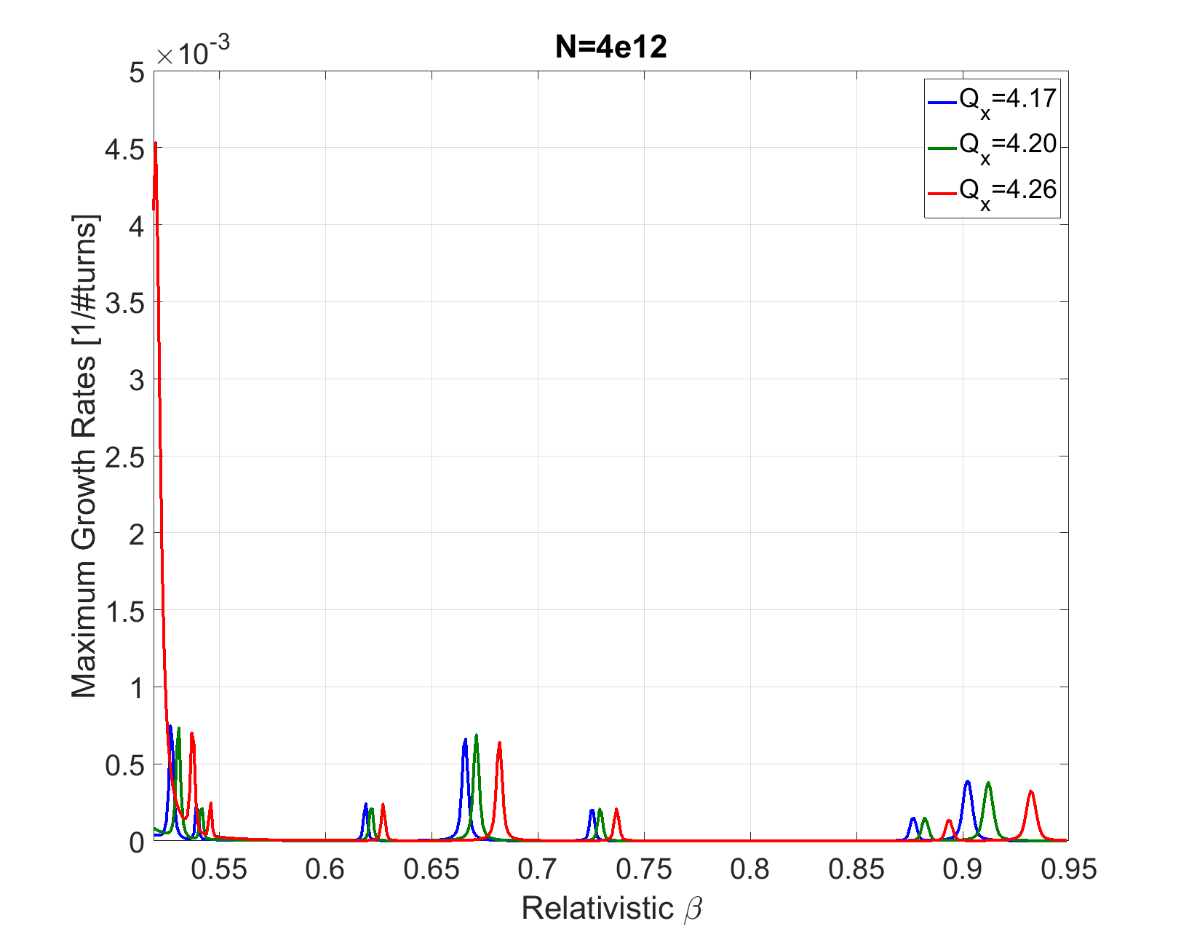
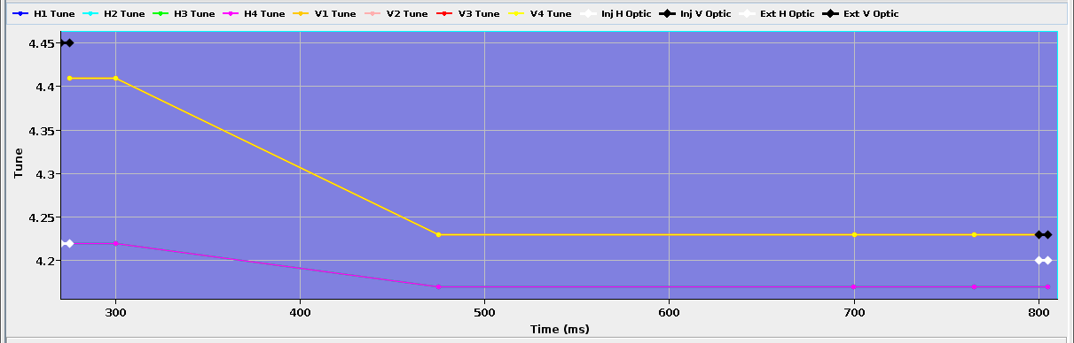
Expected instability in the PSB due to kicker cable impedance
160 MeV instability
330 MeV instability
1.2 GeV instability
2021 nTOF instability
Kicker impedance is not expected to be the cause of the 2021 nTOF instability

Slide 23

Ctime of the instability versus tune
Changing the vertical tune the instability is observed at lower energy
There is a coupling effect between planes?
Qx | Qy | Inst. ctime
4.17 | 4.20 | 680
4.17 | 4.23 | 715
4.17 | 4.26 | 715
4.17 | 4.29 | 715
4.15 | 4.23 | 730
4.19 | 4.23 | 710

Slide 24
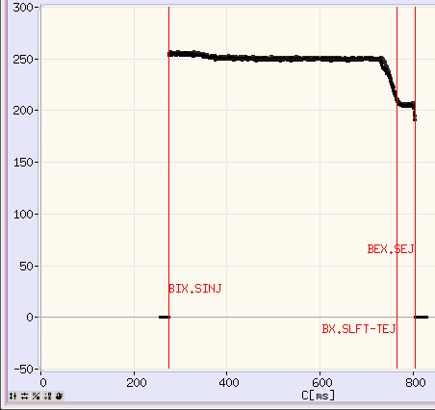
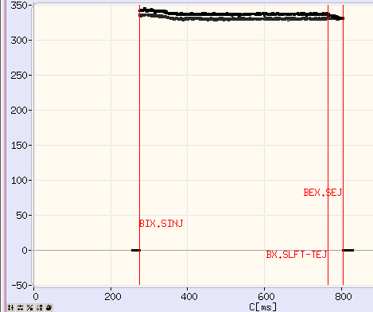
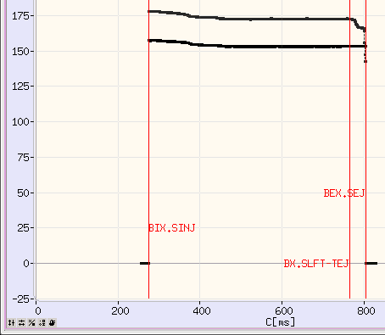
nTOF Instability: measurements as function of chromaticity
Instability threshold measured as function of chromaticity
  Higher chromaticity than natural bring to a slight increase of the threshold (from 250e10 ppb to 300-350e10 ppb in ring 2)
  Smaller chromaticity to a significant reduction of the threshold (from 250 ppb to 150 ppb in ring 2)
Natural chromaticity
Higher chromaticity than natural
Lower chromaticity than natural

Slide 25
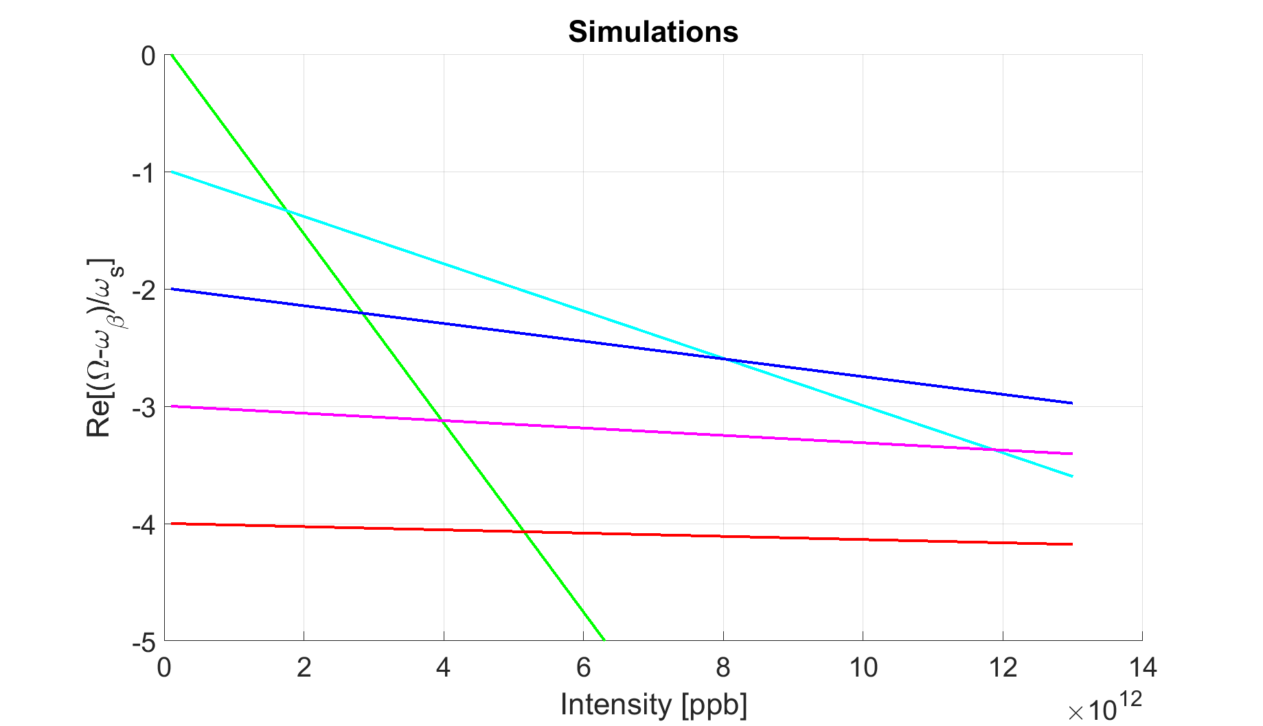
Modes tune shift at natural chromaticity
Expected mode coupling intensity range is consistent with the measured intensity thresholds
Chromaticity higher than natural is not expected to change the mode coupling picture

Slide 26
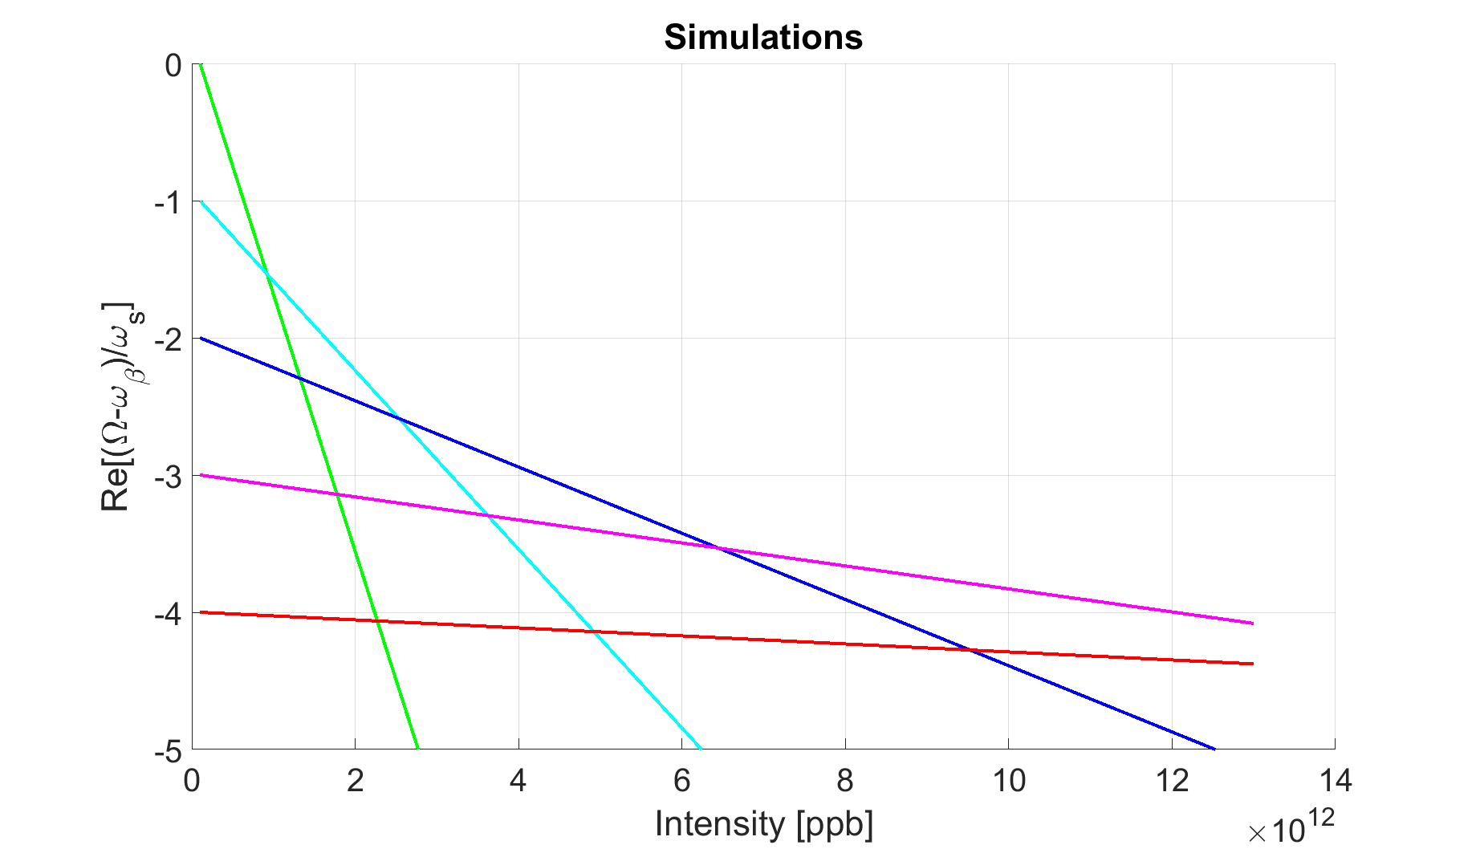
Modes tune shift for corrected chromaticity
For corrected chromaticity
coupling is expected to occur at lower intensities consistently with the lower threshold observed in measurements.
Run eDELPHI simulations to get a more accurate picture of the expected modes tune shift versus frequency

Slide 27
nTOF instability: what is not understood?
If the PSB instability close to 2 GeV is TMCI why the instability is observed in the horizontal plane?
Vertical tune seems to have an impact on the horizontal stability. To be further investigated.
In the hypothesis of TMCI if chromaticity higher than natural is not changing the mode coupling picture, why we see higher intensity threshold in measurements for this case?
Up to which intensity the instability can be cured with linear coupling?

Slide 28
Conclusions
PSB reference measurements
  Tune shifts at 160 MeV
    Good agreement between model and measurements
    Expected increase of the impedance (tune shift) close to zero chromaticity due to FINEMET cavities not observed
      Finemet cavity model to be reviewed
  Horizontal instability at 160 MeV
    As expected, pre-LS2 behaviour has been retrieved
    The slight difference is consistent with the effect of longer bunches
nTOF instability
  Is not expected to be related to ejection kicker impedance
  The vertical tune seems to affect the time (energy) at which the instability occurs
  Intensity threshold depends on chromaticity
What measurements could be still done
  Tune shift measurements at 1.4 GeV
  nTOF instability: in the framework of the PBC project explore up to which intensity the instability is cured

