Slide 1
COVID-19 Restrictions
EHN1 Control Rooms

Slide 2
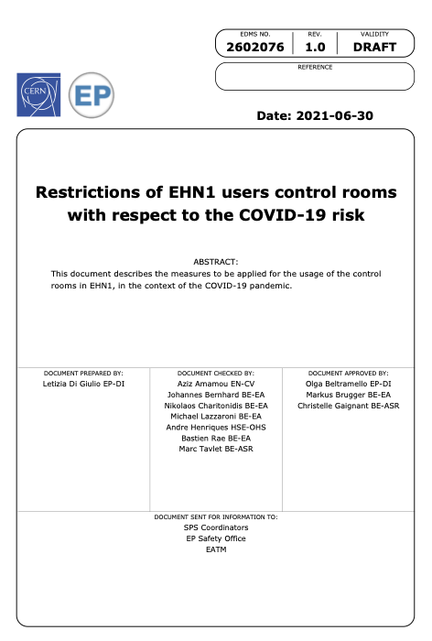
Restrictions in the EHN1 control rooms
A dedicated document with the restrictions and maximum number of people per control room can be find at: EDMS 2602076
The maximum number of people present inside the control rooms is based on existing rules at CERN (and in the Host States) and validated using the CARA simulation software.
Notes:
The level is determined by the incidence rate in the local area, and a qualitative assessment by CERN taking into account, among other parameters, the number of confirmed cases at CERN, vaccination status in the local area, the stratified testing campaign and the local presence of new variants of the virus.

Slide 3
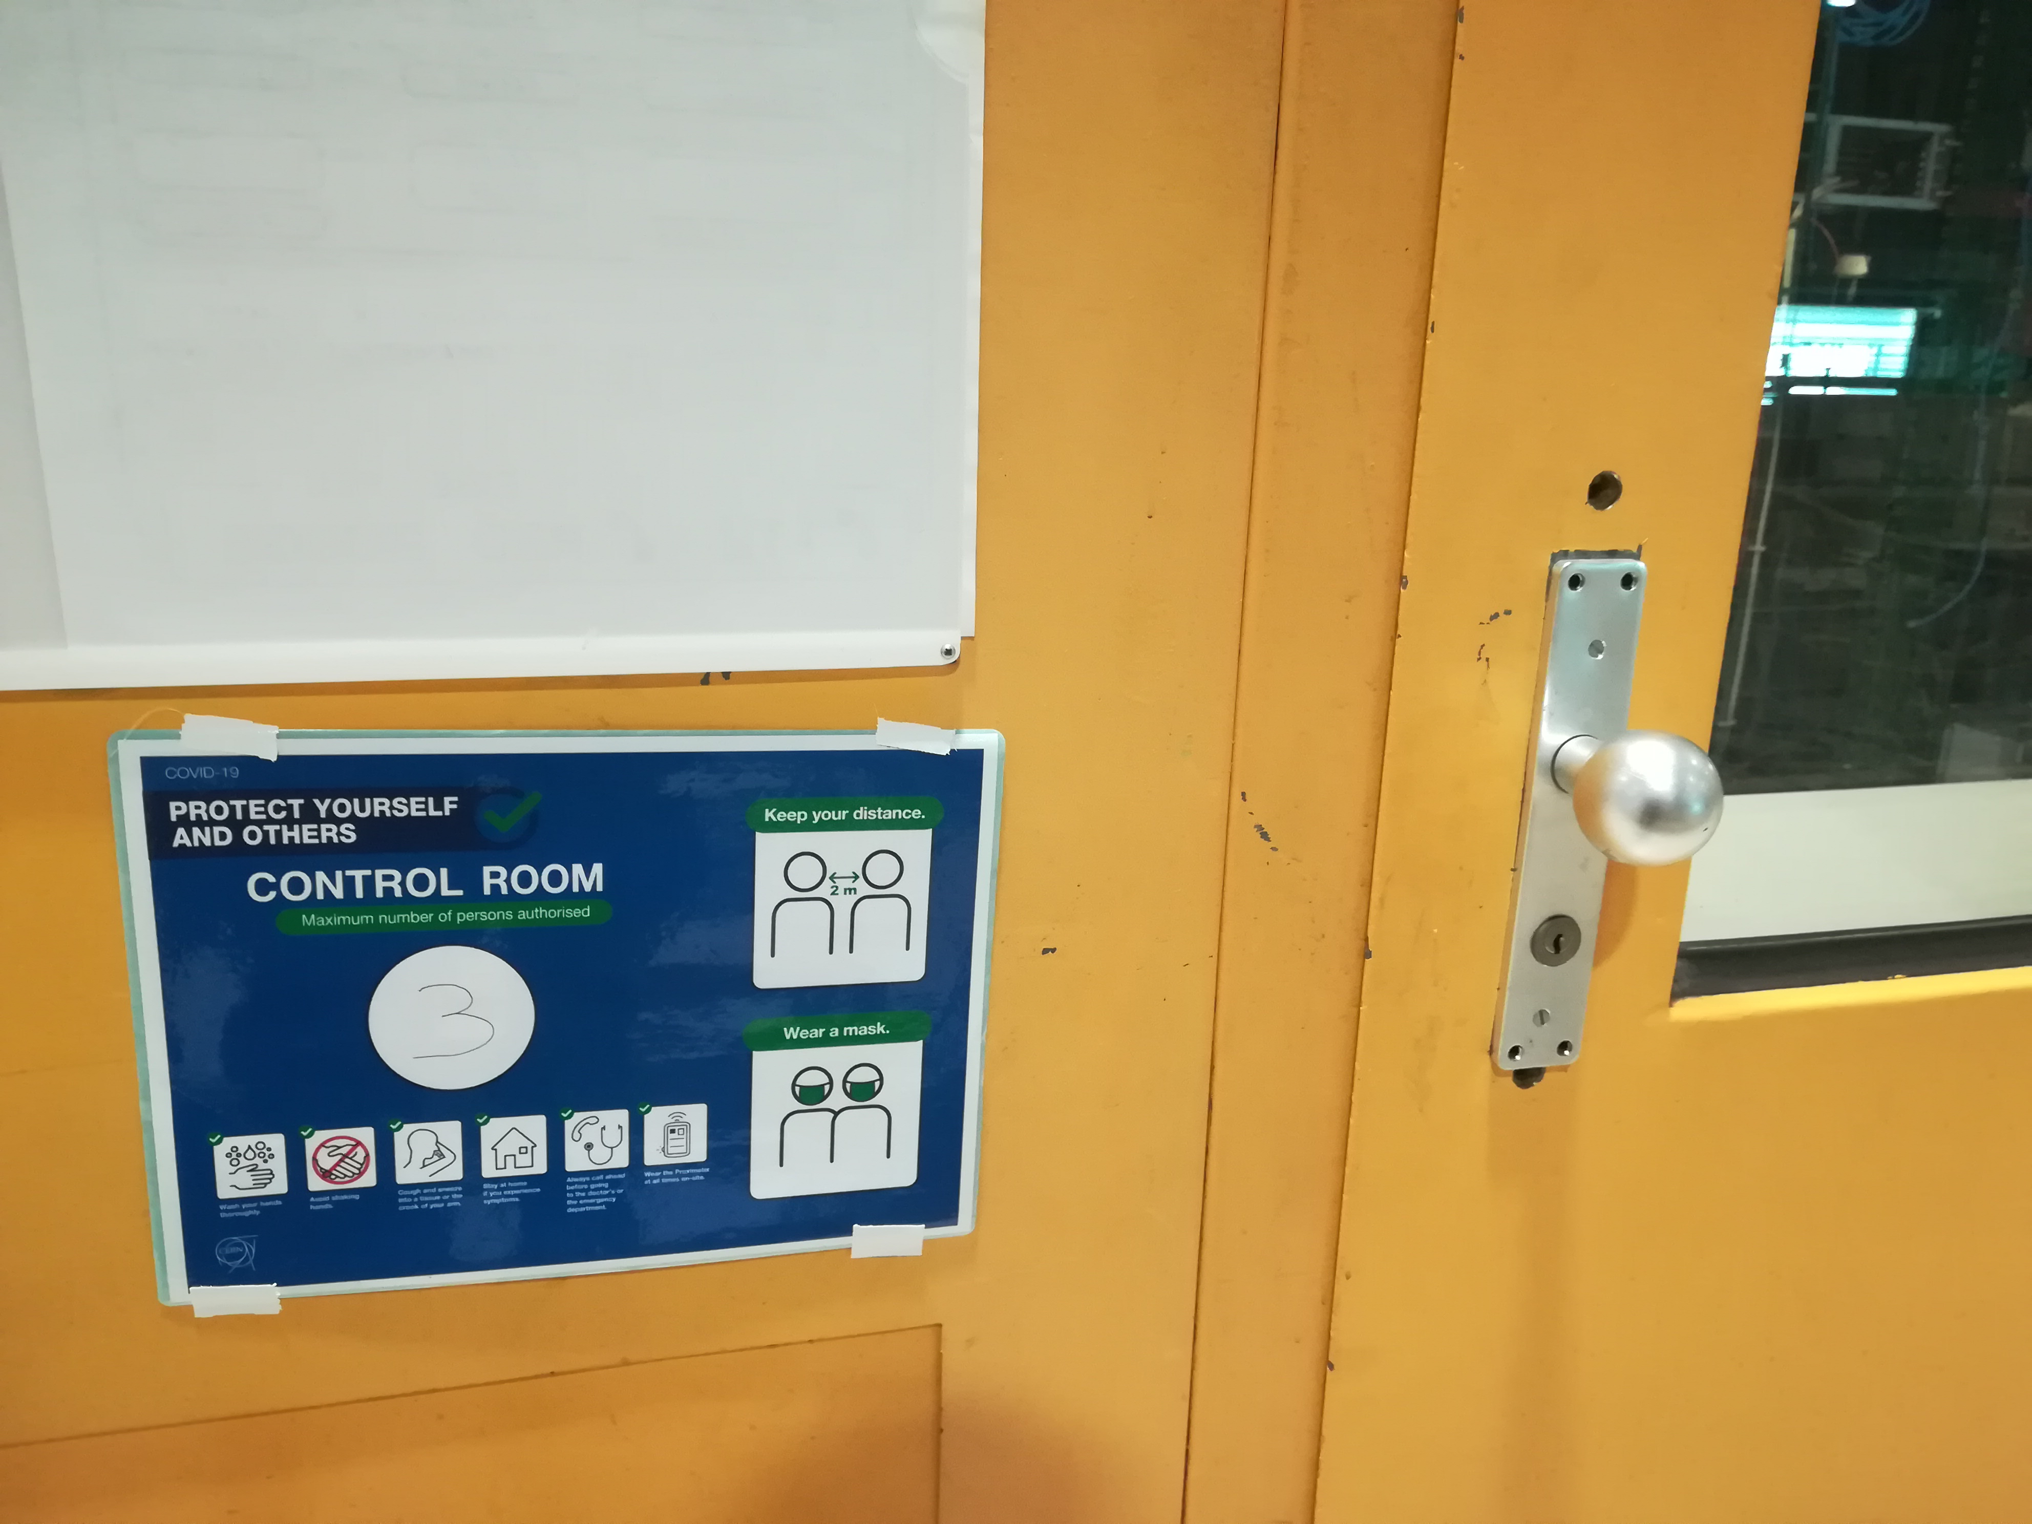
Restrictions in the EHN1 control rooms
For each control room:
  The maximum number of people is displayed on doors
  The ventilation is at least 36 m³/h per person (considering only fresh air)
  Only desks at 1.5m one to the other can be used – interpersonal distance to be respected
  Mask to be worn at all time, even when seated
  Hand disinfection and surface disinfection to be done as often as possible
  Cleaning of the barracks is done regularly by cleaning personnel
Notes:
The level is determined by the incidence rate in the local area, and a qualitative assessment by CERN taking into account, among other parameters, the number of confirmed cases at CERN, vaccination status in the local area, the stratified testing campaign and the local presence of new variants of the virus.

Slide 4
Restrictions in the EHN1 control rooms
Masks, hand disinfectant and surface disinfectant are provided by CERN. This material is centrally stocked in the barrack 887/R-C04 - 1 contact person per experiment has access to this room to get the necessary material
Mask Type 1 will be the default masks, however, mask FFP2 are available and distributed upon request or specific assessment (i.e. vulnerabilities)
For any additional request or question you can contact:
  ep-adso@cern.ch
  EHN1-TSO@cern.ch
These rules might evolve with time. We will make sure to keep you updated accordingly!

