Slide 1
North Area Technical Galleries
Status Update & Consolidation Activities
Alexios Tryfonas CHARALAMBOUS (BE-EA-PR) on behalf of NA CONS Project Team
August 3, 2021, 130th EATM Meeting

Slide 2

Motivation
Dense network of Technical Galleries → Vital sector for North Area’s proper function.
All services (gas pipes, cables, water pipes etc.) pass through the galleries.
No consolidation ever made since the construction of the galleries.
Very rarely visited by users → “Unnoticeable” part of the NA CONS Project.

Slide 3
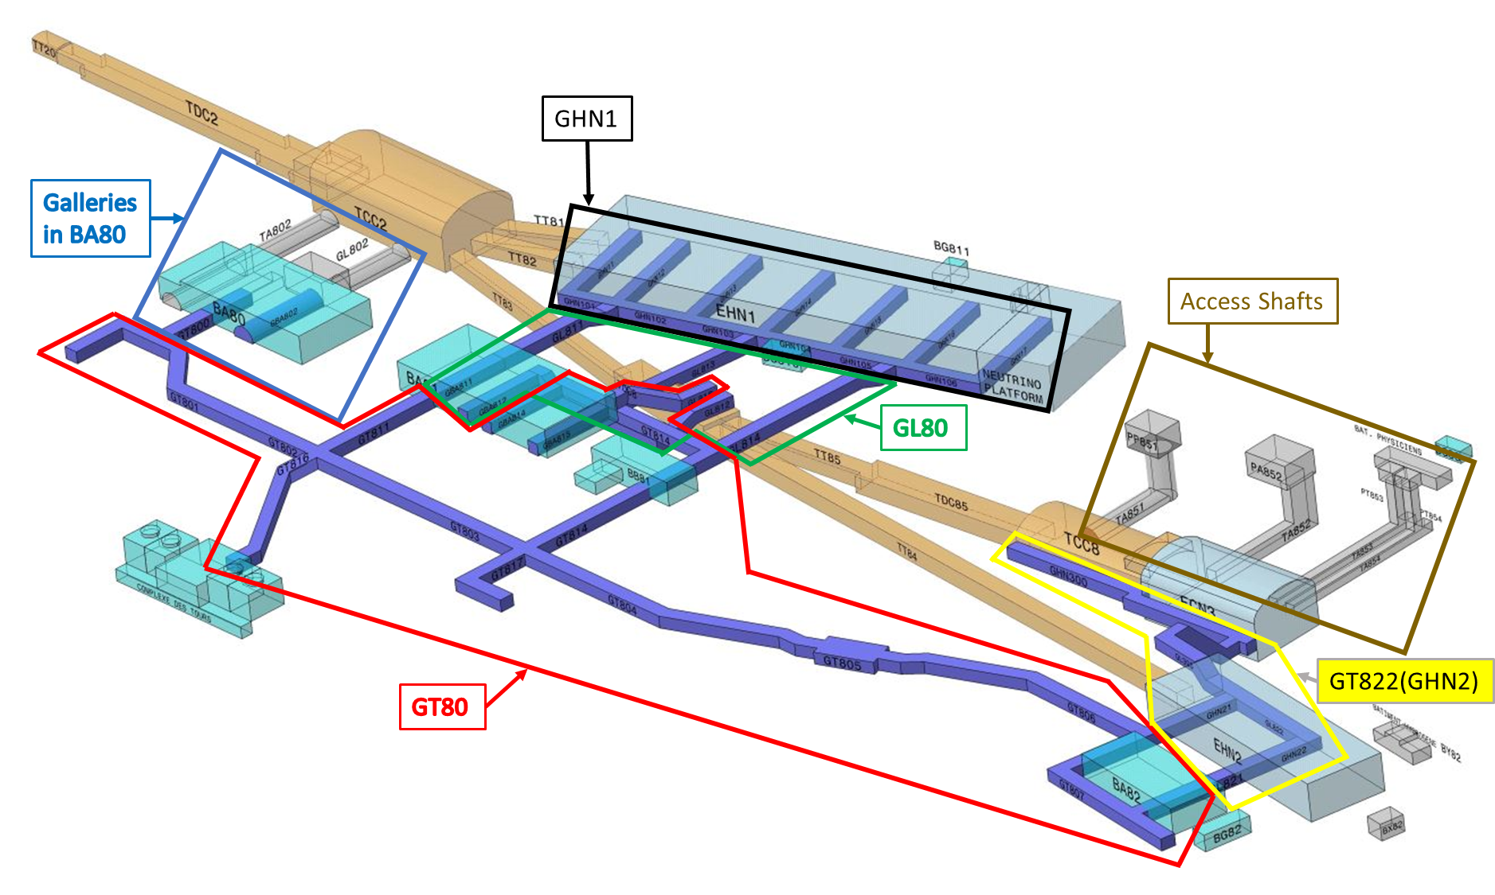
Scope
Groups of galleries:
GT80
  15 sub-galleries
GL80
  6 sub-galleries
GHN1
  13 sub-galleries
GT822(GHN2)
  6 sub-galleries
Galleries in BA80
  4 sub-galleries
Access Shafts
  4 sub-galleries
Total length: 3,075 meters
48 Sub-galleries based on GIS & MTF
42/48 Sub-galleries to be consolidated under the TG CONS framework
Notes:
3

Slide 4


Status Update
GIS Portal
Reports

Slide 5
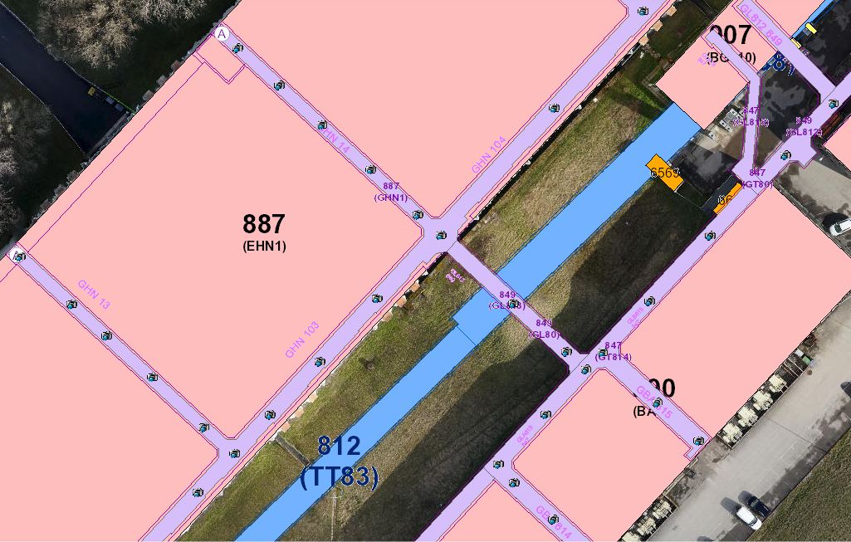
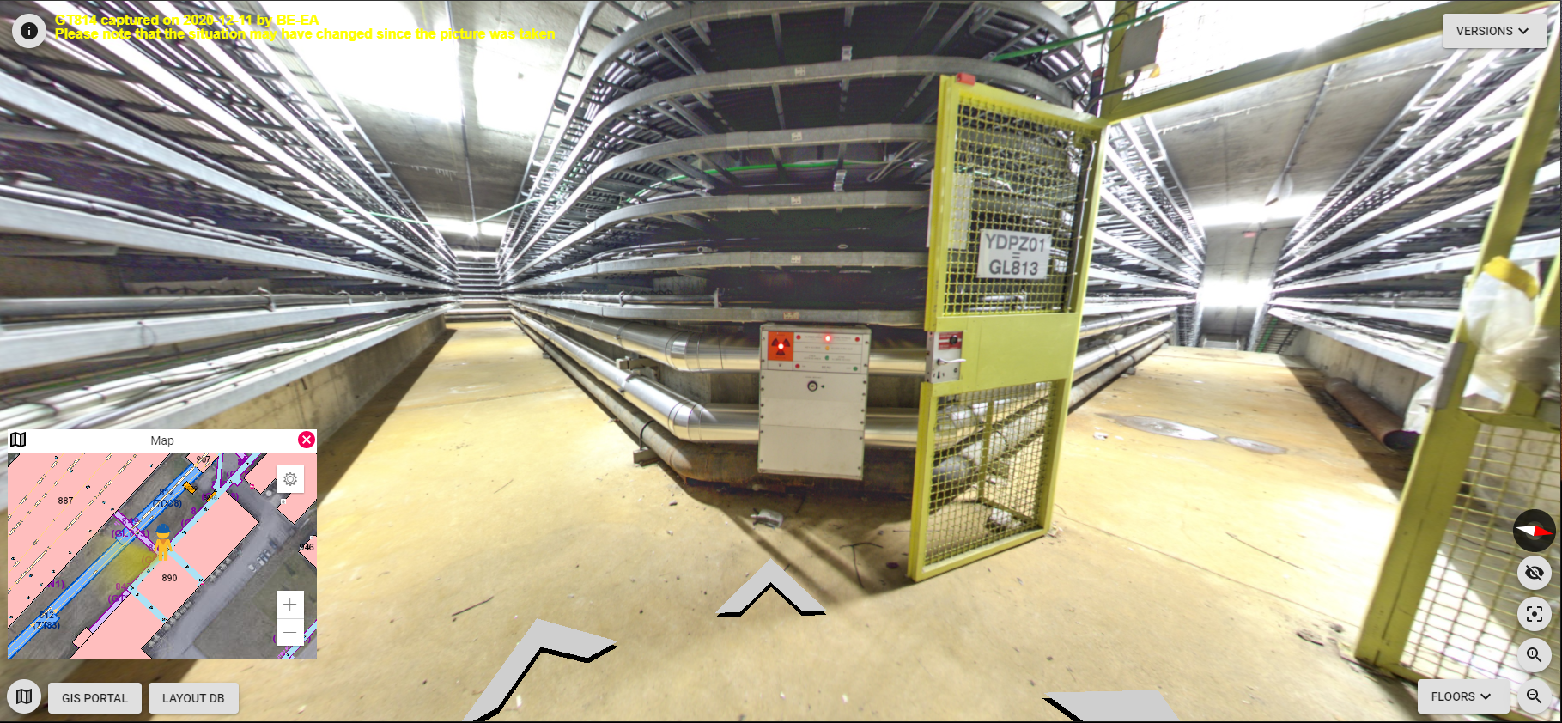
GIS Portal
Panoramic pictures from all the sub-galleries in NA are uploaded on GIS Portal.
How to access the panoramic pictures:
Go to GIS Portal and select:
Data > Underground Data > Galleries &
Data > Other > Panoramic Pictures.
Change floor from SKY to G0 or U0 based on the gallery you are on.
GIS needs to be updated to reflect MTF.
Currently: Sub-galleries of GHN1, GL815, GBA811/12/ 14/15 are not searchable on GIS.
GL815
GL812
Thanks to Jan Buesa Orgaz for the support

Slide 6
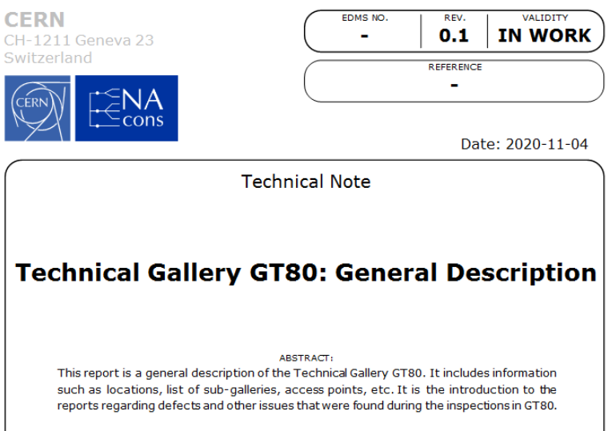
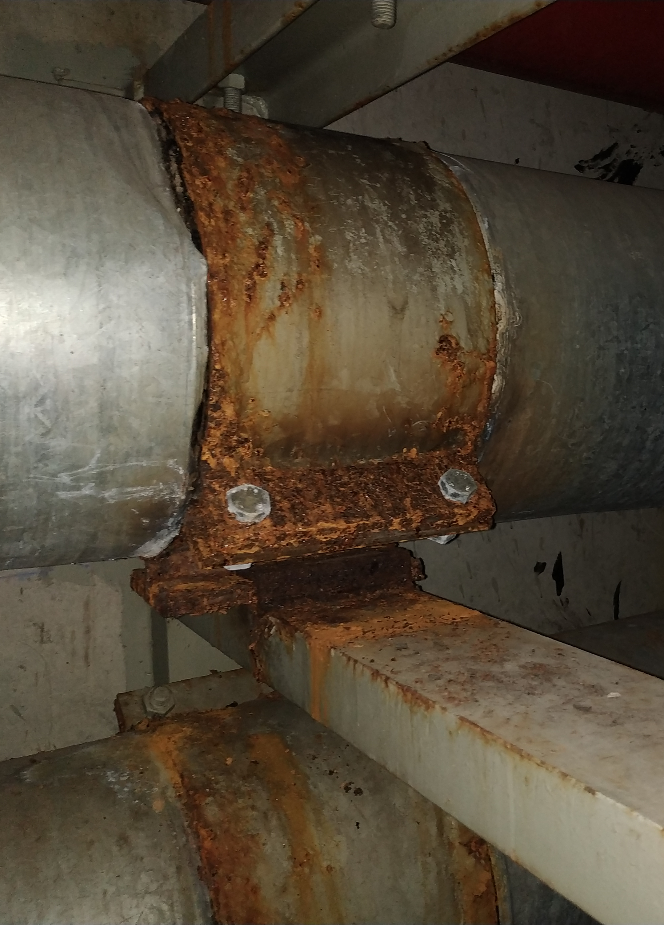
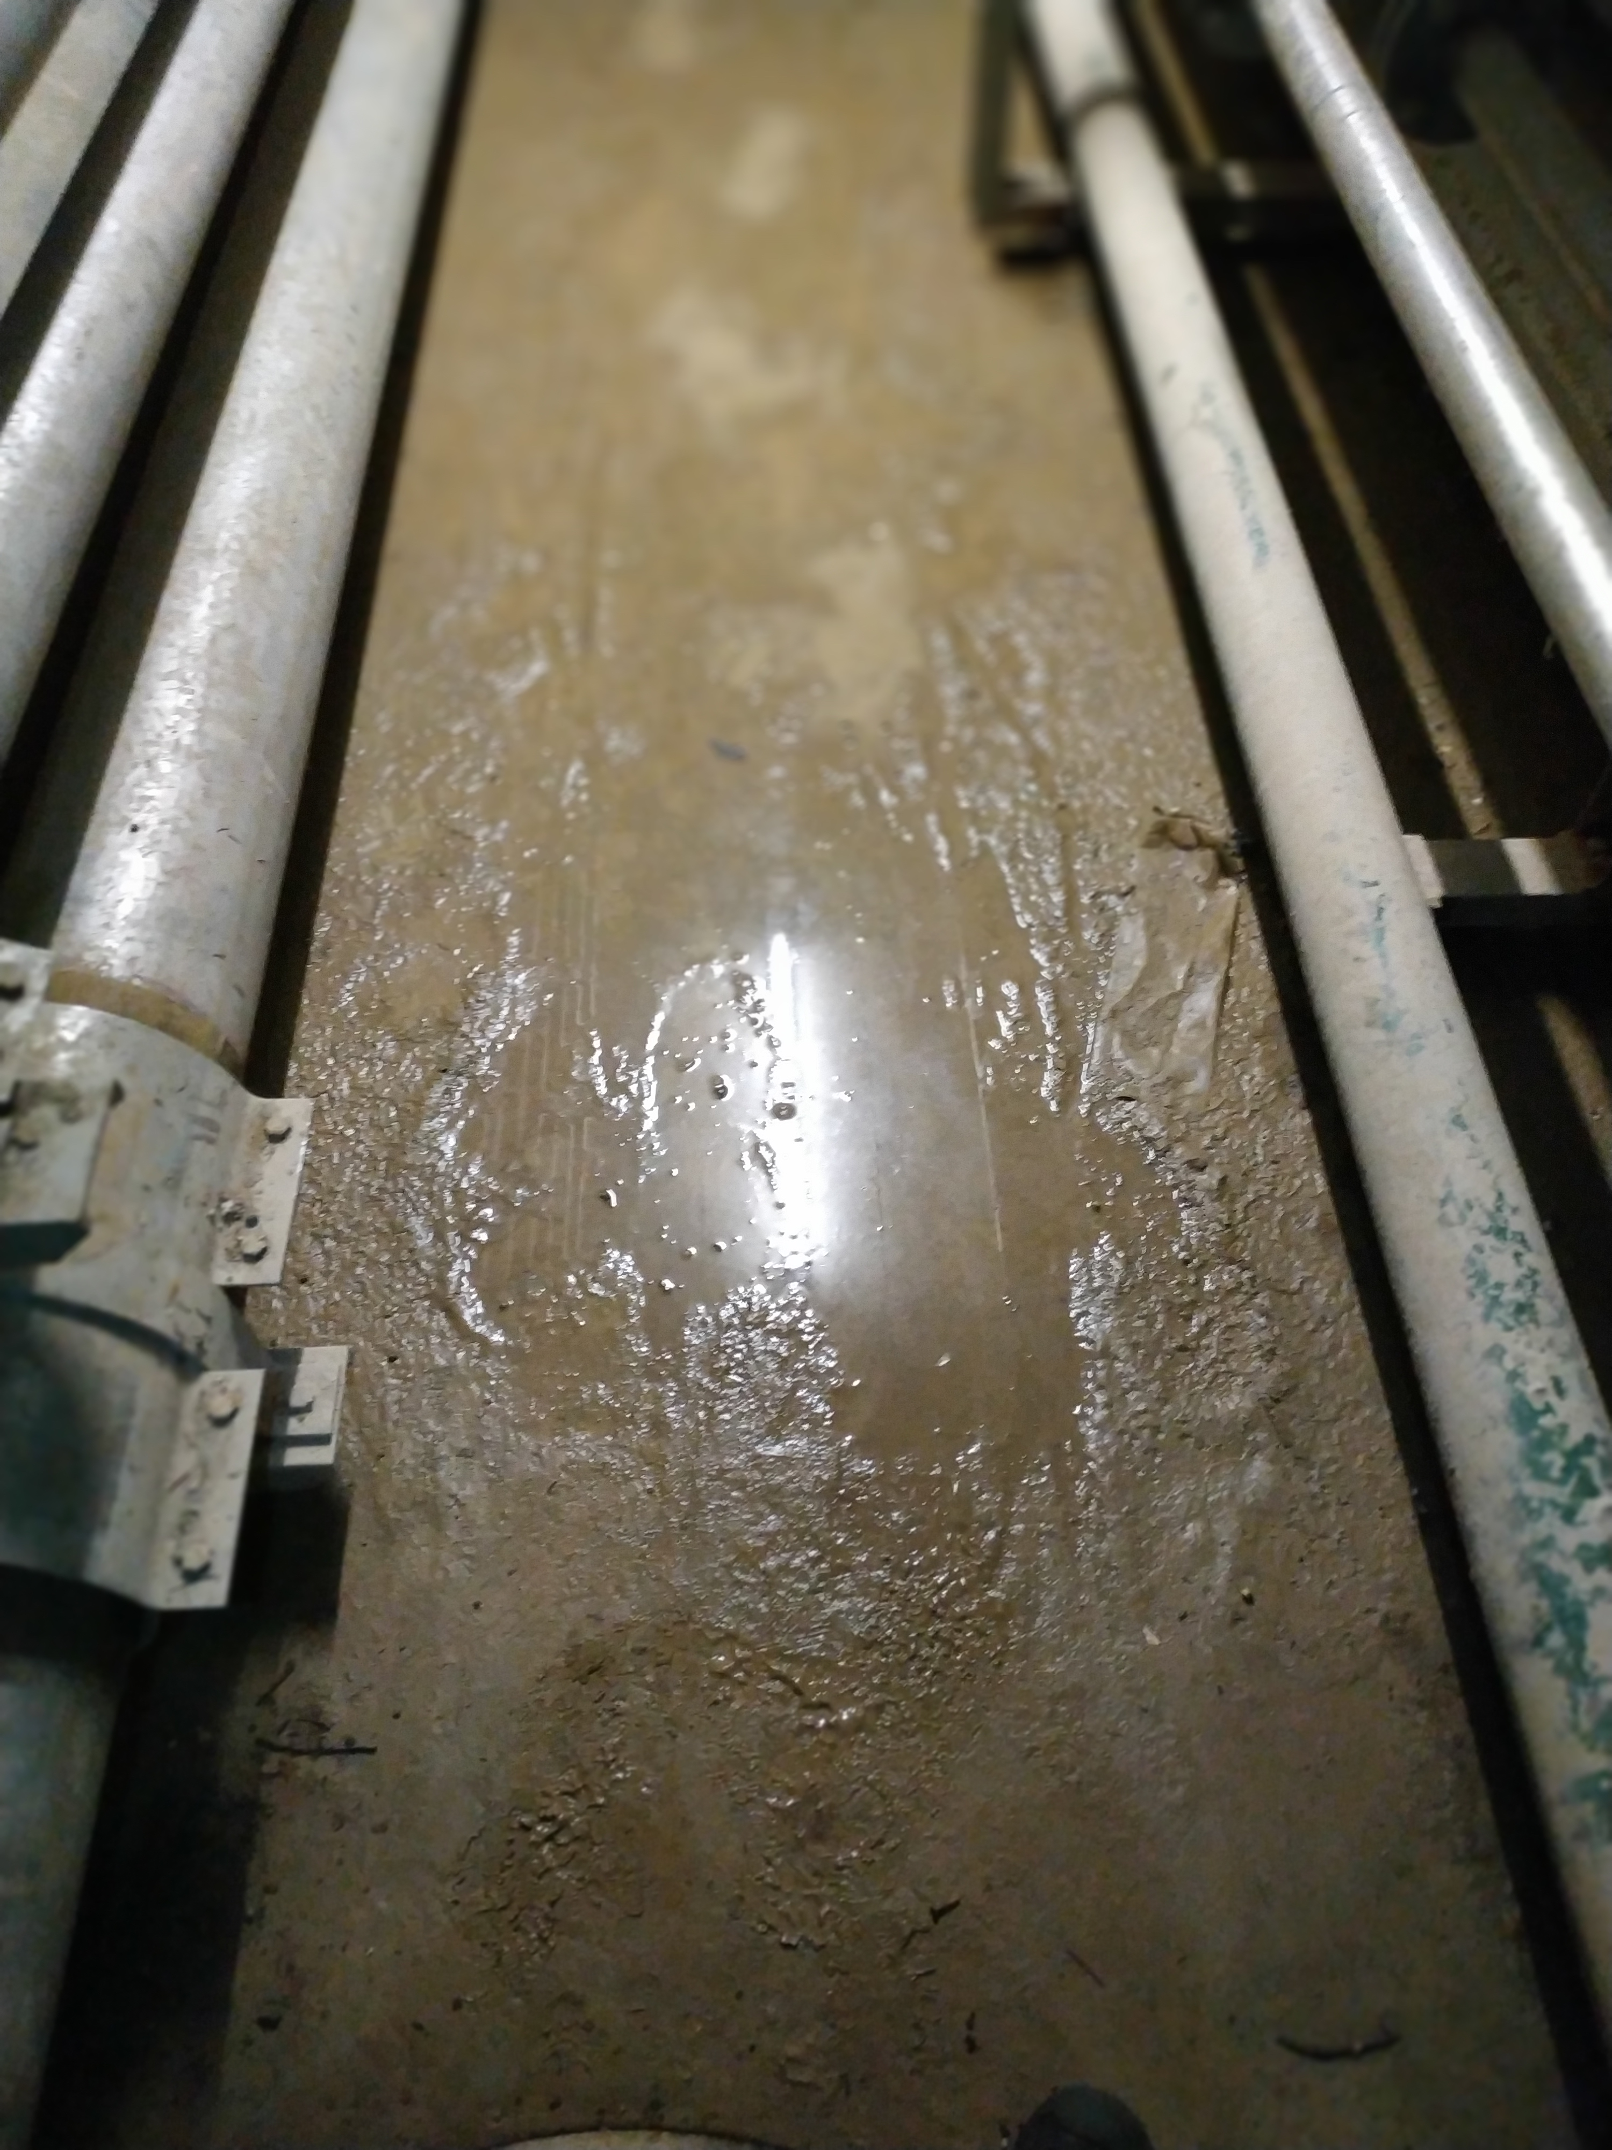
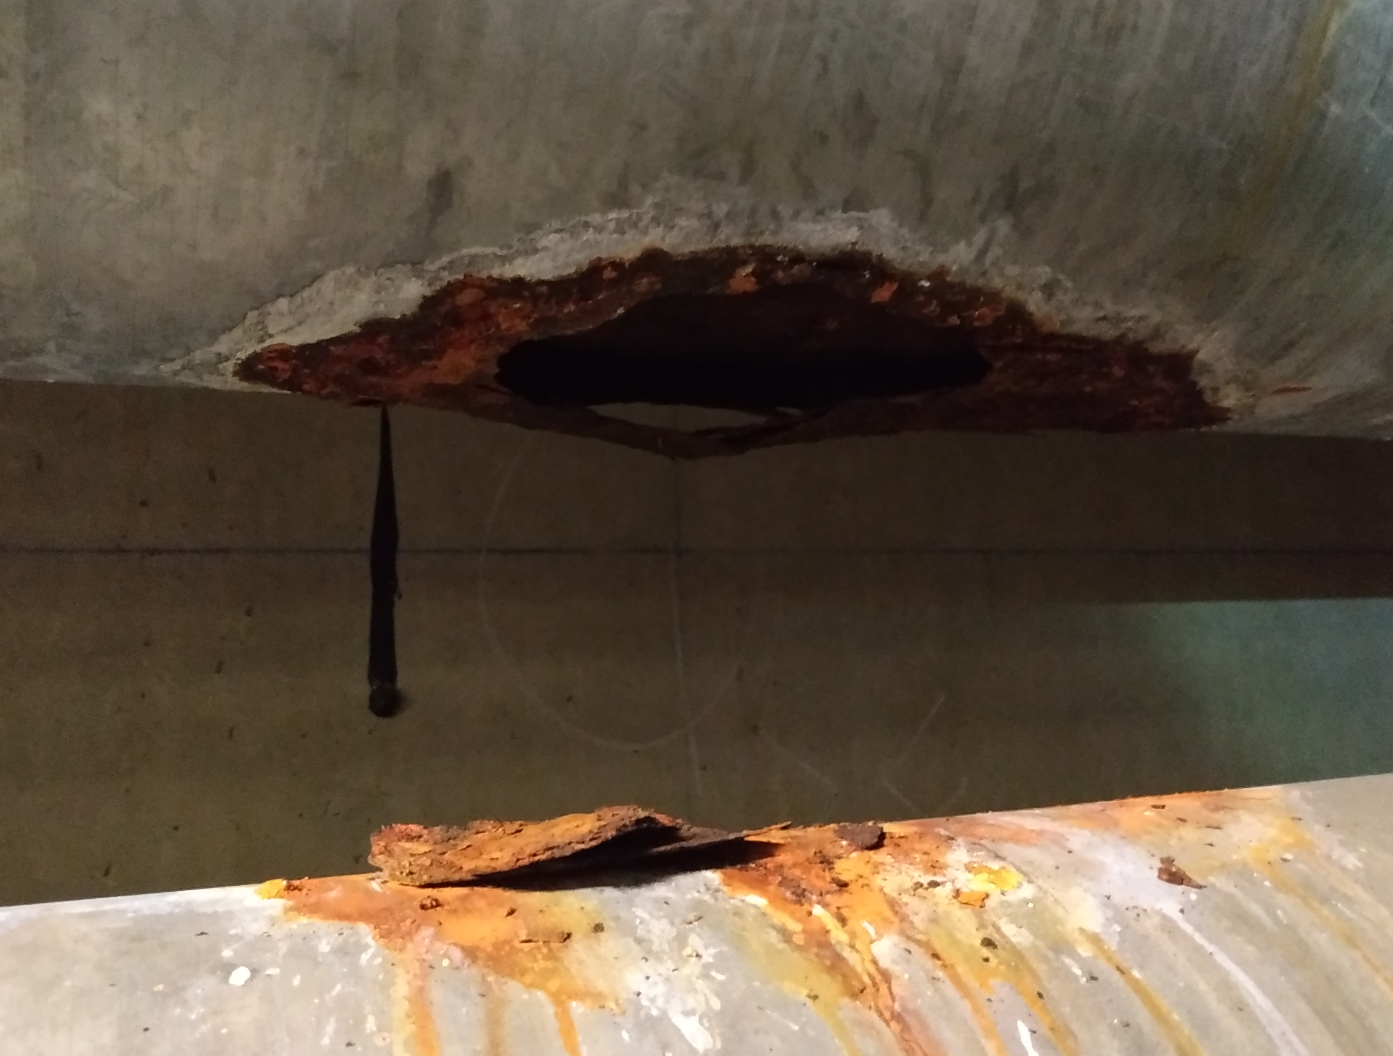
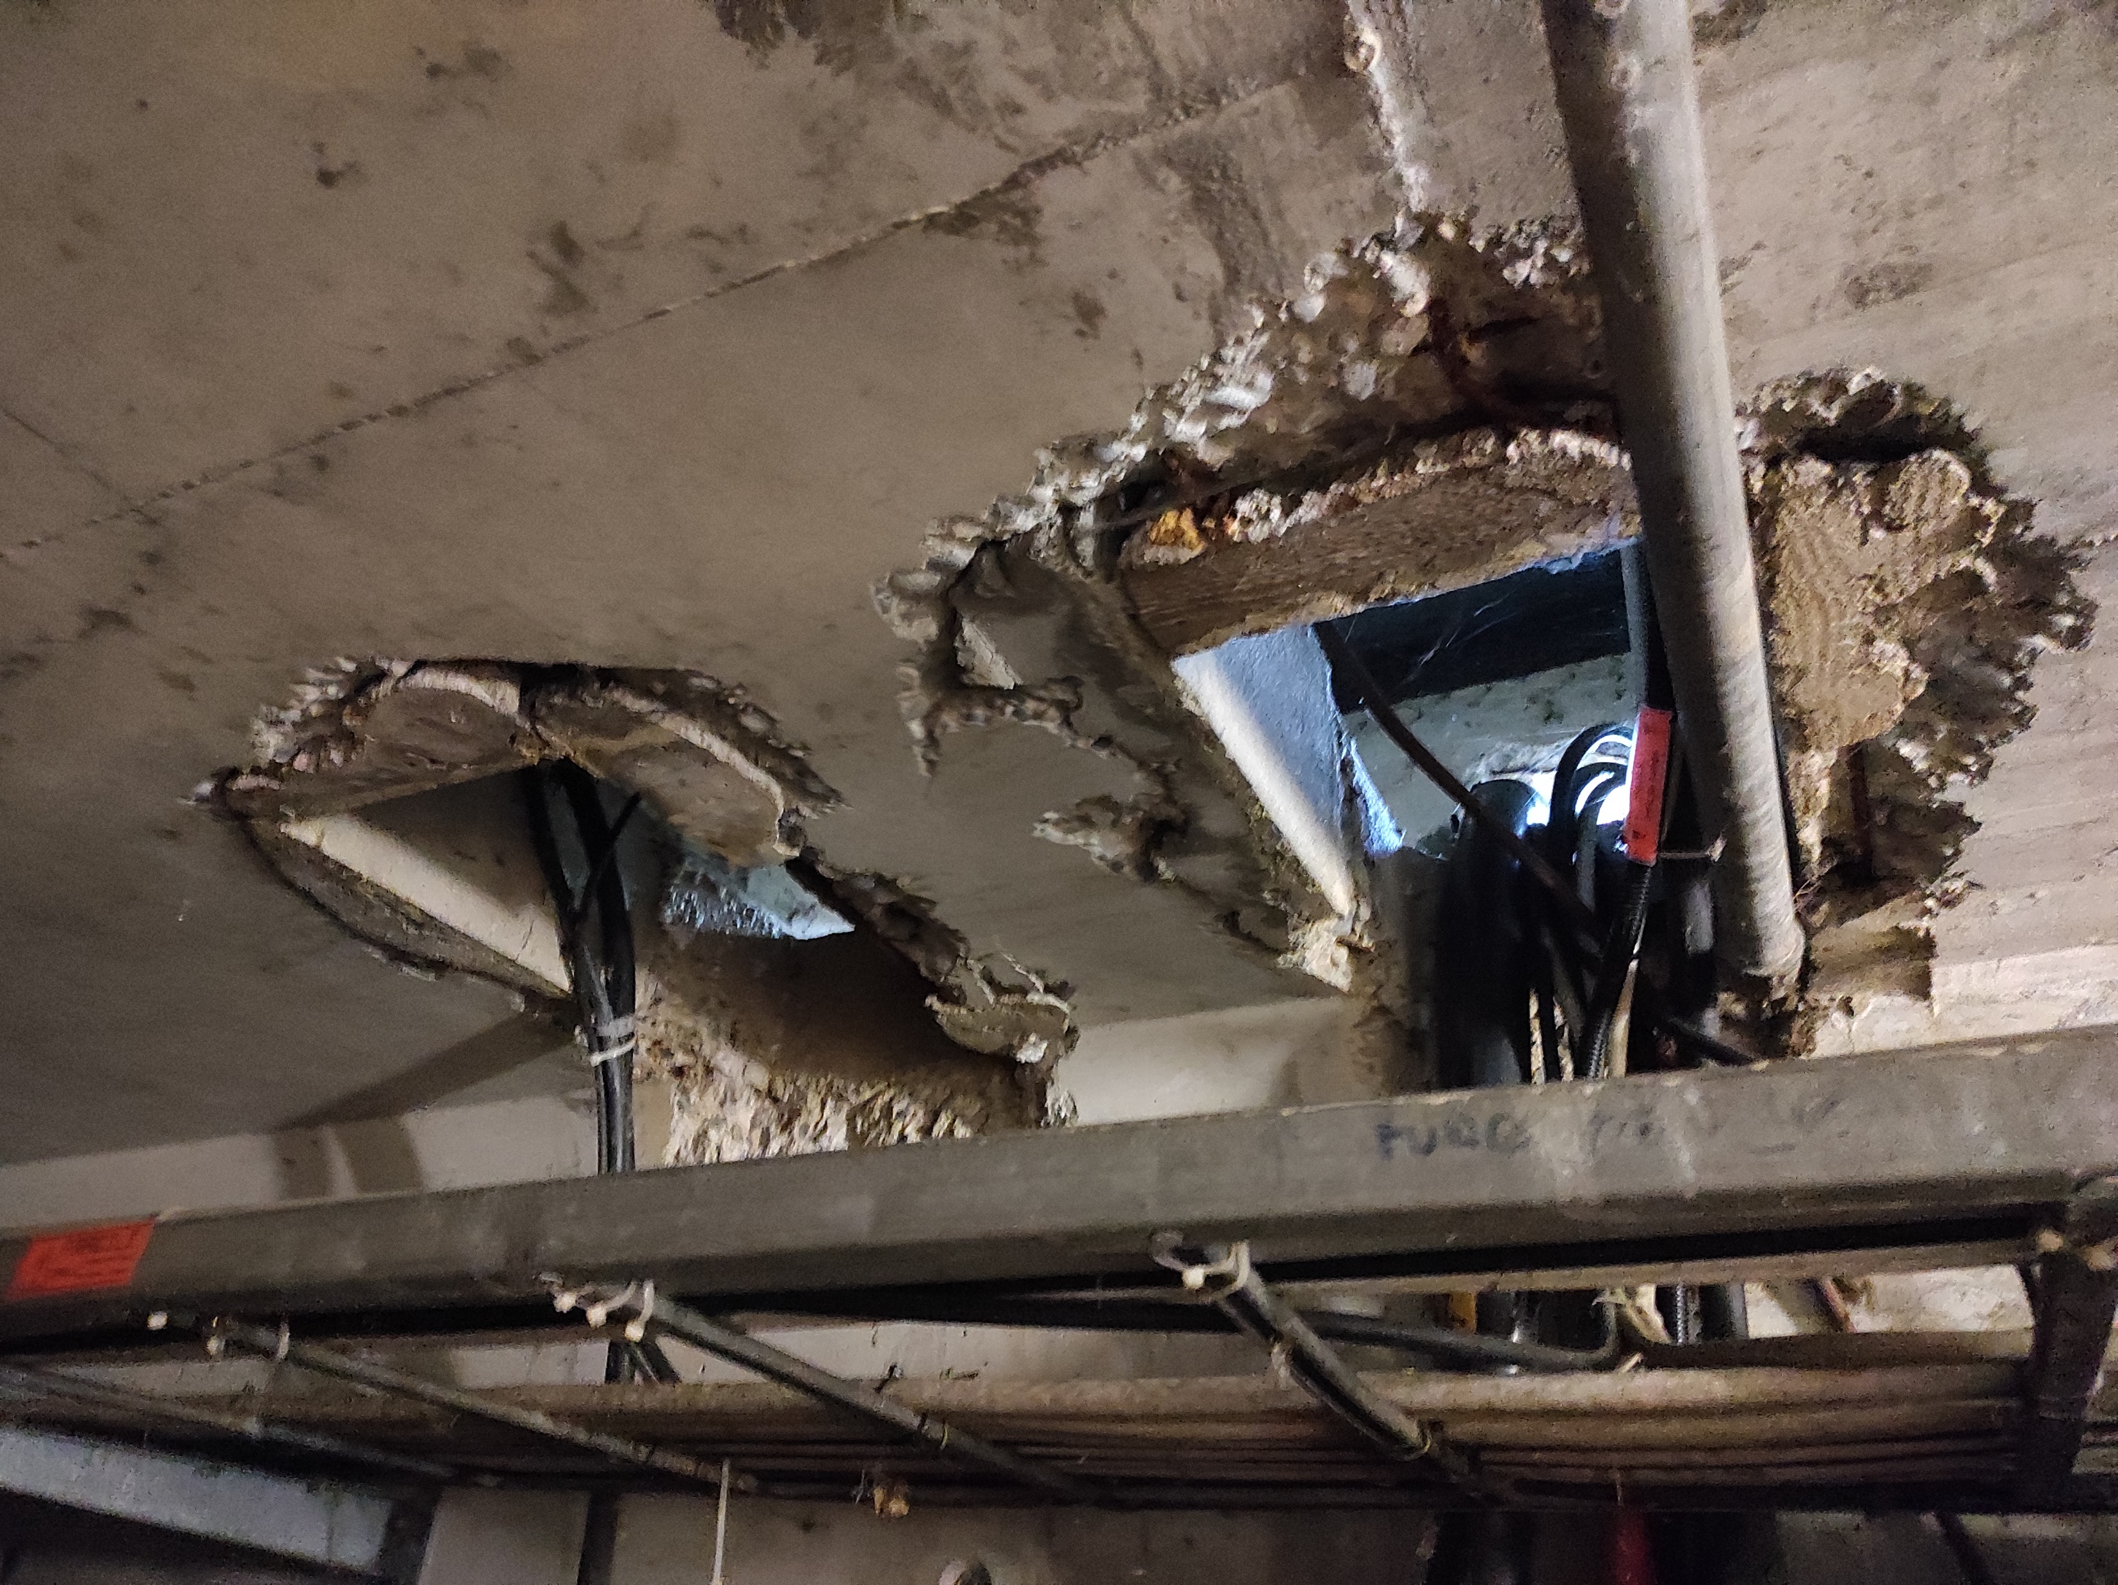
Reports (1/4)
One descriptive report per group of galleries
  Includes: list of sub-galleries, locations, limits, access points etc.
  Members of NA CONS Team & WPLs of TG CONS will check the document.
  PL of NA CONS & PL of TG CONS will approve it.
  EATM members will be informed.
Issues found in the TGs (table view)
GT801
GT817
GT801
GT800
Legend
All reports are available in EDMS .
Notes:
6

Slide 7
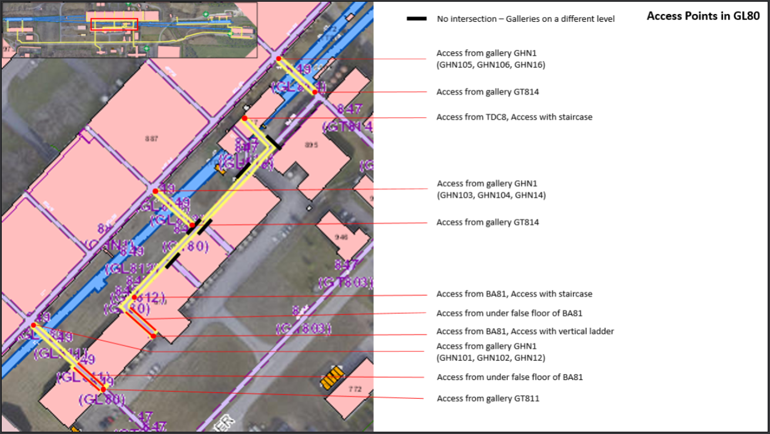
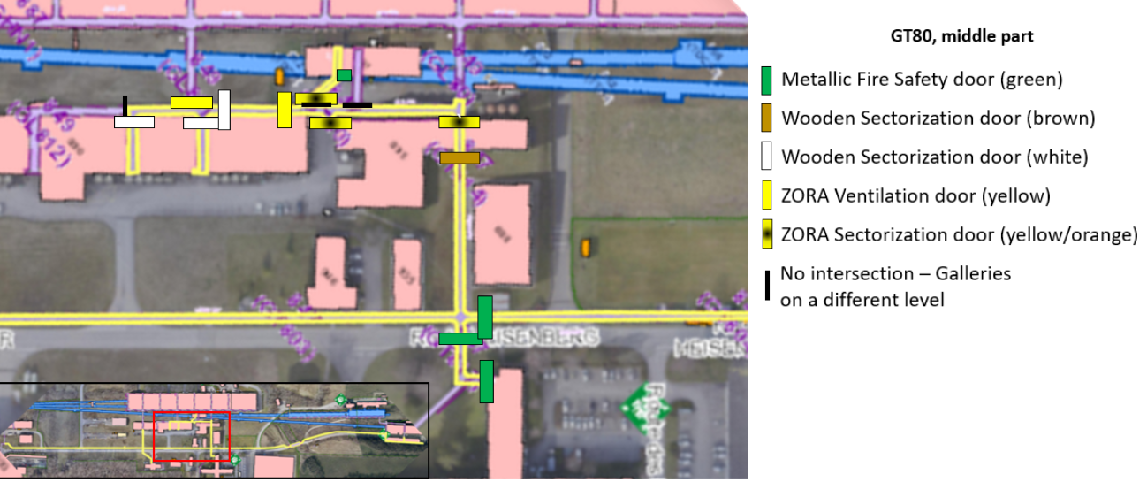
Reports (2/4)
Access Points & Emergency Exits
Doors location
Available for all groups of galleries.
Available for all groups of galleries.
All reports are available in EDMS .

Slide 8
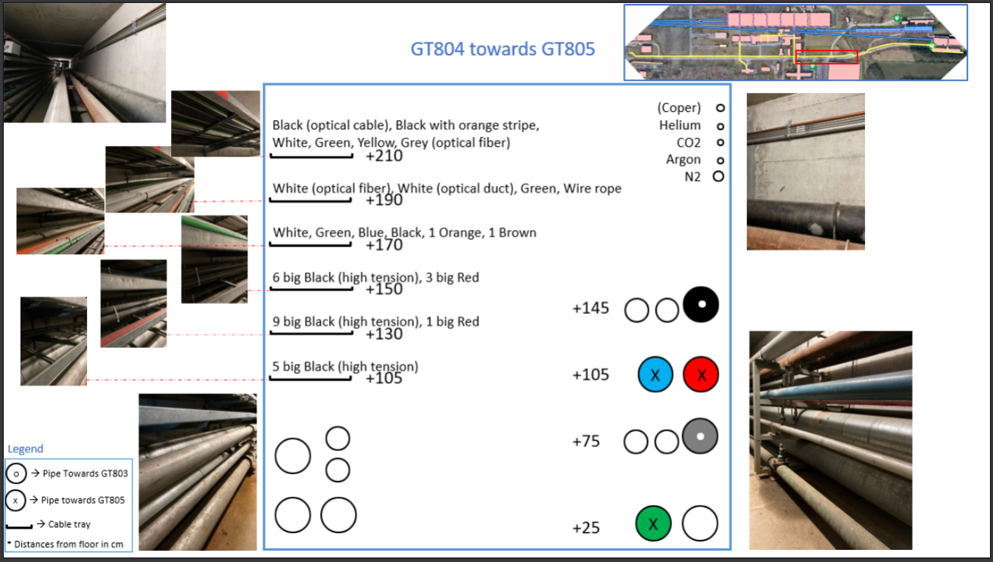
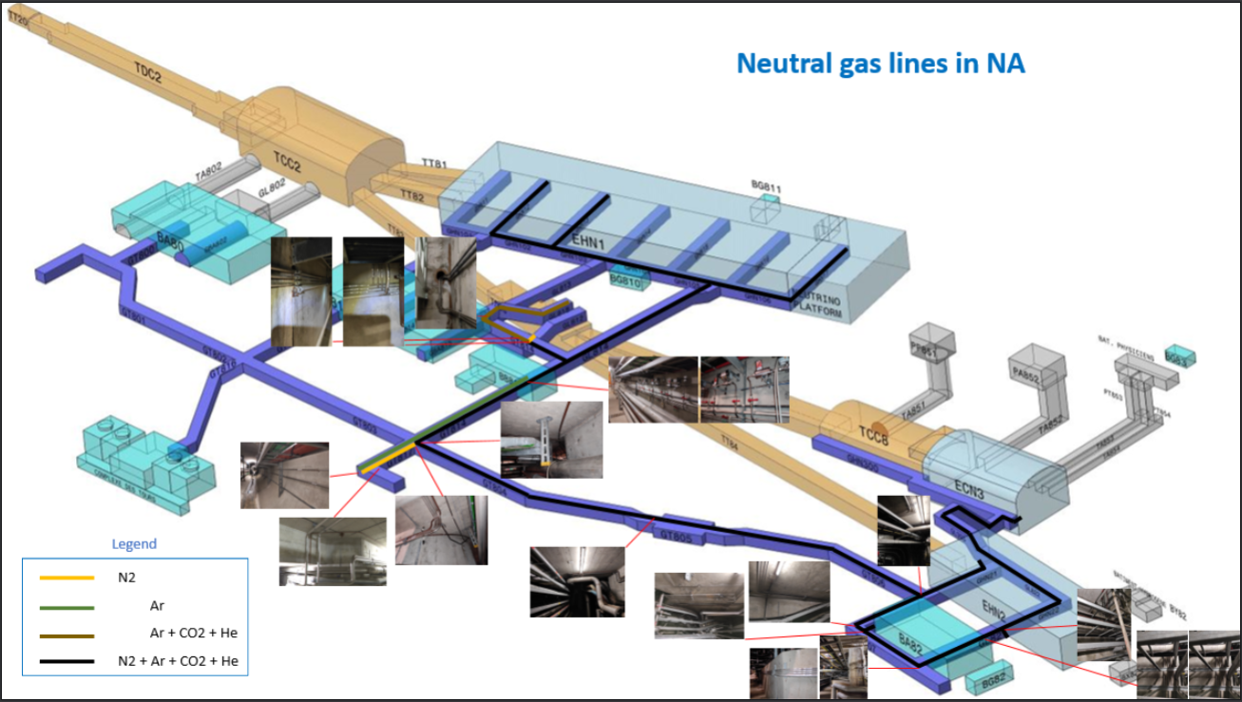
Reports (3/4)
Cross Sections
Neutral Gas Lines Layout
10 sub-galleries completed.
7 sub-galleries halfway complete.
31 sub-galleries to be done.
The report will be available in EDMS soon.
The report will be available in EDMS soon.
Thanks to Deepti Kandhol for the support
All reports are available in EDMS .

Slide 9
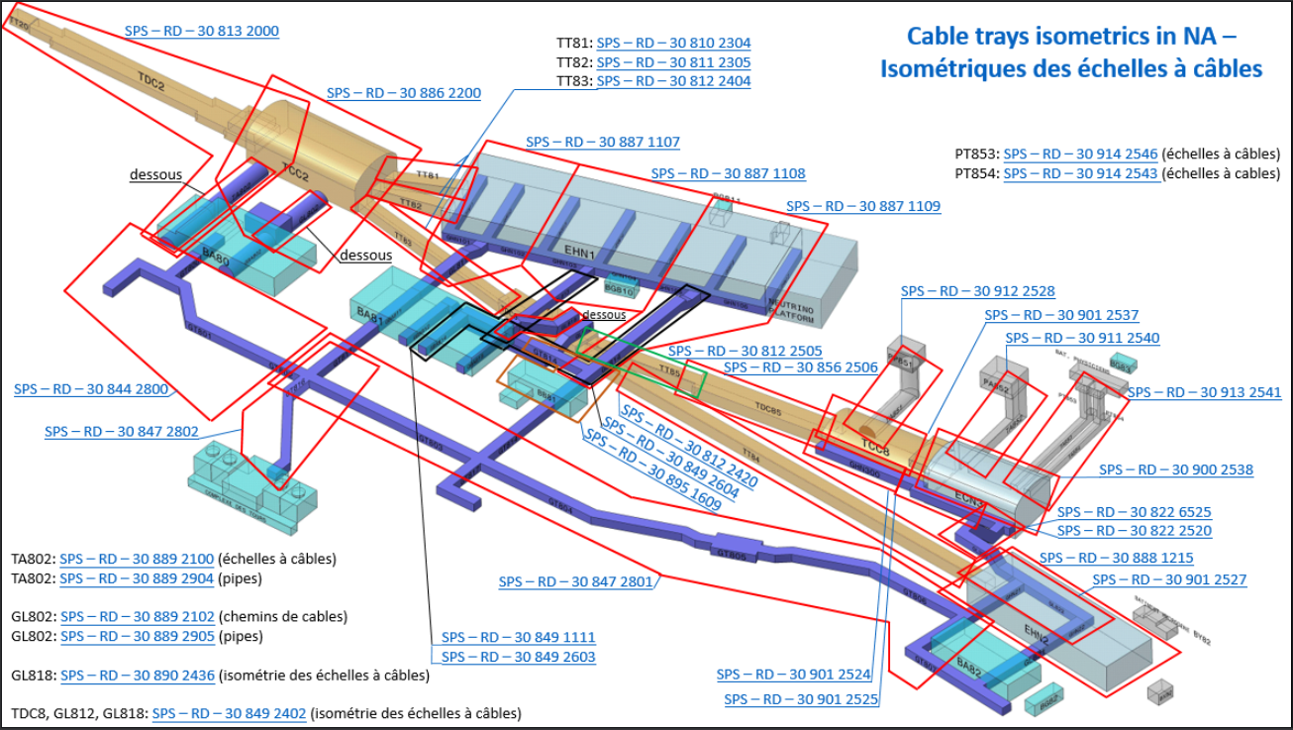
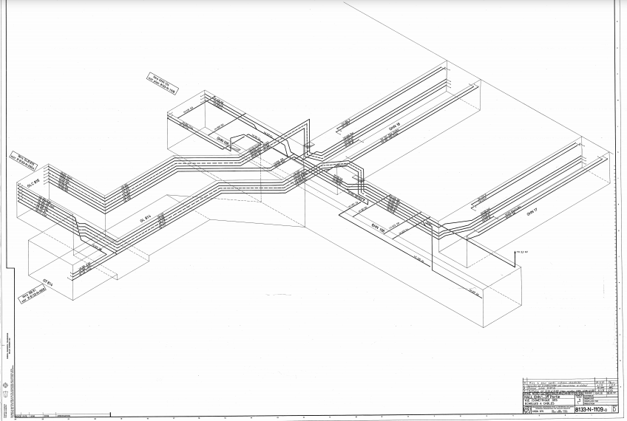
Reports (4/4)
Interactive map of Cable Trays Schemes
Available for all North Area.
All reports are available in EDMS .

Slide 10
Consolidation activities
Access to galleries
3D integration models
Ventilation studies
Cable identification & de-cabling
GSM Network
Other identified needs

Slide 11
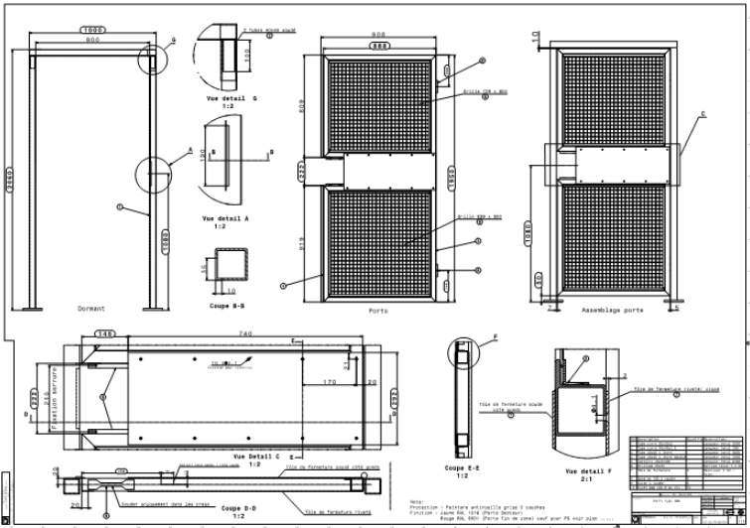
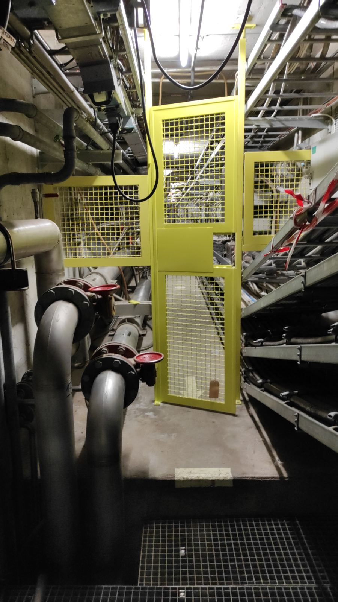
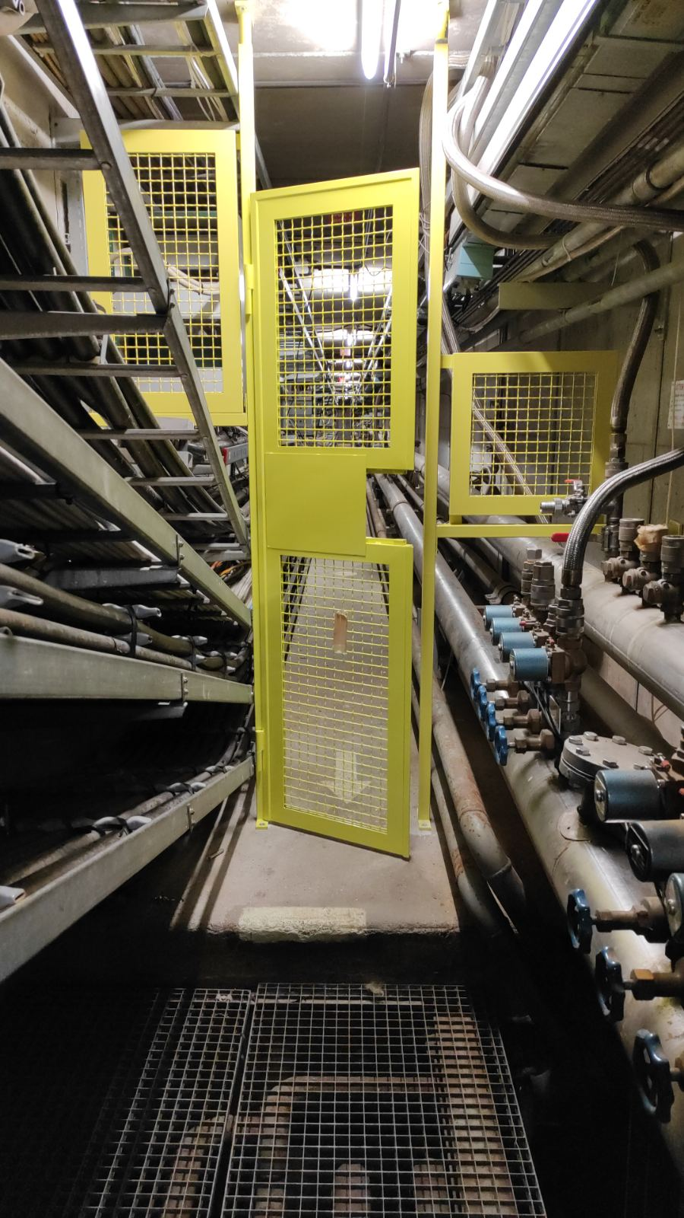
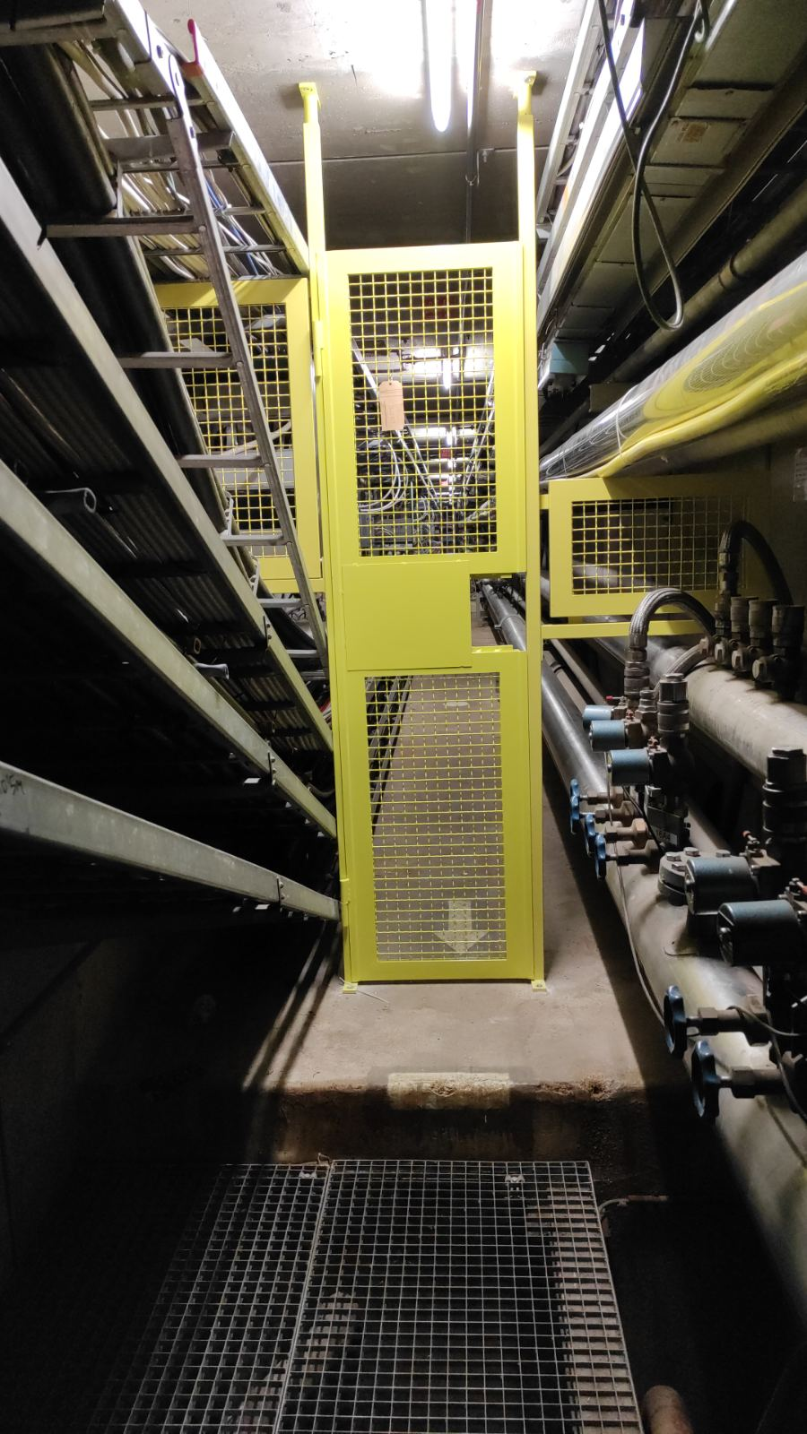
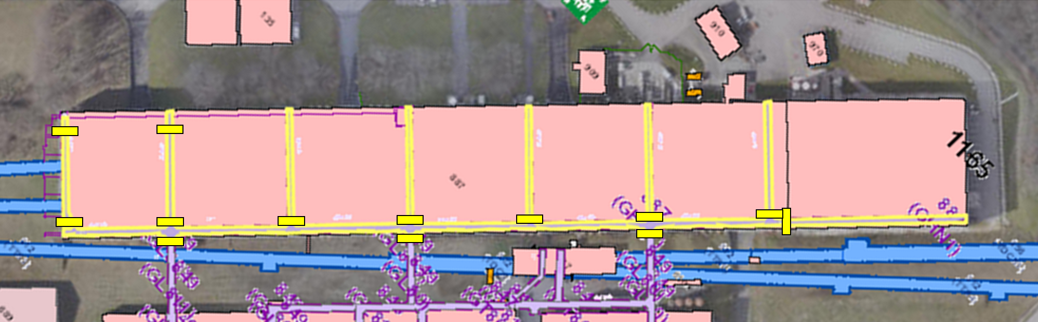

Access to galleries (1/2)
Installation of ZORA ventilation doors in GHN1 (GHN13 – GHN17).
Transversal galleries below the beam → Safety issue.
Access to all the galleries will be studied.
GHN13
GHN15
GHN16
Credits to Jordi Bossy

Slide 12
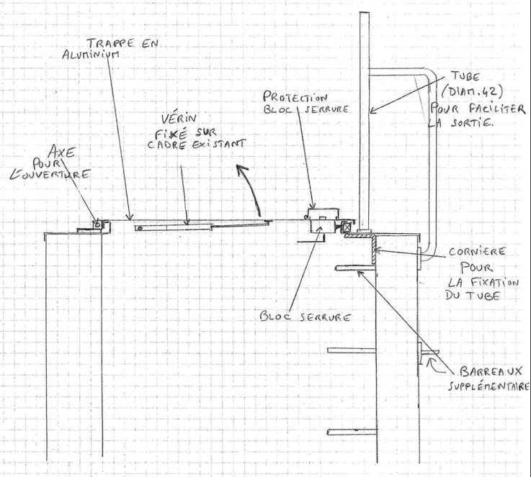
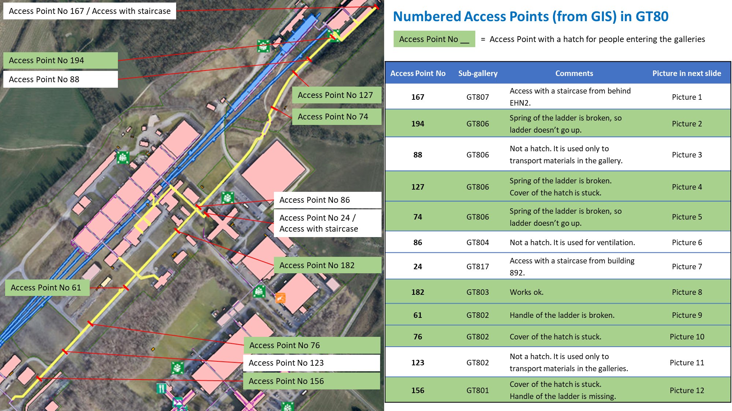
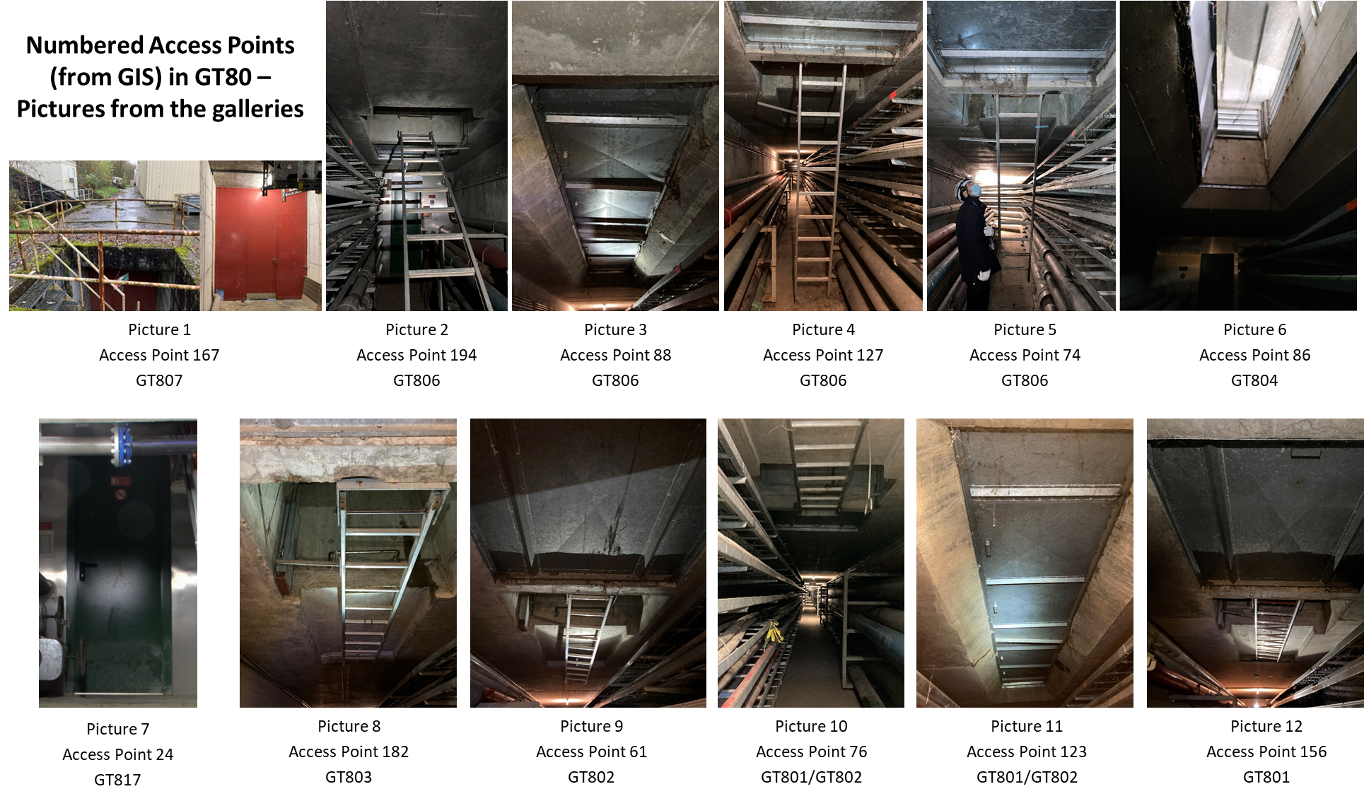
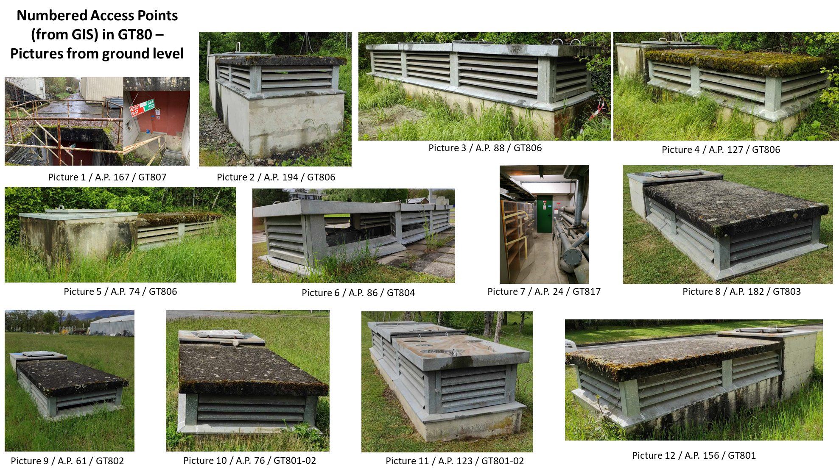
Access to galleries (2/2)
Hatches consolidation in GT80.
Hatch covers will be replaced.
Preliminary study by EN-ACE is ready.
Waiting for the “green light” from TG-CONS.
Presentation about the hatches will be available in EDMS once the consolidation is approved.
Credits to Jordi Bossy and Pascal Catherine

Slide 13
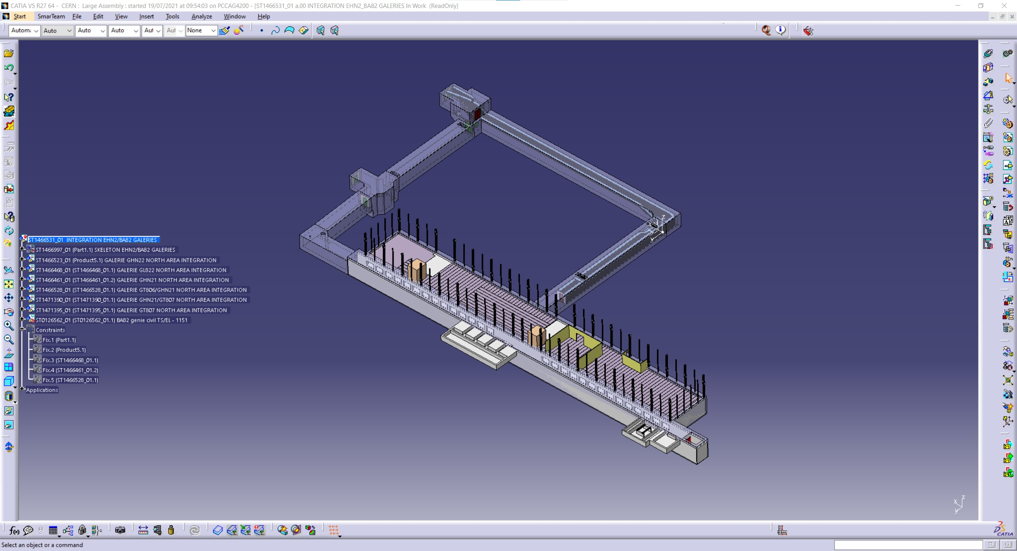
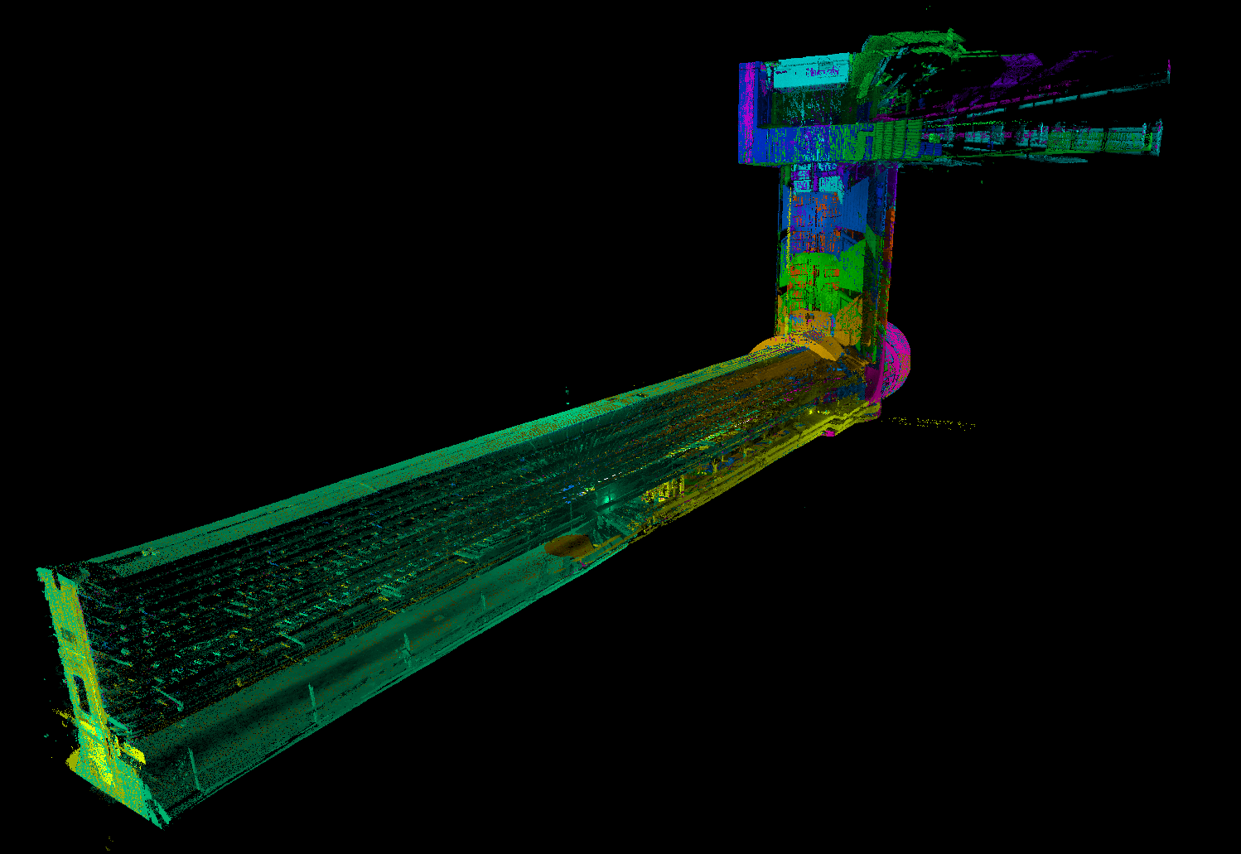
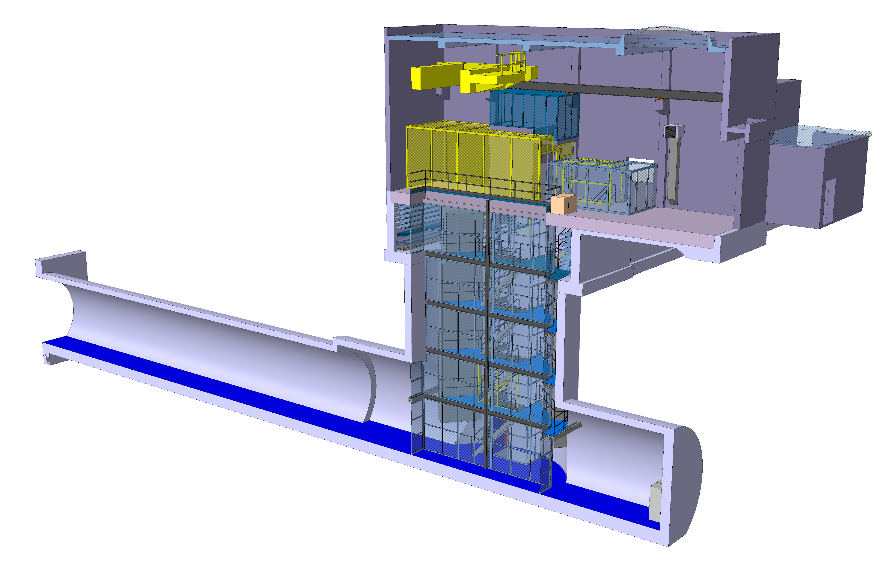
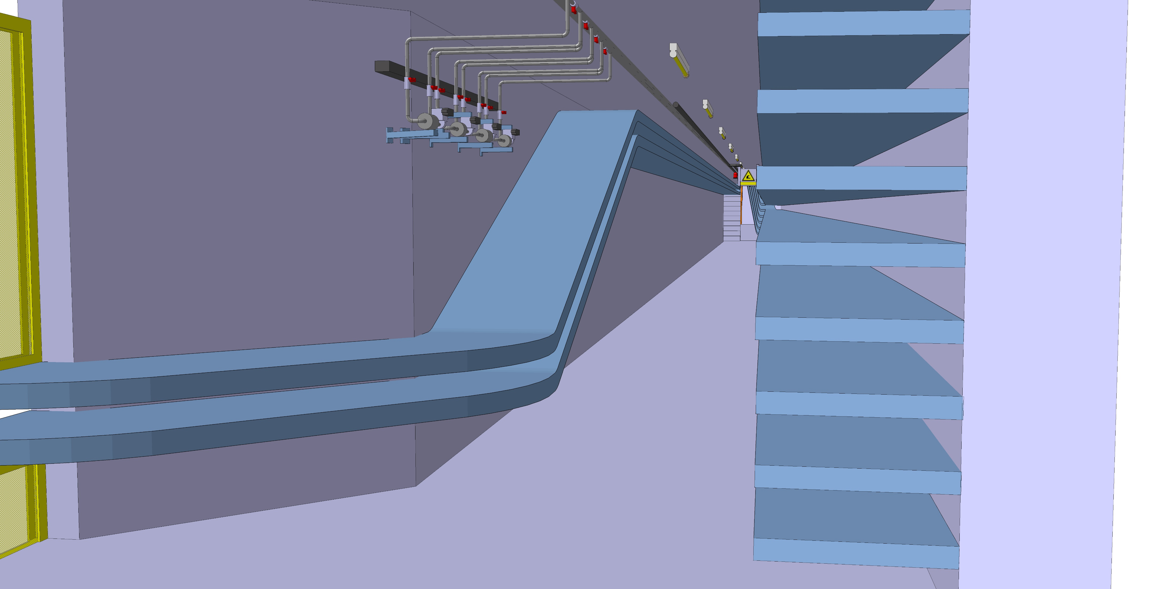
3D models
GL802 (access to TCC2)
GHN2 & GT807 (below EHN2 & BA82)
Drawings only on paper.
Scans → 2D drawings + in situ survey → 3D models
Models “as is”.
Integration of all the services will follow.
TA802 (access to TCC2)
GL822 (below EHN2)
Credits to Rafael Fernandez Gomez and Kevin Joseph Buffet

Slide 14
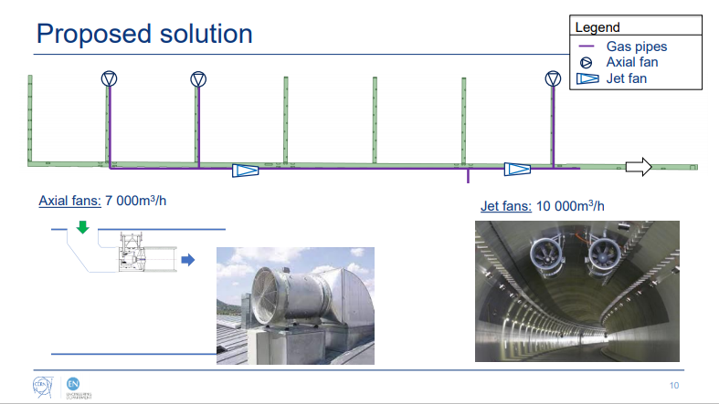
Ventilation studies
Study in EHN1:
  Identification of gases with the highest risks.
  Simulation models of leaks propagation.
  Mitigation measures (axial fans, jet fans) for the worst-case scenario.
Study in EHN2:
  On-going.
  Same procedure as in EHN1, but more efficiently (use of 3D models).
  Studies for the rest of the galleries will follow based on risk analysis for neutral gas lines network.
The full presentation is available here.
Credits to Alejandro Mejica Rodriguez

Slide 15
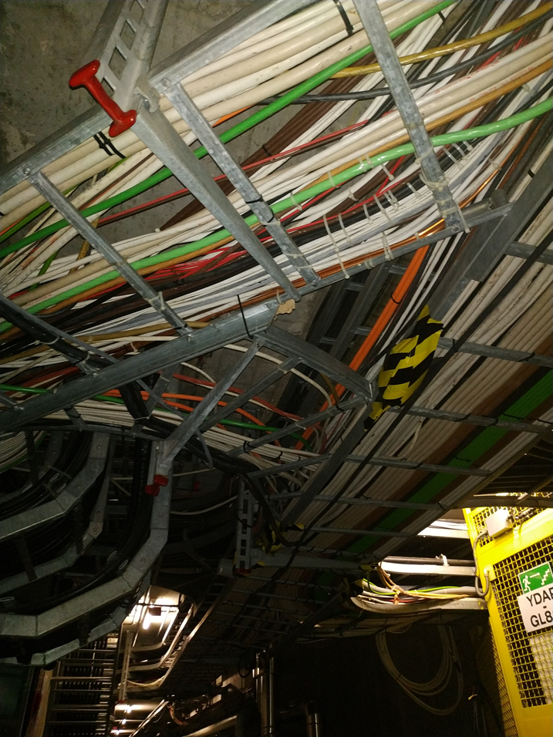
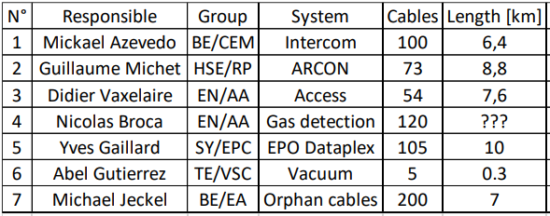
Cable identification & de-cabling
The working group has already been formed.
A dedicated website will be created.
Obsolete cables from 7 systems have been identified.
Work will take place during YETS 2021 – 2022 in EHN1 (ground floor & galleries).
Credits to Michael Jeckel

Slide 16
GSM Network
GSM mapping results in NA
Waiting for a technical solution.
Credits to Michael Jeckel

Slide 17
Other identified needs
Detectors / Alarms
Asbestos / Lead diagnostics
Leaks / Accumulated water / Humidity
Corrosion
Concrete spalling

Slide 18
Thank you for your attention!
Questions?

Slide 19
Additional Slides

Slide 20
List of sub-galleries in NA

Slide 21
Summary of identified needs

