Slide 1


Progress report P42+K12 tuning
Niels Doble, Nikos Charitonidis, Lau Gatignon, Johannes Bernhard (BE-EA)
03 August 2021

Slide 2
What is the issue?
Since the beam was switched on on the 13th of July, no beam, no beam monitoring, i.e. no signal on any SEM, no signal on the XION at the end of the dump tunnel behind ECN3.
The P42 beam transports protons from T4 to the T10 target over 838 m. The K12 beam transports hadrons from T10 to NA62 over 102 m.

Slide 3
What is the issue?
The P42 TAX showed intermittent positioning problems around the 4 mm diameter TAX hole in 2018.
Many detectors in NA62 need beam to be commissioned. In this context the only useful but indirect feedback comes from a large muon counter at the end of ECN3 (MUV3: 2.64 x 2.64 m² with a hole for the beam passage, 246 m behind T10).
In P42 only two modifications were made during LS2: QUAD18 was doubled and BEND2 (MSN plug-in) was replaced about a month ago after it burned. Its polarity was found wrong and corrected on the 16th of July. In the meantime, all currents were checked by EPC, RP surveys were performed and many scans and checks were done.
In K12 the second achromat was reinstalled slightly differently and the first one was re-cabled.
One polarity in the second one was found wrong and corrected before the beam start.
The first one is claimed to be correct but has not been cross checked (high dose rates).
On Thursday 22nd we decided to pick up from the start.

Slide 4
What did we change with respect to the first week?
We need to reduce the beam intensity for initial tuning for reasons of equipment safety, hence the 4 mm TAX hole. To avoid uncertainties due to the positioning problem with the 4 mm hole, we used a 7.5 mm hole in the other TAX. In the second TAX we used the 12 mm diameter hole, routinely used without problems all through the 2018 run.
To keep the intensity low, we used a 300 mm long Beryllium target in T4 (instead of 100 mm) and thus operated at half the proton intensity.
We switched off all dipoles and muon sweepers in K12 to make the muon signal a bit more easy to interpret.
Some SEM monitors, removed at the end of LS2 (they were not used over decades because they never gave a useful signal) were reinstalled and an attempt was made by SY-BI to really make them operational.
Various checks were done again on magnet currents and polarities.
Normally P42 tuning is done using collimators and counting on the SEM counters close to T10, but now we had to use the muon counter of the experiment instead (but in better conditions than in the first week, due to K12 magnets being off).

Slide 5
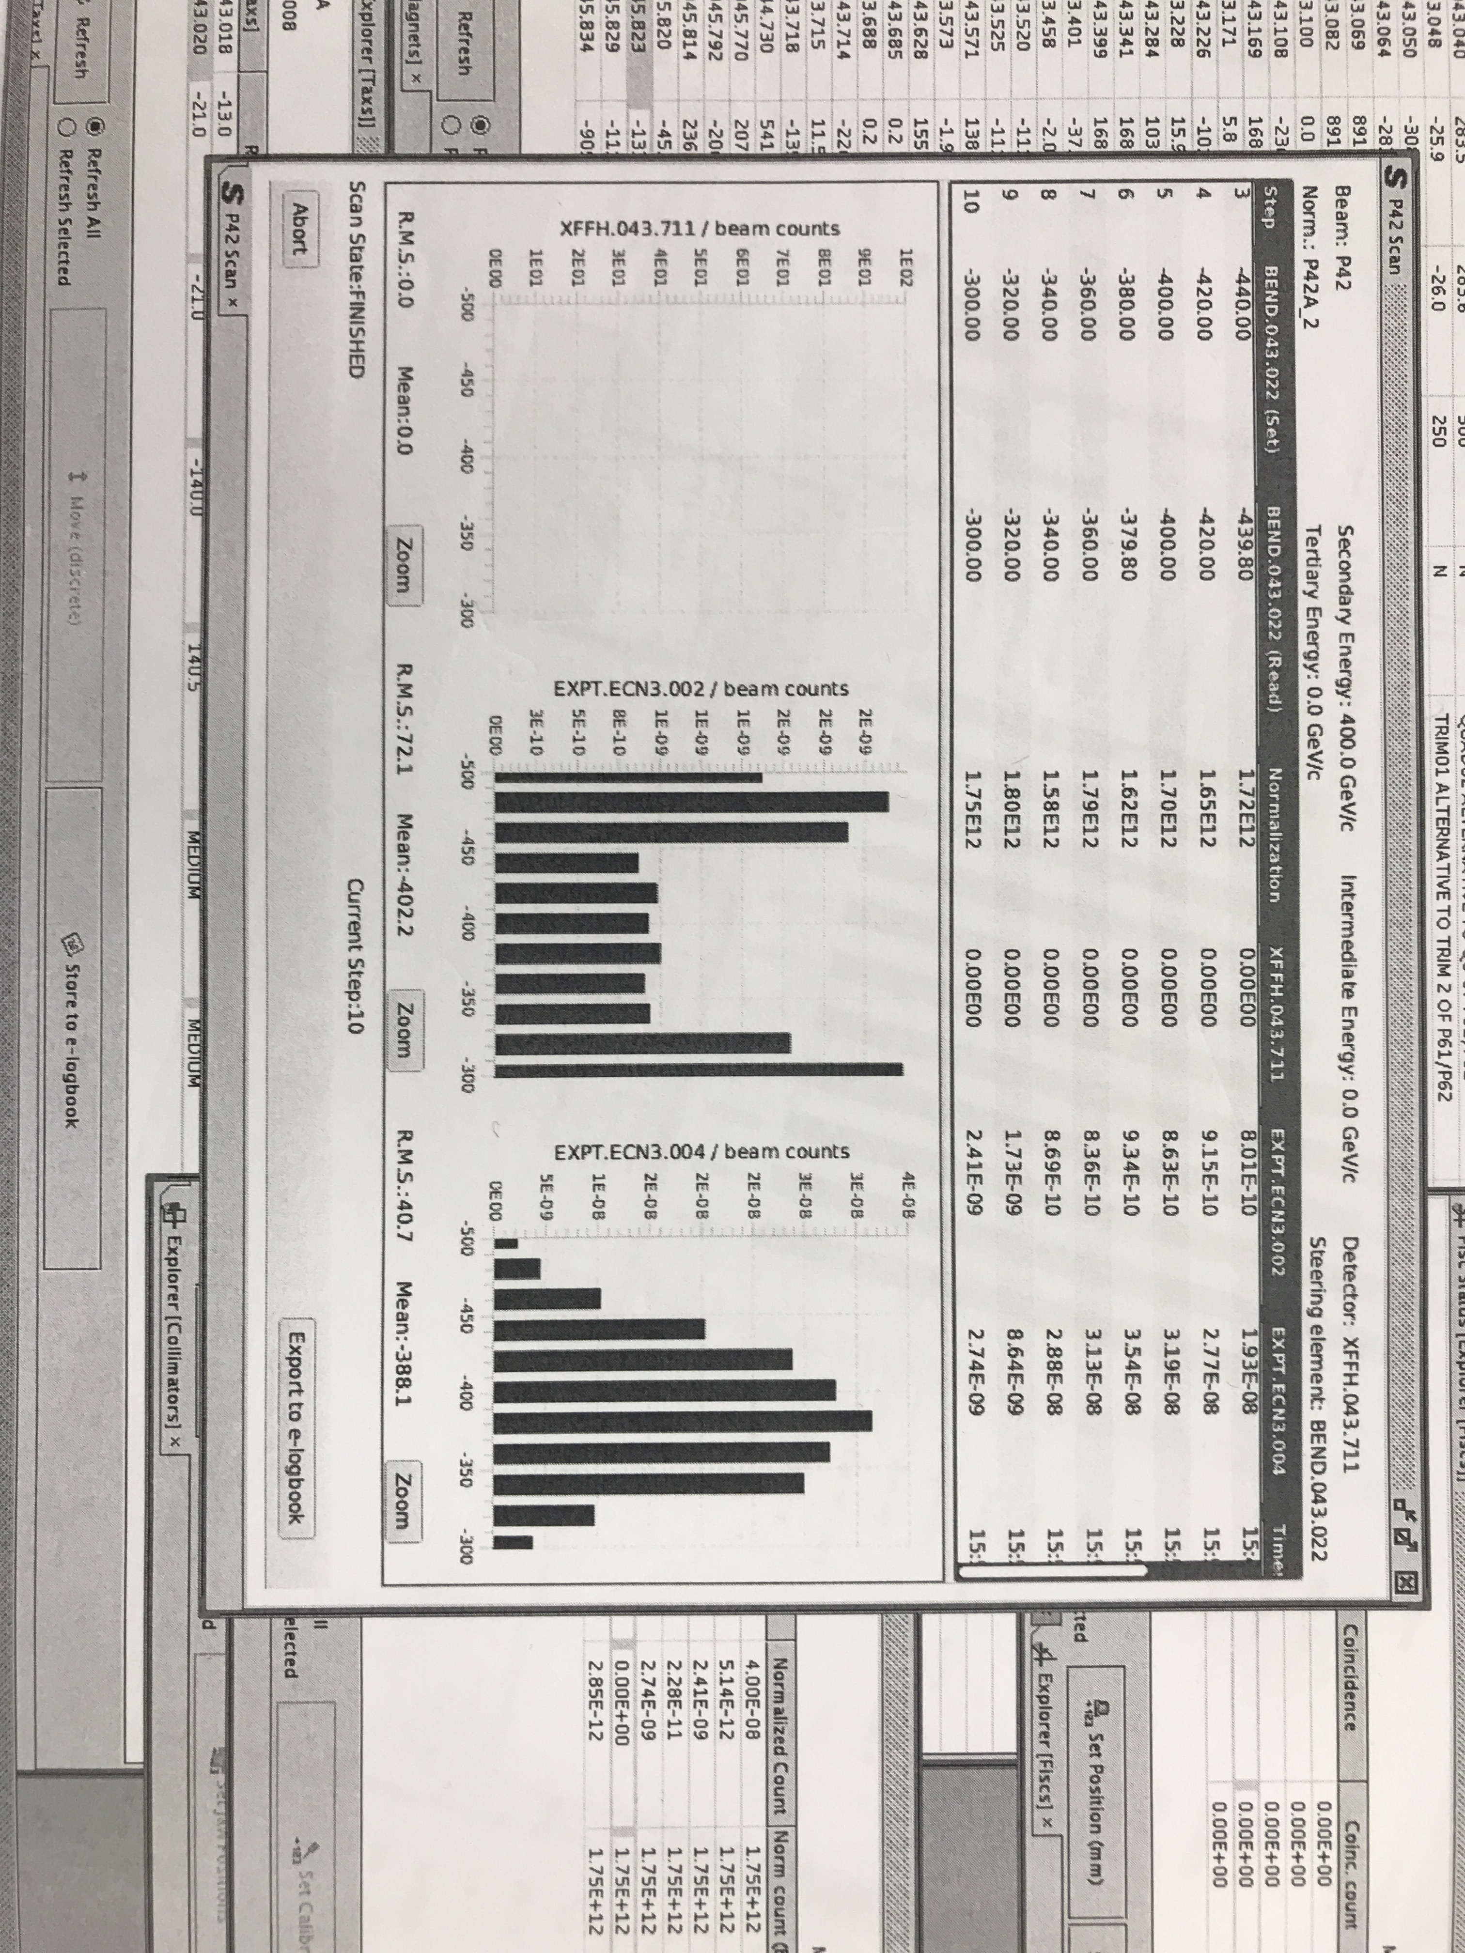
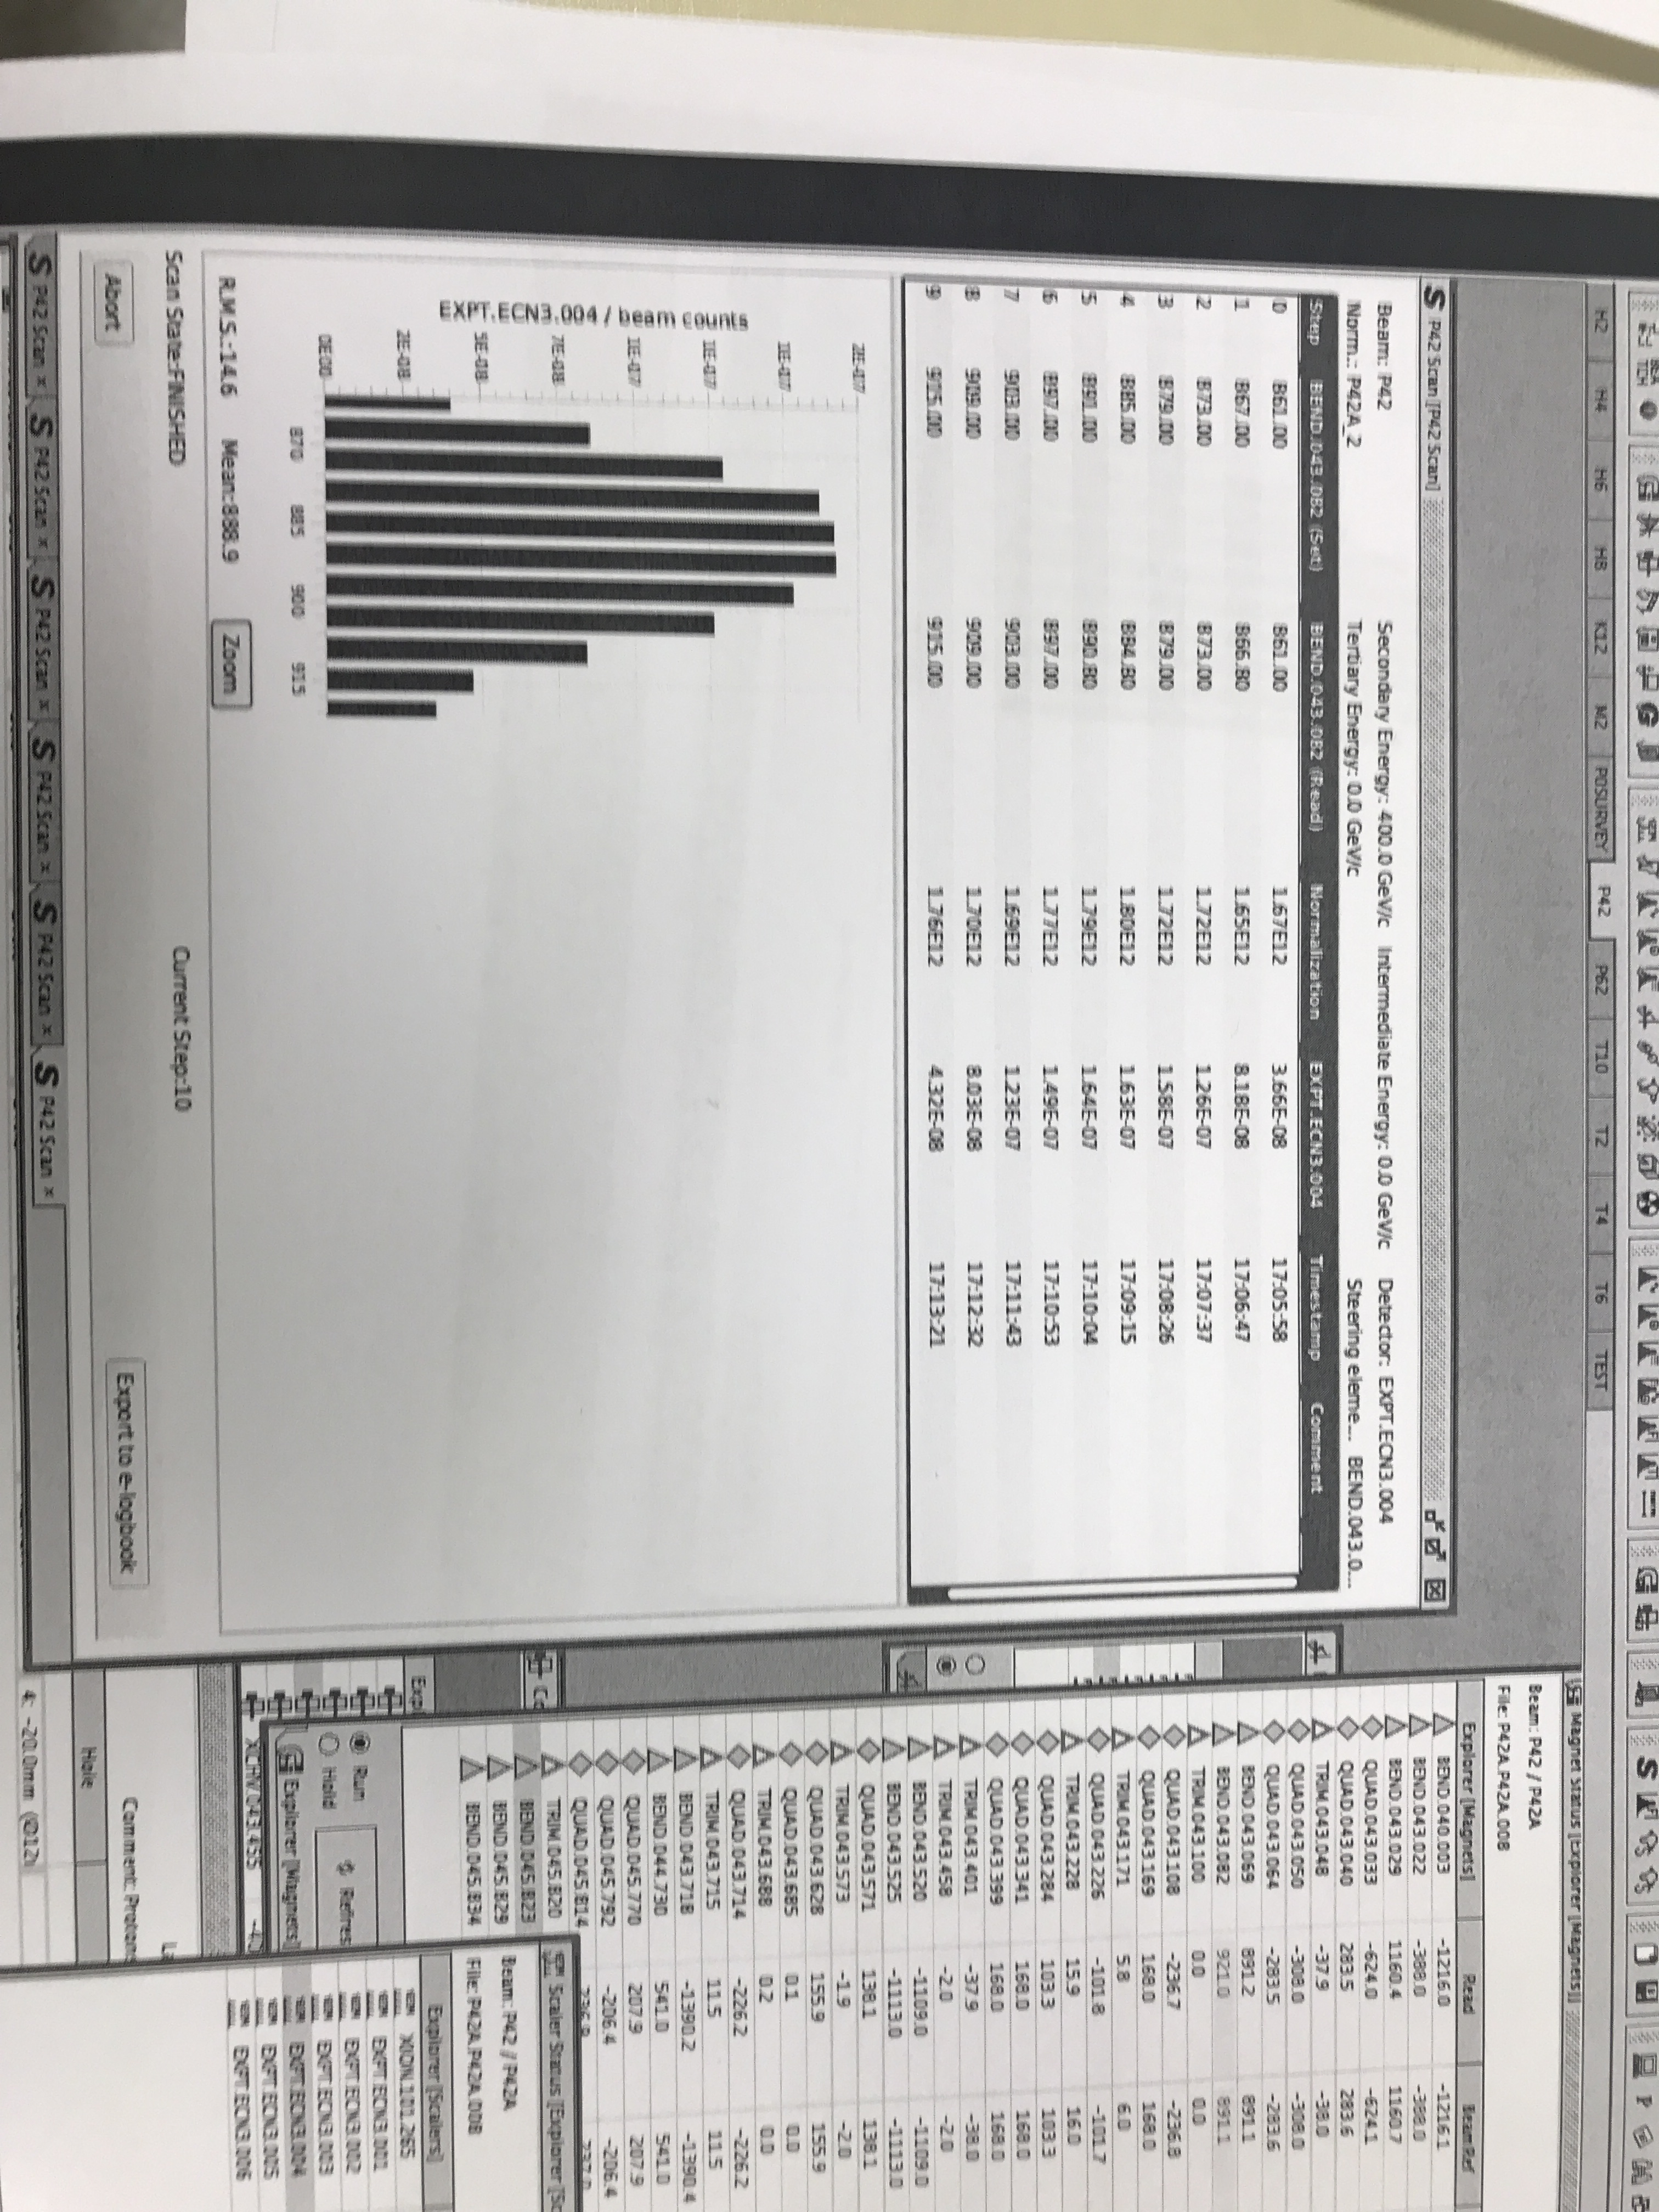
Some relevant observations (find 400 GeV currents)
BEND2_{H} (MSN)
BEND5_{H} (MBN)

Slide 6
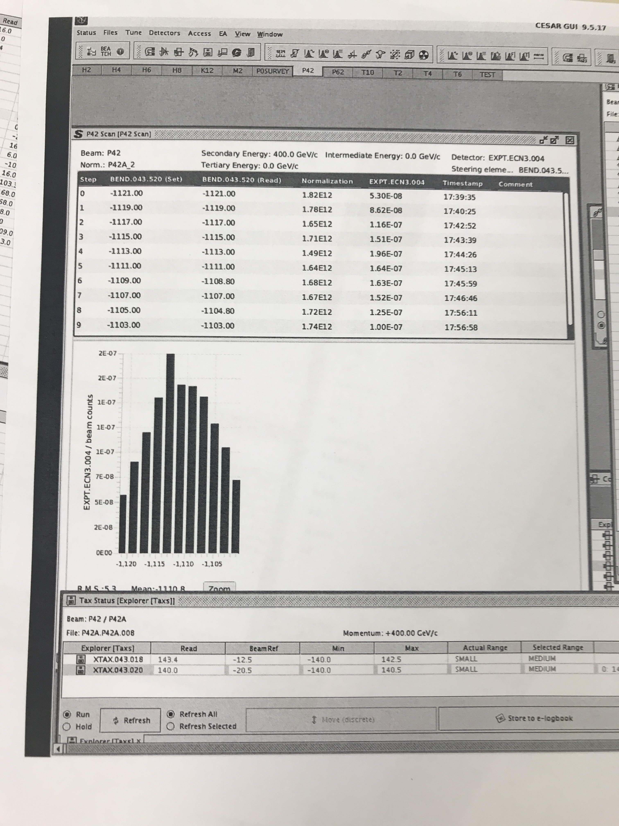
Bend7 scan (very sensitive)
Find nominal current (within 1 permille)
This must therefore be protons.
Scan through small slit in COLL7H (±1 mm).
Notice very high radiation level in tunnel
during the scan (1 Sv/h).
Therefore the rate must be quite high.

Slide 7
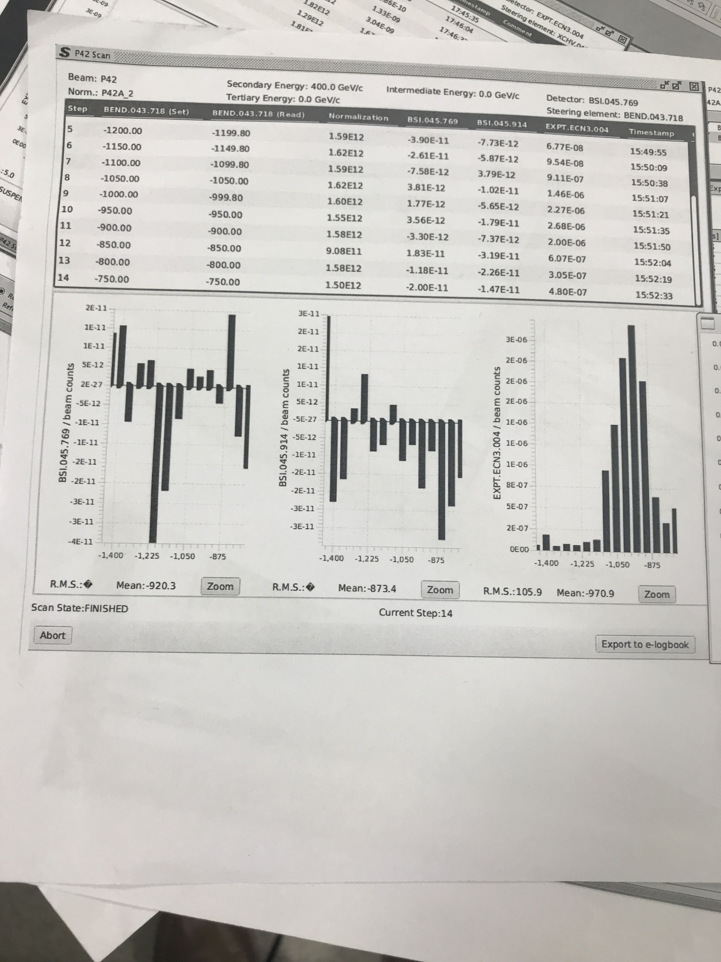
BEND8 and BEND9 scans
This setting gives many times more muons.
This corresponds to a 4.7 mrad difference in angle.
With such an offset the proton beam crosses
the wall of the vacuum chamber about 3 metres
downstream of the exit of B9.
RP found a hot spot at that location (1 mSv/hr).
At nominal settings, inversion of the first vertical
bend downstream (BEND10) showed no change
at all in the muon flux.
This could also indicate that protons do not reach T10.
Hence asked for a thorough check of B8, B9 and some
other magnets on Saturday morning. Thanks to the
magnet experts.
All magnets were found OK.
Nominal
(1390 Amps)

Slide 8
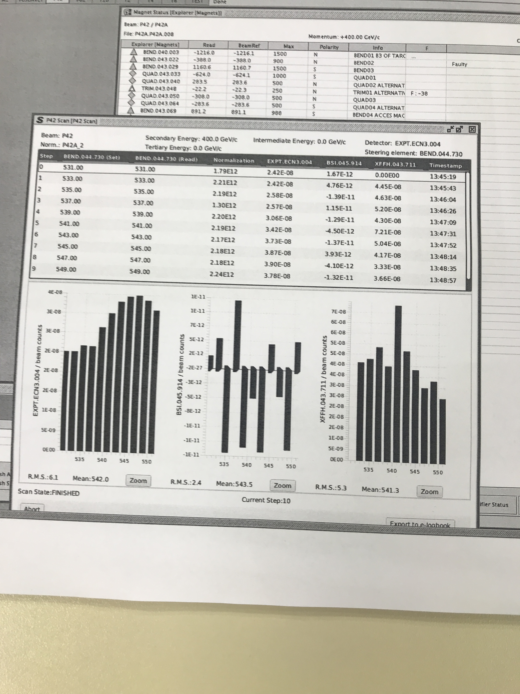
What now?
Believe Maxwell’s law and explore
peak at nominal current.
Set B8 to nominal.
A fine B9 scan around the nominal current shows a nice and narrow peak around the nominal value, as expected.
So with nominal settings we get
beam to Bends 10, 11, 12.
But still no other signal other than
the MUV3 counter of NA62.

Slide 9
Explanation of the B8, B9 ‘puzzle’

Slide 10
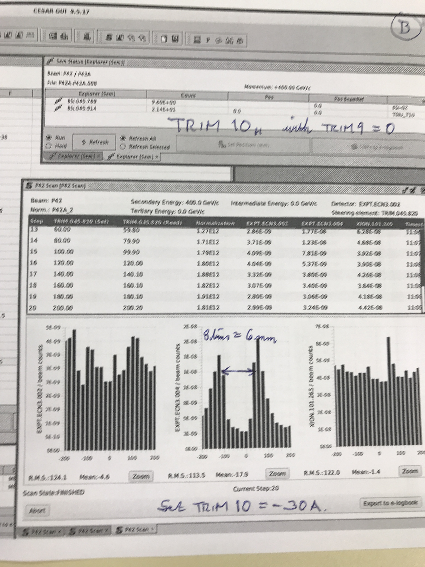
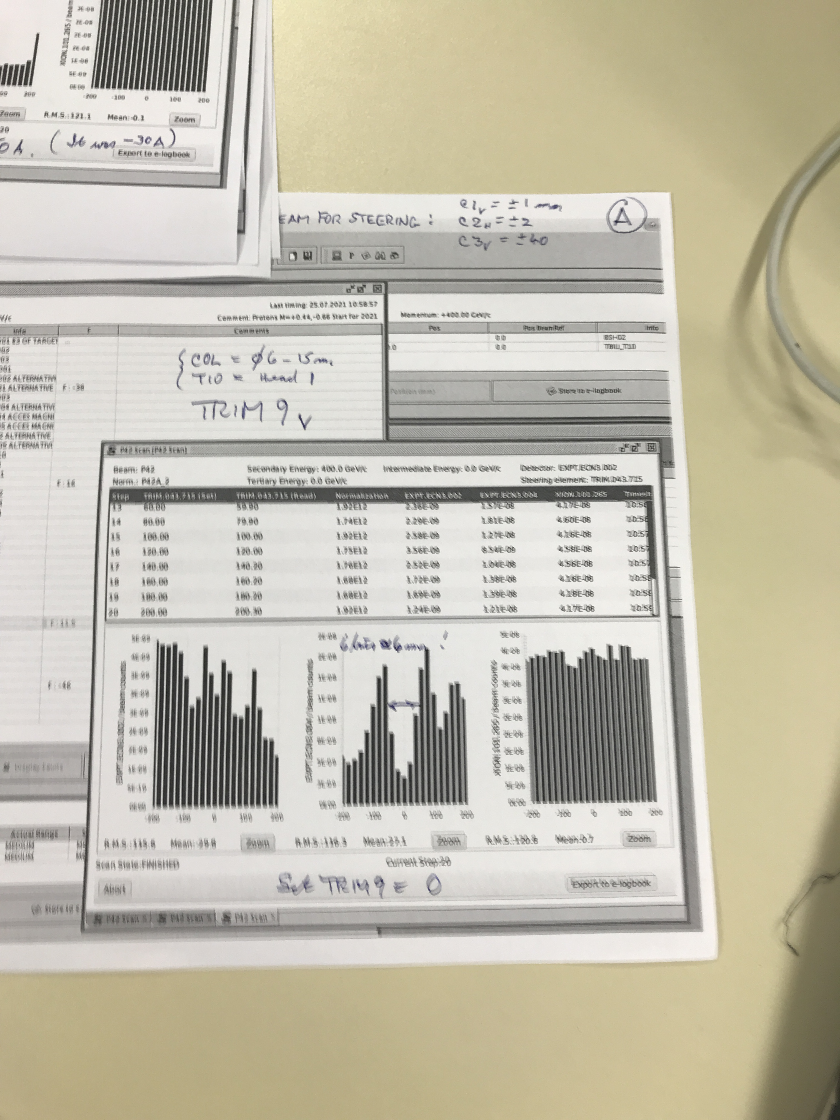
Scanning the edges of a 6 mm diameter hole at T10
TRIM10_{H}. But no sign of the target. Set TRim10=0
TRIM9V. What if this is the target?
Set TRIM9 = 75 Amps

Slide 11
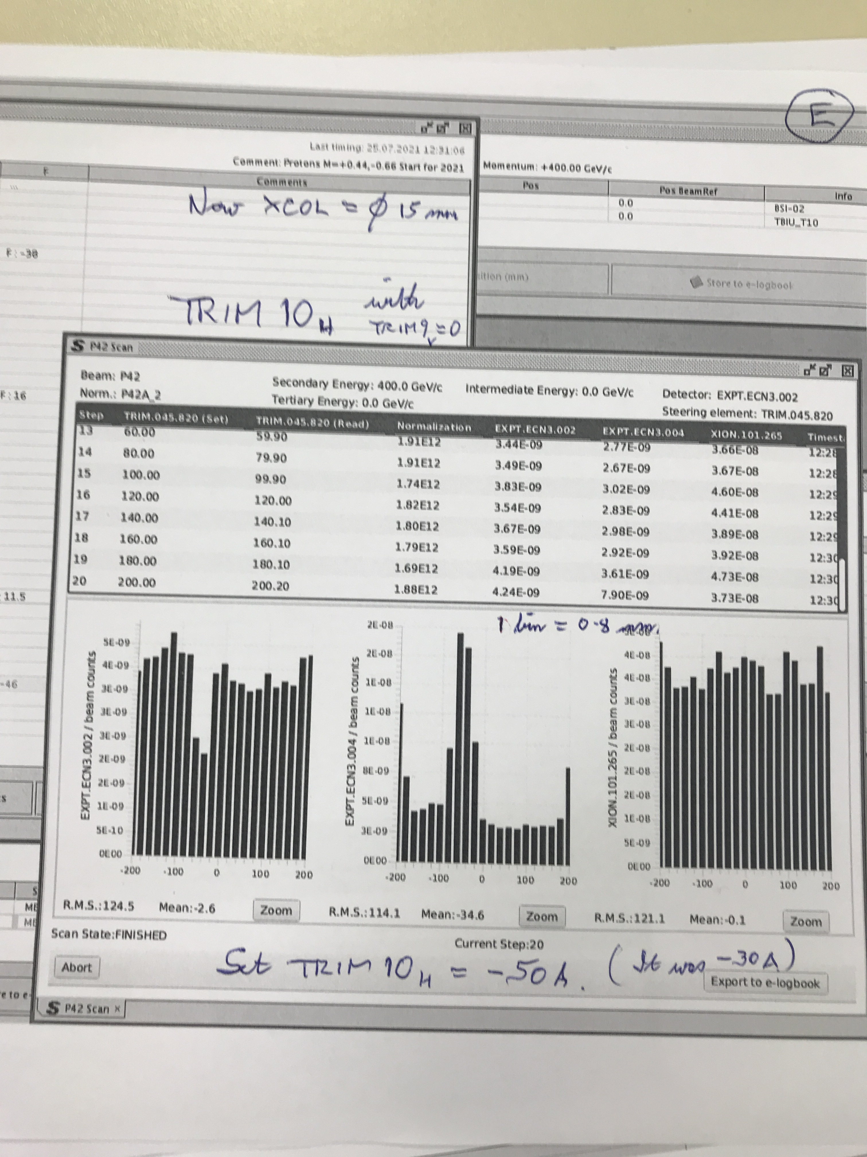
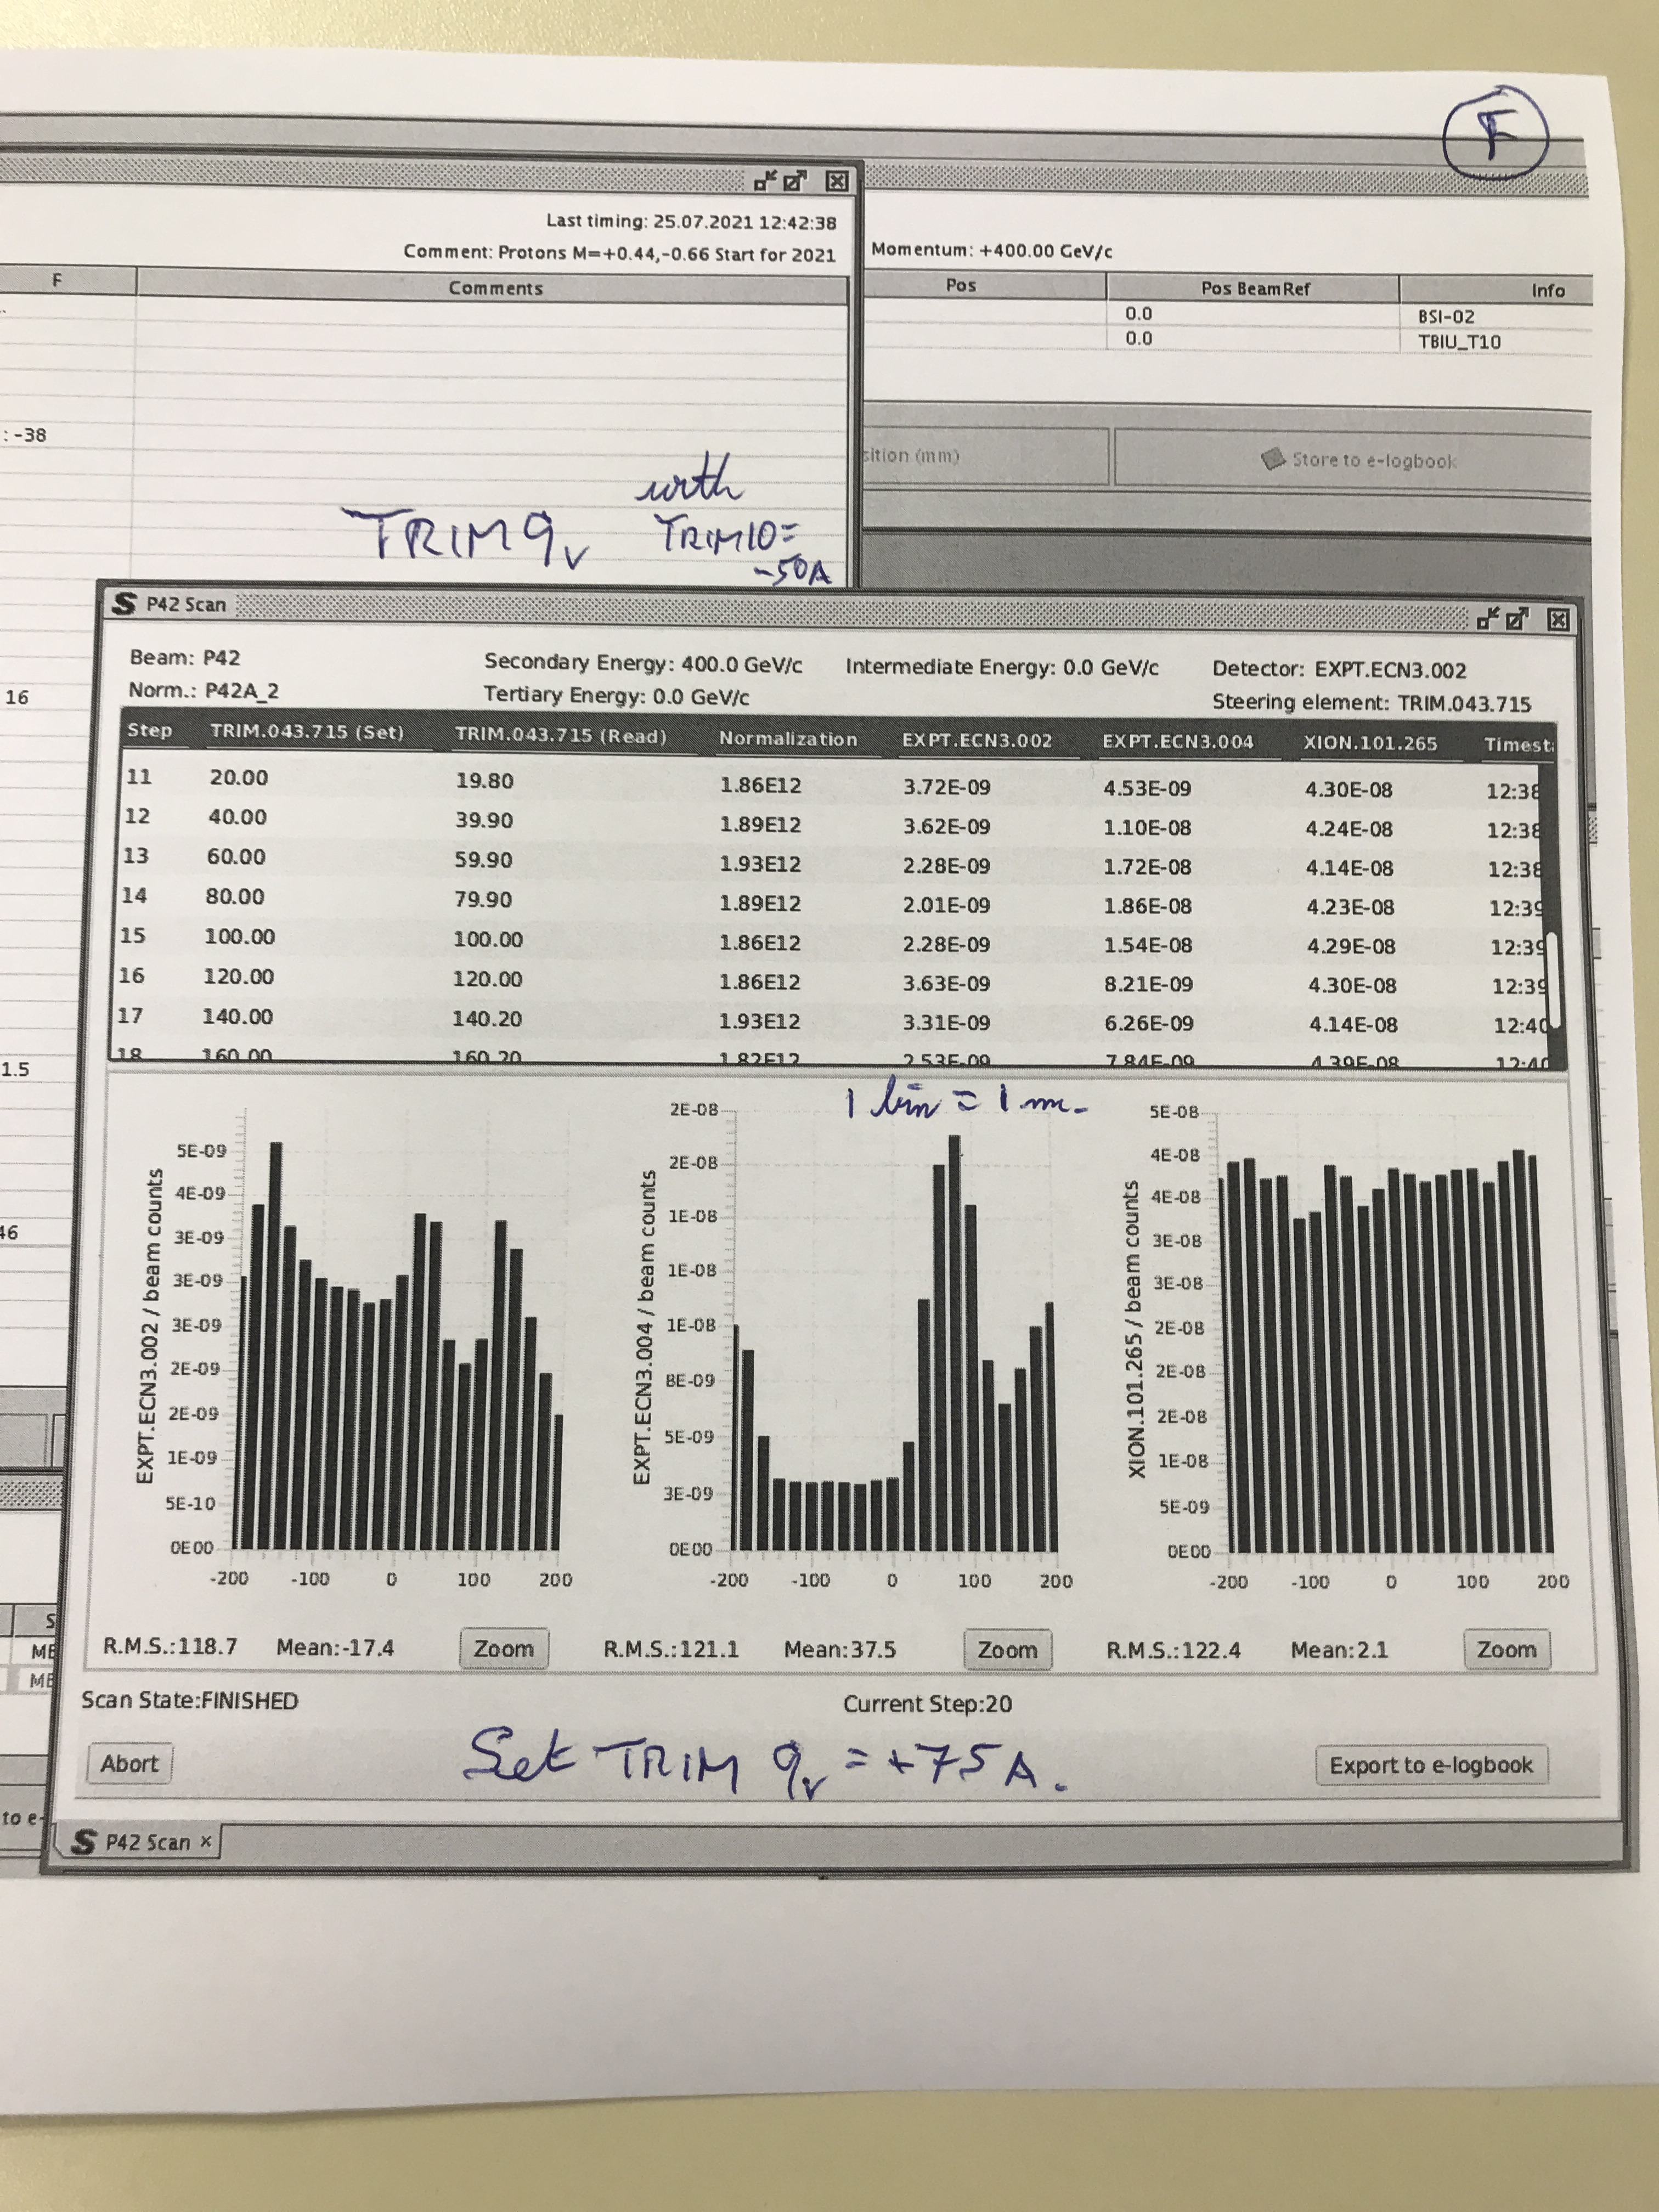
Finding the target with 15 mm hole in T10 collimator
Muons from the T10 target

Slide 12
A look at the K12 beam
The scans on the T10 target and its internal collimator only worked after changing the polarity of K12-BEND2. What about the other polarities? Bend 2 had been recabled during LS2 for the NA62 BD mode and studies for SHADOWS.
We saw no hadrons at the end of the hall yet and suspected a problem in the second achromat. Nikos and Lau measured the four polarities and found them all four wrong with respect to the documentation. The second achromat had been modified to mitigate upstream backgrounds and make space for another NA62 detector.
After fixing the signs of the currents in the beam files, we finally saw a reasonable rate in the ionisation chamber and a profile at the wire chamber.
The TRIM9 and TRIM10 scans look very clean now (with an expected muon tail).
The settings are for roughly 1 permille of the nominal rate (i.e. 2 10⁶ hadrons per spill),
with a factor 100 due collimation in K12 and a factor of order 10 due to the longer T4 target head (x2), the smaller P42 TAX (factor ~2.5) and the lower flux on T4 (x2).
So we expect between 1 and 2 10⁶ in the ionisation chamber

Slide 13
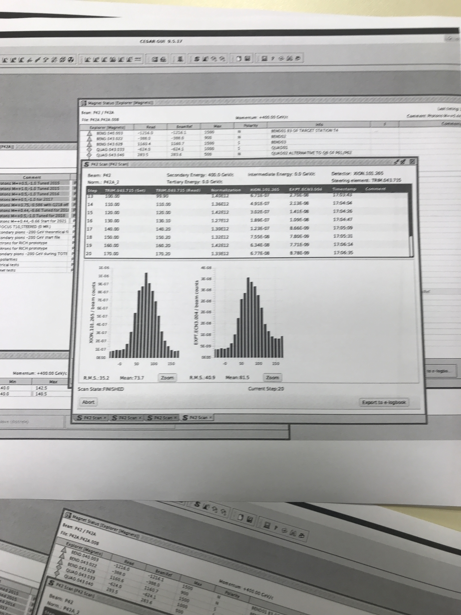
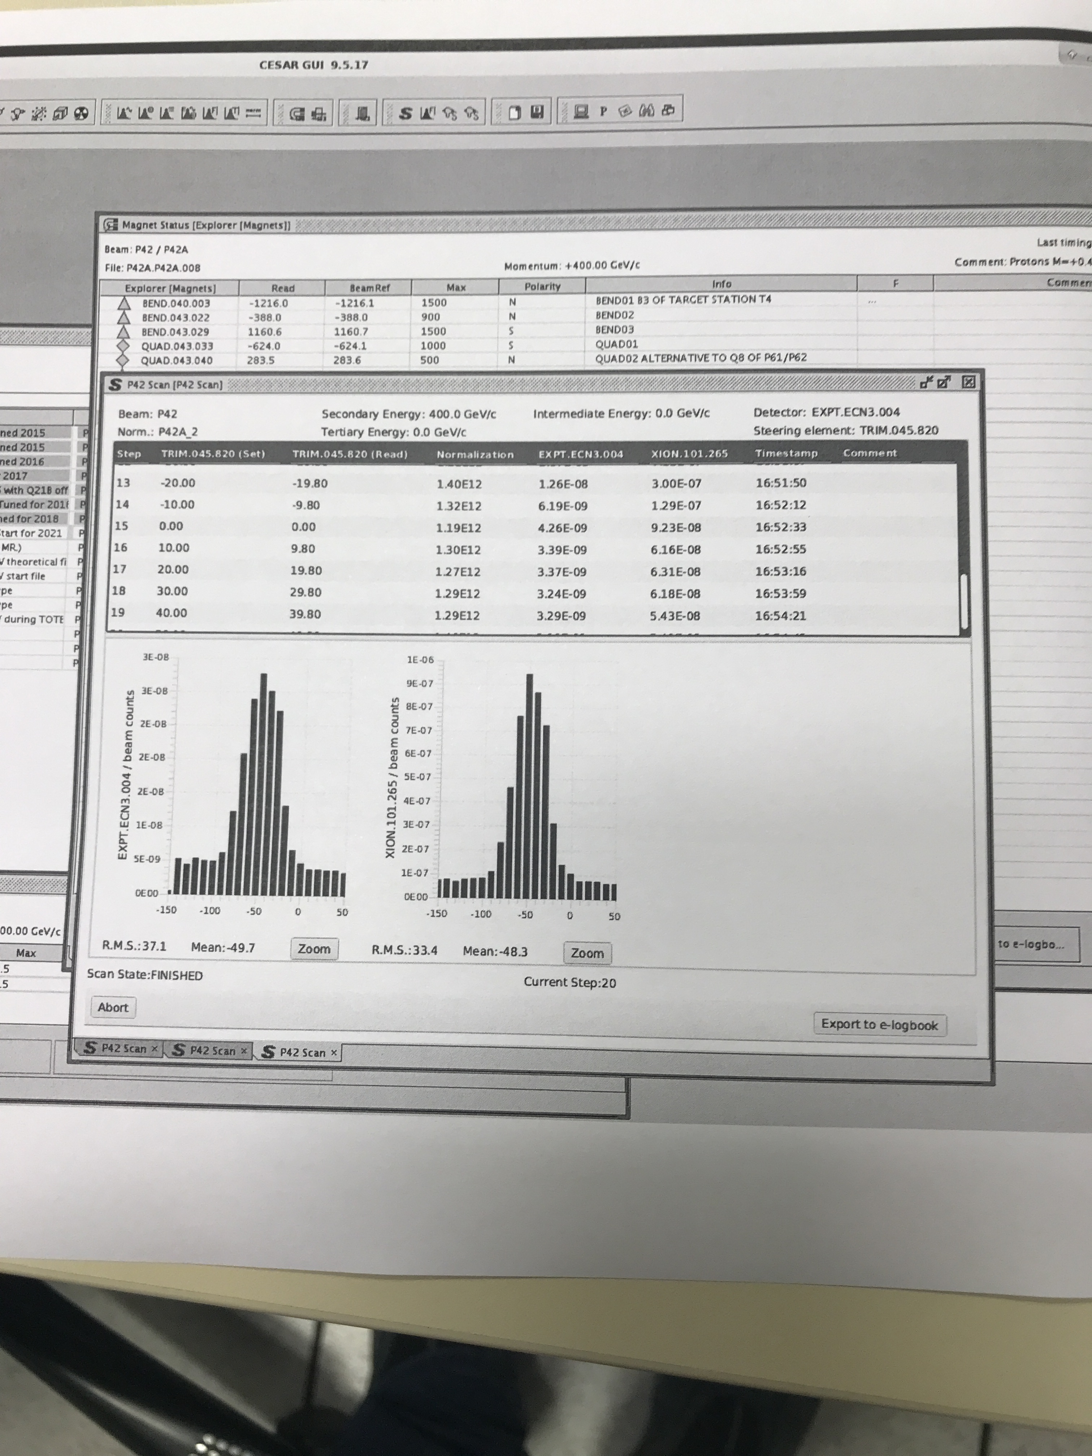
‘Final’ scans onto the T10 target
TRIM9_{V}
TRIM10_{H}

Slide 14
Instrumentation progress
After several accesses to TCC8 and upstream, the BI experts discovered that the bias signal was missing on all of the SEM monitors apart from the SEM grid. This was due to a broken daisy-chain.
On Friday 30th of July this problem was temporarily fixed and the T10 monitor showed 4 10¹¹ ppp for the 7.5 mm TAX hole and just over 7 10¹¹ ppp for the 12 mm diameter hole. The change of calibration was surprisingly close to the guessed factor 25 (within 10% to 15%).
An access and consequent position scanning on August 2nd revealed that the TBIU box as a whole was misaligned by 22.75 mm. After putting it in the correct position, the miniscans at the T10 target work as well. With this instrumentation we could then start looking at the focusing in P42.
Already on the 26th of July we showed that the profile 20 m upstream of T4 was far too wide in the horizontal plane. This is under study with the BE-OP team (CCC).
With a few iterations on the focusing the P42 beam should soon be in a good condition.
That should also allow to conclude on the 2018 focusing issue.
It is not clear how exact the calibrations of the T4 and T10 monitors are (but they use the same factors).

Slide 15
T4 and T10 rates versus time
After fix
Before fix

Slide 16
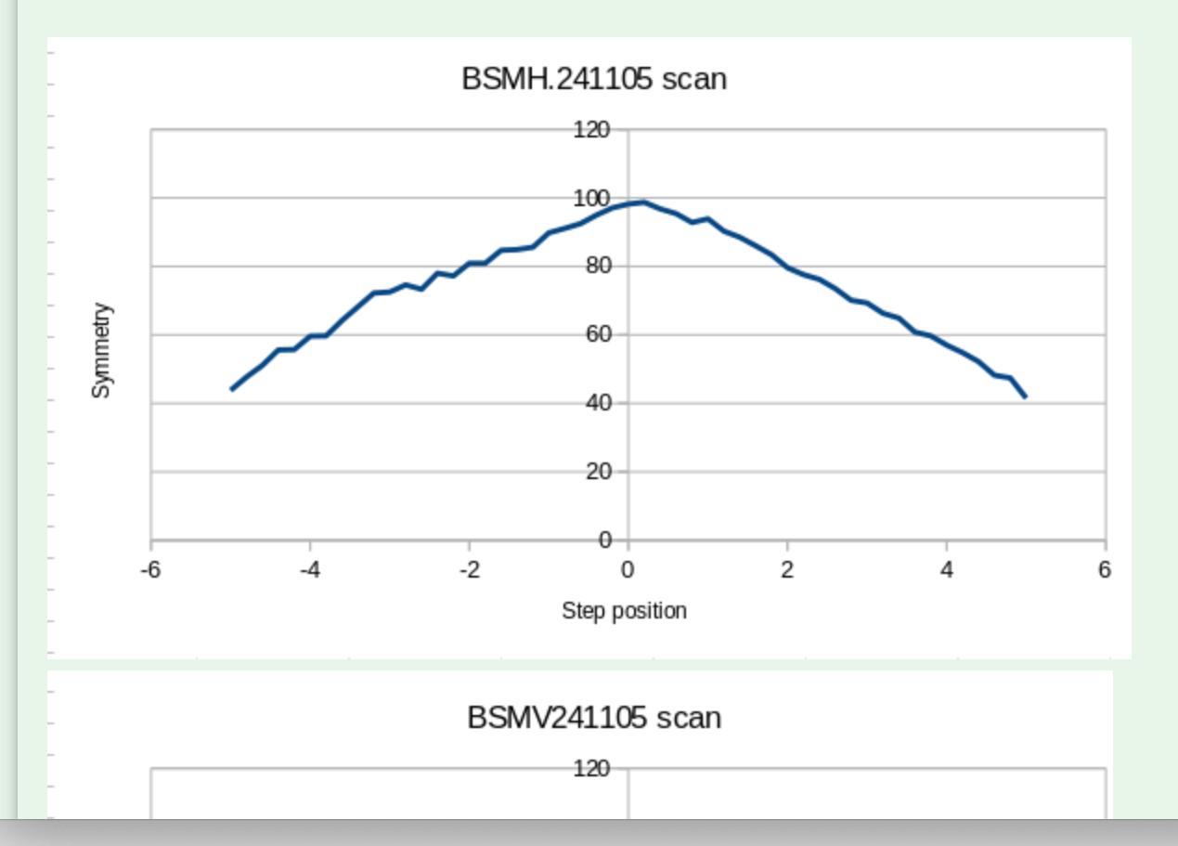
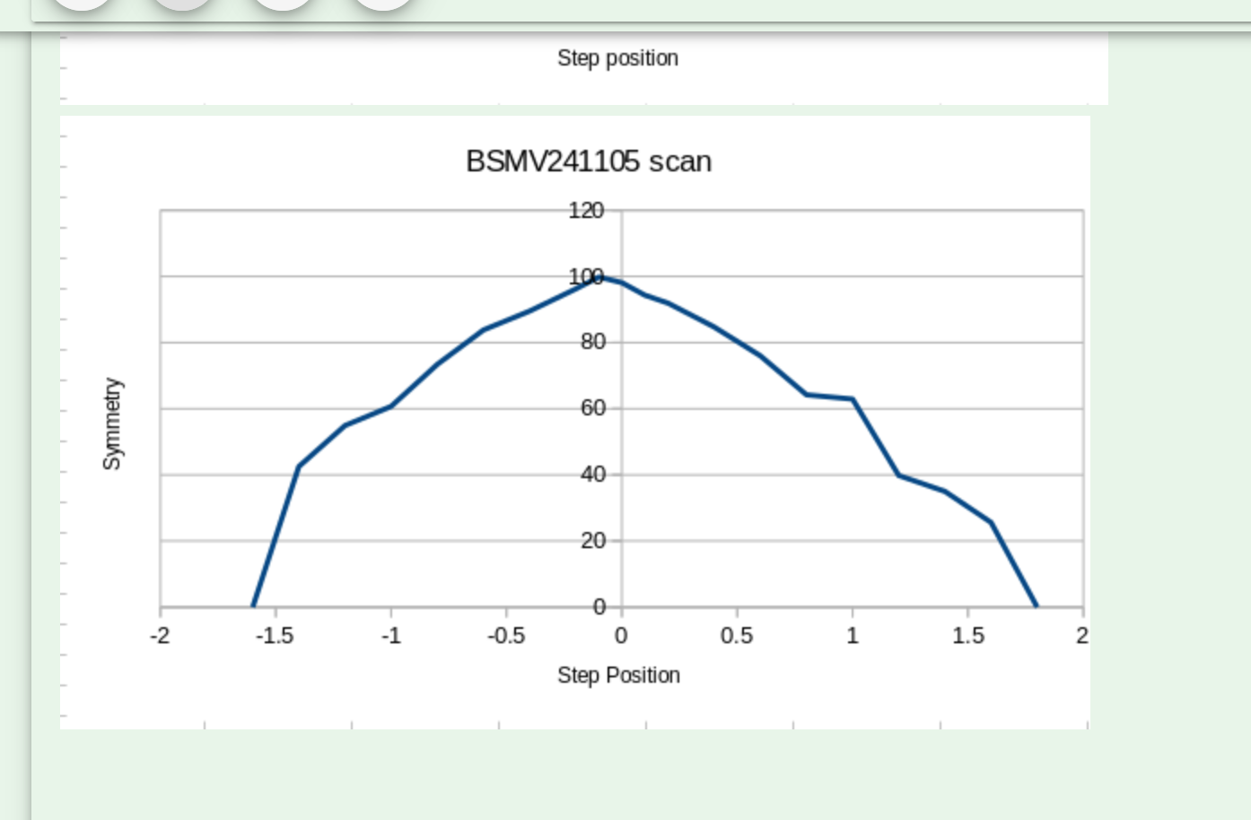
BSM scan ~20 m upstream of T4 (angular spread)
±1σ
±1σ
RMS > 5 mm (should be 3 mm or less)
RMS about 1.5 mm. Smaller than usual but
splitting dependent
Mirror image of beam at P42 TAX

Slide 17
BSM scan upstr. T4 with resteering / step (steering)

Slide 18
Idem with XION and QX
Leave at 65 mm
Move from 62 to 61 mm

Slide 19
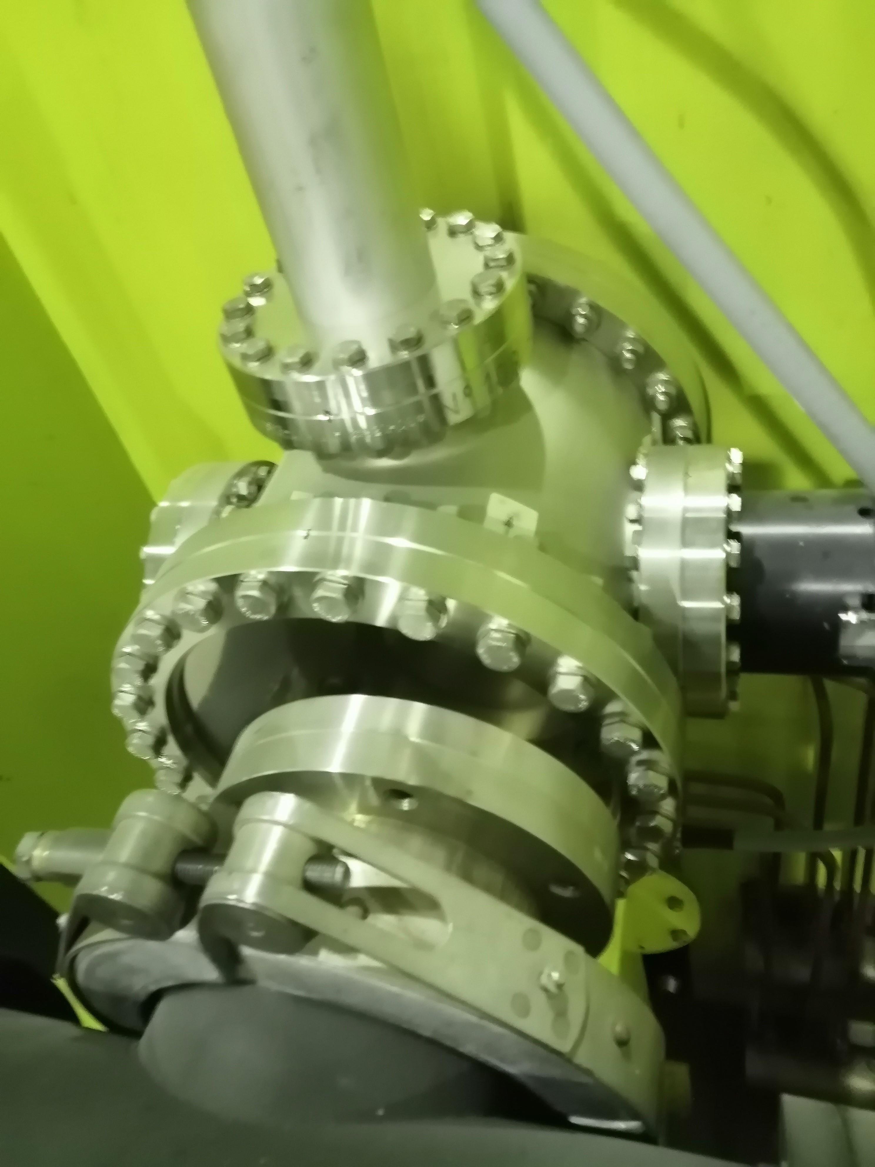
TBIU misalignment
On Monday morning 2nd of August, the TBIU of T10
was found completely misaligned.
The range of the BBS (±10 mm) is much smaller
than the 22.75 mm misalignment.
On Monday evening, the BBS wire was put at the
nominal centre w.r.t. the TBIU box and the TBIU
horizontal position was scanned in 1 mm steps from
min to max (±60 mm) until the signal was found.
The reason for this misalignment is so far not
understood.
From then on the miniscans work properly.

Slide 20
Miniscans on T4
RMS ~ 0.3 mm RMS ~0.4 mm
i.e. as expected (but divergence too wide in X)

Slide 21
Miniscans on T10 (‘standard’ P42 optics, ≤ 2017)
T10
T10

Slide 22
K12 Beam tuning progress
Then from Friday we started to look in more detail at K12
There was steady progress and we have a very clean
profile at the end of the beam line.
The rate shown in the XION is about half of the
one expected per proton on T10.
Probably the XION response has changed or a
fraction of the beam misses the target (see P42).
With the 12 mm TAX hole and 15 10¹¹ ppp on T10
we see 2.5 10⁸ ppp on the XION.
However, the FISCs were not working (software issue
and some need of tuning). The FISCs are mandatory
for checking / tuning the parallelism at the KTAG.
The experts fixed already one problem and continue for a motor exchange from Tuesday 3rd of August.

Slide 23
Final remarks
Beam tuning progresses now ‘normally’ according to the tuning procedure by Niels.
The next step is the parallelism at the CEDAR, followed by final fine-steering through the downstream detectors and final collimation.
The P42 optics problem seems still to be there, but we have a bit more instrumentation to look at this, in particular the SEM grid at position 520 metres and a wire scanner at 283 metres form T4.
However, for the moment these detectors are only visible from the CCC. It is now agreed that they should be made visible from Cesar.
Apart from that, everything behaves rather as expected.
It is foreseen to go to 4 10¹² ppp on T4 after the Wednesday MD or on Thursday morning.

Slide 24
Actions
Understand T10 TBIU (i.e. calibration factor).
Make miniscan / BBS on T10 operational.
Meeting with BI, OP, VSC, STI and EA for report on progress with TBIU/SEM checks.
Define responsibilities for SEM commissioning organisation.
Prepare procedure for routine checks of magnet polarities.
Start normal tuning procedure for P42 and K12 beams.
Document progress in e-logbook.
Keep documentation of magnet power converters and polarities up-to-date.
Add SEM profiles, rates, gains, and mini scan capability to CESAR.
Finish setting-up K12 and P42.
Many thanks to the many persons that helped in this long and painful process, including MSC, EPC, BI, RP, OP, CEM, EA, the management and also for the patience of NA62.

Slide 26
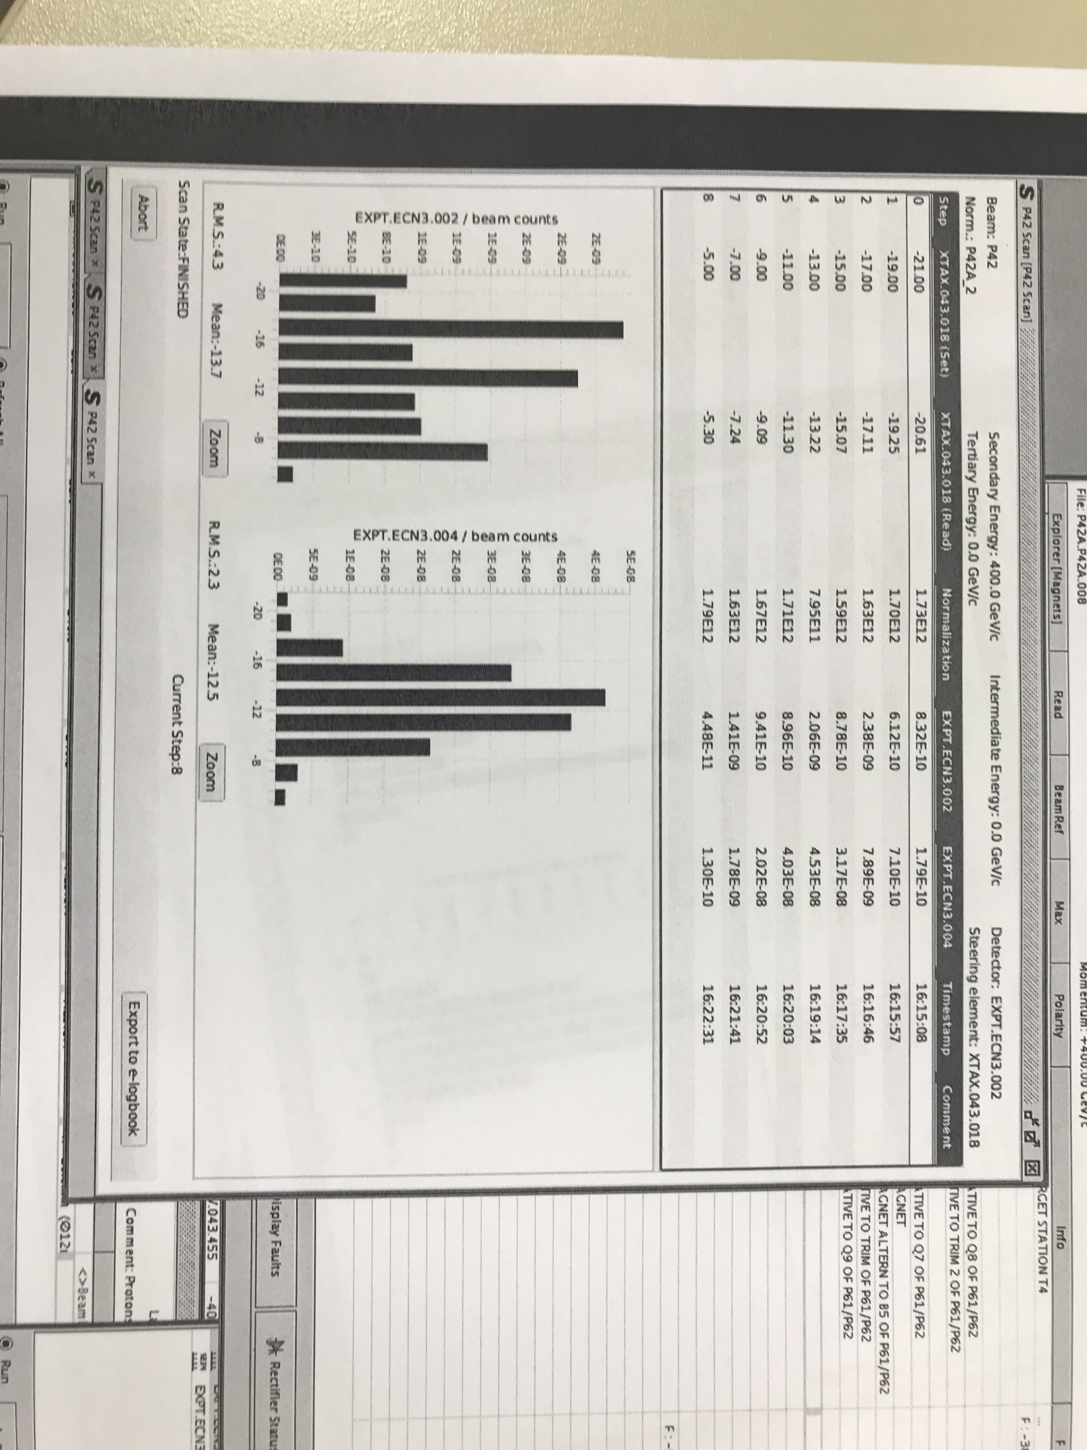
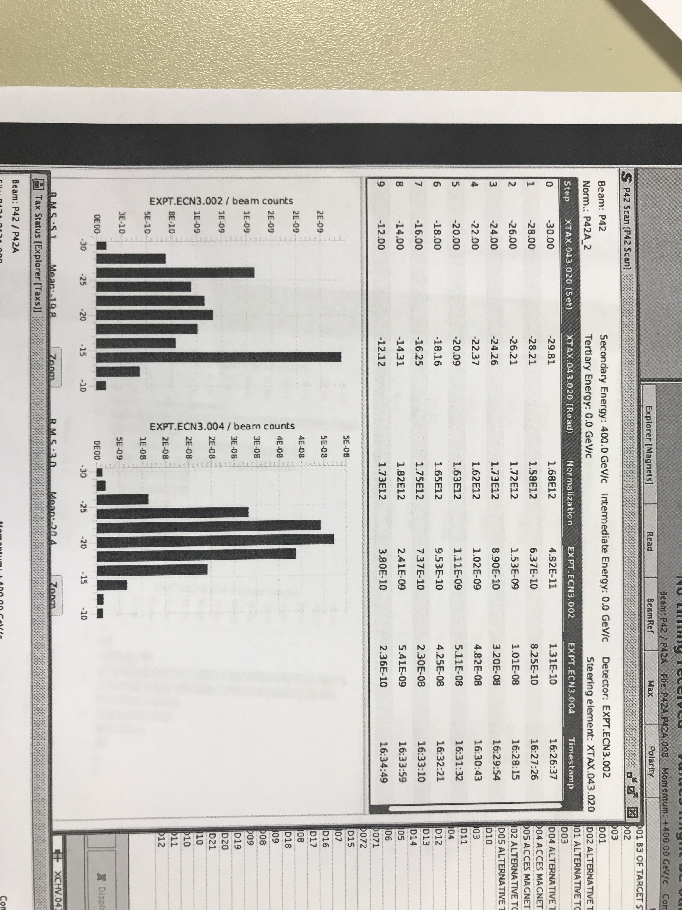
TAX scans (peaks at nominal), count on MUV3
TAX1 (7.5 mm hole)
TAX2 (12 mm hole)

Slide 27
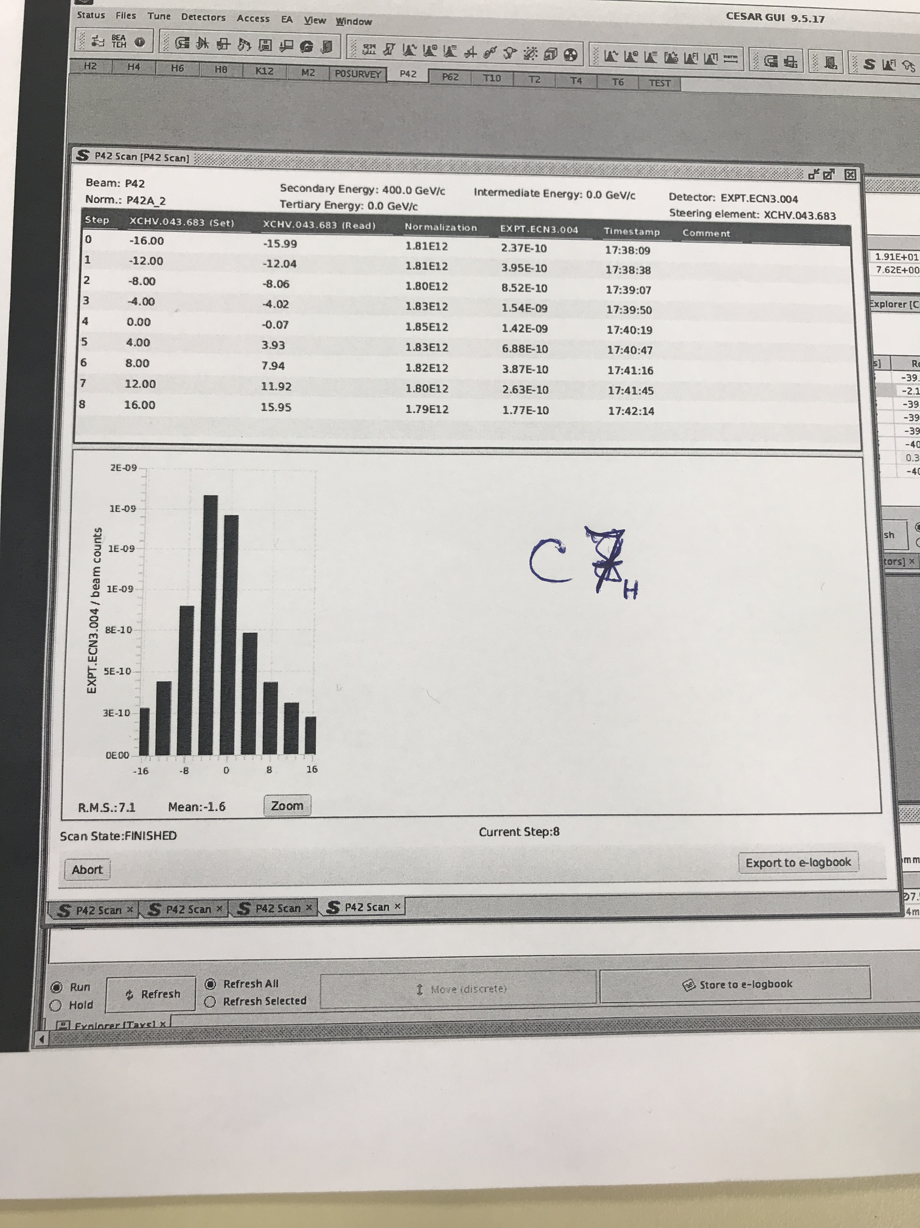
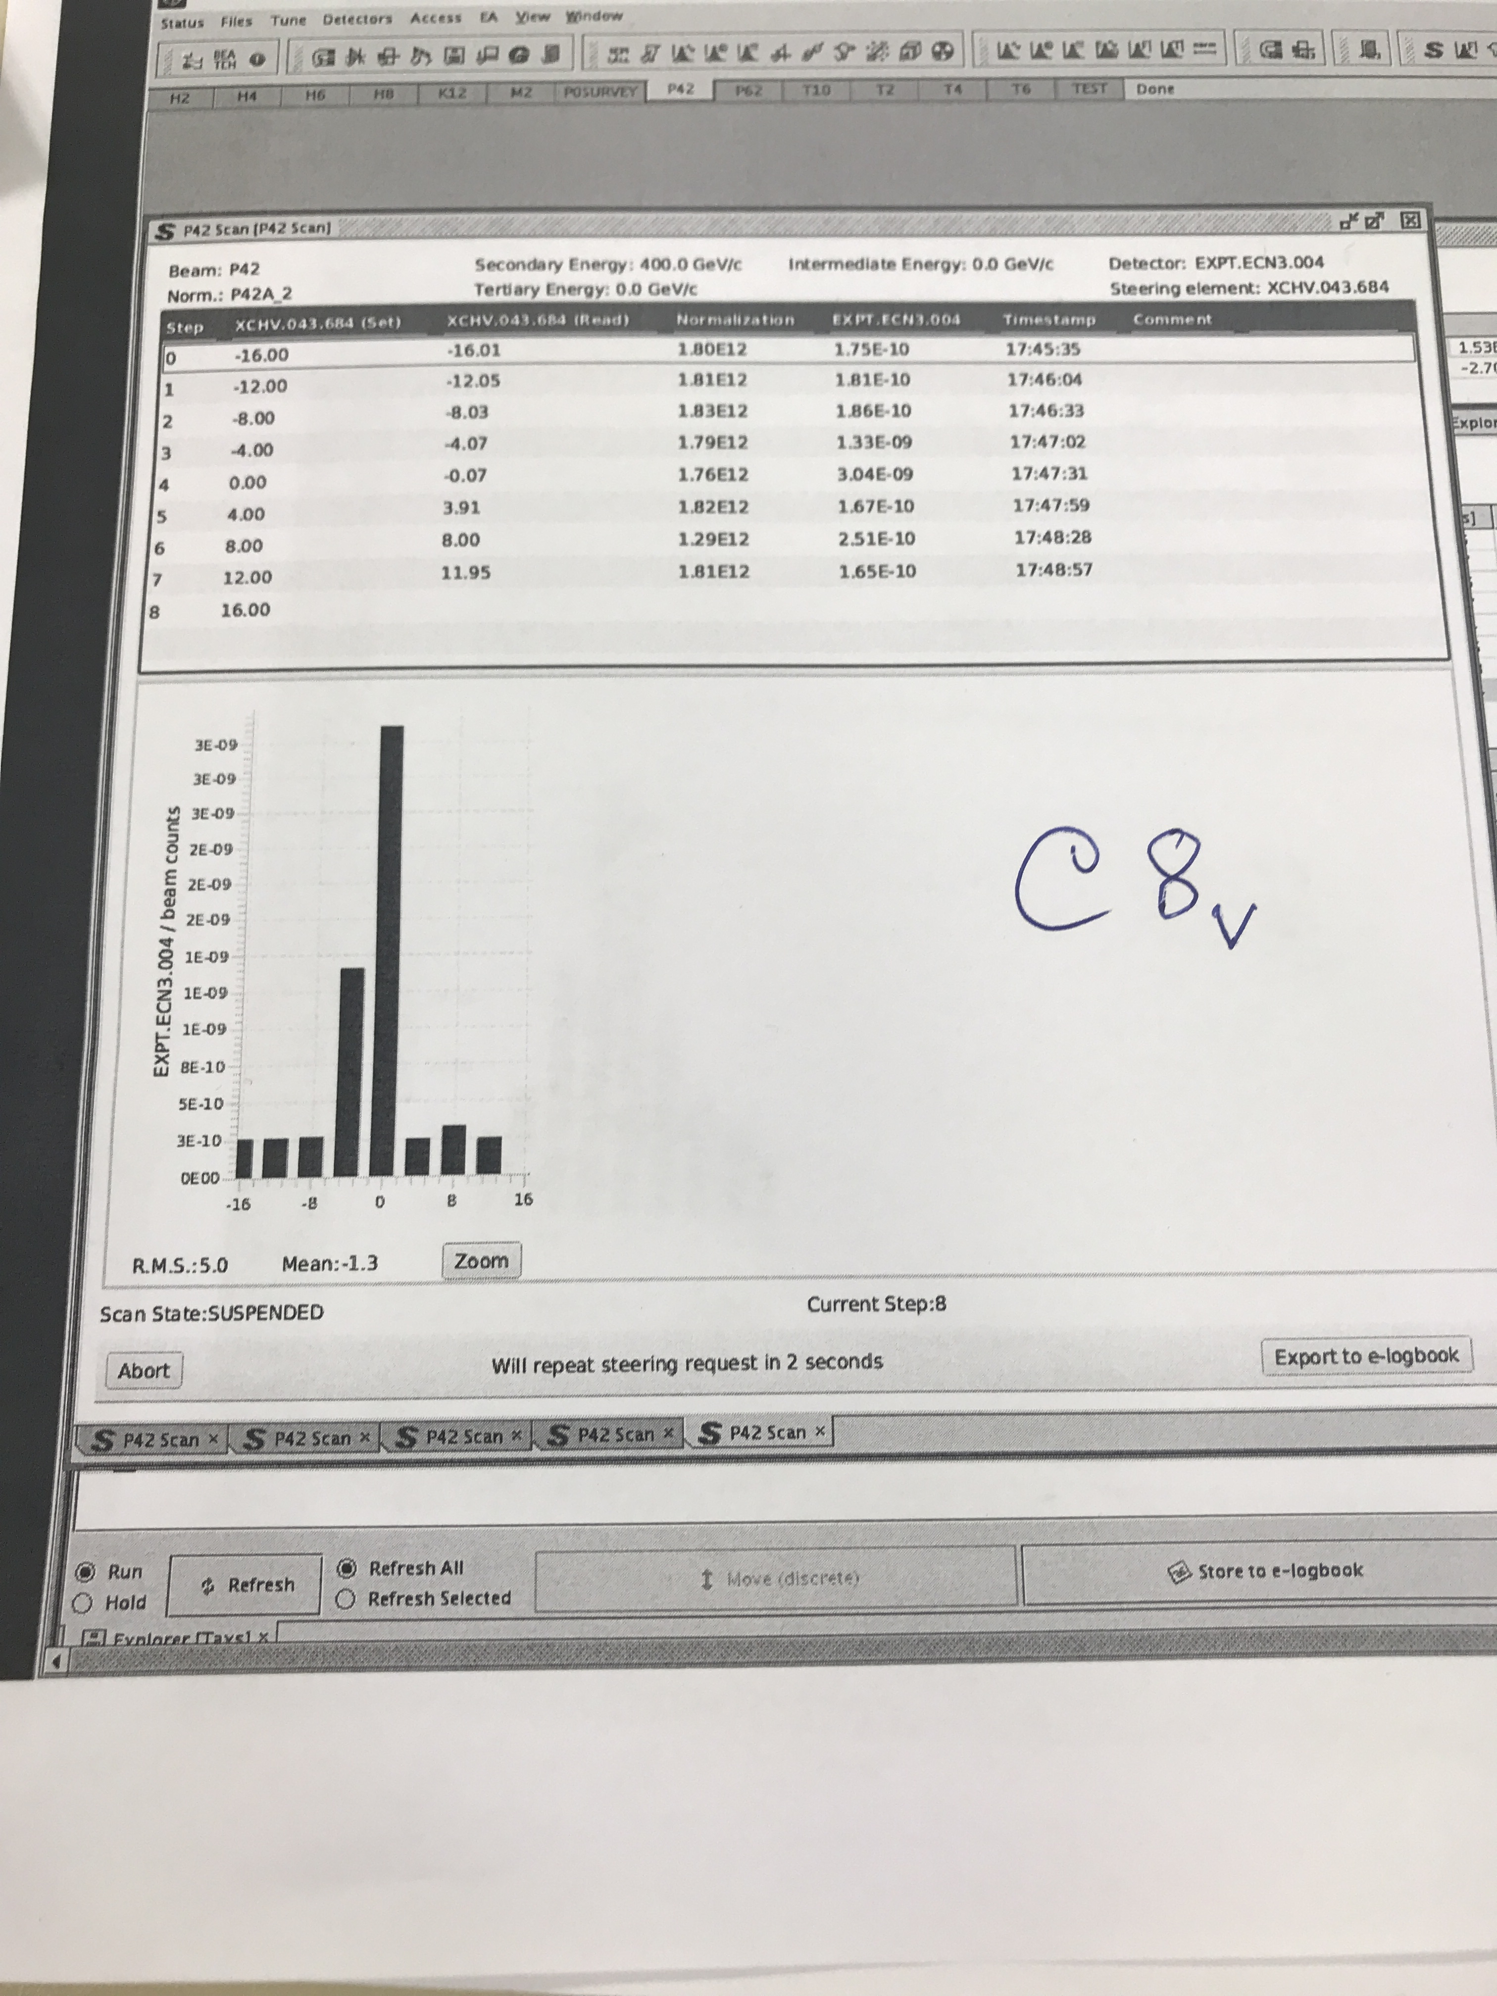
Collimator scans just before BENDS 8 and 9 (horiz.)

Slide 28
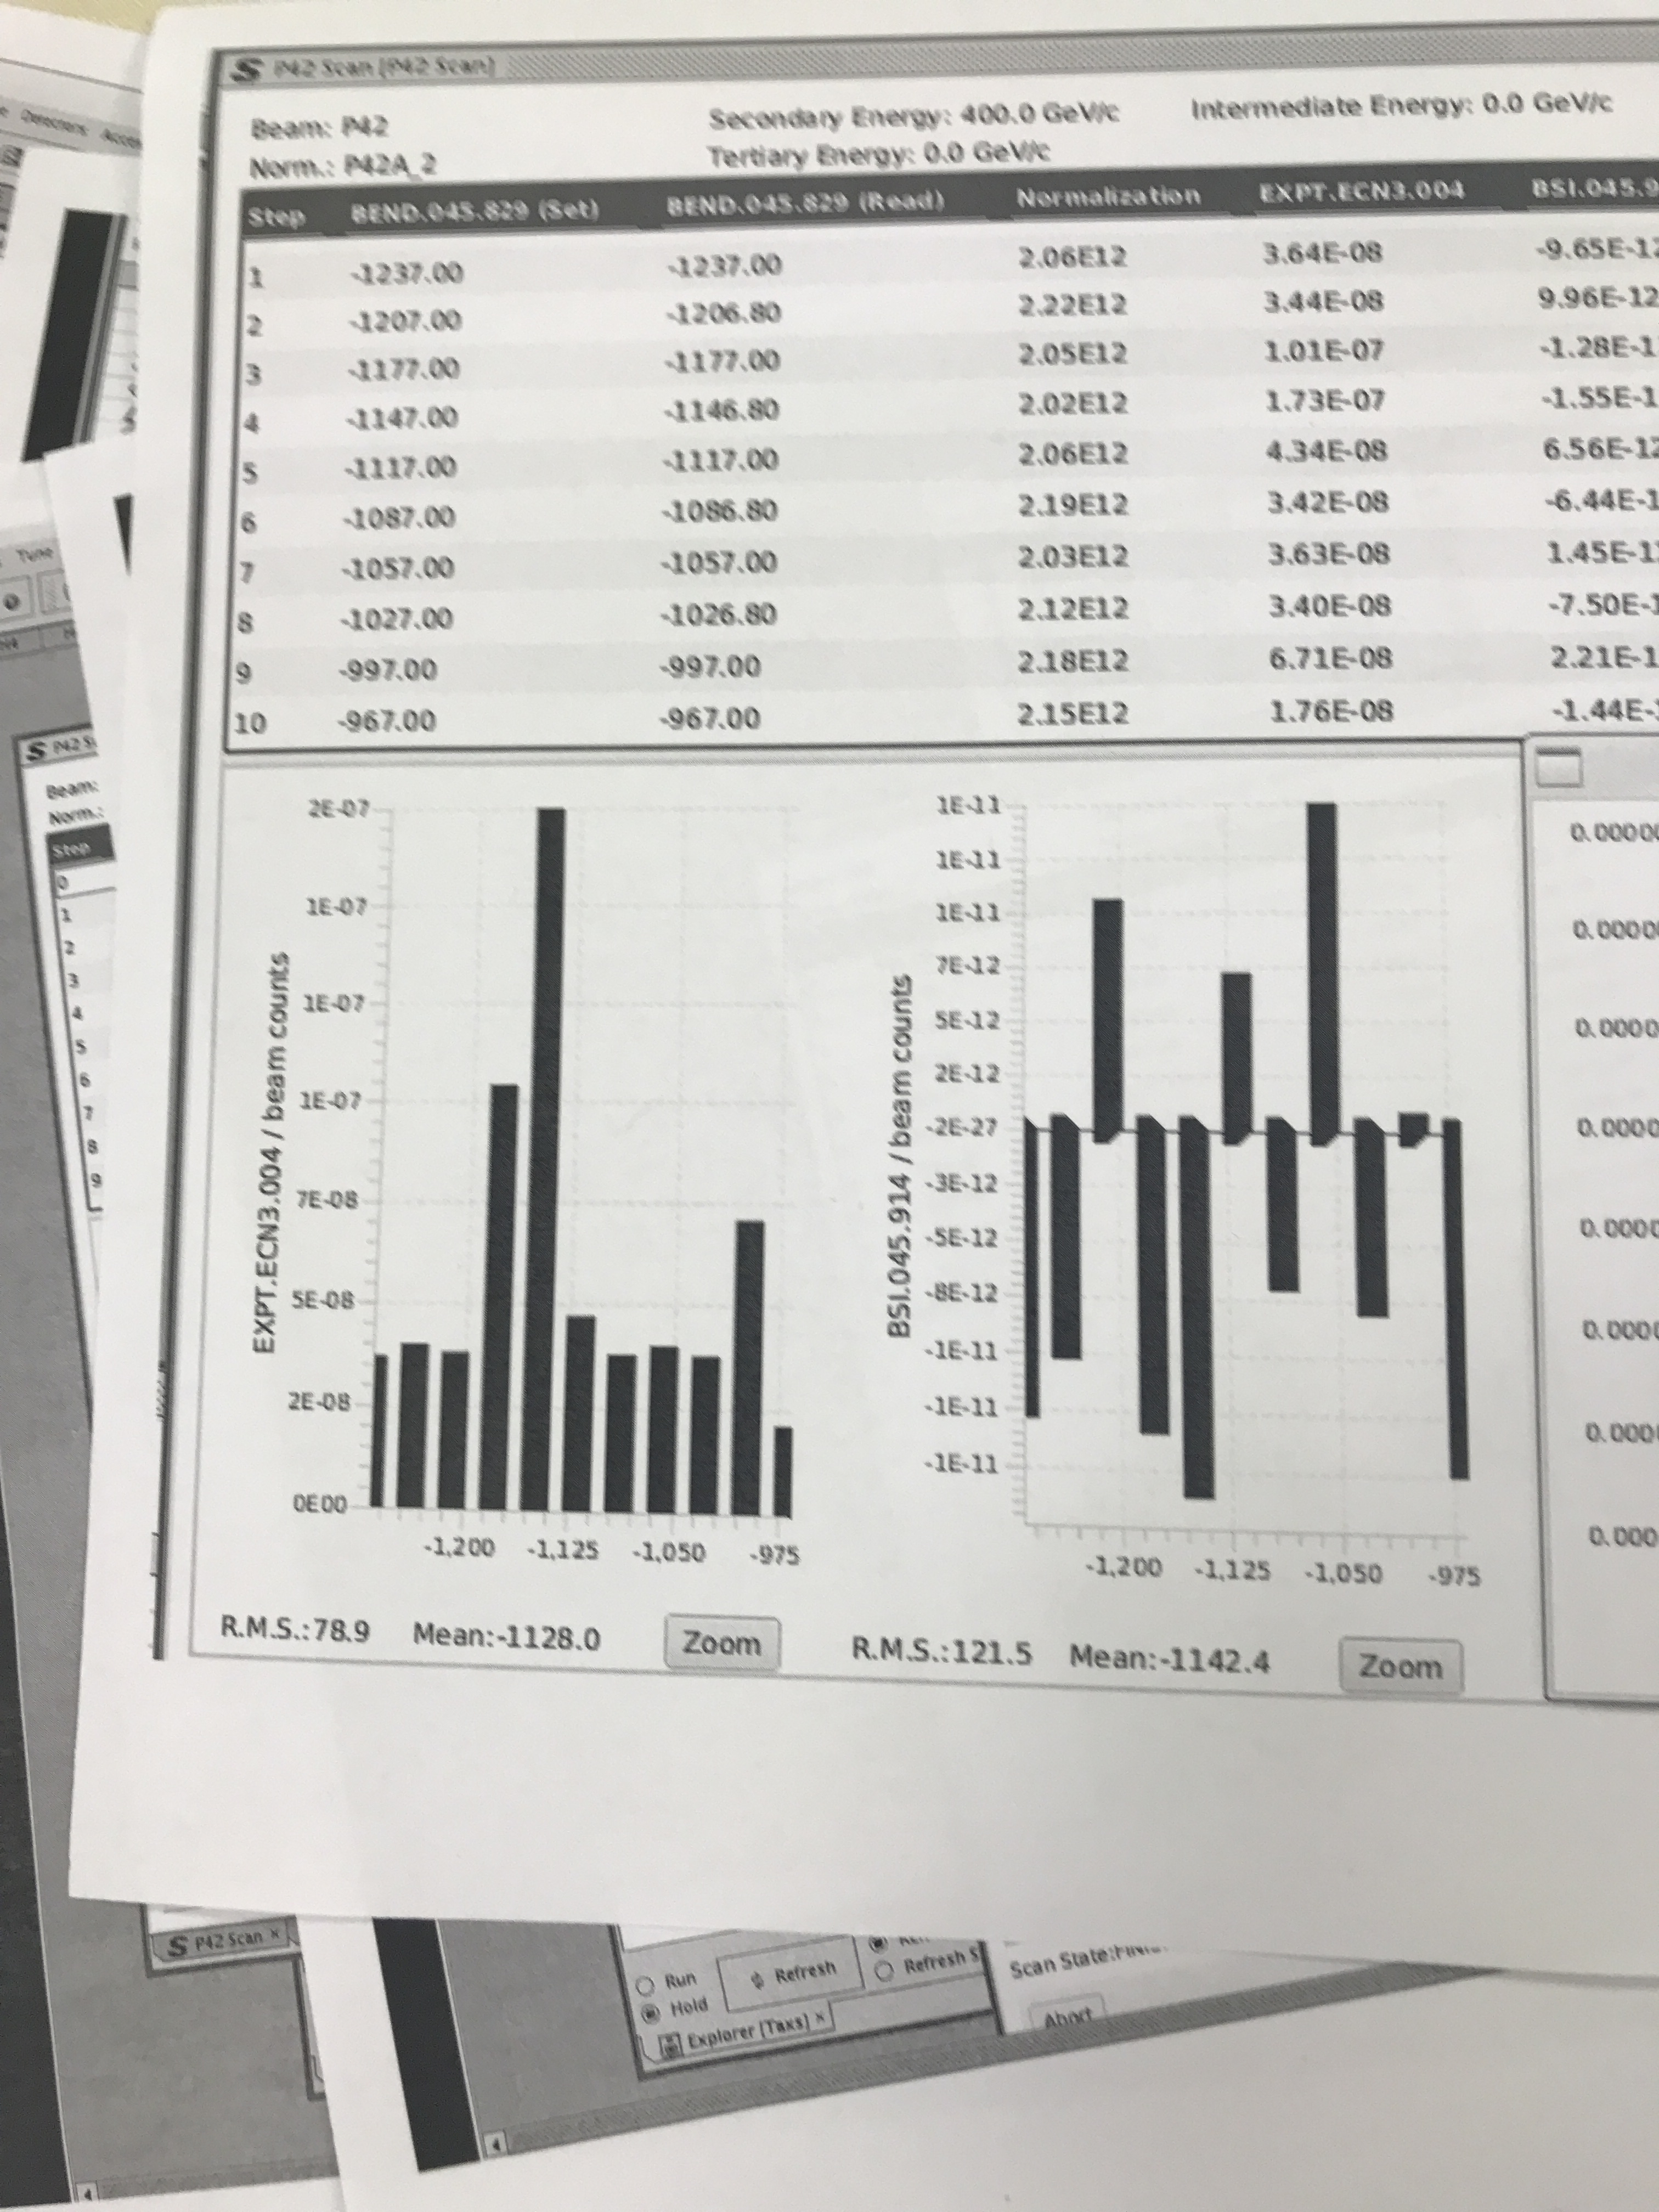
BEND11 scan (vertical)
So the muon rate responds to
these vertical bends.
So protons reach the T10 region.
Next step:
Trying to hit the T10 target (2 mm diameter)
But why are most of the SEMS not responding?

Slide 29
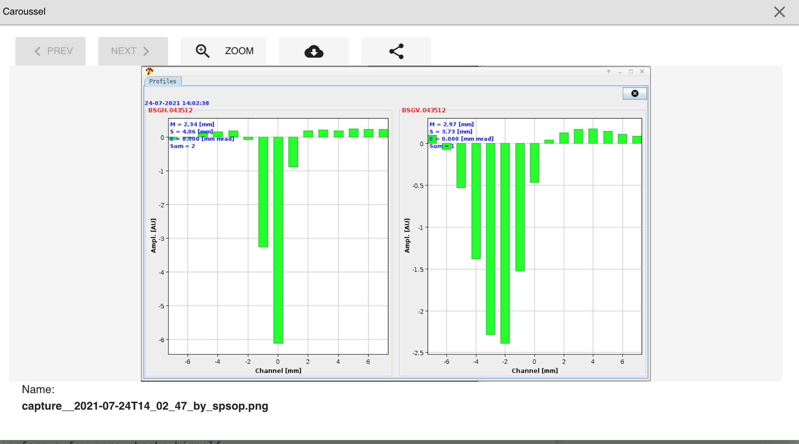
First signal in SEM GRID just before BEND7

Slide 30
Achromat 2 was completely rebuilt (slight
displacements to reduce backgrounds from
upstream decays by adding counters and
changing apertures slightly)
Achromat 1 was re-cabled. Before LS2 the
second magnet was powered independently,
now the fourth. This improves muon sweeping
for NA62 in beam dump mode (see PBC-CB
Report) and even more so for SHADOWS
(under study)
Many changes in NA62 itself, which also
affects monitors we use for beam tuning.
Their setting up needs beam.
Part of this was done over night with muons
that could be provided.
Achromat 1
Achromat 2

Slide 31
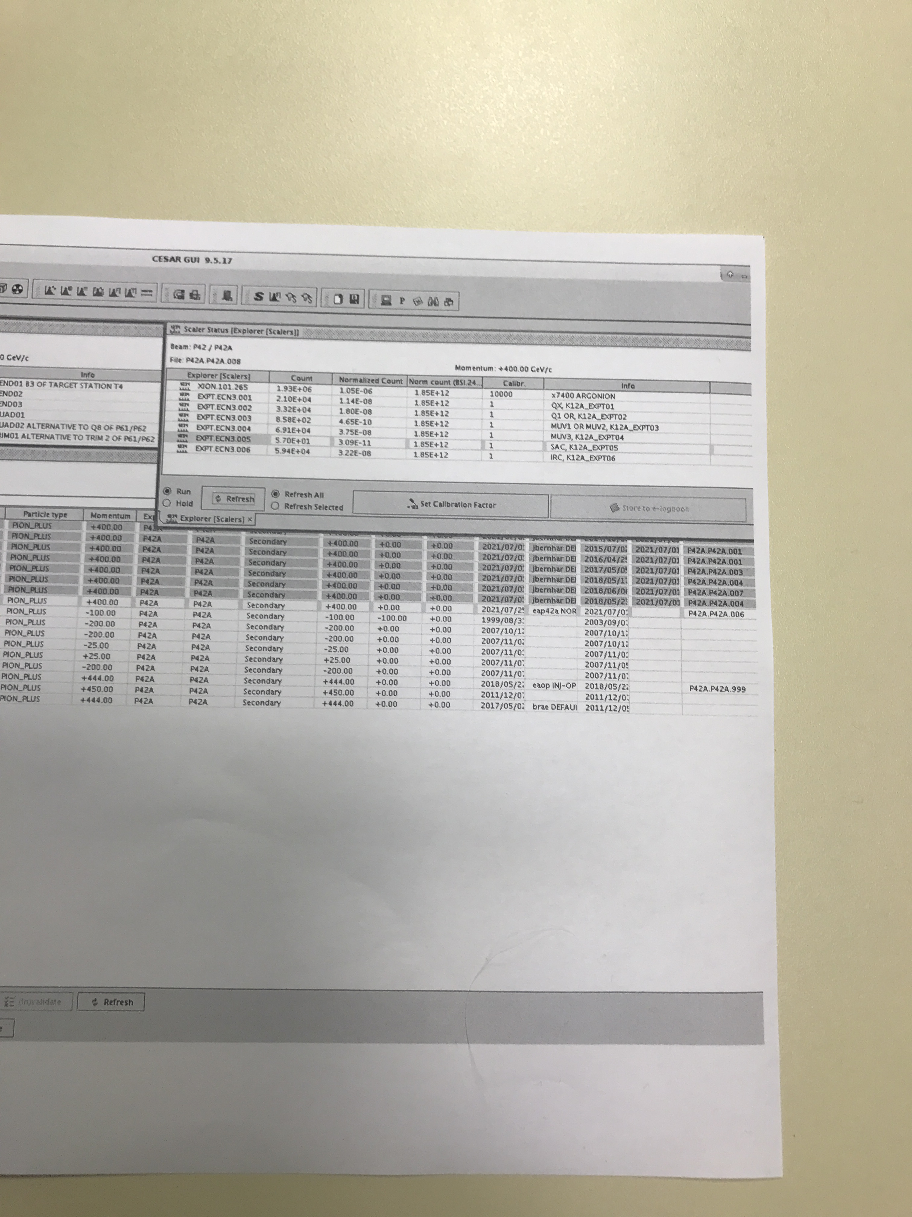
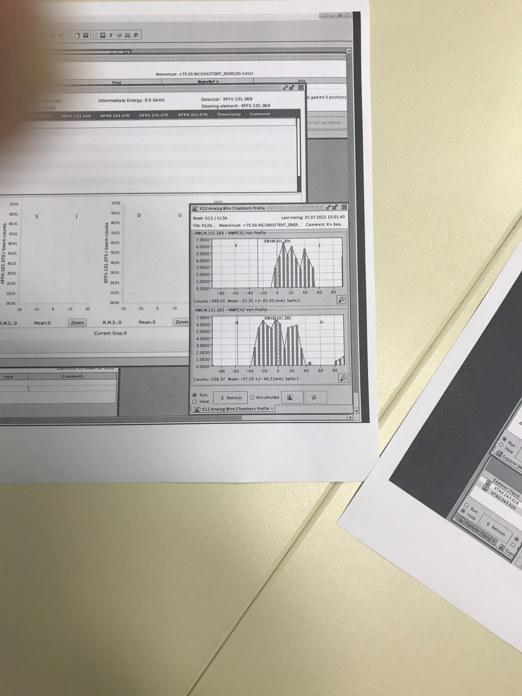
The beam ‘works’ somewhat
Count rate and profile at the very end of ECN3 !

Slide 32
Changes made
P42:
Q18 doubled up
BEND2 replaced (plug-in) after the old one burned
B4 powering modified to avoid problems at end of access
Two 4-jaw collimators replaced (one for vacuum leak, one broken)
Some SEM instrumentation (never used) removed, some put back last week
K12:
First achromat re-cabled
Second achromat modified
Experiment changes (GTK installation)
Overall:
Changes in FESA classes
Changes in CESAR

