Slide 1

ECR/Documents for Information and Approval
Silvia Schuh for BE-EA, 2021-08-03

Slide 2
LIST OF DOCUMENTS
For Information for EATM
Procedure and Risk Assessment for the Individual System Tests of the Personnel Protection System in the East Area | 2426479 | PSZ-S-SR-0002 v.1.1 | Filipa Carvalho Eva Sanchez-Corral Boris Morand Didier Chapuis
Risk Assessment for the Individual System Tests of the Gas System in East Area | 2426485 | PSZ-S-SR-0004 v.1.0 | David Jaillet Anastazja Sedzicka Filipa Carvalho
For Approval by EATM
New Beam Instrumentation for the EA-IRRAD Facility on the T08 Beam line | 2379119 | PSZ-B-EC-0002 v.0.2 | Federico Ravotti
Changes to the M2 Beamline for the 2021 Test Runs | 2338657 | SPSX-L-EC-0003 v.0.3 | Johannes Bernhard, Dipanwita Banerjee
Installation of a Mobile Shutter in the T11 beamline of the New CERN East Area | 2472730 | PSZ-S-EC-0002 v.0.2 | Antonio Alonso

Slide 3
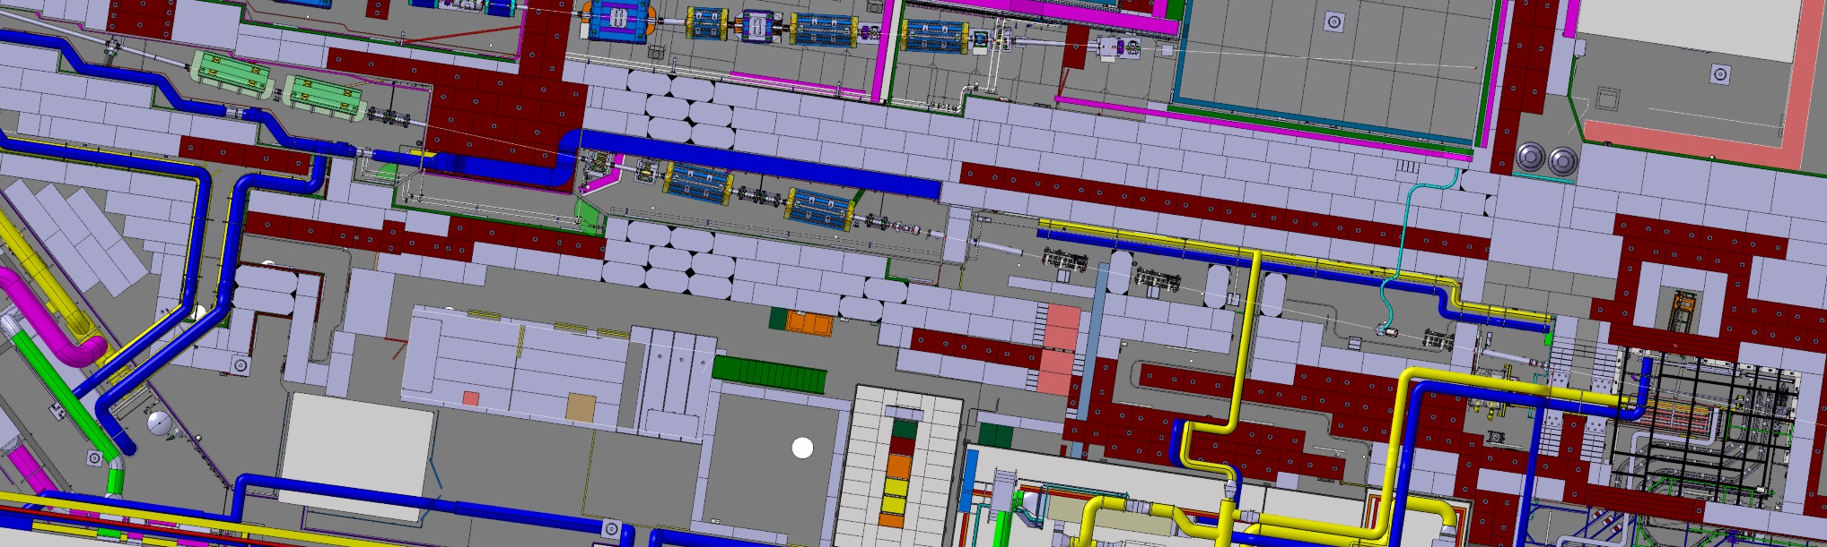
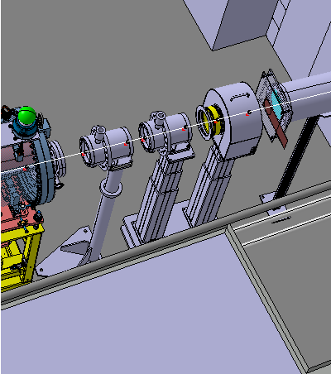
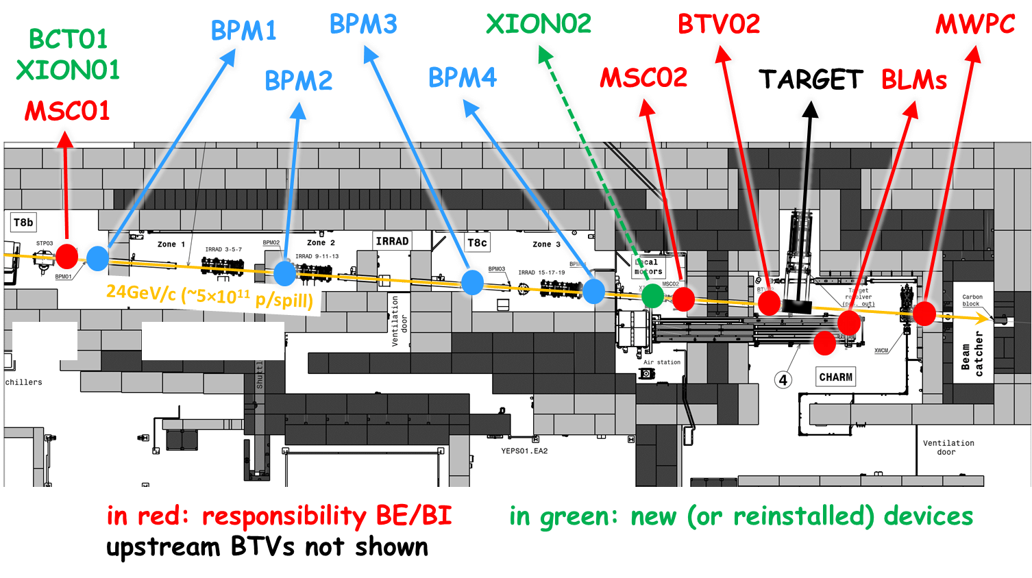
New Beam Instrumentation for the EA-IRRAD Facility on the T08 Beam line
Federico Ravotti
2379119 | PSZ-B-EC-0002 v.0.2
This ECR concerns the upgrade of the beam instrumentation devices on the T08 beamline used for irradiation experiments in EA-IRRAD.
The EA-IRRAD infrastructure in the PS East Area (bld. 157) houses the IRRAD and CHARM facilities for proton and mixed-field irradiation experiments respectively. It was built during LS1 in the T08 beam line to cope with the increasing demand for irradiations arising from the R&D on detector and accelerator components for the High Luminosity upgrade of the LHC. The layout of the T08 beam line has been modified during LS2, in the framework of the East Area Renovation project.
CHARM
T08a
T08b
T08c-IRRAD
A review of the needs and requirements of the T08 beamline beam instrumentation, within the East Area renovation program, showed that the intensity measurements in the IRRAD/CHARM facility appeared to be difficult. In particular, intensity measurements were difficult when:
operating 24 GeV/c proton beams with low intensity (10⁹-10¹⁰ particles per spill), as required for testing certain types of electronic components or for Radiation Protection studies
operating high-energy heavy ion beams (for which the facility was not specifically designed before LS2)
Improving the beam instrumentation and the intensity measurements in T08 will increase the precision of the dosimetry supplied to the IRRAD/CHARM users during the standard proton operation and will allow the facility to be further developed for heavy ion testing.
This upgrade primarily consists in the installation of a new BCT and XION upstream the facility and of the re-installation of the existent XION in between the IRRAD and CHARM radiation-test areas. These devices will be mounted on movable telescopic supports.
Budget-Code has been modified, no further comments received
Seeking final approval from EATM

Slide 4

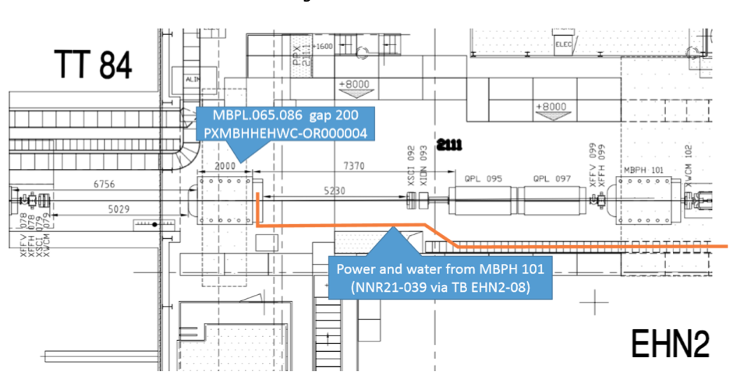
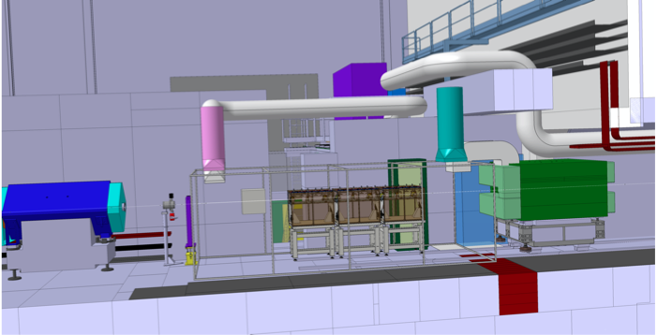
Changes to the M2 Beamline for the 2021 Test Runs
Johannes Bernhard, Dipanwita Banerjee
2338657 | SPSX-L-EC-0003 v.0.3
In the context of the Physics Beyond Colliders study three new experiments have requested beam time in the EHN2 beamline for which the zone PPE211, upstream of the current COMPASS setup, has been deemed as a suitable option. Since PPE211 is currently not a user zone, changes have to be made to accommodate all user requests.
The zone PPE211, that currently houses the CEDAR detectors upstream of the present COMPASS setup, was identified as a suitable option to host all three test runs.
A number of modifications shall take place to accommodate the new user zone, as detailed in the document.
3 experiments have been approved to run in the M2 beamline from 2021 and beyond:
AMBER – a future QCD facility that requires conventional muon and hadron beams up to LS3. It also includes a new RF separated beam option beyond LS3, that is currently under study.
NA64mu – the muon program for dark sector physics that requires medium to high intensity 160 GeV/c muon beam.
MuOnE - aiming to investigate the hadronic contribution to the vacuum polarization in the context of (g_{μ} -2) that requires a high intensity, 160 GeV/c, low divergence muon beam.
CEDAR cooling duct modification to accommodate the MuOnE “tent”.
Safety comments have been included, Safety files created, no further comments received
Seeking final approval from EATM

Slide 5
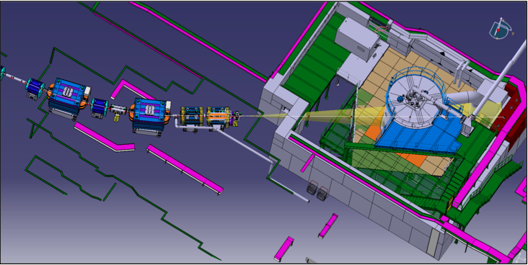
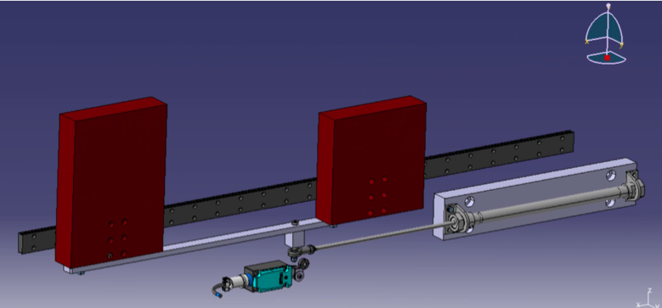
Installation of a Mobile Shutter in the T11 beamline of the New CERN East Area
Antonio Alonso
2472730 | PSZ-S-EC-0002 v.0.2
Due to the new layout of the T11 beamline and the increase of the beam size for the CLOUD experiment, the T11 beam passage hole through the mixed area shielding was enlarged. This hole enlargement has led to an increase of radiation entering the CLOUD chamber, so a mobile shutter shall be installed in order to prevent this radiation to enter the chamber between operation times when people could be inside the CLOUD area.
Various actuation systems to operate the shutter were under consideration.
An electrical motor and a pneumatic piston were proposed. However, due to the small size of the shutter and the fact that it is only going to be activated two times per year, the most suitable movement system was identified to be a crankshaft, located under the shutter and activated on request by the East Area superintendent at the start and at the end of the CLOUD operation period.
In order to optimize the radiation environment in the experimental area, it was proposed to install a mobile shutter in the mixed area shielding, allowing the beam to cross the passage during T11 operation mode and closing the passage for the rest of the year.
Although legally not required, this will allow to reduce the dose inside the T11 area while T9 and T10 are working.
Discussion w/ CLOUD taken place, agreement to stick with manual shutter activation in 2021
Seeking final approval from EATM

Slide 6
Thank you!
S. Schuh, EATM Meeting, 2021/08/03

