Slide 1
Higher-Twist Effect in Pion Parton Distribution
Lihong Wan and Jianhong Ruan
East China Normal University
28 September 2021
Perceiving the Emergence of Hadron Mass through AMBER@CERN - VI

Slide 2
outline
Motivation of this work
A modified-DGLAP equation (ZRS equation)
Comparing with data and some other works
Conclusion
CHIN. PHYS. LETT. 38 (2021) 042501

Slide 3
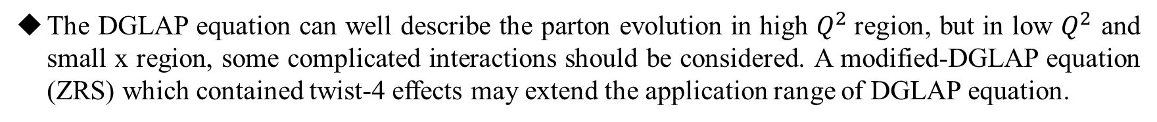
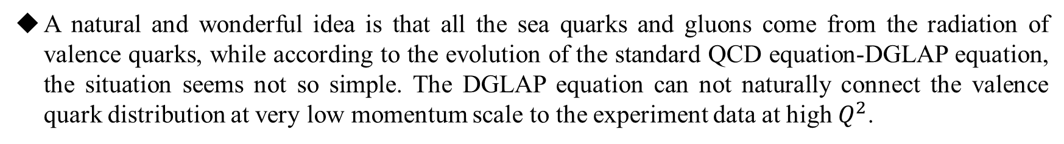
1、Motivation of this work
Pion is the simplest quark component hadron in the world, while its parton distributions are still not very clear, especially the distributions of sea quark and gluon.
A natural and wonderful idea is that all the sea quarks and gluons come from the radiation of valence quarks, while according to the evolution of the standard QCD equation-DGLAP equation, the situation seems not so simple. The DGLAP equation can not naturally connect the valence quark distribution at very low momentum scale to the experiment data at high $Q^{2}$.
The DGLAP equation can well describe the parton evolution in high $Q^{2}$region, but in low $Q^{2}$ and small x region, some complicated interactions should be considered. A modified-DGLAP equation (ZRS) which contained twist-4 effects may extend the application range of DGLAP equation.
Starting with a well defined valence quark distribution, with the evolution of ZRS equation, the pion parton distributions may be well described.

Slide 4
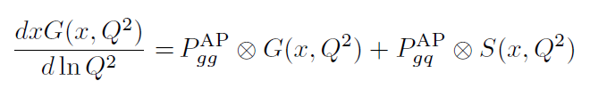

2、A modified-DGLAP equation
(1) DGLAP equation
splitting
The necessity to modify the DGLAP equation:
In small x region, the rapid increase of parton distributions with decreasing x will cause the violation of unitarity bound.
recombination
The increase of the number of partons cannot go on unlimited. When the density of partons becomes too large, they can no longer be considered as independent free particles, they begin to interact with each other.

Slide 5
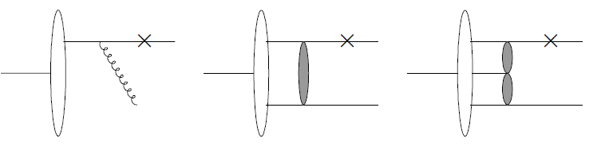
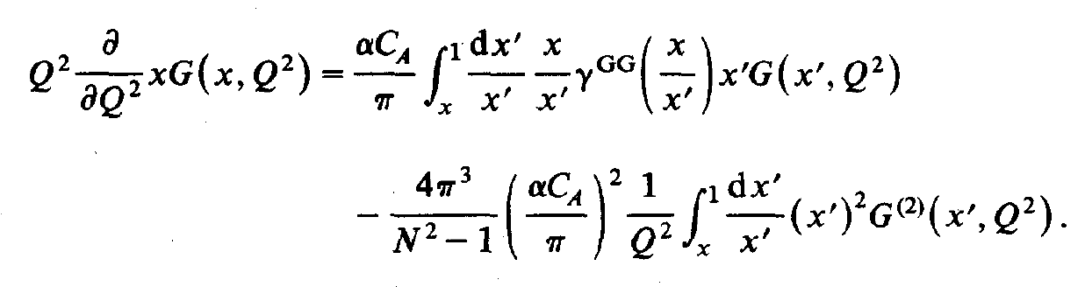
(2) GLR-MQ equation (Phys. Rep. 100 (1983) 1, Nucl. Phys. B 268 (1986)427 )
GLR-MQ equation violates the momentum conservation

Slide 6
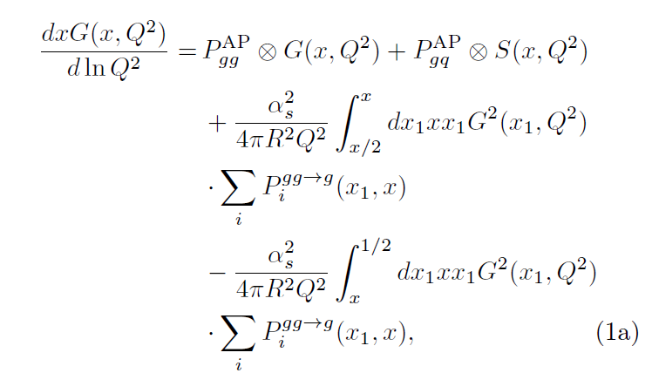
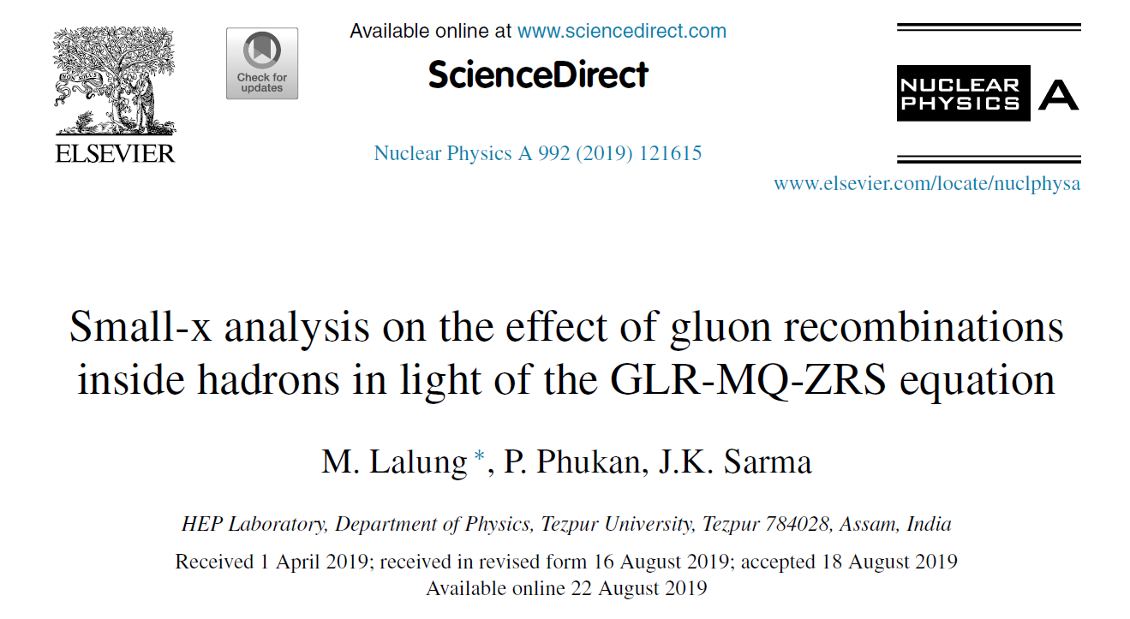
(3) Modified-DGLAP (ZRS) equation
（Nucl. Phys. B 559 (1999) 378，Phys. Rev. D 68 (2003) 094015
Int. J. Mod. Phys. E 23 (2014) 1450057）
Modified DGLAP = DGLAP
An India research group studied this equation in detail
+ antishadowing ( + )
+ shadowing ( - )
the gluon momentum lost due to shadowing is believed to be compensated in terms of new gluons with comparatively larger x.

Slide 7


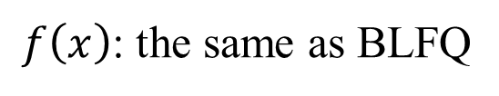



3、Comparing with data and some other works
(A) The input pion parton distributions
BLFQ：
（Phys. Rev. D 101 (2020) 034024, Phys. Rev. Lett. 122 (2019) 172001 ）
valence quark input distribution
$Q_{0}^{2}=0.12GeV^{2}$
$$f\left(x\right)=$$
Our model :
valence quark input distribution
$Q_{0}^{2}=0.09GeV^{2}$
$f\left(x\right)$: the same as BLFQ

Slide 8
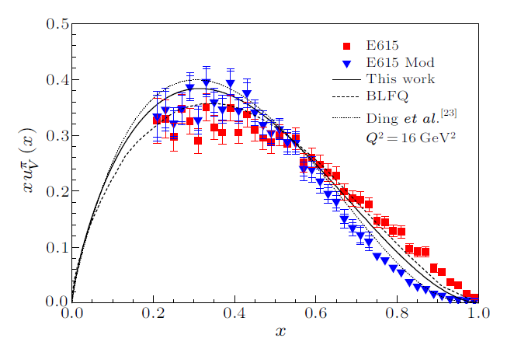





(B) Parton distributions comparison
BLFQ:
$$Q_{0}^{2}=0.12GeV^{2}$$
DGLAP evolution equation
Our model :
$$Q_{0}^{2}=0.09GeV^{2}$$
ZRS evolution equation
Ding et al:
$$Q_{0}^{2}=0.09GeV^{2}$$
$$f\left(x\right)$$
valence quark distributions
（Phys. Rev. D 101 (2020) 054014 )
Chin. Phys. C 44 (2020) 031002）

Slide 9
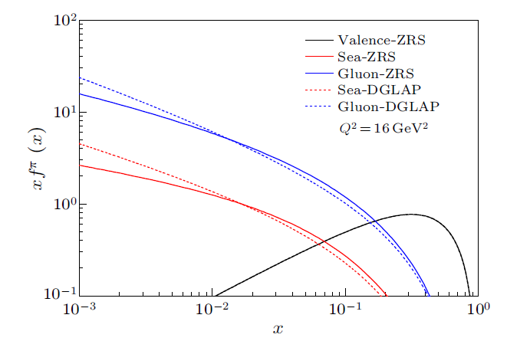


$$Q_{0}^{2}：$$
input distribution：
$$0.09GeV^{2}$$
BLFQ
Evolution equation:
DGLAP equation
ZRS equation
valence quark, sea quark and gluon distributions
This fig directly show the effect of shadowing and anti-shadowing . If the equation contains only the shadowing part, without the anti-shadowing part, the solid lines will always be lower than the dashed lines, and momentum conservation will not be maintained.

Slide 10
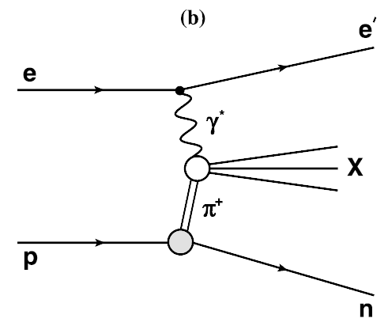








(C) Structure functions
H1:
one pion exchange model
$$x_{L}=0.73$$
$${0.68<x}_{L}<0.77$$
$$p_{T}<0.2 GeV$$
ZEUS:
effective one-pion-exchange model
additive quark model
$$x_{L}=0.73$$
${0.64<x}_{L}<0.$82
the pion flux associated with the splitting of a proton into a 𝜋+𝑛 system
$$p_{T}<0.656x_{L}$$
𝑑𝜎(𝑒𝜋+ → 𝑒′𝑋): the cross section of the e-pion interaction

Slide 11
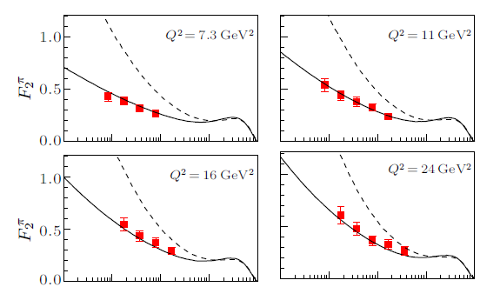
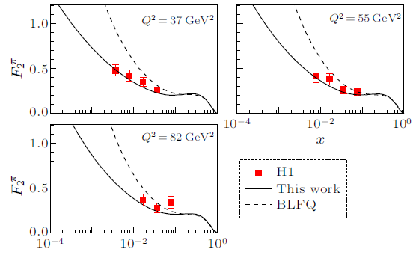

Comparing with H1 data
The dashed lines obtained via the evolution of the DGLAP equation are clearly higher than those for the experimental data.
The solid lines are obtained via the evolution of the ZRS equation The higher-twist correction played an important role in the small x region.
In the leading-order approximation

Slide 12
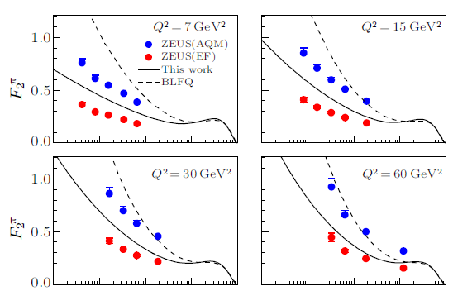
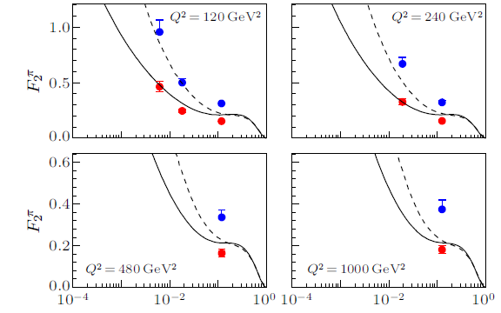
Comparing with ZEUS data
There are two groups of data of ZEUS，our lines are in-between the two sets of data。
The results of BLFQ are much closer to the data of the additive quark model, their line slope is obviously larger than that of the data, particularly in the small x region.
It seems that higher-twist corrections cannot be neglected, even in comparison with the additive quark model.

Slide 13
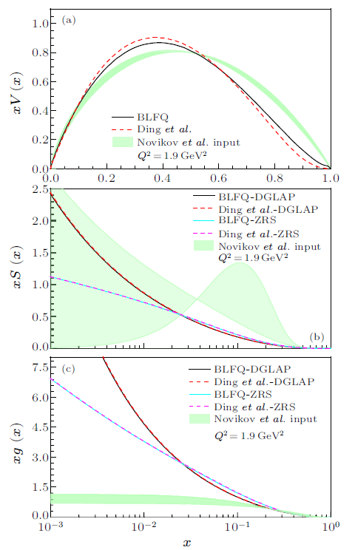

Comparision of BLFQ、Ding et al., and Novikov at al.
$$Q^{2}=1.9{GeV}^{2}$$
Valence quark:
BLFQ is similar to Ding
Novikov: obviously higher in large x region
Sea quark:
BLFQ 、Ding almost the same
Novikov: a very large uncertainty region
obviously higher in large x region
gluon:
BLFQ 、Ding almost the same
Novikov much smaller in small x region
Novikov at al: Phys. Rev. D 102(2020) 014040

Slide 14
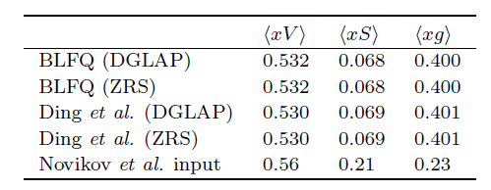
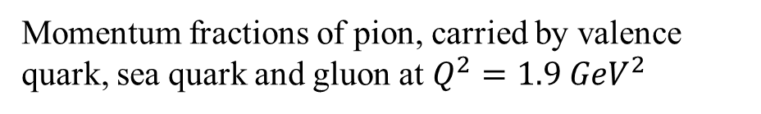
(D) momentum comparison
The momentum fraction of BLFQ and Ding are almost the same
Momentum fractions of pion, carried by valence quark, sea quark and gluon at $Q^{2}=1.9 {GeV}^{2}$
The sea quark momentum of Novikov is much larger than the other two models, and the gluon momentum is much smaller.
The evolution of ZRS equation does not influence the momentum fraction, since it is momentum conservation, it will only change the shape of sea quark and gluon distributions

Slide 15
4、Conclusion:
ZRS equation is an evolution equation considering twist-4 corrections, which satisfies the conservation of momentum. Using the input distribution function of BLFQ and the evolution of ZRS equation, the experimental data of valence quarks distribution and structure functions can be well explained.
The experimental data of structure function show that the higher-twist effect should not be neglected in small x region.
Through comparison, it is found that BLFQ model is very close to Ding's model, but they are quite different from Novikov model. It is expected to be further determined by experiments in the future.

Slide 16
Thank you for your attention!

