Slide 1

Craig Roberts … http://inp.nju.edu.cn/
Vector Meson Production
and Vector Meson Dominance

Slide 2
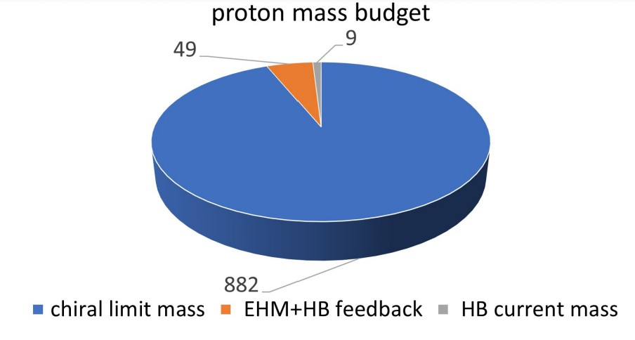
Emergence of Hadron Mass
Proton mass budget
Only 9 MeV/939 MeV is directly from Higgs
Plainly, there is another phenomenon in Nature that is extremely effective in producing mass:
Emergent Hadron Mass (EHM)
  Alone, it produces 94% of the proton’s mass
  Remaining 5% is generated by constructive interference between EHM and Higgs-boson
What is EHM?
Can it be explained by mere mechanisms,
like a Swiss watch?
If so, what are they?

Slide 3
Phenomenon of Emergent Mass
Empirical status:
  proton is stable compound object formed from three valence light-quarks
  proton electric and magnetic charge radii: r_{E} ≈ 0.84 fm, r_{M} ≈ 0.82 fm
    Fresh extraction of the proton charge radius from electron scattering, Z.-F. Cui, D. Binosi, C. D. Roberts, S. M. Schmidt, NJU-INP 033/21, arXiv: 2102.01180 [hep-ph], Phys. Rev. Lett. 127 (2021) 092001
    Pauli radius of the proton, Zhu-Fang Cui (崔著钫), Daniele Binosi, Craig D. Roberts and Sebastian M. Schmidt, NJU-INP 050/21, e-print: 2109.08768 [hep-ph]
  evidently, proton never decays (if it did, wouldn’t be many of us here)
Mass of proton m_{p} = 939 MeV.
Mass of valence quarks in proton = 9 MeV
  Missing mass = 930 MeV = 99%
Higgs mechanism of mass generation responsible for only 1% of proton mass
Where should science look to find the remaining 99% of visible mass in the Universe?
Is the answer contained within the SM?
How will science know when the answer is found? What are the “smoking gun” signals?

Slide 4
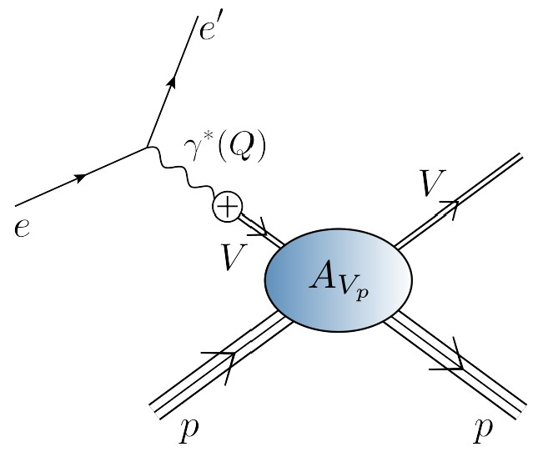
V + p → V + p
Femtoscopy of the Origin of the Nucleon Mass, G. Krein & T.C. Peixoto, Few Body Syst. 61 (2020) 4, 49 • e-Print: 2011.11615 [hep-ph]
Interaction of heavy vector-meson, J/ψ or Υ, with proton
offers prospects for access to
  a QCD van der Waals interaction, generated by multiple gluon exchange
    may relate to, inter alia, the observation of hidden-charm pentaquark states
  and Proton Mass via QCD trace anomaly
    connection with emergent hadron mass (EHM)
Don’t have vector-meson beams, so experiments at modern e-accelerators attempt to access such interactions via electromagnetic production reactions e + p → e’ + V + p
Same is proposed at future electron ion colliders
Why?
  Typically assumed that single-pole vector meson dominance (VMD) can reliably be used to draw direct link between e + p → e’ + V + p & V + p → + V + p

Slide 5
e + p → e ′ + V + p & V + p → V + p
Interaction supposed to take place in a sequence of steps:
    e → e′ + γ^{(∗)}(Q)
    γ^{(∗)}(Q) → V
    V + p → V + p
Step (b) expresses VMD hypothesis
Assumes that:
  photon, at best = real, but generally spacelike (Q² ≥ 0), transmutes into an on-shell vector-meson, with timelike momentum Q² = −m_{V}²
  Q² ≥ 0 strength and character of the transition in (b) is unchanged from that measured in the real process of vector-meson decay,
  V → γ∗ (Q² = −m_{V}²) → e⁺ + e⁻ ,
    i.e., γV coupling is fixed at on-shell value, acquiring NO momentum dependence, irrespective of the size of m_{V}², which defines the arm on required extrapolation

Slide 6
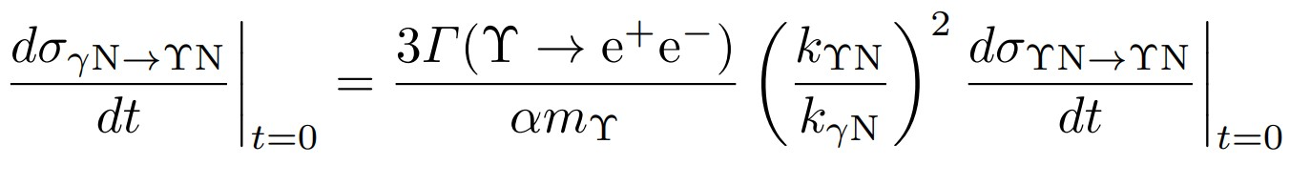
e + p → e ′ + V + p & V + p → V + p
Standard use of VMD
Step b. γ(∗)(Q) → V
V + p → V + p
Q² = 0 photoproduction cross-section
Translation via a constant computed at
Q² = −m_{V}²

Slide 7
More on the VMD Ansatz
VMD Ansatz introduced before the development of QCD [Sakurai:1960ju]
Used in analysing energetic electromagnetic interactions of light hadrons,
viz. states with masses similar to proton
Still used today and for a much wider range of systems
Why?
  Alternative = develop sophisticated, nonperturbative reaction theory that can explain quark+antiquark scattering from hadron targets into vector-meson final-states.
Not Done
Notwithstanding this, lack of alternative does not validate VMD expedient
Fidelity should be reconsidered with QCD constraints in mind.

Slide 8
Trace Anomaly via
Heavy-meson photo-production?
Vector-meson production and vector meson dominance, Yin-Zhen Xu (徐胤禛), Si-Yang Chen (陈斯阳), Zhao-Qian Yao (姚照千), Daniele Binosi, Zhu-Fang Cui (崔著钫) and Craig D. Roberts, NJU-INP 044/21, arXiv:2107.03488 [hep-ph], Eur. Phys. J. C (2021) in press
Is there a relation between the electromagnetic vector-meson production reaction
e + p → e’ + V + p and the purely hadronic process V + p → V + p ?
Answer depends on the fidelity of single-pole VMD assumption
If this VMD assumption is false …
    Then all existing cross-section estimates and conclusions based on VMD must be reviewed
For JLab, EIC, EicC this means … will need to rethink access to and understanding of
  hidden-charm pentaquark production
  origin of the proton mass via trace anomaly
How to check validity of VMD?

Slide 9
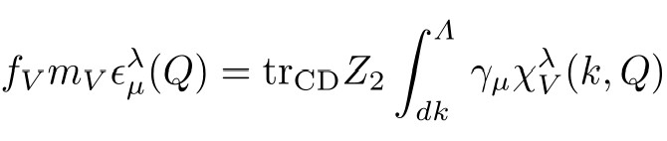
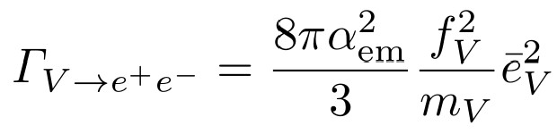
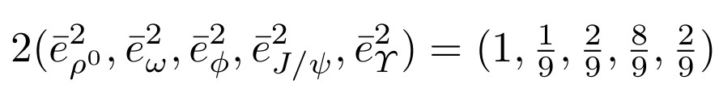
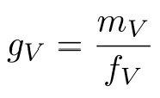
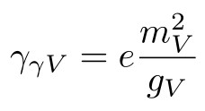
Photon Vacuum Polarisation
Physical process V → e⁺ e⁻ described by leptonic decay constant, f_{V}:
  ϵ_{μ}^{λ} is the polarisation vector
  and χ_{V}^{λ} is the meson’s Bethe-Salpeter wave function
  simply related to Γ_{V}^{λ}, meson’s Bethe-Salpeter amplitude
In terms of this decay constant, the (real) decay width is
The decay is typically connected with a dimensionless constant:
Related to this, the “current-field identity”, definitive of VMD:
VMD assumes this to be immutable: same on-shell and off-shell, no matter how far off-shell.

Slide 10
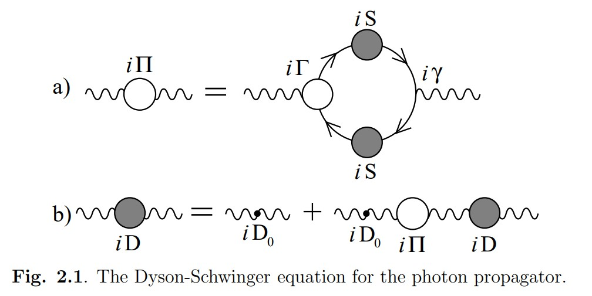
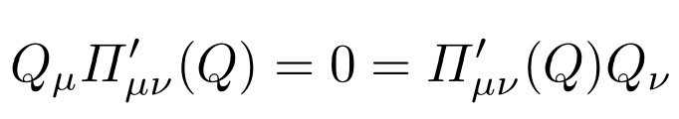
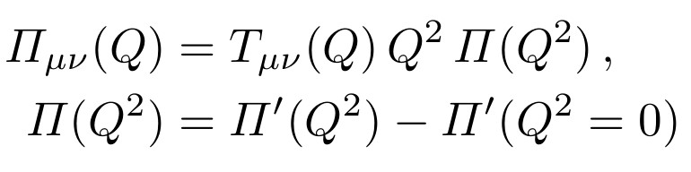
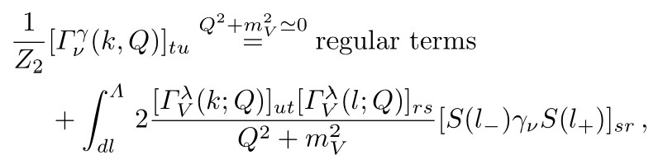
Photon Vacuum Polarisation
Describes ALL QCD corrections to photon propagation
Ward-Green-Takahashi identity
Follows that Π(Q²) = 0, i.e., the photon begins massless and remains massless in interacting theory (No Schwinger mechanism for the QED photon)
– this is a constraint from Nature
Π(Q²) connected to vector-mesons through the dressed photon-quark vertex
In neighbourhood of
  a vector-meson pole,
  ignoring any hadronic width:

Slide 11
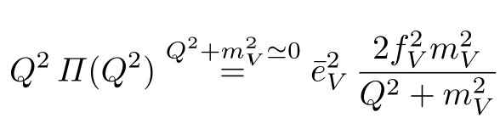
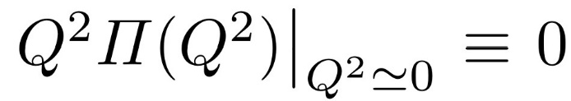
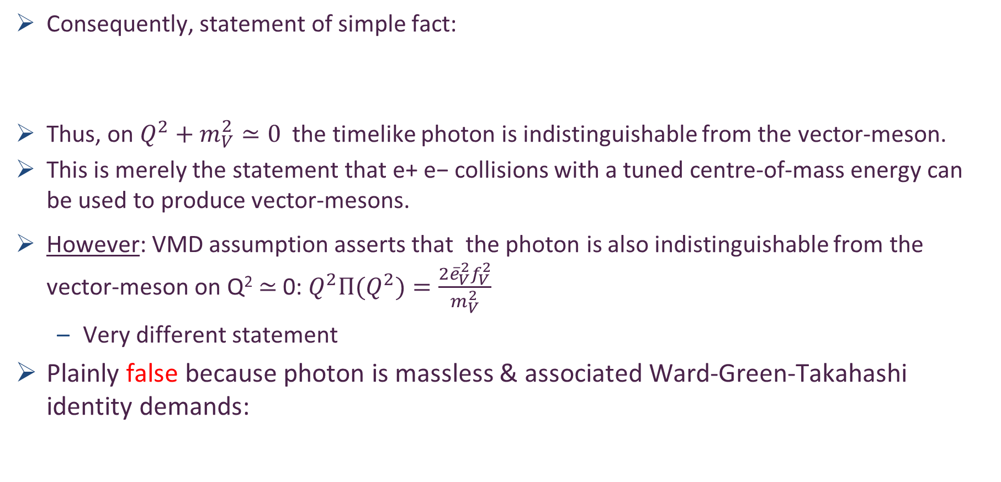

Photon Vacuum Polarisation
Consequently, statement of simple fact:
Thus, on $Q^{2}+m_{V}^{2}≃0$ the timelike photon is indistinguishable from the vector-meson.
This is merely the statement that e+ e− collisions with a tuned centre-of-mass energy can be used to produce vector-mesons.
However: VMD assumption asserts that the photon is also indistinguishable from the vector-meson on Q² ≃ 0: $Q^{2}Π(Q^{2})=\frac{{2\overline{e}}_{V}^{2}f_{V}^{2}}{m_{V}^{2}}$
  Very different statement
Plainly false because photon is massless & associated Ward-Green-Takahashi identity demands:
V-meson e+ e- decay constant
$$≠\frac{{2\overline{e}}_{V}^{2}f_{V}^{2}}{m_{V}^{2}}$$

Slide 12
Current Field Identity
Used in all analyses that attempt to link
  e + p → e’ + V + p with the purely hadronic process V + p → V + p
Necessarily generates a massive photon
In fact, a tachyonic photon
Hence, cannot alone be used to develop or support a VMD phenomenology
This contradiction recovers the objection to current-field identity first raised in 1963
Remedy for this flaw was proposed in 1967:
  Construct a local Lagrangian for pointlike photons & vector-mesons & nucleons
  Tune couplings to ensure cancellation of the tachyonic photon mass
BUT QCD interactions do not generate pointlike hadrons
SO, this solution is untenable.
Is there a QCD alternative?

Slide 13
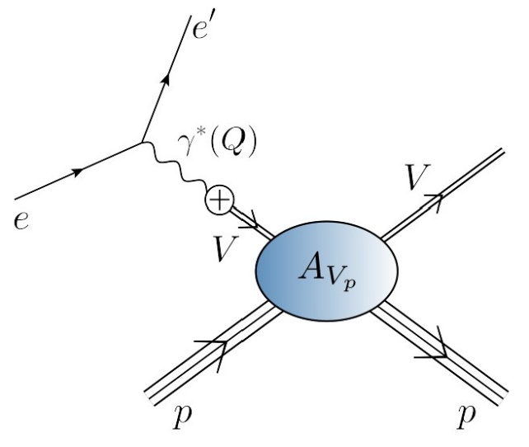
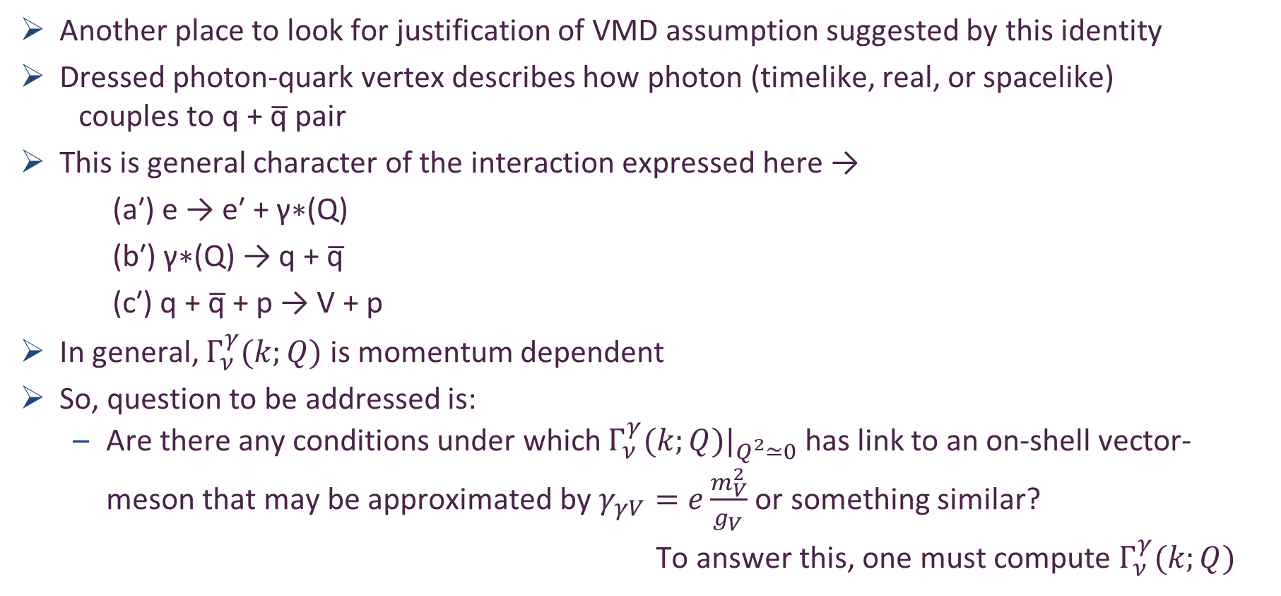
Photon Quark Vertex
Another place to look for justification of VMD assumption suggested by this identity
Dressed photon-quark vertex describes how photon (timelike, real, or spacelike)
couples to q + q̅ pair
This is general character of the interaction expressed here →
    (a′) e → e′ + γ∗(Q)
    (b′) γ∗(Q) → q + q̅
    (c′) q + q̅ + p → V + p
In general, $Γ_{ν}^{γ}(k;Q)$ is momentum dependent
So, question to be addressed is:
  Are there any conditions under which $Γ_{ν}^{γ}(k;Q)|_{Q^{2}≃0}$ has link to an on-shell vector-meson that may be approximated by $γ_{γV}=e\frac{m_{V}^{2}}{g_{V}}$ or something similar?
To answer this, one must compute $Γ_{ν}^{γ}(k;Q)$

Slide 14
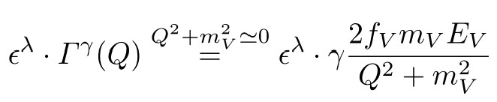
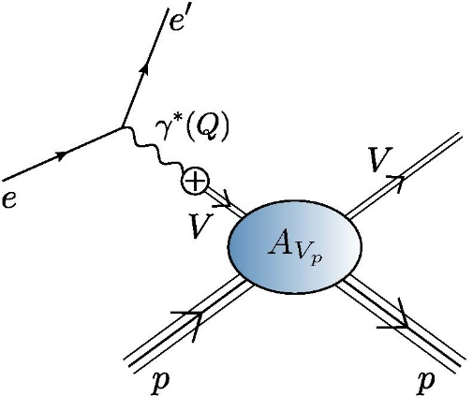
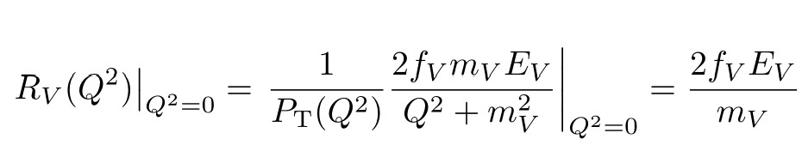
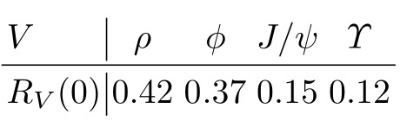

Photon-quark vertex – SCI
Vector-meson production and vector meson dominance, Yin-Zhen Xu (徐胤禛), Si-Yang Chen (陈斯阳), Zhao-Qian Yao (姚照千), Daniele Binosi, Zhu-Fang Cui (崔著钫) and Craig D. Roberts, NJU-INP 044/21, arXiv:2107.03488 [hep-ph], Eur. Phys. J. C (2021) in press
If q + q̅ interaction is momentum-INDEPENDENT (SCI) then $Γ_{ν}^{γ}(k;Q)$ = $Γ_{ν}^{γ}(Q)$
does not depend on $k$.
Similarly, vector meson Bethe-Salpeter amplitude does not depend on $k$.
VMD valid if
Translates into validity of VMD iff R_{V}(Q²) ≡ 1
Results:
Only term in vector meson bound-state amplitude

Slide 15

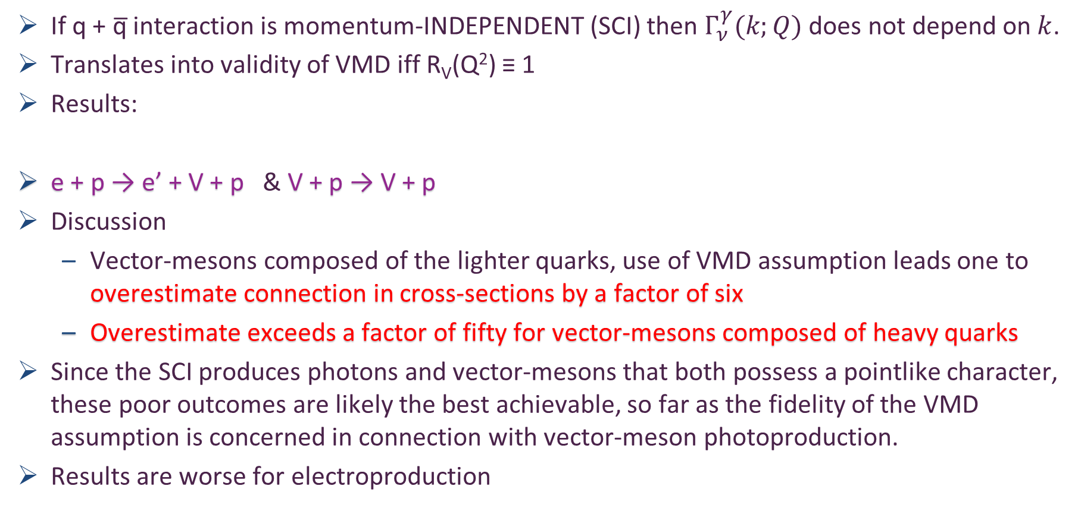
Photon-quark vertex
Vector-meson production and vector meson dominance, Yin-Zhen Xu (徐胤禛), Si-Yang Chen (陈斯阳), Zhao-Qian Yao (姚照千), Daniele Binosi, Zhu-Fang Cui (崔著钫) and Craig D. Roberts, NJU-INP 044/21, arXiv:2107.03488 [hep-ph], Eur. Phys. J. C (2021) in press
If q + q̅ interaction is momentum-INDEPENDENT (SCI) then $Γ_{ν}^{γ}(k;Q)$ does not depend on $k$.
Translates into validity of VMD iff R_{V}(Q²) ≡ 1
Results:
e + p → e’ + V + p & V + p → V + p
Discussion
  Vector-mesons composed of the lighter quarks, use of VMD assumption leads one to overestimate connection in cross-sections by a factor of six
  Overestimate exceeds a factor of fifty for vector-mesons composed of heavy quarks
Since the SCI produces photons and vector-mesons that both possess a pointlike character, these poor outcomes are likely the best achievable, so far as the fidelity of the VMD assumption is concerned in connection with vector-meson photoproduction.
Results are worse for electroproduction
Phenomenology: introduce a Q²-dependent “off-shell” factor to model this suppression

Slide 16
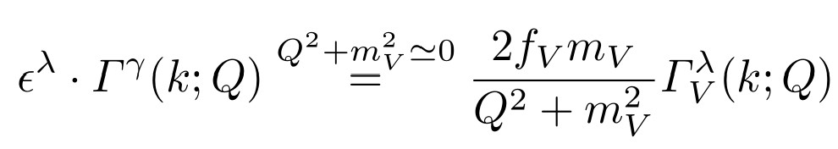
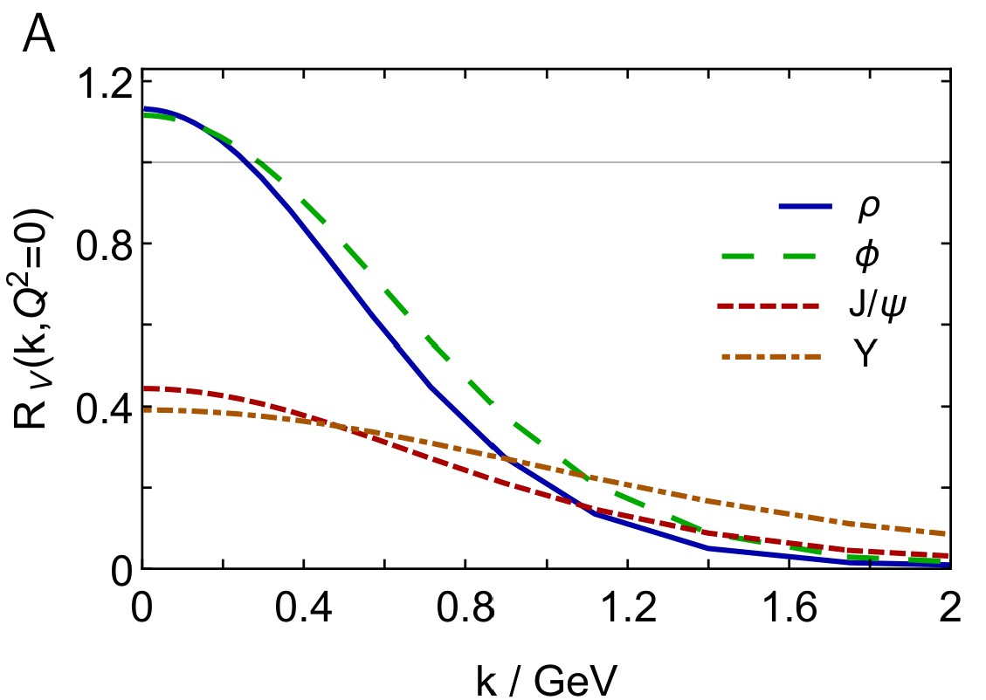
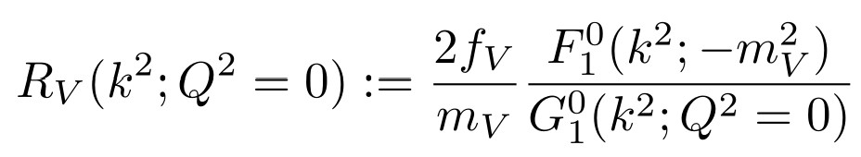
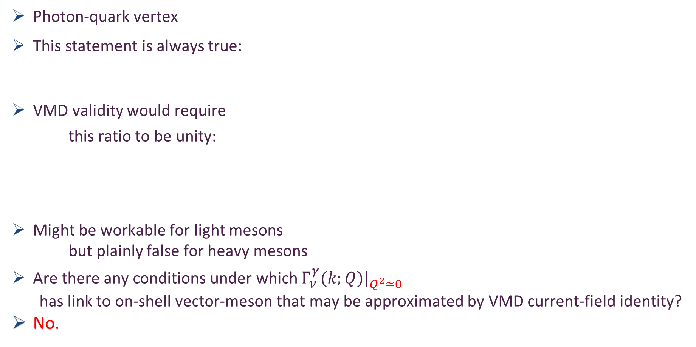
Photon-quark vertex – realistic interaction
Photon-quark vertex
This statement is always true:
VMD validity would require
this ratio to be unity:
Might be workable for light mesons
but plainly false for heavy mesons
Are there any conditions under which $Γ_{ν}^{γ}(k;Q{)|}_{Q^{2}≃0}$
has link to on-shell vector-meson that may be approximated by VMD current-field identity?
No.
Vertex and Bethe-Salpeter amplitude depend on two new variables involving relative momentum: k² and k⋅Q
Leading term in vector meson bound-state amplitude
unity
Leading term in photon-quark vertex

Slide 17
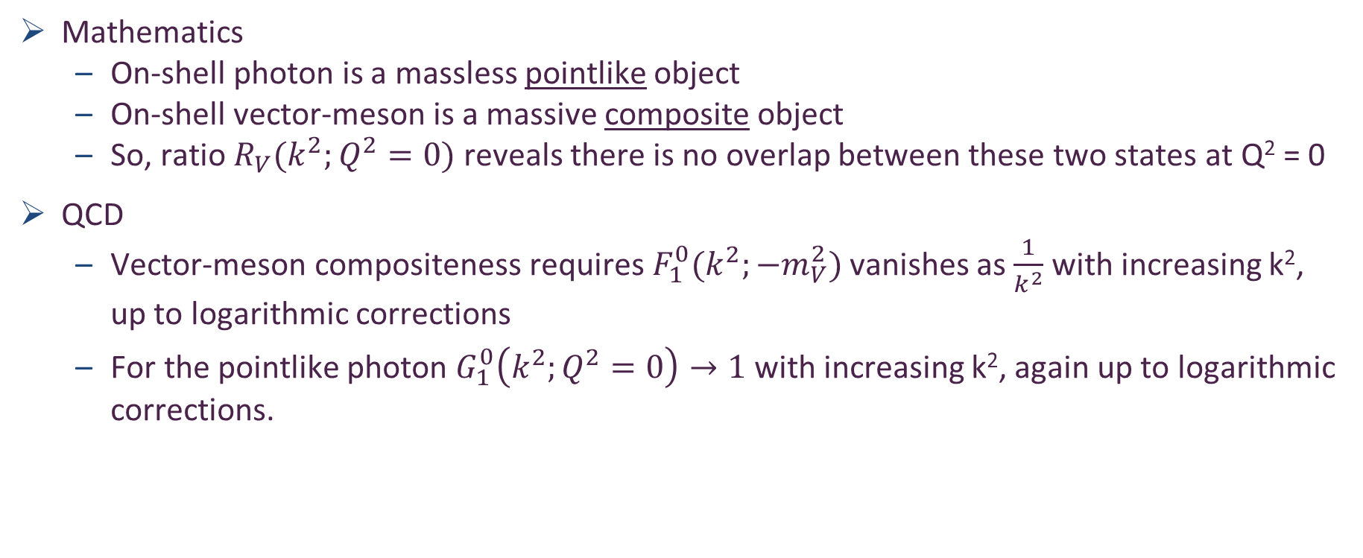
Fidelity of VMD with realistic q + q̅ interactions
Mathematics
  On-shell photon is a massless pointlike object
  On-shell vector-meson is a massive composite object
  So, ratio $R_{V}(k^{2};Q^{2}=0)$ reveals there is no overlap between these two states at Q² = 0
QCD
  Vector-meson compositeness requires $F_{1}^{0}(k^{2};{−m}_{V}^{2})$ vanishes as $\frac{1}{k^{2}}$ with increasing k², up to logarithmic corrections
  For the pointlike photon $G_{1}^{0}\left(k^{2};Q^{2}=0\right)→1$ with increasing k², again up to logarithmic corrections.

Slide 18
Fidelity of VMD with realistic q + q̅ interactions
Q² = 0 photon-quark vertex has only three nontrivial momentum-dependent components,
On-shell vector-meson has eight distinct, momentum-dependent terms.
⇒ Numerous other comparison figures can be drawn
Only three Q² = 0 ratios can be unity.
  J/ψ and Υ … not one of them is unity
  Other five are identically zero.
Abundantly clear that momentum-dependence in any quark+antiquark loop describing scattering in process e + p → e’ + V + p is very different from that in process V + p → V + p
Consequently, the form-factor expedient is inadequate in the realistic case.

Slide 19
VMD for Heavy Vector Mesons?
Vector-meson production and vector meson dominance, Yin-Zhen Xu (徐胤禛), Si-Yang Chen (陈斯阳), Zhao-Qian Yao (姚照千), Daniele Binosi, Zhu-Fang Cui (崔著钫) and Craig D. Roberts, NJU-INP 044/21, arXiv:2107.03488 [hep-ph], Eur. Phys. J. C (2021) in press
Many other tests, all failed by VMD assumption for heavy vector-mesons:
Simply: for heavy-mesons the momentum-dependence of the Q²=0 photon-quark vertex is entirely different from that of vector-meson bound-state amplitude
So, VMD assumption is false for heavy vector-mesons.
No model-independent way to estimate and/or correct for the degree by which VMD distorts any interpretation e + p → e’ + V + p in terms of V + p → V + p
Only V + p → V + p for which a QCD multipole expansion can be used to draw connections with the proton's glue distribution
No existing attempt to connect e + p → e’ + V + p & V + p → V + p via VMD is reliable.
  See also Du, Guo, et al., Deciphering the mechanism of near-threshold J/ψ photoproduction, Eur. Phys. J. C 80 (11) (2020) 1053 … even if VMD were valid, then coupled-channels effects are likely to break the connection
This undermines any interpretation of e + p → e’ + V + p reactions as a route to either
  hidden-charm pentaquark production
  or as a means of uncovering the origin of the proton mass.

Slide 20
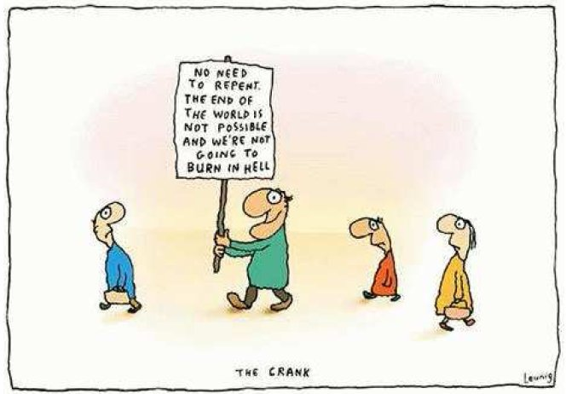

Slide 21
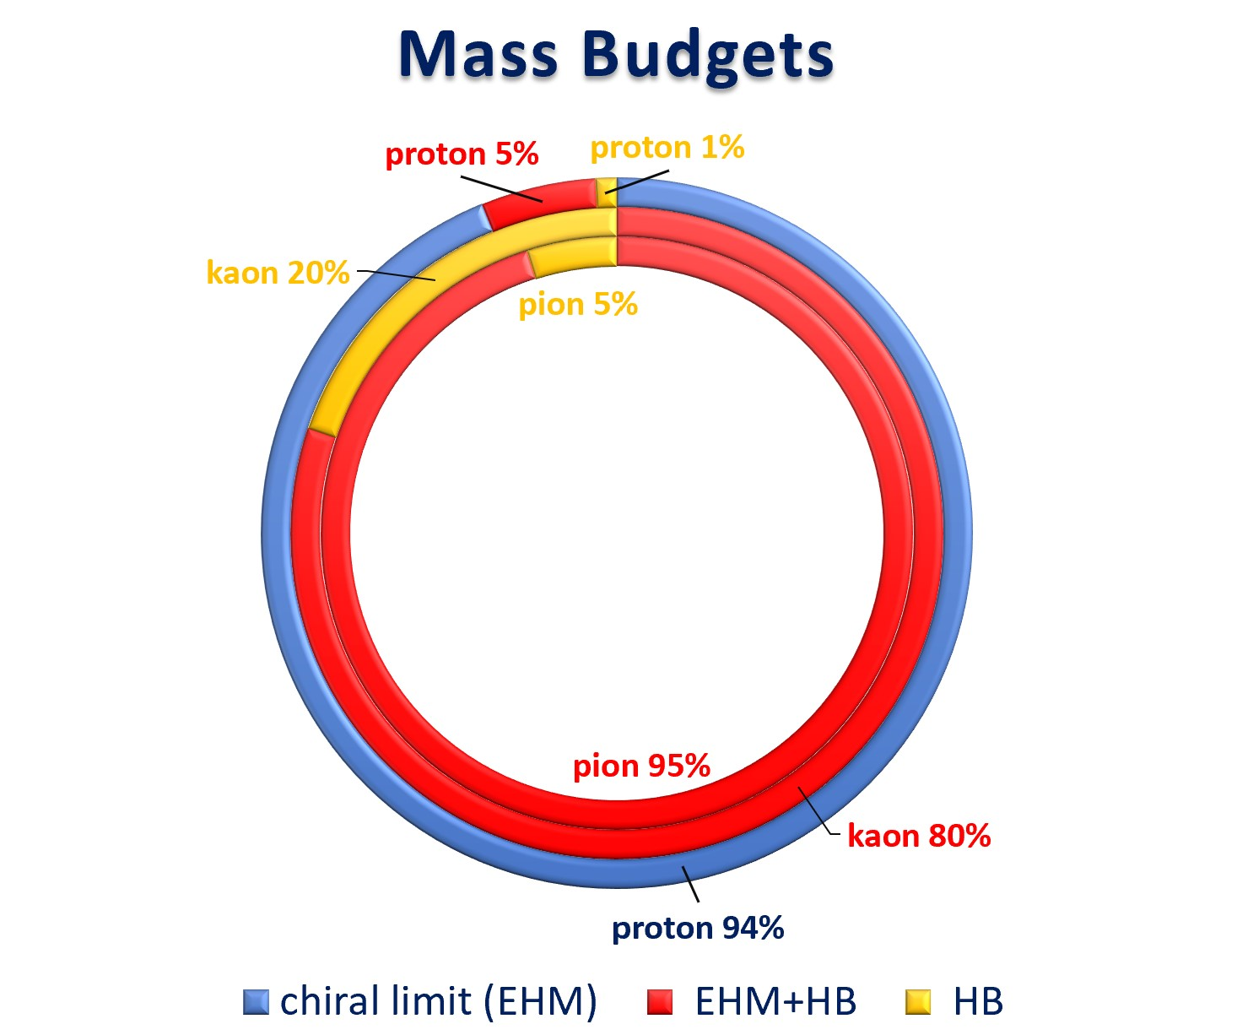
Emergence of Hadron Mass - Contrasts
Compare proton and pion mass budgets
Pion is a Nambu-Goldstone boson
  So, massless in chiral-limit
  No blue annulus
  EHM+HB is 95% of the total
Kaon is somewhere in between
  HB = 20%
  EHM+HB = 80%
Critically, without Higgs mechanism of mass generation, π and K would be indistinguishable from each other
Always distinguishable from proton.
Yet, all states are supposed to be in QCD!
What is, wherefrom, whereto mass?

Slide 22
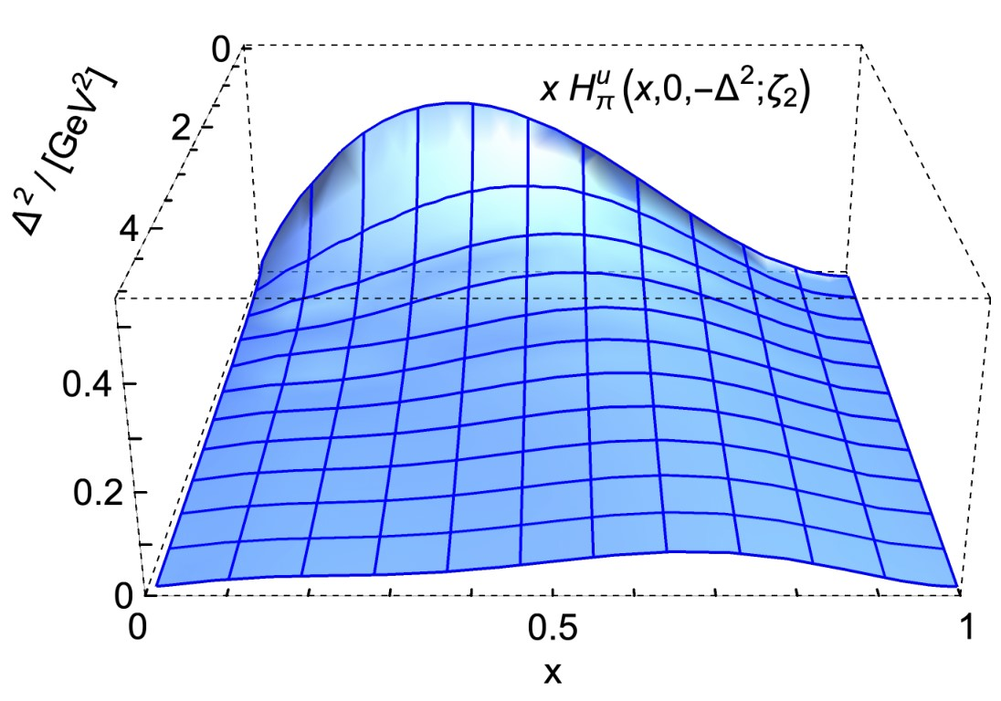
Generalised Parton
Distribution Functions

Slide 23

Measures of Pseudoscalar Meson Structure
🎆 Measures of pion and kaon structure from generalised parton distributions, Jin-Li Zhang, Khépani Raya, J. M. Morgado, et al, NJU-INP 032/21, arXiv: 2101.12286 [hep-ph], Phys. Lett. B 815 (2021) 136158
Revealing pion and kaon structure via generalised parton distributions, Khépani Raya, Zhu-Fang Cui (崔著钫), Lei Chang (常雷), José-Manuel Morgado, Craig D. Roberts and José Rodriguez-Quintero, NJU-INP 051/21, e-Print: 2109.11686 [hep-ph]
What do do in absence of any model-independent link
between e + p → e’ + V + p & V + p → V + p ?
Increasingly many robust connections
being drawn between EHM and the properties of pions and kaons
Revealed in both phenomenological sketches and theoretical predictions
Crucially, the links can be verified empirically
Motivates new analyses of
π- and K-meson
generalized parton distributions (GPDs)

Slide 24
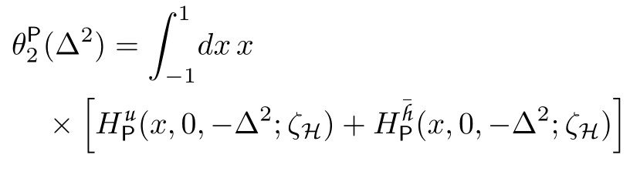

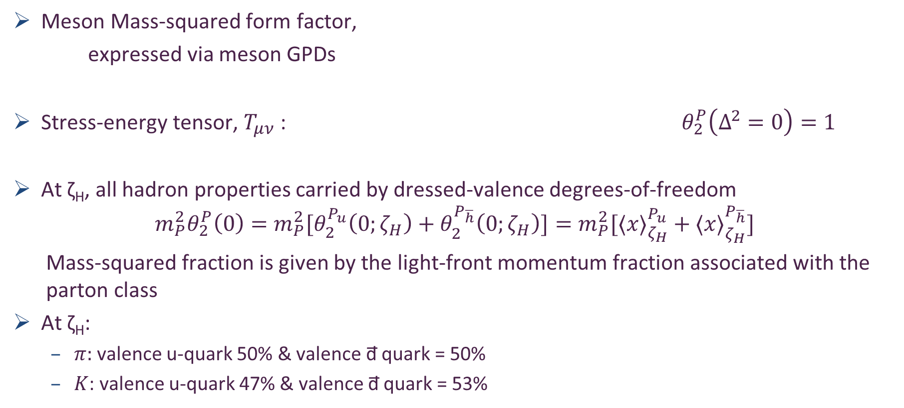
Mass-squared distributions
– Nambu-Goldstone bosons
Revealing pion and kaon structure via generalised parton distributions, Khépani Raya, Zhu-Fang Cui (崔著钫), Lei Chang (常雷), José-Manuel Morgado, Craig D. Roberts and José Rodriguez-Quintero, NJU-INP 051/21, e-Print: 2109.11686 [hep-ph]
Meson Mass-squared form factor,
expressed via meson GPDs
Stress-energy tensor, $T_{μν}$ : $θ_{2}^{P}\left(Δ^{2}=0\right)=1$
At ζ_{H}, all hadron properties carried by dressed-valence degrees-of-freedom
$$m_{P}^{2}θ_{2}^{P}\left(0\right)={m_{P}^{2}[θ}_{2}^{P_{u}}\left(0;ζ_{H}\right)+θ_{2}^{P_{\overline{h}}}\left(0;ζ_{H}\right)]=m_{P}^{2}[⟨x⟩_{ζ_{H}}^{P_{u}}+⟨x⟩_{ζ_{H}}^{P_{\overline{h}}}]$$
  Mass-squared fraction is given by the light-front momentum fraction associated with the parton class
At ζ_{H}:
  $π:$valence u-quark 50% & valence d̅ quark = 50%
  $K$: valence u-quark 47% & valence d̅ quark = 53%
ζ_{H} = Hadron scale
Mass-squared sum rule

Slide 25

Mass-squared distributions
– Nambu-Goldstone bosons
Revealing pion and kaon structure via generalised parton distributions, Khépani Raya, Zhu-Fang Cui (崔著钫), Lei Chang (常雷), José-Manuel Morgado, Craig D. Roberts and José Rodriguez-Quintero, NJU-INP 051/21, e-Print: 2109.11686 [hep-ph]
Hadron scale: $ζ=ζ_{H}$

Slide 26

Mass-squared distributions
– Nambu-Goldstone bosons
Revealing pion and kaon structure via generalised parton distributions, Khépani Raya, Zhu-Fang Cui (崔著钫), Lei Chang (常雷), José-Manuel Morgado, Craig D. Roberts and José Rodriguez-Quintero, NJU-INP 051/21, e-Print: 2109.11686 [hep-ph]
All-orders evolution to $ζ=ζ_{2} ≔2$ GeV

Slide 27
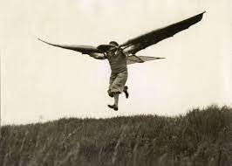
Get off the ground!
The Message
  The ground state proton is not enough
  Ground state of the hydrogen atom did not give us QED
  Studies of the proton alone cannot reveal all the wonders of QCD,
  if QCD is truly the theory of strong interactions in the Standard Model
  Modern and planned high-luminosity facilities
  provide unprecedented opportunities
  to move beyond the 100-year focus
  on the structure of just one (or two = neutron) hadron(s)
  How much richer will be our store of knowledge
  once insights into the full array of Nature’s hadrons is in our hands!

Slide 28
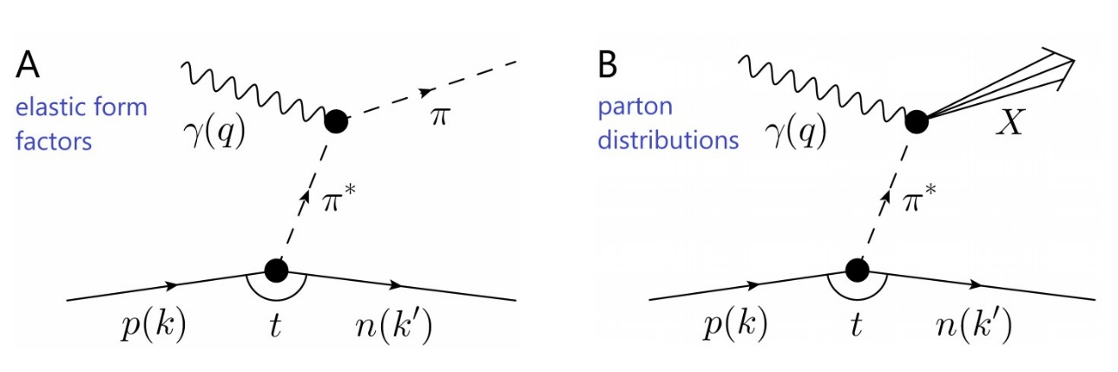
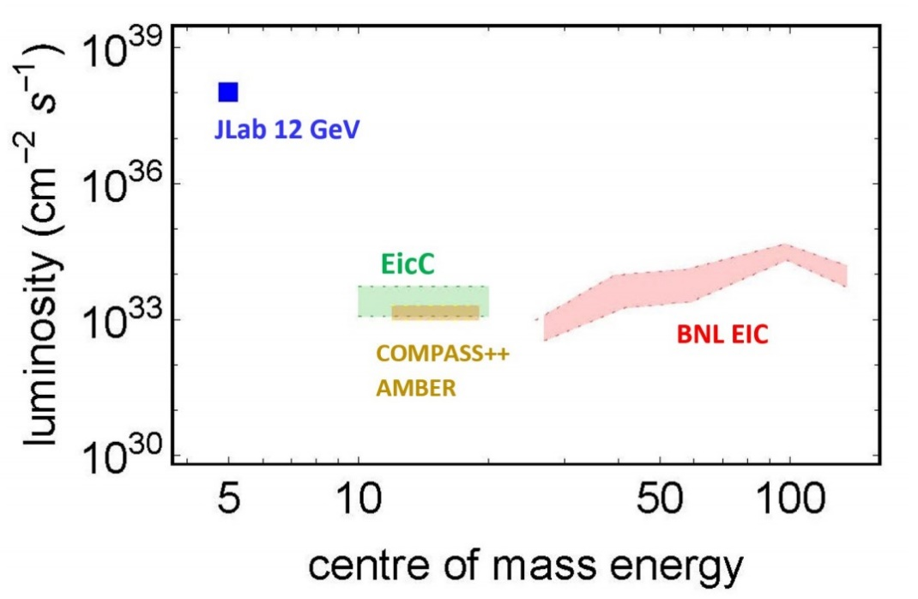
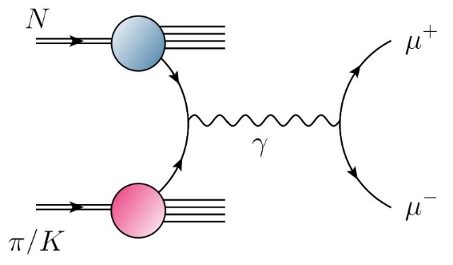
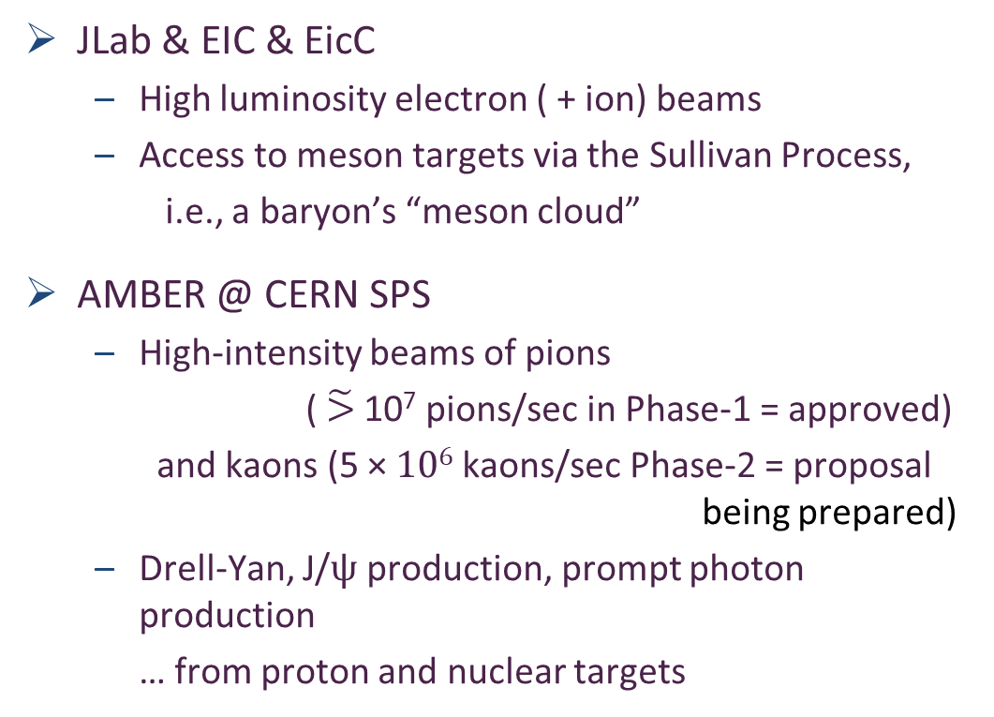
Era of Meson Targets
JLab & EIC & EicC
  High luminosity electron ( + ion) beams
  Access to meson targets via the Sullivan Process,
  i.e., a baryon’s “meson cloud”
AMBER @ CERN SPS
  High-intensity beams of pions
  ($\tilde{>}$ 10⁷ pions/sec in Phase-1 = approved)
    and kaons (5 × 10⁶ kaons/sec Phase-2 = proposal
                being prepared)
  Drell-Yan, J/ψ production, prompt photon production
  … from proton and nuclear targets

Slide 29




Meson Structure
Worldwide Plans and Goals
Letter of Intent: A New QCD facility at the M2 beam line of the CERN SPS. This document covers all ideas for future experiments as of January 2019.
Proposal for Phase-1: COMPASS++/AMBER: Proposal for Measurements at the M2 beam line of the CERN SPS Phase-1: 2022-2024. This document covers the three phase-1 experiments (start in 2022).
Pion and Kaon Structure at the Electron-Ion Collider, Arlene C. Aguilar et al., NJU-INP 001/19, arXiv:1907.08218 [nucl-ex], Eur. Phys. J. A 55 (2019) 190/1-15
Strong QCD from Hadron Structure Experiments, S. J. Brodsky et al., arXiv:2006.06802 [hep-ph], Int. J. Mod. Phys. E 29 (2020) 08, 2030006/1-122
Selected Science Opportunities for the EicC, Xurong Chen, Feng-Kun Guo, Craig D. Roberts and Rong Wang, NJU-INP 022/20, arXiv:2008.00102 [hep-ph], Few Body Syst. 61 (2020) 4, 43/1-37. Invited contribution to the Special Issue: "New Trends in Hadron Physics: a Few-Body Perspective"
Insights into the Emergence of Mass from Studies of Pion and Kaon Structure, Craig D. Roberts, David G. Richards, Tanja Horn and Lei Chang, NJU-INP 034/21, arXiv: 2102.01765 [hep-ph], Prog. Part. Nucl. Phys. 120 (2021) 103883/1-65
Electron-Ion Collider in China, D. P. Anderle et al., NJU-INP 035/21, arXiv:2102.09222 [nucl-ex], Front. Phys. (Beijing) 16 (2021) 6, 64701
Revealing the structure of light pseudoscalar mesons at the Electron-Ion Collider, John Arrington et al., NJU-INP 036/21, arXiv: 2102.11788 [nucl-ex], J. Phys. G 48 (2021) 7, 075106

Slide 30
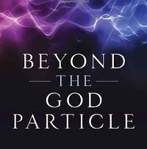
Epilogue
Nature has two sources of mass
  Higgs mass-generating mechanism = understood
  Phenomenon of Emergent Hadron Mass = much to learn
EHM (possibly/probably?) lies within the Standard Model,
i.e., in strong QCD
Basic predictions:
  Gluons acquire mass ⇒ running coupling saturates on infrared domain, restoring approximate conformal behaviour
  Enigmatically, the unusually light Nambu-Goldstone bosons provide the clearest windows onto the Emergence of Mass in Nature
With modern and on-the-horizon facilities having the capacity to deliver practical pion and kaon “targets”, science can finally move beyond the proton and study an entirely different form of hadron matter = the mesons without which observable Universe could not exist

Slide 31
Get off the Ground!
Nature has two sources of mass
  Higgs mass-generating mechanism = understood
  Phenomenon of Emergent Hadron Mass = much to learn
EHM (possibly/probably?) lies within the Standard Model,
i.e., in strong QCD
Basic predictions:
  Gluons acquire mass ⇒ running coupling saturates on infrared domain, restoring approximate conformal behaviour
  Enigmatically, the unusually light Nambu-Goldstone bosons provide the clearest windows onto the Emergence of Mass in Nature
With modern and on-the-horizon facilities having the capacity to deliver practical pion and kaon “targets”, science can finally move beyond the proton and study an entirely different form of hadron matter = the mesons without which observable Universe could not exist

Slide 32
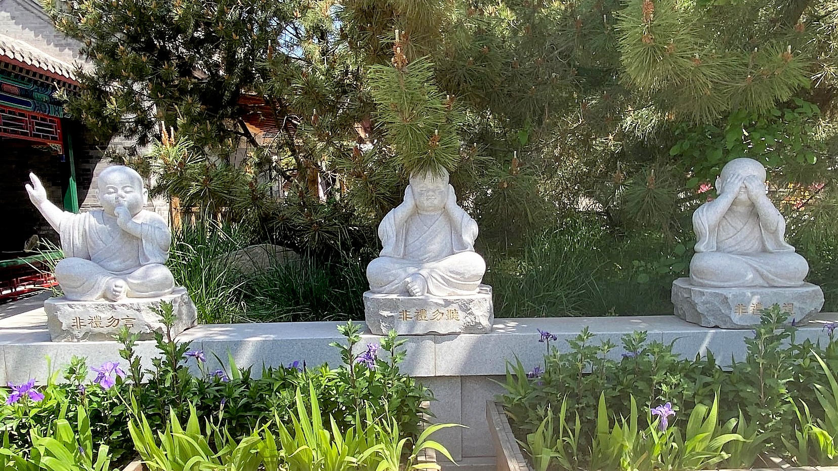
Thankyou

