Slide 1
EIC Readout Overview
Fernando Barbosa (Jlab)
L3 CAM
EP R&D Day 2021
12 November 2021

Slide 2
Outline
EIC Streaming Readout Architecture
Readout Channels & Specifications
DAQ/Computing
Timing
Outline of the EIC Needs
Timeline
Summary
The EIC collision charged particle production rate is four orders of magnitude lower than that of the LHC:
  LHC - aggressive reduction on the collision signal.
  EIC - filtering out potential high background.

Slide 3
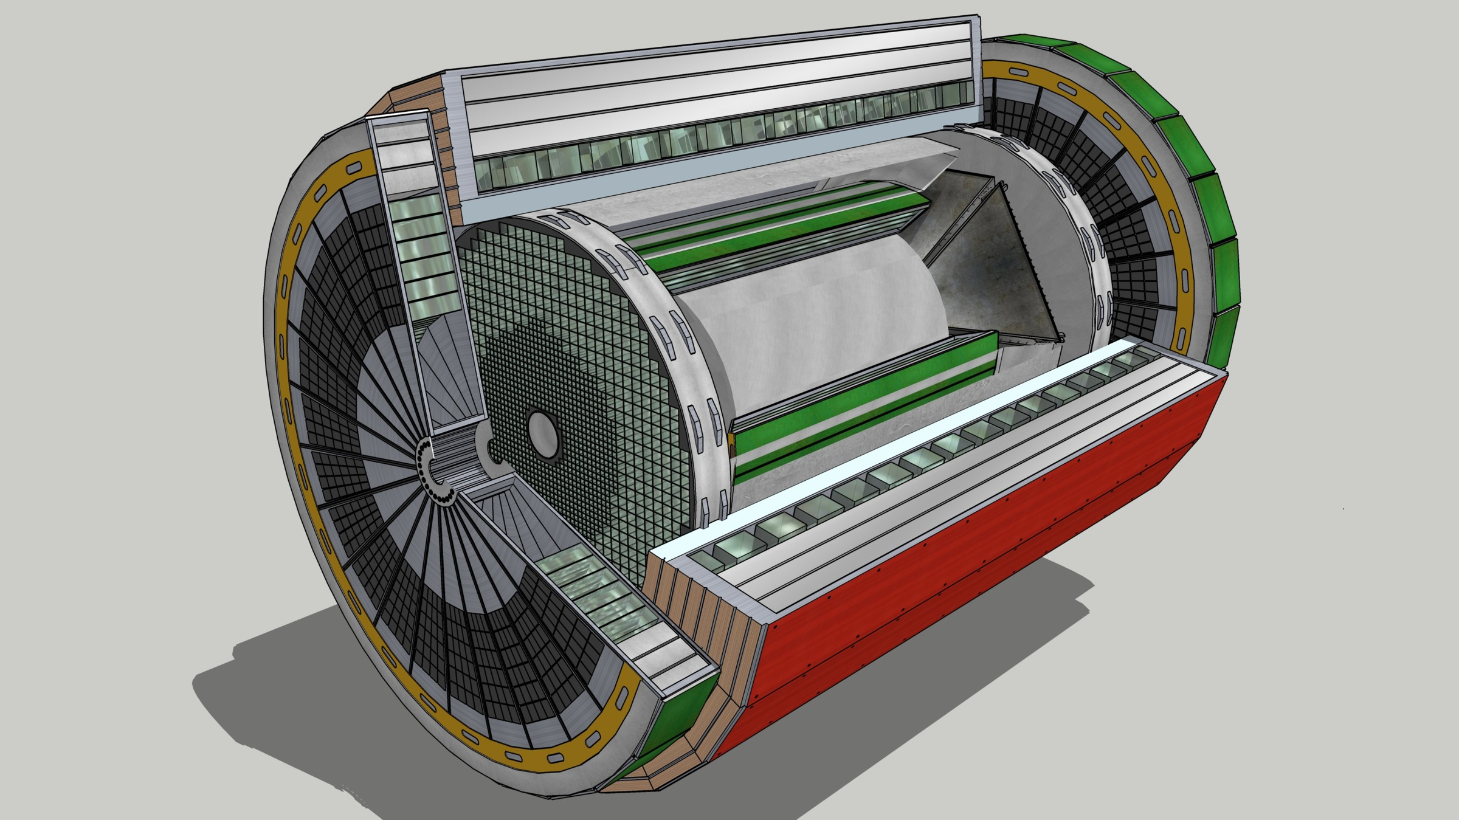
EIC Streaming Readout Architecture
Data
Configuration & Control
Power
Detector
FEB
(Front End Board)
FEP
(Front End Processor)
DAQ
(Data Acquisition)
Total
BW: O(100 Tbps)
BW: O(10 Tbps)
Global timing, busy & sync
Beam collision clock input
L ~ 100 m
fiber
ASIC
Goal: O(100 Gbps)
Fiber
Switch / Server / Link-Exchange:
Readout
Switch / Server: Processing
Switch / Server: Buffer
FEB
Storage
FPGA
Fiber
Monitoring
FEP
FEB
LVDS ~ 5m
Analog ~ 20m
Power Supply System
(HV, LV, Bias)
Cooling Systems

Slide 4
EIC Streaming Readout
FEB – Front-End Boards
  Custom designed for each detector and populated with ASICs, large magnetic fields.
  ASICs designed to process analog signals and digitization tailored to each type of detector technology. Data reduction (e.g. zero suppression) is desirable.
  Simplification of testing and calibration operations with triggered-mode configuration.
  Data transport via optical fibers to minimize cabling.
FEP – Front-End Processors
  Custom designed to process and aggregate data streams from multiple FEBs.
  FPGAs are dominant components on these PCBs.
  Algorithms reduce data flow (e.g., zero suppression)
  Data transport via optical fibers to minimize cabling.
Global Timing
  High speed and precision combines custom designed and COTS componentry.
  Provides synchronization of and clock distribution to the readout elements.
  Jitter better than 1 ps.
Network Switches/Servers/Computing/Link Exchange (FELIX)
  High performance COTS infrastructure.
  Enables further reduction of data flow prior to storage via sophisticated algorithms, e.g., ML and AI.
Radiation levels are much lower than at LHC. Studies are being performed to inform readout technology selection, however.

Slide 5
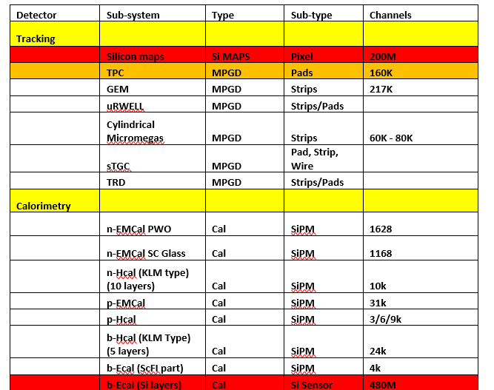
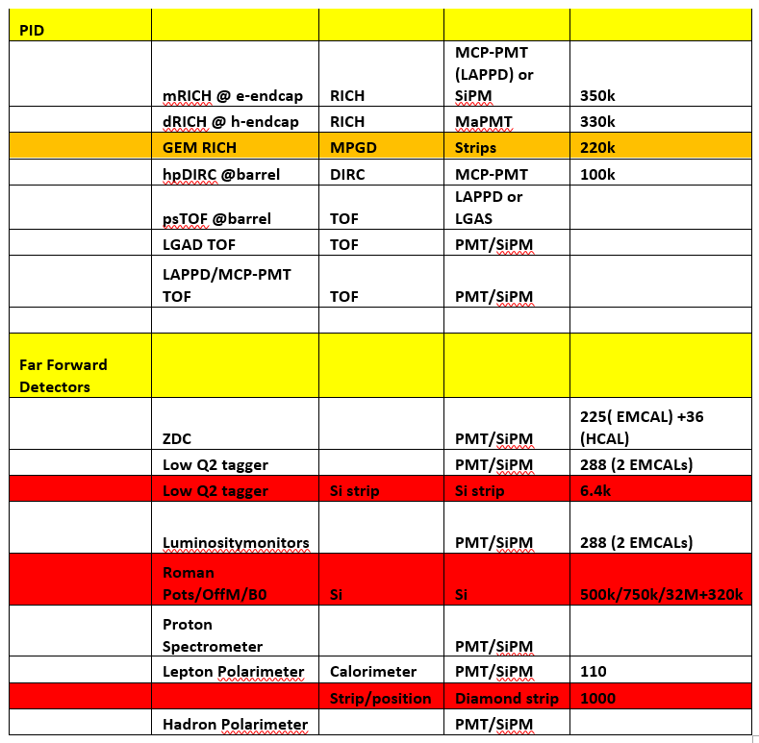
Readout Channels
Developed two documents summarizing the EIC readout requirements:
  EIC Readout Specification Matrix.xlsx – Detectors, channels, requirements spreadsheet.
  Development of the EIC Streaming Readout.doc – Roadmap to realization.
Two detector/sensor categories:
        MPGD
        Photon

Slide 6
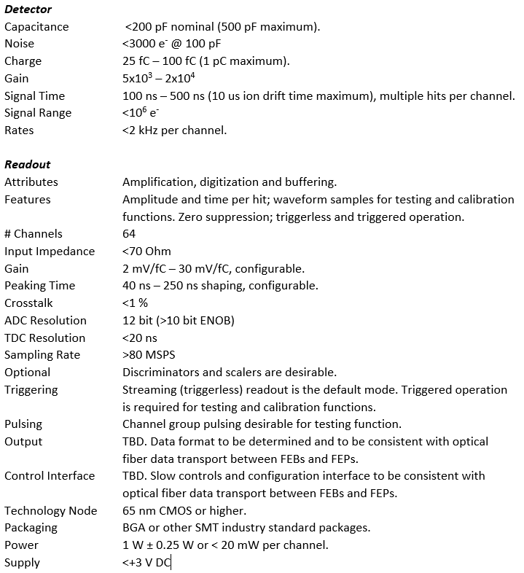
Specifications
Preliminary specifications for MPGD readout (ASIC)

Slide 7
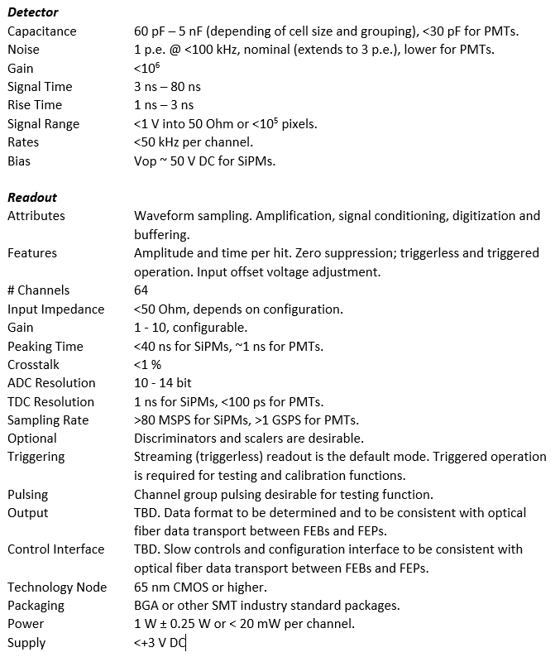
Preliminary specifications for photon sensor readout (ASIC)

Slide 8
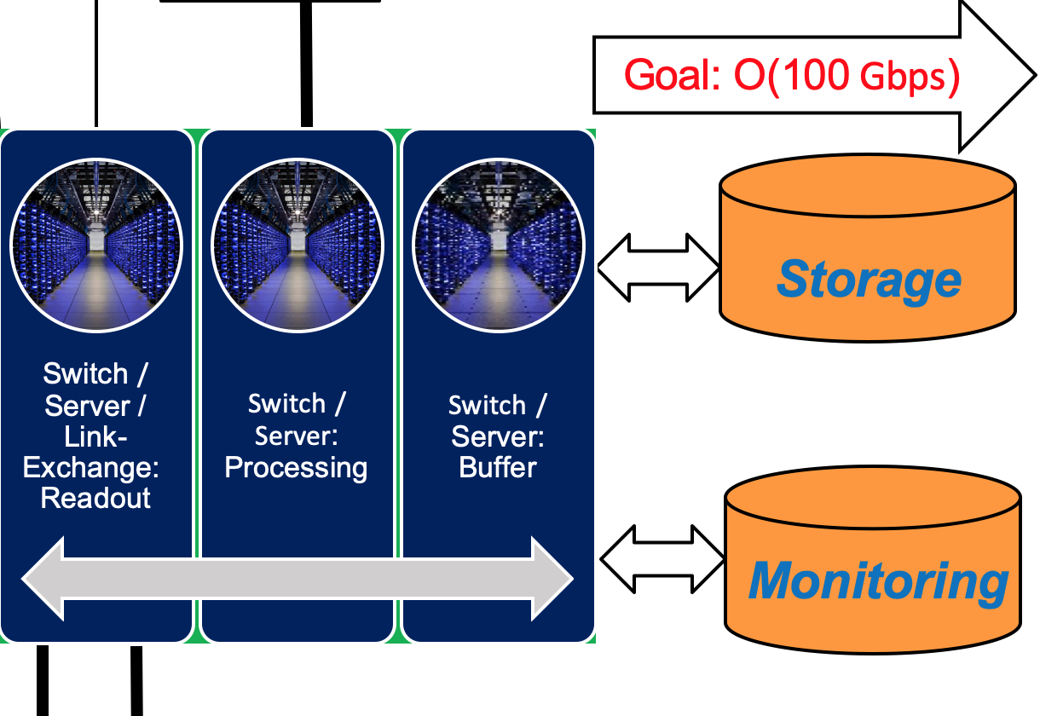
DAQ/Computing
While EIC event rates are are expected to be 500 kHz, much smaller cross sections and multiplicities for (e+p, e+A) collisions will make event identification and reconstruction more manageable in the online system.
  Machine (synchrotron) background levels still uncertain.
  Detector choices (e.g. dark noise rate) can also affect requirements.
A raw data rate to archival storage of the order 100 Gbps
  Includes background and noise estimates.
  Is still half the expected rates for sPHENIX.
  Possible higher rate in the event of excessive background and noise, which would require filtering.
Event reconstruction times for larger JLab experiments (GLUEX, CLAS12) are around 600 ms/event with current (2020) CPUs. Extrapolating to 2030 performances we expect a cluster of <300 nodes (128 cores/node) to be sufficient to support the 500 kHz interaction rate.
Assuming 28 weeks of running and 70% facility efficiency this translates into around 148 PB/year of raw data only.

Slide 9
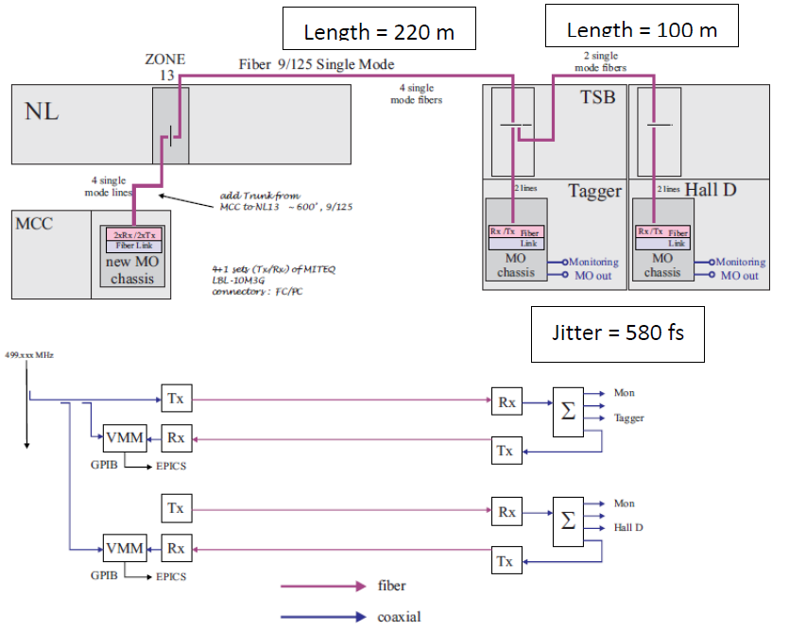
Timing
Using GlueX@JLab as an example:
RF Clock:
4 ns bunches.
580 fs Jitter, single-mode fiber.
Feedback channel for phase compensation.
Experiment Clock:
<4 ps jitter at DAQ crate level.
Multi-mode fiber, LVPECL.
Relative time measured via 25 ps TDCs.
Calibration prior to every run.
Bunch determination via 100 ps - 200 ps resolution scintillating detectors.
Timing performance at EIC will be more challenging.
Distribution and synchronization of front-end with 98.5 MHz with the EIC beam collision clock.
20 ps resolution detectors at EIC will require <1 ps clock jitter.

Slide 10
Outline of the EIC Needs
ASICs – Application Specific Integrated Circuits
  Design and/or Fabrication Services – e.g., MOSIS, TSMC, Global Foundries, etc. Multi-channel, low power, high speed. Qty. > 10,000 devices.
  Considering design re-use from existing ASICs (SAMPA, VMM, lpGBT, etc.)
Photon Sensors (SiPMs/MCP-PMT/MaPMT) – COTS. Qty. < 1 Million cells
Electronic components & PCBs – by consignment or turnkey fabrication and assembly services – e.g., multi-layer with ASICs, FPGAs, etc. Qty. < 1,000.
Cabling – Turnkey fabrication services of various types of cables and optical fibers (COTS) and per supplied specifications. Cables must meet a minimum of UL CL2 specifications. Qty. > 1,000.
Power Supplies – Multi-channel, Low Noise, Floating, Modules:
  Low Voltage (LV) - < 15 VDC, 5 A – 10A range per channel. Qty. > 1,000.
  Bias - < 100 VDC, mA range per channel. Qty. > 10,000.
  High Voltage (HV) - < 8 kV, mA range per channel. Qty. > 1,000.
Racks and Cooling – COTS. Qty. < 100.
Switch/Server/Computing – COTS. Qty. < 100.

Slide 11
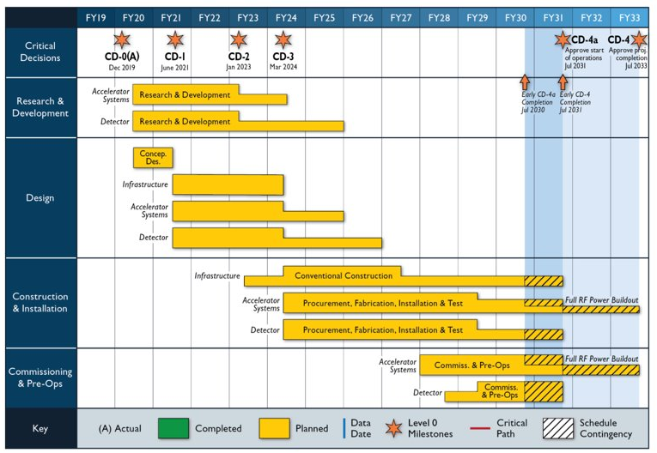
Timeline
Construction and Installation for Electronics & DAQ/Computing:
March 2024 – March 2028
Construction and Installation includes procurements and deliveries and are initiated at different times of this phase.

Slide 12
Summary
The EIC community (proto-collaborations) is currently formalizing proposals for the EIC detector implementation. Selection is expected in early 2022.
We have been working on a streaming readout & DAQ design roadmap, following an aggressive schedule and building upon Yellow Report work. Inputs and suggestions are appreciated.
There is potential flexibility in many of the elements for the EIC electronics and DAQ/Computing architecture.
  Early focus has been on specifications for detectors and ASICs (and their integration).
  Front End Processing and DAQ/Computing stages will benefit from ongoing experiments and from new commercial technology developments.
The EIC User community is growing internationally, and you will be an invaluable resource for input on design and implementation. We hope to benefit from your experience and on-going work.
Thank you for your help!

