Slide 1
Coupled-Bunch Feedback Status
Jan Paszkiewicz
PS LLRF Meeting, 11/08/2021

Slide 2
Background on Coupled-Bunch Feedback
Frequency-domain coupled-bunch feedback system
Measure sidebands of each frev harmonic of the beam spectrum.
Remove f_{rev} carrier to avoid excessive voltage demand from the Finemet cavity.
Mirroring of spectrum: USB of h20 → LSB of h1, etc.
10 signal processing channels spread over 1TFB boards.
Cavity feedback
Implemented in pre-LS2 firmware but not used.
Measure gap return signal around revolution frequency harmonics and feed back at the same frequency.

Slide 3
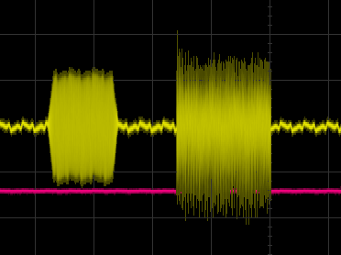
Overview of new firmware
Implemented acquisition of downconverted sidebands.
10 kHz sample rate, 8x65536 sample memory, ie 4 IQ channels for 6.5s
Data saved to SRAM chips on boards.
Implemented control of gains using functions.
Uses Nathan’s FGC core.
Allows ramping of feedback gains, excitation followed by feedback.
Reduction in resource usage.
Introduce downsampling to long CIC filters to reduce memory requirements.
Timings now treated in firmware
Implemented using analogue RF switches previously.
Simplified rack cabling.
Example CBFB output showing excitation and feedback gains controlled by functions.
IF BW = 100 Hz
IF BW = 10 Hz

Slide 4
DSP Channel Block Diagram
sample rates: 30 MHz 7.5 MHz 468 kHz 10 kHz
Cavity feedback enable flag
Complex gain
Bit shift register
Cavity return
IQ conv.
1st order IIR LPF
CIC
↓4
Complex multiply
CIC
↑4
50 MHz clock domain
h_{out} register
CIC
↓50
Acq
SRAM
Σ
IQ conv.
Out
h_{out} register
IQ conv.
1st order IIR HPF
CIC
↓64
Complex multiply
Σ
CIC
↑64
Beam
h_{in} register
Complex gain
DDS sin & cos
Excitation and CBFB enable flags
Sideband swap register
Bit shift register

Slide 5
Gain Scaling Block Diagram
Gain source register
Delay registers
f_{rf_clk}
Gain magnitude registers
Feedback phase registers
Real gains
Multiplexed CORDIC
Imaginary gains
FGC
Freq
DDS frequency register
Excitation DDS
Sin
Similar gain scaling scheme for CBFB and cavity feedback gains.
Amp
DDS amplitude register
Cos
Gain source register

Slide 6
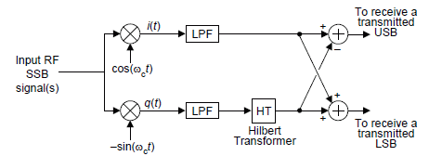
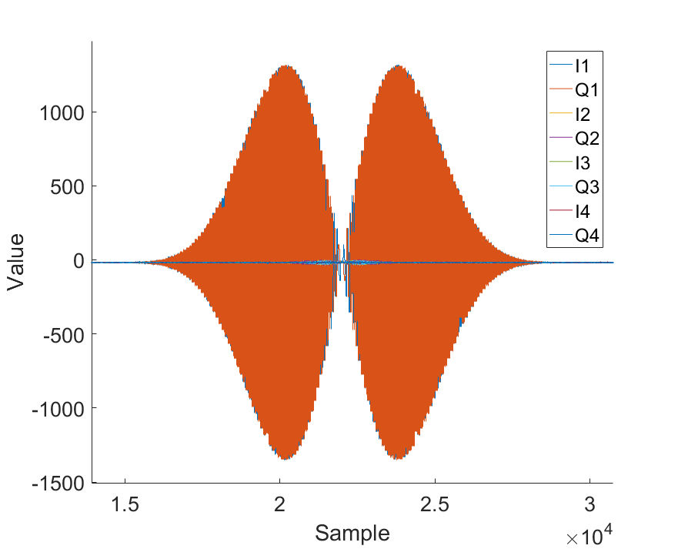
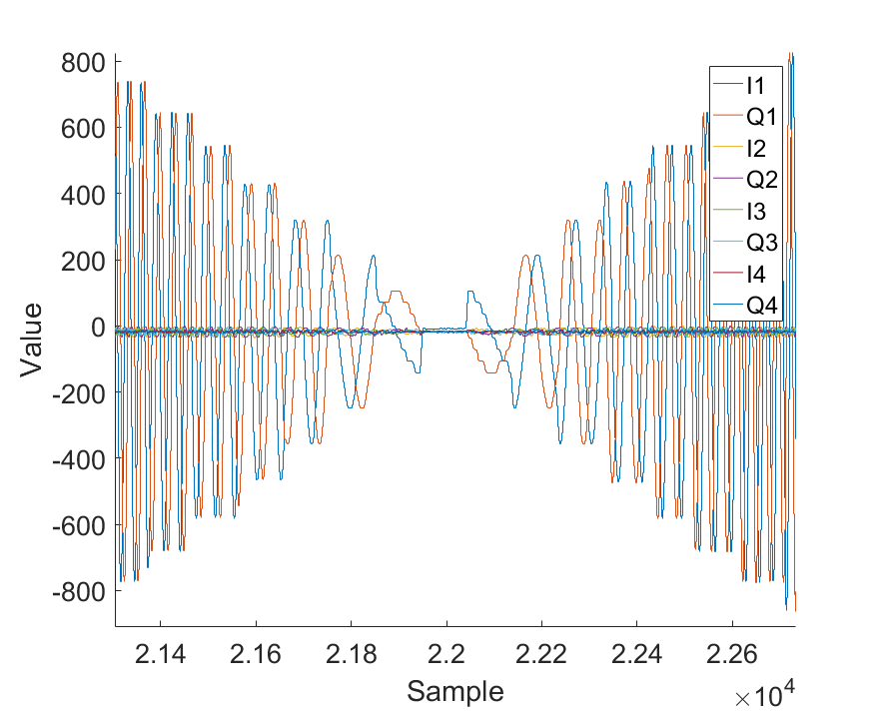
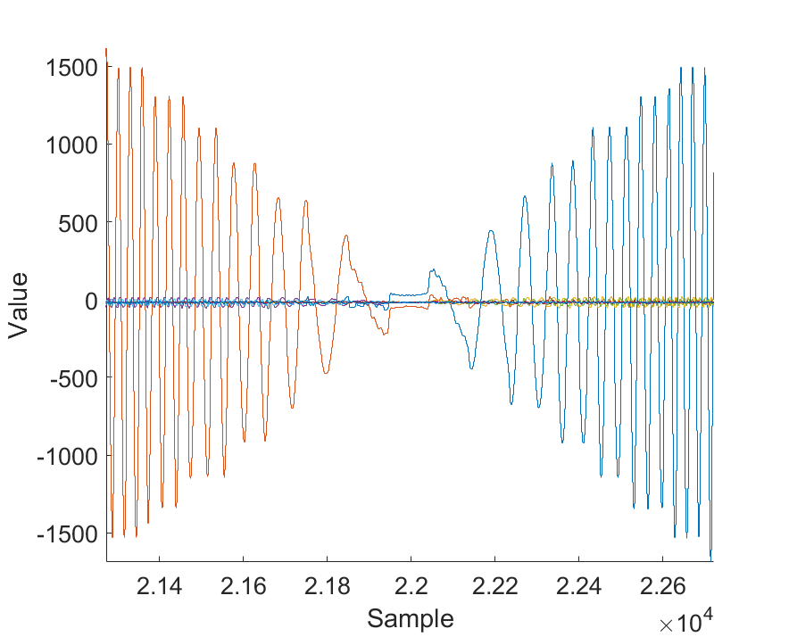
Acquired Data Examples and Processing
Data sampled after high-pass filter to remove f_{rev} harmonic.
Single-sideband demodulation can be done in post-processing.
Hilbert transform has very long delay (~1/4 of synchrotron period) so unlikely to work for a feedback.
Sideband magnitudes shown in further slides.
Frequency sweep from VNA:
Zoomed in, raw IQ data:
With SSB demodulation:
LSB USB

Slide 7
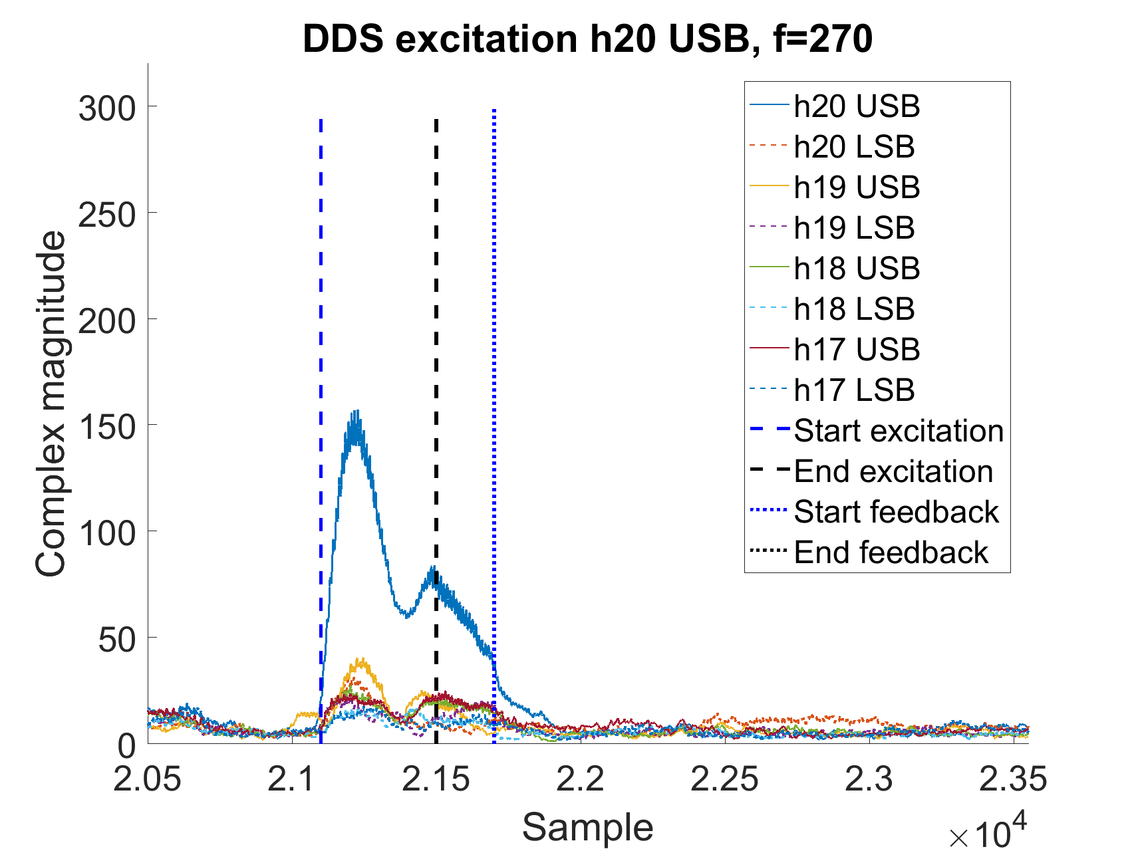
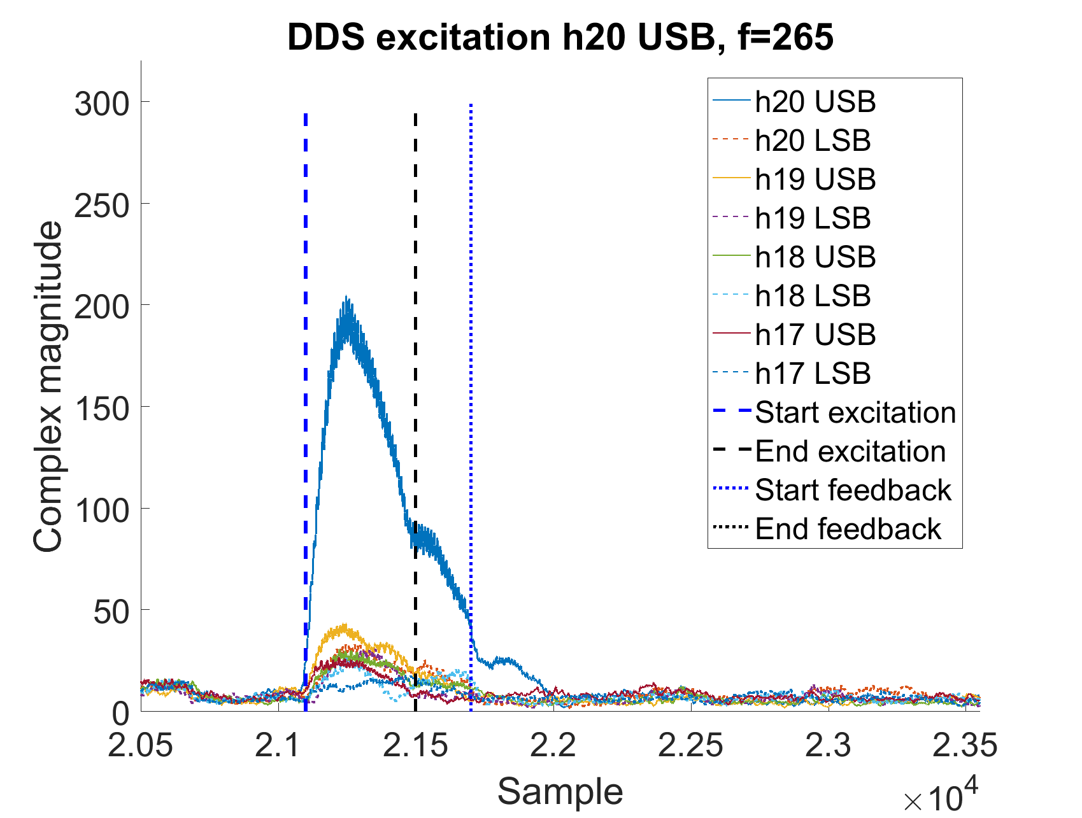
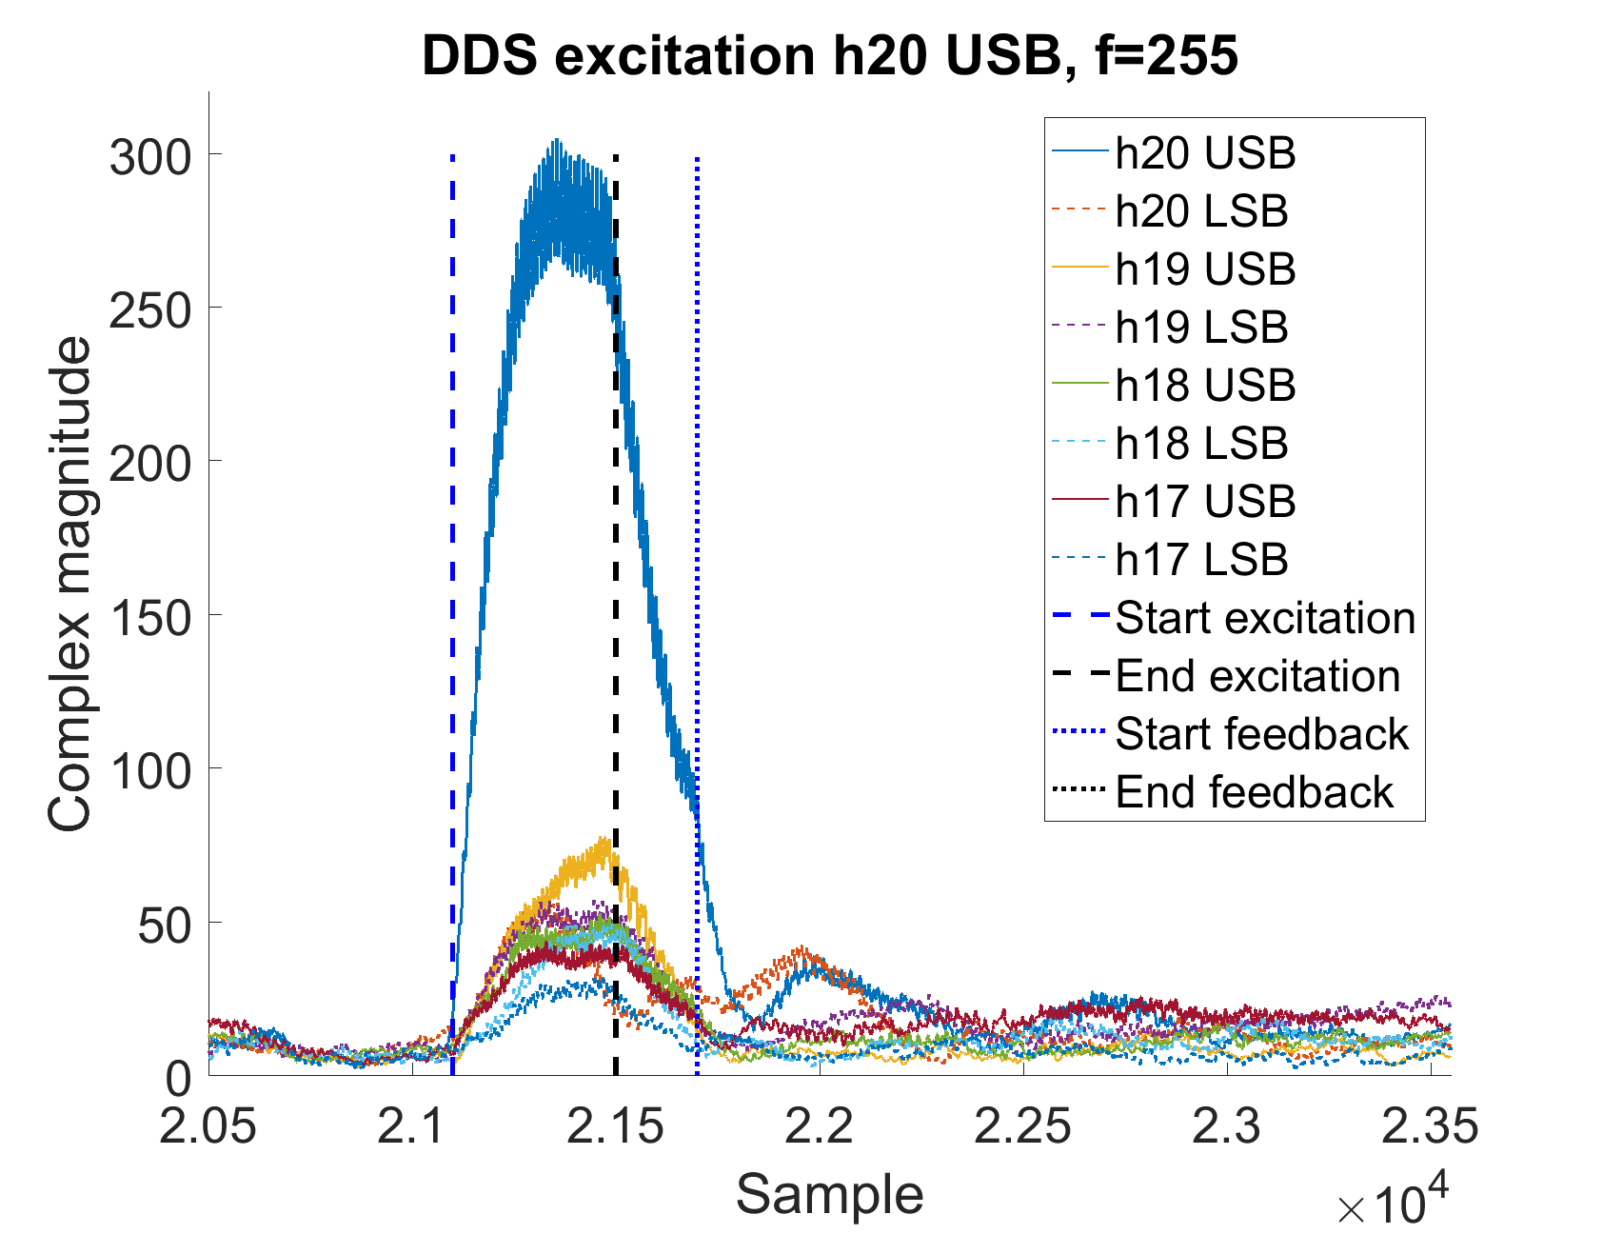
Excitation Frequency Scans
DDS combined with acquisition allows beam studies to be done.
For example: measurement of the response of the beam to excitation at different frequencies.
In this case, an excitation was made on h1 and measurement done on h20.
Excitation for 40 ms, natural decay for 10 ms, then damping with feedback.
Beat frequency decreases as the excitation frequency approaches the synchrotron frequency.

Slide 8
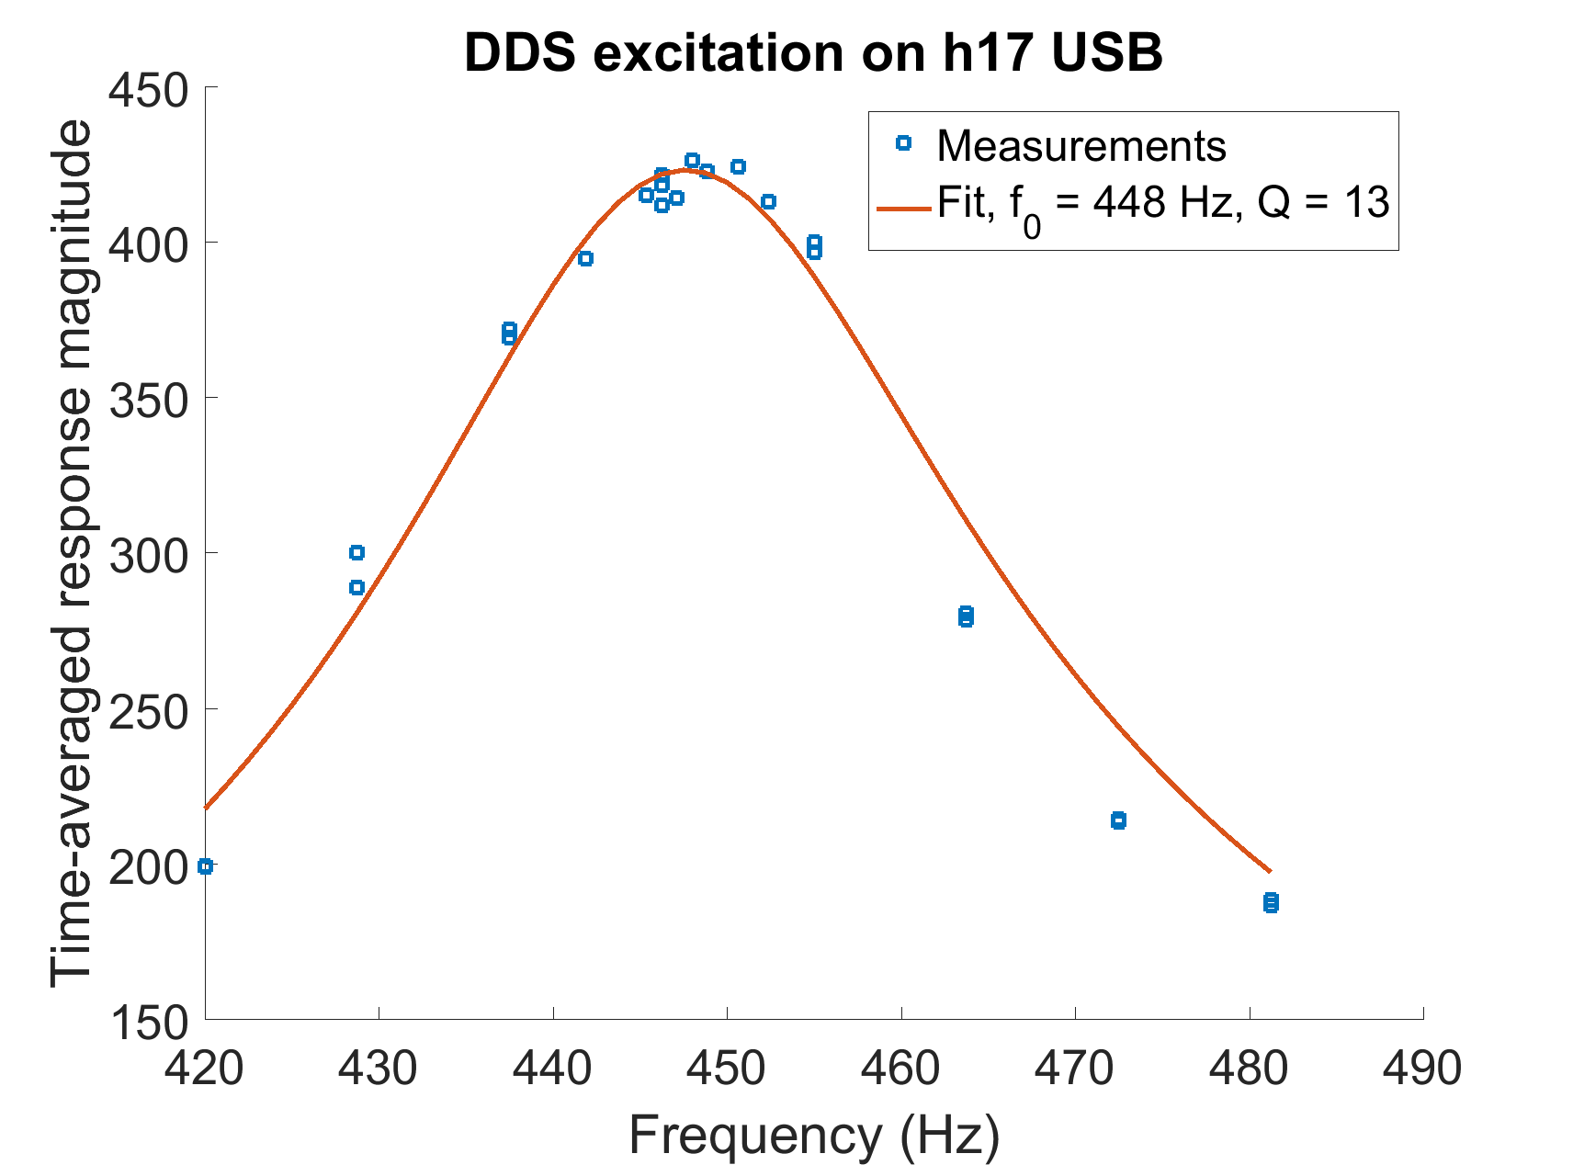
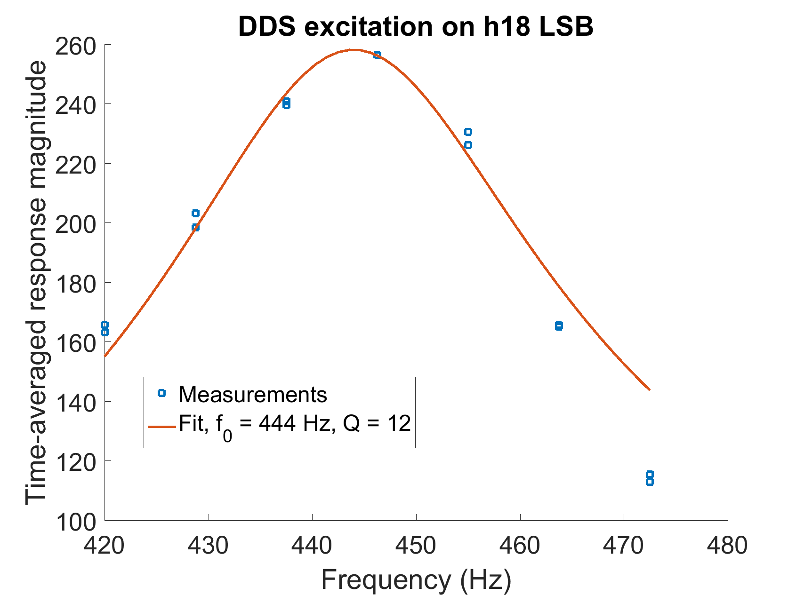
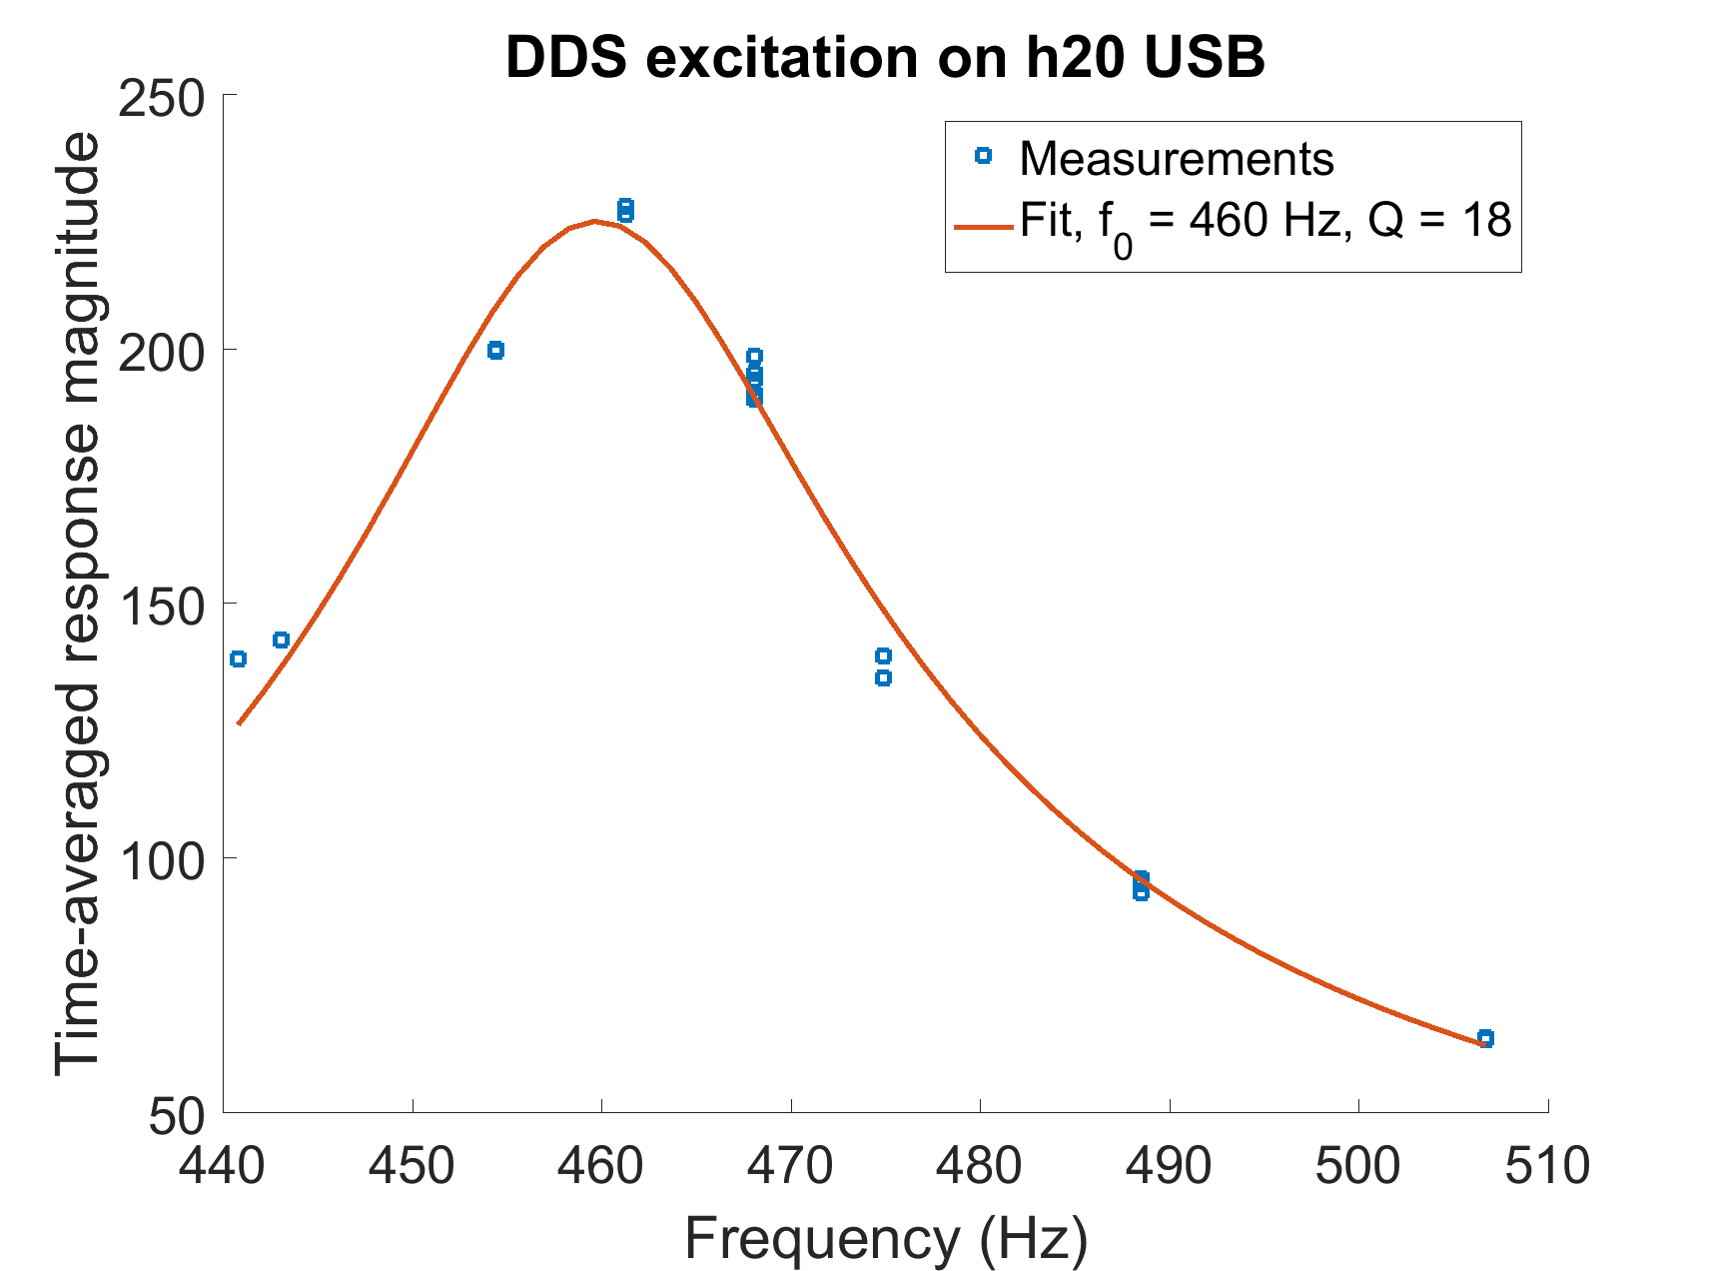
Excitation Frequency Scans
Time-averaged beam response plotted vs. frequency for a few different harmonics.
Lorentzian fitted to measured data to get synchrotron frequency and Q:

Slide 9
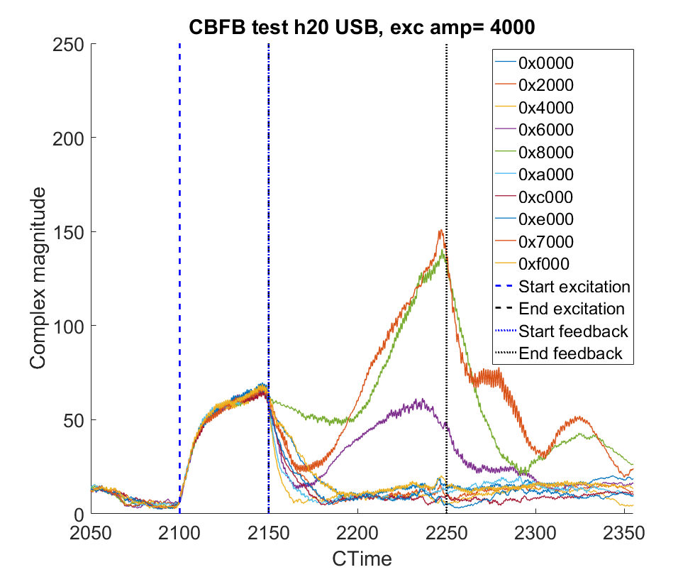
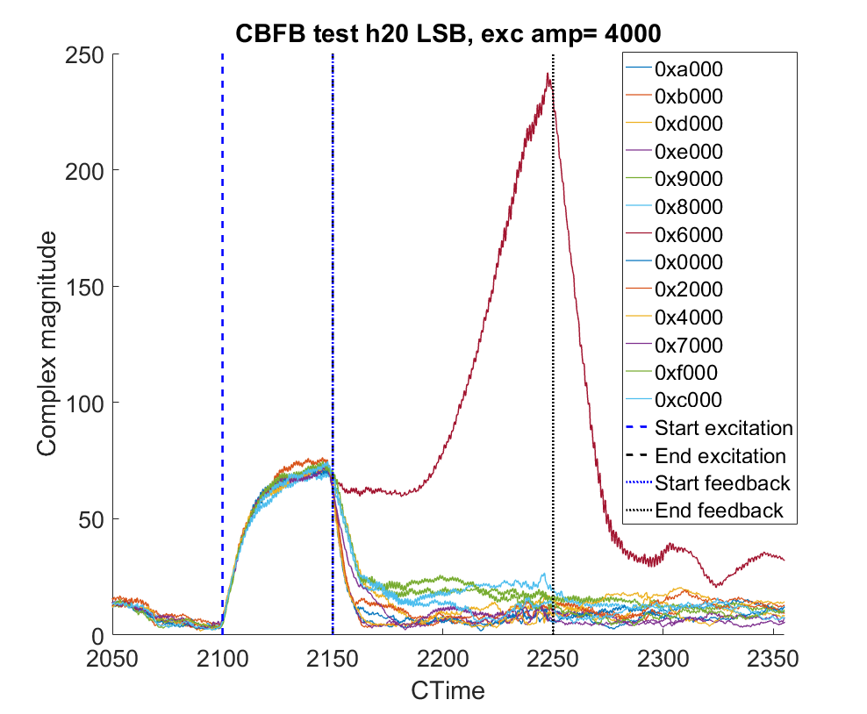
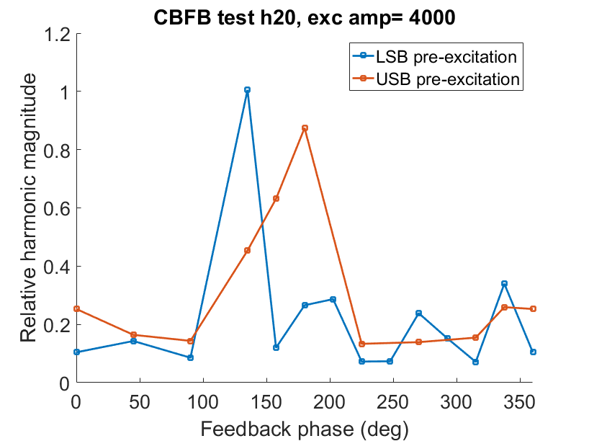
Tuning: Phase Scan Methodology
Excite coupled-bunch oscillations using the DDS between 2100 and 2150 ms (Left: excitation on USB, middle: excitation on LSB. Plots show total baseband magnitude vs time for various feedback phase values).
Activate feedback between 2150 and 2250 ms.
Calculate ratio of baseband magnitude during feedback to baseband magnitude during excitation for different phase values. Lower values indicate stronger damping.

Slide 10
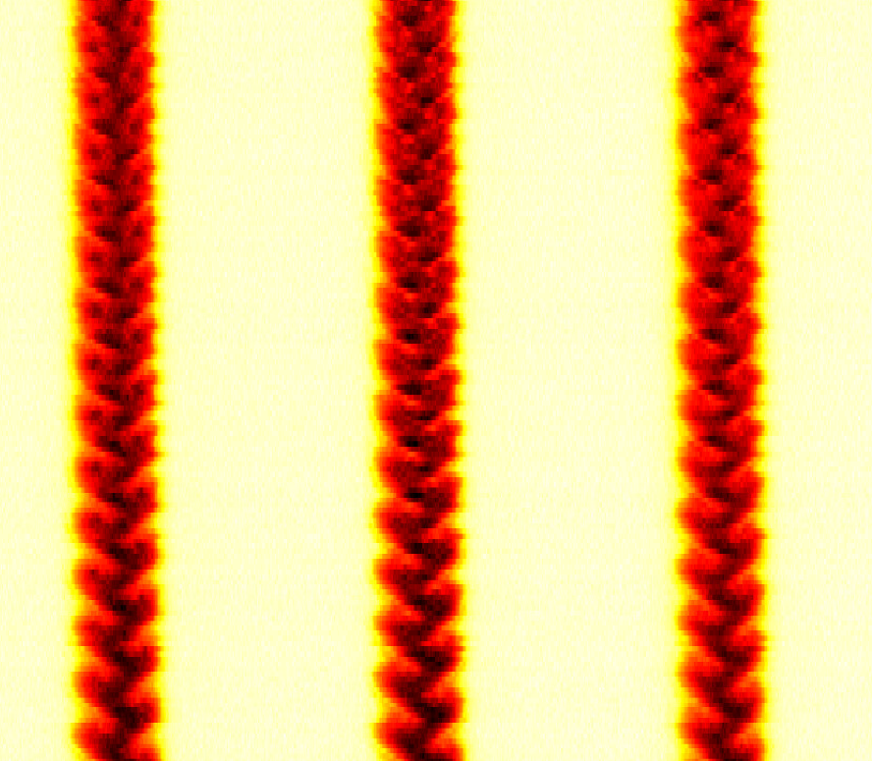
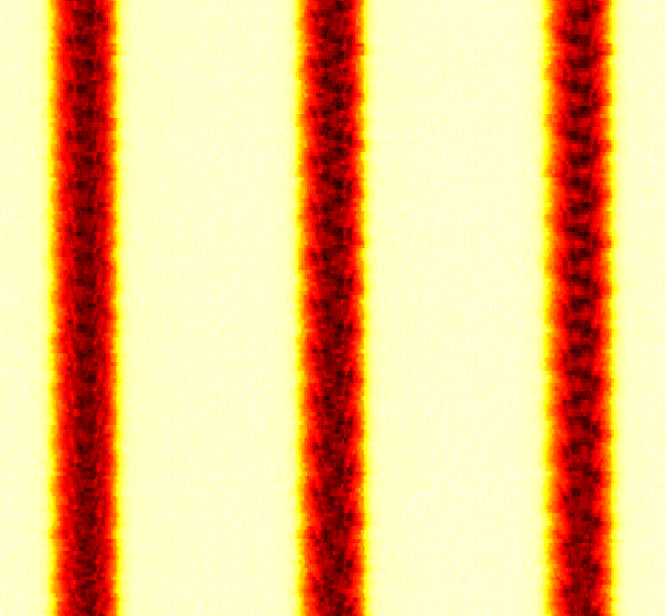
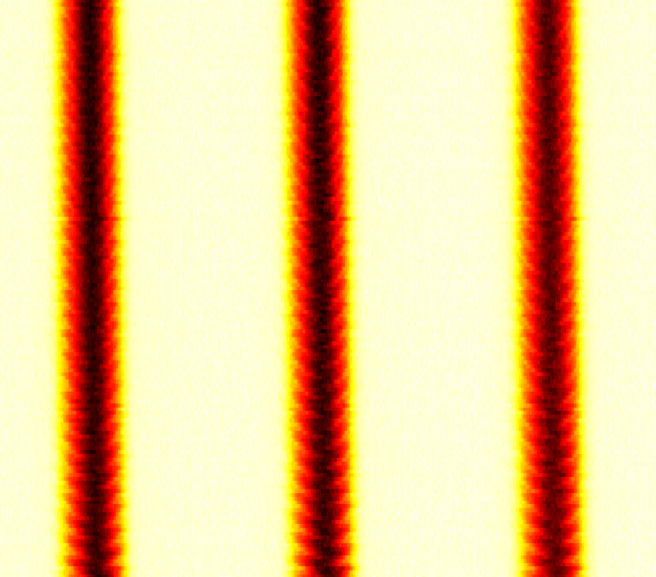
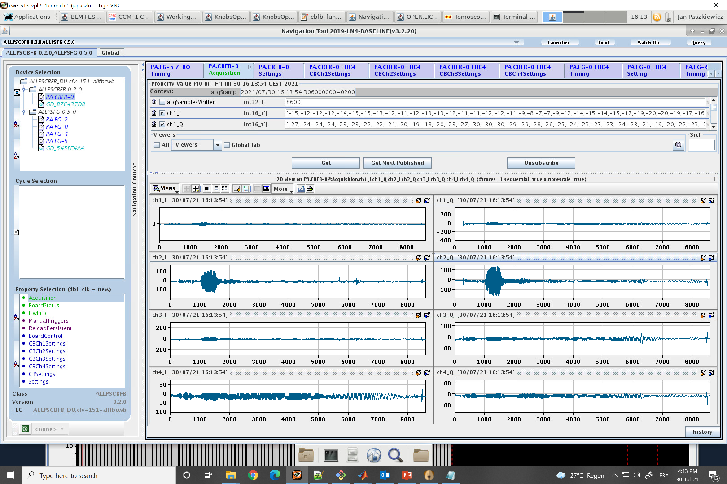
Tuning: Examples with Tomoscope Plots
Amplitude 4000
2140-2171 ms
Amplitude 4000
2250-2281 ms
Amplitude 1600
2140-2212 ms
Amplitude setting of 4000 used for the phase scans.
Demonstrate that the feedback does not self-excite even with very strong oscillations.
Nonlinear oscillations seen in tomoscope plot. Signal also bleeds over into other harmonics in internal acquisition.
Right plot: excitation amplitude of 1600 results in sinusoidal oscillations (linear behaviour).
Raw IQ data from FESA class.

Slide 11
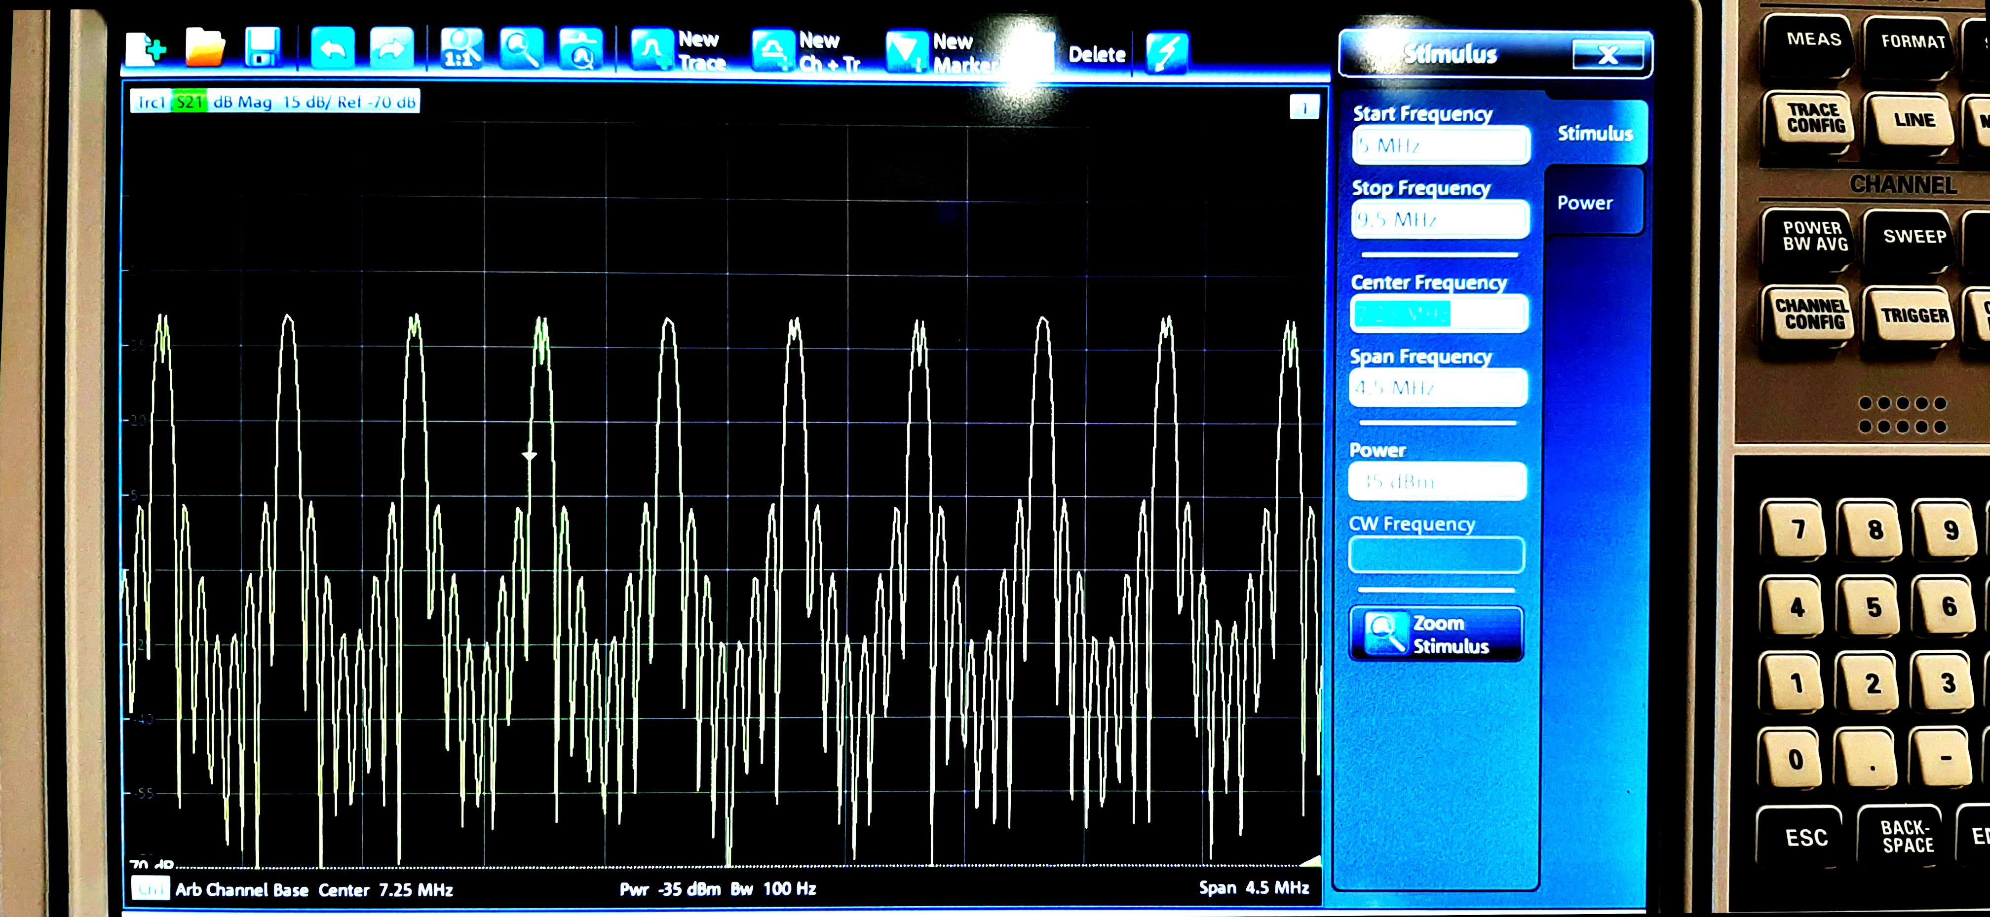
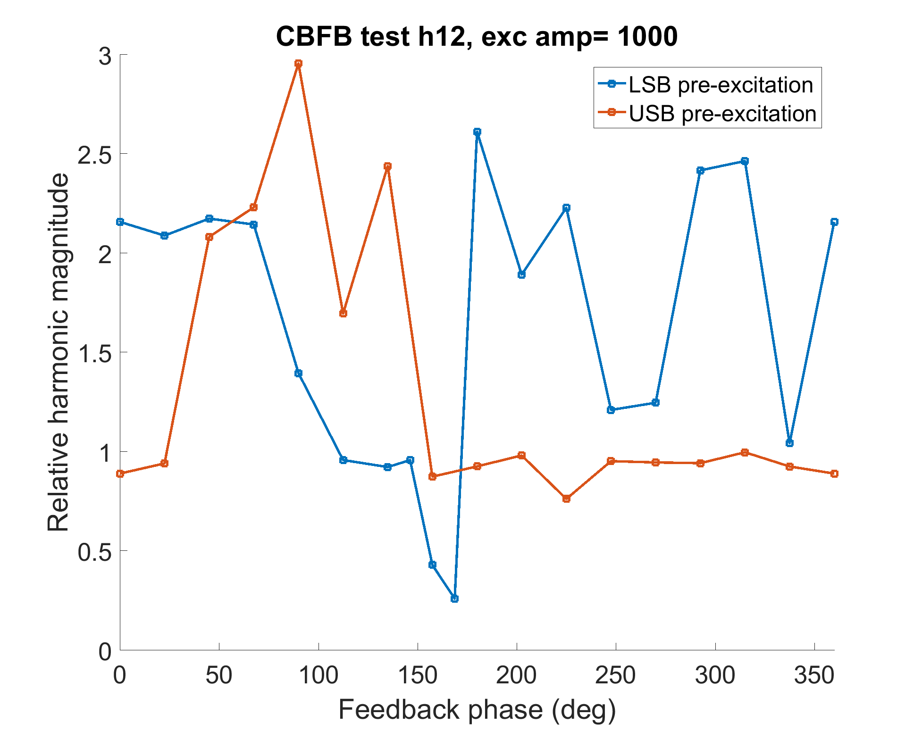
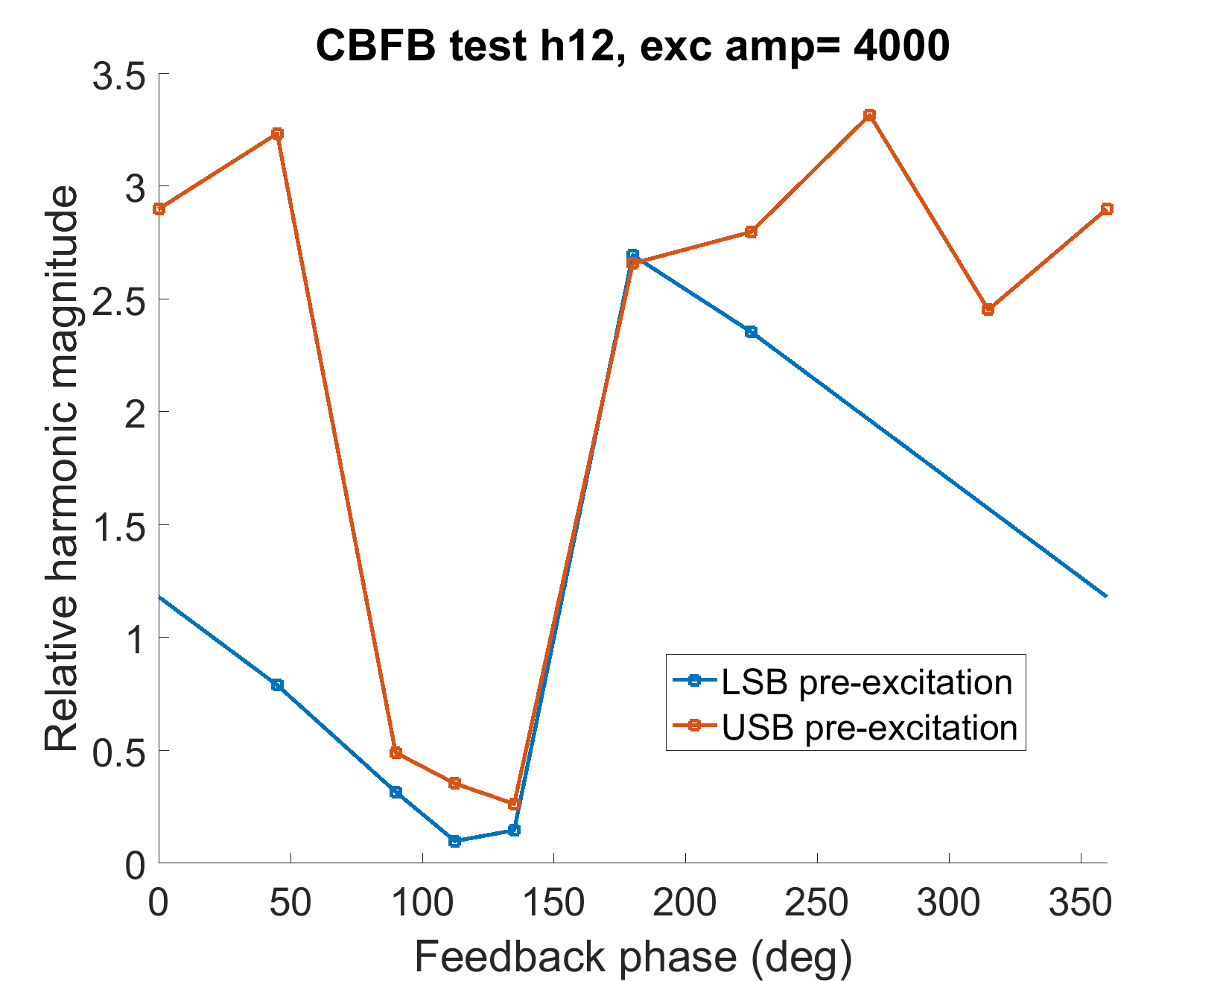
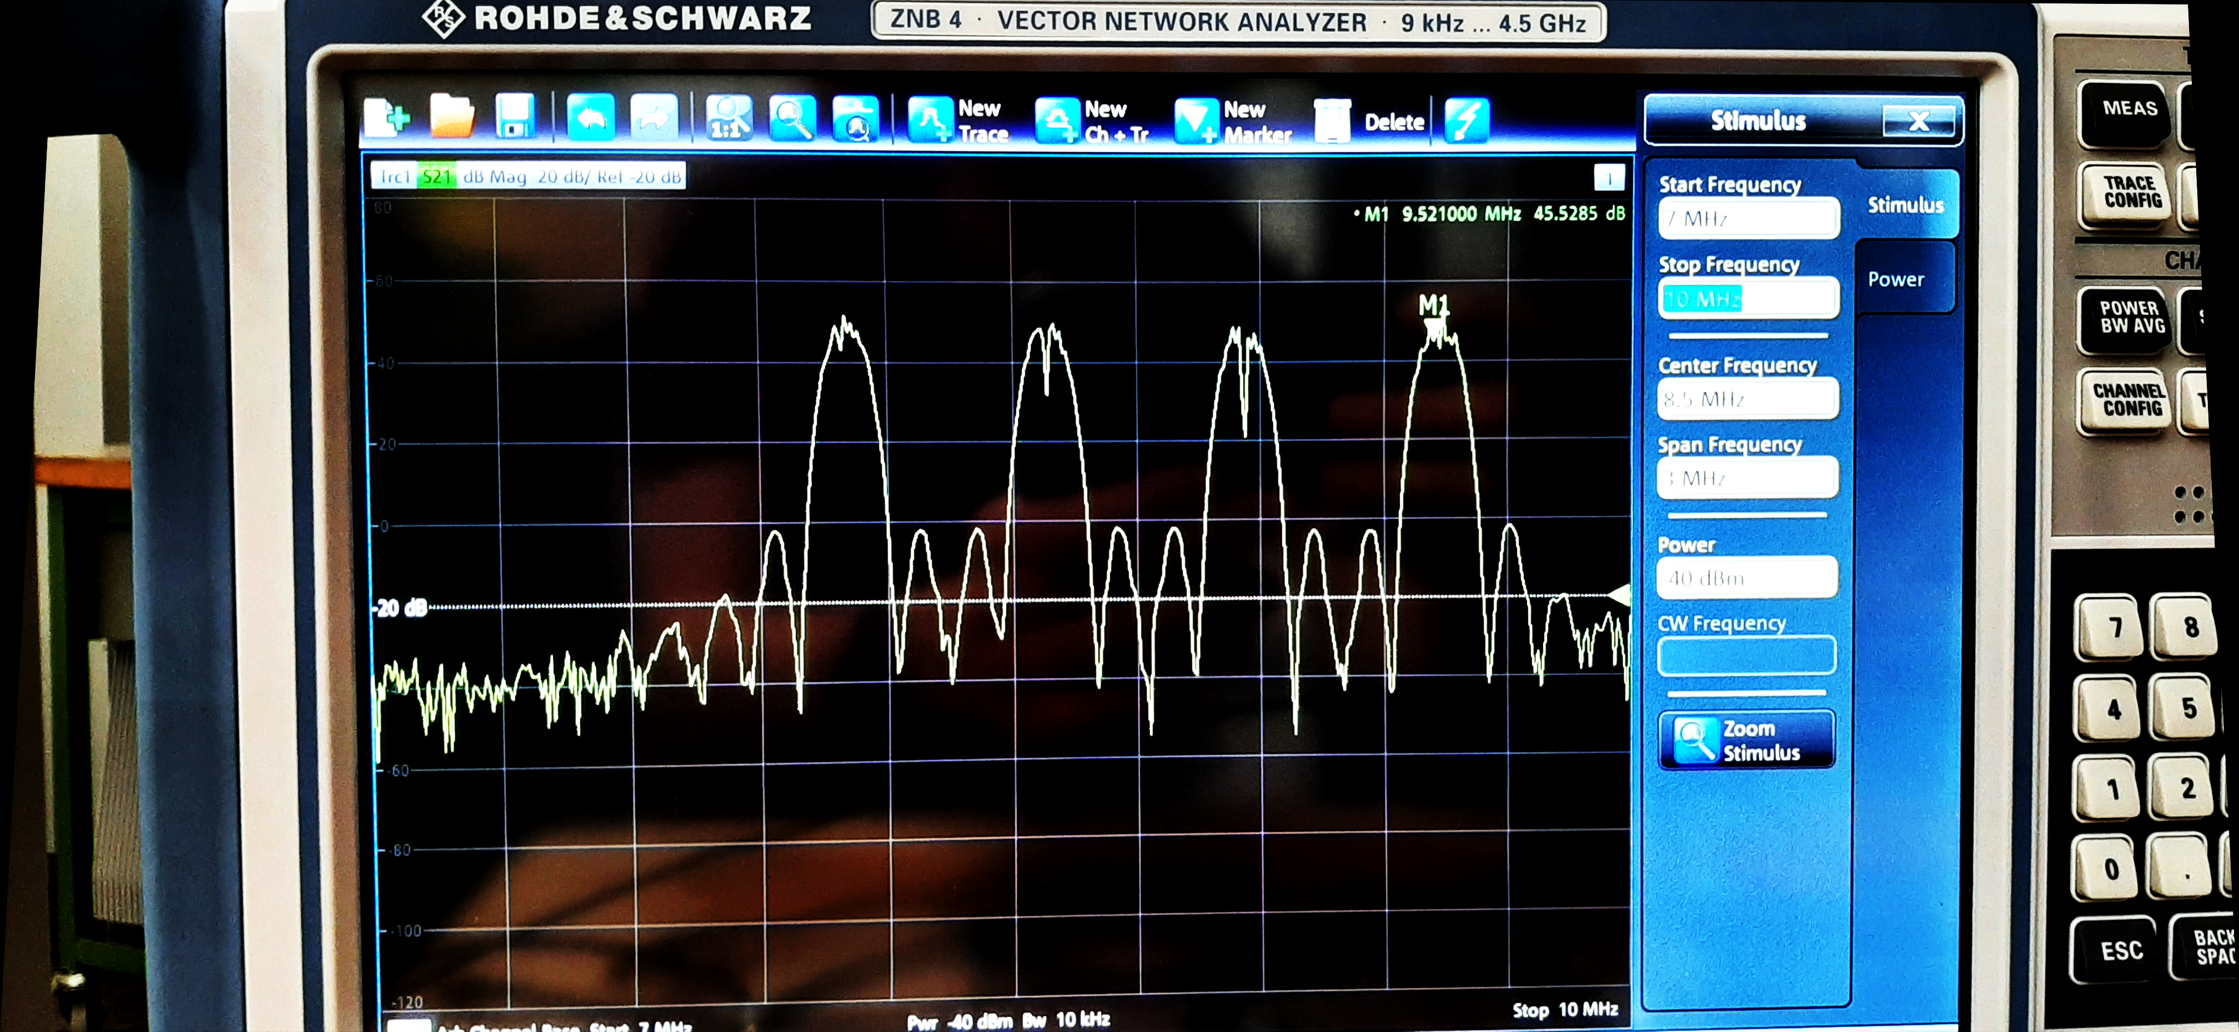
Reduction of Loop Delay
Some channels were difficult to tune with this method. Loop delay was suspected to be the problem.
Parameters of CIC filters modified to increase bandwidth and reduce delay.
N=4, R=64, M=8 → N=2, R=64, M=4
Pre-LS2 firmware delay : 25.6 μs; new firmware : 68.2 μs; reduced delay: 17.1 μs
VNA scan with long delay:
New firmware with long delay:
New firmware with reduced delay:
VNA scan with reduced delay:
No satisfactory phase value.
Strong stabilisation.

Slide 12
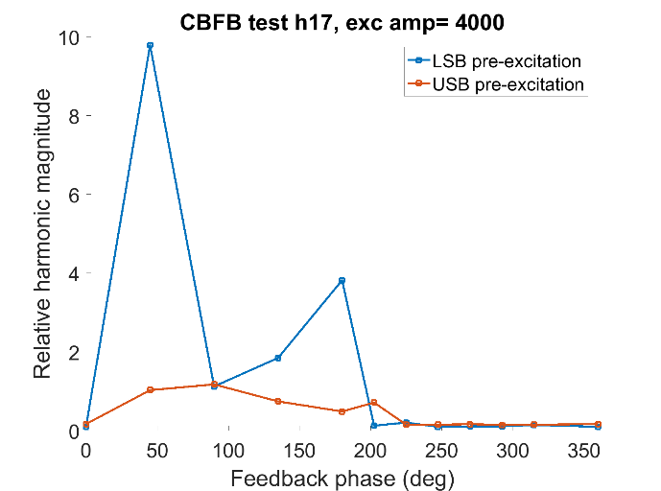
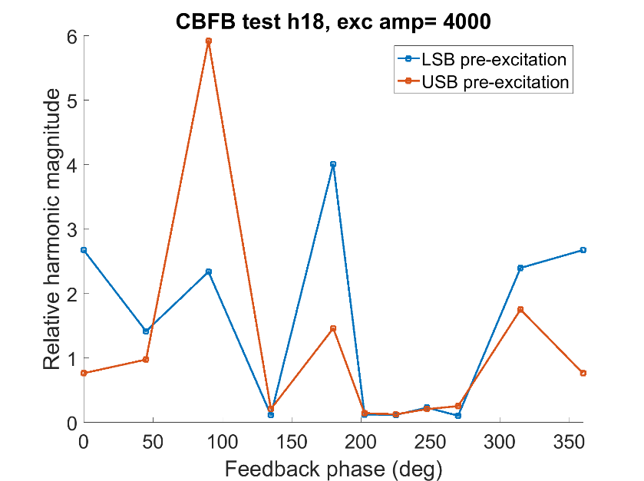
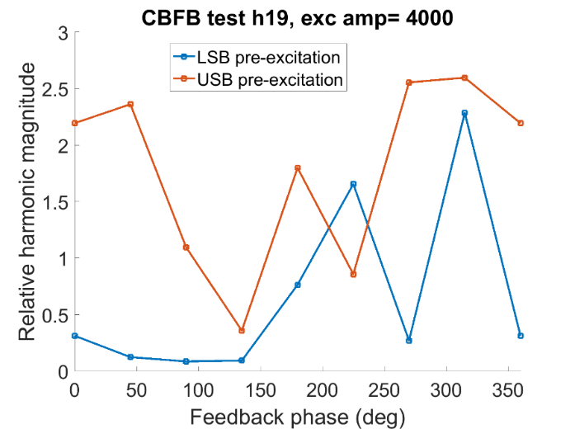
Tuning: Phase Scan Results
Repeated this for all harmonics with excitation amplitude 4000, with the reduced-delay firmware.
Final feedback phase chosen in the middle of the stable range for each channel.
Arrows indicate selected feedback phase for each channel. Plots for first four channels shown.

Slide 13
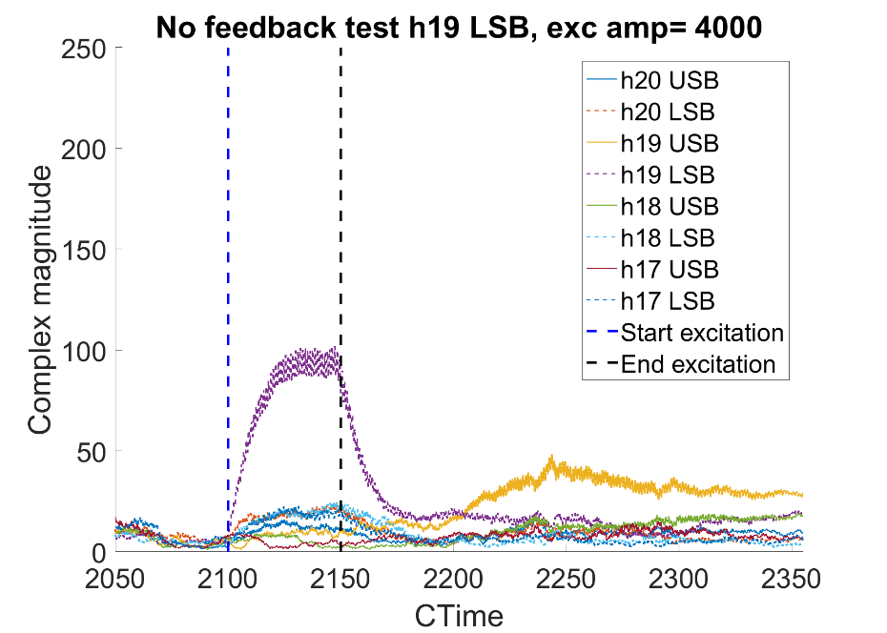
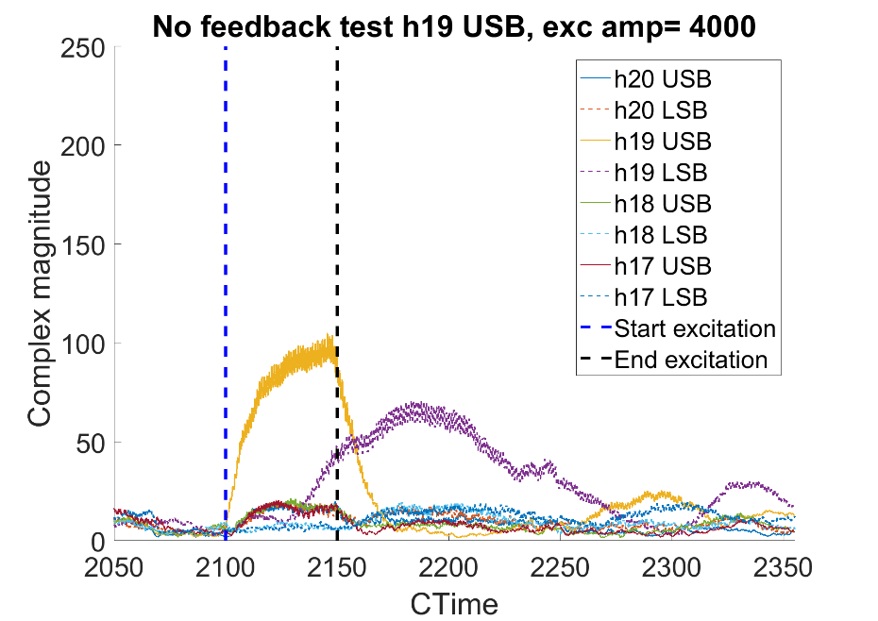
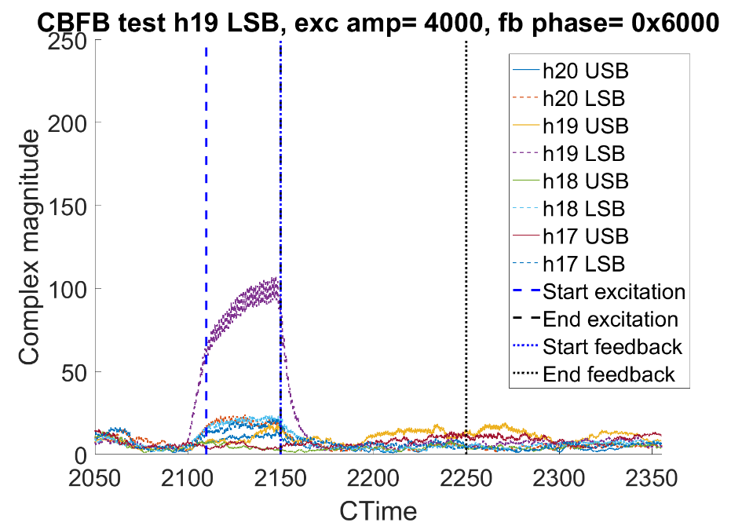
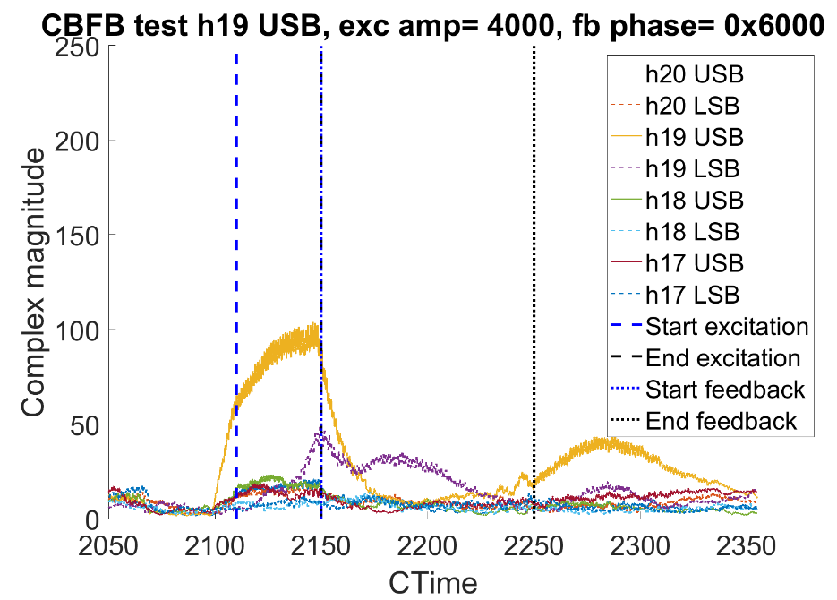
H19:
Phase: 0x6000
Bit shift: 10.
Excitation on LSB:
Excitation on USB:
Excitation with no feedback:
Excitation followed by feedback:

Slide 14
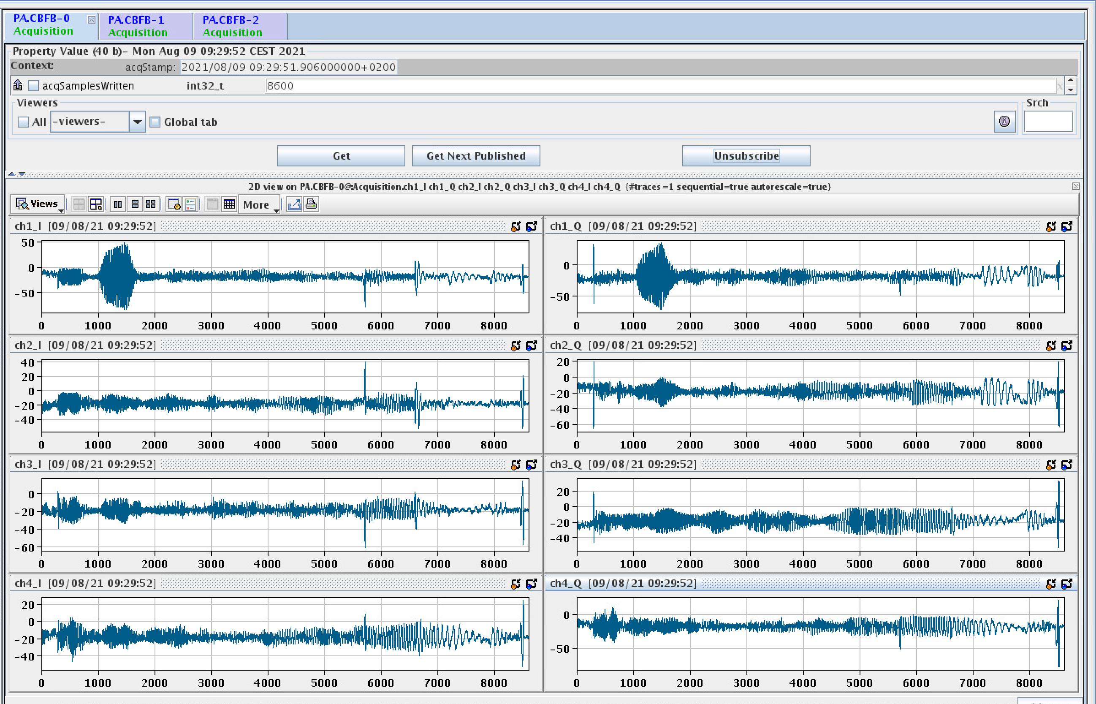
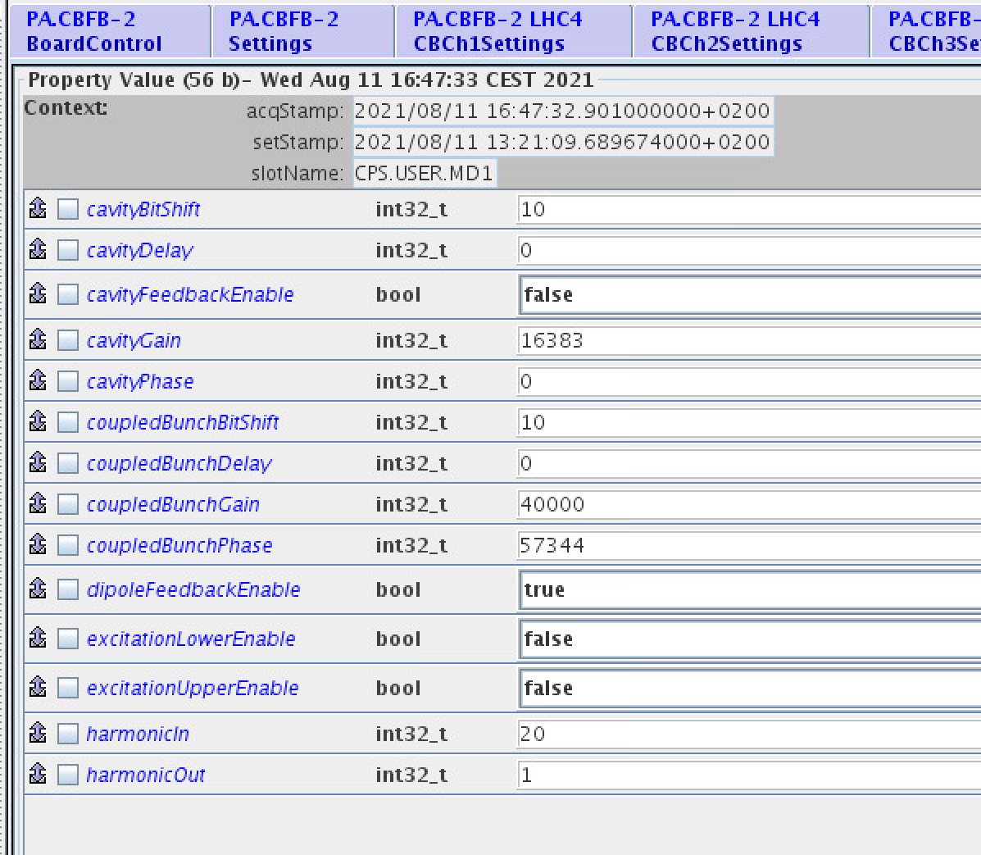
FESA Class
Boards currently operational with FESA class.
Multiplexing available for DSP-related parameters.
Acquisition data readable, currently raw IQ data only.
Possibility of implementing single-sideband demodulation?
Timing of data readout needs revisiting to allow readout of all 10 channels in real time.

Slide 15
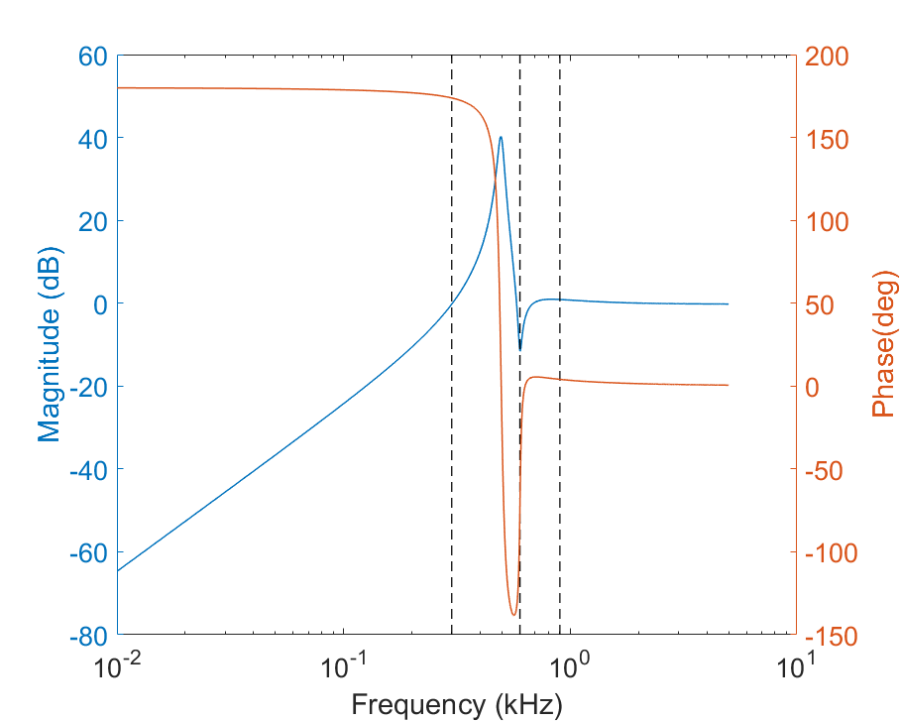
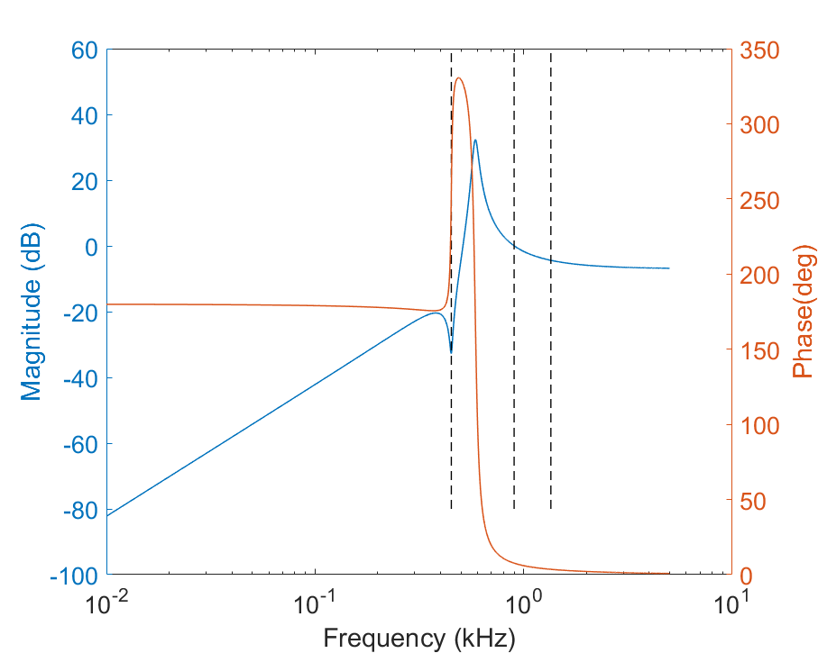
Quadrupole Mode Tracking Filters
Discussed in previous talk: put poles in between synchrotron harmonics.
High Q: ‘compresses’ phase response so group delay is high over a small range of frequencies, but low otherwise.
Produces peak in magnitude response, but no signal expected there.
Filter needs to track synchrotron frequency during ramping.
Specification for dipole mode filter:
Specification for quadrupole mode filter:

Slide 16
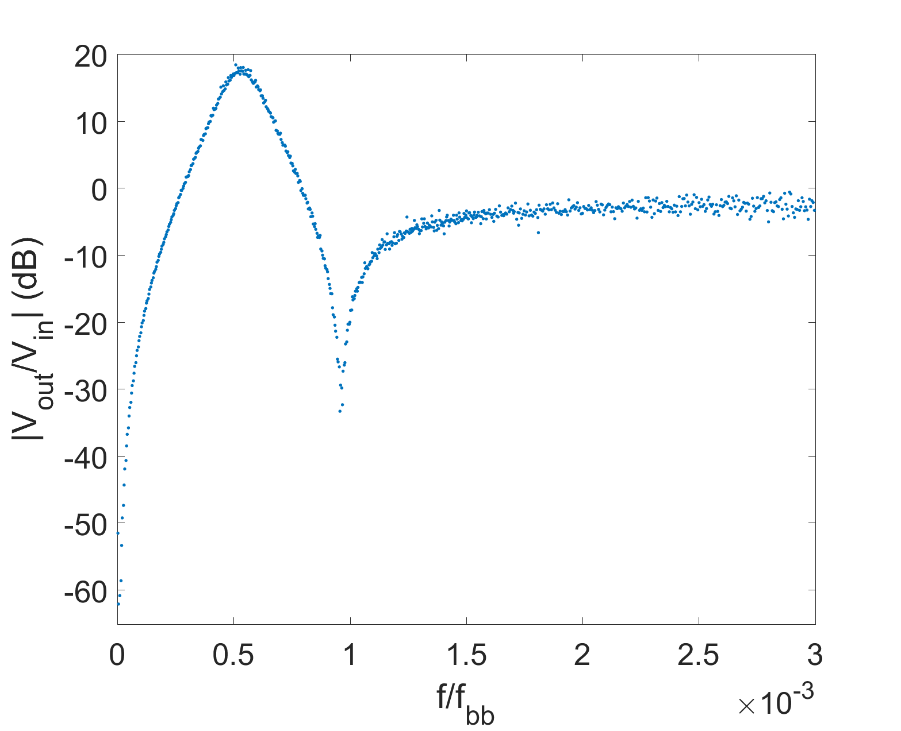
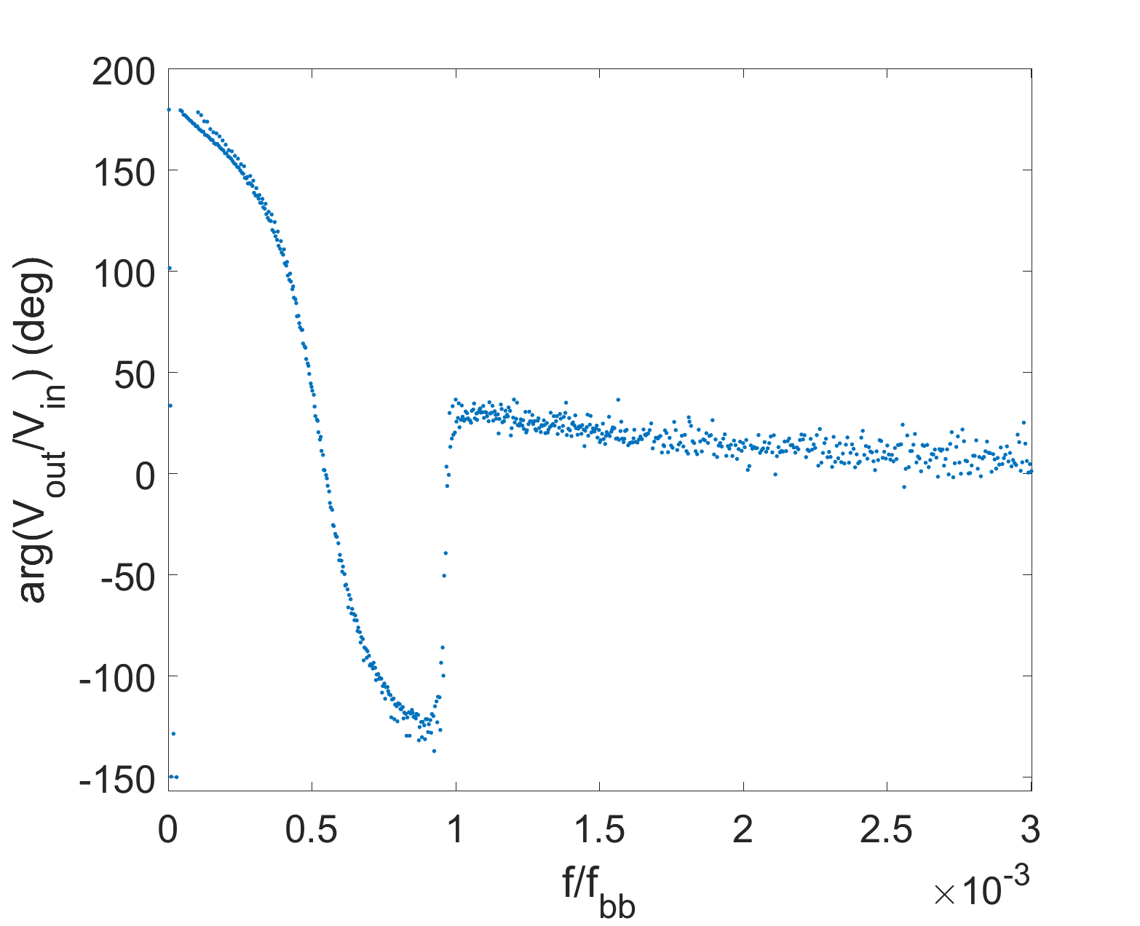
Quadrupole Mode IIR Filters
ModelSim simulation of quadrupole filter:
As in previous talk: put poles in between synchrotron harmonics.
High Q: ‘compresses’ phase response so group delay is high over a small range of frequencies, but low otherwise.
Produces peak in magnitude response, but no signal expected there.
Filter needs to track synchrotron frequency during ramping.
Plan to implement using a sequential DSP core.
2-stage biquad filter: ~40 multiply-accumulate operations per sample per harmonic.
Performs well in RTL simulation.
Details of coefficient sweep still under evaluation.
Notch at dipole frequency
Low delay at quadrupole frequency

Slide 17
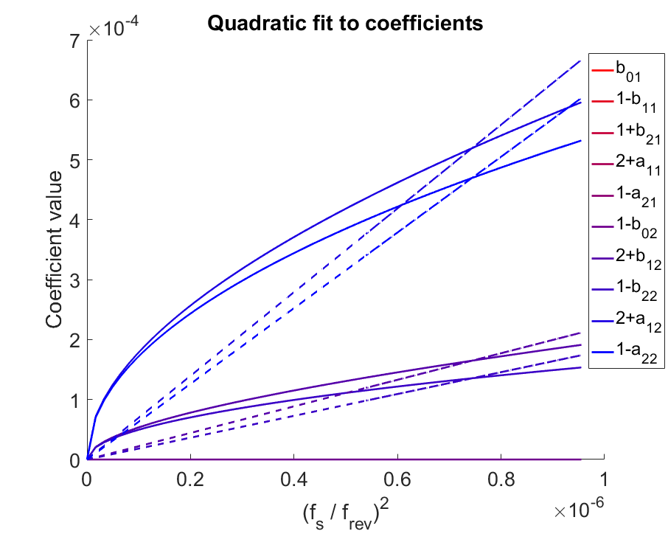
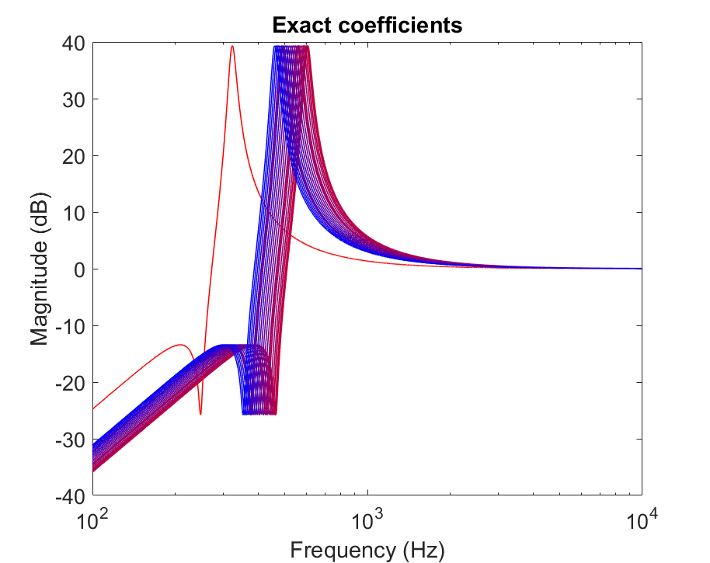
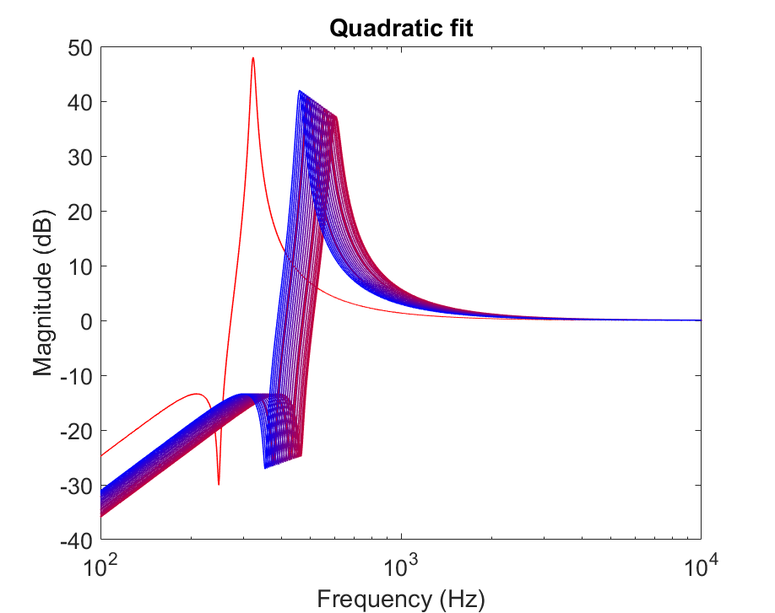
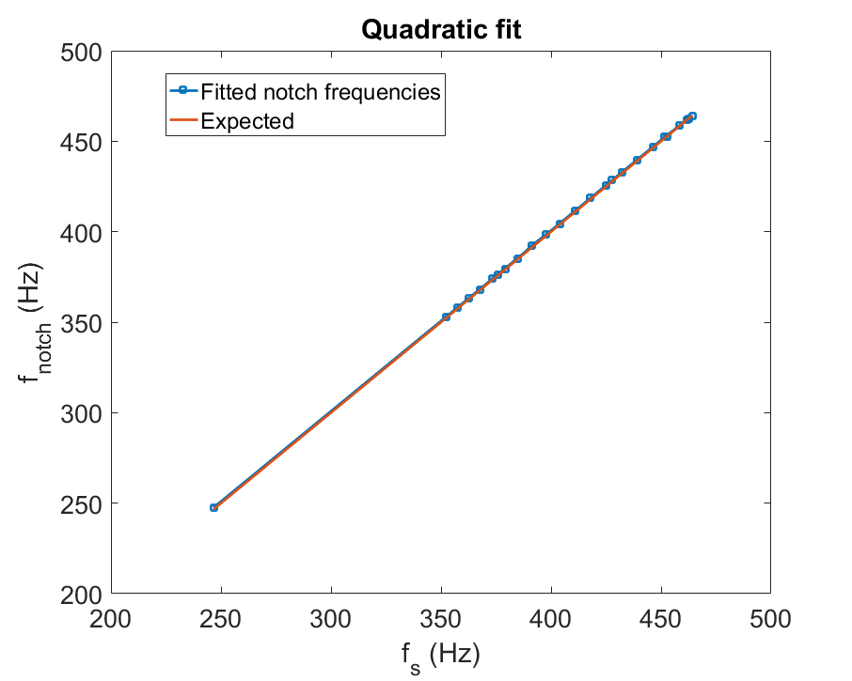
IIR Filter Coefficient Sweeping
Coefficient values from MATLAB vary with synchrotron frequency in a complex way.
Not enough FPGA resources to implement a separate function for each coefficient.
Use one function from FGC, then apply linear offset and scaling to obtain each coefficient.
Using (f_{s} / f_{rev})² as the FGC function reproduces the notch frequencies exactly.

