Slide 1
The P³ project:
A positron source demonstrator for FCC-ee
Nicolas Vallis (PSI / EPFL) on behalf of FCC-ee Injector WP6
FCC-ee Week, 2 June 2022

Slide 2
The P³ project
PSI Positron Production
1. Introduction
2. Key technology
2.1. Adiabatic Matching Device
2.2. RF Structures
2.3. Solenoids around RF structures
2.4. Beam diagnostics
3. Current project status
          3.1 Latest simulation results
          3.2 Main task status

Slide 3
The P³ project
PSI Positron Production
1. Introduction
2. Key technology
2.1. Adiabatic Matching Device
2.2. RF Structures
2.3. Solenoids around RF structures
2.4. Beam diagnostics
3. Current project status
          3.1 Latest simulation results
          3.2 Main task status

Slide 4
P-cubed (WP6) in context

Slide 5
P-cubed (WP6) in context
Design and perform a proof-of-principle experiment for the FCC-ee positron source:
    Provide first experimental measure of the FCC-ee e+ Yield
    Develop and test novel approach technology for e+ production
    Contribute to future accelerators and e+ sources

Slide 6
The FCC-ee Injector complex
P. Craievich et al.

Slide 7
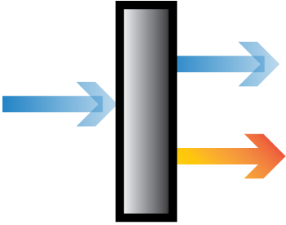
The FCC-ee Injector complex
P. Craievich et al.
e+ production & capture LINAC
6 GeV e-
e+e-
…
200 - 500 MeV
e+e-
Cavity 1
Cavity 2
Cavity 3
Cavity N
Matching Device
solenoids surrounding RF cavities

Slide 8
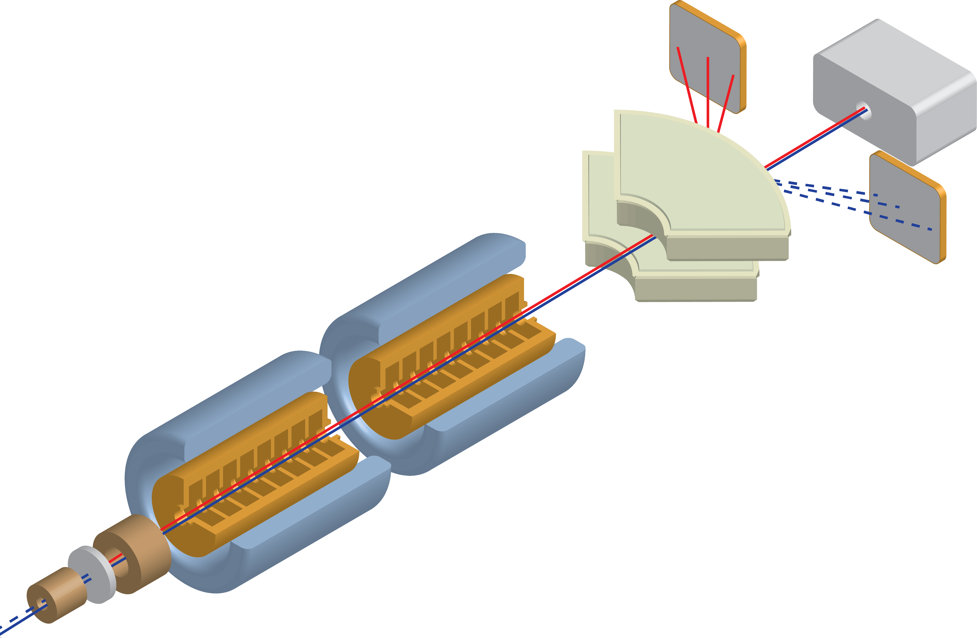
P³ concept design
Beam Diagnostics
Spectrometer
Adiabatic Matching Device
2 RF Structures
4 solenoids around
6 GeV e- beam
from SwissFEL linac
Target
P. Craievich et al.

Slide 9
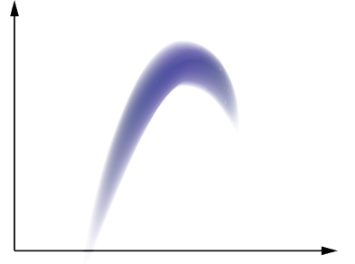

Positron Yield
$$Yield=\frac{Ne^{+}accepted by DR}{Ne^{−}primary beam}$$
Representation of e+ distribution at DR input
And DR acceptance window
E
High yield =
  High capture efficiency
  All particles in one bucket
  Small energy spread
e+ beam at target:
  Extremely large emittance
  No time structure
  Extremely large energy spread
1.54 GeV
+/- 3.8 %
t.b.d.
t

Slide 10
State of the art: SuperKEKB
Yield ≈ 0.5¹
FCC-ee requirement
Yield = 1, w/ safety margin of 2¹
Preliminary simulation studies: FCC-ee and P-cubed
Yield > 5
¹Chaikovska et al., 2019

Slide 11
The P³ project
PSI Positron Production
1. Introduction
2. Key technology
2.1. Adiabatic Matching Device
2.2. RF Structures
2.3. Solenoids around RF structures
2.4. Beam diagnostics
3. Current project status
          3.1 Latest simulation results
          3.2 Main task status

Slide 12
P³ concept design
Beam Diagnostics
Spectrometer
Adiabatic Matching Device
2 RF Structures
4 solenoids around
6 GeV e- beam
from SwissFEL linac
Target
P. Craievich et al.

Slide 13
e+ production at SwissFEL
Amorphous tungsten
SwissFEL is a free electron laser facility at PSI
The SwissFEL linac can provide similar beam as FCC-ee injector linac: 6 GeV, highly coherent and collimated
Dedicated extraction line to be installed at SwissFEL
6 GeV e-
e+e- pairs
Very high yield at target (~13) BUT:
Extremely high divergence, energy spread and no time structure = No beam!
Such distribution needs to be captured, transported and measured.

Slide 14
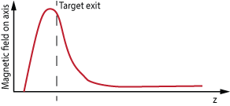
Adiabatic Matching Device (AMD)
AMD
AMD is a strong solenoid lens (up to 17 T in P-cubed studies) surrounding the target.
Field is tapered adiabatically, target is placed downstream from the peak field. higher yield w.r.t. flux concentrator.
Extremely high H field (thus yield) high temperature superconductors (HTS).
6 GeV e-
e+e- pairs

Slide 15
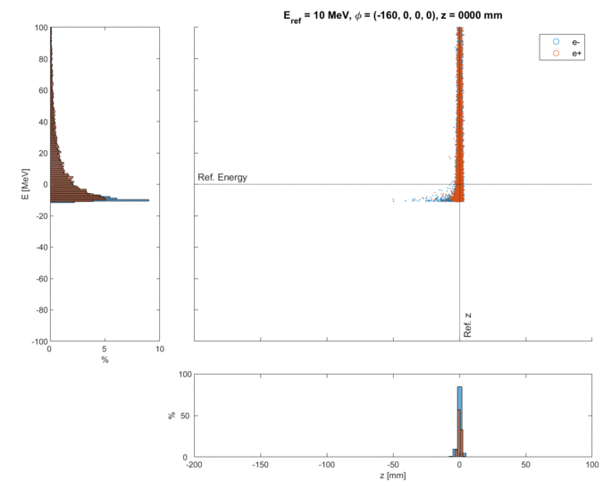
AMD (II): Beam dynamics
Before the AMD
    Similar time structure of primary e+
    Large divergence
    Large energy spread
After the AMD
    No time structure
    Still large emittance
    Still large energy spread
Energy [MeV]
Higher solenoid fields do not necessarily imply higher yield.
z [mm]

Slide 16
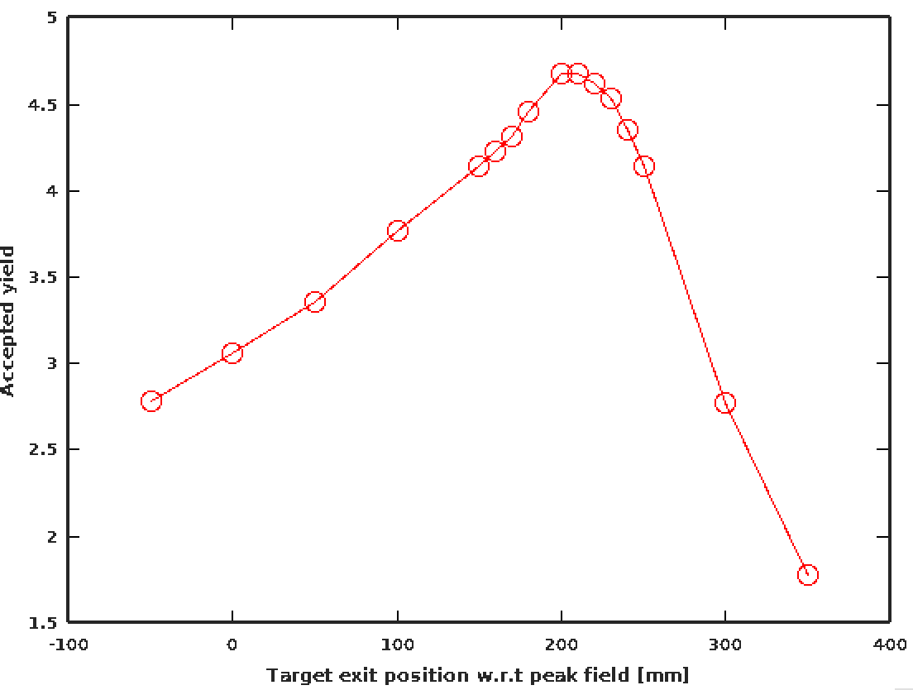
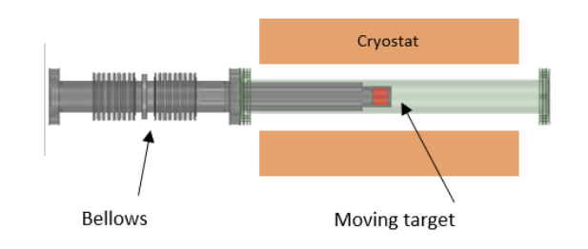
AMD (III): Target handling
72 mm
R. Zennaro
Y. Zhao

Slide 17
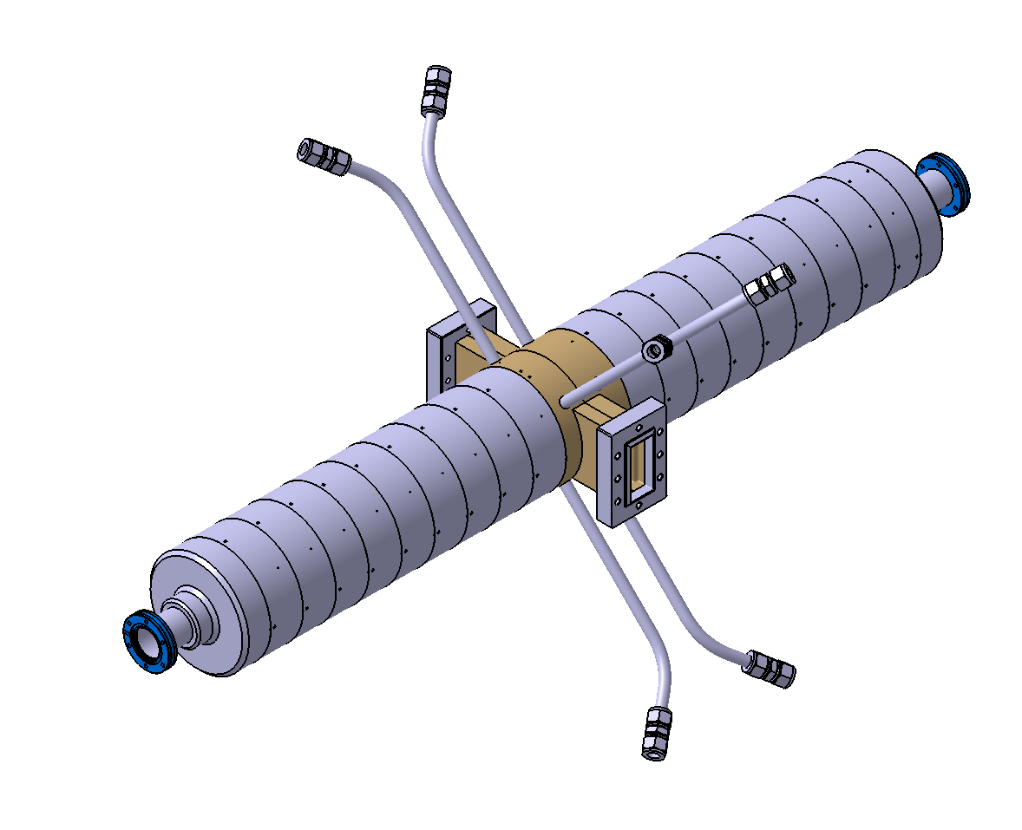
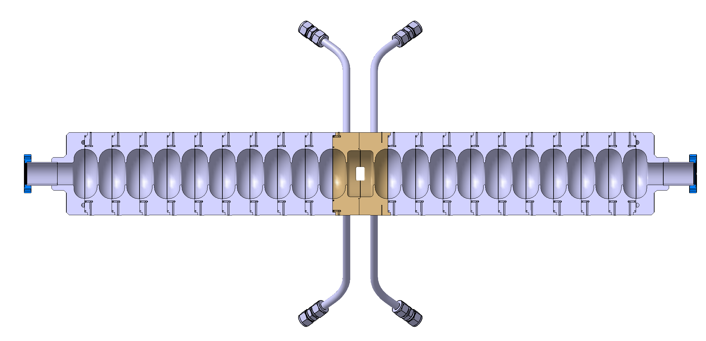
RF Cavities
Standing wave, S-band Cavities
Length | 1.2 m
RF Frequency | 2.9988 GHz
Gradient | ≈ 20 MV/m
N cells | 21
Q-factor | ~21000
R/L | 18.4 MOhm/m
Aperture | 40 mm
Mode Separation | 3.5 MHz (pi mode)
R. Zennaro and A. Magazinik

Slide 18
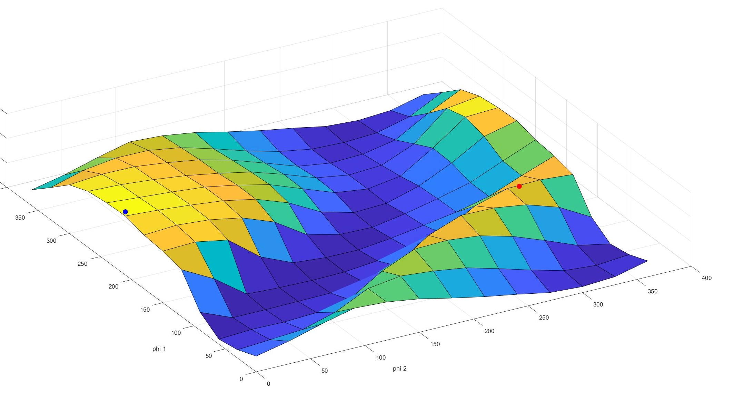
RF(II): Phase tuning
e+ in “second” bucket
e+ in “first” bucket
Phi1
Phi2

Slide 19
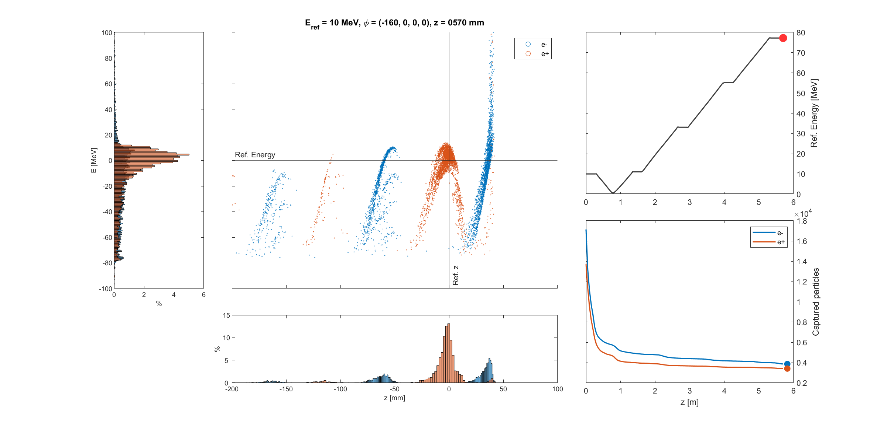
RF(III): Second bucket
4 cavities
Longitudinal phase space
1
2
3
4
Energy [MeV]
Captured particles
z [mm]

Slide 20
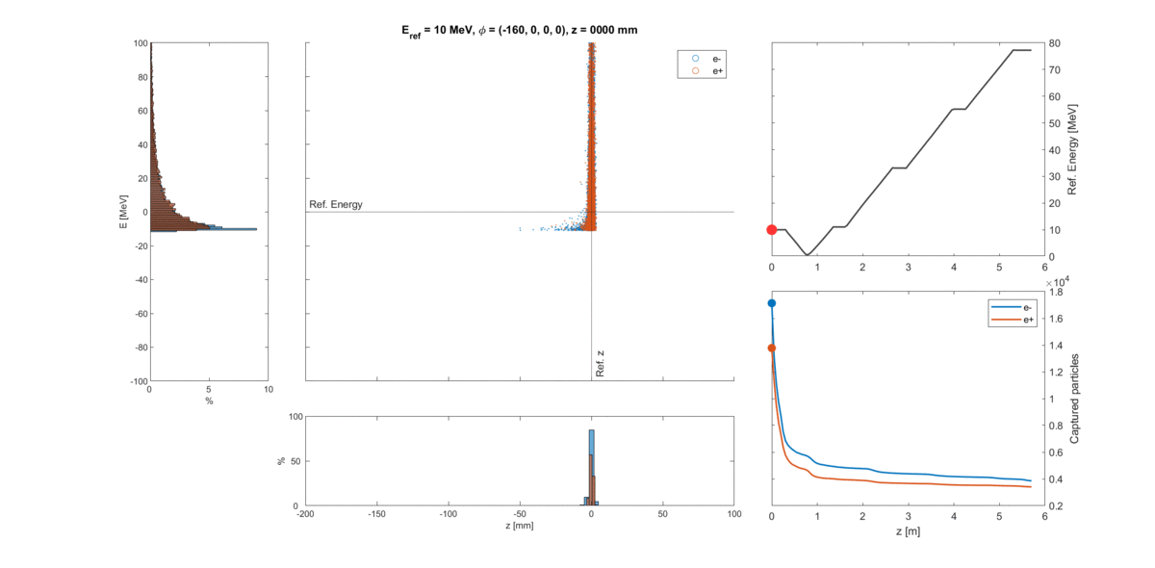
RF(III): Second bucket

Slide 21
RF(III): Second bucket
The beam is decelerated to almost zero during first cells
Beam deceleration is a well-known technique to reduce the energy spread

Slide 22
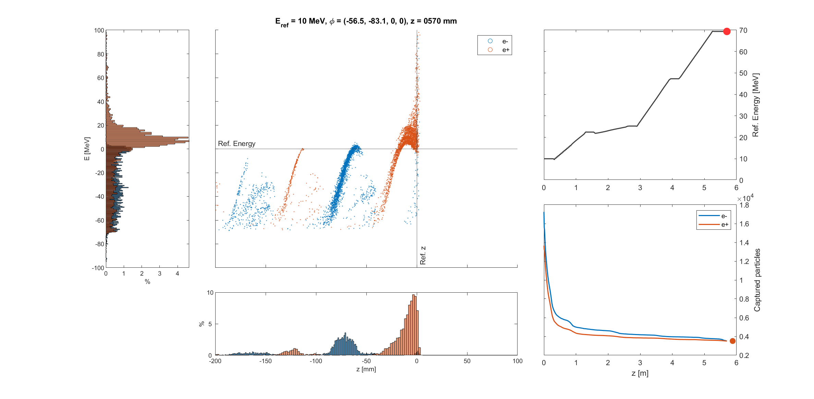
RF(IV): First bucket

Slide 23
RF(V): Best working point
2nd Bucket
Higher yield:
  Higher capture efficiency
  Lower energy spread
  More particle concentration in main bucket
More stable working point (phi1, phi2 scan)
Easier to measure
1st Bucket

Slide 24
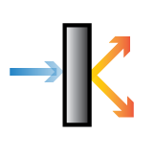
Solenoids around RF structures
The captured e+ beam is extremely divergent
A solenoid field needs to be applied along the RF structures in order to maintain high capture efficiency.
In order to provide a high yield, the field needs to be:
    Strong
    Flat
AMD
solenoids
6 GeV e-
Cavity 1
Cavity 2
Magnetic field around
cavities is not zero!

Slide 25
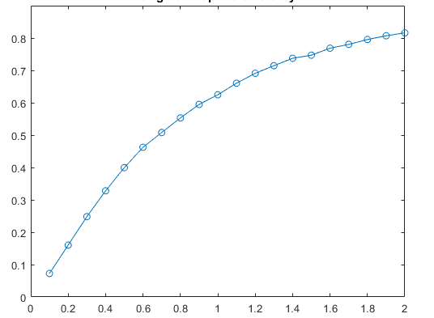
Solenoids (II): Strength
0.3 T as NC
reference point
1.5 T as SC
reference point
72%
Capture efficiency after at 200 MeV
25%
Solenoid strength around cavities [ T ]

Slide 26
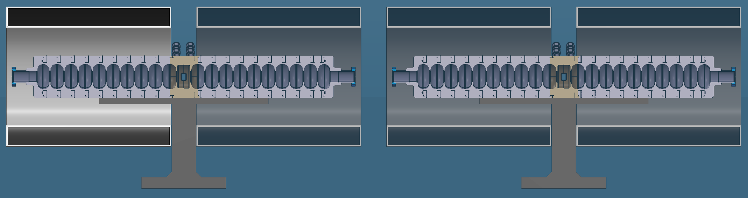
Solenoids (III): Separation
Space for waveguide and cooling
Space for assembly
Cryostat

Slide 27
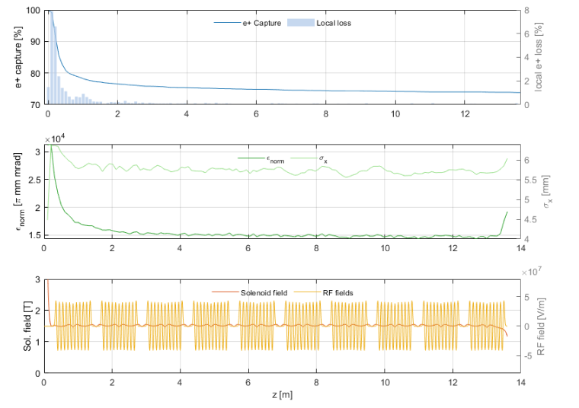
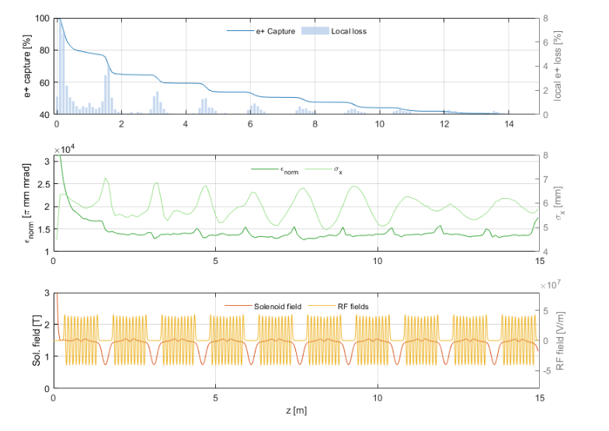
Solenoids (IV): Capture efficiency after 10th cavitiy
Optimized separation (15 cm) between cavities
Large separation (40 cm) between cavities
~75%
~35%

Slide 28
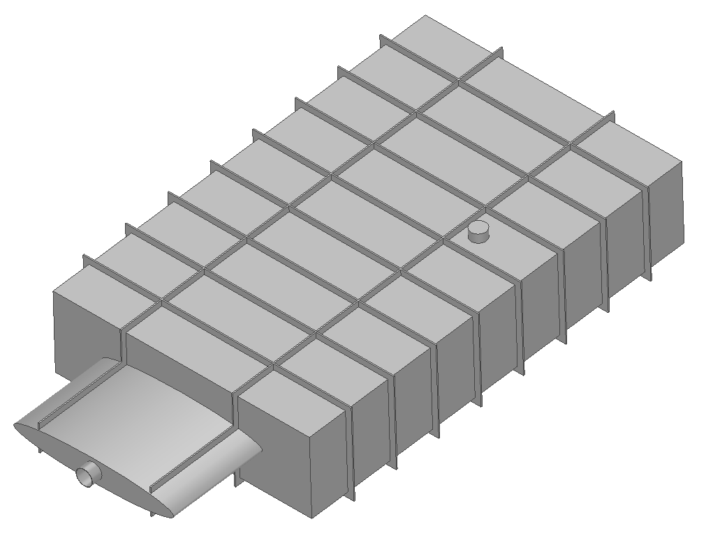
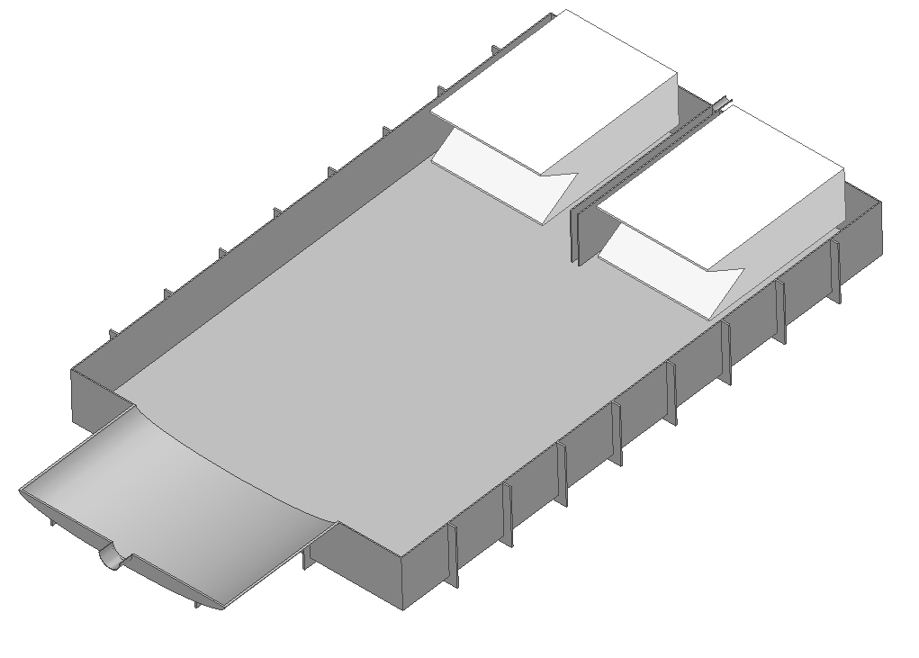
Beam diagnostics: Faraday Cup
25 Ohm Faraday cup
Vacuum chamber
25 Ohm Faraday cup
650
e+
e-
1050
250
B
Location of the spectrometer
R. Zennaro
Spectrometer Magnetic field

Slide 29
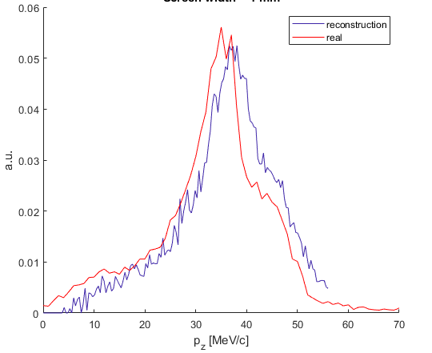
Beam Diagnostics (II): p_{z} profile reconstruction
Vertical strip probe (2 mm width)
Latest p_{z} reconstruction
(work in progress)
e+
B
Measure different Trajectories of the beam
Sweep magnetic strength of the spectrometer

Slide 30
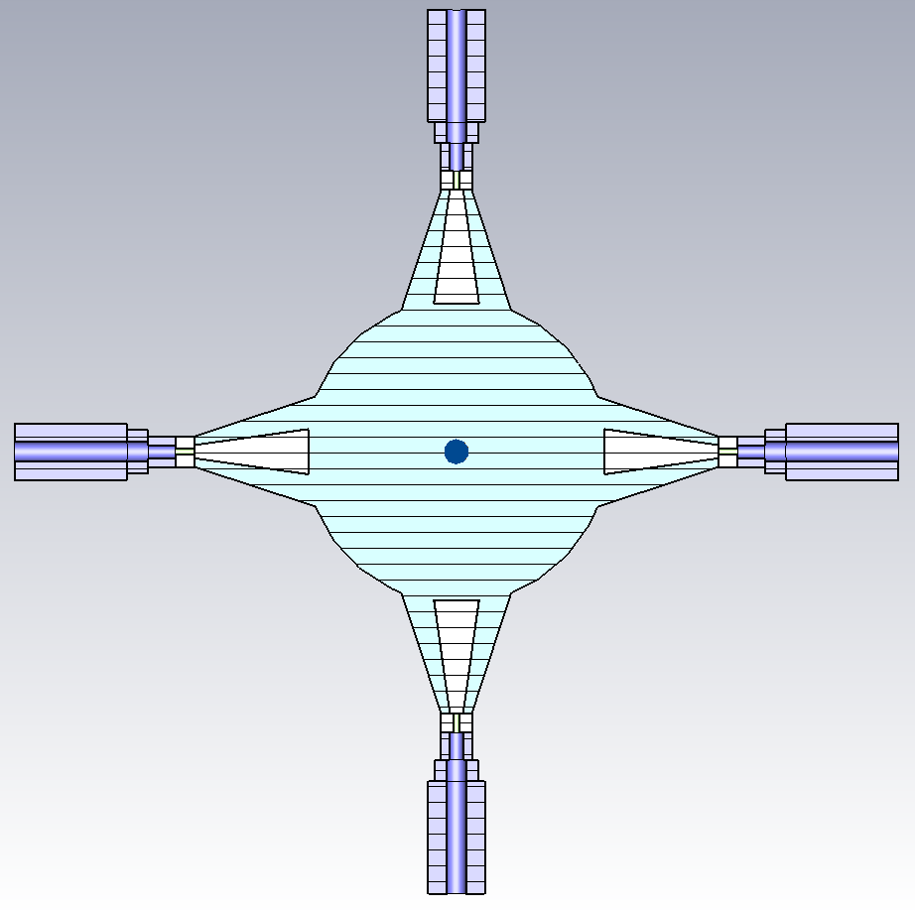
Beam Diagnostics (III): Broad band pickup
Longitudinal distribution of the P3 beam
The use of pick-ups for time structure measurement has been proposed. 60 GHz sampling with coaxial pick-ups is currently under investigation.
The use of a fast BPM has been proposed. Successful precedent settled at SuperKEKB
E. Ismaili and F. Marcellini

Slide 31
The P³ project
PSI Positron Production
1. Introduction
2. Key technology
2.1. Adiabatic Matching Device
2.2. RF Structures
2.3. Solenoids around RF structures
2.4. Beam diagnostics
3. Current project status
          3.1 Latest simulation results
          3.2 Main task status

Slide 32
Status of main tasks
Purchase phase
Main ongoing task
Concept design
 | Target | Concept design defined.
 | RF Structures | Ready for copper purchase.
Magnets | AMD | HTS tape to be purchased shortly. Design of cryostat in progress.
 | Solenoids around RF structures | Feasibility study of NC and SC options ongoing.
Beam diagnostics | Faraday Cups | Concept design defined.
 | Broad-band pick-ups
 | Spectrometer | Baseline design complete. Mechanical modification of existing dipole in progress.
Installation | Radioprotection | Fluka simulations in progress
 | Extraction line at SwissFEL | Location, layout and components defined.

Slide 33
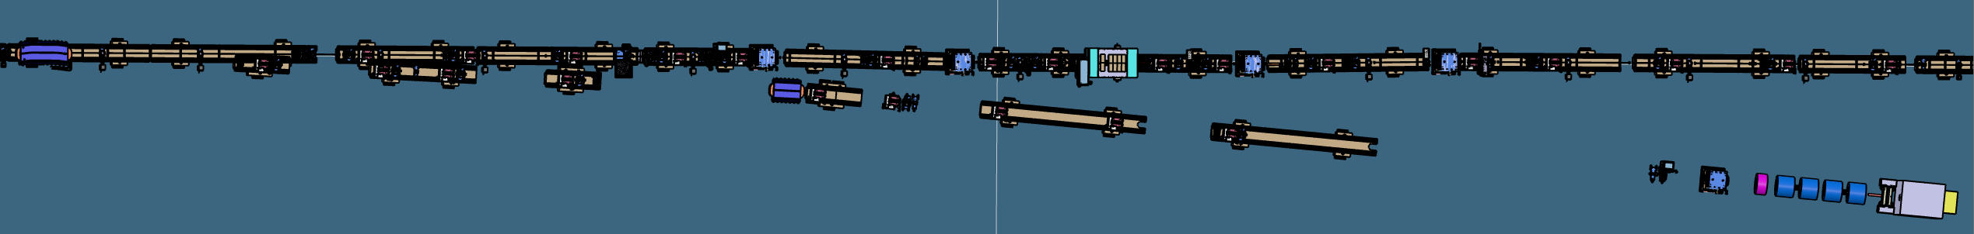
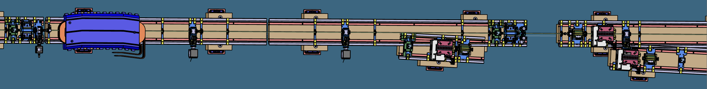
Istallation at SwissFEL
M. Schaer and D. Hauenstein

Slide 34
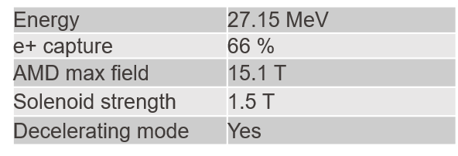
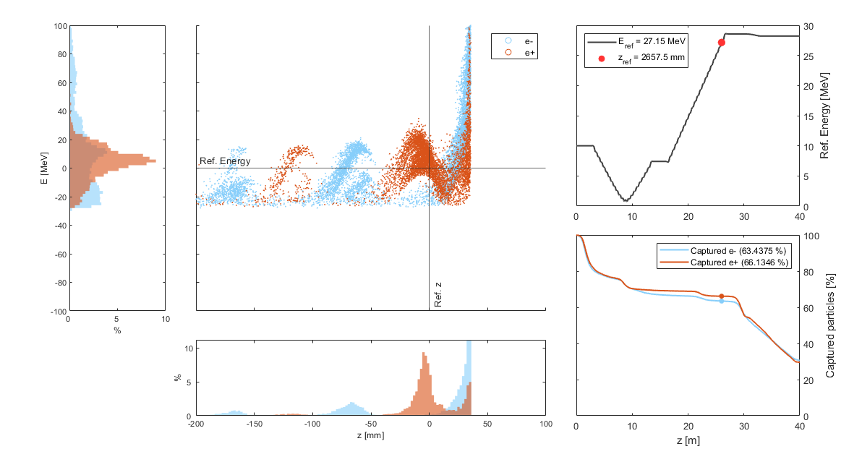
The P3 beam

Slide 35
Yield estimation
Geant4
Particle Tracking with ASTRA
Analytical transformation
DR filter
10 MeV
e+e-
Cavity 1
…
Cavity 10
200 MeV
e+e-
LINAC1
1.5 GeV
e+
6 GeV e-
Matching Device

Slide 36
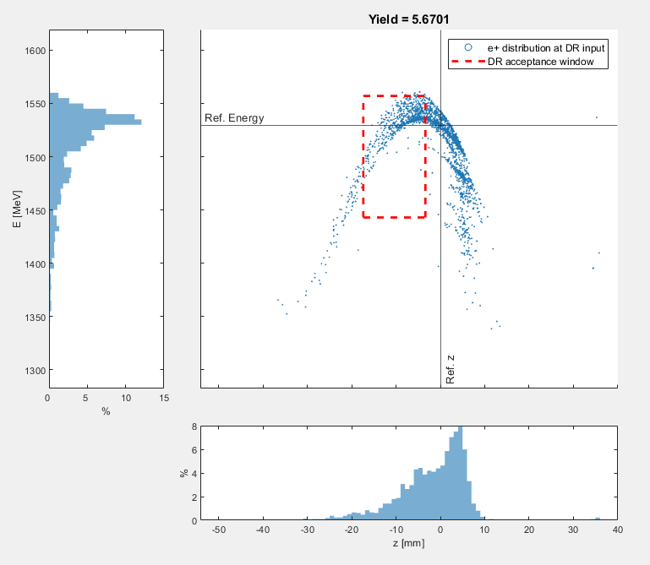
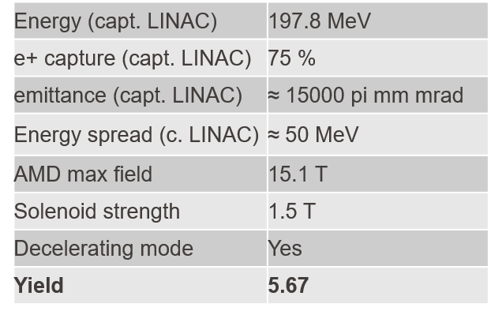
Extended simulation (e+ yield)

Slide 37



Special thanks go to
Prof. Dr. Mike Seidel (EPFL/PSI), thesis advisor;
Dr. Paolo Craievich (PSI), co-advisor;
Dr. Riccardo Zennaro (PSI), supervisor;
and the P³ and FCC-ee Injector team
This work was done under the auspices of CHART (Swiss Accelerator Research and Technology) Collaboration, https://chart.ch
FCCIS: 'This project has received funding from the European Union's Horizon 2020 research and innovation programme under the European Union's Horizon 2020 research and innovation programme under grant agreement No 951754.'

Slide 38
Backup: NC Solenoids
Solenoid strength | Mean power consumption (4 solenoids, cooling power not included)
0.3 T | 48 kW
0.5 T | 136 kW
0.7 T | 268 kW
Mean power consumption of 2 cavities = 25 kW

Slide 39
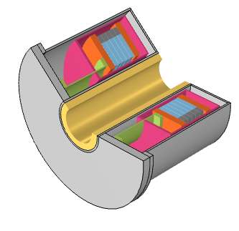
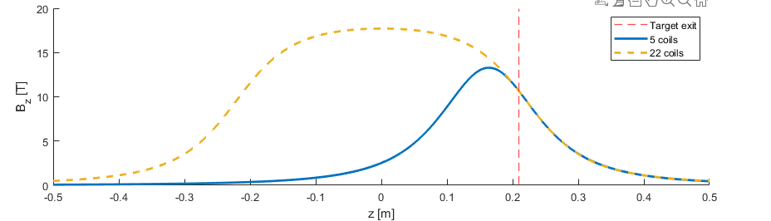
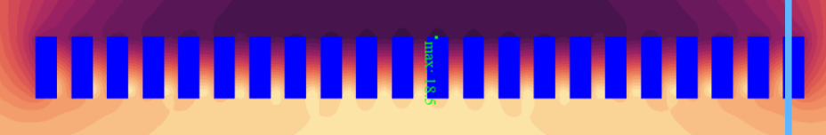
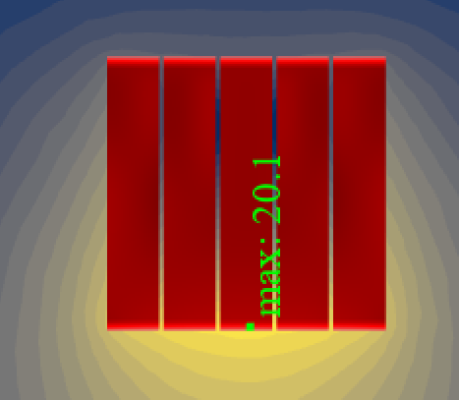
Backup (III): Size-optimized AMD
Downsized version: 5 coils.
Original arrangement: 22 coils
Thanks to J. Kosse and M. Duda

