Slide 1


The RF System of FCC-ee - General Considerations
K Hanke, CERN
FCC week 2022, Paris

Slide 2
The RF System of FCC-ee general considerations
K Hanke, CERN
FCC week 2022, Paris

Slide 3
K Hanke
FCC week 2022
Abstract
The base line for the RF system of FCC-ee is a combination of 400 and 800 MHz systems operating at 4.5 and 2 K respectively. The system is designed to evolve for the different working points of the machine. Taking into account constraints from beam physics, placement and infrastructure, we have identified two straight sections to house the cryomodules. This presentation outlines the constraints and design choices and proposes a base line scenario.

Slide 4
K Hanke
FCC week 2022
Introduction
We base our analysis on a 400/800 MHz system operating at 4.5 / 2.0 K
Physics arguments
Integration constraints:
Space requirements for cryomodules in the straight sections (see presentation by
F. Valchkova)
Infrastructure constraints:
Electrical power, cooling / ventilation, cryo

Slide 5
K Hanke
FCC week 2022
Accelerator / Physics Constraints
In the CDR it was requested that the RF be in a single place to make sure that the RF energy gains do not lead to an uncertainty in the center-of-mass energy for the Z and WW threshold.
It is also essential for the ee→ H experiment that the center of mass energy is the Higgs mass within a few MeV
It appears possible to fulfill the requirement with only one RF station at e.g. point L or H for the “first phase” of FCC-ee (Z, WW, HZ, eeH)
The High Energy (top) situation requires ~10 GV of RF (“FCC-ee upgrade”)
two RF stations each accelerating both e+ and e- (shared RF)
This time we also consider the boost of the IP
P_{cm}= (E(e+) – E(e-))

Slide 6
K Hanke
FCC week 2022
Accelerator / Physics Constraints
A Blondel
A
B
C
e- and e+ RF
e+ RF
e- and e+ RF
e- RF
e- and e+ RF
RF placements for low energies (Z, W, H)
-A- It is mandatory to have the whole RF in a single point for the precision measurements (Z, WW, eeH)
for ee→ H one should take into account that beam energies might be different leading to a difference in the total beam energy loss by 3.6 MeV/turn (within tolerance).
-B- It might also be possible to have all e+ RF in one point and all e- RF in another point, but his will lead to large differences between collision points for 4-exp scenario and might cause issues – not preferred
-C- for ee→ H the scheme of two RF stations where both e+ and e- get accelerated should also be investigated,
it will work if the acceleration in the RF stations can be controlled at 1% level; the RF stations do not need to be opposite.

Slide 7
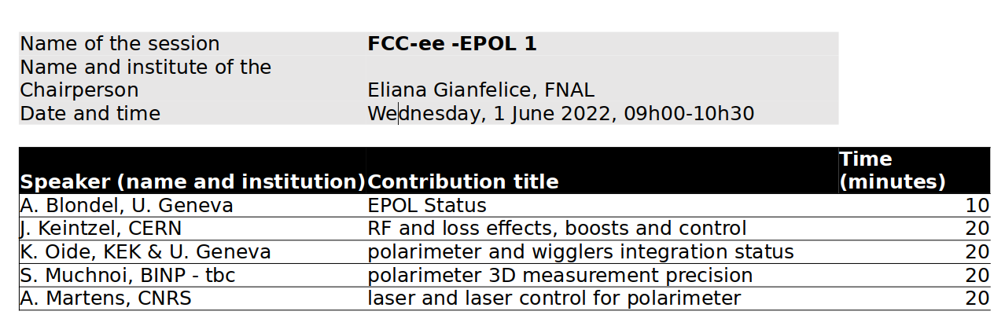
K Hanke
FCC week 2022
Accelerator / Physics Constraints
A Blondel
C
D
e- and e+ RF
e- and e+ RF
e- and e+ RF
e- and e+ RF
RF placements for high energies
After an upgrade, the FCC-ee will have two RF points with RF shared between e+ and e-
same energy gain for e+ and e- at two different places.
No need to have opposite points (e.g. “C”), any configuration is acceptable (e.g “D”)?
See presentation by J. Keintzel: Center-of-mass energy and boosts for various RF-configurations, Wednesday morning

Slide 8
K Hanke
FCC week 2022
Infrastructure Constraints
We exclude Experiment Sites (A, D, G, and J). Furthermore we recommend that point B not be an RF site (highly sensitive area, difficult access, no resources).
Therefore, from an infrastructure point of view, three of the points are eligible to house the RF for FCC-ee (H, L, and F).

Slide 9
K Hanke
FCC week 2022
Infrastructure Constraints
Point H Good location; a 400 kV line is passing not far away in the north.
Point L Good traffic connections and access to water and electricity; access to water and electricity through CERN (additional service shaft on the CERN site) may be an option. Relatively close to the CERN site (interventions, maintenance)
Pont F features a long lateral access tunnel. However we do not exclude PF a priori to be an RF point, as the RF equipment (klystrons and klystron power supplies) would be placed underground close to the machine, and electrical power would need to be brought via relatively long cables, which is not unconceivable.

Slide 10
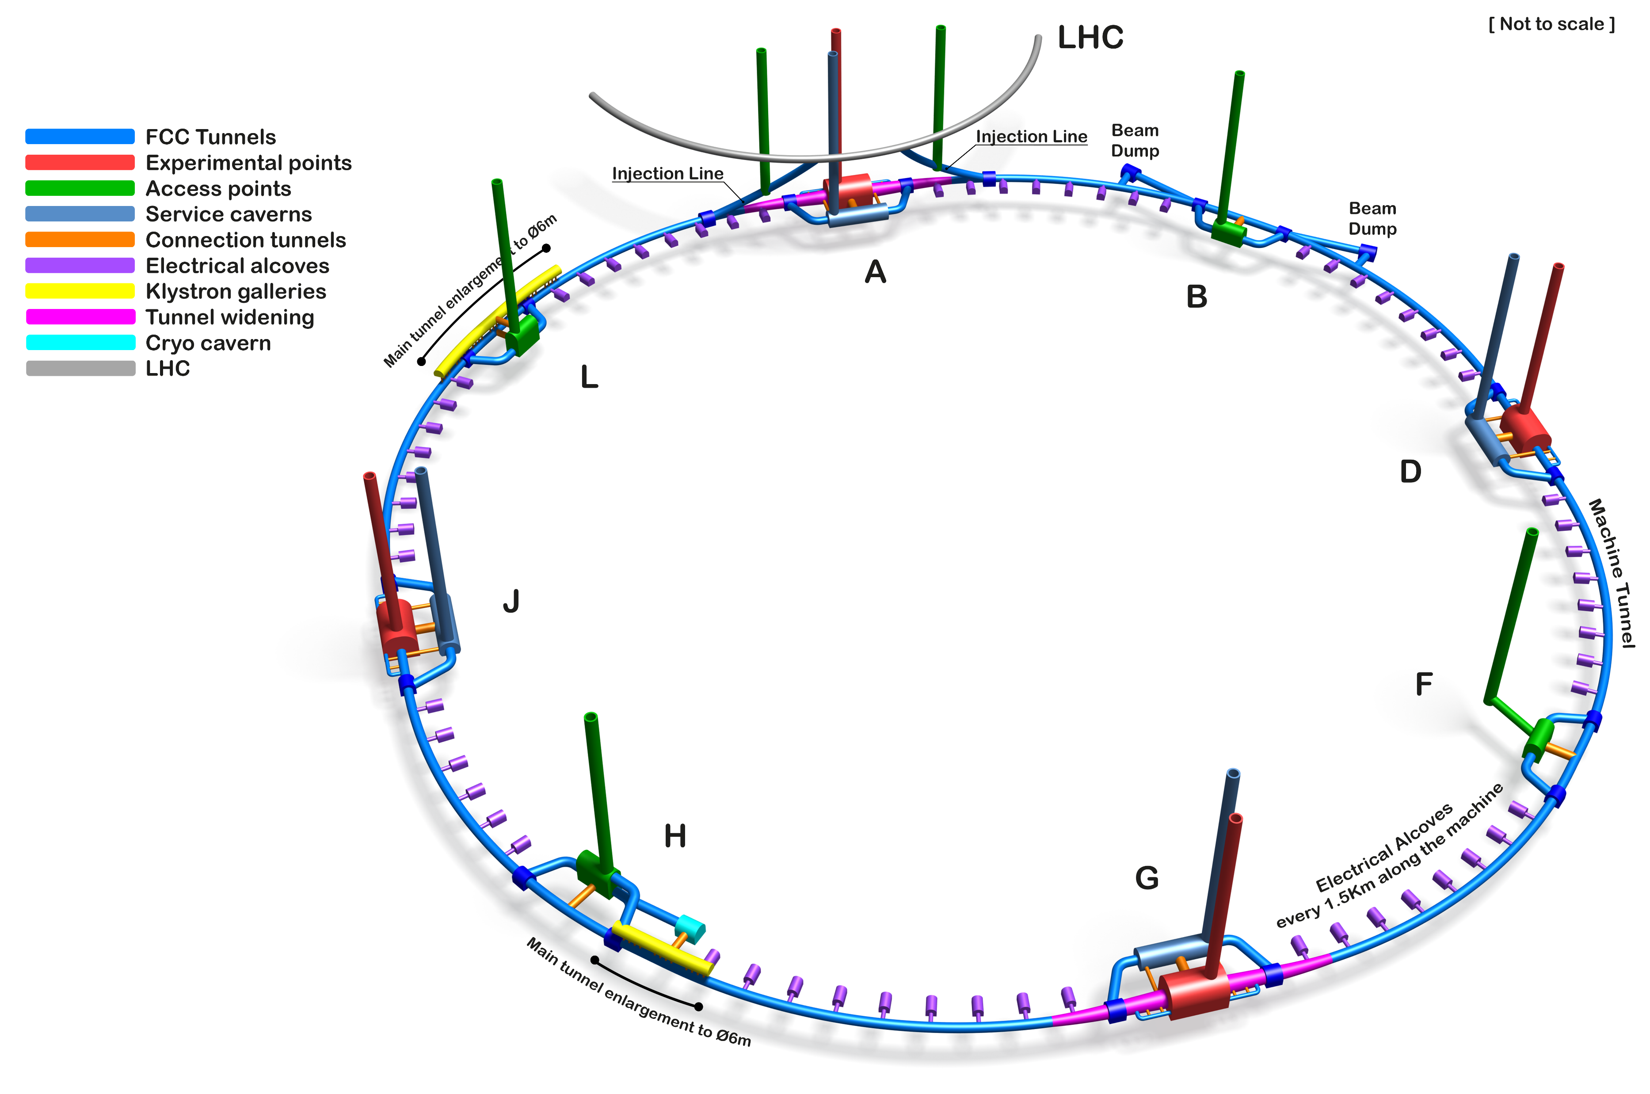
K Hanke
FCC week 2022

Slide 11
K Hanke
FCC week 2022
Point L Power
Point L can be powered by 2 different solutions, for a power demand up to 200 MW.
Solution 1: the electricity is coming from a 225kV sub-station not far from point L (3 km). However, the capacity is probably limited, strategy lines for Geneva.
Solution 2: A new 400 kV sub-station is built at this point to get a power up to 200 MW.
Surface needed for 200 MW: RF power supplies 6000 m², SVC 6000 m², 400 kV-63 kV-18 kV sub-stations 6000 m²
→ See presentation J.-P. Burnet

Slide 12
K Hanke
FCC week 2022
Point L Cooling & Cryo
Cooling & Ventilation:
The cooling water need of the RF is 58.1 MW. The additional cooling needed from other users at point F is around 4.8 MW (including chillers used for air cooling in the RF area).
This gives a total of 63 MW, without contingency.
Cryo:
The number of RF cryomodules and their heat loads have both increased since CDR data published in 2019, inducing de facto an increase in the cryogenic cooling requirements
→ See presentation L. Delprat

Slide 13
K Hanke
FCC week 2022
Point H Power
Point H can be power by 2 different solutions, for a power demand up to 160 MW.
Solution 1: A new 400 kV sub-station is built at this point to get a power up to 200 MW. A 400 kV line is already passing close to point H, will need a new 400 kV sub-station and 4 km of lines.
Solution 2: the electricity is coming from point F through the FCC tunnel. This will require 132 kV lines in the tunnel. Up to 160 MW sounds feasible. With Point F as main power sub-station (400 kV).
Surface needed for 200 MW: RF power supplies 6000 m², SVC 6000 m², 400 kV-63 kV-18 kV sub-stations 6000 m²
→ See presentation J.-P. Burnet

Slide 14
K Hanke
FCC week 2022
Point H Cooling & Cryo
Cooling & Ventilation:
In case all RF equipment is installed at point H the water cooling need from the RF equipment is around 38.7 MW. The additional cooling needed at point H is around 3.2 MW (includes chillers).
Therefore, the cooling capacity of the cooling towers is 42 MW, without additional capacity for backup.
Cryo:
The number of RF cryomodules and their heat loads have both increased since CDR data published in 2019, inducing de facto an increase in the cryogenic cooling requirements
→ See presentation L. Delprat

Slide 15
K Hanke
FCC week 2022
Summary
2 RF points proposed for FCC-ee: L and H
Integration wise this would nicely fit
For Z and W and H machines all CMs (400 and 800 MHz) to be installed at point L
For ttbar machines we will split the 400 MHz (point L) and 800 MHz (point H and L)
Tunnel diameter will be 6 m for the RF points compared to 5.5 m for the tunnel – Civil Engineering are looking into cost and schedule; might review once engineering design of the cryomodules is available
Klystron gallery will sit on top of collider tunnel, waveguides coming down, being elaborated by Civil Engineering (as CDR!)
implicit assumption: Booster will sit on top of collider ring; needs also to be confirmed!

Slide 16
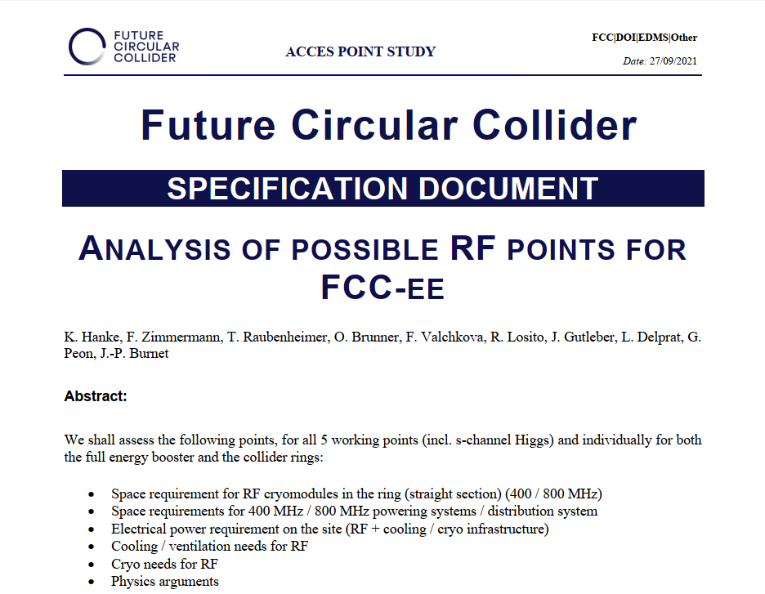
K Hanke
FCC week 2022
Next Steps
Review 2nd half 2022
Freeze and document base line

Slide 17
Thank you for your attention

