Slide 1
RF design of traveling-wave structures for the FCCee injector
H. W. Pommerenke, A. Grudiev, A. Latina :: CERN
S. Bettoni, P. Craievich, M. Schär, J.-Y. Raguin :: PSI
FCC Week ‘22, 30th May – 3rd June 2022
Campus des Cordeliers, Sorbonne Université, Paris, France

Slide 2
FCCee injector linacs layout
P. Craievich

Slide 3
Methodology

Slide 4
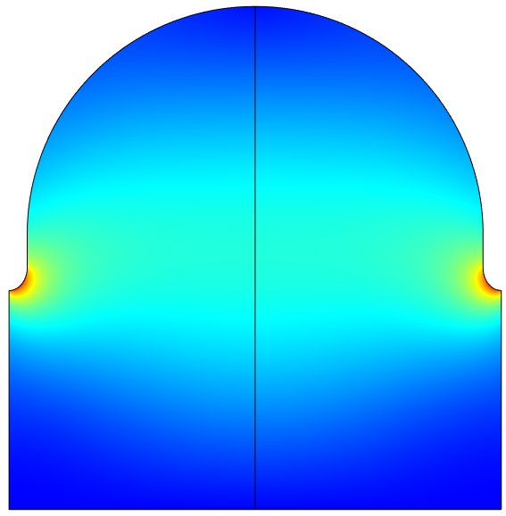
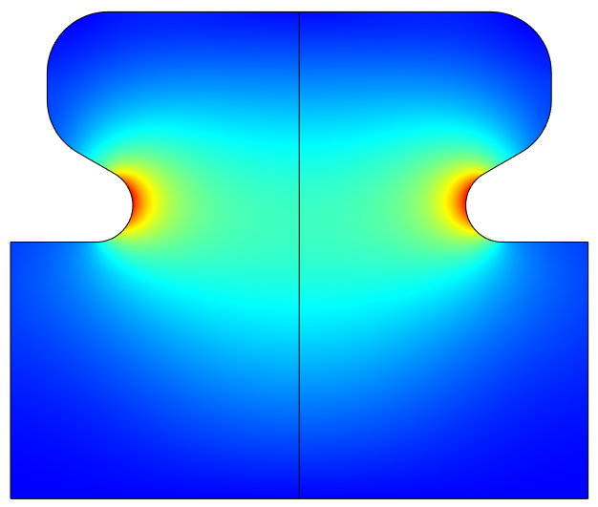
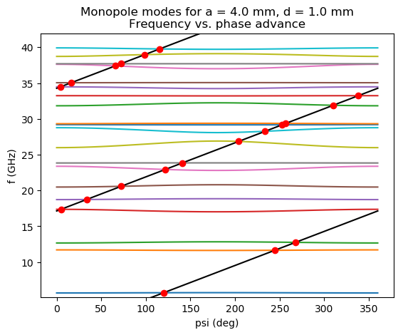
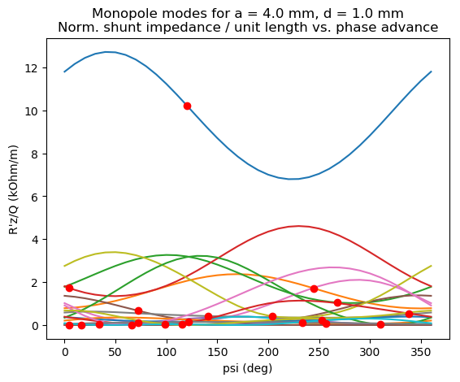
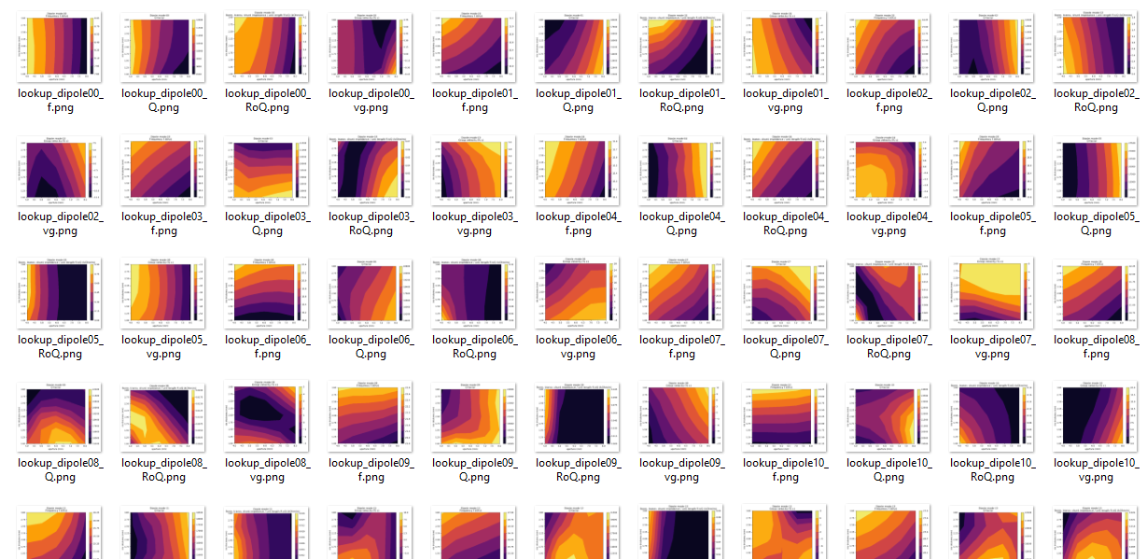
Cell lookup tables
consider both convex and reentrant geometries
cells with large phase advance and reentrant geometry
have low group velocities at large apertures → interesting for positron linac
rapidly compute many structures:
lookup table based on ~200 reference cells & analytic formulas
lookup table parameter space:
  rf phase advance: ψ = 2π/3 … 9π/10
  aperture: a = 0.08 λ … 0.34 λ
  iris thickness: d = 0.02 λ … 0.19 λ
d/2
a
convex
reentrant
find synchronous phase advance of modes
get f, R/Q, Q, vg at synchronous phase advance
lookup tables for f, R/Q, Q, v_{g}, E_{max}, …. + first 20 HOMs
as functions of aperture and iris thickness

Slide 5
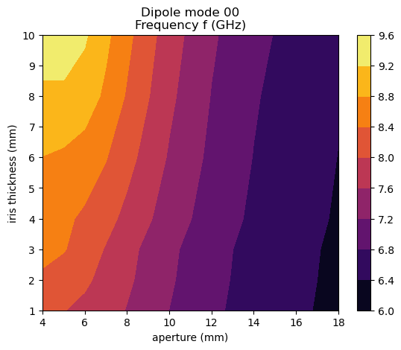
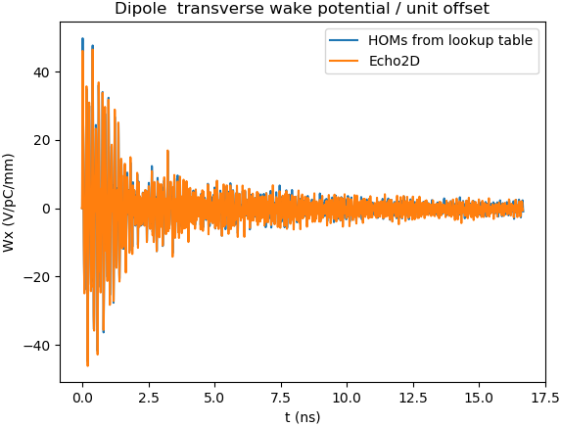

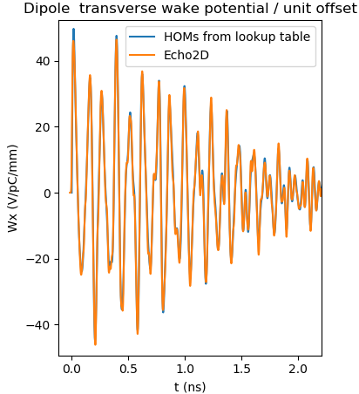
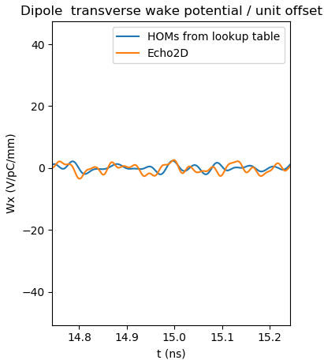
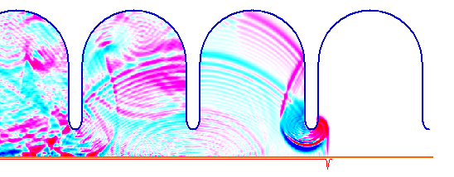
Long-range wake damping by dipole mode detuning
Long-range wake from frequency-domain parameters (R/Q, Q, ω)
Benchmark: Lookup table vs. Echo2D
detuning is effective by tapering both aperture and iris thickness
Echo2D: time-domain wakefield solver by I. Zagorodnov

Slide 6
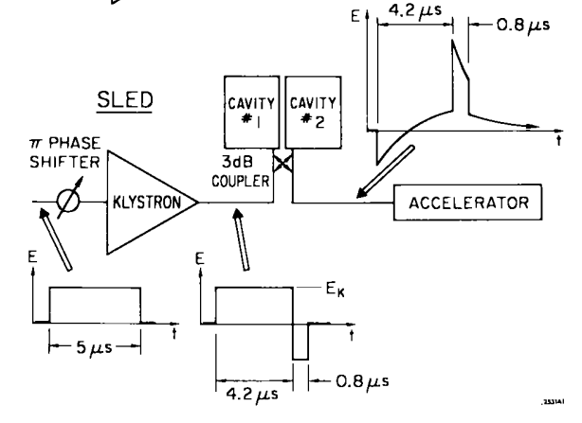
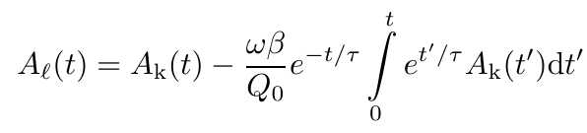

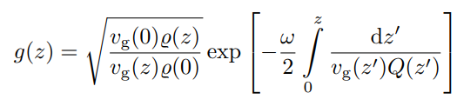
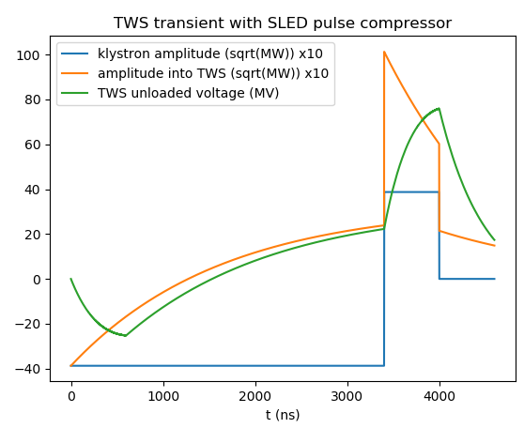
SLED-type RF pulse compressor
increase peak pulse amplitude and reduce pulse length by charging storage cavity
output pulse A_{L} given by
where A_{K}: klystron pulse, β, Q₀, τ: coupling, Q-factor, filling time of storage cavity
for rectangular klystron pulse, gradient at injection can also be derived analytically:
where
we define an effective shunt impedance R_{eff} = V²(T_{k})/P_{k}/L_{structure} [MΩ/m]
Farkas et al., A method of doubling SLAC‘s energy, Proc. HEACC 1974
Example:
inject beam here, one filling time after phase reversal,
at end of klystron pulse, when voltage (<G>) is maximum

Slide 7
RF structures for Electron Linac and Common Linac

Slide 8
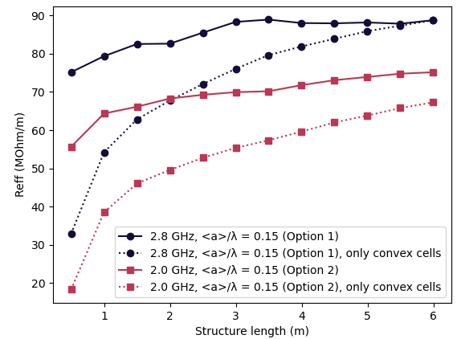
Structures for the Electron Linac
Beam dynamics options for tolerable 10 % action amplification [S. Bettoni]:
 | Option 1 | Option 2
Gradient (MV/m) | 25 +/- | 25 +/-
Frequency | 2.8 | 2.0
Average aperture <a>/λ | 0.15 | 0.15
Average aperture <a> (mm) | 16.0603 | 22.4844
rf phase (deg) | 90 | 90
Kick @ 17.5 ns, 5 nC (V/pC/mm/m) | 0.2 | 0.2
Approximate structure length (m) | 3 +/- | 3 +/-
Effective shunt impedance vs. structure length
for optimum structures
Option 1
Option 2
Option 1 is preferred,
higher frequency gives higher shunt impedance
3 m is a good structure length for both options
reentrant geometry is preferred,
for convex we need ~20 % more power or almost double the structure length
Option 1 is the same as option 1 of Common Linac, just stricter wake requirement (→ next slide)
→ cost efficient option: same structure for Electron and Common Linac

Slide 9
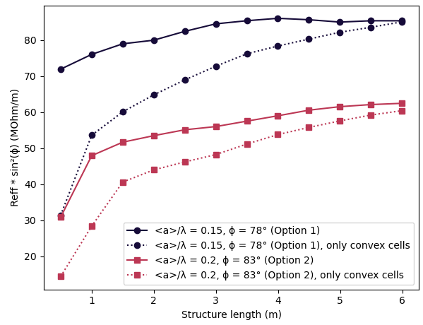
Structures for the Common Linac
Beam dynamics options for tolerable 10 % action amplification [S. Bettoni]:
 | Option 1 | Option 2
Gradient (MV/m) | 25 +/- | 25 +/-
Frequency | 2.8 | 2.8
Average aperture <a>/λ | 0.15 | 0.20
Average aperture <a> (mm) | 16.0603 | 21.4137
rf phase (deg) | 78 | 83
Kick @ 17.5 ns, 5 nC (V/pC/mm/m) | 0.36 | 0.36
Approximate structure length (m) | 3 +/- | 3 +/-
Effective off-crest shunt impedance vs. structure length
for optimum structures
Option 1
Option 2
Option 1 is preferred,
closer-to-crest-operation of option 2 does not compensate
for loss in shunt impedance (by far!) & high-gradient limit
3 m is a good structure length for option 1
reentrant geometry is preferred,
for convex we need ~20 % more power or almost double the structure length
Option 1 is the same as option 1 of Electron Linac, just less strict wake requirement
→ cost efficient option: same structure for Electron and Common Linac

Slide 10
A few selected structures
for the Electron Linac and the Common Linac
 | Electron Linac |  | Common Linac
Option | Option 2 | Option 1 | Option 1
Frequency | 2.0 GHz | 2.8 GHz
Average aperture | 0.15 λ | 0.15 λ
Phase advance | 5π/6 | 2π/3
Length (num cells) | 3.0 m (48) | 3.0 m (84)
Cell geometry | reentrant | reentrant
Transverse wake at 17.5 ns | 0.10 V/pC/mm/m | 0.20 V/pC/mm/m
Filling time | 884 ns | 486 ns
Min. group velocity | 1.1 % c | 1.4 % c
SLED coupling | 14 | 15
rf phase φ | 90° | 90° | 78°
Eff. shunt imp. x sin²φ | 66 MΩ/m | 87 MΩ/m | 83 MΩ/m
Average gradient | 25 MV/m | 25 MV/m
E_{max} (instant.)* | 100 MV/m | 95 MV/m | 97 MV/m
S_{c,max} (instant.)* | 737 mW/μm² | 685 mW/μm² | 716 mW/μm²
Klystron pulse length | 5 μs | 3 μs | 3 μs
Klystron power per structure | 28 MW | 21 MW | 22 MW
* high-gradient limits (1 µs pulse) : Emax < 100 MV/m and Sc < 2300 mW/μm²

Slide 11
RF structures for Positron Linac

Slide 12
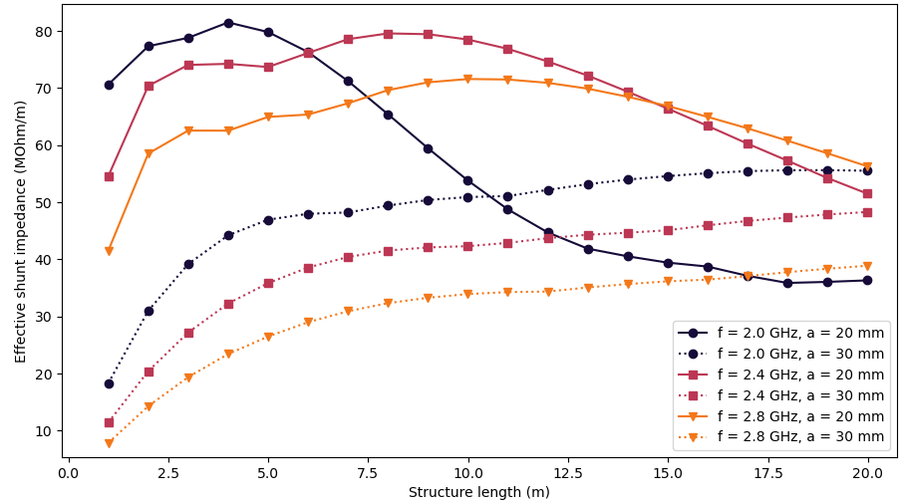
Structures for the Positron Linac
positron beam size (before DR) demands large aperture for high transmission
(considered: 20 mm, 30 mm)
need to reduce group velocity to increase efficiency (effective shunt impedance):
  high phase advance (9π/10 = 162°)
  reentrant geometry
  lower frequency (2.0 GHz, L-band, harmonic of 400 MHz)
Effective shunt impedance vs. structure length
for 2.0 GHz, 2.8 GHz, and 20 mm, 30 mm aperture
A
C
E
F3
current „baseline“ structure: 2.0 GHz, 30 mm aperture, 3 m long

Slide 13
A few selected structures for the Positron Linac
 | A | C | E | F3 („baseline“)
Frequency | 2.0 GHz | 2.0 GHz | 2.0 GHz | 2.0 GHz
Constant aperture | 20 mm | 20 mm | 30 mm | 30 mm
Phase advance | 2π/3 | 9π/10 | 5π/6 | 9π/10
Length (num cells) | 3.0 m (60) | 0.9 m (14) | 6.0 m (96) | 3.0 m (44)
Entr., exit iris thickness | 10.6 mm, 20.0 mm | 14.3 mm, 20.0 mm | 12.4 mm, 20.0 mm | 14.3 mm, 20.0 mm
Transverse wake at 17.5 ns | 0.21 V/pC/mm/m | 0.16 V/pC/mm/m | 0.15 V/pC/mm/m | 0.13 V/pC/mm/m
Filling time | 678 ns | 702 ns | 544 ns | 447 ns
Min. group velocity | 1.1 % c | 0.4 % c | 3.1 % c | 1.9 % c
Largest cell radius | 63 mm | 59 mm | 63 mm | 61 mm
SLED coupling | 14 | 14 | 15 | 17
Eff. shunt impedance | 79 MΩ/m | 71 MΩ/m | 45 MΩ/m | 39 MΩ/m
Average gradient | 20 MV/m | 20 MV/m | 20 MV/m | 20 MV/m
E_{max} (instant.)* | 79 MV/m | 77 MV/m | 77 MV/m | 77 MV/m
S_{c,max} (instant.)* | 414 mW/μm² | 370 mW/μm² | 542 mW/μm² | 585 mW/μm²
Klystron pulse length | 5 µs | 5 µs | 5 µs | 5 µs
Klystron power per structure | 14 MW | 5 MW | 53 MW | 30 MW
Number of structures** | 23 | 75 | 12 | 23
* high-gradient limits (1 µs pulse) : Emax < 100 MV/m and Sc < 2300 mW/μm²
** 200 MeV → 1.54 GeV, approx

Slide 14
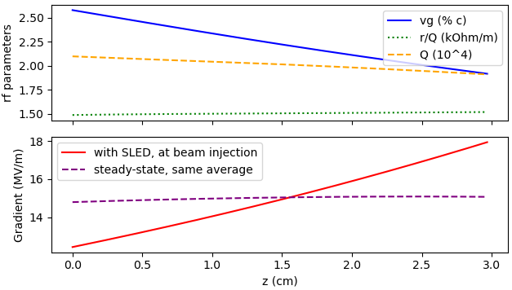
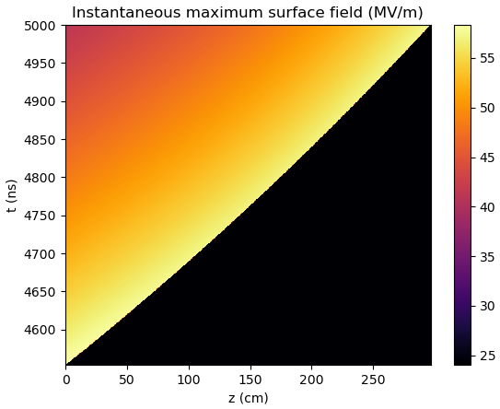
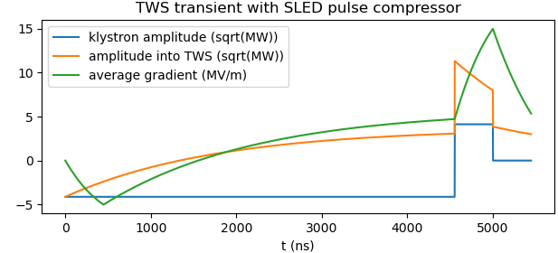
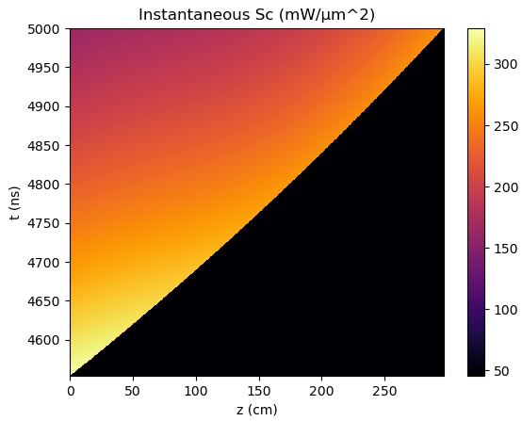
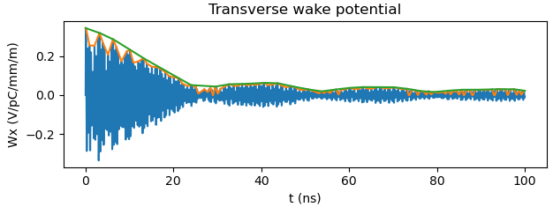
Current baseline structure „F3“ for Positron Linac
positron beam size demands large aperture (30 mm) → low frequency, reentrant geometry, high phase advance
3 m for integration into lattice
(a bit longer is more efficient)
same or shorter version considered
also for Positron Capture Linac
 | F3 (baseline)
Frequency | 2.0 GHz
Constant aperture | 30 mm = 0.2 λ
Phase advance | 9π/10
Length | 3.0 m = 44 cells
Entr., exit iris thickness | 14.3 mm, 20.0 mm
Transverse wake at 17.5 ns | 0.13 V/pC/mm/m
Filling time | 447 ns
Min. group velocity | 1.9 % c
Largest cell radius | 61 mm
SLED coupling | 17
Eff. shunt impedance | 39 MΩ/m
Average gradient | 20 MV/m
E_{max} (instant.) | 77 MV/m
S_{c,max} (instant.) | 585 mW/μm²
Klystron pulse length | 5 µs
Klystron power per structure | 30 MW

Slide 15
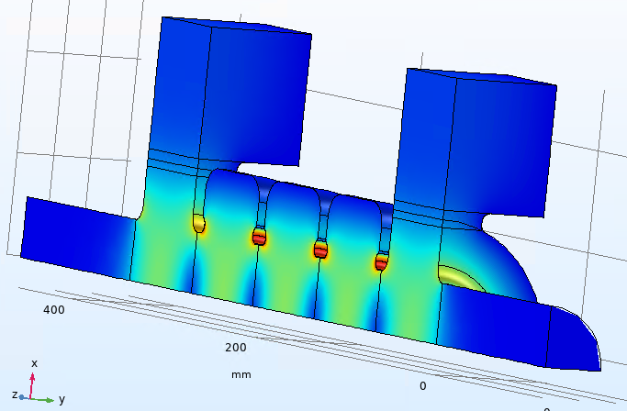
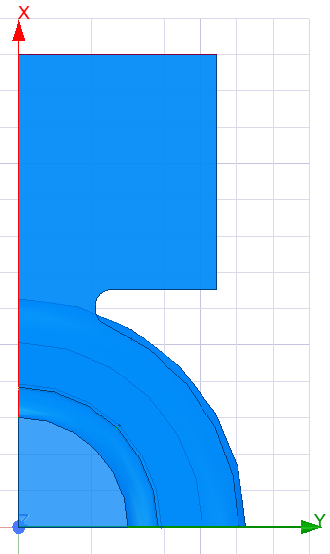
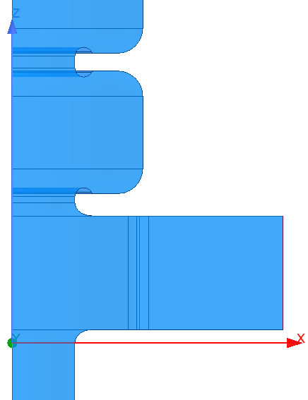
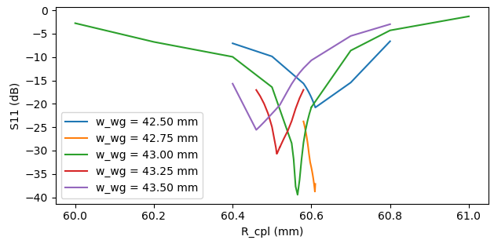
Power coupler design (preliminary)
at 2 GHz, 9π/10: TWS cell length L_{cell} = 67.453 mm → fits well with WR-430 waveguide
double waveguide coupler (symmetric in each XZ and YZ plane)
matching:
  parameters: coupling cell (first cell) radius (R_{cpl}) and waveguide iris (w_{wg})
  procedure: minimize max(|S₁₁|) of short model with 1,2,3 cells between coupling cells
b
a/2
a/2
Input match
w_{wg}
b
R_{cpl}
L_{cell}
L_{cell}

Slide 16

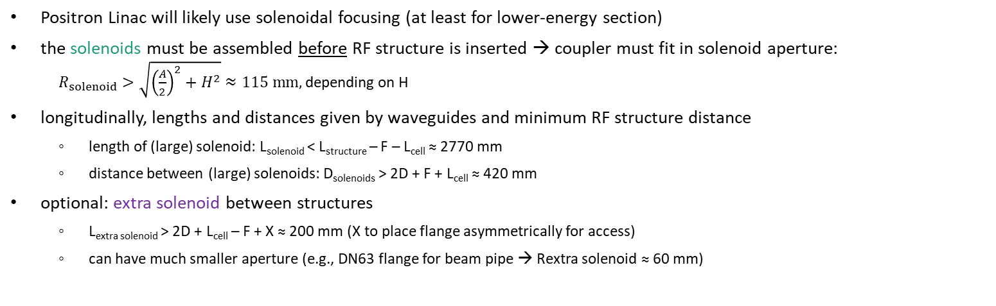
Integration into lattice: with solenoids
Positron Linac will likely use solenoidal focusing (at least for lower-energy section)
the solenoids must be assembled before RF structure is inserted → coupler must fit in solenoid aperture:
$R_{solenoid}>\sqrt{{\left(\frac{A}{2}\right)}^{2}+H^{2}}≈115 mm,$ depending on H
longitudinally, lengths and distances given by waveguides and minimum RF structure distance
  length of (large) solenoid: L_{solenoid} < L_{structure} – F – L_{cell} ≈ 2770 mm
  distance between (large) solenoids: D_{solenoids} > 2D + F + L_{cell} ≈ 420 mm
optional: extra solenoid between structures
  L_{extra solenoid} > 2D + L_{cell} – F + X ≈ 200 mm (X to place flange asymmetrically for access)
  can have much smaller aperture (e.g., DN63 flange for beam pipe → Rextra solenoid ≈ 60 mm)
A = 161 mm
a = 109.22 mm
R_{solenoid}
H ≈ 80 mm
R ≈ 65 mm
D_{solenoids}
L_{solenoid}
L_{extra solenoid}
F
L_{cell}
D
X
D
L_{cell}
L_{structure}

Slide 17
Integration into lattice: with quadrupoles
Option 1: Quadrupoles between structures
conventional, need to tune only focusing & structure length
●●●
structure F3
●●●
~ 3 m
Option 2: Quadrupoles around structures
shorter FODO period, external structure geometry vs. magnet pole radius
quadrupoles can be assembled around structures
studies on production of quadratic cross section ongoing
R_{cell}
R_{pole}
a

Slide 18
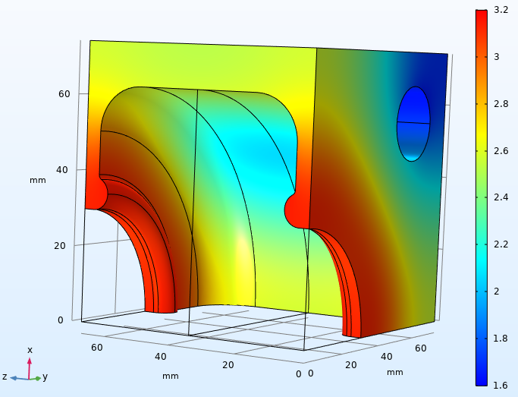
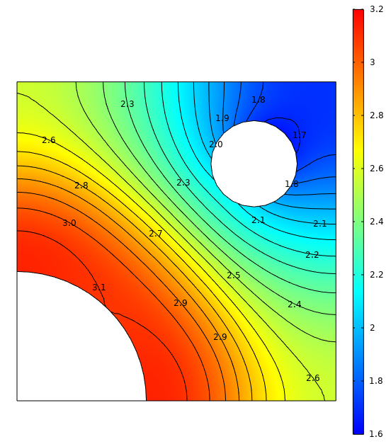
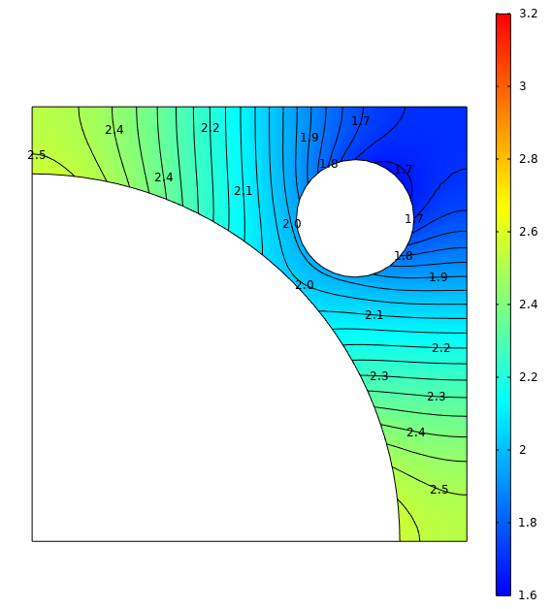
Thermal simulation of first cell
(thinner copper)
Steady-state temperature rise (K)
Thermal load parameters
Linac repetition rate | 200 Hz
Avg. structure input power | 24 kW
Avg. klystron output power | 30 kW
Avg. losses in pulse compressor | 6 kW (20 %)
Total avg. wall losses | 5.7 kW (1.9 kW/m)
Avg. wall losses first cell | 126 W
Exterior geometry parameters
Cell radius | ≈ 63 mm
Magnet pole radius | 79 mm
Copper btwn. vacuum and air | 11 mm
Cooling channel diameter | 20 mm
Copper btwn. channel and vacuum | ≈ 5 mm
Copper btwn. channel and air | 9 mm
iris cross section
center cross section
Material properties | Cu OFE
Electrical conductivity | 58 MS/m
Thermal conductivity | 398 W/m/K
Density | 8.93 g/cm³
Specific heat | 385 J/kg/K
Convection to water channel | 4 kW/m²/K

Slide 19
Summary
Have written Python tool + lookup database to rapidly calculate structure parameters
incl. higher-order modes / long-range wakefield
Preliminary RF traveling-wave structure parameters for Electron, Positron, and Common Linacs
  very few more iterations with beam dynamics will converge on final choice of main parameters:
  frequency (N x 400 MHz), length, aperture, gradient
  can fine tune parameters based on more input, e.g. available klystrons
Positron Linac TW structure is more advanced: 2.0 GHz, 3 m long, 30 mm aperture radius;
preliminary 3D design; will study next / study deeper:
  validate short-range wake, compare available models and numerical codes
  coupler design
  integration with lattice (quadrupoles, solenoids?)
  thermal behavior
  fabrication aspects

Slide 20
Spare Slides

Slide 21
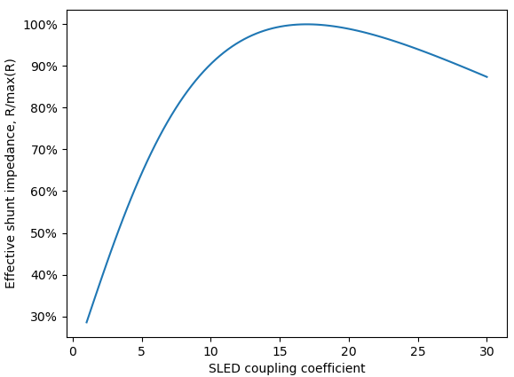
F3 structure: Reff vs. SLED coupling
baseline Positron Linac TWS structure reached optimum shunt impedance with SLED pulse compressor coupling strength of 17
(large-aperture structure with T_{fill} < T_{klystron} / 10)
β = 17 is quite high and might be difficult to achieve in pulse compressor RF design
with β = 10 → -10 % shunt impedance
with β = 8 → - 20 % shunt impedance
F3 structure eff. shunt impedance vs. SLED coupling

Slide 22
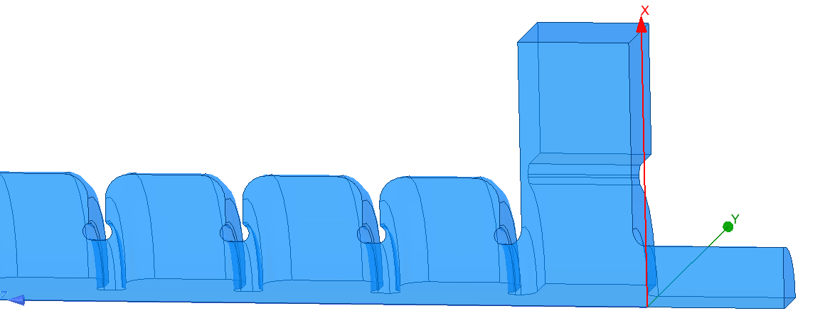
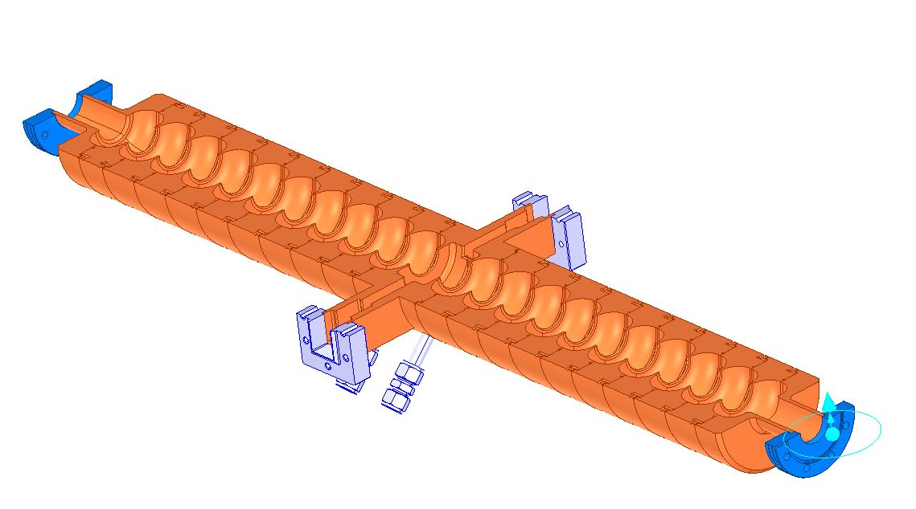
Positron Linac TW vs. SW structure
 | TW structure „F3“ | 2x SW structure for P³
Frequency | 2.0 GHz | 2.0 GHz
Constant aperture | 30 mm | 30 mm
Phase advance | 9π/10 | π
Length (num cells) | 3.0 m (44) | 2x 1.5 m
Entr., exit iris thickness | 14.3 mm, 20.0 mm | 5.25 mm
Transverse wake at 17.5 ns | 0.13 V/pC/mm/m | 0.12 V/pC/mm/m
Filling time | 447 ns
Min. group velocity | 1.9 % c
Largest cell radius | 61 mm
SLED coupling | 17
Eff. shunt impedance | 39 MΩ/m | 14.9 (29.8) MΩ/m
Average gradient | 20 MV/m | 20 MV/m
E_{max} (instant.) | 77 MV/m | 88 MV/m
S_{c,max} (instant.) | 585 mW/μm²
Klystron pulse length | 5 µs | 5 µs (β = 2)
Klystron power per structure | 30 MW | 45 MW (β = 2)
TWS baseline „F3“
SWS for P³
Courtesy of R. Zennaro (https://indico.cern.ch/event/1150396/contributions/4830169/attachments/2433628/4167805/20220429_WP1_3_6.pdf)

Slide 23
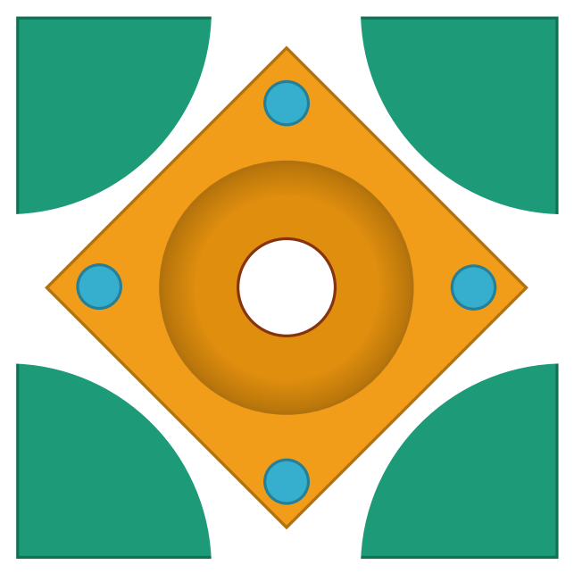
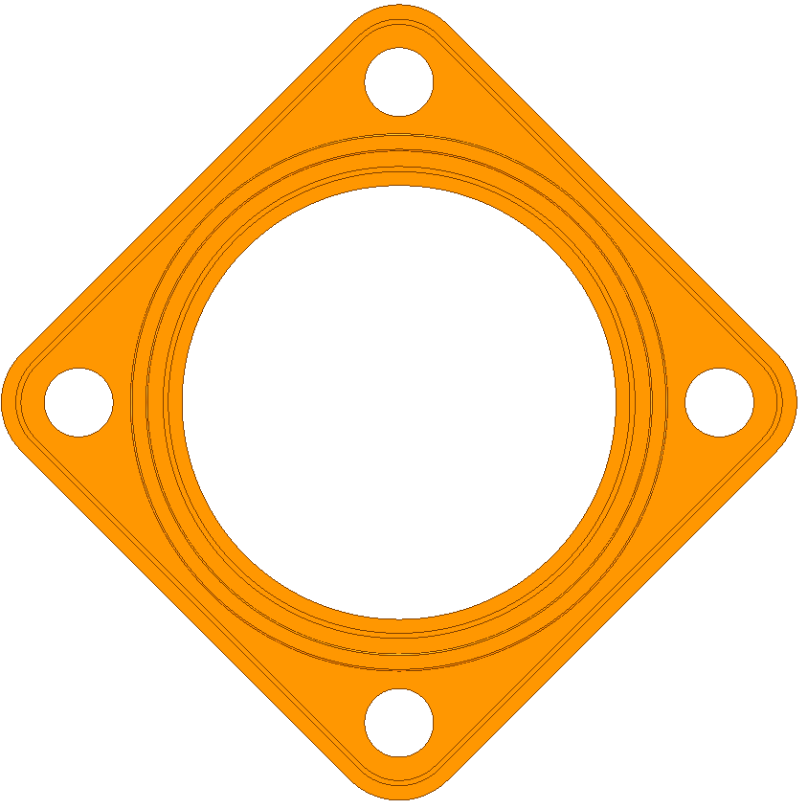
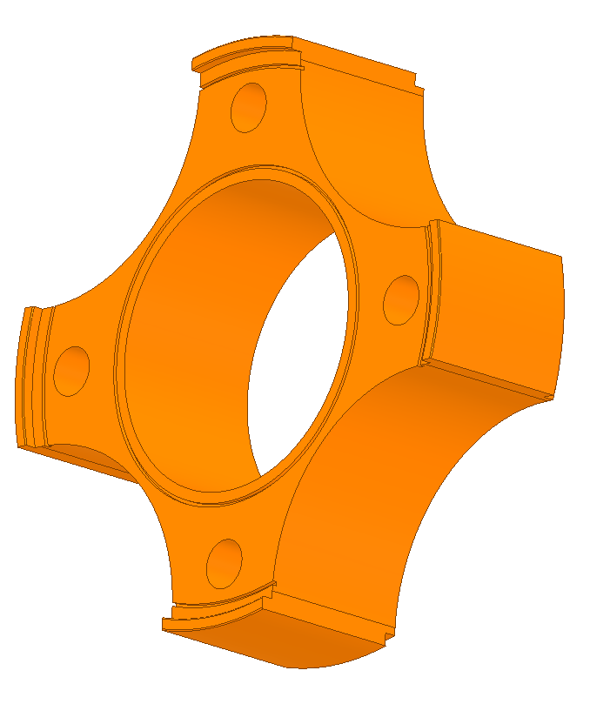
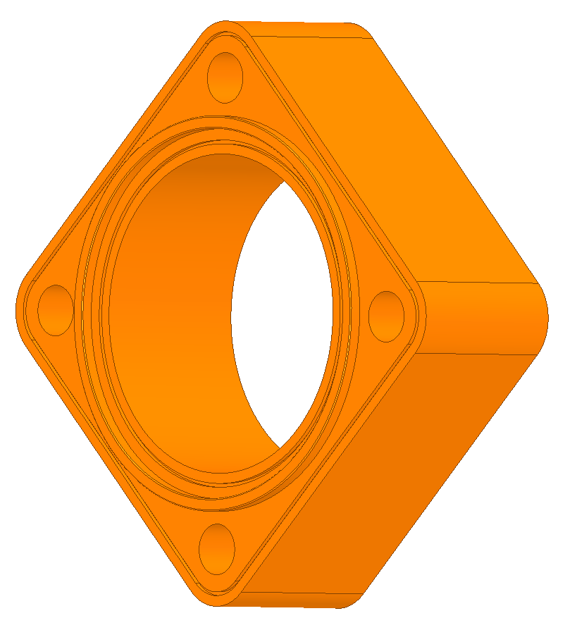
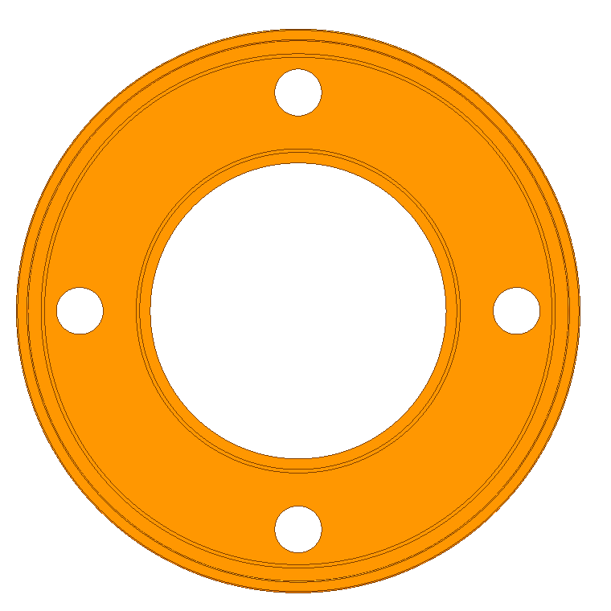
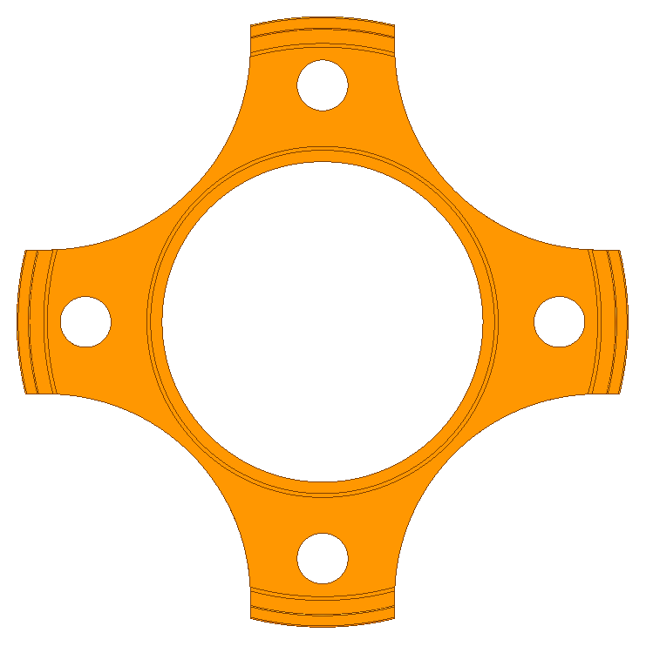
Possible fabrication of F3 structure
with quadratic outer cross section
Squared shape of the disks, circular housing included in the design. Brazing and machining to be tested.
Conventional circular cup design, conventional brazing. Machining of the cavity after brazing. Requires final machining tests.
126
126
146
Courtesy of R. Zennaro (https://indico.cern.ch/event/1150396/contributions/4830169/attachments/2433628/4167805/20220429_WP1_3_6.pdf)

Slide 24
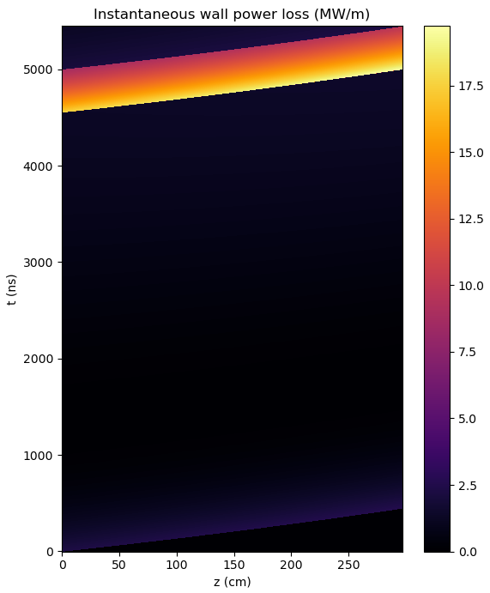
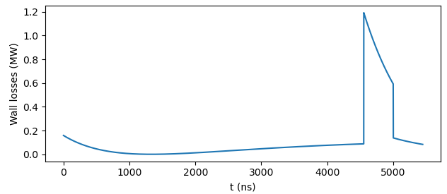
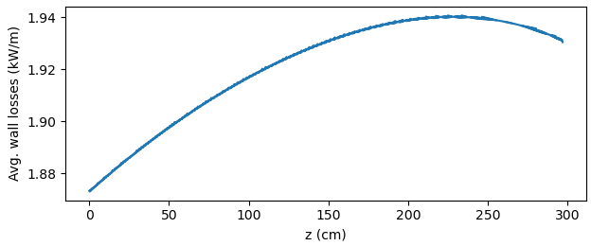
Thermal load
Instantaneous wall losses in first cell
Structure RF optimization parameters (Structure F3)
Frequency | 2.0 GHz
Length (num cells) | 3.0 m (44)
Largest cell radius | 61 mm
Eff. shunt impedance | 39 MΩ/m
Average gradient | 20 MV/m
E_{max} (instant.) | 77 MV/m
S_{c,max} (instant.) | 585 mW/μm²
Klystron pulse length | 5 µs
Klystron power per structure | 30 MW
Thermal load parameters
Linac repetition rate | 200 Hz
Avg. klystron output power | 30 kW
Avg. structure input power | 24 kW
Avg. losses in pulse compressor | 6 kW (20 %)
Total avg. wall losses | 5.7 kW (1.9 kW/m)
Avg. wall losses in first cell | 126 W
Average wall losses along structure

Slide 25
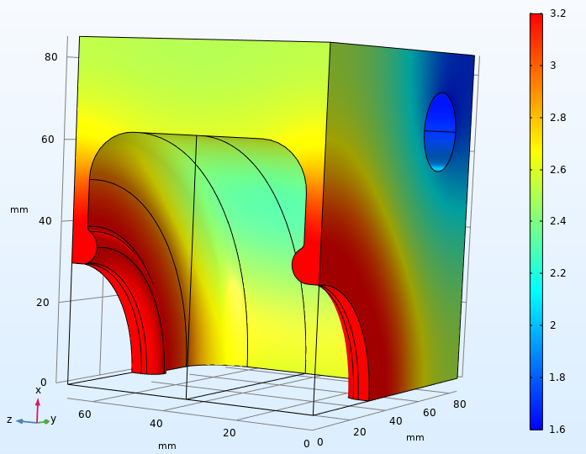
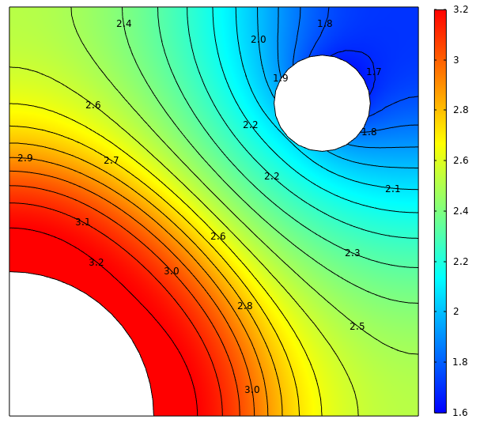
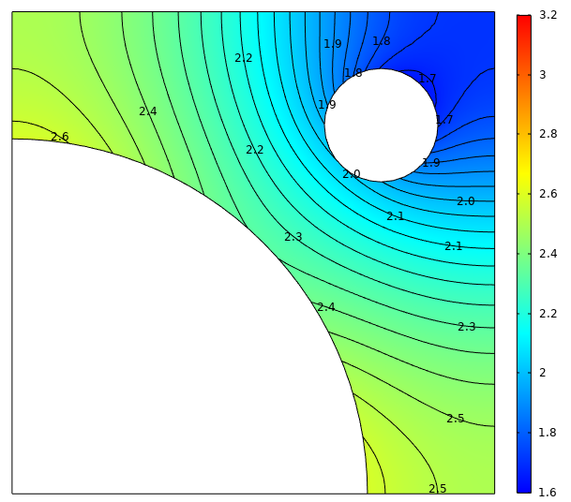
Thermal simulation of first cell
(thicker copper)
Steady-state temperature rise (K)
Thermal load parameters
Linac repetition rate | 200 Hz
Avg. structure input power | 24 kW
Avg. klystron output power | 30 kW
Avg. losses in pulse compressor | 6 kW (20 %)
Total avg. wall losses | 5.7 kW (1.9 kW/m)
Avg. wall losses first cell | 126 W
Exterior geometry parameters
Cell radius | ≈ 63 mm
Magnet pole radius | 90 mm
Copper btwn. vacuum and air | 22 mm
Cooling channel diameter | 20 mm
Copper btwn. channel and vacuum | ≈ 19 mm
Copper btwn. channel and air | 15 mm
iris cross section
center cross section
Material properties | Cu OFE
Electrical conductivity | 58 MS/m
Thermal conductivity | 398 W/m/K
Density | 8.93 g/cm³
Specific heat | 385 J/kg/K
Convection to water channel | 4 kW/m²/K

Slide 26
Thermal simulation of first cell
(thinner copper)
Steady-state temperature rise (K)
Thermal load parameters
Linac repetition rate | 200 Hz
Avg. structure input power | 24 kW
Avg. klystron output power | 30 kW
Avg. losses in pulse compressor | 6 kW (20 %)
Total avg. wall losses | 5.7 kW (1.9 kW/m)
Avg. wall losses first cell | 126 W
Exterior geometry parameters
Cell radius | ≈ 63 mm
Magnet pole radius | 79 mm
Copper btwn. vacuum and air | 11 mm
Cooling channel diameter | 20 mm
Copper btwn. channel and vacuum | ≈ 5 mm
Copper btwn. channel and air | 9 mm
iris cross section
center cross section
Material properties | Cu OFE
Electrical conductivity | 58 MS/m
Thermal conductivity | 398 W/m/K
Density | 8.93 g/cm³
Specific heat | 385 J/kg/K
Convection to water channel | 4 kW/m²/K

