Slide 1
Transport requirements
02/06/2022 / FCC Week 2022
C. Colloca – R. Rinaldesi
gratefully acknowledging the contributions of J. Bauche, J. Osborne, T. Otto and FIML

Slide 2
Table of contents
02/06/2022 / FCC Week 2022
C. Colloca – R. Rinaldesi
Requirements for underground transport and handling of magnets
Requirements for underground transport of people
Boundary conditions
Open points

Slide 3

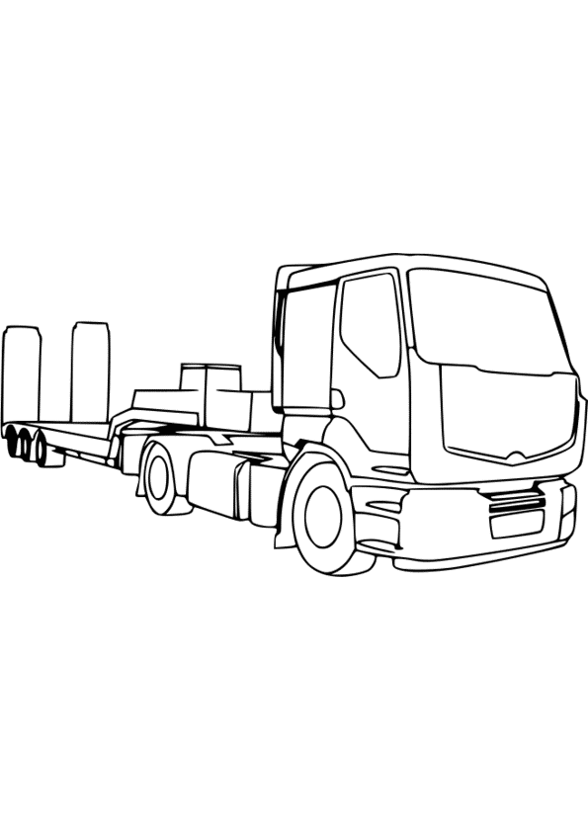


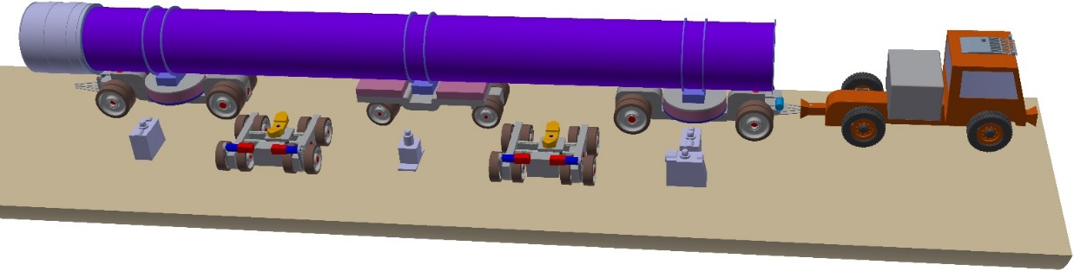
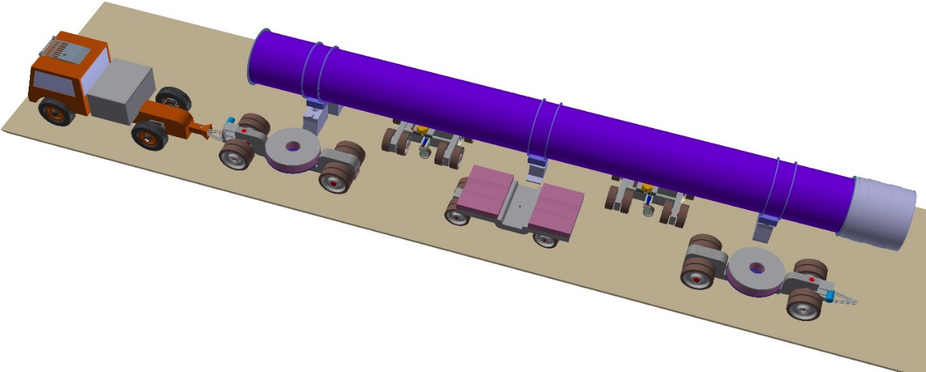
Requirements for underground transport and handling of magnets¹
02/06/2022 / FCC Week 2022
C. Colloca – R. Rinaldesi
Manufacturing-> Transport to FCC sites -> Storage
Lowering -> Underground transport
Unloading
¹ FCC-ee magnets only are considered at this stage

Slide 4
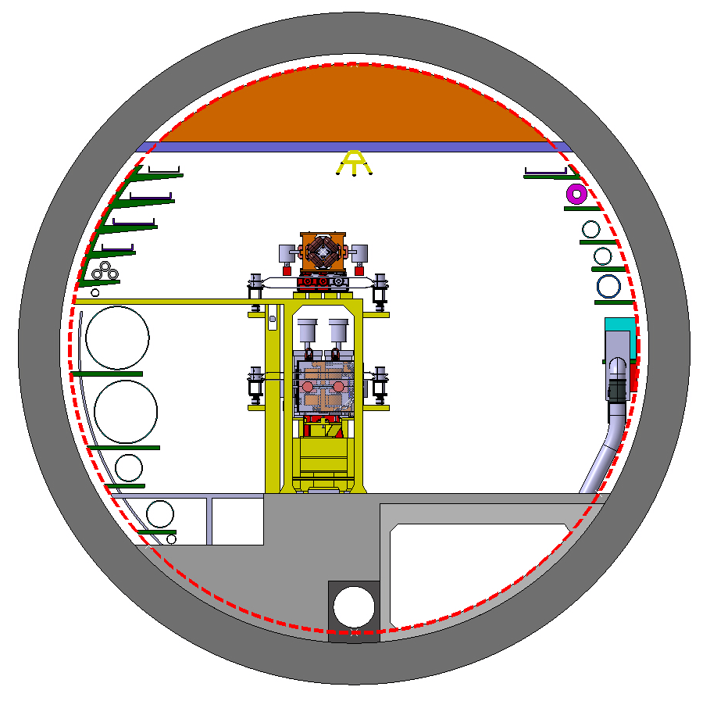
Requirements for underground transport and handling of magnets
02/06/2022 / FCC Week 2022
C. Colloca – R. Rinaldesi
Booster ring
Collider ring

Slide 5
Requirements for underground transport and handling of magnets
02/06/2022 / FCC Week 2022
C. Colloca – R. Rinaldesi
Collider ring
Type | Dipoles | Quadrupoles | Sextupoles
Number | 5800 | 2900 | 3560
Length [cm] | 1200 | 340 | 170
Width [cm] | 45 | 60 | 30
Height [cm] | 30 | 70 | 50
Weight [kg] | 3700 | 5500 | 600

Slide 6
Requirements for underground transport and handling of magnets
02/06/2022 / FCC Week 2022
C. Colloca – R. Rinaldesi
Collider ring
Unit | Q-S | Q-S-S
Length [cm] | 520 | 700
Width [cm] | 60 | 60
Height [cm] | 100 | 100
Weight [kg] | 6620 | 7400
Magnets will be installed as follows:
5800 single dipoles
492 single quadrupoles
1256 units made up of quadrupole-sextupole and supporting girder (Q-S)
1152 units made up of quadrupole-sextupole-sextupole and supporting girder (Q-S-S)

Slide 7
Requirements for underground transport and handling of magnets
02/06/2022 / FCC Week 2022
C. Colloca – R. Rinaldesi
Booster ring
Type | Dipoles | Quadrupoles | Sextupoles
Number | 5888 | 2944 | Unknown
Length [cm] | 1140 | 170 | 70
Width [cm] | 30 | 50 | 30
Height [cm] | 30 | 70 | 50
Weight [kg] | 2500 | 2000 | 200

Slide 8
Requirements for underground transport and handling of magnets
02/06/2022 / FCC Week 2022
C. Colloca – R. Rinaldesi
Data about collider ring have been defined based on existing design;
Data about booster ring have been derived by scaling the collider ones;
No specific requirements concerning the max allowed acceleration and tilt angle;
Max tunnel slope: 0.5%

Slide 9
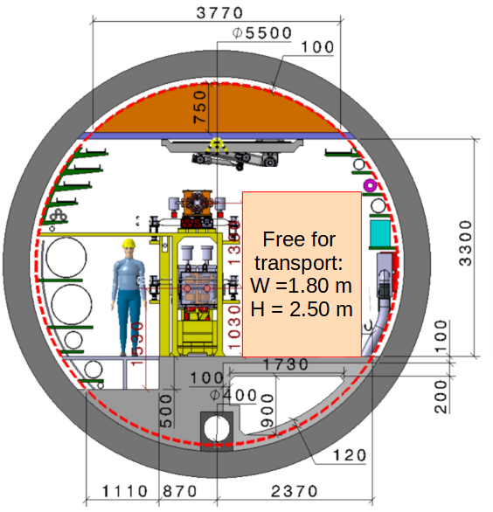
Requirements for underground transport of people 1/2
02/06/2022 / FCC Week 2022
C. Colloca – R. Rinaldesi
Vehicle shall be used to transport personnel
with material and evacuate them in case of emergency;
Minimum capacity: 6 people - 500 kg (possibly a bit more)
Materials payload: 1000 kg
Total capacity: 1500 – 2000 kg
Max speed: 30 km/h (lower for material);
Battery powered;

Slide 10
Requirements for underground transport of people 2/2
02/06/2022 / FCC Week 2022
C. Colloca – R. Rinaldesi
Possibility for autonomous drive to be investigated;
Vehicles connected between them and/or with a centralized system;
Modular design allowing the mounting of different platforms;
Hosting equipment for autonomous
or remote interventions (minimise human access to the tunnel).

Slide 11
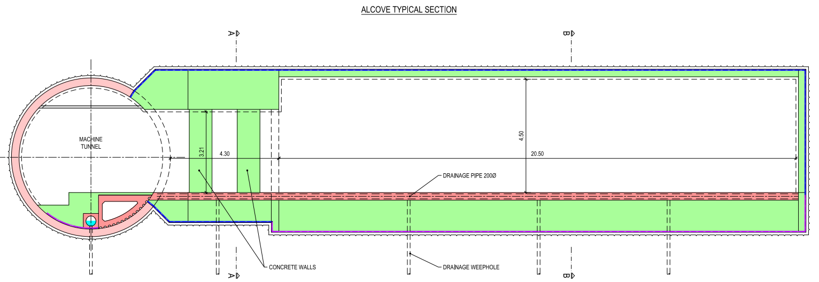
Boundary conditions
02/06/2022 / FCC Week 2022
C. Colloca – R. Rinaldesi
Vehicle design shall take into account the interaction with the surrounding environment, in particular:
Vehicle-vehicle crossing (especially for people vehicle)
-> if this shall be possible anywhere, a rail-bound system is not possible;
Vehicle-people crossing;
Presence of alcoves;
Dedicated areas for vehicles parking;
Passage through fire protection doors in fire partitions.

Slide 12
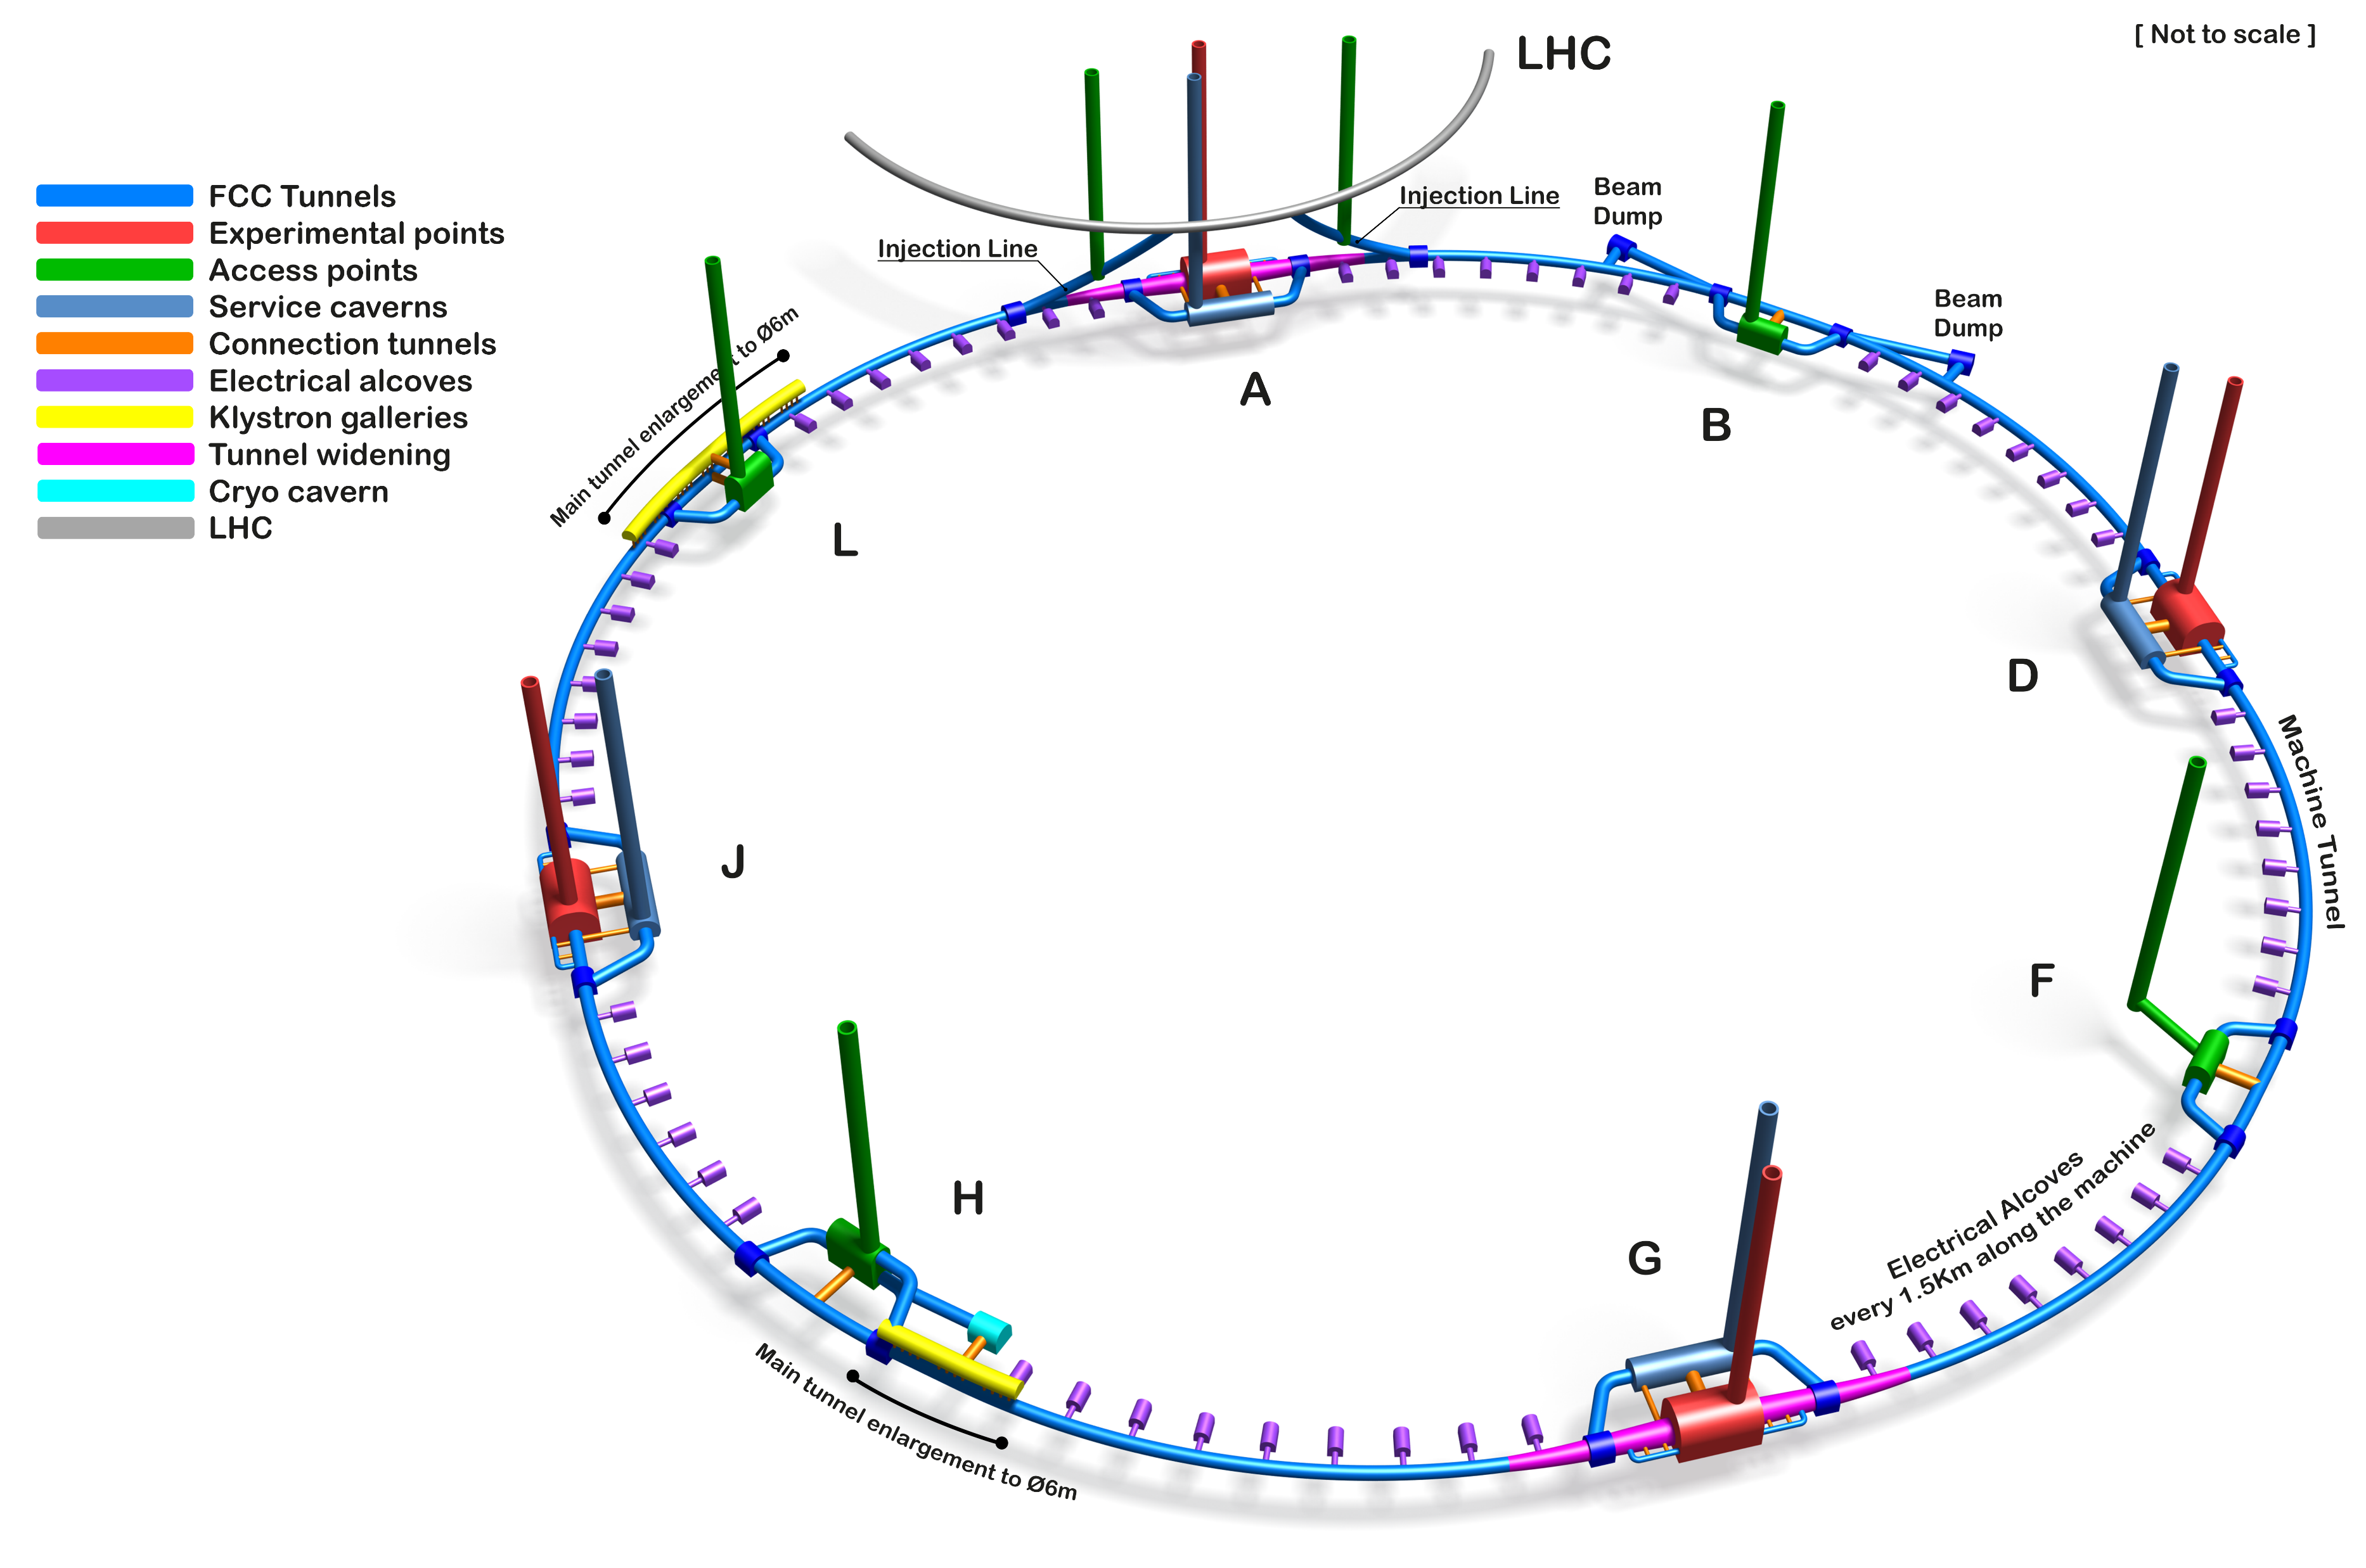
Open points 1/2
02/06/2022 / FCC Week 2022
C. Colloca – R. Rinaldesi
Same vehicle for all types of magnets?
Number of shafts dedicated to magnets’ handling
Magnets design:
  Connection design;
  Installation procedure and time;
  Number of support points.

Slide 13
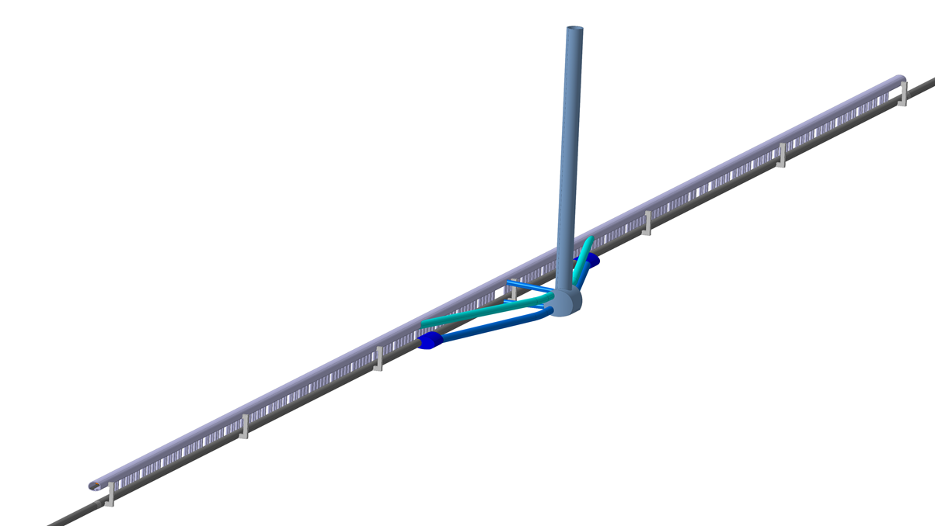
Open points 2/2
02/06/2022 / FCC Week 2022
C. Colloca – R. Rinaldesi
Number of people/sector present at each stage (installation of the machine, operation i.e. technical stops, dismantling)
Installation schedule and sequence of magnets, technical services and fire protection doors
Information about components
to be installed in the klystron gallery
Klystron Gallery
Machine tunnel

Slide 14
Open points per phase
02/06/2022 / FCC Week 2022
C. Colloca – R. Rinaldesi
 | Installation | Operation (technical stops) | Dismantling
Different types of vehicles | x | x | x
Number of shafts for magnets’ handling | x |  | x
Magnets design: Connection design Installation procedure and time Number of support points | x | x
Number of people/sector | x | x | x
Installation schedule and sequence of magnets, technical services and fire protection doors | x |  | x
Information about components to be installed in the klystron gallery | x |  | x

Slide 15
Thank you for your attention.
02/06/2022 / FCC Week 2022
C. Colloca – R. Rinaldesi
15

