Slide 1


Slide 2
Power Converters R&D
–
From DC Distribution to Energy Storage Systems
FCC Week 2022
30 May 2022 to 3 June 2022
Université Sorbonne, Paris
D. Aguglia, F. Blanquez, F. Boattini, M. Colmenero Moratalla, K. Papastergiou , S. Pittet, S. Uznanski
CERN
Electrical Power Converter (EPC) Group, Accelerator Systems (SY Dept.)
Many thanks to:
J. Bauche, CERN Magnet Group
M. Parodi, CERN Electrical Group
J.-P. Burnet, CERN Acc. Deputy Systems Dept. Head

Slide 3
Outline
FCC-ee Power Converter DRAFT layout
Evaluating DC Distribution
FCC-hh powering specificities
Conclusion

Slide 4
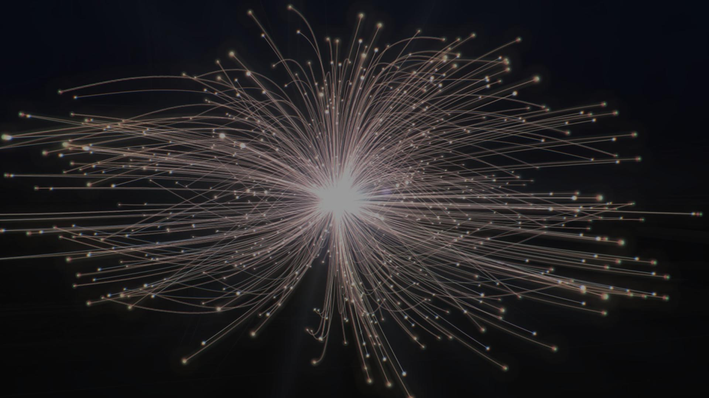
FCC-ee Power Converter DRAFT layout

Slide 5

FCCee power converters DRAFT layout
A first attempt
The Power Converter Group at CERN will start optimizing the powering layout at the end of this year
However, a draft, non-optimal baseline is needed to provide starting point numbers for losses and volumes to other working groups
→ Decided to propose first draft layout based on our group’s expertise's
In the following slides, numbers are draft/preliminary!

Slide 6
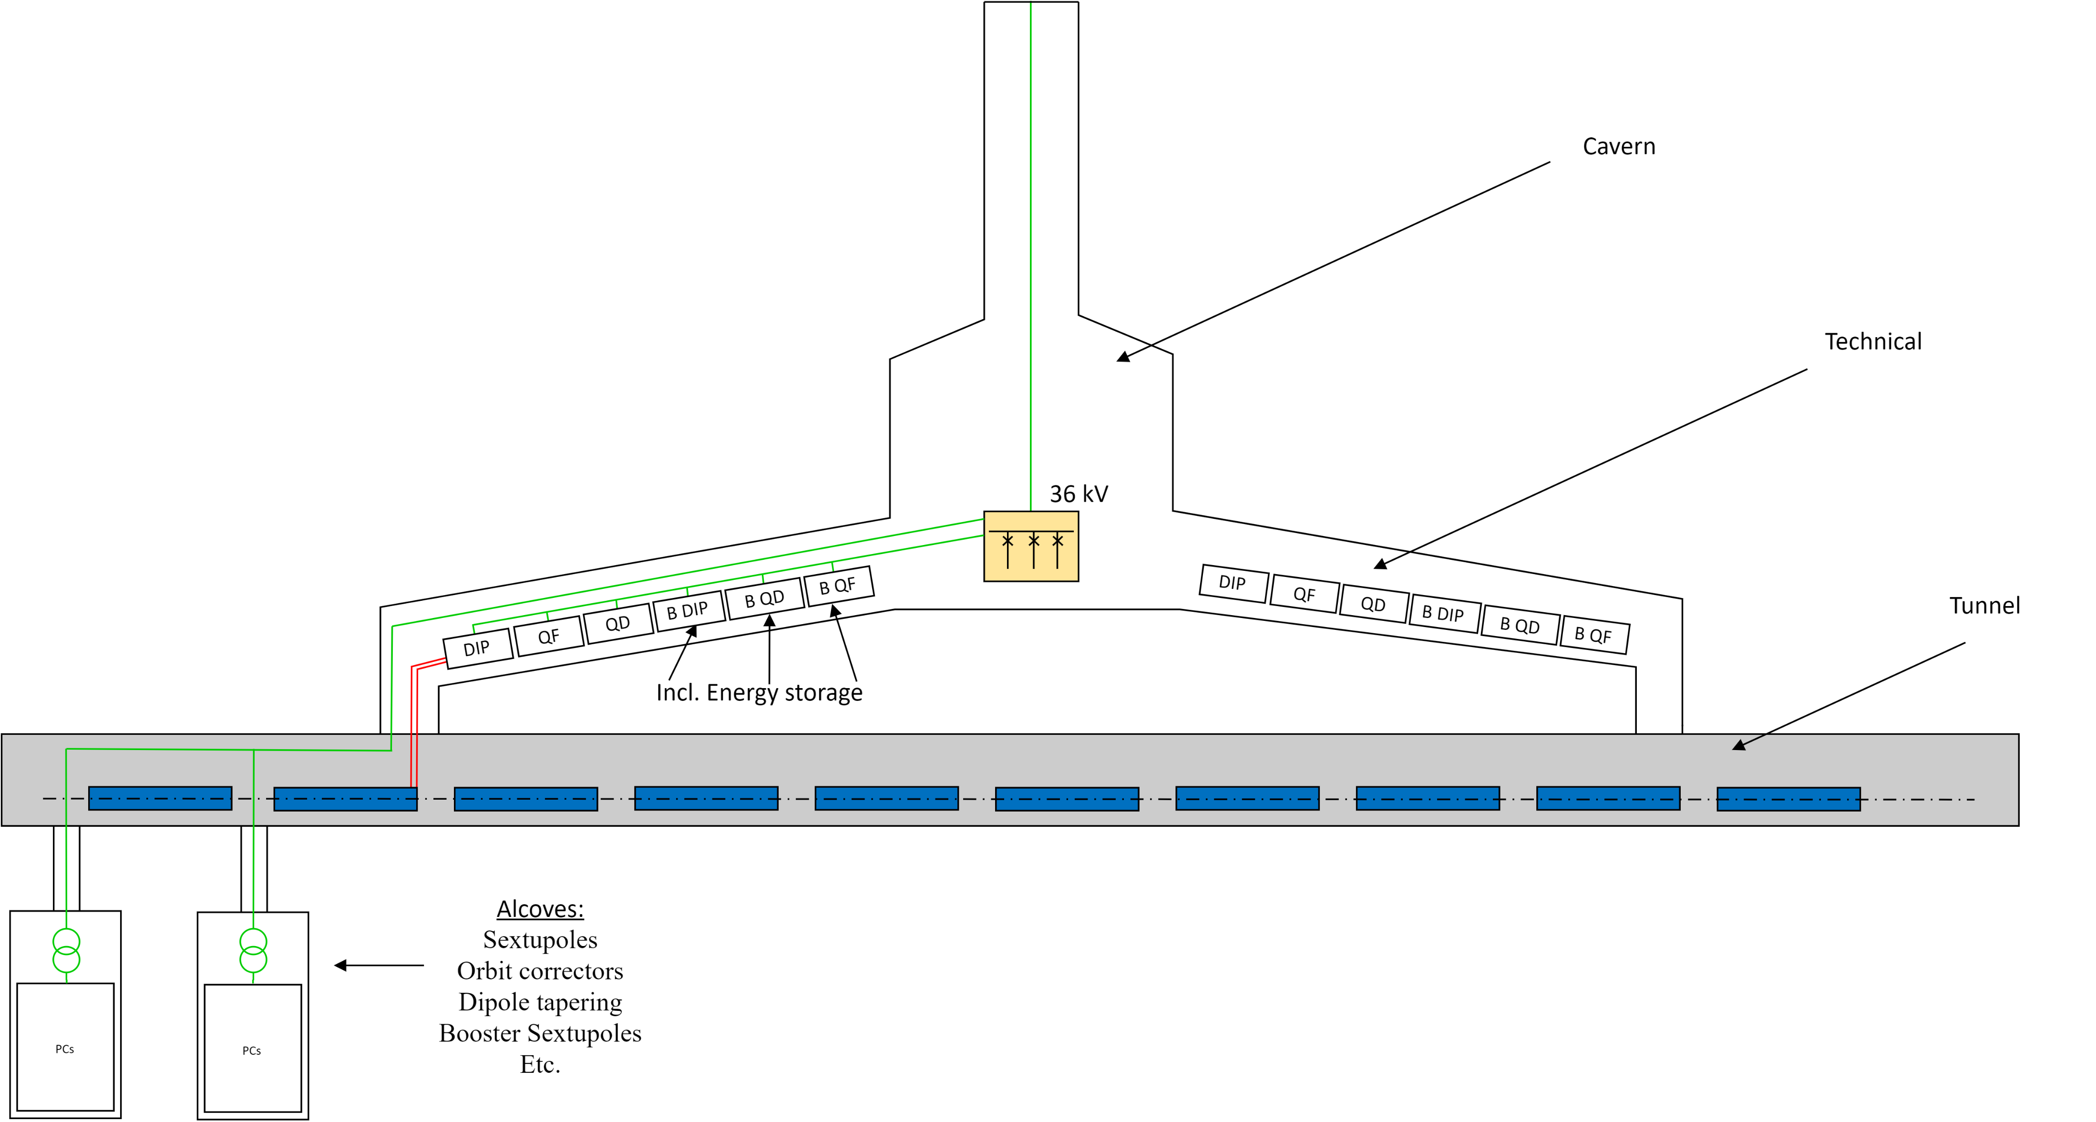
FCCee power converters DRAFT layout
First non-optimized attempt
General layout – power converters location
Collider
power converters
Booster
power converters
Underground
substation

Slide 7
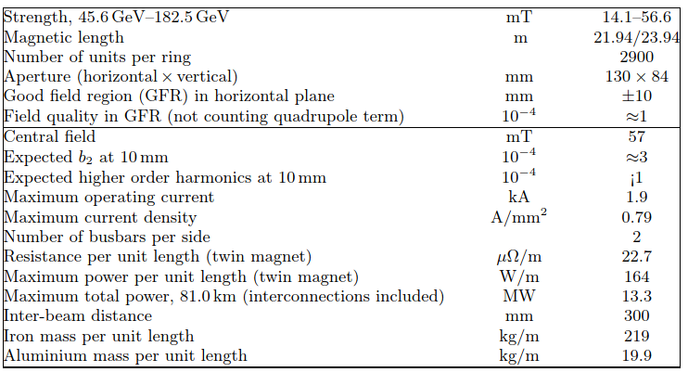
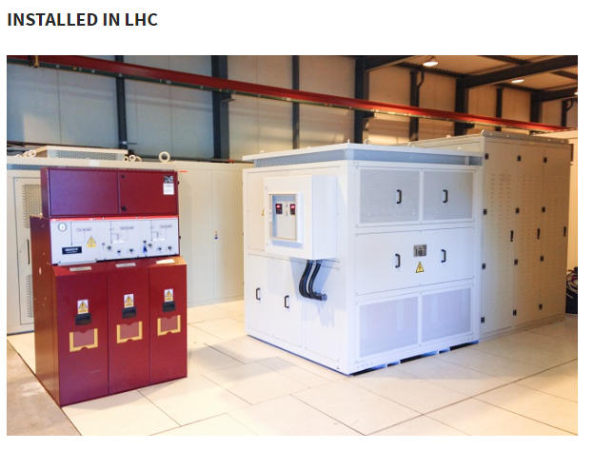
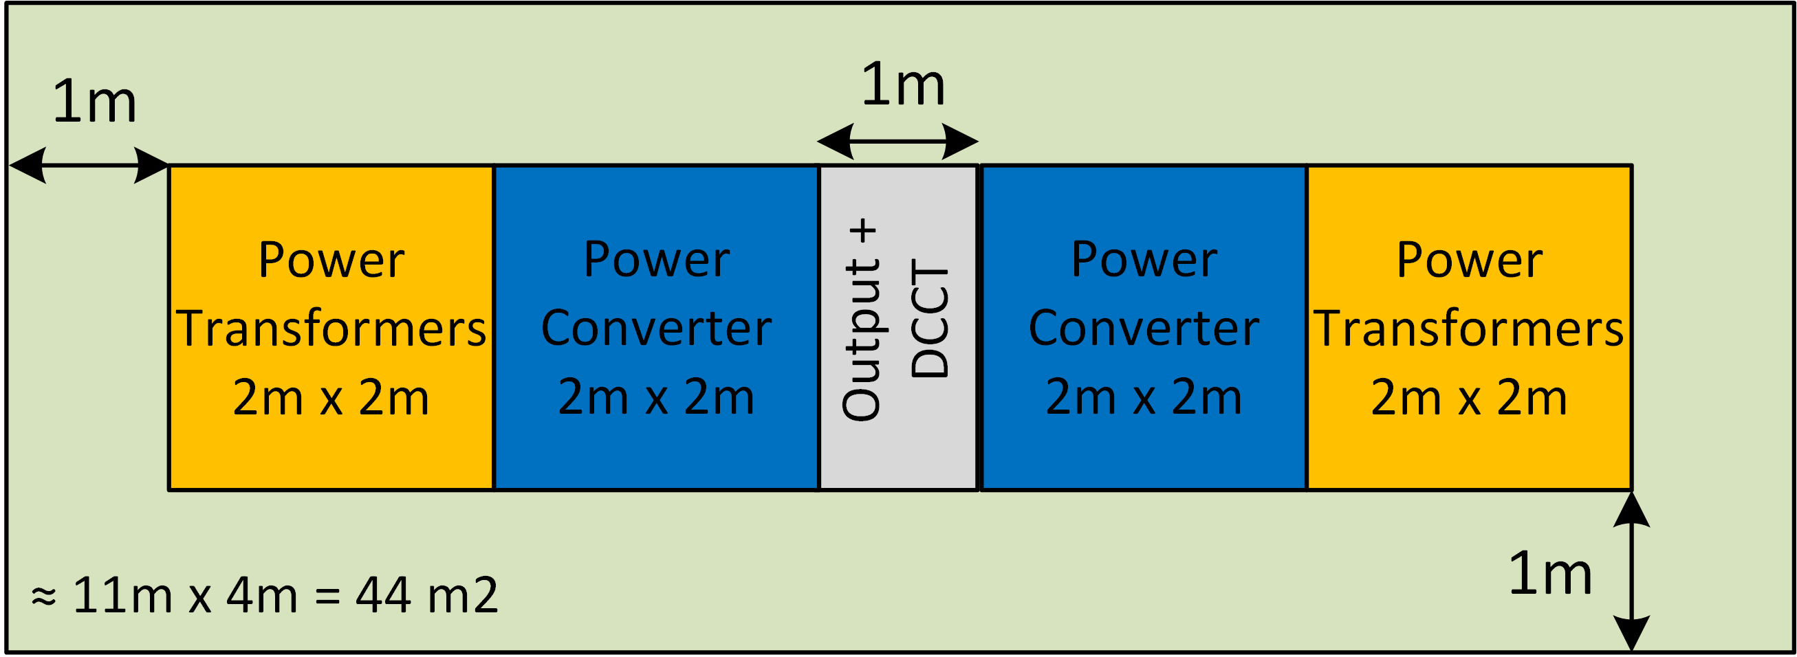
FCCee power converters DRAFT layout
Collider’s Dipoles – Underground service gallery
Dipole magnet specifications from CDR
 | Value | Unit
Converters/circuits number per power sector | 2 | -
Resistance per circuit | 50 | mΩ
Current per circuit (1 turn magnet) | 3.8 | kA
Voltage per circuit | 189 | V
Nominal power | 717 | kW
Converter dimensioning power (250V, 3.8 kA) | 950 | kW
Converter footprint requirement (1 unit) | ~45 | m²
Converter’s losses | 10 | %
Converter losses in water | ~85 | kW
Converter losses in air | ~10 | kW
DC cable distance per circuit (4 x 400 mm²/ pole) | 50 | m
DC cable losses per circuit | ~18.8 | kW
Draft numbers!
Estimated converter footprint

Slide 8
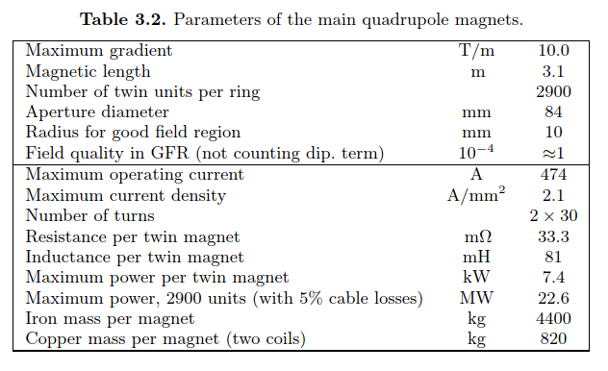

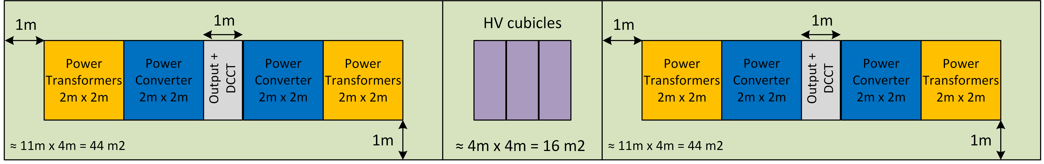
FCCee power converters DRAFT layout
Collider’s Quadrupoles – Underground service gallery
Quadrupole magnet specifications from CDR
 | Value | Unit
Converters/circuits number per power sector | 4 | -
Resistance per circuit | ~3 | Ω
Current per circuit (1 turn magnet) | 474 | A
Voltage per circuit | 1430 | V
Nominal power | 680 | kW
Converter dimensioning power (1500V, 500A) | 750 | kW
Converter footprint requirement (1 unit) | ~105 | m²
Converter’s losses | 10 | %
Converter losses in water | ~68 | kW
Converter losses in air | ~7 | kW
DC cable distance per circuit (2 x 150 mm²/ pole) | 11500 | m
DC cable losses per circuit | ~178 | kW
Draft numbers!
NOTE: Cable resistance not considered for the power converter dimensioning as optimization with magnet design is required
Estimated converter footprint

Slide 9
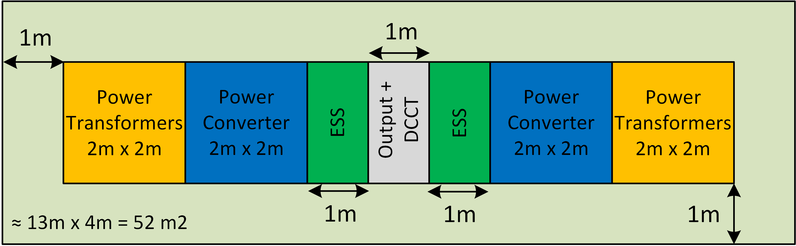
FCCee power converters DRAFT layout
Booster’s Dipoles – Underground service gallery
Dipole magnet specifications from CDR
 | Value | Unit
Converters/circuits number per power sector | 2 | -
Resistance per circuit | 50 | mΩ
Inductance per circuit | ~160 | mH
Current per circuit (1 turn magnet) | 3.8 | kA
Voltage per circuit | 378 | V
Nominal maximum power (selected converter: 400V, 3.8kA) | 1436 | kW
Magnet’s average consumption | 260 | kW
Converter footprint requirement (1 unit) | ~55 | m²
Converter’s losses | 10 | %
Converter losses in water | ~23 | kW
Converter losses in air | ~3 | kW
DC cable distance per circuit (4 x 400 mm²/ pole) | 50 | m
DC cable losses per circuit | ~10 | kW
Estimated energy storage (valid for Z and tt ) | ~1 | MJ
Draft numbers!
Estimated converter footprint

Slide 10
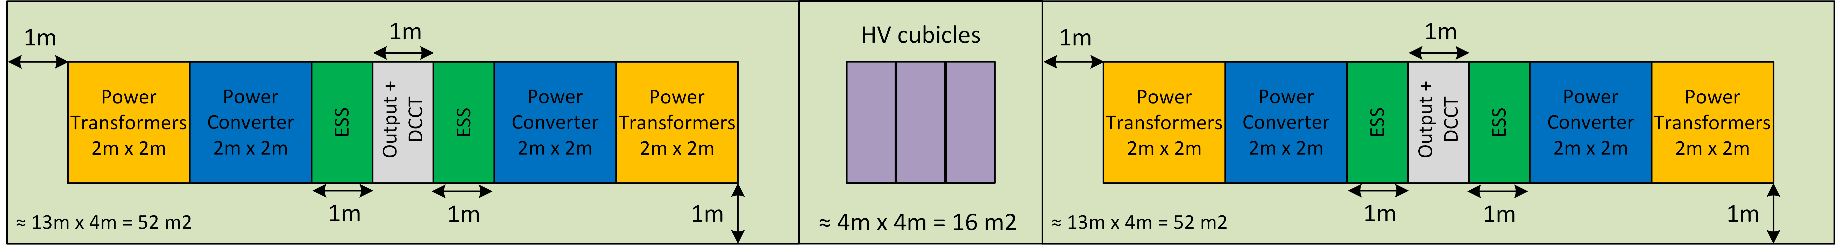
FCCee power converters DRAFT layout
Booster’s Quadrupoles – Underground service gallery
Quadrupole magnet specifications from CDR
 | Value | Unit
Converters/circuits number per power sector | 4 | -
Resistance per circuit | ~3 | Ω
Inductance per circuit | 3,67 | H
Current per circuit (1 turn magnet) | 474 | A
Voltage per circuit | 1716 | V
Nominal maximum power (selected converter: 2000V, 500A) | 814 | kW
Magnet’s average consumption | 242 | kW
Converter footprint requirement (1 unit) | ~125 | m²
Converter’s losses | 10 | %
Converter losses in water | ~21 | kW
Converter losses in air | ~3 | kW
DC cable distance per circuit (2 x 150 mm²/ pole) | 11500 | m
DC cable losses per circuit | ~64 | kW
Estimated energy storage (covers up to ttbar ) | ~1 | MJ
Draft numbers!
NOTE: Cable resistance not considered for the power converter dimensioning as optimization with magnet design is required
Estimated converter footprint

Slide 11
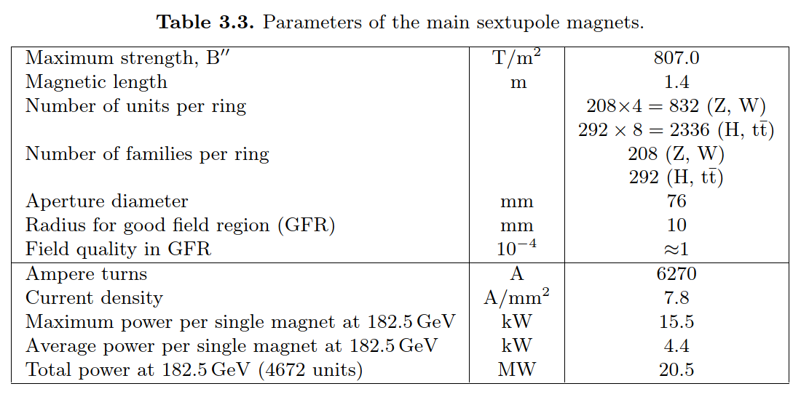
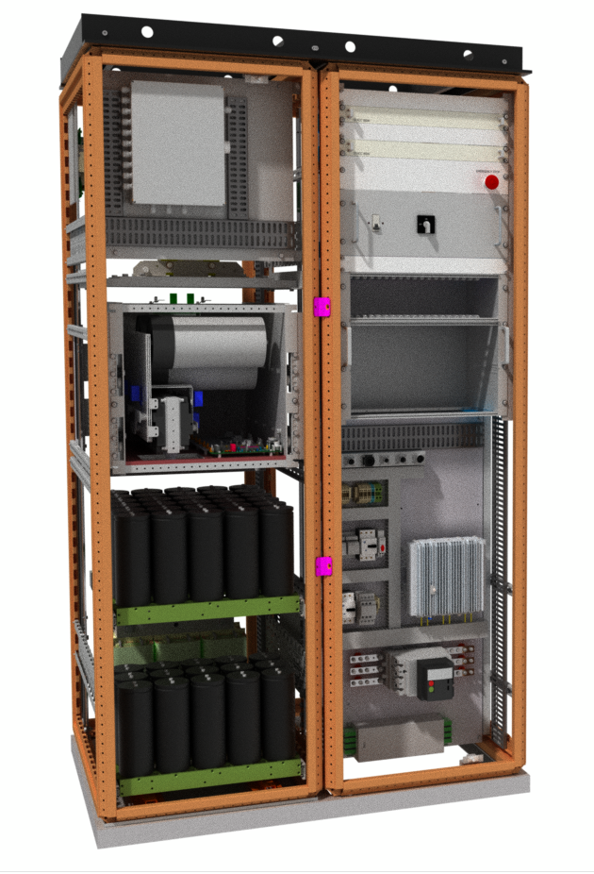

FCCee power converters DRAFT layout
Collider’s Sextupoles – Alcoves
Sextupole magnet specifications from CDR
 | Value | Unit
Converters/circuits number per power sector | 73 | -
Resistance per circuit | 1 | Ω
Current per circuit (1 turn magnet) | 200 | A
Voltage per circuit | 176 | V
Nominal power | 35.2 | kW
Converter dimensioning power (200V, 200 A) | 40 | kW
Converter footprint requirement (1 unit) | ~1,5 | m²
Converter’s losses | 10 | %
Converter losses in water | ~3.6 | kW
Converter losses in air | ~0.4 | kW
DC cable distance per circuit (2 x 120 mm²/ pole) | ~250 | m
DC cable losses per circuit | ~3,2 | kW
Draft numbers!
All based on a first arbitrary assumption of 1 alcove every 400m
3 power converters
≈ 4.5 – 5 racks
Estimated converter footprint
Space required for power converters only!
1.5 racks/converter

Slide 12
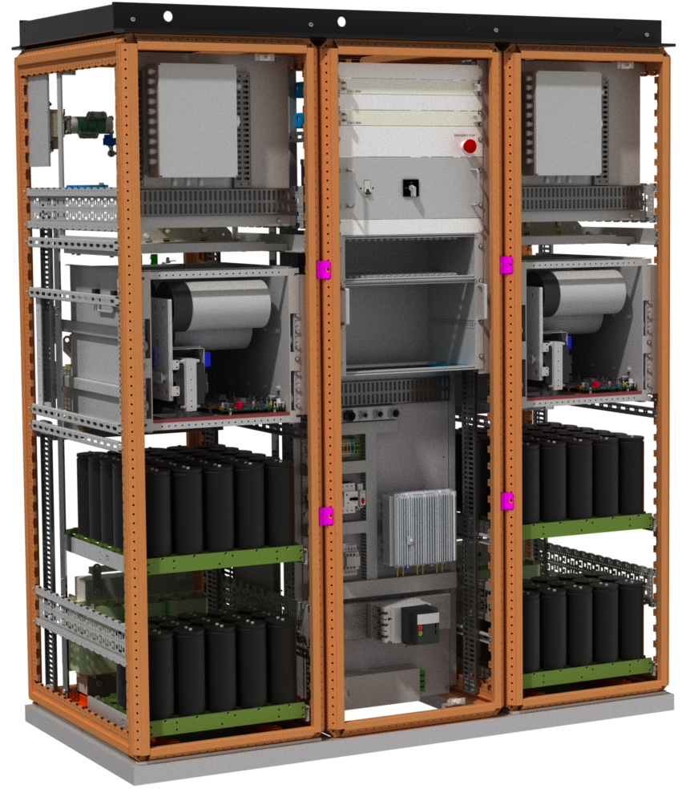
FCCee power converters DRAFT layout
Booster’s Sextupoles – Alcoves
Sextupole magnet specifications from CDR
 | Value | Unit
Converters/circuits number per power sector | 37 | -
Resistance per circuit (292 circuits of 8 magnets) | 1 | Ω
Inductance per circuit (292 circuits of 8 magnets) | 128 | mH
Current per circuit | 200 | A
Voltage per circuit | 215 | V
Nominal maximal power (selected converter: 250V, 200A) | 43 | kW
Magnet’s average consumption | 14.4 | kW
Converter footprint requirement (1 unit) | ~2 | m²
Converter’s losses | 10 | %
Converter losses in water | ~1.2 | kW
Converter losses in air | ~0.2 | kW
DC cable distance per circuit (2 x 120 mm²/ pole) | ~250 | m
DC cable losses per circuit | ~3,2 | kW
Draft numbers!
All based on a first arbitrary assumption of 1 alcove every 400m
Including energy storage
Estimated converter footprint
2 power converters
≈ 6 racks
Space required for power converters only!
3 racks/converter

Slide 13

Summary of required space
Draft numbers!
Alcoves:
75m2/alcove are required only for Power Conv. equipment
18000 m2 required in total in alcoves for whole ring
Underground Technical galleries:
660m2/power sector are required only for Power Conv. equipment
5280 m2 required in total for the whole ring

Slide 14
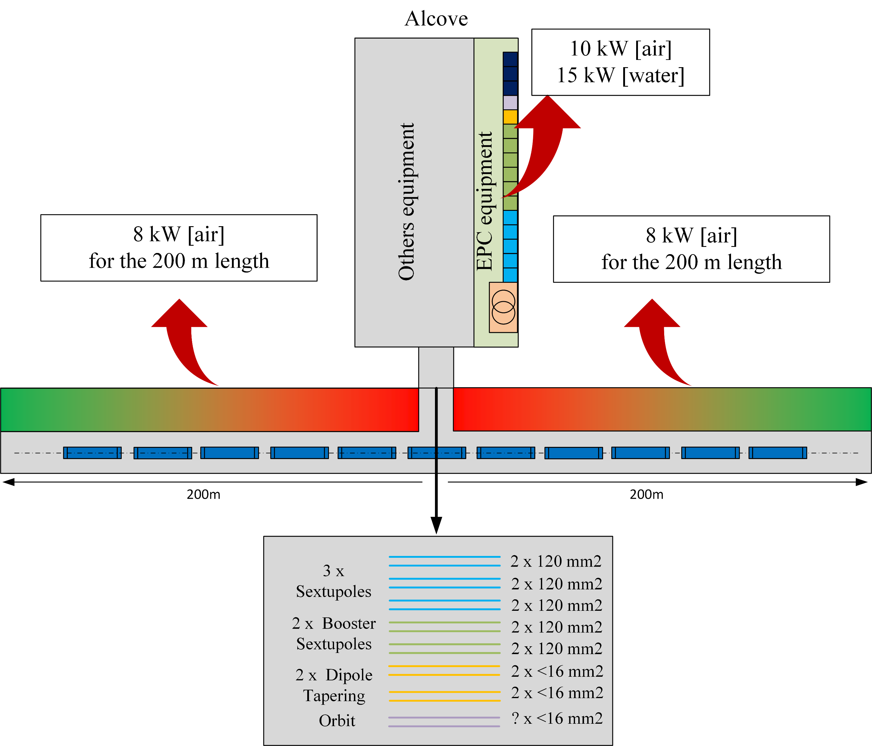
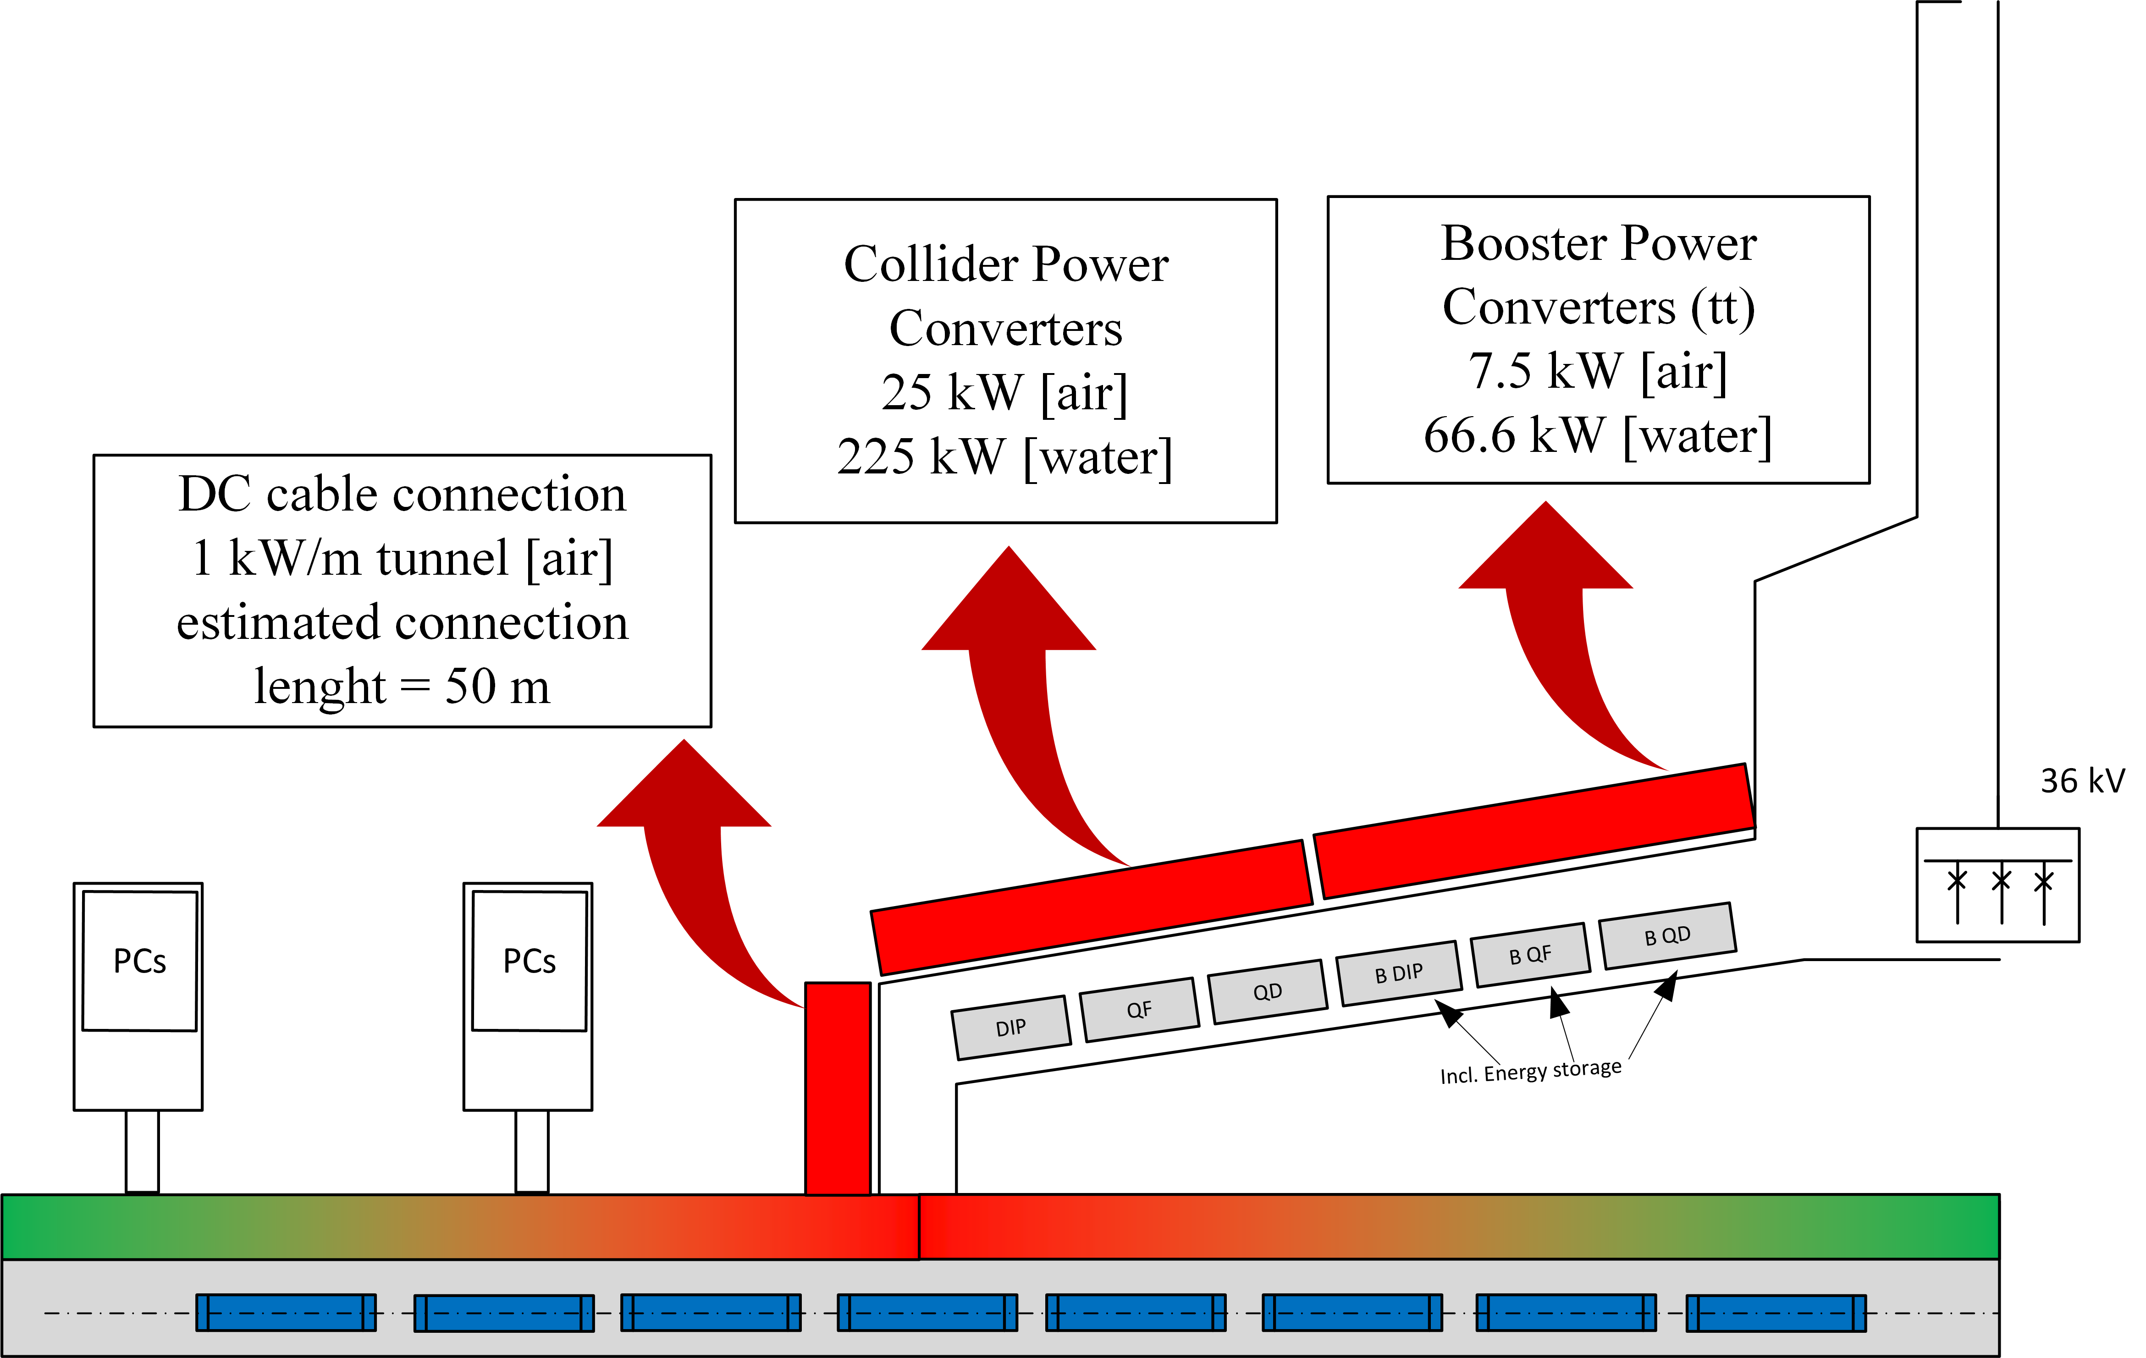
Simplified heat maps for thermal losses
Draft numbers!
Alcoves
Underground technical galleries
This does not include magnet losses, only converters and DC cables

Slide 15
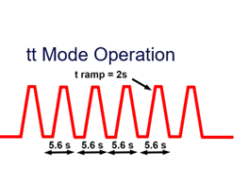
Summary of power consumption and losses
Estimated power converters consumption
Summary
Power converter | Power consumption / circuit (kW) | Nb Circuits / Access point | Total consumption / access point (MW)
Collider Dipoles | 830 | 2 | 1.662
Collider Quadrupoles | 930 | 4 | 3.72
Collider Sextupoles | 42.4 | 73 | 3.1
Booster Dipoles | 296 | 2 | 0.592
Booster Quadrupoles | 330 | 4 | 1.32
Booster Sextupoles | 18.3 | 37 | 0.677
TOTAL |  |  | 9.4
Circuit |  | Power requirement (MW) | Total (MW)
Collider | Dipoles | 13.3 | 68
 | Quadrupoles | 29.8
 | Sextupoles | 24.8
Booster | Dipoles | 4.7 | 20.7
 | Quadrupoles | 10.6
 | Sextupoles | 5.4
All circuits |  |  | 88.7
…from which DC cable losses
Considering CDR top-up injection cycle
DC cable connection | DC Cable losses / Power converter (kW) | Nb Converters / Access point | Total DC cable losses / Access point (kW)
Collider Dipoles (4 x 400 mm²/ pole) | 18.8 | 2 | 37.6
Collider Quadrupoles (2 x 150 mm²/ pole) | 175 | 4 | 700
Collider Sextupoles | 3.2 | 73 | 234
Booster Dipoles (4 x 400 mm²/ pole) | 10 | 2 | 20
Booster Quadrupoles (2 x 150 mm²/ pole) | 64 | 4 | 256
Booster Sextupoles | 2,5 | 37 | 93
TOTAL |  |  | 1340
Note on these numbers:
All this is draft and consider some arbitrary choices
This includes only the 3 magnet’s families for which we have a draft spec – many converters/circuits missing!

Slide 16
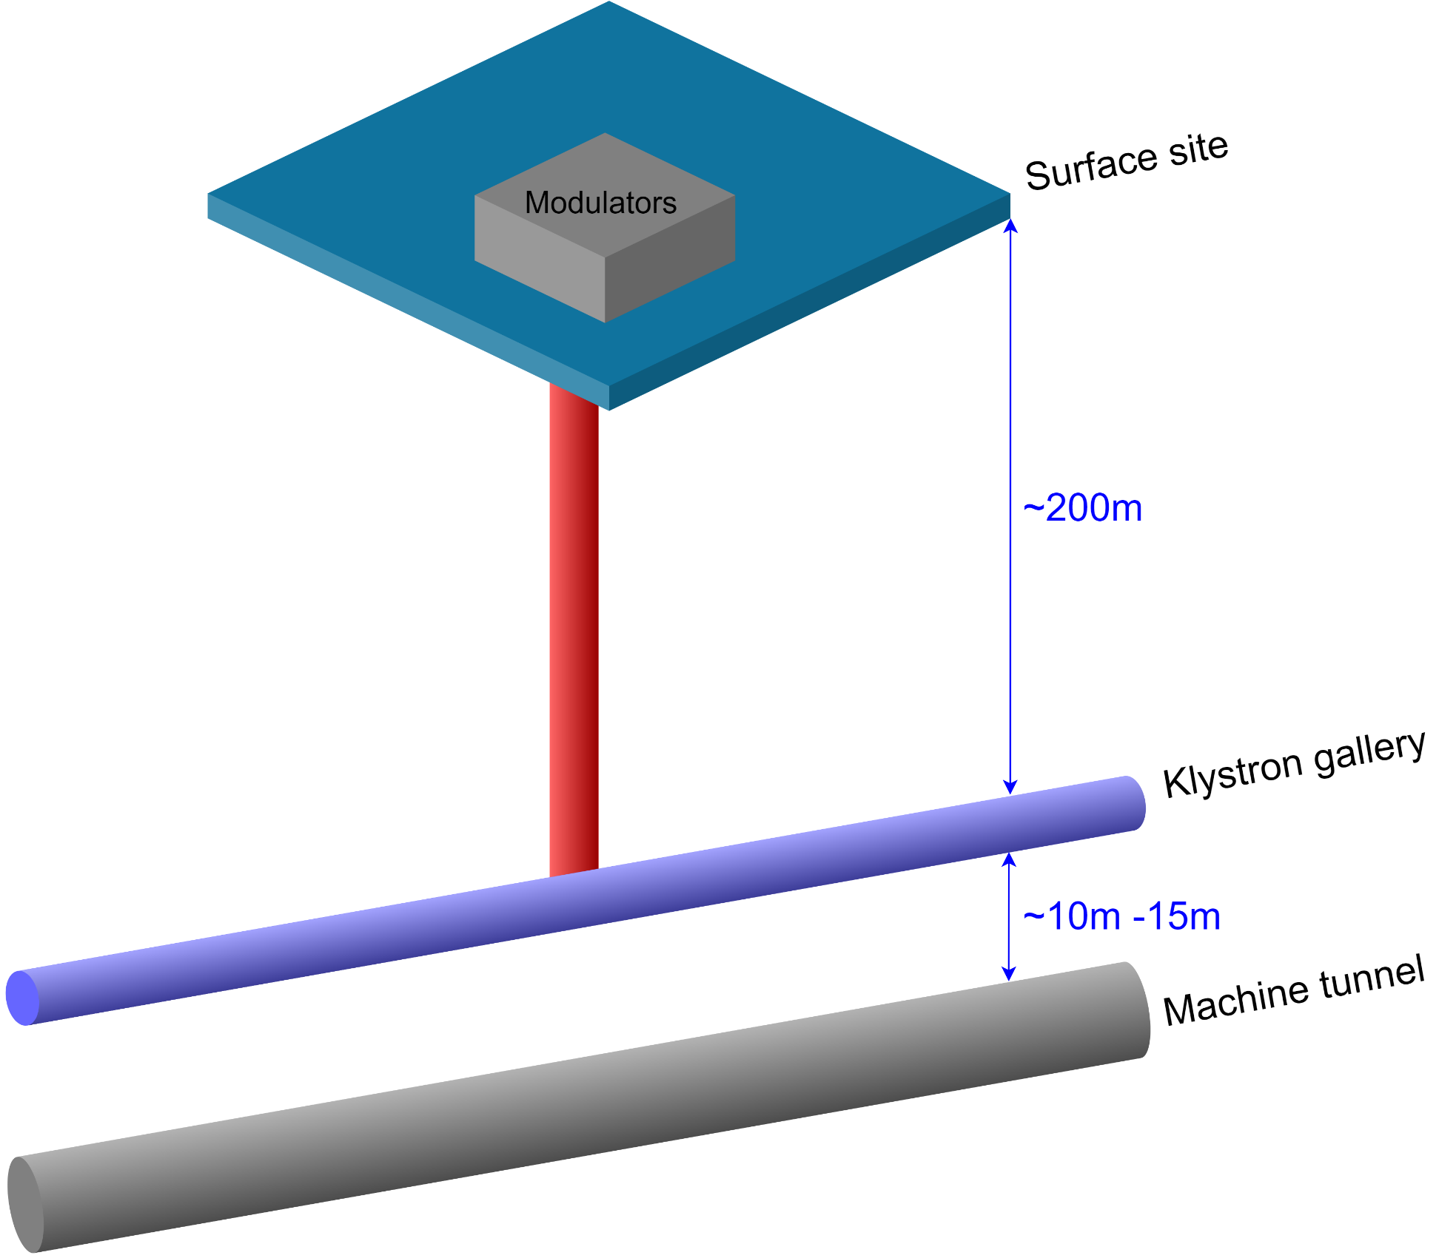
FCCee power converters DRAFT layout
RF Powering
50 MW synchrotron radiation loss per beam (collider only)
  ~150MW electrical power (with high efficiency klystrons)
  ~15 MW losses
Modulators in pseudo DC (or CW) mode (or very slow cycling mode)
  No need to install them near klystrons
  Installation on surface possible
High Voltage cables
  length ~140 m to 250 m
  Present roughly 100 pF/m → some energy stored!
Still to be checked if cost effective to install modulator on surface…
Protection devices would be needed in klystron gallery to protect klystrons in case of arcing

Slide 17
Evaluating DC Distribution

Slide 18
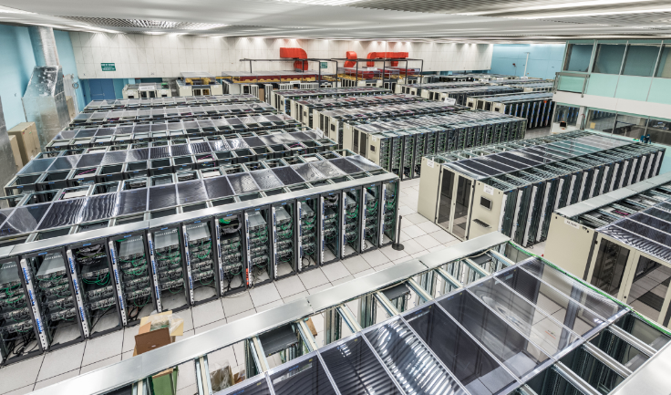
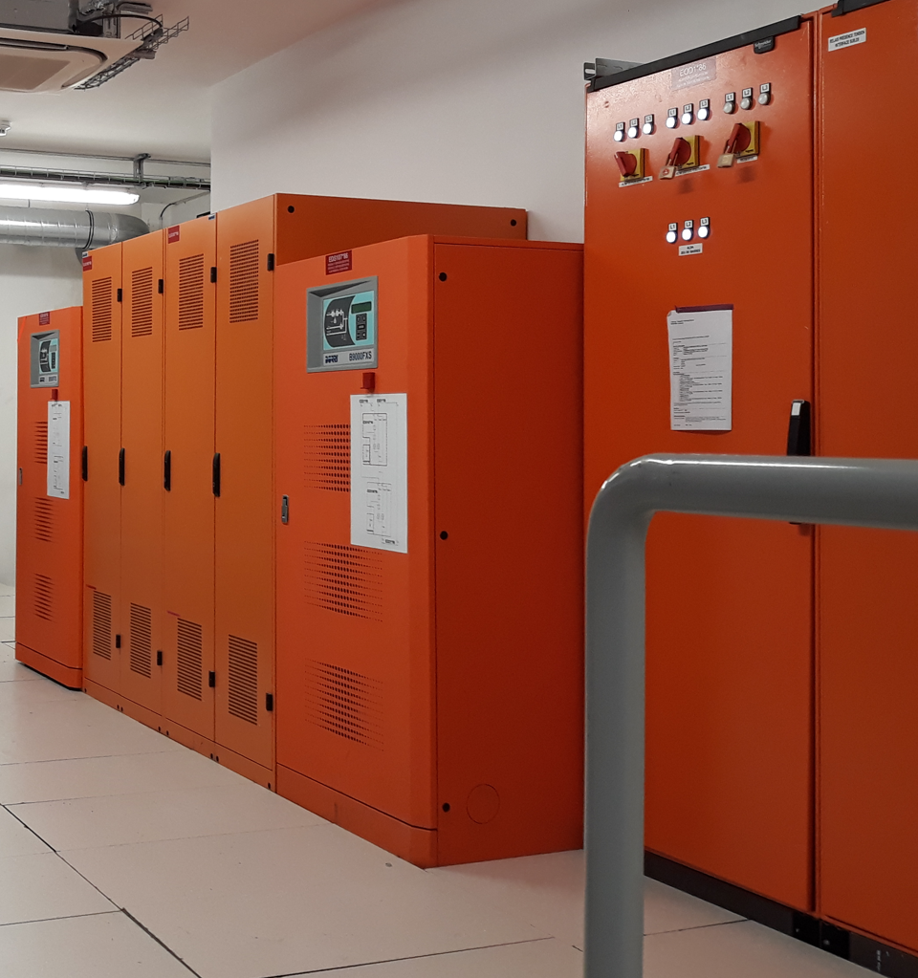
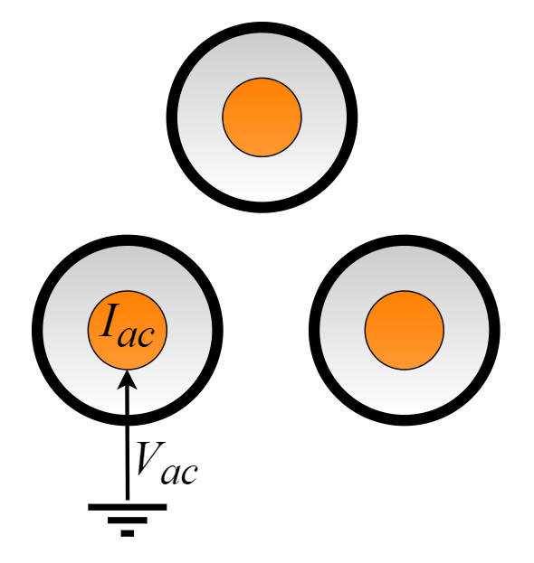
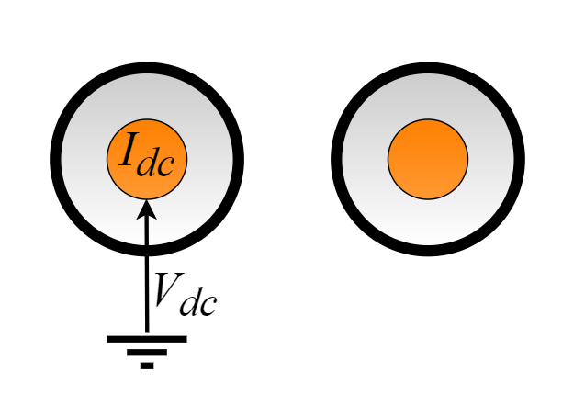

Advantages of DC systems over AC
18
Many loads require somewhere a DC voltage:
Power converters for magnet supply
Uninterruptible power supplies
Computing infrastructure and data centers
Detector equipment
…
A DC system can transmit more power (for equal current and voltages) on two cores than the AC using three cores
lower transmission losses, less copper required
increased power transfer capacity, no need of compensating equipment
Lower voltage drops due to inductive effects
$$\frac{P_{DC}}{P_{AC}}=\frac{\frac{2}{\sqrt{3}}\sqrt{2}V_{DC}I_{DC}}{3V_{AC}I_{AC}}≈0.95$$
AC three phase system
DC system

Slide 19
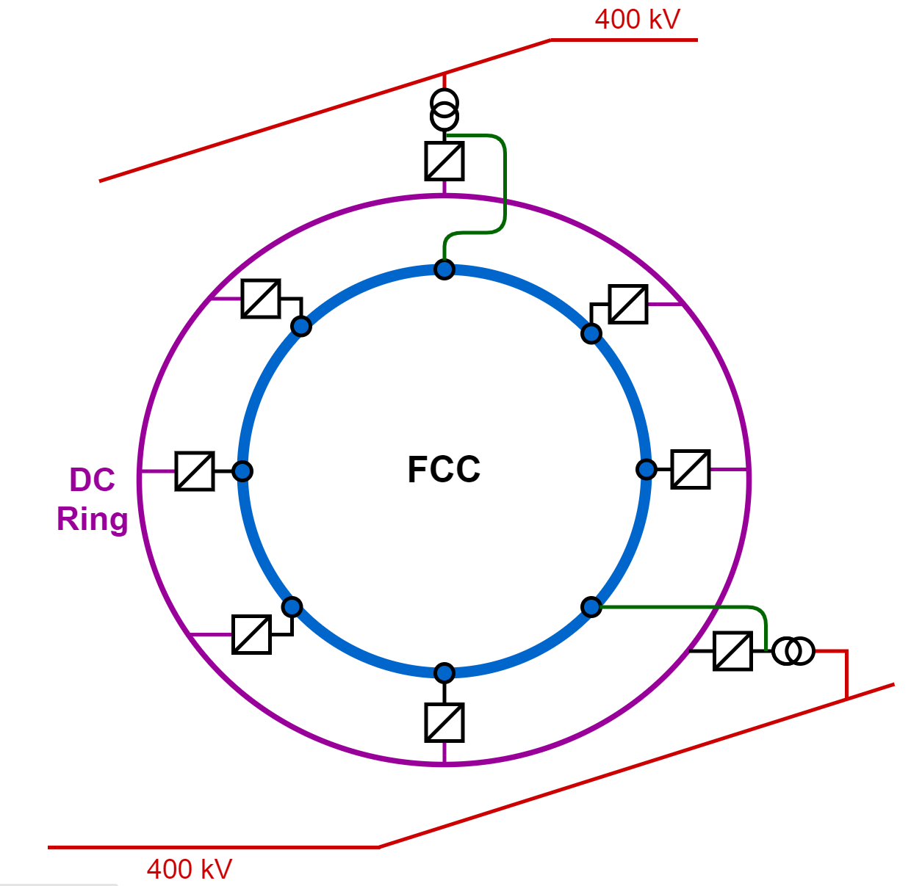
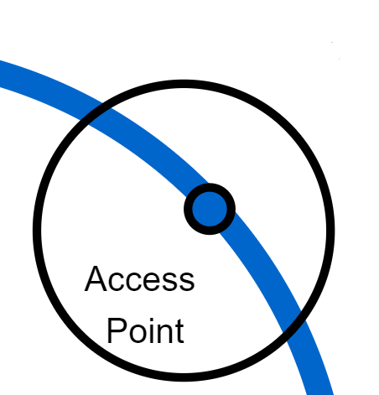
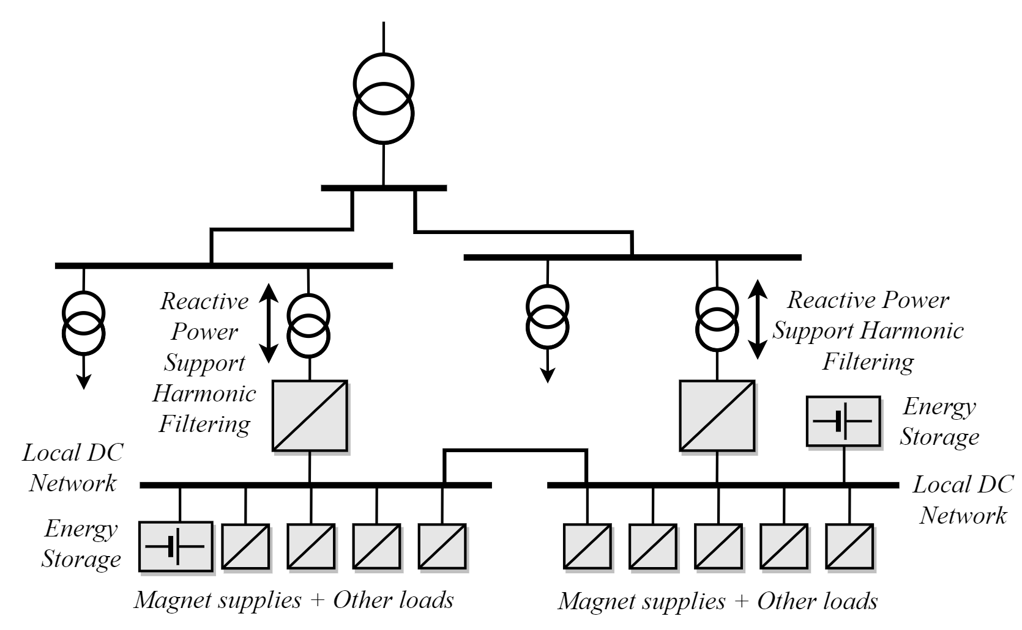
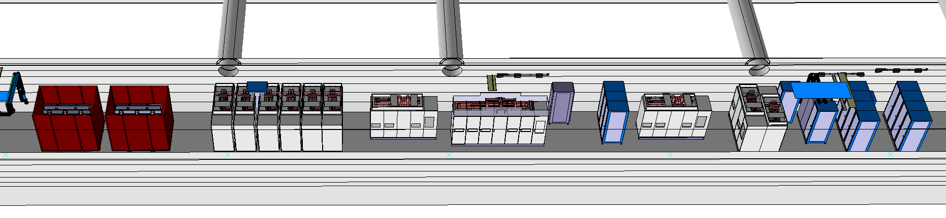
DC networks for the FCC: scope
Level of readiness – Voltage Level
HVDC Transmission
1MV – 50 kV
MVDC Distribution
50kV – 10 kV
MVDC applications
10 kV – 1.5 kV
LV Distribution
1.5kV– 12V
?
Case study being analysed to supply one of LHC points via DC distribution
A cost-effective solution not found
HV-LV conversion difficult
Transmission over 90-100 km

Slide 20
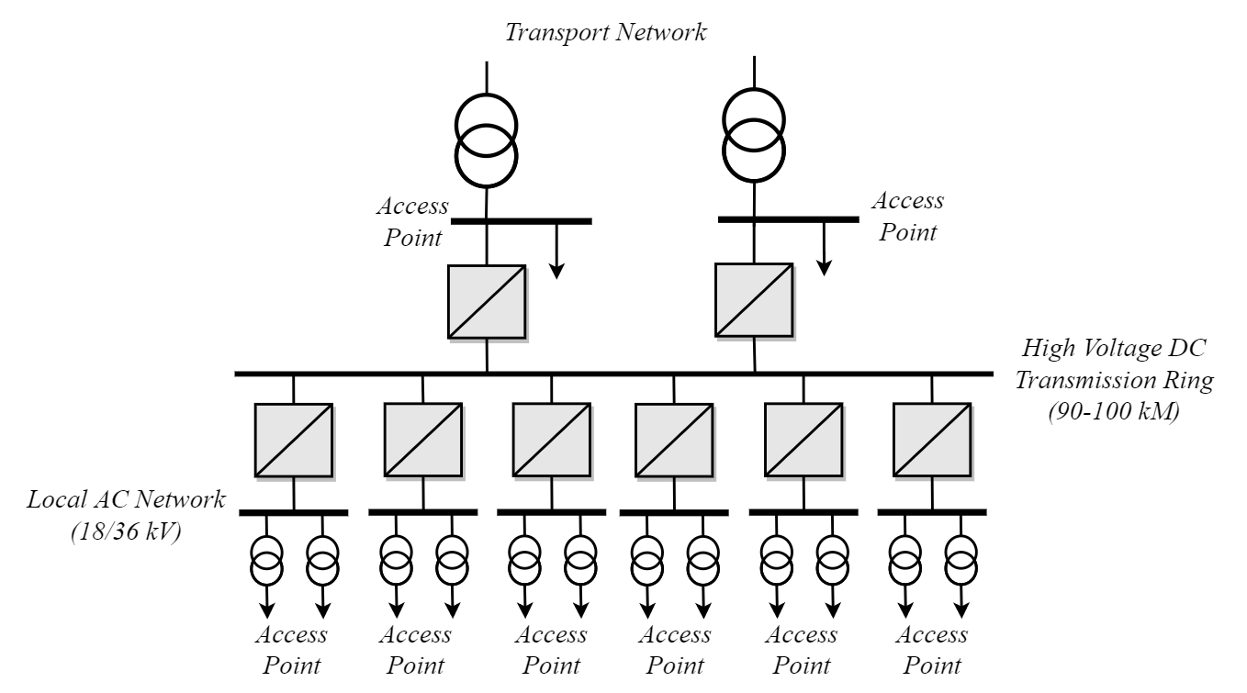
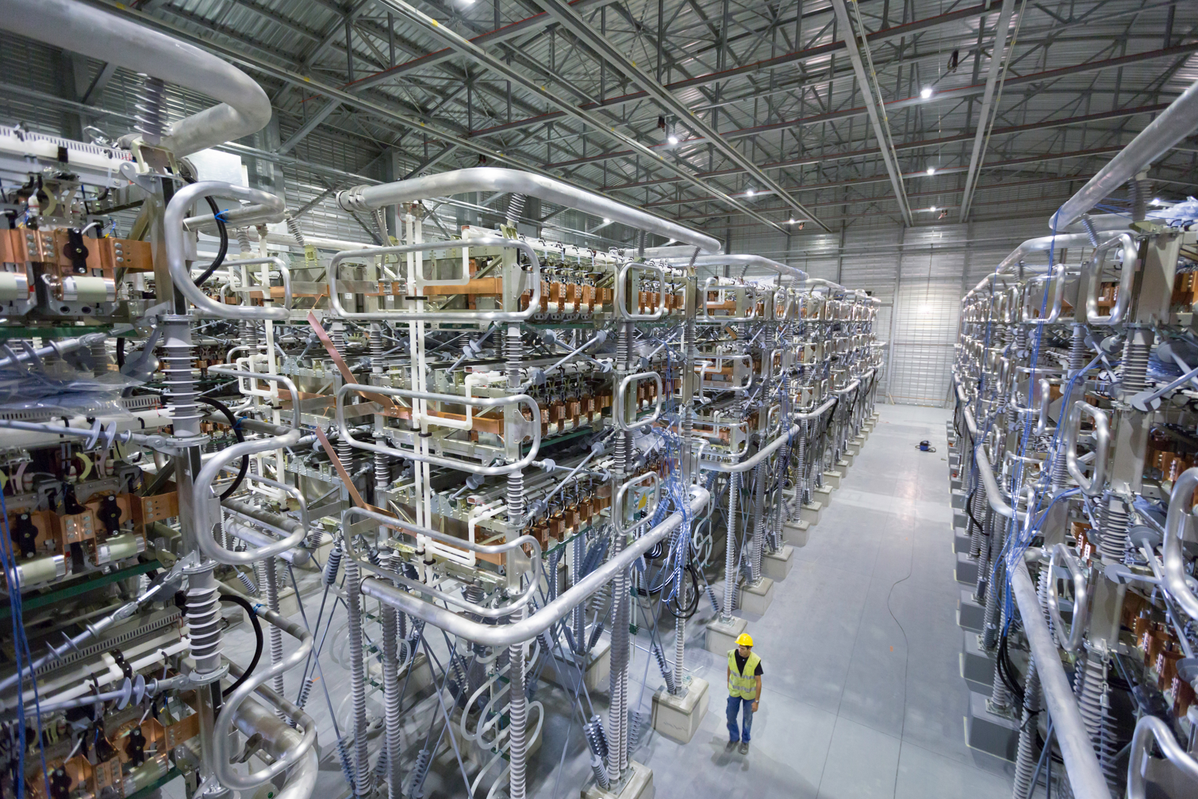
HVDC Transmission for the FCC
20
Build a DC transmission ring along the FCC circumference
This network would operate at a DC voltage of 50-150 kV (depending on power demand)
Energy storage can easily be integrated in MMC
These voltage levels can be easily achieved by using Modular Multilevel Converters (MMC)
The DC link decouples the grids regarding quality issues: SVCs are not required
Other features:
Better control of power flows
Better immunity to networks Voltage Dips
Modular design – high availability
BUT: protection systems still requiring R&D
Economical feasibility needs to be further developed
Savings in cable and reactive power compensation
However slightly higher CAPEX and OPEX of converters

Slide 21
FCC-hh powering specificities

Slide 22
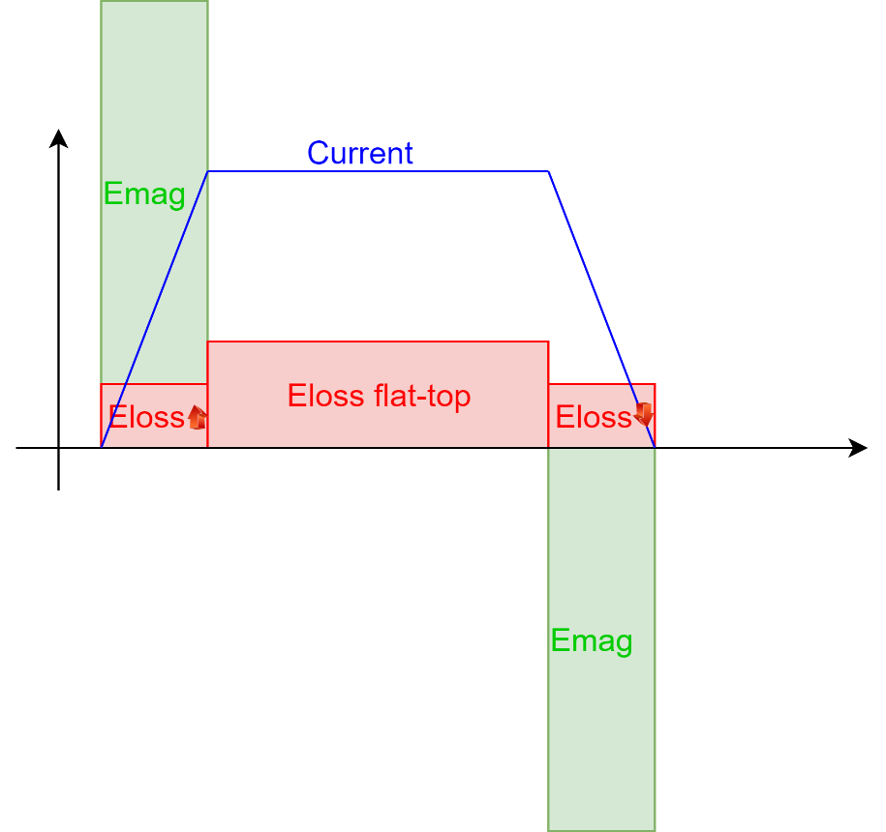
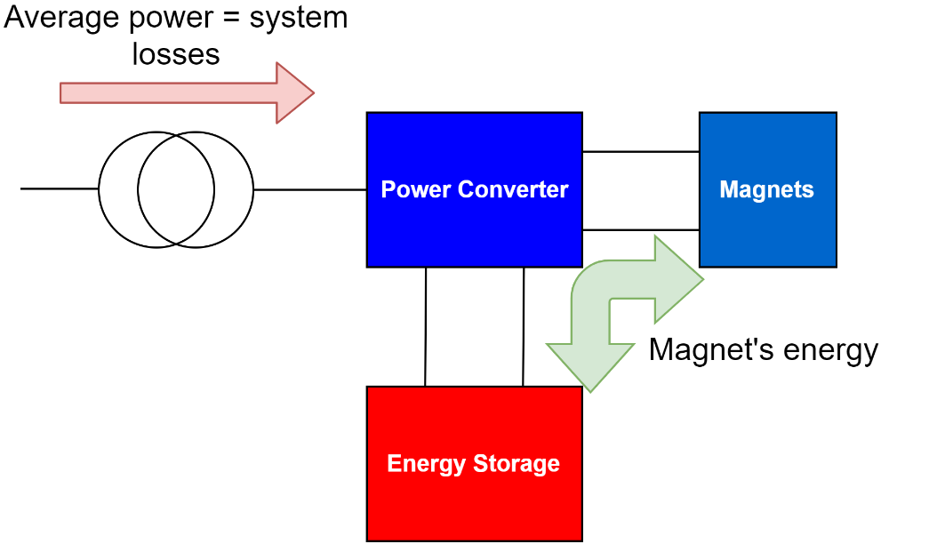
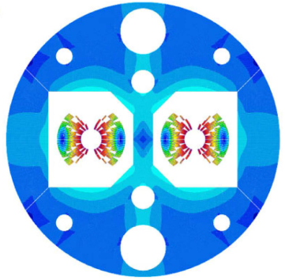
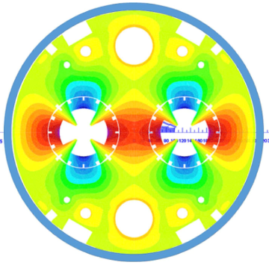
FCChh magnet powering specificities
A different machines to power…
Main magnet specs form CDR:
From an “RF machine” to a “superconducting and cycling magnet machine”
  Need to deal with higher currents and big distances…
  Need for energy storage for peak power shaving into the network
 | Main dipoles | Main quadrupoles
Number of units | 4668 | 744
Operating current | 11.4 kA | 22.5 kA
Inductance | 570 mH | 14.4 mH
Total stored energy | 174 GJ | 2.7 GJ
Peak power | 290 MW | 4.5 MW
Main dipoles
Main quadrupoles

Slide 23
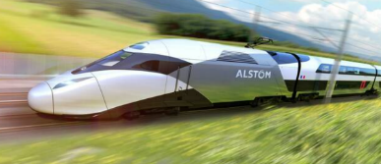
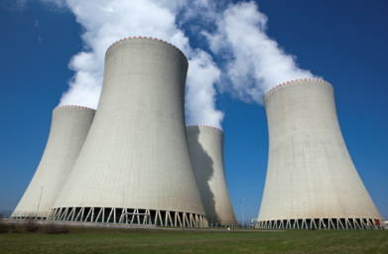
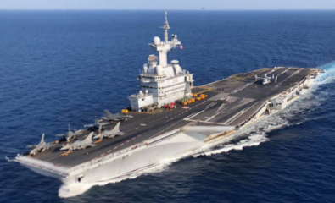

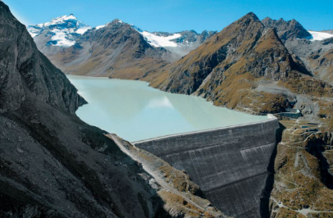
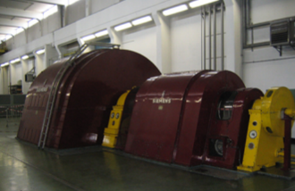
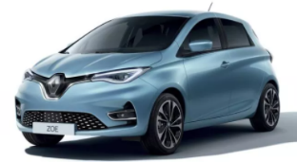

175 GJ…
90 TGV at 360 km/h
3.2 minutes production of a nuclear reactor
“Charles de Gaulle” lifted 410 m overseas
38 tons of TNT
880 fully charged electrical vehicles
875 PS rotating machines
5’000 CHF
(0.1 CHF/kWh)
10 min production / 16 min pumping
of the “Dixence” hydroelectric facility

Slide 24
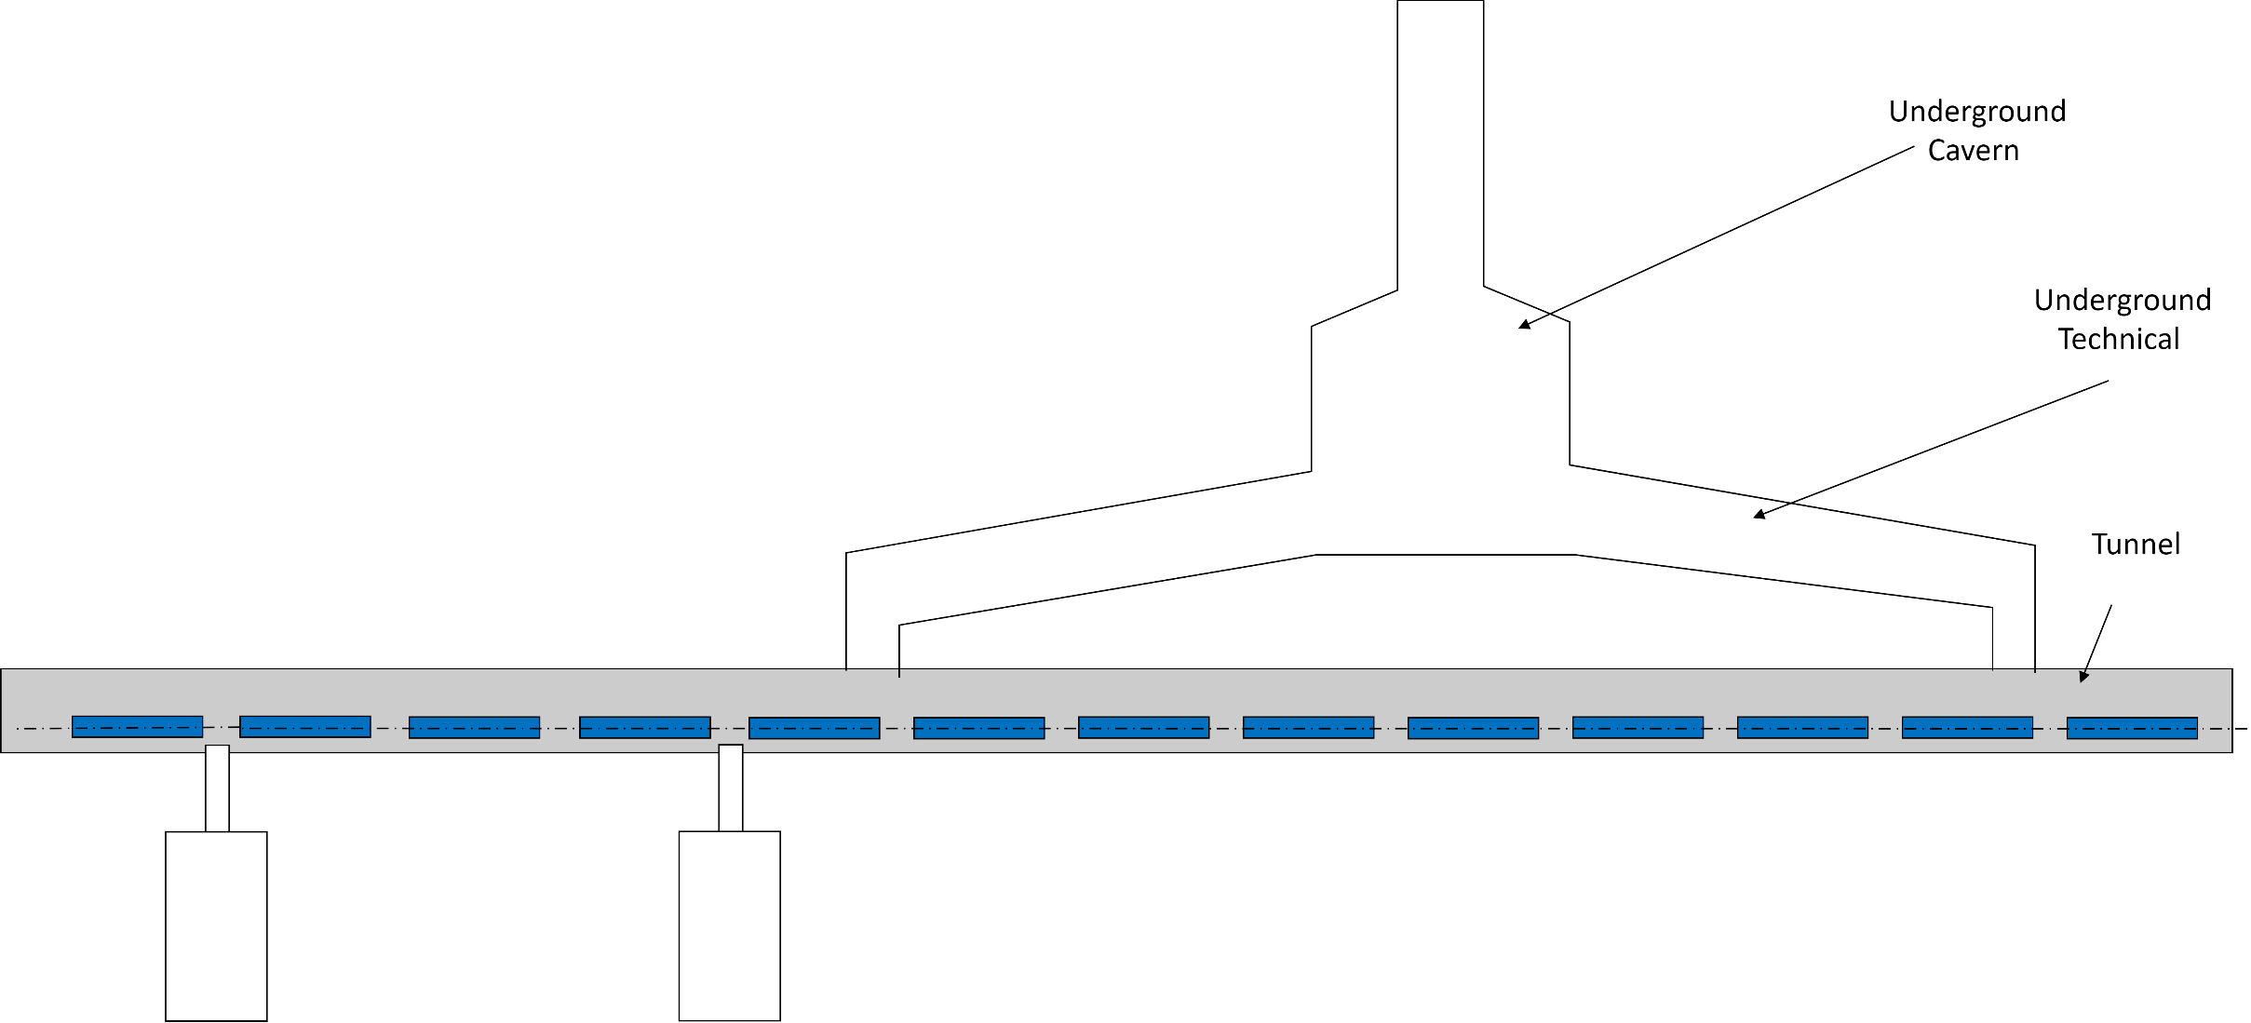
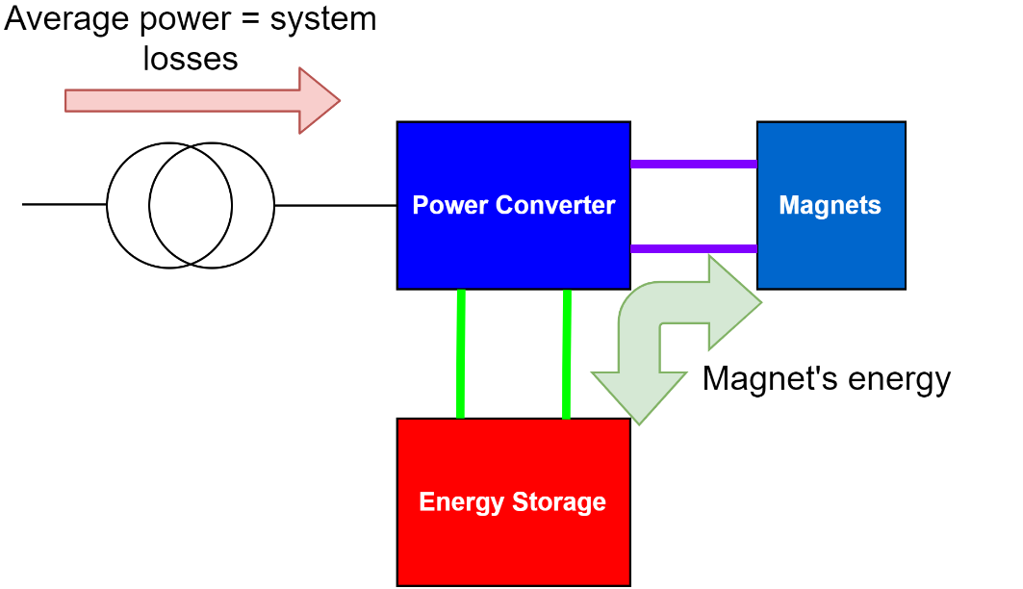
FCChh magnet powering specificities
Where to place energy storage? (and Power Converters)
Colour code
Energy storage in underground technical galleries
High DC currents with high losses if resistive cables
Superconducting cables or superconductors passing through magnet’s cold masses

Slide 25
FCChh magnet powering specificities
Electrical network
Centralised converter & energy storage
Where to place energy storage? (and Power Converters)
Surface
Colour code
Hybrid approach…
This link can be DC or AC (involving transformers and/or DC/DC conversion)
All this depends on:
  What we can/should do to support the electrical network side
  What technology is used for energy storage
  Do we integrate, and to which extent, DC distribution

Slide 26
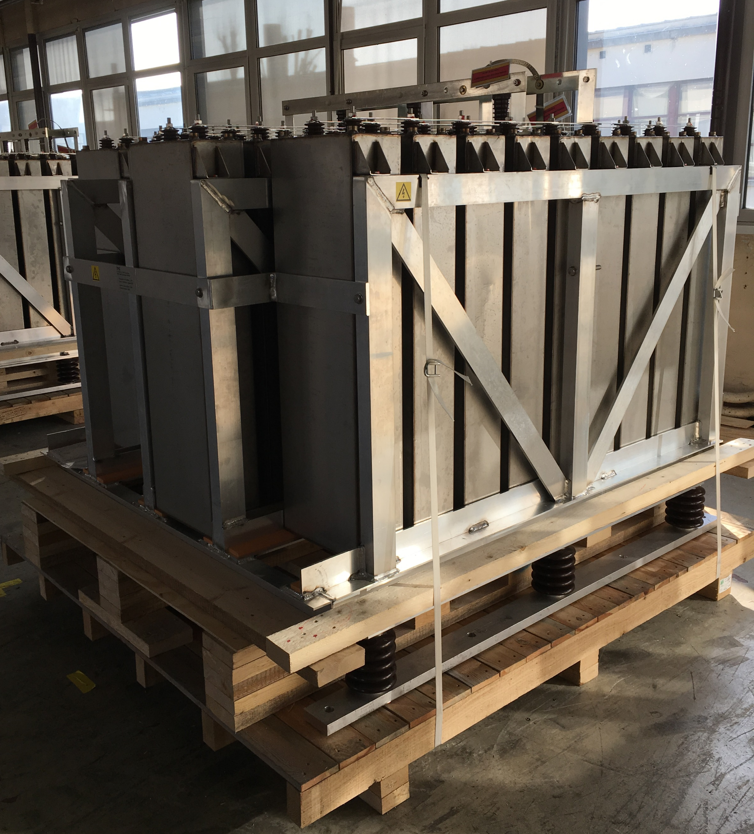
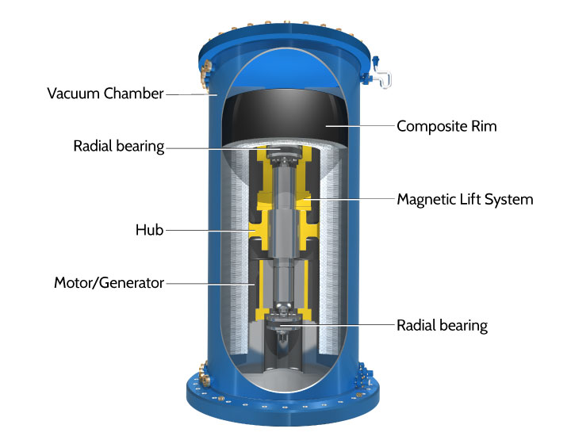
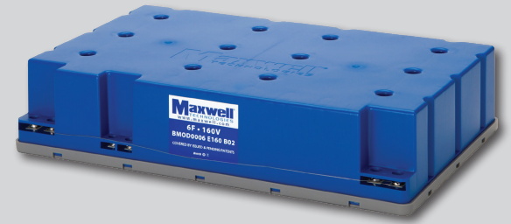
FCChh magnet powering specificities
How big the energy storage? Depends on Technology! Few ones we evaluated so far…
Several technologies evaluated
Capacitors
Flywheels
Supercapacitors
Energy/power still too low
We would need
  18980 m3
  14220 Tons
Energy/power ratio too low
Too voluminous
No maintenance / chemicals
Room for improvements in the next 20 - 40 years (SC mag. levitation & bearings)
Energy/power ratio too low
Too voluminous
Today batteries seem the only viable solution!

Slide 27
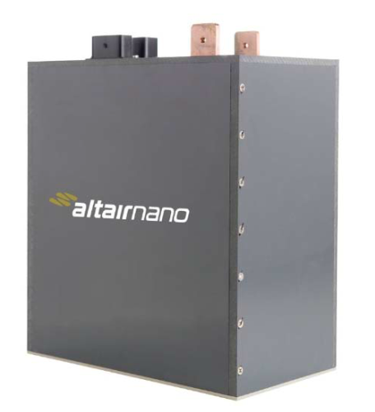
FCChh magnet powering specificities
How big the energy storage? Depends on Technology! Few ones we evaluated so far…
Chemical storage – Batteries – LTO (Lithium-Titanate-Oxide)
The ratio Energy / power of the LTO batteries (280 J/W) is not far from the main dipoles (600 J/W) requirement.
The storage is sized to the required energy, which provides almost twice the required power.
The oversizing in power allows to reduce the cells temperature and increases the lifetime.
The system can be charged/discharged at 7C/7C within the 20% to 80% State of charge range.
  Total volume: 760 m³
  Total weight: 1450 Tons
  Expected lifetime with 1600 cycles / year: 22 years
  Calendar life at 25°C: 25 years
  No emission of hydrogen in case of failure.
95 m³ in each access point
→ ~50m²
24 V / 70 Ah
(3.4 MJ from 20% to 80%)
LTO module
Batteries technology and recycling evolves rapidly, pushed by a demanding market (EV, photovoltaic) and shall be fully reassessed at the time of procurement.

Slide 28
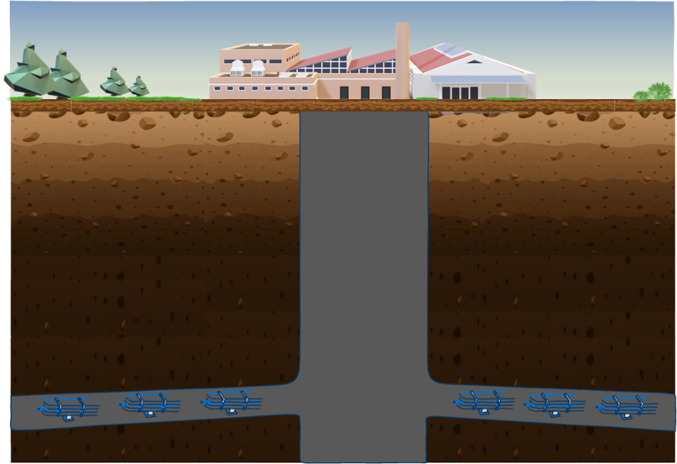

FCChh magnet powering specificities
Only a conceptual idea
Thinking a bit out of the box…
An example of a centralized energy storage system – Gravitational
Well established/durable technology (e.g. pumped hydro)
Utilisation of access shaft volume
Technology leadership in Europe
Only a principle scheme– several layouts possible
Type | Max cycles/lifetime | Energy Density (wh/liter)
Pumped hydro | 30-60 yrs | 0.2-2
Compressed air | 20-40 yrs | 2-6
Li-ion battery | 10-10,000 | 200-400
Lead acid | 6-40yrs | 50-80
Hydrogen | 5-30yrs | 600
Platform mass
18500tn
1522m³
Platform volume
generation plant
<4m
Platform height
Shaft
height
200m
Max Power 28.3MW
Displacement of 0.17m/s
Descend time: 20mins
Energy stored: 9.4MWh
34 MJ
Shaft diameter
Gravitational (lead mass) | 30-60 yrs | 6.2
Gravitational (molasse mass) | 30-60 yrs | 1.6
55% more than what stored in magnets!
25m
Re-use of excavated materials (molasses-granite) of 7300m3/point

Slide 29
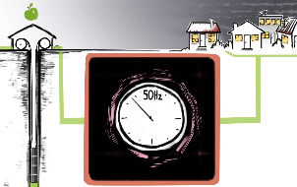
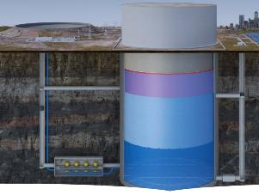
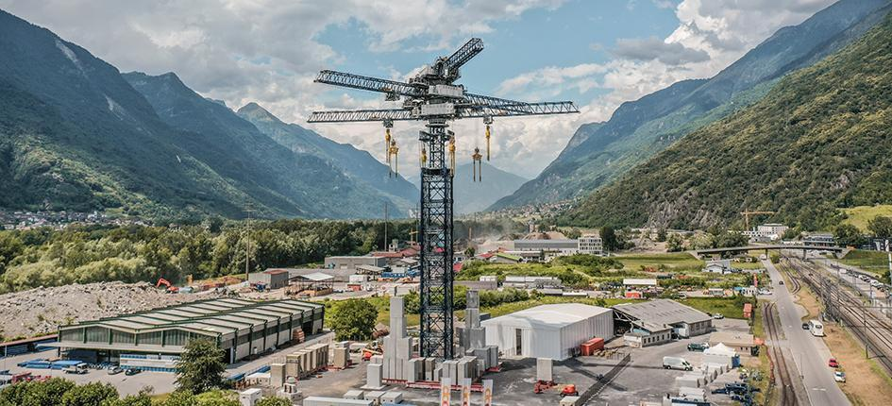
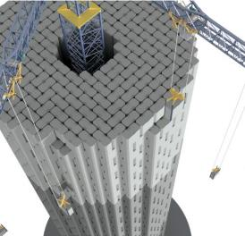
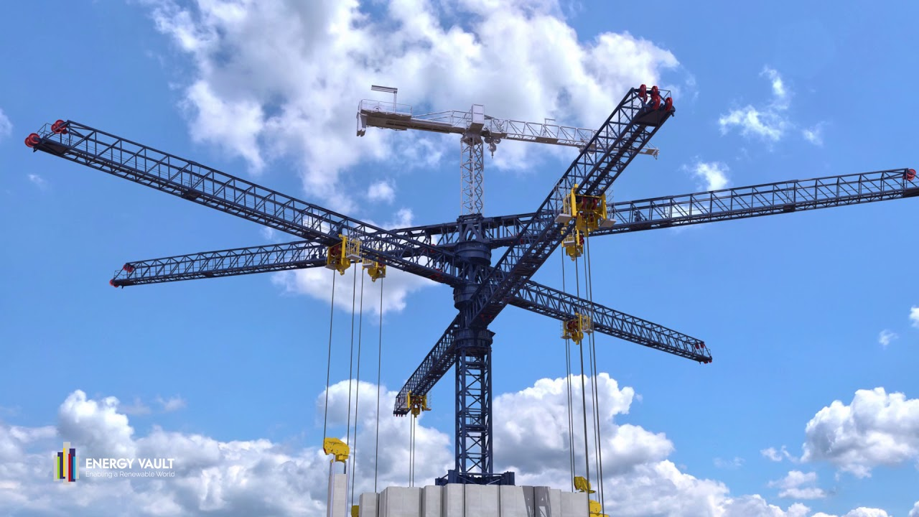
FCChh magnet powering specificities
Only a conceptual idea
Thinking a bit out of the box…
An example of a centralized energy storage system – Gravitational
Centralised energy storage can be used to better integrate renewables on surface sites! (e.g. solar)
Gravitricity, Scotland, UK 12000tn up to 300m depth
New Energy Let’Go, Hamburg Germany
Heavy piston lifting by pumping water in reservoir
Energy Vault, CH, Ticino Joule storing Jenga

Slide 30
conclusion

Slide 31
Conclusion and R&D to come
FCCee powering does not present huge challenges – Its powering can be done with power converters in use, or in development at CERN
FCCee and FCChh powering need an integrated optimal design approach to maximize energy saving and investment cost
FCChh needs to integrate a huge amount of energy storage. Centralized vs. decentralized storage need to be addressed considering electrical network support capabilities interests from RTE. With external support, evaluation of technological trends, and long-term commodity outlook, for energy storage & savings
Need to develop reliability & availability models for power conv. controls and its infrastructure & energy storage. These models will be integrated into the optimal design tool considering MTBF (FEMA) prediction, Fault Tree Analyses, and FCC operational availability predictions
In the framework of the energy management WG, we need to evaluate solutions to produce (or regenerate) energy by exploiting the FCC infrastructure

Slide 32
Thank you for your attention.

