Slide 1


Slide 2
Update of the power demand for
FCC-ee
Jean-Paul Burnet (CERN)
Technical and Infrastructure Working Group
Electricity & Energy Management Work Package
FCC Week 2022
Paris

Slide 3
Abstract
The FCC-ee will be the largest accelerator ever built with kilometers of different accelerator devices.
The identification of the main loads is crucial for designing the electricity infrastructure and for evaluating its energy consumption.
An update of the FCC power demand is ongoing with the evaluation of its annual energy consumption depending on the machine configurations.
The next step is to identify how energy consumption can be reduced, by design and optimization of equipment and systems, and by optimization of the operation mode of the accelerators and their infrastructures.
The goal is to identify where the effort needs to be focused to reduce the environmental impact of the project.

Slide 4
Content
Update of the power demand / main loads for FCC-ee
Distribution of the power demand by points and by the beam energies
Estimation of energy consumption per machine configurations
Optimization of the accelerator systems to reduce the power demand
Ways to reduce the energy consumption
Electricity & Energy Management

Slide 5
Radio-frequency systems
Energy loss from synchrotron radiation limited to 50MW per beam
Power demand for RF Storage ring Z, W, H
P_{RF} = 100MW
P_{EL} = 100 / ηklystron / ηmodulator / ηdistribution
P_{EL}= 100 / 0.8 / 0.9 / 0.95 = 146MW
Booster
P_{RF} = 15% P_{RF} storage (1 beam) = 7.5MW
P_{EL} = 7.5 / ηklystron / ηmodulator / ηdistribution
P_{ELav} = P_{EL} * booster duty cycle = 1.7MW
The Booster duty cycle has a huge impact on its power demand. With a low duty cycle, the power demand is very low
Storage ring | Z | W | H | TT
Beam Energy (GeV) | 45.6 | 80 | 120 | 182.5
PRF (MW) | 100 | 100 | 100 | 100
Klystron efficiency | 0.8 | 0.8 | 0.8 | 0.8
PRF EL (MW) | 146 | 146 | 146 | 146
Booster | Z | W | H | TT
Beam Energy (GeV) | 45.6 | 80 | 120 | 182.5
PRFb (MW) | 7.5 | 7.5 | 7.5 | 7.5
Klystron efficiency | 0.8 | 0.8 | 0.8 | 0.8
Booster duty cycle | 0.15 | 0.15 | 0.15 | 0.15
PRFb EL (MW) | 2 | 2 | 2 | 2
R&D High-efficiency klystron, today 50-60%,
target 80%
Electricity & Energy Management

Slide 6
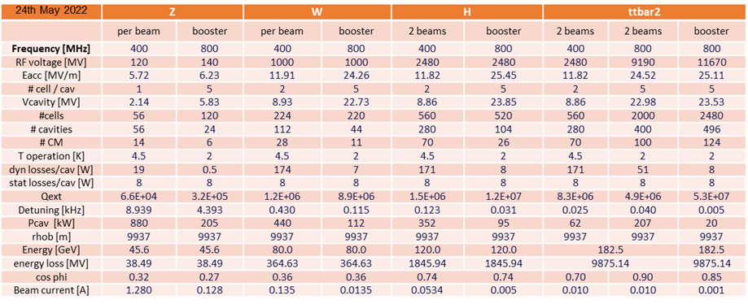
Cryogenic systems
Cryogenic systems needed for RF cavities
Storage ring
Cryo power demand varies Z, W, H, ttbar
Cavities with very low static losses
High-efficiency cryoplant
250Welec/W@4.5K (as LHC)
Storage ring | Z | W | H | TT
Beam Energy (GeV) | 45.6 | 80 | 120 | 182.5
Pcryo (MW) | 1,3 | 12,6 | 15,8 | 47,5
Electricity & Energy Management

Slide 7
Storage Ring Magnet systems
Energy loss in magnets
Magnet losses storage ring
P_{magnets} = 56MW from CDR
P_{cables} = 20MW (rough estimation)
P_{ELmagnets} = 76 / ηconversion / ηdistribution
P_{ELmagnets} = 76 / 0.9 / 0.95 = 89MW
A lot of magnet families still unknown, inner triplet, single quadrupoles, octupoles, correctors…
They should have a limited impact on the power demand <10%.
Storage Ring | Z | W | H | TT
Beam Energy (GeV) | 45.6 | 80 | 120 | 182.5
Magnet current | 25% | 44% | 66% | 100%
Power ratio | 6% | 19% | 43% | 100%
Dipoles (MW) | 0.8 | 2.6 | 5.8 | 13.3
Quadrupoles (MW) | 1.4 | 4.3 | 9.8 | 22.6
Sextupoles (MW) | 1.3 | 3.9 | 8.9 | 20.5
Power cables (MW) | 1.2 | 3.8 | 8.6 | 20
Total magnet losses | 4.8 | 14.7 | 33.0 | 76.4
Power demand (MW) | 5.6 | 17.2 | 38.6 | 89
Low-loss magnets design
Electricity & Energy Management

Slide 8
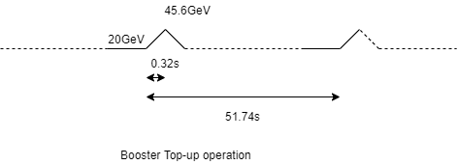
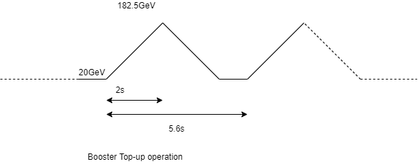
Booster Magnet systems
Energy loss in magnets
Booster | Z | W | H | TT
Beam Energy (GeV) | 45.6 | 80 | 120 | 182.5
Magnet current | 25% | 44% | 66% | 100%
Power ratio | 6% | 19% | 43% | 100%
Dipole (MW) | 0.8 | 2.6 | 5.8 | 13.3
Quads (MW) | 1.4 | 4.3 | 9.8 | 22.6
Sextupoles (MW) | 0.6 | 2.0 | 4.4 | 10.25
Power cables (MW) | 1.2 | 3.8 | 8.6 | 20
Booster duty cycle | 0.15 | 0.15 | 0.15 | 0.15
Total magnet losses | 0.6 | 1.9 | 4.3 | 9.9
Power demand (MW) | 0.7 | 2.2 | 5.0 | 12
We made the assumption that the magnets are the same as the storage ring, except sextupole (half power).
The duty cycle taken for calculation is 15%, one Booster cycle of 4s every 26.6s.
However, in CDR, the repetition rate is up to 1 cycle every 5.6s.
Low-loss magnets design
Electricity & Energy Management

Slide 9
Cooling and Ventilation systems
Power demand for cooling and ventilation systems
Electrical consumption (MW) | Cooling | Chillers | Ventilation | Total
POINT
A | 1.7 | 1.2 | 1.3 | 4.2
B | 0.3 | 1.0 | 1.3 | 2.6
D | 1.7 | 1.1 | 1.3 | 4.2
F | 0.3 | 1.0 | 1.3 | 2.6
G | 1.7 | 1.2 | 1.3 | 4.2
H | 3.3 | 2.1 | 2.1 | 7.5
J | 1.7 | 1.1 | 1.3 | 4.2
L | 5.5 | 2.6 | 2.5 | 10.6
Total | 16.3 | 11.2 | 12.7 | 40.2
Power demand is constant for RF loads
It varies for cryogenics and magnets depending on the machine configuration Z, W, H, ttbar.
 |  | Z | W | H | TT
Beam energy (GeV) |  | 45.6 | 80 | 120 | 182.5
Pcv (MW) | all | 33 | 34 | 36 | 40.2
Electricity & Energy Management

Slide 10
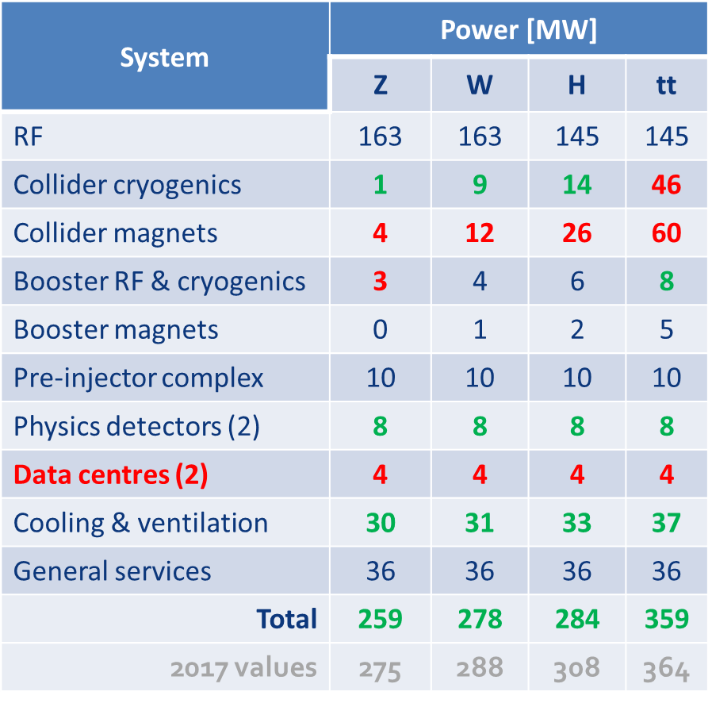
Total power demand by machine configuration
Update of FCC-ee power demand
 |  | Z | W | H | TT
Beam energy (GeV) |  | 45.6 | 80 | 120 | 182.5
Magnet current |  | 25% | 44% | 66% | 100%
Power ratio |  | 6% | 19% | 43% | 100%
PRF EL (MW) | Storage | 146 | 146 | 146 | 146
PRFb EL (MW) | Booster | 2 | 2 | 2 | 2
Pcryo (MW) | all | 1,3 | 12,6 | 15,8 | 47,5
Pcv (MW) | all | 33 | 34 | 36 | 40.2
PEL magnets (MW) | Stroage | 6 | 17 | 39 | 89
PEL magnets (MW) | Booster | 1 | 3 | 5 | 11
Experiments (MW) | Pt A & G | 8 | 8 | 8 | 8
Data centers (MW) | Pt A & G | 4 | 4 | 4 | 4
General services (MW) |  | 36 | 36 | 36 | 36
Power during beam operation (MW) |  | 237 | 262 | 291 | 384
Average power / year (MW) |  | 143 | 157 | 173 | 224
The previous estimation (2018) was from 259 to 359MW

Slide 11
Estimation uncertainties
Power demand uncertainties
The main loads are known for the storage ring, still, a lot of equipment is not defined.
Also, a lot of unknown on the Booster, equipment and operation mode (types of cycle)
Power cables, 20MW, can be optimized, 50% gain?
Option for 4 experiments, 4 * 4MW
General services are over-estimated (estimation based on LHC, but with mixed loads), should be below 26MW
Despite of a lot of unknown of the accelerator systems, the global uncertainty is < 5%
 |  | Z | W | H | TT
Beam energy (GeV) |  | 45.6 | 80 | 120 | 182.5
Experiments (MW) | Pt A, D, G, J | 16 | 16 | 16 | 16
Data centers (MW) | Pt A, D, G, J | 8 | 8 | 8 | 8
General services (MW) |  | 26 | 26 | 26 | 26
Compare to previous slide (MW) |  | +2 | +2 | +2 | +2
Power during beam operation (MW) |  | 239 | 264 | 293 | 386

Slide 12
Power demand per points, focus RF loads
Infrastructure needed for FCC-ee
Z,W,H, RF point, 180MW
Strong dissymmetry of the power needs:
1 point needs 141MW
1 point needs 180MW
6 points need <30MW
High RF loads move from PL to PH.
 |  | Max power (MW)
Point A | Experiment | 27
Point B |  | 21
Point D |  | 21
Point F |  | 21
Point G | experiment | 27
Point H | RF TT | 141
Point J |  | 21
Point L | RF Z,W,H | 180
TT, RF point, 141MW

Slide 13
Power demand per points, configuration Z, W, H
Infrastructure needed for FCC-ee Z, W,H
PL, 100% RF, 180MW
PA, 20MW
Very high power demand on point L, 180MW.
2 experiments, point A and G.
PB, 14MW
 |  | Max power (MW)
Point A | Experiment | 20
Point B |  | 14
Point D |  | 14
Point F |  | 14
Point G | experiment | 20
Point H | RF TT | 14
Point J |  | 14
Point L | RF Z,W,H | 180
PD, 14MW
PJ, 14MW
PH, 14MW
PF, 14MW
PG, 20MW

Slide 14
Power demand per points, configuration TTbar
PL, 1/3 RF power, 101MW
400MHz system
Infrastructure needed for FCC-ee TTbar
PA, 27MW
2 high power demands,
Point L 101MW, 40% 400MHz
Point H, 141MW, 60% 800MHz
PB, 21MW
 |  | Max power (MW)
Point A | Experiment | 27
Point B |  | 21
Point D |  | 21
Point F |  | 21
Point G | experiment | 27
Point H | RF TT | 141
Point J |  | 21
Point L | RF Z,W,H | 101
PD, 21MW
PJ, 21MW
PH, 2/3 RF power, 141MW
800MHz system
PF, 21MW
PG, 27MW

Slide 15
Electrical sub-stations, FCC-ee
Infrastructure needed for FCC-ee
PL, 180MW
2 high power demands,
Point L 101MW, 40% 400MHz
Point H, 141MW, 60% 800MHz
Need 2 main sub-stations for RF loads.
Need an additional sub-station for East part of the machine.
PD, 90MW
 |  | Max power (MW)
Point A | Experiment | 28
Point B |  | 22
Point D |  | 22
Point F |  | 22
Point G | experiment | 28
Point H | RF TT | 141
Point J |  | 22
Point L | RF Z,W,H | 101
PH,141MW

Slide 16
Electrical sub-stations, FCC-hh
Infrastructure needed for FCC-hh
PL, 188MW
The power demand will be spread all around the machine, due to the cryogenic needed for superconducting magnets distributed all around the machine.
500MW / 8 = 62.5 MW per point
Need 3 substations for hh configuration, rated at ~200MW .
Interesting scheme also for redundancy.
PD, 188MW
PH,125MW

Slide 17
Energy consumption, 45,6 GeV (Z)
Beam operation | All systems ON
Downtime operation | 0% RF, 100% cryo, 50% magnets
Hardware + Beam commissioning (COM) | 50% magnets, 50% RF+Cryo
Machine Development (MD) | 30% RF, 100%Cryo, 100%magnets
technical stop (TS) | 20% croy, 0% RF + magnets
Shutdown | 20% cryo, 50%CV, 0% RF + Magnets
Estimation of energy consumption, 1.25TWh
Energy consumption FCC alone.
45,6 GeV | Days | Hours | Power OP | Power Com | Power MD | Power TS | Power Shutdown
Beam operation | 143 | 3432 | 237 |  |  |  |  | 813125 | MWh
Downtime operation | 42 | 1008 | 85 |  |  |  |  | 85413 | MWh
Hardware, Beam commissioning | 30 | 720 |  | 114 |  |  |  | 82299 | MWh
MD | 20 | 480 |  |  | 133 |  |  | 63707 | MWh
technical stop | 10 | 240 |  |  |  | 81 |  | 19489 | MWh
Shutdown | 120 | 2880 |  |  |  |  | 65 | 186342 | MWh
Energy consumption / year | 365 | 8760 |  |  |  |  |  | 1.25 | TWh
Average power |  |  |  |  |  |  |  | 143 | MW
Electricity & Energy Management

Slide 18
Energy consumption, 80 GeV (H)
Beam operation | All systems ON
Downtime operation | 0% RF, 100% cryo, 50% magnets
Hardware + Beam commissioning (COM) | 50% magnets, 50% RF+Cryo
Machine Development (MD) | 30% RF, 100%Cryo, 100%magnets
technical stop (TS) | 20% cryo, 0% RF + magnets
Shutdown | 20% cryo, 50%CV, 0% RF + Magnets
Estimation of energy consumption, 1.35TWh
Energy consumption FCC alone.
80 GeV | Days | Hours | Power OP | Power Com | Power MD | Power TS | Power Shutdown
Beam operation | 143 | 3432 | 257 |  |  |  |  | 881810 | MWh
Downtime operation | 42 | 1008 | 93 |  |  |  |  | 94153 | MWh
Hardware, Beam commissioning | 30 | 720 |  | 123 |  |  |  | 88553 | MWh
MD | 20 | 480 |  |  | 148 |  |  | 71275 | MWh
technical stop | 10 | 240 |  |  |  | 83 |  | 20020 | MWh
Shutdown | 120 | 2880 |  |  |  |  | 66 | 191232 | MWh
Energy consumption / year | 365 | 8760 |  |  |  |  |  | 1.35 | TWh
Average power |  |  |  |  |  |  |  | 154 | MW
Electricity & Energy Management

Slide 19
Energy consumption, 120 GeV (W)
Beam operation | All systems ON
Downtime operation | 0% RF, 100% cryo, 50% magnets
Hardware + Beam commissioning (COM) | 50% magnets, 50% RF+Cryo
Machine Development (MD) | 30% RF, 100%Cryo, 100%magnets
technical stop (TS) | 20% cryo, 0% RF + magnets
Shutdown | 20% cryo, 50%CV, 0% RF + Magnets
Estimation of energy consumption, 1.52TWh
Energy consumption FCC alone.
120 GeV | Days | Hours | Power OP | Power Com | Power MD | Power TS | Power Shutdown
Beam operation | 143 | 3432 | 293 |  |  |  |  | 1005644 | MWh
Downtime operation | 42 | 1008 | 109 |  |  |  |  | 110266 | MWh
Hardware, Beam commissioning | 30 | 720 |  | 139 |  |  |  | 100079 | MWh
MD | 20 | 480 |  |  | 177 |  |  | 85196 | MWh
technical stop | 10 | 240 |  |  |  | 87 |  | 20985 | MWh
Shutdown | 120 | 2880 |  |  |  |  | 69 | 199872 | MWh
Energy consumption / year | 365 | 8760 |  |  |  |  |  | 1.52 | TWh
Average power |  |  |  |  |  |  |  | 174 | MW
Electricity & Energy Management

Slide 20
Energy consumption, 182.5 GeV (TT)
Beam operation | All systems ON
Downtime operation | 0% RF, 100% cryo, 50% magnets
Hardware + Beam commissioning (COM) | 50% magnets, 50% RF+Cryo
Machine Development (MD) | 30% RF, 100%Cryo, 100%magnets
technical stop (TS) | 20% cryo, 0% RF + magnets
Shutdown | 20% cryo, 50%CV, 0% RF + Magnets
Estimation of energy consumption, 1.97TWh
Energy consumption FCC alone.
182.5 GeV | Days | Hours | Power OP | Power Com | Power MD | Power TS | Power Shutdown
Beam operation | 143 | 3432 | 387 |  |  |  |  | 1329001 | MWh
Downtime operation | 42 | 1008 | 149 |  |  |  |  | 149702 | MWh
Hardware, Beam commissioning | 30 | 720 |  | 178 |  |  |  | 128301 | MWh
MD | 20 | 480 |  |  | 248 |  |  | 119208 | MWh
technical stop | 10 | 240 |  |  |  | 98 |  | 23595 | MWh
Shutdown | 120 | 2880 |  |  |  |  | 78 | 224928 | MWh
Energy consumption / year | 365 | 8760 |  |  |  |  |  | 1.97 | TWh
Average power |  |  |  |  |  |  |  | 225 | MW
Electricity & Energy Management

Slide 21
Energy consumption, 182.5 GeV (TT)
Estimation of energy consumption by systems
Energy consumption FCC alone.
182.5 GeV | Days | Hours | Power OP | Power Com | Power MD | Power TS | Power Shutdown
RF systems | 165 | 3960 | 150 |  |  |  |  | 594000 | MWh | 29%
Magnets | 180 | 4320 | 90 |  |  |  |  | 388800 | MWh | 19%
Cryogenics | 245 | 5880 | 47,5 |  |  |  | 10 | 322800 | MWh | 16%
Cooling & Ventilation | 245 | 5880 | 40 |  |  |  | 20 | 292800 | MWh | 14%
General services | 365 | 8760 | 26 | 26 | 26 | 26 | 26 | 227760 | MWh | 11%
Experiments + data centers | 365 | 8760 | 24 | 24 | 24 | 24 | 24 | 210240 | MWh | 10%
Electricity & Energy Management

Slide 22
CERN energy consumption with Meyrin site, SPS and FCC
Estimation of CERN global energy consumption
Meyrin site, with all facilities, is around 27MW, 202 GWh/y
SPS with North Area is around 60MW, 362 GWh/y
FCC injector won’t increase the energy consumption, it has a minor impact compare to SPS with North Area.
Prevessin data center (up to 12MW) not included !
2018 consumption | Days | Hours | Power OP | Power Com | Power MD | Power TS | Power Shutdown |  |  | Year
Meyrin site | 300 | 7200 | 27 | 20 | 27 | 20 | 15 | 207000 | MWh | 2018
SPS with North Area | 275 | 6600 | 60 | 30 | 60 | 15 | 5 | 362000 | MWh | 2018
CERN Meyrin, SPS, FCC | Z | W | H | TT
Beam energy (GeV) | 45.6 | 80 | 120 | 182.5
Energy consumption (TWh/y) | 1.82 | 1.92 | 2.09 | 2.54
Electricity & Energy Management

Slide 23
Optimization of the accelerator systems
Focus on reduction of the power demand
FCC team has already identified the main accelerator systems which need to be optimized to reduce the energy consumption.
High-efficiency klystron, target 80%
Low-loss magnet design
Low static losses of RF cavities
High-efficiency cryoplant
The power demand estimation is already based on these optimisations!
Nice behaviour of FCC-ee: RF power (150MW) is present only with beam operation!
Power demand drops when there is no beam, be careful with electrical network stability!
Electricity & Energy Management

Slide 24
Ways to reduce energy consumption
Focus on reduction of the energy consumption
For beam operation, the only way to reduce the energy consumption is to work on accelerator systems optimisation, see the previous slide.
A lot of energy is consumed without beams, this is also where energy saving can be developed.
High-Q cavities, which can bring down the Cryo power (50%), R&D effort to be pursued
Economic mode for magnets (Switch-off magnets during short or long stops)
Economic mode for cryoplant (Static losses represent less than 10%, can we operate cryoplants at 20%,50% for short or long stop?)
Economic mode for cooling an ventilation
can we reduce the tunnel ventilation when nobody is inside or regulated it on temperature? Different from fixed speed.
can we adapt the water flow rate depending on the power dissipation? Motor drive systems regulated on power demand.
can we modulate the cooling tower with the power dissipation? Motor drive systems regulated on power demand.
Economic mode for experiments
can we identify some systems that can be put in sleep mode?
…
Under discussion, a proposal for a working group on energy saving
Target 10% ? 200GWh
Electricity & Energy Management

Slide 25
Summary
The main loads of the machine are known
An estimation of the power demand was presented depending of the machine configuration, with an uncertainty around 5%
The power demand is known by point of the machine which allows for defining the electrical infrastructure
The energy consumption of FCC was detailed
The way to reduce the energy consumption was highlighted
Next steps
Define the electrical infrastructure based on these numbers
Work on the reduction of the energy consumption
Keep updated the power demand with new inputs
Introduce energy production and energy recovery
Electricity & Energy Management

Slide 26
Thank you for your attention

