Slide 1

Baseline optics and layout for the FCC-ee collider Ring
M. Hofer
Many thanks to K. Oide, T. Raubenheimer, D. Shatilov, R. Tomás, F. Zimmermann,
and all colleagues from the FCC-ee collaboration
FCCIS – The Future Circular Collider Innovation Study. This INFRADEV Research and Innovation Action project receives funding from the European Union’s H2020 Framework Programme under grant agreement no. 951754

Slide 2
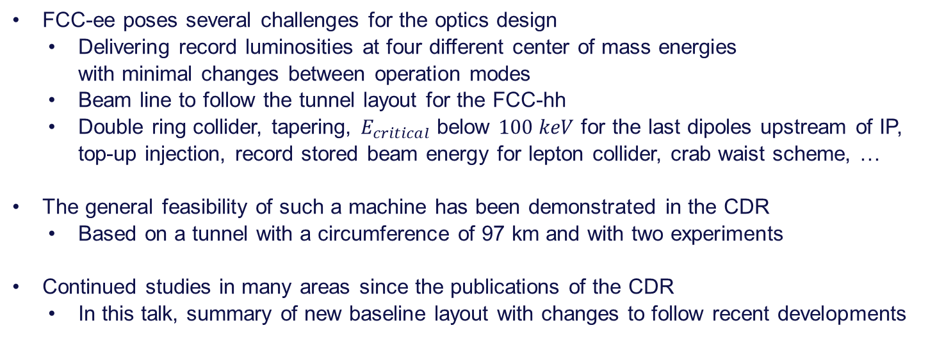
Introduction
FCC-ee poses several challenges for the optics design
  Delivering record luminosities at four different center of mass energies
  with minimal changes between operation modes
  Beam line to follow the tunnel layout for the FCC-hh
  Double ring collider, tapering, $E_{critical}$ below $100 keV$ for the last dipoles upstream of IP, top-up injection, record stored beam energy for lepton collider, crab waist scheme, …
The general feasibility of such a machine has been demonstrated in the CDR
  Based on a tunnel with a circumference of 97 km and with two experiments
Continued studies in many areas since the publications of the CDR
  In this talk, summary of new baseline layout with changes to follow recent developments

Slide 3
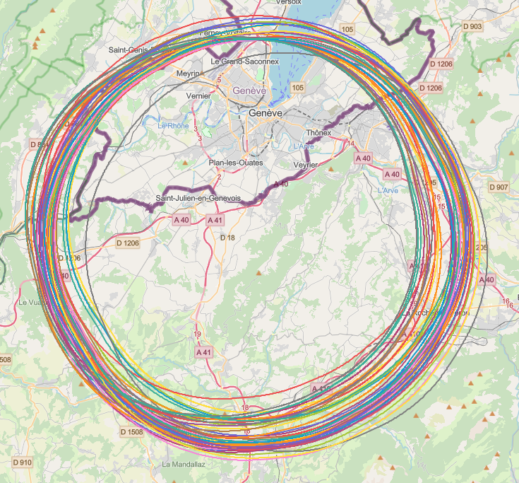
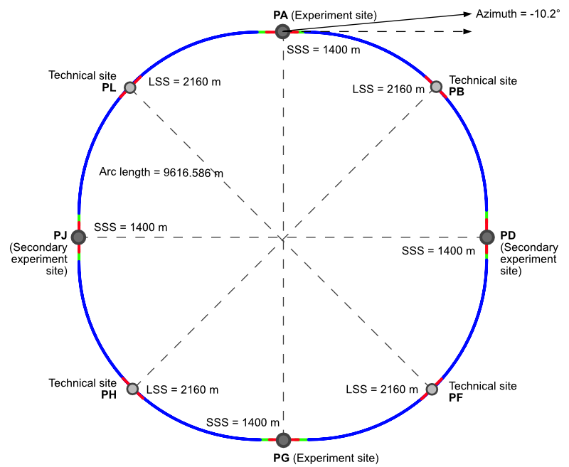
Placement Studies & new tunnel baseline
Following the CDR, continued studies to
optimize the placement of ring
  Many factors to consider:
  Geology, Infrastructure, Access tunnels,
  Periodicity, …
New baseline tunnel layout PA31-1.0
  Decrease in circumference to 91 km
  Four-fold periodicity
Small adjustments foreseen
to facilitate injection into FCC-hh
J. Gutleber, V. Mertens

Slide 4
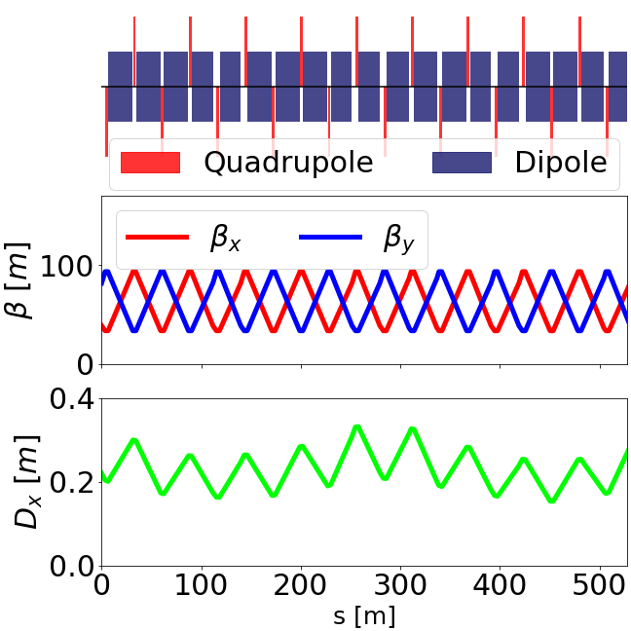
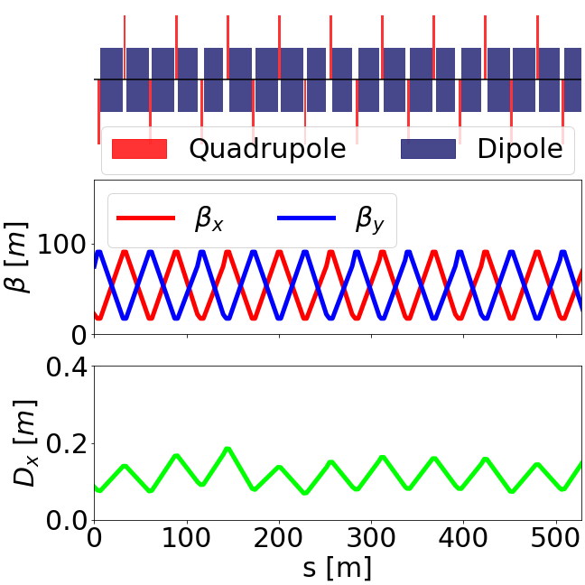
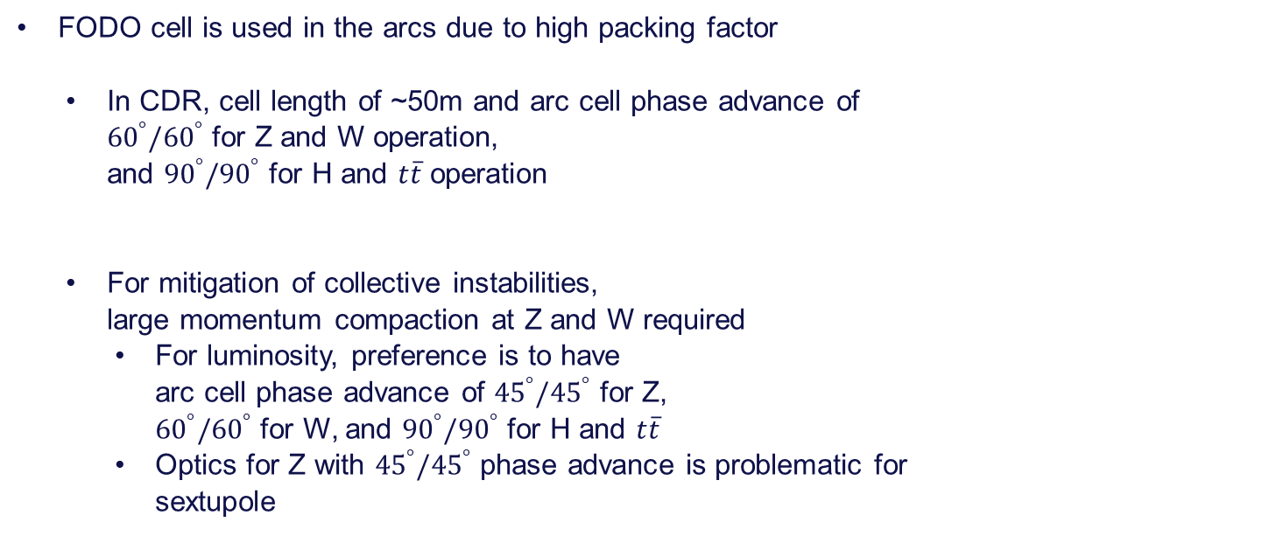


Arc cell considerations & CDR layout
$$Z$$
FODO cell is used in the arcs due to high packing factor
  In CDR, cell length of ~50m and arc cell phase advance of
  ${60}^{°}/{60}^{°}$ for Z and W operation,
  and ${90}^{°}/{90}^{°}$ for H and $t\overline{t}$ operation
  For mitigation of collective instabilities,
  large momentum compaction at Z and W required
    For luminosity, preference is to have
    arc cell phase advance of ${45}^{°}/{45}^{°}$ for Z,
    ${60}^{°}/{60}^{°}$ for W, and ${90}^{°}/{90}^{°}$ for H and $t\overline{t}$
    Optics for Z with ${45}^{°}/{45}^{°}$ phase advance is problematic for
    sextupole
$$t\overline{t}$$

Slide 5
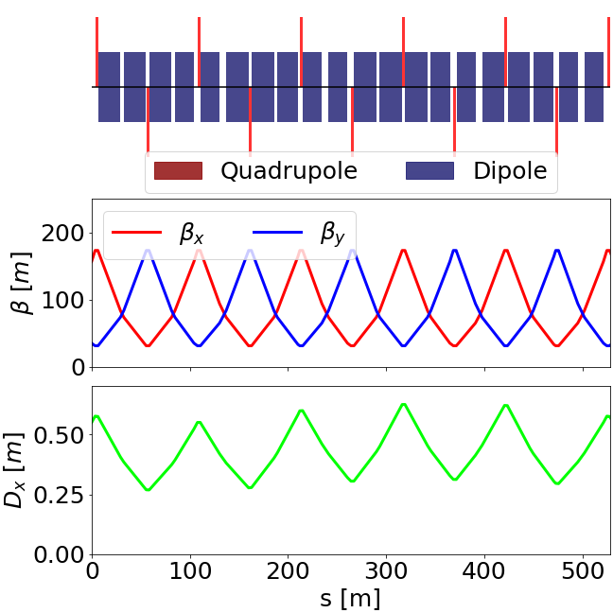
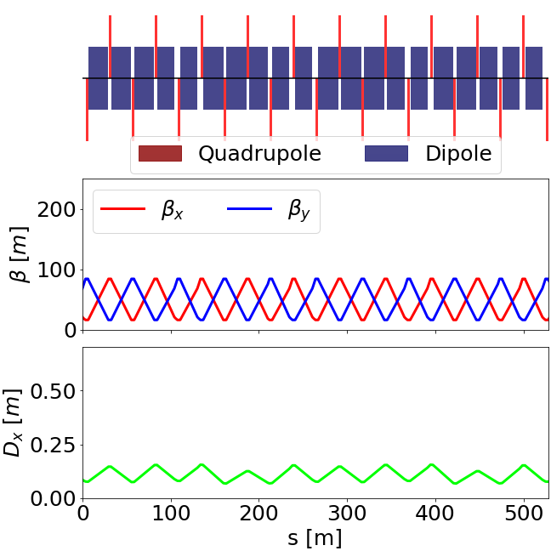
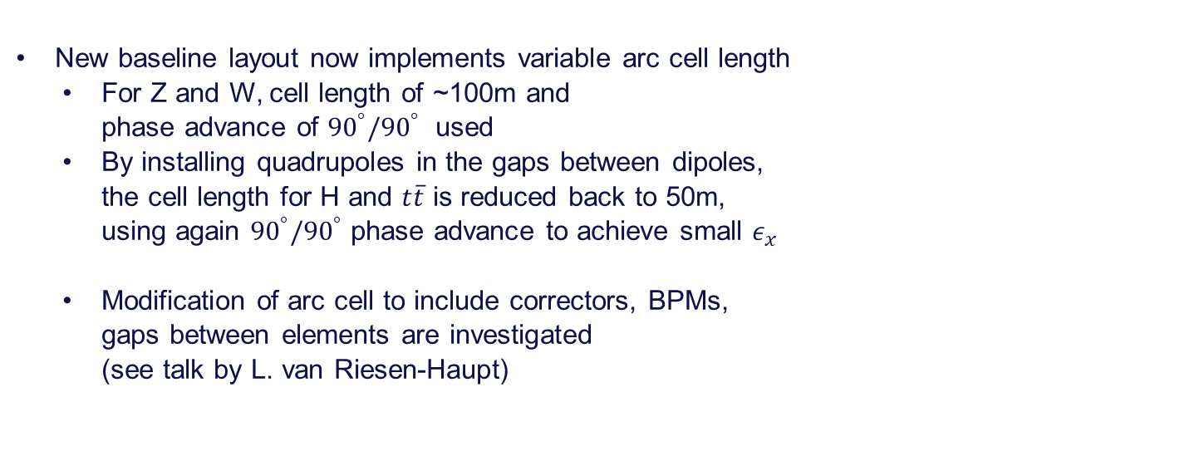


Arc optics in new layout
$$Z$$
New baseline layout now implements variable arc cell length
  For Z and W, cell length of ~100m and
  phase advance of ${90}^{°}/{90}^{°}$ used
  By installing quadrupoles in the gaps between dipoles,
  the cell length for H and $t\overline{t}$ is reduced back to 50m,
  using again ${90}^{°}/{90}^{°}$ phase advance to achieve small $ε_{x}$
  Modification of arc cell to include correctors, BPMs,
  gaps between elements are investigated
  (see talk by L. van Riesen-Haupt)
$$t\overline{t}$$

Slide 6
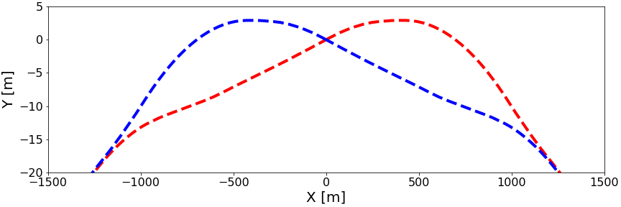
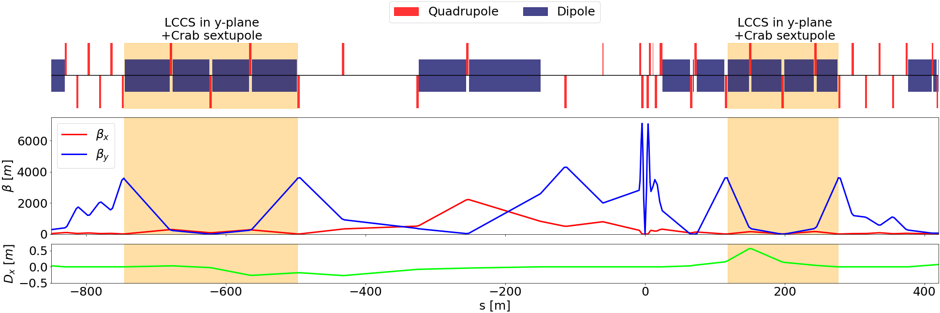
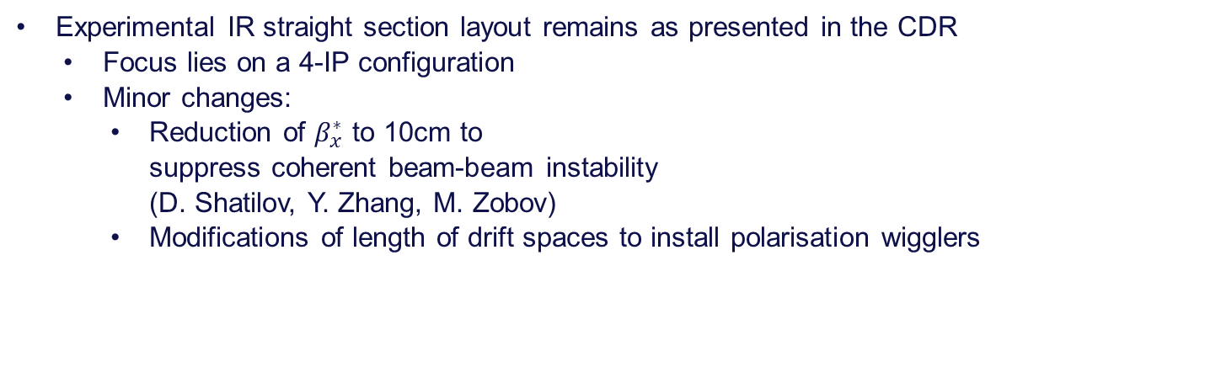
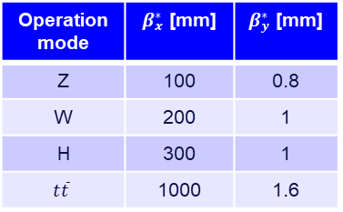
Experimental IR
Experimental IR straight section layout remains as presented in the CDR
  Focus lies on a 4-IP configuration
  Minor changes:
    Reduction of $β_{x}^{∗}$ to 10cm to
    suppress coherent beam-beam instability
    (D. Shatilov, Y. Zhang, M. Zobov)
    Modifications of length of drift spaces to install polarisation wigglers
Operation mode | $β_{x}^{∗}$ [mm] | $β_{y}^{∗}$ [mm]
Z | 100 | 0.8
W | 200 | 1
H | 300 | 1
$$t\overline{t}$$ | 1000 | 1.6

Slide 7
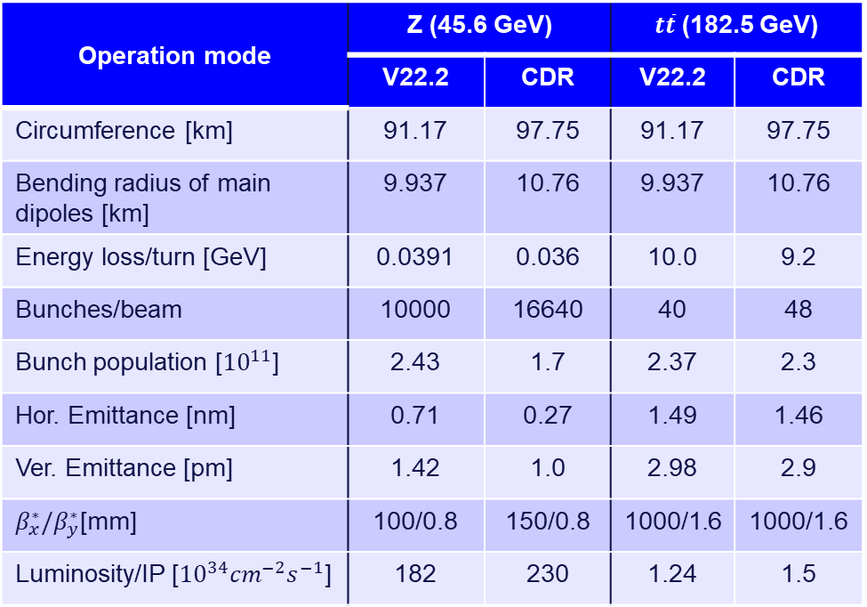
Parameters
Operation mode | Z (45.6 GeV) |  | $t\overline{t}$ (182.5 GeV)
 | V22.2 | CDR | V22.2 | CDR
Circumference [km] | 91.17 | 97.75 | 91.17 | 97.75
Bending radius of main dipoles [km] | 9.937 | 10.76 | 9.937 | 10.76
Energy loss/turn [GeV] | 0.0391 | 0.036 | 10.0 | 9.2
Bunches/beam | 10000 | 16640 | 40 | 48
Bunch population [${10}^{11}$] | 2.43 | 1.7 | 2.37 | 2.3
Hor. Emittance [nm] | 0.71 | 0.27 | 1.49 | 1.46
Ver. Emittance [pm] | 1.42 | 1.0 | 2.98 | 2.9
$β_{x}^{∗}/β_{y}^{∗}$[mm] | 100/0.8 | 150/0.8 | 1000/1.6 | 1000/1.6
Luminosity/IP [${10}^{34}{cm}^{−2}s^{−1}$] | 182 | 230 | 1.24 | 1.5
New optics and parameter
on the FCC-ee optics repo
in the V22 branch
Parameters adjusted
for lower circumference and
new arc optics
  Results in a
  slight decrease of
  luminosity per IP
  Luminosity numbers
  based on simple model,
  to be refined
  with simulations
Reference

Slide 8
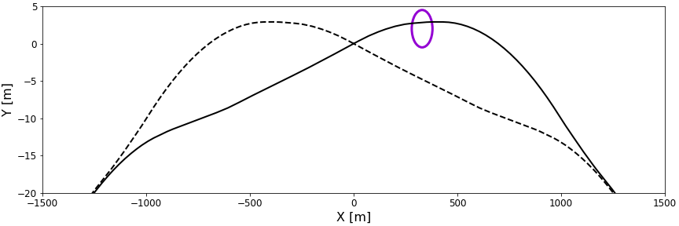
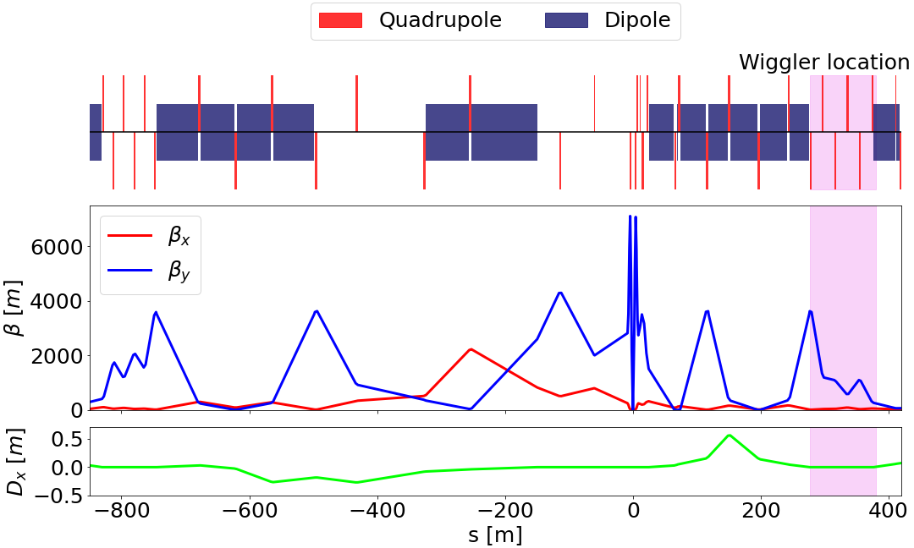
Lattice modifications
For energy calibration runs at Z and W, two critical systems:
  Wiggler to reduce the polarization time
  Polarimeter to measure polarization
  based on spin-dependent Compton scattering
Integration into new baseline layout ongoing
(see talk by K. Oide)
  Wiggler installed downstream
  of the experimental straight
  Two locations for polarimeter under study:
    Upstream of either
    an RF insertion or experimental insertion

Slide 9
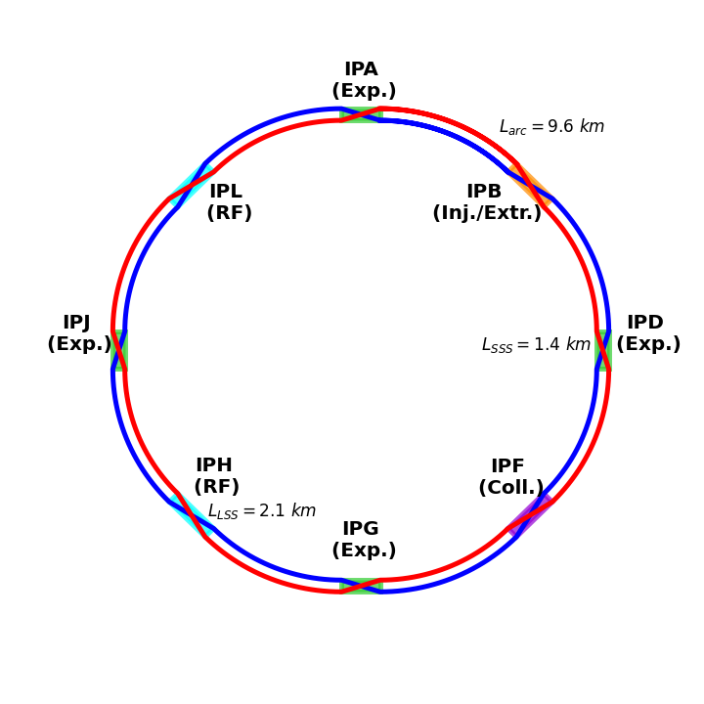
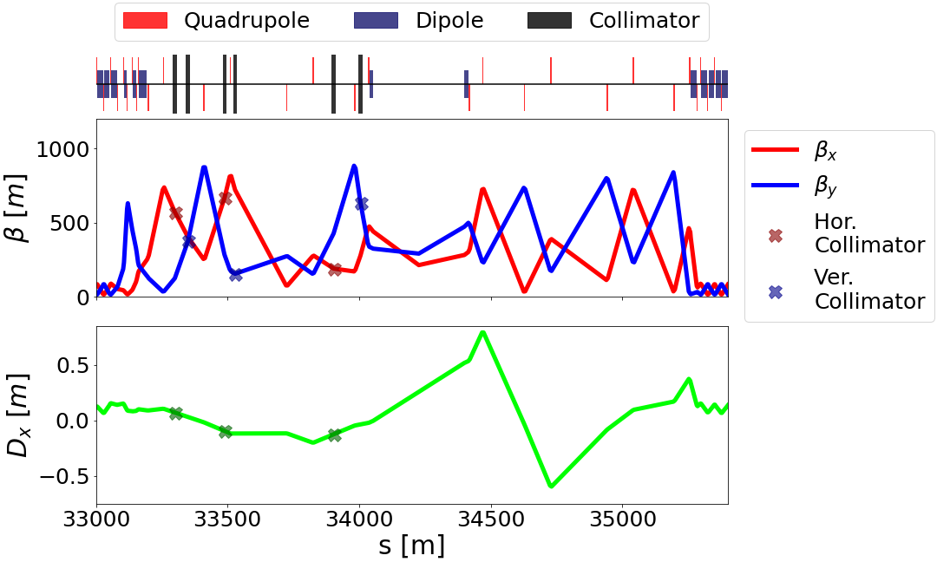
Integration of auxiliary insertions
In 4-IP layout, beam crossing in every straight section required
First design of a collimation insertion under study
(see talk by A. Abramov)
  Betatron and momentum collimation in point F
Top-up injection and extraction potentially located
in point B
  Studies on top-up injection currently ongoing,
  using CDR type lattice for now
  (see talk by P. Hunchak)
  Layout to be adapted to 4-IP

Slide 10
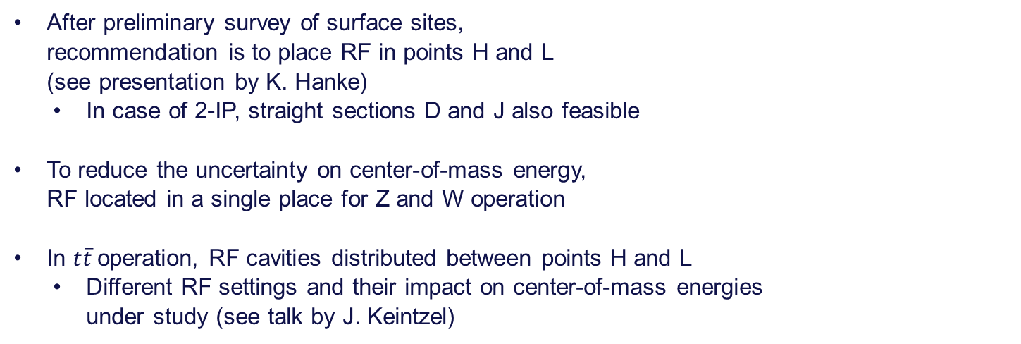
RF insertions
After preliminary survey of surface sites,
recommendation is to place RF in points H and L
(see presentation by K. Hanke)
  In case of 2-IP, straight sections D and J also feasible
To reduce the uncertainty on center-of-mass energy,
RF located in a single place for Z and W operation
In $t\overline{t}$operation, RF cavities distributed between points H and L
  Different RF settings and their impact on center-of-mass energies
  under study (see talk by J. Keintzel)

Slide 11
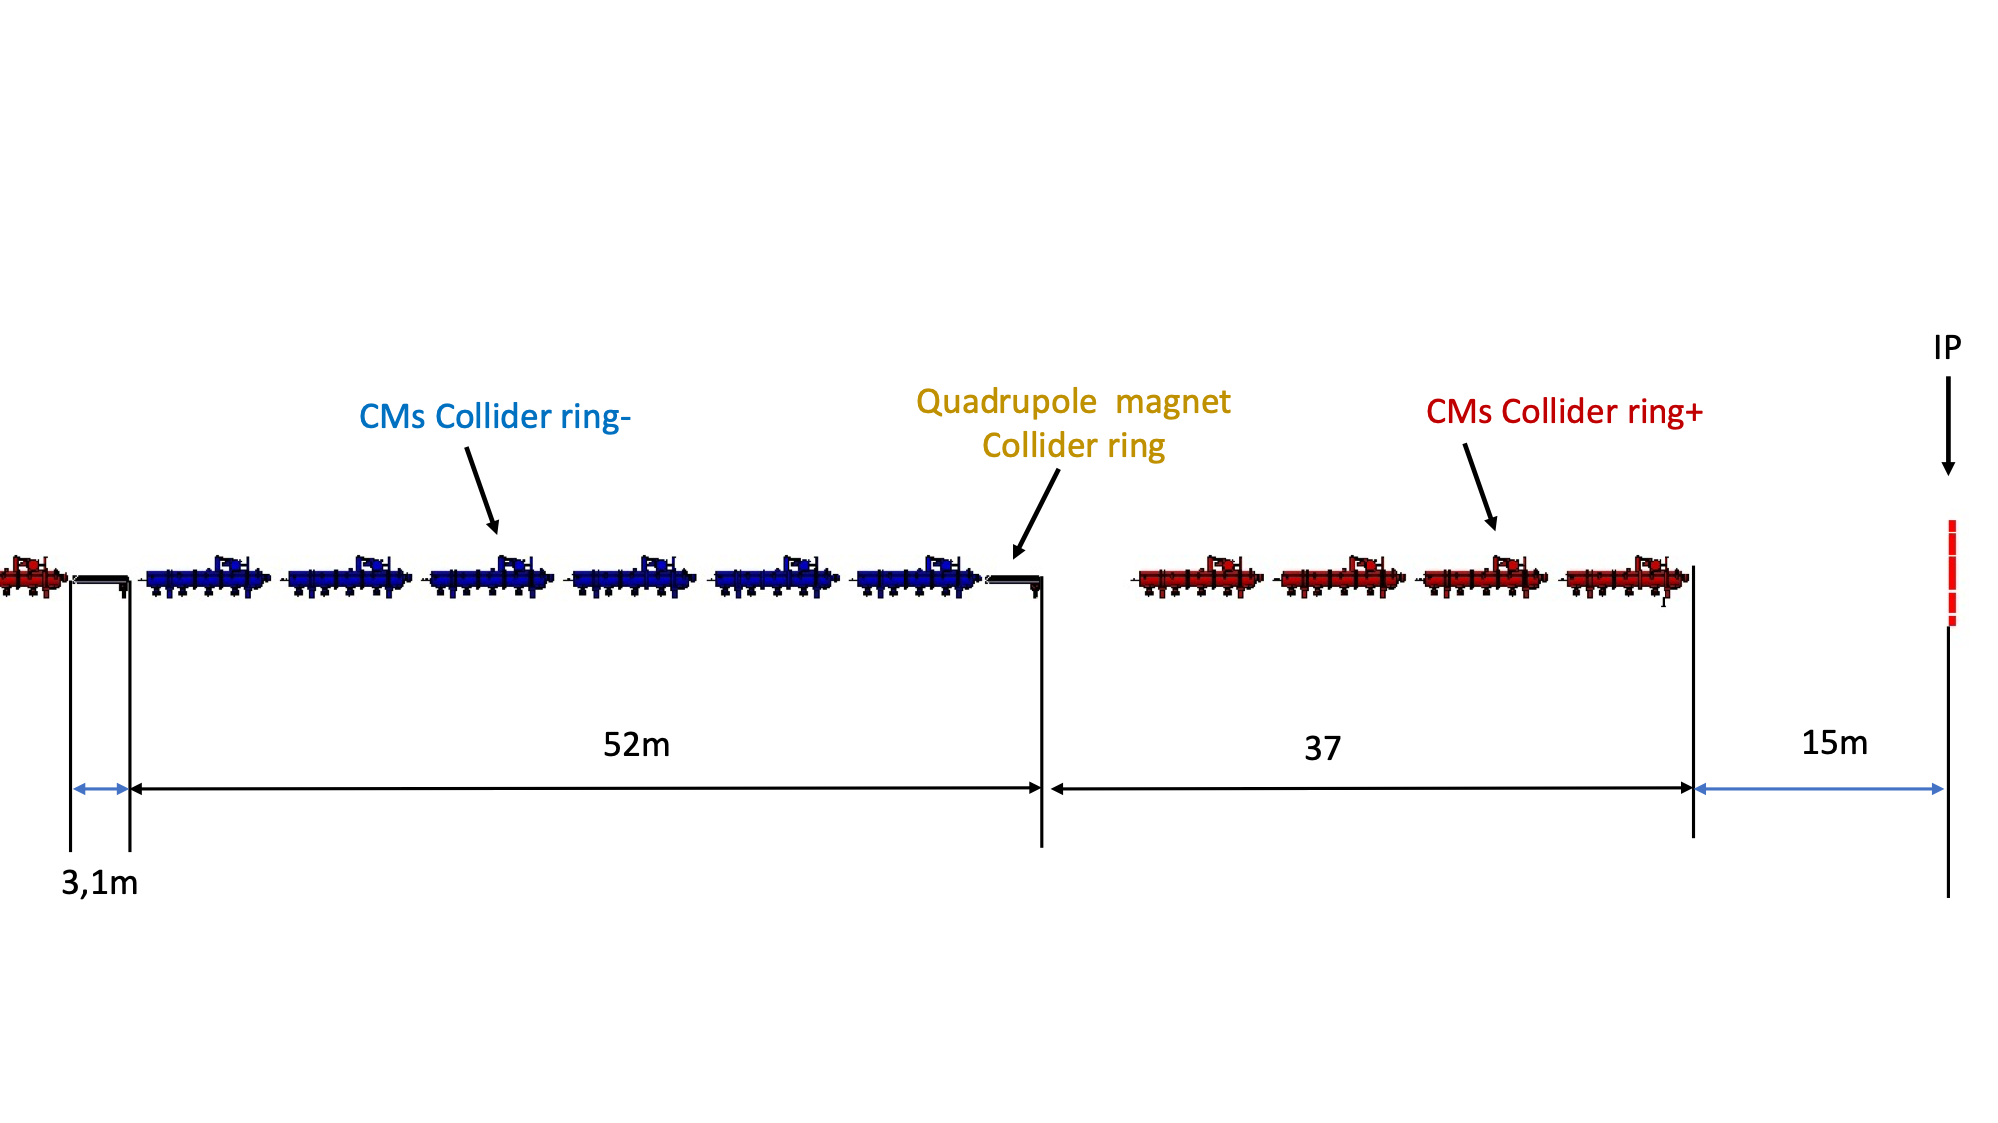
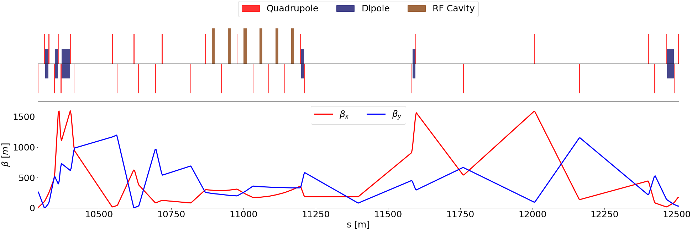
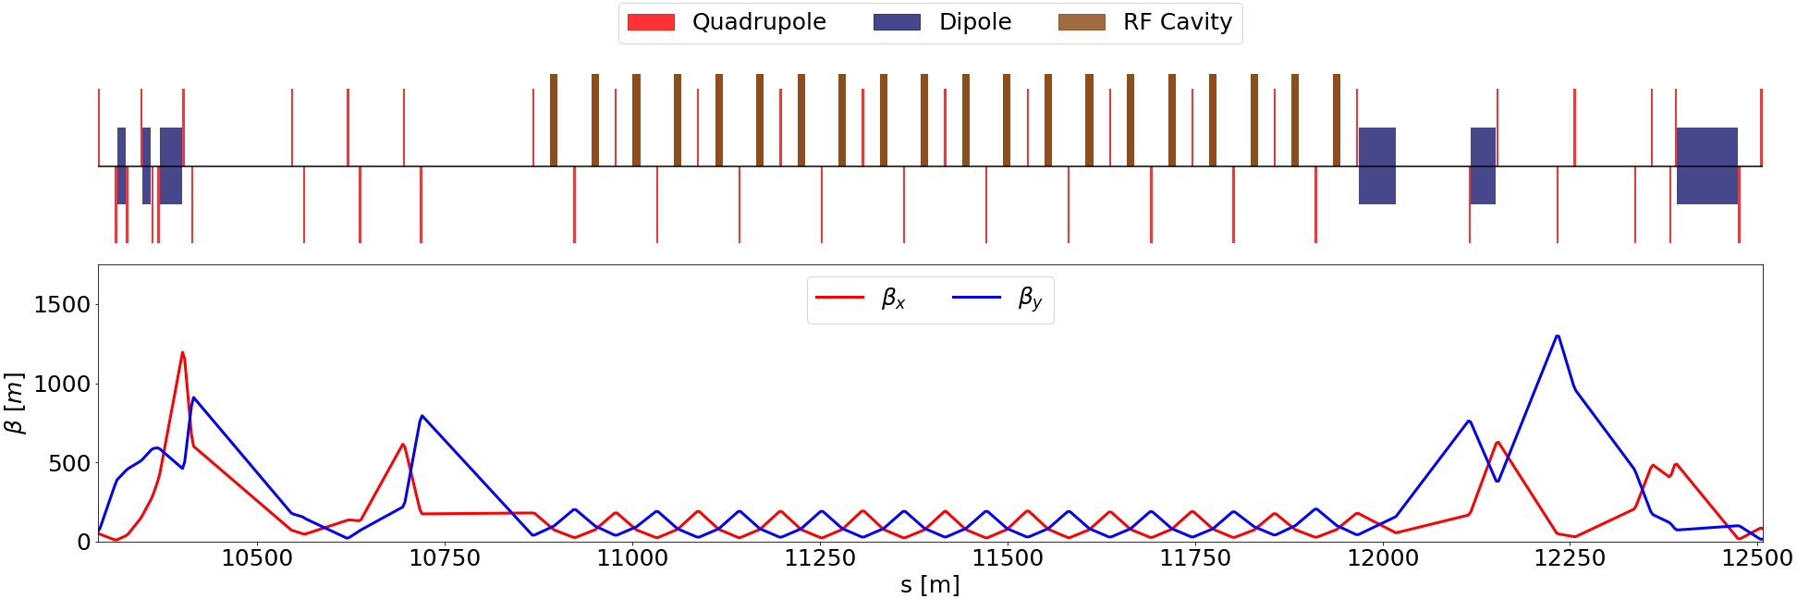

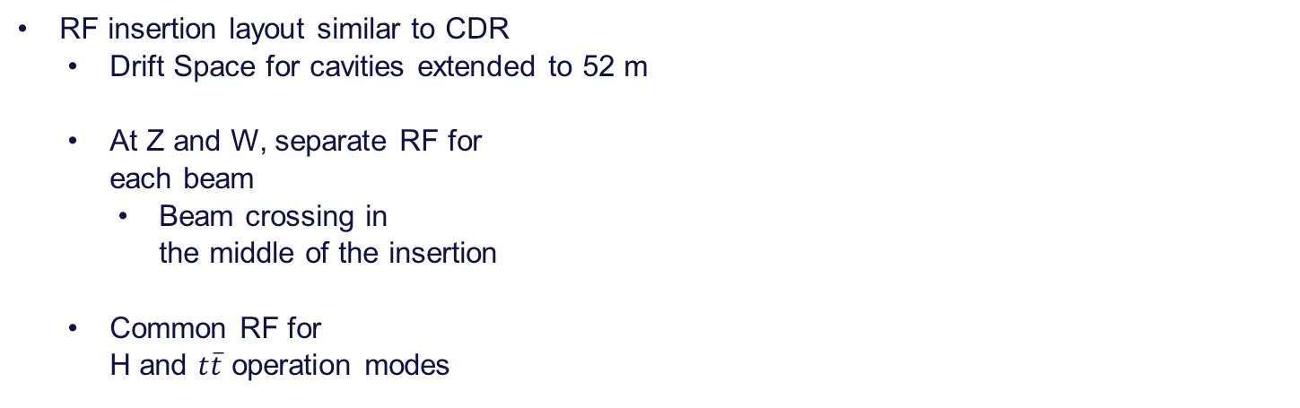

RF insertions II
  F.K. Valchkova
RF insertion layout similar to CDR
  Drift Space for cavities extended to 52 m
  At Z and W, separate RF for
  each beam
    Beam crossing in
    the middle of the insertion
  Common RF for
  H and $t\overline{t}$ operation modes
$$Z$$
$$t\overline{t}$$

Slide 12
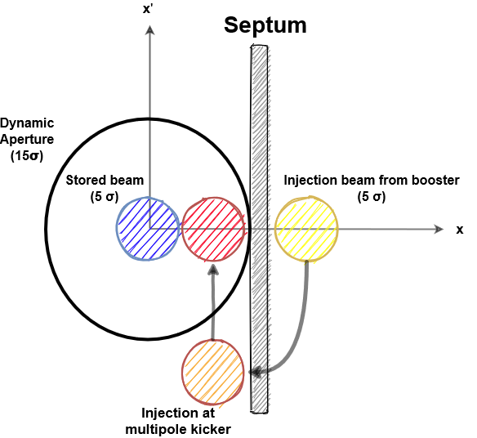
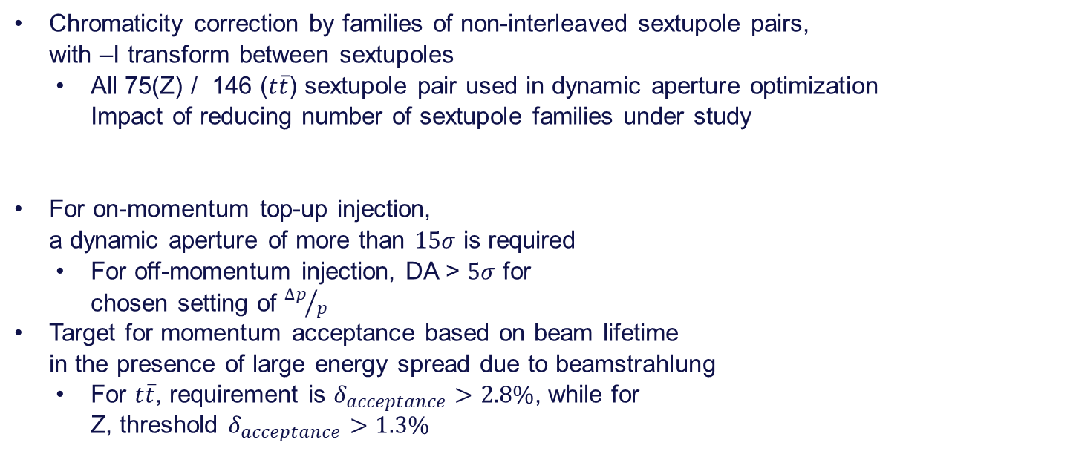
Sextupoles and DA optimization
Chromaticity correction by families of non-interleaved sextupole pairs,
with –I transform between sextupoles
  All 75(Z) / 146 ($t\overline{t}$) sextupole pair used in dynamic aperture optimization
  Impact of reducing number of sextupole families under study
For on-momentum top-up injection,
a dynamic aperture of more than $15σ$ is required
  For off-momentum injection, DA > $5σ$ for
  chosen setting of ${∆p}/p$
Target for momentum acceptance based on beam lifetime
in the presence of large energy spread due to beamstrahlung
  For $t\overline{t}$, requirement is $δ_{acceptance}>2.8\%$, while for
  Z, threshold $δ_{acceptance}>1.3\%$

Slide 13
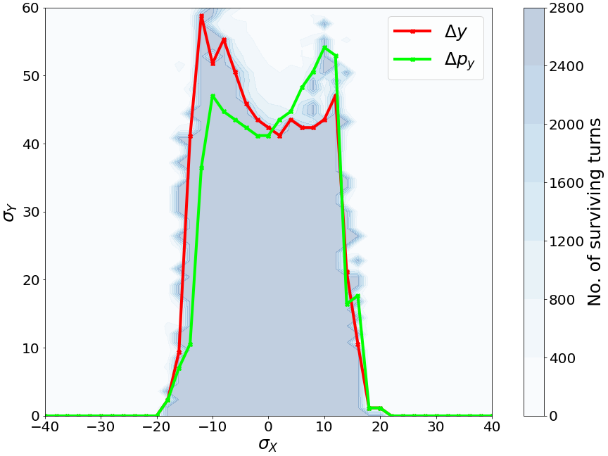
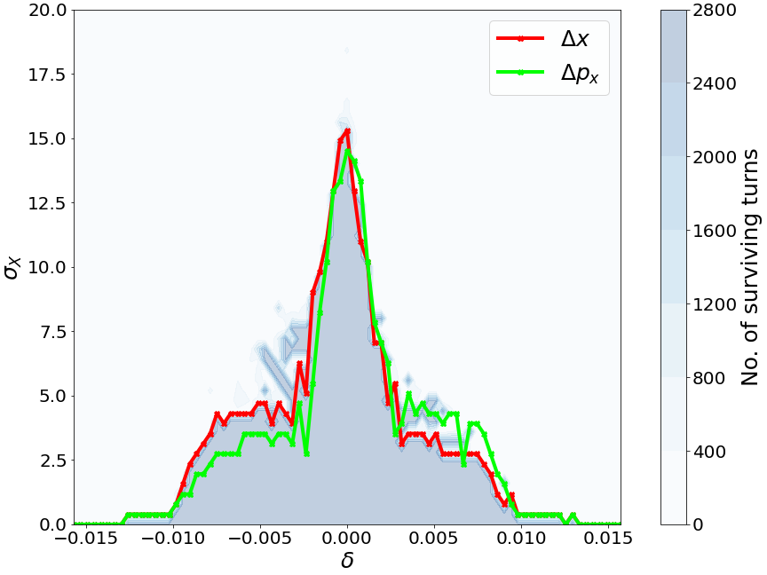
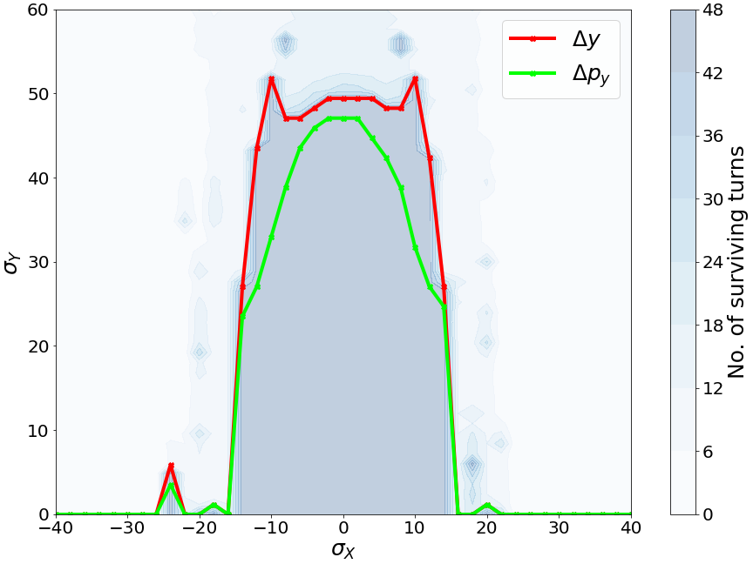
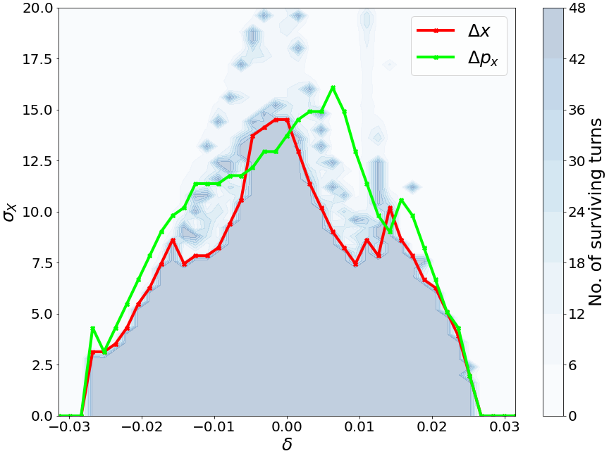


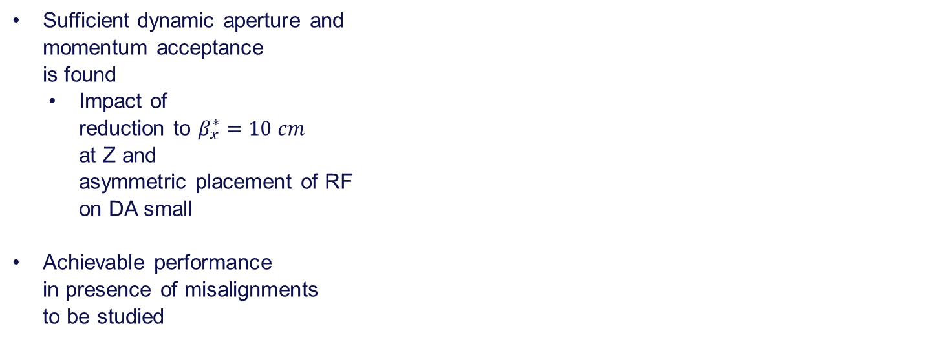
Sextupoles and DA optimization
Sufficient dynamic aperture and
momentum acceptance
is found
  Impact of
  reduction to $β_{x}^{∗}=10 cm$
  at Z and
  asymmetric placement of RF
  on DA small
Achievable performance
in presence of misalignments
to be studied
$$Z$$
$$t\overline{t}$$

Slide 14
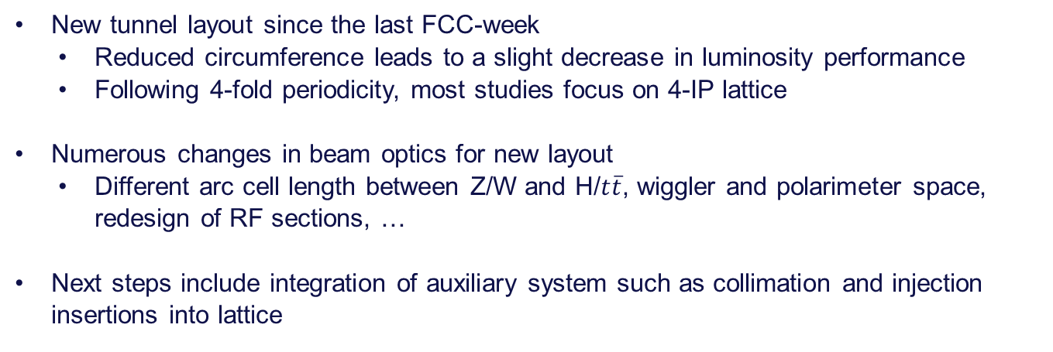
Conclusions and next steps
New tunnel layout since the last FCC-week
  Reduced circumference leads to a slight decrease in luminosity performance
  Following 4-fold periodicity, most studies focus on 4-IP lattice
Numerous changes in beam optics for new layout
  Different arc cell length between Z/W and H/$t\overline{t}$, wiggler and polarimeter space,
  redesign of RF sections, …
Next steps include integration of auxiliary system such as collimation and injection insertions into lattice

Slide 15
Thanks for your attention!

Slide 16
Arc cell parameters
D

