Slide 1
Development progress on TS MBK for FCC^{ee}
Zaib Un Nisa (CERN)
Igor Syratchev (CERN), Jinchi Cai (UESTC), Graeme Burt (ULAN),
Anis Baig (ULAN, CERN)

Slide 2


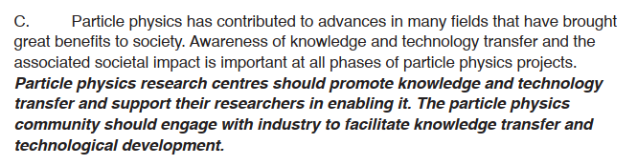
https://europeanstrategy.cern/home

Slide 3
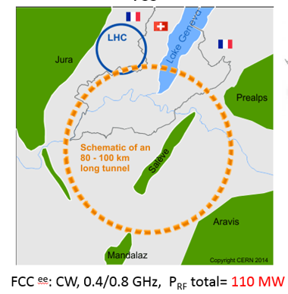
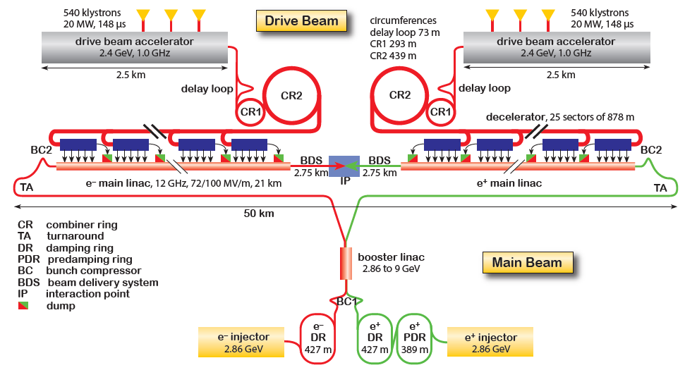
Average RF power needs of the large-scale HEP Accelerators Studies.
The klystron efficiency impact on the FCC^{ee} power consumption.
Example of the efficiency upgrade from existing 65% to 80%.
 | Klystron eff. 65% | Klystron eff. 80% | Difference
RF power needed for 3TeV CLIC | 105 MW
DC input power | 161.5MW | 131.25MW | -30.25MW
Waste heat | 56.5MW | 26.25MW | -30.25MW
Annual consumption (5500 h assumed) | 888 GWh | 721.9GWh | -166.1 GWh
Annual cost (50MCHF/MWh assumed) | 44.5 MCHF | 36.1 MCHF | -8.4 MCHF
Electricity installation dimensioned for | 161.5MW | 131.25 MW | -20.6%
CV installation dimensioned for | 56.5 MW | 26.25 MW | -53.54%
105 MW
Potential saving are 1.04 TWh in 10 years (84 MCHF in 10 years).
Reduced environmental impact (cooling and ventilation)
Reduced installation cost (stored energy in modulators).
Reduced maintenance cost (klystron life time).
R&D on increasing the useable efficiency is worth every penny/cent invested!
3.0 TeV CLIC^{e+e-} ; pulsed, 1.0 GHz, P_{RF} total = 180 MW

Slide 4
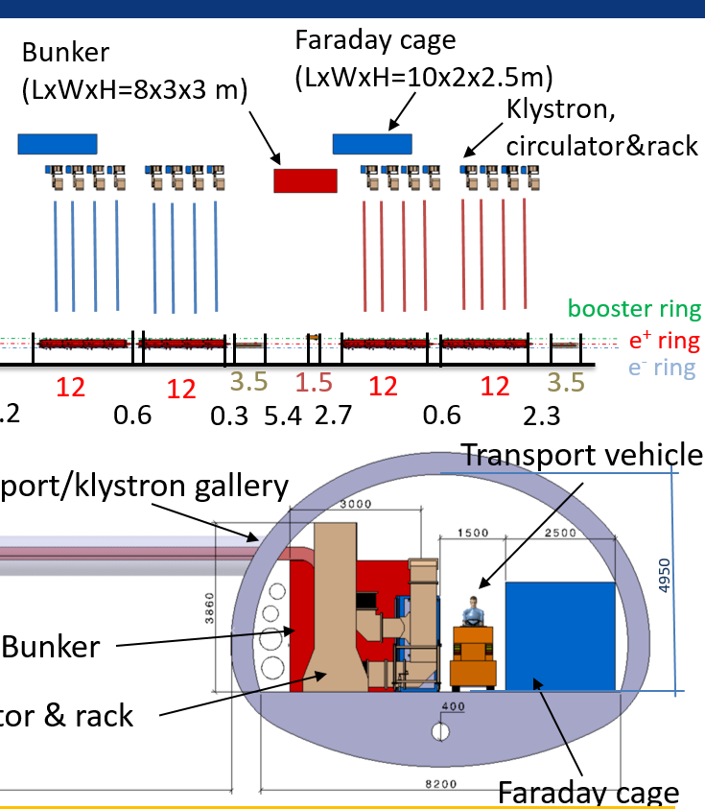
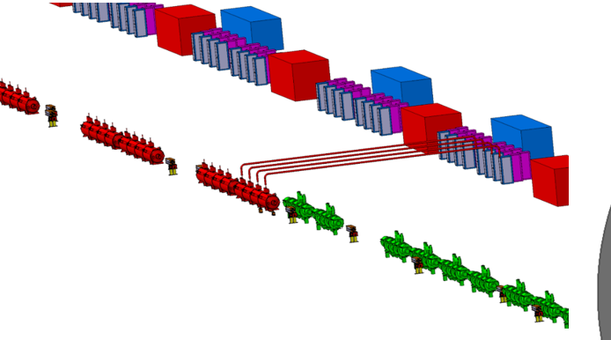
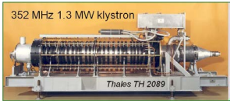
FCC_{ee} (Z) accelerator tunnel integration
Bunker:HV
Klystrons
1.3MW CW, 352MW, 100kV, 20A, eff.=63%.
5.5m
Each Klystron should deliver 1MW @ 400MHz.
Preferably, klystron should be placed vertically in the tunnel.
The total length of Klystron should be about 3m.
The efficiency of Klystron is targeted at 80%.

Slide 5
High efficiency klystrons projects at CERN
Task 1: HE Design and simulation
Task 2:HE LHC 400 MHz klystron
Task 3: HE-TS MBK L-band klystron
Validate the HE klystron technology (~70%) while upgrading and retro-fitting current LHC klystrons
The klystron design is accepted by Thales. Expected delivery of the prototype to CERN is in March 2023.
Task 4: HE 50MW X-band klystron with high rep-rate
Built a klystron, demonstrate >60% efficiency (cf. 38% in existing commercial tube) in collaboration with INFN and CPI
Reinforce synergies with CLIC, FLASH, Compact Light, Compton sources...
Klystron simulation code KlyC version 5 was released in May 2021. About 50 users worldwide.
Development and maintenance of the fast and accurate 2D klystron codes.
Demonstrate two-stage multibeam technology with 80%+ RF production efficiency
Complete design of TS MBK for CW FCC: 400 MHz, 1.2 MW
built demonstrator -> WP5 of the FCC SRF R&D Program
Promote this new technology towards CLIC, ILC, CEPC, by means of design and collaboration
New KlyC version 6 will include CGUN tracking module for the beam optics simulation (gun, solenoid and collector). Will be released in January 2021.
great showcase for CERN's technology. Contribution to the worldwide society.
Prepare the acceptance tests at CERN

Slide 6
Two-Stage Multi Beam Klystron (TS MBK) Technology
Commercial HE MBK
Efficiency 70%
Specific features:
Bunching at a low voltage (high perveance). Very compact RF bunching circuit.
Bunched beam acceleration and cooling (reducing Δp/p) along the short DC voltage post-accelerating gap.
Final power extraction from high voltage (low perveance) beam. High efficiency.
V
V₁+V₂
TS HE MBK
Efficiency ~85%
Additional advantages:
HV insulators
The second HV stage can be operated in DC mode. Thus simplifying the modulator topology (cost/volume) and increasing the modulator efficiency (in pulsed mode).
Simplified feedback for the first stage pulsed voltage. Improved klystron RF phase and amplitude stability.
Stage 1
V₁
V₂
Post accelerating gap
Stage 2

Slide 7
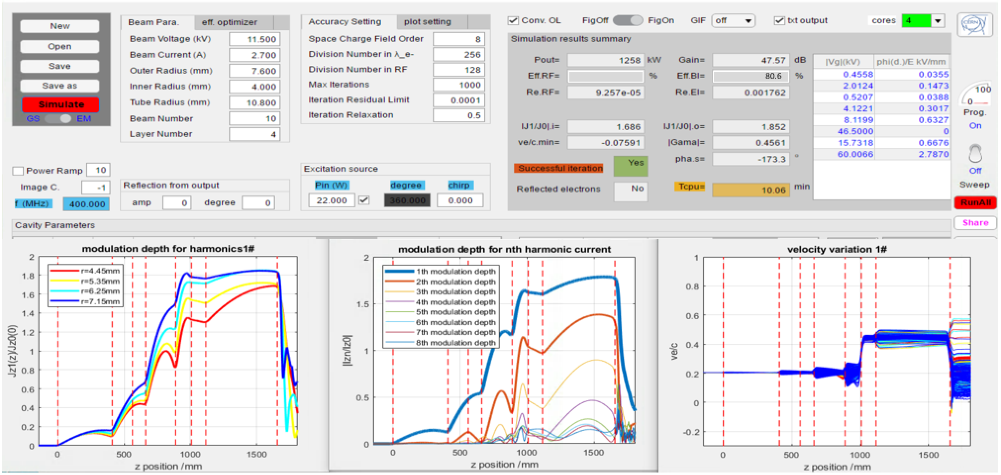
KlyC (CERN-made 1.5D klystron code) simulation results

Slide 8
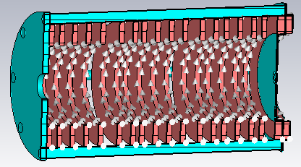
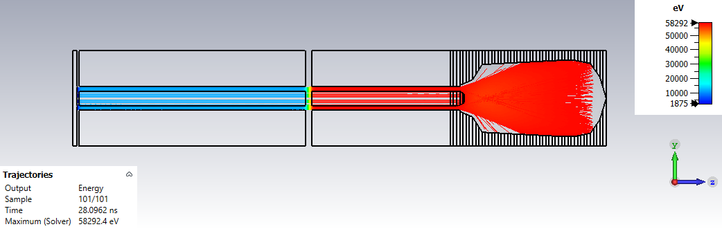
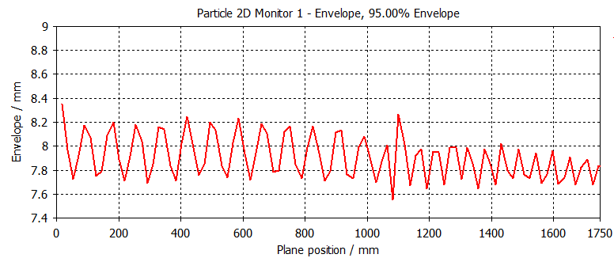
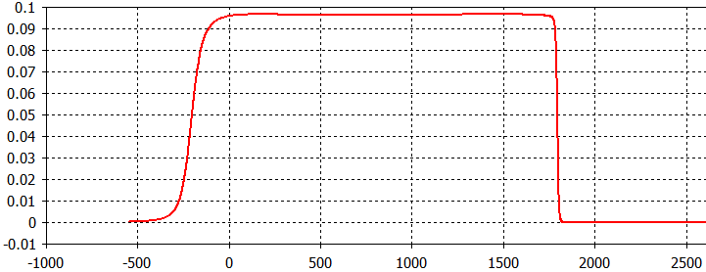
TS MBK Solenoid Design
Bz field on axis
Bz/ T
Z/mm
Magnetic field: Bz=5.5XBrillouin (0.095 T) for non-convergent beam optic system.
Beam envelop along the beam tunnel. Gap length is optimize to minimize the beam scalloping before and after DC accelerating gap.

Slide 9
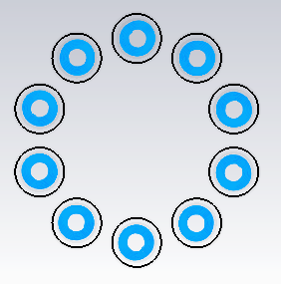
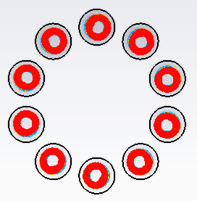
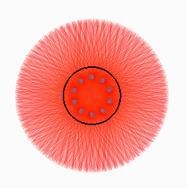
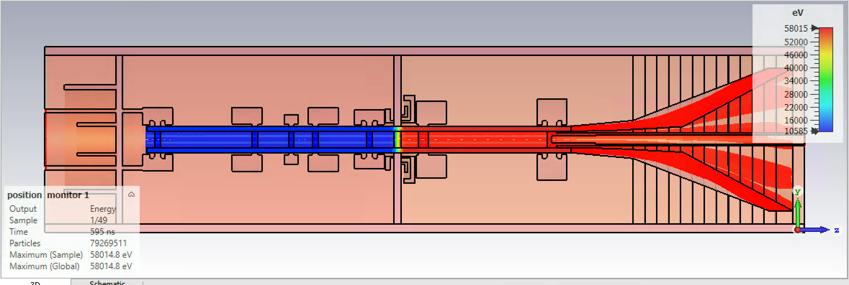
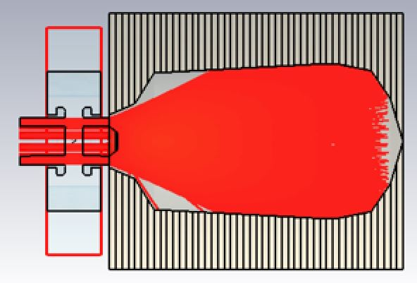
3D TRK & PIC (CST) beam optic simulations
3D Magnetic field is imported;
3D effects brought by the MB topology is fully considered
Tube is stabilized during 2000ns simulation time in PIC.
Peak surface power losses of 500W/cm² were set as a target following industrial data.
TRK
dP/dS, kW/cm²
PIC
Z/mm

Slide 10
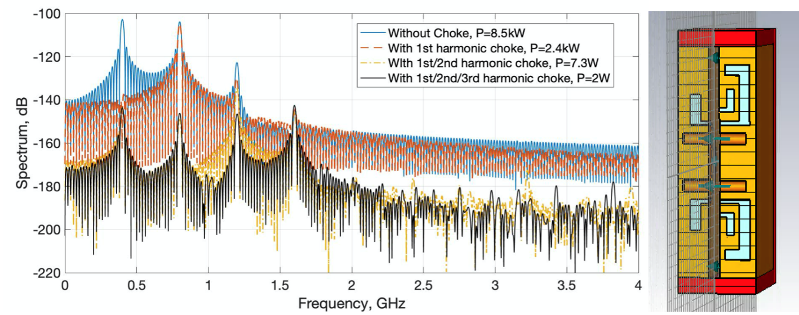
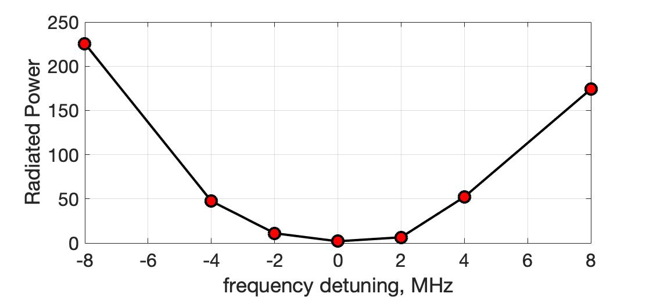
Parasitic RF power radiation into Post acceleration DC gap
    Bunched beam passing through the open gap will partially radiate RF power into the gap (wakefield problem).
    Radiation level is rather high: 8.5kW. The set of 3 frequencies (bunch harmonics) resonant rejecters reduces the radiation level by 36dB (down to 2W)

Slide 11
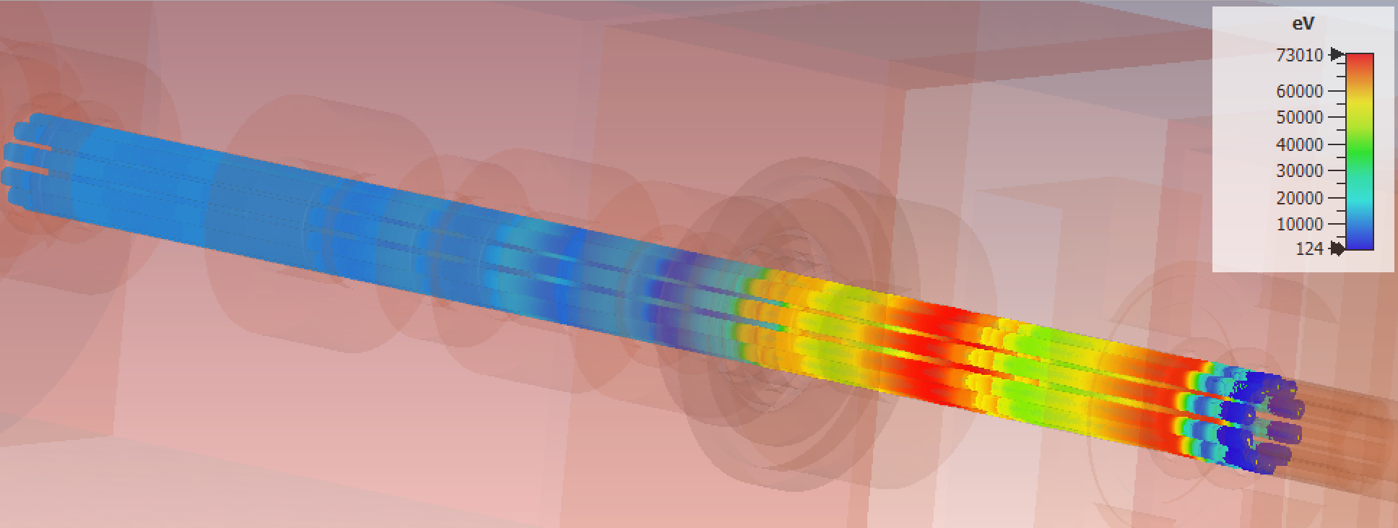
Full 3D PIC Simulation of TS MBK RF Circuit
Rendering of the particles’ velocity modulation in the steady state and saturation
Efficiency is 79% without reflected electrons in the output cavity.

Slide 12
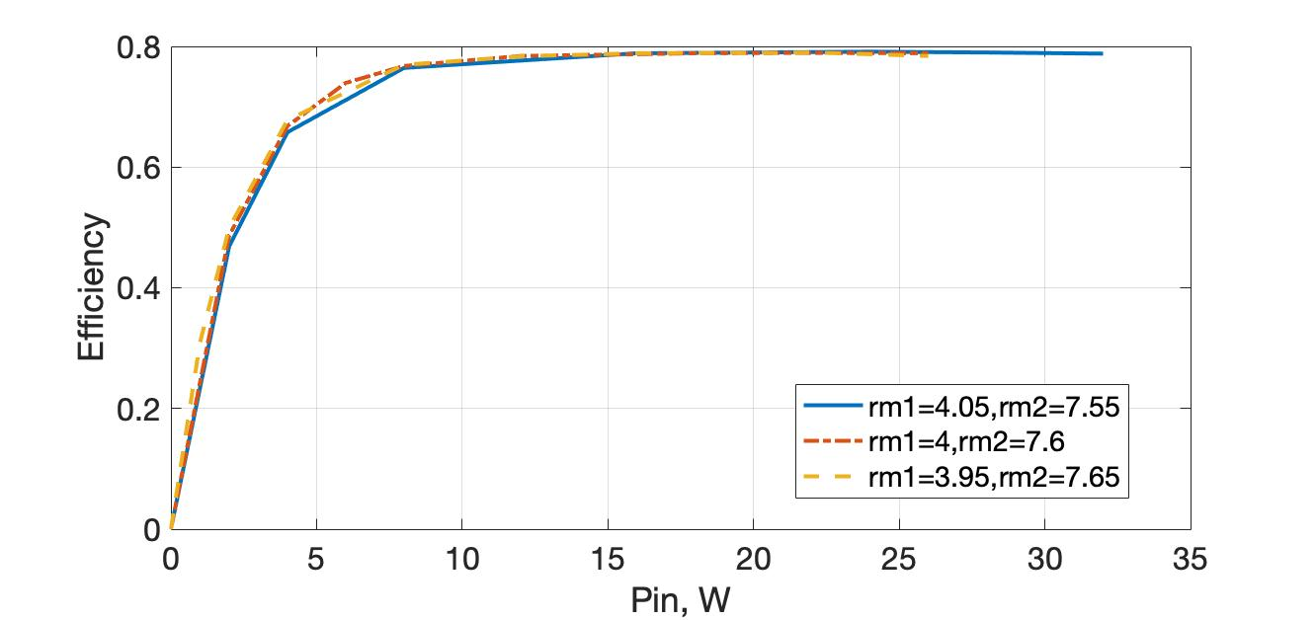
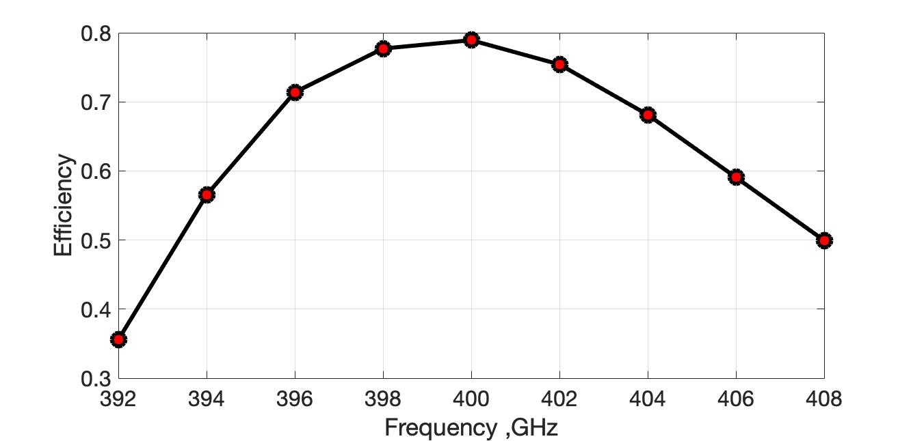
Power transfer and frequency band of TS MBK (CST PIC)
Hollow beam design makes tube less sensitive to beam parameter.
11.5 kV for the first stage, 58kV for the second stage, oil tank is not necessary for HV insulation.
-3dB bandwidth is over 16MHz.
Klystron could deliver 1.23MW output power at 400MHz, with circuit length of 1.6m. No instability in RF circuit were found.

Slide 13
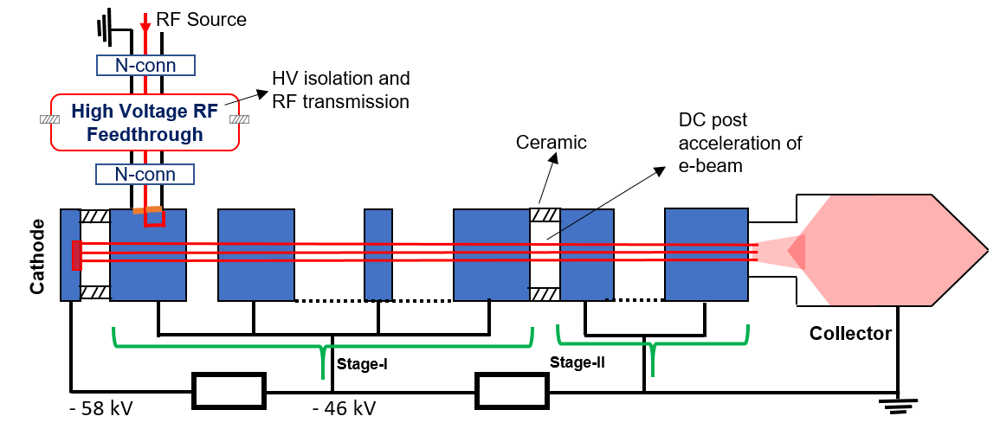
TS MBK High Voltage isolated RF Feed Through (HVRFT)
HVRFT is a special device which has to protect the klystron’s RF driver from the biasing voltage of the first stage (~50kV) and to enable efficient RF transmission of the driving RF signal (~100W) into the input cavity.

Slide 14
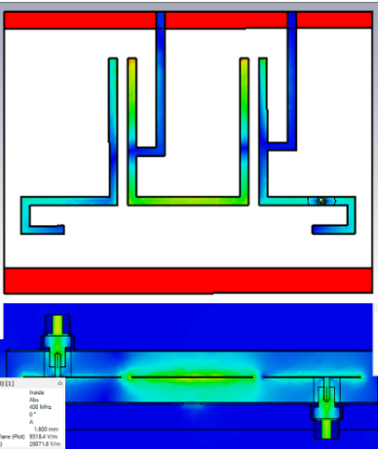
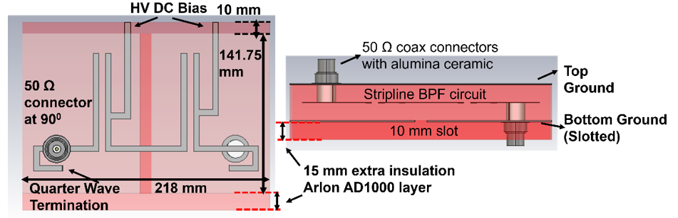
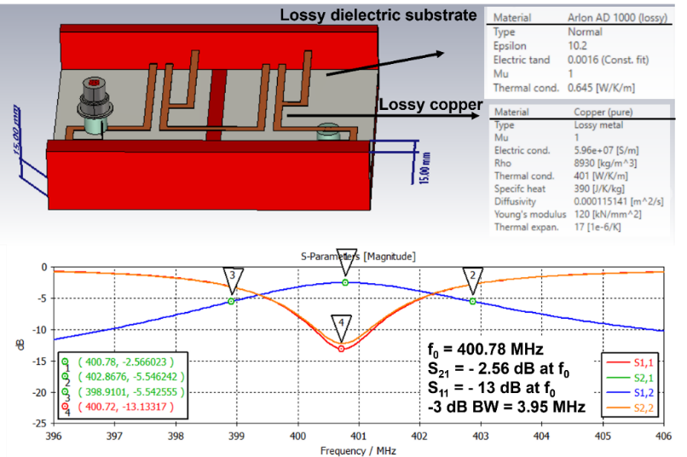
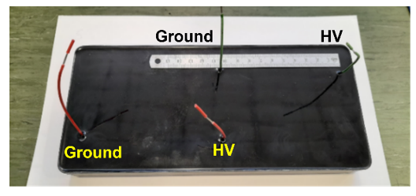
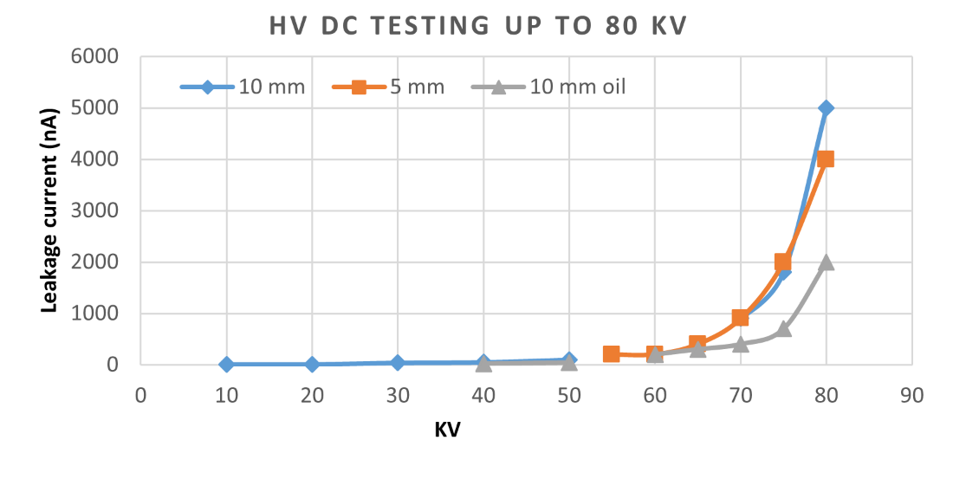
HVRFT design based on the strip-line topology
RF field map
High voltage tests of the stipeline electrodes imbedded into dielectric casing.
Strip-line topology allows for the compact solution. It provides HV isolation up to 65kV (measured) and efficient enough (60%) RF power transmission.
The full-scale prototype is now in fabrication and will be tested in September 2022.

Slide 15
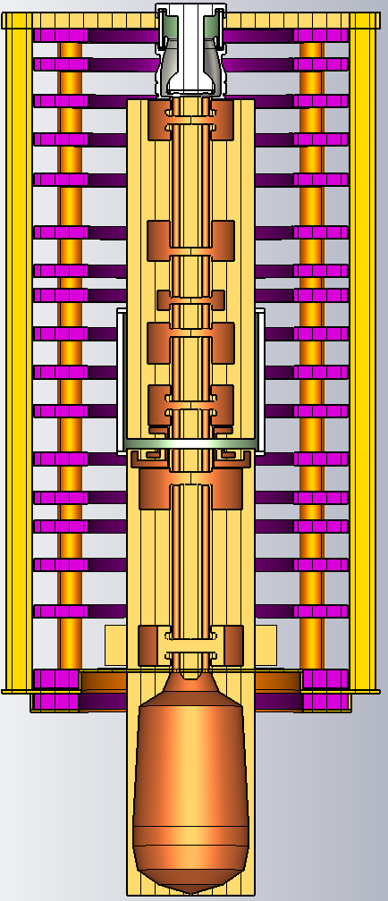
1 m
Design Parameters for TS MBK for FCC^{ee}
Parameters | Design Target | KlyC | CST
Frequency (GHz) | 0.4 | 0.4 | 0.4
Voltage (kV) | 58 | 58 | 58
First stage (kV) | 10-20 | 11.5 | 11.5
N beams | 10 | 10 | 10
Total Current (A) | 27 | 27 | 27
Output Power (MW) | 1.2 | 1.28 | 1.2
Efficiency (%) | 80 | 80.6 | 79
Tube length (m) | <3 | -- | 2.8
2.8 m

Slide 16
FCC TS MBK Summary and outlook
The reduction of energy consumption in the future large scale accelerators, like FCC, is of a great importance.
Novel two-stage (TS) klystron technology was introduced recently. It enables compact solution in UHF band, with potential to increase the efficiency from 65% in existing commercial tubes up to 80%.
Such a 400 MHz, 1.2 MW TS MBK klystron for FCC is now under development at CERN as a part of the High Efficiency Klystrons project.
RF circuit, beam optics and special axillaries, like HVRFT and DC accelerating gap rejector, have been evaluated and confirmed in simulation the tube conceptual feasibility with potential to reach target efficiency of 80%.
The next step will be integration of beam optics and RF circuit, followed by technological development and prototype fabrication in collaboration with industrial partner.

Slide 17
Thanks for your attention!
Notes:
75% ESS tube 110kV,16.84A; 70% LHC tube 54kV,9A

