Slide 1
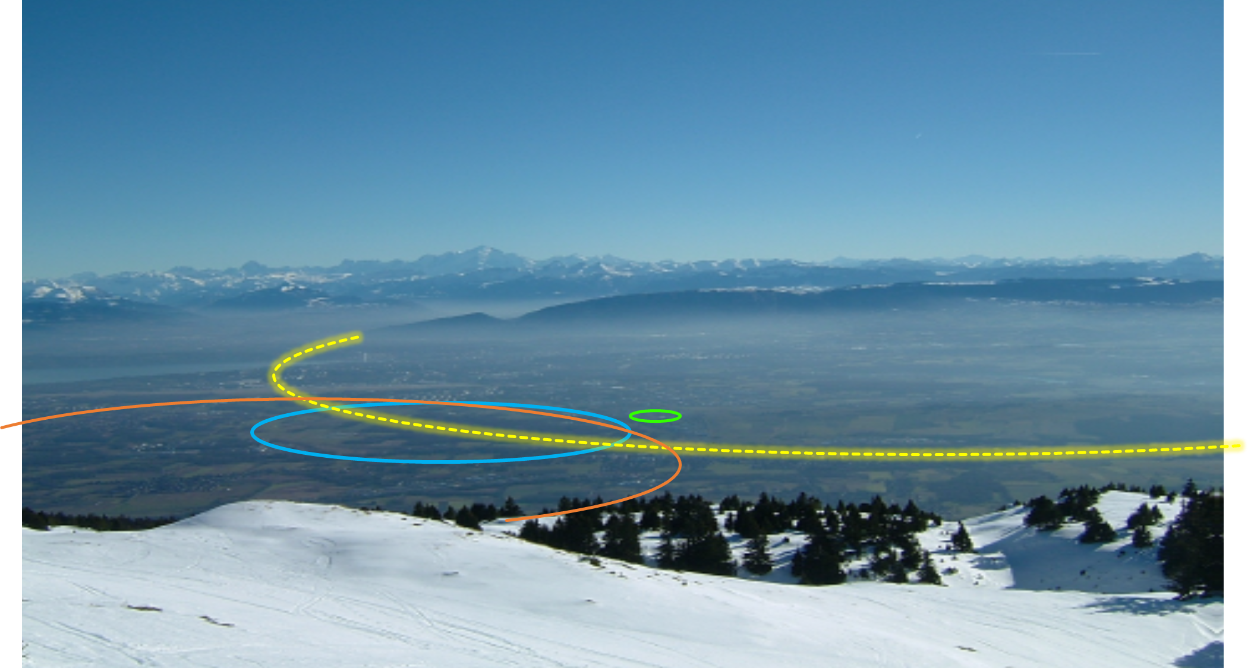
FCC-hh layout and optics studies
Massimo Giovannozzi and Thys Risselada
CERN, BE Department
FCC Week 2022, 1 June 2022
PS
LHC
FCC
SPS
Work supported by the European Commission under the HORIZON 2020 projects EuroCirCol, grant agreement 654305; EASITrain, grant agreement no. 764879; ARIES, grant agreement 730871, FCCIS, grant agreement 951754, and E-JADE, contract no. 645479
photo: J. Wenninger

Slide 2



Outline
The CDR baseline
Layout and optics of
new FCC-hh ring
Progress with combined
function lattice
Outlook
Acknowledgements: A. Abramov, W. Bartmann, M. Benedikt, K. Brodzinski, L. Bromiley, R. Bruce, L. Delprat, J. Gutleber, R. Lopez, V. Mertens, J. Osborne, G. Perez Segurana, T. Raubenheimer, S. Redaelli, E. Todesco, F. Valchkova-Georgieva, B. Weyer, F. Zimmermann

Slide 3
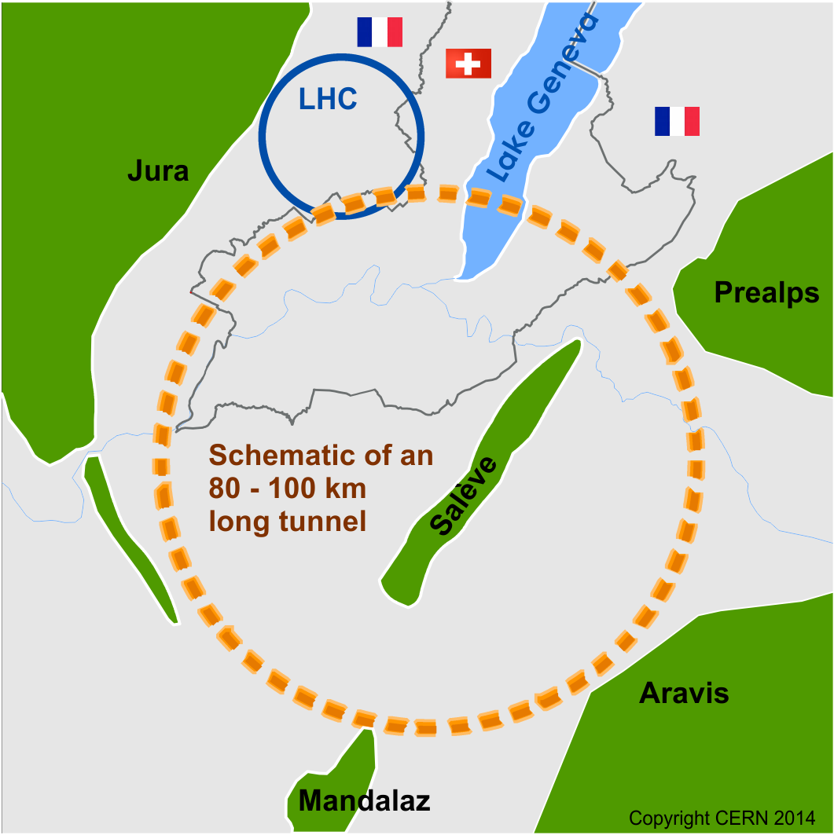
Future Circular Collider Study
launched in 2014
international FCC collaboration (CERN as host lab) to study:
pp-collider (FCC-hh) → defining infrastructure requirements
80-100 km infrastructure in Geneva area
e⁺e⁻ collider (FCC-ee) as a possible first step
p-e (FCC-he) option, HE-LHC …
~16 T ⇒ 100 TeV pp in 100 km

Slide 4

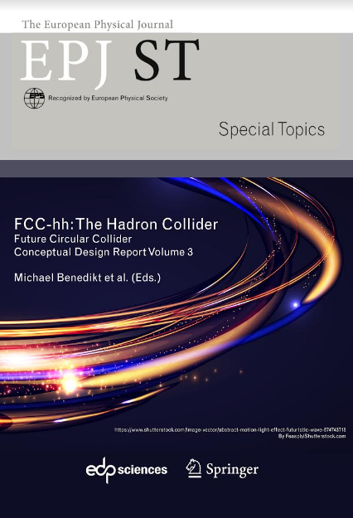
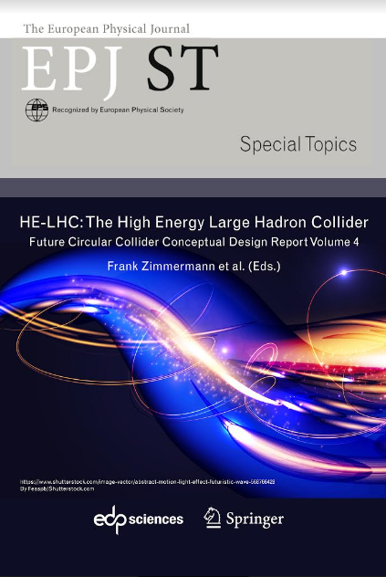
FCC CDR and Study Documentation
FCC-Conceptual Design Reports (completed in 2018):
  Vol 1 Physics, Vol 2 FCC-ee, Vol 3 FCC-hh, Vol 4 HE-LHC
  CDRs published in European Physical Journal C (Vol 1) and ST (Vol 2 – 4)
  EPJ C 79, 6 (2019) 474 , EPJ ST 228, 2 (2019) 261-623 , EPJ ST 228, 4 (2019) 755-1107 , EPJ ST 228, 5 (2019) 1109-1382
Summary documents provided to EPPSU SG
  FCC-integral, FCC-ee, FCC-hh, HE-LHC
  Accessible on http://fcc-cdr.web.cern.ch/
>1350 contributors from
> 350 institutes,
a truly global effort

Slide 5
FCC-hh (pp) collider parameters
parameter | FCC-hh |  | HL-LHC | LHC
collision energy cms [TeV] | 100 |  | 14 | 14
dipole field [T] | 16 |  | 8.33 | 8.33
circumference [km] | 97.75 |  | 26.7 | 26.7
beam current [A] | 0.5 |  | 1.1 | 0.58
bunch intensity [10¹¹] | 1 | 1 | 2.2 | 1.15
bunch spacing [ns] | 25 | 25 | 25 | 25
synchr. rad. power / ring [kW] | 2400 |  | 7.3 | 3.6
SR power / length [W/m/ap.] | 28.4 |  | 0.33 | 0.17
long. emit. damping time [h] | 0.54 |  | 12.9 | 12.9
beta* [m] | 1.1 | 0.3 | 0.15 (min.) | 0.55
normalized emittance [μm] | 2.2 |  | 2.5 | 3.75
peak luminosity [10³⁴ cm⁻²s⁻¹] | 5 | 30 | 5 (lev.) | 1
events/bunch crossing | 170 | 1000 | 132 | 27
stored energy/beam [GJ] | 8.4 |  | 0.7 | 0.36

Slide 6
FCC-hh layout
Two high-luminosity experiments (A & G)
Two other experiments combined with injection (L & B)
Two collimation insertions
  betatron cleaning (J)
  momentum cleaning (F)
Extraction insertion (D)
Clean insertion with RF (H)
Compatible with LHC or SPS as injector
circumference: 97.75 km

Slide 7
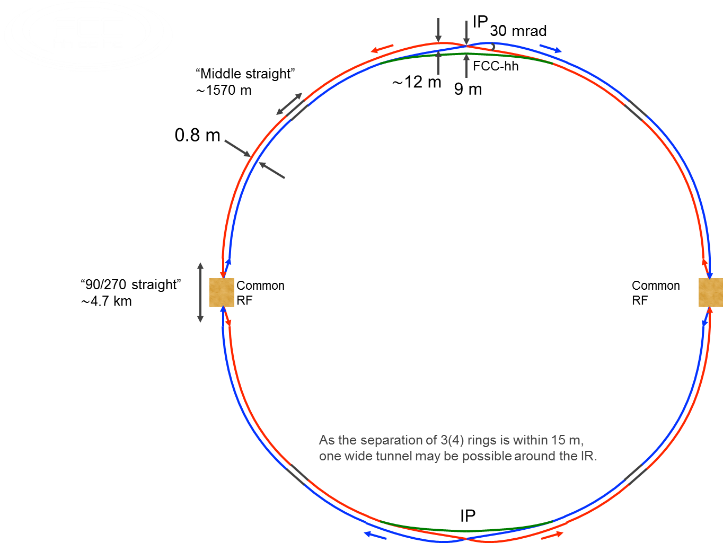
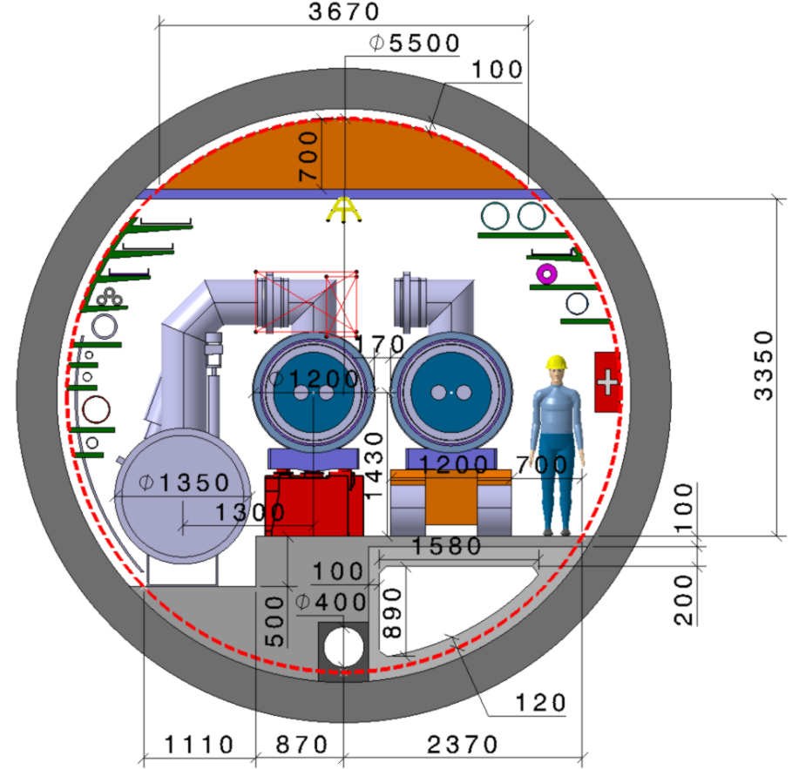
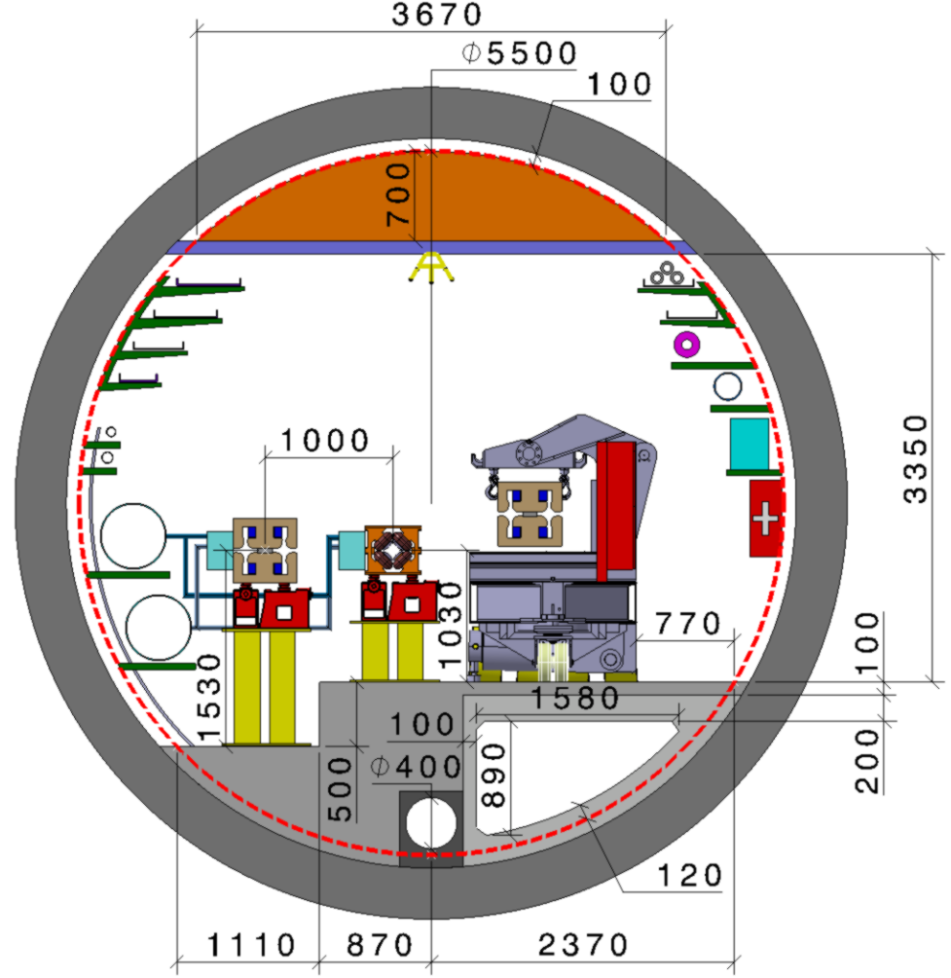
FCC consistent machine layouts
FCC-hh
FCC-ee 1, FCC-ee 2,
FCC-ee booster (FCC-hh footprint)
9 m off-centred IPs
wrt. hh IPs
Optics solutions for full ring for both machines available

Slide 8
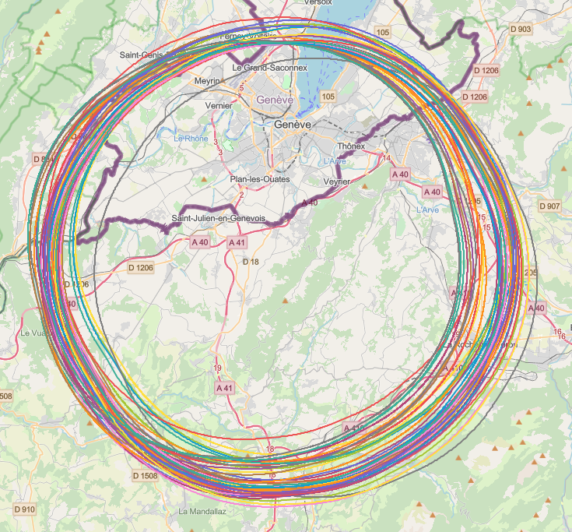
Collider placement optimisation
Overall layout and placement optimisation process across both host states
Following the "avoid-reduce-compensate" directive of European and French regulatory frameworks
Process integrates diverse requirements and constraints:
  performance permitting world-leading scientific research
  technical feasibility of civil engineering and subsurface constraints
  territorial constraints on surface and subsurface
  nature, accessibility, technical infrastructure, and resource needs & constraints
  economic factors including development of benefits for, and synergies, with the regional developments
  …
Collaborative effort of technical experts at CERN, consultancy companies and government notified bodies
See FCCIS WP3: Placement session today

Slide 9
F Following outcome of placement studies
Exact four-fold symmetry
Four experiments (A, D, G, & J)
Two collimation insertions
  betatron cleaning (F)
  momentum cleaning (H)
Extraction insertion + injection (B)
RF insertion + injection (L)
Last part of transfer lines in the ring tunnel
Compatible with LHC or SPS as
injector
Number of arc cells: 42
Cell length: 215.3 m
Length of experimental straight sections: 1400 m
Length of technical straight sections: 2160 m
Length of circumference: 91.1 km

Slide 10
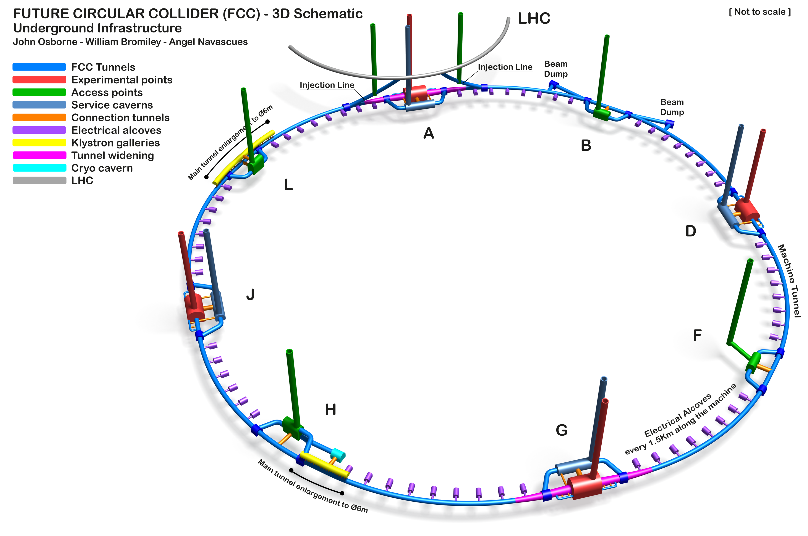
Overall FCC-hh layout
See Civil Engineering session today

Slide 11
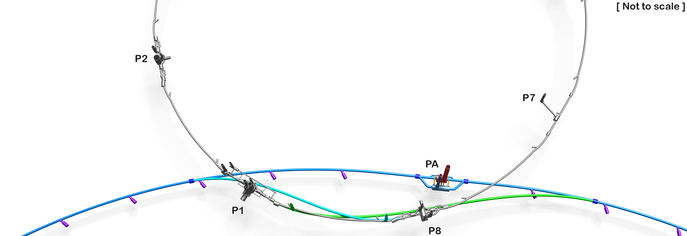
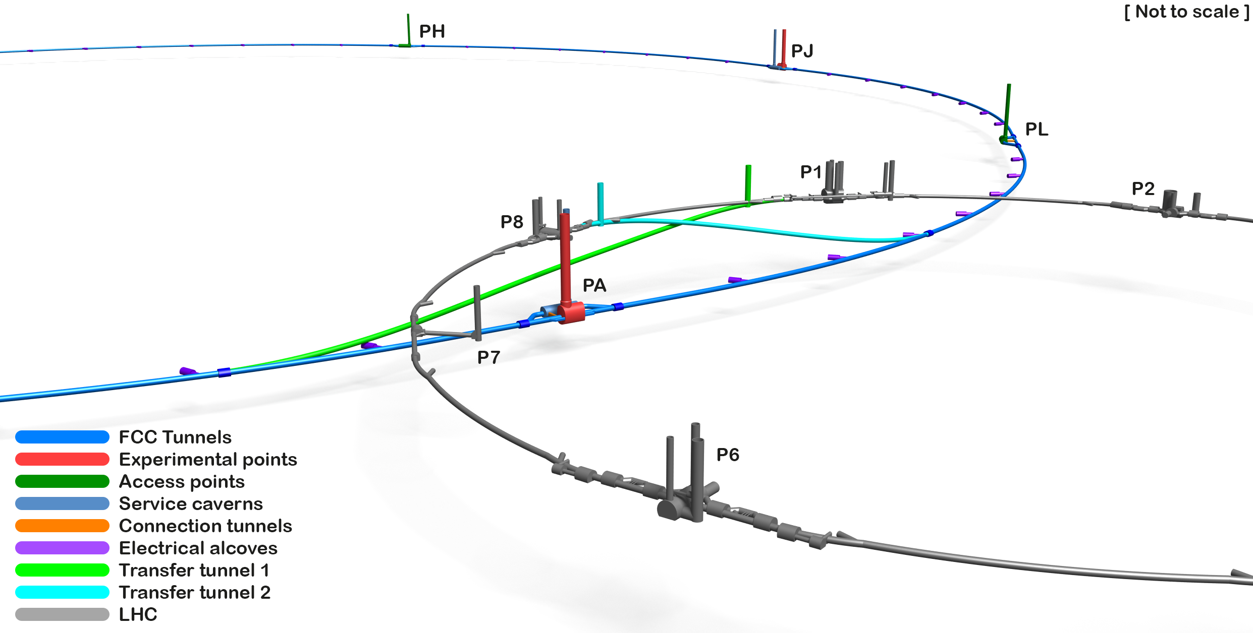
FCC-hh layout and transfer lines
Courtesy J. Osborne, W. Bromiley, A. Navascues
Injection tunnel towards PL: 4.1 km
Injection tunnel towards PB: 6.1 km
This is the current baseline. Further optimisation of the design in progress (see talk by W. Bartmann).
See Civil Engineering session today

Slide 12
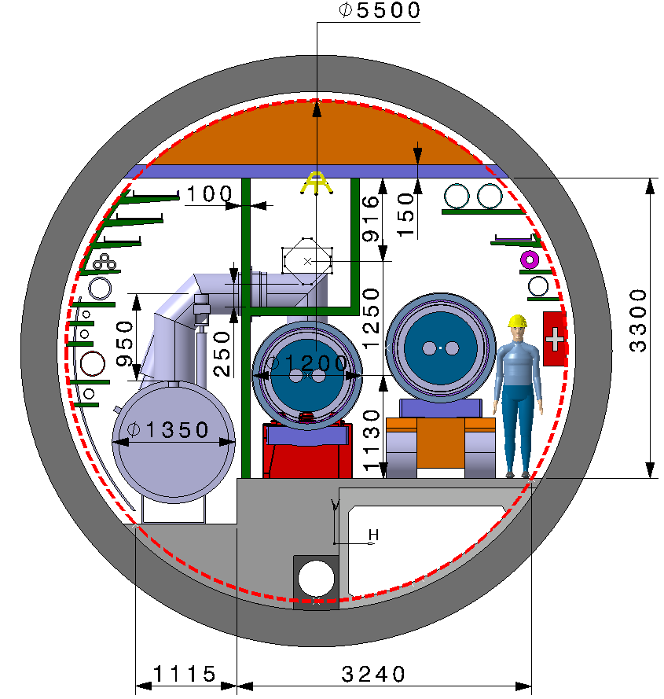
Comments on transfer lines
The transfer lines are proposed to be installed in the ring tunnel in the arcs from PA to PB and from PA to PL:
  Normal conducting magnets can be used.
  Same cell design as arc cell.
Courtesy R. Lopez, F. Valchkova-Georgieva
Integration of transfer lines in the ring tunnel in progress
Analysis of the jumper design to assess whether optimisation is possible

Slide 13
Experimental insertions
Same length as CDR
Very similar optics and layout as CDR
Same optics for PA, PD, PG, and PJ
Major change to be implemented soon (already tested for the CDR version): radial displacement of FCC-hh IP towards that o FCC-ee
(m)
Courtesy T. Risselada
Possible advantages
Minimisation of the region of increased tunnel cross section.
Optimisation of the size of the experimental cavern.
Reuse of detector components for FCC-ee to FCC-hh?
(m)

Slide 14
Collimation insertions
Betatron collimation
  Shorter than CDR version
  New optics proposed
  New layout of dogleg proposed
Courtesy T. Risselada
Momentum collimation
  Longer than CDR version
  New optics proposed
  New layout of dogleg proposed
For more detail see talk by R. Bruce in this session

Slide 15
Other insertions
PL
  RF
  Injection of counter-clockwise beam
  Optics design in progress
PB
  Dump of both beams
  Injection of clockwise beam
  Optics design in progress (see talk by W. Bartmann)

Slide 16
Progress with combined-function lattice
The use of combined-function (dipole-quadrupole) might be an interesting option to
  Increase filling factor
  Simplify production (a single magnet type for the arcs)
Recent progress
  Design of dispersion suppressors for a combined-function lattice
  Optimisation of the regular cell length (increased length)
Nominal FCC-hh FODO cell
FCC-hh combined-function cell
In collaboration with E. Todesco

Slide 17
Outlook
The eight-point solution is being built and the main ingredients are already available.
The next steps consists in providing a complete design of the optics of the new ring layout
  Innovate the optics of the collimation insertion including new concepts from HL-LHC design
  Review the dump optics merged with injection
  Review the RF optics merged with injection
Then, the optics design (collimation and dump) should be validated with detailed numerical simulations.
Finally, a complete solution for the transfer lines integrated in the ring tunnel should be provided.
The study of the combined-function solution will be pursued by considering the interplay with radiation and the layout of the cell correctors.

Slide 18
Thank you for your attention!

Slide 19
Reserve slides

Slide 20
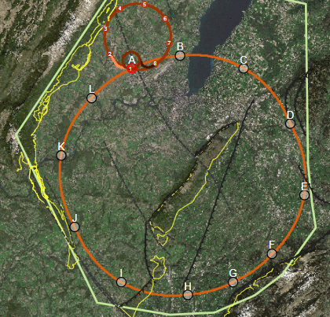
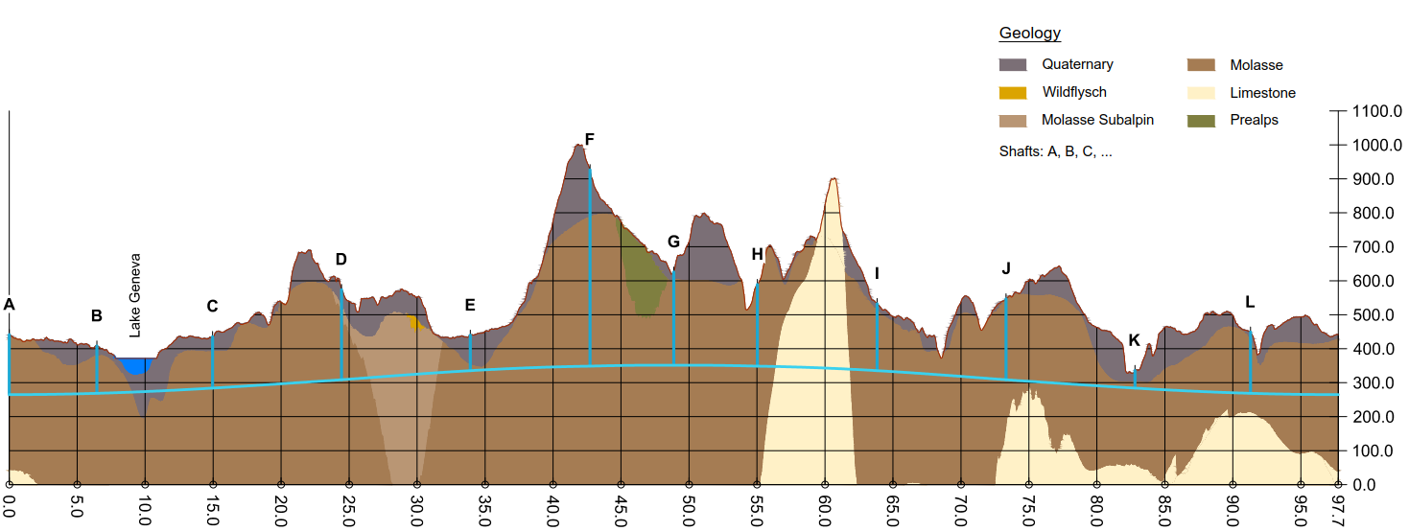
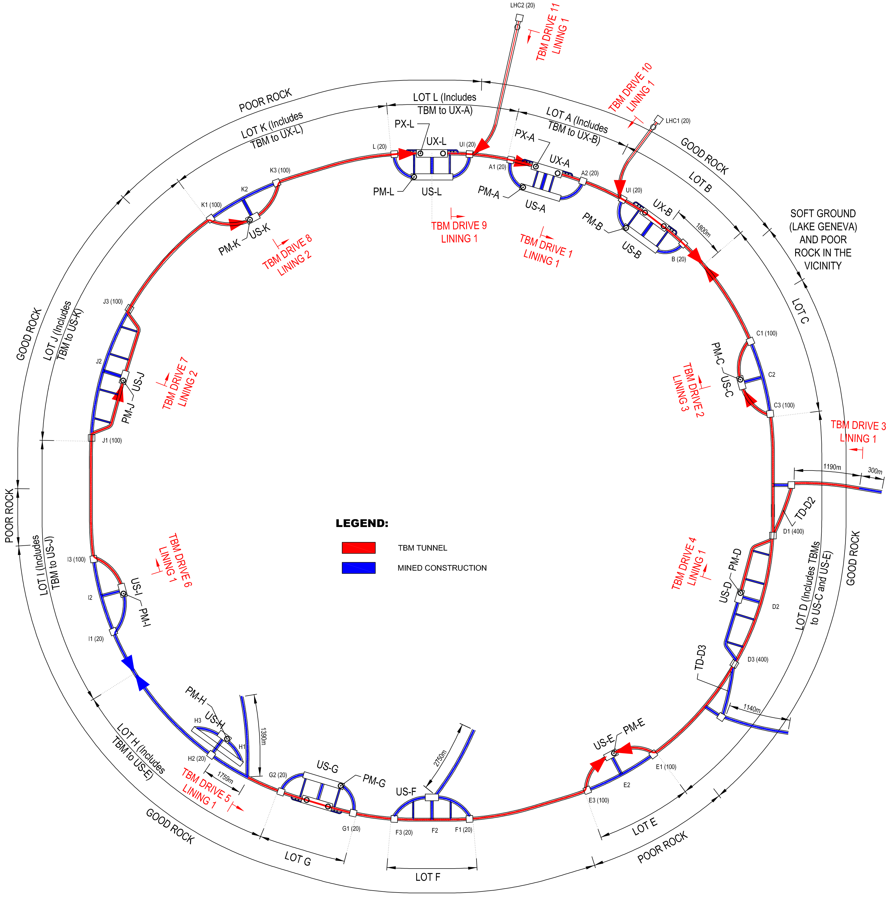
FCC implementation - footprint baseline
Current baseline position based on:
lowest risk for construction, fastest and cheapest construction
feasible positions for large span caverns (most challenging structures)
90 – 100 km circumference
12 surface sites with few ha area each

