Slide 1




Top-UP Injection Studies for the FCC-ee Collider ring
FCC Week 2021 – 31-05-2022
Patrick Hunchak
P. Hunchak, M. Aiba, W. Bartmann, M. Boland,
Y. Dutheil, M. Hofer, R. Ramjiawan, F. Zimmermann
and many more FCCIS collaborators.

Slide 2

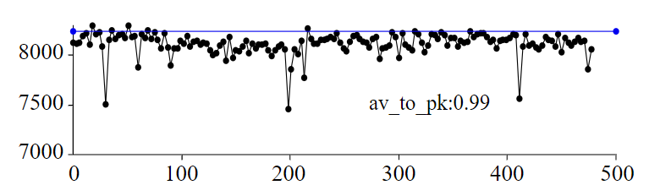
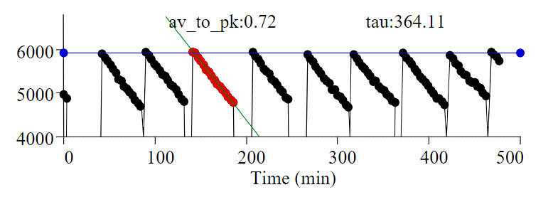
Motivation
With FCC-ee we aim for unprecedented luminosities.
Top-up injection is an essential ingredient to maximize the integrated luminosity.
  Implemented in other colliders (KEKB and in PEP-II) and is common in light sources
Previously four top-up injection schemes
were selected for the FCC-ee collider ring
  Currently performing tracking studies to
  find optimal injection approach for each
  operation mode
  Hardware parameters and feasibility are
  being studied in parallel (R. Ramjiawan)
Wienands, U. “Lepton Collider Operation with Constant Currents”. Proceedings of the 2005 Particle Accelerator Conference. doi:10.1109/pac.2005.1590385

Slide 3
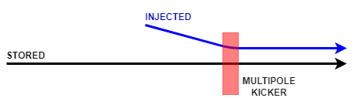
Top-up Injection Schemes
Regular injection from full energy booster, keeps stored current consistent
Multipole Kicker Injection (MKI)
Off-axis injected beam
Kicker has minimal on-axis field (stored beam)
Kicker has significant off-axis field (injected beam)
Conventional Orbit Bump Injection
  Dipole kickers create a one turn orbit bump
  Reducing the effective amplitude of off-axis injected beam
  Bump is closed quickly to avoid septum on subsequent turns.
Both modes also work off-momentum, with dispersion allowing on-axis injection.
For all cases the injection is performed in the horizontal plane.

Slide 4
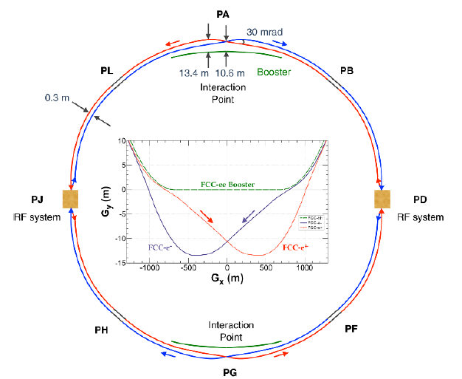

Injection Considerations
Dedicate one insertion (PB) to injection
  For 2 IP layout injection insertion has
  been designed and integrated
  In 4 IP layout, injection insertion requires
  beam crossing and integration with
  other system
Machine protection considerations need to
be included in design.
Collider | Stored Beam Energy
PEP II | 70 kJ
LEP II | 130 kJ
SuperKEKB | 180 kJ
FCC-ee at Z | 20 MJ
https://indico.cern.ch/event/995850/contributions/4419415/attachments/2271652/3858072/FCC-ee_Injection_aiba.pdf

Slide 5
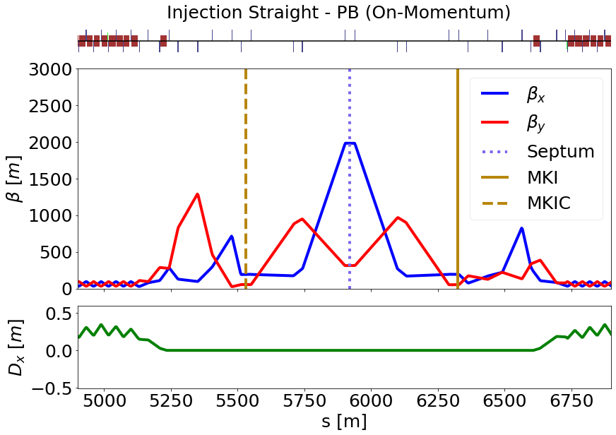
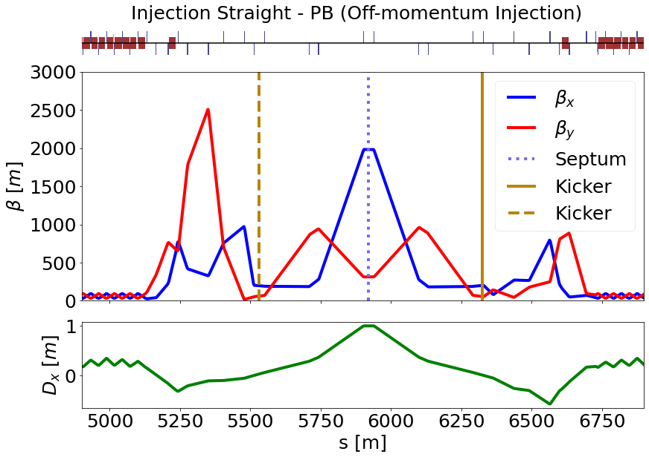
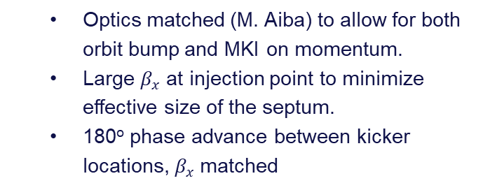
Insertion Optics
  Optics matched (M. Aiba) to allow for both orbit bump and MKI on momentum.
  Large $β_{x}$ at injection point to minimize effective size of the septum.
  180º phase advance between kicker locations, $β_{x}$matched
Optics matched for orbit bump off-momentum.
Dispersion of 1.0m at the Septum
Off-momentum MKI optics still ongoing.

Slide 6
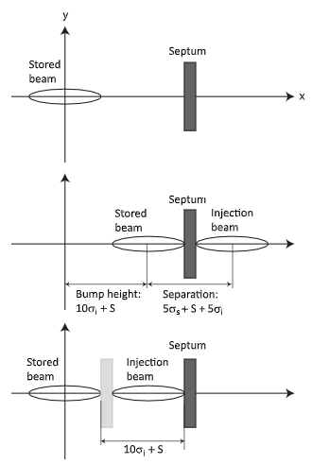
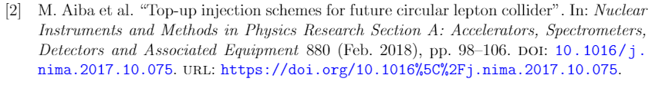
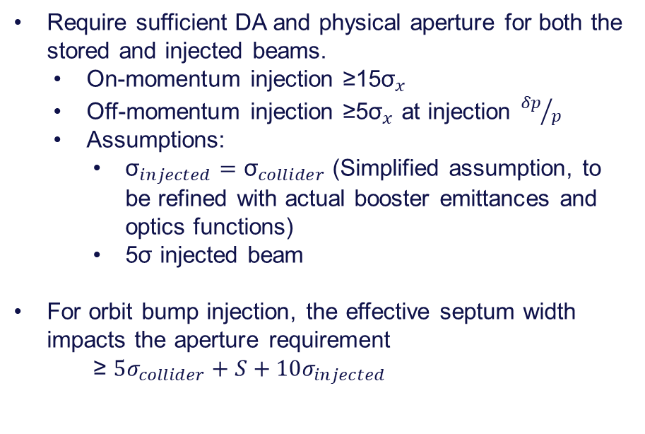
Top-up Requirements
Require sufficient DA and physical aperture for both the stored and injected beams.
  On-momentum injection ≥15${\text{σ}}_{x}$
  Off-momentum injection ≥5${\text{σ}}_{x}$ at injection ${δp}/p$
  Assumptions:
    ${\text{σ}}_{injected}={\text{σ}}_{collider}$ (Simplified assumption, to be refined with actual booster emittances and optics functions)
    5$\text{σ}$ injected beam
For orbit bump injection, the effective septum width impacts the aperture requirement
  ≥ $5σ_{collider}+S+10σ_{injected}$

Slide 7
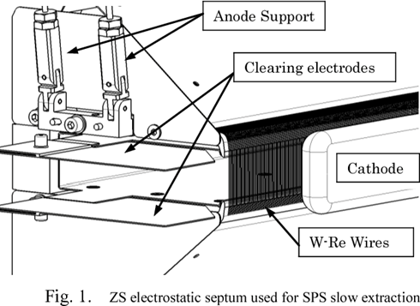
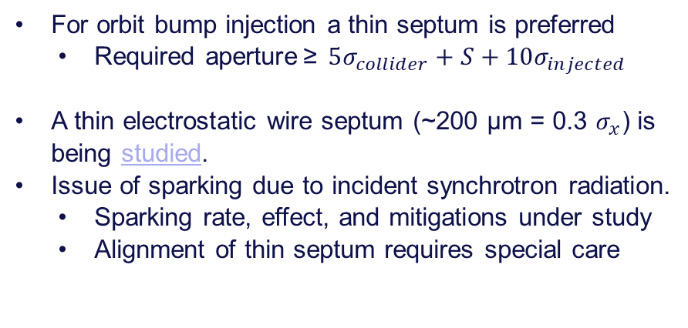
Top-up Requirements (Orbit Bump)
For orbit bump injection a thin septum is preferred
  Required aperture ≥ $5σ_{collider}+S+10σ_{injected}$
A thin electrostatic wire septum (~200 μm = 0.3 $σ_{x}$) is being studied.
Issue of sparking due to incident synchrotron radiation.
  Sparking rate, effect, and mitigations under study
  Alignment of thin septum requires special care
https://ieeexplore.ieee.org/document/7764034

Slide 8
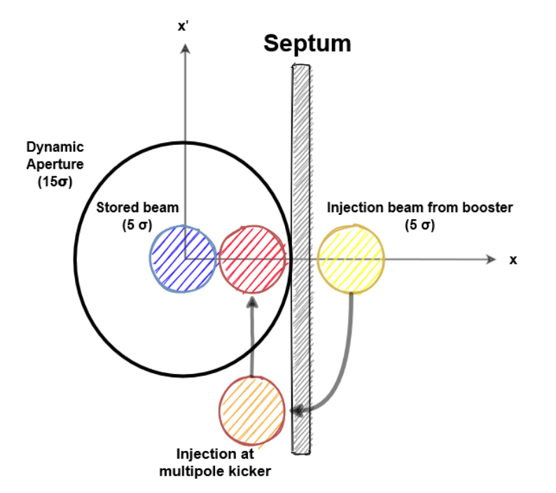
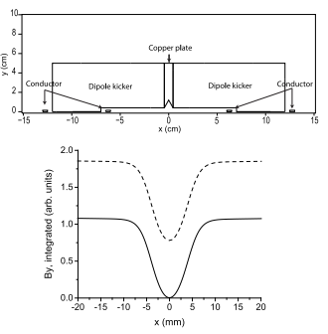
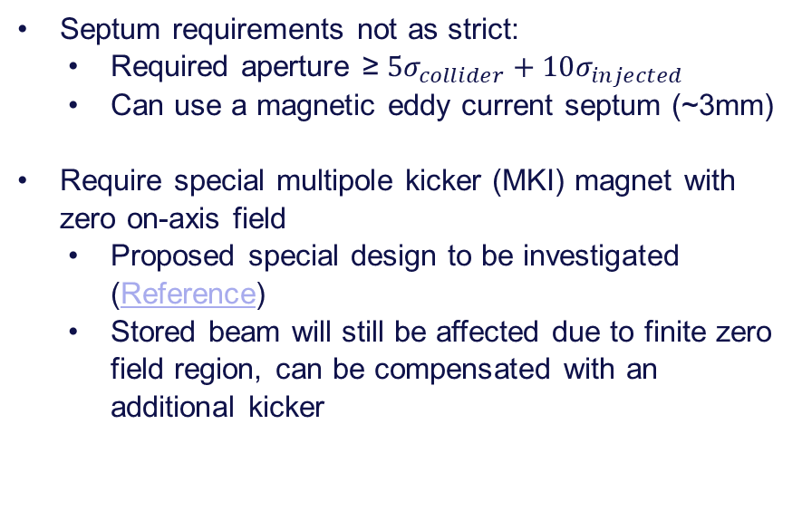
Top-up Requirements (MKI)
Septum requirements not as strict:
  Required aperture ≥ $5σ_{collider}+10σ_{injected}$
  Can use a magnetic eddy current septum (~3mm)
Require special multipole kicker (MKI) magnet with zero on-axis field
  Proposed special design to be investigated (Reference)
  Stored beam will still be affected due to finite zero field region, can be compensated with an additional kicker

Slide 9
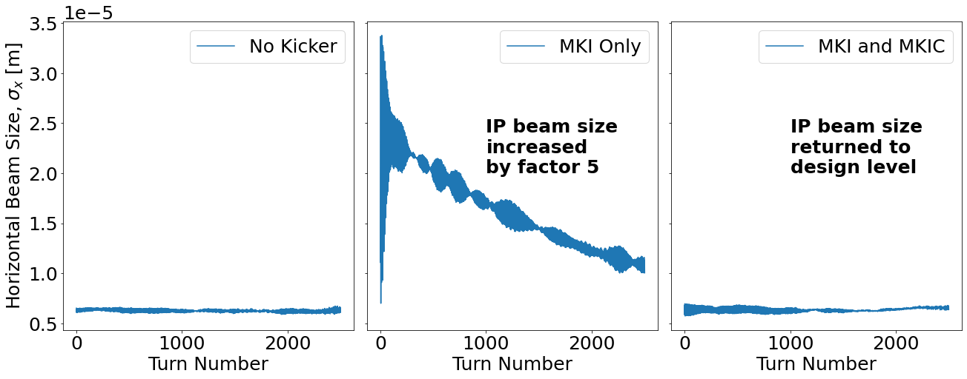
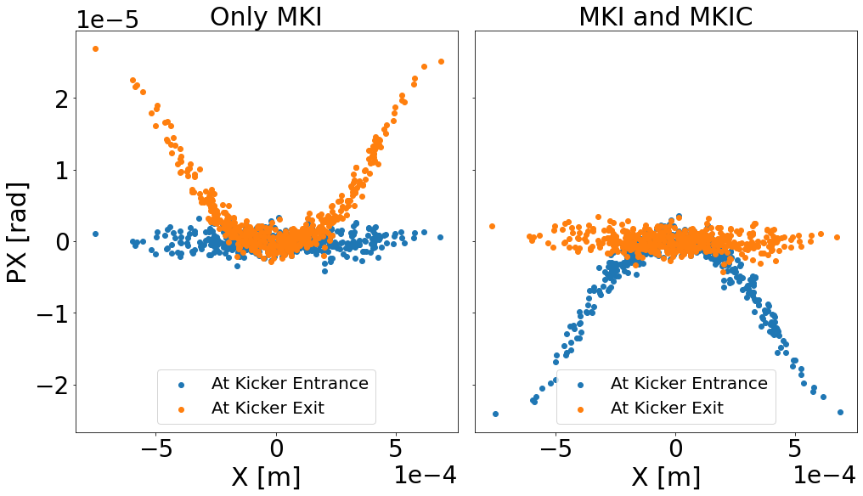
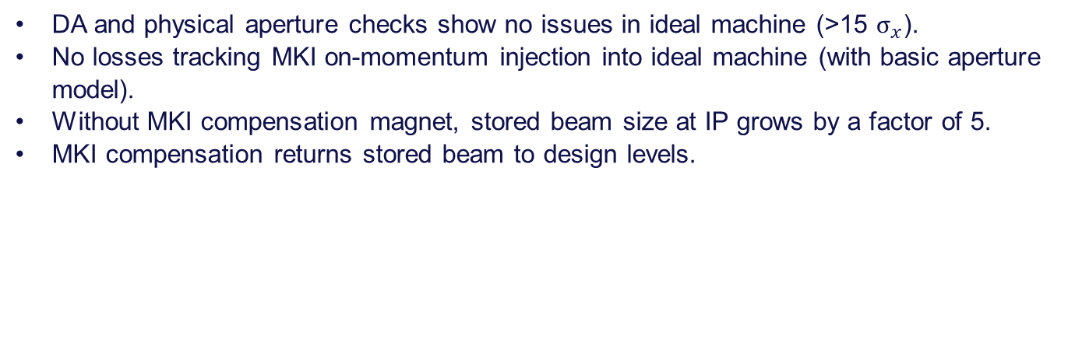
Initial Injection Tracking MKI
DA and physical aperture checks show no issues in ideal machine (>15 $σ_{x}$).
No losses tracking MKI on-momentum injection into ideal machine (with basic aperture model).
Without MKI compensation magnet, stored beam size at IP grows by a factor of 5.
MKI compensation returns stored beam to design levels.
Stored beam at IP
Stored beam at MKI location

Slide 10
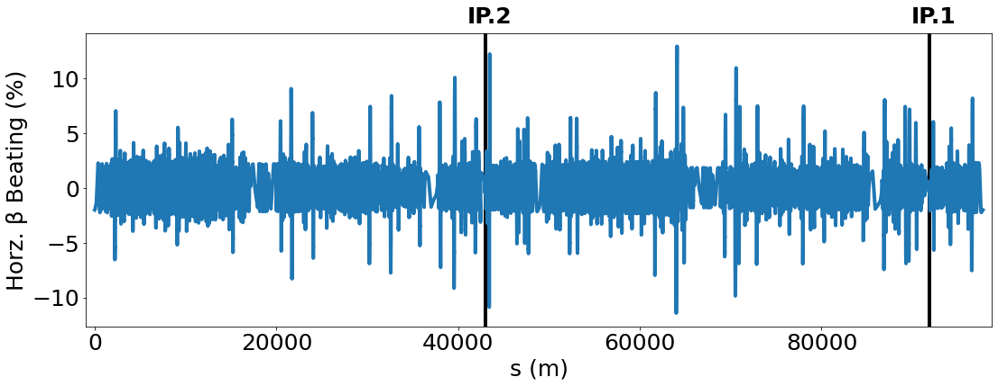
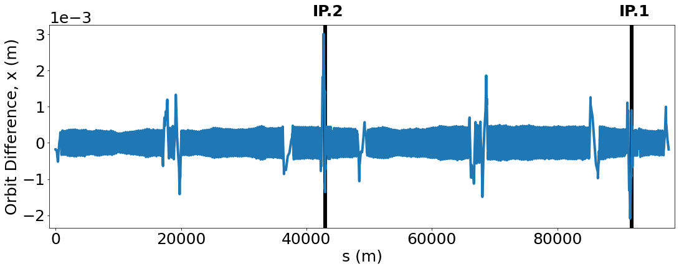
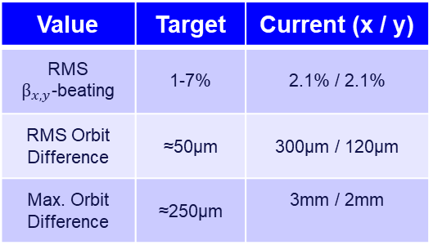
Inclusion of Errors
For a study of injection efficiency of the different schemes errors are implemented in the lattice
  Choose unrealistic alignment tolerances to reach error levels akin to full tuning studies but without needing correction → effective lattice
    Tuning studies in ttbar used as guideline for beta-beating and orbit deviations
    Effective lattice still to be refined
Value | Target | Current (x / y)
RMS $β_{x,y}$-beating | 1-7% | 2.1% / 2.1%
RMS Orbit Difference | ≈50µm | 300µm / 120µm
Max. Orbit Difference | ≈250µm | 3mm / 2mm

Slide 11
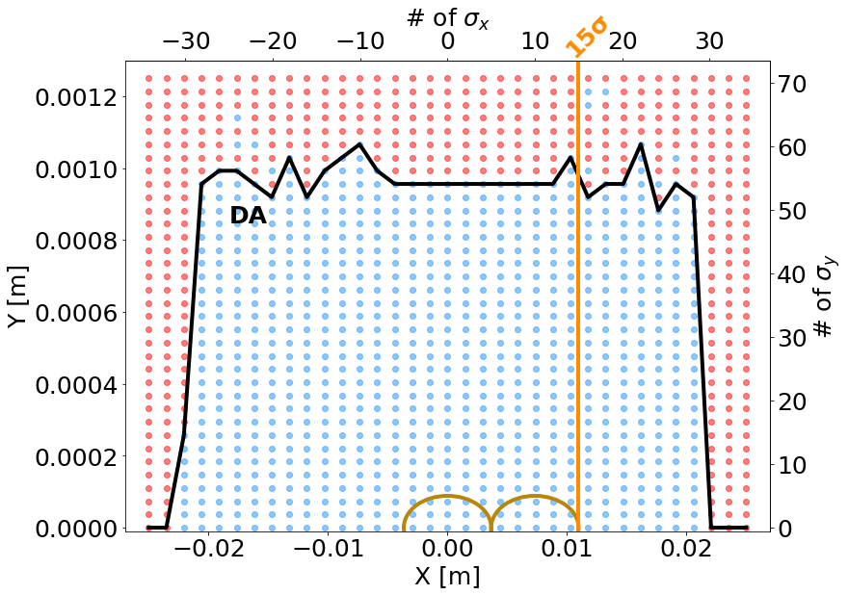
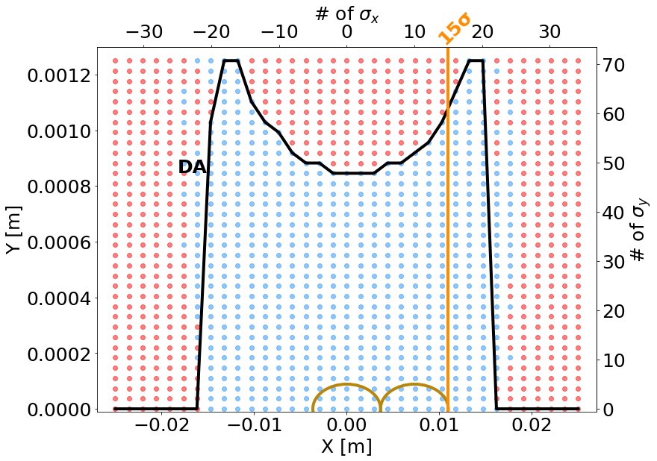

Inclusion of Errors
Dynamic aperture in effective lattice still sufficient (≥15${\text{σ}}_{x})$
  Full tuning studies show this is not yet the case (e.g.)
Studies are ongoing to evaluate injection efficiency and the effect on the stored beam in the presence of errors.
Ideal Lattice DA
Effective Errors DA

Slide 12
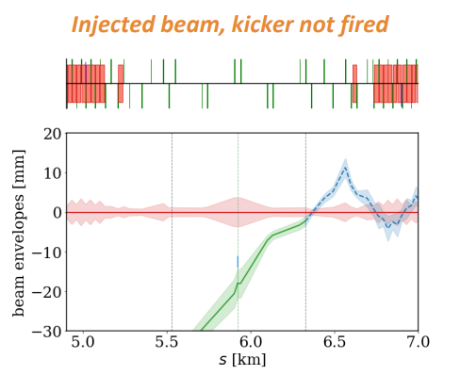
Machine Protection Aspects
Septum failure is slow so consider active protection. Kicker failure is fast so passive protection (absorbers) required.
Kicker failure modes under study:
  No kicker turn-on
    Injected beam steered into absorber (MKI/Conv.)
    Orbit bump not closed (Conv.)
  Erratic turn-on
    Circulating beam deflection (Conv.)
    Emittance increase (MKI)
  Incorrect kick (vacuum flash-over)
Conventional Injection
  Septum at risk if orbit bump amplitude increases
Multipole Kicker Injection
  Septum not at risk from these failure modes
https://indico.cern.ch/event/1114439/contributions/4683210/attachments/2378676/4063908/MachineProtectionInjection_Ramjiawan.pdf

Slide 13

Outlook
Top-up injection is a key component of FCC-ee performance
Four top-up injection schemes are deemed feasible for FCC-ee
  Studies are ongoing to evaluate performance and identify a scheme for each operation mode.
  Feasibility of injection hardware under study
Many more things to be studied:
  Injection insertion in a 4 IP lattice
  Effect of beam-beam on injection
  Machine protection aspects

