Slide 1
3D Compton polarimeter
Aurélien MARTENS (IJCLab Orsay)
On behalf of FCC-ee FS EPOL group
https://indico.cern.ch/category/8678/

Slide 2
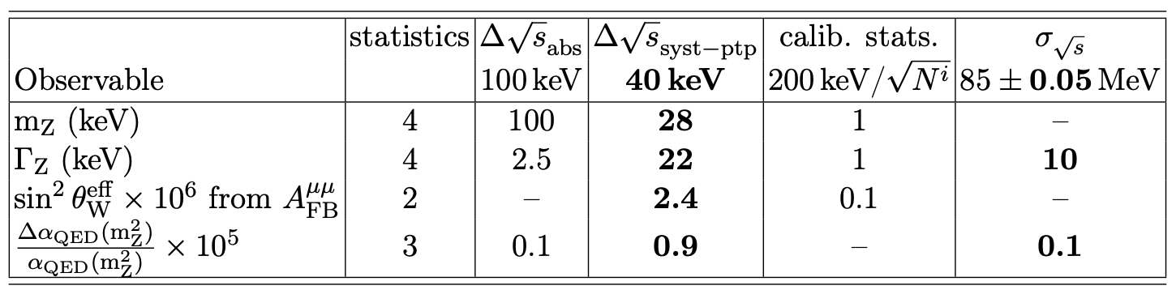
Introduction: Physics requirements
Blondel et al., arXiv:1909.12245
High reproductibility of measurements for various sqrt(s) is critically needed
Extract as much information as possible from physics experiments themselves (crossing angle, luminosity, sqrt(s) spread)
Beam-based measurements in real time, including beams energy with resonant depolarization
24/7 operable measurement of depolarization

Slide 3
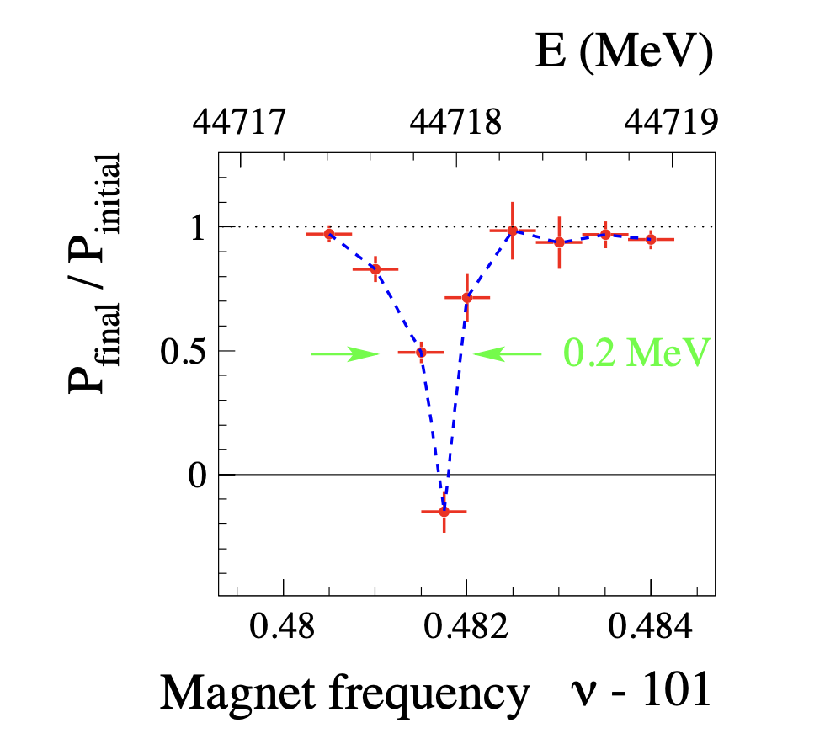
Resonant depolarization
Scan spin precession frequency with magnetic kicker
LEP legacy
Detect beam depolarization at resonance
Assman et al., Eur. Phys. J. C 6, 187–223 (1999), Blondel et al., arXiv:1909.12245; Baier & Khoze, Sov. J. Nucl. Phys. \textbf{9}, 238-240 (1969)
beam energy spread too large for colliding beams
(smeared spin resonances)
Use pilot bunches instead
24/7 operable Compton polarimeter for pilot bunches

Slide 4
Precision experiments and Pz
Precision EW physics is sensitive to longitudinal polarization (Pz)
few 10⁻⁵ accuracy on EW asymmetries require that Pz is known at 10⁻⁵ level !
High precision polarimetry in all directions AND accurate spin propagation desired for colliding bunches too
Can the same polarimeter be used for both colliding (accurate P measurement)
and pilots bunches (accurate E measurement from P) ?

Slide 5
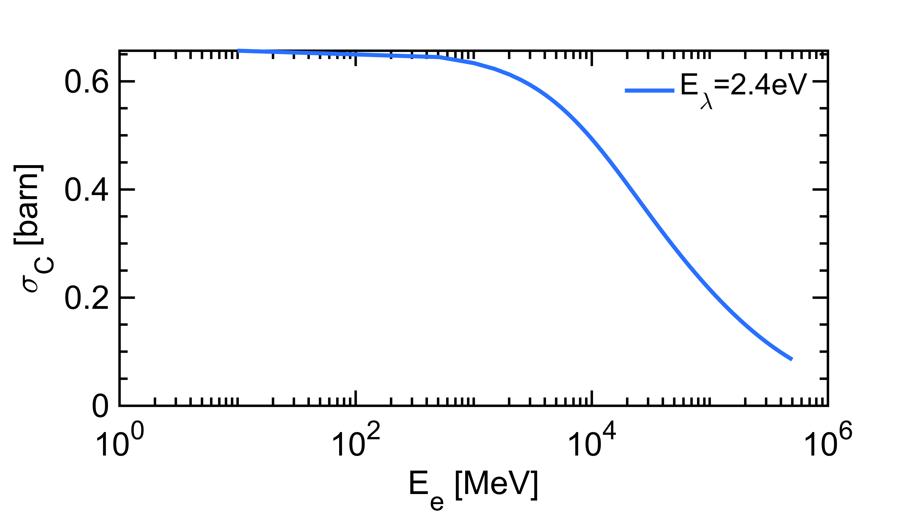
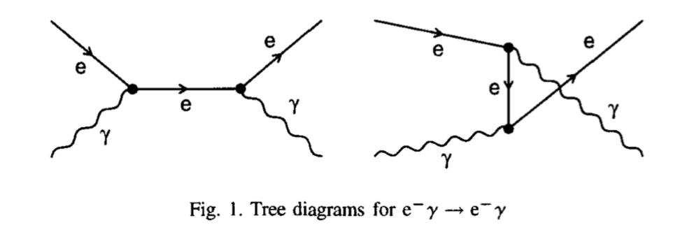
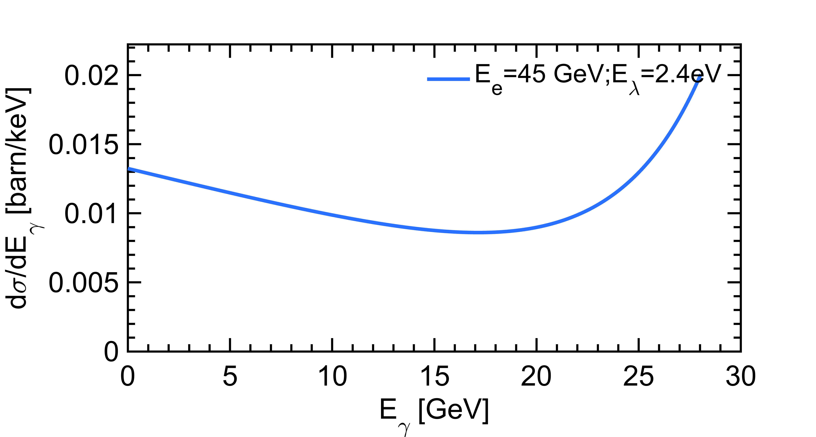
The Compton process
Compton x-section
~0.3b (Ee~45GeV)
Klein O. and Nishina Y., Z. Phys. 52(1929) 853; Ginzburg I. et al., Nucl. Instr. Methods in Phys. Research 219 (1984) 5, V. B. Berestetskii, E. M. Lifshitz, L. P. Pitaevskii (1982). Quantum Electrodynamics. Vol. 4 (2nd ed.)
Kinematic edge

Slide 6
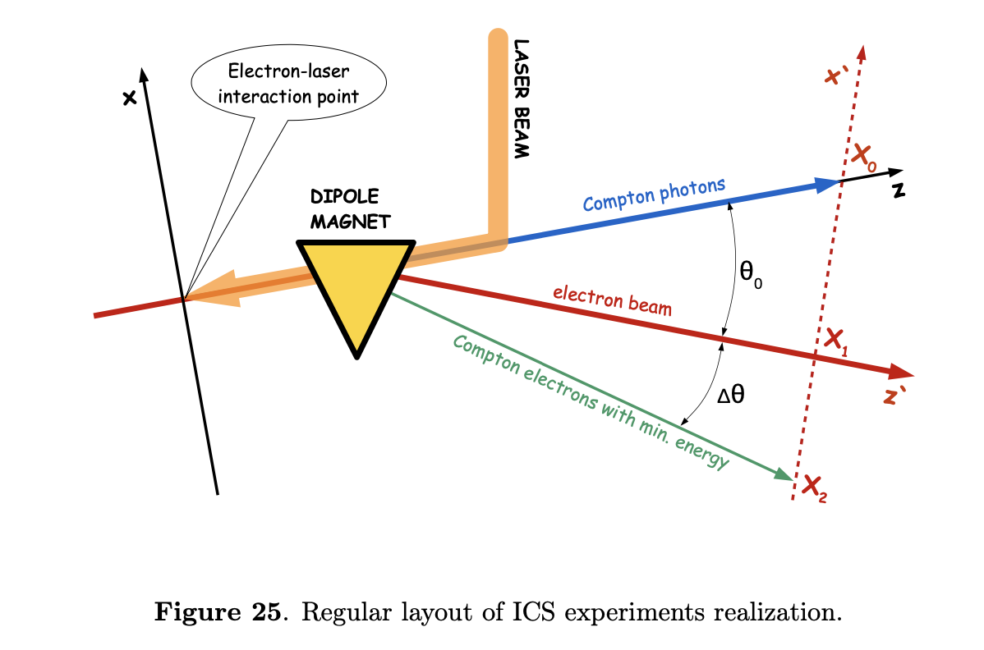
Compton polarimeter layout
Blondel et al., arXiv:1909.12245
Redundancy: measure both electrons and photons

Slide 7
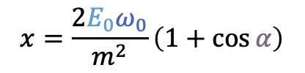
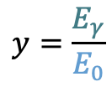
Compton cross-section
$$x=\frac{2E_{0}ω_{0}}{m^{2}}\left(1+\cos{α}\right)$$
$$y=\frac{E_{γ}}{E_{0}}$$
The Compton cross-section averaged over scattered particles spins:
Differential cross-section
Transverse laser polarisation: nuisance parameter to minimize and keep under control
Transverse electron beam polarisation: intervenes as an asymmetry in the transverse plane
Berestskii & Lfshitz QED textbook
$$\frac{dσ}{dydφ_{obs}}\left(x,y\right)=\frac{dσ_{0}}{dy}\left(x,y\right)+\frac{dσ_{⊥}}{dy}\left(x,y\right)\cos\left(2\left(φ_{obs}−φ_{las}\right)\right)𝒫_{⊥}^{las}+\frac{dσ_{∥}}{dy}\left(x,y\right)𝒫_{C}^{las}(P_{T}f_{T}\left(x,y\right)\cos\left(φ_{obs}−φ_{elec}\right)+P_{L}f_{L}(x,y))$$
Electron beam polarization independent
Electron beam polarization dependent
⚠️ But small opening angle of scattered particles:
  Electrons → spectrometer
  Photons → difficult to measure asymmetric distribution of a narrow spot → long lever arm needed

Slide 8
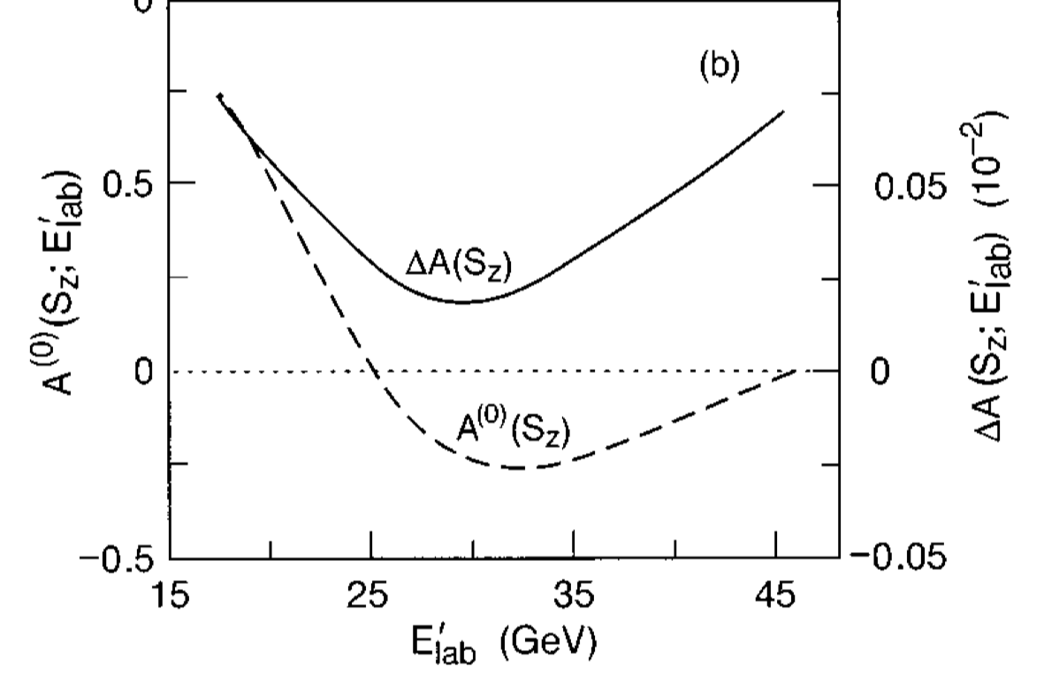
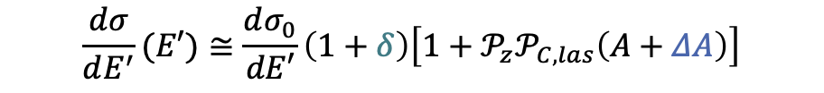
QED corrections
Involved processes e𝛾→ e𝛾, e𝛾→eee, e𝛾→ e𝛾𝛾
$$\frac{dσ}{dE^{′}}(E′)≅\frac{dσ_{0}}{dE′}\left(1+δ\right)\left[1+𝒫_{z}𝒫_{C,las}\left(A+ΔA\right)\right]$$
QED corrections<0.001 @ 45 GeV
Denner & Dittmaier Nucl. Phys. B 540 (1999) 58, Swartz Phys. Rev. D 58 014010 (1998), Veltman Ophys. Rev. D 40 2810 (1989), Veltman Phys. Rev D 42 1856E (1990)
Scattered electron energy
Need to be eventually included in simulations…

Slide 9



Transverse distributions
in a few seconds for pilots
Based on measurement of scattered particles transverse distributions (pixelized detectors)
All components extracted with ~0.001 precision in few seconds
Blondel et al., arXiv:1909.12245
Beam energy may be extracted too! → redundancy
Realistic detector specifications to be drawn
Open questions: detector spatial resolution, longitudinal sampling, rates, combined fits, laser polarization flips,…

Slide 10
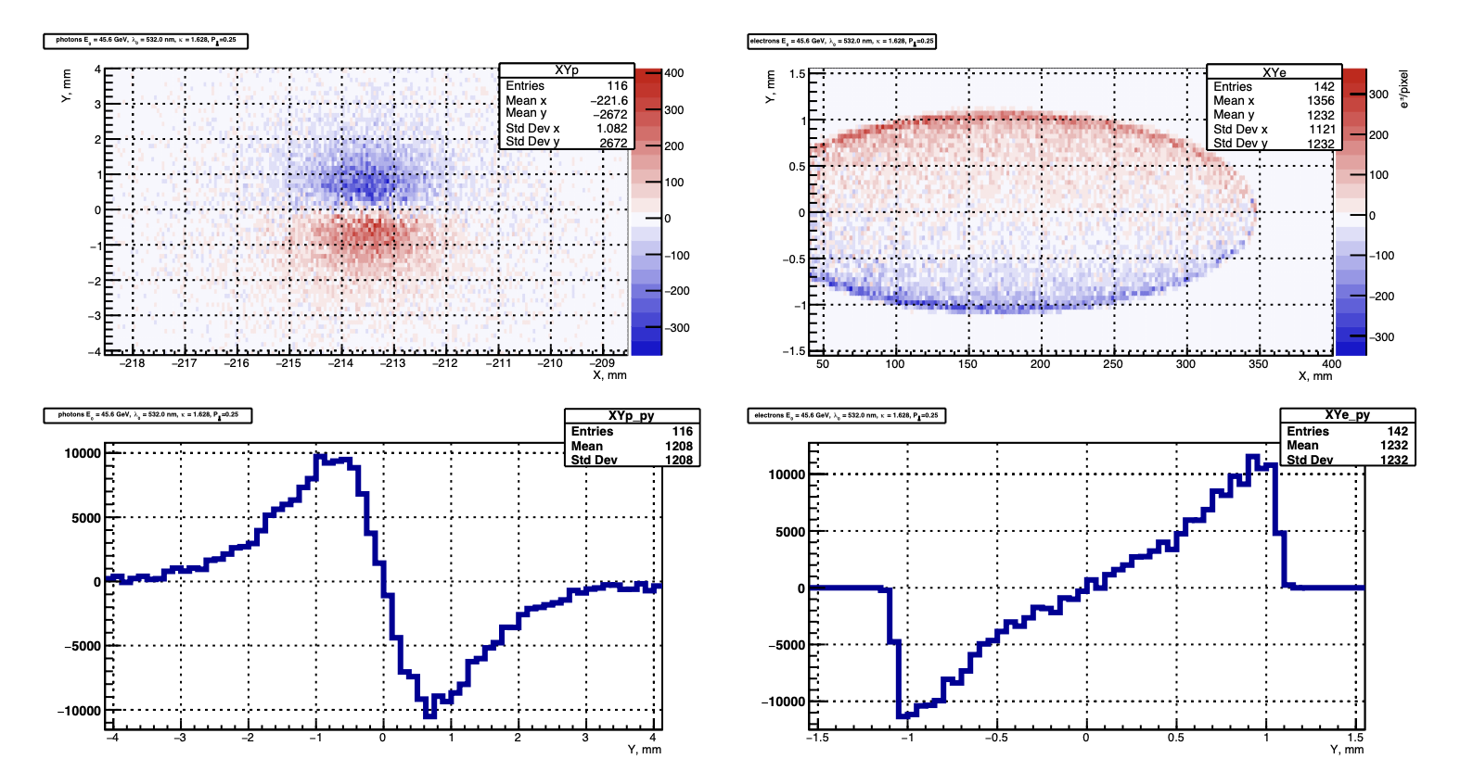
Laser helicity asymmetries
Blondel et al., arXiv:1909.12245
Reproductible and well known laser helicity flip is required

Slide 11
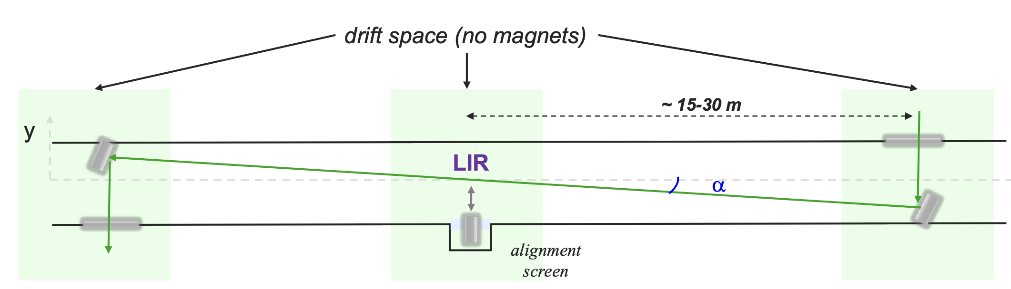
Laser injection
Some constraints
  Small crossing angles are preferred (cross-section, beam jitters) few mrad typically
  Vertical crossing angle is preferred (space and synchrotron in horizontal plane)
  beam impedance
  beam induced currents in metallic parts
  mechanical stability
  ease of maintenance works
sun
Blondel et al., arXiv:1909.12245
Fully vertical scheme → not very convenient ?

Slide 12
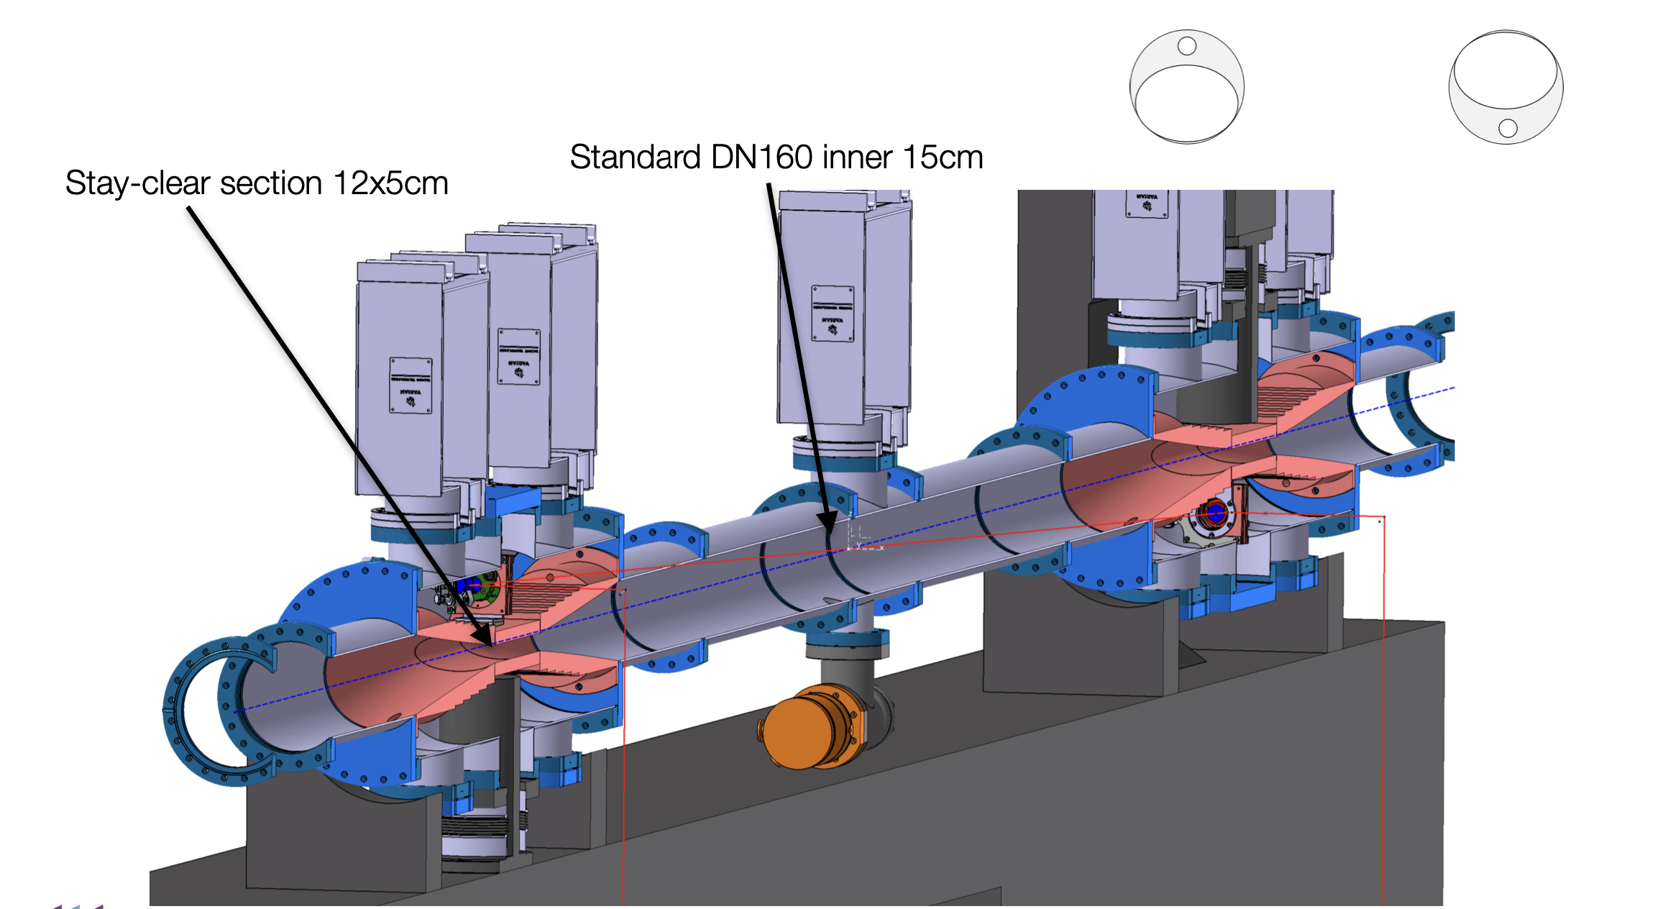
Laser injection: some inspiration
Gamma Factory SPS proof of principle optical cavity mechanical design could be adapted ?
Interaction point
Vertically asymmetric drilling
Beam shield
Gamma Factory Proof of Principle LOI SPSC-I-253
Laser system and diags below ground
(in excavation) or send them up in a dedicated room

Slide 13
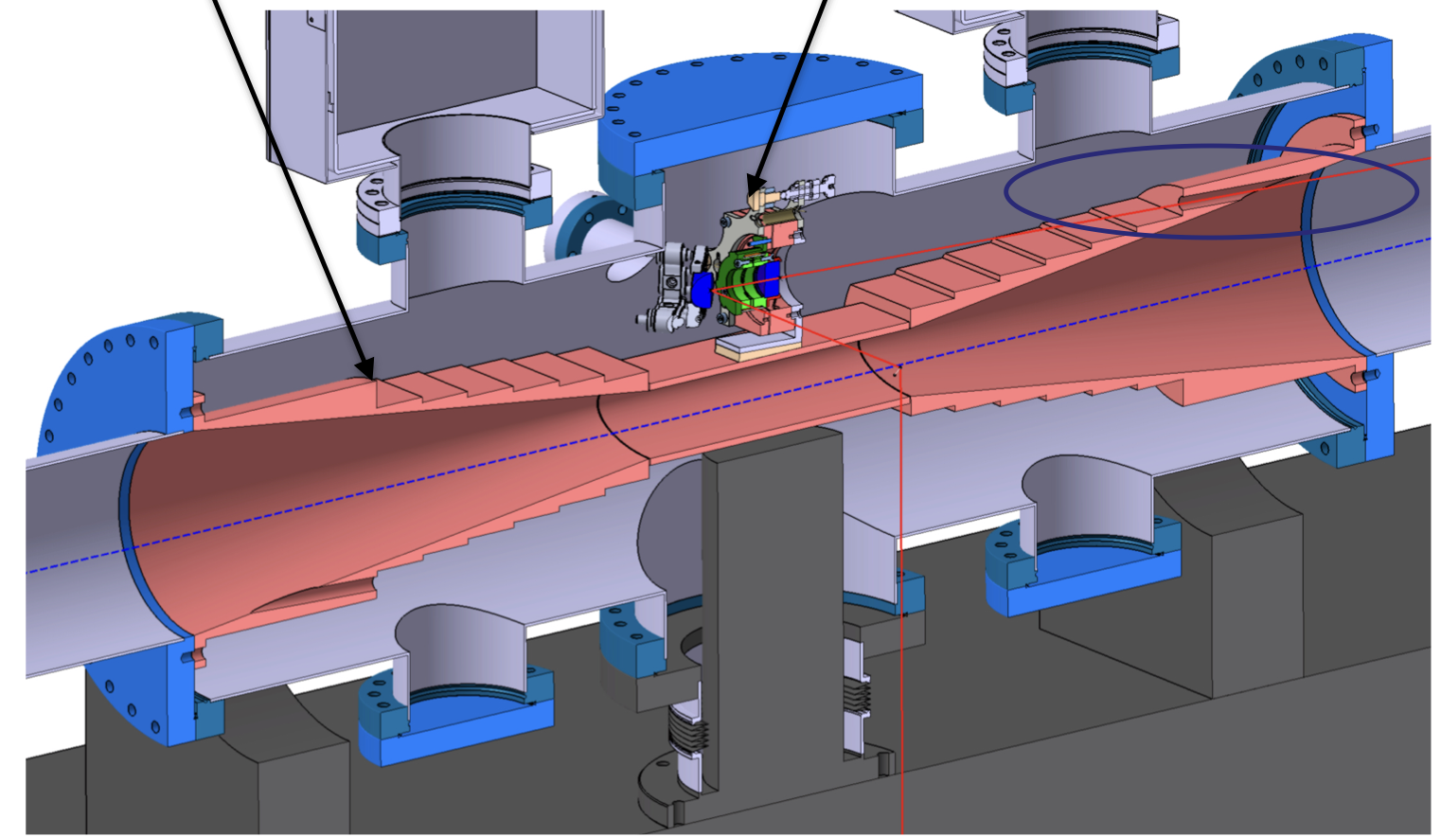
Laser injection: some inspiration
Impedance and currents shield
To be removed in present case
Maintenance port
Gamma Factory Proof of Principle LOI SPSC-I-253
Cantilevered support (not drawn) directly on ground
Decoupling to pipe
Deport beam aside

Slide 14
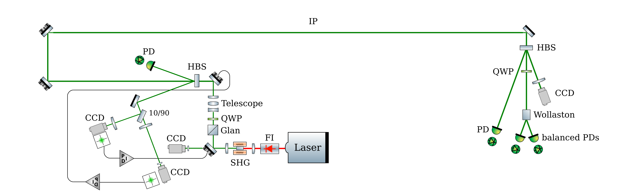
Schematic layout of laser system
Rough design based on past experience, similar to other polarimeters
Polarisation &
beam shaping
S. Barneljee, M. Roney et al., Upgrading SuperKEKB with a Polarized Electron Beam
laser
Box with rough temperature control
Box with rough temperature control
Polarisation monitoring
Duplicated at injection
Add Position and pointing monitoring
Position, pointing control and monitoring
Polarisation independent intensity monitoring
Optical spectrum monitoring possible
24/7 operable laser system, with full monitoring, remote control
Some comments
  usual scheme for polarization control and monitoring rely on DC measurements
  actual figures for beam size are constrained by integration related issues (inputs needed)
  Laser polarization flipping rate ?
R&D path: photo-elastic modulators allow to measure polarization with FFT or lock-in detection techniques (synergy with SuperKEKB upgrade)

Slide 15
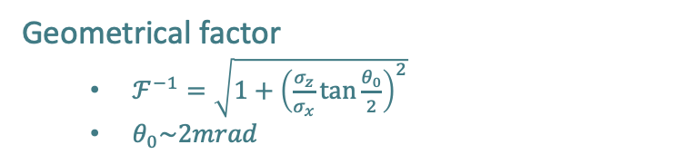
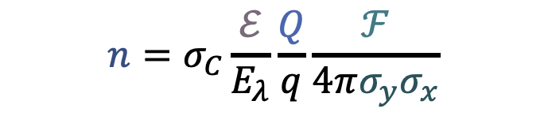
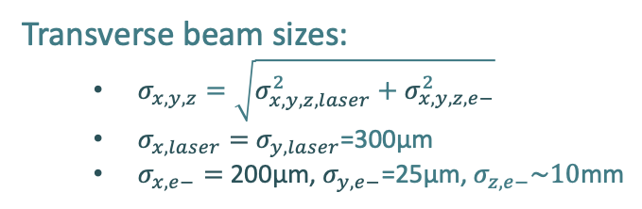
Scattered photon rate
Laser-beam single pulse energy
Compton cross-section
pilots
Electron bunch charge (25nC or 6nC)
Geometrical factor
  $ℱ^{−1}=\sqrt{1+{\left(\frac{σ_{z}}{σ_{x}}\tan{\frac{θ_{0}}{2}}\right)}^{2}}$
  $θ_{0}\sim 2mrad$
$$n=σ_{C}\frac{ℰ}{E_{λ}}\frac{Q}{q}\frac{ℱ}{4π{σ_{y}σ}_{x}}$$
Photon rate
Transverse beam sizes:
  $σ_{x,y,z}=\sqrt{σ_{x,y,z,laser}^{2}+σ_{x,y,z,e−}^{2}}$
  $σ_{x,laser}=$ $σ_{y,laser}$=300µm
  $σ_{x,e−}=$ 200µm, $σ_{y,e−}$=25µm, $σ_{z,e−}\sim 10$mm
Laser photon energy
(2.4eV for 0.5µm wavelengths)

Slide 16
Some possible laser systems
Nikolai’s baseline
Laser param. | 1 pilot | 1 pilot v2 | All colliding bunches (at Z)
Repetition rate | 3 kHz | 3 kHz | 50 MHz
Pulse energy | 1 mJ | 1 mJ | 100 nJ
Pulse duration | 5 ns | 5 ps ^{(**)} | 5 ps ^{(**)}
Average power | 3 W | 3 W ^{(***)} | 5 W ^{(***)}
Scattering rate | 4x10⁵/s ^{(*)} | 2x10⁶/s ^{(****)} | 2x10⁶/s ^{(****)}
Scattering rate per bunch | 4x10⁵/s ^{(*)} | 2x10⁶/s | 1.7x10²/s
Same oscillator may be used but two different amplification schemes
^{(*)} Large piwinski contribution, nearly scales as crossing angle, very dependent on laser beam size (was 2x10⁶/s in ref. paper)
^{(**)} Short pulse duration → broader laser spectrum, energy measurement from threshold more difficult
^{(***)} Can be increased to typically ~100W (nowadays) but requires operational validation, management of thermal effects…
^{(****)} not limited by Piwinski contribution → significantly increases when decreasing laser beam size

Slide 17
Conclusion
High precision beams energy calibration
High precision beams polarimetry
24/7 operable Compton polarimeter for pilot and colliding bunches
24/7 operable laser system, with full monitoring, remote control
Seems technically achievable with present day technology
Statistical precision compatible with physics requirements
Design being prepared within FCC-FS
A lot of work ahead still (laser design and polarimeter detector design and performance)

