Slide 1

Future Circular Collider
Technical Infrastructure
Cooling and Ventilation systems for the new FCC configuration
G. Peon (EN/CV)
2/ June / 2022
FCC week 2022

Slide 2

2 June 2022 / FCC week 202
Guillermo Peon (CERN/EN/CV)
Outline
Introduction
Cooling of the new eight point configuration of the FCC-ee surface and underground
  Primary cooling
  Raw water (needs only)
  Demineralised water distribution
  Chilled water
New parameters of the FCC tunnel ventilation system
RF for FCC-ee cooling and ventilation
  Point H
  Point L
Further steps

Slide 3
Introduction
2 June 2022 / FCC week 202
Guillermo Peon (CERN/EN/CV)
Cooling:
  Environmental aspects
  Energy consumption and waste heat recovery
  Cost of installation for FCC-ee and cost of modification for FCC-hh
  Safety aspects (firefighting water)
Ventilation:
  Connected to safety studies
  Environmental aspects
  Costs
  Particular technical challenges in the tunnel and in the RF points.

Slide 4
2 June 2022 / FCC week 202
Guillermo Peon (CERN/EN/CV)
European Strategy for Particle Physics 2020
update document
      Core paragraph and main request “order of the further FCC study”:
      “Europe, together with its international partners, should investigate the technical and financial feasibility of a future hadron collider at CERN with a centre-of-mass energy of at least 100 TeV and with an electron-positron Higgs and electroweak factory as a possible first stage.
      Such a feasibility study of the colliders and related infrastructure should be established as a global endeavour and be completed on the timescale of the next Strategy update.” (Feasibility study to be delivered end 2025 as input for ESPP Update expected for 2026/2027, )
From Benedikt’s talk last year referring to CERN DG:
Technologies of machine and experiments: First priority of feasibility study: magnets; minimise environmental impact; energy efficiency and recovery

Slide 5
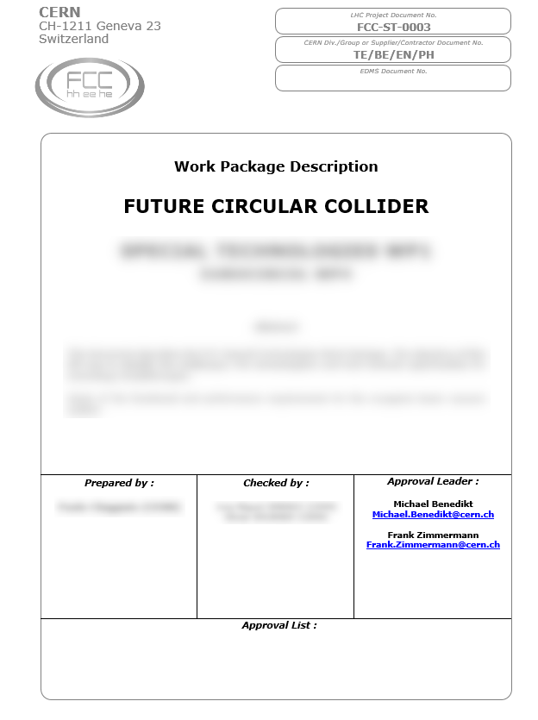
Main topics and milestones for CV activities
Main system design activities
Feasibility Design Report
2021 2022 2023 2024 2025 2026
Review, collection and update of CV user requirements for FCC-ee for each surface point, including CV building and plants specification (assuming no change on FCC-hh requirements); this is
input for iteration in particular with safety concepts
starting point for external consultant contract(s) for CV concept plan and design
Refined concept design of CV infrastructures, also taking into account later evolution to FCC-hh; this is
input for start of Environmental Evaluation process
(Pre-)technical design of CV infrastructures, installation time plan, cost estimate; this is
input for a full iteration of the design with all users, CE and other systems
input for the Feasibility Design Report
«Work package descriptions»
with deliverables, planning/milestones, ...
(useful for planning and follow-up)
M. Benedikt, 18.1.2021

Slide 6
2 June 2022 / FCC week 202
Guillermo Peon (CERN/EN/CV)
Cooling water FCC-ee
Primary cooling water
Raw water
Demineralised water
Chilled/Mixed water
Clear water sumps

Slide 7
2 June 2022 / FCC week 202
Guillermo Peon (CERN/EN/CV)
Primary Cooling Water
Primary water
    Cooling Towers combined with alternative cooling solutions
        Reducing water consumption, visual pollution, noise…
      Waste Heat Recovery options:
        District heating as for LHC;
        Other applications (medical, industrial, agricultural, leisure, …);
        Combined or not with thermal energy storage.
    Water treatment:
        Reducing corrosion;
        Scaling, fouling and legionella;
        Environmentally friendly : smaller chemical footprint
  Blowdown water:
      Finding reject water points;
      Treatment before rejection.
    Maintenance strategies
Notes:
CHALLENGES CONCERNING PRIMARY COOLING

Slide 8
2 June 2022 / FCC week 202
Guillermo Peon (CERN/EN/CV)
Primary Cooling Water
The baseline consists of sets of cooling towers located at each FCC surface point
The eight point FCC-ee configuration has “large” cooling towers at all points except for point B and F
The estimative cooling power needed is:
FCC-ee COOLING POWER NEEDS FOR PRIMARY CIRCUITS (MW)
Point | Cryogenics | Experiment | General Services | Power Converters (RF) | Chilled water | From underground | TOTAL
PA |  | 0.5 | 2 |  | 4,6 | 41.5 | 48.6
PB |  |  | 2 |  | 3,9 | 1.0 | 7.0
PD |  | 0.5 | 2 |  | 4,6 | 41.5 | 48.6
PF |  |  | 2 |  | 3,9 | 1.0 | 7.0
PG |  | 0.5 | 2 |  | 4,6 | 41.5 | 48.6
PH | 48 |  | 2 | 4 | 8.4 | 41.6 | 103.9
PJ |  | 0.5 | 2 |  | 4,6 | 41.5 | 48.6
PL | 95 |  | 2 | 6 | 10.3 | 60.9 | 174.2

Slide 9
2 June 2022 / FCC week 202
Guillermo Peon (CERN/EN/CV)
Primary Water : Cooling Towers (I)

Slide 10
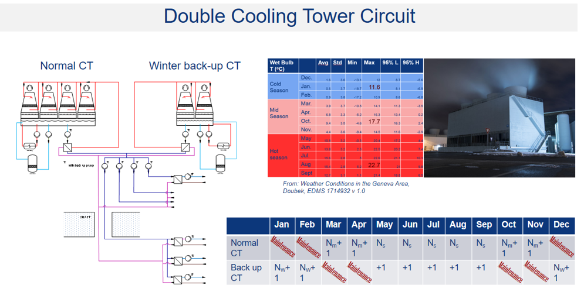
2 June 2022 / FCC week 202
Guillermo Peon (CERN/EN/CV)
Primary Water : CT Maintenance

Slide 11
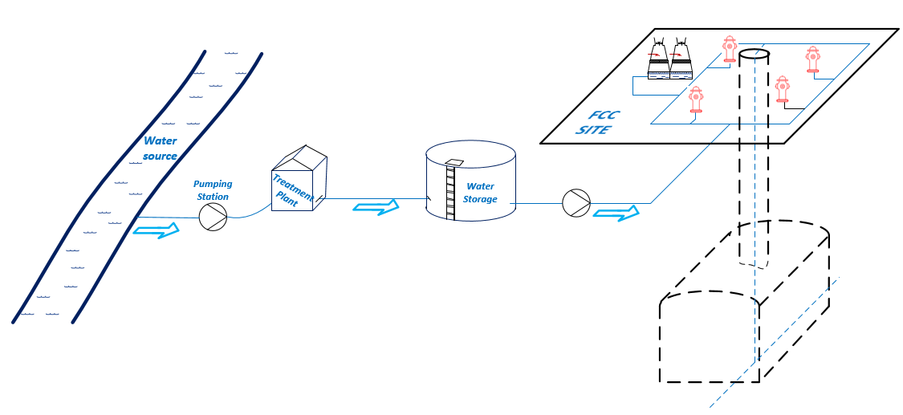
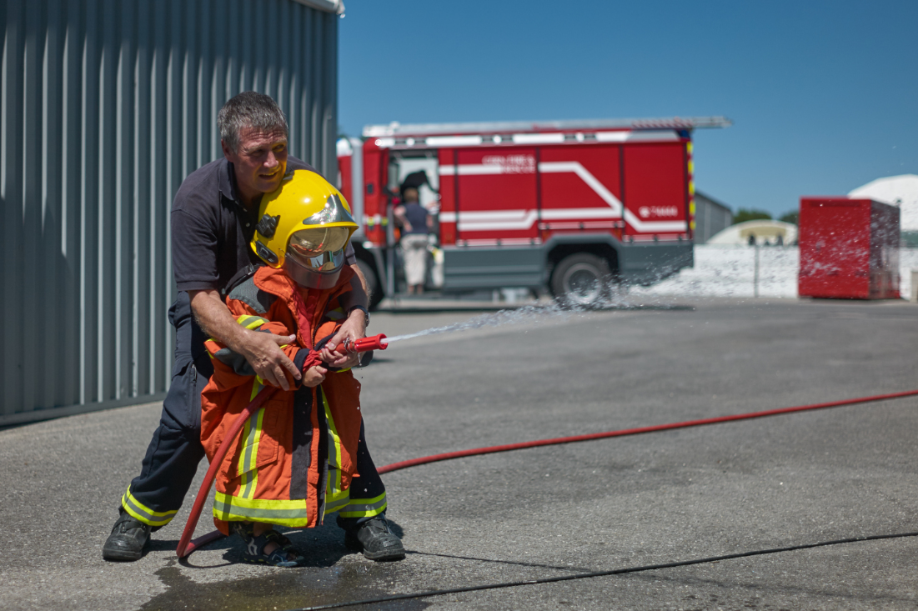
2 June 2022 / FCC week 202
Guillermo Peon (CERN/EN/CV)
Raw water
Raw water supply:
  From which points ? What flow?
    Position of the surface points;
    Water availability per point;
    Water need per point;
    Maximum diameter of the raw water pipe in the tunnel and shafts;
    FCC-hh needs.
  Firefighting system;
  Pumping Stations and
  distribution systems are needed
Water supplier
To other points
To other points

Slide 12
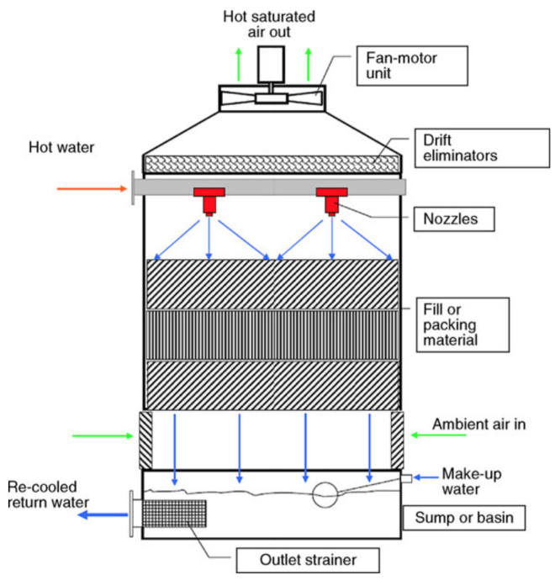
2 June 2022 / FCC week 202
Guillermo Peon (CERN/EN/CV)
Raw water
Make-up water needs (m³/hr)
Point | Classical cooling tower | Blowdown recycling
PA | 140 | 92
PB | 20 | 13
PD | 140 | 92
PF | 20 | 13
PG | 140 | 92
PH | 298 | 197
PJ | 140 | 92
PL | 500 | 330
TOTAL | 1,398 | 921
Notes:
- Raw water: consumption from cooling towers in FCC-ee and FCC-hh, estimation per point for firefighting, worst case, scenario if we have to bring water from a different point. I have to talk about worst scenarios as I don’t have real data.

Slide 13
2 June 2022 / FCC week 202
Guillermo Peon (CERN/EN/CV)
Raw water: possible distribution
Raw water supply:
  Assumption: high flow available at point A, supplying raw water to all the surface points
    DN450 pipe in the tunnel cross section: main drawback is the integration (pipe could also be used for firefighting purposes)
    Need of a DN300 pipe (point L) in the shaft
    Point A is at the lowest level of all: 141 m pressure difference between point A and J for example -> PN 16 is not enough
    DN400, PN25 would be another option

Slide 14
2 June 2022 / FCC week 202
Guillermo Peon (CERN/EN/CV)
Raw water: altitude to be considered
Sumps and Raw Water transfer among points have to considered altitude differences;
Surface points D and F have the highest altitude difference between two surface points : important to consider if sending water from D to F;
Point F has the longest shaft : important to consider for dimensioning of sumps systems;
Point J and H underground have 84 m of altitude difference: important for the demi water circuits design.

Slide 15
2 June 2022 / FCC week 202
Guillermo Peon (CERN/EN/CV)
Demineralised Water
Demineralised water
  Production and distribution
    Central production vs Local production vs On truck production
    A mix of solutions to be used differently according to:
      The need : first filling or coping with major or minor leaks
      Access to the point (distance and access roads)
  Main Cooling circuits in the FCC-ee underground
    For copper circuits (quadrupoles, sextupoles, photon absorbers)
    For aluminium circuits (dipoles)
    RF cooling circuits
    Experimental Area
    … others ?
    Pipes nominal pressure, circuit pressurisation, balancing, etc.
Notes:
DEMI WATER SCHEMATIC AND TOTAL FIGURES FOR THE

Slide 16
Demineralised Water Needs
2 June 2022 / FCC week 202
Guillermo Peon (CERN/EN/CV)
FCC-ee COOLING POWER NEEDS FOR DEMINERALISED WATER CIRCUITS IN THE UNDERGROUND (MW)
Point / Sectors | Magnets | Alcoves | Synchrotron Radiation Absorbers | Experimental Area | Power converters (for accelerator) | RF underground | Cryo RF | TOTAL
PA / L-A, A-B | 2 x 6.6 | 2 x 0.9 | 2 x 12.5 | 0.5 | 1.05 |  |  | 41.5
PB |  |  |  |  | 1.05 |  |  | 1.05
PD / B-D D-F | 2 x 6.6 | 2 x 0.9 | 2 x 12.5 | 0.5 | 1.05 |  |  | 41.5
PF |  |  |  |  | 1.05 |  |  | 1.05
PG / F-G G-H | 2 x 6.6 | 2 x 0.9 | 2 x 12.5 | 0.5 | 1.05 |  |  | 41.5
PH |  |  |  |  | 1.05 | 38.7 | 1.8* | 41.6
PJ / H-J J-L | 2 x 6.6 | 2 x 0.9 | 2 x 12.5 | 0.5 | 1.05 |  |  | 41.5
PL |  |  |  |  | 1.05 | 58.1 | 1.8* | 60.9

Slide 17
Demineralised Water Circuits at A, G, D, J
2 June 2022 / FCC week 202
Guillermo Peon (CERN/EN/CV)
UW-A
SECTOR
CIRCUITS
Detector
Cryo
Chillers
UW-J
UW-D
UW
SECTOR
Dipoles
SECTOR
Q+S_poles & Others
UW-G
Detector

Slide 18
2 June 2022 / FCC week 202
Guillermo Peon (CERN/EN/CV)
Chilled Water
Chilled / Mixed water
  Air cooling and dehumidification);
    Temperature ranges, cooling power, location;
  Production and distribution
    Chiller alternatives;
    Back up strategy;
    Number of circuits.
Point | Cooling power (kW) | Flow rate (m³/h) | Number of chillers | Cooling power/ chiller (kW)
A | 3,834 | 551 | 5 | 1,000
B | 3,284 | 472 | 5 | 900
D | 3,814 | 548 | 5 | 1,000
F | 3,284 | 472 | 5 | 900
G | 3,834 | 551 | 5 | 1,000
H | 6,980 | 1,002 | 6 | 1,500
J | 3,814 | 548 | 5 | 1,000
L | 8,584 | 1,233 | 6 | 1,800

Slide 19
2 June 2022 / FCC week 202
Guillermo Peon (CERN/EN/CV)
Tunnel Ventilation (Users’ requirements)
  USER’S REQUIREMENTS (INPUT FOR CV)
    Modes: Run, Flushing, Access;
    Thermal loads to air from magnets, synchrotron radiation, electrical racks, cables, etc. ; (Run)
      Location and value;
    Air temperature constraints : maximum and minimum values (Run, Flushing, Access);
    Maximum air speed (vibration) (Flushing);
    Flushing mode:
      Radiation rate at exhaust air and in the tunnel (HSE);
      Delay between accelerator stop and access to the tunnel;
    Air renewal rate, air quality requirements (Access);

Slide 20
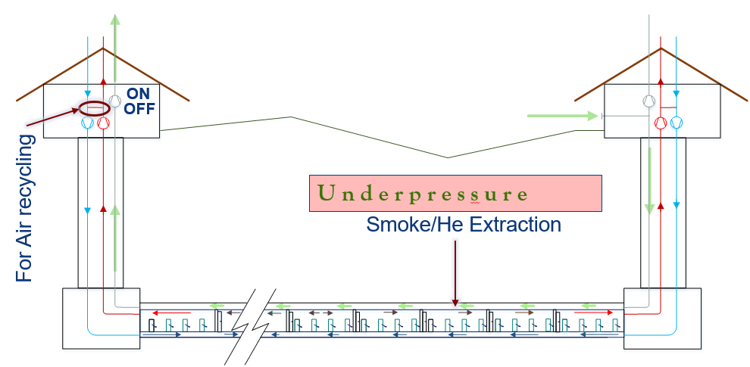
2 June 2022 / FCC week 202
Guillermo Peon (CERN/EN/CV)
20
Ventilation principle
  Air handling units configuration
      Back up units
          Working strategy in case of breakdown

Slide 21
2 June 2022 / FCC week 202
Guillermo Peon (CERN/EN/CV)
21
Tunnel Ventilation
General Input data
Cross section area | 15.2 m²
Sector length | 11,396 m
Max. Temperature (running conditions) | 32ºC (to be confirmed)
Max. dew point Temperature | 12ºC (to be confirmed
Ventilation parameters
Normal operation air flow per sector | 2 x 27,000 m³/h
Flushing air flow (longitudinal) per sector | 100,000 m³/h
Air supply points per compartment | 4
Air flow per supply point (normal operation) | 520
Time to complete air renewal (flushing) | 1.7 h
Maximum air speed (normal operation – flushing) | 0.5 m/s – 1.8 m/s
Cooling capacity in normal operation for ΔT = 15 K per sector | 271 kW
Compartment Input data
Number of Compartments | 26
Compartment length | 440 m
Volume Compartment | 6,688 m³

Slide 22
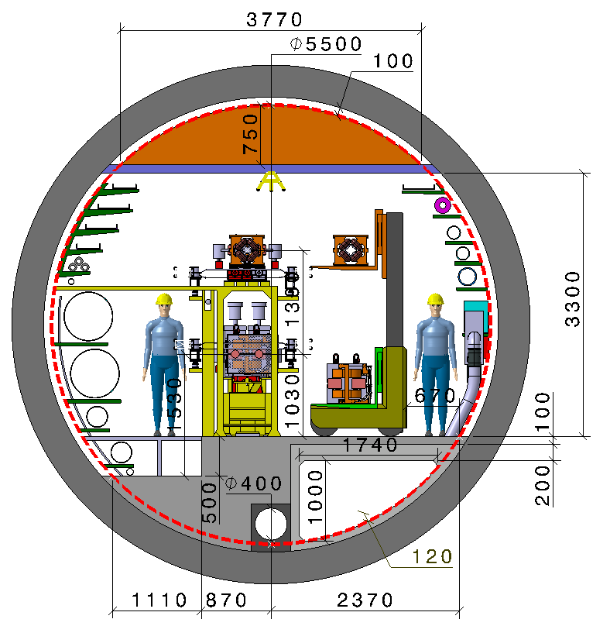
2 June 2022 / FCC week 202
Guillermo Peon (CERN/EN/CV)
22
Ventilation: new tunnel cross section
700 in CDR
1580 in CDR
890 in CDR

Slide 23
2 June 2022 / FCC week 202
Guillermo Peon (CERN/EN/CV)
23
Heat loads on Air (kW)
POINT | Cryogenics | Experimental Areas | General Services | Power Converters | Shaft pressurisation | Fresh air for underground areas | TOTAL
A |  | 50 | 500 |  | 300 | 150 | 1000
B |  |  | 500 |  | 150 | 50 | 700
D |  | 40 | 500 |  | 300 | 150 | 990
F |  |  | 500 |  | 150 | 50 | 700
G |  | 50 | 500 |  | 300 | 150 | 1000
H | 2,400 * |  | 500 | 2,000 * | 150 | 150 | 5,200 (800 to CW)
J |  | 40 | 500 |  | 300 | 150 | 990
L | 4,750 * |  | 500 | 3,000 * | 150 | 150 | 8,550 (800 to CW)
On the surface
* Extracted w/o chilled water
In underground areas
POINT | Cryogenics | RF | Experimental Areas | Power Converters | Ventilation UW | TOTAL
A |  |  | 50 | 220 | 200 | 470
B |  |  |  | 220 |  | 220
D |  |  | 40 | 220 | 200 | 460
F |  |  |  | 220 |  | 220
G |  |  | 50 | 220 | 200 | 470
H | 180 | 3,200 |  | 220 | 200 | 3,800
J |  |  | 40 | 220 | 200 | 460
L | 180 | 4,800 |  | 220 | 200 | 5,400
… and for EACH
SECTOR
Magnets | Cables | Synchrotron radiation absorbers | TOTAL
352 | 1,763 | 250 | 2,364

Slide 24
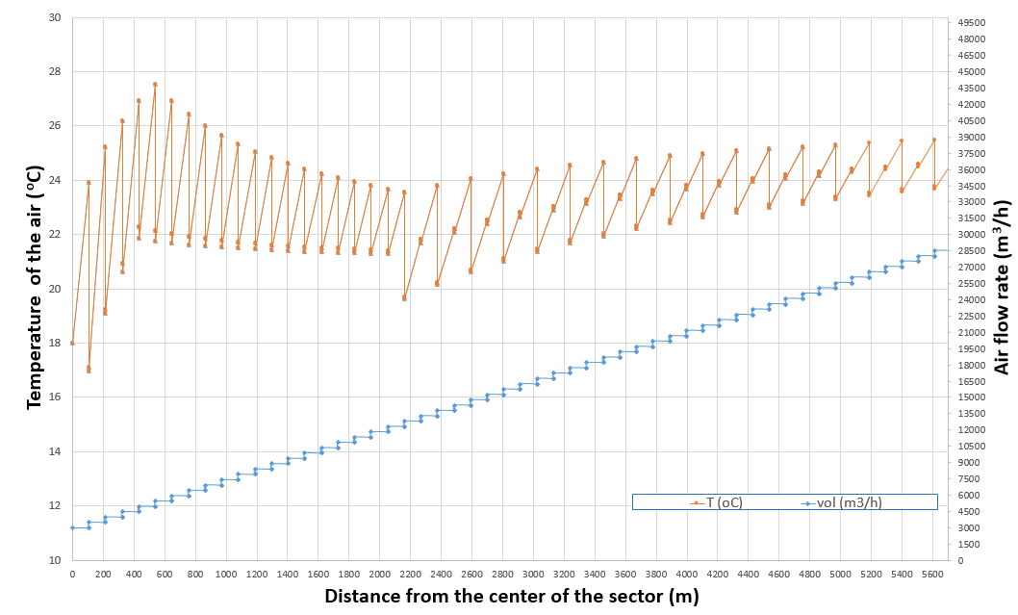
2 June 2022 / FCC week 202
Guillermo Peon (CERN/EN/CV)
Ventilation FCC-ee: Particular Aspects
  Extracting heat load without generating high temperature gradients (Survey constraints)
    Heat loads distribution over the tunnel
    Local cooling distribution over the tunnel
    Example:
    Flow at the center of the sector:
    3000 m³/h
    Flow at an extremity of the sector: 28000 m³/h
    Local cooling:
      4 x 7 kW,
      15 x 9 kW,
      17 x 16 kW
      TOTAL Local air cooling: 435 kW
    TOTAL Main ventilation: 65 kW
    TOTAL both systems: 500 kW

Slide 25
2 June 2022 / FCC week 202
Guillermo Peon (CERN/EN/CV)
Other Ventilation Systems
  Ventilation of the Experimental Caverns
  Ventilation of the RF areas in the underground
Ventilation of the auxiliary areas
  Connecting caverns
  Alcoves
Pressure cascade between zones
  Sense and pressure difference between zones
  Air locks location

Slide 26
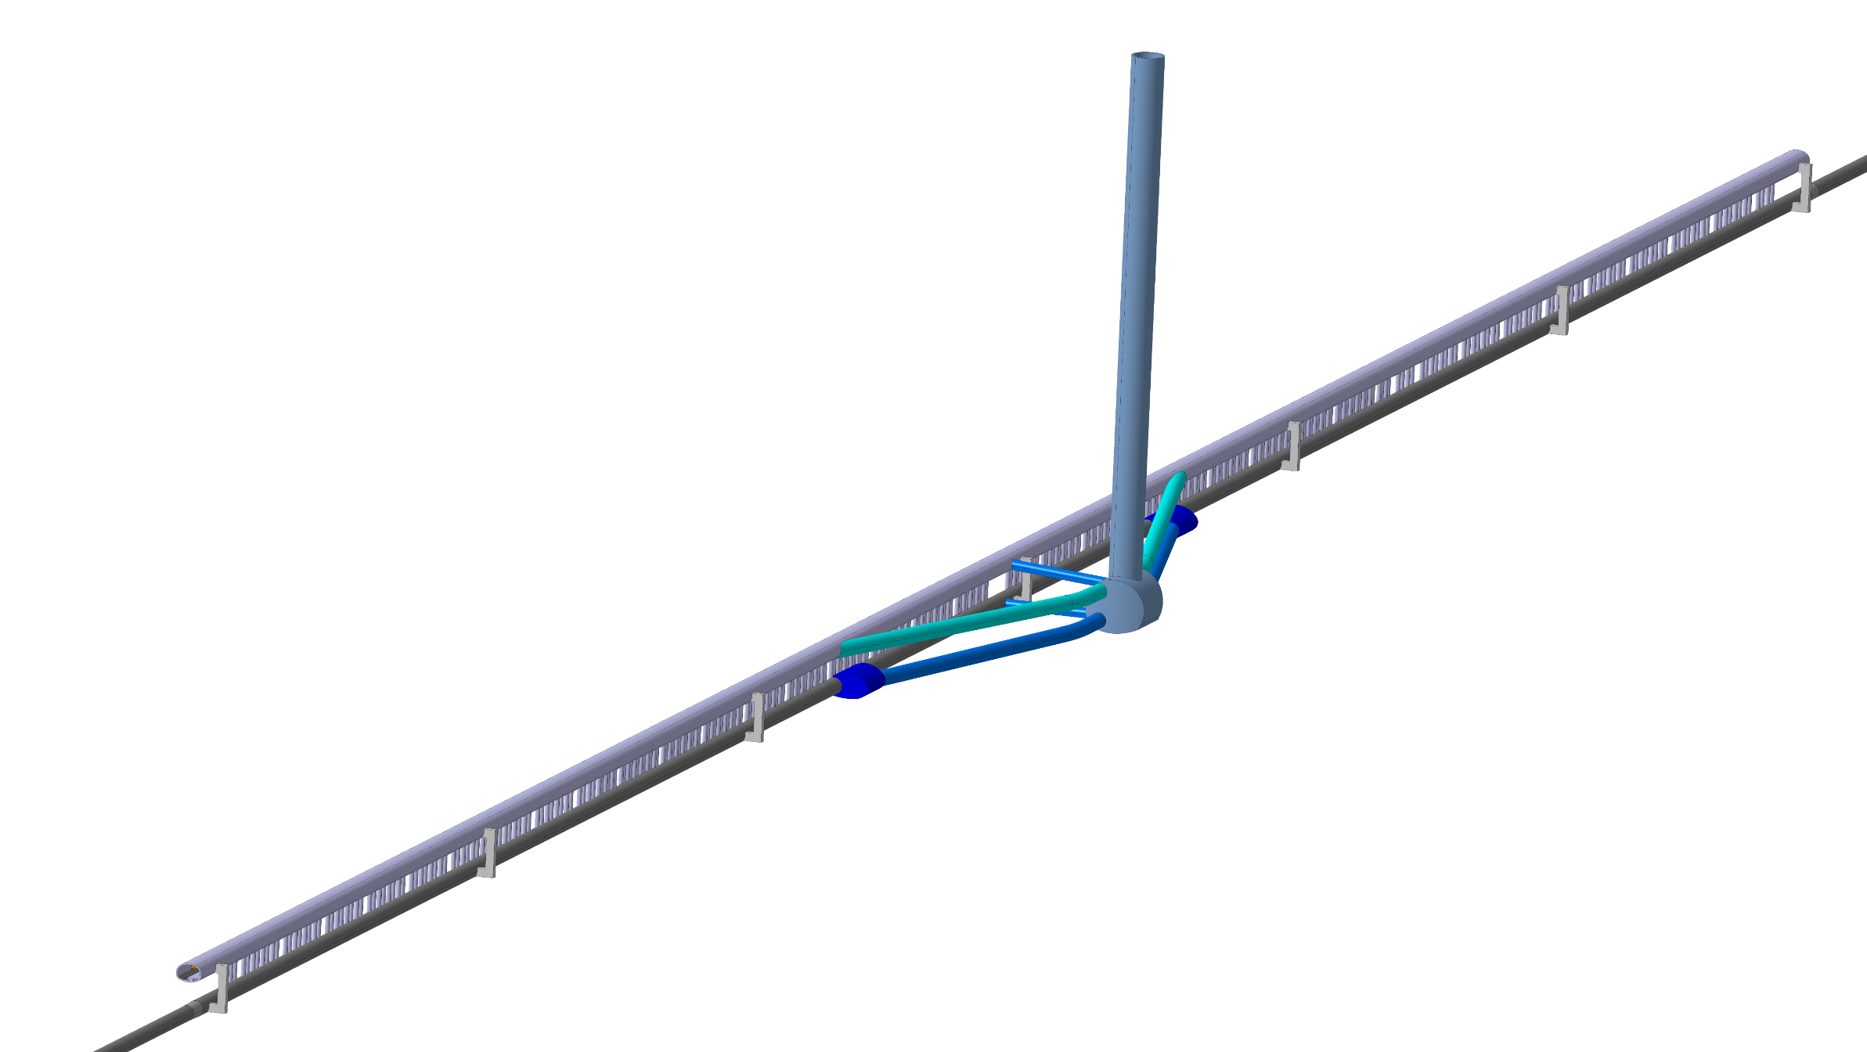
2 June 2022 / FCC week 202
Guillermo Peon (CERN/EN/CV)
Other Ventilation Systems
RF at Point L
FCC accelerator
tunnel
Klystron Gallery

Slide 27
2 June 2022 / FCC week 202
Guillermo Peon (CERN/EN/CV)
  Ventilation of the RF areas in the underground of Pt. L
Level -1
Klystron
Gallery
4,800 kW dissipated to the air
Over 2014 m -> 2.38 kW/m
Point L
240 local AHU of 20 kW each
One unit every 8.4 m
Level -2
Accelerator
Tunnel

Slide 28
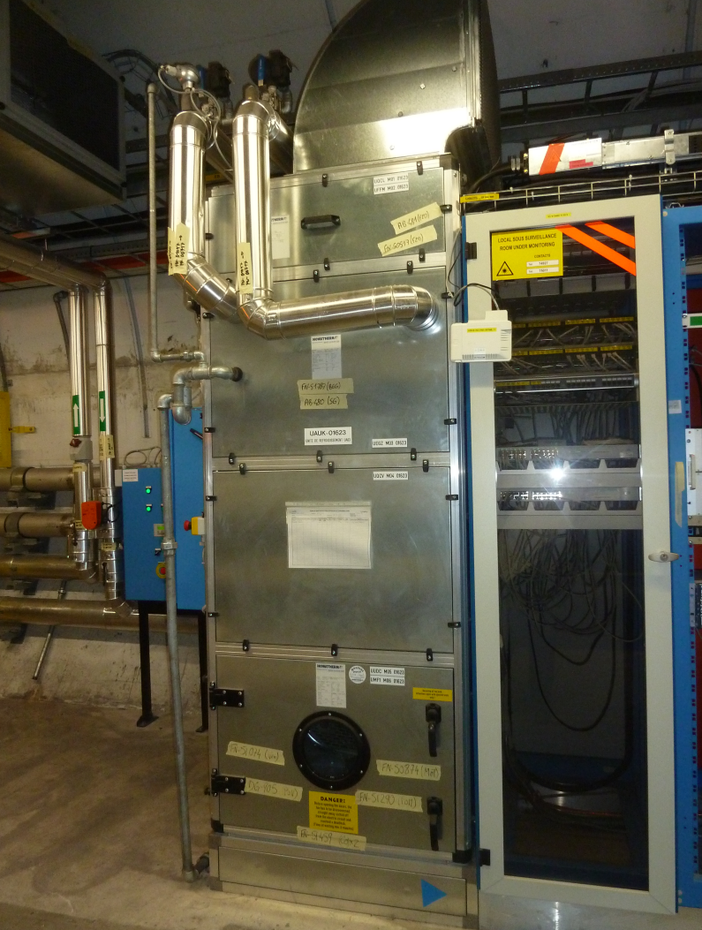
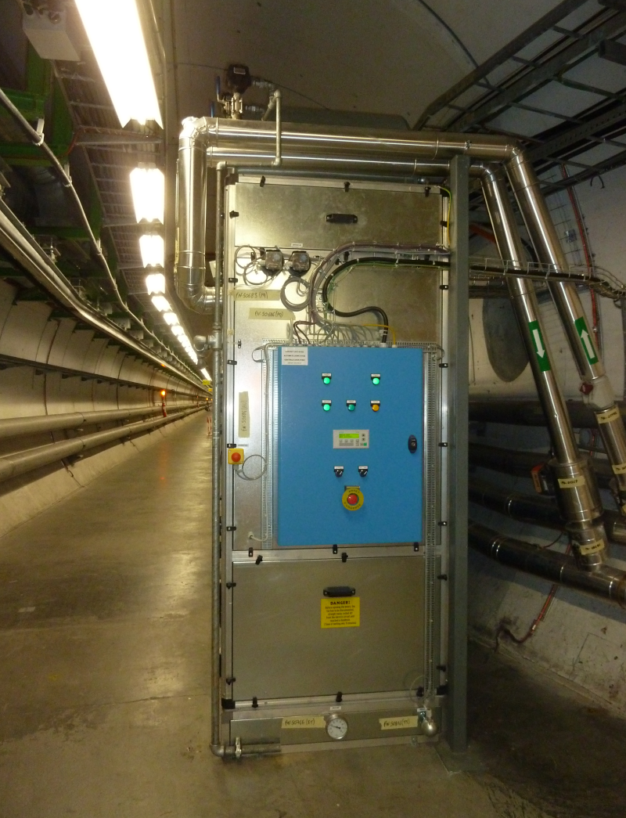
2 June 2022 / FCC week 202
Guillermo Peon (CERN/EN/CV)
  Ventilation of the RF areas in the underground of Pt. L
240 local AHU of 20 kW each
One unit every 8.4 m

Slide 29
2 June 2022 / FCC week 202
Guillermo Peon (CERN/EN/CV)
Next Steps
  Get needed data from users and other services, including FCC-hh;
  Call for Tenders for consultants;
    Selection criteria: Experience, Qualified Personnel, Software,…
    Deliverables:
      What :
        Cost estimate of baseline design;
        New design in search of efficiency;
      Solid basis:
        Calculations;
        Previous experience;
        Measurements.
  Accompany the consultants through the project and be a facilitator between them and the different stakeholders
  Produce documentation for the next Design Review.

Slide 30
2 June 2022 / FCC week 202
Guillermo Peon (CERN/EN/CV)
Thank you
for your attention.
Thank you
for your attention.

