Slide 1
Alignment network error propagation and alignment
FCC week 2022, June 1st 2022
Georg Gassner

Slide 2
Content
Alignment steps
Error Propagation in tunnel alignment networks
Issues with error propagation for tunnel measurements
Examples from SLAC
Alignment examples from FCC-ee optics tuning and alignment mini-workshop
Summary

Slide 3
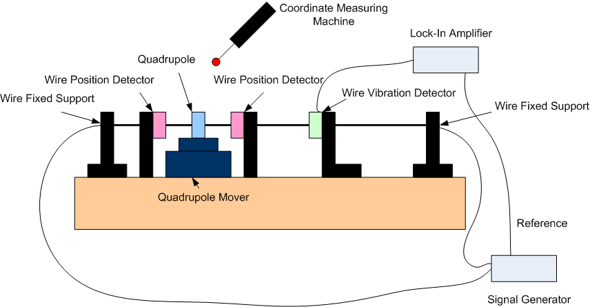
Alignment steps
LCLS-I
LCLS-II
FACET II
LCLS
Establish reference network
Fiducialize components / rafts
Align components relative locally to reference network
Smoothing to maintain alignment afterwards

Slide 4
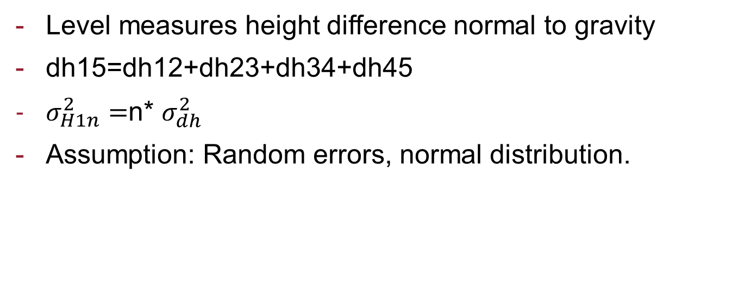
Error Propagation - Vertical
H1
H2
H3
H4
H5
dh12
dh23
dh34
dh45
Level measures height difference normal to gravity
dh15=dh12+dh23+dh34+dh45
$σ_{H1n}^{2}=$n* $σ_{dh}^{2}$
Assumption: Random errors, normal distribution.

Slide 5
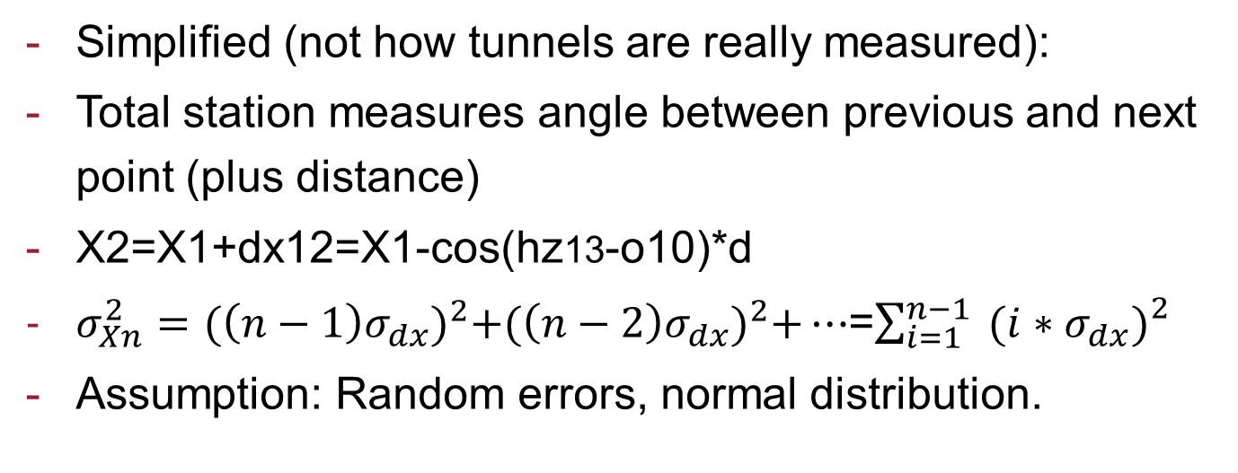
Error Propagation - Horizontal
hz02
hz13
hz24
o10
d
d
d
d
X0
X1
X2
X3
X4
Simplified (not how tunnels are really measured):
Total station measures angle between previous and next point (plus distance)
X2=X1+dx12=X1-cos(hz13-o10)*d
$σ_{Xn}^{2}={(\left(n−1\right)σ_{dx})}^{2}+{(\left(n−2\right)σ_{dx})}^{2}+…$=$\sum_{i=1}^{n−1}{{ (i∗σ_{dx})}_{}^{2}}$
Assumption: Random errors, normal distribution.

Slide 6
Issues with error propagation for tunnel measurements
Assumption was that we only have random errors, a large portion of errors are not random, simulation results are usually optimistic.
None random factors:
Mainly environmental factors like refraction (e.g. the tunnel wall is usually at a different temperature than the air. Especially in ring where inside wall is closer to line of site.)
Instrument errors (calibration at certain conditions, differ from field).
Guide to the expression of uncertainty in Measurements (GUM)

Slide 7
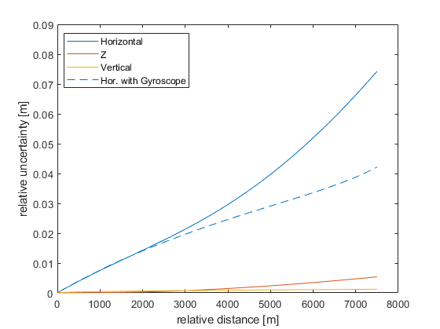
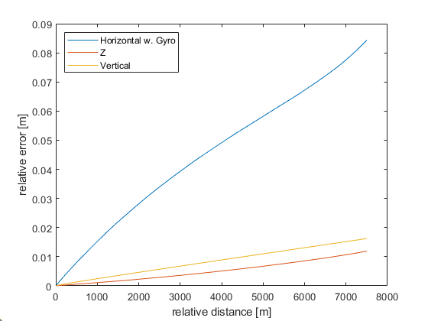
Simulations for 100km ring – conventional system
Wall monuments
50m
floor monuments
Simulation
Part of errors not random

Slide 8
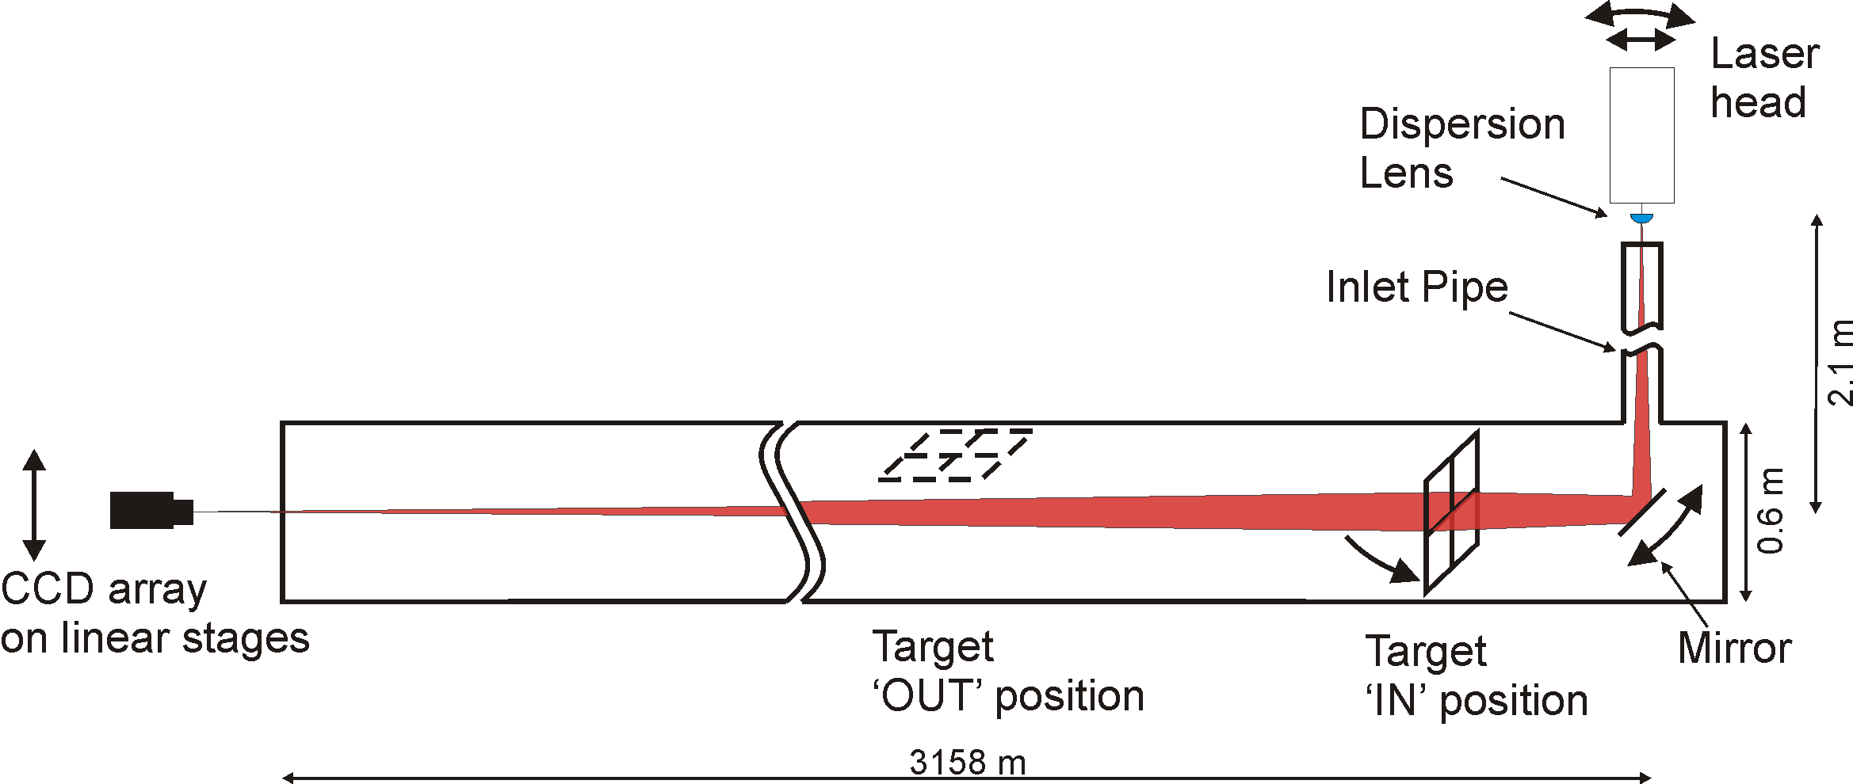
SLAC - Reference Network –
Linac Laser Alignment System (LLAS)
270 girders of 12m and 3m length
Every girder has one fresnel zone plate target

Slide 9
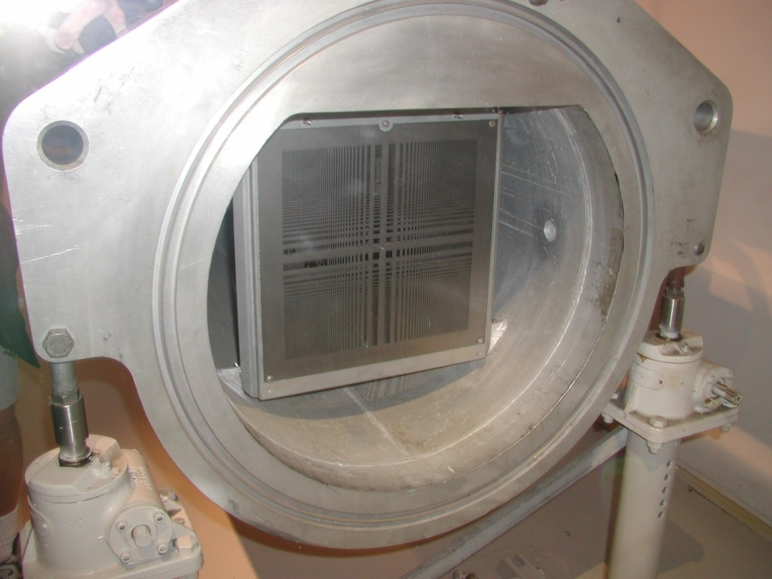
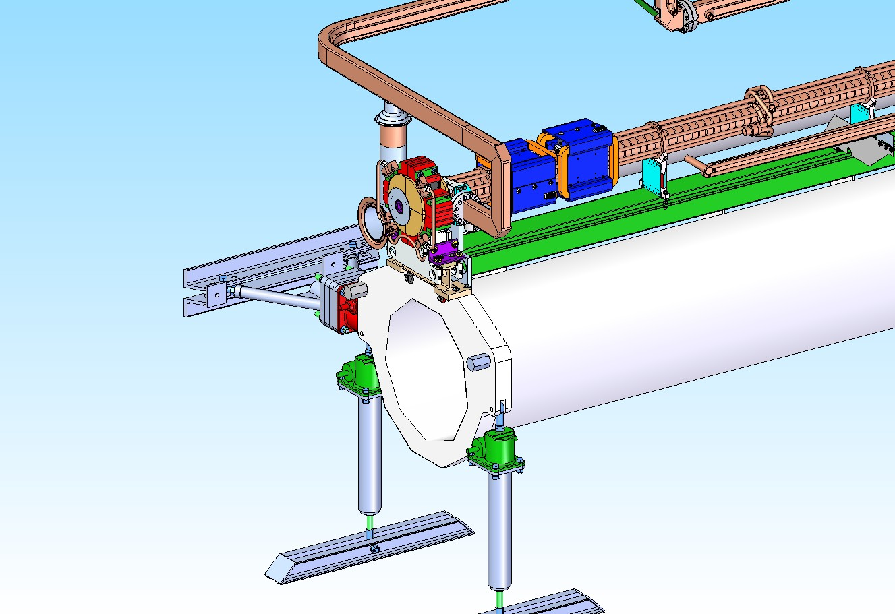
Linac Alignment System - Girder
Fiducials
Fresnel Lens Target
Telescope mount
Horizontal
Adjustment Jack
Height / Roll
Adjustment jacks

Slide 10

LCLSII – Cryomodule installation - Reconfigure LLAS
LCLS-II
Spherical
Lenses

Slide 11
Conventional Alignment Network S0-S30 – Layout
First kilometer no longer has a light pipe and in addition bypass lines are not tied to girders -> Monument based network
Opposing wall monuments to mitigate effect of refraction
3km
3.3m
Cryomodule
Wall Monument
Floor Monument
12m

Slide 12
Alignment Network S0-S30 - Measurements
311 Laser Tracker (Leica AT401/402) setups with 5082 measurements
577 Height differences (Leica DNA03)
200 Linac Light Pipe readings
(3km - 6 weeks with 1 crew (2-person)
->100km –> 200 weeks 1 crew + above ground network)
Least Squares Adjustment with GEONET which allows the Linac Light Pipe readings (σ=±0.5mm) to be included as deviations from a straight line

Slide 13
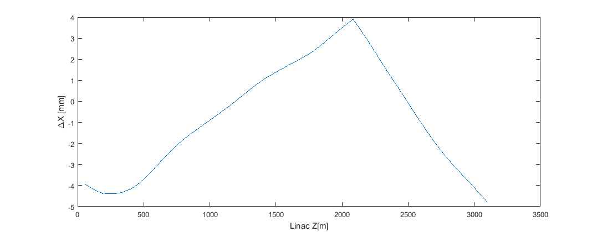
Alignment Network S0-S30 – Results (1)
Comparison of coordinate results between adjustment with LLAS and without LLAS.
Location of
radiation chicane
no direct line of sight
13 µrad

Slide 14
SLAC LCLS – 1km new construction
LCLS

Slide 15
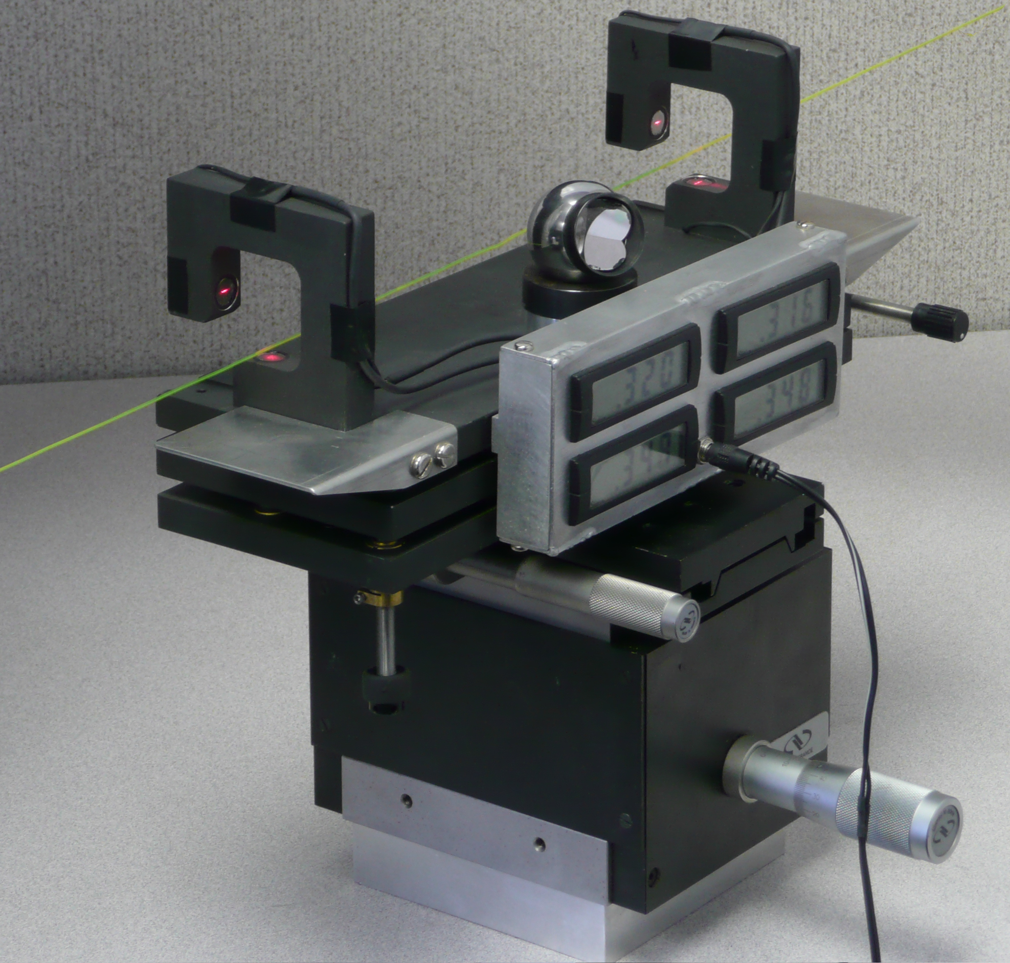
Network Measurements –
Portable Wire Measurement System
In house development
Laser System
Position 1
Position 2 …
Laser system
Laser Diode
Scan of a wire with the laser system
Laser Beam
Wire
Window (10μm slit)
Photo Cell

Slide 16
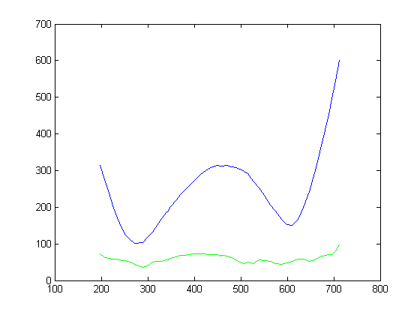
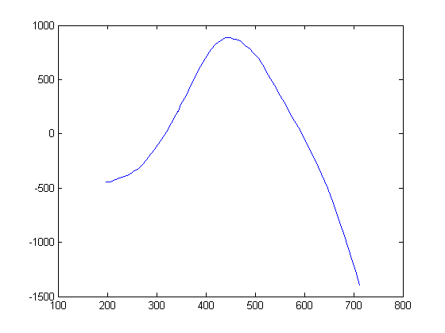
LCLS-I Portable Wire Results
Impact of wire on standard deviations
Impact of wire on coordinates
Network measurements alone
Wire measurements included
Coordinate change [µm]
Sigma [µm]
Position [m]
Position [m]
Network of 393 points with the following observation schema: triplets from 69 tracker setups, 465 height differences and 57 offset measurements to two overlapping wires (240m long and 370m long).
A-priori standard deviations:
Laser Tracker: σ_{D}=50 µm, σ_{Hz}=7 µm/m, σ_{V}=10 µm/m
Level: σ_{Δh}=70 µm
Offset measurement: σ_{Δo}=30 µm

Slide 17
Alignment tolerances
Fiducialization (4m) (Laser Tracker / Arm)
  Usually within 50µm
Field alignment tolerances (20m) (Laser Tracker):
  Local alignment relative to the network 100µm
Network
  Mid range (200m) 0.3mm (Laser Tracker / Level / Wire)

Slide 18
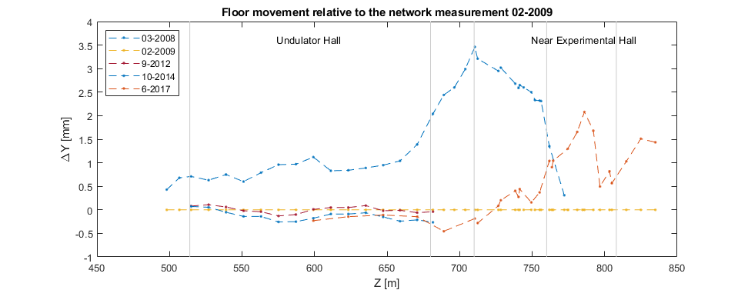
Alignment Network – Building stability
The floor in the undulator hall showed very little movement over the last 10 years, the only significant movement was in the FEE and NEH where another floor was installed.

Slide 19
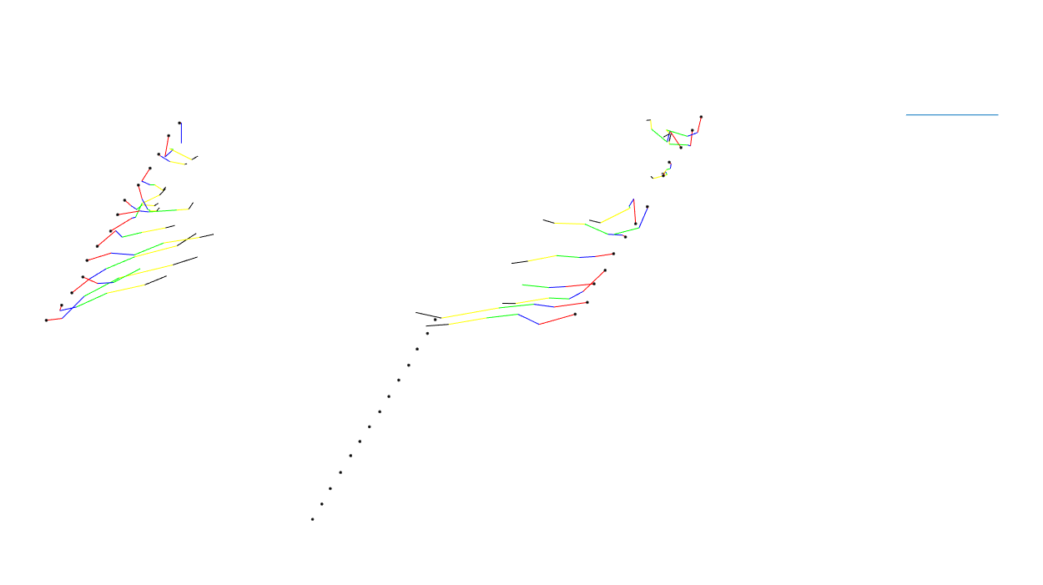
Alignment Network – Building stability
The walls in the undulator hall are still moving inward, the rate has slowed down.
Deformation Scale:
1mm
Feb. 08 – July 08
July 08 – Feb. 09
Feb. 09 – Jan. 10
Jan. 10 – Sep. 12
Sep. 12 – Oct. 16
E-Dump
Undulator Hall (160 m)
LTU

Slide 20
FCC-ee alignment mini-workshop
All labs reported that their respective rings / accelerators are constantly moving with especially large motion during new construction and new equipment installation requiring re-alignment.
Several labs apply smoothing techniques to re-align tunnel.
  Conventional methods are very time consuming.
  No other trade should be working in same location.
Number of surveyors is limited, it took SLAC almost a year to hire one. FCC would need 50 (25 teams, data from Mark Jones) with a 4-month duration.
Fiducialization of components / rafts was highlighted and the importance of temperature control and automation of setups is significant.

Slide 21
Summary
Alignment network:
  Vertical is not an issue (measurements relative to gravity)
  Horizontal (normal to beam) uncertainty grows faster and might need additional measurement system.
Conventional alignment methods will either take a long time or a very large workforce (very repetitive job).
Fiducialization should be automated as much as possible.
Tunnels are not stable, especially right after construction. Re-establishing the alignment network based on tolerances and smoothing of the ring is required.

