Slide 2
Status of the technology development for the FCC-ee vacuum system
C. Garion, CERN/TE/VSC
Content:
  Introduction to the FCC-ee vacuum system in the arcs
  UHV connections with Shape Memory Alloy couplers
  Additive manufacturing with gas dynamic cold spray coating
  Prototyping phase
  Summary

Slide 3
FCC-ee vacuum system in the arcs
The FCC-ee Vacuum system has to cope with beam parameters from low-energy (45.6 GeV) high current (1390 mA) version to high-energy (182.5 GeV) low current (5.4 mA) configuration.
Beam Energy E(GeV) | Beam Current I(mA) | Photon Flux F’(ph/s/m) | Dynamic Gas Load Q’(mbar·l/s/m)
45.6 | 1390 | 7.17·10¹⁷ | 2.90·10⁻⁸
80 | 147 | 1.38·10¹⁷ | 5.58·10⁻⁹
120 | 29 | 4.13·10¹⁶ | 1.67·10⁻⁹
182.5 | 5.4 | 1.18·10¹⁶ | 4.78·10⁻¹⁰
For the vacuum system, the synchrotron radiation leads to:
High local heat deposition:
  The limit is given by 50 MW/beam synchrotron radiation losses (~650 W/m).
High outgassing:
  Pressure: low 10⁻⁹ mbar range.
Relevant FCC-ee parameters for the vacuum system design
Shielded bellows
Dipole
Dipole
Quad
Layout:
2 rings of ~ 100 km.
Cell length: ~55.9 m.
~12 m
Flange connection

Slide 4
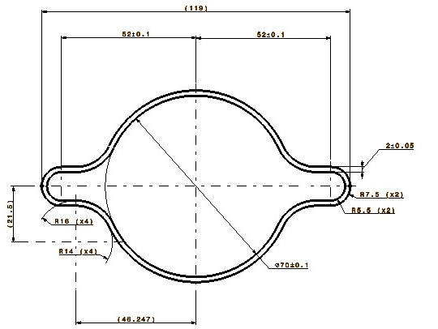
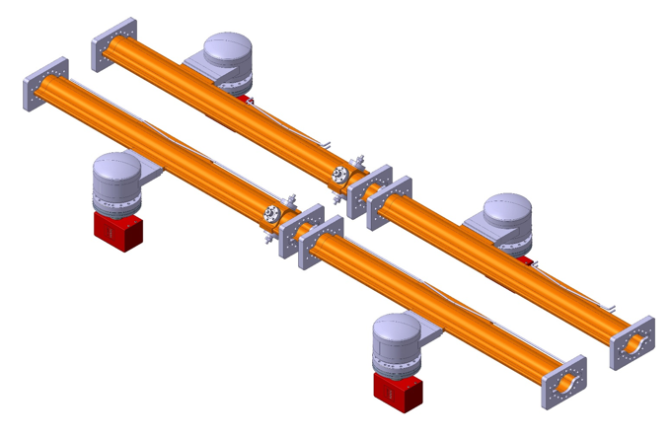
FCC-ee vacuum chambers
Present design as presented in the CDR:
119
Geometry: Tube with two winglets
2 mm thick, 70 mm ID
Material: Copper
  Good thermal conductivity and low electrical resistivity
  Shielding for the X-Ray synchrotron radiation fan and minimizing the irradiation of machine and tunnel components
Surface treatment: NEG coating
  Distributed pumping speed
  Low SEY
  Quick vacuum conditioning
Lumped SR photon absorber:
Distanced by about 5.8 m
Lumped pump: no need for a systematic installation in vicinity of the absorbers →1 or 2 per cell
φ70
Vacuum chamber prototype cross-section
Illustration of vacuum chambers with absorbers and pumps
The whole vacuum system shall be designed with a cost-effective and sustainable approach.

Slide 5
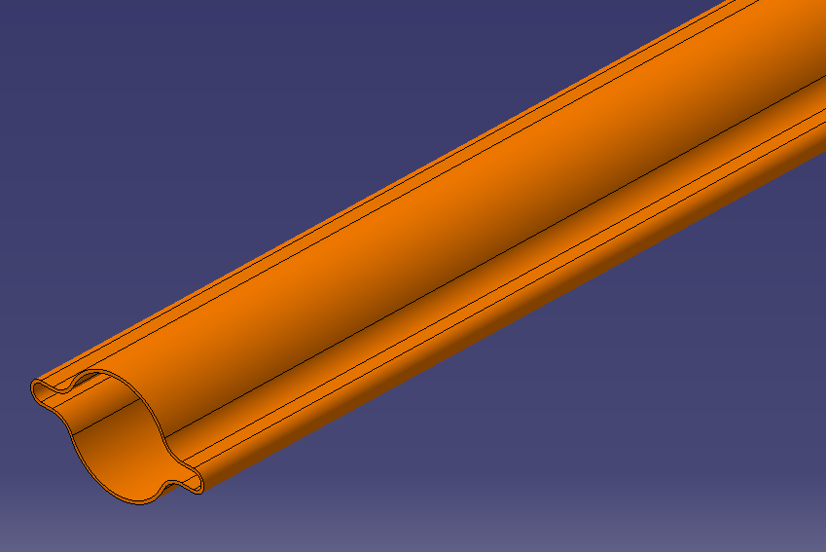
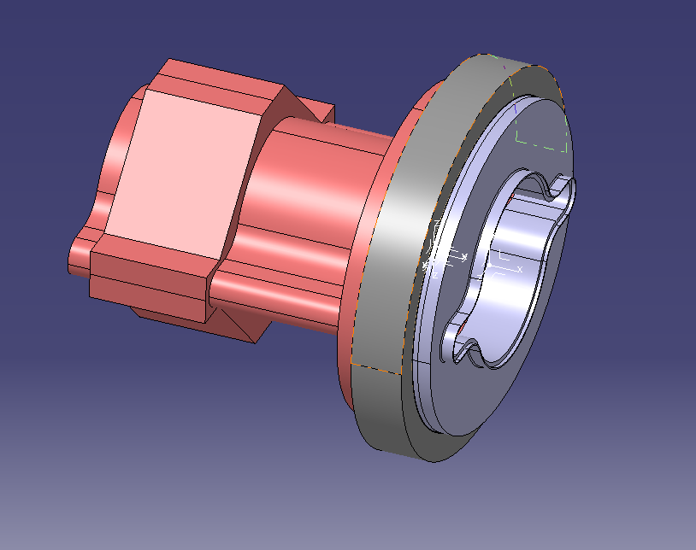
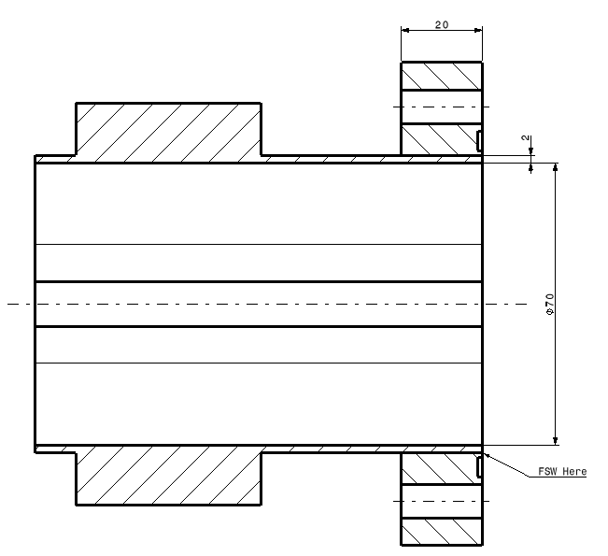
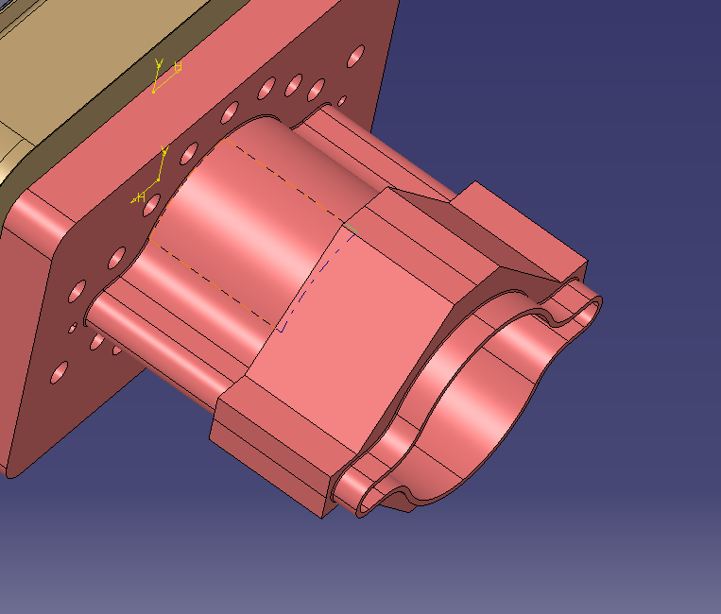
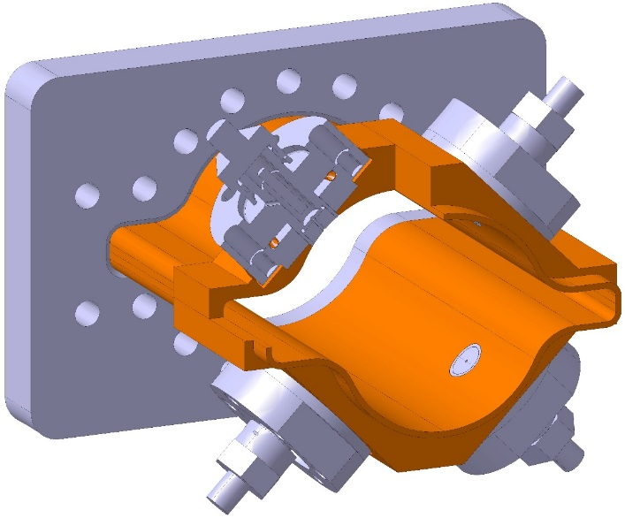
New technologies in development for HEP and of interest for FCC-ee
Beyond the vacuum challenges related to the synchrotron radiation and dynamic vacuum, the vacuum system shall have an affordable cost.
Technical solutions shall be defined to minimize the cost of the system. The production should be based on series industrial processes and with a minimum of interfaces.
Some technologies are being developed and assessed for the main ring vacuum chambers:
  Shape Memory Alloy UHV connectors for:
    Interconnection.
    BPM pick-ups.
  Gas dynamic cold spray for:
    Additive manufacturing of copper.
    Permanent radiation hard bake out system.
  Weld of extruded chamber/flange.
SMA connector
Copper extrusion
Welding extrusion/flange
Cold sprayed copper for BPM integration

Slide 6
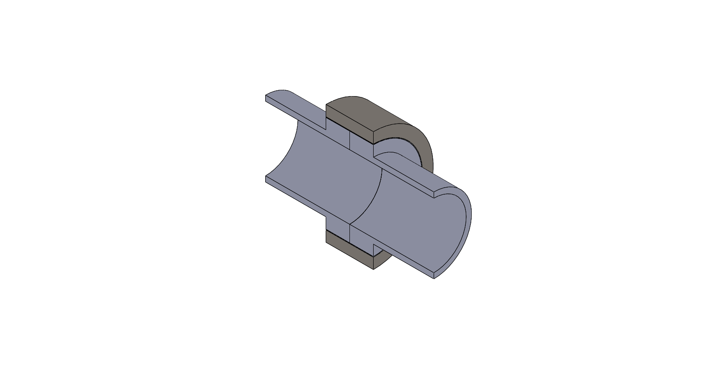
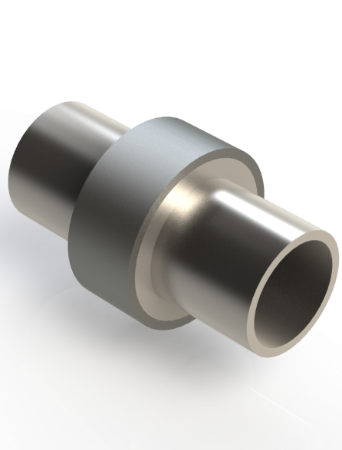
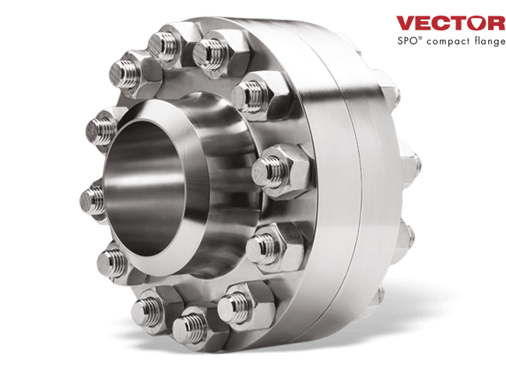
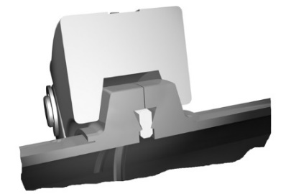
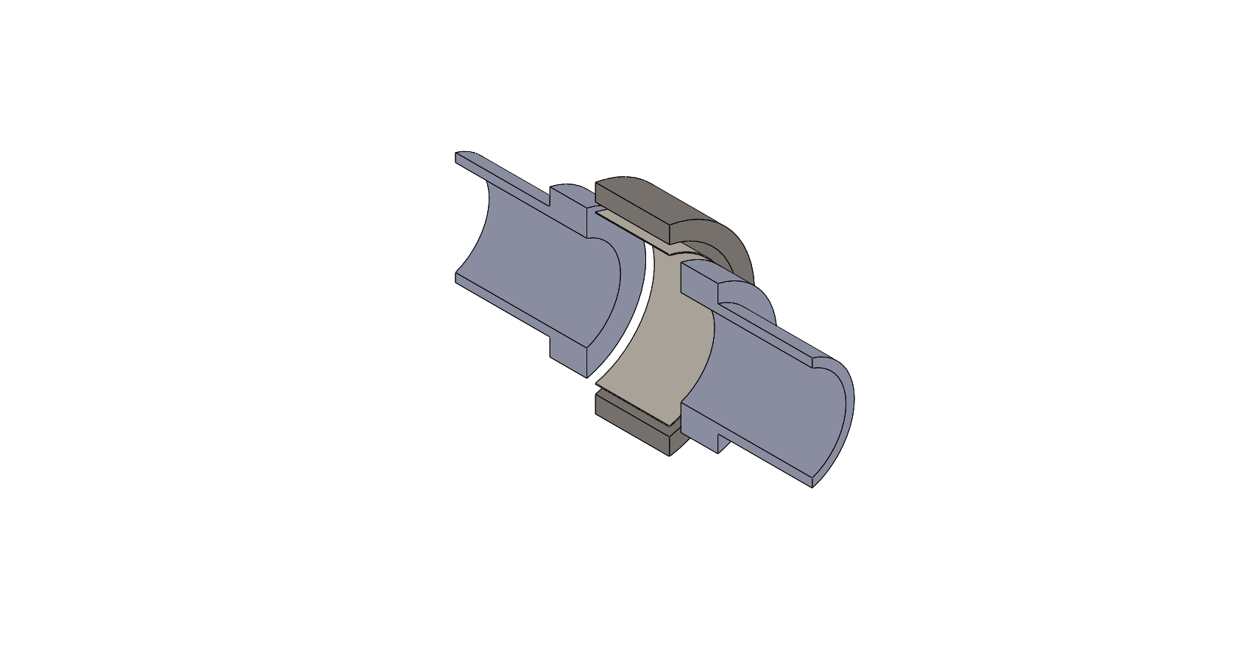
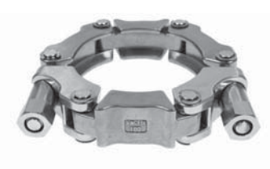
Concept of SMA connectors for UHV applications
Standard vacuum coupling systems
Shape memory alloy couplers
Austenitic contracted hot-shape
Heating/mounting
Cooling/dismounting
SMA ring coupler
Thin cylindrical gasket
Soft/hard materials + mechanical force
Martensitic enlarged cold-shape
  Image source: web
Soft/hard materials + temperature control

Slide 7
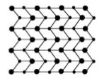
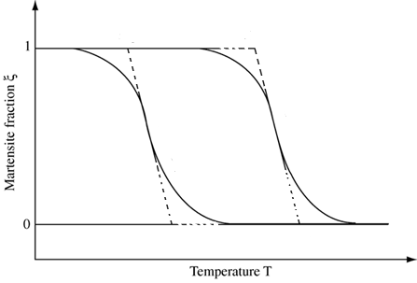
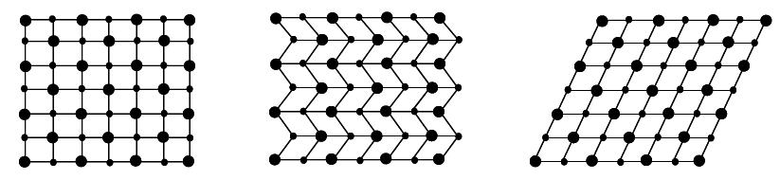
Concept of SMA connectors for UHV applications
Heating/mounting
Martensite: stable at low temperature and high stress
Austenite: stable at high temperature and low stress
M_{f}
A_{S}
Heating
Cooling
Twinned (low stress) or detwinned (high stress) martensite
Austenite
M_{S}
A_{f}
Martensitic enlarged cold-shape
Austenitic contracted hot-shape
Cooling/dismounting
Reversible phase transformation: displacive transformation without diffusion process
A_{s}: Austenite start temperature
A_{f}: Austenite finish temperature
M_{s}: Martensite start temperature
M_{f}: Martensite finish temperature
Transformation Temperatures (TTs) depend on:
Chemical composition
Internal stress/strain field (dislocation arrays/precipitates)
Thermo-mechanical cycling

Slide 8
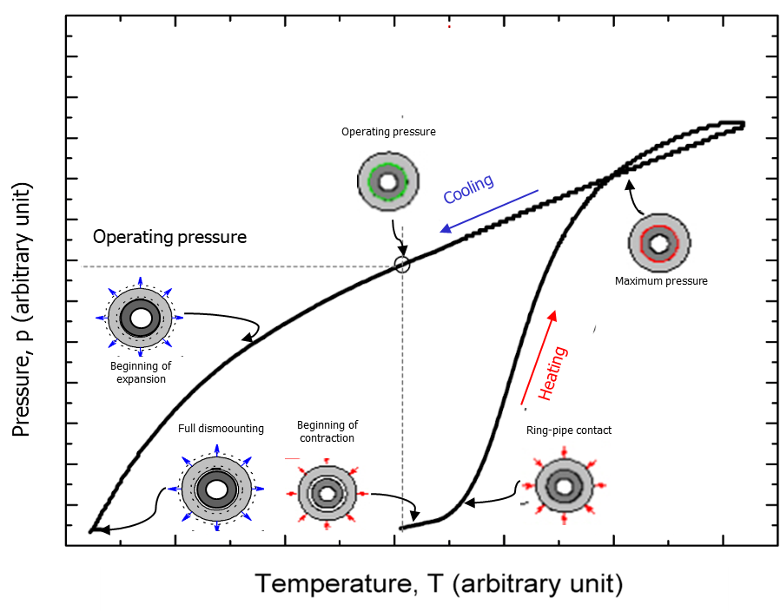
Operation principle
A_{s}: Austenite start temperature (Ring contraction starts)
A_{f}: Austenite finish temperature (Ring contraction ends)
M_{s}: Martensite start temperature ( Ring expansion starts)
M_{f}: Martensite finish temperature (Ring expansion ends)
2
Mounting at room temperature
Tightening by heating above 100 °C
Leak Rate < 10⁻¹⁰ mbar·l·s⁻¹ at room temperature
Dismounting by cooling down to -40°C
3
4
1
1: T<A_{s} (40 °C)
2: T>A_{f} (>100 °C)
3: T = RT
4: T≈M_{f} (-40 °C)
p_{max}
p_{op}
SMA ring
(martensitic)
Tube
Mounting
Clamping
Operation
Dismounting

Slide 9
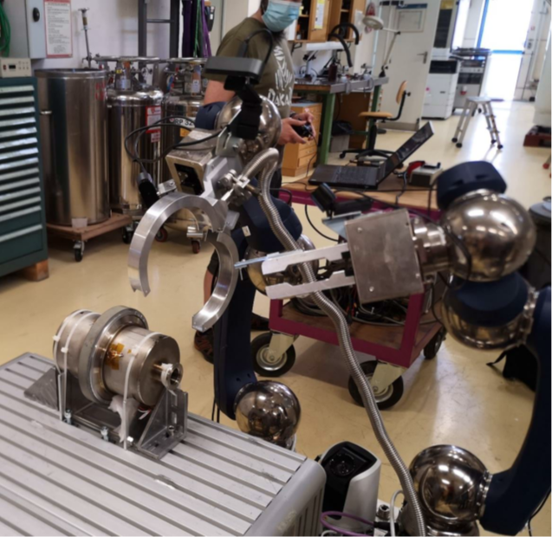
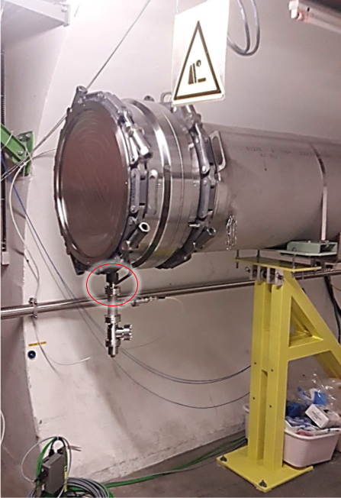
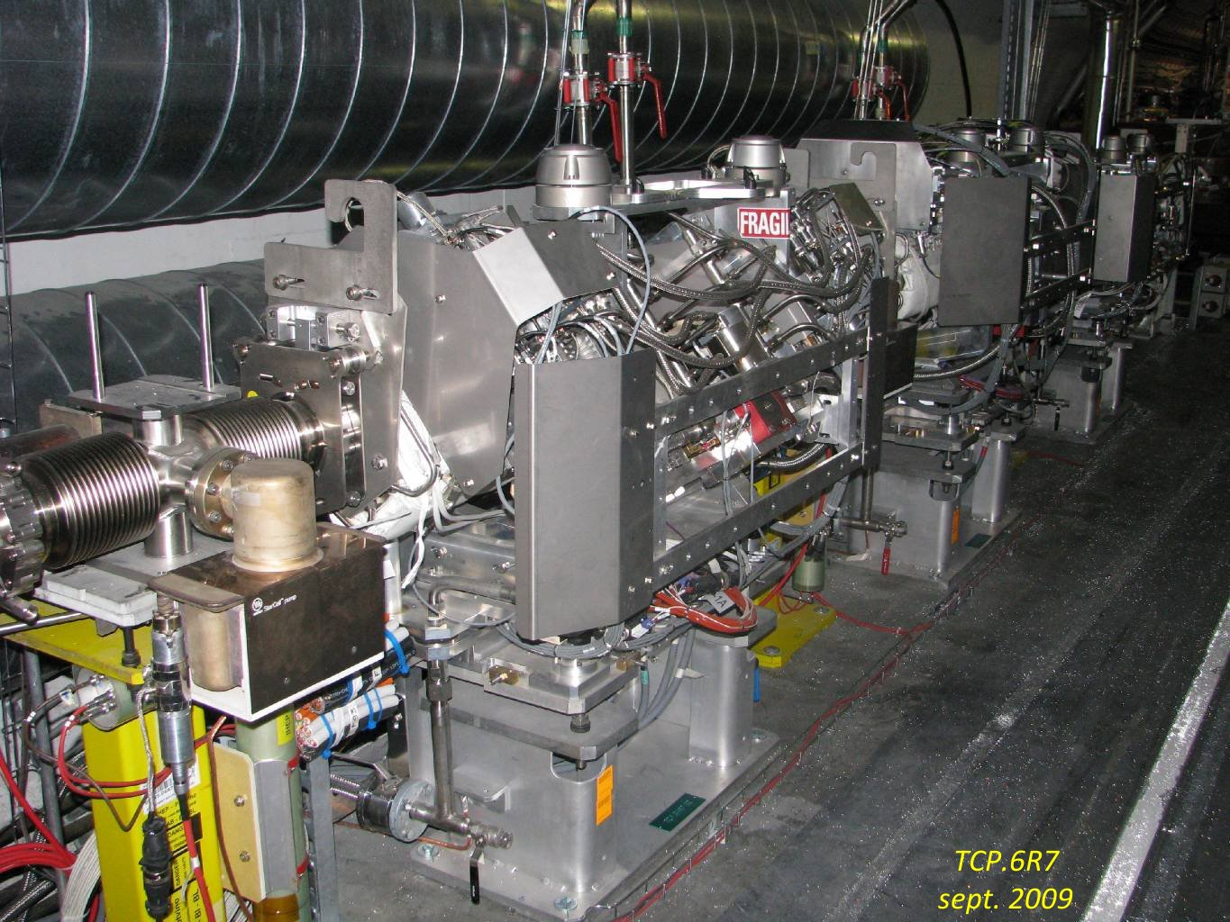
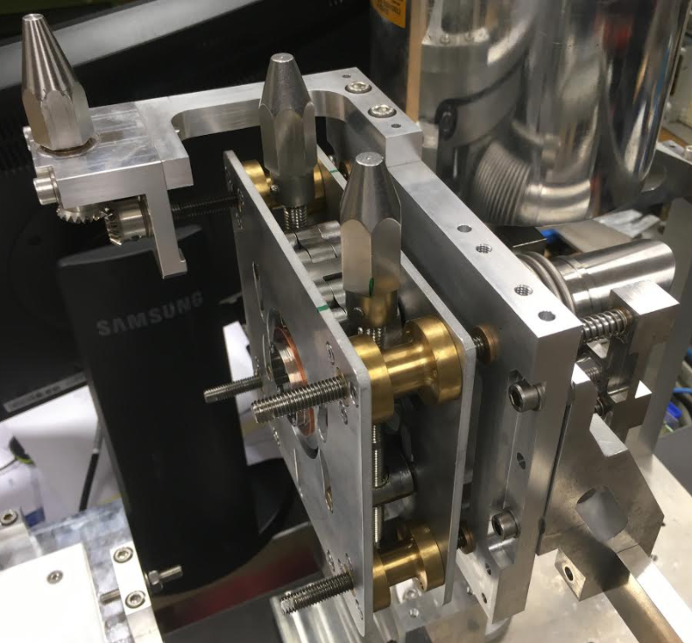
Advantages and potential applications
    A compact, leak tight and easily mountable\dismountable connection system, compatible with accelerator environment:
      Magnetic permeability < 1.002
      Thermal outgassing < 10⁻¹³ mbar.l⁻¹.s⁻¹.cm⁻²
      Radiation hard (up to 4 MGy at least)
    Possibility of remote controlling\activation
    Possibility to connect dissimilar materials
    Possibility to use in high demanding areas (e.g. collimator areas, machine/detector interface)
LHC collimators
Vacuum module for the MDI area
Declamping with a robot
LHC dump windows

Slide 10
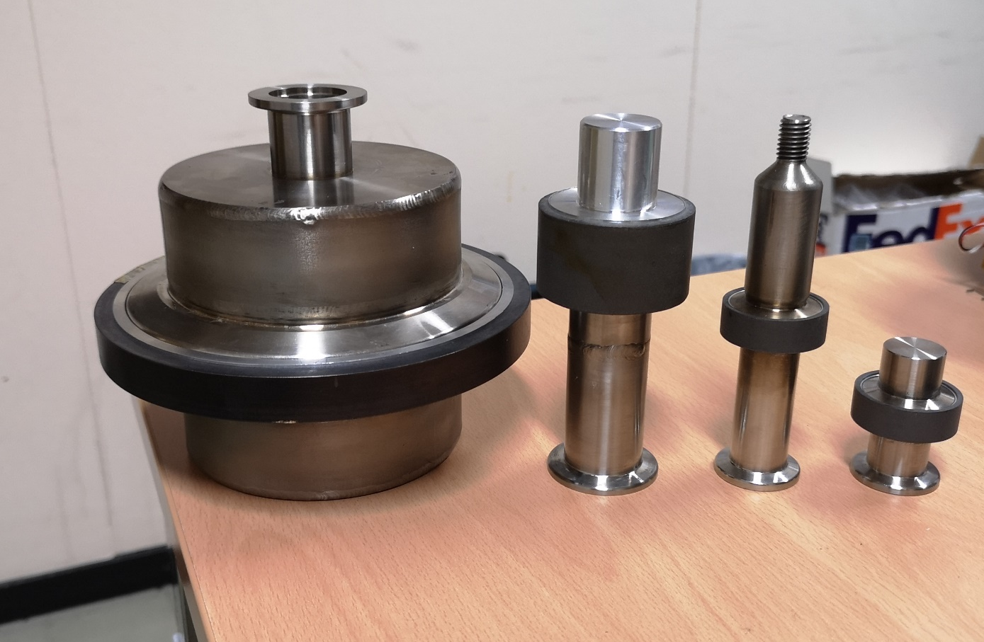
SMA-based UHV prototype joints validated
Compatibility with various pipe geometries (DN16, DN25, DN50, DN100) and metals (steel, aluminum, copper, etc.)
Bimetallic joints (St/Ti,St/Alu)
Zero - longitudinal gap connection
φ134
φ30
Examples of different validated SMA connectors

Slide 11
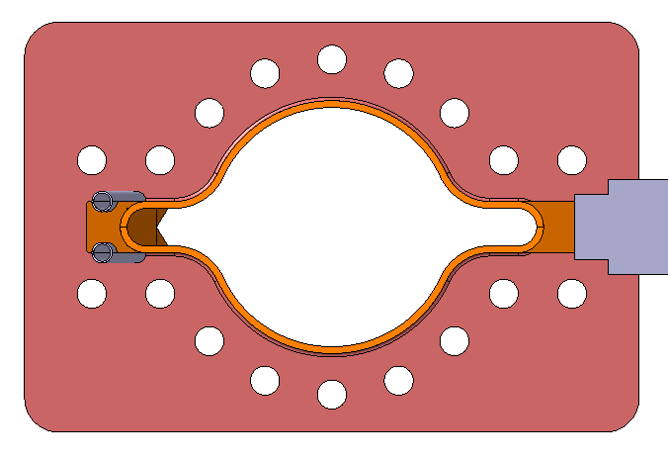
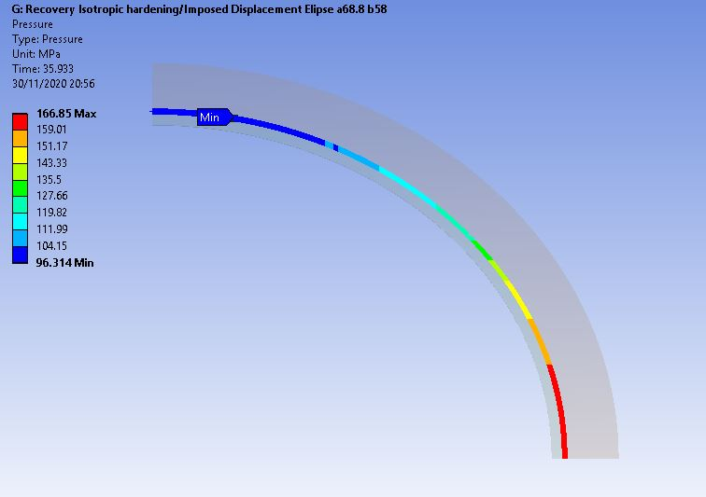
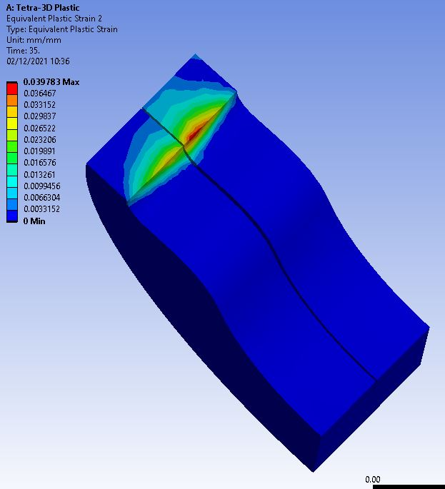
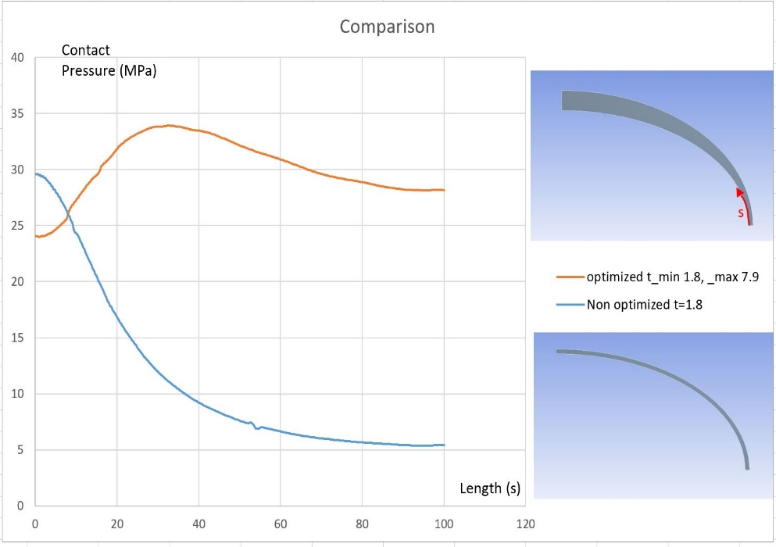
Oval-shaped connectors for FCC-ee chamber interconnections
Preliminary analytical calculations and FE simulations
122
Preliminary elliptic profile for SMA connector compatibility based on existing DN100 QCF.
145
Replacement of bolted flanges by SMA connectors
Typical expected space in the interconnection
SMA connector
Challenges:
Non Uniform contact pressure
Training of Oval SMA rings
Rigid oval chamber
Simulations of contact pressure
Plastic strain in the flange

Slide 12
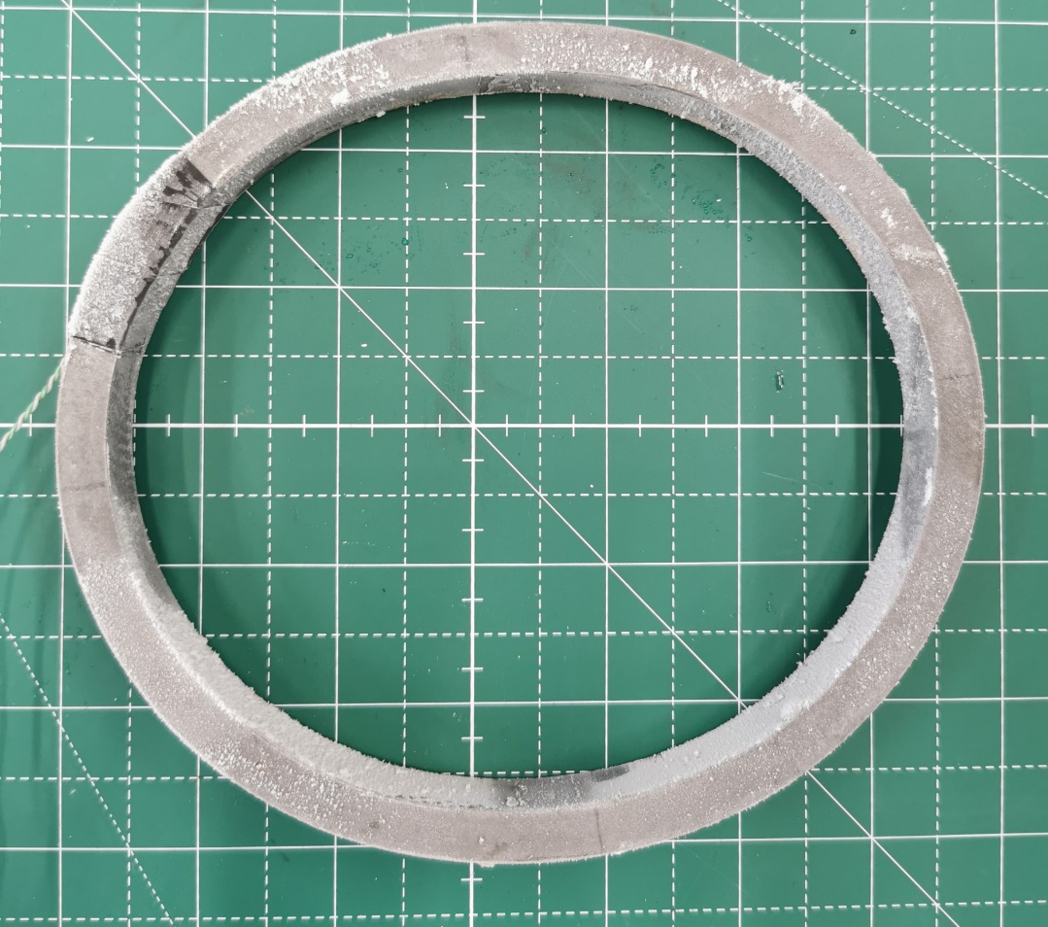
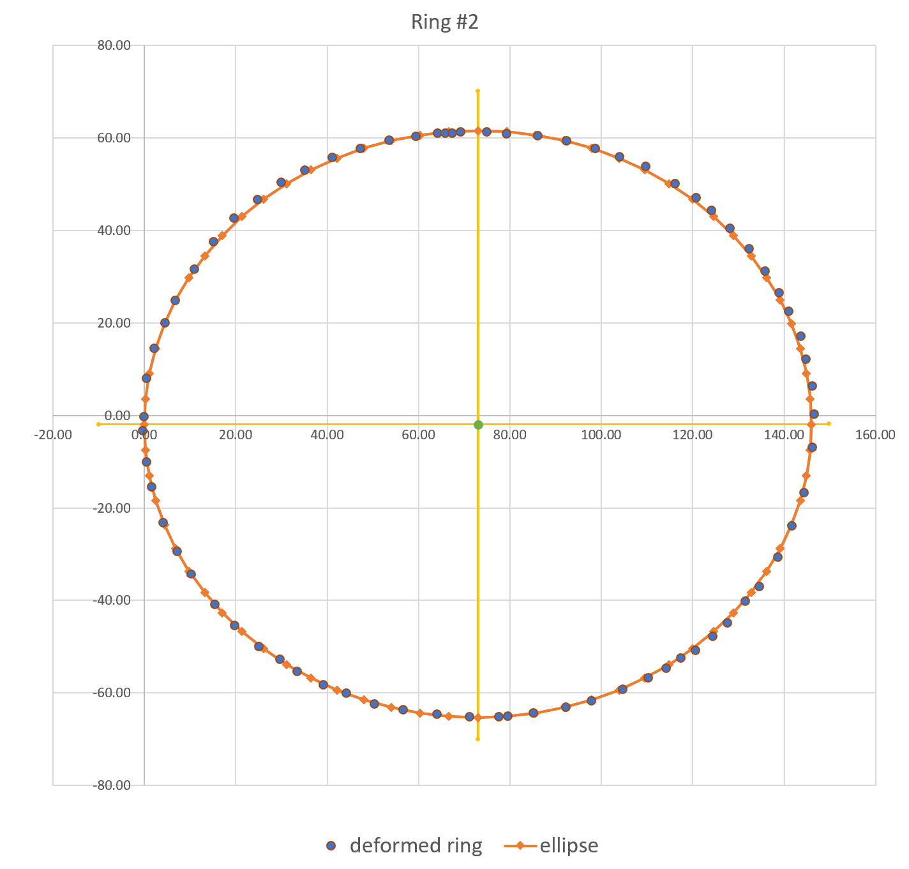
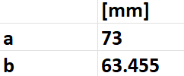
Training setup for oval-shaped connectors
Design, Simulations and Manufacturing
b
a
Trained ring after ovalisation
Next steps:
  Future tests
    Recovery stress test (contact pressure measurement)
    Repeatability of training
  Optimisation of the ring/flange and training

Slide 13
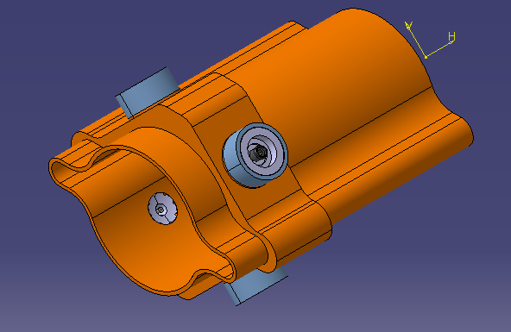
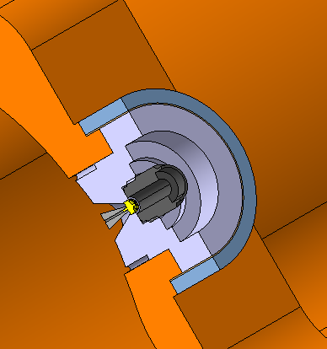
Circular connectors for FCC-ee chamber/BPM button
Preliminary considerations
SMA connectors could be advantageously used to integrate the BPM pickup to the vacuum chamber :
More compact than DN16 CF flange.
Easier to assemble.
Transition with copper (no brazing) → cheaper.
Design update of the FCC-ee BPM block on the vacuum chamber, incorporating the proposed equipment (BPM design given CERN/SY/BI for illustration)

Slide 14
Principle of Cold Spray
The gas dynamic cold spray coating is based on the projection of solid powder at high velocity.
Substrate
De Laval Nozzle
Compressed gas
Powder feeder
A compressed gas is heated before entering in a DeLaval Nozzle.
The gas is accelerated in the nozzle.
Powder is injected in the gas stream and accelerated as well.
The powder reaches velocity up to 1200 m/s.
The powder is plastically deformed and the coating is building up.

Slide 15
Cold Spray Advantages and Limitations
Advantages:
No powder melting.
  No phase change.
  No grain growth.
  Low heating of the substrate.
No significant impact on the oxide content w.r.t. initial material.
Powder mixture possible.
Compressive residual stress (fatigue life increase).
Nozzle geometry can be tuned for a given jet size.
Thick coating.
High deposition rate.
Limitations:
One constituent has to be ductile.
Accessibility to the surface to be coated.
Possible applications:
Additive manufacturing
Coating (surface or local coating, metallization of polymer)
Metallization of
New materials (composite material)

Slide 16
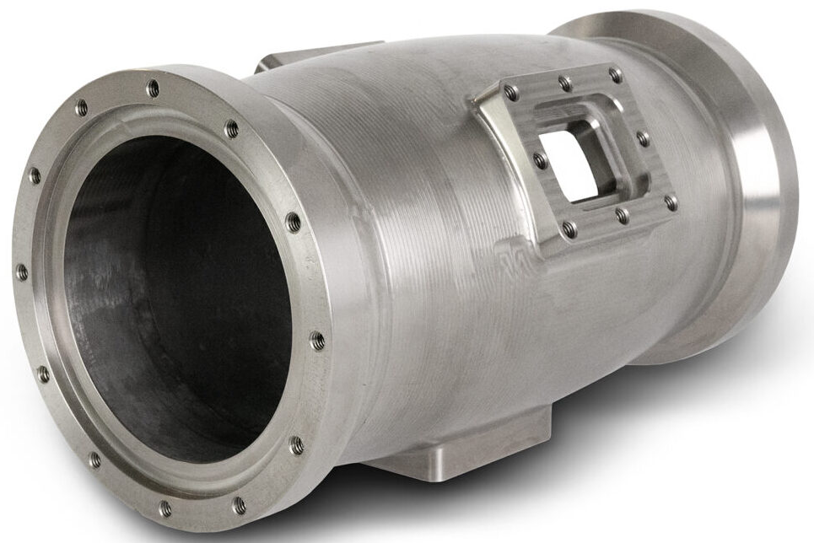
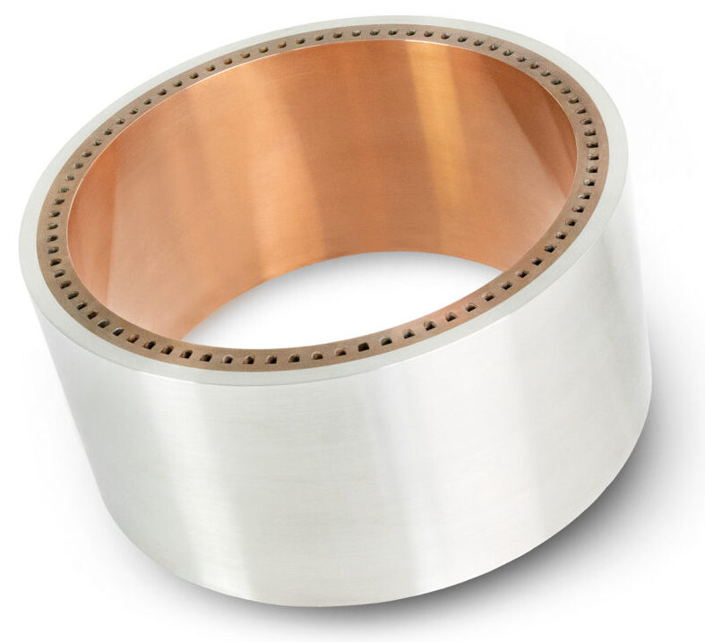
New Manufacturing Process
Additive manufacturing for:
Manufacturing of components of potentially dissimilar materials
Joining of dissimilar materials
New feature
Repair
Local reinforcement of thin walled structure
Impact Innovations website
J. Villafuerte, ADVANCED MATERIALS & PROCESSES, 2014
FCC-ee quadrupole chamber with BPM

Slide 17
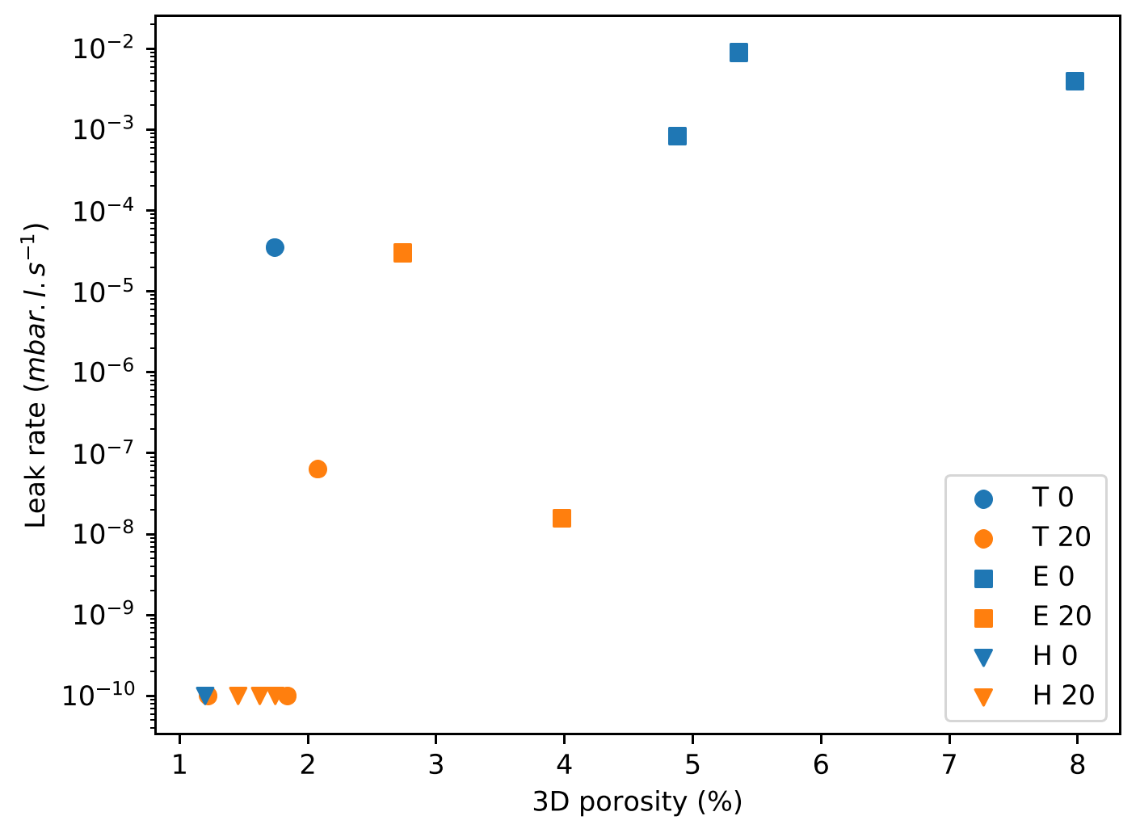
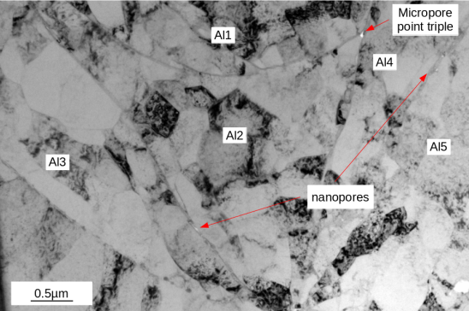
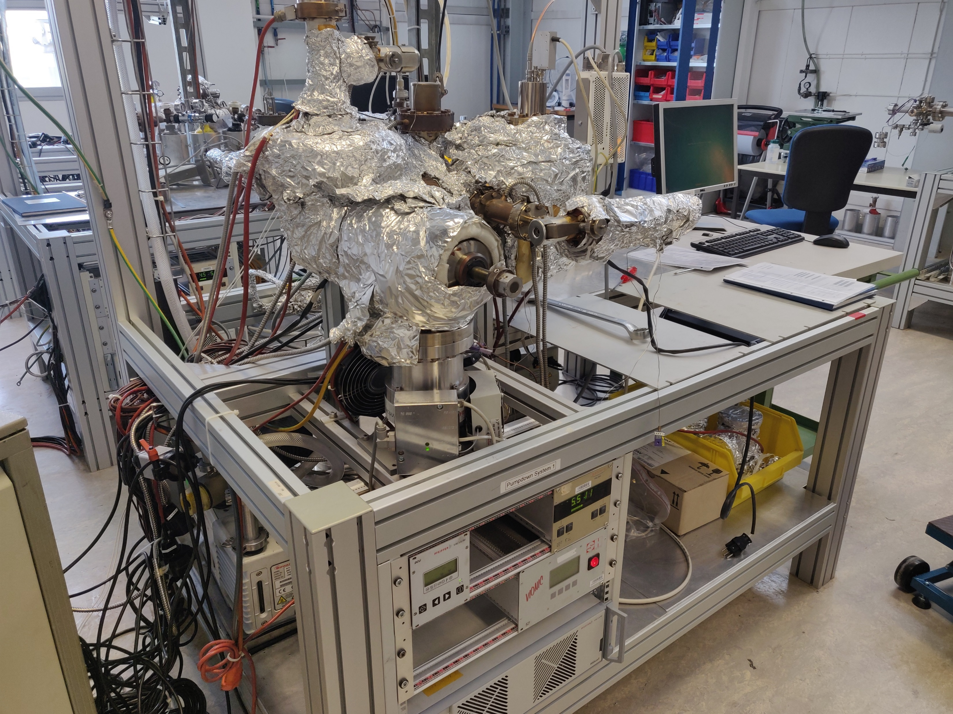
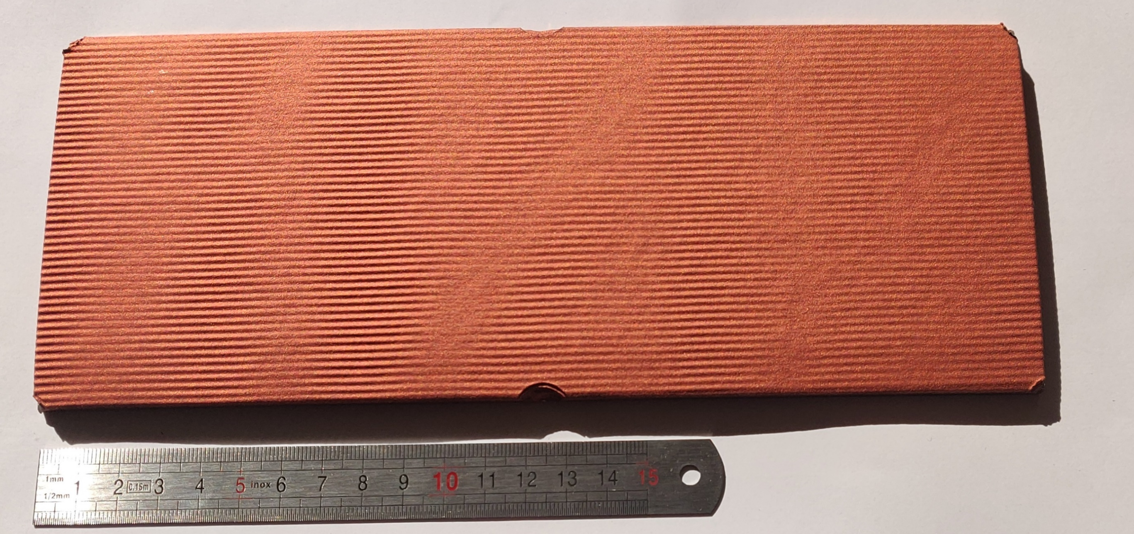
Suitability of cold spray additive manufacturing for UHV applications?
Leak tightness of cold sprayed additive materials:
A previous study on aluminium coating has shown [1]:
Helium leak tight coatings are achievable.
The presence and the role of microporosities formed during the process.
The influence of powder morphology on the porosity formation.
Influence of porosity on leak tightness for different powders and process parameters [1]
Porosity formation in cold sprayed aluminium [1]
Preliminary tests on copper are in preparation:
Copper-to-Copper Cold-Spray samples manufactured
Test bench for thermal outgassing fully refurbished
Tooling for leak tightness test available
Samples for leak tightness and thermal outgassing tests
Test bench for thermal outgassing measurement by accumulation of baked samples
[1] Etude de la relation entre porosité et étanchéité à l'ultra-vide de dépôts à base d'aluminium obtenus par projection dynamique par gaz froid ("cold spray"), Sébastien Weiller: http://www.theses.fr/2021UPSLM004

Slide 18
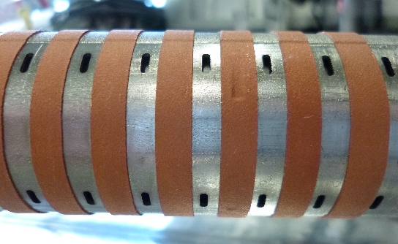
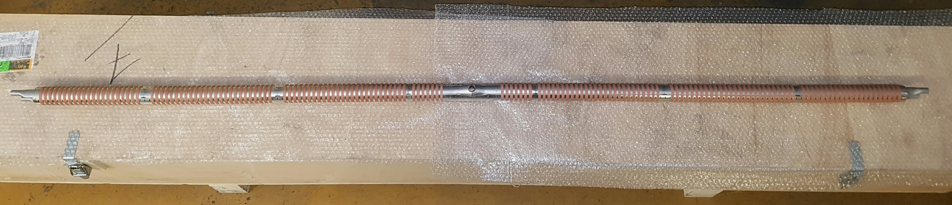
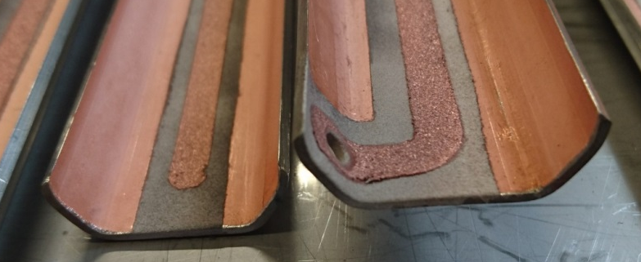
A technology successfully applied in Accelerators
Local coating:
Heat transfer:
Copper trips on FCC-hh beam screen prototype.
Electrode:
Measurement of electrons for the FCC-hh beam screen prototype experiment at ANKA.
Clearing electrode (optimisation of ceramic layer required for non-baked system).
Copper and aluminium cold spray coating on ceramic insulated copper coated stainless steel sheet

Slide 19
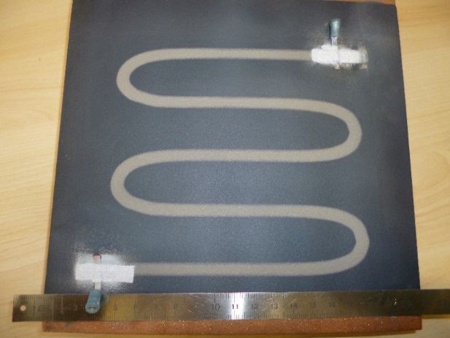
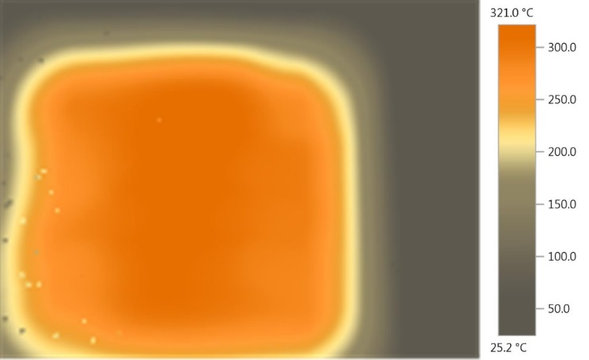
Possible Applications in Accelerators
Local coating:
Permanent radiation hard heating element for bake out (in or outside vacuum)
Protective layer
Ceramic
Cold sprayed resistive track
Ceramic
Substrate
Insulating layer
Copper plate with plasma sprayed ceramic and 0.2 mm thick cold sprayed titanium heating track
Measurement of the temperature field

Slide 20
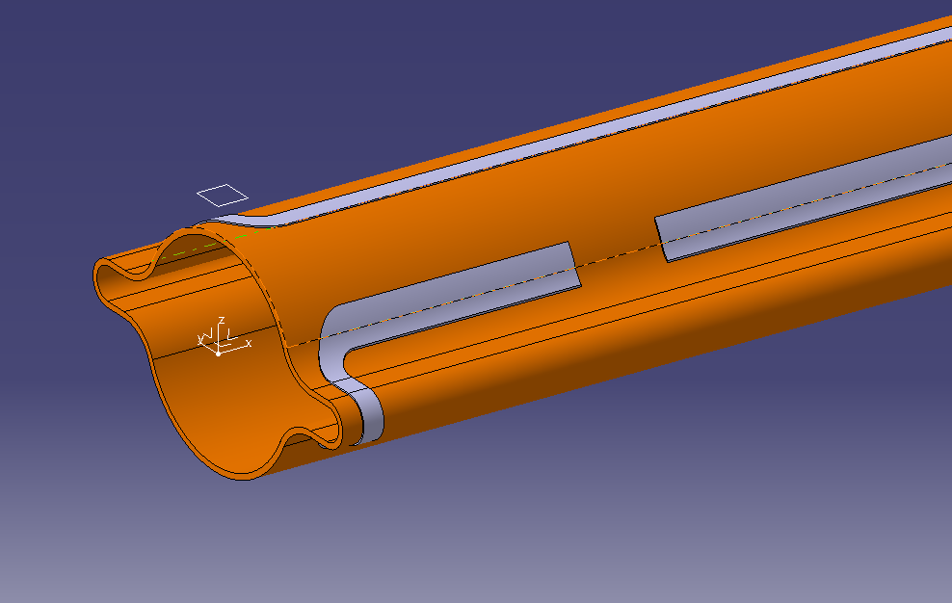
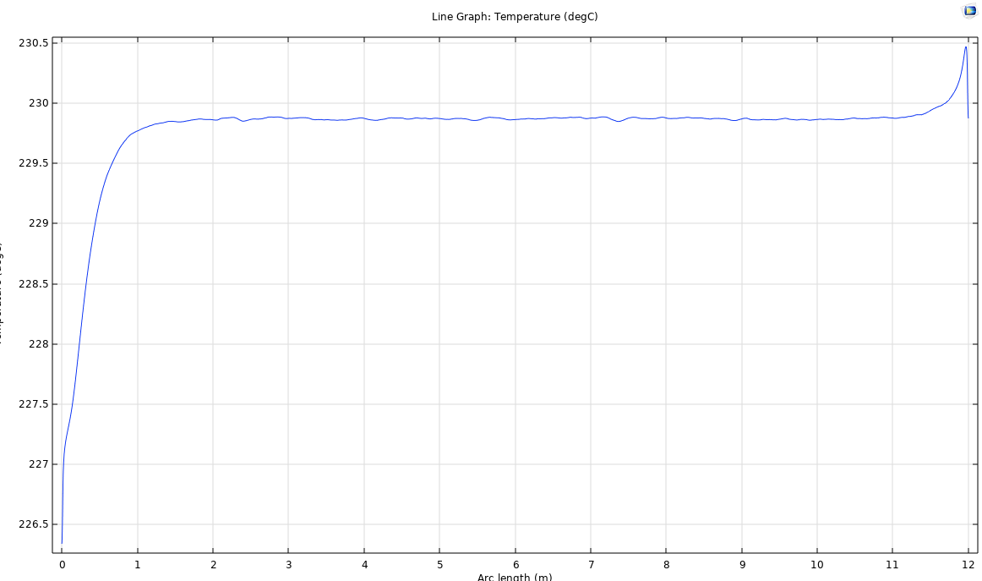
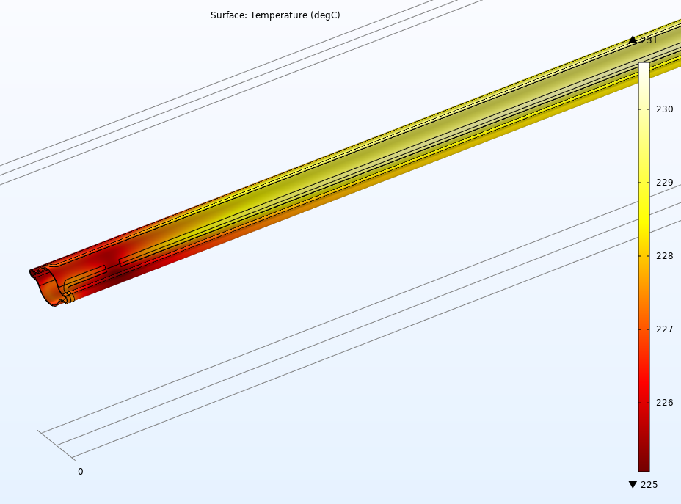
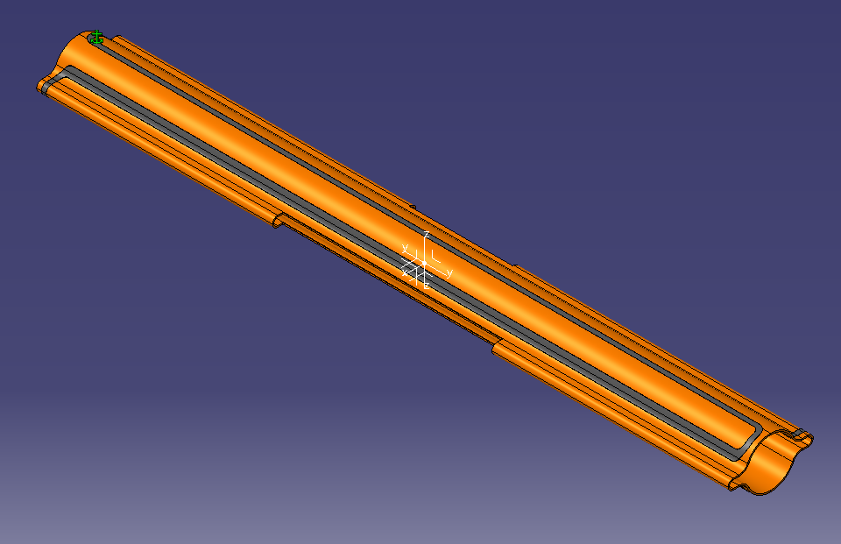
Possible Applications in Accelerators
Local coating:
Permanent radiation hard heating element for bake out (in or outside vacuum)
Copper Chamber
231
Titanium heating track
Connectors
225
Expected temperature field along the vacuum chamber
Expected temperature profile along the vacuum chamber

Slide 21
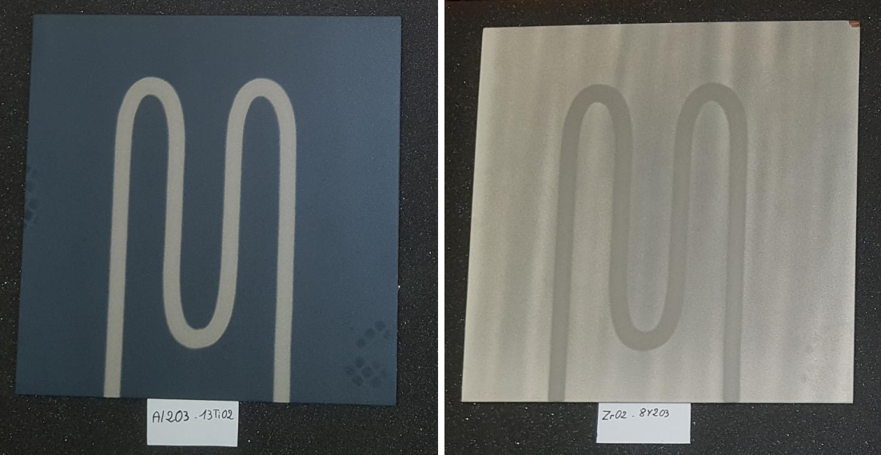
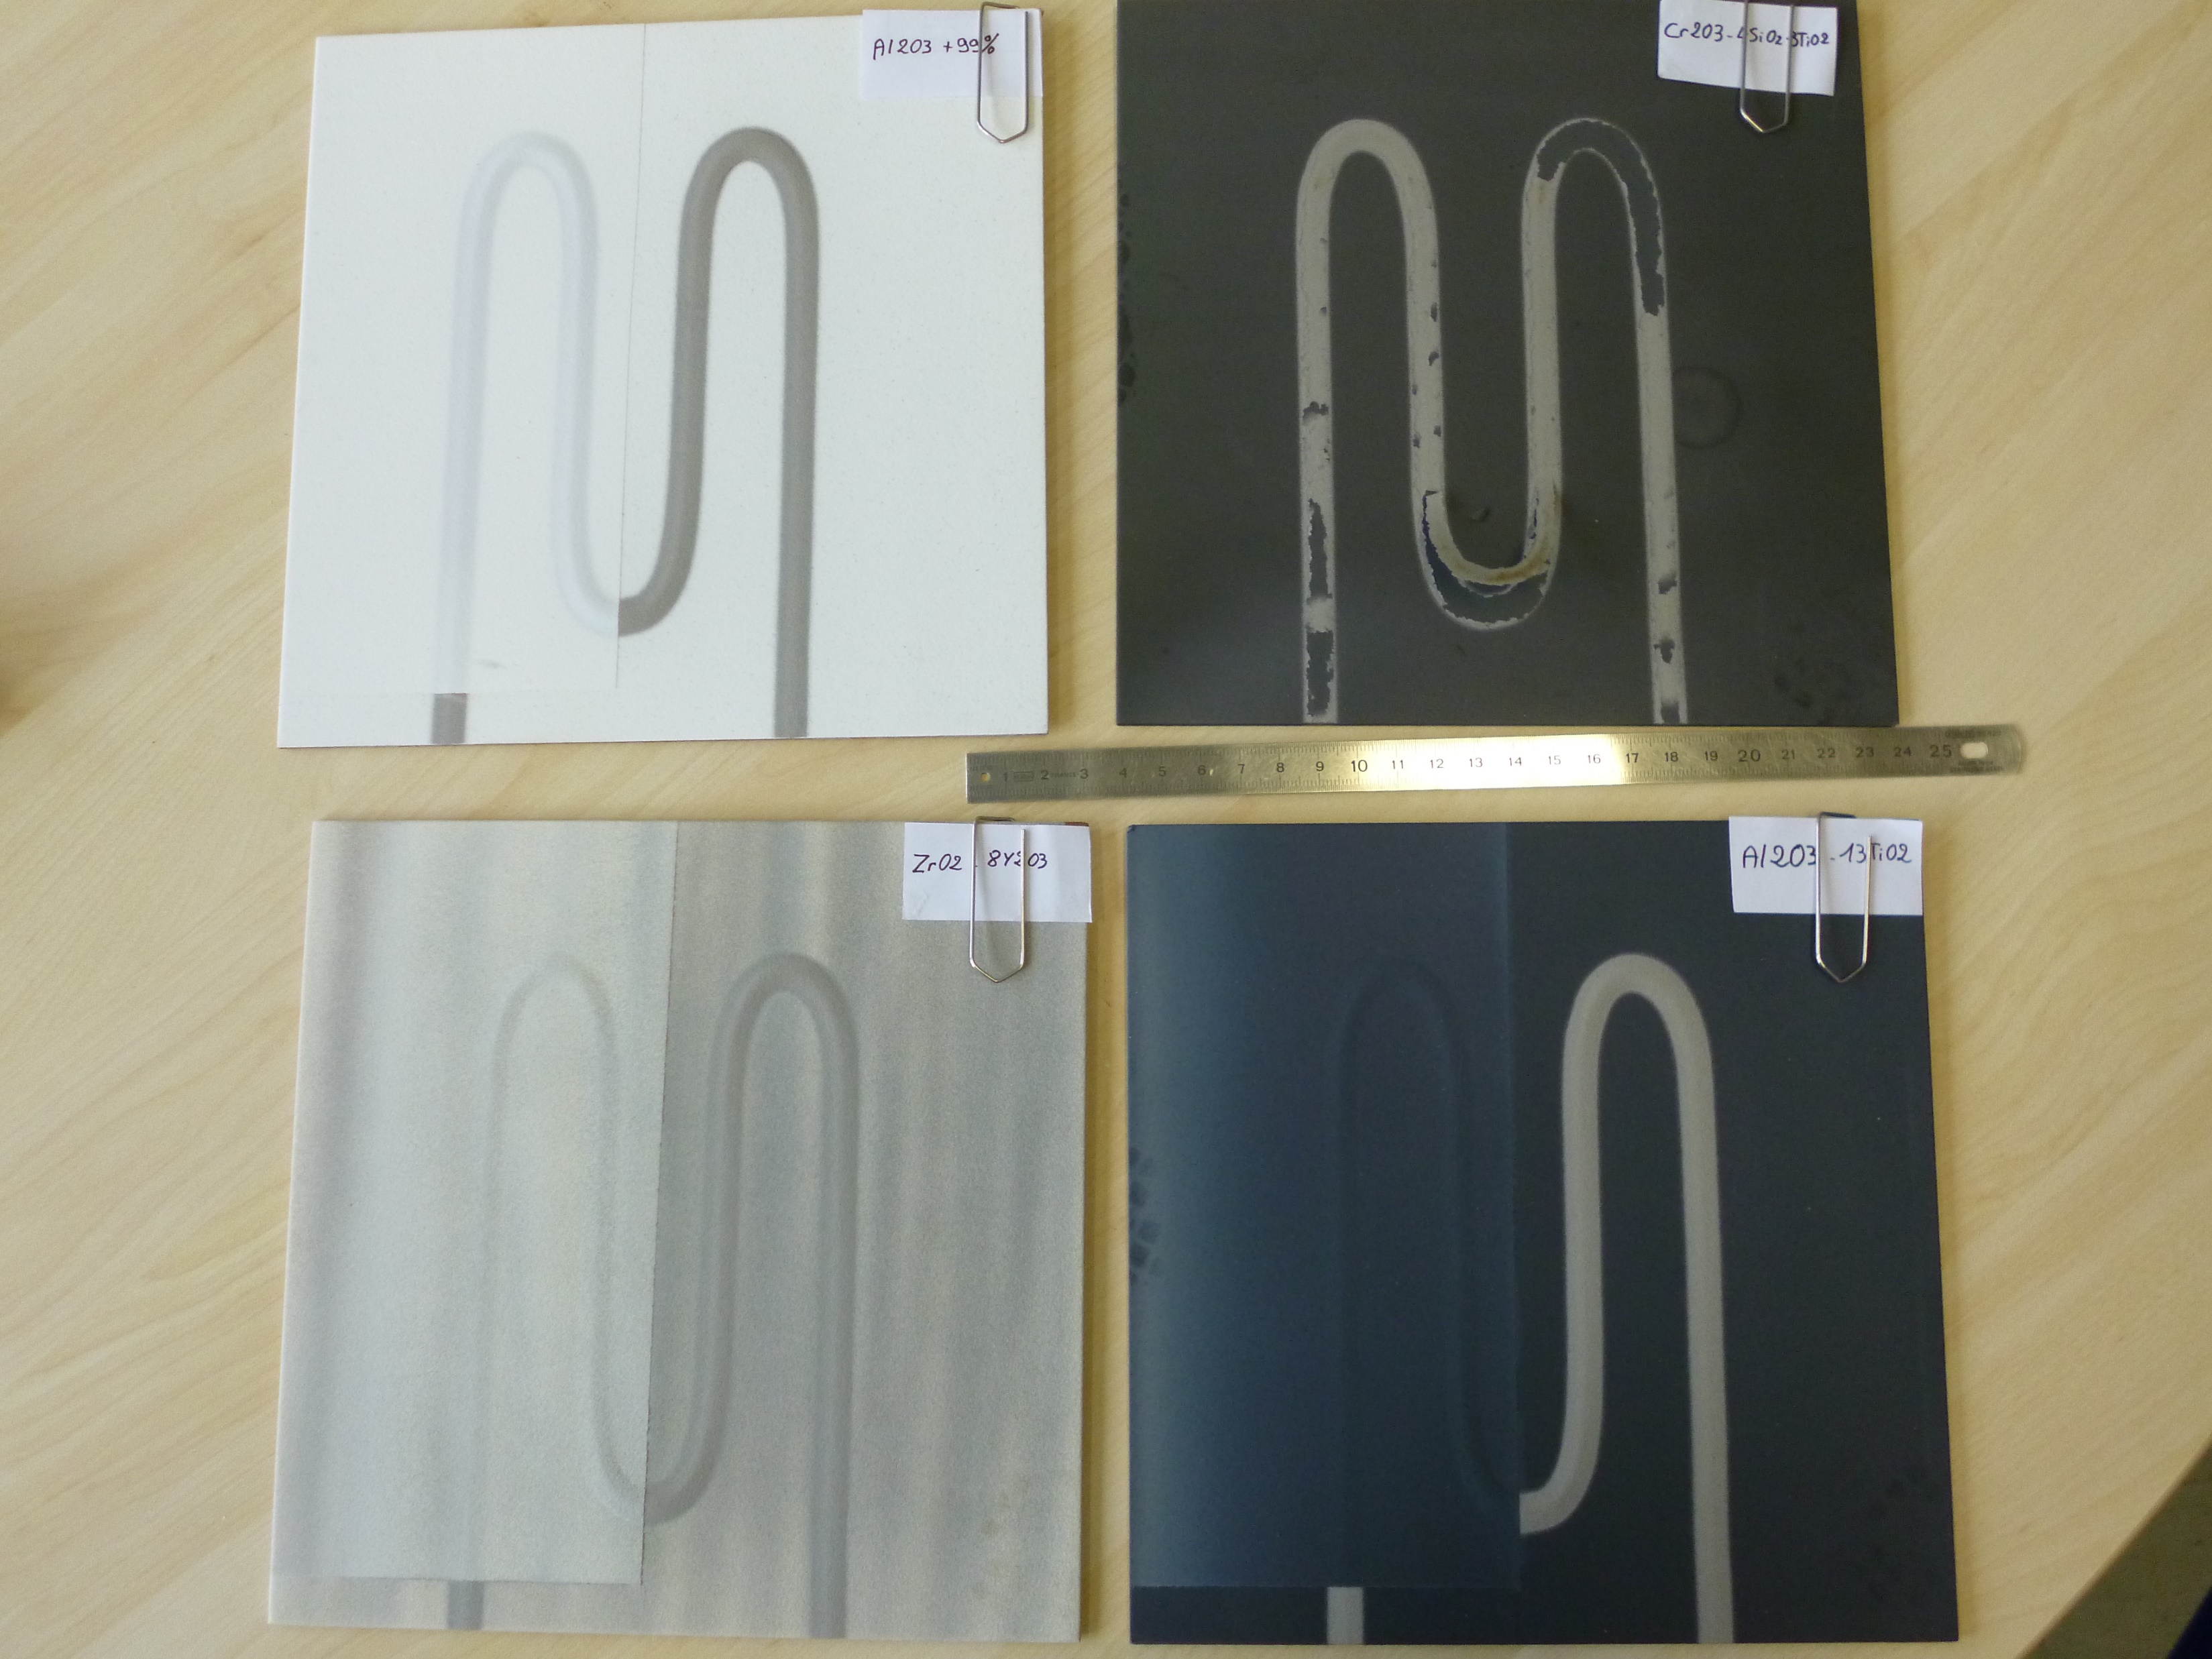
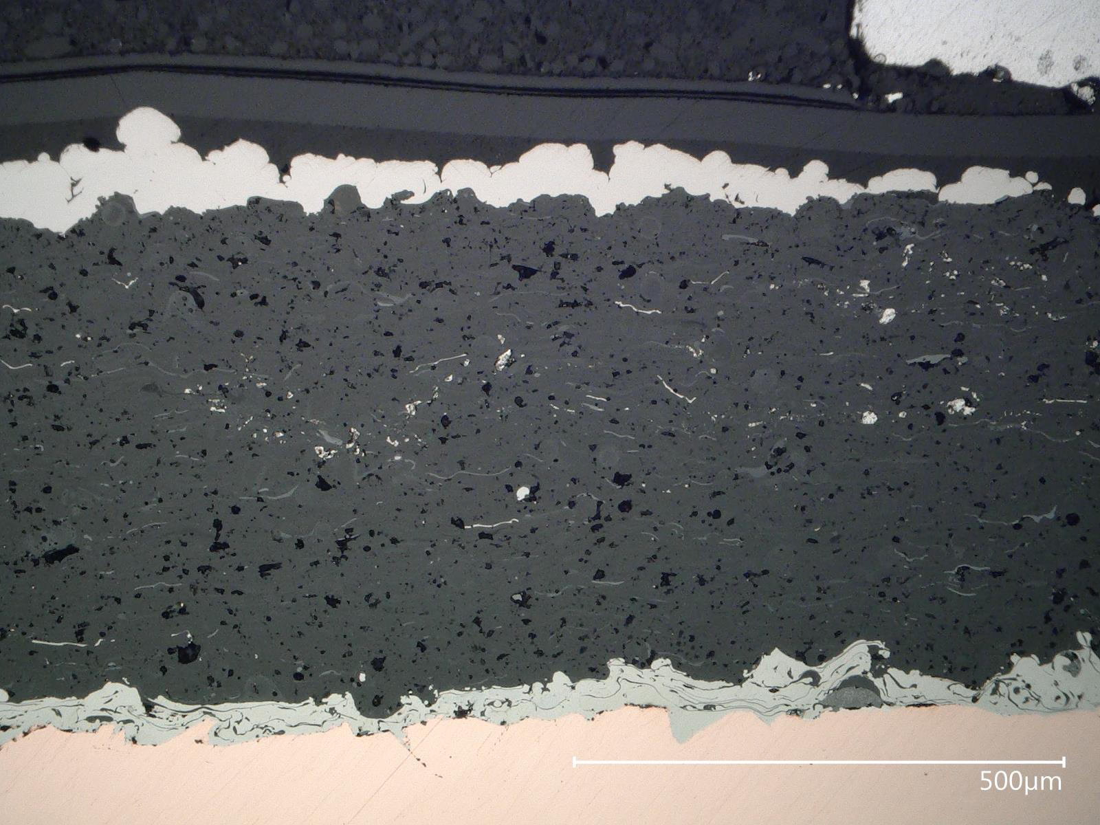
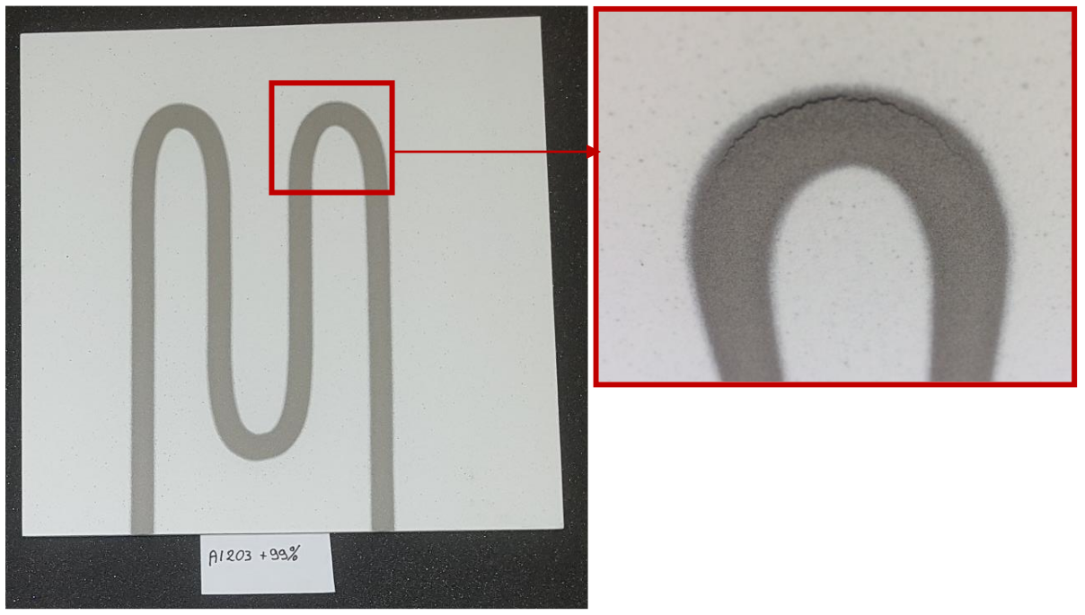
Study of the ceramic layer
Samples with different ceramics, ~ 0.5 mm thick, plasma sprayed on copper plates, have been manufactured:
Al₂O₃ 99%
Al₂O₃ – 13 TiO₂
Cr₂O₃ – 4 SiO₂ – 3 TiO₂
ZrO₂ – 8Y₂O₃
Al2O3+13TiO2
The different ceramic layer revealed different adhesion quality of the Ti track.

Slide 22





Residual stresses
Residual stresses have been assessed by hole drilling method, on the ceramic and on the track.
Comparative strain measurements
Significant difference is observed between the different ceramics.
Al₂O₃-13TiO₂ exhibits the lowest residual stress, in the 10 MPa range.
Strain measurements for Al₂O₃-13TiO₂ ceramic layer
Functional tests have been successfully carried out on the Al₂O₃-13TiO₂ plate, including 50 thermal cycles to 250 °C.

Slide 23





Prototype – Proof of concept
A first prototype of a copper tube with a permanent radiation tolerant bake out system has been produced:
OFE copper tube, 84 mm * 2 mm, 500 mm long
Al₂O₃-TiO₂ ceramic layer
Track in titanium, ~ 110 μm thick, 8 mm width
Distance between the tracks: ~30 mm
Interfaces for the electrical connections
Expected temperature field and profile along the φ80 mm vacuum chamber prototype

Slide 24



Prototype – Proof of concept
Thermal tests:
Low thermal conductance supports
DC current power supply
Electrical connections clamped on the tube
Temperature field
Successful heating to more than 250 °C.
Good temperature homogeneity: +/- 10 °C.
Longitudinal temperature profile

Slide 25



Prototype – Proof of concept
Some further developments are required:
Thickness irregularities have been observed in the corners of the track (different speed of the gun) → cold spots (thicker) and hot spots (thinner).
Better management of the robot displacement required.
Tests of different track U turn paths.
Thickness irregularities
Hot/cold spots induced by thickness irregularities
Measurements of the electrical resistance is not in agreement with expected value → measurement of resistivity of cold sprayed material ongoing.
Electrical connections to be defined for a safe operation.

Slide 26



Prototyping phase
Different technologies are being assessed, on small samples, independently and in parallel:
SMA connectors
Copper cold spray additive manufacturing
Radiation hard permanent bake out system
Friction stir welding
In parallel:
Design of lump absorbers: thermal mechanical study, water cooling, assembly to the vacuum chamber.
Water channel:
300 mm
700 mm
170 mm
3.8 W power transmitted in the air (over 700 mm)
Heat deposition of ~4kW per absorber
Typical expected temperature profile

Slide 27
Prototyping phase
In parallel:
Alternative designs and manufacturing processes will be explored to take into account, in particular, the design and integration of the synchrotron radiation absorbers.
Discussions about the vacuum system integration, in particular in the magnets, just started. Significant changes, i.e. interbeam distance, length of interconnections with shielded bellows, might be required.
In a second step, the technologies will be applied for the manufacturing of a representative short vacuum chamber prototype:
~ 2 m
Based on copper extrusion and lump absorber
Early 2023

Slide 28
Conclusion
In a desire to propose cost-effective technical solutions for the FCC-ee vacuum system, the CERN vacuum group has undertaken a series of developments in UHV technologies:
SMA connectors is a mature technology for UHV applications. Implementation study to FCC-ee has been initiated as well as the verification of its suitability to respond to the FCC-ee particularities.
Radiation hard permanent bake out system is under development. Good progress has been done so far: proof of concept test has been successfully carried out.
Additive manufacturing of copper by cold spray is in a first exploratory phase.
Further activities are initiated and will be reinforced in the near future:
Lumped absorber: thermal mechanical design, integration study and prototyping.
Interconnection: Some conceptual designs available. Technical design to be done.
Vacuum chamber prototype manufacturing.
The development of the FCC-ee vacuum system and the related technologies started but requires significant efforts.

Slide 29
Thanks for your attention.
Thanks to the vacuum team, in particular Christian Duclos, Roberto Kersevan, Hendrik Kos, Marco Morrone, Fabrizio Niccoli and last but not least Samuel Rorison.

Slide 30





Principle of Cold Spray
1D isentropic flow equations:
De Laval Nozzle
P₁, v₁, T₁,
A₁
P₀, v₀, T₀
A*
$$\frac{P_{0}}{P_{1}}={\left(1+\frac{γ−1}{2}M_{1}^{2}\right)}^{\frac{γ}{γ−1}}$$
$$\frac{T_{0}}{T_{1}}=1+\frac{γ−1}{2}M_{1}^{2}$$
$$M_{1}=\frac{v_{1}}{c_{1}}=\frac{v_{1}}{\sqrt{γR_{s}T_{1}}}$$
$$\frac{A_{1}}{A^{∗}}=\frac{1}{M_{1}}{\left[\frac{2}{γ+1}\left(1+\frac{γ−1}{2}M_{1}^{2}\right)\right]}^{\frac{γ+1}{2\left(γ−1\right)}}$$
$$γ=\frac{c_{p}}{c_{v}}$$
γ=5/3 (1.67) for monoatomic perfect gas
γ=7/5 (1.4) for diatomic perfect gas and
γ=1,33 for polyatomic perfect gas
R_{s} is the specific gas constant given by R/M_{molar}
Nitrogen is commonly used. Helium is used to reach higher velocity.
Notes:
P0 ~30 – 50 bars
T0 : 300 C

Slide 31
Bounding mechanism
Copper on copper
Rebound zone
T. Schmidt et al., From Particle Acceleration to Impact and Bonding in Cold Spraying, Journal of Thermal Spray Technology, 18, 5-6, 794-808, 2009
Typical surface around the critical velocity
A1050 powder on 2024-T3 substrate
Material jet
Q. Blochet, Influence of substrate surface roughness on cold-sprayed coating-substrate bond strength in aluminum-based systems, PhD Thesis, Mines ParisTech, 2015
Assadi et al., Bonding mechanism in cold gas spraying, Acta Materialia, 51, 4379-4394, 2003
Notes:
Adiabatic shear instability

Slide 32
Some properties: example of copper
Electrical conductivity
Bounding strength
With helium
With nitrogen
T. Stoltenhoff et al., Microstructures and key properties of cold-prayed and thermally sprayed copper coatings, Surface & coatings Technology, 200, 2006
Coating strength
After Jeandin et al., Coating properties in Modern cold spray, Ed. J. Villafuerte, Springer, 2015
N₂
He
C.H. Boyle, Mechanical performance of integrally bounded copper coatings for the long term disposal of used nuclear fuel, Nuclear Engineering and design, 293, 2015
F. Gärtner, Mechanical properties of cold-sprayed and thermally sprayed copper coatings, Surface & Coatings Technology 200, 2006
→ Material properties are affected by the cold spray process but they can significantly be recovered by dedicated post treatment.

Slide 33

Application to FCC
FCC-hh beam screen
Cooling channel
Colaminated copper- stainless steel internal screen
Copper strip for heat transfer
Pumping holes
Requirements:
Copper material (thermal conductivity)
Stainless steel substrate
Discountinuous (longitudinally → reduced Lorentz forces during a magnet quench)
Continuous as close as possible to the cooling channel (better cooling and temperature control)
Done after beam screen assembly (welds)
No spray or coating contamination inside the beam screen
Industrial process

Slide 34


Application to FCC beam screen
Surface preparation by blasting (Al2O3)
Cold sprayed copper on austenitic stainless steel.
Possible improvements:
Surface preparation: laser treatment
Nozzle geometry: correct width
Process parameters

Slide 35



