Slide 1
S.M.Liuzzo, A.Franchi, D.Martin, G.Gatta, et al. , FCC Week, Paris June 2022
ESRF tuning algorithms
History of ESRF tuning → 60μm mag-mag tolerances,
      → simulated survey replace girder-to-girder
→ align on existing survey
New tuning techniques tests → NOECO (Non-linear optics from Off-Energy Closed Orbit
FCC-ee tuning simulations → 10μm no IP , NOECO
Outline Conclusions

Slide 2
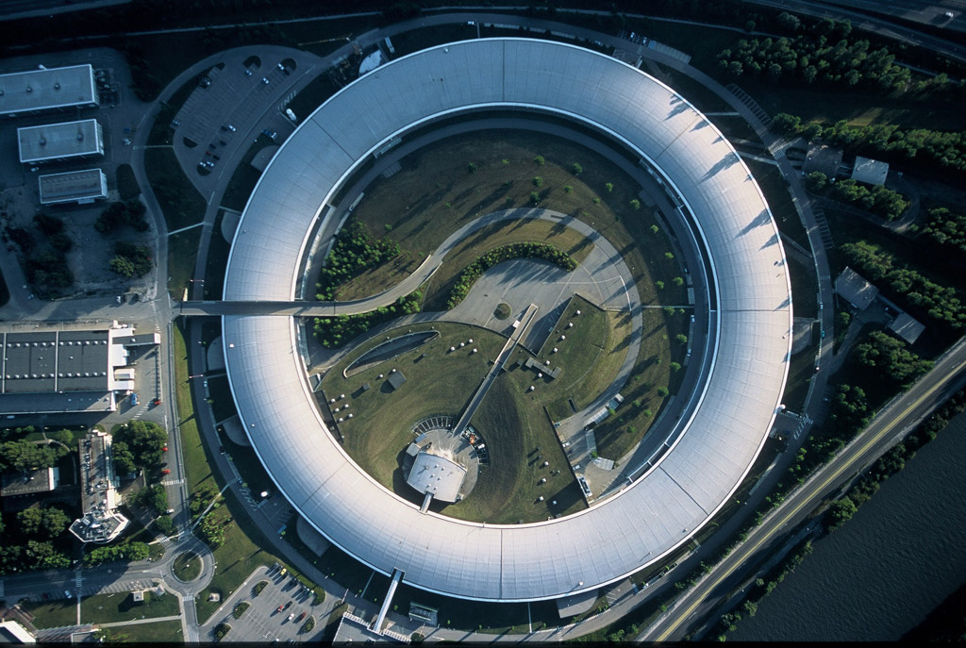
Current ESRF, Accelerator Chain Layout and main parameters
ERSF
Storage ring
C=844 m
E=6 GeV
τ= 5-26 h *
V_{RF}= 6 MV
ε_{x}=134 nm rad
ε_{y}= 10 pm rad
I = 40-200 mA *
(*) according to filling mode
6GeV
1994-2018 and 2019-??
0.2-6GeV
0-200MeV
Compute error tolerances for the SR upgrade

Slide 3
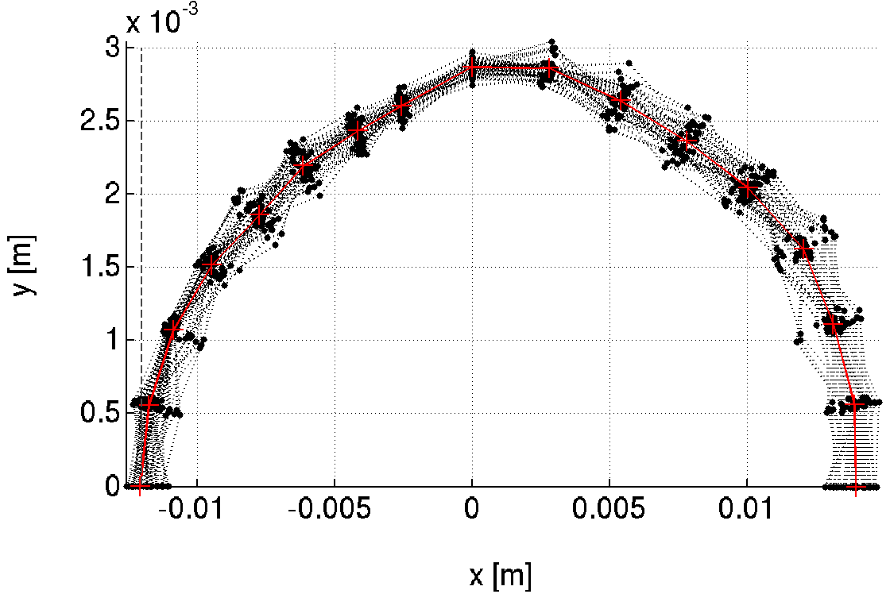
Tolerance estimates objective
Septum
2 main parameters to achieve,
Absolute values depend on facility layout.
TARGET
Injected
beam
-10mm (-8.1mm @INJECTION)
~100% Injection Efficiency
>10h
Touschek Lifetime
@ 200mA uniform, 5pm
Also :
Emittance variation < 2pm
Feasible correction strengths
Orbit < 100um rms
etc…

Slide 4
Outline: 90 DAYS to get stable-STORED-BEAM
From EBS MAC 2017
GUN, LINAC, Transfer Line to Booster
Booster Tr. Line Booster → SR
SR : inject beam
make first turn : lattice steerers, BPM, CT, beam losses ...
few turns -> RF on, beam accumulation (few mA)
orbit, tunes, BPM-QUAD offsets, chromaticity
Response matrix (optics/coupling)
Resonance knobs, sextupoles
specific optics adaptations
beam tuning for users
optimize injection efficiency / lifetime
Wait for vacuum, close collimators
Repeat:
Compute DA, lifetime, injection efficiency, etc…
days 1-30, 2 shifts/day
days 31-60, 2 shifts/day

Slide 5
What is simulated in Commissioning-like beam tuning procedures
0
Assign lattice errors: magnetic centers + alignment survey
Many days to simulate a fraction of the activity to be done in few days only!
Most difficult and neglected
GUN, LINAC, Transfer Line to Booster
Booster Tr. Line Booster → SR
SR : inject beam
make first turn : lattice steerers, BPM, CT, beam losses ...
few turns -> RF on, beam accumulation (few mA)
orbit, tunes, BPM-QUAD offsets, chromaticity
Response matrix (optics/coupling)
Resonance knobs, sextupoles
specific optics adaptations
beam tuning for users
optimize injection efficiency / lifetime
Wait for vacuum, close collimators
Repeat: in an optimal order
Compute DA, lifetime, injection efficiency, etc…
1
2
days 1-30, 2 shifts/day
4
5
3
6
Not included in commissioning-like simulations
dedicated simulations, not included in the loop
days 31-60, 2 shifts/day
6
3
4
5
6
7

Slide 6
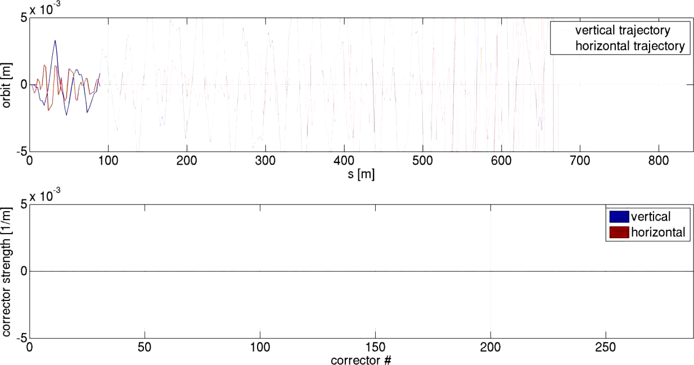
Example of one step of the commissioning-like tuning loop: First Turns (beam threading)
From beam threading till accumulation
Injection on axis (static bump) or off axis (fit injected beam oscillation) available. Start from injection off-axis.
All magnets at their nominal working point
Power orbit steerers to achieve first turn (from simulations, beam survives about 3-4 cells without orbit steering, if magnets & alignment within tolerances).
Measure and correct tune based on few turns data (most relevant for off-axis injection)
Switch on RF, search for optimal frequency and phase
Beam accumulation
Video: first turn correction simulations for beam injected on axis. Large BPM offsets (500μm) are included.
Not included in tuning simulations as it, but could be done. Usually before step 4, AT is able to provide a closed orbit and tunes.
Measurements here:
Preparation of the EBS beam commissioning
S M Liuzzo et al 2019 J. Phys.: Conf. Ser. 1350 012022
Use in commissioning here: https://doi.org/10.1103/PhysRevAccelBeams.24.110701

Slide 7
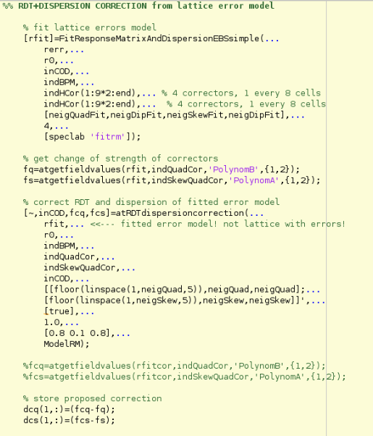
Procedure for optics correction
Commissioning-like sequence of corrections is implemented using matlab accelerator toolbox.
Fit of “measured” partial Orbit Response Matrix (slow)
→ FITTED OPTICS MODEL
Computation of normal and skew quadrupoles RDTs + dispersion and correction
→ Normal and skew quadrupole correction strengths
This is LOCO equivalent (+ RDTs)
Linear problem + generalize potentially different fit and correction locations

Slide 8
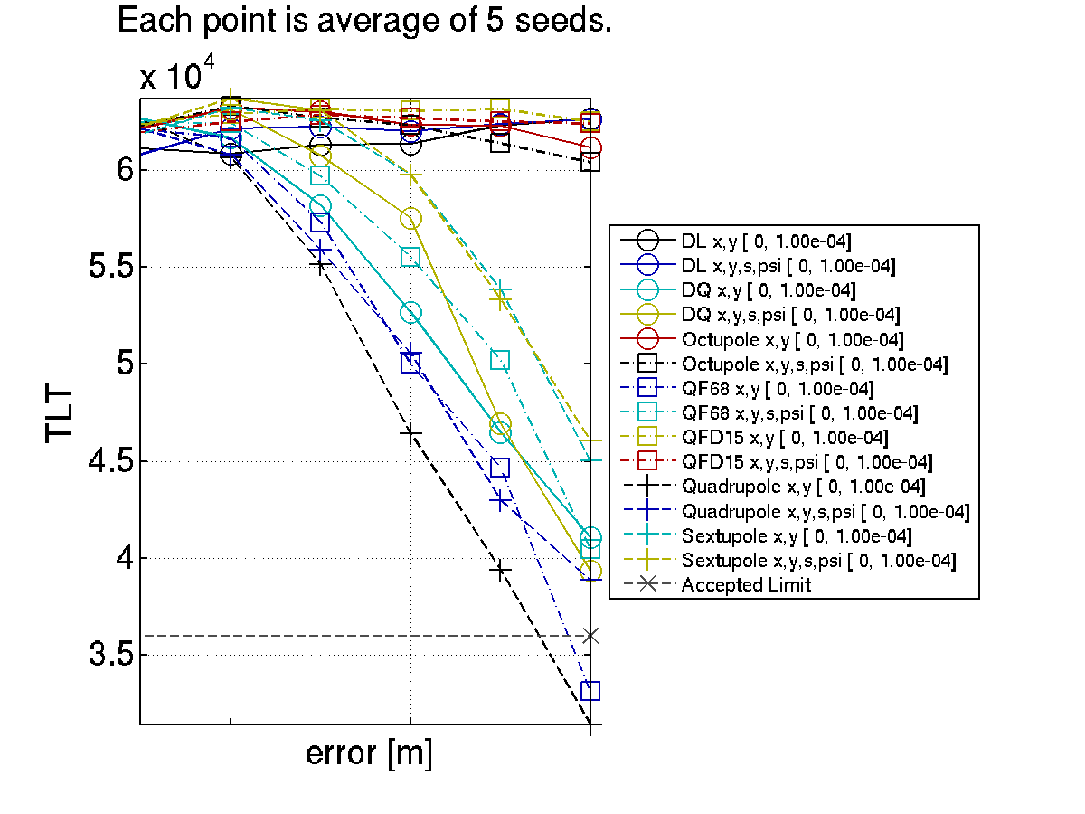
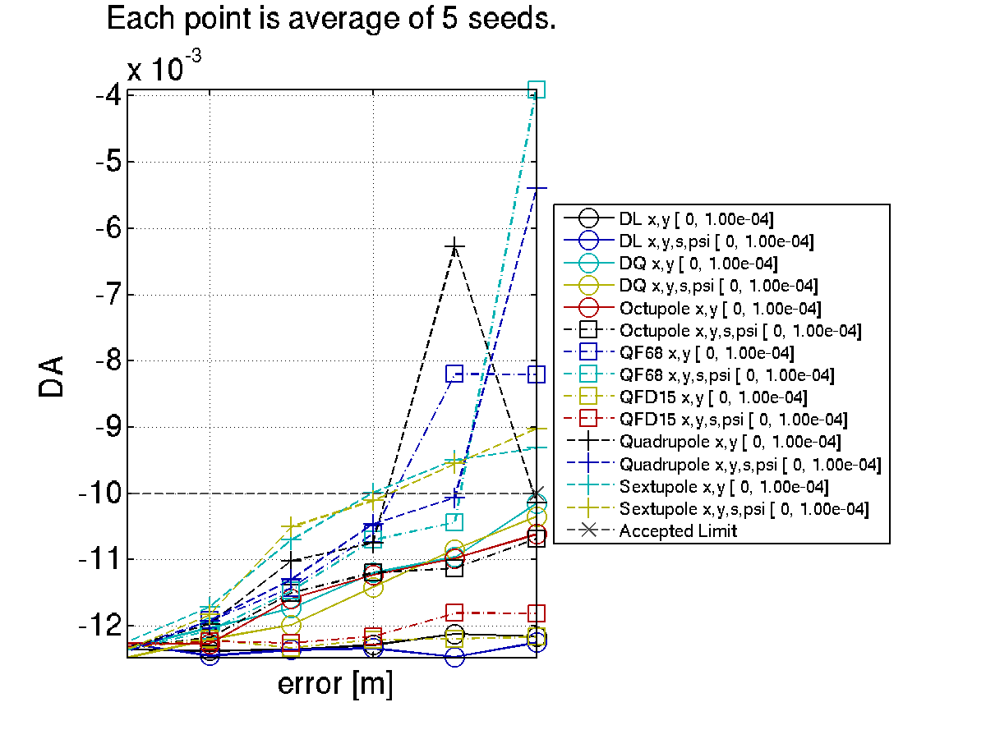
LifEtime and dynamic apertures vs error sources
A CLUSTER is crucial for this analysis. Each error set to analyze requires 1CPUx4h
17h
The line where I should have placed it.
DA=-10mm
Lifetime = 10h
10h
The line where I should have placed it.
Sext. Alignment do more on DA than on TLT ;
Moderate gradient are irrelevant compared to high gradient ;
Etc. etc.
How to determine the ”tolerance” ? ➔ DRAW A LINE (relative impact of each error), RESCALE globally.
CAoPAC Workshop l GSI, Darmstadt 10-13 March 2015 l S.M.Liuzzo

Slide 9
Tolerable random errors
Each error, on each magnet family, is studied individually looking at the dependence of DA, lifetime, emittances and all relevant parameters vs error amplitude.
Required: | DX | DY | DS | DPSI | DK
 | μm | μm | μm | μrad | 10^-4
DL | >100 | >100 | 1000 | 500 | 10
DQ, QF[68] | 70 | 50 | 500 | 200 | 5
Q[DF][1-5] | 100 | 85 | 500 | 500 | 5
SFD | 70 | 50 | 500 | 1000 | 35
OF | 100 | 100 | 500 | 1000
This table represents only magnetic centers errors.
No alignment survey errors.
Sextupoles and high gradient quadrupoles are the most relevant limitations, nevertheless, this alignment specifications are currently achievable.
(DX=DY=60μm, 84 μm between two magnets).

Slide 10
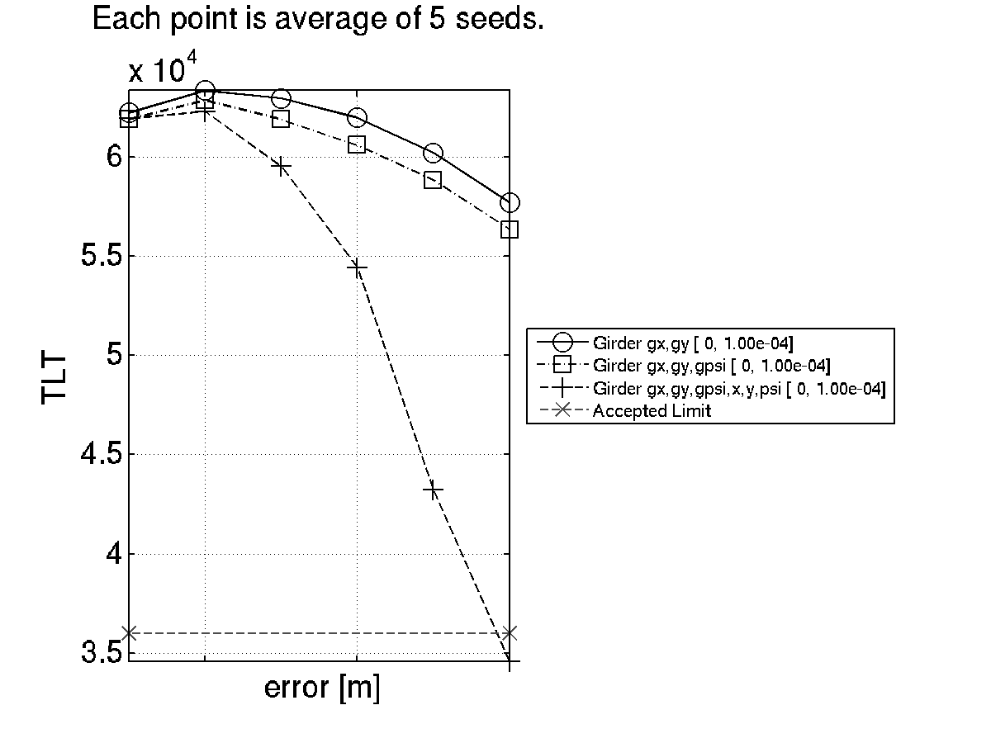
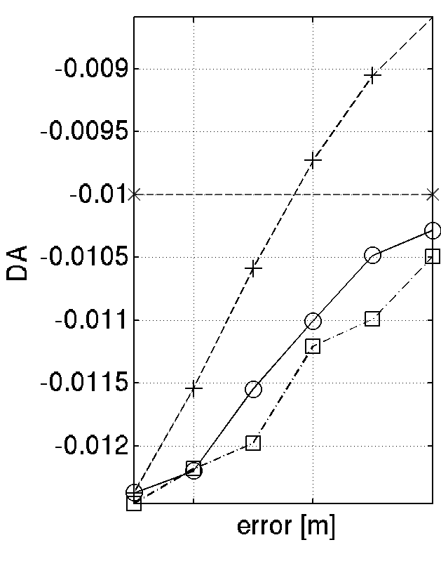
Alignment survey errors, option 1 (the old school): Girder Errors
Hor. DA @ QFI, X0.81 to scale at S3,
8mm required at S3, 10mm accepted at QFI
Girders+Magnets
17h
girders
BAD
Girders+Magnets
In terms of DA girders and magnet alignment approx. sum up. In terms of lifetime, magnets+girder have a stronger impact.
Girders only
(g) Stands for girder errors,
no (g), are quadrupole and sextupole individual misalignments
10h
GOOD

Slide 11
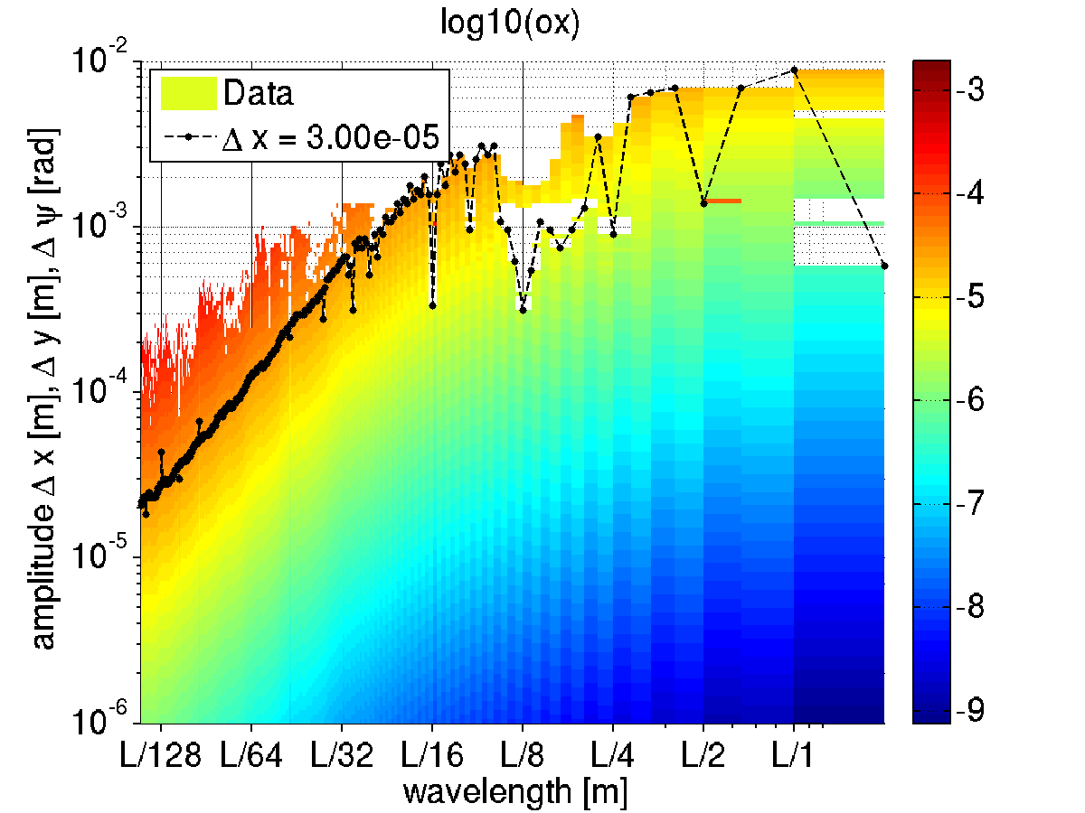
Alignment survey errors, option 2 (the long one): long range error waves
Impact of error “waves” on horizontal orbit
At a wavelength of L/128~6m
30um errors amplitude give
30 um residual orbit distortion.
At a wavelength of L/2~422m
7mm errors amplitude give
30 um residual orbit distortion.
SLOW, LARGE VARIATIONS HAVE LIMITED IMPACT ON THE OPTICS
26/07/2013

Slide 12
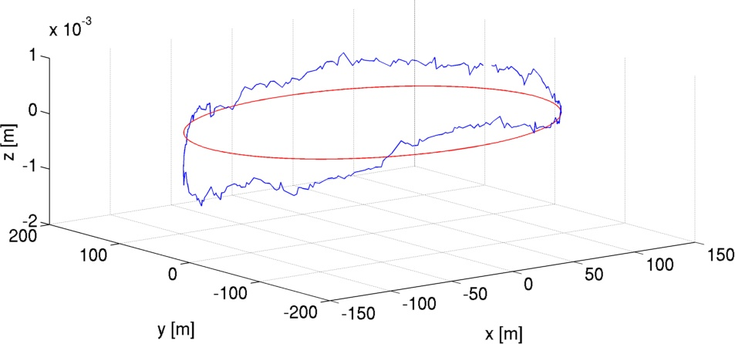
The measured position of the lattice
This is where the machine is. Let’s use this information!
nominal
current
ESRF 1994-2018
EBS 2019-?? We placed EBS where the old SR used to be. Everyone is happy.

Slide 13
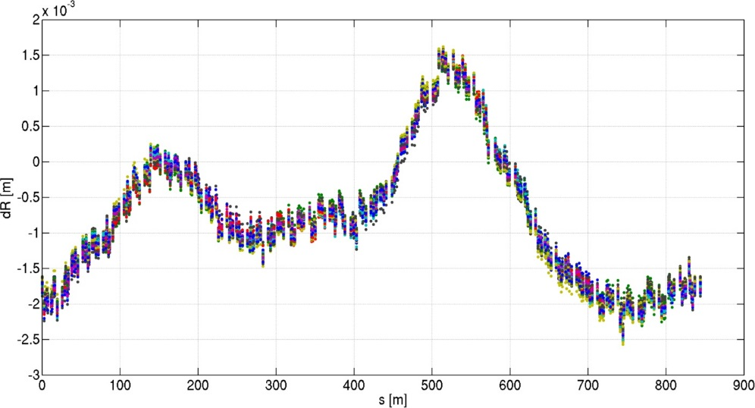
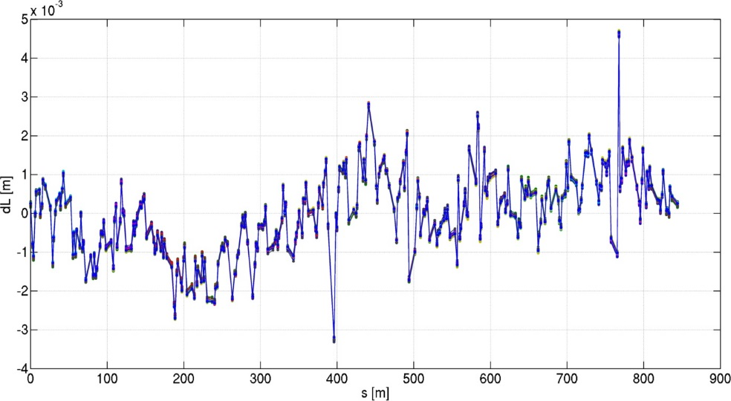
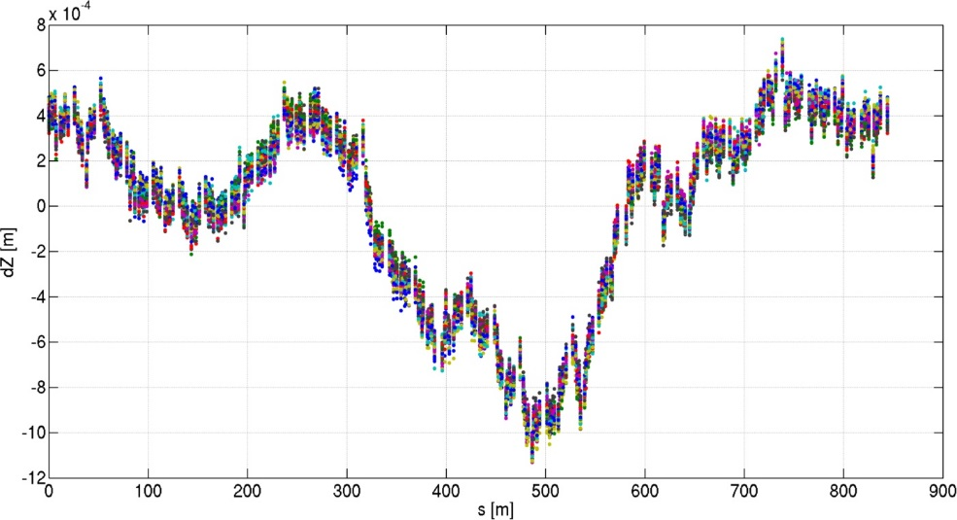
Alignment survey errors, option 3 (the modern way): simulated surveys (replacement of existing SR)
WHERE WILL THE SR BE
if we remove it and reinstall it?
horizontal
Longitudinal (electrons path)
50 cases
D.Martin, G.Gatta
D.Martin, G.Gatta
DATA from ALIGNMENT GROUP
Simulated survey errors about the current position of the lattice.
Rotations are random, but for a 21urad systematic outward tilt.
Data provided in 320 points for the current lattice.
vertical
D.Martin, G.Gatta
Idea by P.Riamondi
26/07/2013

Slide 14
Dynamic aperture and lifetime
The above curves are interpolated to set the errors in the S28A lattice.
On the blue curve
nominal
current
Lifetime: 16.6h
range:[16.4 17.1]
MEASURED SURVEY + simulated alignment errors
SET IN THE LATTICE
AND TESTED FOR DA/LIFETIME AFTER CORRECTION
TARGET
-10mm (-8.1mm @S3)
26/07/2013

Slide 15
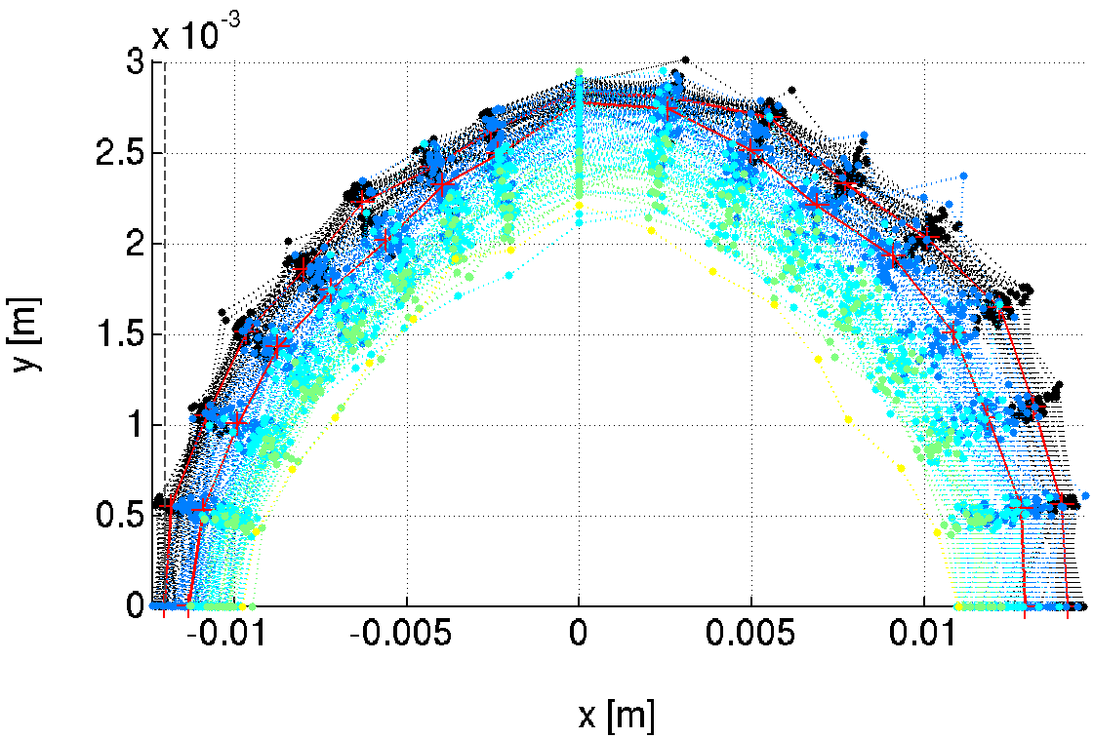
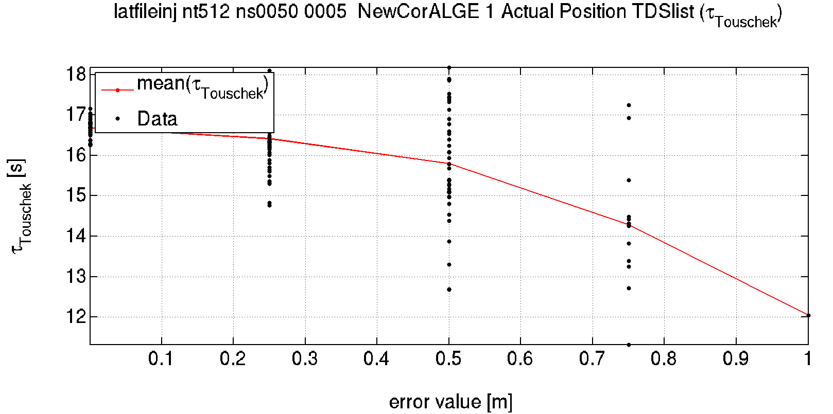
Additional Random errors
Additional random errors are still required to describe the error on the position of the magnetic centers of the magnets.
Increasing random errors
Lifetime goes from 16.6h to about 12h with many lost seeds and increasing range.
TARGET
-10mm (-8.1mm @S3)
As above + RANDOM ERRORS SET IN THE LATTICE
AND TESTED FOR DA/LIFETIME AFTER CORRECTION

Slide 16
In practice
We have no specific beam dynamics interest in the girder-girder tolerance themselves.
Those are not precisely defined among different groups and may lead to lack of understanding.
From beam dynamics, we can say that: large, slow, smooth, variations of position are not detrimental.
In order to model the lattice at the location where it will be installed, we included in all “predictive” (DA, LT, IE,etc) simulations the Simulated Survey Position provided by the alignment group.
From a beam dynamics point of view, as long as magnet-magnet tolerances (actually, single magnets rms position errors) are achieved at every location in the machine, including between magnets standing on neighboring girders, we will get the foreseen Dynamic Aperture and LIFETIME.
We let the alignment group decide how to achieve this requirement.
For ESRF-EBS It worked extremely well, largely exceeding expectations/simulations.
From steerers/orbit data
Achieved magnet-to-magnet
25-55 μm
Expected magnet-to-magnet
60-70 μm
rms DX DY
alignment

Slide 17
Tolerable random errors
What girder-girder tolerances did you use?
Required: | DX | DY | DS | DPSI | DK
 | μm | μm | μm | μrad | 10^-4
DL | >100 | >100 | 1000 | 500 | 10
DQ, QF[68] | 70 | 50 | 500 | 200 | 5
Q[DF][1-5] | 100 | 85 | 500 | 500 | 5
SFD | 70 | 50 | 500 | 1000 | 35
OF | 100 | 100 | 500 | 1000
All relative tolerance are as expectable from theory. Alignment will be based on a single value. Why running infinity of simulations? Just use a single number.
60
Many simulations for 1 number needed
How far can be two magnets on opposite sides of the ring?
GIRDERS
SAME AS worst case MAGNET-MAGNET
girder-girder error simulations are useless.
Long range
Simulated Survey
Long range error simulations are useless.
Sextupoles and high gradient quadrupoles are the most relevant limitations, nevertheless, this alignment specifications are currently achievable.
(DX=DY=60μm, 84 μm between two magnets).

Slide 18
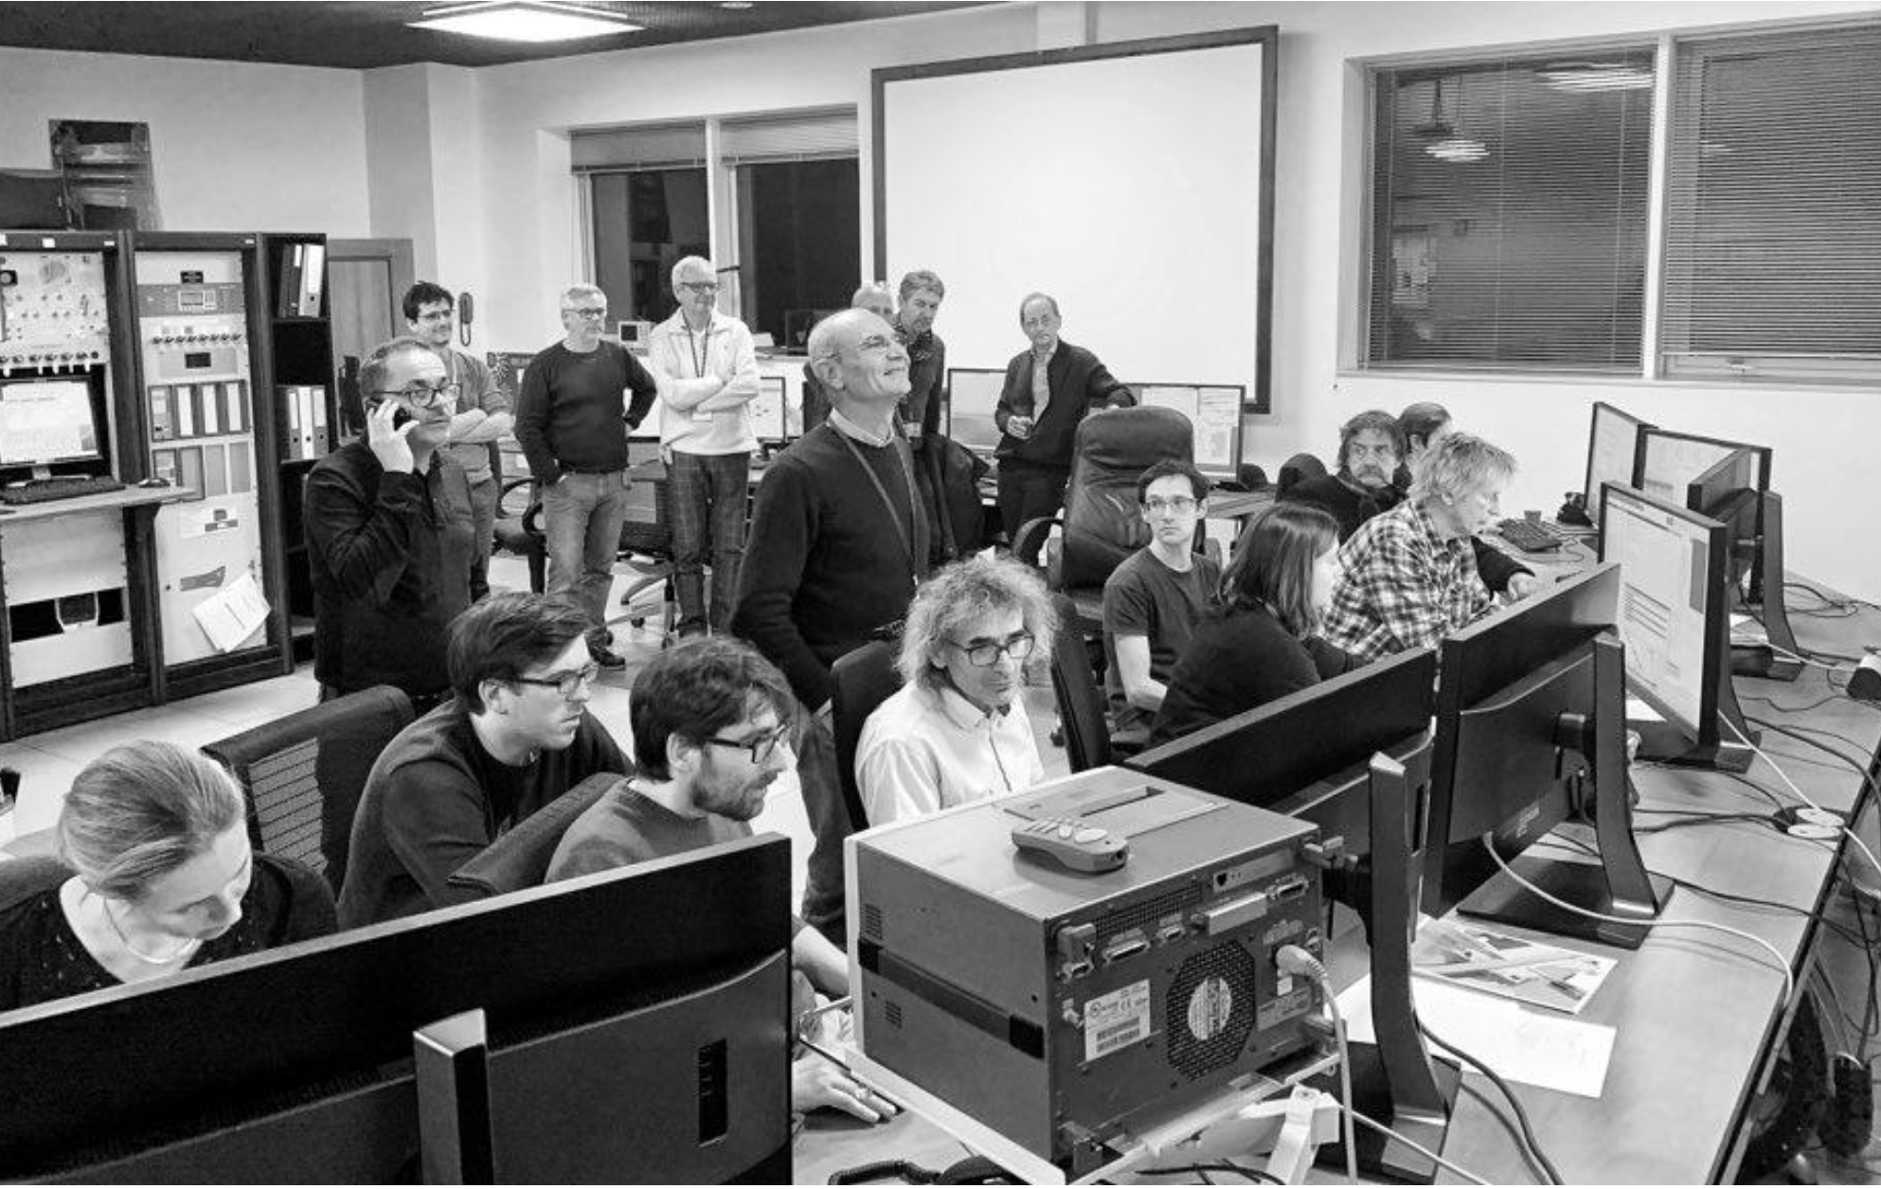
NOECO: sextupoles tuning to maximize lifetime
After commissioning,
Improve measurement based tuning compared to the schemes used in commissioning-like simulations.

Slide 19
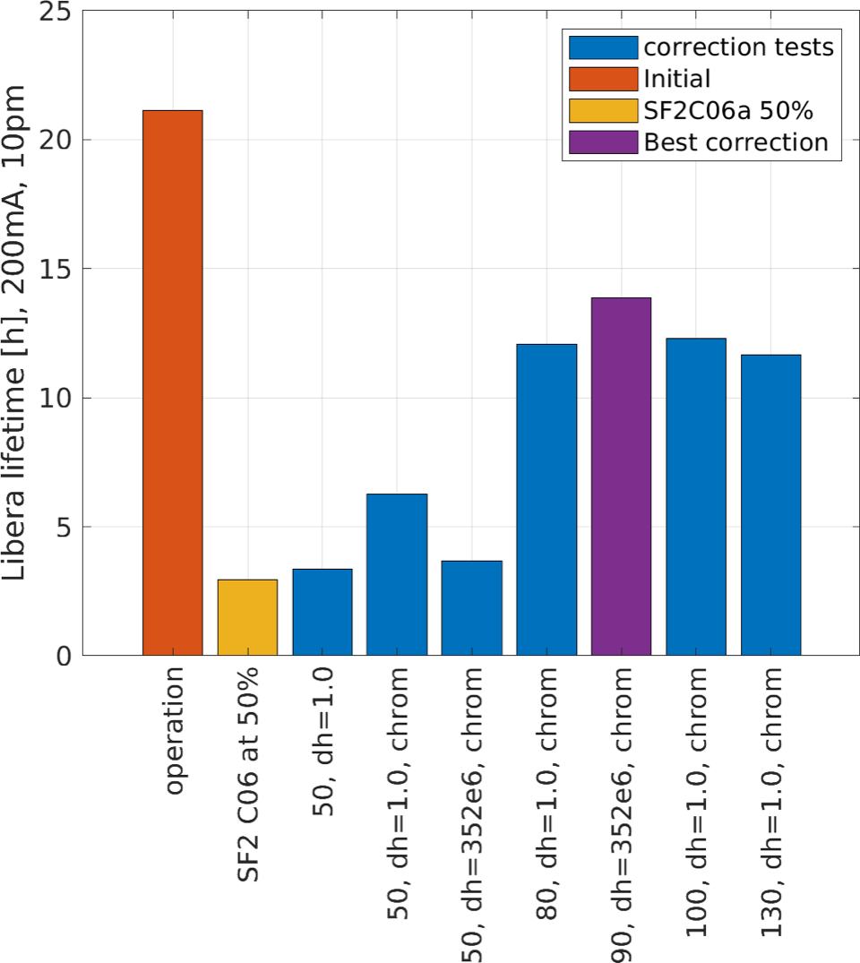
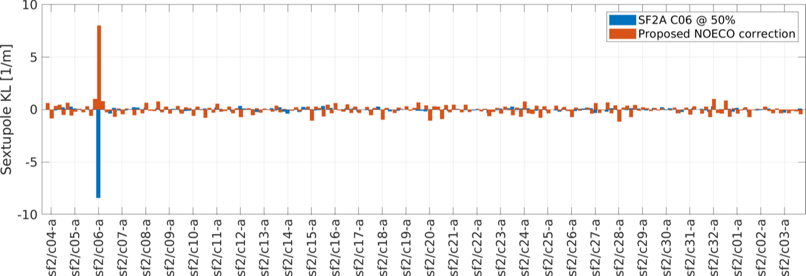
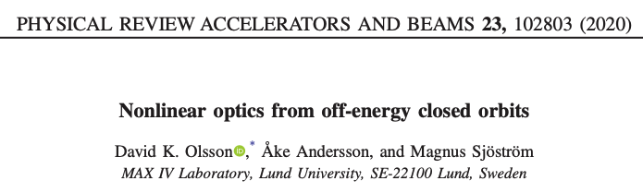
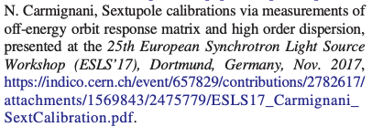
NOECO correction at ESRF, MEASUREMENTS with BEAM
Compute SEXTUPOLE correction strengths based on off-energy Fast-RM and dispersion measurement
Data: Jan 24 2022
Preliminary, to be confirmed in future MDTs
Proof of principle: OK
SF
Data: 24th Jan 2022
A.Franchi,
Function developed based on:

Slide 20
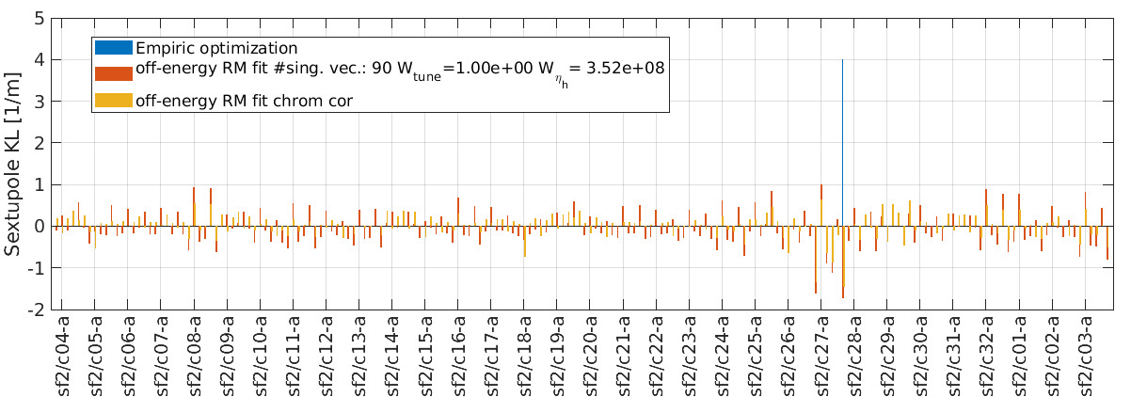
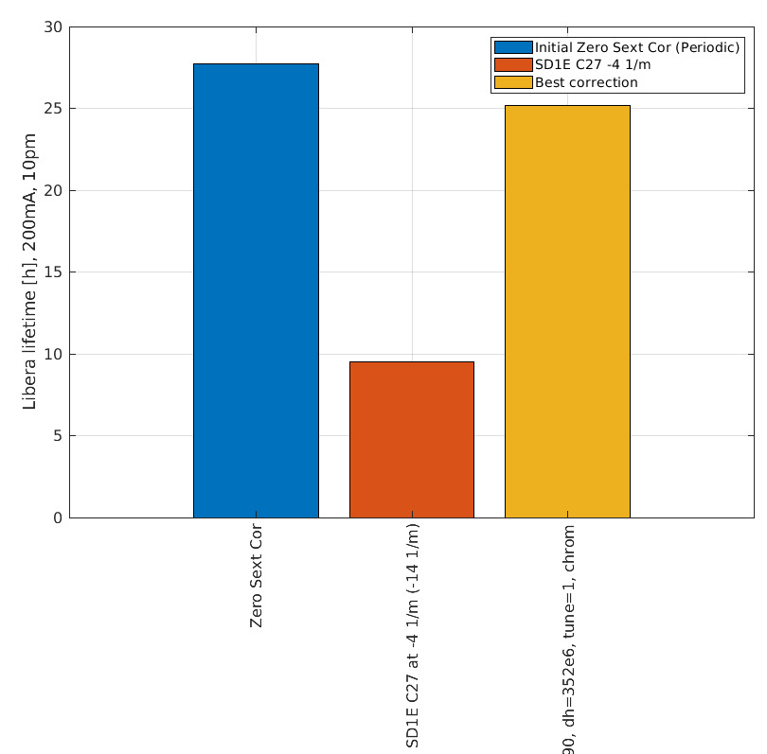
Start from a bad SD
Preliminary, to be confirmed in future MDTs
Data: 19th Apr 2022
The specific SD sextupole corrector is NOT found.
Nevertheless, the correction applied recovers the lifetime.

Slide 21
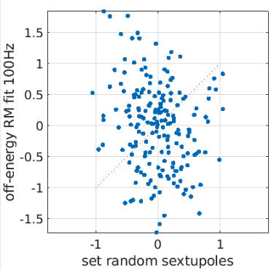
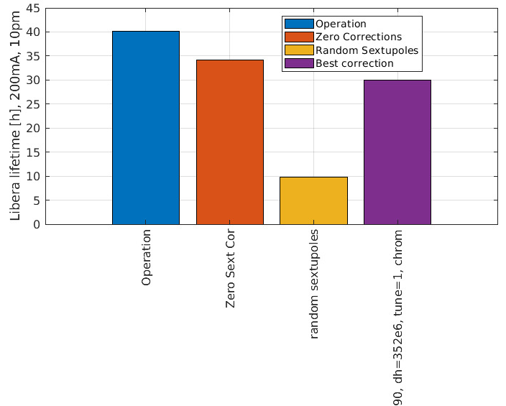
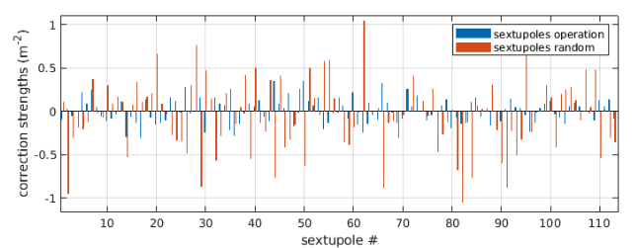
Random sextupole correctors giving ~10h lifetime
30h
The specific random sextupole corrector pattern is NOT found.
Nevertheless, the correction applied recovers the lifetime.
Zero correction strengths are better then 1 iteration of NOECO correction
Data: 19th Apr 2022
Preliminary, to be confirmed in future MDTs
NOECO
10h
40h
10h
Empiric sextupoles optimization

Slide 22
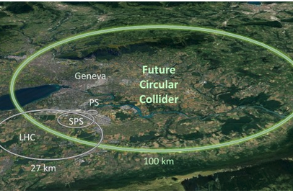
FCC-ee
Apply the same tuning strategy for FCC-ee.
Not trivial!
Yet not comparable to existing studies (see T. Charles presentation)

Slide 23
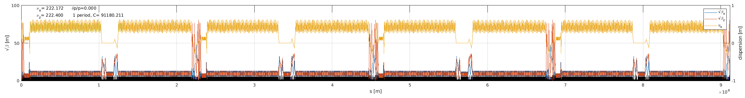
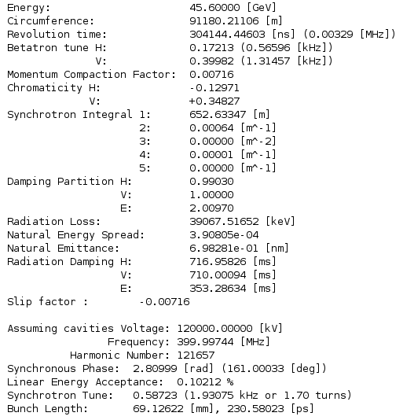
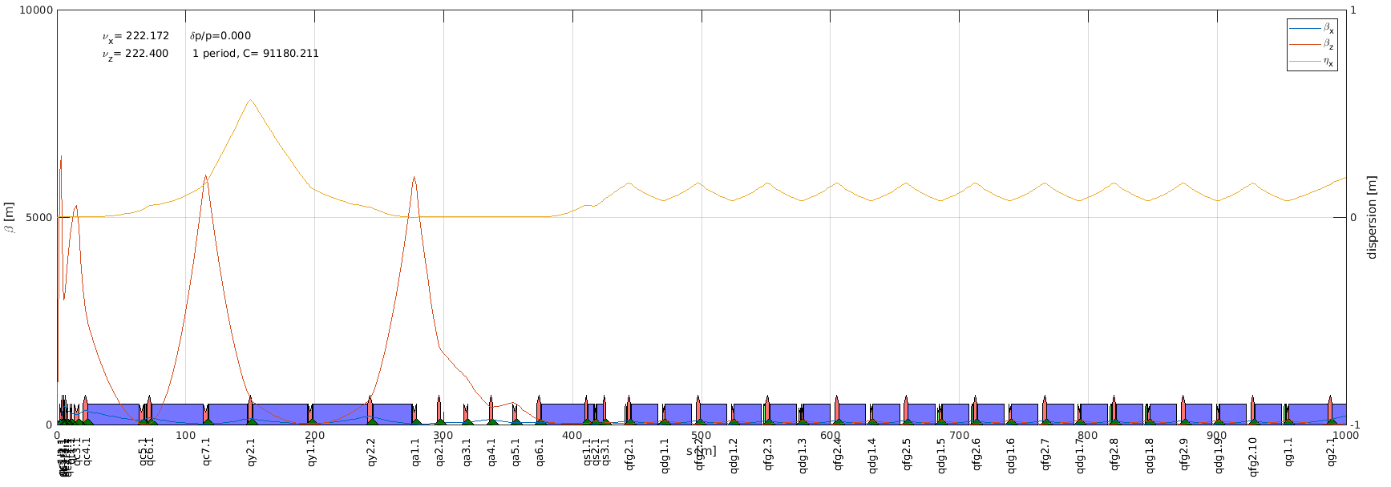
Lattice converted By Felix CARLIER
FCC-ee Z V10 MADX->AT by Felix Carlier
Add
1 BPM at each quadrupole
1892 BPMs
Consider
Each quadrupoles is an H/V steerer and a skew quad. (1862 correctors)
222.
222.
Parameters table

Slide 24
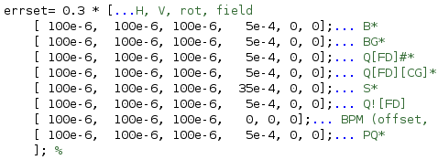
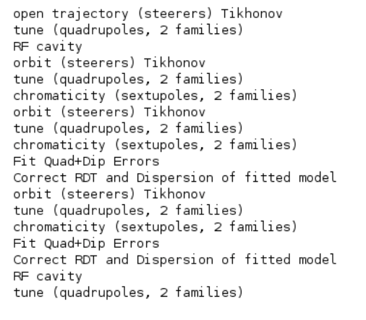
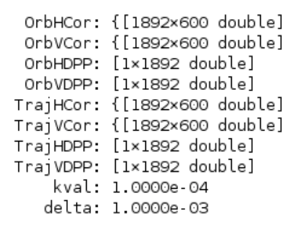
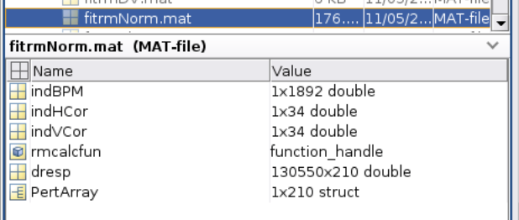
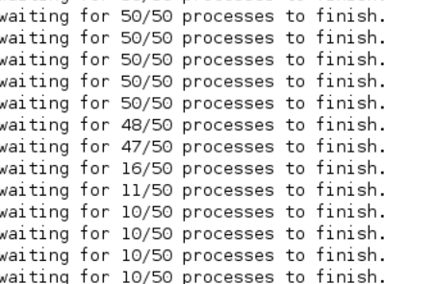
Lattice tuning functions adapted
Grouped trying to follow family naming
Errors:
No multipole errors
Correction strategy:
SOME MAGNETS ARE described with “slices”: MUST MOVE TOGETHER For now, do not move
Correction matrices
Derivatives for optics fit, on computing cluster
+ matrices for RDT correction

Slide 25
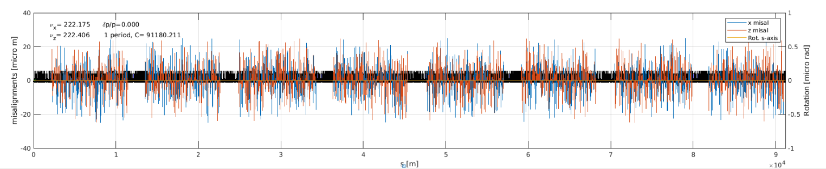
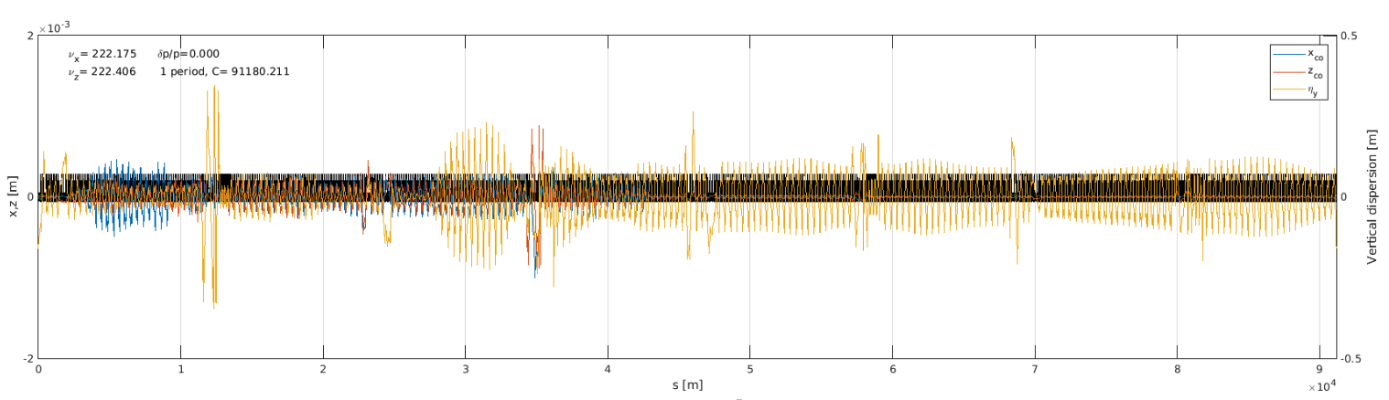
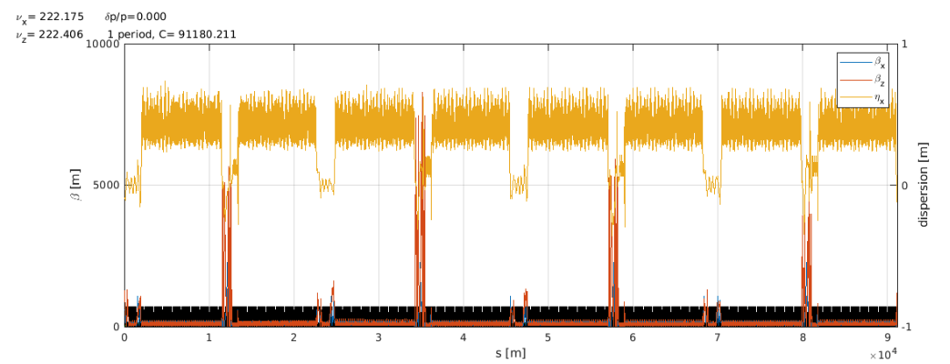
Commissioning like correction sequence completed for 3 seeds with limited errors.
10 um rms (truncated at 2.5sigmas)
SEQUENCE OF CORRECTIONS
--------------------------------------------------
------ total std corrector values applied --------
------ --------
HK (1892) [1/m]: 0.00e+00 -> 9.67e-08
VK (1892) [1/m]: 0.00e+00 -> 6.64e-08
SK (1892) [1/m2]: 0.00e+00 -> 1.11e-06
QK (1892) [1/m2]: 4.17e-07 -> 5.14e-06
------ --------
------ residual orbit and dispersion --------
------ --------
OH (13363) [m]: 4.29e-04 -> 1.99e-05
OV (13363) [m]: 2.23e-04 -> 1.60e-05
DH (13363) [m]: 9.43e-02 -> 1.25e-01
DV (13363) [m]:7.39e-02 -> 5.36e-03
BBH (13363) %: 2.9 -> 1.6
BBV (13363) %: 116.7 -> 2.4
PhH (13363) : 2.28e-02 -> 1.22e-02
PhV (13363) : 8.48e-02 -> 3.30e-02
------ --------
------ tune and emittance --------
------ --------
Qx [222.172]: 222.176 -> 222.175
Qy [222.400]: 222.387 -> 222.402
Cx [-0.070]: -0.354 -> -0.065
Cy [-0.123]: -13.748 -> -1.718
EX [705.313 pm]: -183082.420 -> 787.625
EY [0.000pm]: -3340463.956 -> 0.105
------ --------
--------------------------------------------------

Slide 26
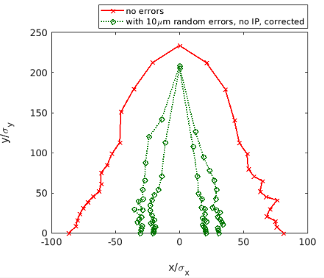
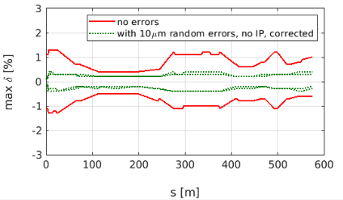
Dynamic aperture and momentum acceptance with errors
1/3 seeds failed completing the loop.
Preliminary, more tuning of commissioning-like scripts for FCC-ee is needed
Preliminary, more tuning of commissioning-like scripts for FCC-ee is needed
This is only a preliminary plot, only showing that we can compute DA and MA for FCC-ee with errors and correction.
We need to work more time on it!
Assume the recent updates in AT
Tune the correction parameters (singular values cuts)
Tune the correction loop steps (tune, orbit, etc)
Start with COMMISSIONING OPTICS
The correction loop is unstable above 20-30 um (no IP errors). In most cases a closed orbit is found but tunes are NaN. May be fixed including an estimate of tunes from few turns, not presently available in the matlab AT toolkit.

Slide 27
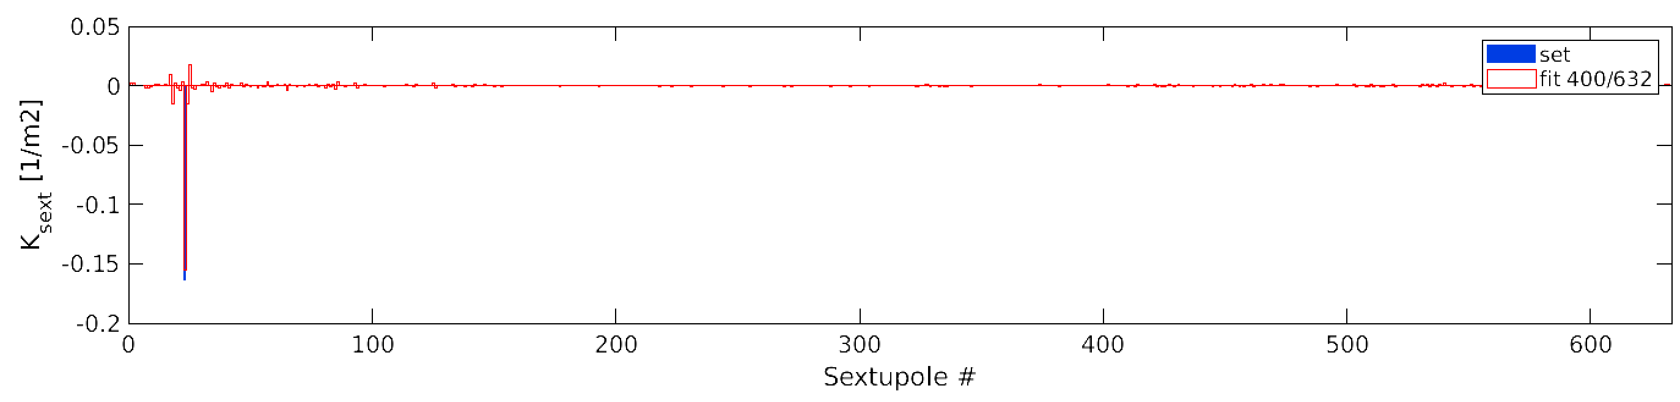
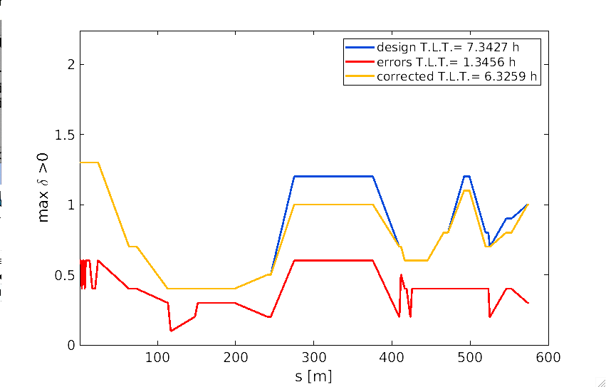
NOECO Simulations (Fit & correction) FOR FCC-ee
Test with one large sextupole error (50%)
FCC-ee ideal lattice
only ± 25 Hz RF freq. shift possible w/o making optics unstable
Top: Retrieve (large) sextupole error.
Right: computed momentum acceptance (over 600 m only) & Touschek lifetime

Slide 28
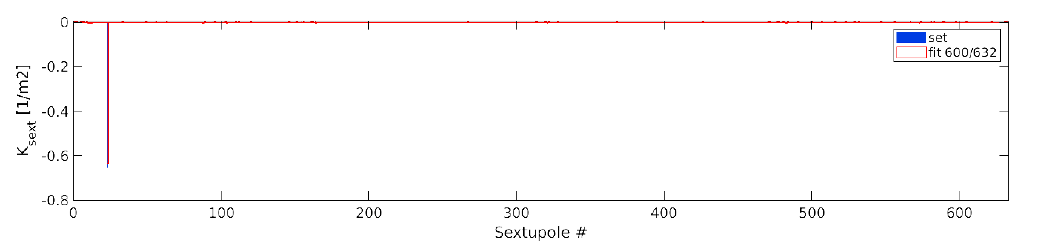
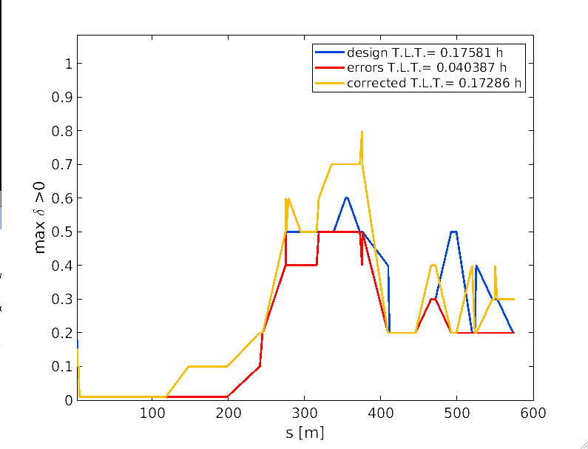
NOECO Simulations (Fit & correction) FOR FCC-ee
Test with one sextupole with inverted polarity
FCC-ee uncorrected lattice with random quad. & sext. misalignments (RMS 0.1 μm)
Top: Retrieve (large) sextupole error.
Right: computed momentum acceptance (over 600 m only) & Touschek lifetime

Slide 29
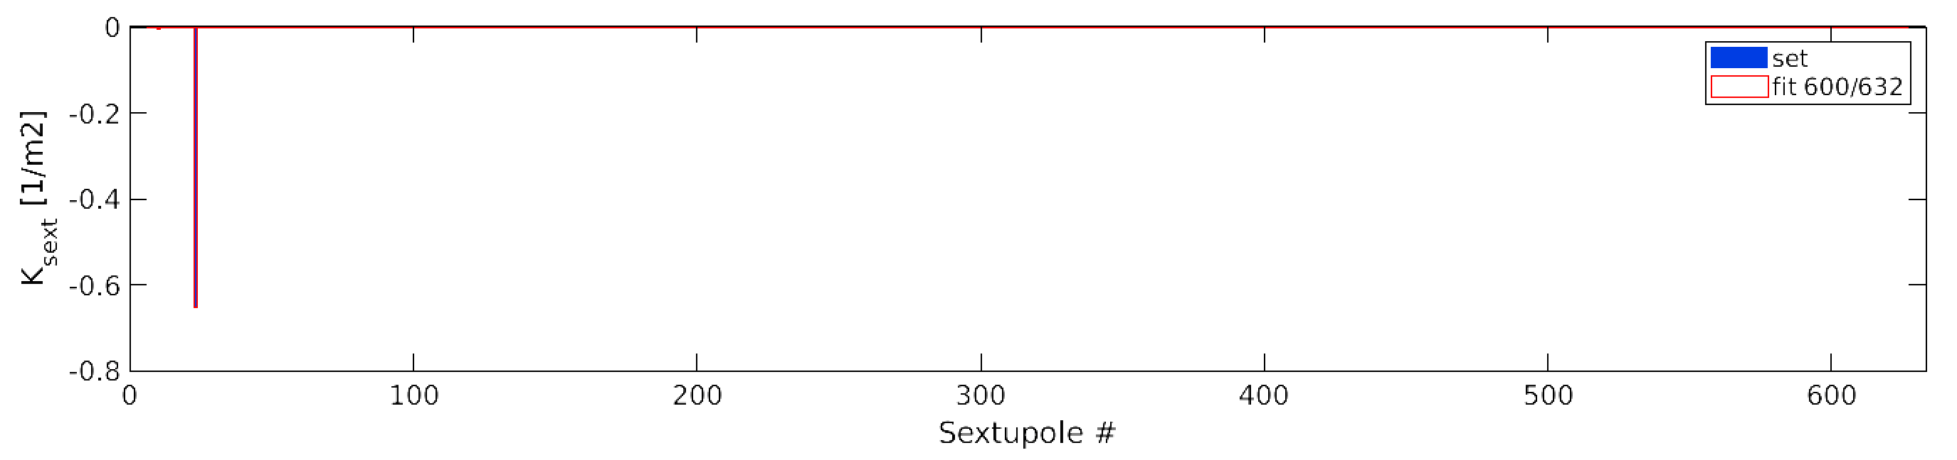
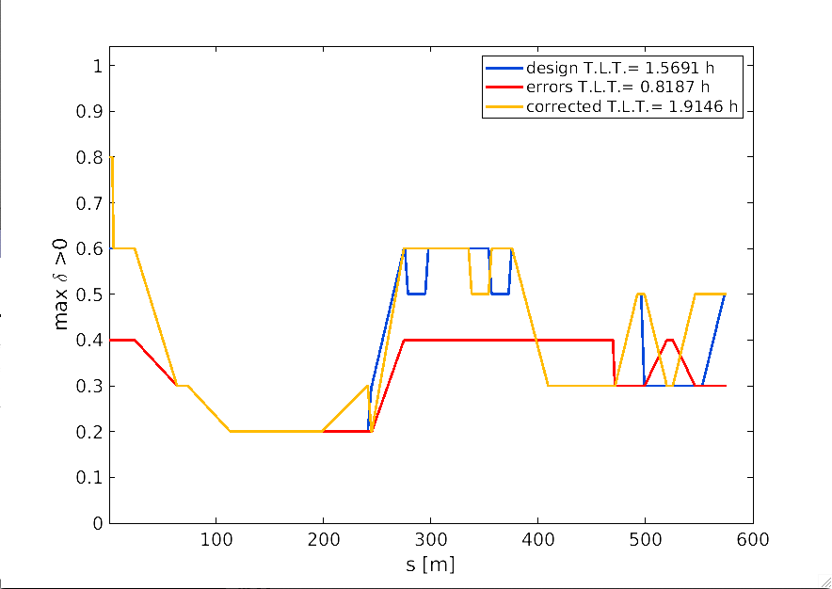
NOECO Simulations (Fit & correction) FOR FCC-ee
Test with one sextupole with inverted polarity
FCC-ee uncorrected lattice with random quad. gradient errors (RMS 3x10⁻⁵ m⁻²)
Top: Retrieve (large) sextupole error.
Right: computed momentum acceptance (over 600 m only) & Touschek lifetime

Slide 30
Conclusions
Commissioning-like simulations do not include many of the steps that are actually done during commissioning. Space for future developments.
For EBS tuning was not the real issue. It was rather to set the most correct and realistic errors.
  Only one number is necessary for magnetic centers tolerances (for EBS 60 um). All other values are useful only if locally this value may not be achieved.
  Use simulated survey rather than girder-to-girder tolerances: more information, more realistic, easier to simulate.
NOECO has been tested in MDT and shows good potential, even if it does not improve compared to our best optimized settings for operation.
Contrary to EBS, FCC-ee optics tuning with errors is not trivial at all. Even without radiation!
The matlab AT tuning procedure used for EBS is being adapted to FCC. Seen the amount of changes needed till now and the speed at which AT is developing, it is likely that the work will start over using pyAT. This activity is synergic with several other laboratories working on python AT commissioning like simulations.
NOECO has been used in simulations also for the FCCee lattice, recovering the local momentum acceptance also in presence of errors.
Commissioning optics are being prepared and translated to AT. Dipoles will be sliced prior to the correction.

Slide 31
BACKUP

Slide 32
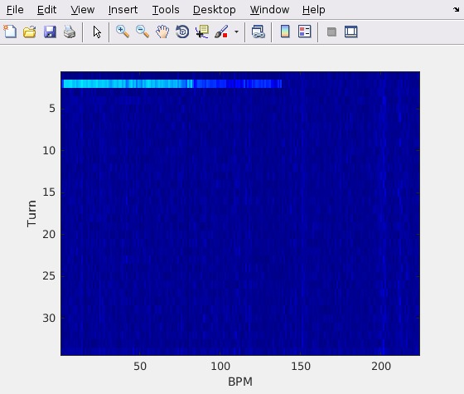
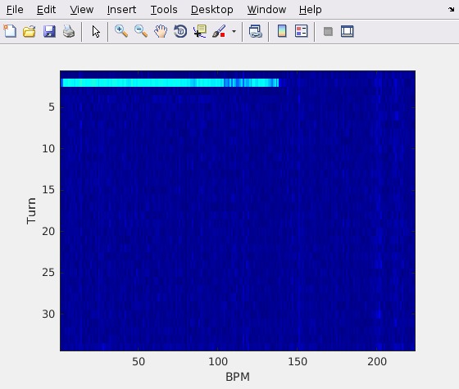

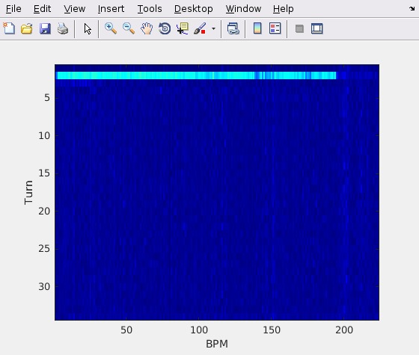
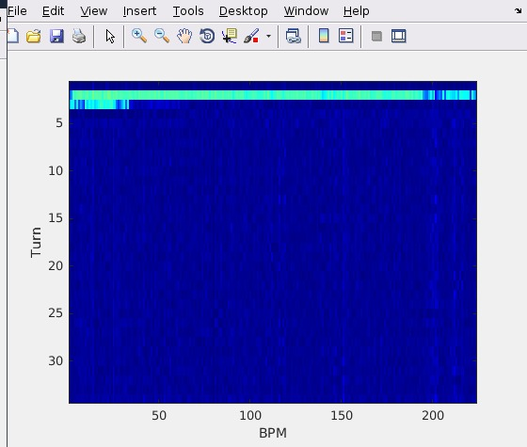
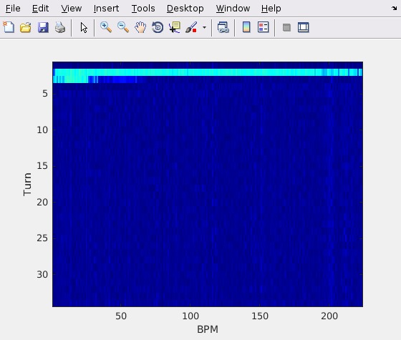








First-turns trajectory correction progress on tbt BPMs
Sextupoles and octupoles ON
DATA
October 2018
Number of turns
BPM #
0
1
2
3
21h22
4 (first turn)
5
6
7
8
Stored beam
9
10 (few turns)
11
12
21h38
Preparation of the EBS beam commissioning
S M Liuzzo et al 2019 J. Phys.: Conf. Ser. 1350 012022

Slide 33

low intensity tuning (phase 1)
Optics tuning/correction
response matrix
beam-based alignment
tune working point
emittances
chromaticity
dynamic apertures
specific optics tuning (ex: phase advance between sextupoles)
Response matrix (ORM) measurements is used for:
Precise orbit control (full, not compulsory)
Optics and coupling tuning (partial)
Check magnet calibrations
It is possible to use AC steerers for a fast partial response measurement. At ESRF this was only possible after the initial SLOW measurements, for calibration.
Separated simulations for BBA, DA and special tunings.
For BBA in the tuning loop we assume it is possible by reducing BPM offsets from 500 to 50 um. (not as trivial as it sounds, as changing the offset the orbit has to be re-corrected)

Slide 34
Comparable tolerance table
How tolerances were defined
In RED
The worst crossing of the “line” for each performance parameter
DQ (combined function dipoles) behave as quadrupoles concerning errors. Evident the impact on vertical dispersion compared to the other quadrupoles (defocussing quadrupoles).
Quadrupoles have large impact on orbit and horizontal dispersion, also in this case, lifetime and DA are strongly affected. QF6 and QF8 are dominant.
Sextupoles have the largest impact on DA, they are also the strongest source of beta-beating and emittance as expected.
Octupoles influence is limited compared to quadrupole and sextupoles, nevertheless they do have an impact on DA. Their effect on lifetime is very small.
Rotations up to 100urad have impact on the various parameters but limited.

Slide 35

Correction of realistic errors (100um) , no RADIATION
Last simulations with errors only in arcs and of 30um rms.
Now 100 um rms errors in all the elements, a part IP magnets (50um)

Slide 36

Matrices for correction steps
orbit
Trajectory (Threading)
Optics correction
Long quads, small kicks (not integrated 1/m)!

Slide 37

Trajectory correction, fails due to missing correctors at the beginning of the lattice.
Solution:
add more correctors : NOT OK. The corrector indexes look correct, first corrector before first BPM. Nevertheless the first block of the Trajectory response is ZEROS, thus the trajectory correction never starts.
Trajectory correction Response Matrix
RECOMPUTE TRAJECTORY RM.

Slide 38



Beam threading is running ok
All magnets ON at their nominal strengths.
Steerers powered as soon as there is beam on the next BPMs
Steering till one turn and closure of the orbit with the last 2 steerers.
Allow for 0.5mm trajectory amplitude accepted. May be this has to be revisited.

Slide 39

Closed orbit correction
Once a closed orbit is found, correct it using all available H/V steerers.
No limits set to steerers for now.
Truncation of SVD to 500 singular vectors / >1800, to keep forces required to a minimum.
There is a closed orbit but tunes are several units different from nominal.

Slide 40

Correction loop continues with tune and chromaticity correction
TO DO: Add orbit in in all functions, it must be given to atlinopt, atfittune, atmatch, …

Slide 42
Try reduced errors and simplified orbit correction (2 steps only)

Slide 43


Girder Errors
How
GIRDER
tolerances were defined
Girder displacements and rotations
Girder displacements and rotations
+ random errors Quad. and Sext.
4 girders, BPMs are moved with the girder.
l 30-31 May 2014 l S.M.Liuzzo

Slide 44
Dynamic aperture @S3 septum vs errors for s28A + RDT correction
How
GIRDER
tolerances were defined
-20%
All is NOT the sum of each error
26/07/2013
l WP1 ESRF upgrade l May 2014 l S.M.Liuzzo

Slide 45
error values for a reduction of 20% of Hor. Dynamic Aperture @S3
How
GIRDER
tolerances were defined
RDT correction
Strong impact of quadrupole errors
No influence on emittances

Slide 46




Summary Table of Girder Errors
Commissioning-like correction sequence to get these data
Cluster, Average over several (10) error seeds.
Computing cluster
(g) Stands for girder errors, no g, are quadrupole and sextupole individual misalignments
How
GIRDER
tolerances were defined

Slide 47
The measured position of the lattice
How
GIRDER
tolerances were excluded
This is where the machine is. Let’s use this information!
nominal
current
ESRF 1994-2018
EBS 2019-?? We placed EBS where the old SR used to be. Everyone is happy.

Slide 48
Survey errors PLUS random errors
How GIRDER
tolerances were excluded
D.Martin, G.Gatta
The blue curve represents the current ESRF storage ring position.
The x symbols are the interpolated positions on this curve for the S28A lattice.
BPM are positioned on the same curve.
DX and DZ and girder rotations are applied.
Errors are ramped in steps of 20% up to the nominal value.
Added random errors to account for unknown magnetic center position
Random Gaussian DX DY in quadrupoles and sextupoles on top of the survey errors.
l ESRF Upgrade l June 2014 l S.M.Liuzzo

Slide 49
Long range errors
How
GIRDER
tolerances were excluded
Error “waves” applied to the lattice: DX, DY, Rotations for quad and sext.
Correction performed for each frequency and amplitude set as:
Open trajectory correction
Orbit correction
RDT correction
storage ring survey data
simulated 1st harmonic,
Simulations performed on the OAR asd cluster, 8h-600cpu
26/07/2013

Slide 50


displacements and global tilt
--------------------------------------------------
------ total std corrector values applyed --------
------ --------
HK (288) [1/m]: 0.00e+00 -> 1.06e-04
VK (288) [1/m]: 0.00e+00 -> 1.19e-04
SK (288) [1/m2]: 0.00e+00 -> 0.00e+00
QK (514) [1/m2]: 0.00e+00 -> 0.00e+00
HKL (288) [rad]: 0.00e+00 -> 1.08e-05
VKL (288) [rad]: 0.00e+00 -> 8.25e-06
SKL (288) [T/m]: 0.00e+00 -> 0.00e+00
QKL (514) [T/m]: 0.00e+00 -> 0.00e+00
------ --------
------ residual orbit and dispersion --------
------ --------
OH (288) [m]: 3.78e-05 -> 9.02e-06
OV (288) [m]: 1.48e-04 -> 9.05e-07
DH (288) [m]: 3.80e-04 -> 1.18e-04
DV (288) [m]:1.38e-03 -> 3.33e-04
BBH (288) %: 0.9 -> 0.3
BBV (288) %: 0.6 -> 0.3
PhH (288) : 2.09e-02 -> 1.75e-02
PhV (288) : 1.70e-02 -> 1.07e-02
------ --------
------ tune and emittance --------
------ --------
Qx [0.580]: 0.580 -> 0.580
Qy [0.620]: 0.619 -> 0.619
EX [147.528 pm]: 147.506 -> 147.545
EY [0.000pm]: 0.986 -> 0.049
------ --------
--------------------------------------------------
----- ----- -- -- -- -- ------ -----
initial (ex, ey): 147.53, 0.00,
errors (ex, ey): 147.51, 0.99,
corrected (ex, ey): 147.54, 0.05,
Freq 1, every 32

Slide 51


every 8 cells
--------------------------------------------------
------ total std corrector values applyed --------
------ --------
HK (288) [1/m]: 0.00e+00 -> 1.37e-04
VK (288) [1/m]: 0.00e+00 -> 1.63e-04
SK (288) [1/m2]: 0.00e+00 -> 0.00e+00
QK (514) [1/m2]: 0.00e+00 -> 0.00e+00
HKL (288) [rad]: 0.00e+00 -> 1.54e-05
VKL (288) [rad]: 0.00e+00 -> 1.14e-05
SKL (288) [T/m]: 0.00e+00 -> 0.00e+00
QKL (514) [T/m]: 0.00e+00 -> 0.00e+00
------ --------
------ residual orbit and dispersion --------
------ --------
OH (288) [m]: 8.79e-05 -> 1.31e-05
OV (288) [m]: 1.35e-03 -> 1.67e-06
DH (288) [m]: 2.59e-03 -> 2.61e-04
DV (288) [m]:1.02e-02 -> 3.12e-03
BBH (288) %: 3.9 -> 0.5
BBV (288) %: 2.2 -> 0.5
PhH (288) : 2.95e-02 -> 6.91e-03
PhV (288) : 2.13e-02 -> 5.69e-03
------ --------
------ tune and emittance --------
------ --------
Qx [0.580]: 0.574 -> 0.580
Qy [0.620]: 0.612 -> 0.619
EX [147.528 pm]: 147.077 -> 147.596
EY [0.000pm]: 67.039 -> 4.014
------ --------
--------------------------------------------------
----- ----- -- -- -- -- ------ -----
initial (ex, ey): 147.53, 0.00,
errors (ex, ey): 147.08, 67.04,
corrected (ex, ey): 147.60, 4.01,
Freq 4, every 8 cells

Slide 52


Misalignment pattern, every 2 cells
--------------------------------------------------
------ total std corrector values applyed --------
------ --------
HK (288) [1/m]: 0.00e+00 -> 1.05e-04
VK (288) [1/m]: 0.00e+00 -> 5.10e-05
SK (288) [1/m2]: 0.00e+00 -> 0.00e+00
QK (514) [1/m2]: 0.00e+00 -> 0.00e+00
HKL (288) [rad]: 0.00e+00 -> 1.07e-05
VKL (288) [rad]: 0.00e+00 -> 6.21e-06
SKL (288) [T/m]: 0.00e+00 -> 0.00e+00
QKL (514) [T/m]: 0.00e+00 -> 0.00e+00
------ --------
------ residual orbit and dispersion --------
------ --------
OH (288) [m]: 4.93e-05 -> 8.49e-06
OV (288) [m]: 3.13e-05 -> 1.60e-06
DH (288) [m]: 5.04e-04 -> 3.98e-04
DV (288) [m]:3.92e-04 -> 1.69e-04
BBH (288) %: 1.1 -> 0.6
BBV (288) %: 0.8 -> 0.2
PhH (288) : 7.76e-03 -> 2.97e-03
PhV (288) : 9.02e-03 -> 3.40e-03
------ --------
------ tune and emittance --------
------ --------
Qx [0.580]: 0.582 -> 0.579
Qy [0.620]: 0.616 -> 0.622
EX [147.528 pm]: 147.483 -> 141.513
EY [0.000pm]: 0.301 -> 13.404
------ --------
--------------------------------------------------
----- ----- -- -- -- -- ------ -----
initial (ex, ey): 147.53, 0.00,
errors (ex, ey): 147.48, 0.30,
corrected (ex, ey): 141.51, 13.40,
Freq 16, Every 2 cells

Slide 53
Long range errors: error envelope function
How
GIRDER
tolerances were excluded
Impact of error “waves” on horizontal orbit
At a wavelength of L/128~6m
30um errors amplitude give
30 um residual orbit distortion.
At a wavelength of L/2~422m
7mm errors amplitude give
30 um residual orbit distortion.
SLOW, LARGE VARIATIONS HAVE LIMITED IMPACT ON THE OPTICS
26/07/2013

Slide 54
The measured position of the lattice
How
GIRDER and LONG RANGE
tolerances were excluded
This is where the machine is. Let’s use this information!
nominal
current
ESRF 1994-2018
EBS 2019-?? We placed EBS where the old SR used to be. Everyone is happy.

Slide 55


every 16 cells
--------------------------------------------------
------ total std corrector values applyed --------
------ --------
HK (288) [1/m]: 0.00e+00 -> 1.51e-04
VK (288) [1/m]: 0.00e+00 -> 1.68e-04
SK (288) [1/m2]: 0.00e+00 -> 0.00e+00
QK (514) [1/m2]: 0.00e+00 -> 0.00e+00
HKL (288) [rad]: 0.00e+00 -> 1.54e-05
VKL (288) [rad]: 0.00e+00 -> 1.17e-05
SKL (288) [T/m]: 0.00e+00 -> 0.00e+00
QKL (514) [T/m]: 0.00e+00 -> 0.00e+00
------ --------
------ residual orbit and dispersion --------
------ --------
OH (288) [m]: 6.01e-05 -> 1.28e-05
OV (288) [m]: 2.61e-04 -> 1.31e-06
DH (288) [m]: 5.95e-04 -> 1.75e-04
DV (288) [m]:2.41e-03 -> 5.84e-04
BBH (288) %: 1.4 -> 0.5
BBV (288) %: 0.9 -> 0.5
PhH (288) : 1.77e-02 -> 1.28e-02
PhV (288) : 1.42e-02 -> 8.11e-03
------ --------
------ tune and emittance --------
------ --------
Qx [0.580]: 0.579 -> 0.580
Qy [0.620]: 0.618 -> 0.619
EX [147.528 pm]: 147.487 -> 147.563
EY [0.000pm]: 2.806 -> 0.137
------ --------
--------------------------------------------------
Freq 2, evry 16 cells

Slide 56


every 4 cells
--------------------------------------------------
------ total std corrector values applyed --------
------ --------
HK (288) [1/m]: 0.00e+00 -> 1.24e-04
VK (288) [1/m]: 0.00e+00 -> 1.63e-04
SK (288) [1/m2]: 0.00e+00 -> 0.00e+00
QK (514) [1/m2]: 0.00e+00 -> 0.00e+00
HKL (288) [rad]: 0.00e+00 -> 1.59e-05
VKL (288) [rad]: 0.00e+00 -> 1.14e-05
SKL (288) [T/m]: 0.00e+00 -> 0.00e+00
QKL (514) [T/m]: 0.00e+00 -> 0.00e+00
------ --------
------ residual orbit and dispersion --------
------ --------
OH (288) [m]: 6.11e-05 -> 1.40e-05
OV (288) [m]: 1.37e-04 -> 1.84e-06
DH (288) [m]: 7.00e-04 -> 2.83e-04
DV (288) [m]:1.72e-03 -> 3.68e-04
BBH (288) %: 3.8 -> 2.4
BBV (288) %: 1.8 -> 2.5
PhH (288) : 2.23e-02 -> 1.34e-02
PhV (288) : 1.19e-02 -> 1.38e-02
------ --------
------ tune and emittance --------
------ --------
Qx [0.580]: 0.583 -> 0.580
Qy [0.620]: 0.622 -> 0.620
EX [147.528 pm]: 147.809 -> 147.692
EY [0.000pm]: 1.477 -> 0.133
------ --------
--------------------------------------------------
----- ----- -- -- -- -- ------ -----
initial (ex, ey): 147.53, 0.00,
errors (ex, ey): 147.81, 1.48,
corrected (ex, ey): 147.69, 0.13,
Freq 8, every 4 cells

Slide 57






Emittance, dispersion and beta-beating vs wavelength
How
GIRDER
tolerances were excluded

Slide 58


Comparison of various Error Sources to obtain 30 um orbit

Slide 59






Comparison of various Error Sources (other parameters)

Slide 60
DRAFT table of tolerable rms of error distributions
Error (S28 Table) | TDS value | New value
Dipole DPSI | 300 mrad | Splitted
Dipole DX | 50 μm | Splitted
Dipole DY | 50 μm | Splitted
Quadrupole DX | 50 μm | Splitted
Quadrupole DY | 100 μm | Splitted
Quadrupole DPSI | 350 μrad | Splitted
Sextupole DX | 50 μm | 70
Sextupole DY | 75 μm | 50
Sextupole DPSI | - | 500 μrad
Girder DX | 50 μm | Removed
Girder DY | 50 μm | Removed
Girder DPSI | 200 μrad | Removed
BPM X-offset | 50 μm | Separated
BPM Y-offset | 50 μm | Separated
Dipole DK0/DK0 | 10 10⁻⁴ | 10 10⁻⁴
Quadrupole DK1/K1 | 5 10⁻⁴ | 5 10⁻⁴
Sextupole DK2/K2 | 35 10⁻⁴ | 35 10⁻⁴
Error (S28 Table) | TDS value | New value
DL DPSI | 300 | 500 μrad
DL DX | 50 | 100 μm
DL DY | 50 | 100 μm
DL DS | - | 1000 μm
DQ and QF6-8 DPSI | 300 | 200 μrad
DQ and QF6-8 DX | 50 | 50 μm
DQ and QF6-8 DY | 50 | 70 μm
DQ and QF6-8 DS | - | 500 μm
Octupole DX | - | 100 μm
Octupole DY | - | 100 μm
Octupole DPSI | - | 500 μrad
Octupole DS | - | 1000 μm
Q [D-F] [1-5] DPSI | 350 | 500 μrad
Q [D-F] [1-5] DX | 50 | 100 μm
Q [D-F] [1-5] DY | 100 | 85 μm
Q [D-F] [1-5] DS | - | 500 μm
Sextupole DS | - | 1000 μm
DS = longitudinal displacement
DX = radial displacement
DY = vertical displacement
DPSI = rotation about beam axis
Girder errors replaced by smooth wave summing first 4 long wavelengths with 0.6mm amplitude.

Slide 61


d.A. and lifetime: Table above + waves + Bpm errors 50 um rms
“Closed” continuous waves
DA about 7mm at S3 septum.
Some seeds have bad DA and some are lost. Work in progress to recover them. this may change the above list of tolerable errors.
Lifetime is about 7h.

Slide 62

Dynamic aperture and lifetime
How
GIRDER and LONG RANGE
tolerances were excluded
The above curves are interpolated to set the errors in the S28A lattice.
On the red curve
nominal
current
Lifetime: 16.7h
range:[16.6 17]
IDEAL SURVEY SET IN THE LATTICE
AND TESTED FOR DA/LIFETIME AFTER CORRECTION
TARGET
-10mm (-8.1mm @S3)

Slide 63



Alignment survey errors, option 3 (the modern way): simulated surveys (ideal position)
WHERE WILL THE SR BE
after green field installation?
horizontal
Longitudinal (electrons path)
50 cases
D.Martin, G.Gatta
DATA from ALIGNMENT GROUP
Simulated survey errors about the nominal position of the lattice.
Rotations are random, but for a 21urad systematic outward tilt.
Data provided in 320 points for the current lattice.
vertical
D.Martin, G.Gatta
PREVIOUS

Slide 64


Additional Random errors
Additional random errors are still required to describe the error on the position of the magnetic centers of the magnets.
On the red curve
nominal
current
Increasing random errors
Increasing errors
TARGET
-10mm (-8.1mm @S3)
Lifetime goes from 16.7h to about 13h with many lost seeds and increasing range.
IDEAL SURVEY + RANDOM ERRORS SET IN THE LATTICE
AND TESTED FOR DA/LIFETIME AFTER CORRECTION

Slide 65
X-ray beam position at ID (60 meters) : decision to place the new SR where the old was.
All ID are assumed to be at 60m from the source.
The position of the beam after 60m is very similar for ESRF and S28A considering the current survey measurement.
The position if the ring was aligned on the reference circumference would be about (0,0) for al ID.
S28
ESRF
“on theory geom”.
Good choice. During commissioning (Jan2019): ALL beamlines but one could see the x-ray beam at the white beam viewers at very first Front End opening.
Current (simulated) position of the X-ray at the beamline
position of the X-ray at the beamline for S28A on the same survey
4TH APAC 2014

Slide 66


Larger errors on more magnets
30 um rms (truncated at 2.5sigmas)
1/10 seeds failed

Slide 67
Procedure for optics correction
Fit of “measured” partial Orbit Response Matrix (slow)
→ FITTED OPTICS MODEL
Computation of normal and skew quadrupoles RDTs + dispersion and correction
→ Normal and skew quadrupole correction strengths
This is LOCO equivalent (+ RDTs)
Linear problem + generalize potentially different fit and correction locations

