Slide 1
Status and plans for
FCC-hh collimation
29/06/2021 FCC week
Roderik Bruce
Space for additional logos
R. Bruce, A. Abramov, F. Cerutti, M. Giovannozzi, S. Redaelli, T. Risselada
CDR studies:
Y. Alexahin, W. Bartmann, A. Bertarelli, S. Arsenyev, I. Besana, F. Carra, A. Chance, B. Dalena, A. Faus-Golfe, M. Fiascaris, S. Gilardoni, E. Gianfelice-Wendt, G. Gobbi, J. Hunt, J. Jowett, A. Krainer, G. Lamanna, A. Langner, A. Lechner, R. Martin, A. Mereghetti, D. Mirarchi, N. Mokhov, J. Molson, A. Narayanan, L. Nevay, M. Pasquali, A. Perillo Marcone, E. Renner, M. Schaumann, D. Schulte, M. Serluca, E. Skordis, M.J. Syphers, I. Tropin, M. Varasteh, Y. Zou

Slide 2
Outline
Introduction and motivation
  Challenges with collimation in high-energy hadron colliders
  FCC-hh vs LHC
  Recap of collimation design for CDR
  Updates since CDR
  Outlook and needed future work
  Conclusions

Slide 3
Collimation in high-energy colliders
High energy and intensity => Typically, very high stored beam energy
Need superconducting magnets to reach sufficiently high magnetic fields
  Cooled to cryogenic temperatures
  Sensitive to heating => Small temperature rise causes a quench (loss of superconductivity)
  Beam losses are unavoidable during regular operation
    Even a tiny loss could cause a quench, or even material damage
  Need collimation system to safely intercept and attenuate these losses

Slide 4
Collimation challenge: LHC vs FCC
HL-LHC
FCC-hh
Cold aperture, superconductors
Cold aperture, superconductors
Quench limit
~ 30 W/m
Quench limit
~ 100 W/m
Loss power up to ~1 MW
Loss power up to 11.6 MW
collimator
collimator
Beam: 680 MJ
Beam: 8.3 GJ
Needed loss attenuation: factor ~3×10⁴
Needed loss attenuation: factor ~10⁵

Slide 5
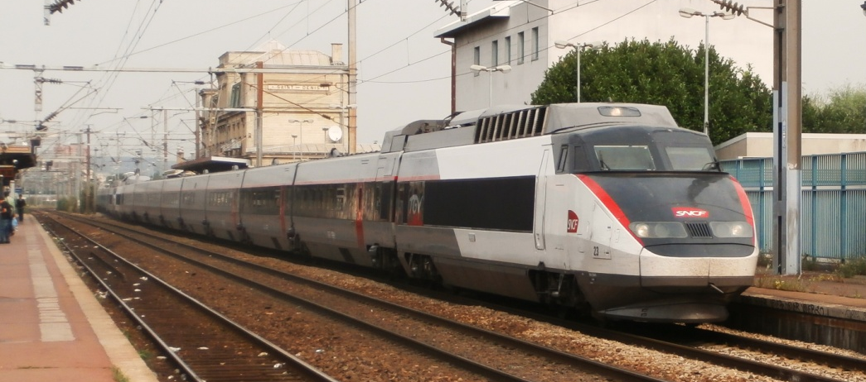

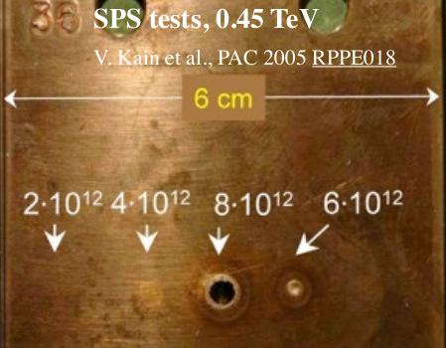
How much is 8.3 GJ?
LHC: 362 MJ - kinetic energy of
TGV train cruising at 155 km/h
FCC-hh: 8.3 GJ – kinetic energy of
Airbus A380 (empty) cruising at 880 km/h
0.6 MJ
FCC-hh beams are highly destructive!!

Slide 6
Outline
Introduction and motivation
  Challenges with collimation in high-energy hadron colliders
  FCC-hh vs LHC
  Recap of collimation design for CDR
  Updates since CDR
  Outlook and needed future work
  Conclusions

Slide 7
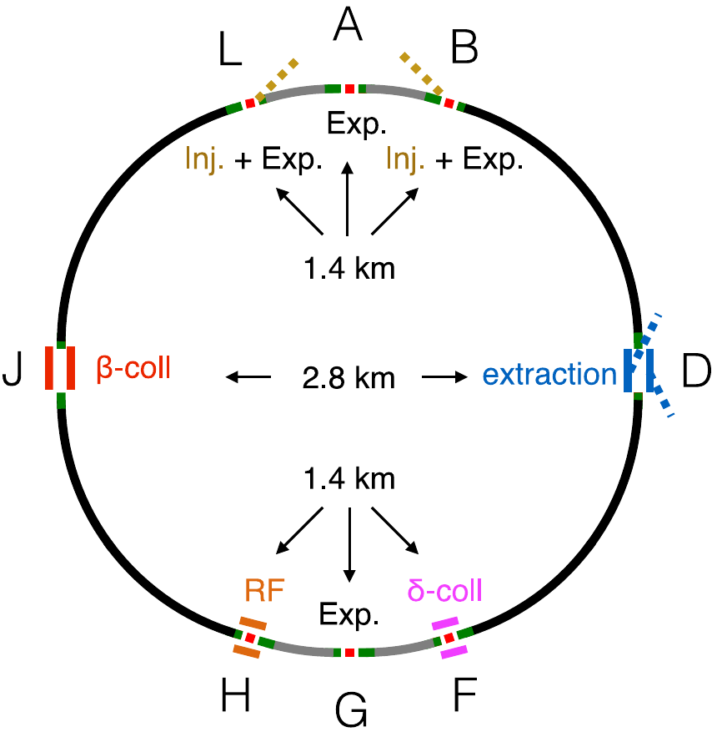
FCC-hh collimation layout: CDR version
The following few slides are a summary of previous studies for CDR, references:
  R Bruce et al 2019 J. Phys.: Conf. Ser. 1350 012009
  Previous FCC week talks, FCC collimation meetings
  Long CDR (not yet published)
Separate betatron (PJ) and momentum cleaning (PF)
The FCC-hh collimation system is a scaled up version of the HL-LHC/LHC system (NIM, A 894 (2018) 96-106)

Slide 8
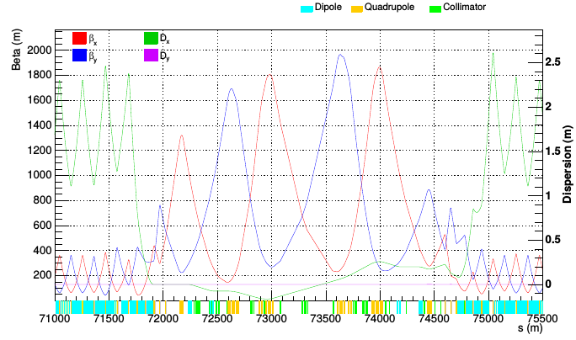
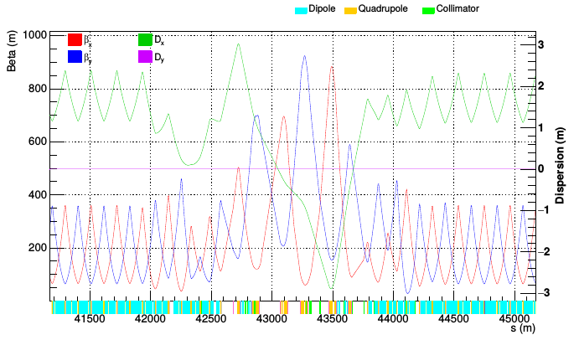
Optics of collimation insertions: CDR version
Scaled β-functions and insertion length by factor 5 from the LHC → 2.8 km insertion length
Increased dispersion in momentum cleaning insertion
IRJ (Betatron cleaning)
IRF (Momentum cleaning)

Slide 9
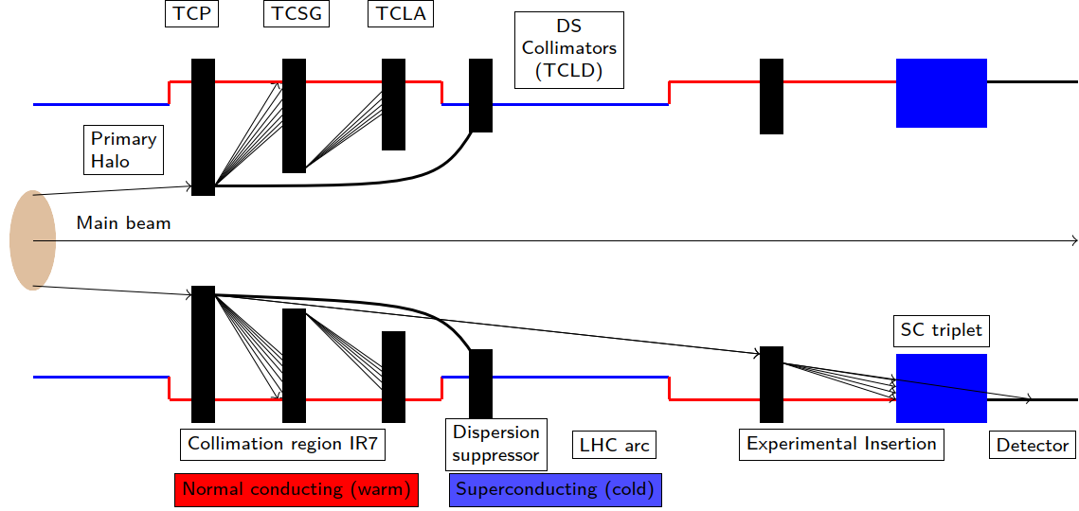
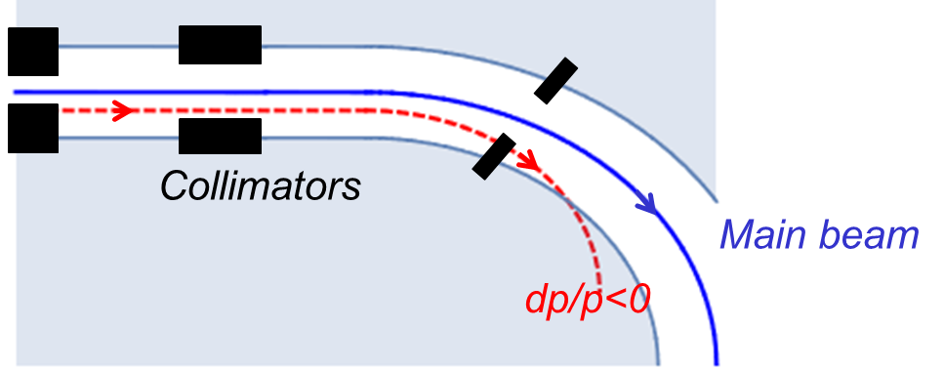
FCC-hh multi-stage collimation system
As in the LHC, using a multi-stage system with primary and secondary collimators, shower absorbers, dispersion suppressor (DS) collimators
  DS collimators are placed in the cold region, in between dipoles where dispersion has risen
Similar layout as the LHC, but some modifications: DS collimators in many insertions, extra shower absorbers in extraction insertion, removal of skew primary
DS collimator

Slide 10
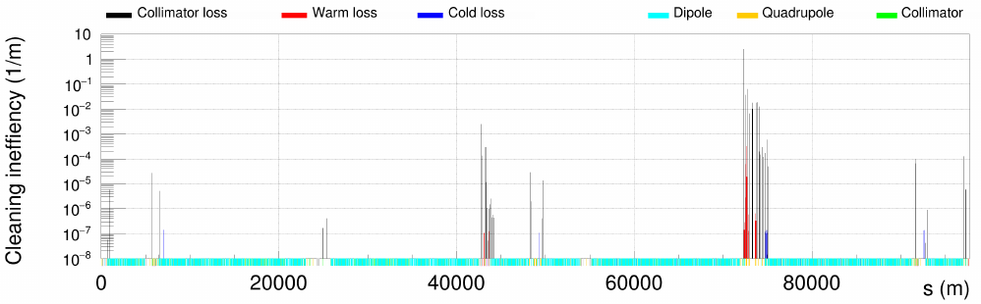
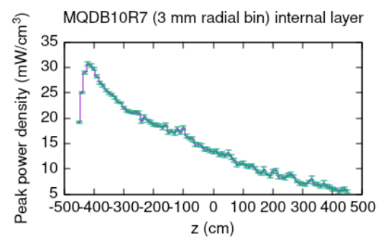
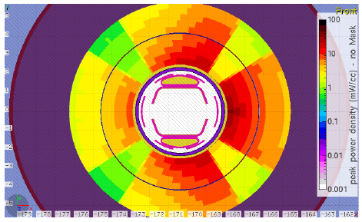
Collimation performance – FCC-hh protons
Collimation performance checked with tracking studies using the SixTrack-FLUKA coupling and dedicated FLUKA simulations of exposed magnets
Collimation system is extremely efficient at absorbing horizontal and vertical losses – almost no losses on cold machine aperture, thanks to dispersion suppressor collimators
Collision, 50 TeV
J. Molson
Most loaded cold magnet
M. Varasteh

Slide 11
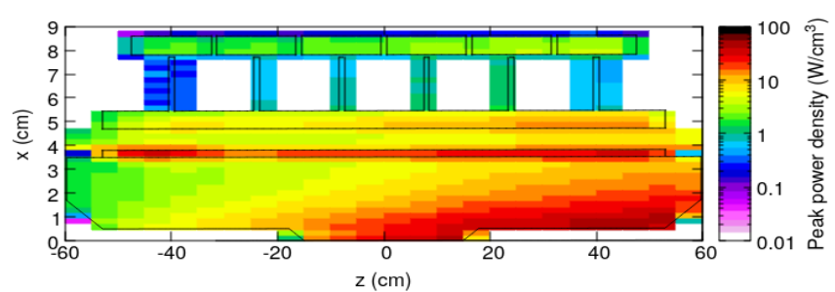
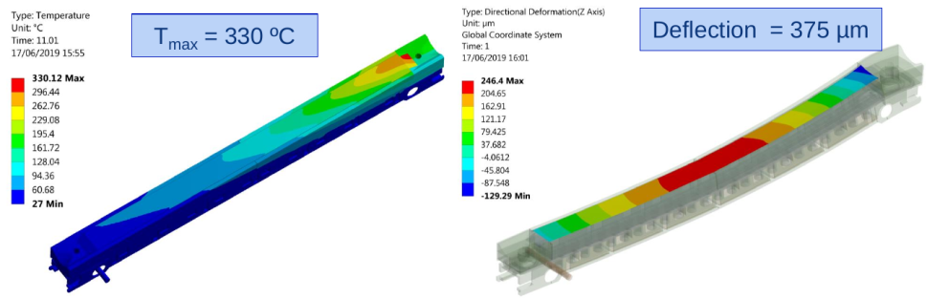
FCC collimator design
Horizontal primary
Assuming LHC-type collimators, with some design modifications, following iterative simulations of tracking, energy deposition and thermo-mechanical response
Materials
  Primary collimators, and most loaded secondary collimator made of carbon-fiber-composite (CFC) for maximum robustness
  Remaining secondary collimators in MoGr with 5 μm Mo coating for a good compromise between impedance and robustness
Collimators would survive design losses in simulations, but some challenges remain: high temperature leading to potential outgassing, high deflection, load on cooling pipes
M. Varasteh
G. Gobbi, M. Pasquali

Slide 12
Outline
Introduction and motivation
  Challenges with collimation in high-energy hadron colliders
  FCC-hh vs LHC
  Recap of collimation design for CDR
  Updates since CDR
  Outlook and needed future work
  Conclusions

Slide 13
Updates since CDR
Tunnel layout updated – see talk M. Giovannozzi
  Need to revisit optics and layout of the whole ring
Symmetric 8-point layout, ring circumference decreased from 97.7 km to 91.1 km
Betatron collimation moved to shorter insertion: 2.1 km instead of 2.8 km
Momentum collimation in longer insertion: 2.1 km instead of 1.4 km
2022
CDR

Slide 14
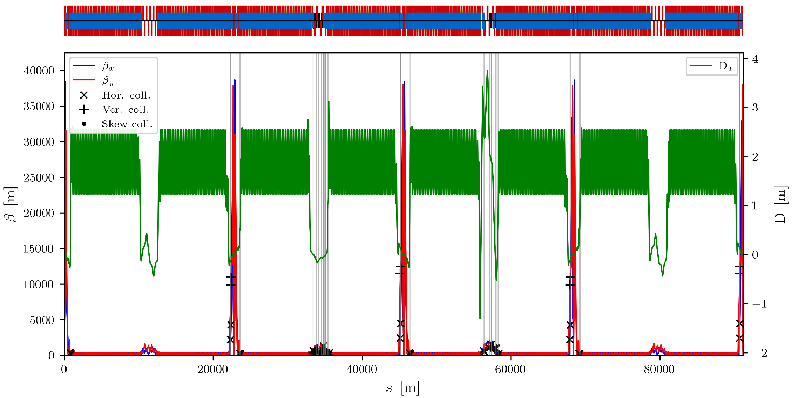
Updates to FCC-hh ring
New layout and optics under development – work in progress, but first results available (T. Risselada)
  Details shown in talk by M. Giovannozzi
Inserted collimators similar to LHC layout, including betatron and momentum collimation, tertiary collimators at experiments
  Some collimators still to be implemented (at beam dump, physics debris…)
IRA
IRB
IRD
IRF
IRG
IRH
IRJ
IRL
exp
dump
exp
collim.
exp
collim.
exp
RF

Slide 15
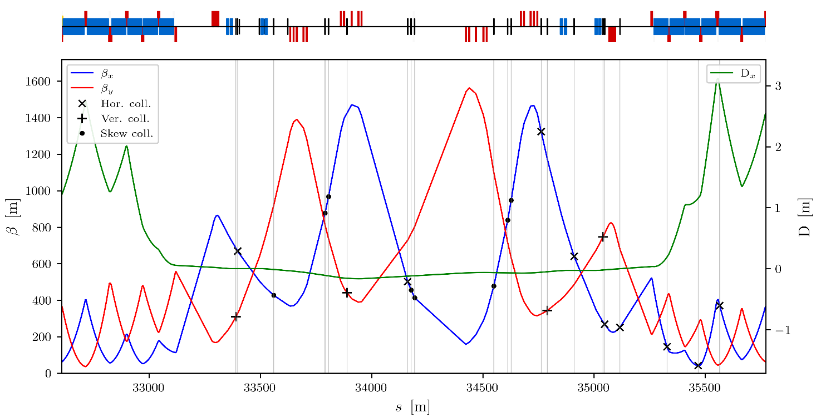
Updates to betatron collimation layout
IRF
Scaling the original LHC collimation optics to new insertion lengths
(T. Risselada)
Similar collimator layout as LHC, but including 3 dispersion suppressor collimators as CDR-version of FCC-hh
Insertion length and beta functions scaled by a factor ~4 compared to the LHC
Smallest collimator half gap (vertical primary) around 0.8 mm
  Compare: ~1mm in LHC

Slide 16
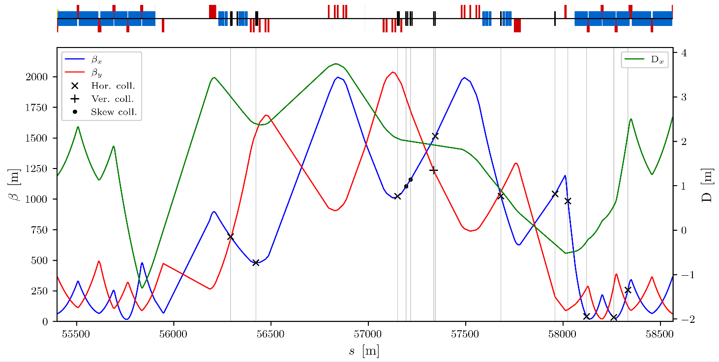
Momentum collimation
IRH
For momentum collimation, LHC scaling used as starting point
First implementation of optics and layout available
Features high dispersion at primary collimator to give flexibility and independence between betatron and momentum cuts
DS collimators added

Slide 17
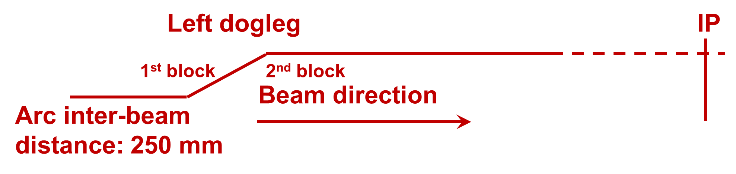
Optimization of doglegs
M. Giovannozzi
Dogleg changes the distance between the beams in collimation insertion
  Separate primary beam from neutrals.
  Minimise flux of neutrals on the first superconducting magnet on right side of IP
  Needed separation depends on geometry of insertion
CDR layout: dogleg scaled from the LHC
New version: dogleg geometry worked out based on actual geometry in IRH
  290 mm separation proposed (compare 250 mm in the arc)
  To be confirmed with energy deposition studies

Slide 18
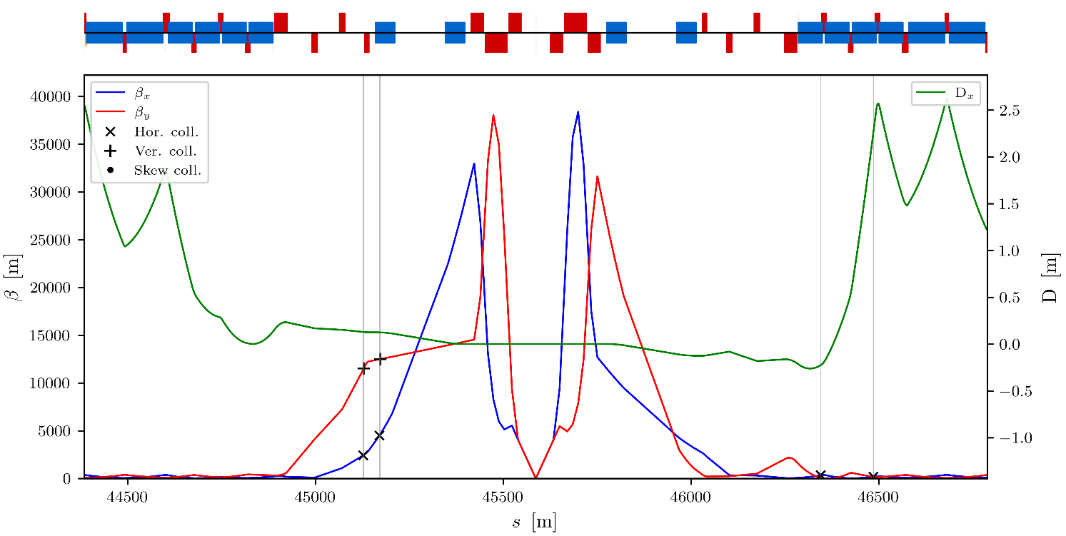
Collimation in experimental insertions
Two pairs (horizontal-vertical) tertiary collimators on incoming beam
Two dispersion suppressor collimators on outgoing beam
Physics debris collimators still to be implemented
IRG

Slide 19
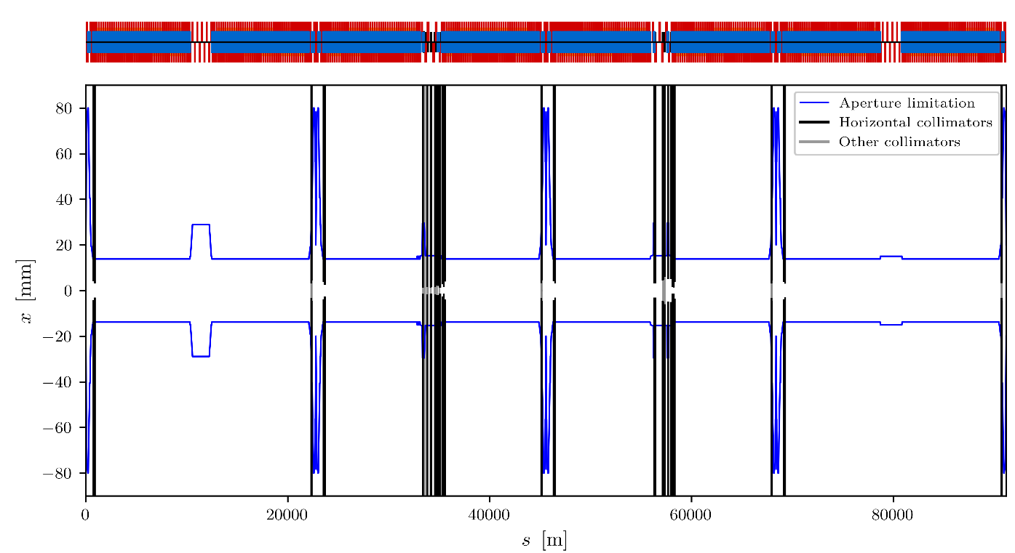
Updates to aperture model
A detailed aperture model around the ring is crucial for collimation studies
First implementation of new aperture model, based on mapping from CDR lattice (A. Abramov)
  Including main magnets and collimators in insertion regions and arcs
To be refined in future iterations
Full ring
A. Abramov

Slide 20
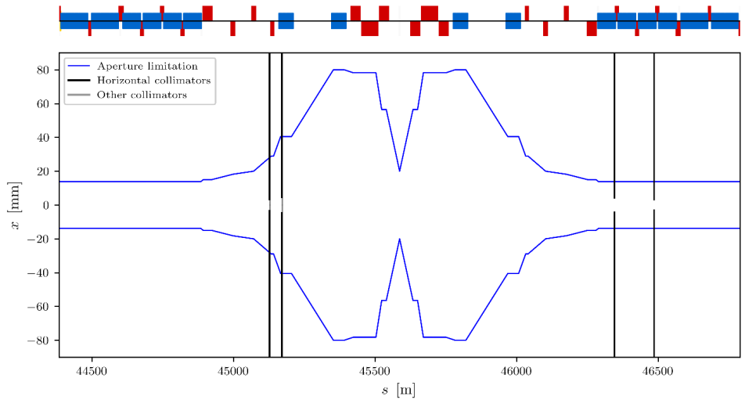
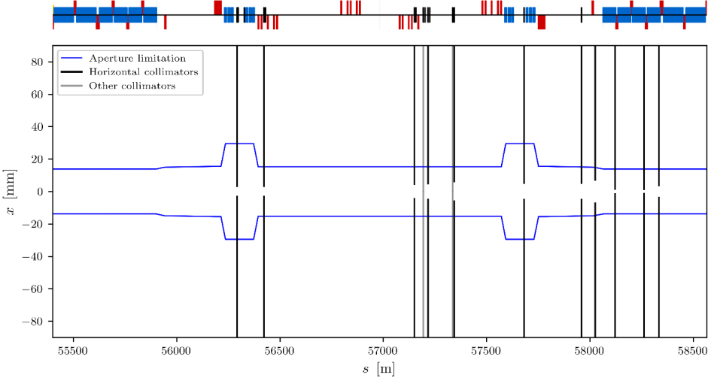
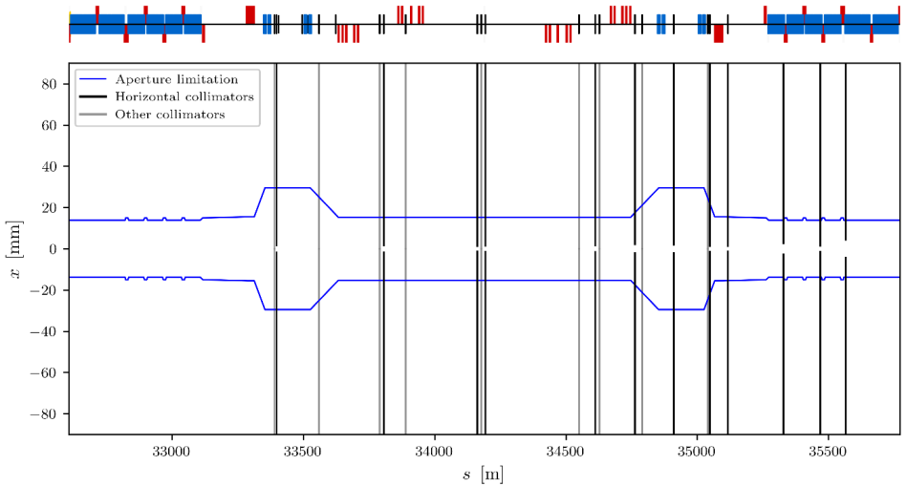
Aperture model in insertions
IRG (experiment)
Apertures mapped from similar elements in CDR lattice – to be refined in future iterations
Preliminary result
IRH (momentum collimation)
IRF (betatron collimation)
A. Abramov

Slide 21
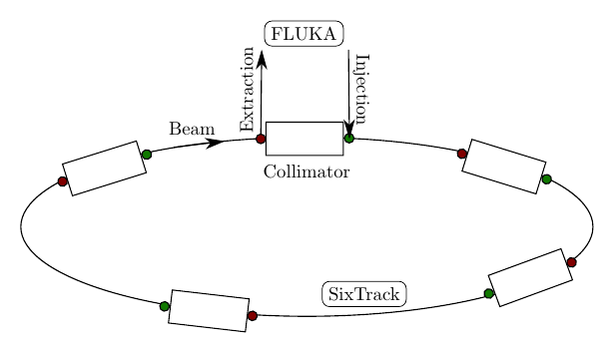
Simulations of collimation performance
Collimation performance simulated for latest version of FCC-hh using the SixTrack-FLUKA coupling
  Magnetic tracking using SixTrack, particle-matter interactions in FLUKA
Simulation assumptions
  1 μm impact parameter of generic halo on primary collimator – not simulating diffusion bringing halo onto collimators
  Same collimator settings in σ and materials as in CDR
Impact parameter
Main beam

Slide 22
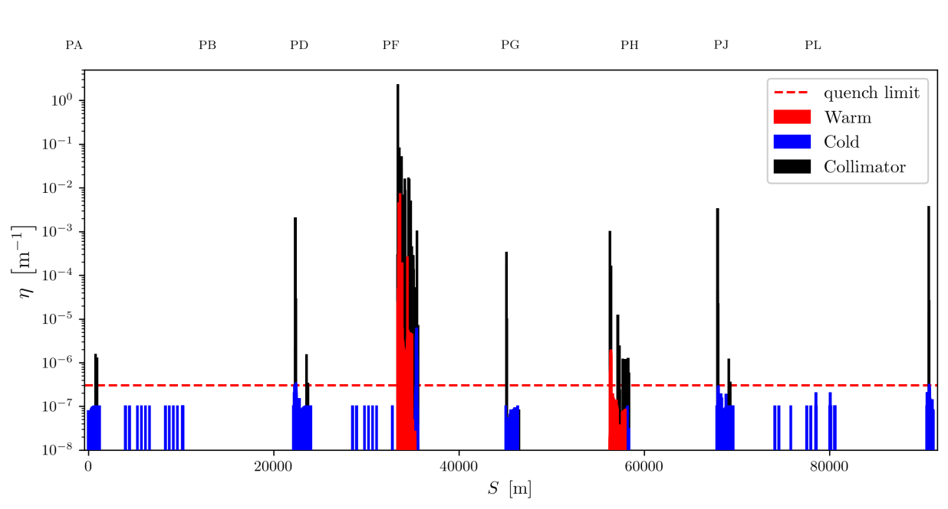
Simulated performance
Generally very good protection of the ring, losses localized on betatron collimation system
Rather high losses on tertiary collimators, with downstream leakage to cold magnets
  Potentially problematic, to be followed up in future iterations
Horizontal halo, beam 1, 50 TeV
A. Abramov
Preliminary result

Slide 23
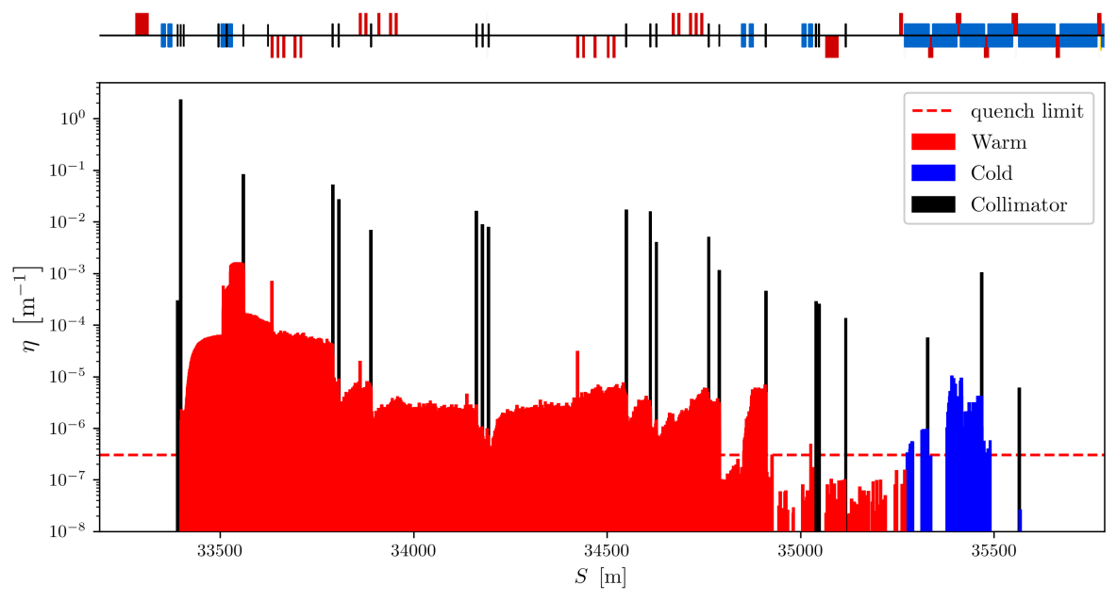
Simulated performance - IRF
Dispersion suppressor collimators essential for protecting the ring and the DS
Nevertheless losses in between them are well above the assumed quench limit
  Further iterations are needed to optimize collimation performance
Energy deposition should be evaluated with dedicated studies at critical locations – future work
  Compare power load in magnet coils with quench limit
  Note: Particle showers not seen in the loss map plots, which show only proton losses
Horizontal halo, beam 1, 50 TeV, Zoom in IRF
A. Abramov
Preliminary result

Slide 24
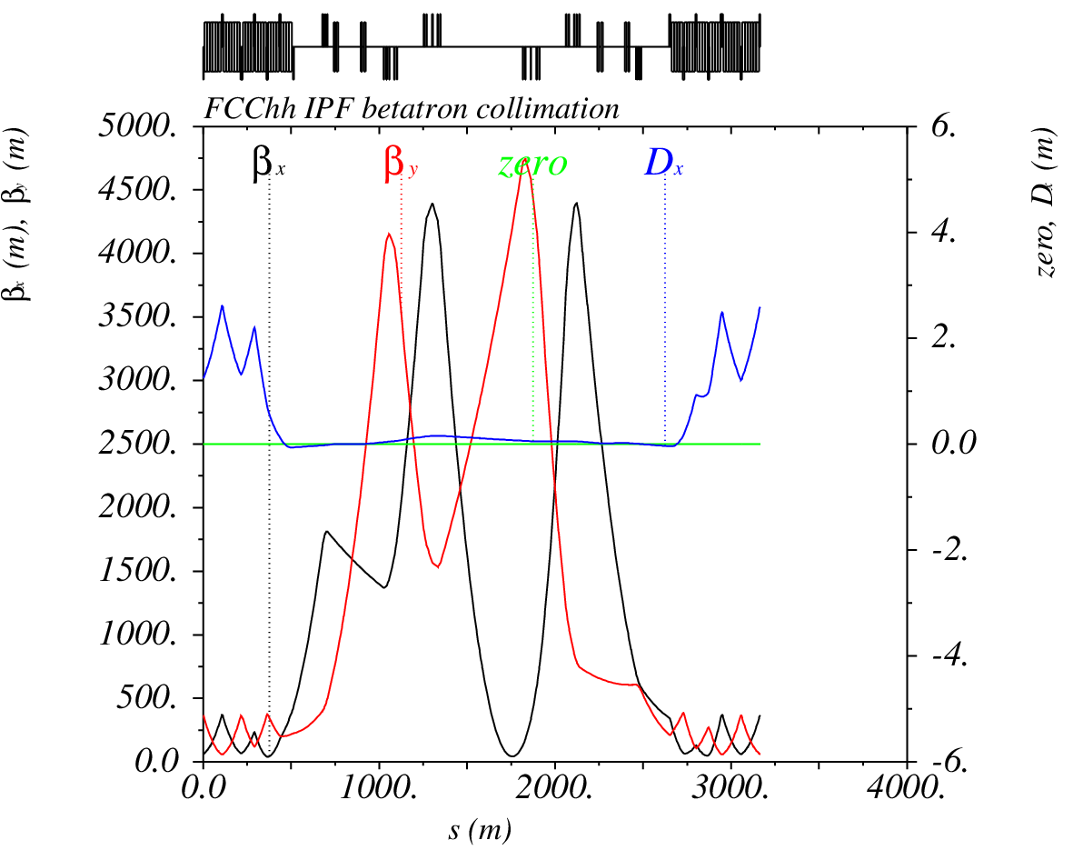
High-β optics for collimation
T. Risselada
Small collimator gaps might lead to problematic impedance (to be evaluated)
Could be mitigated through an optics with larger β-functions
Such an optics could also give significant gains in cleaning efficiency
  As for LHC studies in IPAC’21 paper
First exploratory studies carried out for new FCC-hh layout (T. Risselada)
  To be followed up with impedance and cleaning performance studies

Slide 25
Outline
Introduction and motivation
  Challenges with collimation in high-energy hadron colliders
  FCC-hh vs LHC
  Recap of collimation design for CDR
  Updates since CDR
  Outlook and needed future work
  Conclusions

Slide 26
Next steps
Need to repeat work from CDR for new layout
Explore optimizations of optics and collimator settings
Study performance of momentum cleaning
Study impedance
Energy deposition studies to quantify risk of quench for design losses
Maybe new thermo-mechanical studies of most loaded collimators
Study outgassing and cooling of the most impacted elements in collimation insertion
Study failure scenarios
Collimation for Pb ion operation
  Energy deposition studies of collimation insertion and dispersion suppressor, possibly including imperfections
  Further studies of secondary beams from collision points
Imperfection studies?
Think of possible HiRadMat tests?
  Potential alternative: Laser-induced mechanical shock – possible synergies with tests carried out at GSI facility?

Slide 27
Conclusions
An excellent collimation performance is crucial to keep the FCC-hh safe, and to operate smoothly without quenches
  8.3 GJ stored beam energy, 11.6 MW beam loss power
Fairly mature design presented in CDR, new iterations needed with latest layout
  Shorter insertion length for betatron collimation
  First new optics and collimation layout developed for betatron and momentum cleaning insertions
    Work in progress
First studies of cleaning performance with new lattice performed
  Generally good performance, but some bottlenecks need further study and performance improvements
    Tertiary collimators
    IRF dispersion suppressor

Slide 28
Thank you for your attention.
Date / Name of the event
Name of the speaker/author
Space for additional logos
28

