Slide 1


Modelling process for vibrations estimation of the MDI
B. Aimard, G. Balik, L. Brunetti, J.P. Baud, A. Dominjon, S. Grabon, G. Lamanna,
E. Montbarbon, F. Poirier L

Slide 2
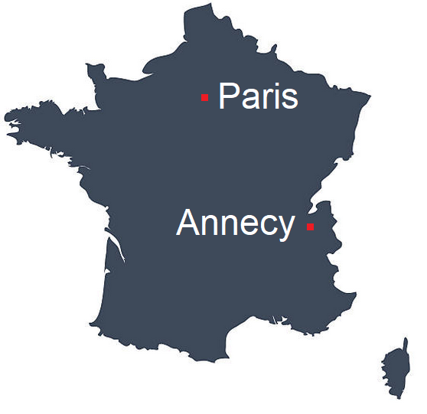
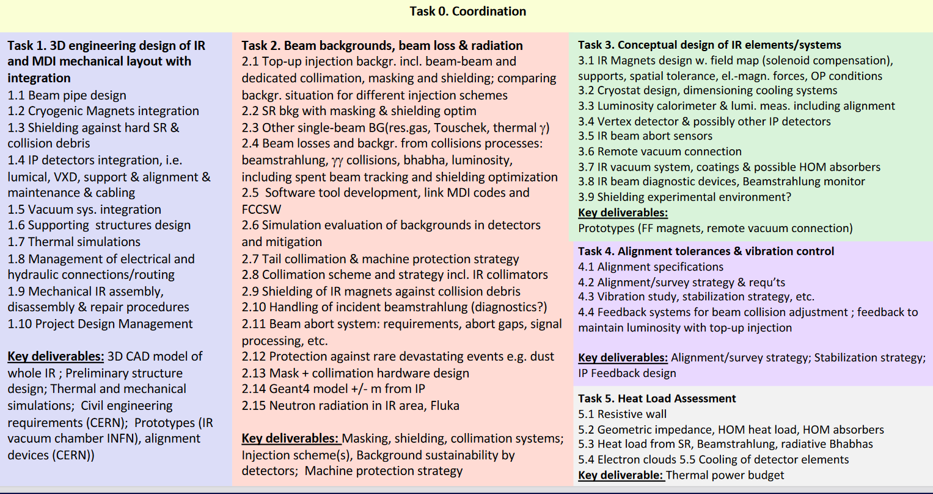
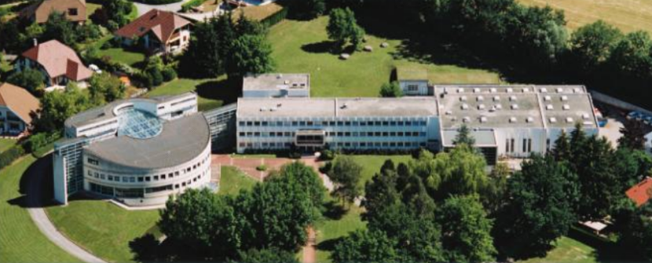
MDI Work packages

Slide 3
Presentation overview
Goal
Current situation
Overview of the process
Modelling
Modal analysis
State space model
State space model’s processing
First results
Conclusion
Perspectives

Slide 4
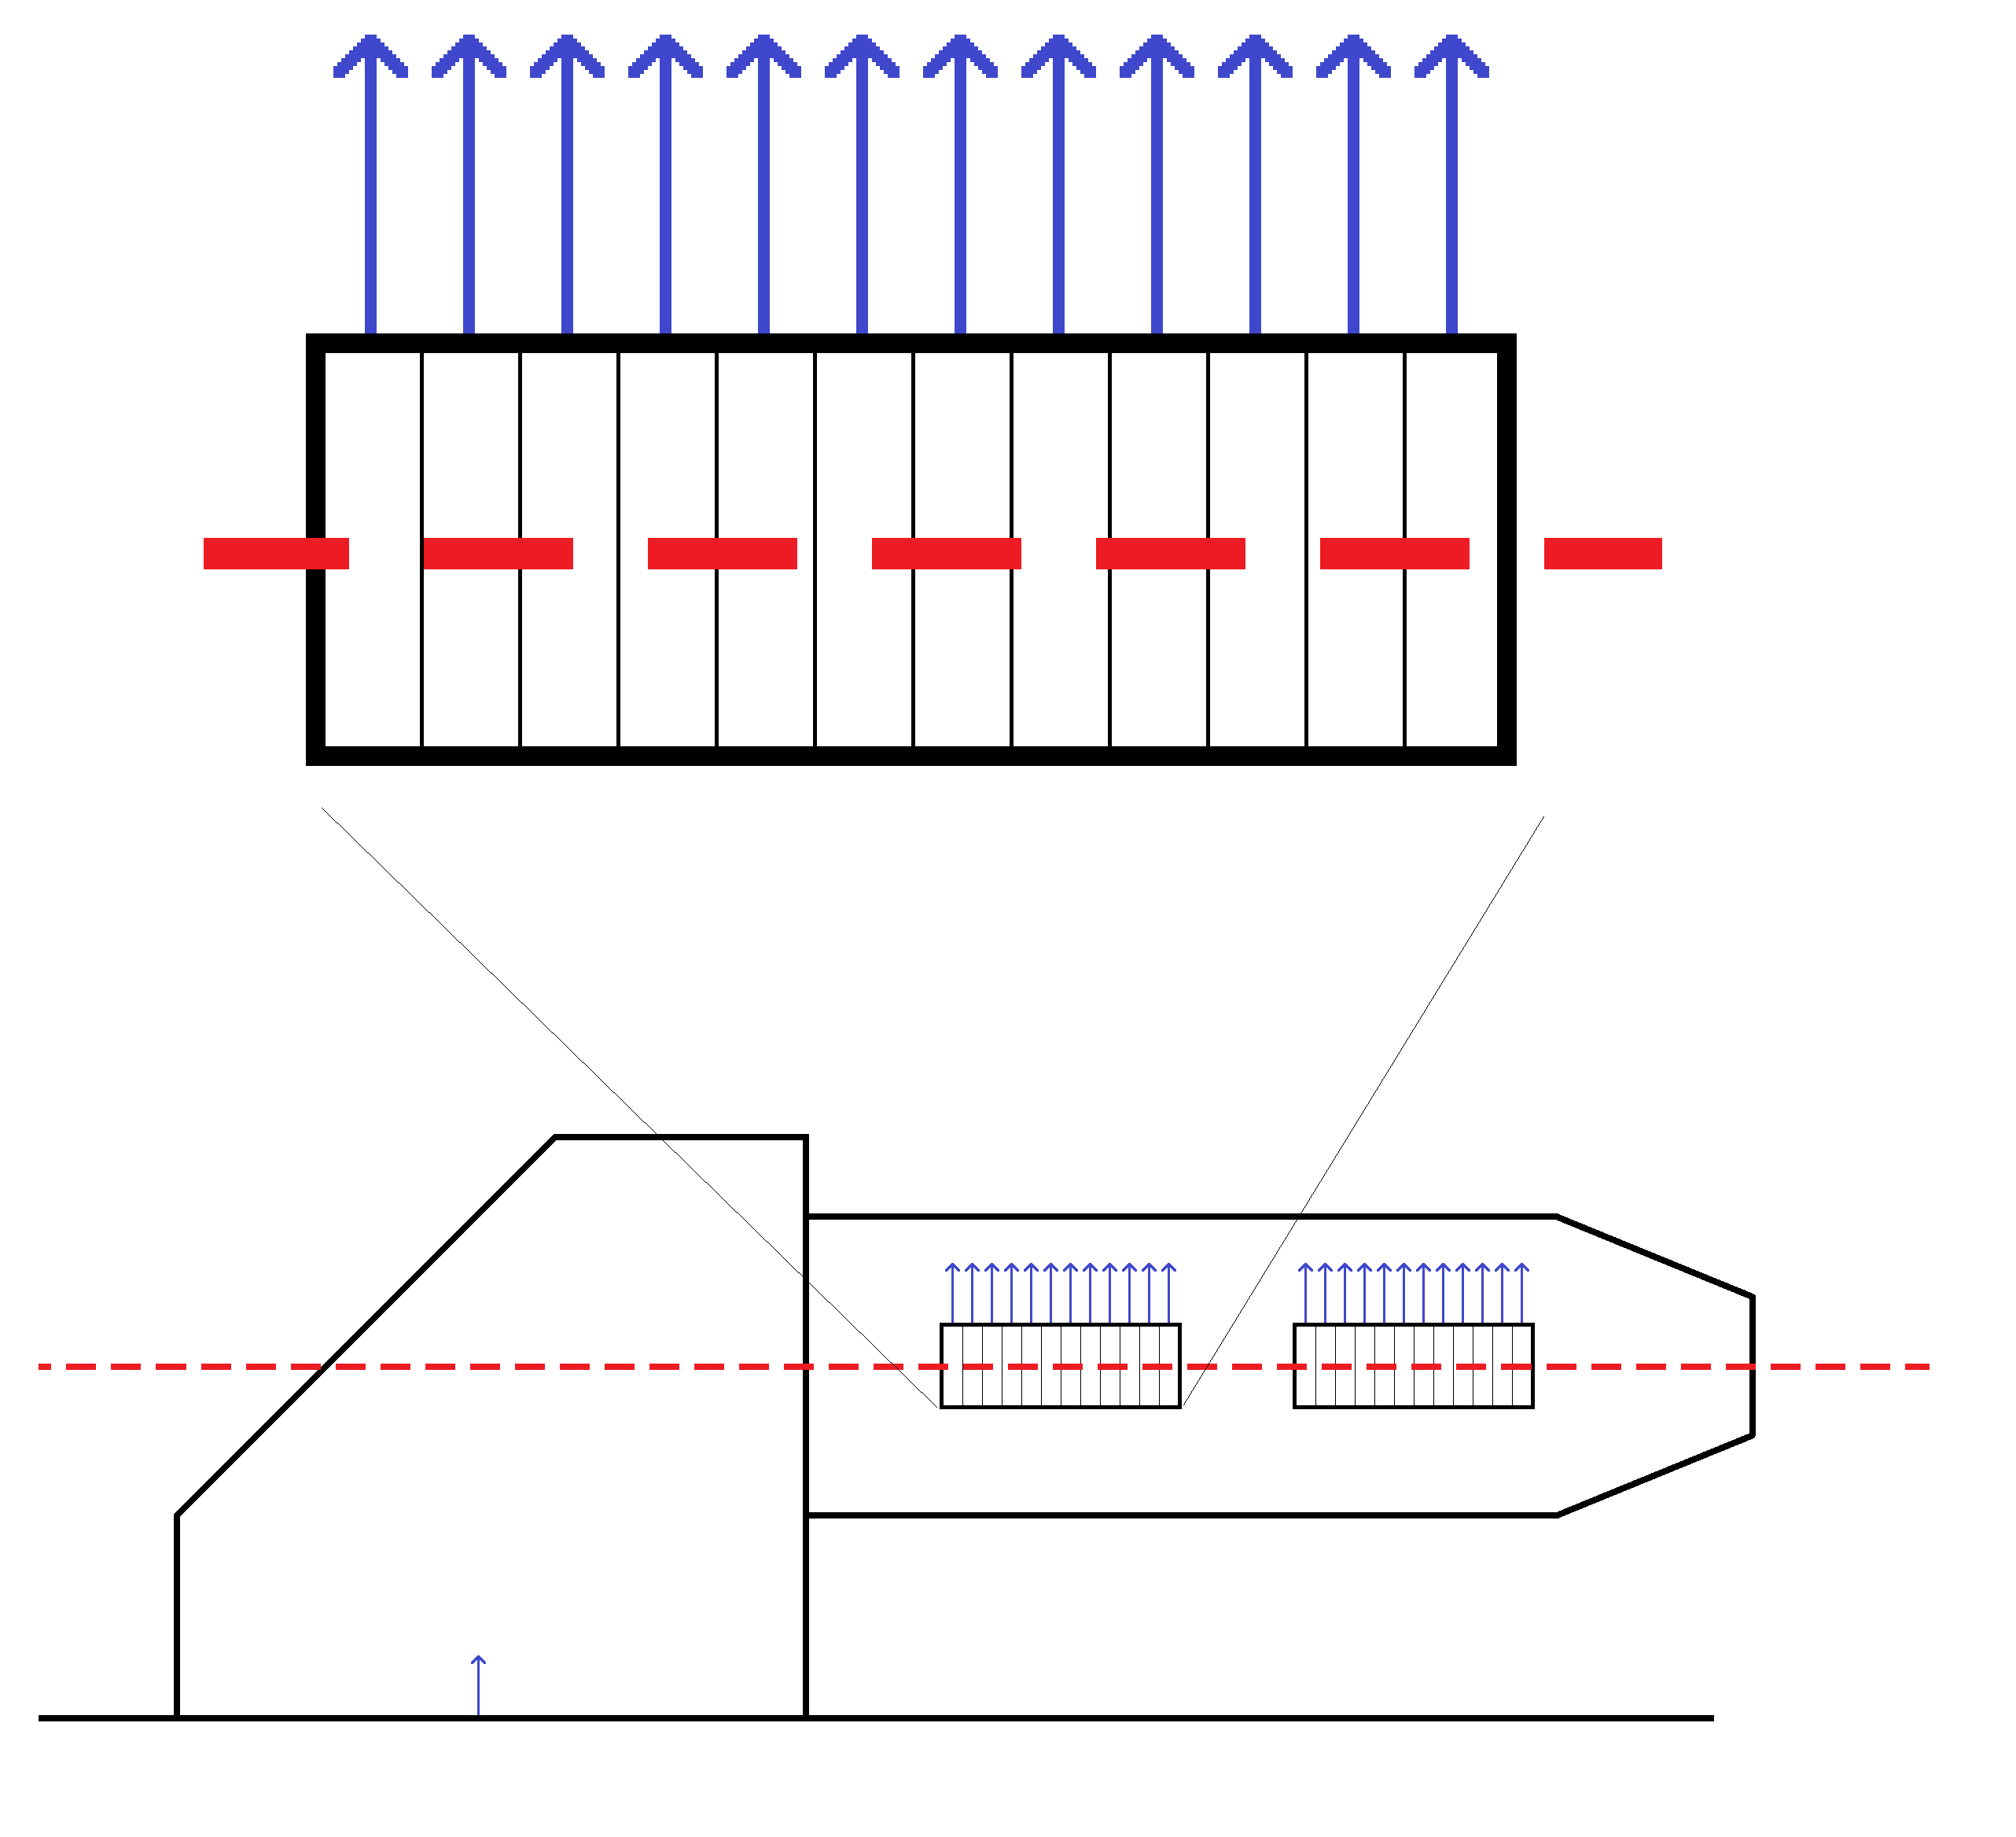
Goal
Magnet slices displacement
Magnet’s dynamic behaviour
Emittance,
luminosity
Magnet slices
Beam
?
Studied by Eva on MAD-X
(Work in progress)
Ground displacement
Magnets

Slide 5
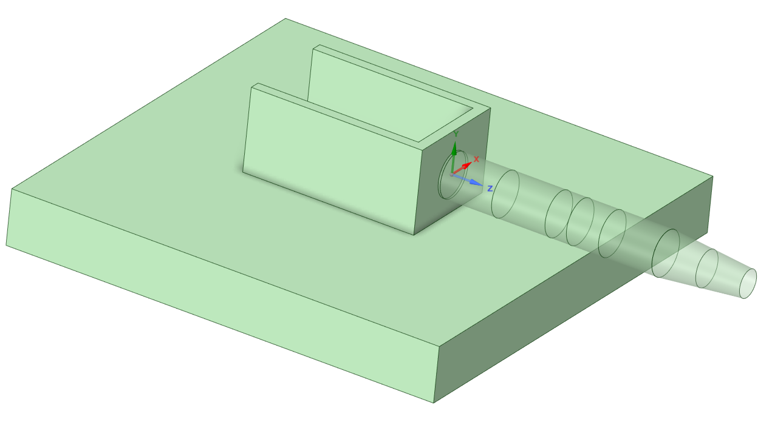
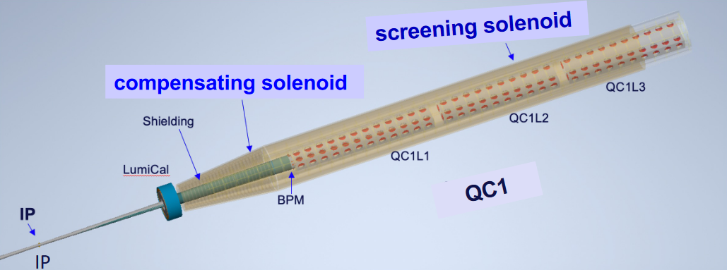
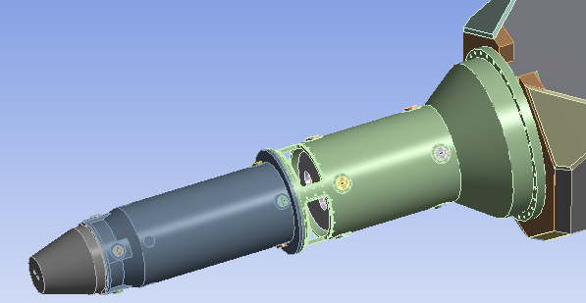
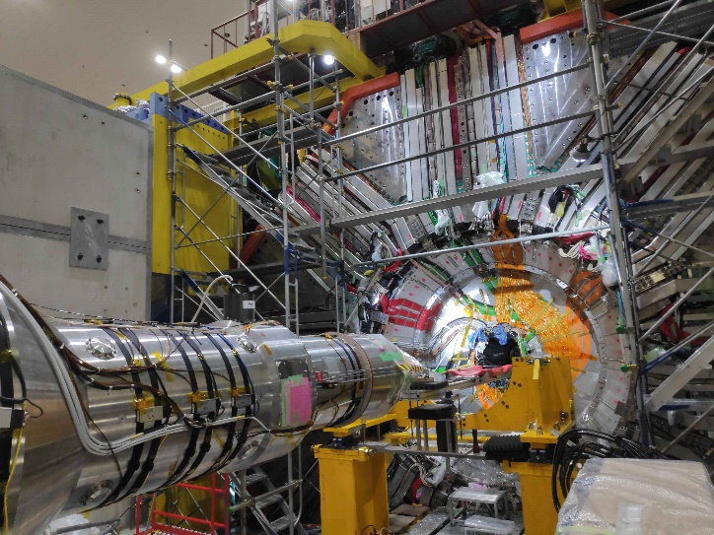

Current situation
The design of the MDI is still in progress.
Development of the process using a simplified 3D model
accelerometer
SuperKEKB
Similarities:
Similar beam, cryostat in cantilever
Difference:
The HER and LER final focus magnets are not symmetrical inside the cryostat

Slide 6
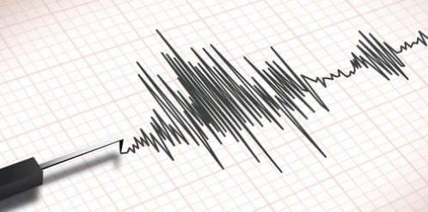
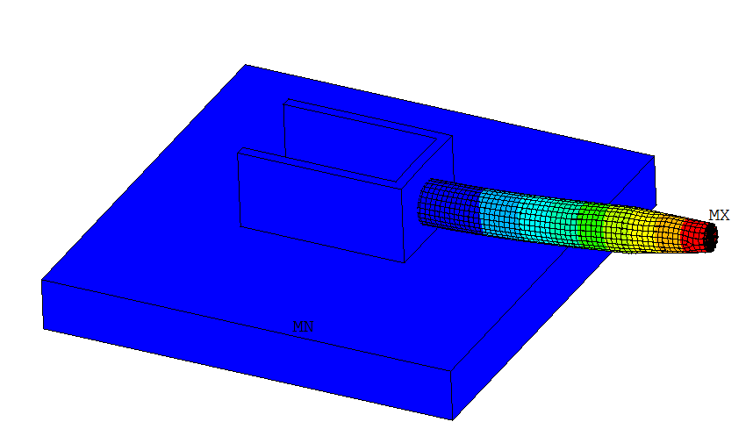
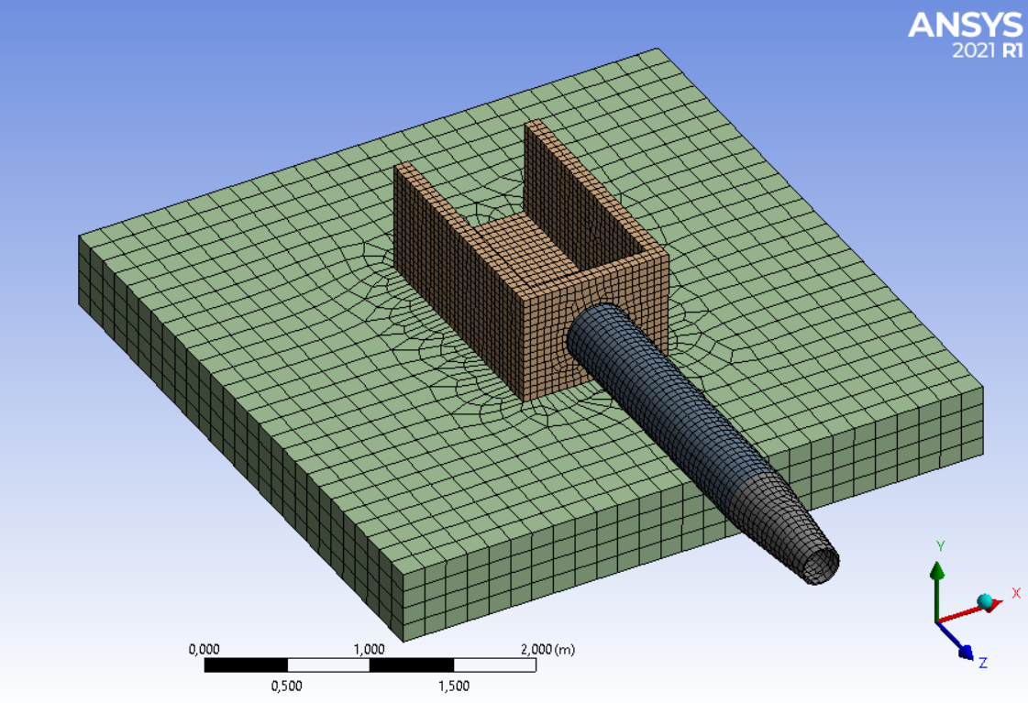

Overview of the process
Simple mathematical model
Input displacements
Output displacements
1
Modelling
2
Modal Analysis
3
State space model

Slide 7
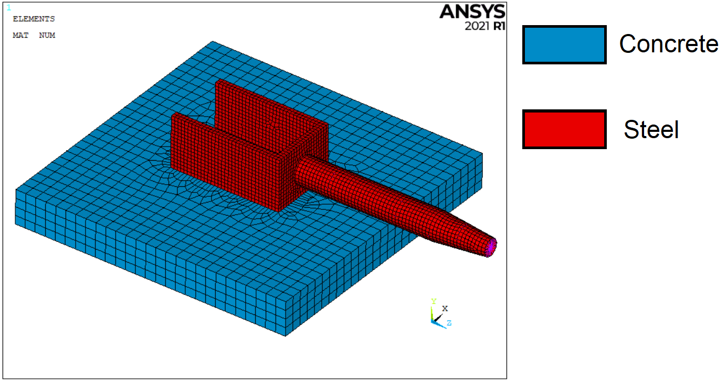
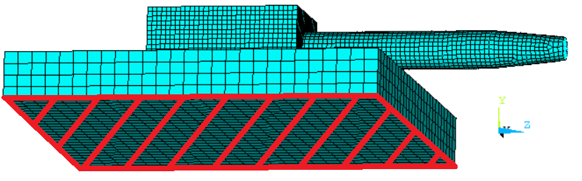
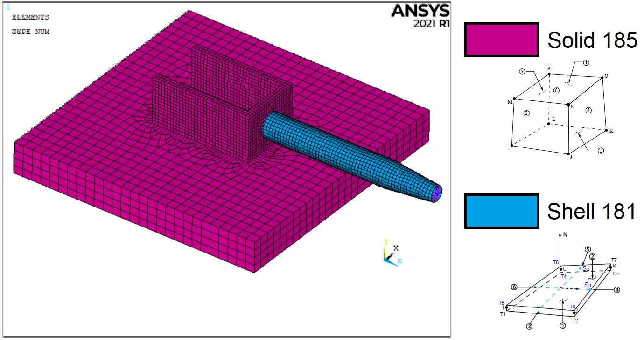
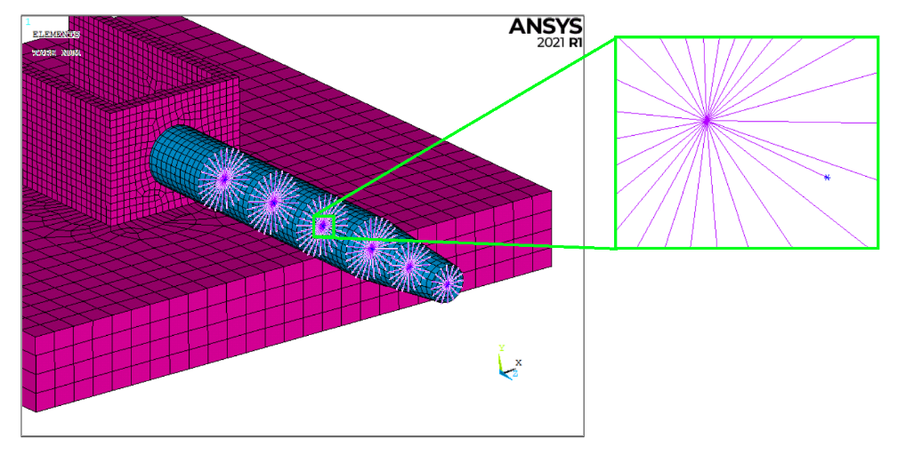
1 : Modelling
1
3 translations and 3 rotations blocked
Materials
Boundary conditions
Mass point
Very stiff massless beams
Element type
Inner structure

Slide 8

Modal analysis
2
modal analysis
Linear model:
(no plasticity, no contacts, etc…)
natural frequencies and mode shapes
Mode-extraction method:
Block Lanczos

Slide 9
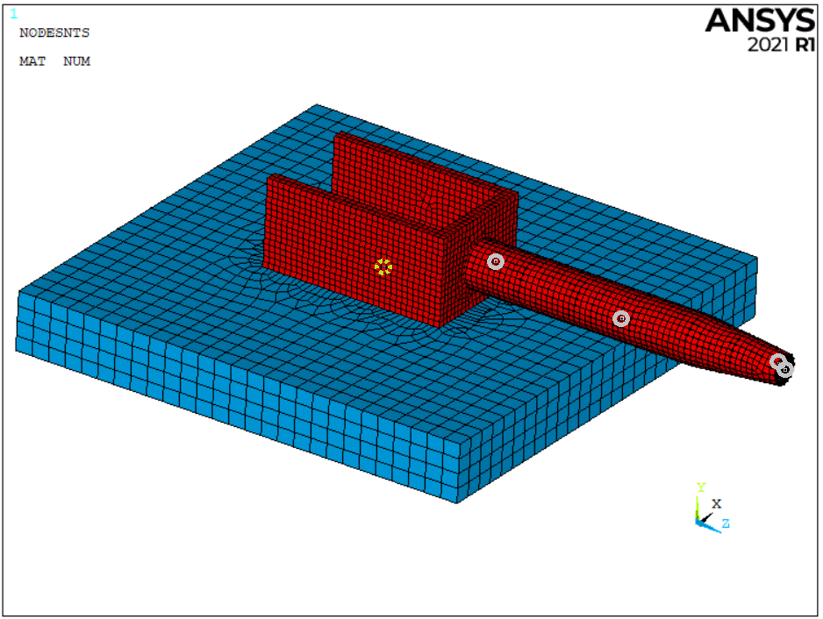
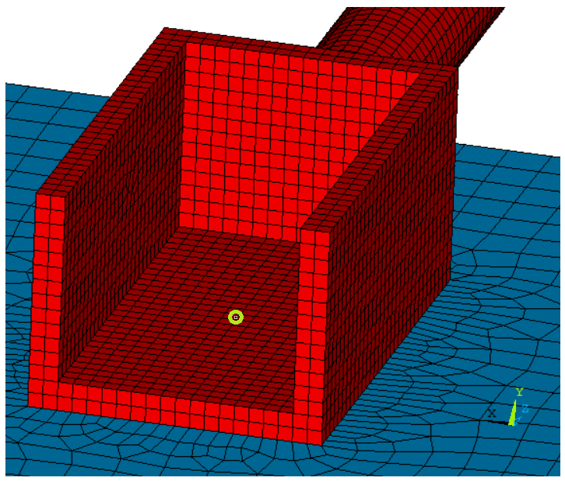

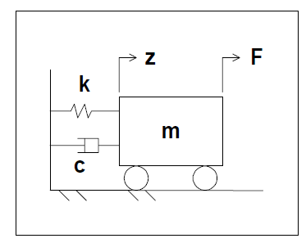






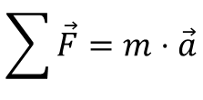


State space model
3
Output points
Calculation of the state-space matrices
$$\sum{\vec{F}}=m⋅\vec{a}$$
General formula:
For one point:
$$m⋅\vec{a}+c\vec{v}+kz={\vec{F}}_{ext}$$
Input point
Matrix form:
$\left[M\right]⋅\left[\ddot{z}\right]+\left[C\right]⋅\left[\dot{z}\right]$ $+$ [K] $⋅$ $\left[z\right]$ = [F ]
$$x_{1}=z_{1}$$
Position of Mass 1
Variable change:
$$x_{2}={\dot{z}}_{1}$$
Velocity of Mass 1
$$\left[\dot{x}\right]=\left[A\right]⋅\left[x\right]+\left[B\right]⋅\left[u\right]$$
x, u and y represent the states, inputs and outputs respectively, while A, B, C and D are the state-space matrices.
$$x_{3}=z_{2}$$
Position of Mass 2
$$\left[y\right]=\left[C\right]⋅\left[x\right]+\left[D\right]⋅\left[u\right]$$
$$x_{4}={\dot{z}}_{2}$$
Velocity of Mass 2
…

Slide 10
State space model’s treatment
Calculation of the state-space matrices
Output displacements
Input displacements

Slide 11
First results
PSD : Power spectral Density

Slide 12
Conclusion
  very light model
  very fast calculation
  modal calculation independent of input displacements: only one FE calculation
  can’t take into account non linearities
State space matrices
MAD-X
Output displacements
Input displacements

Slide 13
Perspectives
Simple cantilever beam
Build an instrumented prototype to test the process:
During the development of the MDI, we will need different prototypes to characterize the dynamic behavior of the structure and estimate the impact on future emittance and luminosity.
FCC reduced model
Small cryostat section
Test on different parts
Test on the connecting parts

Slide 14
Thank you for your attention!
14

