Slide 1
RF tests of 1.3 GHz Nb/Cu elliptical cavities
L. Vega-Cid, S. Atieh, A. Bianchi, G. Favre, L. Ferreira, L. Lain-Amador, S. Leith, C. Pereira, M. Redondas, G. Rosaz, K. Scibor, W. Venturini Delsolaro, P. Vidal-Garcia
FCC Week 2022
31th of May 2022

Slide 2
Contents
FCC Framework:
  SRF requirements
  Timeline
Overview of 1.3 GHz cavities program:
  Workflow
  Tested cavities
RF tests results
  Towards FCC: At 4.2 K
  Towards high gradient, high energy machines: At 1.85 K
Summary and conclusions

Slide 3
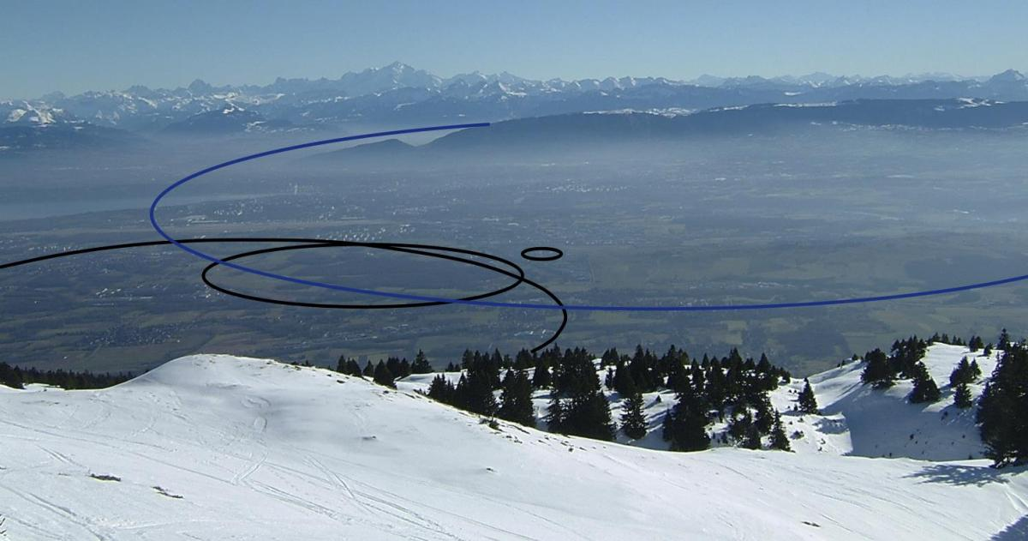
FCC FRAMEWORK

Slide 4
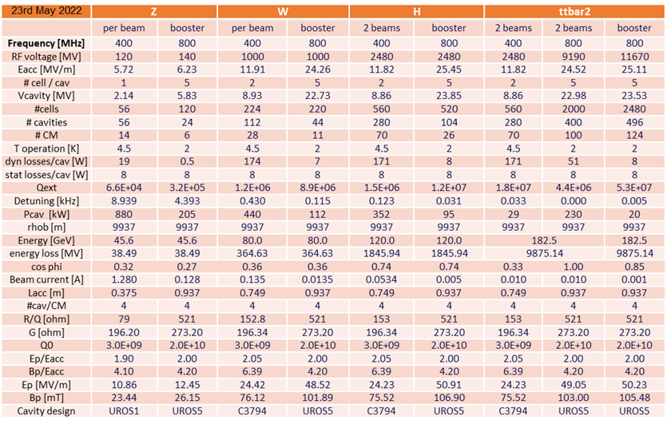
SRF System requirements
Evolved scenario from the CDR (Input from WP1):
Most demanding scenario:
Frequency | 400 MHz
E_{acc} [MV/m]
# cell/ cav
T_{operation} [K]
Q₀
Frequency | 400 MHz
E_{acc} [MV/m] | 12
# cell/ cav
T_{operation} [K]
Q₀
Frequency | 400 MHz
E_{acc} [MV/m] | 12
# cell/ cav | 2
T_{operation} [K]
Q₀
Frequency | 400 MHz
E_{acc} [MV/m] | 12
# cell/ cav | 2
T_{operation} [K] | 4.5
Q₀
Frequency | 400 MHz
E_{acc} [MV/m] | 12
# cell/ cav | 2
T_{operation} [K] | 4.5
Q₀ | 3E9
Notes:
To give context to the RD program within the FCC, let’s see the requirements of the SRF system.

Slide 5
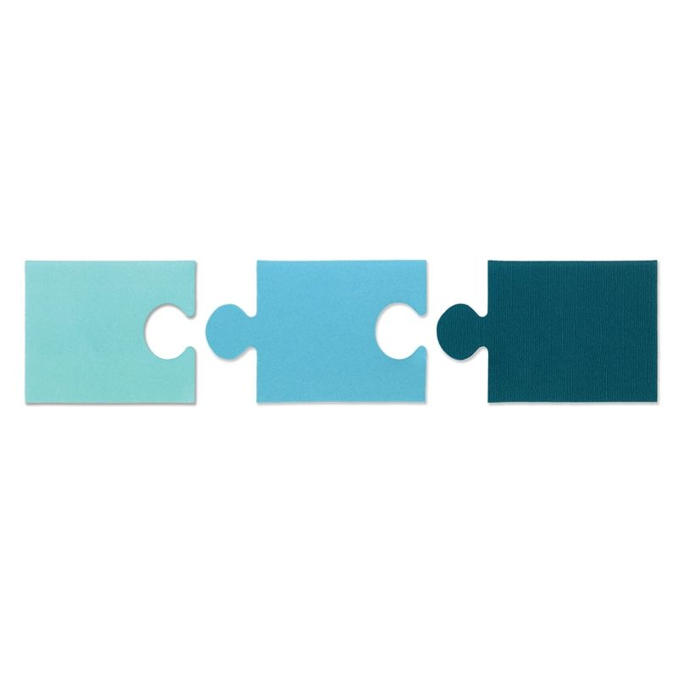
Timeline
Provide an optimized recipe for 400 MHz cavities fabrication
Delivery of FCC Feasibility Study
2021
2022
2023
2024
2025
@400 MHz:
E_{acc}~12 MV/m Q₀~3E9
T= 4.5 K
400 MHz elliptical cavities
@1.3 GHz:
E_{acc}~12 MV/m Q₀~4E8
T= 4.2 K
1.3 GHz elliptical cavities
Synergy (and co-funding) with general SRF R&D project
Thin film of low Rs
Good bonding
High quality substrate
Notes:
Looking at the timeline, two milestones within the FCC framework:
At the end of 2025 an elliptical cavity of 400 MHz needs to be provided meeting FCC requirements.
At the end of this year, we need to provide an optimized recipe as input for producing the bigger 400 MHz cavities. We have targeted the optimization in each of the steps

Slide 6
overview of 1.3 GHz cavities program

Slide 7
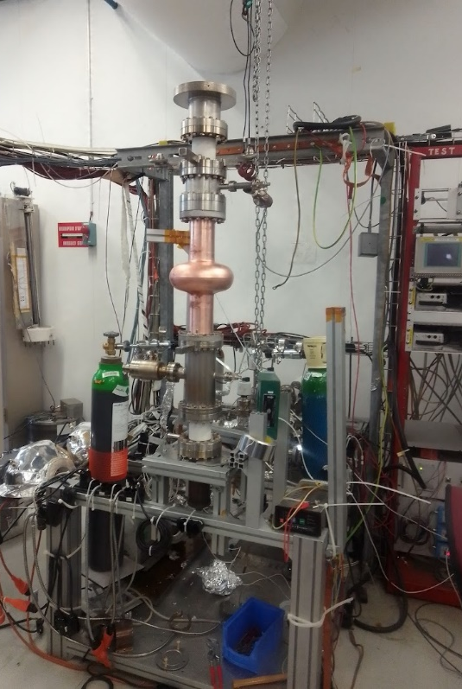
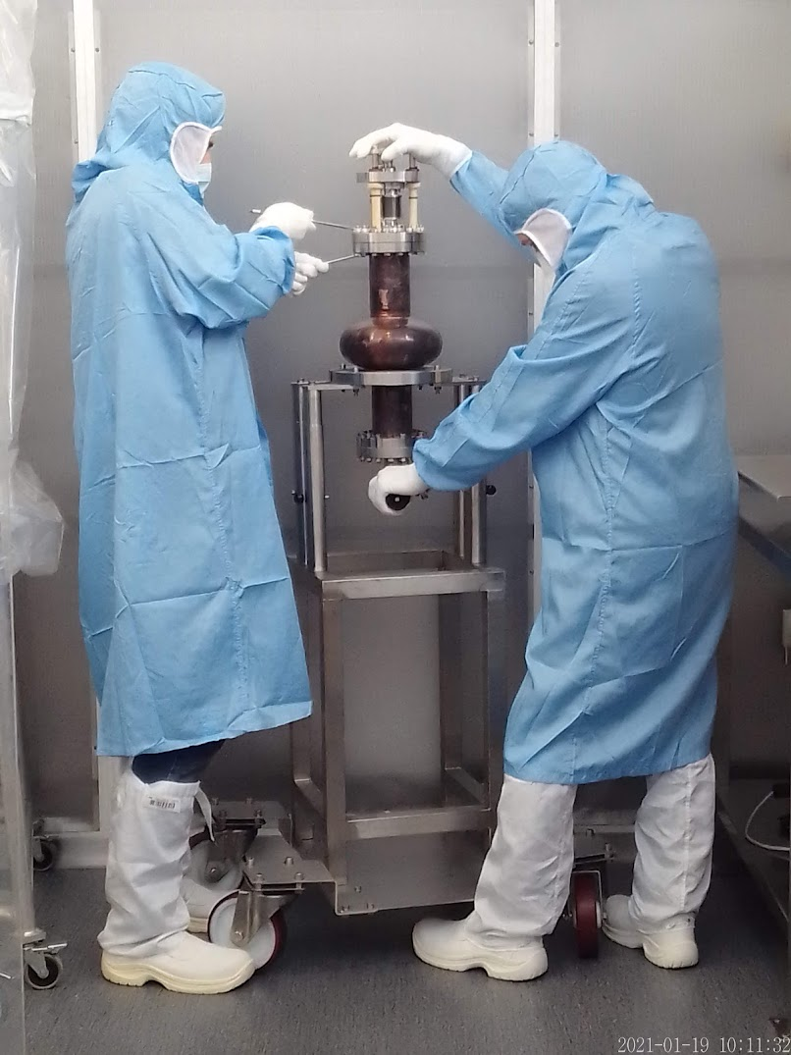
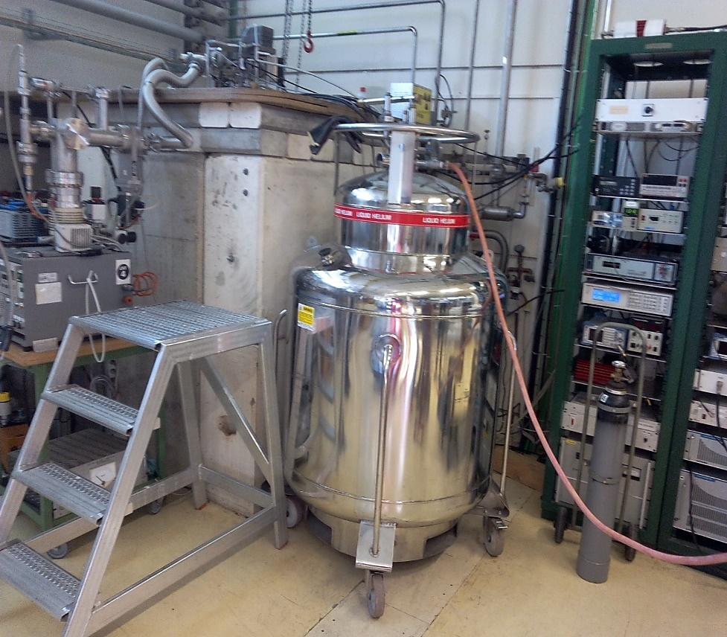
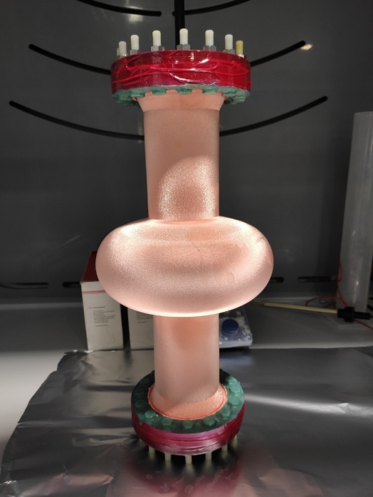
Workflow
Substrates manufacturing
Surface treatments + Coating
Cleanroom assembly
RF testing
EN-MME, TE-VSC, collaborations with INFN/LNL, JLab…
TE-VSC-SCC
SY-RF-SRF
SY-RF-SRF, TE-CRG
1.5 week
1 day
1 week

Slide 8
Workflow
Substrates manufacturing
Surface treatments + Coating
Cleanroom assembly
RF testing
EN-MME, TE-VSC, collaborations with INFN/LNL, JLab…
TE-VSC-SCC
SY-RF-SRF
SY-RF-SRF, TE-CRG
1.5 week
1 day
1 week
Regular meetings to comment results and establish a plan of action accordingly.

Slide 9
Tested cavities
R&D 1.3 GHz elliptical cavities
2021
2022
Jan
Feb
Mar
Apr
May
Jun
Jul
Aug
Sep
Oct
Nov
Dec
Jan
Feb
Mar
Apr
May
BM1.1
L1.2
BM1.2
W1.3
BM1.3a
W1.4
L1.5
BM2.1
W1.5
BM2.2
BM4.1
BM3.1
BM2.3
BM3.2a
BM2.4
BM1.3b
N4.1
BM4.2
BM3.2b
18 tests performed in the last 15 months thanks to the fruitful collaboration!

Slide 10
Tested cavities
BM
Machined from bulk billet
Seamless
Welded
W
E-beam welded
L
Electroformed

Slide 11
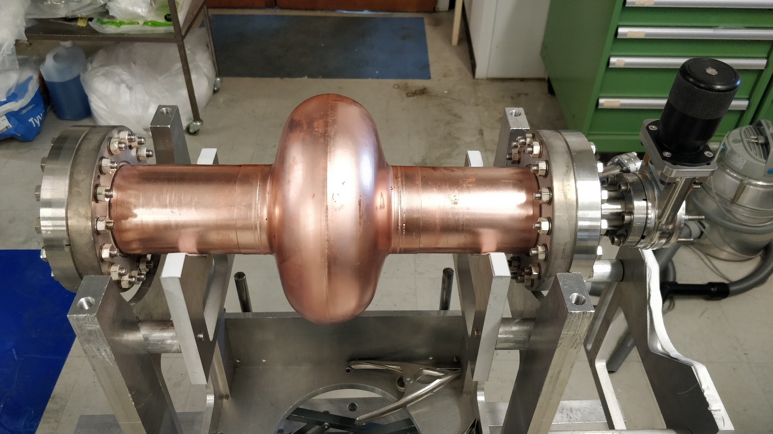
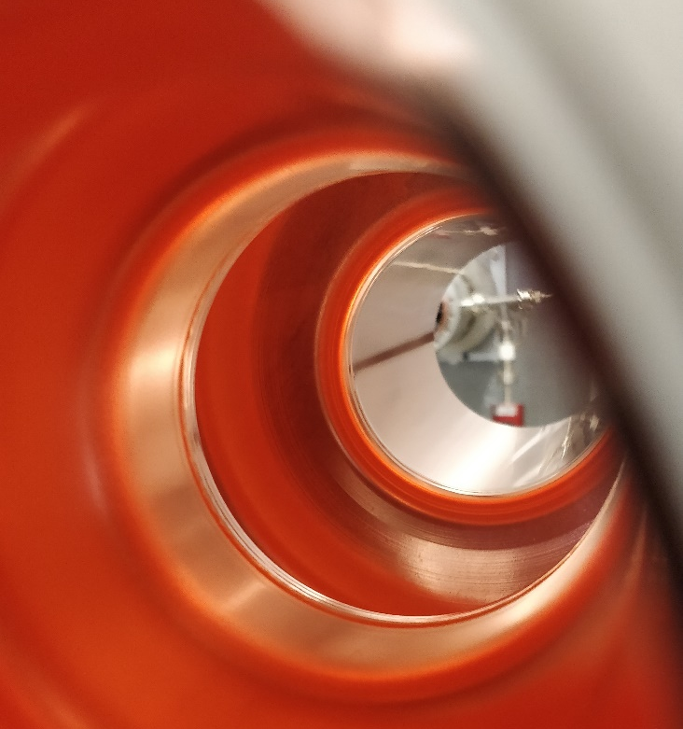
Tested cavities: Welded
EQUATOR: E-beam welded from inside using a deflector
IRIS: Welded from inside by firing at a tilted angle from outside the cavity.

Slide 12
Tested cavities
BM
Machined from bulk billet
Seamless
Welded
W
E-beam welded
L
Electroformed

Slide 13
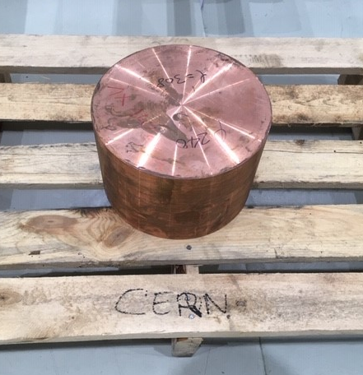
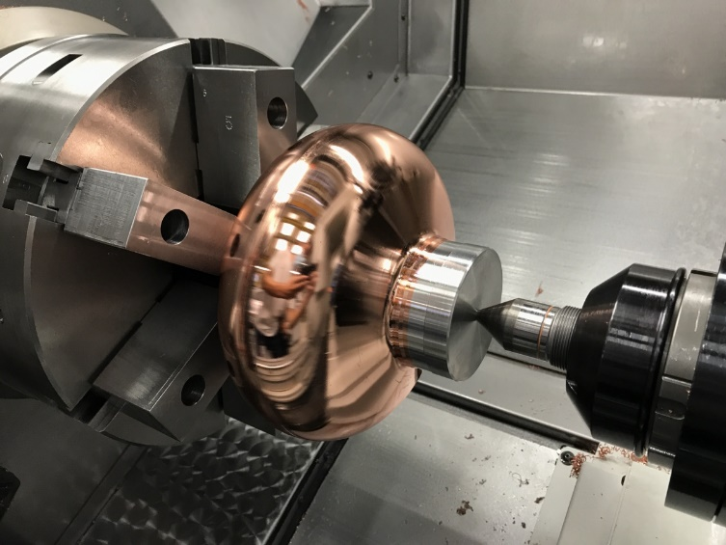
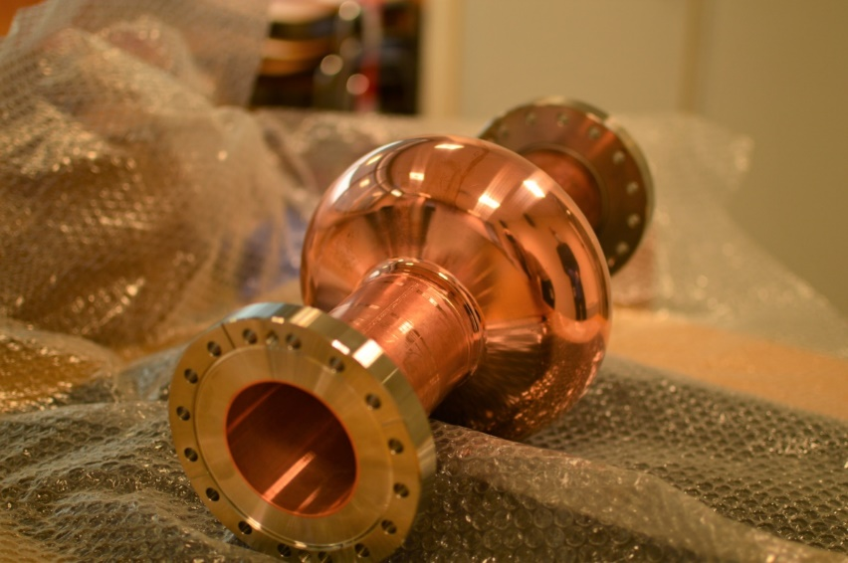
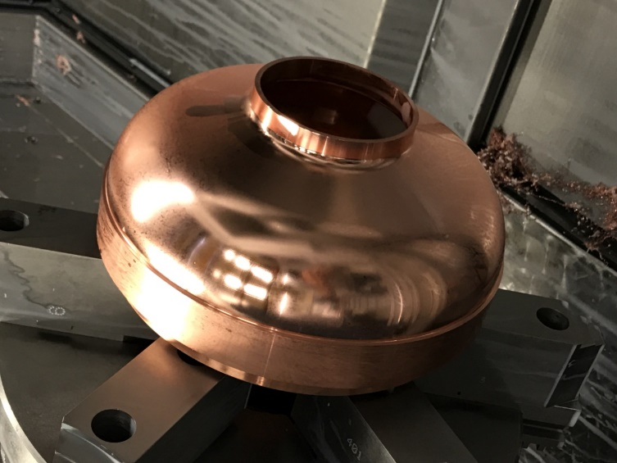
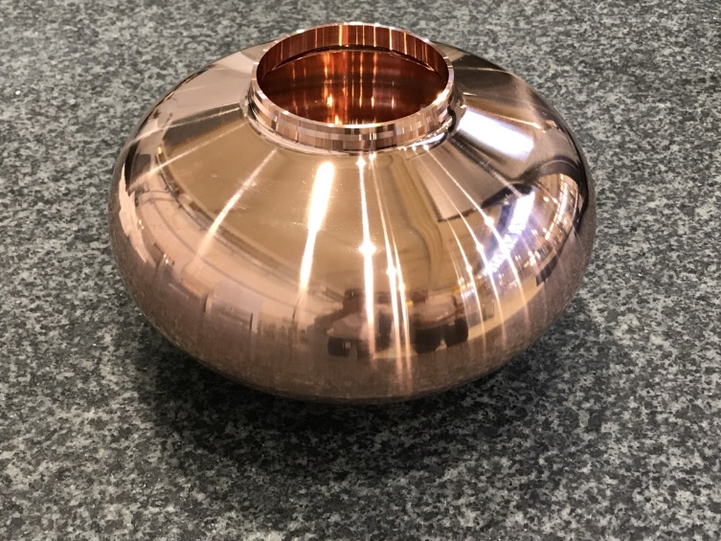
Tested cavities: Machined from bulk billet
Bulk Cu billet
Machining of second half cell
E-beam welded to cut-offs
Machining of first half cell
Machined cell
Courtesy: K. Scibor

Slide 14
Tested cavities
BM
Machined from bulk billet
Seamless
Welded
W
E-beam welded
L
Electroformed

Slide 15
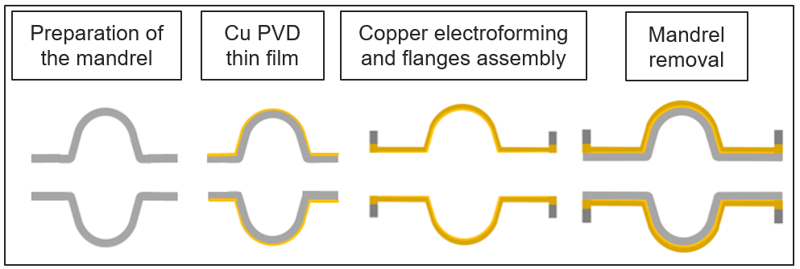

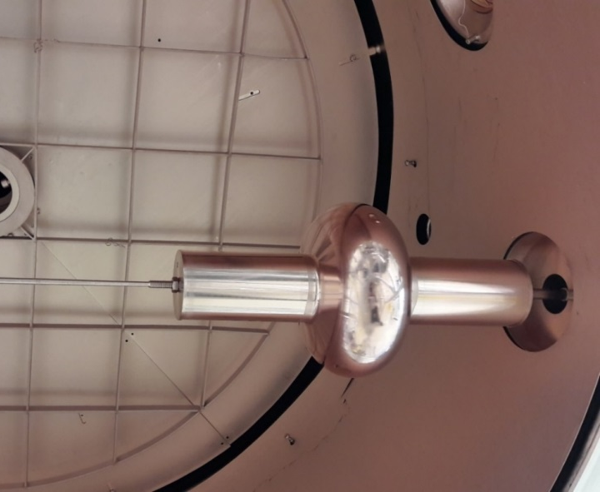
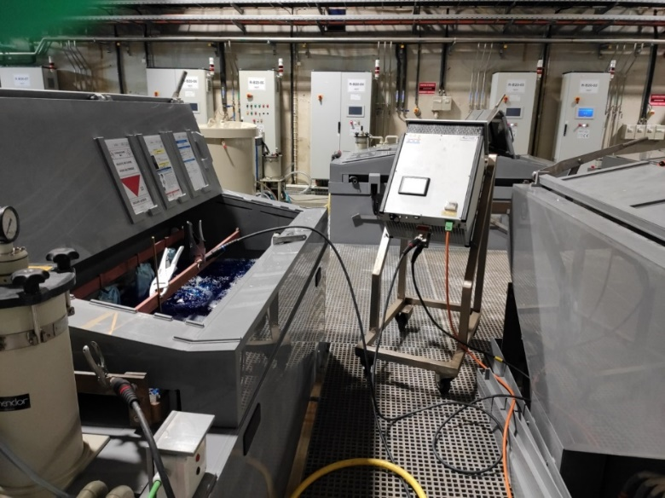
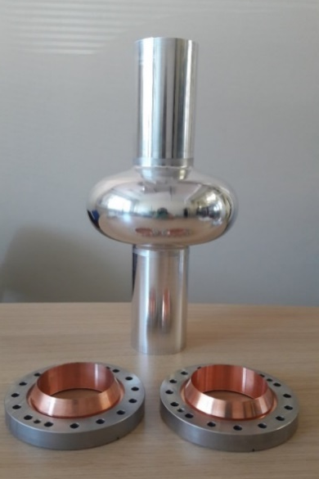
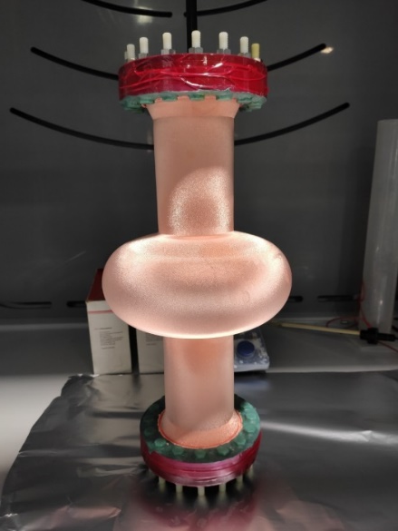
Tested cavities: Electroformed
“L. Laín Amador. et al., “Electrodeposition of copper applied to the manufacture of seamless superconducting rf cavities ”, Phys. Rev. Accel. Beams 24, 082002 ,2021
Notes:
https://journals.aps.org/prab/abstract/10.1103/PhysRevAccelBeams.24.082002

Slide 16
rf tests results

Slide 17
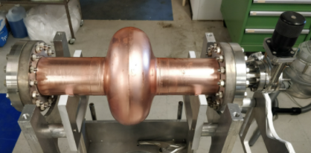
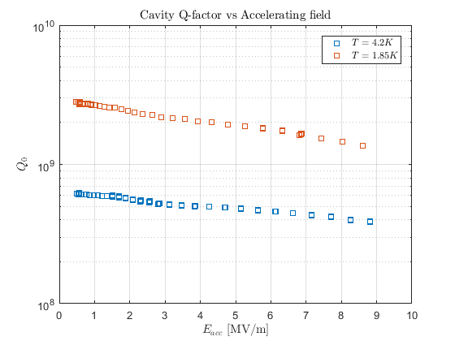
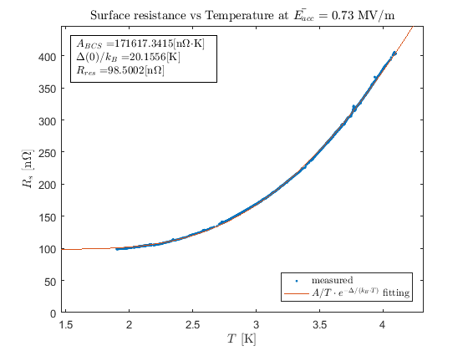
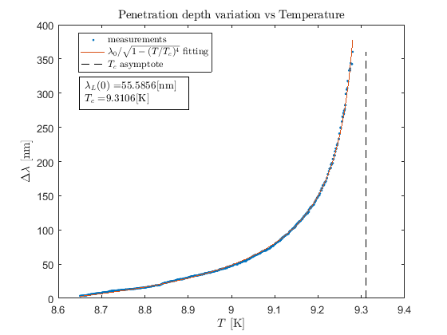
RF tests
1.3 GHz cavity testing campaign:
  Q vs E_{acc} at 1.85K and 4.2 K
  Q vs Temperature
  Frequency vs Temperature

Slide 18
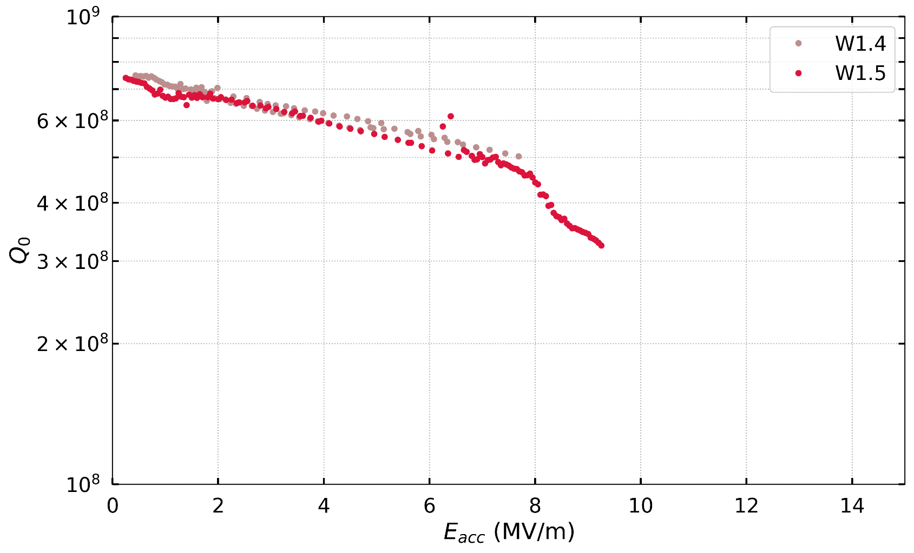
RF performance at 4.2 K
Welded
W
Internal e-beam welding
Remarks:
W: 1 substrate tested. No big impact of weld on 4.5 K (BCS) performance, likely the higher probability of defects only affects R_{residual}.
Notes:
Why study at 1.85 K?
To determine the superconducting parameters we test at 1.85K.
Besides, interest goes beyond FCC, to study potential application of this technology in other machines: high gradient and high energy

Slide 19
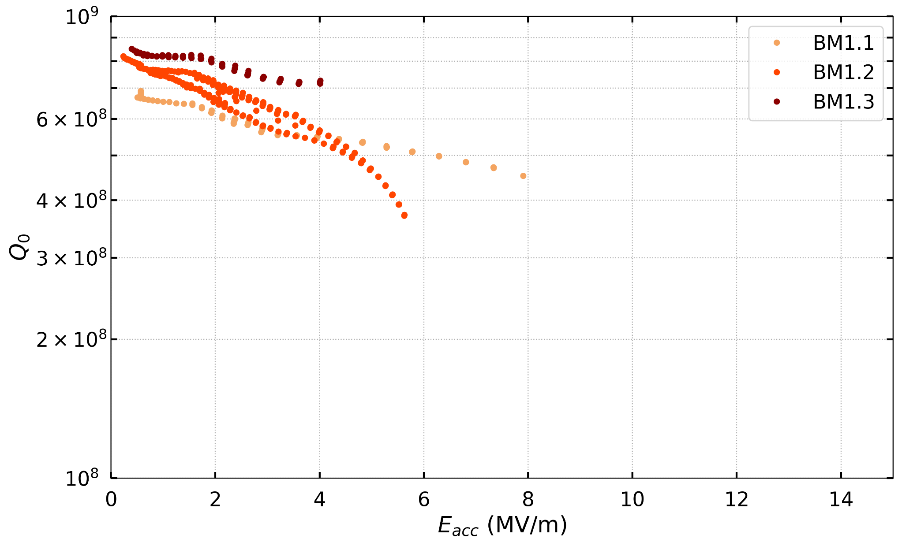
RF performance at 4.2 K
Seamless
BM
Machined from bulk billet
Remarks:
BM: 4 substrates from different billets.
  BM1: Last coating has record performance. Test stopped at low field at 4.2 K for safety.
Notes:
Why study at 1.85 K?
To determine the superconducting parameters we test at 1.85K.
Besides, interest goes beyond FCC, to study potential application of this technology in other machines: high gradient and high energy

Slide 20
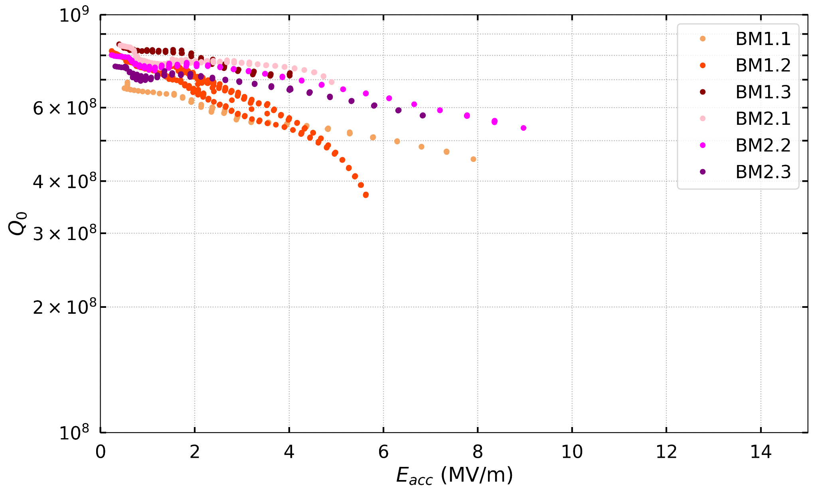
RF performance at 4.2 K
Seamless
BM
Machined from bulk billet
Remarks:
BM: 4 substrates from different billets.
  BM1: Last coating has record performance. Test stopped at low field at 4.2 K for safety.
  BM2: Very similar performance achieved after re-coating.
Notes:
Why study at 1.85 K?
To determine the superconducting parameters we test at 1.85K.
Besides, interest goes beyond FCC, to study potential application of this technology in other machines: high gradient and high energy

Slide 21
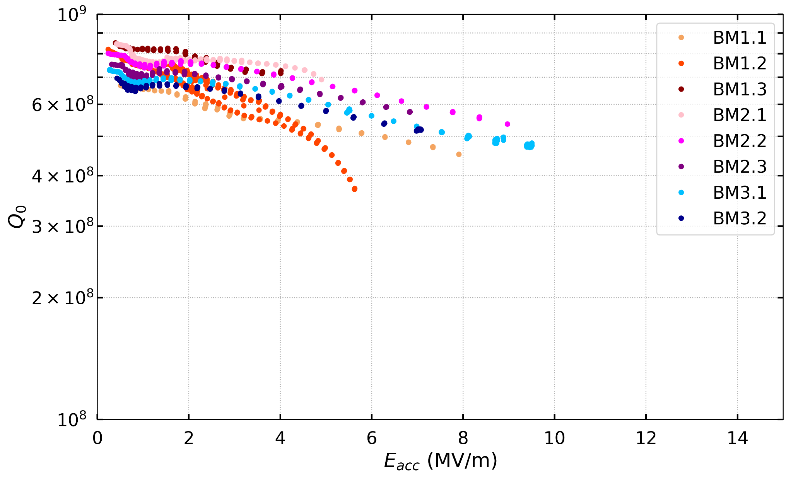
RF performance at 4.2 K
Seamless
BM
Machined from bulk billet
Remarks:
BM: 4 substrates from different billets.
  BM1: Last coating has record performance. Test stopped at low field at 4.2 K for safety.
  BM2: Very similar performance achieved after re-coating.
  BM3: Very similar performance achieved after re-coating.
Notes:
Why study at 1.85 K?
To determine the superconducting parameters we test at 1.85K.
Besides, interest goes beyond FCC, to study potential application of this technology in other machines: high gradient and high energy

Slide 22
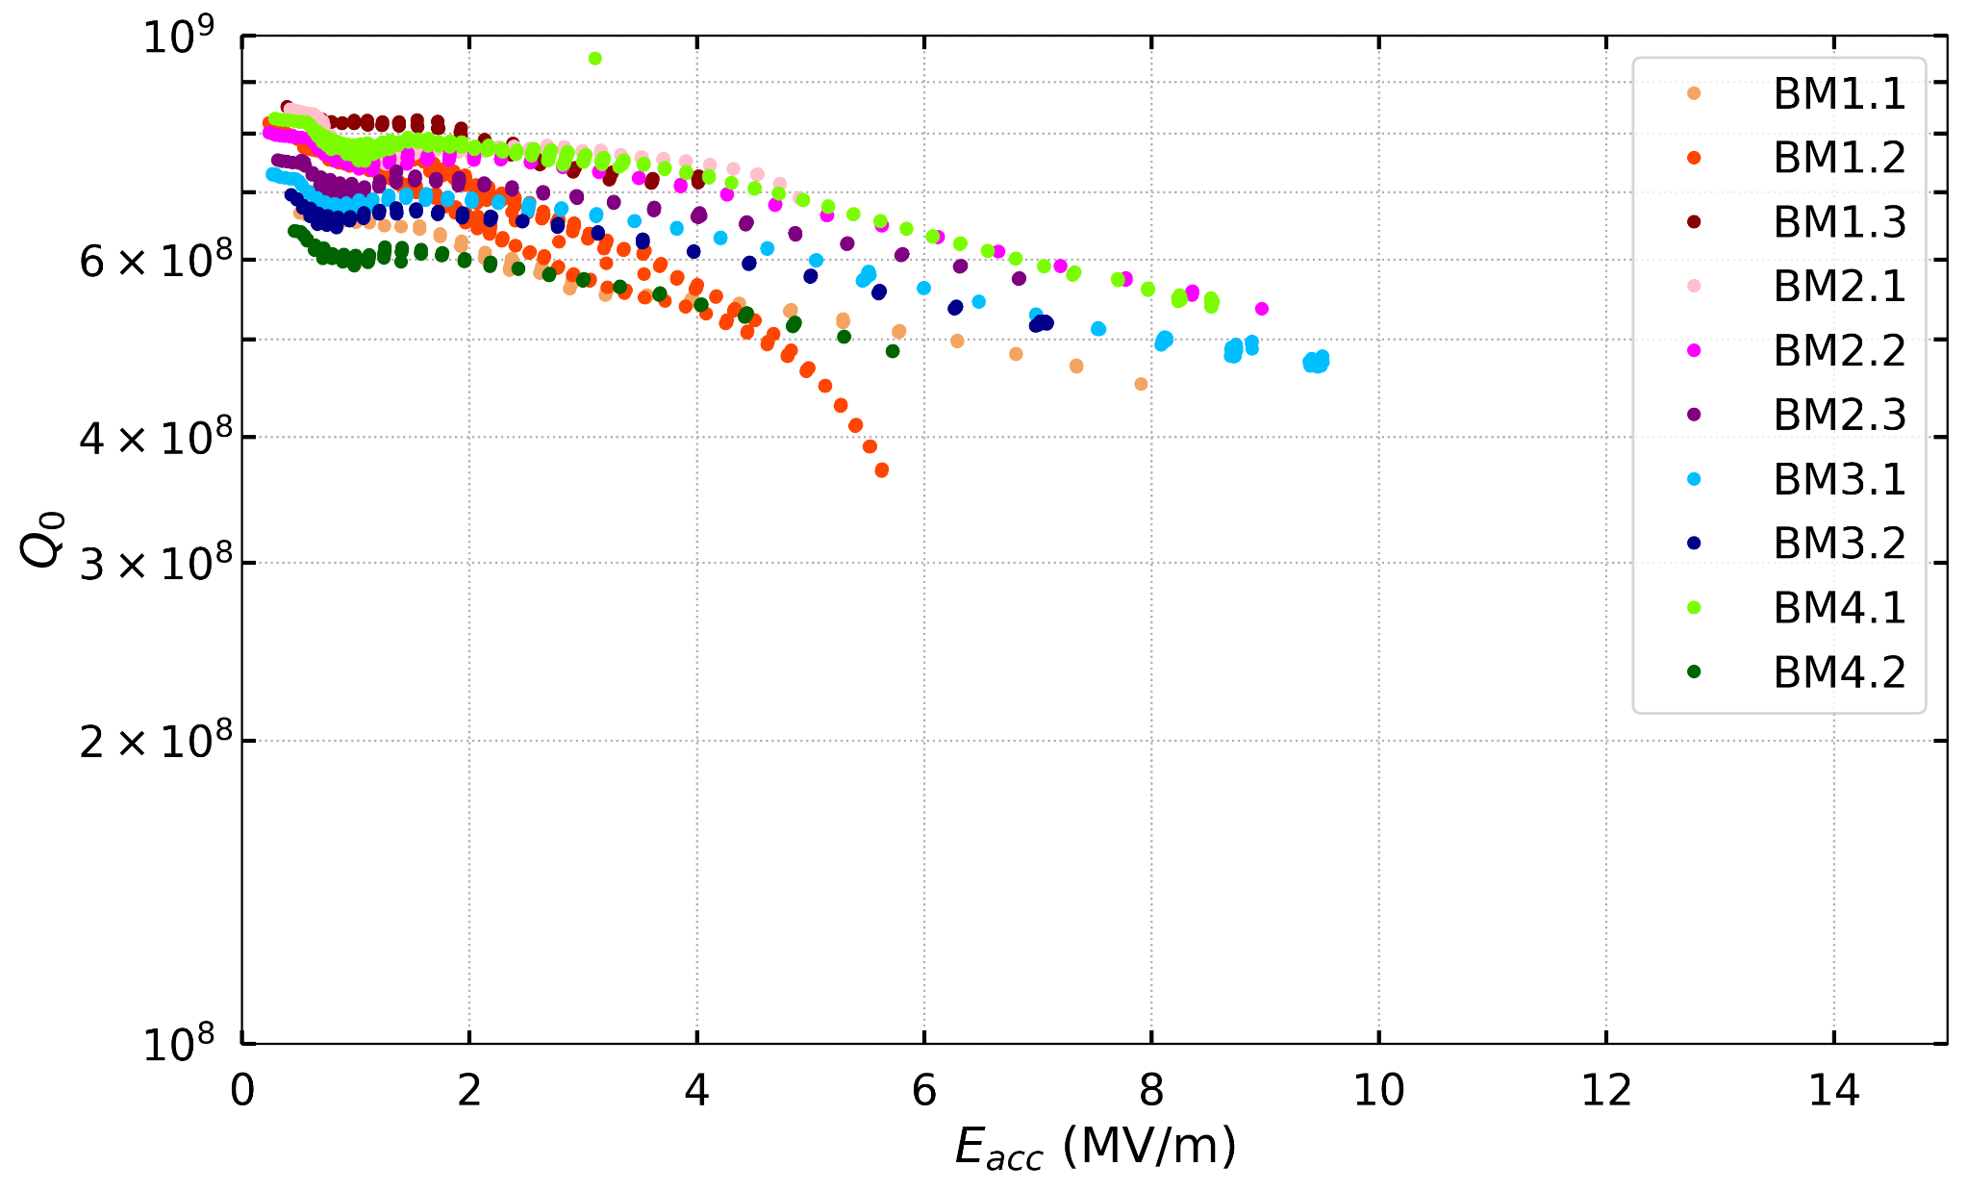
RF performance at 4.2 K
Seamless
BM
Machined from bulk billet
Remarks:
BM: 4 substrates from different billets.
  BM1: Last coating has record performance. Test stopped at low field at 4.2 K for safety.
  BM2: Very similar performance achieved after re-coating.
  BM3: Very similar performance achieved after re-coating.
  BM4: Second coating worse due to issues during assembly.
Notes:
Why study at 1.85 K?
To determine the superconducting parameters we test at 1.85K.
Besides, interest goes beyond FCC, to study potential application of this technology in other machines: high gradient and high energy

Slide 23
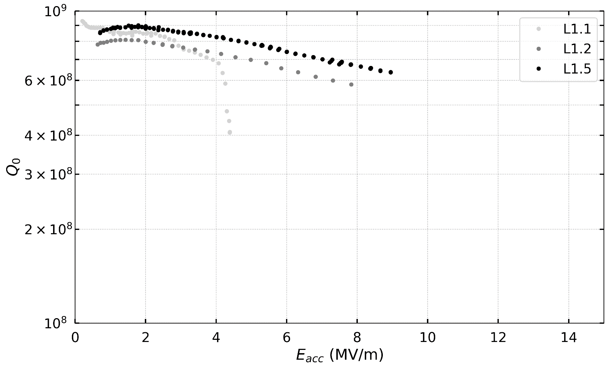
RF performance at 4.2 K
Seamless
L
Electroformed
Remarks:
L: 1 substrate produced. Peel-off during 1st coating. Very promising results of 2nd and 3rd coatings at 4.5 K.
Notes:
Why study at 1.85 K?
To determine the superconducting parameters we test at 1.85K.
Besides, interest goes beyond FCC, to study potential application of this technology in other machines: high gradient and high energy

Slide 24
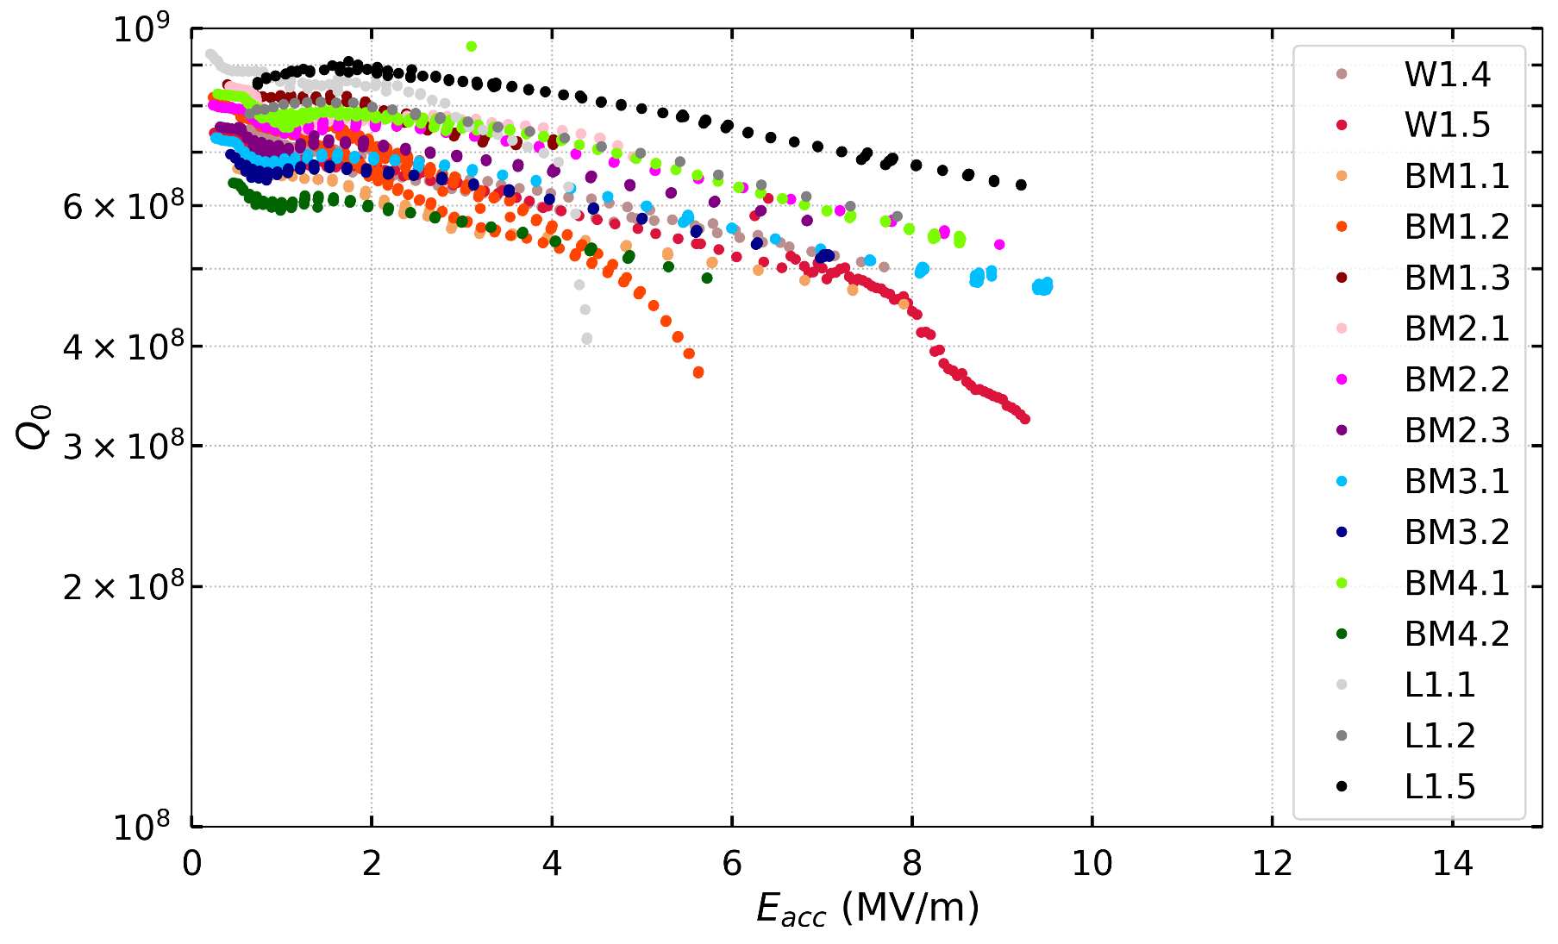
RF performance at 4.2 K
Conclusions:
BCS resistance has been optimized.
FCC SRF requirements in terms of material properties are are potentially met with high repeatability using Nb/Cu technology.
Next steps:
Scale HIPIMs on 400 MHz cavity substrates (starting now)
Continue the R&D for optimizing this technology to use it in high energy, high gradient accelerators (applications including FCC)

Slide 25
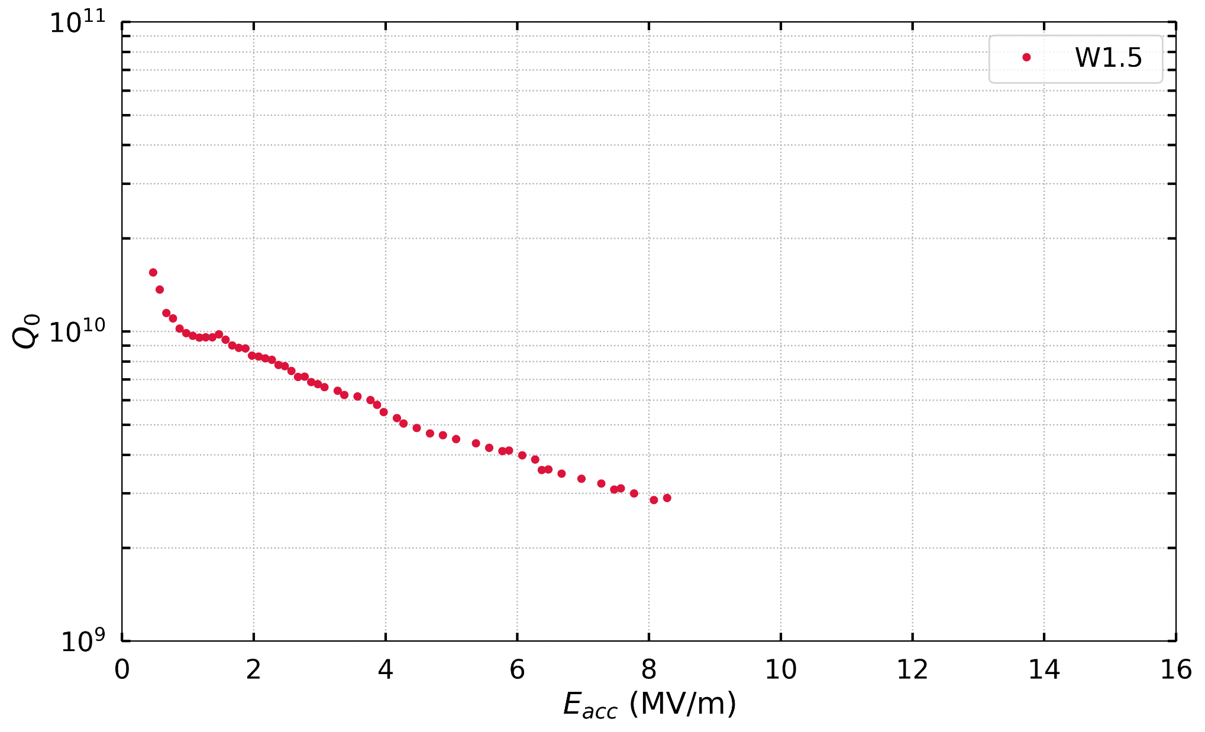
RF performance at 1.85 K
Welded
W
Internal e-beam welding
Remarks:
W: Remarkable Q slope.
Notes:
Why study at 1.85 K?
To determine the superconducting parameters we test at 1.85K.
Besides, interest goes beyond FCC, to study potential application of this technology in other machines: high gradient and high energy

Slide 26
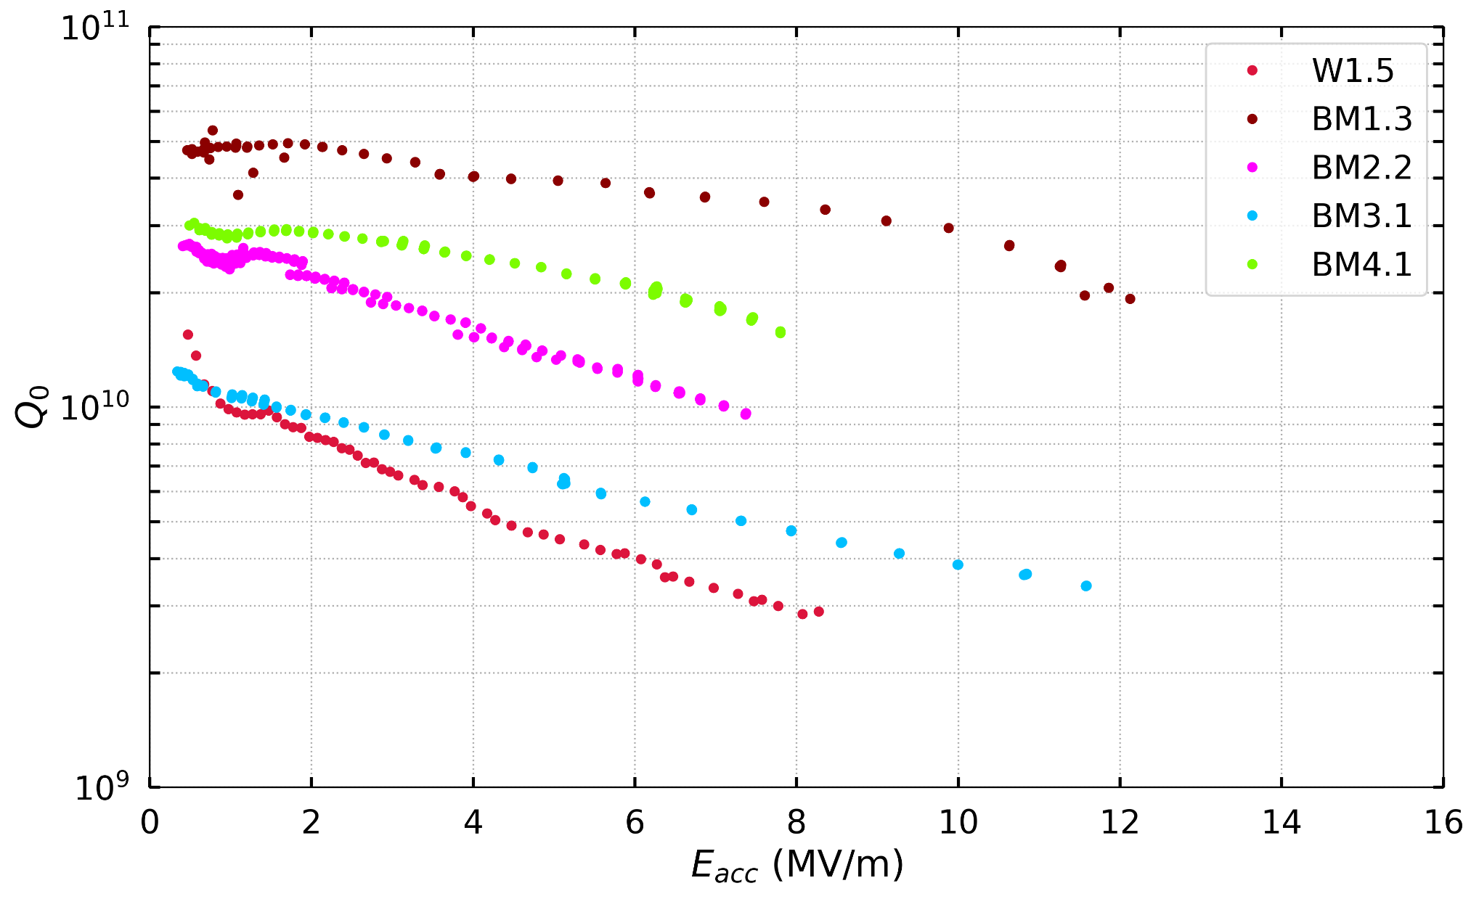
RF performance at 1.85 K
Seamless
BM
Machined from bulk billet
Remarks:
W: Remarkable Q slope.
BM: Very promising results, with BM1.3 showing record performance. Although same recipe has been followed to coat the cavities, this performance has not been achieved again. Currently under investigation.
Notes:
Why study at 1.85 K?
To determine the superconducting parameters we test at 1.85K.
Besides, interest goes beyond FCC, to study potential application of this technology in other machines: high gradient and high energy

Slide 27
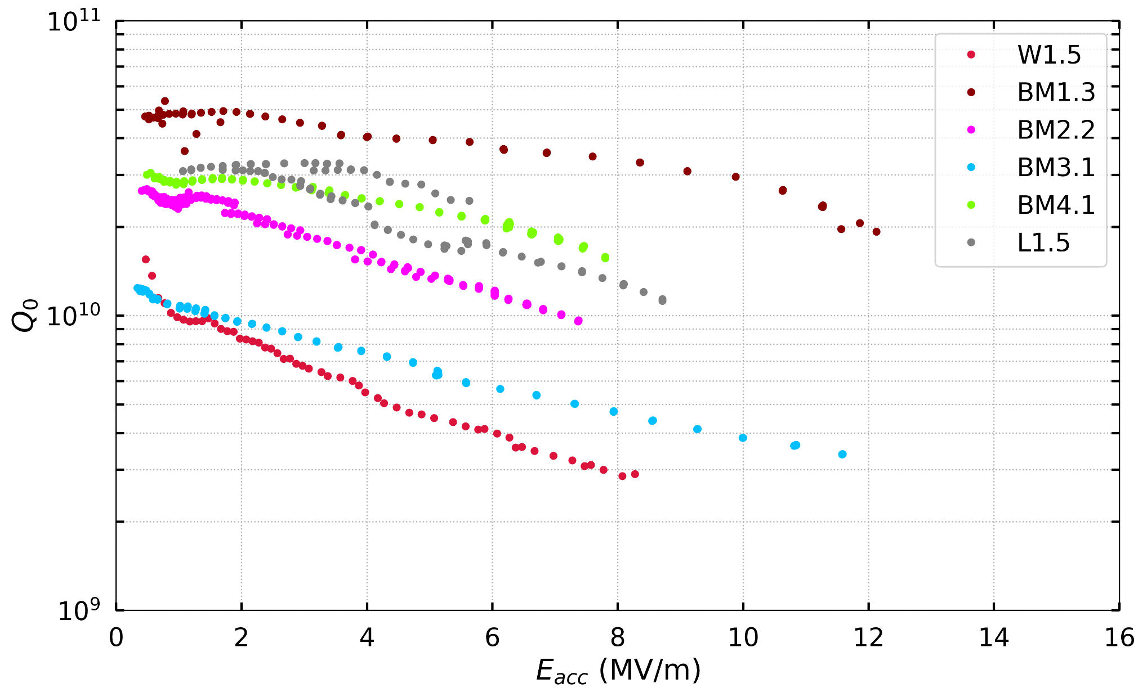
RF performance at 1.85 K
Seamless
L
Electroformed
Remarks:
W: Remarkable Q slope.
BM: Very promising results, with BM1.3 showing record performance. Although same recipe has been followed to coat the cavities, this performance has not been achieved again. Currently under investigation.
L: Promising results obtained. More substrates are being produced.

Slide 28
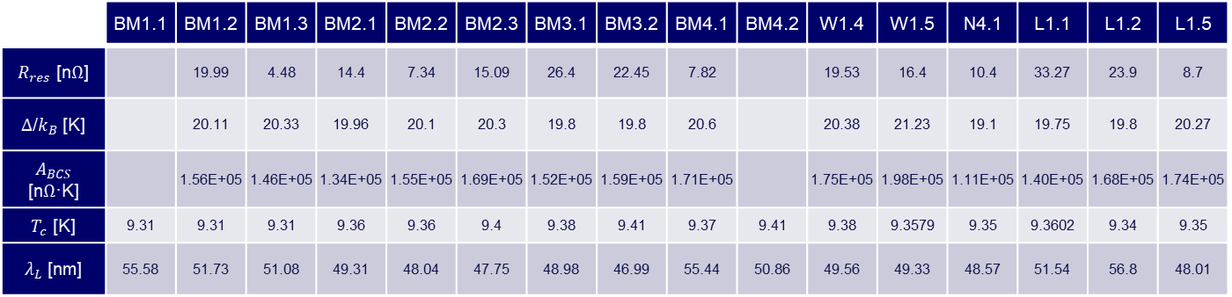
RF performance at 1.85 K
Superconducting parameters
 | BM1.1 | BM1.2 | BM1.3 | BM2.1 | BM2.2 | BM2.3 | BM3.1 | BM3.2 | BM4.1 | BM4.2 | W1.4 | W1.5 | N4.1 | L1.1 | L1.2 | L1.5
$R_{res}$ [n$Ω$] |  | 19.99 | 4.48 | 14.4 | 7.34 | 15.09 | 26.4 | 22.45 | 7.82 |  | 19.53 | 16.4 | 10.4 | 33.27 | 23.9 | 8.7
$∆$/$k_{B}$ [K] |  | 20.11 | 20.33 | 19.96 | 20.1 | 20.3 | 19.8 | 19.8 | 20.6 |  | 20.38 | 21.23 | 19.1 | 19.75 | 19.8 | 20.27
$A_{BCS}$ [n$Ω$·K] |  | 1.56E+05 | 1.46E+05 | 1.34E+05 | 1.55E+05 | 1.69E+05 | 1.52E+05 | 1.59E+05 | 1.71E+05 |  | 1.75E+05 | 1.98E+05 | 1.11E+05 | 1.40E+05 | 1.68E+05 | 1.74E+05
$T_{c}$ [K] | 9.31 | 9.31 | 9.31 | 9.36 | 9.36 | 9.4 | 9.38 | 9.41 | 9.37 | 9.41 | 9.38 | 9.3579 | 9.35 | 9.3602 | 9.34 | 9.35
$λ_{L}$ [nm] | 55.58 | 51.73 | 51.08 | 49.31 | 48.04 | 47.75 | 48.98 | 46.99 | 55.44 | 50.86 | 49.56 | 49.33 | 48.57 | 51.54 | 56.8 | 48.01

Slide 29
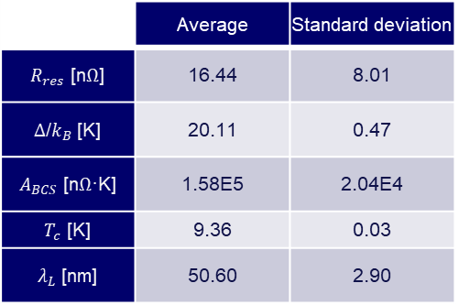
RF performance at 1.85 K
Superconducting parameters
 | Average | Standard deviation
$R_{res}$ [n$Ω$] | 16.44 | 8.01
$∆$/$k_{B}$ [K] | 20.11 | 0.47
$A_{BCS}$ [n$Ω$·K] | 1.58E5 | 2.04E4
$T_{c}$ [K] | 9.36 | 0.03
$λ_{L}$ [nm] | 50.60 | 2.90
Remarks:
Standard deviation of superconducting parameters is low: Reproducible coatings, process well under control.
Residual resistance is more variable, which is expected as this parameter is influenced even by tiny defects.
Correlation observed between Q slope and residual resistance.

Slide 30
RF performance at 1.85 K
Superconducting parameters
A_{BCS} and λ_{L} are not dependent on the residual resistance.
λ_{L} is not correlated to the transition temperature.

Slide 31
SUMMARY AND CONCLUSIONS

Slide 32
Summary and conclusions
The R&D program on 1.3 GHz cavities is exploring the potential of the Nb/Cu technology on a high turnaround cavity substrate, which is recognized as international standard in the SRF community.
An important goal is to provide a coating recipe for producing 400 MHz cavities that meet the FCC SRF system requirements.
Different recipes have been investigated with a total of 18 cavities tested since 2021.
The performance at 4.2 K (“BCS” resistance) has been optimized with high repeatability.
RF results at 1.85 K are encouraging and ensure the potential application of this technology to high energy, high gradient accelerators.
Repeatability of results at 1.85 K is however not yet achieved. Further investigations are ongoing to optimize the still occasionally occurring high residual resistance at 1.85 K, which includes a non linear component (Q-slope)

Slide 33
Thank you for your attention
Questions ?
Acknowledgements
Laetitia Dufay-Chanat, Zoran Jankovic, Serge Forel, Agostino Vacca, Torsten Koettig, Gabriel Pechaud, Sebastien Prunet

