Slide 1


The economic multiplier of the FCC-ee procurement: preliminary results
May 31, 2022/ FCC Week 2022
Francesco Giffoni
Francesco Giffoni (CSIL)
FCCIS WP4
FCCIS – The Future Circular Collider Innovation Study. This INFRADEV Research and Innovation Action project receives funding from the European Union’s H2020 Framework Programme under grant agreement no. 951754. The information herein only reflects the views of its authors and the European Commission is not responsible for any use that may be made of the information.

Slide 2
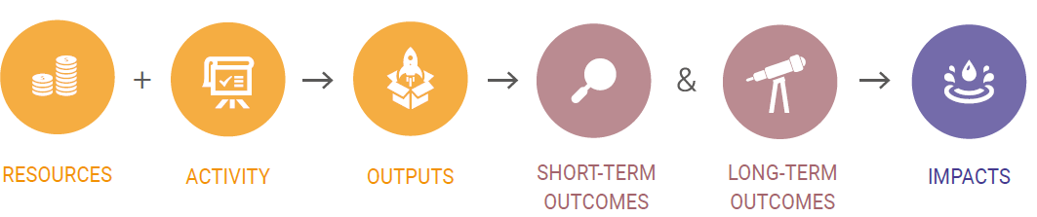
From HEP to industry: logic of the procurement impact pathway
May 31, 2022/ FCC Week 2022
Francesco Giffoni (CSIL)
Money
Skills
Dedicated staff
Procurement relationships between the firm and the research infrastructure
N of orders processed
N of products delivered
N of services delivered
Acquisition of know-how
Product and process innovation
Entered new markets
Acquisition of new clients
Improved firm’s reputation
Increased turnover
Increased profit
Increased employment
New business units
*The graph on the top is from the RI-PATHS Guidebook for Socio-economic Impact Assessment of Research Infrastructures (2020). Deliverable D5.4 https://ri-paths.eu/deliverable/
See also Florio (2019), Investing in Science Social Cost-Benefit Analysis of Research Infrastructures, MIT Press.

Slide 3
The concept of Procurement Economic Multiplier (PEM)
May 31, 2022/ FCC Week 2022
Francesco Giffoni (CSIL)
$$PEM= \frac{Incremental suppliers^{′} profit generated by CERN Procurement }{Value of CERN procurement contracts}$$
Where profit is given by incremental revenues net of incremental costs generated by the procurement contract
Revenues include:
  revenues from sales to other customers (non-CERN)
  costs savings (e.g., more efficient production processes)
Costs include:
  additional costs to meet the CERN requirements
  potential missed opportunities caused by the commitment with CERN
  potential losses caused by the contract with CERN

Slide 4

PEM: evidence from previous studies
May 31, 2022/ FCC Week 2022
Francesco Giffoni (CSIL)
Organisation | Method | PEM | Source
 |  | Average value
CERN | Survey to suppliers | 3 | Schmied (1977)
CERN | Survey to suppliers | 1.2 | Schmied (1982)
CERN | Survey to suppliers | 3 | Bianchi-Streit et al. (1984)
European Space Agency | Survey to suppliers | 3 | Brendle et al. (1980), Bach et al. (1988)
European Space Agency | Survey | 1.5 – 1.6 | Schmied (1982)
European Space Agency | Survey | 4.5 | Danish Agency for Science (2008)
NASA Space Programmes | Input–Output model | 2.1 | Bezdek and Wendling (1992)
Italian National Institute of Nuclear Physics | Input–Output model | 2 – 2.7 | Salina (2006)
John Innes Centre, UK | Input–Output model | 3 | Webb, D and White, R. (2009)
Italian Space Agency | Econometric regressions model | 3 | Florio et al., (2021)
PEM $≅$3
1 CHF spent by CERN in a (high-tech) contract generates 3 CHF of additional profit to suppliers on average
Our study
We wanted to recompute the PEM for more recent CERN procurement data (LHC and HL-LHC)
Analysis of balance sheet data of suppliers (more objective evidence) triangulated with survey data
Use the PEM to forecast the socio-economic spillovers of FCC-ee procurement
Source: Author based on Florio (2019; Table 5.1; p. 138). Investing in science: Social cost-benefit analysis of research infrastructures. MIT Press.
The result for the Italian Space Agency (ASI) is from Florio et al., (2021) available at https://www.asi.it/wp-content/uploads/2022/01/Report_ASI-UNIMI.pdf
Notes:
Schmied (1977): average 4.2 (from 1.7 to 31.6)
Bianchi-Streit et al. (1984): average 3 (from 1.4 to 4.2)

Slide 5
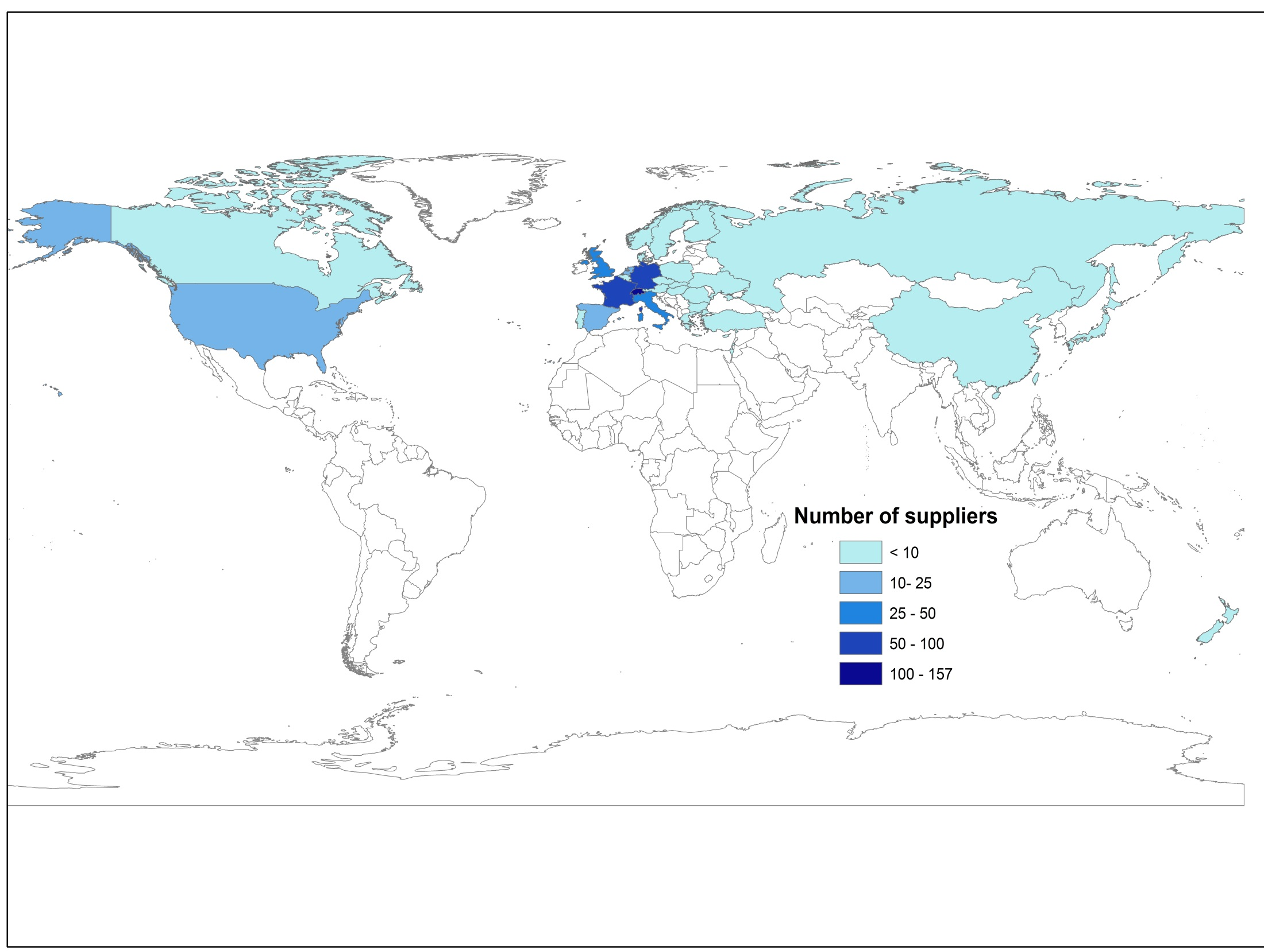
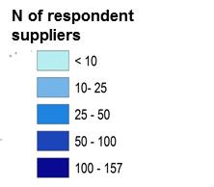
The procurement activity of CERN (HL-) LHC
May 31, 2022/ FCC Week 2022
Francesco Giffoni (CSIL)
Population
4,204 suppliers from 47 countries
33,414 orders
4,318 Million CHF of expenditure
Analysed sample
669 (15%) suppliers from 31 countries
8,247 (25%) orders
757 (27%) Million CHF of expenditure
Period 1995 – 2015; Orders > 10.000 CHF
Source: Castelnovo, P., Florio, M., Forte, S., Rossi, L., Sirtori, E. (2018);
Florio F., Giffoni, F., Giunta, A., Sirtori, E. (2018)

Slide 6
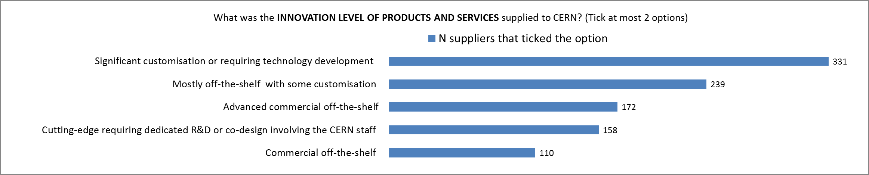
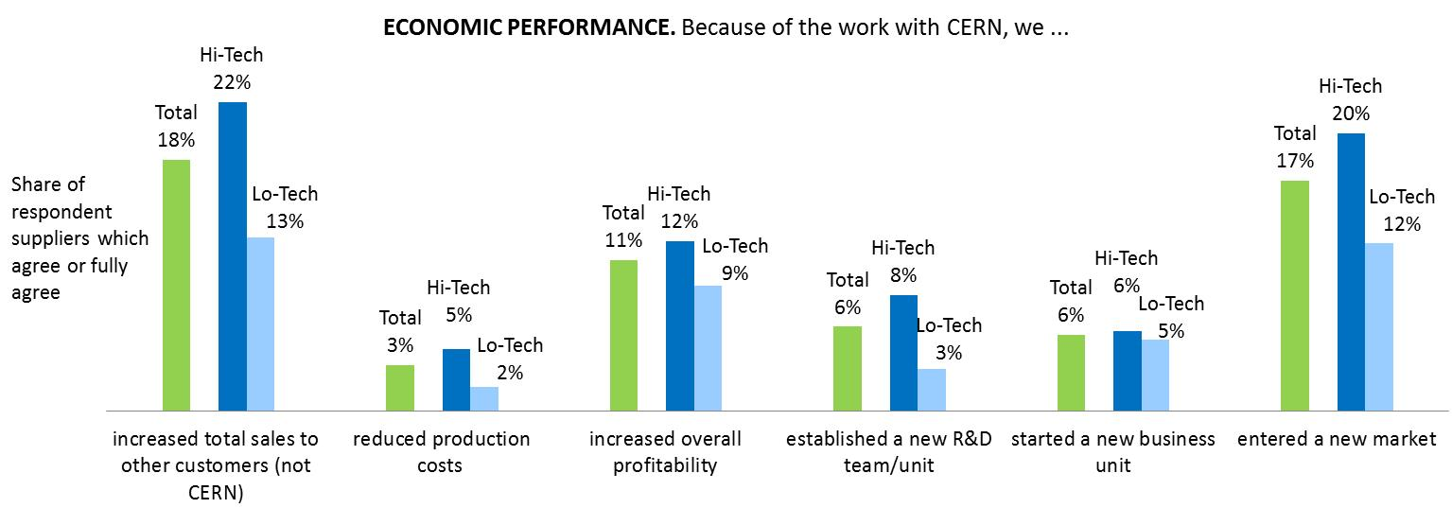
Impact of procurement activity of CERN (HL-) LHC: evidence from a survey
May 31, 2022/ FCC Week 2022
Francesco Giffoni (CSIL)
What was the innovation level of products and services supplied to CERN? (tick at most 2 options)
Economic performance.
Because of the work with CERN, we …
Source: Florio F., Giffoni, F., Giunta, A., Sirtori, E. (2018) - Number of survey respondents: 669
Notes:
In the sample: 58% are high-tech suppliers; 42% are low-tech suppliers
High-tech supplier: the firm received at least one high-tech order based on CERN activity codes.
An high-tech order is an order that required cutting edge R&D, significant customisation or technology development, often in collaboration with CERN staff

Slide 7
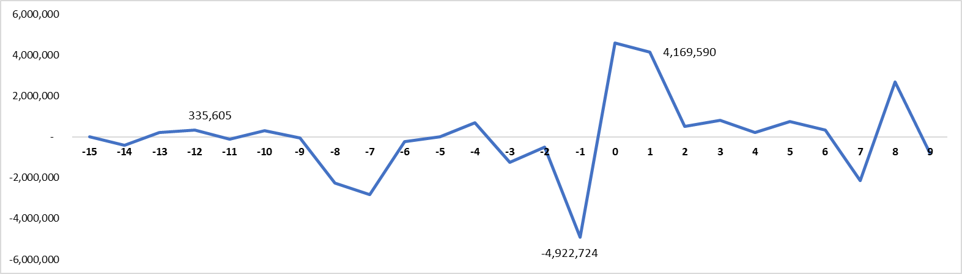

Impact of procurement activity of CERN (HL-) LHC: analysis of balance sheets data
May 31, 2022/ FCC Week 2022
Francesco Giffoni (CSIL)
Average profit* per firm (yearly changes – EUR) wrt the year of the 1st order received by CERN
The firm is not supplier yet
Average= EUR -1,183,823
The firm is supplier
Average = EUR 504,207
Is this difference attributable to the CERN procurement?
The challenge to calculate the CERN Procurement Economic Multiplier is to isolate the CERN impact from all other factors that can influence the suppliers’ profit (firm’s characteristics, firm strategic investment decisions, macroeconomic conditions, etc.)
Profit is defined as EBIT = Earnings before interests and taxes

Slide 8
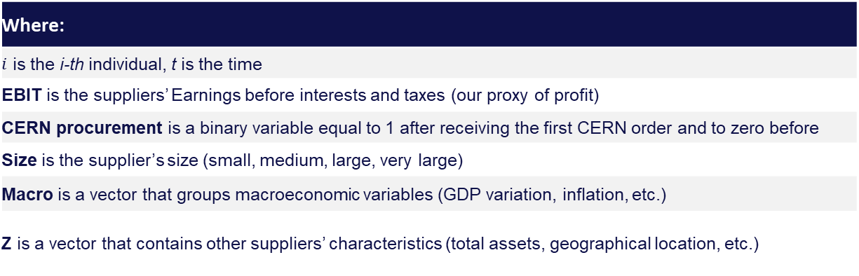
Estimation of the PEM with an econometric analysis
May 31, 2022/ FCC Week 2022
Francesco Giffoni (CSIL)
$${EBIT}_{i,t}{=β_{o}}+ γ CERN procurement+ β_{1}{Size}_{i,t}+β_{2}{\overline{Macro}}_{t}+ β_{3}{{\overline{Z}}_{i}+ε}_{i,t}$$
Suppliers’ profit
Impact of CERN on suppliers’ profit
Where:
$i$ is the i-th individual, t is the time
EBIT is the suppliers’ Earnings before interests and taxes (our proxy of profit)
CERN procurement is a binary variable equal to 1 after receiving the first CERN order and to zero before
Size is the supplier’s size (small, medium, large, very large)
Macro is a vector that groups macroeconomic variables (GDP variation, inflation, etc.)
Z is a vector that contains other suppliers’ characteristics (total assets, geographical location, etc.)

Slide 9
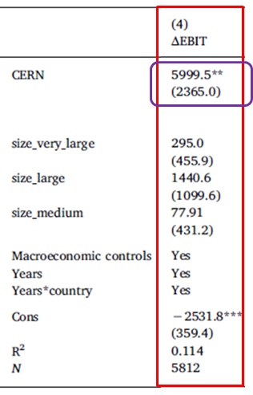

Estimation of the PEM: results of the regression model
May 31, 2022/ FCC Week 2022
Francesco Giffoni (CSIL)
Dependent variable to be explained: EBIT variation over time
CERN procurement impact on EBIT (th EUR) $(γ)$
Effect of being a very large-sized supplier wrt be small $({\hat{β}}_{1,1})$
Effect of being a large-sized supplier wrt be small $({\hat{β}}_{1,2})$
Effect of being a medium-sized suppliers wrt be small $({\hat{β}}_{1,3})$
Effects of macroeconomic conditions and time related conditions
$$\text{Constant} \text{of} \text{the} \text{model} ({\hat{β}}_{0})$$
Period 1995 – 2015;
Orders > 10.000 CHF
Source: Castelnovo, P., Florio, M., Forte, S., Rossi, L., Sirtori, E. (2018)

Slide 10
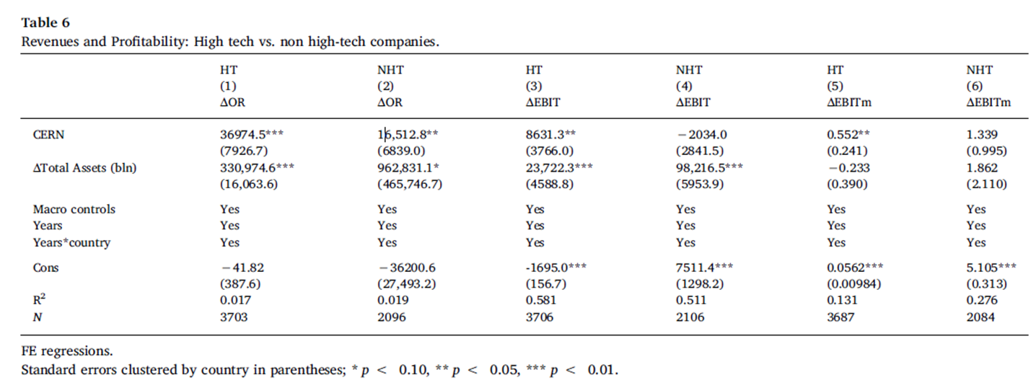

Estimation of the PEM by type of supplier
May 31, 2022/ FCC Week 2022
Francesco Giffoni (CSIL)
The impact is higher for companies receiving high-tech orders
Impact of CERN procurement on high-tech suppliers’ EBIT
It is statistically significant (i.e. different from zero at 5% level)
Impact of CERN procurement on low-tech suppliers’ EBIT
It is not statistically significant: there is no CERN impact
Source: Castelnovo, P., Florio, M., Forte, S., Rossi, L., Sirtori, E. (2018)
Incremental profit generated by CERN for high-tech suppliers (per supplier)
Total N of high-tech suppliers for which financial data from balance sheets were available
$$PEM= \frac{8,631 th EUR∗222}{616 M EUR}=3.11$$
Value of CERN procurement high-tech contracts
processed by the 222 high-tech suppliers

Slide 11
May 31, 2022/ FCC Week 2022
Francesco Giffoni (CSIL)
From the PEM to the FCC-ee industrial suppliers impact
Socio-economic benefit of FCC-ee for high-tech suppliers
Estimation of FCC-ee cost structure and time profile
Estimation of the share of high-tech procurement
Application of the procurement economic multiplier
Estimation of FCC-ee procurement socio-economic local / regional effects (beyond suppliers)

Slide 12
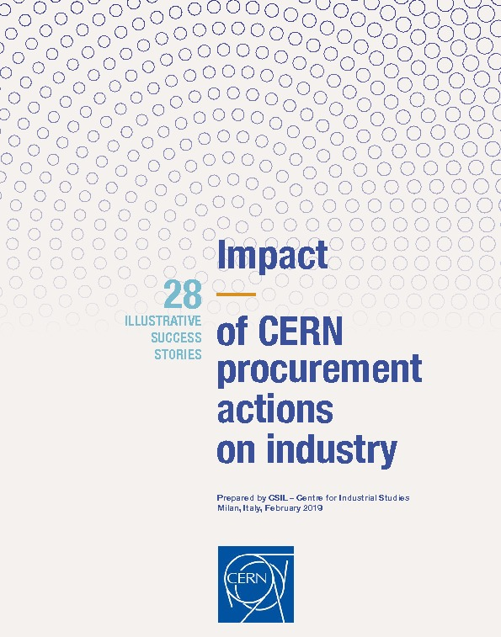

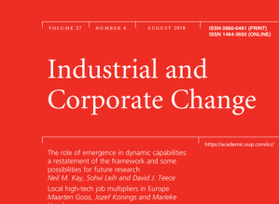
Main References
May 31, 2022/ FCC Week 2022
Francesco Giffoni (CSIL)
CSIL - Centre for Industrial Studies (2018)
Castelnovo P., Florio M., Forte S., Rossi L. Sirtori, E. (2018). The economic impact of technological procurement for large-scale research infrastructures: Evidence from the Large Hadron Collider at CERN. Research Policy, 47(9), 1853-1867.
Florio, M., Giffoni, F., Giunta, A., Sirtori, E. (2018). “Big Science, Learning, and Innovation: Evidence From CERN Procurement.” Industrial and Corporate Change 27 (5): 915–936.
Estimation of the impacts on industrial suppliers from balance sheet data
Analysis of survey data to investigate the impact mechanisms of procurement
Qualitative case studies on a sample of supplier companies

Slide 13
Thank you for your attention
May 31, 2022/ FCC Week 2022
Francesco Giffoni (CSIL)
13

