Slide 1
Progress with bipolar HiPIMS-deposited Nb₃Sn films on Cu for SRF applications
S. Leith, C.P.A. Carlos, G. Rosaz, M. Himmerlich, M. Taborelli, D. Fonnesu, E. Reches, T. Koettig, A. Baris, B. Ruiz Palenzuela, S. Pfeiffer, A. -T. P. Fontenla

Slide 2
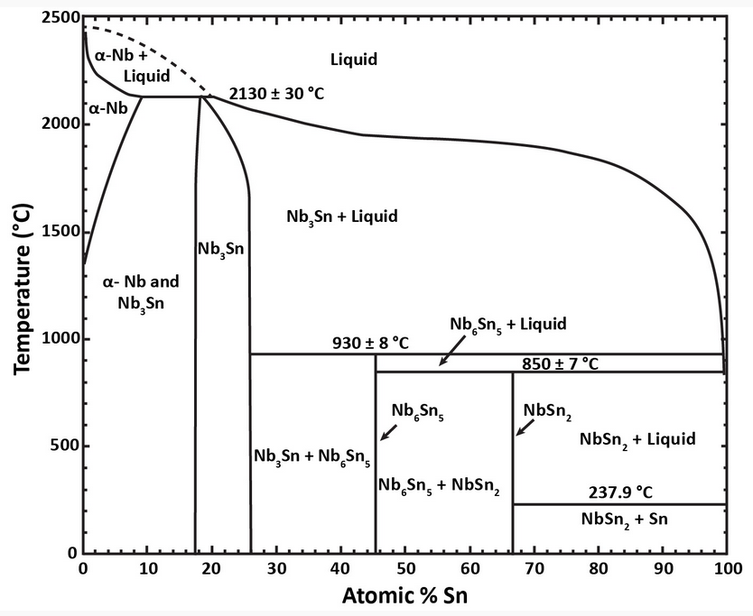
Motivation
Nb₃Sn: Q₀ at 4.2 K ~ bulk Nb at 2 K
Tc | Nb ~ 9.2 K
 | Nb₃Sn ~ 18.3 K
Nb₃Sn
RBCS @4.2K and 500MHz | Nb ~ 45nΩ
 | Nb₃Sn ~ 0.4nΩ
Challenges
A15 phase formation (typically high temperature)
Stoichiometry control (Sn at. % 18 - 26 at. %)
Copper substrate influence
Binary phase diagram of the Nb-Sn system [1]
[1] J. Charlesworth, I. MacPhail, and P. Madsen, J. Mater. Sci. 5, 580 (1970).

Slide 3
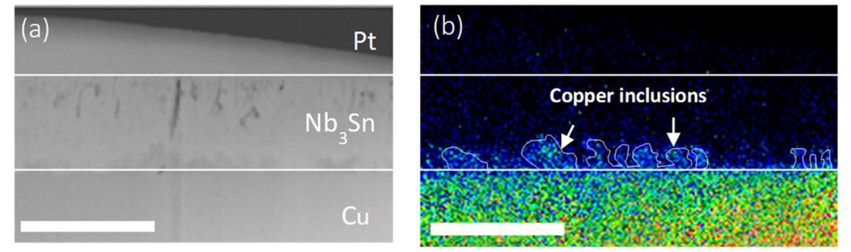
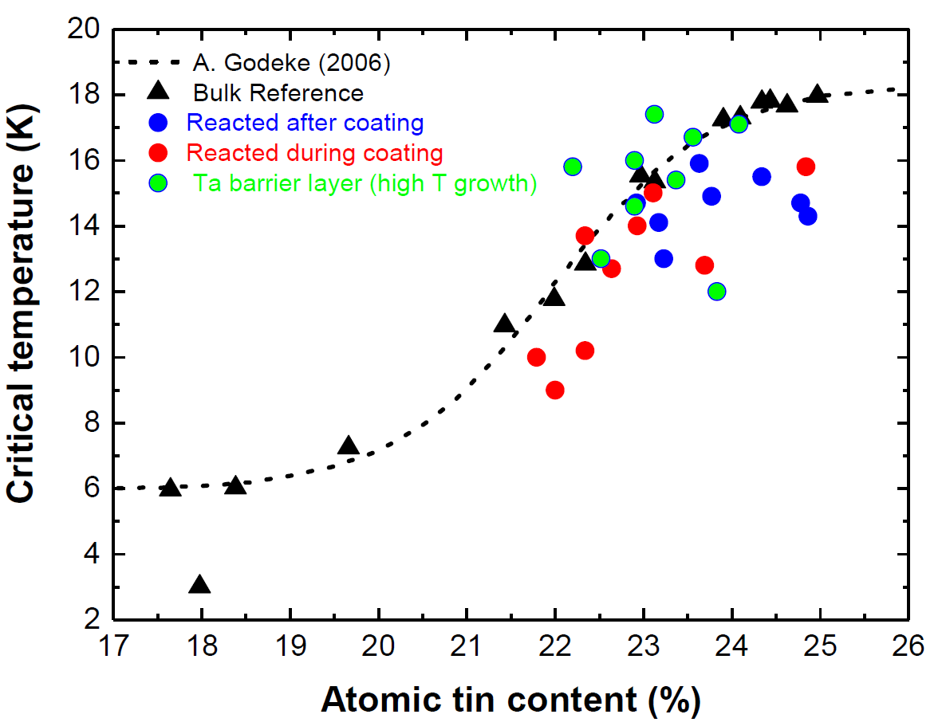
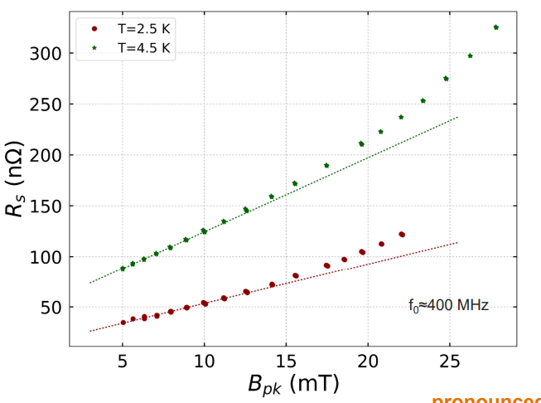
DC MS Coatings @ CERN
Film porosities and Cu inclusions/interdiffusion
Formation of A15 phase
  High temperatures required!
Cu Diffusion
  Interlayer required (Ta/Nb)
1 µm
1 µm
Surface cracking
  Mitigated with Kr
T=2.5K
T=4.5K
Pronounced Q-slope
Impressive T_{c}
  Sn dependent (increased with Kr)
  Increased with Ta interlayer
Ta barrier layer (high T growth)
Q-slope
[2] K. Ilyina et al. Supercond. Sci. Technol., 32 (2019)
[3] M. Arzeo et al. FCC Week 2018

Slide 4
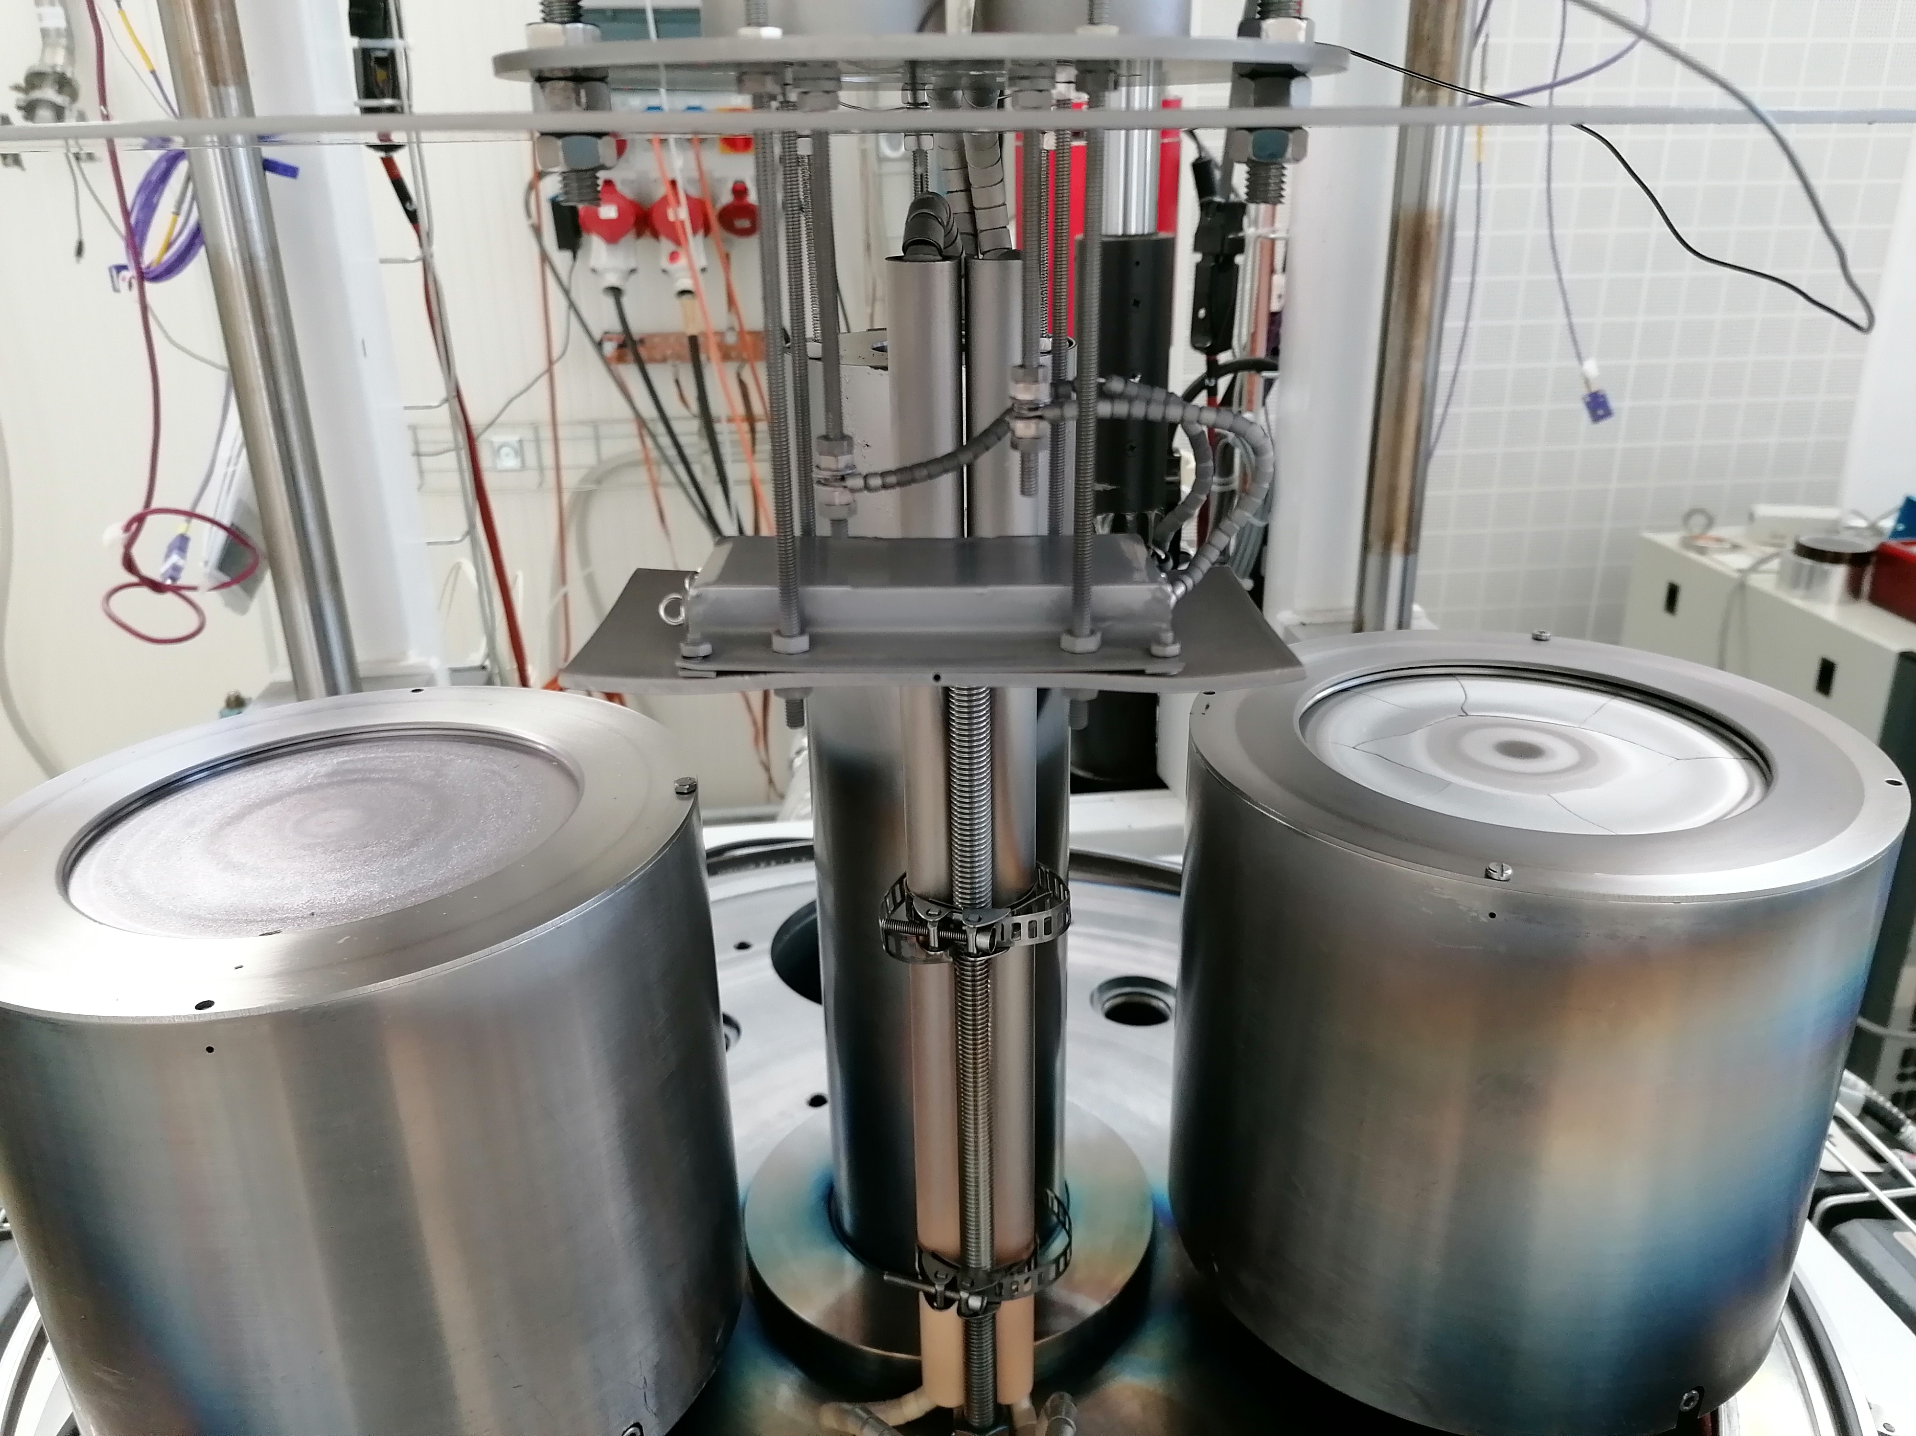
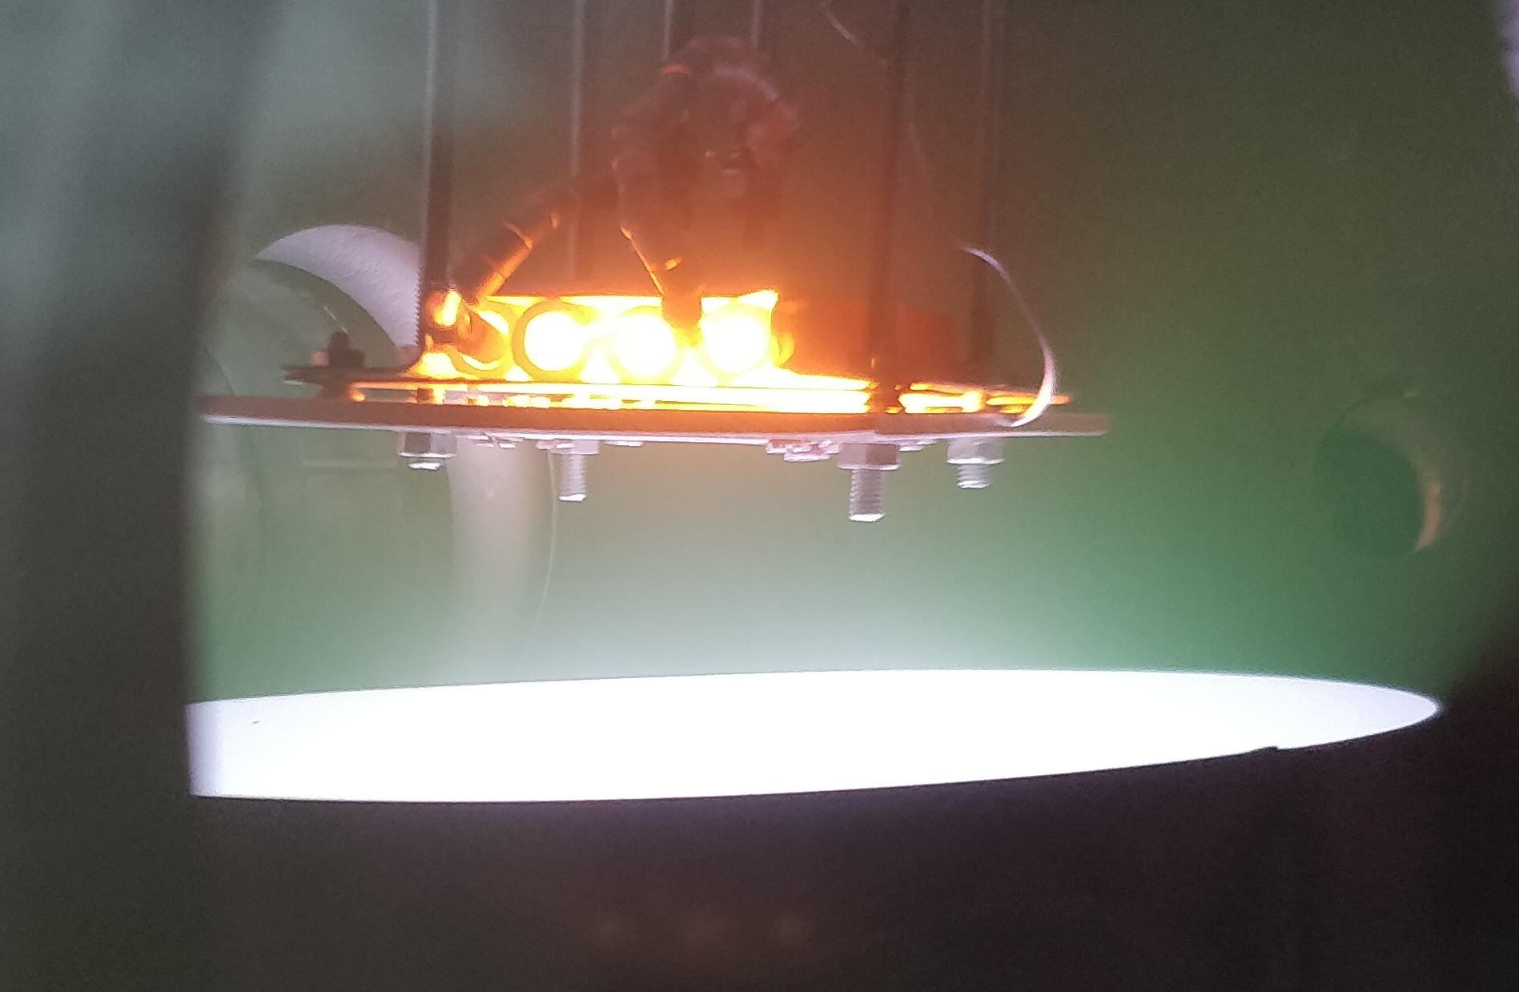
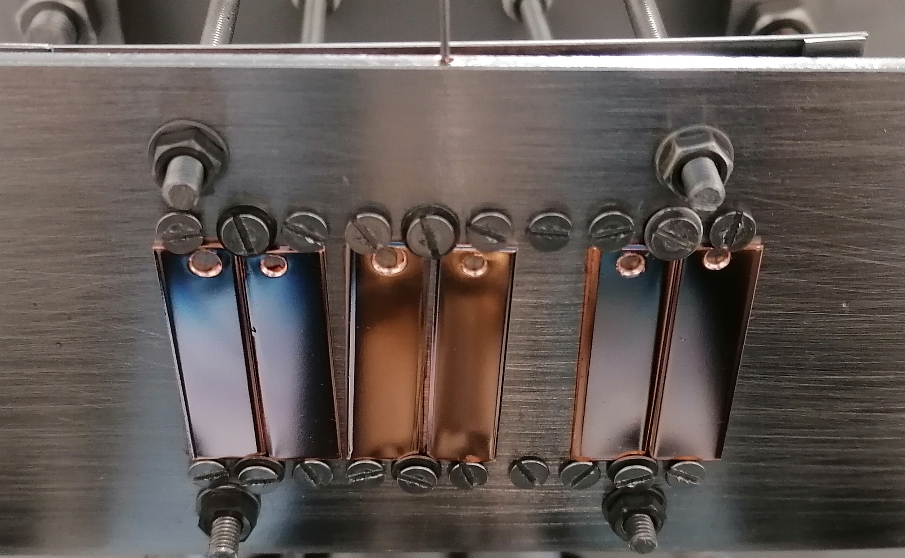
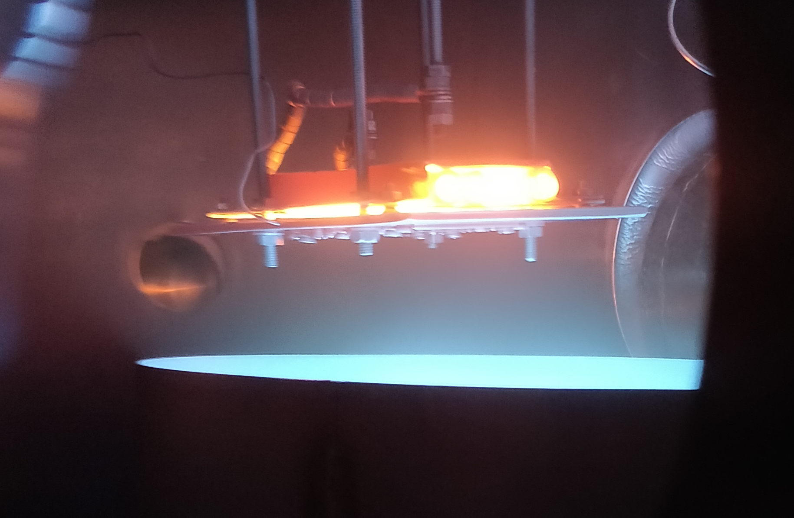
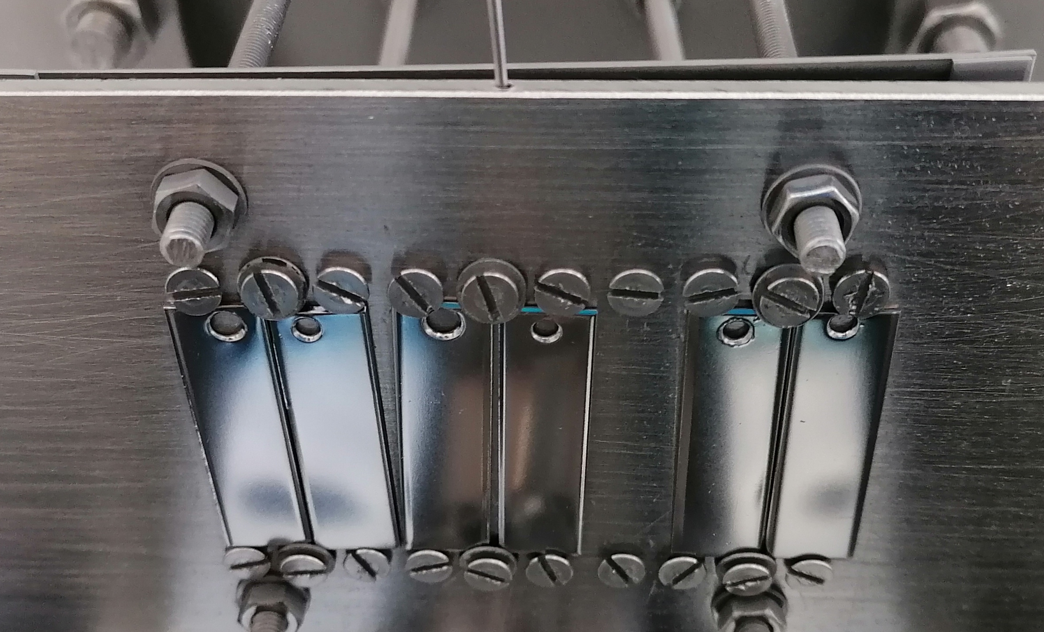
Bipolar HiPIMS Nb₃Sn/Ta/Cu
Improved density required for RF performance
  Proven with Nb/Cu
Lessons learnt dictate starting coating parameters
Coating parameters:
Gas: Kr
T_{s}: 650 … 750°C
P: 7·10⁻⁴ … 5·10⁻² mbar
PP: 35 … 100 V
Post anneal: 0 … 72 hrs
Nb₃Sn
Cu
Ta
Cu

Slide 5
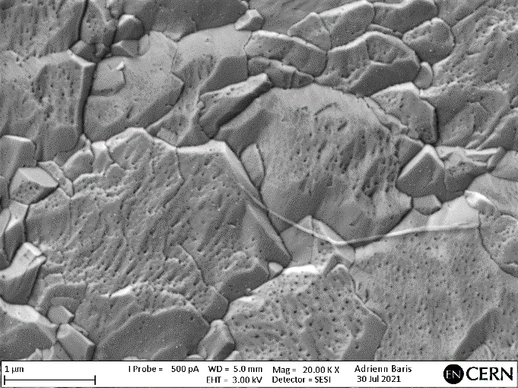
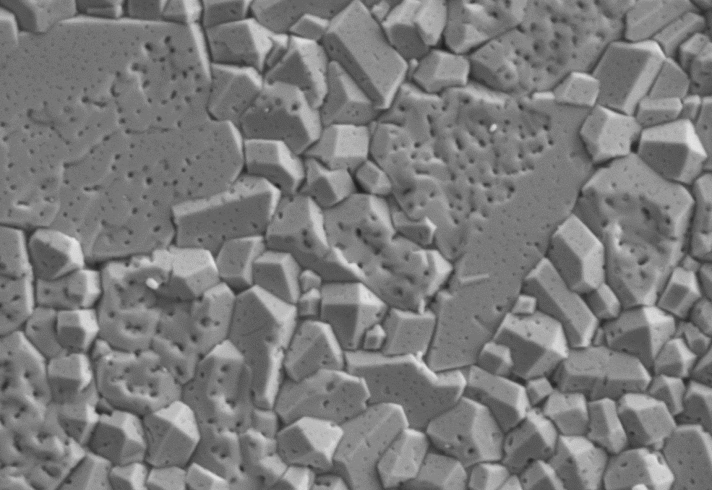
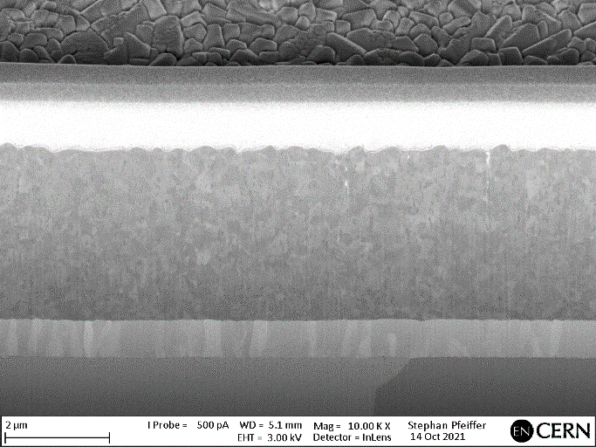
Crystallinity and Morphology
100 V
Correct A15 phase within studied parameter regime
  Further analysis ongoing
2μm
Morphology mainly affected by pressure and positive pulse
  Dense, crack free, porous surface
  Dense cross section. Grainy Nb₃Sn
1μm
50 V
7.0e-4 mbar
Pt
2.5.10⁻² mbar
Nb₃Sn
Ta
2μm
2μm
Cu
1μm
1μm

Slide 6
Compositional Analysis
Correct stoichiometry range
  Sn % = 19.8 to 26.4 at. % (EDS)
No Anneal
Post Anneal
Sn depleted near surface region
Sn reduction with annealing
    Near surface only
1μm
1μm
35V PP
7.0e-4 mbar
50V PP

Slide 7
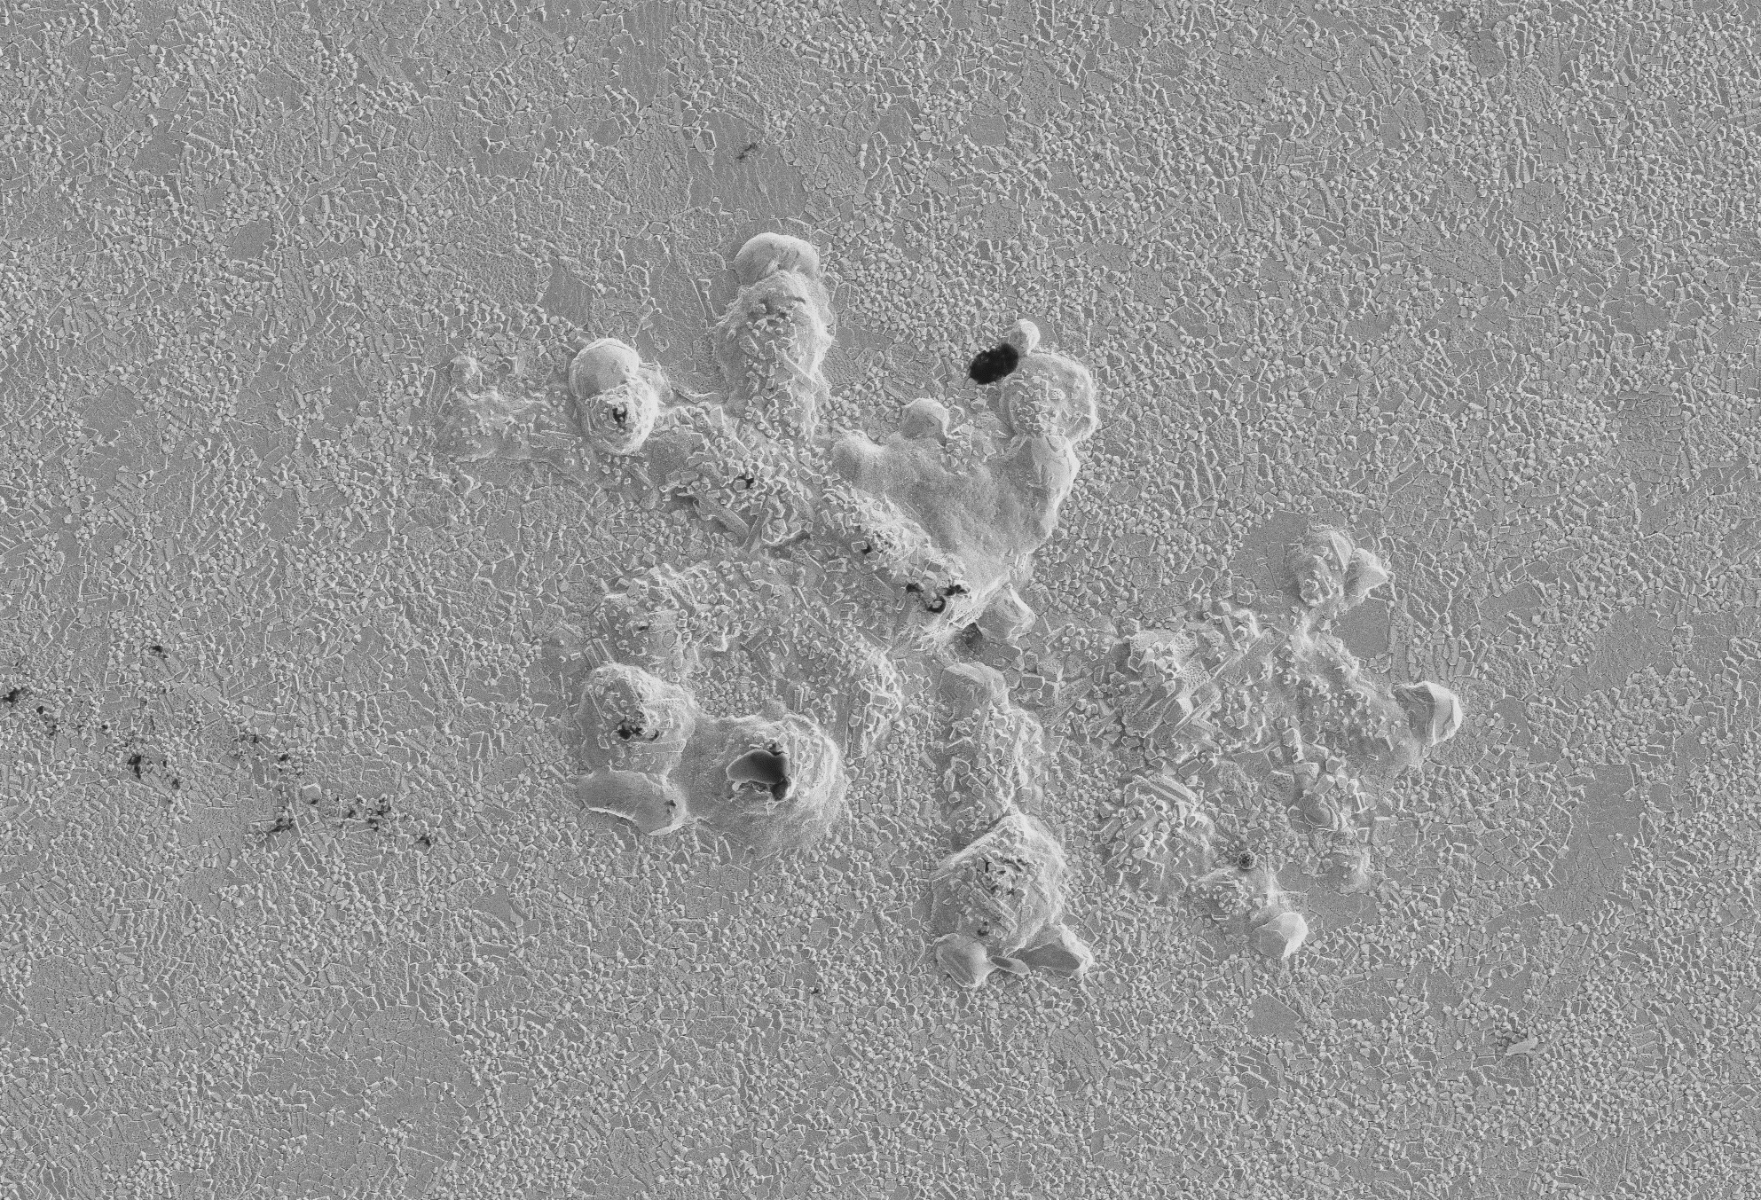
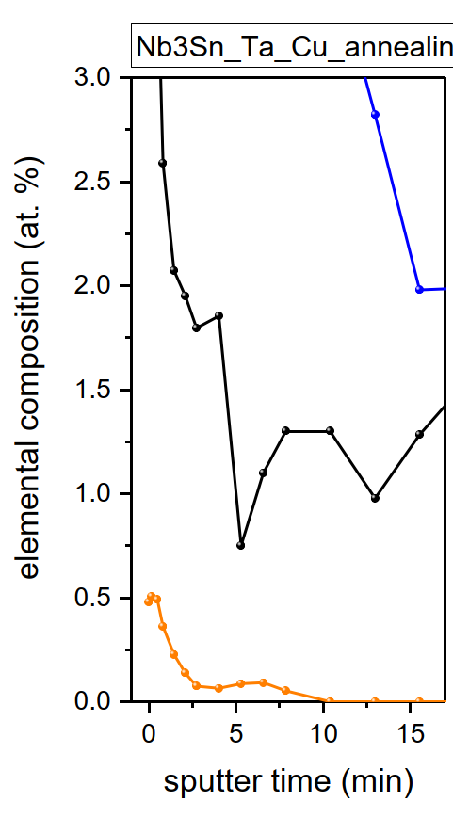
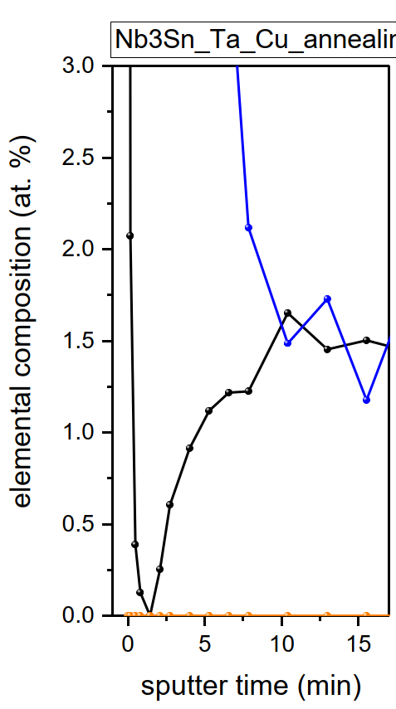
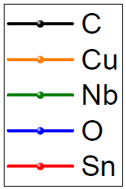
Surface Contamination
Evident
Unclear
Presence of Cu on film surface
  Evident/unclear in SEM (XPS vs. EDS)
    Evaporation from uncoated Cu surfaces
    Diffusion through Ta
10μm
20μm
5μm
XPS and EDS
XPS only
Reduction methods
  Decreased Ta coating temp
  Stainless steel substrate holder
  Annealing
    Sublimation? (3.9e16 / m²s @ 750°C)
  Further investigations ongoing
72h, 750°C Anneal

Slide 8
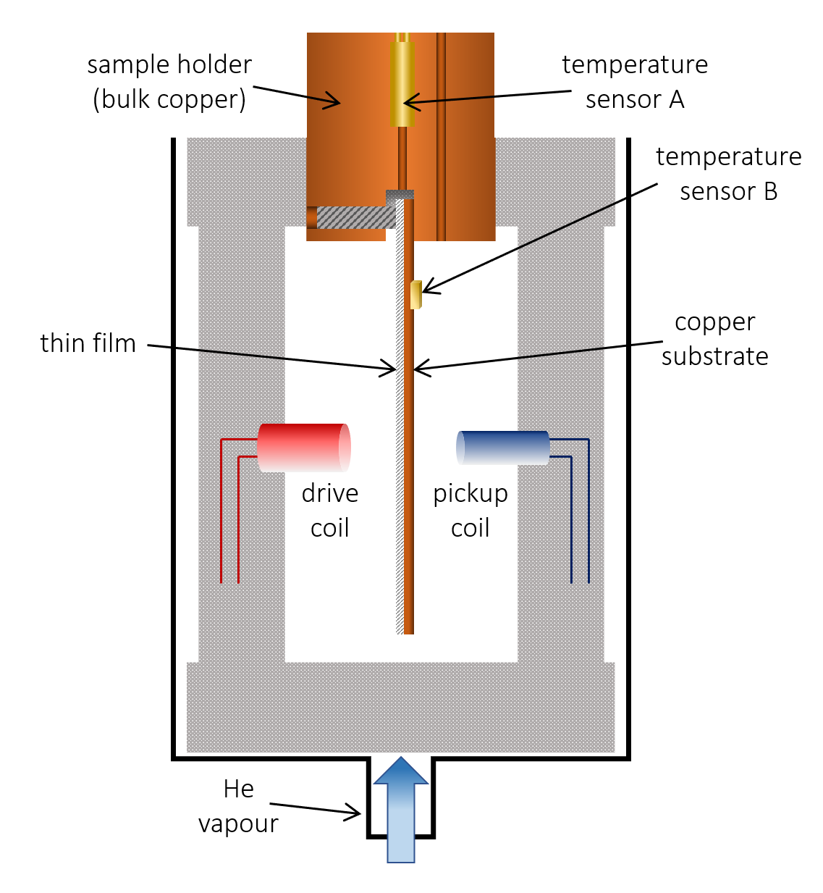
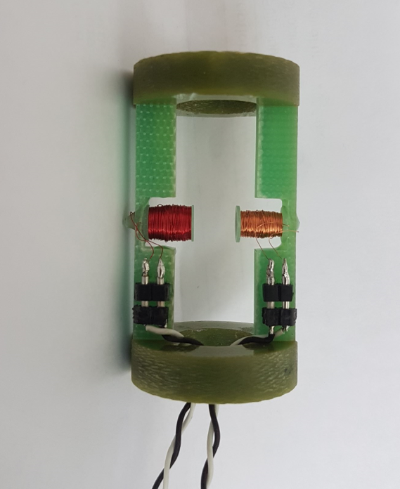
Superconducting Performance
Inductive T_{c} measurement
[5] D. Fonnesu - PhD Thesis (to be published)

Slide 9
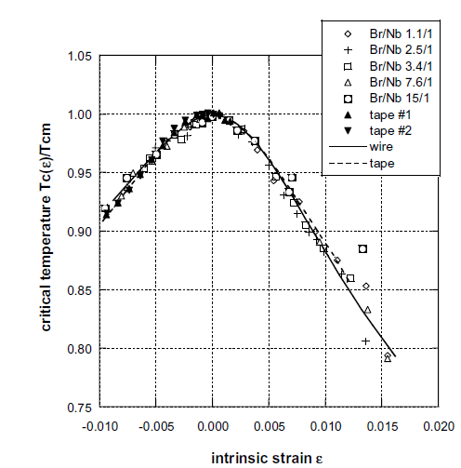

Superconducting Performance
[7]
Compressive residual stress
Godeke Trend [6]
[6] A. Godeke. Supercond. Sci. Technol., 19 (2006)
[7] G. De Marzi et al. J. Phys.: Condens. Matter 25 (2013)

Slide 10
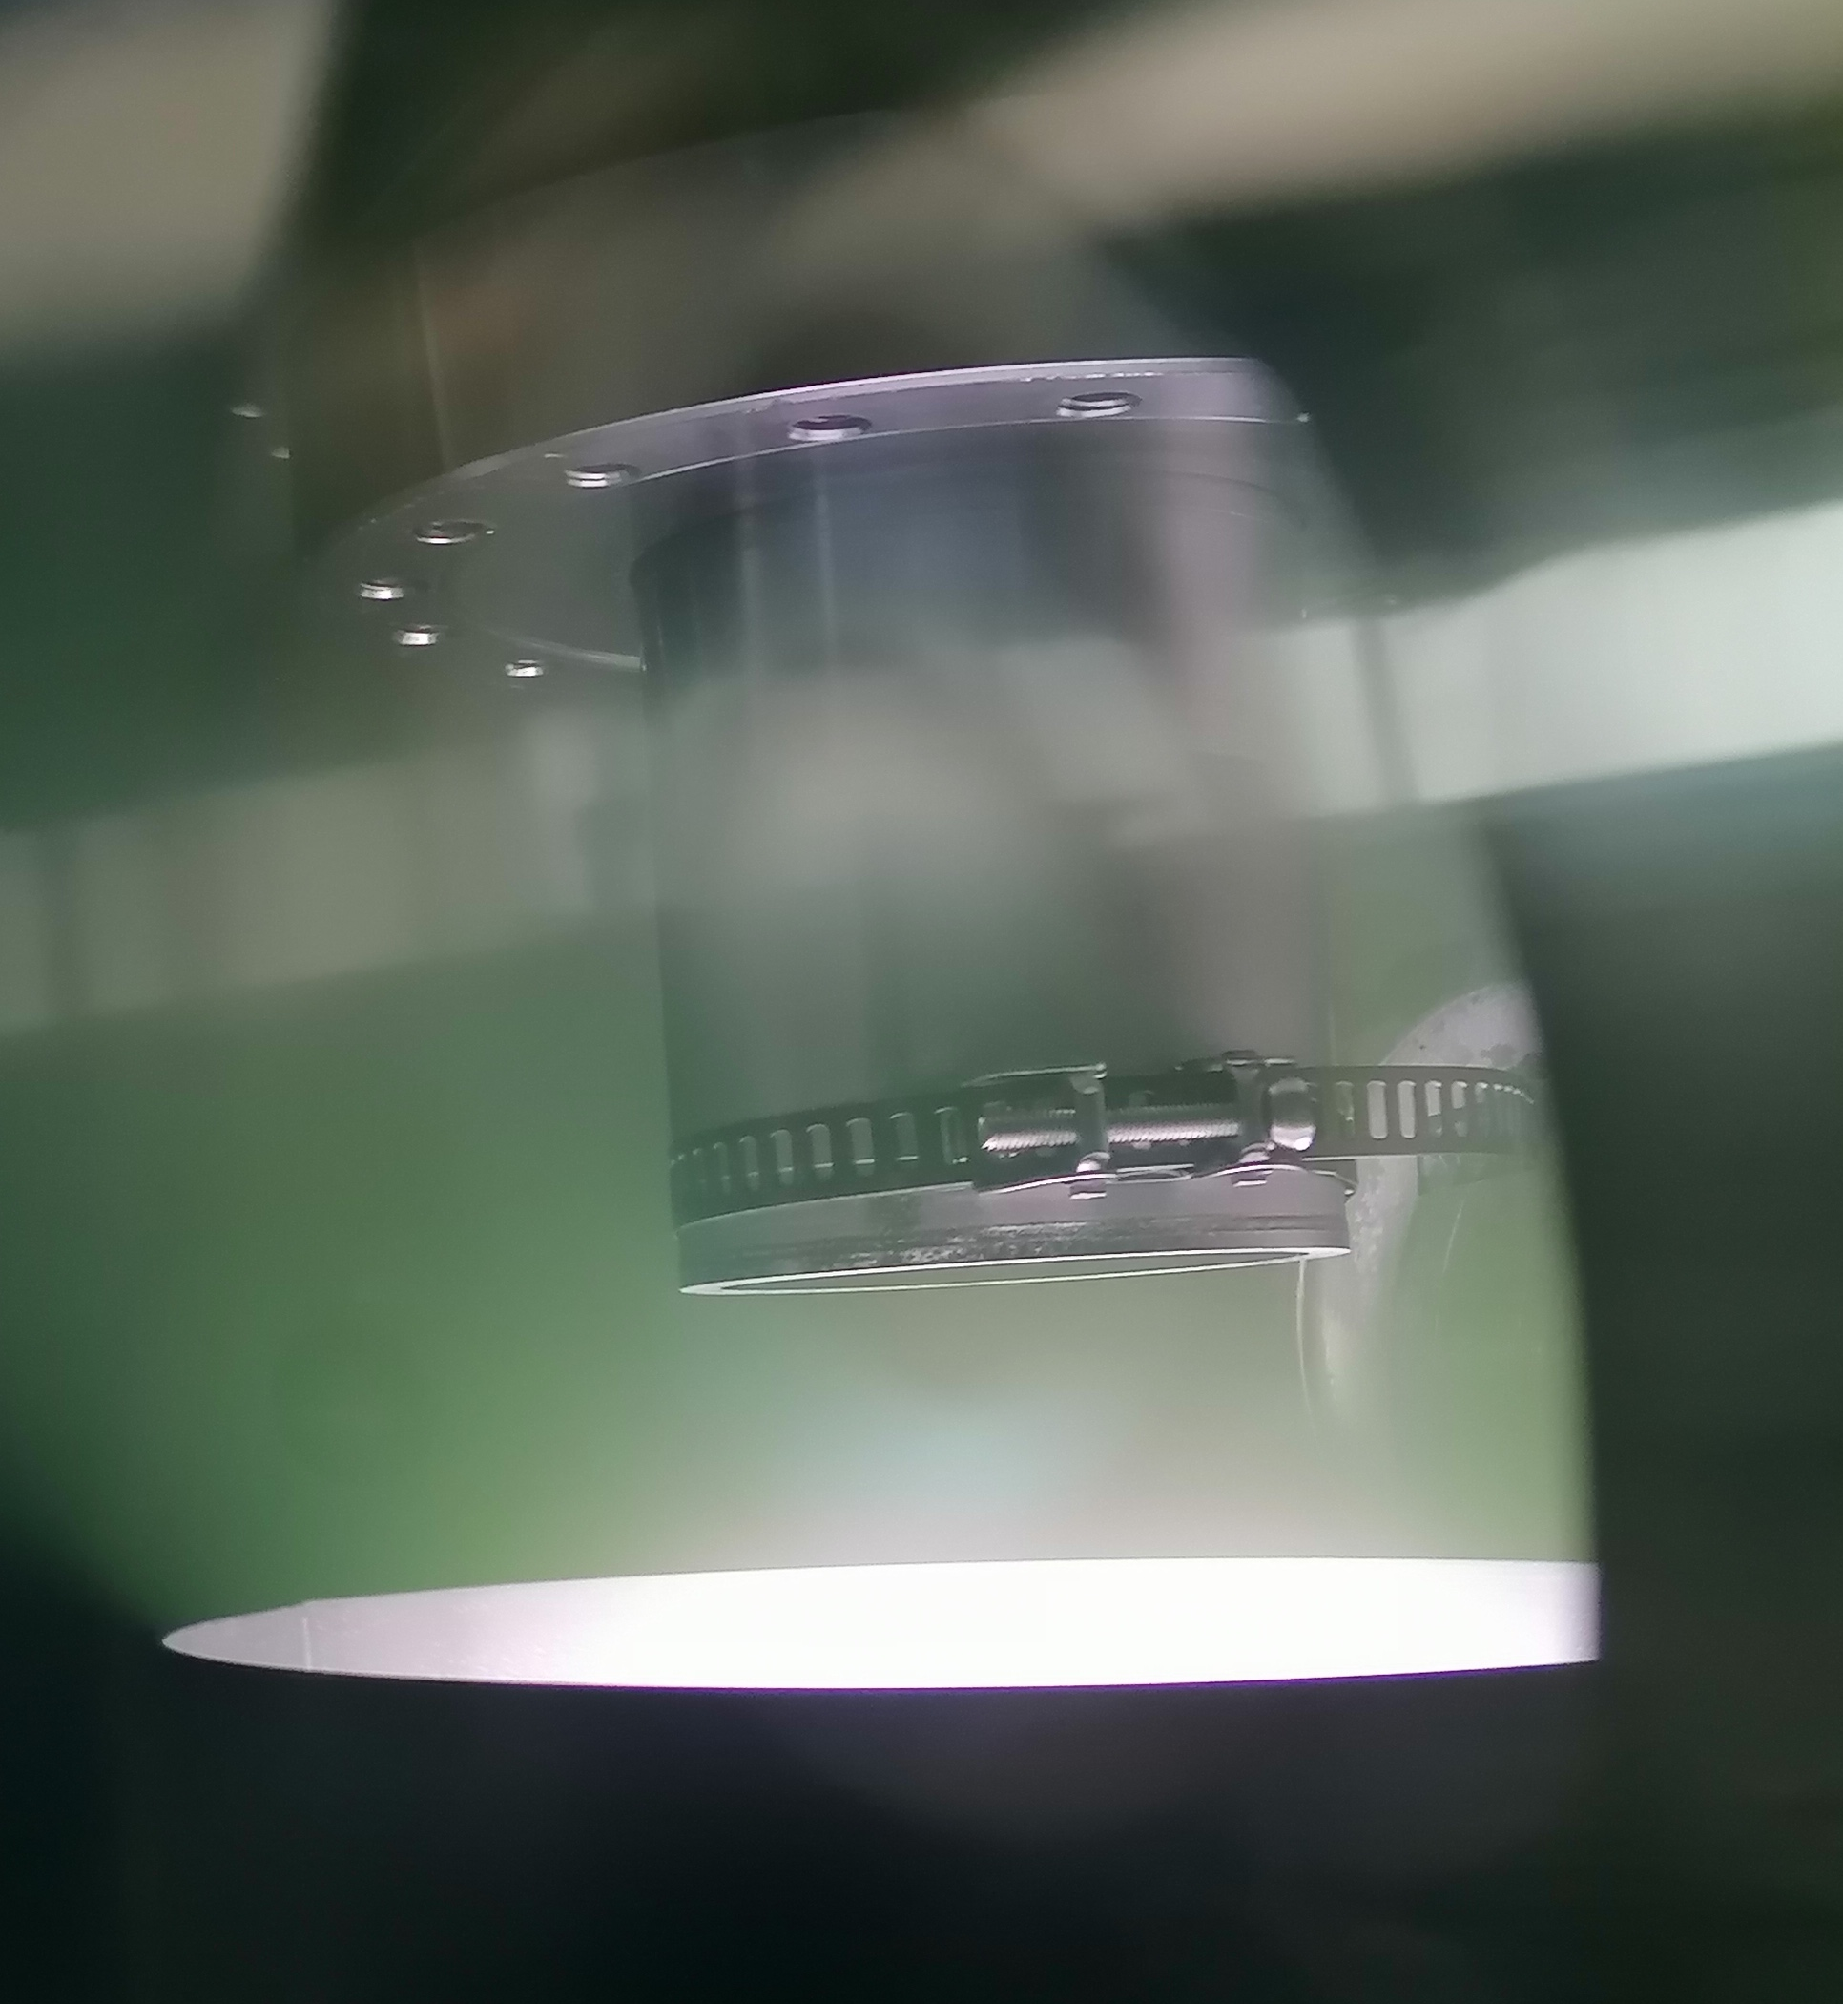
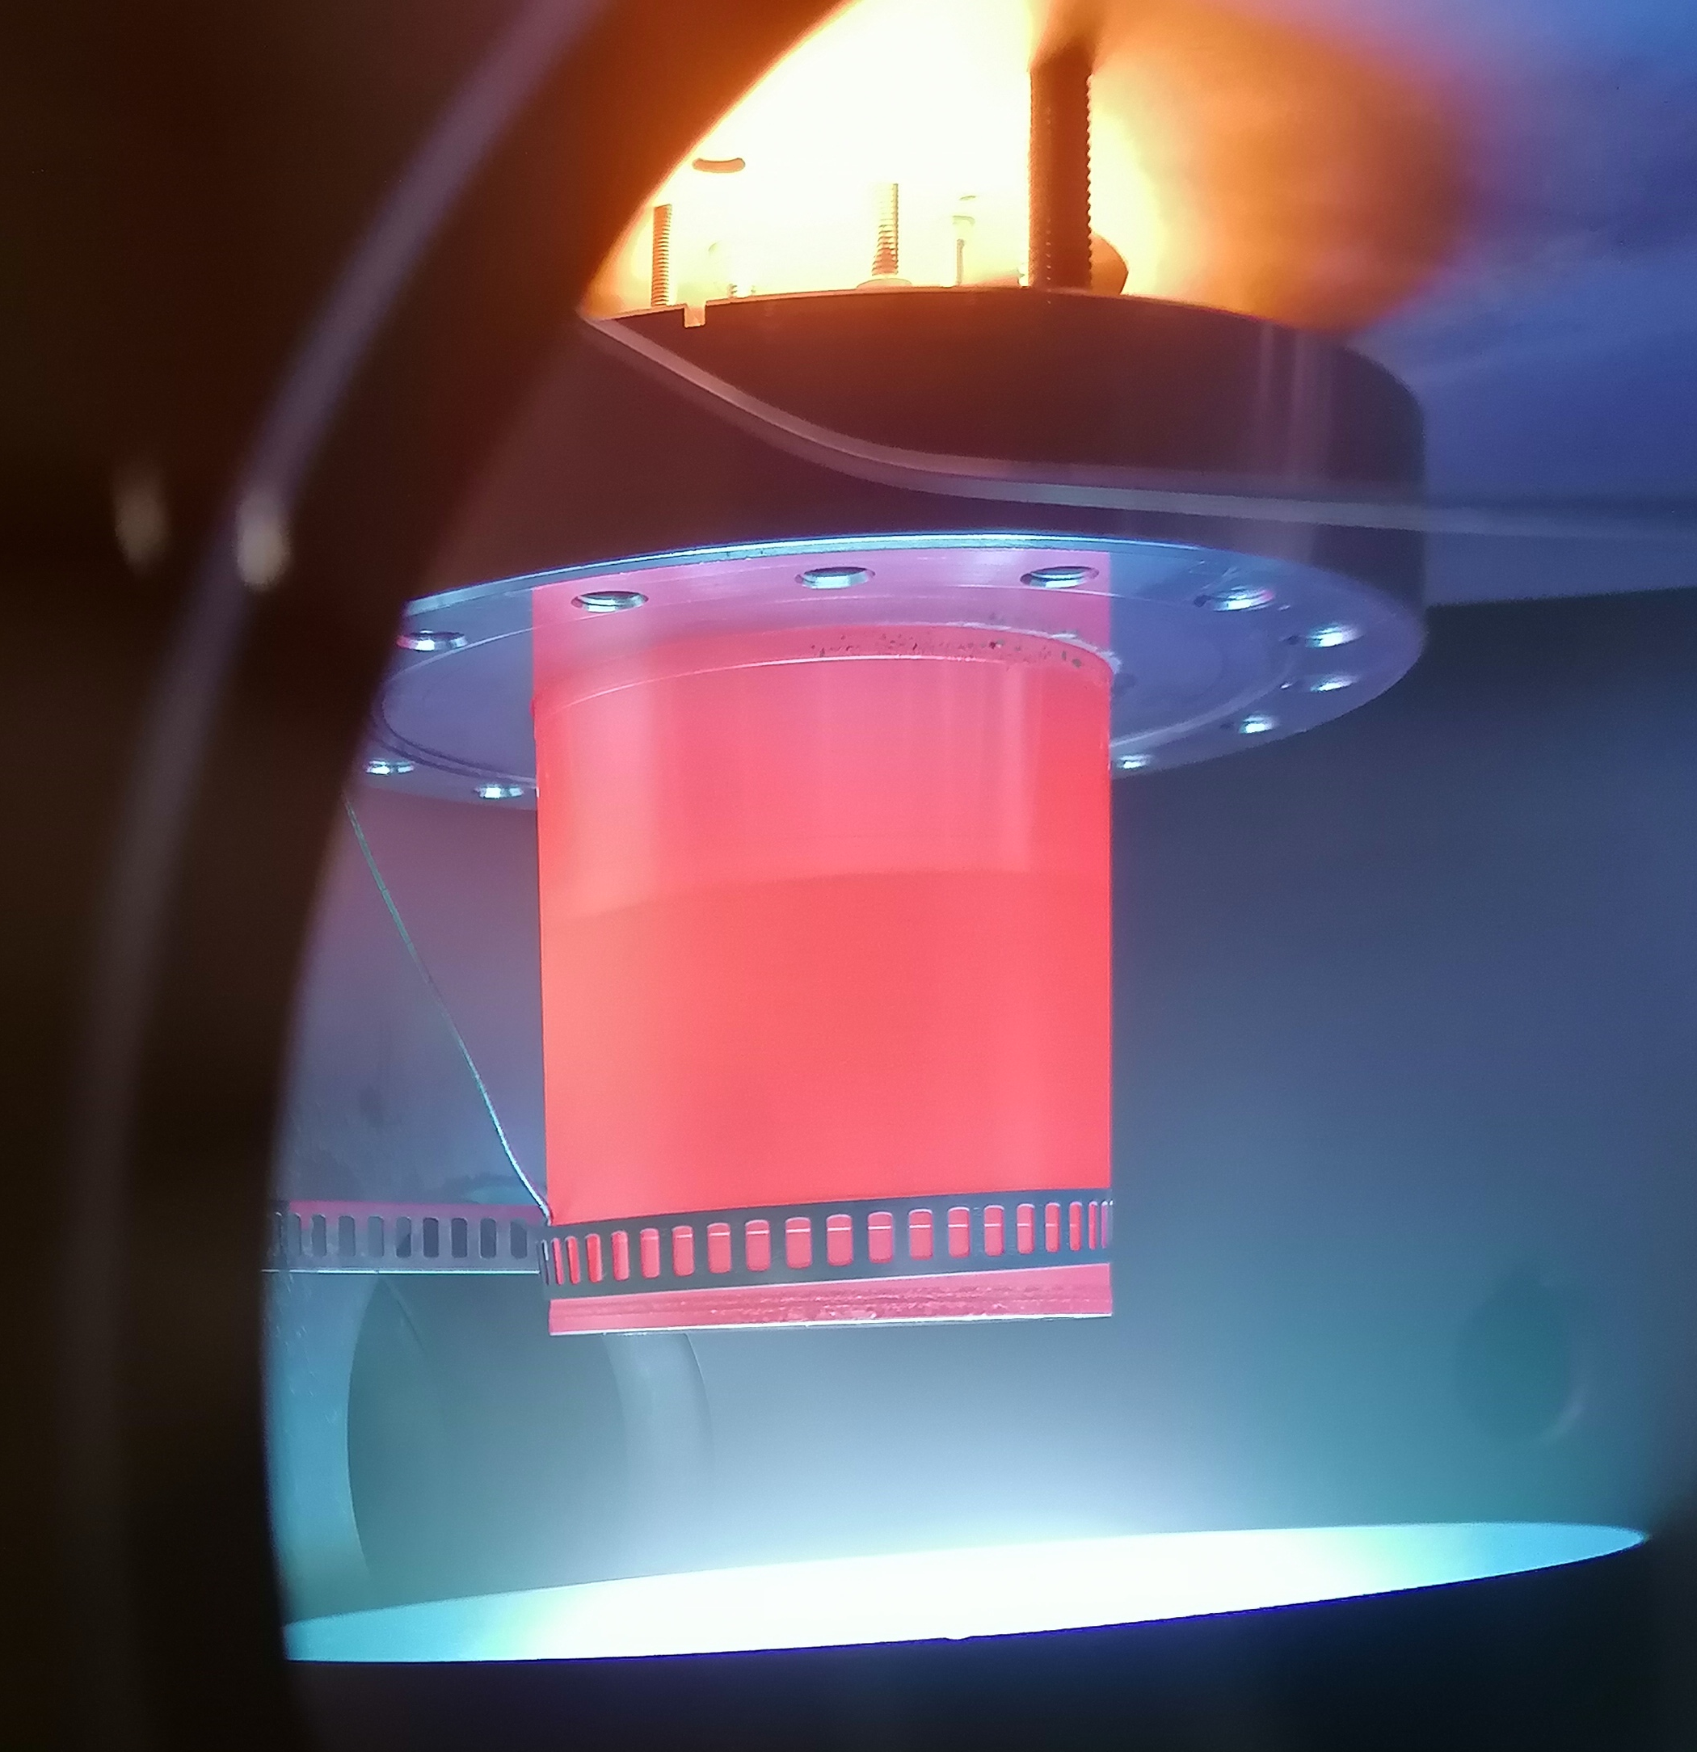
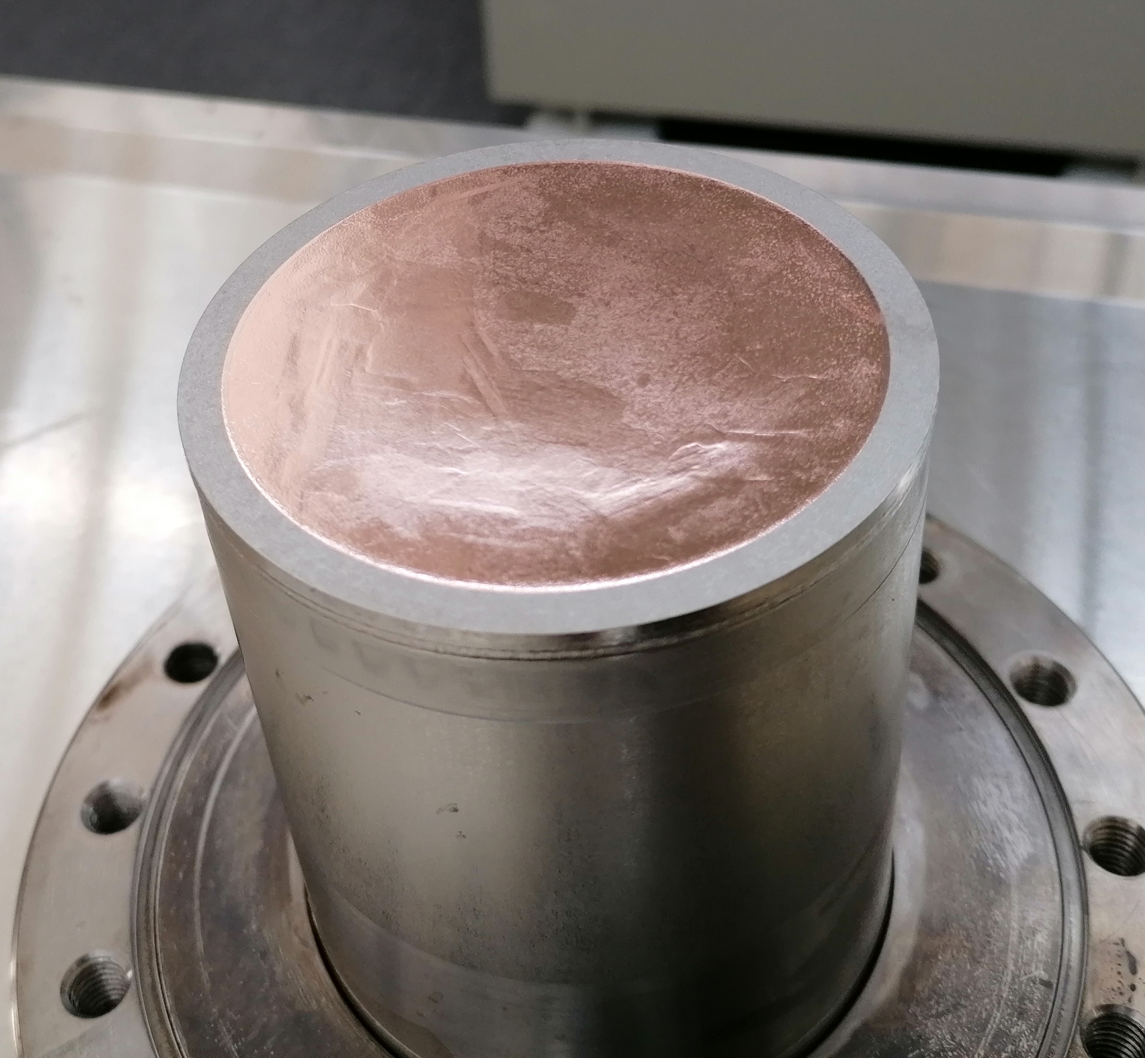
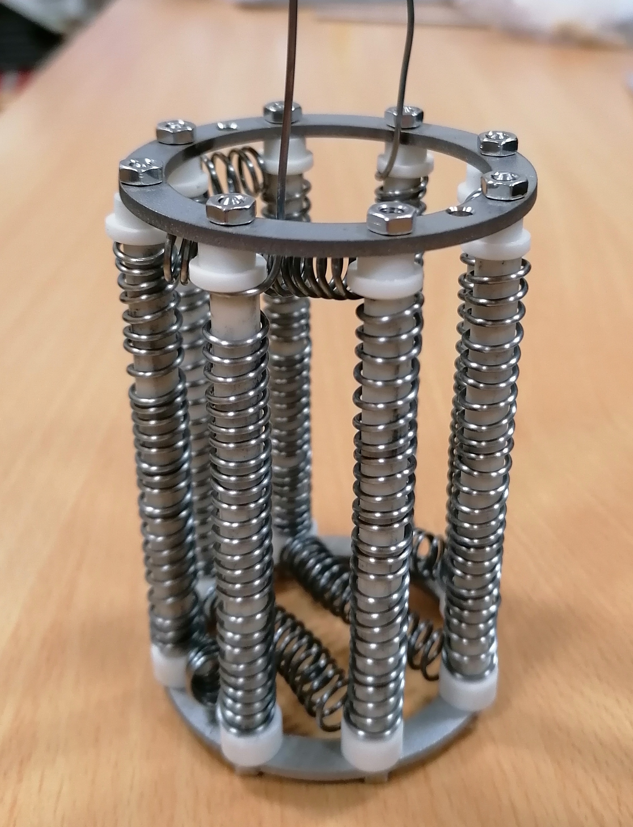
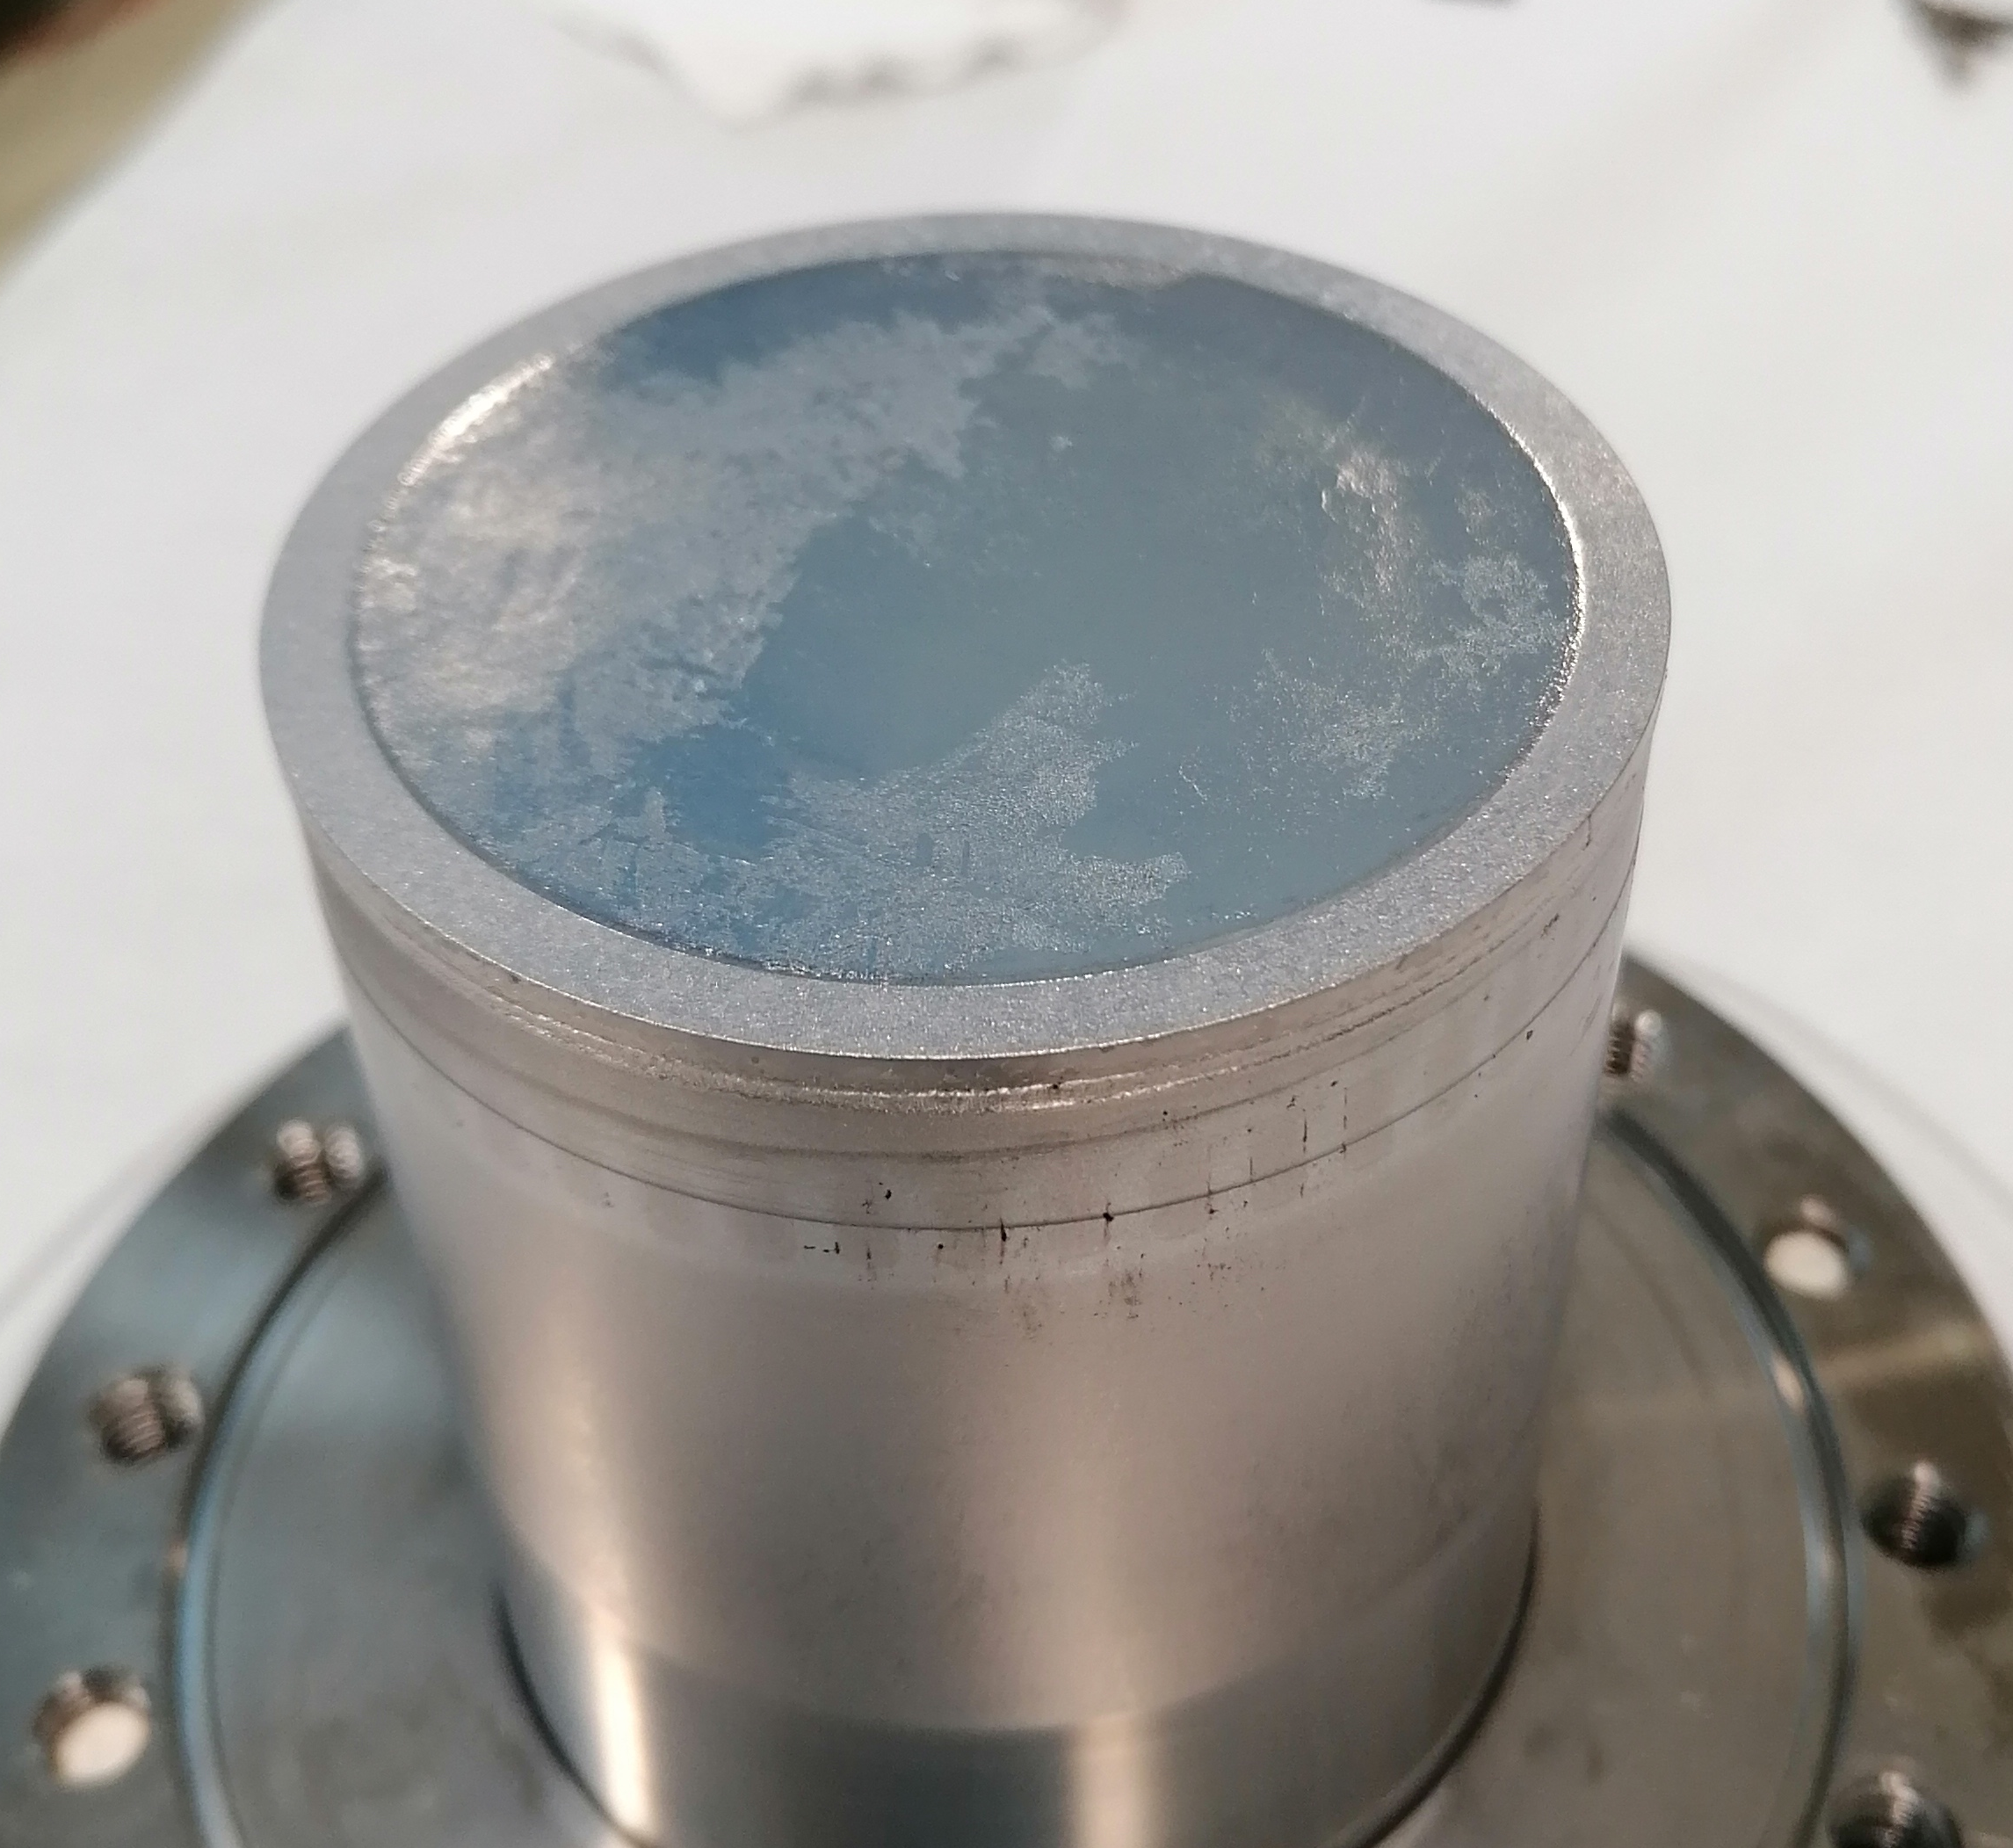
Superconducting Performance
QPR Coating for RF measurements
  Targeting High T_{c}
Ta Coating:
P = 1.0.10⁻³mbar
No heating
PP = 50V
Nb₃Sn Coating:
P = 2.5.10⁻² mbar
T_{s} = 750°C
PP = 35 V
No anneal
Ta Coating
Nb₃Sn Coating

Slide 11
Summary and Future Work
A15 phase deposited
  Sn % within required stoichiometric range
  Encouraging 15.4 K T_{c} soft limit
Surface Cu contamination
  Lower coating temperature
  Interlayer optimisation
Minimisation of residual stress
  Film thickness optimisation
  Post coating annealing
Deposition of further QPR samples

Slide 12
Thank you for your attention!

Slide 13
Extra Slides

Slide 14
Thermal expansion Coefficients
Element | α (x 10⁻⁶) K⁻¹
Cu | 16.8
Ta | 7.64
Nb | 7.02
Nb₃Sn | 6.3

Slide 15
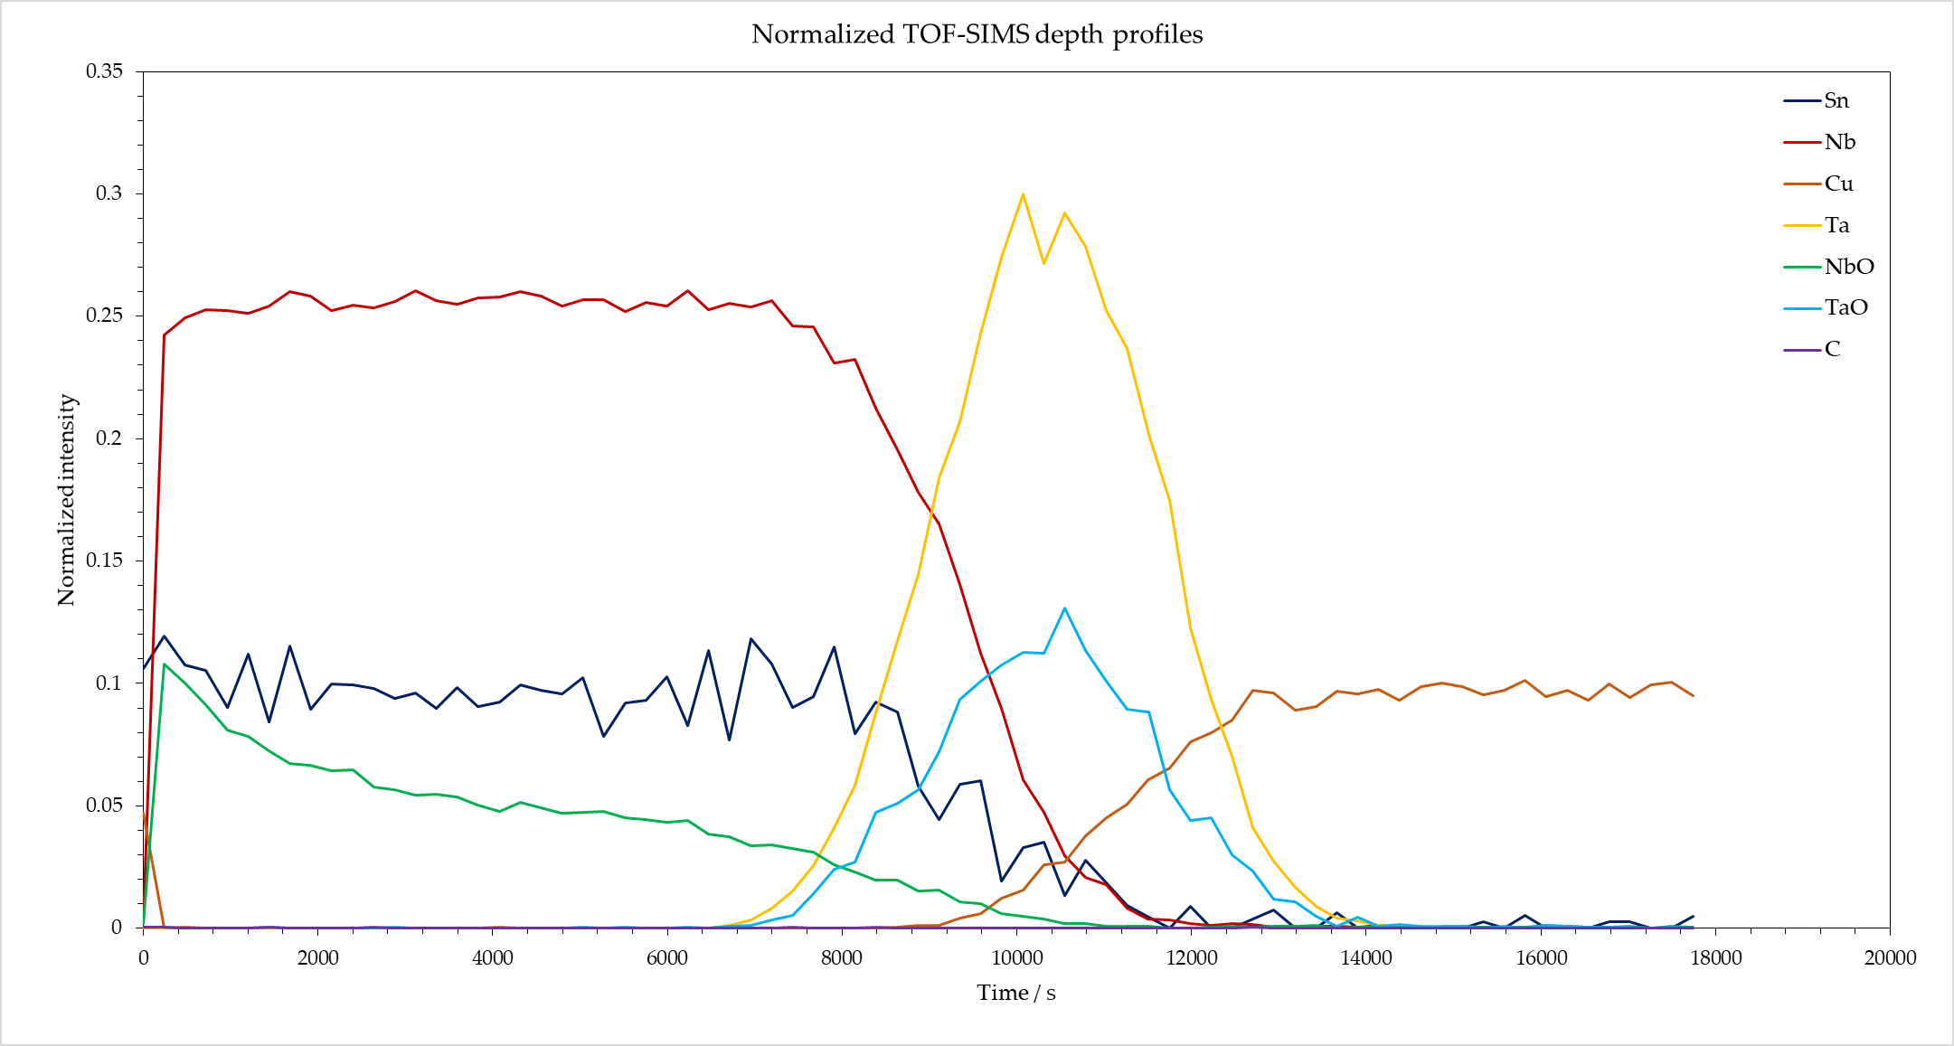
SIMS Results

Slide 16
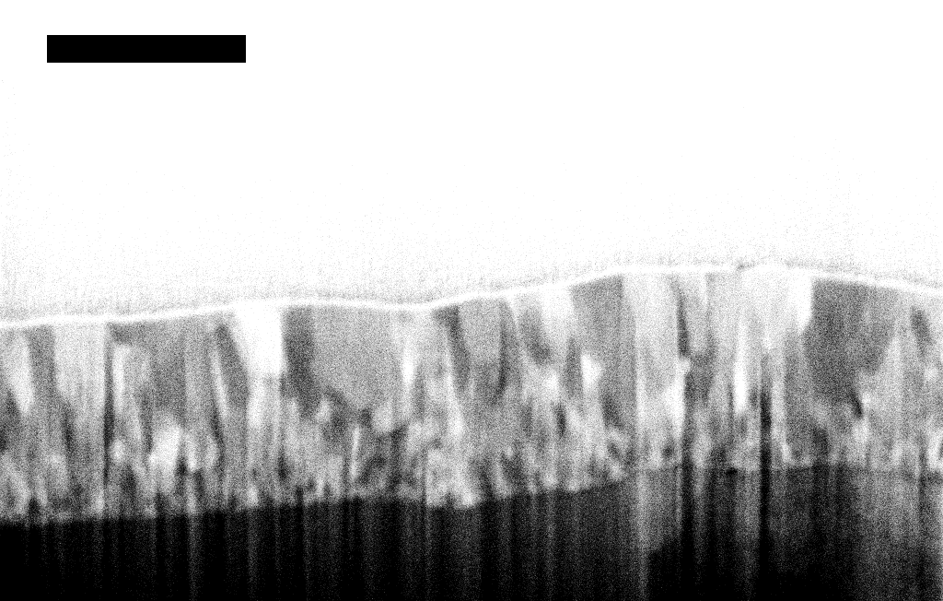
DCMS
HiPIMS
700 MHz β=0.65 Single Cell Cavity profile

