Slide 1

Single-Bunch Instabilities
Emanuela Carideo
Acknowledegements: M. Migliorati, F. Zimmermann, M. Zobov, D.Quartullo,
Y.Zhang, M.Behtouei
FCCIS – The Future Circular Collider Innovation Study. This INFRADEV Research and Innovation Action project receives funding from the European Union’s H2020 Framework Programme under grant agreement no. 951754. The information herein only reflects the views of its authors and the European Commission is not responsible for any use that may be made of the information.

Slide 2

Outline
Wakefields and impedances evaluated so far: The method used to calculate the wakepotential
Repository
Longitudinal single beam instabilities: MI analysis
Transverse single beam instabilities : TMCI mode analysis
ITSR instability
One possible strategy for calculating the impedance of collimators

Slide 3
Impedance Sources: CST and IW2D simulations
Longitudinal wake potentials for a Gaussian bunch with nominal bunch length due to the main FCC-ee components, evaluated so far.
How did we do these simulations?

Slide 4
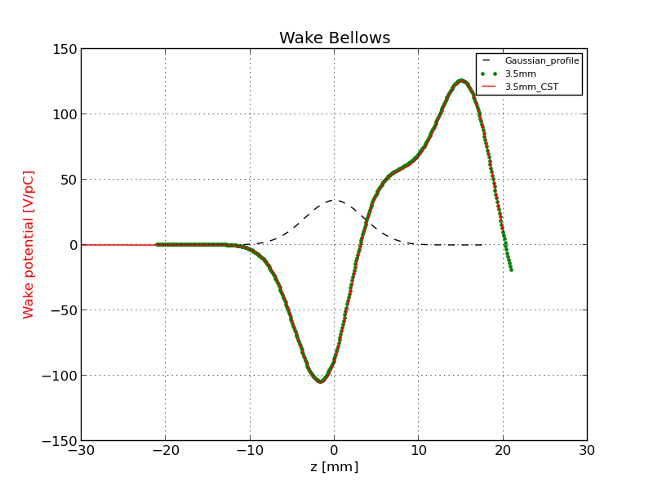
Method to calculate the Wake Potential by software simulation
Comparison of the wake potential of 3.5 mm bunch length between PyHT and CST: Bellows
Wake potential for a Bellow of a 3.5 mm Gaussian bunch obtained directly by CST (red curve) and with the convolution by using the wake potential of 0.4 mm Gaussian bunch (green dots).

Slide 5
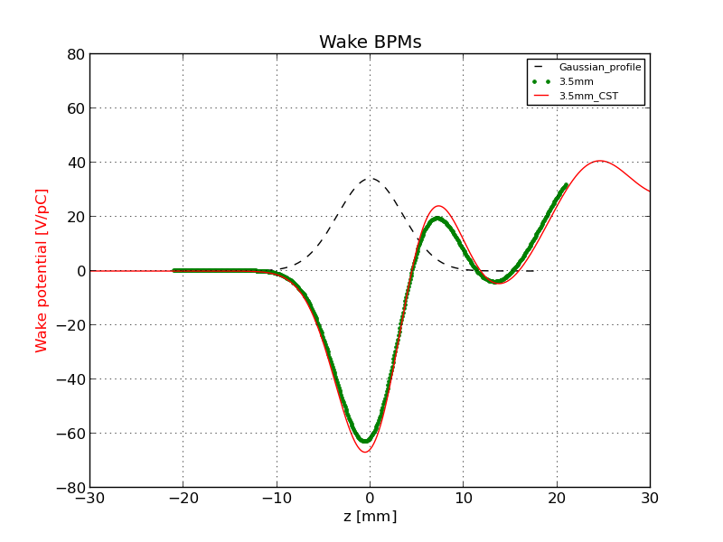
Comparison of the wake potential of 3.5 mm bunch length between PyHT and CST: BPMs

Slide 6
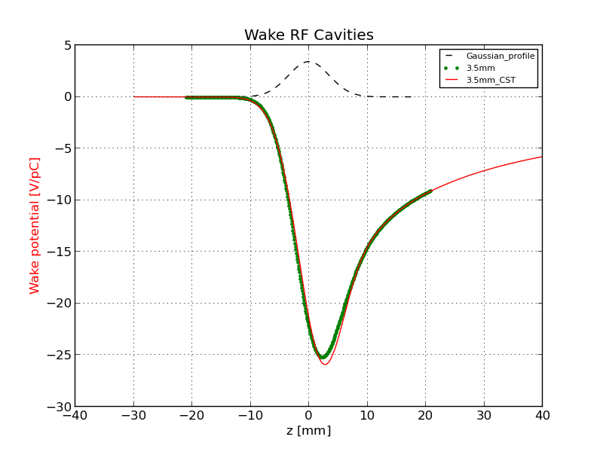
Comparison of the wake potential of 3.5 mm bunch length between PyHT and CST: RF Cavities

Slide 7
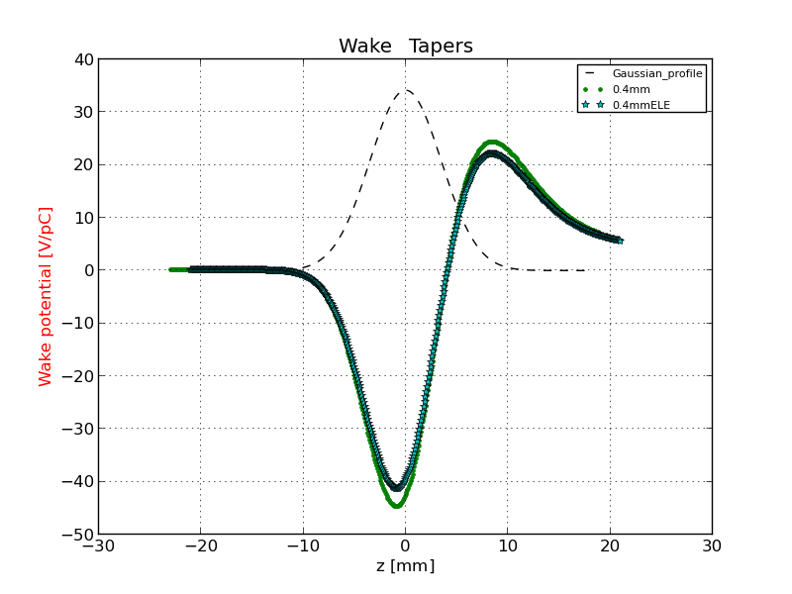
Comparison of the wake potential of 3.5 mm bunch length between PyHT and CST: RF double tapers
3.5 mm
3.5_ABCI

Slide 8
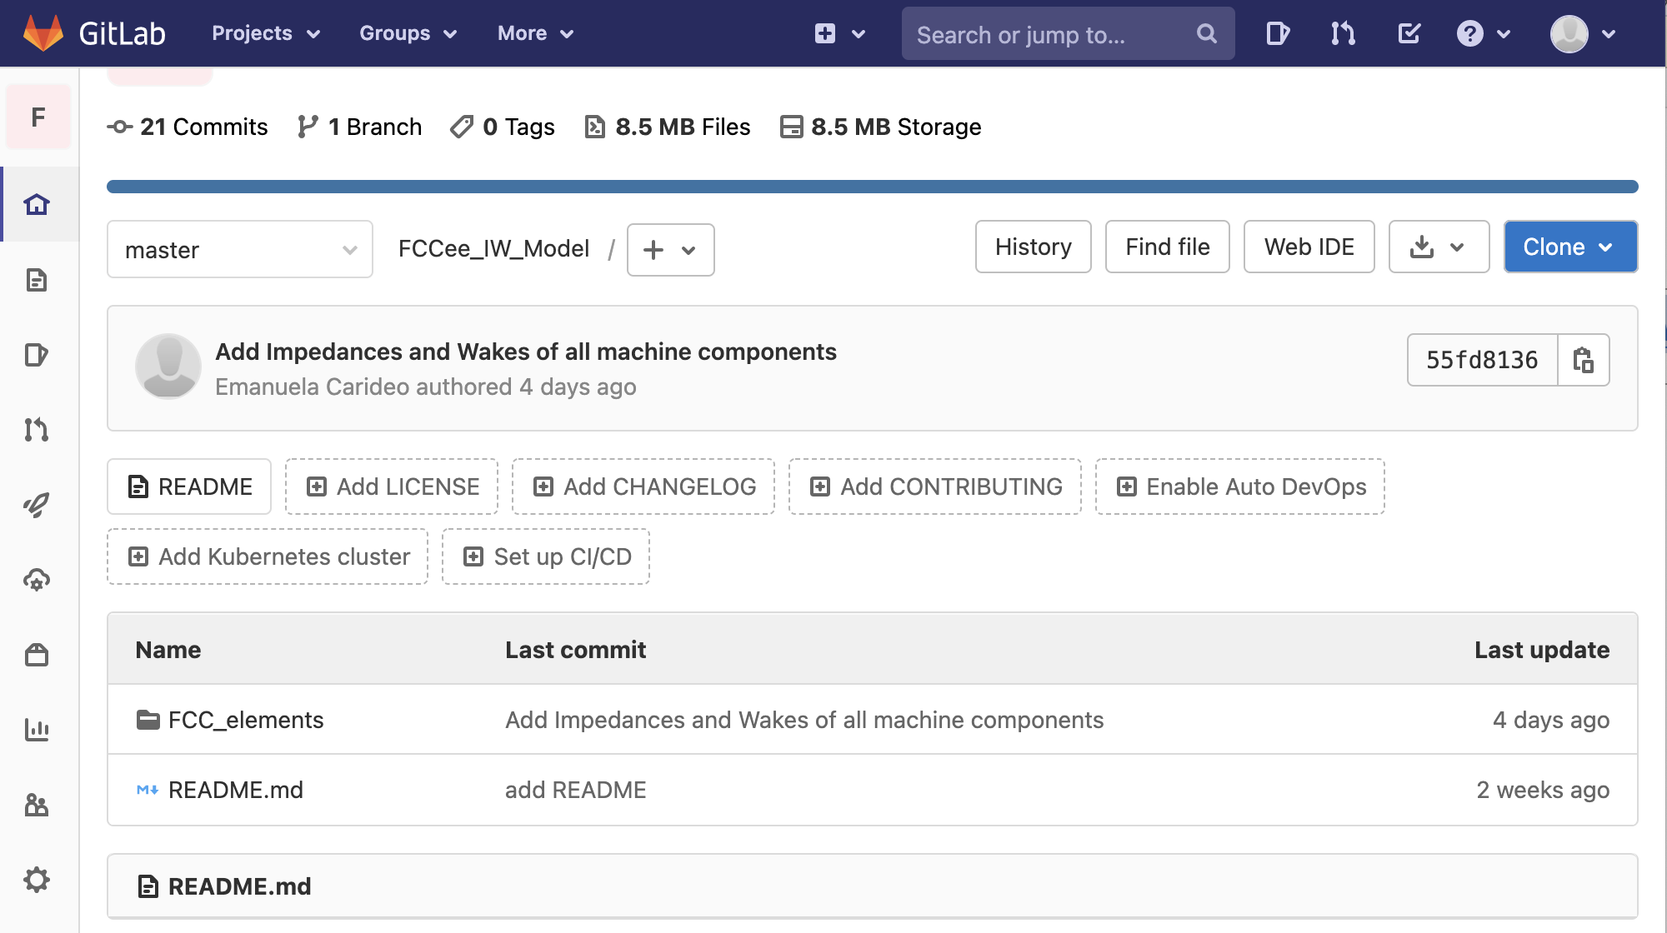
Wake and impedance repository for FCC-ee: https://gitlab.cern.ch/ecarideo/FCCee_IW_Model
A repository, or Git project, encompasses the entire collection of files and folders associated with a project. Working in repositories keeps development projects organized and organized and protected.
The Repository also provides more opportunities for project transparency and collaboration, working together to build the best possible final product.
How is it developed?
In this folder there are some of FCC-ee components and for each machine components the calculated impedance and wake

Slide 9
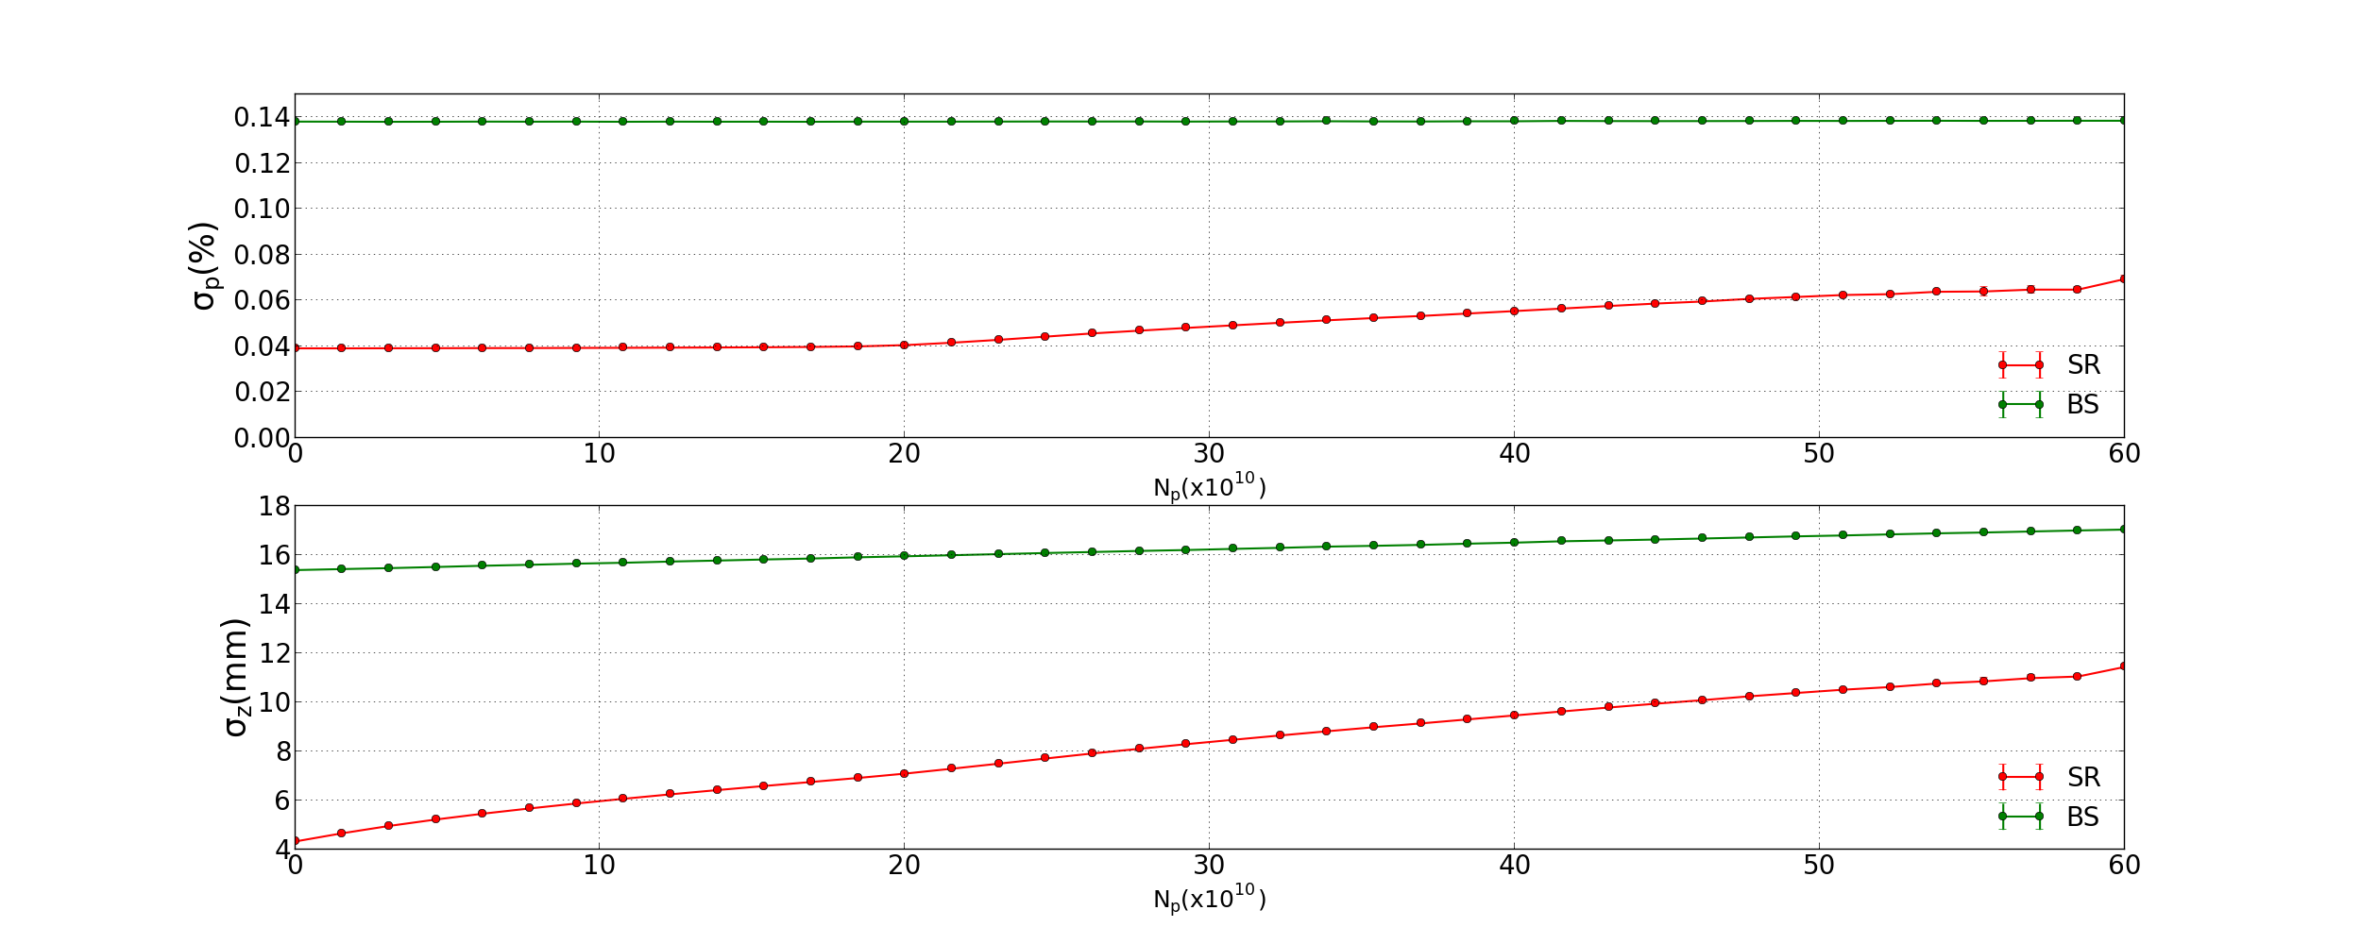
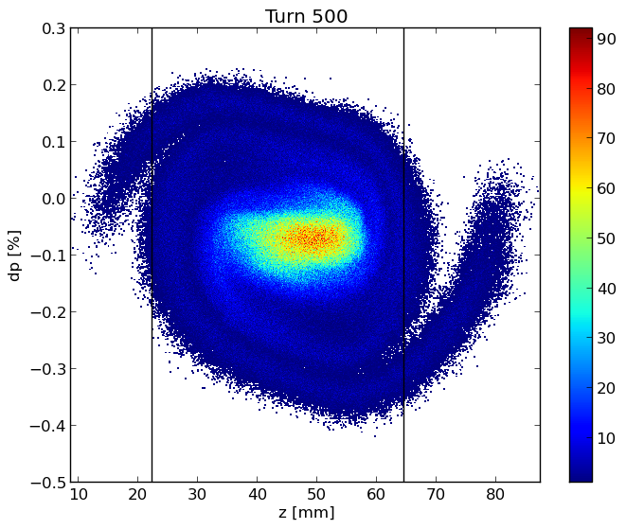
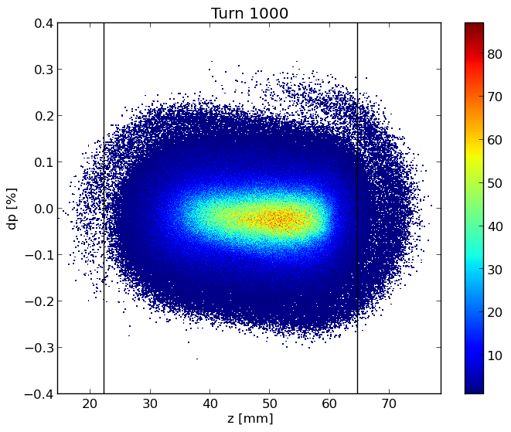
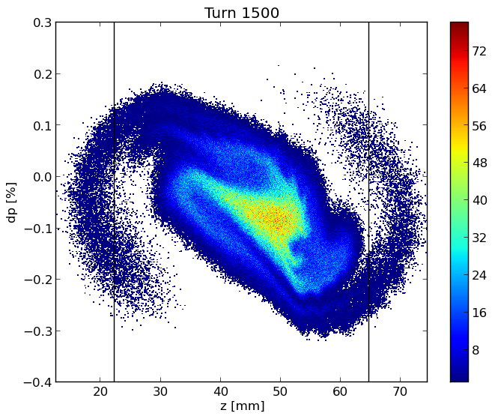
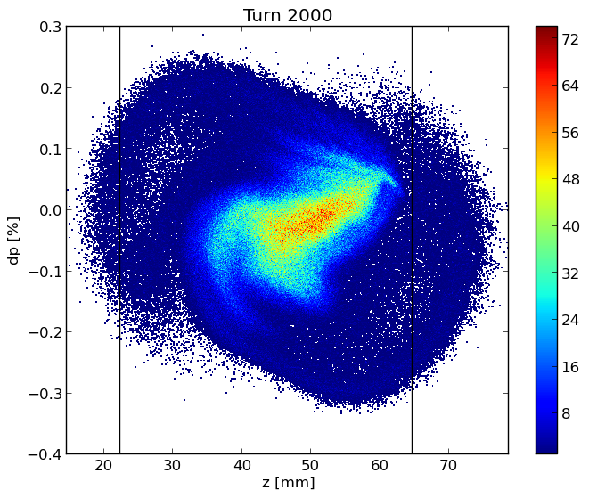
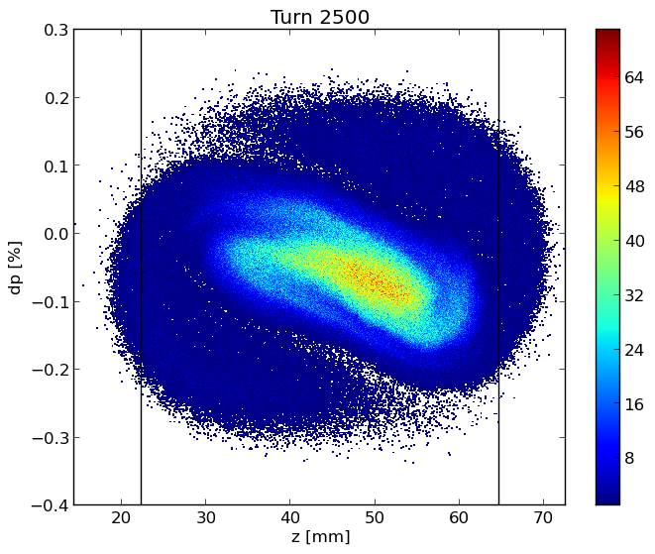
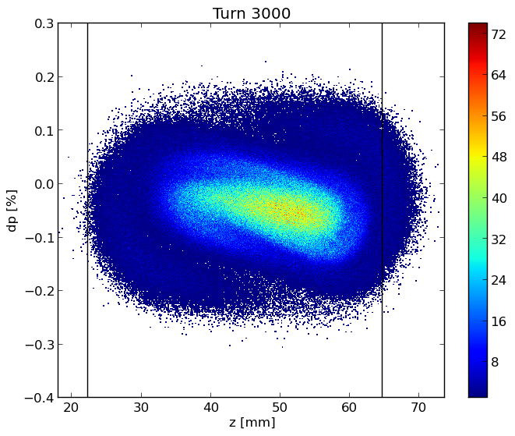
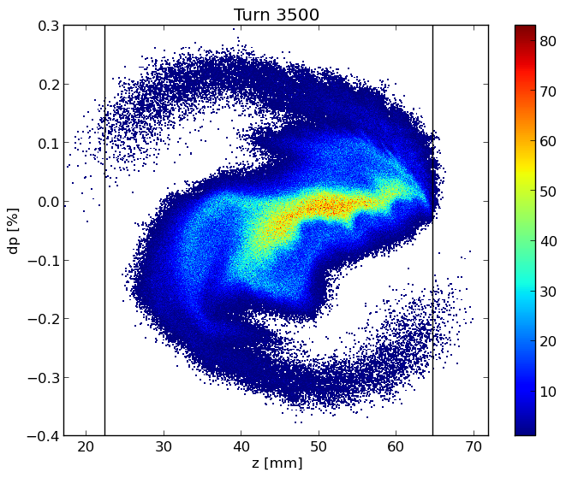
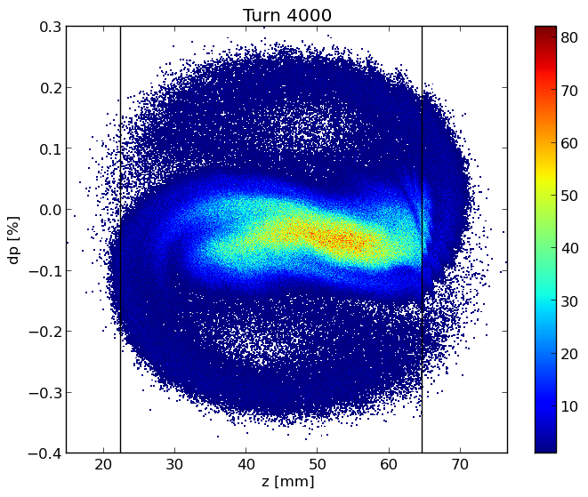
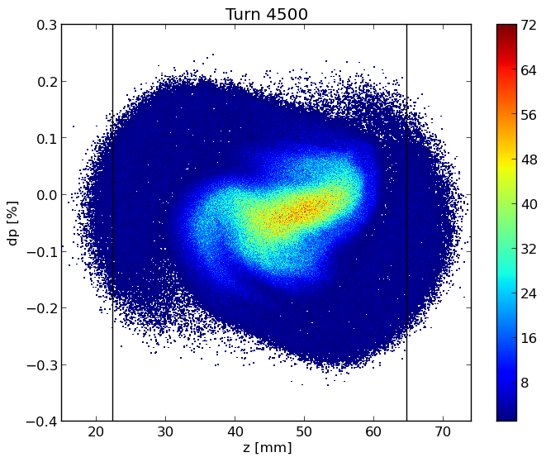
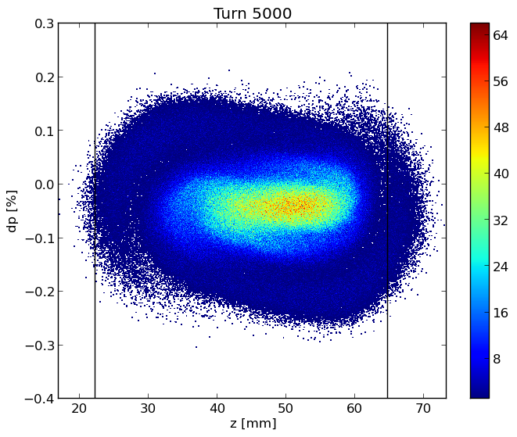
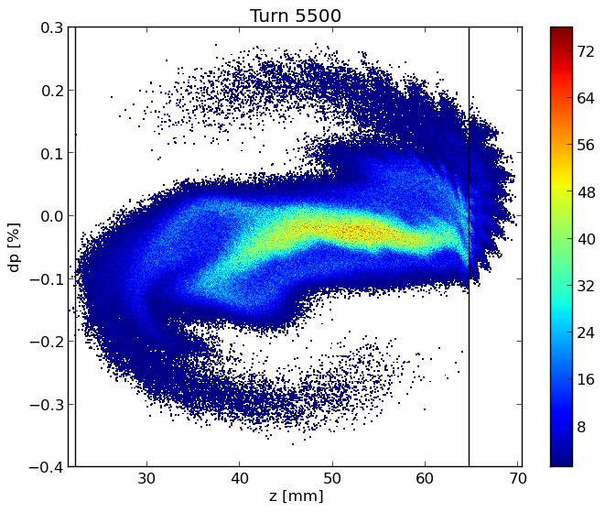
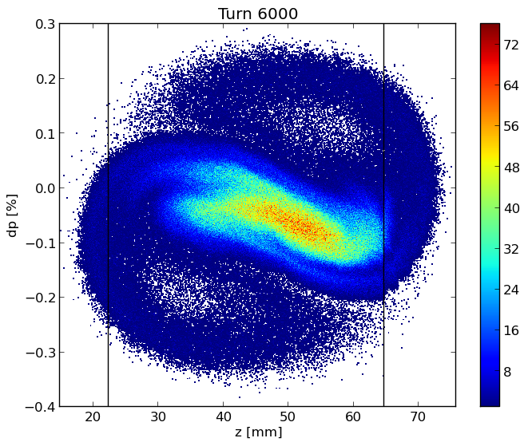
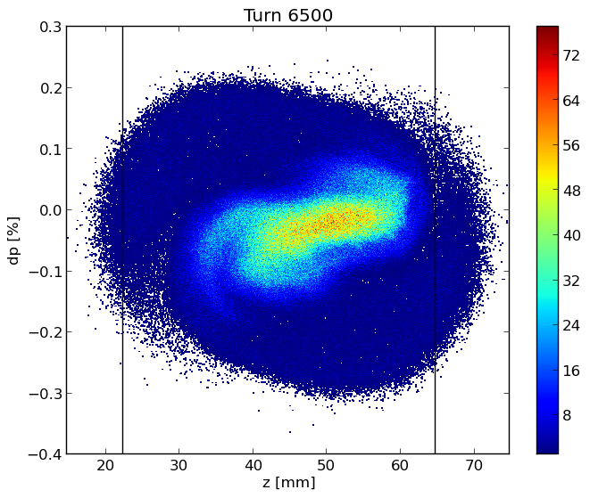
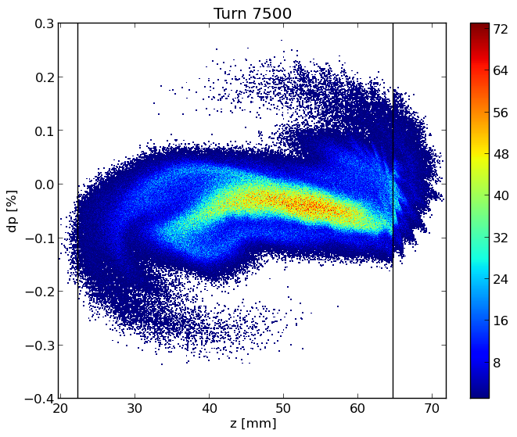
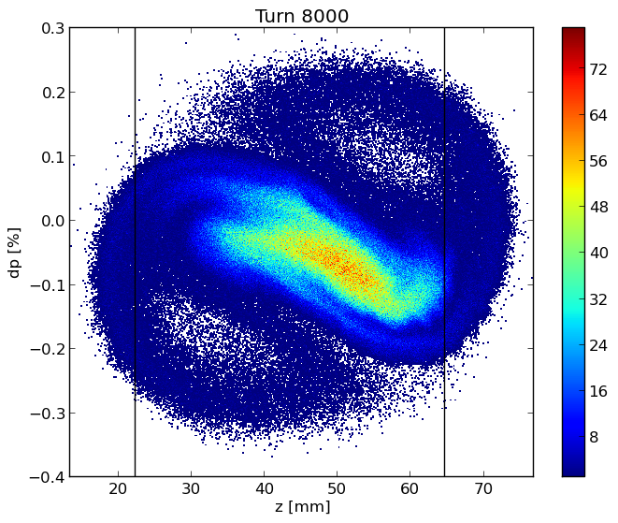
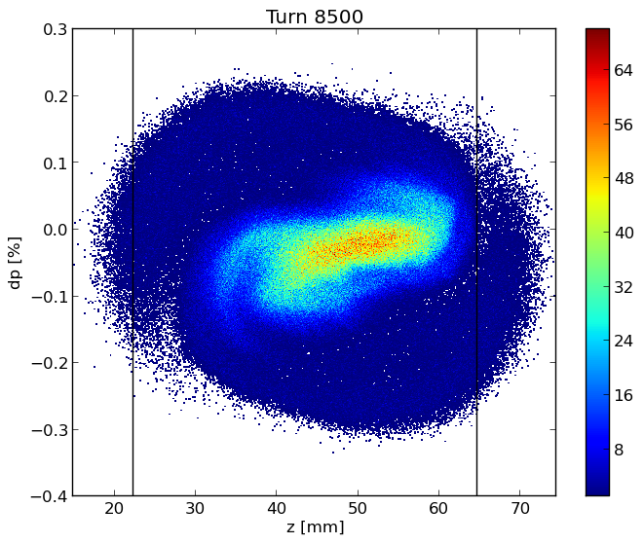
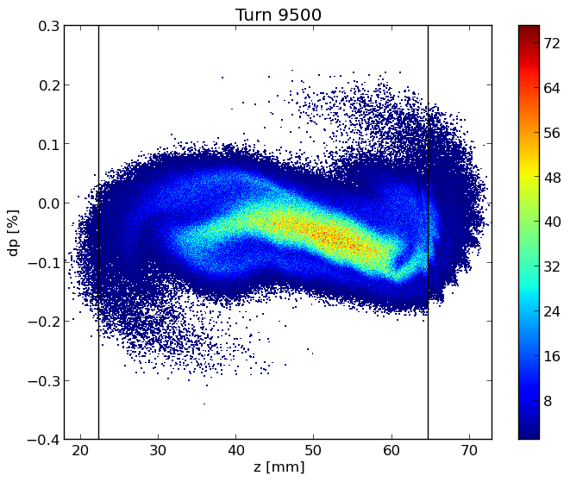
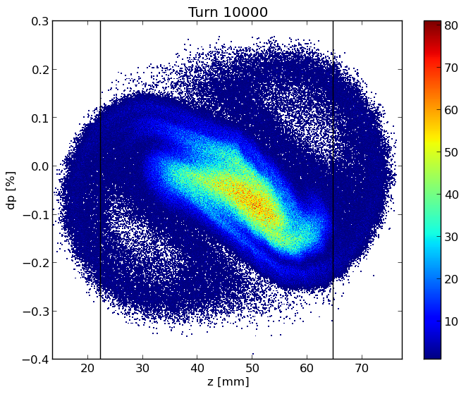
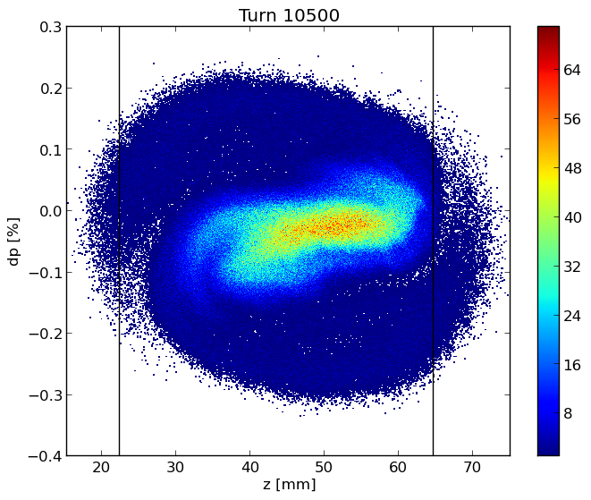
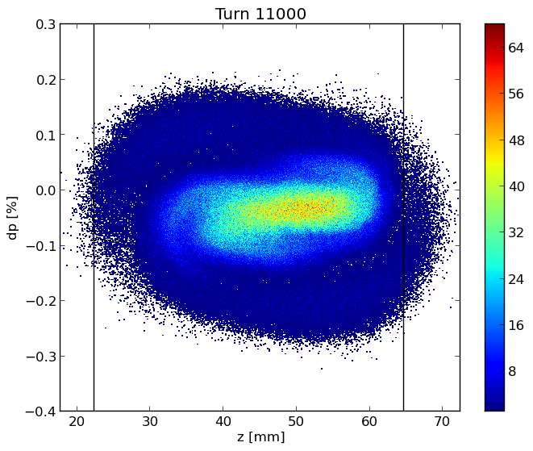
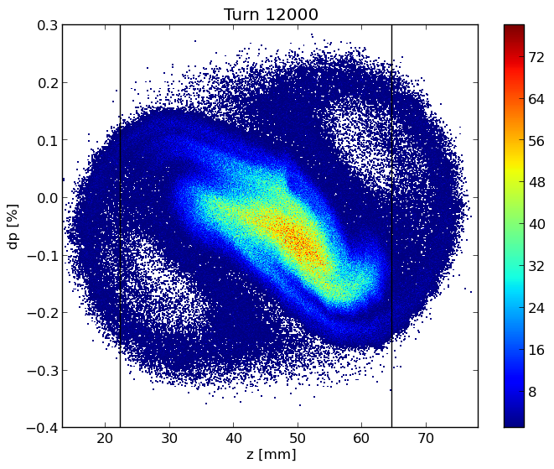

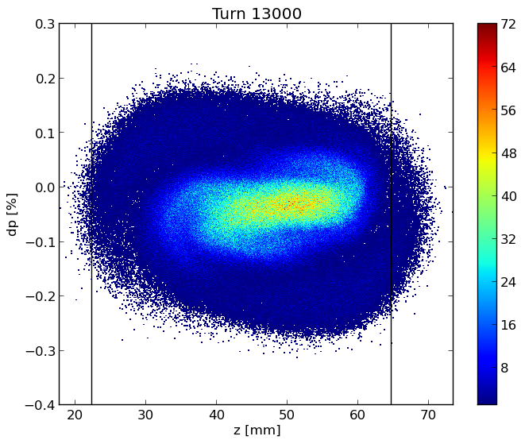
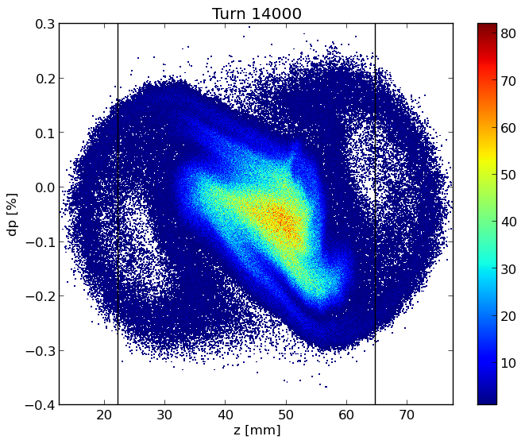
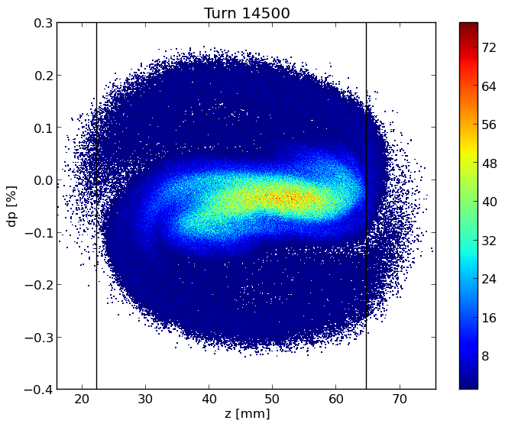
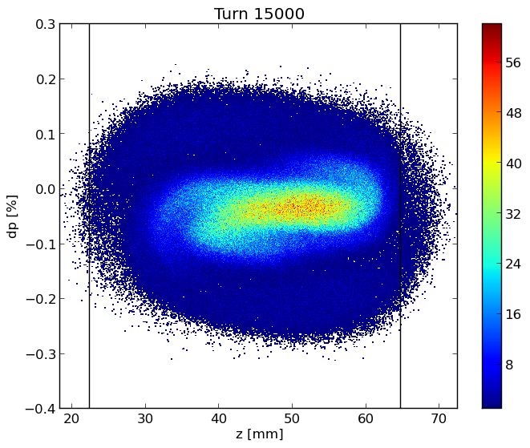
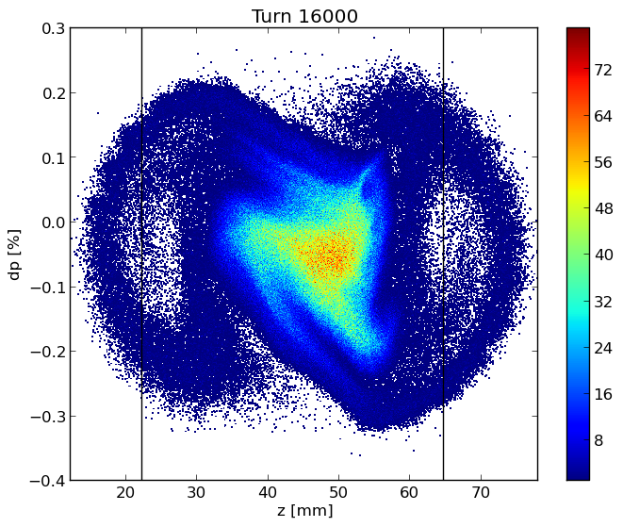
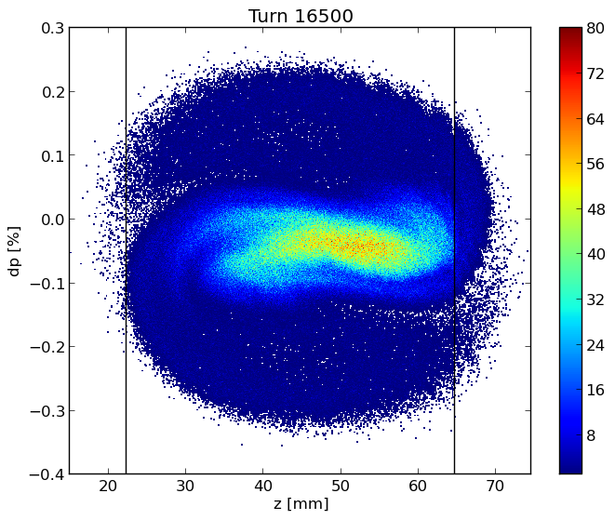

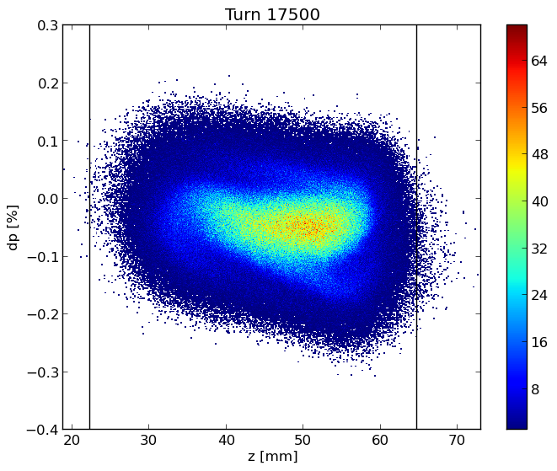
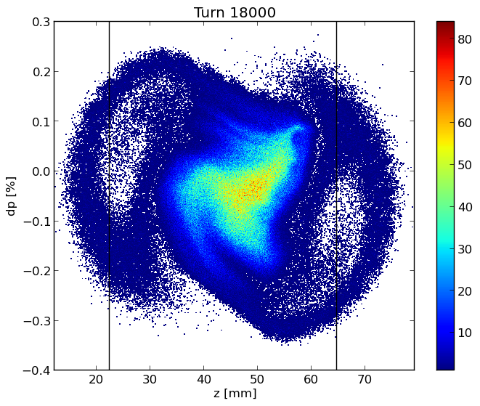
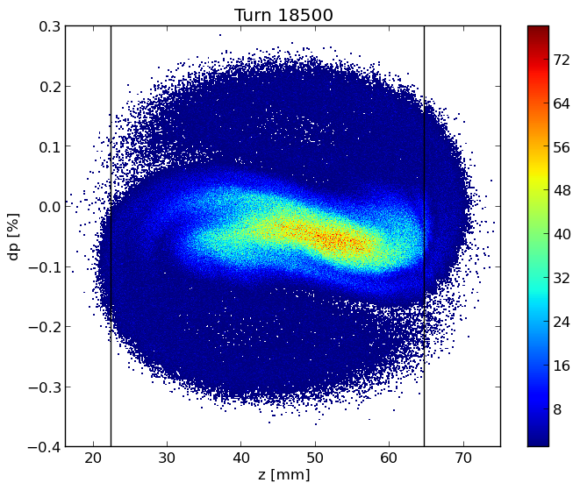
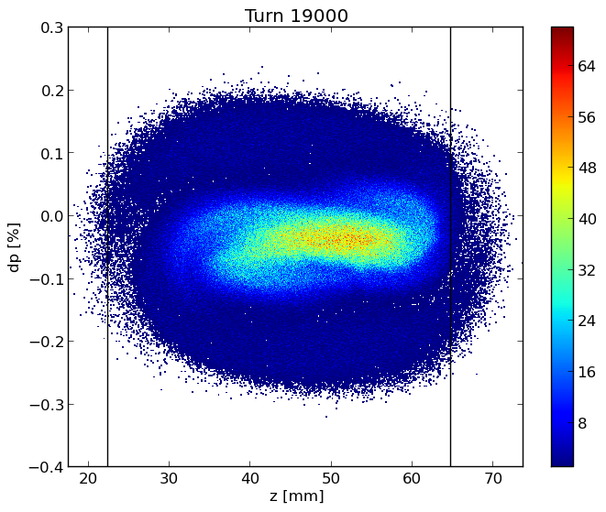
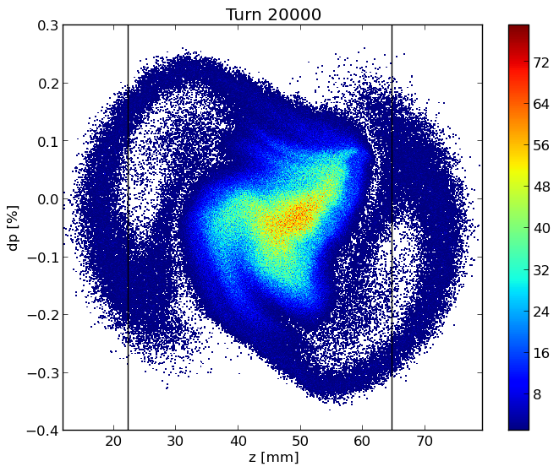
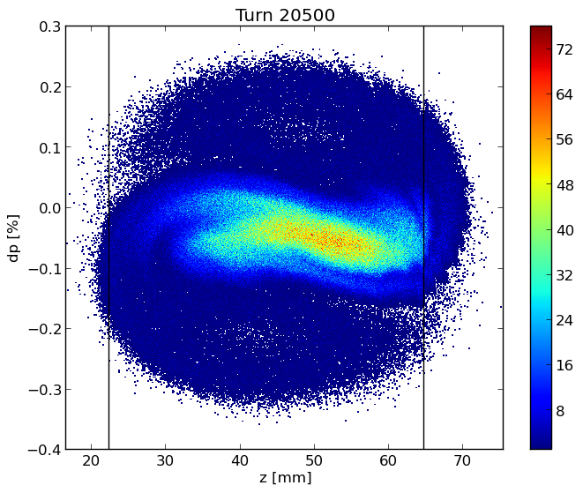
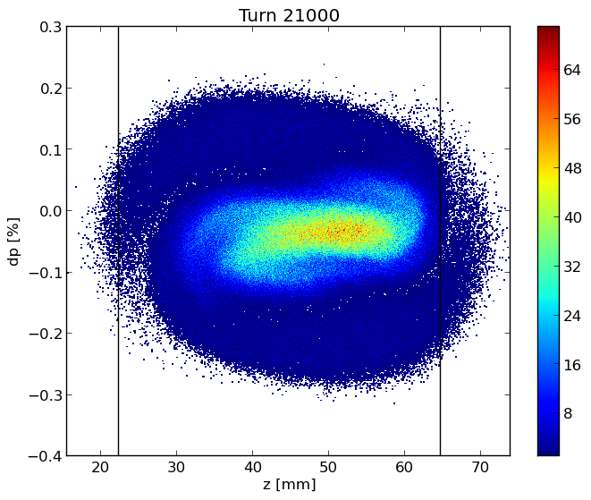
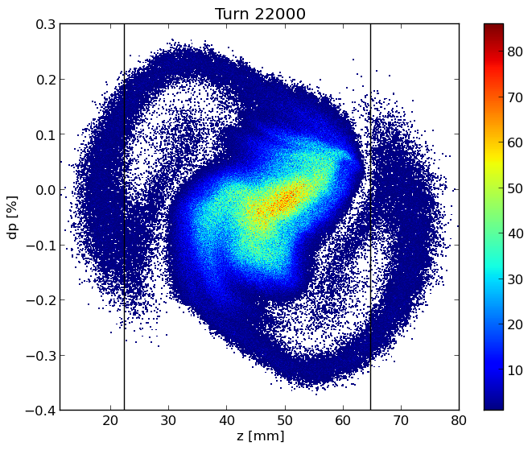
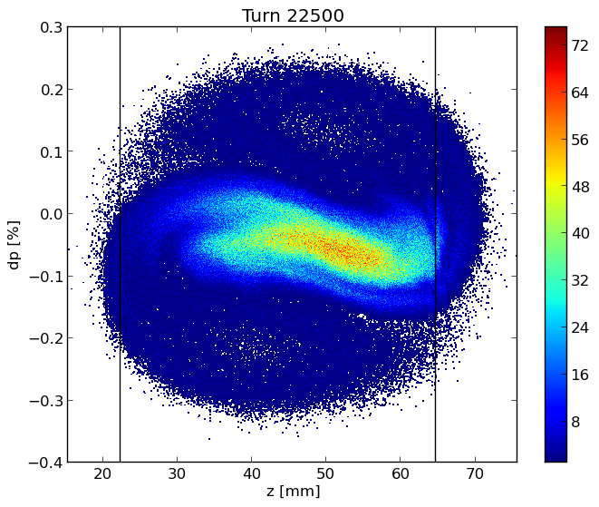
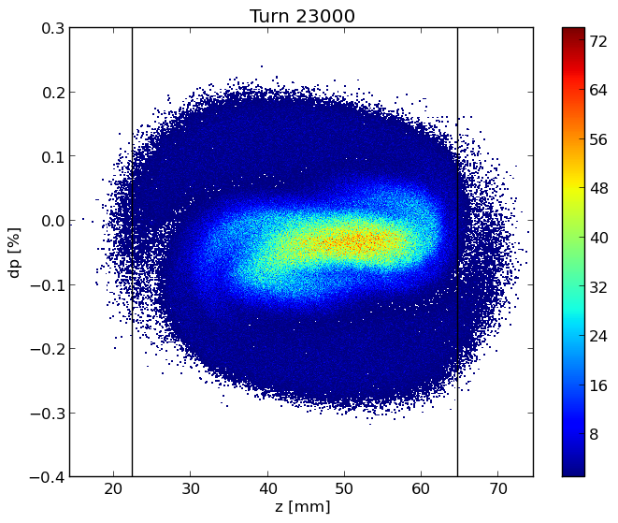
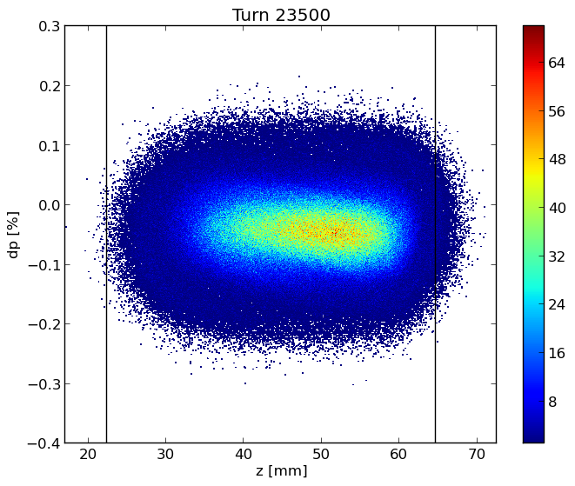
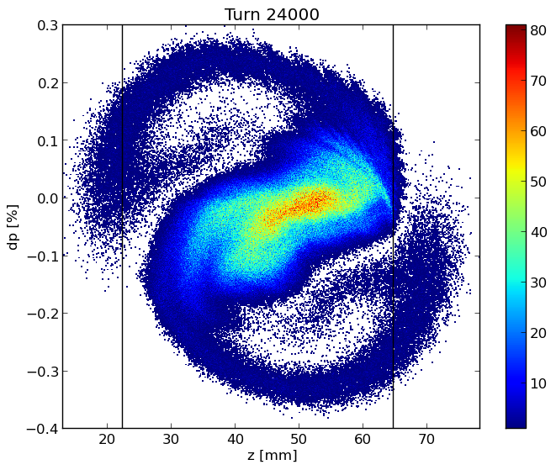
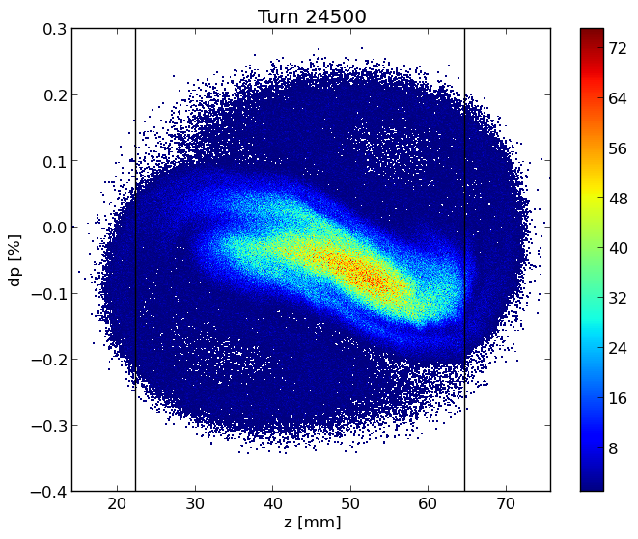
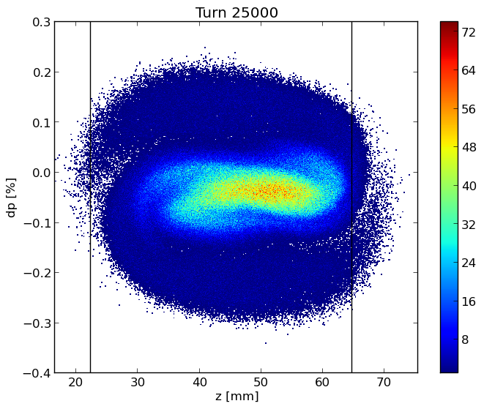
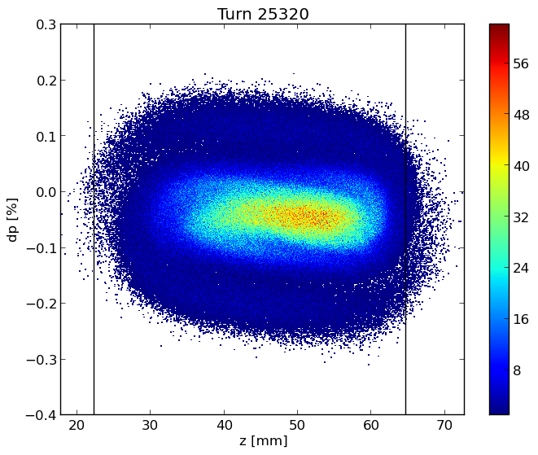
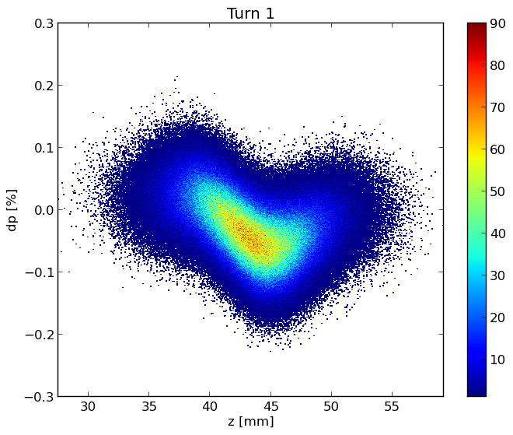
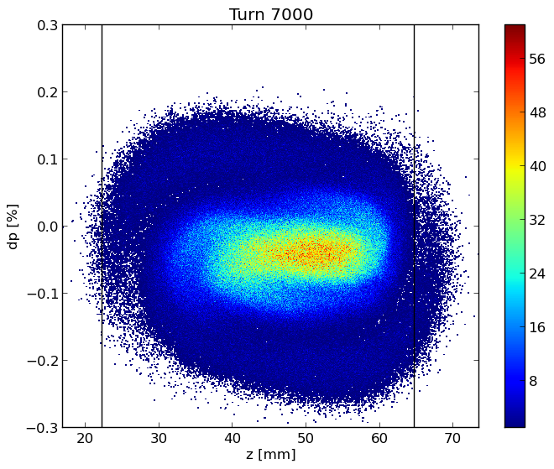






Longitudinal dynamics
Longitudinal phase space
Bunch length (bottom) and RMS energy spread (top) as a function of bunch population in the case with (BS) and without (SR) beamstrahlung, which is considered here independent of the longitudinal impedance.

Slide 10


Bunch length and energy spread for considered cases
The transverse impedance almost does not affect the longitudinal dynamics

Slide 11


Transverse Dynamics
SR: Bunch length of 4.37 mm
The TMCI, Transverse Mode Coupling Instability,
occurs when the frequencies of two neighboring coherent oscillation modes merge together. Above the transverse instability threshold the bunch is lost and this makes the TMCI very dangerous for the beam.
On the top, real part of the frequency shift of the first coherent oscillation modes as a function of the bunch population without beamstrahlung, by considering only the RW impedance produced by a NEG film with 150 nm thickness given by IW2D.
On the right, real part of the coherent tune shift as a function of intensity considering both longitudinal and transverse wakefield, by using PyHEADTAIL.

Slide 12
TMCI: longitudinal and transverse wake with a bunch length of 14.5 mm (BS)

Slide 13


Variable Chromaticity
On the left, real part of the frequency shift of the first coherent oscillation modes as a function of the bunch population without beamstrahlung, so considering a bunch length of 4.37mm and a value of Chromaticity of +5
On the right, real part of the frequency shift of the first coherent oscillation modes as a function of the bunch population without beamstrahlung, so considering a bunch length of 4.37mm and a value of Chromaticity of -5

Slide 14

Strong dependence of the TMCI from the Chromaticity
Real part of the frequency shift of the first coherent oscillation modes as a function of the bunch population considering a bunch length of 4.37mm and a value of Chromaticity of +50 (Absurd of course!)

Slide 15


ITSR instability: Imaginary Tune Split and Repulsion
Only Transverse wakefield, resistive feedback, 10 turns damping time
$$N_{p}=16×{10}^{10}$$
$$N_{p}=18×{10}^{10}$$

Slide 16

ITSR instability: Imaginary Tune Split and Repulsion
Long. + Transverse wakefield, resistive feedback, 10 turns damping time
$$N_{p}=34×{10}^{10}$$
The spread in the synchrotron tune due to the longitudinal wakefield helps to mitigate the ITSR instability

Slide 17

ITSR instability: Imaginary Tune Split and Repulsion
Long. + Transverse wakefield, resistive feedback, 4 turns damping time
Beamstrahlung reduces the effect of the longitudinal wakefield which, on its turn, has a beneficial effect on the TMCI with a resistive transverse damper. What happens if both effects are present?
$$N_{p}=46×{10}^{10}$$

Slide 18



Work in progress
Collaboration with Super KEKB
CST Studio Suite is a “high-performance 3D EM analysis software package for designing, analyzing and optimizing electromagnetic (EM) components and systems”
Which is the problem?
Vertical FCCee collimator

Slide 19





Preliminary work
Used a round taper model to calculate the transverse impedance
The approximate formula that I have used for the round taper is extrapolated from Stupakov1 ‘s paper :
$$Z_{⏊}^{round}=−\frac{iZ_{0}}{2π}\int{dz{\left(\frac{g^{′}}{g}\right)}^{2}}$$
Z₀=377 # Ohm
a, b₁, b₂ are gaps
α₁= 11.74*0.0174533 is the angle of the taper in radiant
α₂= 4.38*0.0174533 is the angle of the taper in radiant
Z₀=377 # Ohm
a and b are gaps
α= 11.74*0.0174533 is the angle of the taper in radiant
$$Z_{⏊1}^{round}=\frac{Z_{0}∗tan⁡(α1) }{2π}\left(\left(\frac{1}{a}\right)−\left(\frac{1}{b1}\right)\right)$$
$$Z_{⏊}^{round}=\frac{Z_{0}∗tan⁡(α) }{2π}\left(\left(\frac{1}{a}\right)−\left(\frac{1}{b}\right)\right)$$
α₁
$$Z_{⏊2}^{round}=\frac{Z_{0}∗tan⁡(α2) }{2π}\left(\left(\frac{1}{b1}\right)−\left(\frac{1}{b2}\right)\right)$$
At frequency [0-1.3] GHz the impedance
does not change much
α₂
$Z_{⏊}^{round}$=$Z_{⏊1}^{round}$+$Z_{⏊2}^{round}$
1: "Low frequency impedance of tapered transitions with arbitrary cross sections“ G. Stupakov, Stanford Linear Accelerator Center, Stanford University, Stanford, CA 94309

Slide 20


How could we do?
We have the simulation data for some gaps.
We extrapolate the transverse impedance at different gaps by using a nonlinear fits in Python:
We have the impedance from the theory
Where:
Z - transverse impedance
g - gap
A and alpha - constants to be found during the fit.
$$Z=A∗g^{−α}$$

Slide 21
Future Plan
Continue the work for the evaluation, reduction and optimization of the impedances of the main machine elements (e. g. flanges, collimators), and also implementing the FCC-ee repository.
In additionally to the bellows, update of some impedance sources (e. g., BPMs, RF tapers) with more realistic models.
Future investigations about the reduction of the TMCI threshold due to the longitudinal wake are required, as well as possible mitigation solutions.
For the ITSR instabilities: In additionally to the resistive feedback we want to study what happen adding a reactive feedback
Implement the work with the CST simulations and continue the “segments project” (splitting the accelerator ring in to segments) to study the effect of different distributed wake along the machine.

Slide 22
Thanks for your attention!

Slide 23
Back-up Slides

Slide 24

Updated FCC-ee impedance model
Longitudinal wake potentials of some machine elements evaluated so far for a Gaussian bunch with a nominal bunch length of 3.5 mm, considering 8000 bellows.
Component | Number | K_{loss}(3.5mm)[V/pC] | K_{loss}(12.1mm)[V/pC]
Resistive Wall | 97.75 km | 210 | 33.1
RF cavities | 56 | 18.5 | 9.44
BPMs | 4000 | 40.1 | 4.81
Bellows | 8000 | 49 | 4.7e-5
RF double tapers | 14 | 26.6 | 2.5116

Slide 25
Impedance Sources: CST and IW2D simulations
Longitudinal wake potentials for a Gaussian bunch with nominal bunch length σ_{z} = 3.5mm due to the main FCC-ee components, evaluated so far.
Loss factor and Power loss contribution of FCC-ee devices at nominal intensity and bunch length of 12.1 mm, in the lowest energy case of 45.6 GeV
Component | Number | K_{loss}(12.1mm)[V/pC] | 𝑃_{𝑙𝑜𝑠𝑠} [𝑀𝑊]
Resistive Wall | 97.75 km | 33.1 | 1.21
RF cavities | 52 | 8.76 | 0.334
BPMs | 4000 | 4.81 | 0.180
Bellows | 20000 | 23.95 | 0.880
RF double tapers | 13 | 2.33 | 0.088

Slide 26

Updated FCC-ee impedance model: 20000 Bellows
We initially considered a number of 8000 Bellows
BUT
85% of arcs (~ 79 km)
Every arc is 8m long
X2 because we have another bellow before any quadrupole
12000-13000 but to be sure we are performing our calculations considering up to 20000 bellows

Slide 27

Method to calculate the Wake Potential by software simulation: Resistive Wall
Real and imaginary part of the resistive wall impedance calculated by using the code IW2D
Wake potential of a 0.4 mm Gaussian bunch convoluted with the nominal bunch length and compared with the wake potential obtained directly from the convolution of the wakefield with the 3.5 mm Gaussian bunch.

Slide 28


New Wakes with new machine parameters :
Longitudinal RW with 150nm of coating plus the Bellows without neglected the perturbation introduced by the lateral winglets used to place synchrotron radiation absorbers
https://indico.cern.ch/event/995850/contributions/4401571/attachments/2275135/3864813/FCCweek.pdf

Slide 29

Longitudinal dynamics: OLD machine parameters
Bunch length (bottom) and RMS energy spread (top) as a function of bunch population in the case with (BS) and without (SR) beamstrahlung, which is considered here independent of the longitudinal impedance.

Slide 30


Bunch length and energy spread
(old machine parameters)

Slide 31
Transverse Dynamics
The TMCI occurs when the frequencies of two neighbouring coherent oscillation modes merge together. Above the transverse instability threshold the bunch is lost and this makes the TMCI very dangerous for the beam.
In addition to simulations with the tracking code, the TMCI threshold has been also evaluated with the analytic Vlasov solver DELPHI
On the top, real part of the frequency shift of the first coherent oscillation modes as a function of the bunch population without beamstrahlung, by considering only the RW impedance produced by a NEG film with 150 nm thickness given by IW2D.
On the right, real part of the coherent tune shift as a function of intensity considering the longitudinal resistive wall wakefield, by using PyHEADTAIL.

Slide 32

TMCI
Without longitudinal resistive wall wakefield
Considering the longitudinal resistive wall wakefield

Slide 33




Transverse RW for a beam length of 12.1mm:
TMCI analysis
Transverse wake: PyHT vs Delphi
Considering the longitudinal wakefield
Without longitudinal wakefield
Longitudinal wake

Slide 34
TMCI: longitudinal wake (on the right) and transverse wake (on the left) with a bunch length of 14.5 mm

Slide 35
New evaluation of the impedances using different NEG coating : 100 nm 150 nm and 200 nm

Slide 36


Longitudinal dynamics

Slide 37
TMCI analyzes using wake with different NEGs : 100nm, 150 nm and 200 nm
On the letf the plot of the TMCI considering a wake with 100nm of NEG and a beam length of 3.5mm
On the right the plot of the TMCI considering a wake with 100nm of NEG and a beam length of 12.1mm

Slide 38


TMCI analyzes using wake with different NEGs :
100nm, 150 nm and 200 nm
On the letf the plot of the TMCI considering a wake with 150nm of NEG and a beam length of 3.5mm
On the right the plot of the TMCI considering a wake with 150nm of NEG and a beam length of 12.1mm

Slide 39


TMCI analyzes using wake with different NEGs : 100nm,150 nm and 200 nm
On the letf the plot of the TMCI considering a wake with 200nm of NEG and a beam length of 3.5mm
On the right the plot of the TMCI considering a wake with 200nm of NEG and a beam length of 12.1mm

