Slide 1


Slide 2
the FCC
Safety Feasibility Study
FCC Week 2022
Thomas Otto
The FCC Safety Study Working Group:
Thomas Otto, André Henriques, Oriol Rios, Ghislain Roy, Pavol Vojtyla, Markus Widorski
CERN

Slide 3
Safety Workpackage
The FCC Accelerator projects are only feasible when safety of personnel, population and environment within legal limits and best practice are demonstrated.
The Safety Workpackage answers safety challenges which are specific to an underground high-energy particle accelerator:
  Fire Safety
  Cryogenic Safety
  Beam- and access safety
  Ionising radiation, in the facility and the environment
Supported by a hazard register and summarised in a safety report

Slide 4
What is Dangerous and How do We Control it ?
A Hazard Register constitutes a systematic collection of hazards encountered in the FCC facilities
Ordered by
  Technology (Magnets, cryogenics, RF, cooling and ventilation, transport …)
  Location (Surface buildings, shafts, straight sections, arcs, experimental caverns…)
  Operational phase (Installation, commissioning, operation, maintenance, dismantling)
Based on a model by the Swiss Occupational Accident Insurance SUVA and completed for accelerator-specific hazards
Complemented by standard-best practice (SBP) hazard controls
Hazards without SBP need to be analysed by a risk assessment

Slide 5
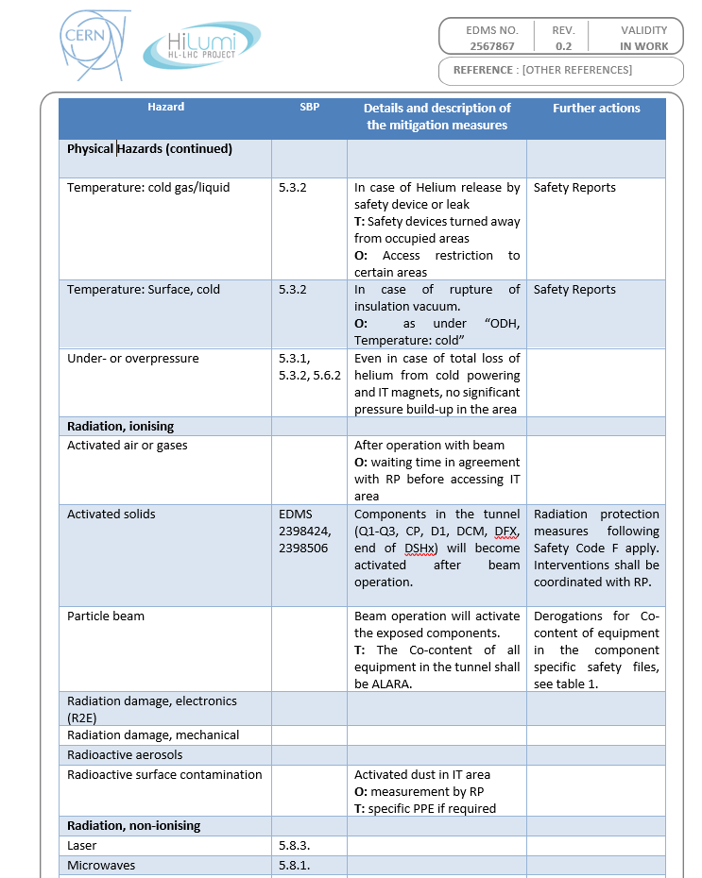
A Proven Method
The Hazard Register is the central element of the safety documentation for the HL-LHC project
Experience from HL-LHC, both from
  Implementing the method and
  Identifying SBP hazard controls
are transferable to FCC

Slide 6
Fire Safety Feasibility
Objectives of the Fire Safety Feasibility Study:
Extend the fire safety concept to all underground facilities of FCC
Solve the technical details of the compartmentalisation strategy
Make conceptual plans for emergency interventions in FCC

Slide 7
Fire Response Strategy from CDR
≈ 3500 m³/h
≈ 7000 m³/h
≈ 3500 m³/h
+ + + + + + + + + + + + + + + + + + + + + + +
+ + + + + + + + + + + + + + + + + + + + + + + +
+ + + + + + + + + + + + + + + + + + + + + + + +
+ + + + + + + + + + + + + + + + + + + + + + + + + + + + + + + +
≈ 2000m³/h
~ 3500 m³/h
~ 7000 m³/h
~ 3500 m³/h
≈ 2000m³/h
Depends on ventilation and smoke extraction (EN/CV), and alarm system (EN/AA)
In case of fire:
  Fire compartment and neighbours are isolated (doors shut)
  All smoke extraction dampers close, except for:
  4 in the fire compartment, 2 in adjacent compartments
  Air inlets supply air (no underpressure, no smoke accumulation)
Overpressure created in neighbouring compartments
Normal longitudinal ventilation in all other compartments

Slide 8
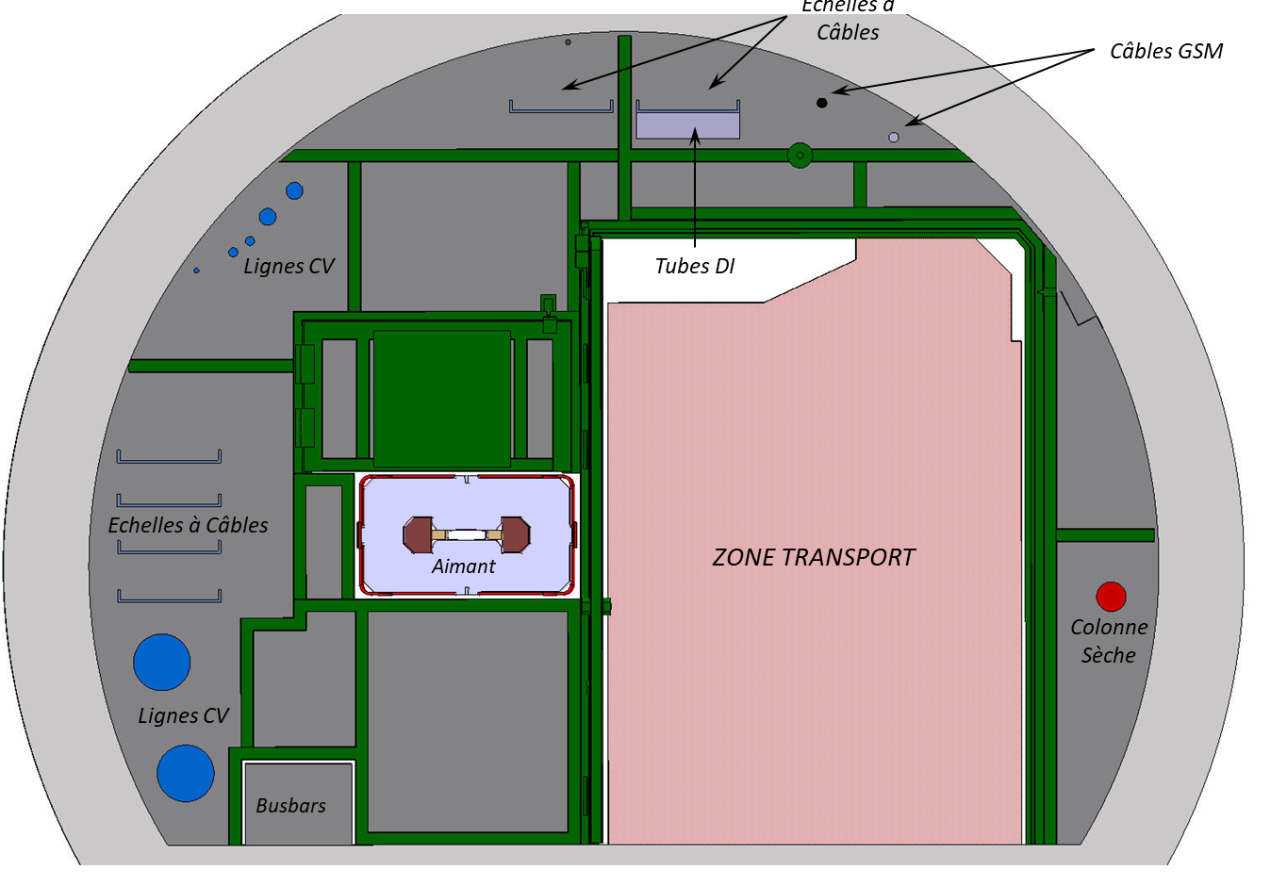
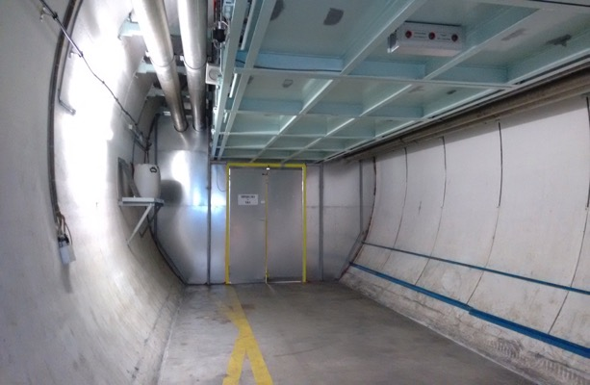
Check Feasibility of the Fire Safety Concept
Preliminary Design Questions for the Fire Compartment Walls:
  Fit accelerator and services through the walls.
  Walls mounted before or after accelerator installation ?
  Walls dismounted for the change from FCC-ee to FCC-hh.
  Other requirements for FCC-hh walls (see cryogenic safety).
Fire safety for technical galleries, RF sections, klystron galleries,
and access tunnels:
Adapt the fire compartment principle to different environments.
Fire safety for experiments:
Large volumes which cannot be subdivided.
How to ensure evacuation and fire fighting ?
All supported by computational fluid dynamics (CFD)
SPS fire compartment

Slide 9
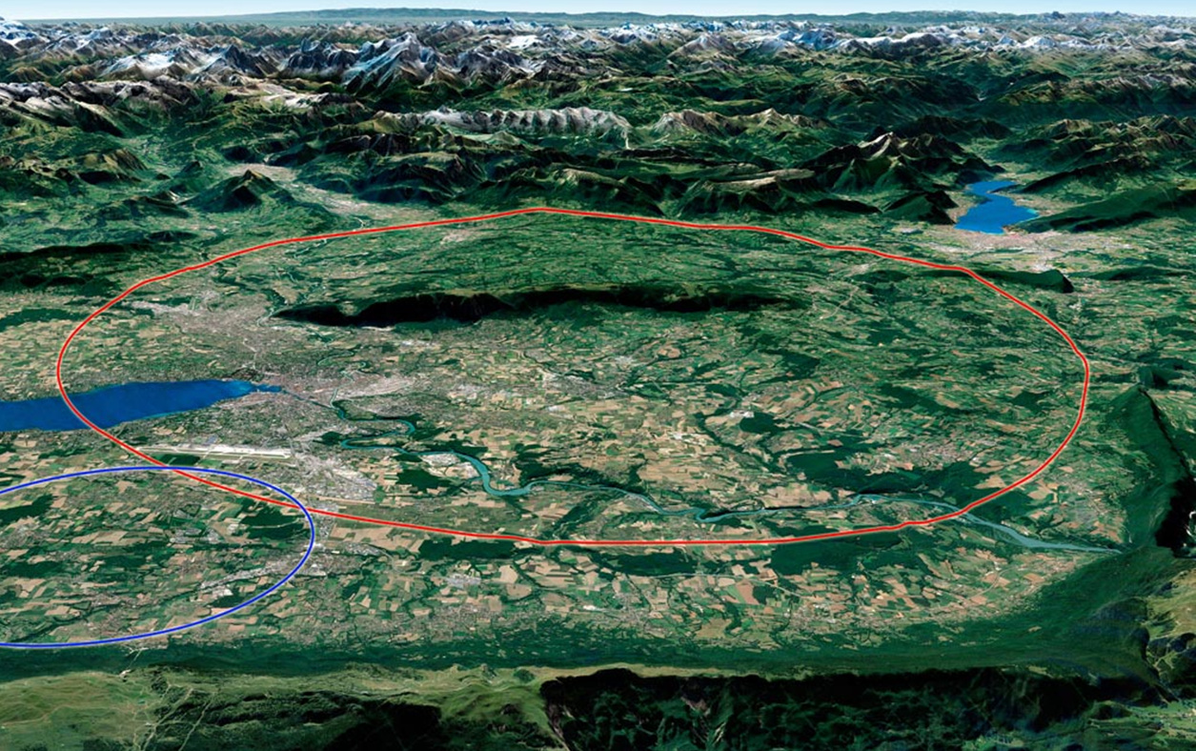
Organisation of Emergency Response
Unprecedented size of FCC:
Access to farthest PA from CERN: 29 km as the bird flies,
  in a region known for its traffic congestion,
  partly on rural streets.
  Local solutions discussed:
    CERN detachments at access points.
    Second FCC centre close to Annecy
    Collaboration with local fire brigades.
Distance between access points: in the worst case, 11 km underground to the accident site:
  Rapid underground fire vehicle required.
  Use of remotely controlled or autonomous robots → see next contribution by Oriol Rios.
29 km
11 km

Slide 10
Cryogenic Safety Feasibility
Objectives of Cryogenic Safety Feasibility Study:
Complete the performance-based risk assessment made during the CDR, with qualitative values using numerical simulations.
Define the most credible cryogenic release scenarios for FCC-ee and FCC-hh, including the mass flow of released cryogenic fluid (in FCC-ee: helium).
Estimate the dynamics of cryogenic fluid propagation after a release in FCC-ee and FCC-hh underground facilities.
Develop mitigation strategies: compartmentalisation, access restrictions.
Evaluate risk of cryogenic incidents during cold standby (i.e. when personnel has access).

Slide 11
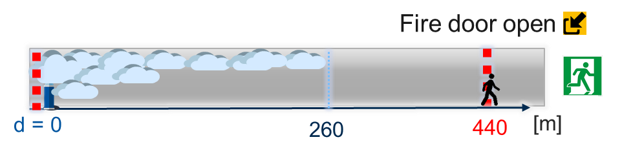
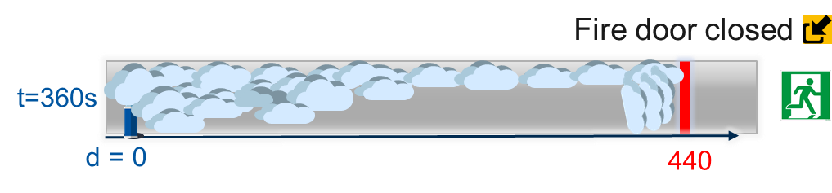

Cryogenic Safety Strategy from CDR
Qualitative estimations, to be validated by CFD calculations:
For helium release rates < 0.3 kg/s, personnel evacuates ahead of the helium cloud
Fire doors must not close during helium release as long as sector not empty !

Slide 12
Feasibility of the Cryogenic Safety Concept
Preliminary design questions for the compartment walls and doors:
Important distinction between smoke and ODH detection: doors must close in case of fire, but remain open in case of helium release.
During a Helium MCI ( > 25 kg/s helium release) walls must withstand the rising pressure.
In collaboration with TE-CRG, SY-RF and TE-MSC:
Develop helium release scenarios for FCC-ee and FCC-hh
  from RF cavities, QRL and s.c. magnets,
  based on the design of the equipment and its safety devices.
Describe the dynamics of a helium release
  with simple but approximate analytical means,
  checked by computational fluid dynamics (CFD).

Slide 13
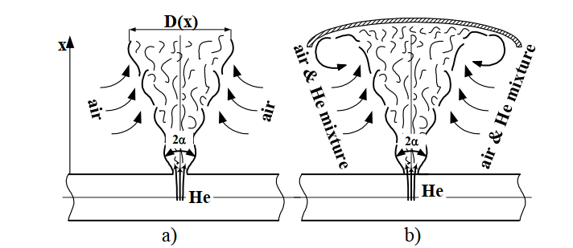
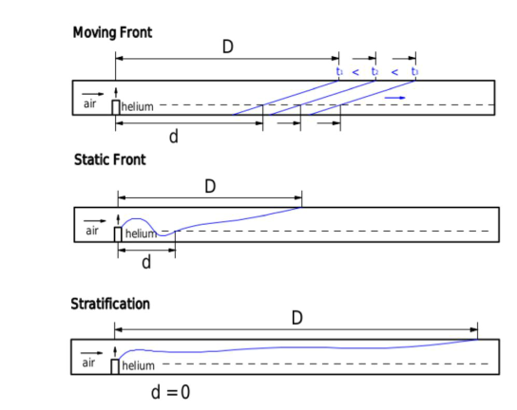
Helium release and propagation studies
Evaluate helium release mass flow depending on
Thermodynamic state of helium
Leak size
Power stored in magnetic circuit or
insulation vacuum rupture
Systematic Analysis of helium propagation in tunnel:
Depends on mass flow and ventilation speed
First attempt by C. Kotnig (former TE/CRG) in 2019
Up to which potential release rate is access safe ?

Slide 14
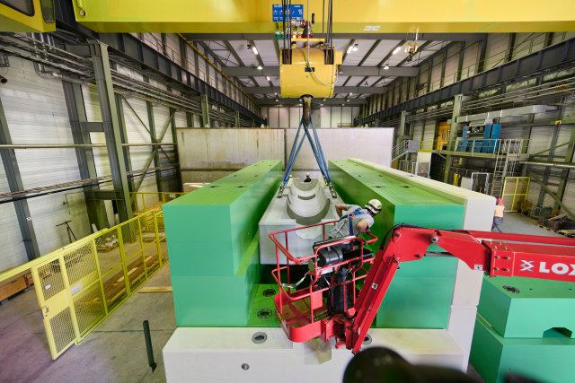
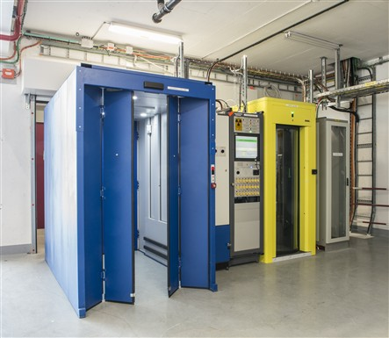
Beam Safety and Access
Building upon the LHC accelerator safety and access control systems (LASS/ LACS)
Layout of the underground structures,
Sectorisation for access control
Localization of access points.
Should be based on hazards and topology.
Early identification of Safety Elements
Early identification of access conditions based on identified hazards. (e.g. access and powering of magnets)
Beam Dump
Access Control

Slide 15
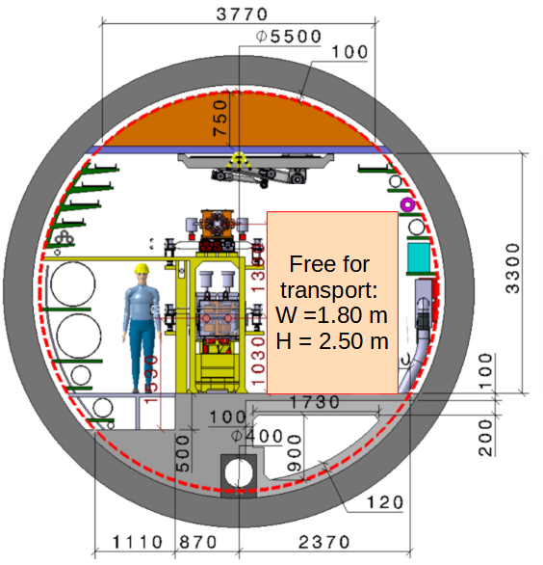
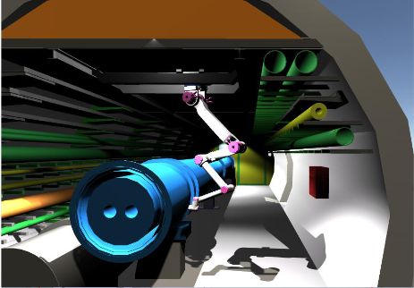
Transport and Remote Manipulation
The tunnel lay-out has a narrow transport area (1.8 metres in FCC-ee).
Too narrow to move with electrical vehicles in opposite directions or to overtake a parked vehicle.
Widest possible use of remote manipulation and robotics in all FCC phases (construction, operation, maintenance):
Less persons exposed to hazards
Less traffic
See next Presentation by Oriol Rios

Slide 16
Radiation Protection Studies for FCC-ee
Required Input
RP assessment
Activation & shielding compliance for prompt radiation from beam interactions:
Impact from beam-gas interactions, beam-beam collisions and beam on cleaning insertions and dumps
Access tunnels and connecting galleries
Ducts towards the RF galleries
Accelerator (relevant elements) & integration layout
Beam parameters
Operation parameters (run/shutdown scenarios, commissioning)
Beam loss maps
Activation by synchrotron radiation
+ vacuum system layout (photon dumps)
Source terms of radioactive releases to be used by the environmental impact study
+ Ventilation layout & operation parameters
+ Cooling fluid layout & operation parameters
Radioactive waste production
+ Maintenance plans (exchange of equipment)
Radiation protection at the injectors
Main topic: positron production target
Positron target design and integration layout
Beam parameters
Operation parameters

Slide 17
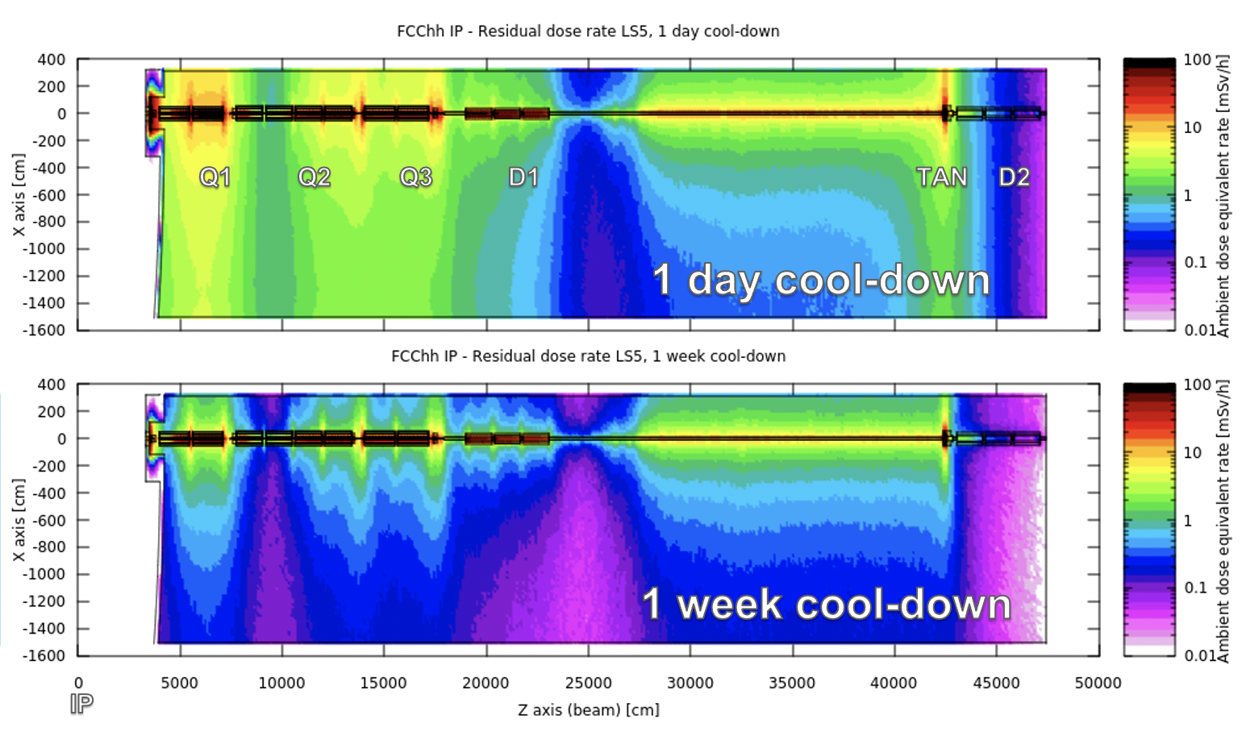
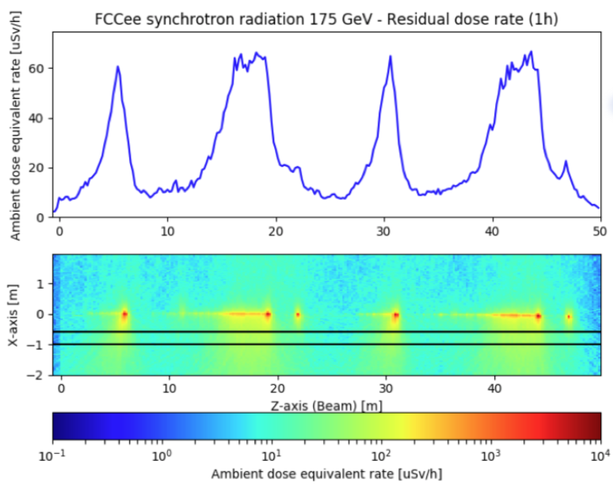
Activation in FCC-ee and FCC-hh
Evaluate and optimise design from civil engineering level down to individual items:
  determine activation level → identify and integrate optimisation potential (material choices, option selection),
  integrate adapted mitigation in the design of expected critical locations: collimation, dumps, interaction points, experiments/detectors,
  consider operational processes (maintenance, removal/installation, transport, storage, repair).

Slide 18
Radiological Environmental Impact Assessment
Assessment of radiological impact is a complex task, requiring knowledge of the accelerator, the region, land use, and population habits:
Prospective assessment for planned exposure
    Normal operation, each site
  Prospective assessment for planned potential exposure:
    A few envelope cases of design accidents (e.g. FIRIA methodology);
    Emergency preparedness.

Slide 19
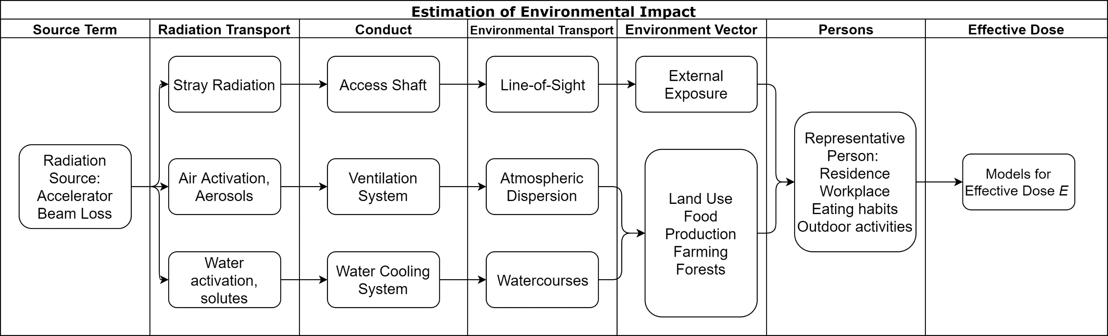
Radiological Environmental Impact Assessment

Slide 20
Source Terms and Transfer to the Environment
  Sources of ionizing radiation:
  beam loss in collimators, activation of cooling water and air (different for FCC-ee and FCC-hh),
  synchrotron radiation (dominant in FCC-ee),
  “collision debris” from interaction point (different for FCC-ee and FCC-hh).
  Need loss estimates (loss maps).
First stage of transport:
  by ventilation system,
  in cooling water (different for FCC-ee and FCC-hh),
  “streaming” through shafts,
  Need technical details of cooling and ventilation systems.
  May imply operational changes in these systems (e.g. ventilation speed, decay buffers).

Slide 21
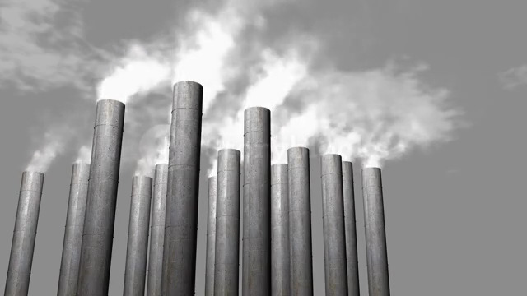
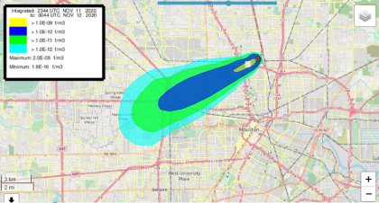
Atmospheric Dispersion
Must be assessed for each FCC site:
Characteristics of release sites
Wind and precipitation statistics
Representative Person from the public
  Dispersion of substances released with air depends on:
  Local geography (orography)
  For continuous release:
      Long-term wind and precipitation statistics
  For acute release (after an accident):
      Present wind direction and strength

Slide 22
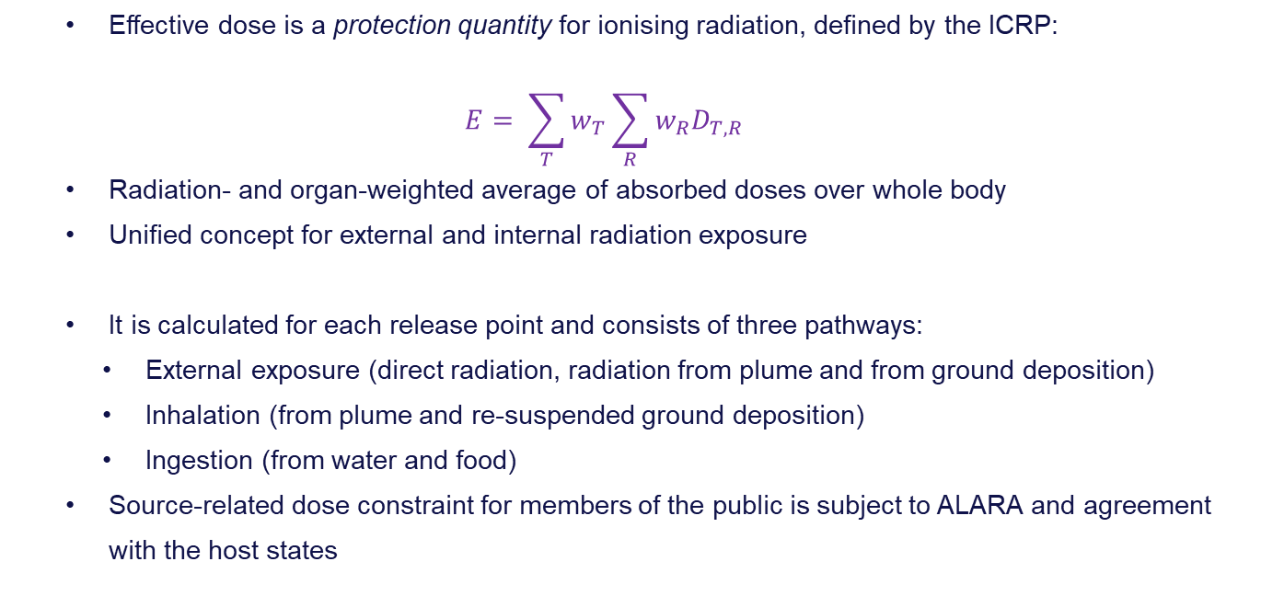
Effective Dose to the Representative Person(s)
  Effective dose is a protection quantity for ionising radiation, defined by the ICRP:
  $$E= \sum_{T}{w_{T}\sum_{R}{w_{R}D_{T,R}}}$$
  Radiation- and organ-weighted average of absorbed doses over whole body
  Unified concept for external and internal radiation exposure
  It is calculated for each release point and consists of three pathways:
    External exposure (direct radiation, radiation from plume and from ground deposition)
    Inhalation (from plume and re-suspended ground deposition)
    Ingestion (from water and food)
  Source-related dose constraint for members of the public is subject to ALARA and agreement with the host states

Slide 23
Pulling it all together – FCC Safety Report
The FCC Safety Feasibility Report will constitute a record for the next generations who may build the FCC-ee and FCC-hh.
From the Report, shorter documents for approval or information of stakeholders can be extracted.

Slide 24
The FCC Safety Working Group
Thomas Otto | ATS-DO | Study coordination, hazard register, editor
André Henriques | HSE-OHS | Occupational health and safety
Oriol Rios | HSE-OHS | Fire and emergency response
Ghislain Roy | BE-ABP | Operational safety, personnel safety systems
Pavol Vojtyla | HSE-RP | Environmental impact of ionising radiation
Markus Widorski | HSE-RP | Radiation protection
Safety-minded individuals from the wider collaboration are invited to join us and work on specific topics

