Slide 1


Slide 2

Update on FCC electrical network and grid connection
Mario PARODI (CERN EN-EL) – TIWG – Electricity & Energy Management WP
FCC week 2022, Paris
Many thanks to J.P. Burnet, D. Aguglia, F. Blanquez, M. Colmenero Moratalla, G. Cappai, K. Zielinski for the important support

Slide 3
Content
M. Parodi – Update on FCC electrical network and grid connection
3
Baseline CDR 2018
Load estimate FCC-ee
High voltage Network scheme
Network software model
Load flow simulations
RTE grid connection – Procedure and timeline
RTE grid connection – Technical Options
RTE grid connections – Proposal
Moving forward – Horizon FCC-hh
Conclusions

Slide 4
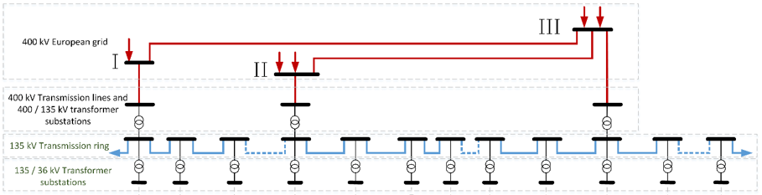
Baseline CDR 2018
M. Parodi – Update on FCC electrical network and grid connection
4
Baseline CDR FCC
12 Access points
Maximum target power consumption: 364 MW FCC-ee ttbar (554 MW FCC-hh)
Based on the layout studied for FCC-hh
3 connection points to 400 kV RTE grid (A, E, J)
n. 3 220 MVA 400/135 kV per connection point
Internal 135 kV transmission open loop

Slide 5
Load Estimate FCC-ee
M. Parodi – Update on FCC electrical network and grid connection
5
Electrical power | Z [MW] | W [MW] | H [MW] | ttbar [MW]
Radio Frequency | 148 | 148 | 148 | 148
Cryogenics | 1 | 7 | 17 | 51
Cooling and Ventilation | 33 | 34 | 36 | 40
Magnets | 7 | 20 | 44 | 100
Experiments | 8 | 8 | 8 | 8
Data centers | 4 | 4 | 4 | 4
General services | 36 | 36 | 36 | 36
Total | 237 | 257 | 293 | 387
Split | P [MW] | P [MW] | P [MW] | P [MW]
PA | 16 | 17 | 20 | 28
PB | 10 | 11 | 14 | 22
PD | 10 | 11 | 14 | 22
PF | 10 | 11 | 14 | 22
PG | 16 | 17 | 20 | 28
PH | 10 | 11 | 14 | 141
PJ | 10 | 11 | 14 | 22
PL | 159 | 167 | 180 | 102
Updated estimate
Maximum target power consumption FCC-ee: 387 MW (ttbar)
Highly unbalanced request:
  Point H and Point L: 100 ÷ 180 MW
  Other points: < 30 MW
Focus on evolution of RF point:
  Point H: 14 MW (up to H) 141 MW (ttbar)
  Point L: 180 MW (up to H) 102 MW (ttbar)
  Challenge for an optimized solution that fits all phases
For all details:
Thursday 2nd June at 11:00
“Update of the power demand for FCC-ee”
from Jean-Paul Burnet

Slide 6
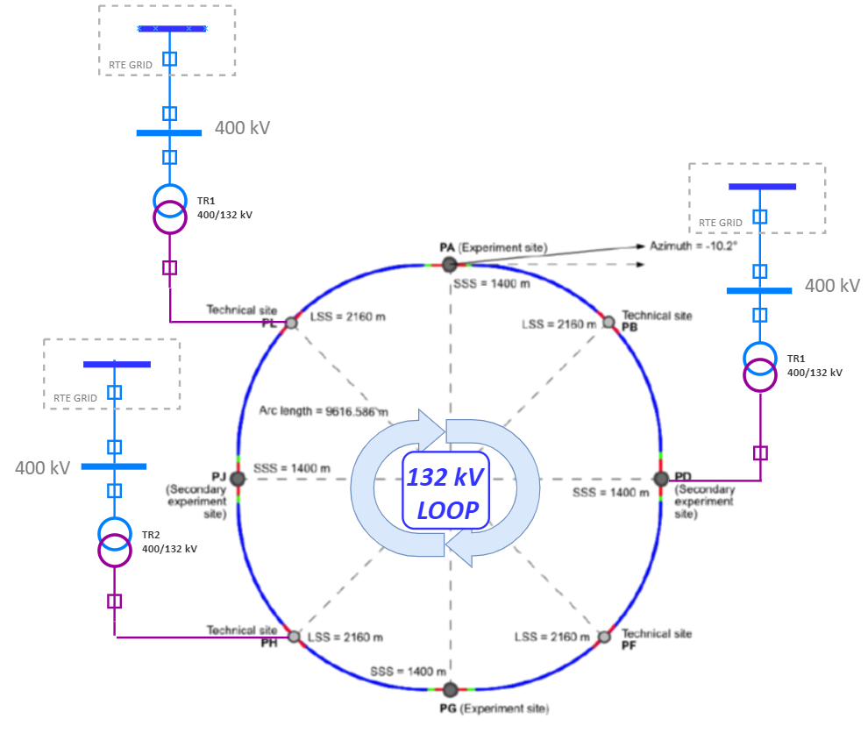
High Voltage Network Scheme
M. Parodi – Update on FCC electrical network and grid connection
6
Present baseline
Adaptation to the 8-points new layout
Confirmation of n. 3 connection points to RTE grid:
  n. 2 HV connections at RF points
  n. 1 HV connection at point D (preferred) or point F (alternative)
Internal 132 kV transmission loop
  Running through the main tunnel
  Cost of investment Vs. FCC RAMS requirement: analysis to be performed
  High cable capacitance:
    Charging current
  Proposal: move to closed loop:
    High reliability
    Existing control and protection technologies suitable for the topology
    Balanced power flow
    Need a confirmation from RTE about feasibility
P

Slide 7
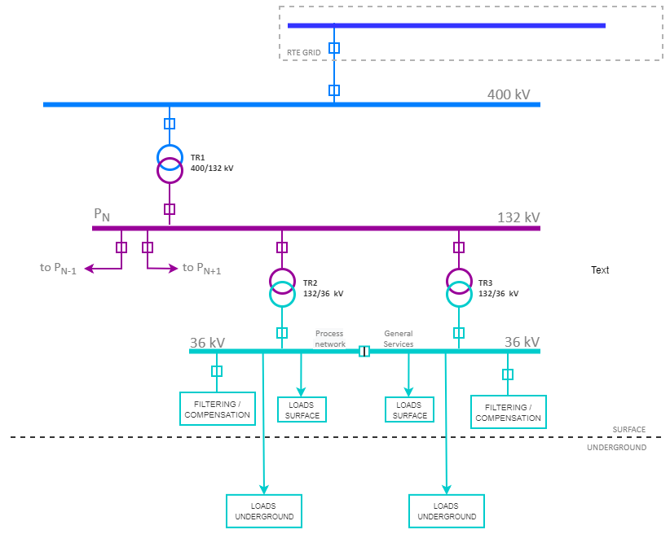
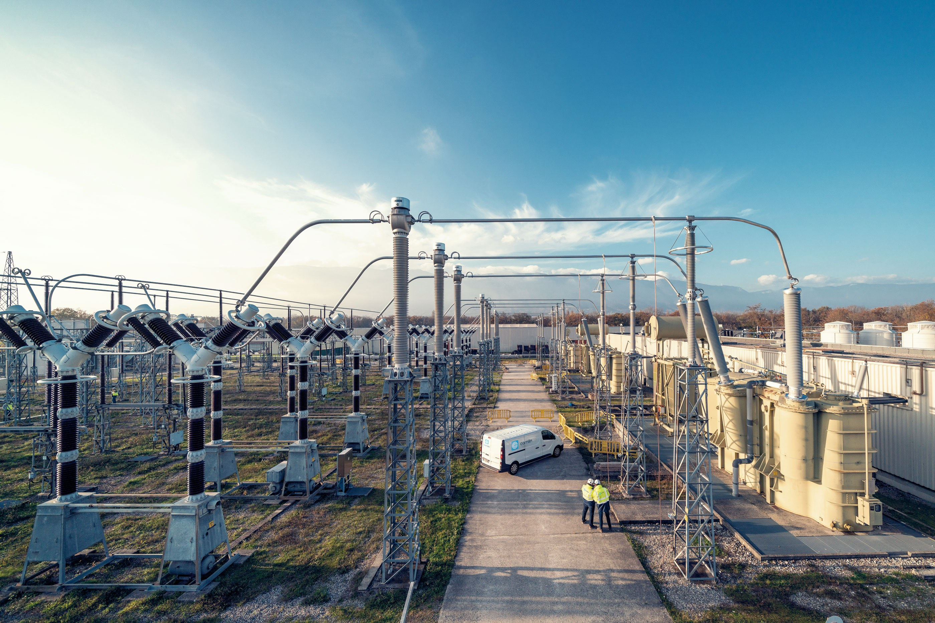
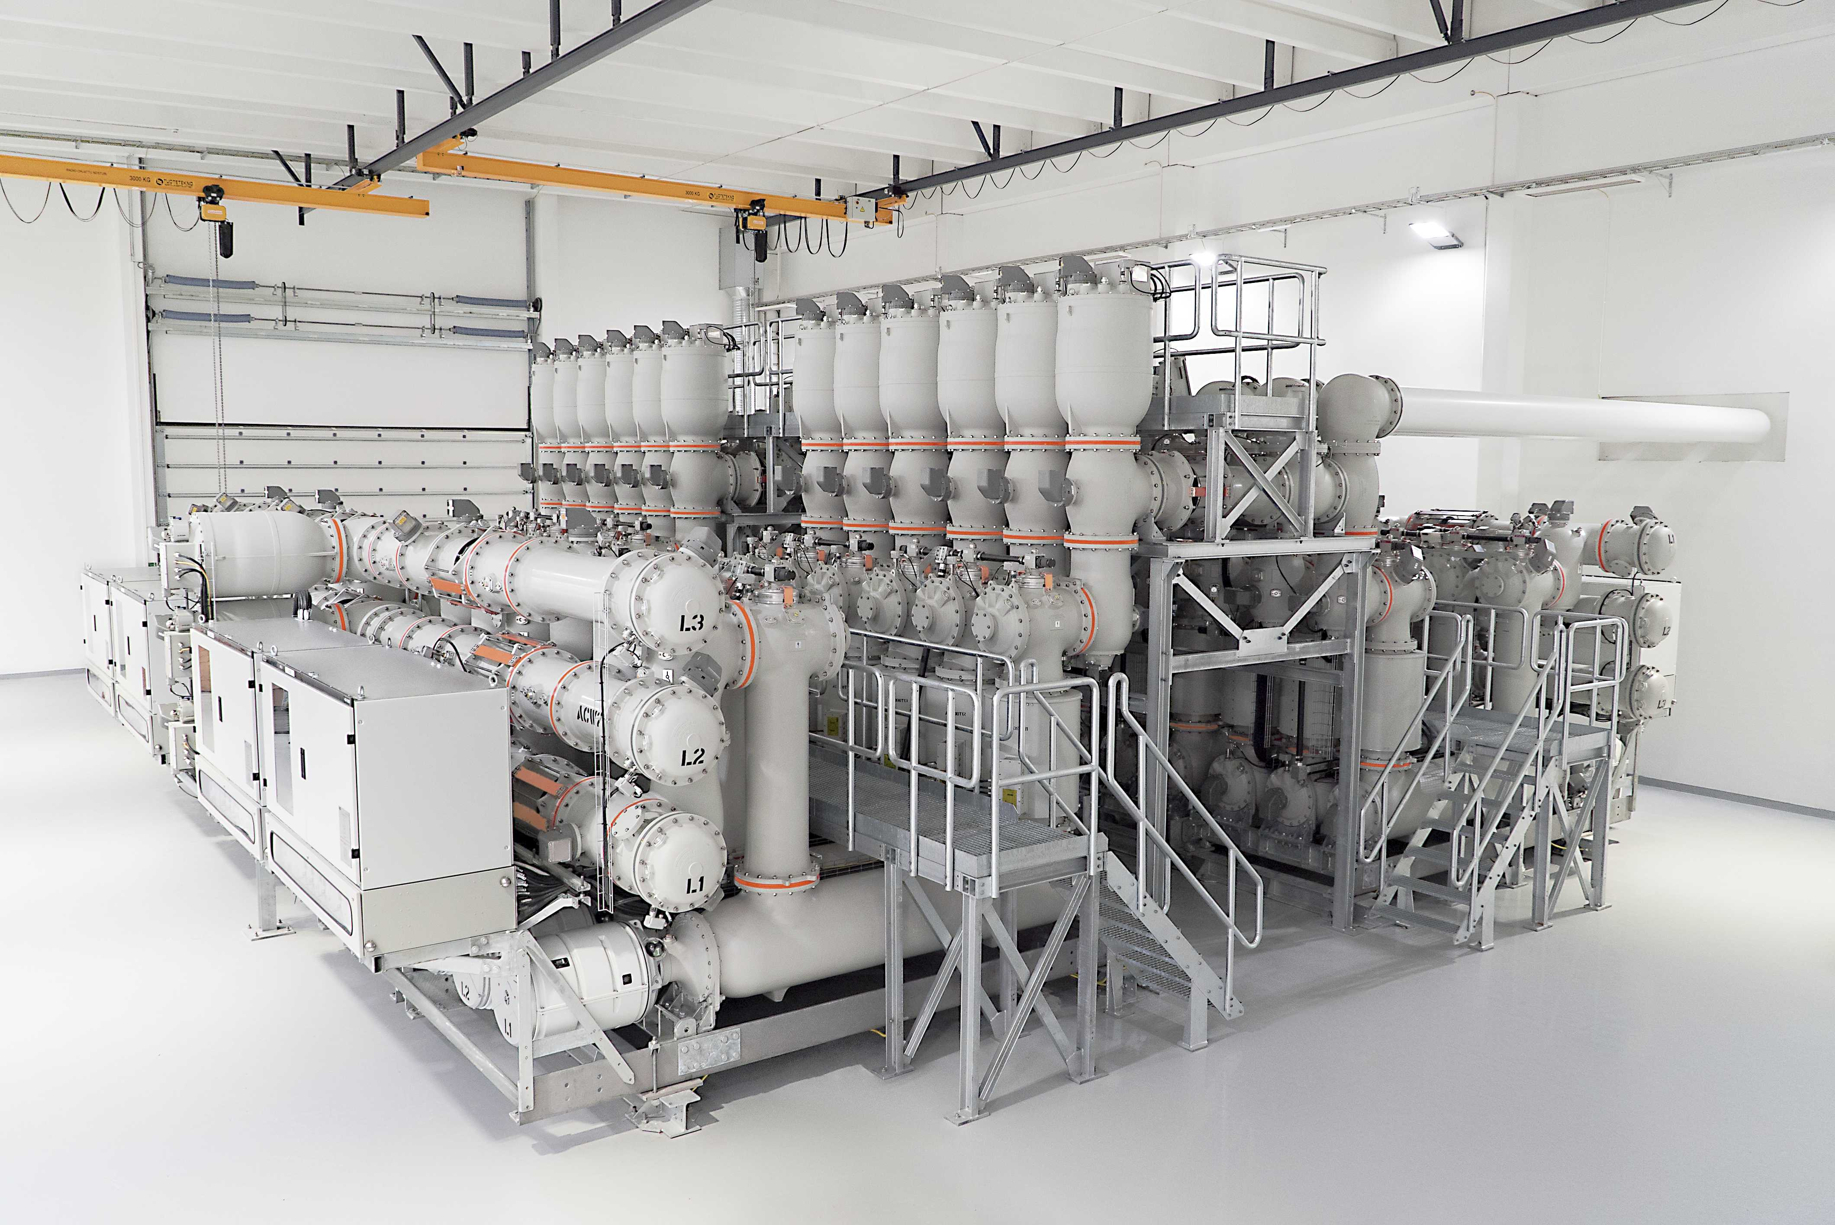
High Voltage Network Scheme
M. Parodi – Update on FCC electrical network and grid connection
7
High voltage transmission and distribution
n. 3 400/132 kV AIS substations (points H, L, D)
For all points: n. 1 132/36 kV AIS substation
36 kV distribution network for :
  Process (machine) and General Service
  Surface buildings: distribution links to each building
  Underground facilities: distribution links to service galleries and alcoves
  Each link: MV/LV transformer + Power Center
Total surface of HV substations:
  Points H, L, D: approx. 12,000 m²
  Other points: approx. 4,000 m²
  Opportunity: GIS substation (approx. factor 4 of surface reduction, higher cost, today’s technology based on greenhouse insulating gases at high voltage)

Slide 8
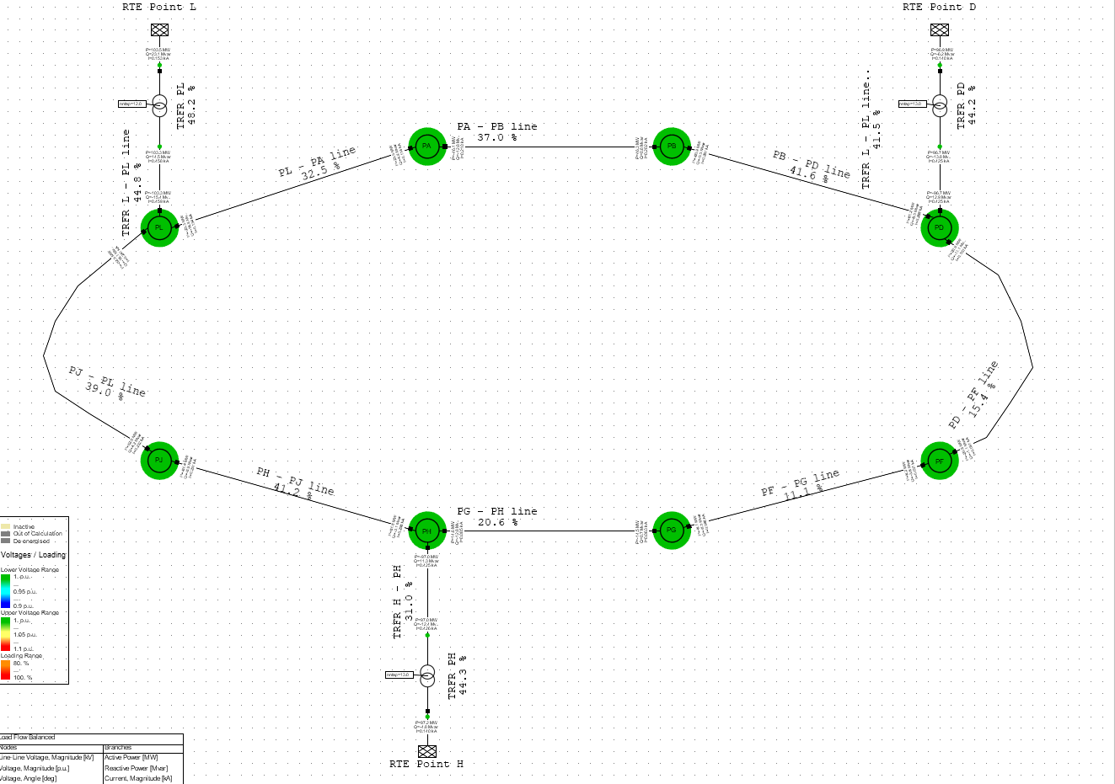
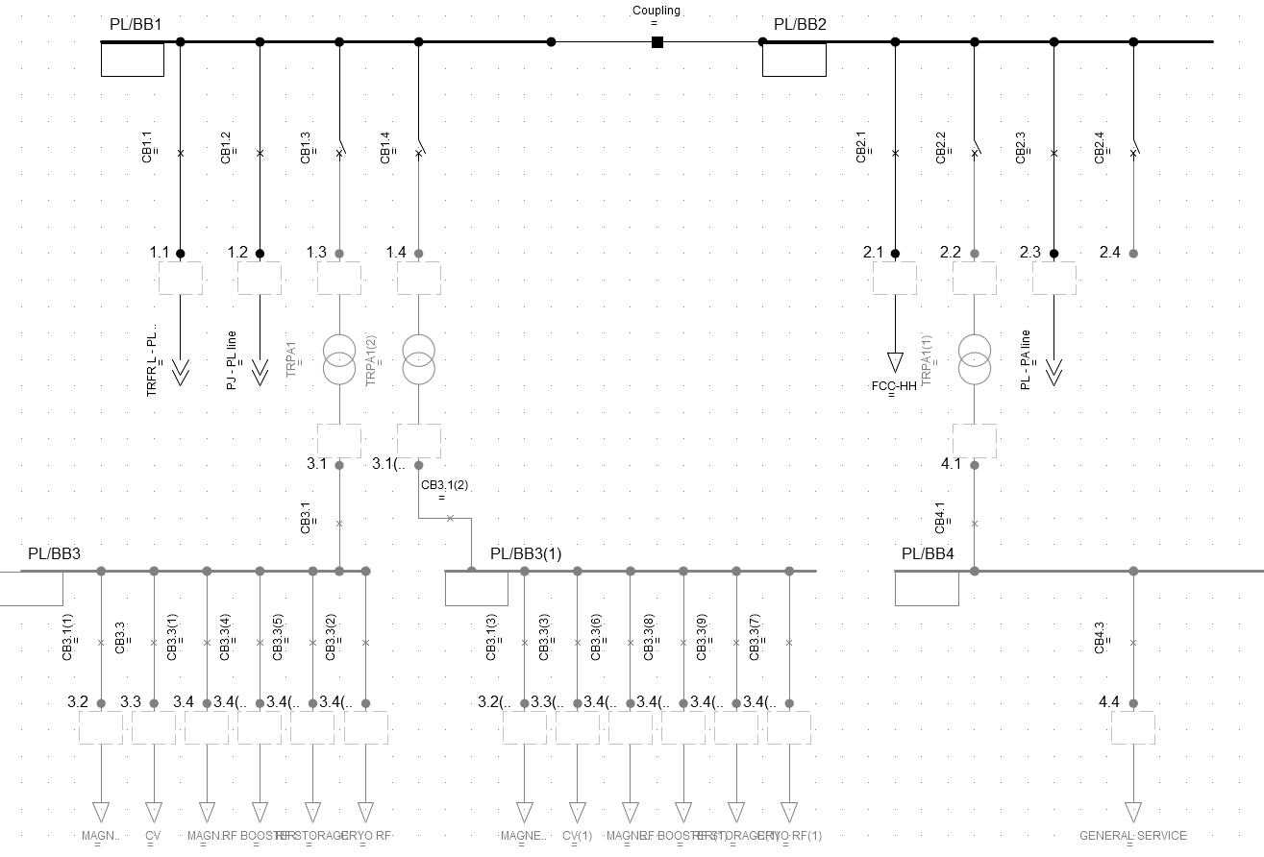
Network Software Model
M. Parodi – Update on FCC electrical network and grid connection
8
FCC network model available since 2022
Aim: support network analysis and sizing with reliable data, and ease decision making process
Main features:
  Expandable from main topology to detailed schemes
  Multi-scenarios simulation (loads/network schemes)
  Voltage analysis and regulation modelling
  Contingency analysis
  Power flows and losses reporting
  Fault analysis
  Transient analysis
  Cost modelling
Steady state (load flow) performed on 400/132 kV levels
Focus on two stages of FCC-ee:
  H: maximum power in one point (PL)
  ttbar: maximum total power

Slide 9
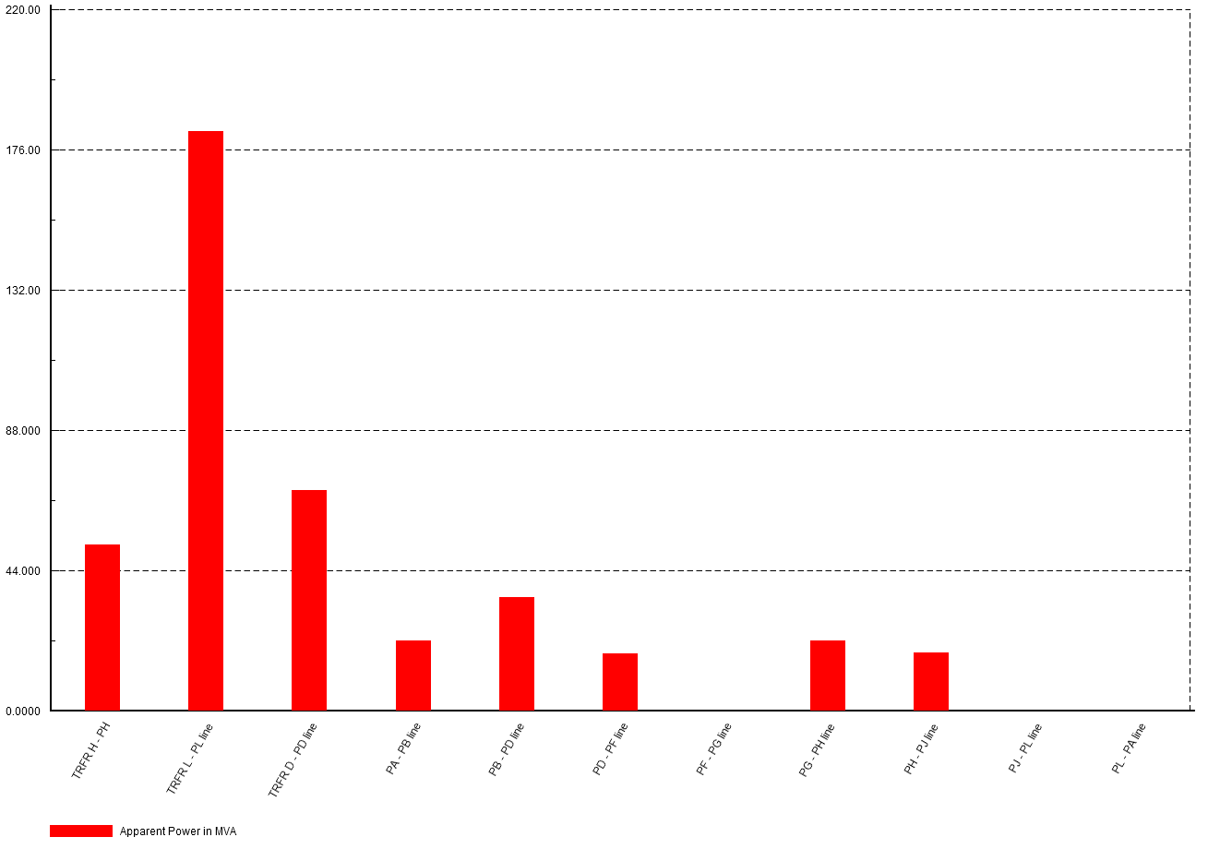
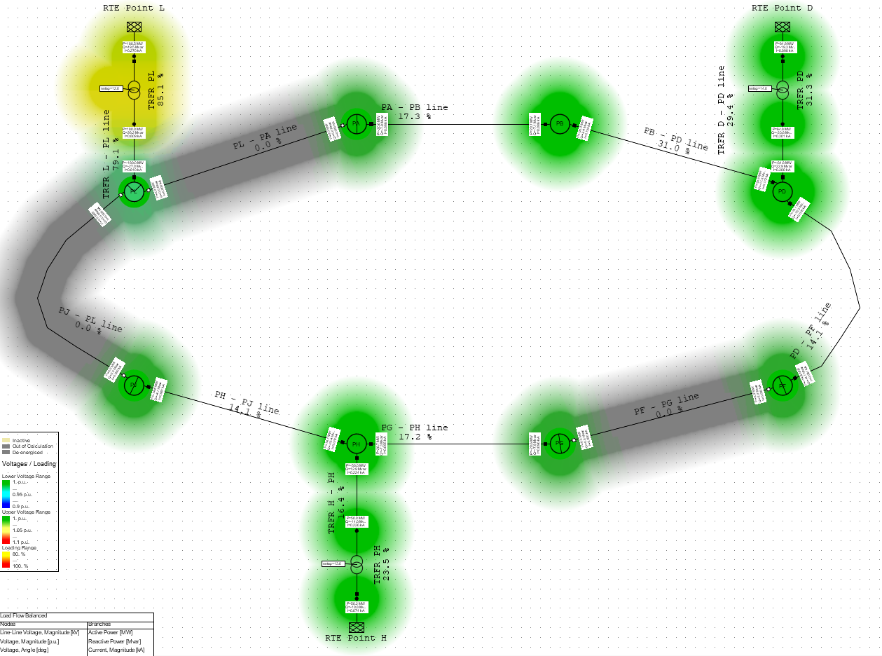
Load Flow Simulations
M. Parodi – Update on FCC electrical network and grid connection
9
FCC-ee H – Nominal Supply
220 MVA (transformers)
Open loop
Incomers
Loop Branches

Slide 10
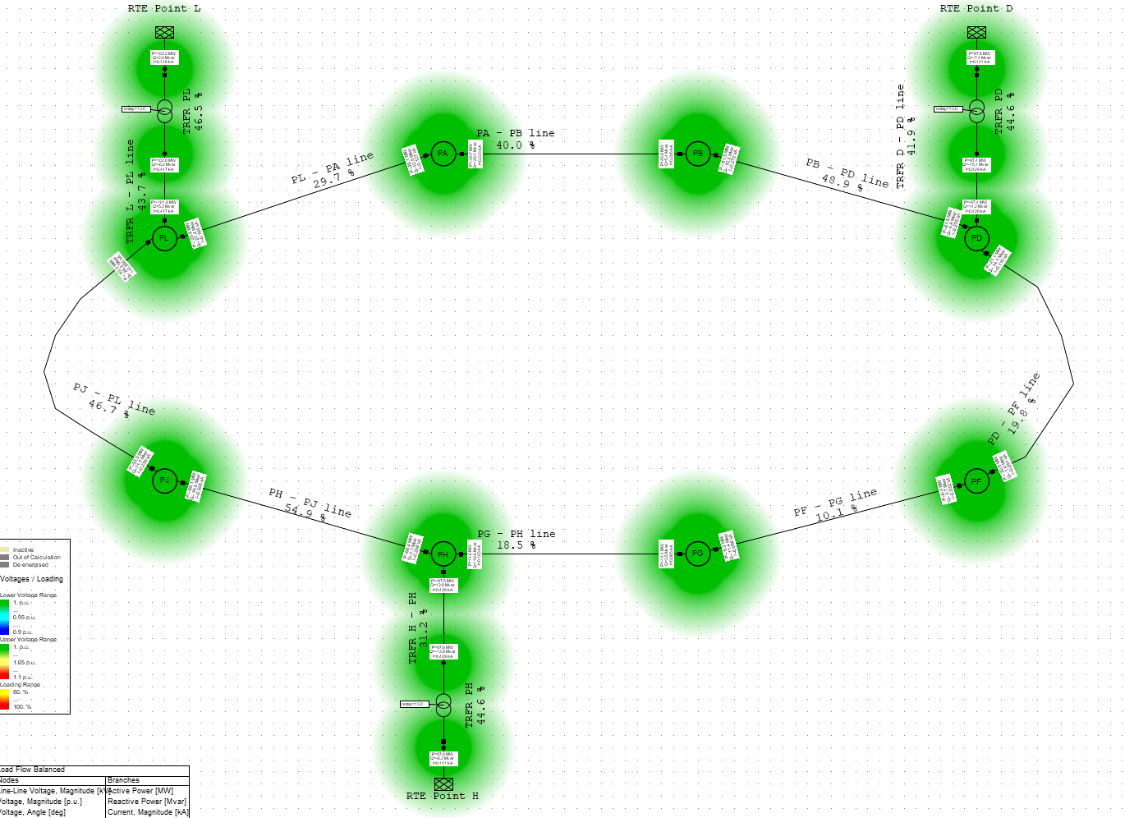
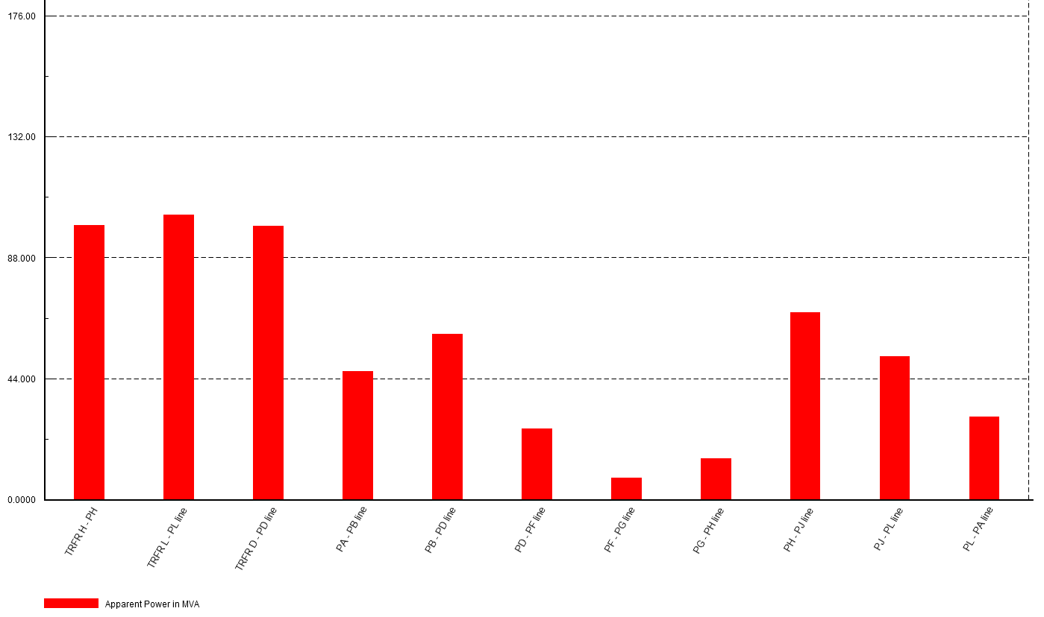
Load Flow Simulations
M. Parodi – Update on FCC electrical network and grid connection
10
FCC-ee H – Nominal Supply
Closed loop
Incomers
Loop Branches

Slide 11
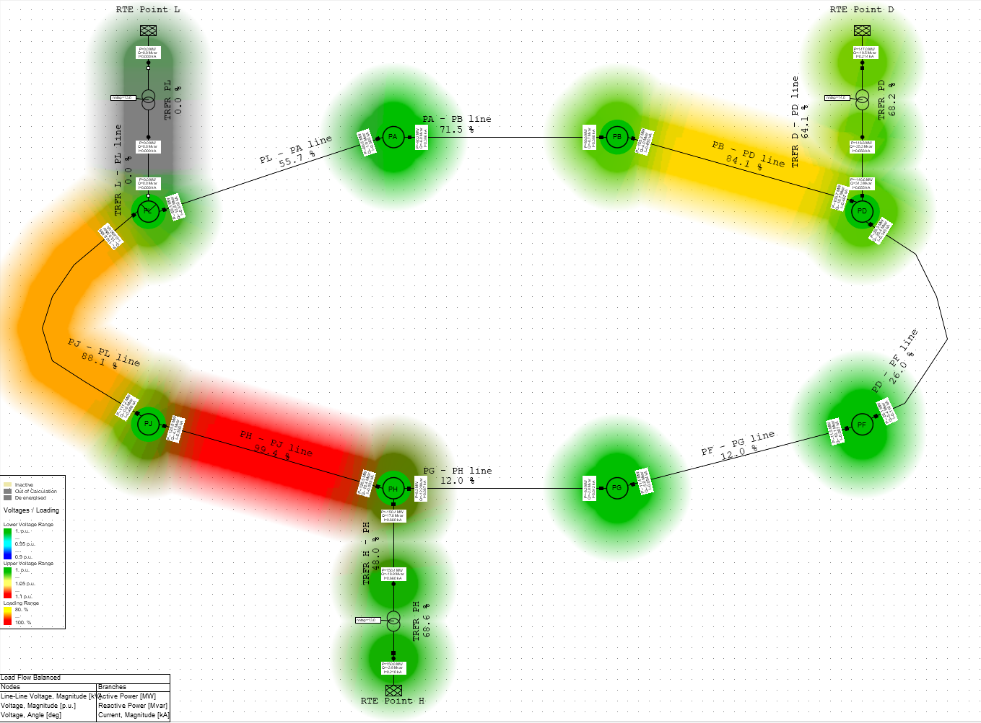
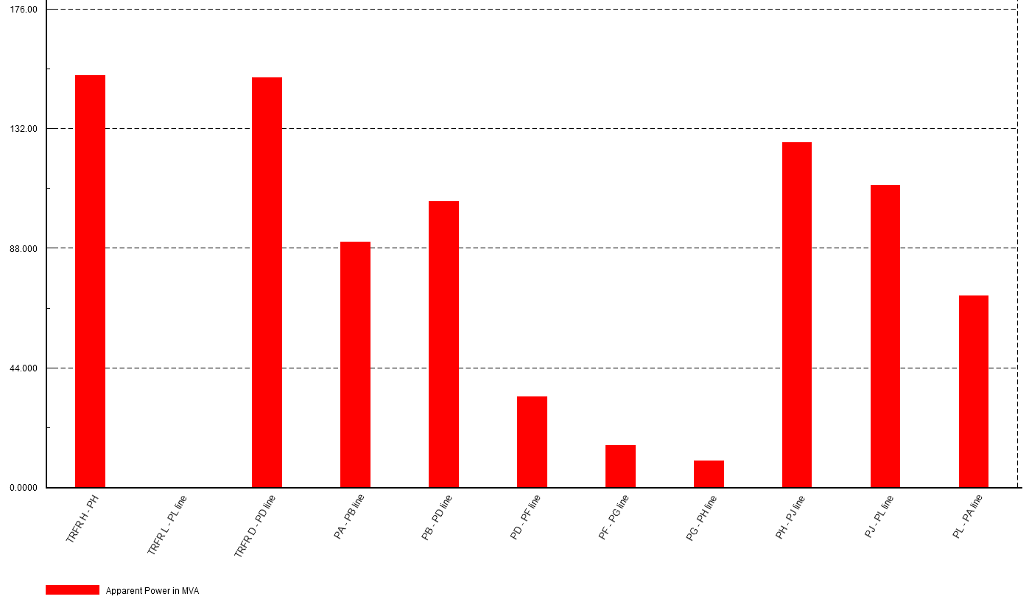
Load Flow Simulations
M. Parodi – Update on FCC electrical network and grid connection
11
FCC-ee H – Loss of one supply
~ 130 MVA
Incomers
Loop Branches

Slide 12
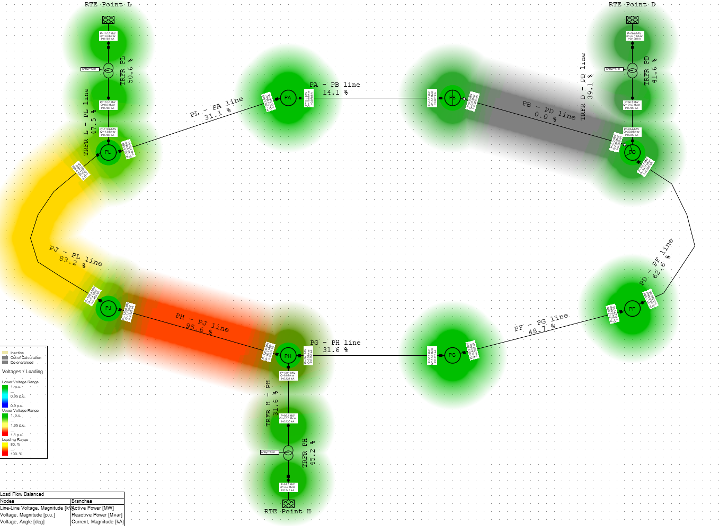
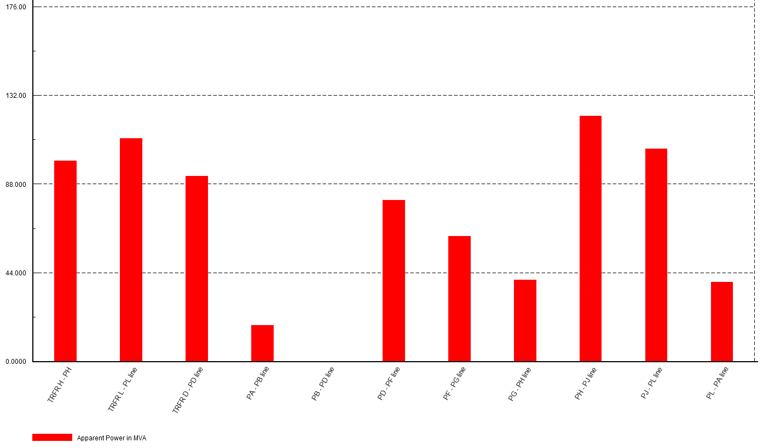
Load Flow Simulations
M. Parodi – Update on FCC electrical network and grid connection
12
FCC-ee H – Loss of one branch
~ 130 MVA
Incomers
Loop Branches

Slide 13
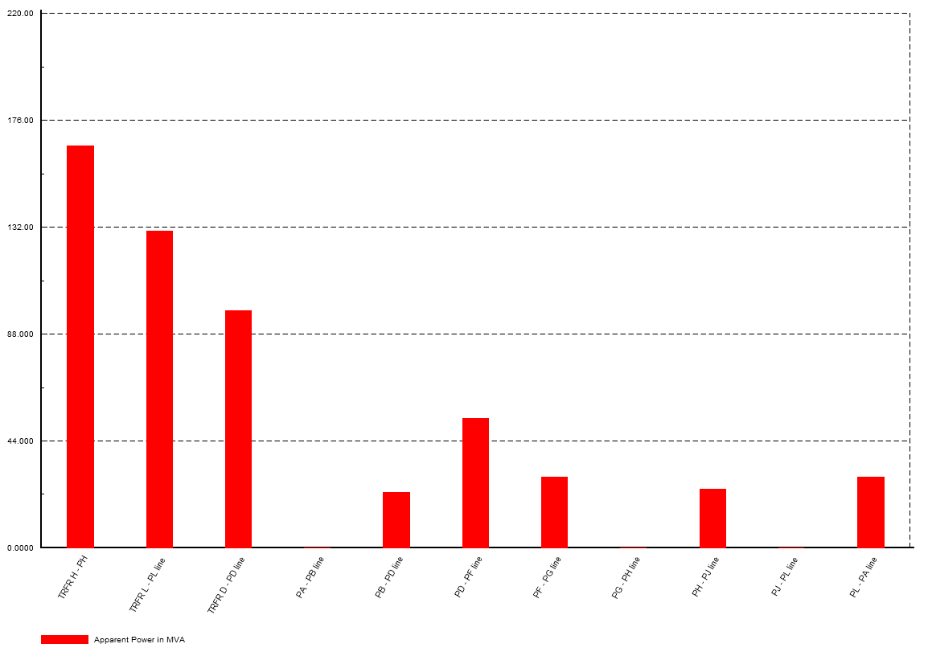
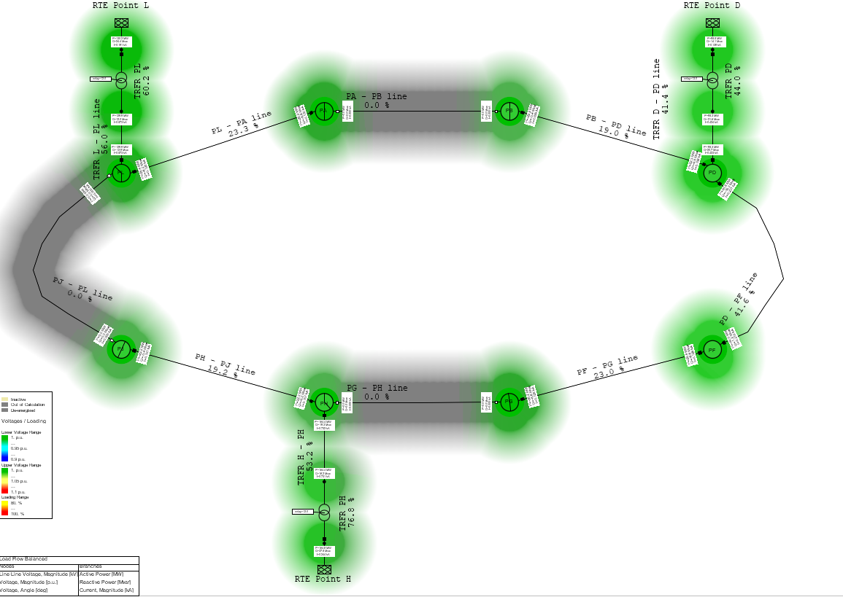
Load Flow Simulations
M. Parodi – Update on FCC electrical network and grid connection
13
FCC-ee ttbar
Open loop
Incomers
Loop Branches

Slide 14
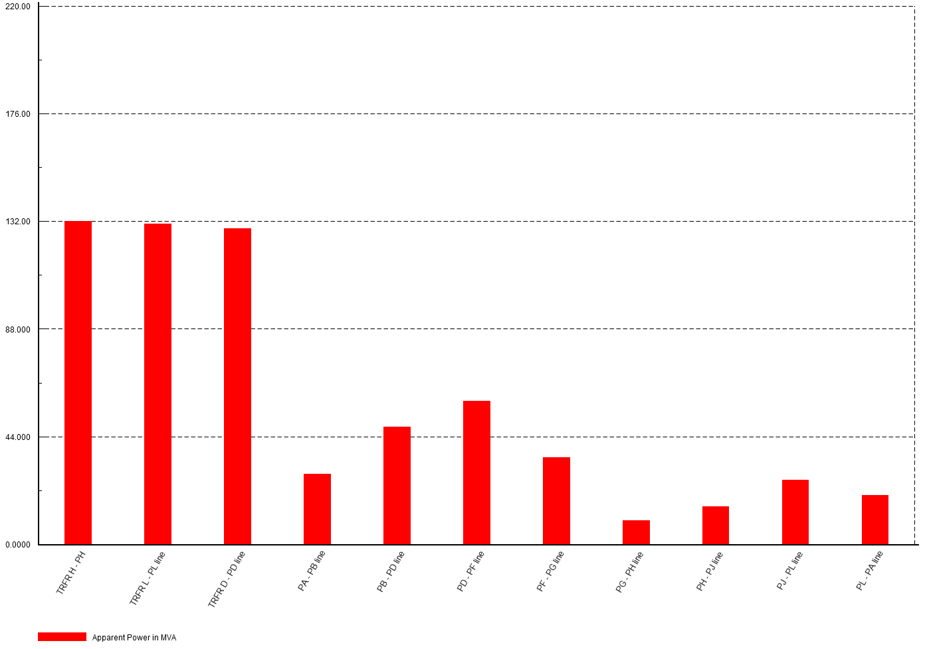
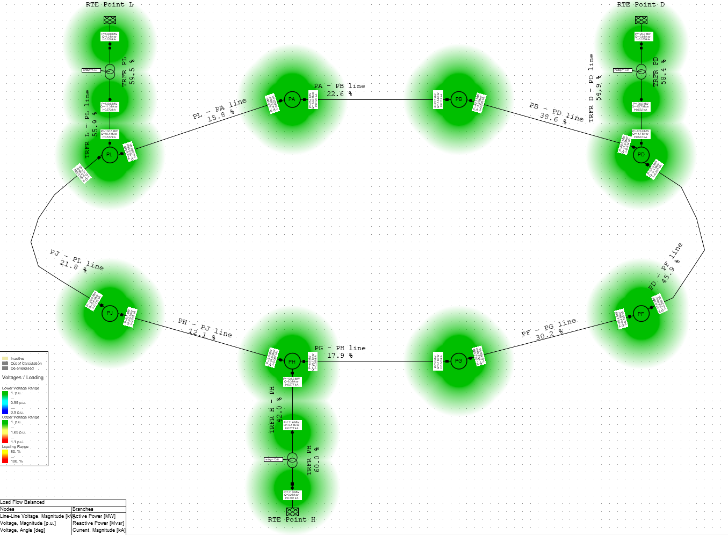
Load Flow Simulations
M. Parodi – Update on FCC electrical network and grid connection
14
FCC-ee ttbar
Closed loop
Incomers
Loop Branches

Slide 15
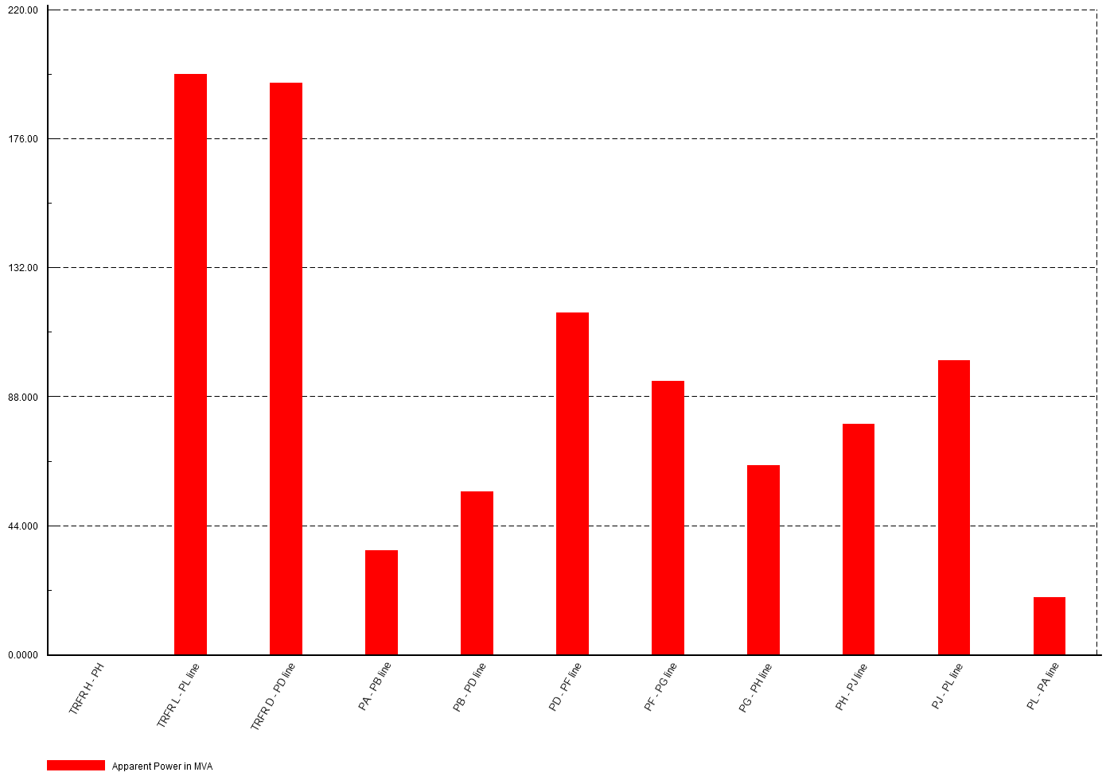
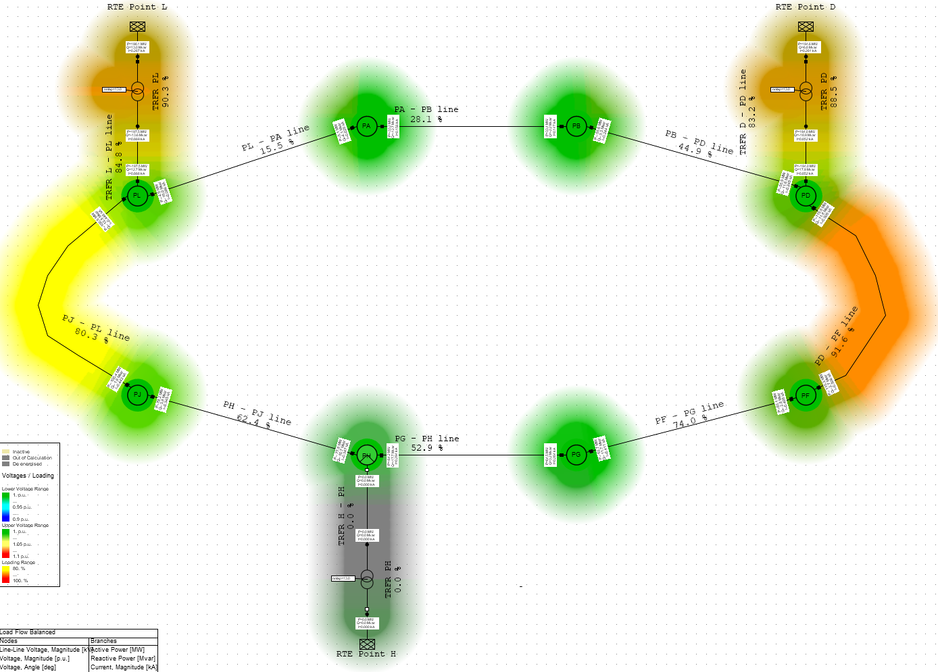
Load Flow Simulations
M. Parodi – Update on FCC electrical network and grid connection
15
FCC-ee ttbar
220 MVA (transformers)
~ 130 MVA
Incomers
Loop Branches

Slide 16
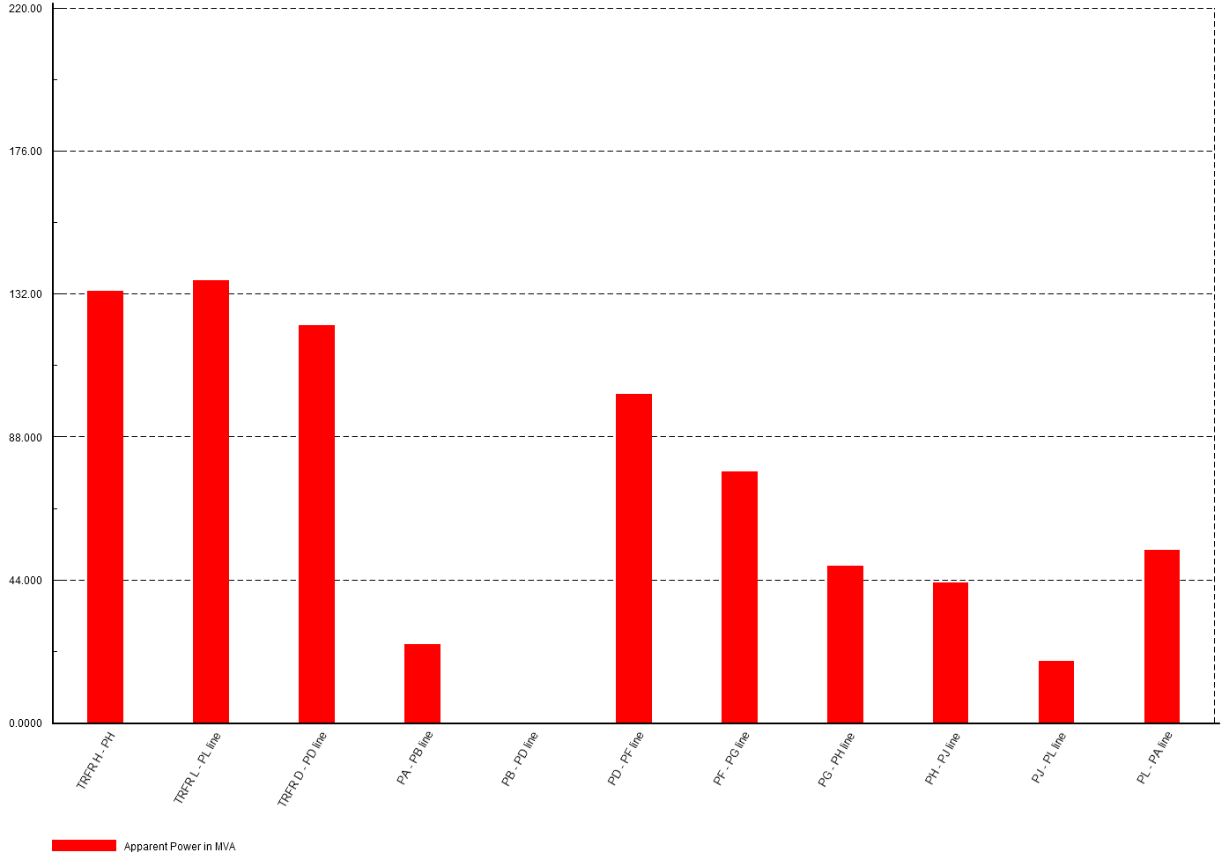
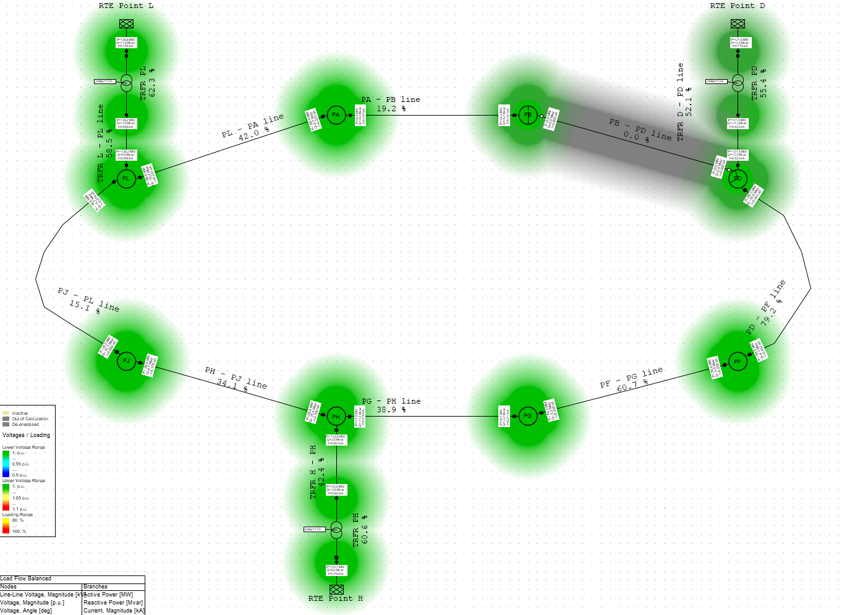
Load Flow Simulations
M. Parodi – Update on FCC electrical network and grid connection
16
220 MVA (transformers)
FCC-ee ttbar
~ 130 MVA
Incomers
Loop Branches

Slide 17
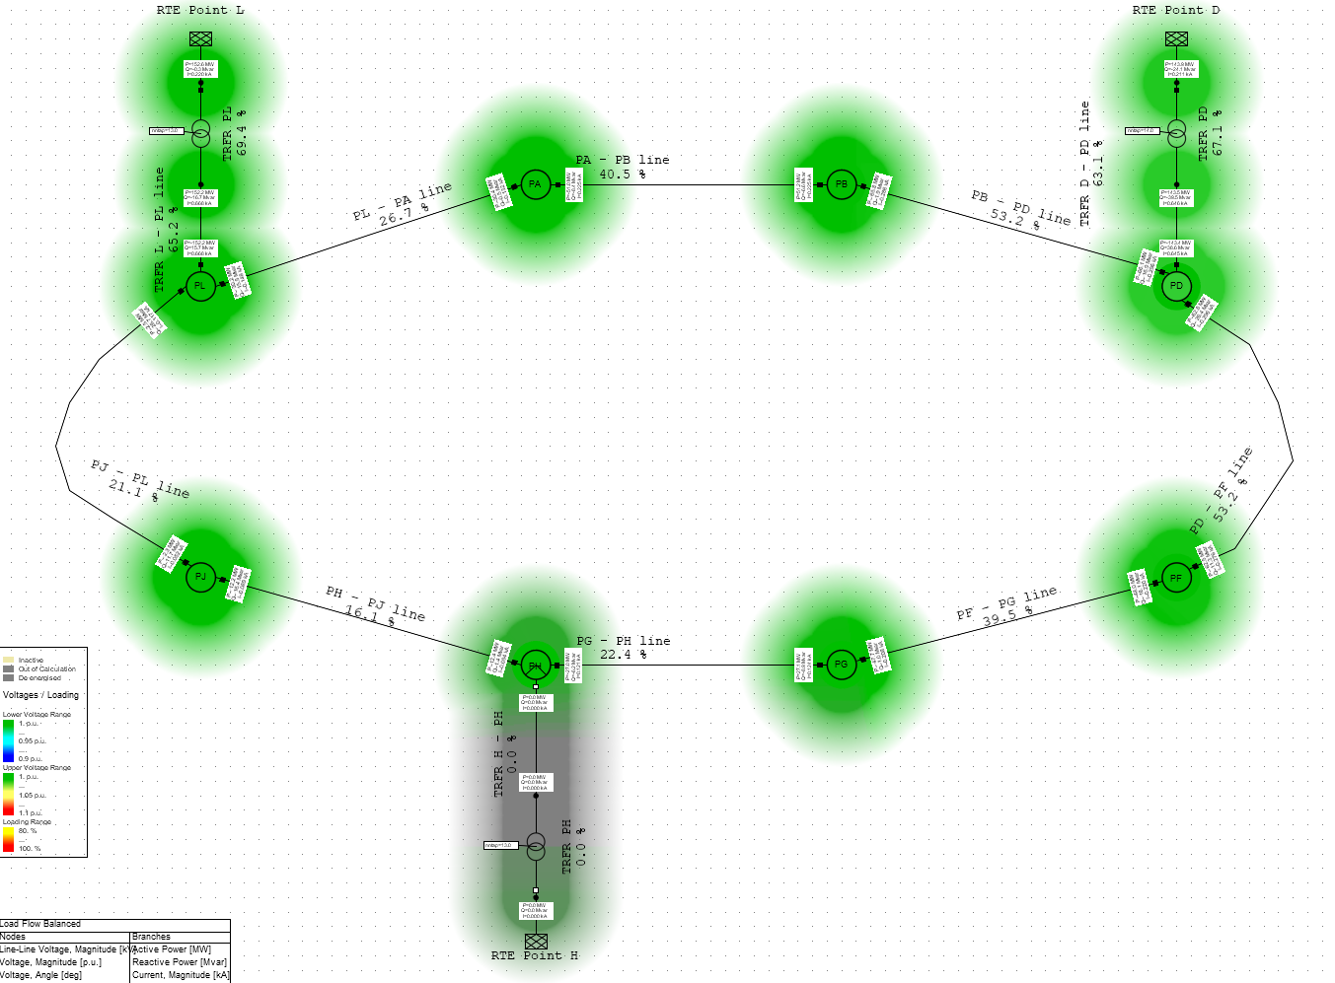
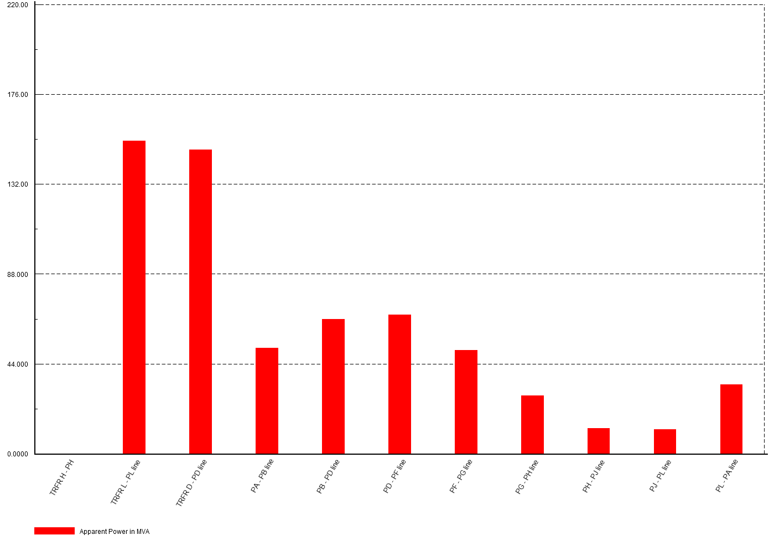
Load Flow Simulations
M. Parodi – Update on FCC electrical network and grid connection
17
FCC-ee H (n-1) → ttbar
220 MVA (incomers)
130 MVA (loop branches)

Slide 18
Load Flow Simulations
M. Parodi – Update on FCC electrical network and grid connection
18
Main outcomes
Target sizing criteria: FCC-ee H + FCC-ee ttbar (n-1):
  Run possible if one connection point or one branch of the loop is lost
Main outcomes:
  Confirmation of the baseline for connections: n. 3 200 MW incomers, n. 3 220 MVA 400/132 kV transformers
  Both open and closed loop operations possible
  Identification of worst case scenario for branches in closed loop (approx. 130 MVA)
    n-1 respected
  Open loop cannot easily respect all n-1 scenarios (important oversizing required)
  Closed loop operation ideal in terms of power balance and reliability, but to be confirmed with RTE
  From H to ttbar: possible staging for 400/132 kV substations procurement and construction
The sizing scenarios for each 132 kV loop branch changes → Possible tuning (optimization) of cross section
Scenarios at lower capability can be explored (less availability, bigger MTTR)
Renouncing to the loop is possible:
  Lower investment
  Lower reliability
  Local MV backup power providers required for basic operations of each point

Slide 19
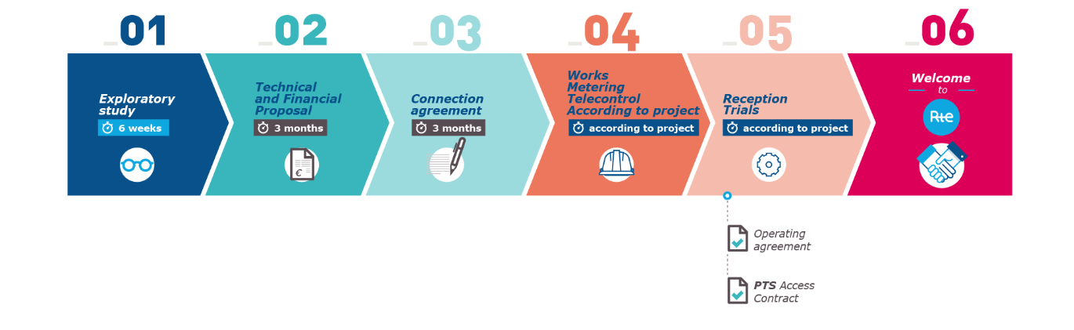
RTE grid connections – Procedure and Timeline
M. Parodi – Update on FCC electrical network and grid connection
19
Feedbacks from RTE after first approach
The overall power demands justifies a connection to RTE 400 kV (or alternatively 225 kV) grid
Request of connection (source: RTE website):
  Technical and Financial Proposal (RTE): up to 6-9 months of preparation for FCC
  From approval of TFP to Commercial Operation: approximately 10 years or more
The first step (exploratory study) is free of charge and not binding. Data Collection Sheet available online.
The further study and execution phases need investment and commitment from both parties
The technical solution includes upgrade to RTE upstream infrastructure where required

Slide 20
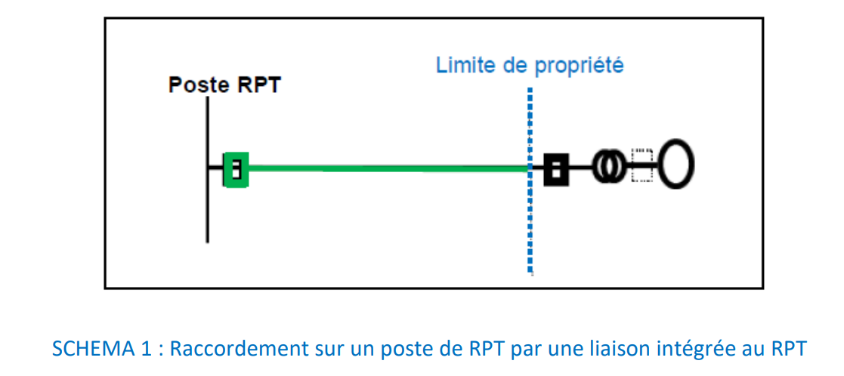
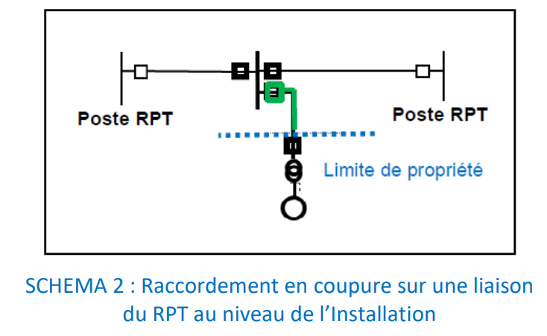
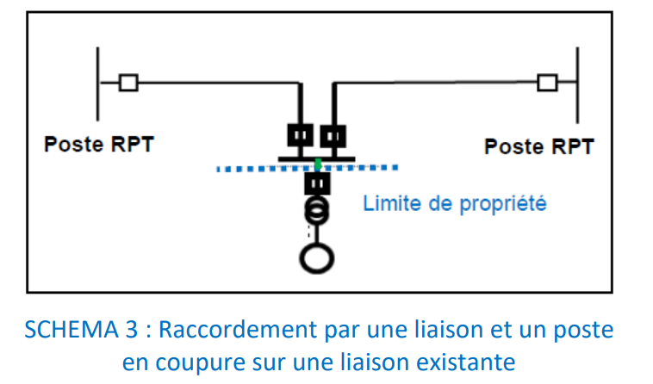
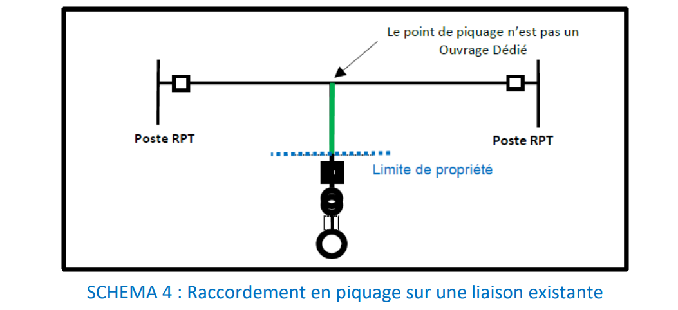
RTE grid connections – Technical Options
M. Parodi – Update on FCC electrical network and grid connection
20
Connections to RTE: possible solutions (source: RTE procedure for connection request)

Slide 21
RTE Grid connection - Proposal
M. Parodi – Update on FCC electrical network and grid connection
Three connection points
Power demand per each connection: 200 MW
PH and PL– 1st and 2nd connections (RF points)
  Proximity to 400 kV lines (~1.5 km)
  Proximity and 225 kV line (~1.2 km)
  Proximity to 225 kV substation (~3.2 km)
PD or PF –3rd connection (PD preferred, equidistant from PH and PL)
  Proximity to 400 kV substation (~5 km)
  Proximity to 225 kV line (~3 km)
Check the allowed internal operations
Very promising options for the technical feasibility
Exploratory study to be launched as soon as possible:
Available capability of RTE
Open/close internal loop operations
Ancillary services for grid stability ?

Slide 22
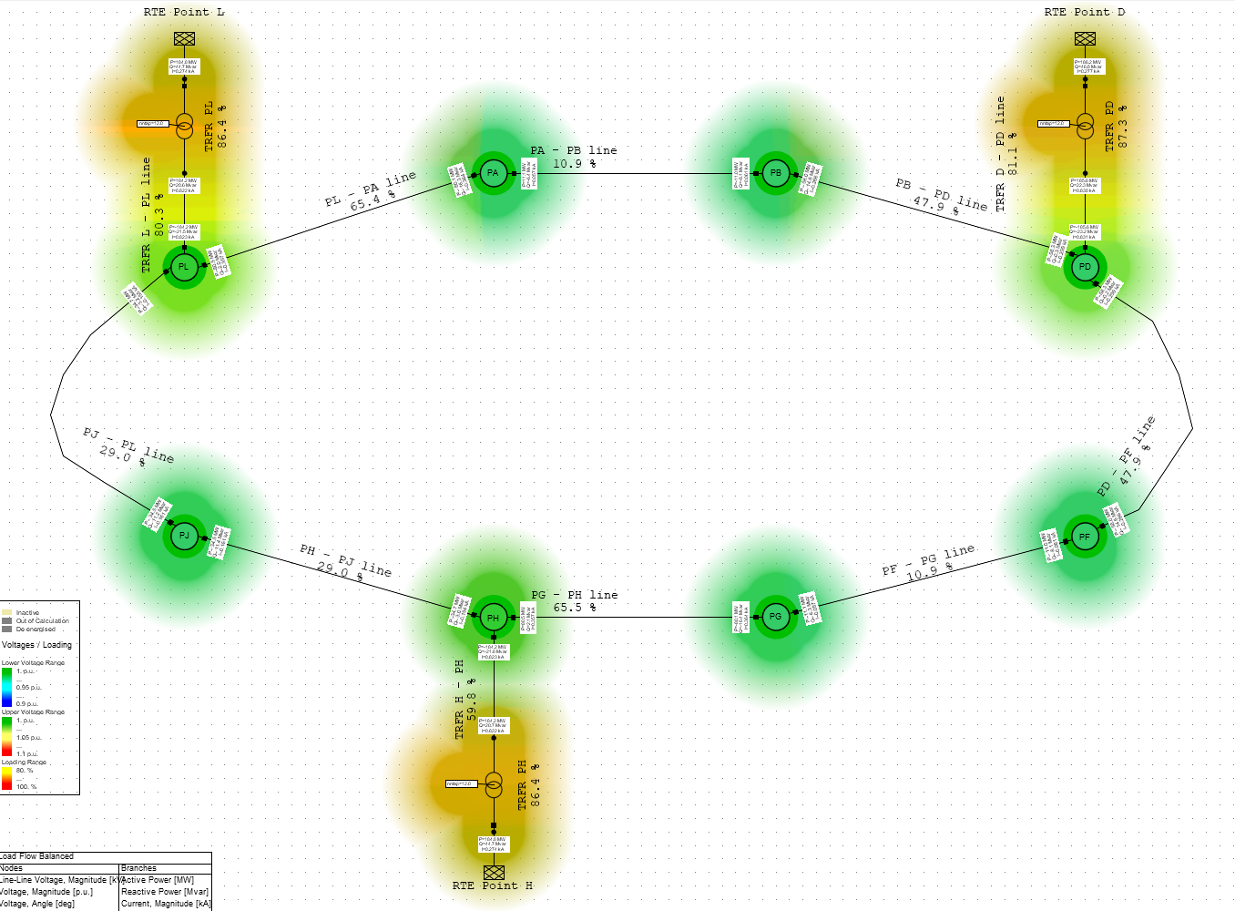
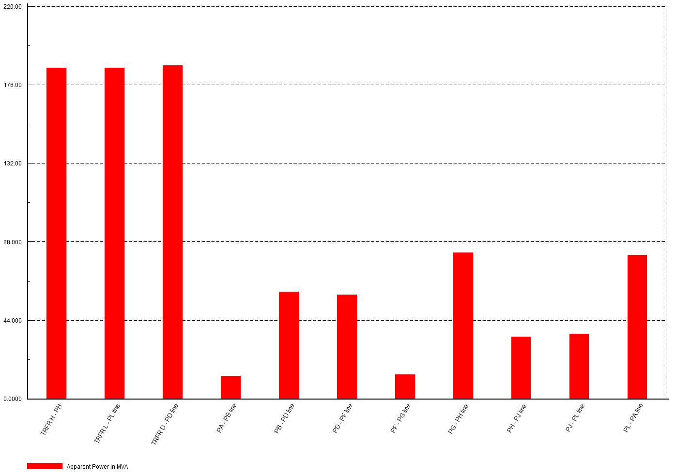
Moving Forward – Horizon FCC-hh
M. Parodi – Update on FCC electrical network and grid connection
22
Qualitative assessment of FCC-hh case:
Preliminary and simplified load distribution
Target load: 556 MW (FCC Week 2018)
Technical solution for FCC-ee compatible with FCC-hh requirement in RUN
The internal 132 kV ring allows to balance the transmission even with the new load profile without further integrations
n-1 scenario would not allow RUN mode
At distribution level (36/0.4 kV) the installed base will drastically change:
  For FCC-ee RF points important difference: re-work probably needed
    Possibility to re-use part of the equipment if the life cycle compatible
  In all other points: possible staging from FCC-ee to FCC-hh
220 MVA (incomers)
130 MVA (loop branches)

Slide 23
Conclusions
M. Parodi – Update on FCC electrical network and grid connection
23
Status and challenges
Baseline of 2018 CDR: solid and good starting point for the new layout
Proposed HV network: compliant with FCC-ee and adapted for the evolution to FCC-hh
Technologies and expertise widely available to implement the proposed solution
Space for optimization
Closed loop operation: promising, but to be verified with RTE
Target load based on estimations that shall be confirmed at the next stages of the study
Studies still ongoing: the presented results shall be considered preliminary
Next steps:
  Feasibility/Impact of connections to RTE grid - Exploratory study to be launched
  Define the minimum requirements of HV and MV network in terms of RAMS
  Complete the analysis of network scenarios
  Optimal sizing of HV equipment
  Progress on the definition of the downstream MV distribution (overall underground)
  Share/update preliminary requirements for underground integration and C&V

Slide 24
Conclusions
M. Parodi – Update on FCC electrical network and grid connection
24
Opportunities
Use of GIS technology to minimize the layout oh HV substations
Staging (if compliant with FCC reliability and availability requirements):
  400/132 kV substations
  Downstream electrical equipment
  132 kV loop
FCC-hh:
  High-level infrastructure ready
  Possible re-use of electrical systems installed in RF points of FCC-ee
Integration of internal renewable power generation
Provision of ancillary services for RTE grid stability (voltage and frequency regulation)
Use of DC alternative solutions to at least part of the powering infrastructure, e.g. supply of power converters
  Comparison of AC-DC solutions in the pipeline of the WG
  Still the connection to RTE AC grid shall be ensured
For more details on DC powering:
Wednesday 1st June at 12:00
“Power Converters R&D – From DC
Distribution to Energy Storage System"
from Davide Aguglia

Slide 25
Thank you for your attention

