Slide 1
Integration of FCC-ee
RF sections
02.06.2022 / FCC Week
F. Valchkova-Georgieva / J-P. Corso

Slide 2
02.06.2022 / FCC Week
F. Valchkova-Georgieva / J-P. Corso
  FCC-ee Underground Structure Overview
  FCC-ee Machine tunnel Layout
  FCC-ee RF/Cryogenic Layout
    FCC-ee RF/Cryogenic Layout point L
FCC-ee Underground Structure point L
    FCC-ee RF Machine tunnel cross sections
    FCC-ee Klystron Gallery cross sections
    FCC-ee Undergeound structure Isometric views
  FCC-ee RF/Cryogenic Layout
    FCC-ee RF/Cryogenic Layout point H
FCC-ee Underground Structure point H
    FCC-ee RF Machine tunnel cross sections
    FCC-ee Klystron Gallery cross sections
    FCC-ee Undergeound structure Isometric views

Slide 3
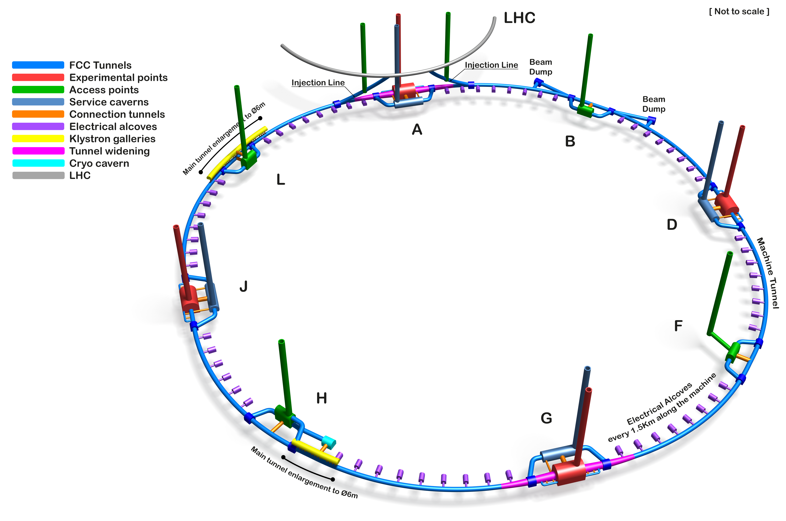
02.06.2022 / FCC Week
F. Valchkova-Georgieva / J-P. Corso
Only schematic, and not to scale.
  FCC-ee Underground Structure Overview
Courtesy A. Navascues Cornago

Slide 4
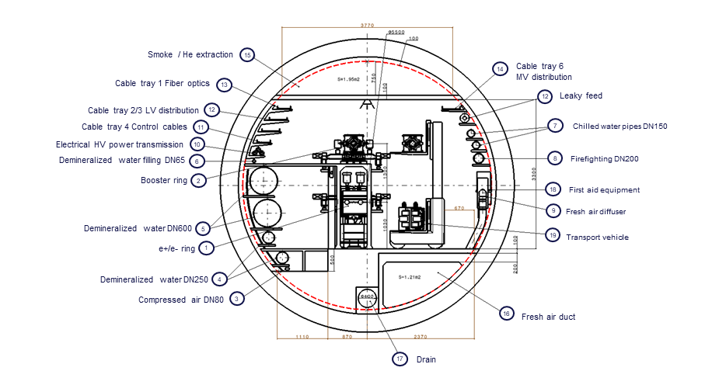
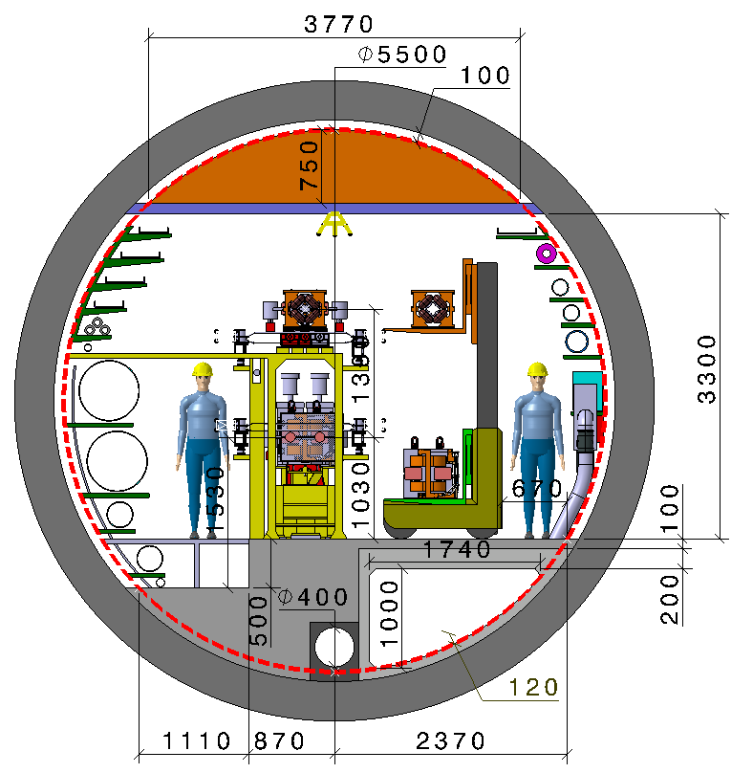
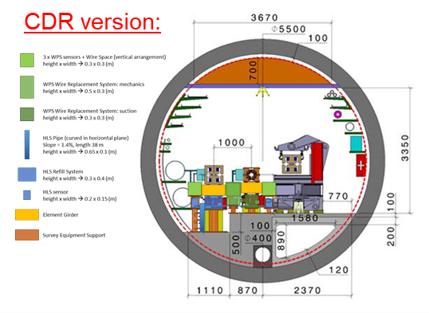
02.06.2022 / FCC Week
F. Valchkova-Georgieva / J-P. Corso
  Integration of FCC-ee machine elements (regular arc)
Machine tunnel 5.5m in diameter
Main cross section as for FCC-hh
Main ring below of booster ring
Main ring and booster ring 1.3 m distant
Water distribution changed
Collider Center

Slide 5
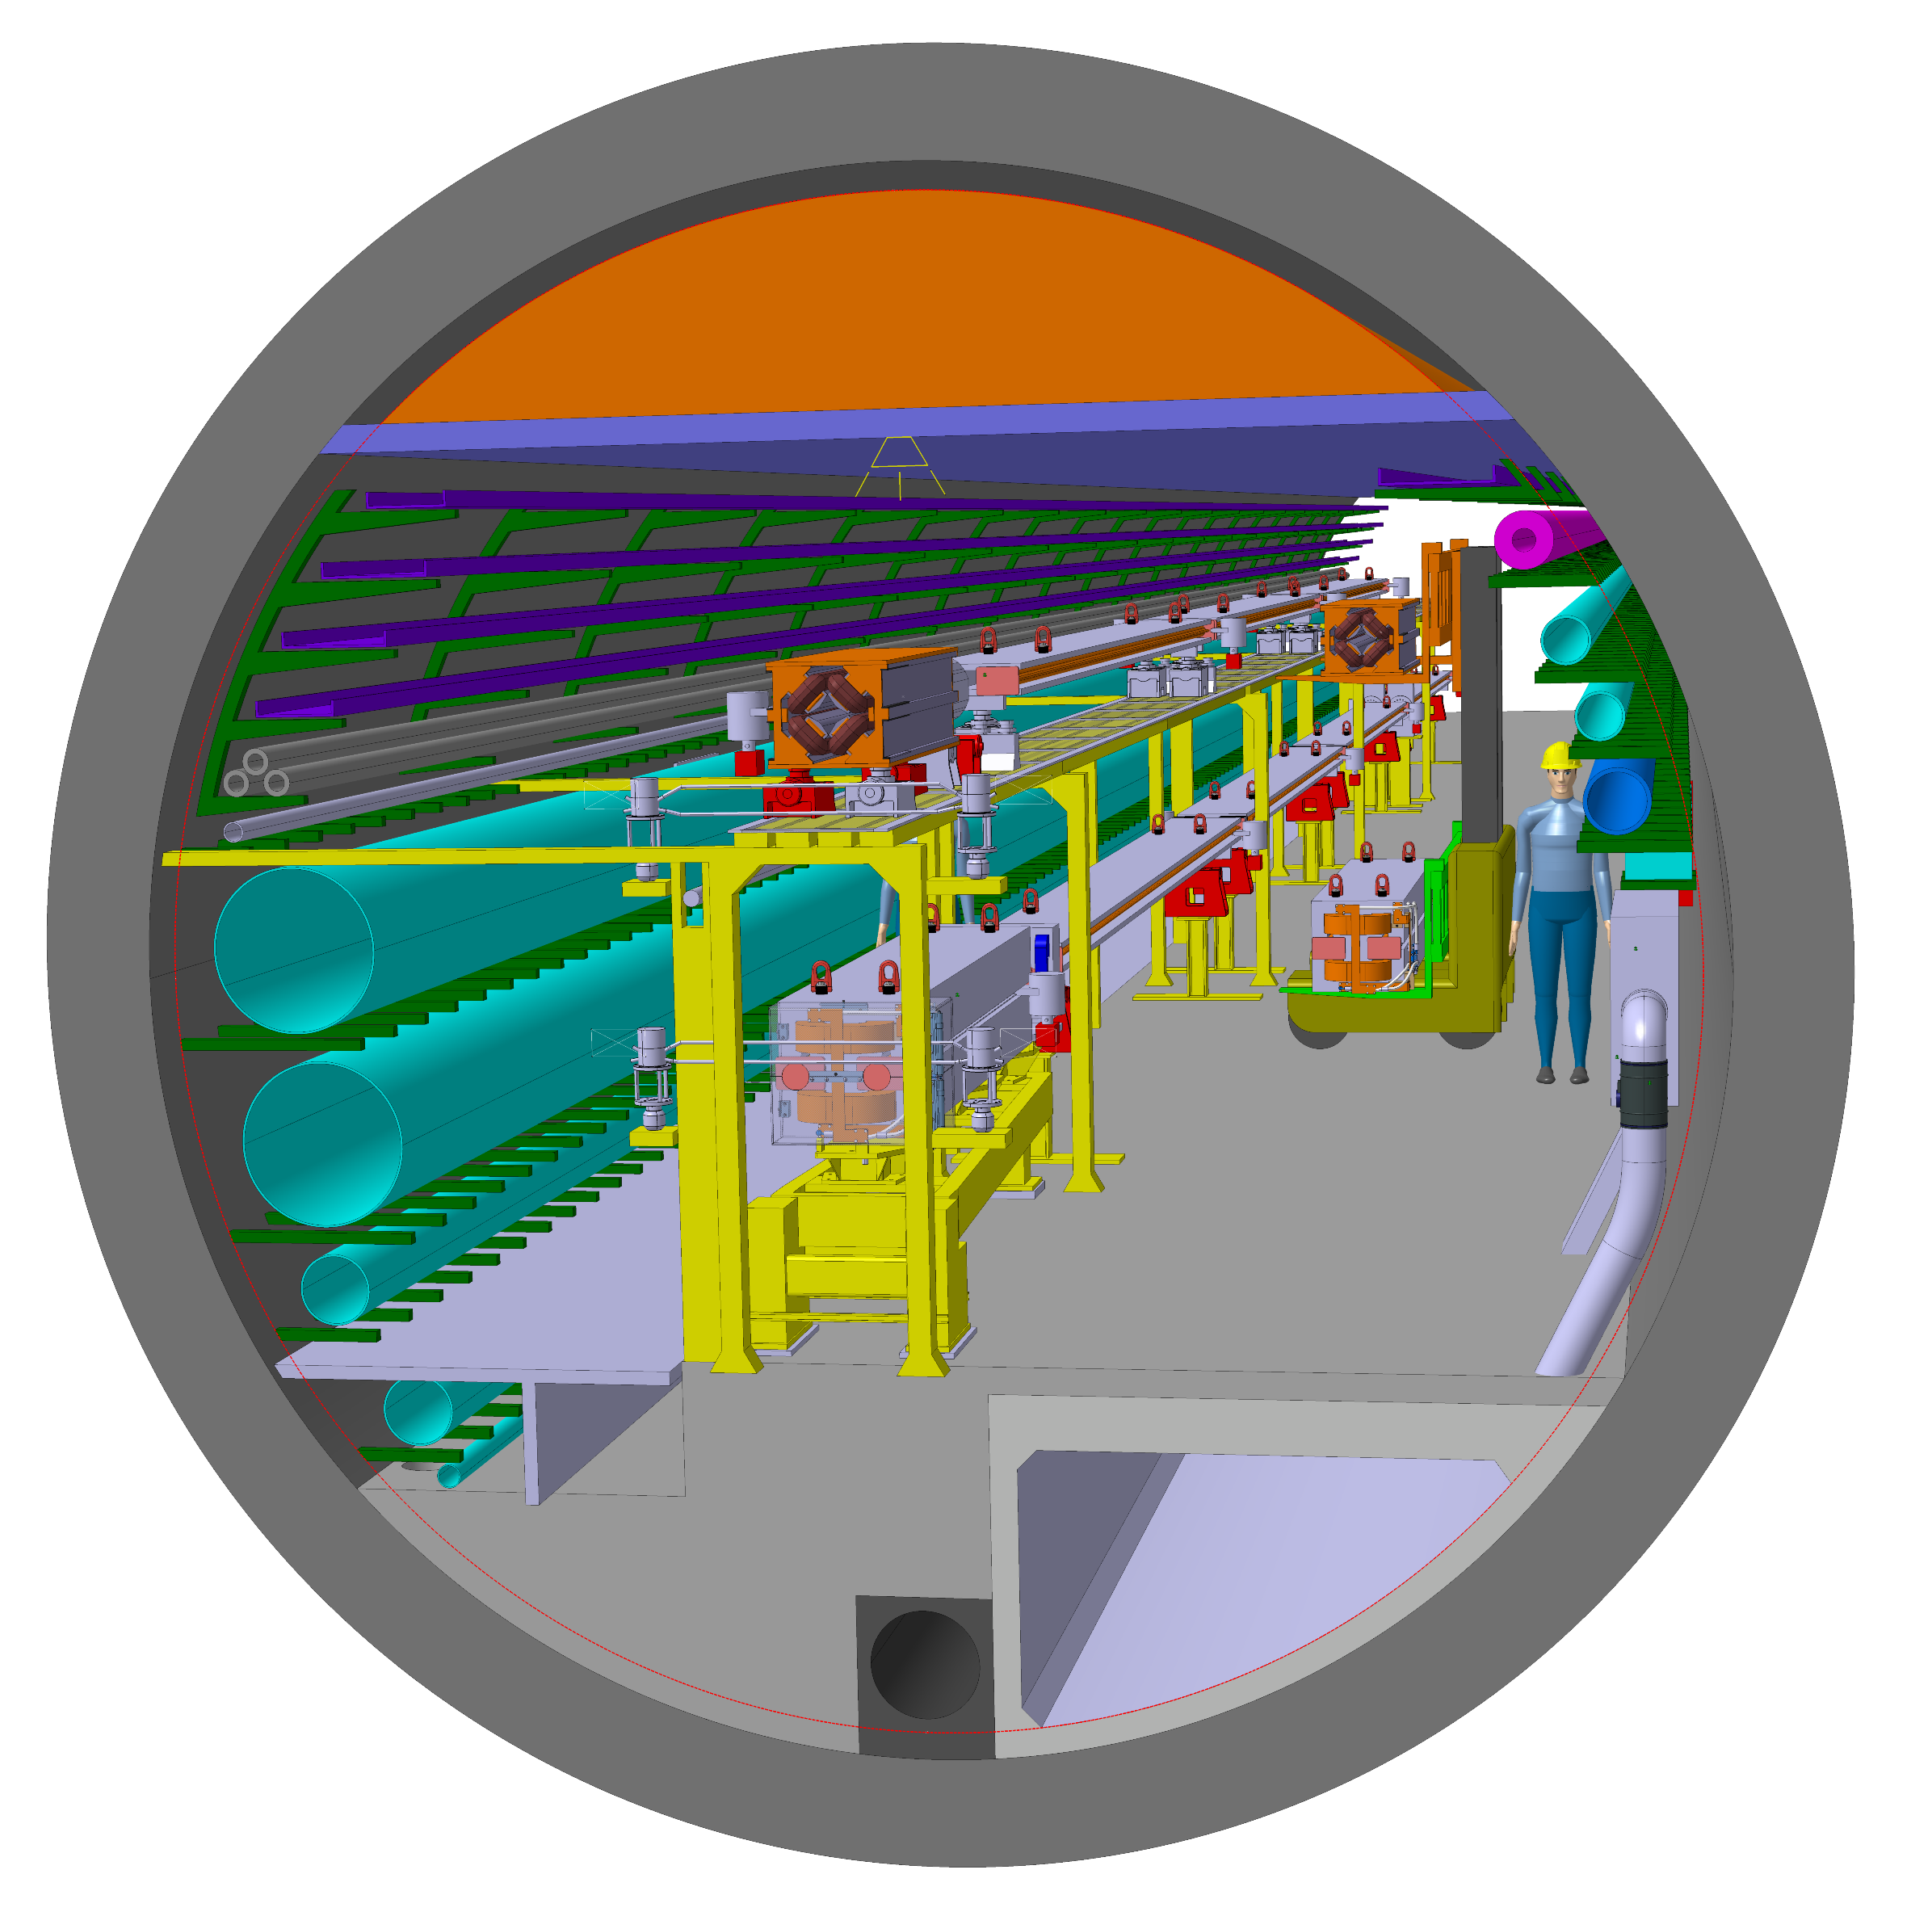
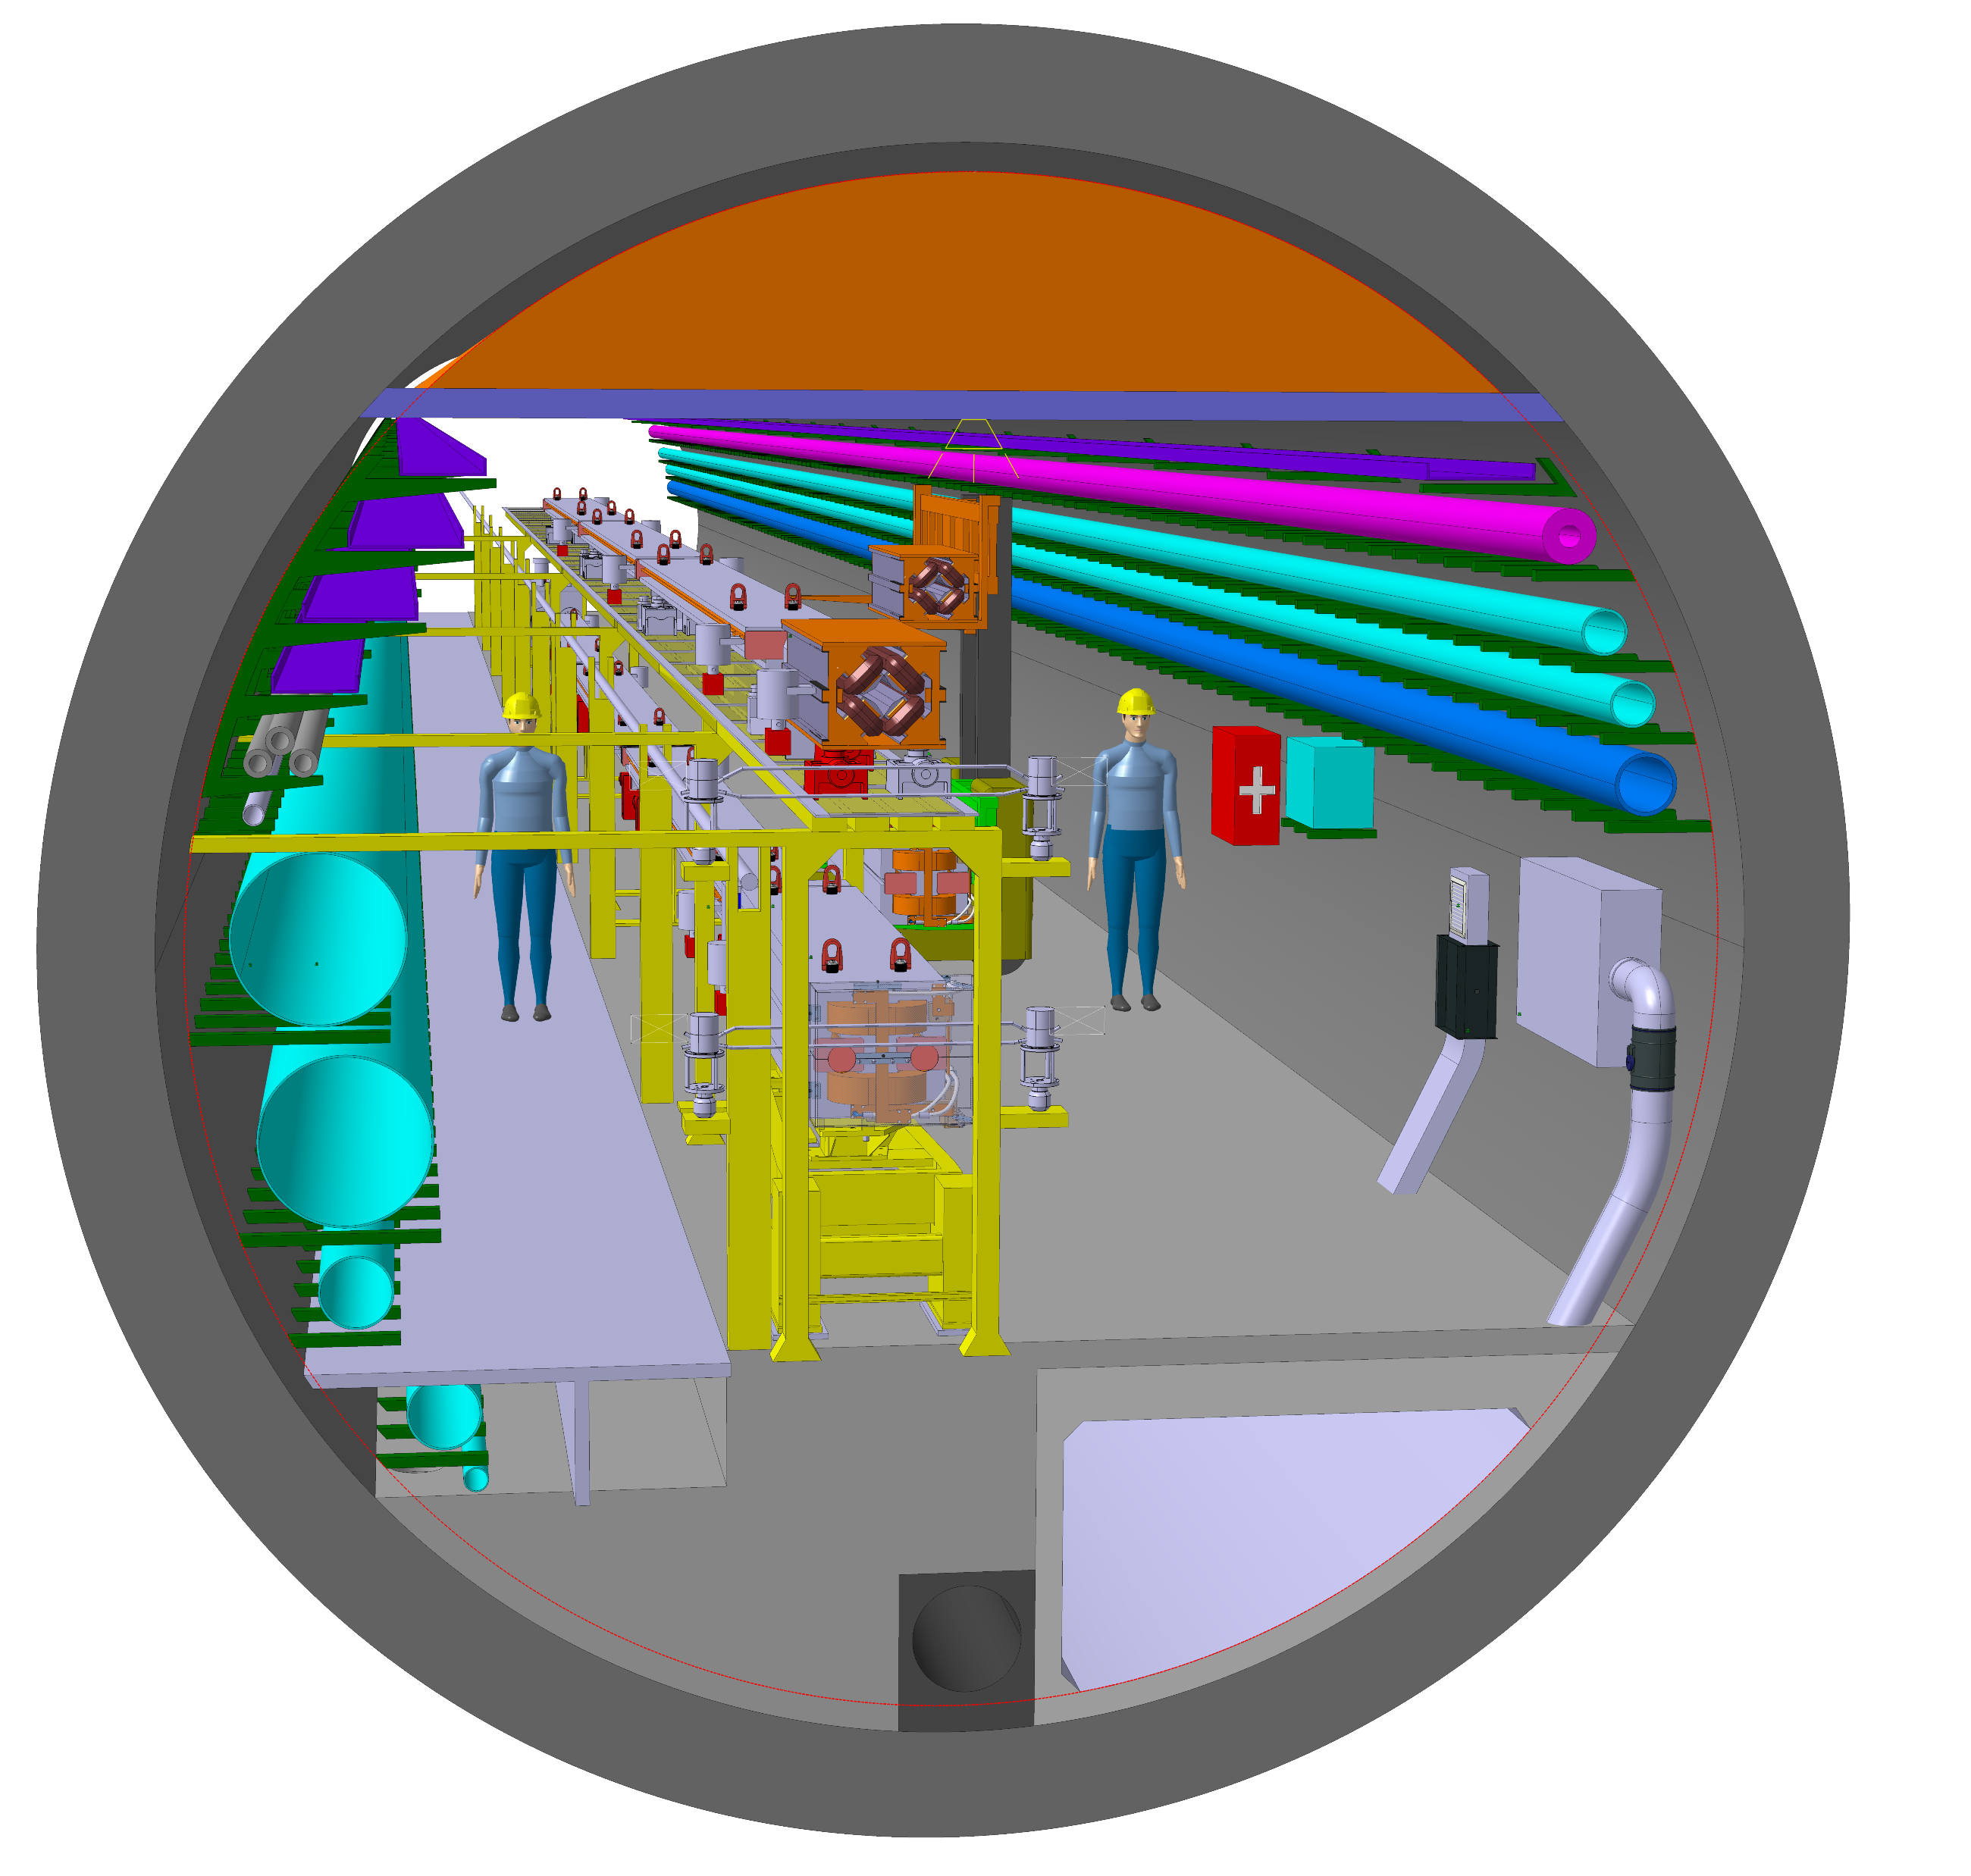
02.06.2022 / FCC Week
F. Valchkova-Georgieva / J-P. Corso
  Integration of FCC-ee machine elements (regular arc)
Perspective view
Collider Center

Slide 6
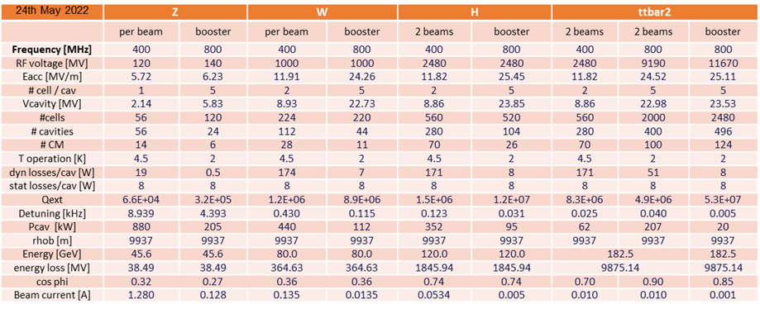
02.06.2022 / FCC Week
F. Valchkova-Georgieva / J-P. Corso
Courtesy F. Peauger and O. Brunner
  FCC-ee RF reference table

Slide 7
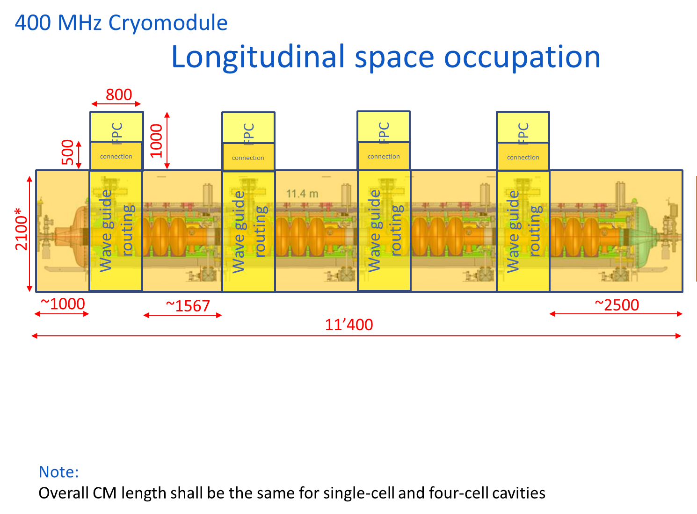
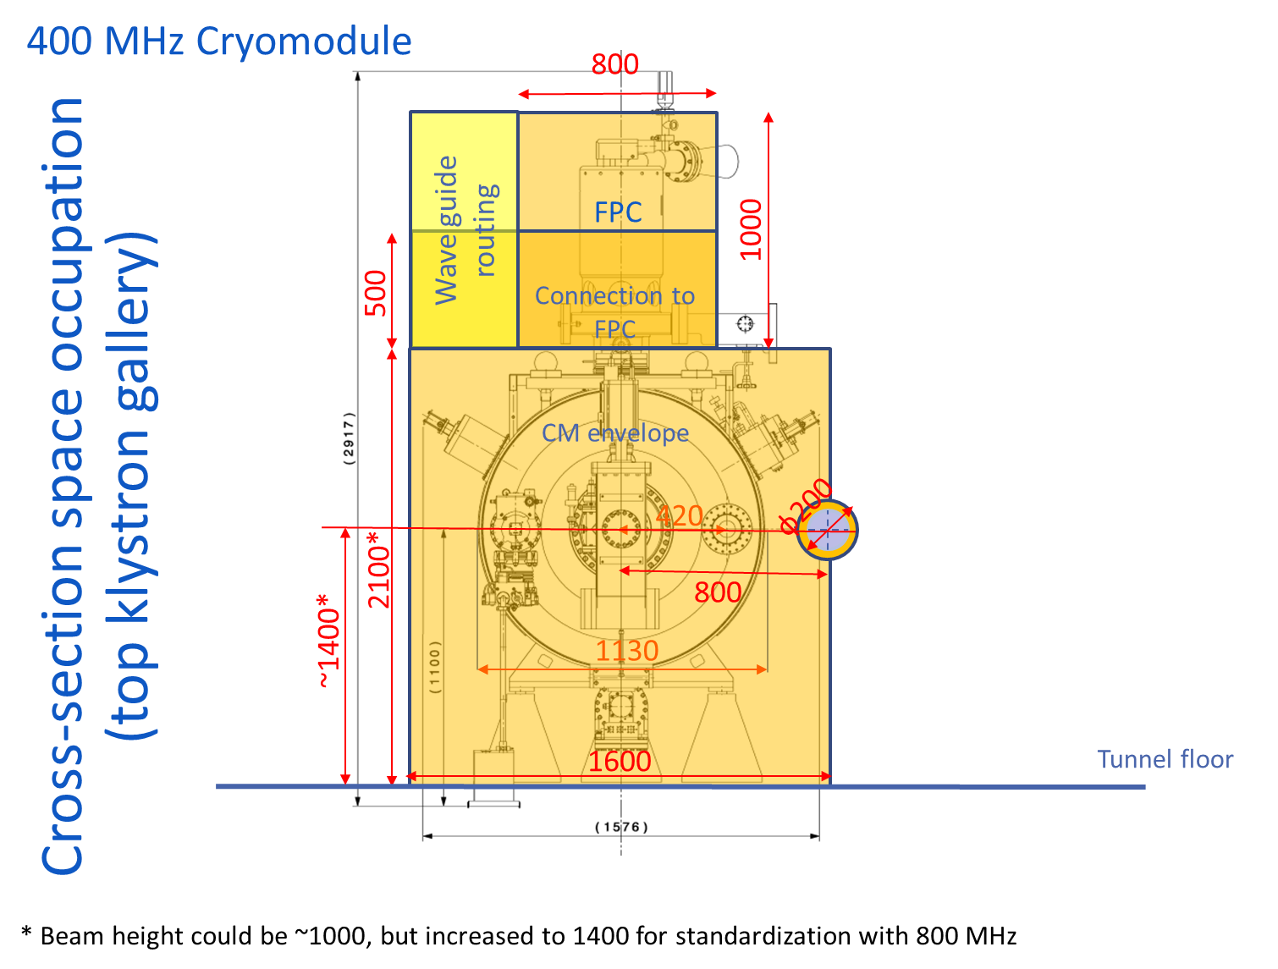
02.06.2022 / FCC Week
F. Valchkova-Georgieva / J-P. Corso
  FCC-ee RF 400 MHz Cryomodules space occupation
Courtesy V.Parma/E. Montesinos
Consider only 2 types of CM
Same CM design for 1_cells (Z) and 2_cells (W, H) 400 MHz systems – distance between WG must remain constant
The use of half-height WG may allow to reduce the number of WG holes – to be studied in detail

Slide 8
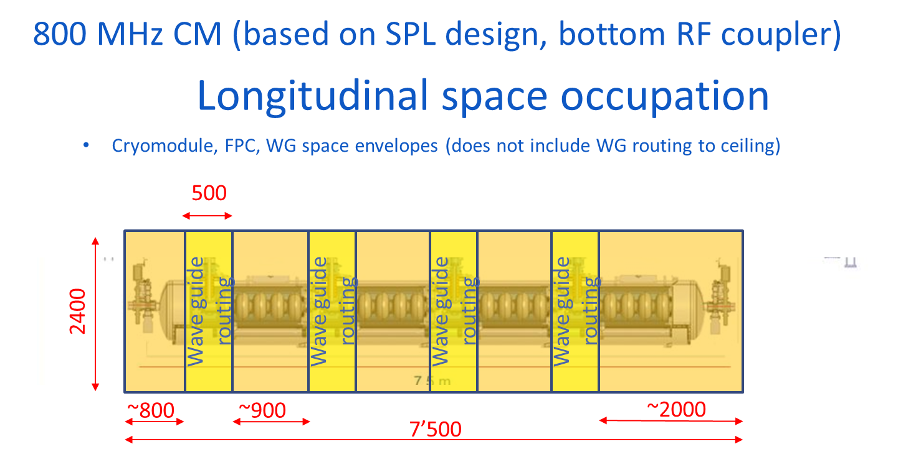
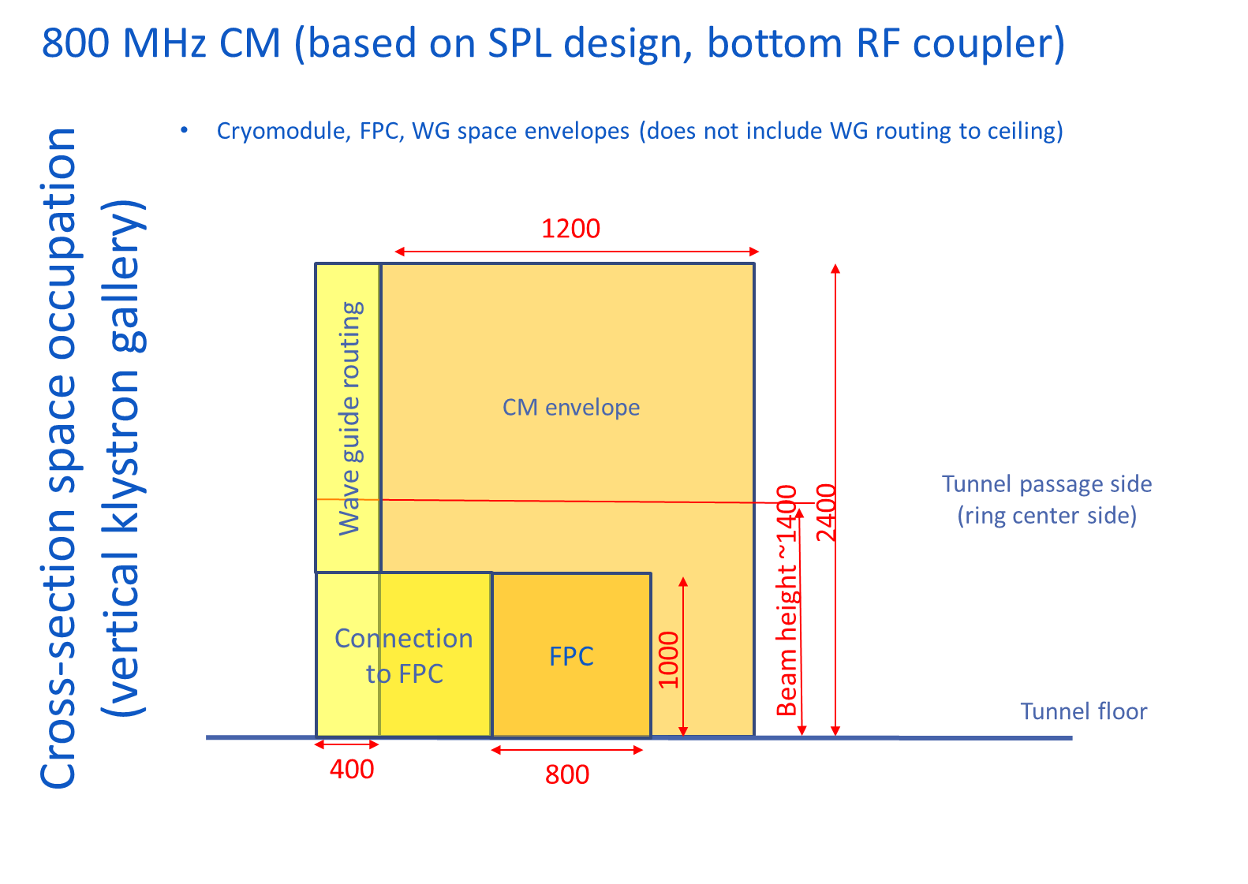
02.06.2022 / FCC Week
F. Valchkova-Georgieva / J-P. Corso
  FCC-ee RF 800 MHz Cryomodules space occupation
Courtesy V.Parma/E. Montesinos
The use of half-height WG may allow to reduce the number of WG holes – to be studied in detail

Slide 9
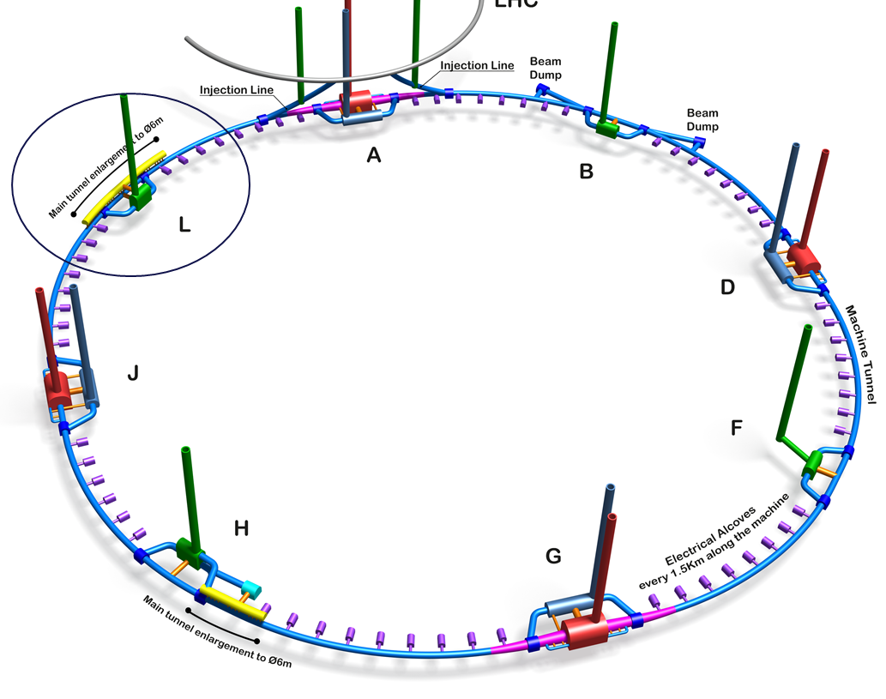
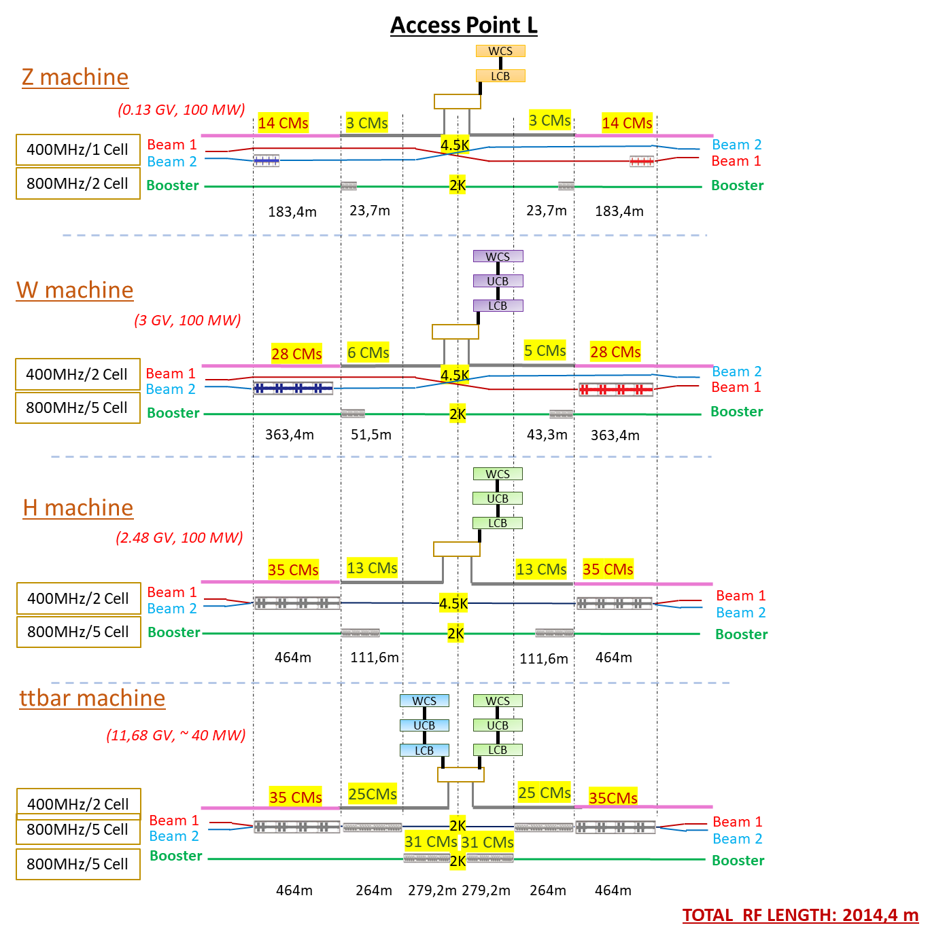
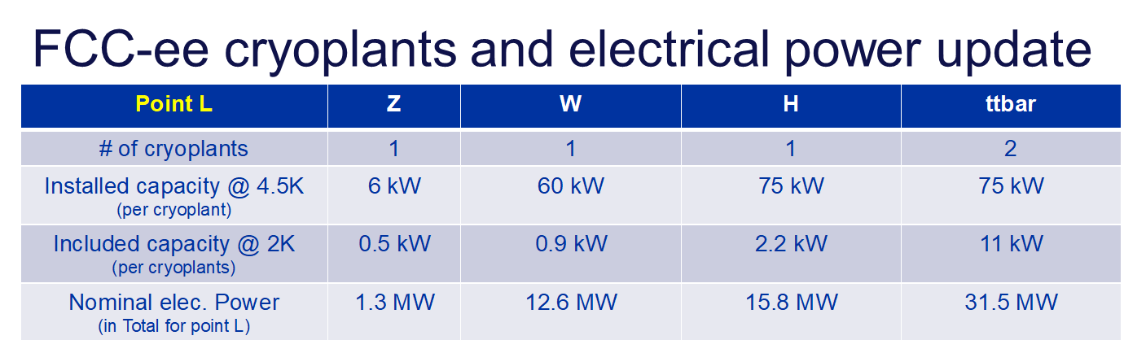
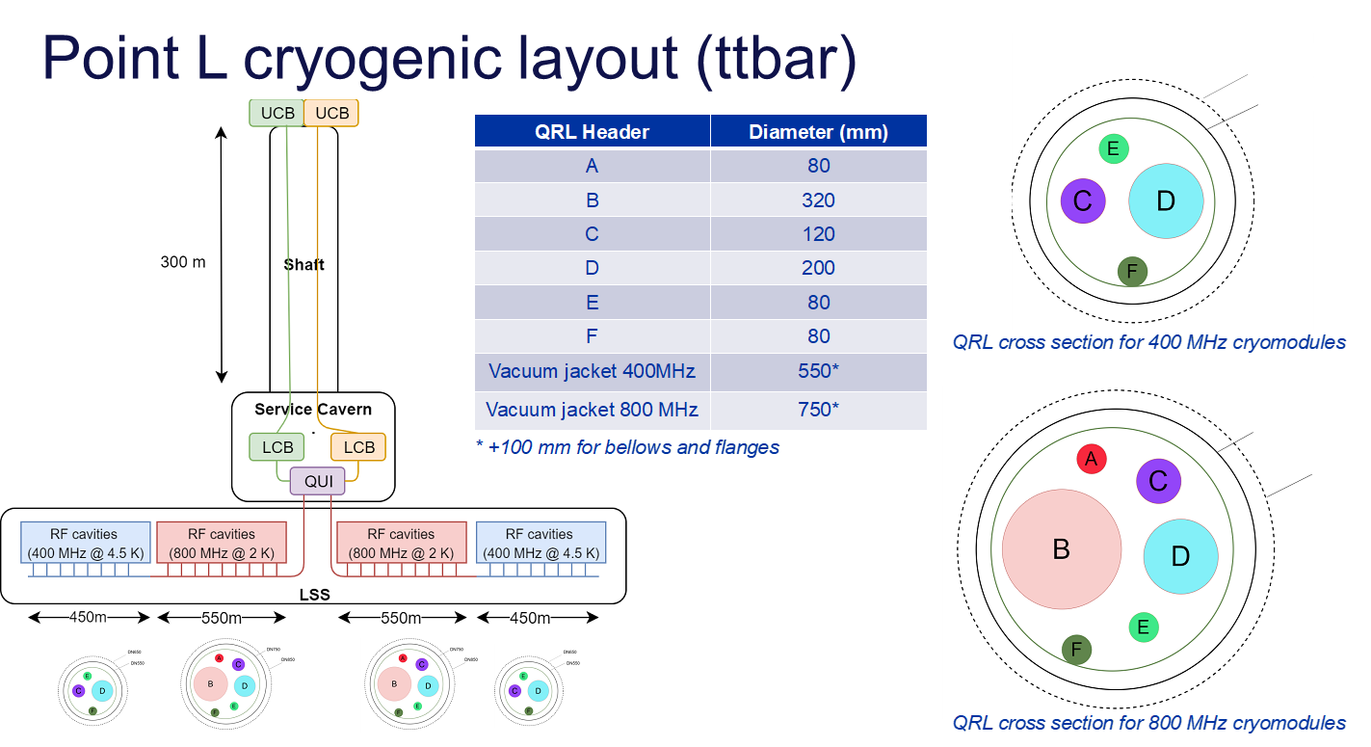
02.06.2022 / FCC Week
F. Valchkova-Georgieva / J-P. Corso
TLSS length: 2160 m
  FCC-ee RF/Cryogenic Layout point L
Courtesy L.Delprat, B.Bradu and K.Brodzinski
DN650
DN550
DN750
DN850
2K Booster CMs near to cryoplants then 4.5K Collider CMs

Slide 10
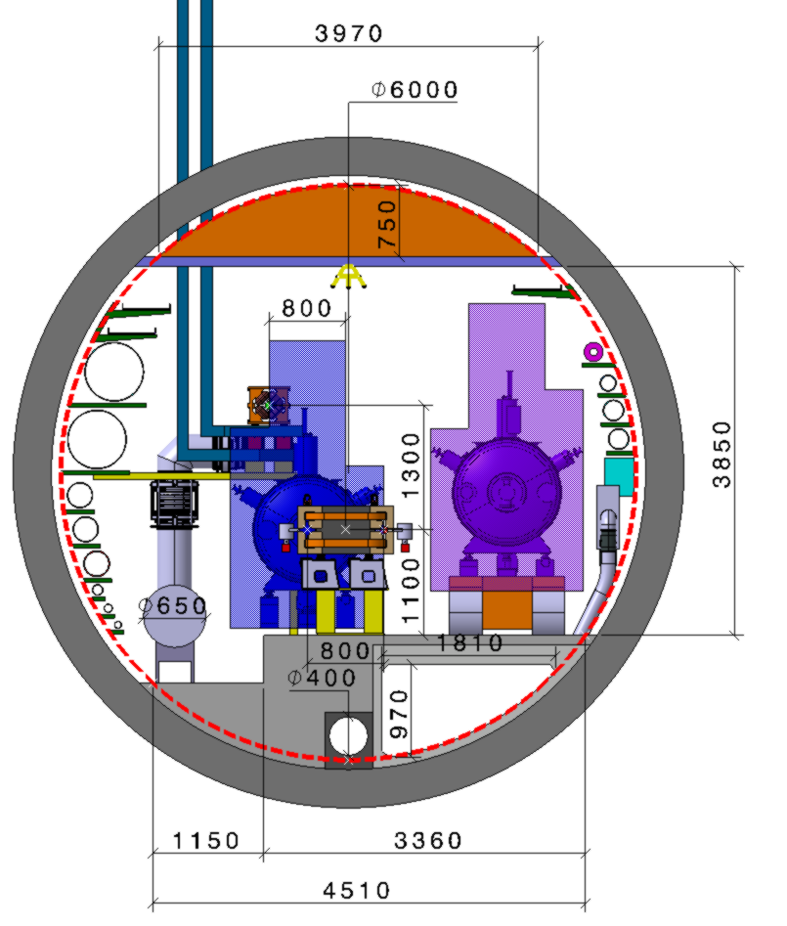
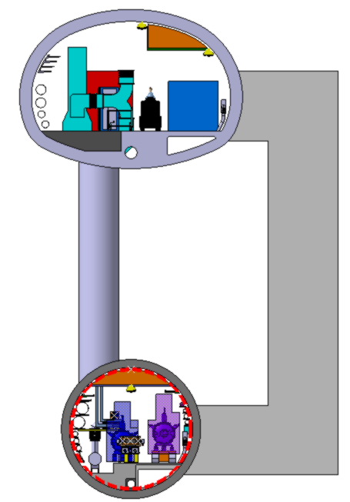
02.06.2022 / FCC Week
F. Valchkova-Georgieva / J-P. Corso
  FCC-ee RF Machine tunnel cross section (Z,W,H machine)
e⁺e⁻ beam separation 0.8 m (needs quadrupole (model) with that spacing).
QRL Ø along 400 MHz section 0.65 m.
Distance between e⁺e⁻ quadrupoles 52 m, length 3.1 m.
Distance between booster quadrupoles 52 m, length 1.5 m.
Waveguide
Machine tunnel 6 m in diameter
Booster ring
Transport
Klystron Gallery
10 000
Waveguide duct
Need a new design of
Quadrupole magnet
Collider ring
Cryomodule 400 MHz
Machine tunnel
Collider Center

Slide 11
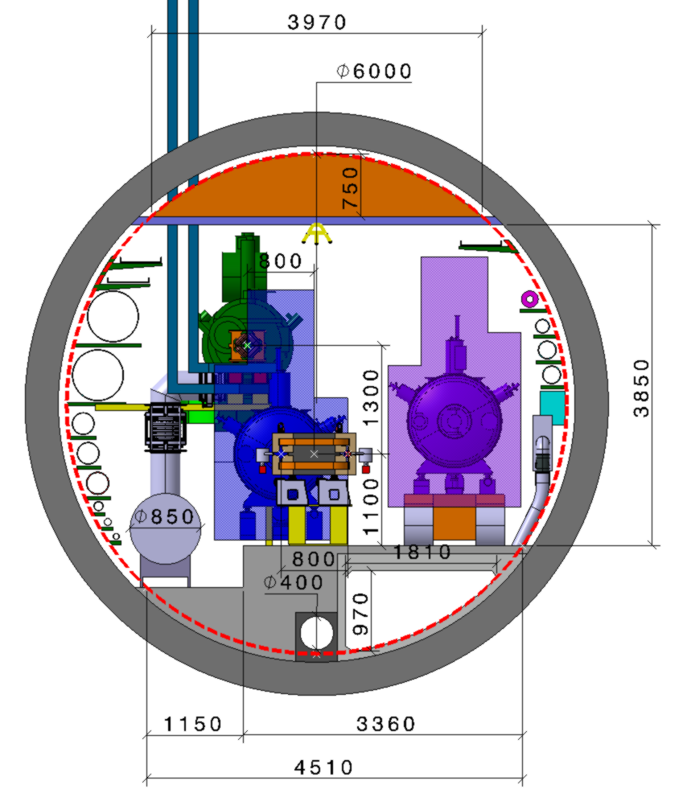
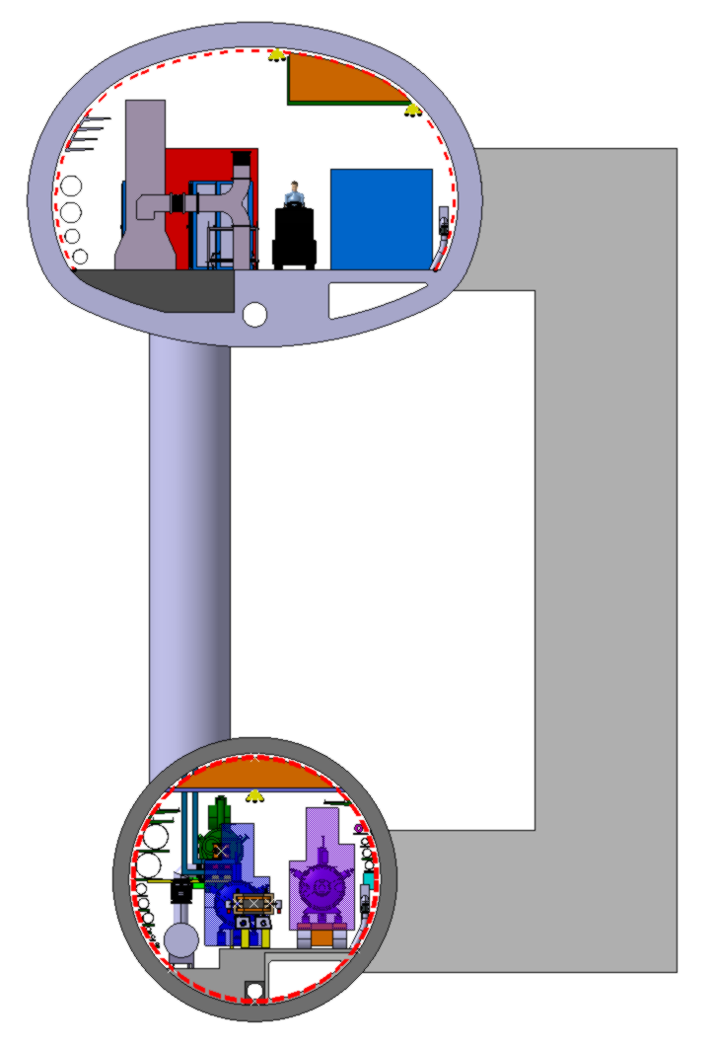
02.06.2022 / FCC Week
F. Valchkova-Georgieva / J-P. Corso
  FCC-ee RF Machine tunnel cross section (Z,W,H machine)
e⁺e⁻ beam separation 0.8 m (needs quadrupole (model) with that spacing).
QRL Ø along 400 MHz section 0.65 m.
QRL Ø along 800 MHz section 0.85 m
Distance between e⁺e⁻ quadrupoles 52 m, length 3.1 m.
Distance between booster quadrupoles 52 m, length 1.5 m.
Waveguide
Machine tunnel 6 m in diameter
Booster ring
Cryomodule 800 MHz
Transport
Klystron Gallery
10 000
Waveguide duct
Need a new design of
Quadrupole magnet
Collider ring
Cryomodule 400 MHz
Machine tunnel
Collider Center

Slide 12
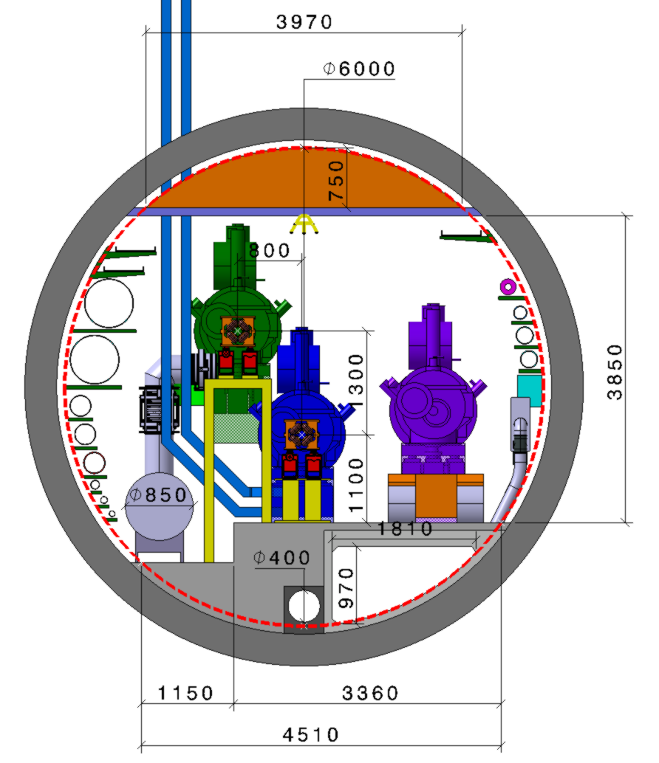
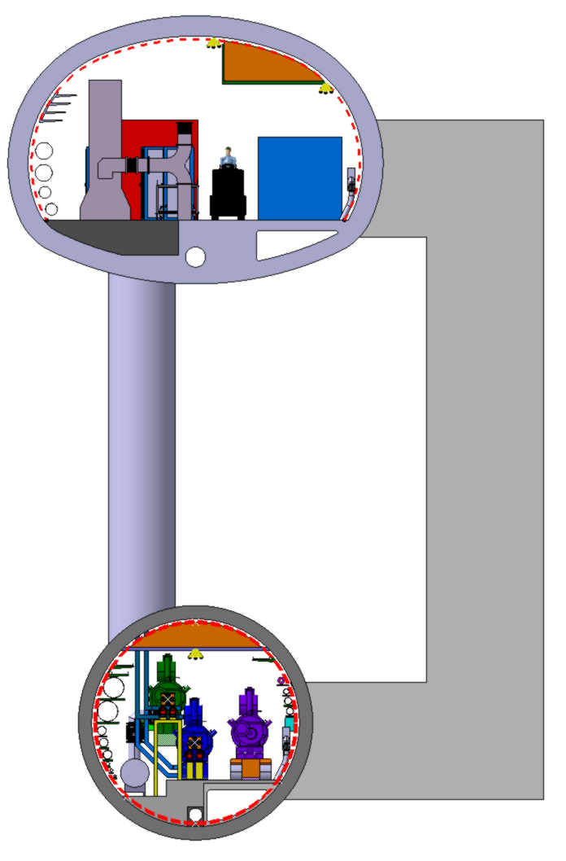
02.06.2022 / FCC Week
F. Valchkova-Georgieva / J-P. Corso
  FCC-ee RF Machine tunnel cross section (ttbar machine)
e⁺e⁻ beam separation 0.8 m (needs quadrupole (model) with that spacing).
QRL Ø along 800 MHz section 0.85 m
Distance between e⁺e⁻ quadrupoles 52 m, length 3.1 m.
Distance between booster quadrupoles 52 m, length 1.5 m.
Waveguide
Machine tunnel 6 m in diameter
Booster ring
Cryomodule 800 MHz
Transport
Klystron Gallery
10 000
Waveguide duct
Collider ring
Cryomodule 800 MHz
Concrete cut-out
Machine tunnel
Collider Center

Slide 13
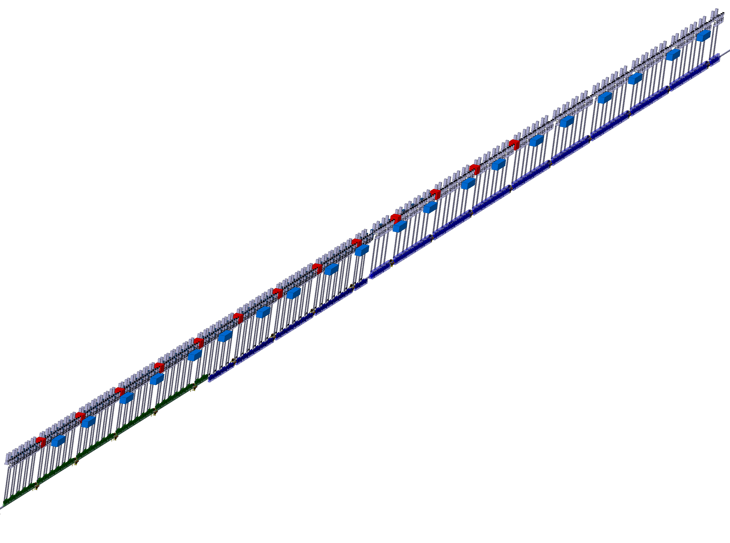
02.06.2022 / FCC Week
F. Valchkova-Georgieva / J-P. Corso
  FCC-ee RF Machine tunnel longitudinal view (ttbar machine)
Distance between e⁺e⁻ quadrupoles 52 m, length 3.1 m.
Distance between booster quadrupoles 52 m, length 1.5 m.
800 MHz cryomodules (ø 1.09 m x 7.5 m), half RF LSS
25 e⁺e⁻ CM + 31 booster CM = 56 CM (543.2 m)
112 klystrons
Klystron, circulator & rack
Faraday cage
(LxWxH=10x2x2.5m)
Collider 400 MHz Cryomodules
Bunker
(LxWxH=5x3x3 m)
Collider 800 MHz Cryomodules
400 MHz cryomodules (ø 1.17 m x 11.4 m), half RF LSS
35 e⁺e⁻ CM (464 m)
70 klystrons
IP
Quadrupole magnets
Booster 800 MHz Cryomodules
Collider Center

Slide 14
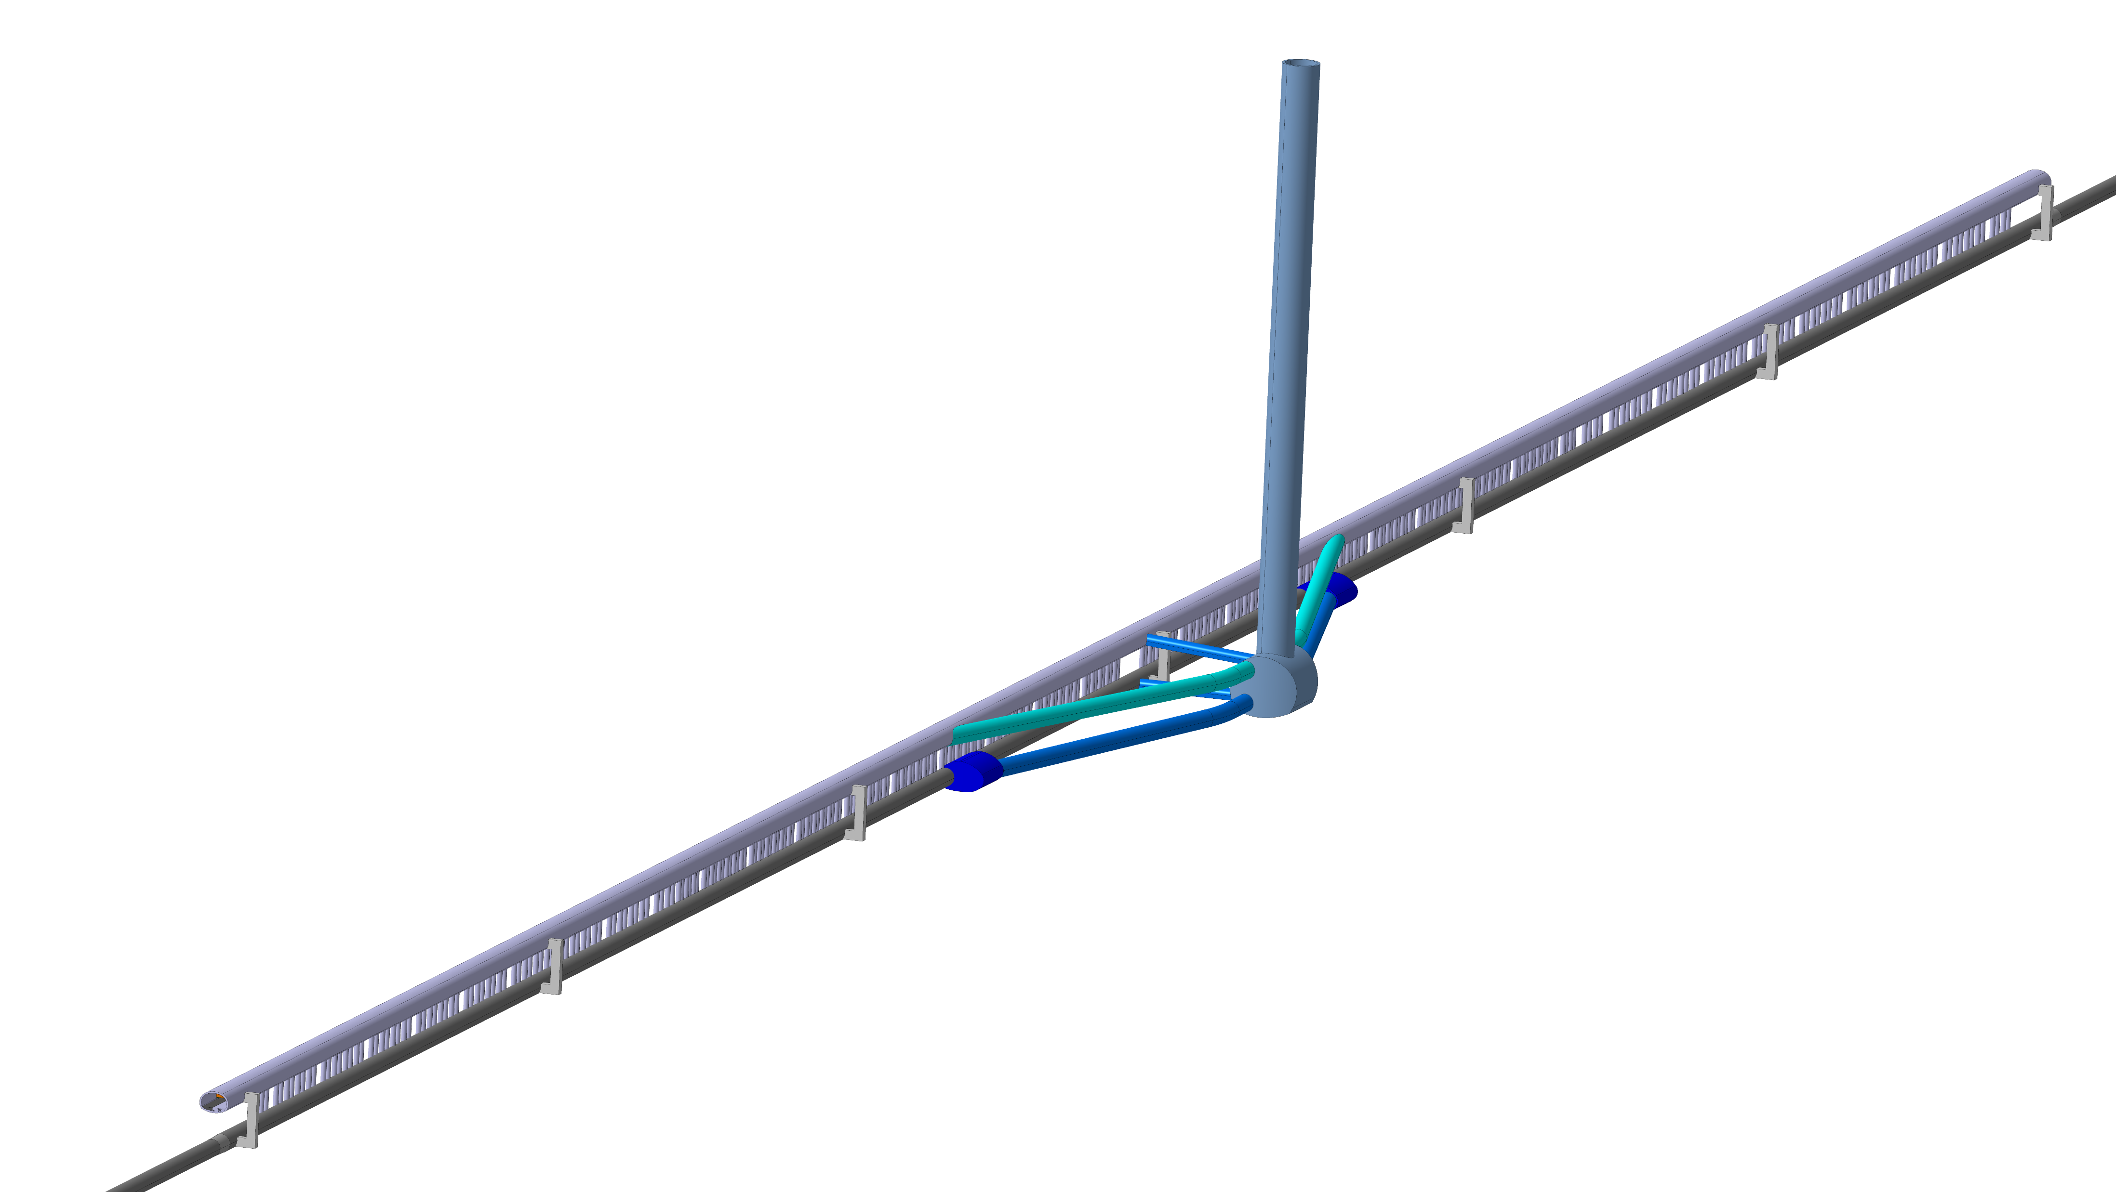
02.06.2022 / FCC Week
F. Valchkova-Georgieva / J-P. Corso
  FCC-ee Underground Structure
Service Shaft
Connection Tunnel (Cavern/Klystron Gallery)
IP
7 Evacuation staircase
(each 280 m)
Klystron Gallery
Service Cavern
Connection Tunnel (Cavern/Machine Tunnel)
Junction Cavern
Machine tunnel
Collider Center

Slide 15
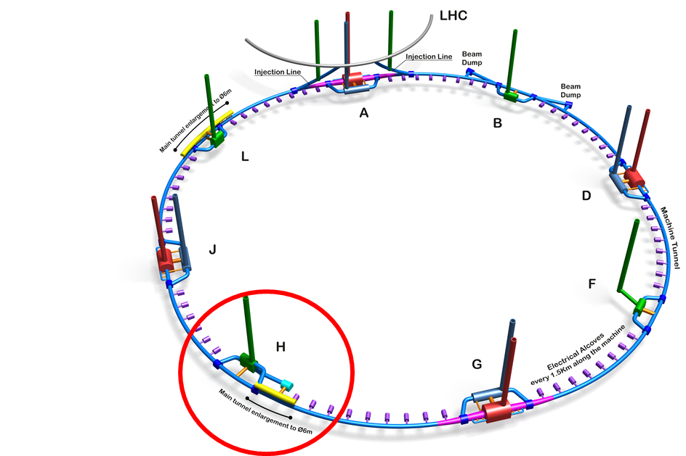
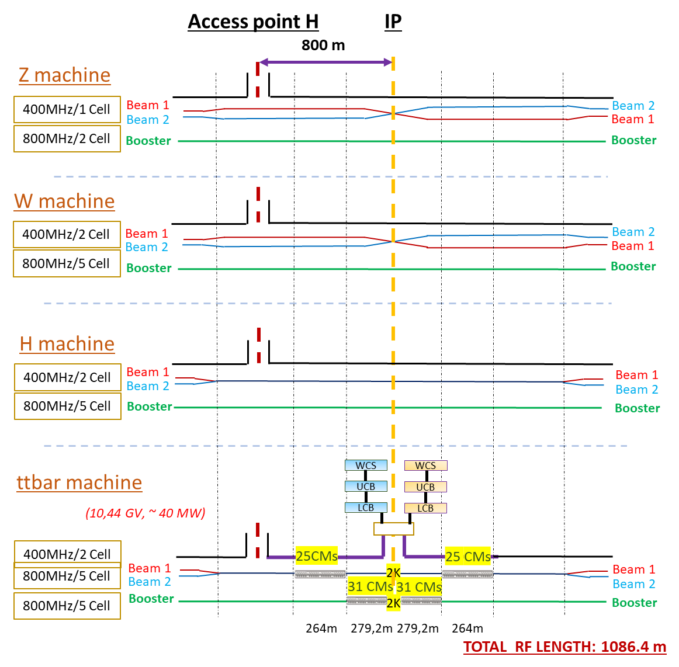
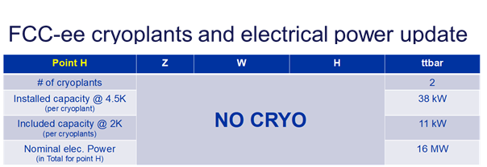
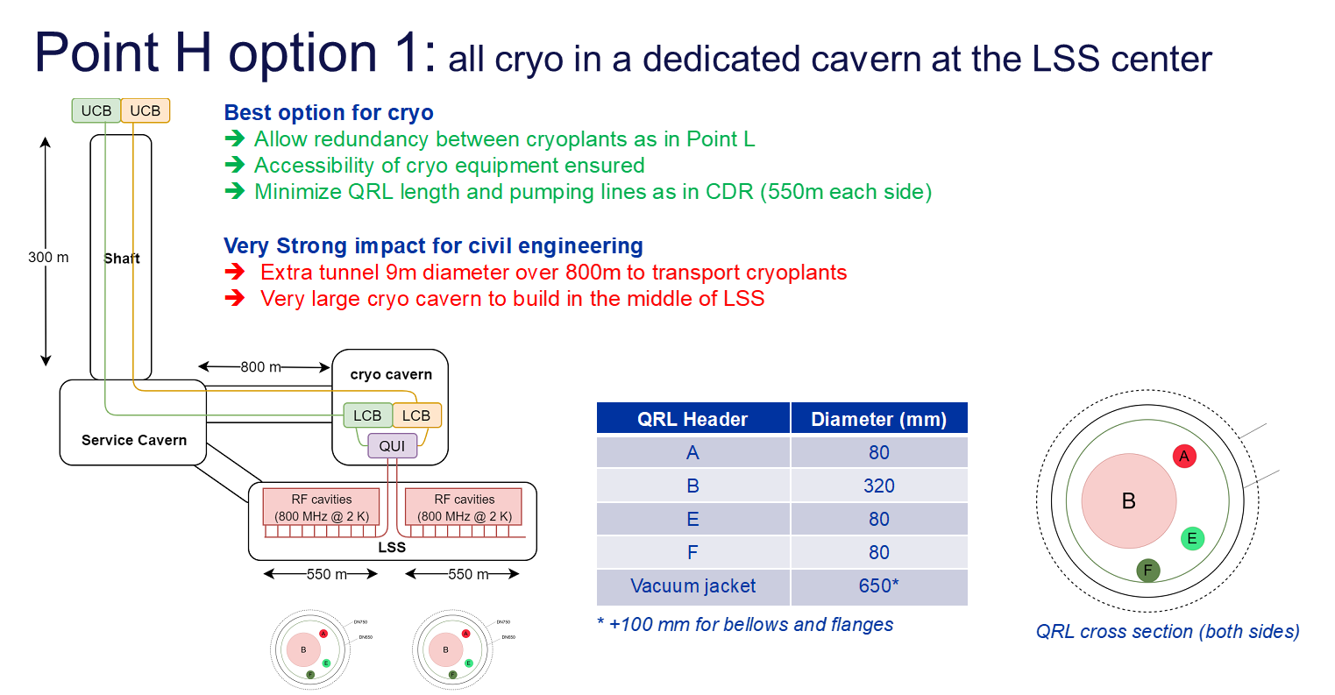
02.06.2022 / FCC Week
F. Valchkova-Georgieva / J-P. Corso
TLSS length: 2160 m
  FCC-ee RF/Cryogenic Layout point H option 1
Courtesy L.Delprat, B.Bradu and K.Brodzinski
DN750
DN650
2K Booster CMs near to cryoplants

Slide 16
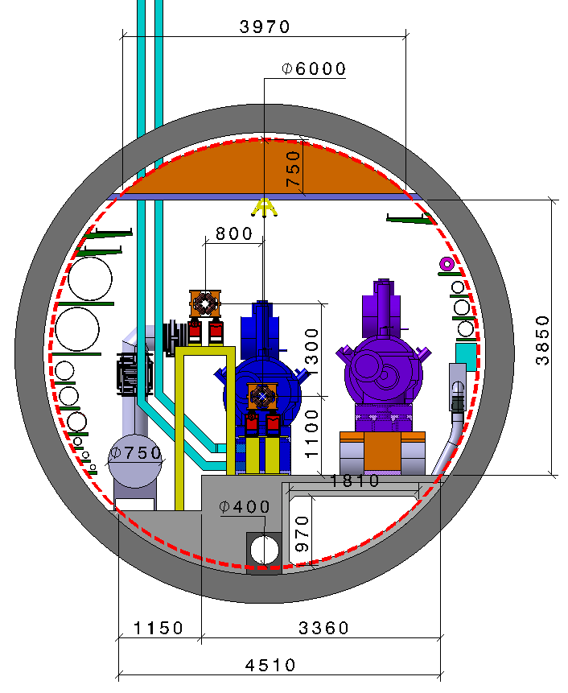
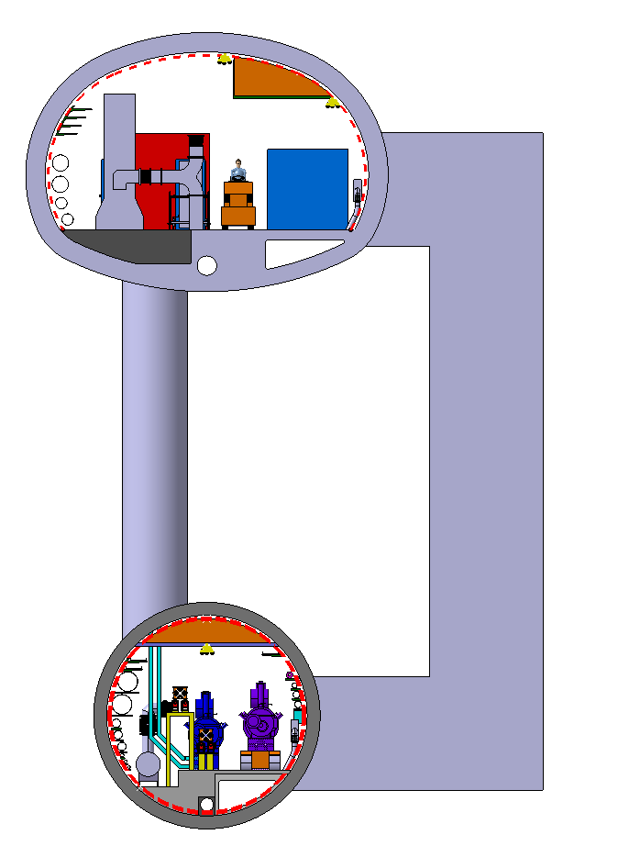
02.06.2022 / FCC Week
F. Valchkova-Georgieva / J-P. Corso
  FCC-ee RF Machine tunnel cross section (ttbar machine) option 1
QRL Ø along 800 MHz section 0.75 m.
Distance between e⁺e⁻ quadrupoles 52 m, length 3.1 m.
Distance between booster quadrupoles 52 m, length 1.5 m.
Waveguide
Machine tunnel 6 m in diameter
Booster ring
Transport
Klystron Gallery
10 000
Collider ring
Cryomodule 800 MHz
Waveguide duct
Concrete cut-out
Machine tunnel
Collider Center

Slide 17
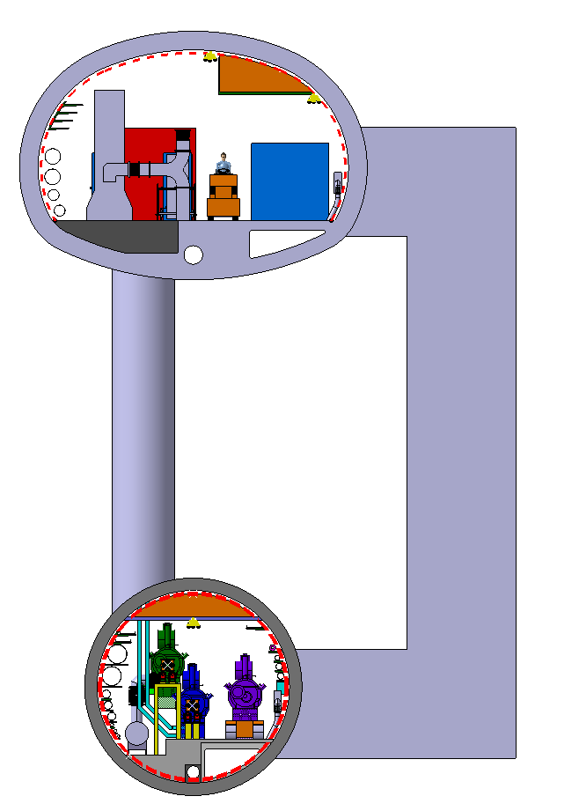
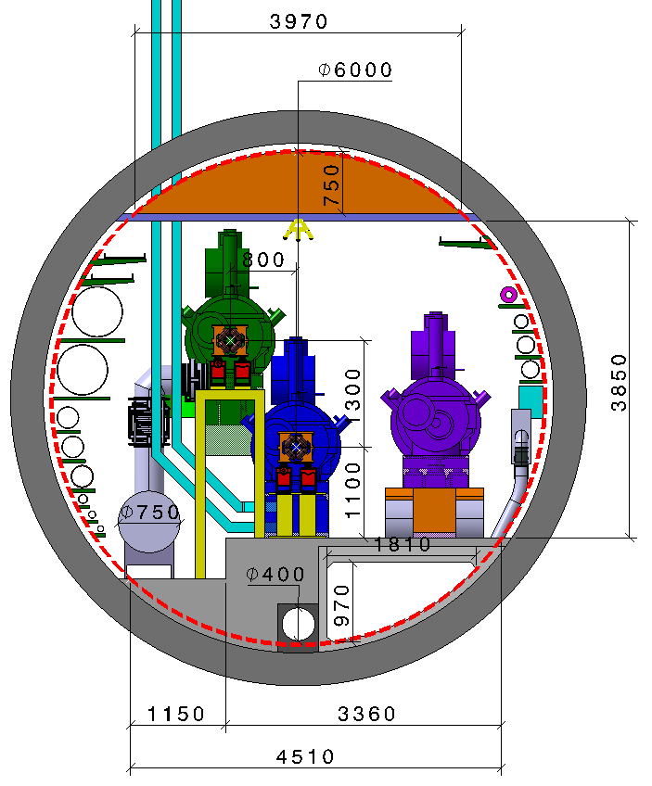
02.06.2022 / FCC Week
F. Valchkova-Georgieva / J-P. Corso
  FCC-ee RF Machine tunnel cross section (ttbar machine) option 1
QRL Ø along 800 MHz section 0.75 m.
Distance between e⁺e⁻ quadrupoles 52 m, length 3.1 m.
Distance between booster quadrupoles 52 m, length 1.5 m.
Waveguide
Machine tunnel 6 m in diameter
Booster ring
Cryomodule 800 MHz
Transport
Klystron Gallery
10 000
Collider ring
Cryomodule 800 MHz
Waveguide duct
Concrete cut-out
Machine tunnel
Collider Center

Slide 18
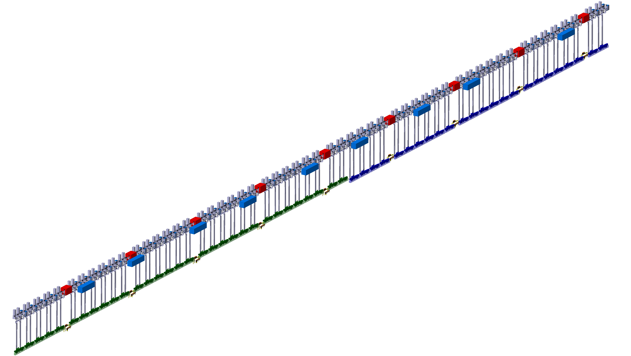
02.06.2022 / FCC Week
F. Valchkova-Georgieva / J-P. Corso
  FCC-ee RF Machine tunnel longitudinal view (ttbar machine) option 1
Distance between e⁺e⁻ quadrupoles 52 m, length 3.1 m.
Distance between booster quadrupoles 52 m, length 1.5 m.
800 MHz cryomodules (ø 1.09 m x 7.5 m), half RF LSS
25 e⁺e⁻ CM + 31 booster CM = 56 CM (543,2 m)
112 klystrons
Klystron, circulator & rack
Faraday cage
(LxWxH=10x2x2.5m)
Collider 800 MHz Cryomodules
Bunker
(LxWxH=5x3x3 m)
Quadrupole magnets
IP
Booster 800 MHz Cryomodules
Collider Center

Slide 19
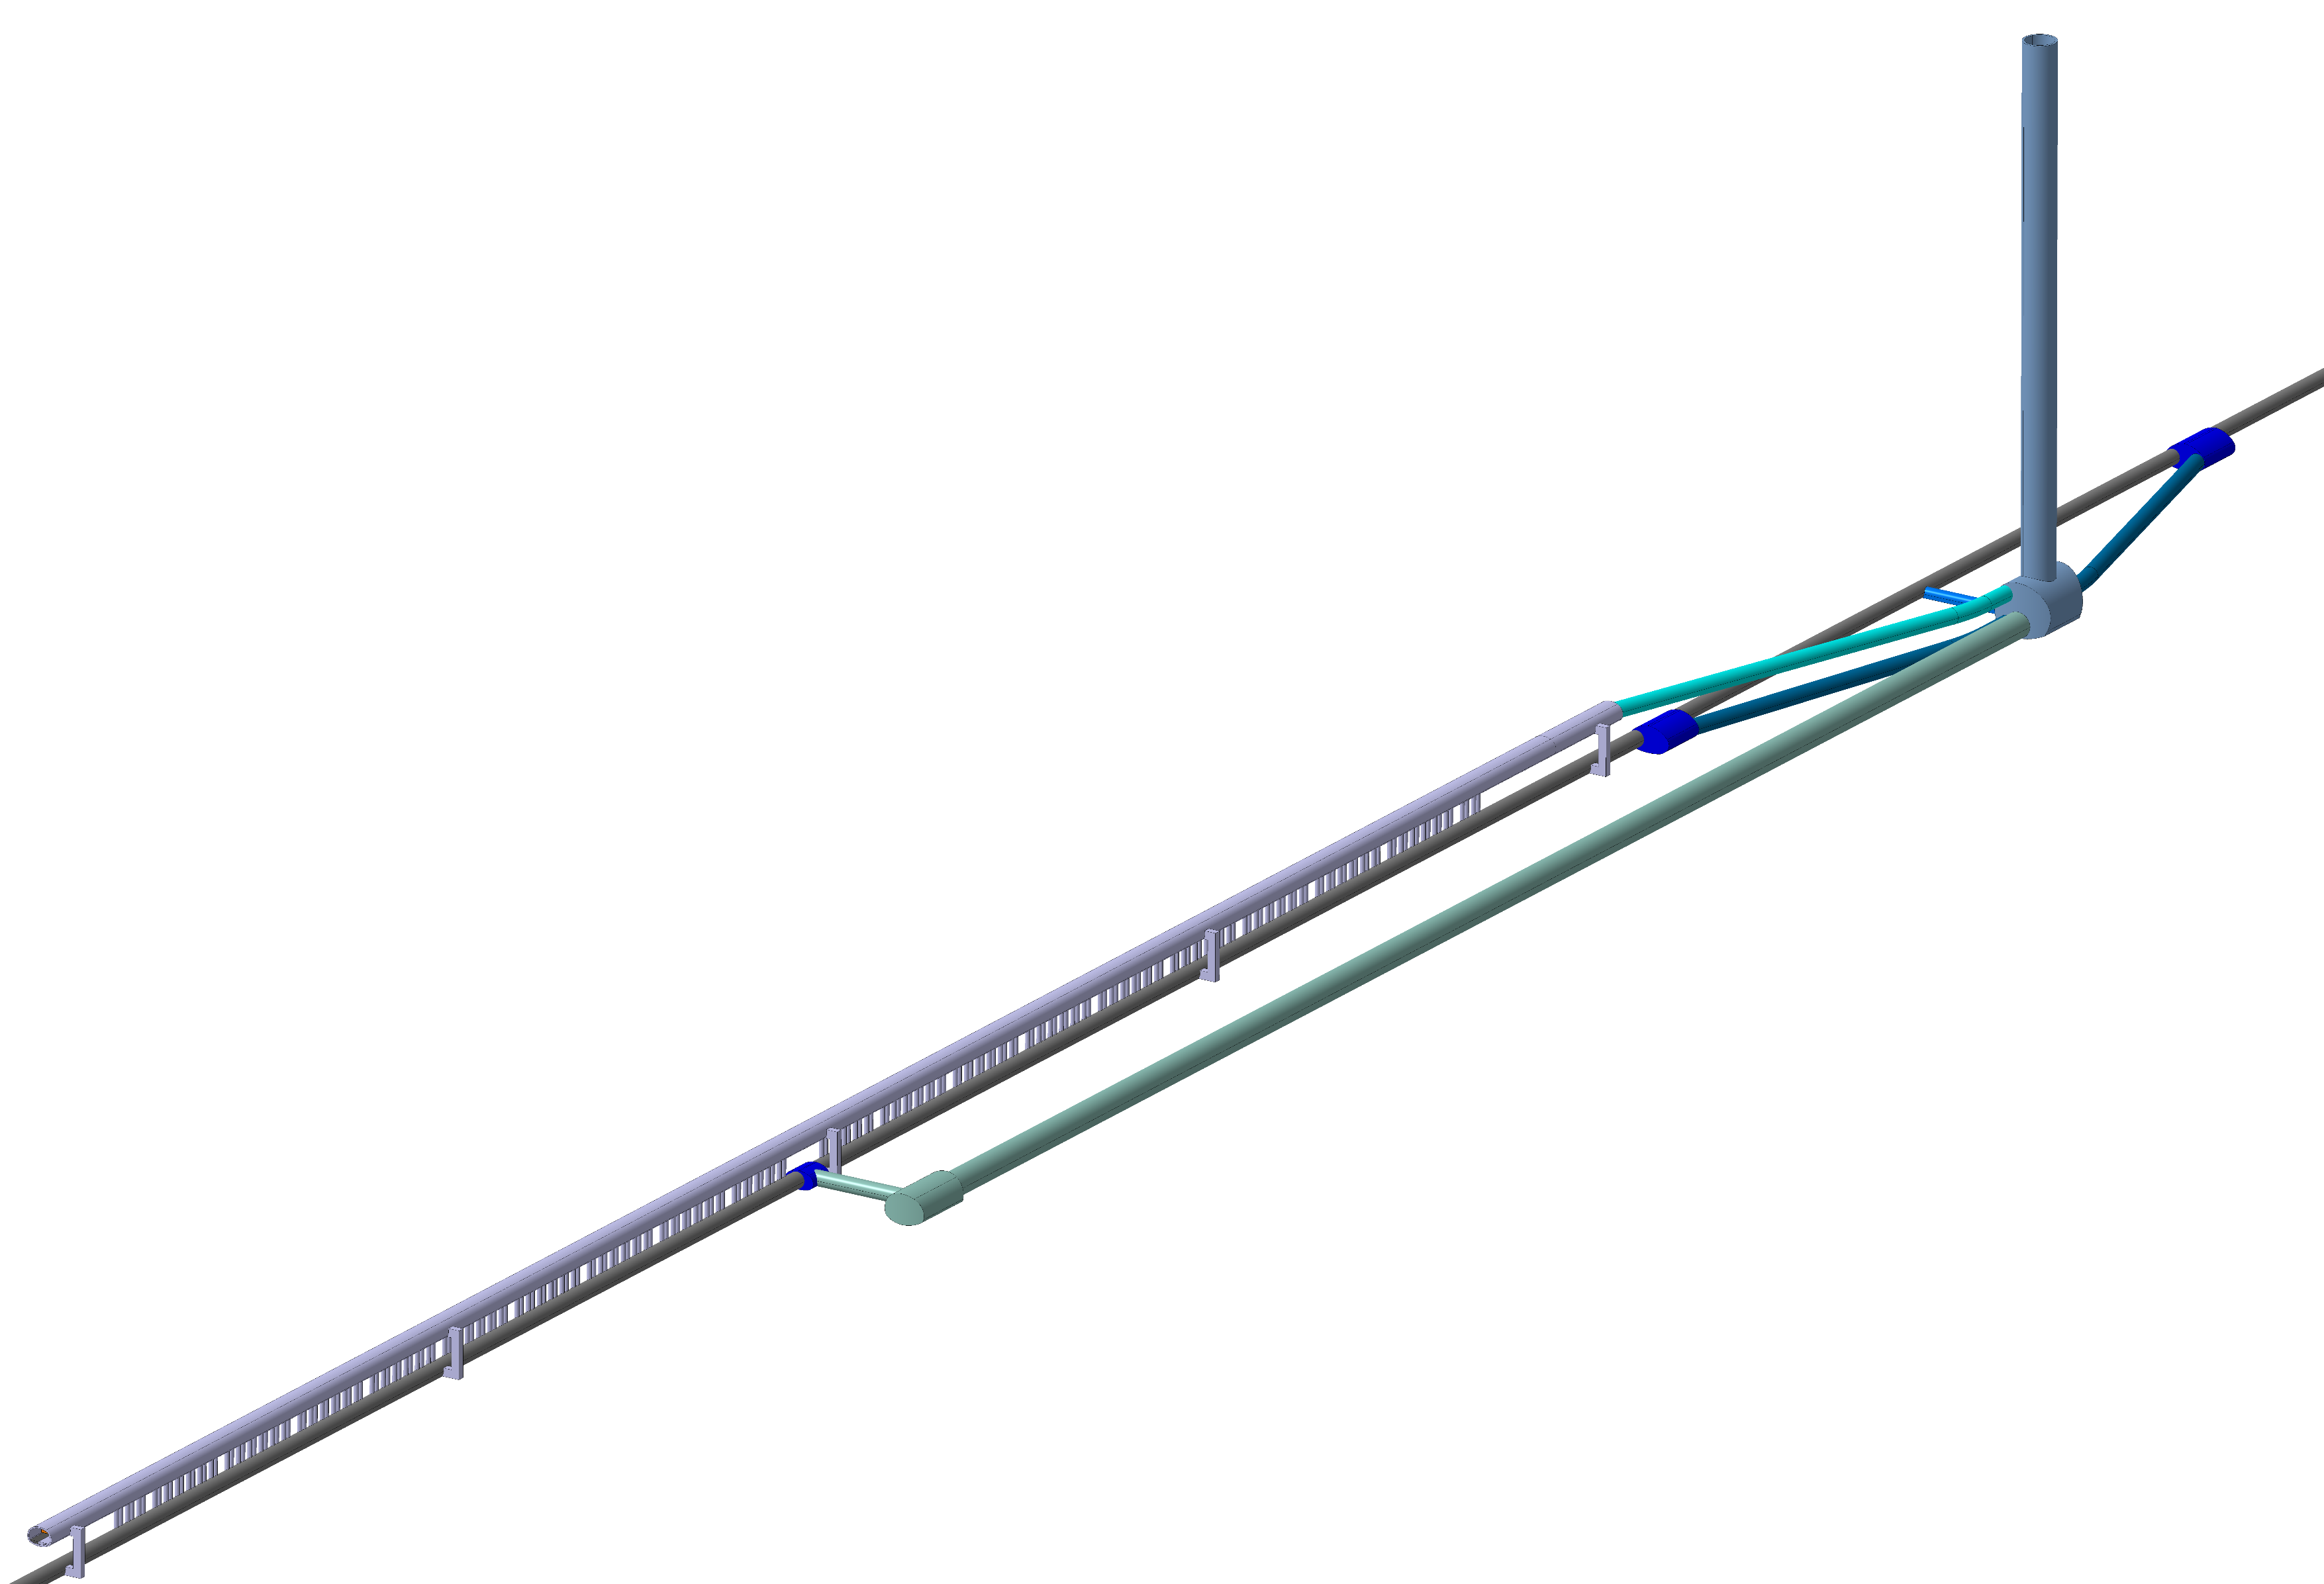
02.06.2022 / FCC Week
F. Valchkova-Georgieva / J-P. Corso
  FCC-ee Underground Structure option 1
Service Shaft
Connection Tunnel (Cavern/Klystron Gallery)
Junction Cavern
Connection Tunnel (Cavern/Klystron Gallery)
Connection Tunnel
(Cavern/Machine Tunnel)
Service Cavern
Klystron Gallery
IP
Connection Tunnel
(Service Cavern/Cryo Cavern)
5 Evacuation staircase
(each 220 m)
Cryo Cavern
Junction Cavern
Collider Center
Machine tunnel

Slide 20
02.06.2022 / FCC Week
F. Valchkova-Georgieva / J-P. Corso
  Conclusion
For Z, W, H and ttbar machine all 400MHz Cryomodules will be housed at point L .
For Z, W, H machine all 800MHz Cryomodules will be housed at point L .
For ttbar machine 800MHz Cryomodules will be divided into point L and point H.
 | Point L |  | Point H
 | 400 MHz CMs | 800 MHz CMs | 400 MHz CMs | 800 MHz CMs
Z machine | 4.5K | 2K | NO CMs | NO CMs
W machine | 4.5K | 2K
H machine | 4.5K | 2K
ttbar machine | 4.5K | 2K |  | 2K
RF machine tunnel will be 6m in diameter compared to machine tunnel in the regular arcs and other TLSS
Integration study of RF scenarios and stages, selection of cavities and location of cryomodule, RF frequency and cryogenic temperature continue.
Further work on the underground structure at point H with a view to deepening the needs in certain areas.

Slide 21
Thank you for your attention.
02.06.2022 / FCC Week
F. Valchkova-Georgieva / J-P. Corso
21

