Slide 1

Progress oF the Excavated materials management CONCEPT
FCC Week 2022 / 1st June 2022
Luisa ULRICI - CERN
Grant agreement No 951754
Grant agreement No 951754
Luisa ULRICI, CERN
WG3 – Integrate Europe
Task 3.4 - Management of excavated materials
D3.4: Preliminary excavation materials management plan (CETU)

Slide 2
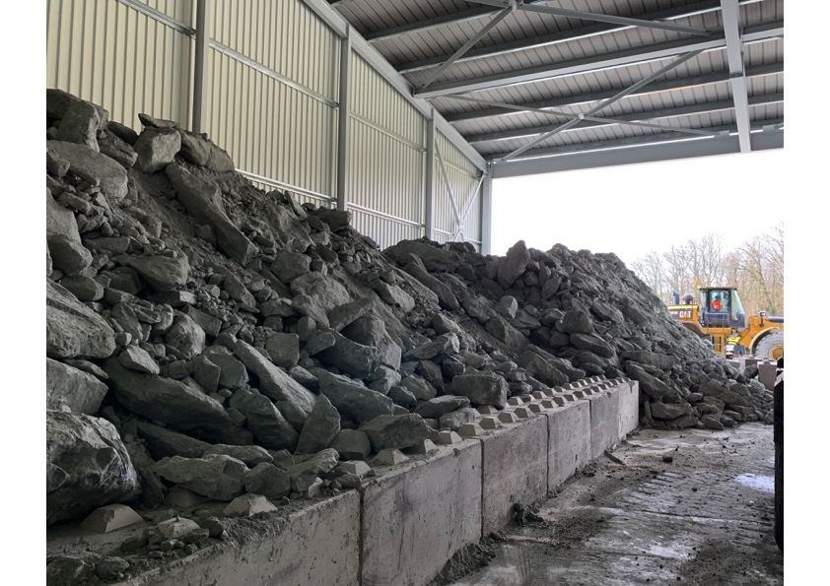
Table of contents
FCC Week 2022 / 1st June 2022
Luisa ULRICI - CERN
Description of deliverable D3.4 Preliminary excavation materials management plan
Current evaluation/studies
Progress
Schedule

Slide 3





Contributors to the deliverable D3.4:
FCC Week 2022 / 1st June 2022
Luisa ULRICI - CERN
In addition to
FR:
Centre d'études des Tunnels
CH:
Collaboration with external experts:
Regulatory framework: University of Lyon 3,
3D subsurface modelling: University of Geneva, GESDEC, University of Grenoble, University “La Sorbonne” (Paris)
Support by external consultants:
e.g. Inventory of regional opportunities: SETEC/Lerm
Geology, soil and waste department (GESDEC)
A:

Slide 4
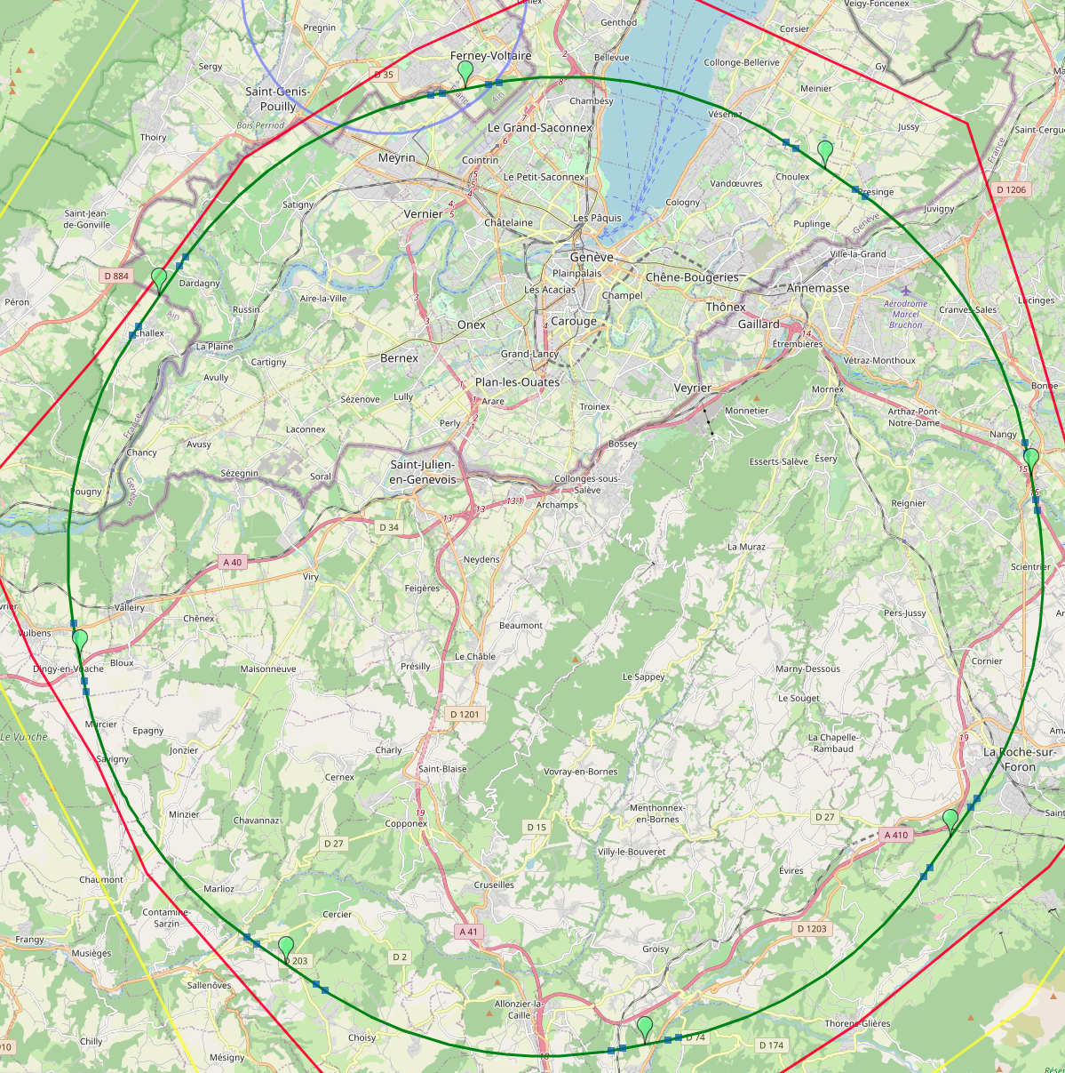
Excavation material quantities
FCC Week 2022 / 1st June 2022
Luisa ULRICI - CERN
PA
Site | Estimated spoil volume per site in m³ | Estimated spoil volume per year at each site in m³
A | 348'973 | 139'589
B | 1'580'821 | 263'470
D | 194'643 | 77'857
F | 883'513 | 147'252
G | 1'433'976 | 220'612
H | 177'229 | 88'614
J | 937'801 | 144'277
L | 1'584'755 | 264'126
LHC | 25'265 | 12'633
Total | 7'166'976
Placement for illustration only
First estimates of excavated material volumes- to be confirmed according to the final scenario and excavation method.
PB
PL
PD
PJ
PF
PH
PG
Courtesy of J. Osborne , W. Bromiley

Slide 5
Description of deliverable D3.4 Preliminary excavation materials management plan
FCC Week 2022 / 1st June 2022
Luisa ULRICI - CERN
As mentioned in the FCCIS Program …
“A technical/managerial report that summarises the approach for managing the approximately 9(*) million cubic meters of excavation materials in a resource- and cost-effective way, pointing to innovation potentials with economic benefits for companies and environmental advantages for the European society.
The plan is considered to be preliminary, since specific management processes, the economic viability and the environmental benefits of the envisaged excavation materials use cases depend strongly on the precise sub-surface investigations, the evolution of legal frameworks in the EU and Switzerland and the response of companies to market surveys, all of which are expected to evolve after this H2020 project ends.”
(*) old figure, based on the 12 sites scenario
Objectives:
→ To demonstrate the FCC feasibility from the point of view of the management of excavated materials.
→ To show that the Project Owner has taken into account all aspects (technical, regulatory, timing…).
→ To define the strategy and to specify the commitments of the Project Owner.

Slide 6
Content
FCC Week 2022 / 1st June 2022
Luisa ULRICI- CERN
Chapter 1. An exceptional project concerning the management of excavated materials
1.1. Introduction
1.2. CERN’s Future Circular Collider
1.3. Context and challenges
1.4. The project owner's priorities and commitments in terms of excavated materials management
Chapter 2. Risk management process for the MATEX
2.1. Risk process
2.2. Project phases and associated activities
2.3. Subsurface investigations
2.4. Impact of excavation methods on use
2.5. Strategy for handling and treatment of polluted materials
2.6. Quality management

Slide 7

Content
FCC Week 2022 / 1st June 2022
Luisa ULRICI - CERN
Chapter 3. Management and use of excavated materials
3.1. Regulatory requirements
3.2. Identification of possible use cases
3.3. Excavation material use case descriptions
3.4. Logistics: treatment, transport, delivery, storage and disposal
Chapter 4. Innovative roadmap and action plan
4.1. Predicted schedule and inventory of excavated materials
4.2. Evaluation of excavated materials use
4.3. Planned excavated material use
4.4. Strategy for construction contracts with regards to excavated materials
+ References and appendices

Slide 8
Progress report I
FCC Week 2022 / 1st June 2022
Luisa ULRICI- CERN
FINALISED
Geotechnical, mineralogical and chemical analysis on available samples (existing boreholes, samples). Results available on ZENODO.
A general overview of the strategy for a risk management process
List of the regional reuse/recycling/ disposal pathways:
  Preventing waste generation: preliminary estimate of construction material needs on site and analysis of possible matching with excavated materials - To be refined with final layout.
  First study related to the possible reuse (tiles, bricks, glass, ceramics etc.)
  Second study related to the landscaping/backfilling/landfilling possibilities (quarries, mines, etc.) – to be extended to Switzerland.

Slide 9
List of regional opportunities
FCC Week 2022 / 1st June 2022
Luisa ULRICI - CERN
Map of the old and recent study

Slide 10


Progress report II
FCC Week 2022 / 1st June 2022
Luisa ULRICI - CERN
CURRENTLY ONGOING
Finalisation of the regulatory framework
A general strategy for handling and treatment of polluted materials with respect to the regulatory frameworks (related limits in France and Switzerland).
Summary of management options for excavated materials generated under the FCC project: matrix matching the reuse/recycling pathways with
  the results of the characterization tests
  the regulations on the prevention and management of waste,
  the mechanical and environmental standards dedicated to the recovery of excavated spoil during construction and development,
  previous experience in the treatment of excavated spoil in order to improve its characteristics to facilitate reuse and recovery.
Collaboration with TELT-Tunnel Euralpin Lyon Turin
Logistics: Railroad Access Feasibility Analysis launched

Slide 11

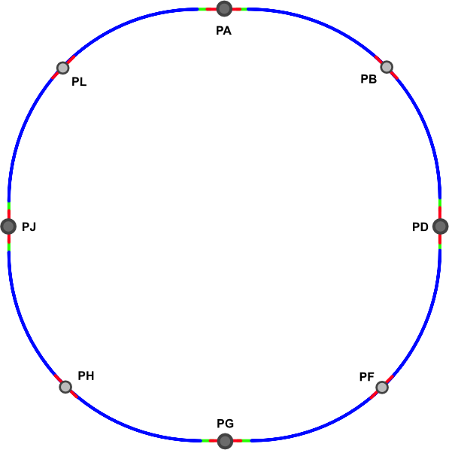
Relevant aspects for matex logistics
FCC Week 2022 / 1st June 2022
Luisa ULRICI - CERN
Link to railway national systems
Access roads
Conveyor belts
Platforms for sorting and treatment
Traceability
Courtesy of J. Gutleber

Slide 12
Progress report III
FCC Week 2022 / 1st June 2022
Luisa ULRICI - CERN
OPEN POINTS:
Subsurface investigations will provide further insights on the geological, geo-mechanical and chemical characteristics of the excavated materials allowing to minimize the project risks.
Confirmation on excavation methods per site will allow to refine current estimates on:
  Excavated material reusability
  Presence of pollutants
  Logistics (surface for temporary storage, conveyor belts, traceability)
Confirmation on engineering solutions for surface buildings and boundary conditions to refine evaluation of possible local reuse of excavated materials
Innovative reuse pathways for molasse (“Mining the future®”)

Slide 13
“Mining the future®”
FCC Week 2022 / 1st June 2022
Luisa ULRICI- CERN
Publication of the competition Mining the future® on 1st May 2021
First phase ended in October 2021: 12 proposals, 4 selected by international jury (9 members)
Proposed applications focus on different phases of the excavated material treatment and reuse.
Type of participants: Key players in excavation projects as well as new startup and research institutes
Second phase: 4 selected are progressing with the feasibility study to bring the proposal to at least TRL4 . Submission by end of June 2022.
Final result by Autumn 2022.
1
2
2
5
5

Slide 14
Schedule
FCC Week 2022 / 1st June 2022
Luisa ULRICI- CERN
FCC week
3D subsurface modelling
FCCIS D3.4 deliverable
Competition «Mining the future»
High risk subsurface investigations
2020
2021 Q1
2021 Q2
2022 Q2
2024 Q1
2024 Q2
Legend:
2022 Q1
2023 Q1
2023 Q2
2028
Documentary effort
Initial material characterisation
Countinous update
Preparatory
phase
Ongoing Activity
Excavation reuse cases (including agricultural study)
Countinous update
Activity
To be started
Risk management
Regulatory framework
Logistics
Input on strategy for construction contracts
First draft for MATEX management plan
Update of the document, verification and approval

Slide 15
Conclusion
FCC Week 2022 / 1st June 2022
Luisa ULRICI - CERN
First draft of the management plan will be available by beginning of 2023, excluding:
cost estimate
circular economy evaluation
Continuous update will be performed as far as information on layout and technical solutions will become available.
CONTRIBUTE TO FCC FEASIBILITY STUDY:
Cost evaluation
Input to the excavation contracting strategy with respect to excavation material

Slide 16
Thank you for your attention.
This project has received funding from the European Union's Horizon 2020 research and innovation programme under the European Union's Horizon 2020 research and innovation programme under grant agreement No 951754.
FCC Week 2022 / 1st June 2022
Luisa ULRICI - CERN
Grant agreement No 951754
16

