Slide 1
Baseline and Options for FCCee SRF Cavities
Franck Peauger
on behalf of the FCC RF team
FCC Week 2022
31-05-22

Slide 2
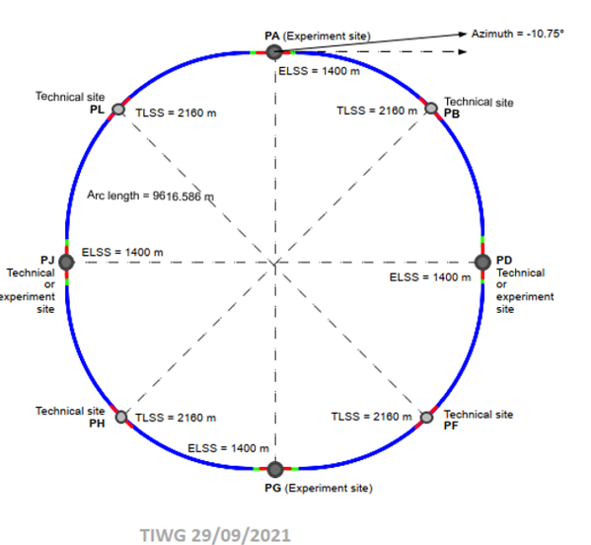
RF system for FCCee
  91 km
  Designed to provide 100 MW of RF power in CW
  to compensate losses by synchrotron radiation
 | Energy (GeV) | Current (mA) | RF voltage (GV)
Z | 45.6 | 1280 | 0.120
W | 80 | 135 | 1
H | 120 | 26.7 | 2.08
ttb | 182.5 | 5 | 11.67
  4 interaction points
  RF systems located in PL for Z, W, H and PH for ttb

Slide 3
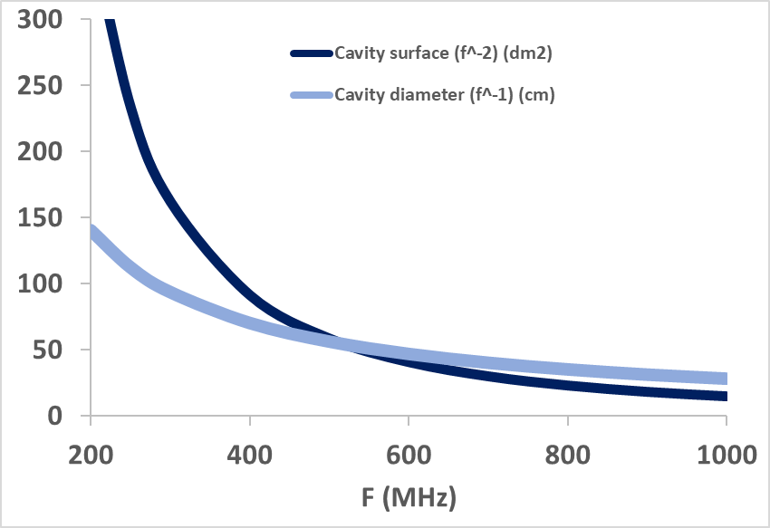
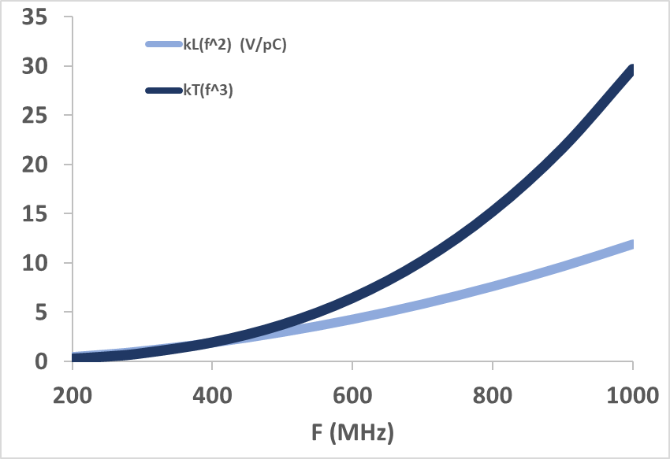
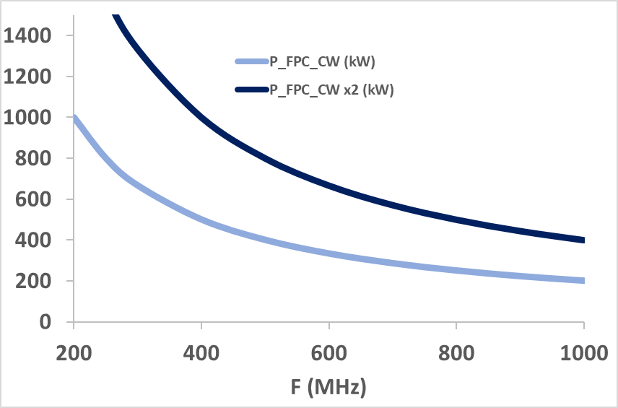
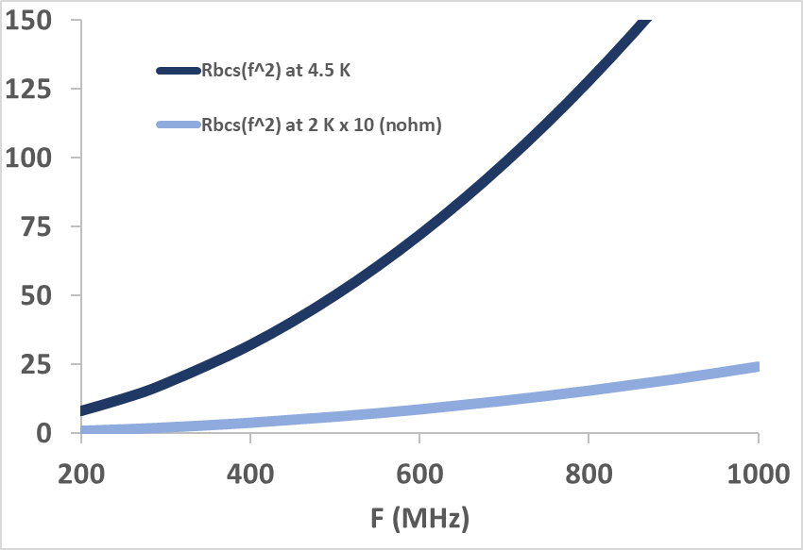
RF Frequency choice – scaling laws (for single cell elliptical cavity)
  Beam induced voltage (Loss factor)
  Cavity size
  a.u.
  LHC
  FCCee Z, W, H
  FCChh
  Transverse α F³
  Surface [dm²] α F²
  High current machines
  Diameter [cm] α F
  FCC ttb – 2nd harm
  Longitudinal α F²
  SWELL
  [kW]
  [nΩ]
  SC surface resistance (BCS)
  α F⁻²
  Power of RF coupler
  α F⁻¹
  SUPER KEKB
  EIC
  CEPC
  …
  From E. Montesinos
  4.5 K
?
  R&D needed
  2 K (x10)
  Present performances

Slide 4
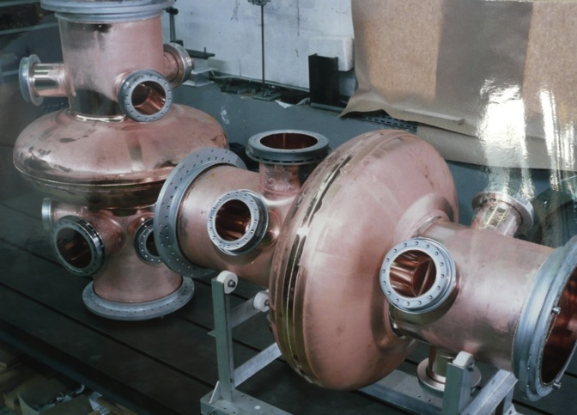
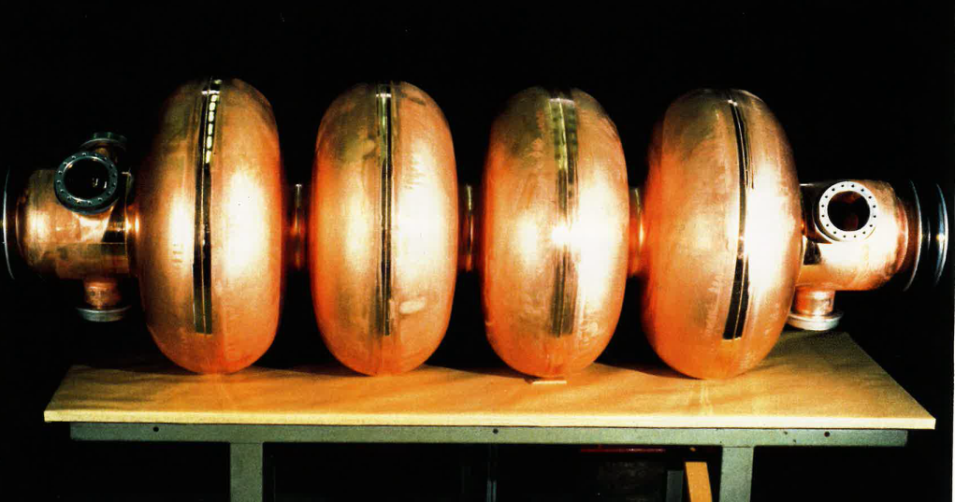
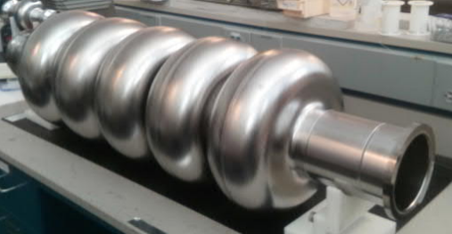
3 different types of SRF cavities for the FCC-ee RF baseline
New
LHC
LEP
JLAB
ttb
Z
W, H
400 MHz 1-cell cavities
Nb/Cu
800 MHz 5-cell cavities
Bulk Nb
400 MHz 2-cell cavities
Nb/Cu
2-cell is better for W working point
(reduced RF power per cav., improved HOM damping)

Slide 5
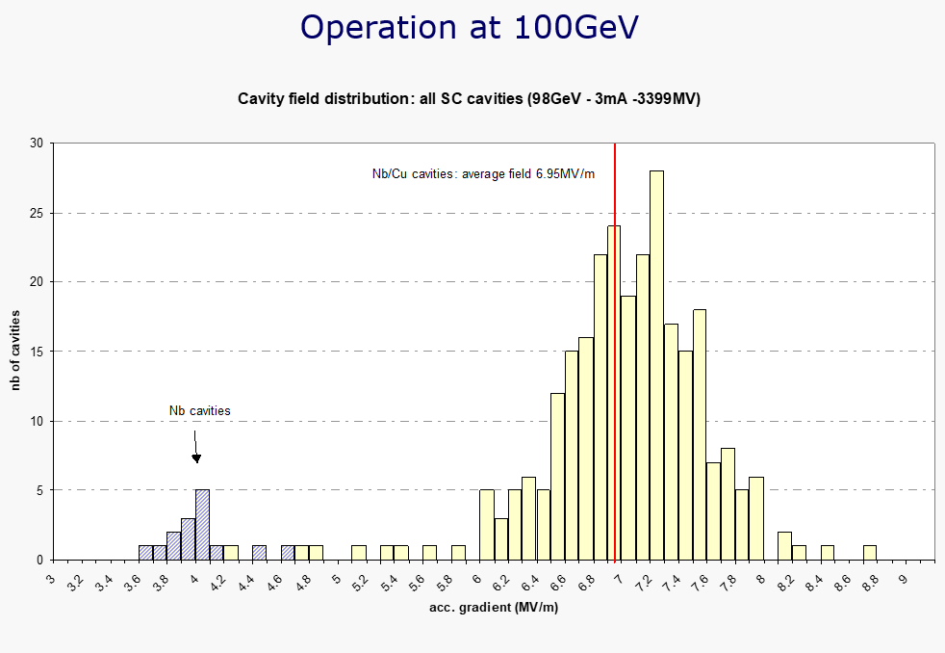
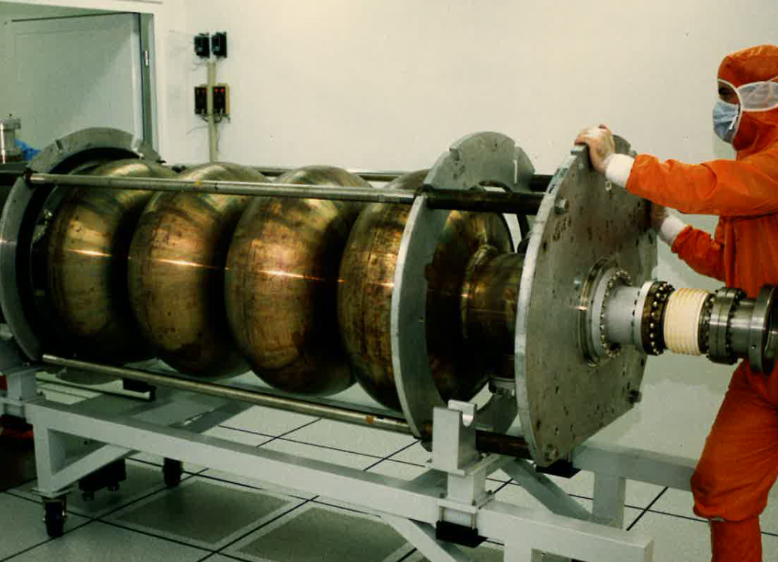
Why 4 → 2-cells ?
  Eacc limited to ~ 7 MV/m in LEP
  Very large superconducting surface ( ~5 m²) → more “chance” to have defects
  Such large cavities require significant SRF infrastructures upgrades at CERN
  Surface treatments recipes for high accelerating gradient will be very painful to adapt
LEP
O. Brunner

Slide 6
RF parameters
- with new beam parameters -
24th May 2022 | Z |  | W |  | H |  | ttb2
 | per beam | booster | per beam | booster | 2 beams | booster | 2 beams | 2 beams | booster
Frequency [MHz] | 400 | 800 | 400 | 800 | 400 | 800 | 400 | 800 | 800
RF voltage [MV] | 120 | 140 | 1000 | 1000 | 2480 | 2480 | 2480 | 9190 | 11670
Eacc [MV/m] | 5.72 | 6.23 | 11.91 | 24.26 | 11.82 | 25.45 | 11.82 | 24.52 | 25.11
# cell / cav | 1 | 5 | 2 | 5 | 2 | 5 | 2 | 5 | 5
Vcavity [MV] | 2.14 | 5.83 | 8.93 | 22.73 | 8.86 | 23.85 | 8.86 | 22.98 | 23.53
#cells | 56 | 120 | 224 | 220 | 560 | 520 | 560 | 2000 | 2480
# cavities | 56 | 24 | 112 | 44 | 280 | 104 | 280 | 400 | 496
# CM | 14 | 6 | 28 | 11 | 70 | 26 | 70 | 100 | 124
T operation [K] | 4.5 | 2 | 4.5 | 2 | 4.5 | 2 | 4.5 | 2 | 2
dyn losses/cav [W] | 19 | 0.5 | 174 | 7 | 171 | 8 | 171 | 51 | 8
stat losses/cav [W] | 8 | 8 | 8 | 8 | 8 | 8 | 8 | 8 | 8
Qext | 6.6E+04 | 3.2E+05 | 1.2E+06 | 8.9E+06 | 1.5E+06 | 1.2E+07 | 8.3E+06 | 4.9E+06 | 5.3E+07
Detuning [kHz] | 8.939 | 4.393 | 0.430 | 0.115 | 0.123 | 0.031 | 0.025 | 0.040 | 0.005
Pcav [kW] | 880 | 205 | 440 | 112 | 352 | 95 | 62 | 207 | 20
rhob [m] | 9937 | 9937 | 9937 | 9937 | 9937 | 9937 | 9937 | 9937 | 9937
Energy [GeV] | 45.6 | 45.6 | 80.0 | 80.0 | 120.0 | 120.0 | 182.5 |  | 182.5
energy loss [MV] | 38.49 | 38.49 | 364.63 | 364.63 | 1845.94 | 1845.94 | 9875.14 |  | 9875.14
cos phi | 0.32 | 0.27 | 0.36 | 0.36 | 0.74 | 0.74 | 0.70 | 0.90 | 0.85
Beam current [A] | 1.280 | 0.128 | 0.135 | 0.0135 | 0.0534 | 0.005 | 0.010 | 0.010 | 0.001
  one RF system per beam
  common RF system for both beams
  Booster (10% beam current and 15% duty cycle) at 800 MHz for W, H, ttb – to be confirmed for Z by Ivan
  RF voltage at 400 MHz for H and ttb to be updated (2.08 GV instead of 2.48 GV)
  quasi on-crest acceleration (cos phi = 0.9) at ttbar energy with 800 MHz cavities (RF power limited to ~ 200 kW max)

Slide 7
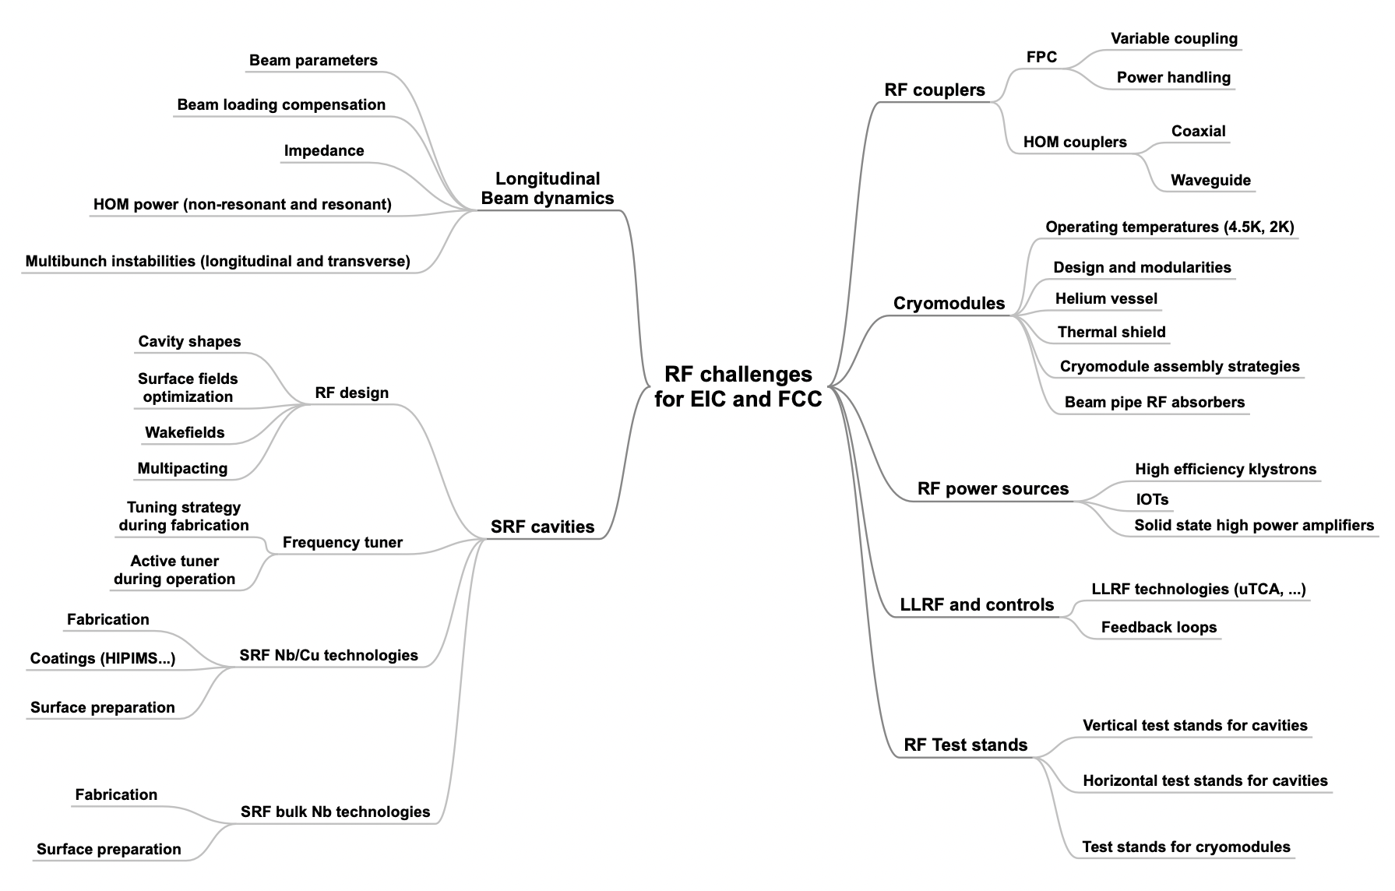
R&D Challenges for FCC RF system
See Ivan’s talk
Topics addressed in priority

Slide 8
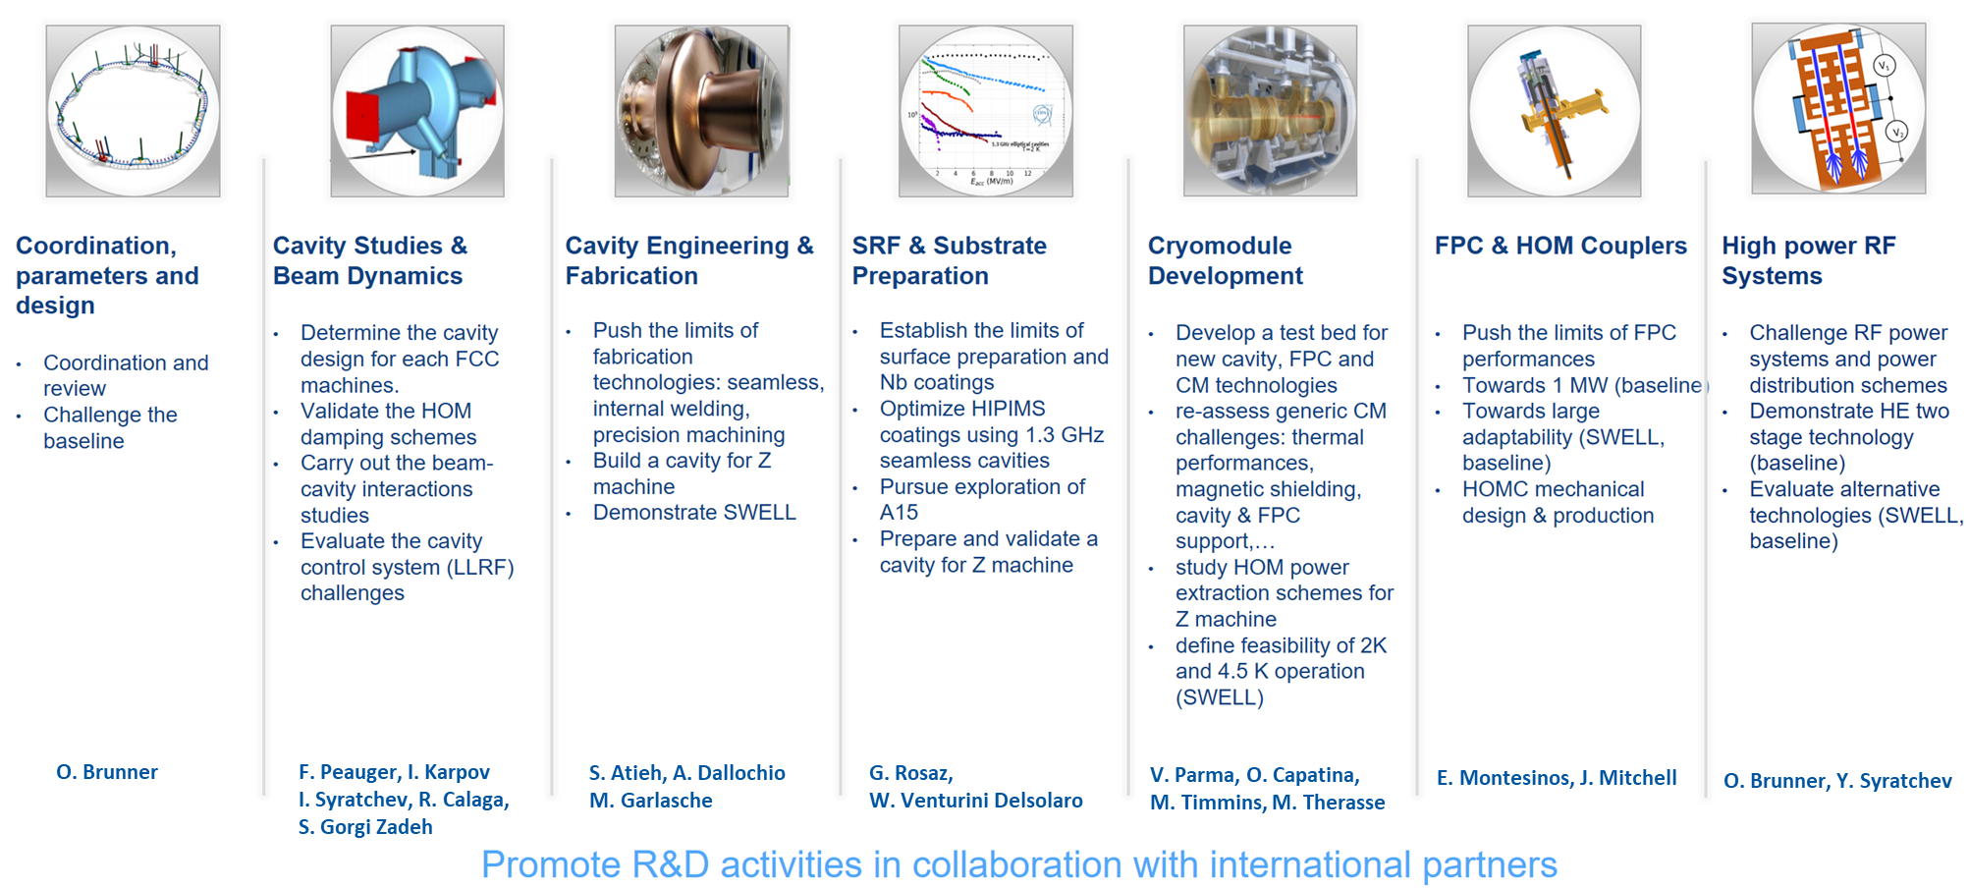
O. Brunner
F. Gerigk
The FCC SRF programme at CERN (2020 – 2025)
WP0
WP1
WP2
WP3
WP4
WP5
WP6

Slide 9
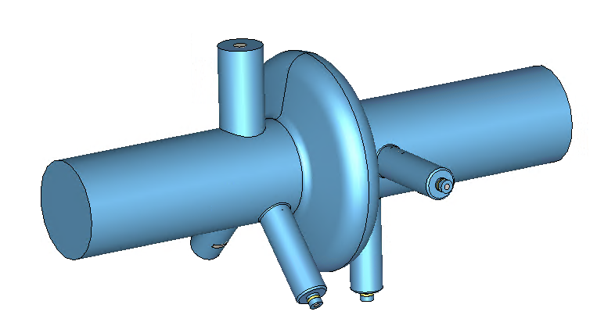
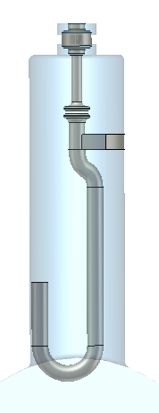
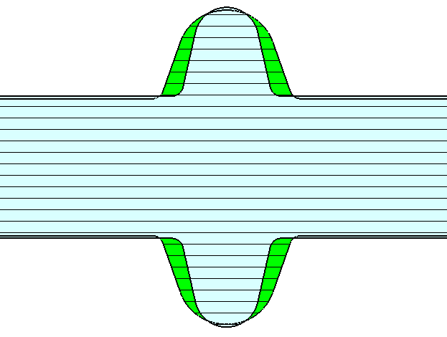
1-cell 400 MHz cavity for Z
S. Gorgi Zadeh
«LHC type», Nb/Cu technology, 4.5 K
E_{acc} = 5.7 MV/m, Q₀ = 3e9, P_{RF} = 900 kW
Elliptical shape optimized to eliminate all longitudinal HOMs
Strong transverse HOMs damping with 4 hooks type couplers
Z_{transv. max} ~ 10 kΩ/m
Hook type HOM coupler (x4)
FCC cavity
LHC cavity

Slide 10
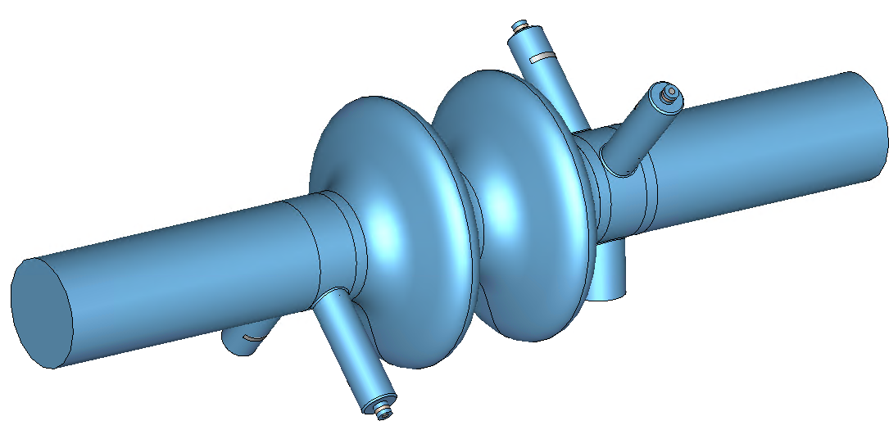
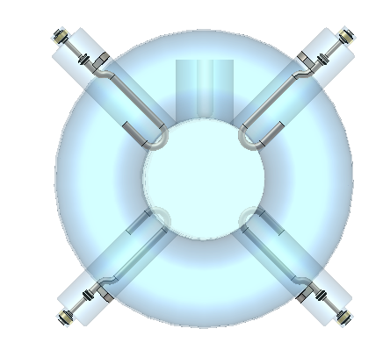
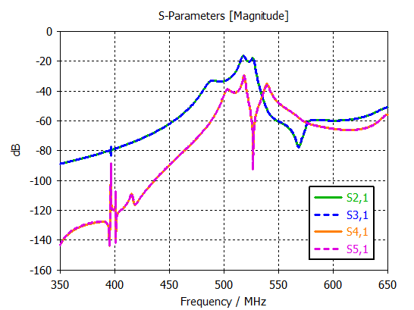
2-cell 400 MHz for W, H
S. Udongwo (Rostock Univ.)
Supervised by R. Calaga
2
1
3
Nb/Cu technology, 4.5 K
E_{acc} = 12 MV/m, Q₀ = 3e9, P_{RF} = 450 kW
Same damping strategy as for Z (no longitudinal HOM, 4 hook-type couplers)
Z_{transv. max} ~ 60 kΩ/m
4
5
  RF transmission FPC → HOM couplers

Slide 11
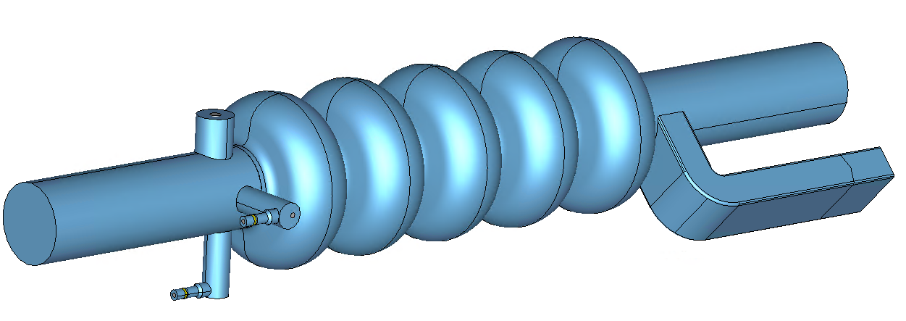
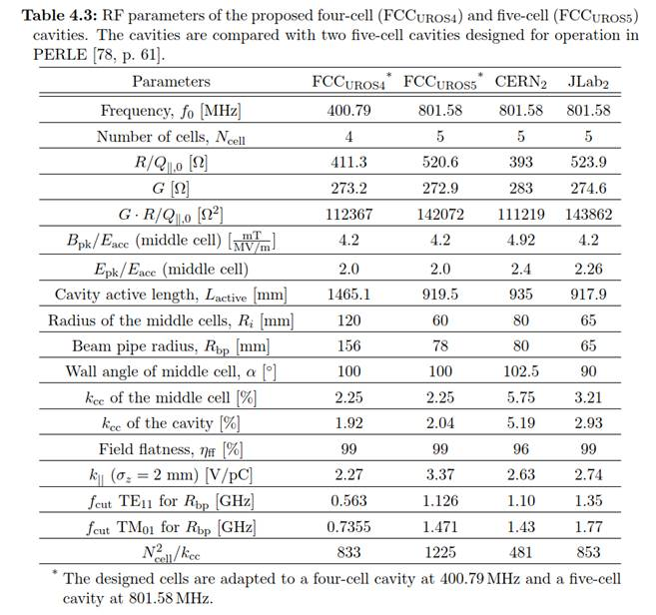
5-cell 800 MHz for ttb and booster
Bulk Nb, 2 K
Similar to SNS, SPL, ESS high beta cavities
High accelerating gradient and high Q0 are required
    E_{acc} = 25 MV/m, Q₀ = 2e10, P_{RF} = 200 kW
HOMs damping with HOM couplers and rect. WG (TBC)
Bare simplified cavity (without ports) successfully built and tested at JLAB in 2018
  ?
Table from S. Gorgi Zadeh’s thesis

Slide 12
RF parameters with cavity design choices
24th May 2022 | Z |  | W |  | H |  | ttbar2
 | per beam | booster | per beam | booster | 2 beams | booster | 2 beams | 2 beams | booster
Frequency [MHz] | 400 | 800 | 400 | 800 | 400 | 800 | 400 | 800 | 800
RF voltage [MV] | 120 | 140 | 1000 | 1000 | 2480 | 2480 | 2480 | 9190 | 11670
Eacc [MV/m] | 5.72 | 6.23 | 11.91 | 24.26 | 11.82 | 25.45 | 11.82 | 24.52 | 25.11
# cell / cav | 1 | 5 | 2 | 5 | 2 | 5 | 2 | 5 | 5
Vcavity [MV] | 2.14 | 5.83 | 8.93 | 22.73 | 8.86 | 23.85 | 8.86 | 22.98 | 23.53
#cells | 56 | 120 | 224 | 220 | 560 | 520 | 560 | 2000 | 2480
# cavities | 56 | 24 | 112 | 44 | 280 | 104 | 280 | 400 | 496
# CM | 14 | 6 | 28 | 11 | 70 | 26 | 70 | 100 | 124
T operation [K] | 4.5 | 2 | 4.5 | 2 | 4.5 | 2 | 4.5 | 2 | 2
dyn losses/cav [W] | 19 | 0.5 | 174 | 7 | 171 | 8 | 171 | 51 | 8
stat losses/cav [W] | 8 | 8 | 8 | 8 | 8 | 8 | 8 | 8 | 8
Qext | 6.6E+04 | 3.2E+05 | 1.2E+06 | 8.9E+06 | 1.5E+06 | 1.2E+07 | 8.3E+06 | 4.9E+06 | 5.3E+07
Detuning [kHz] | 8.939 | 4.393 | 0.430 | 0.115 | 0.123 | 0.031 | 0.025 | 0.040 | 0.005
Pcav [kW] | 880 | 205 | 440 | 112 | 352 | 95 | 62 | 207 | 20
rhob [m] | 9937 | 9937 | 9937 | 9937 | 9937 | 9937 | 9937 | 9937 | 9937
Energy [GeV] | 45.6 | 45.6 | 80.0 | 80.0 | 120.0 | 120.0 | 182.5 |  | 182.5
energy loss [MV] | 38.49 | 38.49 | 364.63 | 364.63 | 1845.94 | 1845.94 | 9875.14 |  | 9875.14
cos phi | 0.32 | 0.27 | 0.36 | 0.36 | 0.74 | 0.74 | 0.70 | 0.90 | 0.85
Beam current [A] | 1.280 | 0.128 | 0.135 | 0.0135 | 0.0534 | 0.005 | 0.010 | 0.010 | 0.001
Lacc [m] | 0.375 | 0.937 | 0.749 | 0.937 | 0.749 | 0.937 | 0.749 | 0.937 | 0.937
#cav/CM | 4 | 4 | 4 | 4 | 4 | 4 | 4 | 4 | 4
R/Q [ohm] | 79 | 521 | 152.8 | 521 | 153 | 521 | 153 | 521 | 521
G [ohm] | 196.20 | 273.20 | 196.34 | 273.20 | 196.34 | 273.20 | 196.34 | 273.20 | 273.20
Q0 | 3.0E+09 | 2.0E+10 | 3.0E+09 | 2.0E+10 | 3.0E+09 | 2.0E+10 | 3.0E+09 | 2.0E+10 | 2.0E+10
Ep/Eacc | 1.90 | 2.00 | 2.05 | 2.00 | 2.05 | 2.00 | 2.05 | 2.00 | 2.00
Bp/Eacc | 4.10 | 4.20 | 6.39 | 4.20 | 6.39 | 4.20 | 6.39 | 4.20 | 4.20
Ep [MV/m] | 10.86 | 12.45 | 24.42 | 48.52 | 24.23 | 50.91 | 24.23 | 49.05 | 50.23
Bp [mT] | 23.44 | 26.15 | 76.12 | 101.89 | 75.52 | 106.90 | 75.52 | 103.00 | 105.48
Cavity design | UROS1 | UROS5 | C3794 | UROS5 | C3794 | UROS5 | C3794 | UROS5 | UROS5

Slide 13
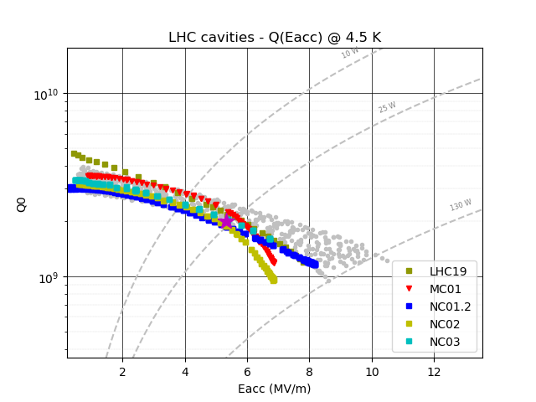
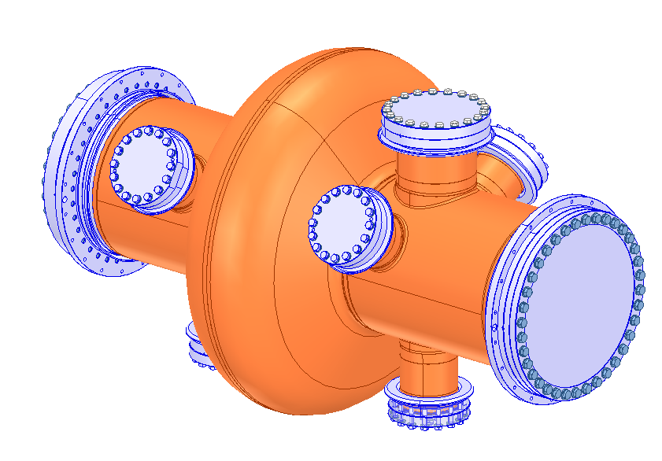
Nb/Cu technology: high gradient / high Q0 challenges
  New LHC spare cavities performances
Significant improvement of Eacc and reduction Q0 slope shall be achieved for FCCee cavities
→ Internal welding of copper hall cells or seamless cavity
→ Electropolishing of the copper cavity
→ Highly performant niobium coating (HIPIMS)
→ Application of modern surface preparation and clean room procedures to reach high gradients
Z (1-cell)
W,H (2-cell)

Slide 14
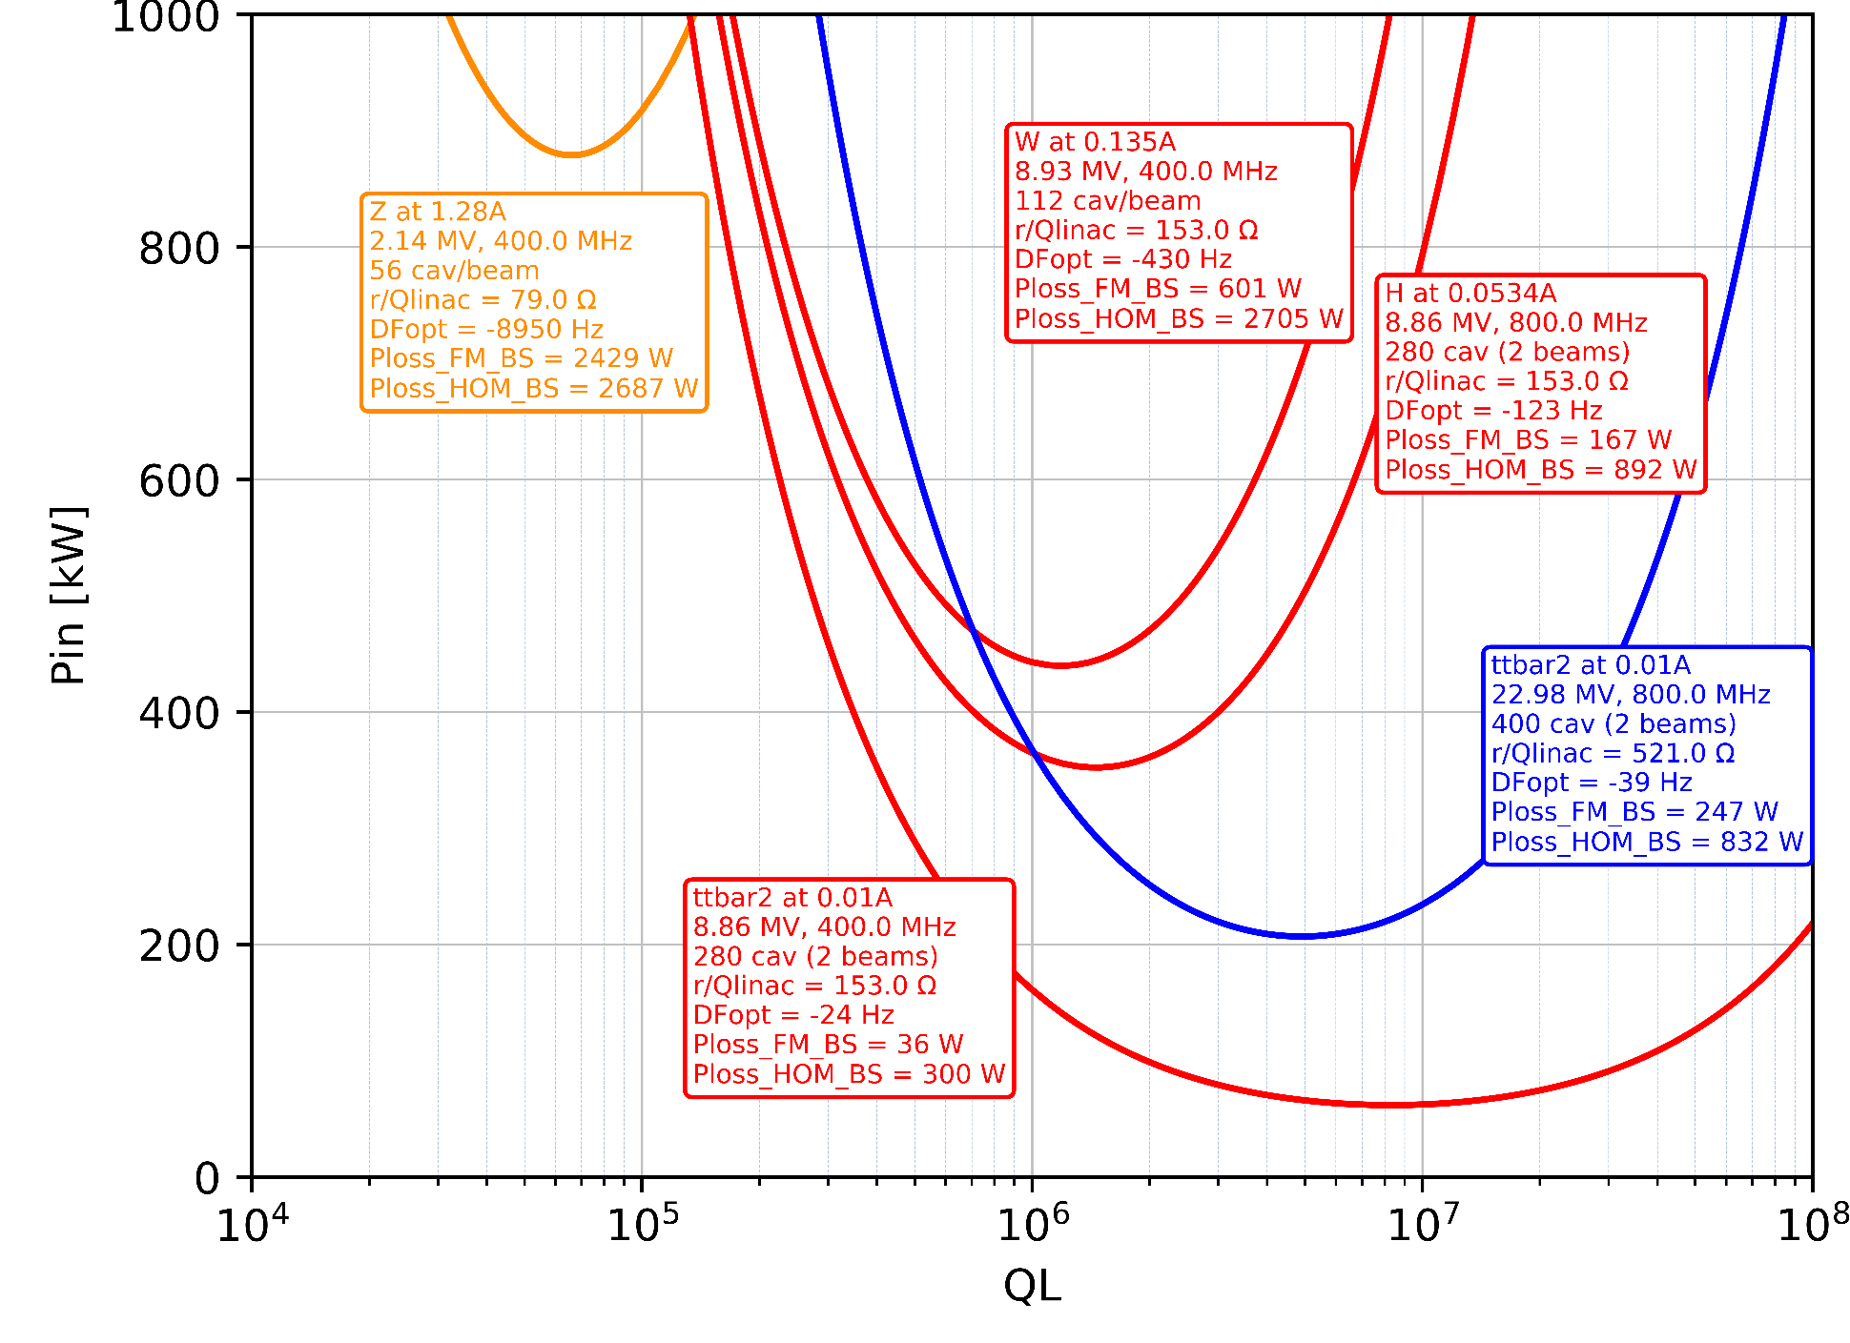
Power requirements for RF Couplers
CW operation
Fundamental Power Couplers:
900 kW - 400 MHz fixed couplers for single cell cavities
450 kW - 400 MHz variable couplers for 2-cell cavities
200 kW - 800 MHz fixed couplers for 5-cell cavities
HOM couplers: ~ 1 kW per coupler at 400 MHz

Slide 15

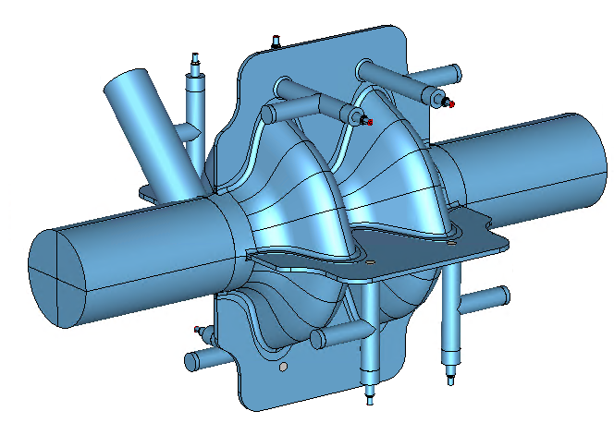
SWELL 2-cell 600 MHz cavity for Z, W, H
Very interesting alternative cavity option which would cover three machines (no need to remove cryomodules after operation at Z)
Highly damped RF cavity for transverse HOMs thanks 4 waveguide slots and coaxial RF lines
E_{acc} = 12.5 MV/m, P_{RF} = 600 kW per FPC
Robust against microphonics and Lorentz forces
Innovative concept compatible with Nb/Cu technology
Feasibility demonstration at 1.3 GHz planned in 2022
I. Syratchev
F. Peauger
O. Brunner
S. Gorgi Zadeh

Slide 16
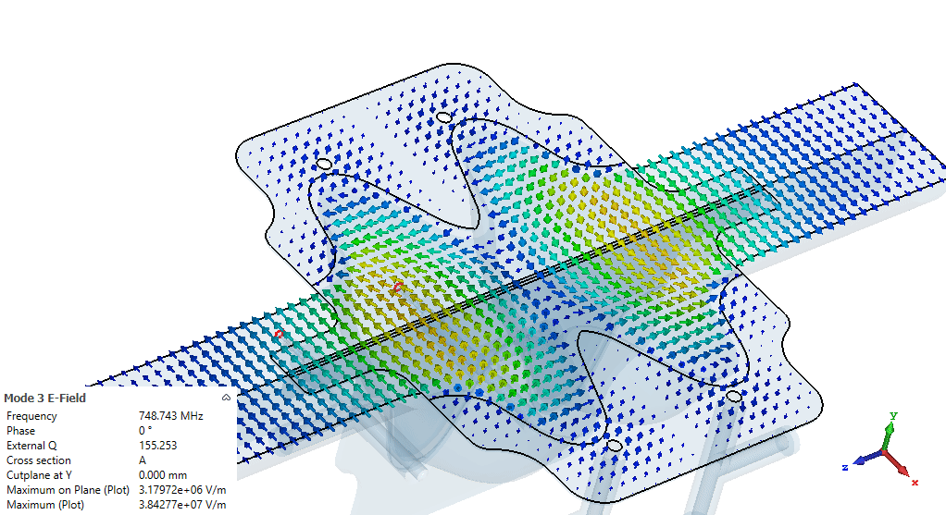
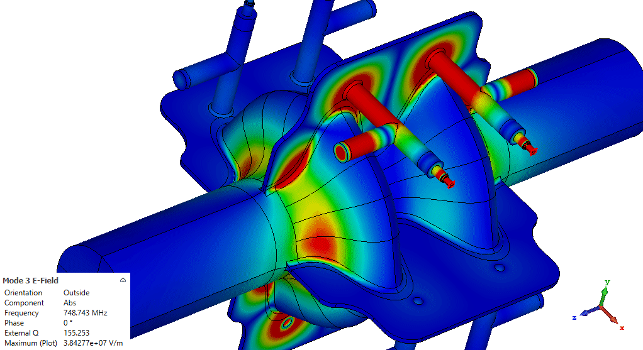
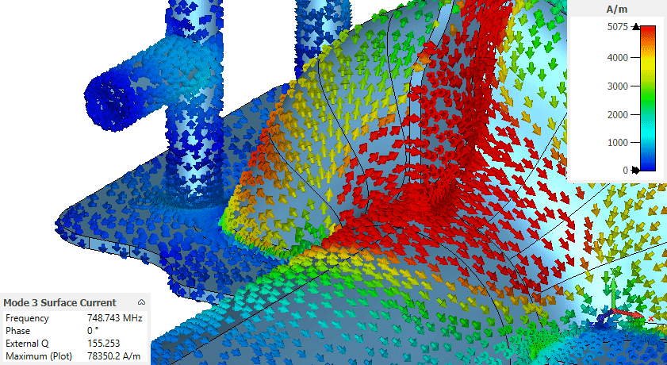
HOM damping mechanism of SWELL
TE mode - F = 748.74 MHz, potentially dangerous for the beam
RF surface currents of the mode are crossed by the waveguide slots
The mode propagates inside the slot and the coaxial lines → Qext factor is reduced to 155
                → risk of instabilities is mitigated
  E-field
  Surface current

Slide 17
FCCee with SWELL cavities up to the Higgs energy
 | Z |  | W | H
ρ_{b} [m] | 9935
Beam energy [GeV] | 45.6 |  | 80 | 120
Energy loss/turn [MV] | 38.5 |  | 364.6 | 1845.9
RF Voltage [MeV] | 120 |  | 1000 | 2480
Cos Φ | 0.32 |  | 0.36 | 0.74
Beam current [mA] | 1280 |  | 135 | 2x26.7 =53.4
RF power per FPC [kW] | 600 |  | 250 | 250
Cavity type | 600 MHz – 2 cells
Number of FPC per cavity | 1 | 2 * | 1 | 1
Number of cavities | 90 per beam | 46 per beam | 200 per beam | 400 2 beams
Total number of cryomodules (2 cav/CM) | 90 | 46 | 200 | 200
Accelerating gradient [MV/m] | 2.67 | 5.22 | 10 | 12.5
Accelerating voltage [MV] (Lacc=0.5m) | 1.33 | 2.61 | 5 | 6.25
Max. surface electric field Epk [MV/m] | 5.95 | 11.64 | 22.3 | 26.67
Max. surface magnetic field Bpk [mT] | 17.4 | 34.04 | 65.25 | 80.9
400 cavities in total for the Z, W and H operating points
2 beams for the H machine (re-alignement of the cryomodules)
RF power per cavity: 600 kW for Z, and 250 kW for W and H
Maximum surface fields: 27 MV/m and 81 mT
RF with SWELL
Beam 1
45/23 CM
45/23 CM
Z
Beam 2
Booster
Beam 1
100 CM
100 CM
W
Beam 2
Booster
Beam 1&2
H
RF
Booster
100 CM
100 CM
* EIC /ESR like

Slide 18
Summary
Successful re-baselining exercise of the RF parameters and cavity types
~1300 cavities in total for FCCee,
  30 % in Nb/Cu → R&D is needed to increase Eacc and cure Q0 slope
  70 % in bulk niobium with well-known manufacturing technics
New SWELL cavity: a very attractive development bringing unique innovations in the RF design and SRF cavity fabrication domains
 | Z |  | W |  | H |  | ttbar
 | coll | boost | coll | boost | coll | boost | coll | coll | boost
CDR | 26 | 3 | 26 | 13 | 68 | 34 | 68 | 93 | 34 +120
NEW | 28 | 6 | 56 | 11 | 70 | 26 | 70 | 100 | 124
-> 341 Cromodules
-> 322 Cryomodules

Slide 19
Thank you for your attention
Questions ?
Acknowledgements
Olivier Brunner, Frank Gerigk, Ivan Karpov, Igor Syratchev, Rama Calaga, Heiko Damerau, Shahnam Gorgi Zadeh,
Eric Montesinos, James Mitchell, Said Atieh, Allessandro Dallochio, Marco Garlasche, Ofelia Capatina, Marc Timmins, Vittorio Parma, Mathieu Therasse, Guillaume Rosaz, Walter Venturini Delsolaro, Sosoho-Abasi Udongwo, Ursula Van Rienen

Slide 20
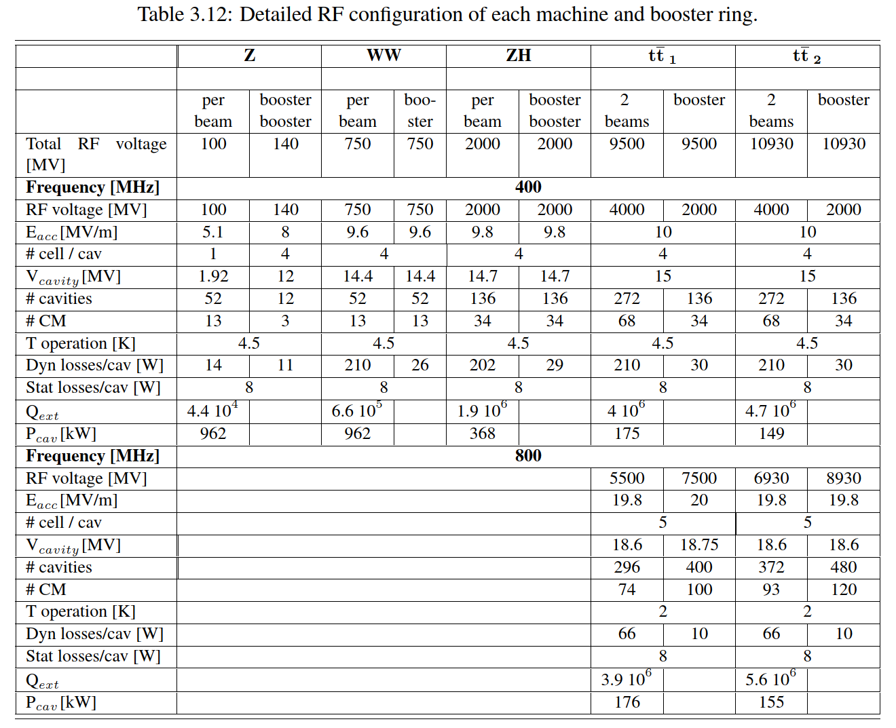
CDR FCC-ee: The Lepton Collider, 2019

