Slide 1
SRF Baseline Cavity Designs for the Z and W
Working Point of the FCC-ee
by Sosoho-Abasi Udongwo
Supervisors: Dr. Shahnam Gorgi Zadeh, Dr. Rama Calaga, Prof. Dr. Ursula van Rienen

Slide 2
Content
SRF Overview
W working point
  Previous Design and Design Update
Z working point
  Previous Design and Design Update HOM Coupler (W Working Point)
Summary

Slide 3
SRF Overview
The previous RF baseline presented in the CDR [1] considers:
  1-cell 400 MHz cavities– Z working point,
  4-cell 400 MHz cavities - W and H working points and
  Hybrid system 4-cell 400 MHz and 5-cell 800 MHz cavities - ttbar working point [2]
A detailed study [1] of the W working point showed strong higher-order mode (HOM) effects in the 4-cell cavities which can limit the operation of the cavities in terms of HOM power and beam stability requirements
A 2-Cell accelerating cavity and HOM coupler have been designed for the W RF working point of the FCC-ee with special attention to the HOM performance of the cavity
The present update to the RF layout considers:
  2-cell 400 MHz cavities - W working point
  1-cell cavities 400 MHz – Z working point (Updated Design)
[1] M. Boscolo et al., “FCC-ee machine design overview”, in FCC week, Amsterdam, 2018.
[2] S. Gorgi Zadeh, “Accelerating cavity and higher-order mode coupler design for the Future Circular Collider”, Ph.D. thesis, Theoretische Elektrotechnik, Universität Rostock, 2020;http://purl.uni-rostock.de/rosdok/id00003023

Slide 4
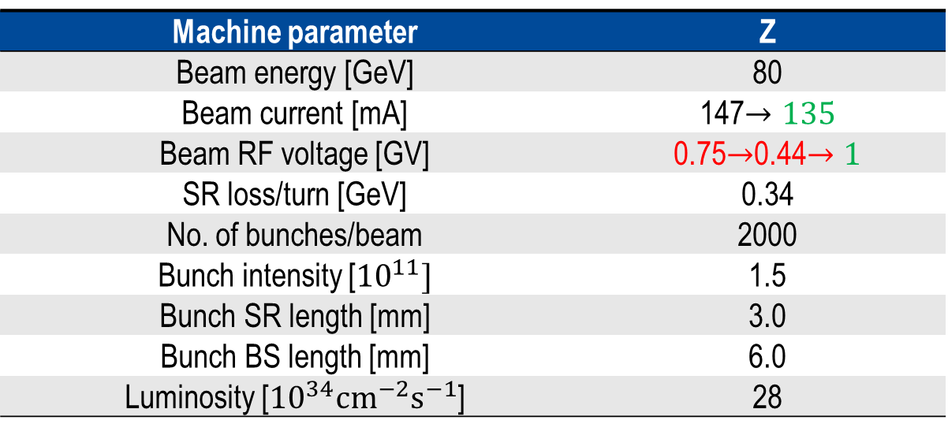
W Working Point
Machine parameter | Z
Beam energy [GeV] | 80
Beam current [mA] | 147$→135$
Beam RF voltage [GV] | 0.75$→$0.44$→1$
SR loss/turn [GeV] | 0.34
No. of bunches/beam | 2000
Bunch intensity [${10}^{11}]$ | 1.5
Bunch SR length [mm] | 3.0
Bunch BS length [mm] | 6.0
Luminosity [${10}^{34}{cm}^{−2}s^{−1}$] | 28

Slide 5
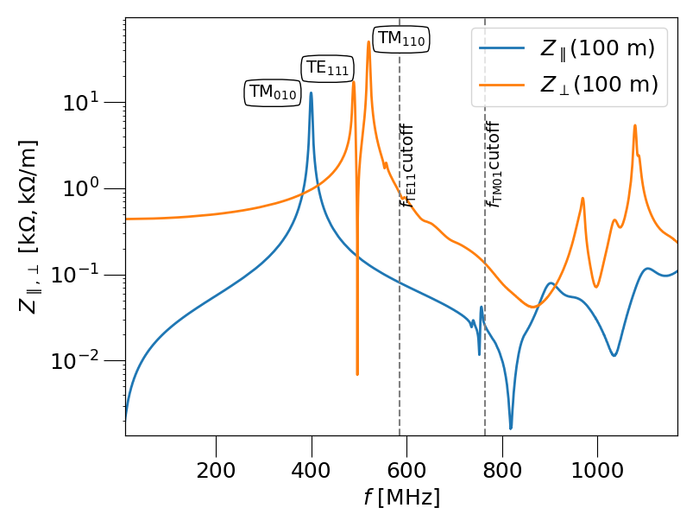
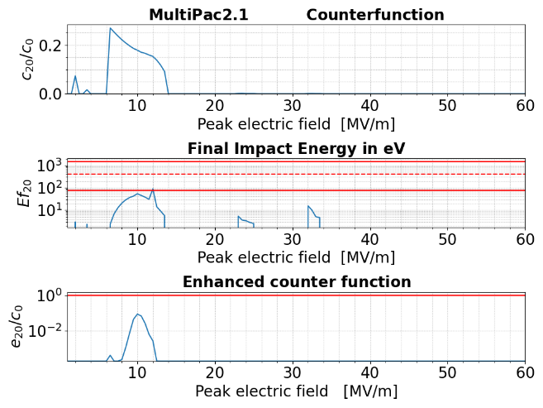
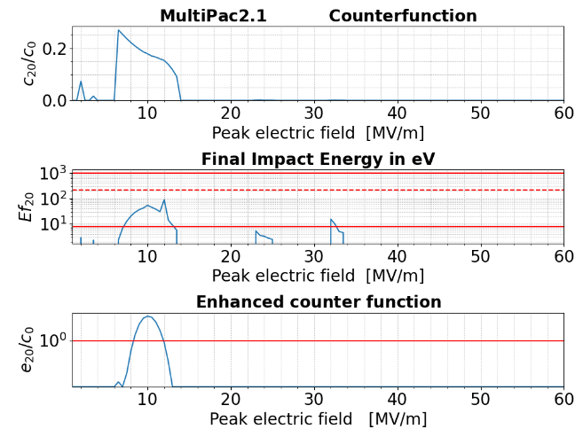
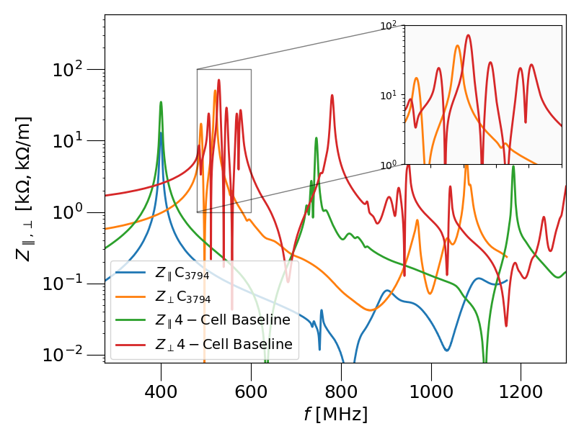
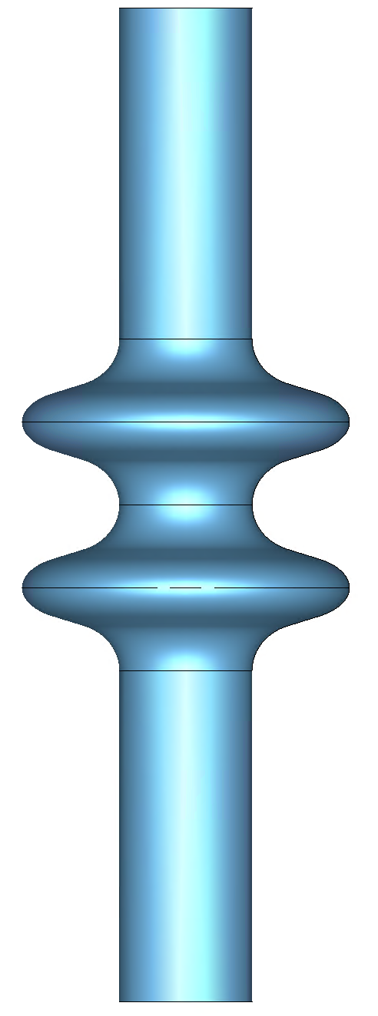
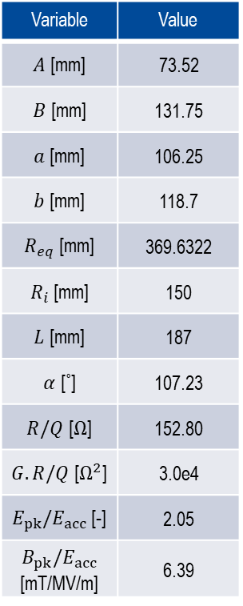
W-Working Point – Cavity Design
Design
Wakefield Results
Multipacting Analysis with Multipac [1]
[1] P. Ylä-Oijala and et al. Multipacting Analysis and Electromagnetic Field Computation by the Boundary Integral Equation Method in RF Cavities and Waveguides. 1999.
With a multi-objective shape optimization, a low longitudinal impedance cavity geometry was found.
Longitudinal and transverse wakefield impedance plots for designed cavity (C3794)
Niobium (Nb)
Peak operating field
(W working point)
Variable | Value
$A$[mm] | 73.52
$B$ [mm] | 131.75
$a$[mm] | 106.25
$b$[mm] | 118.7
$R_{eq}$ [mm] | 369.6322
$R_{i}$[mm] | 150
$L$ [mm] | 187
$α$ [˚] | 107.23
$R/Q$ [$Ω$] | 152.80
$G.R/Q$ [$Ω^{2}$] | 3.0e4
$E_{pk}/E_{acc}$ [-] | 2.05
$$B_{pk}/E_{acc}$$ [mT/MV/m] | 6.39
Copper (Cu)
Longitudinal and transverse wakefield impedance plots C3794 vs 4-Cell baseline cavity
[1] P. Ylä-Oijala and et al. Multipacting Analysis and Electromagnetic Field Computation by the Boundary Integral Equation Method in RF Cavities and Waveguides. 1999.

Slide 6
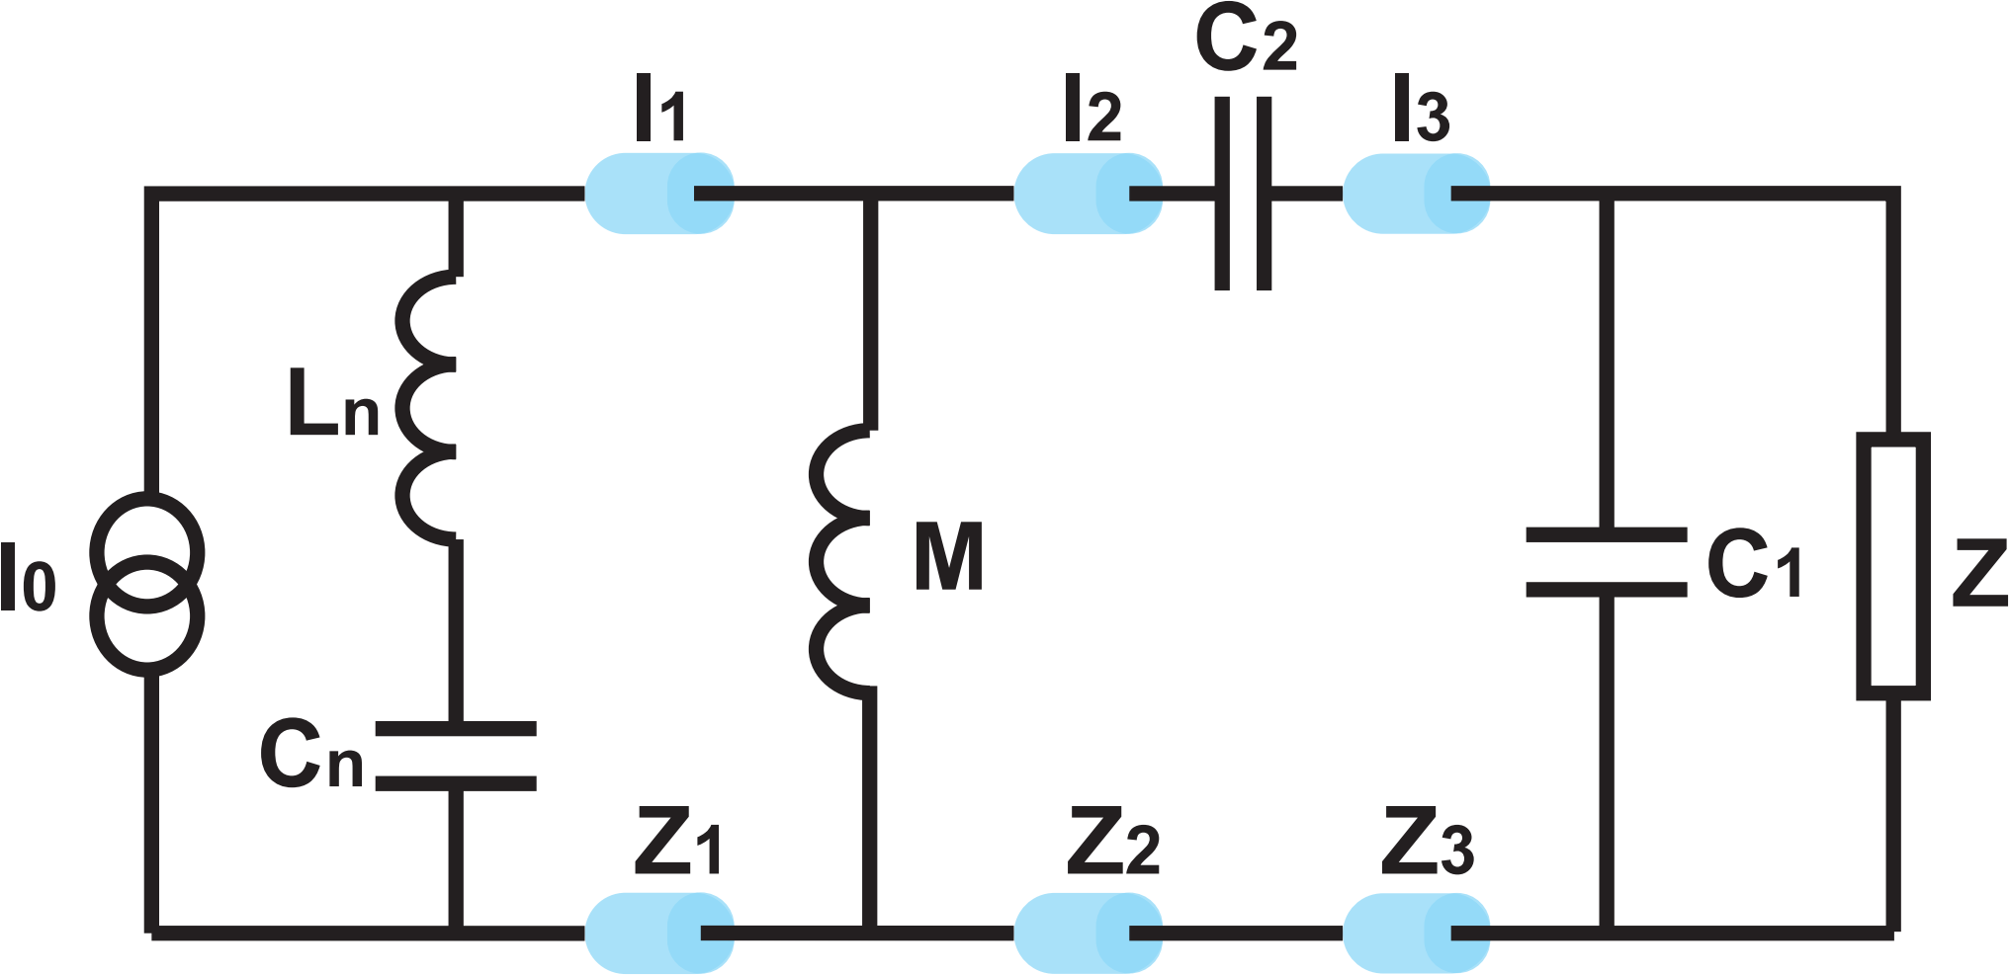
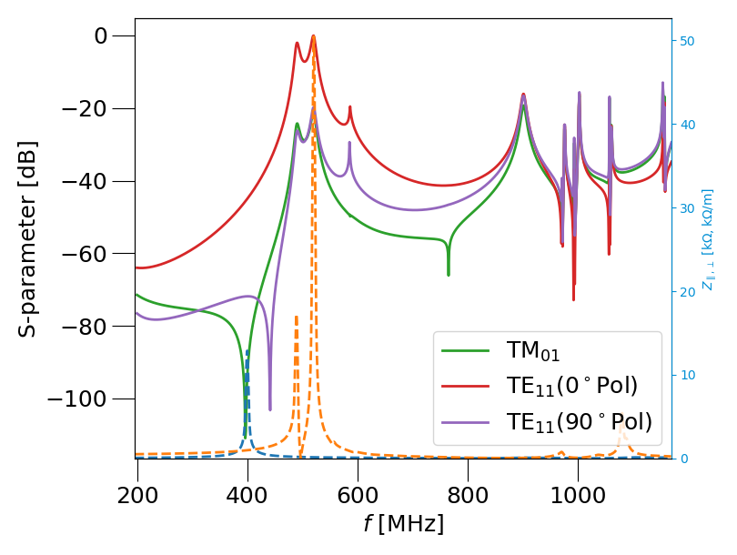
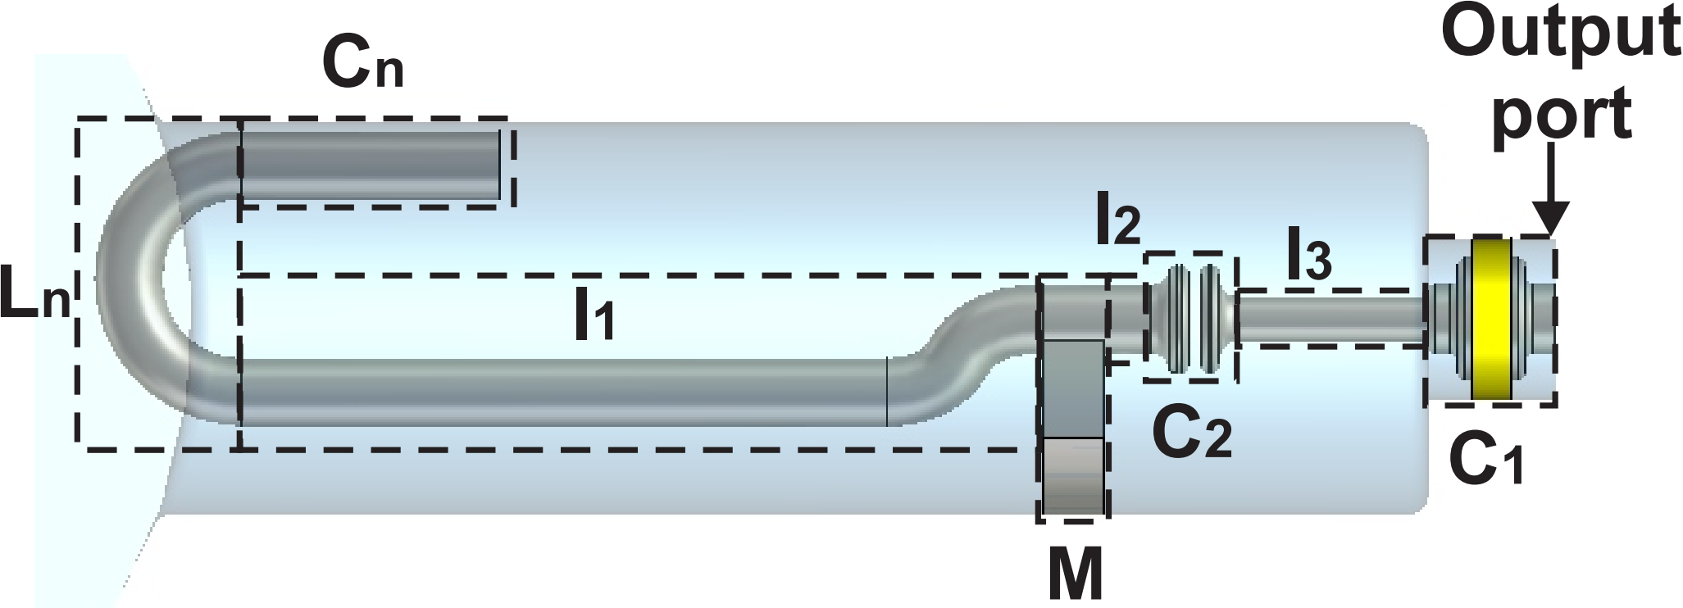
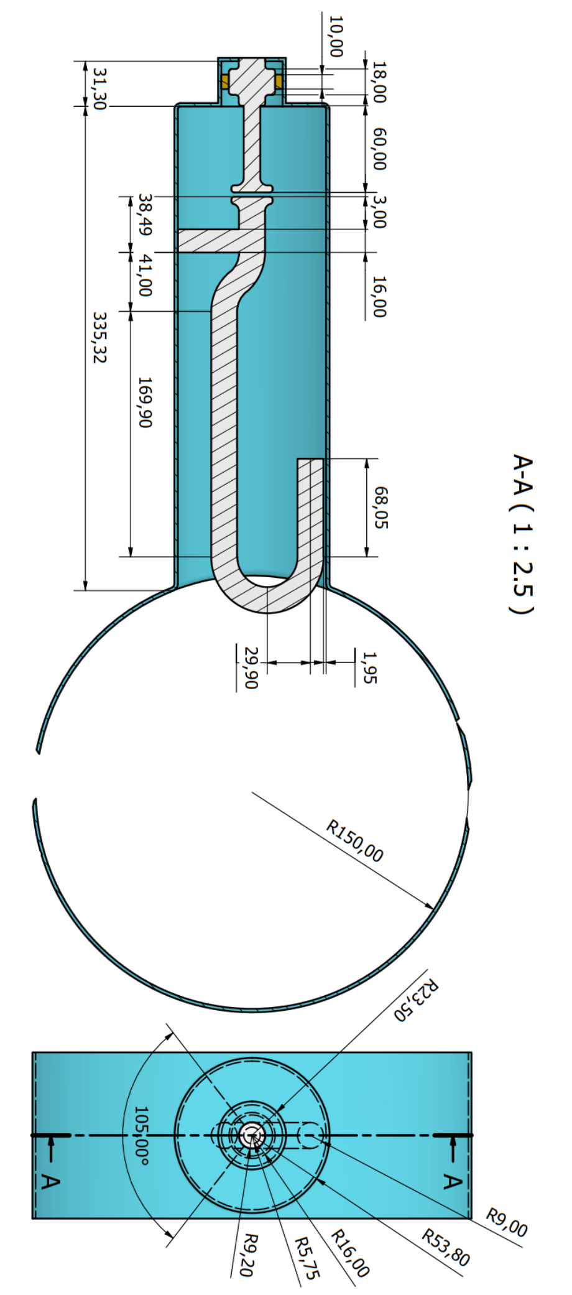
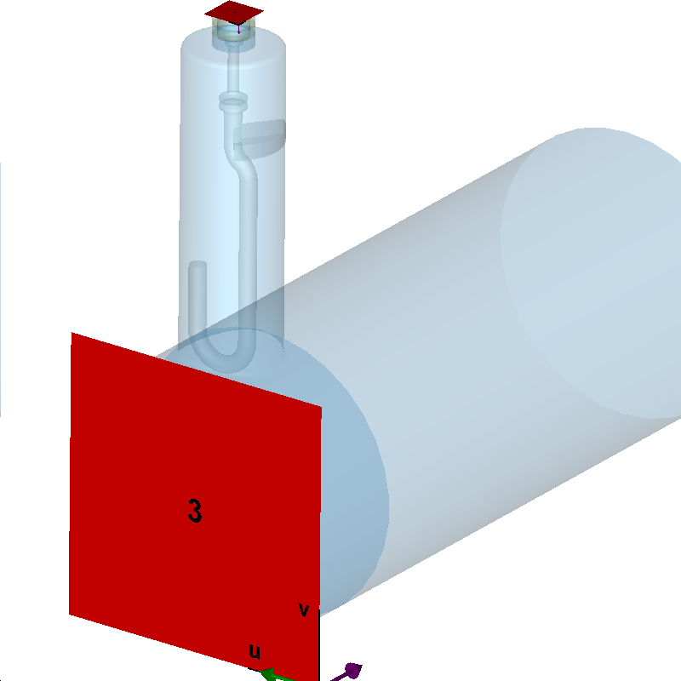
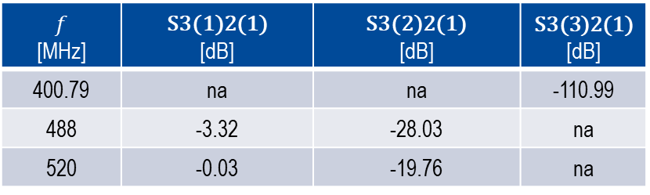
HOM Coupler Design
Design
Result
S3(3)2(1)
S3(1)2(1)
Port 2
S3(2)2(1)
Port 3
Transmission curve of the HOM coupler
$$f$$ [MHz] | S3(1)2(1) [dB] | S3(2)2(1) [dB] | $$\text{S}\text{3}\text{(}\text{3}\text{)2(1)}$$ [dB]
400.79 | na | na | -110.99
488 | -3.32 | -28.03 | na
520 | -0.03 | -19.76 | na

Slide 7
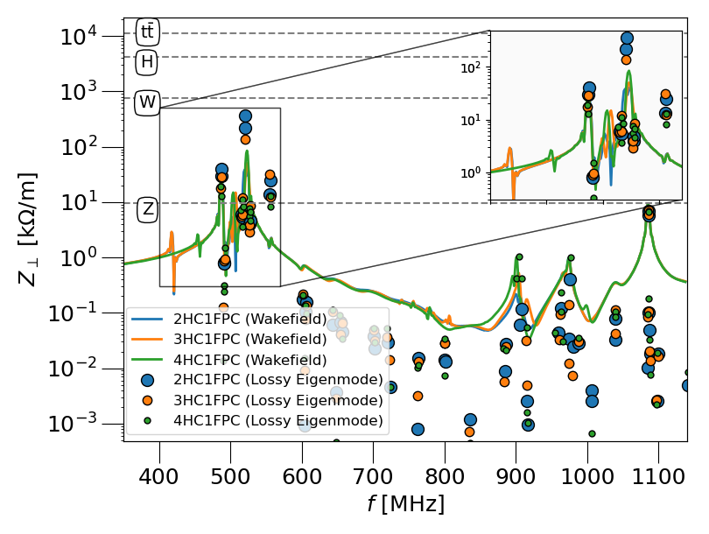
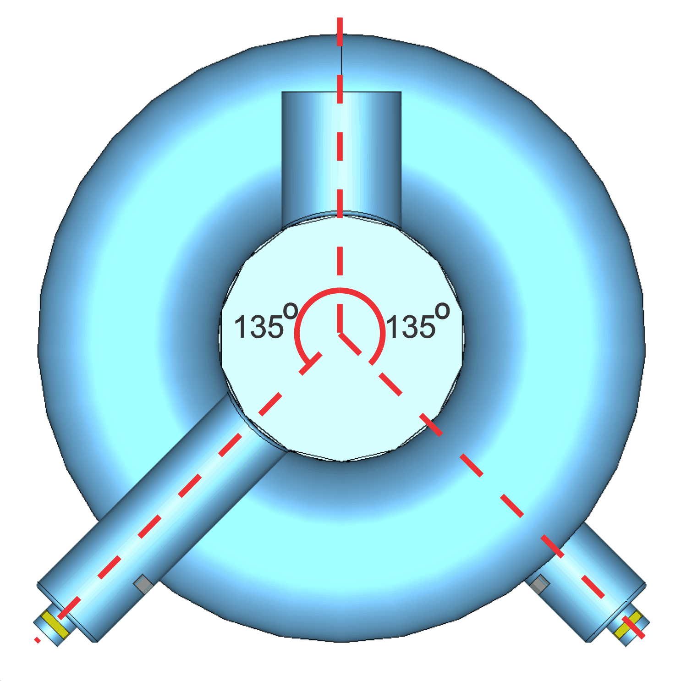
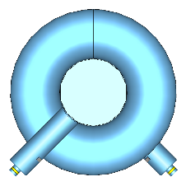
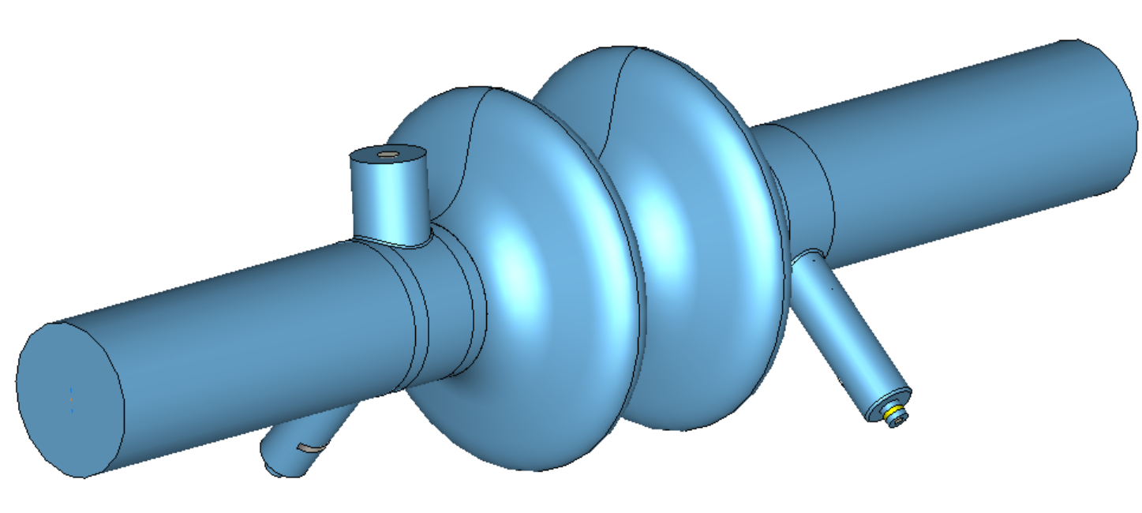
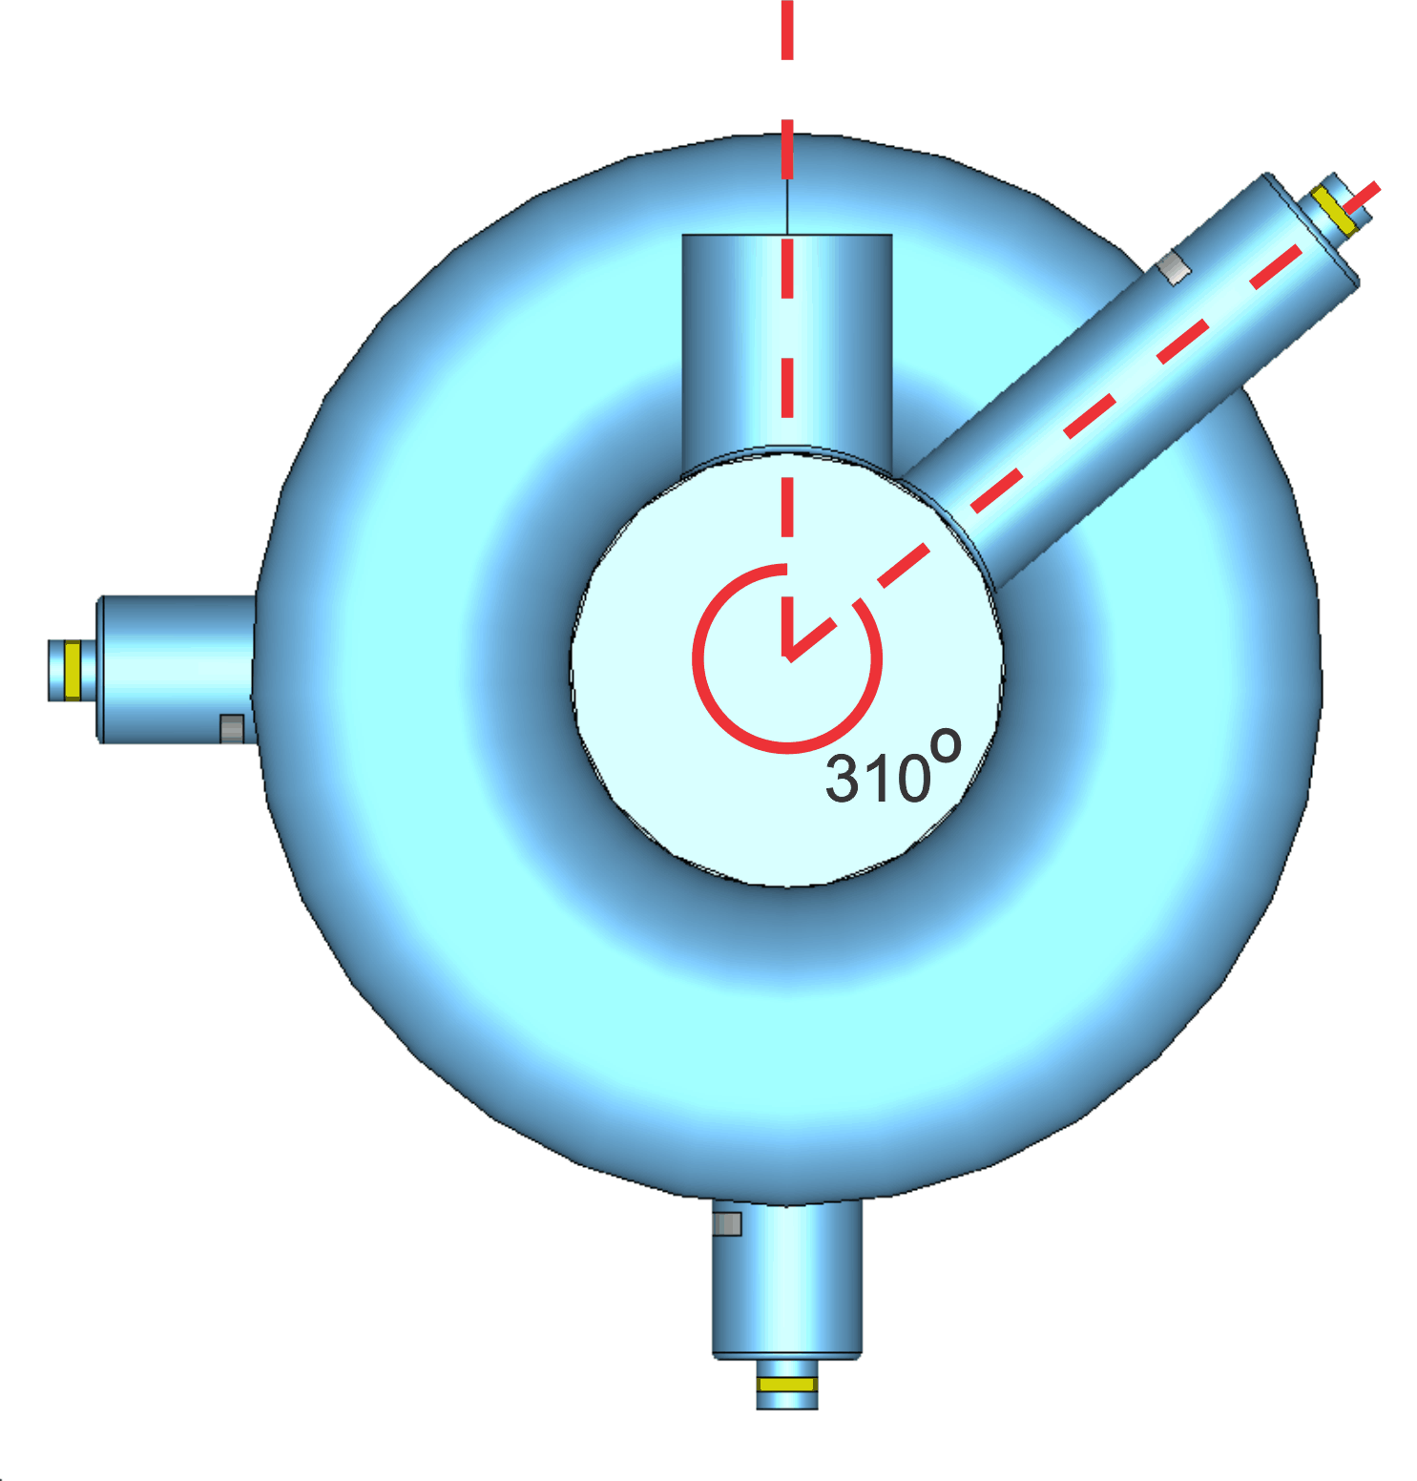
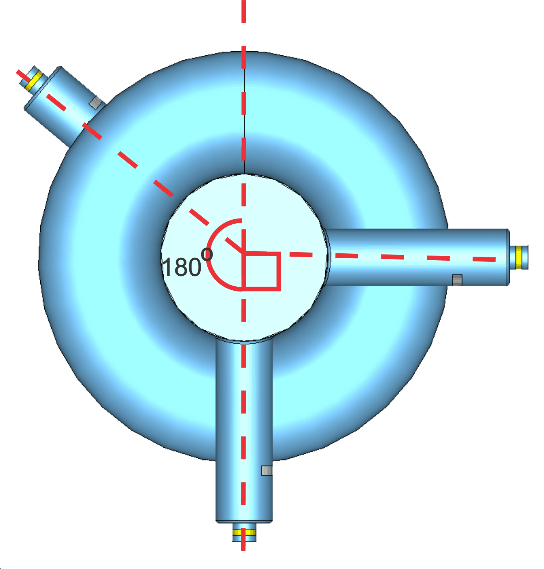
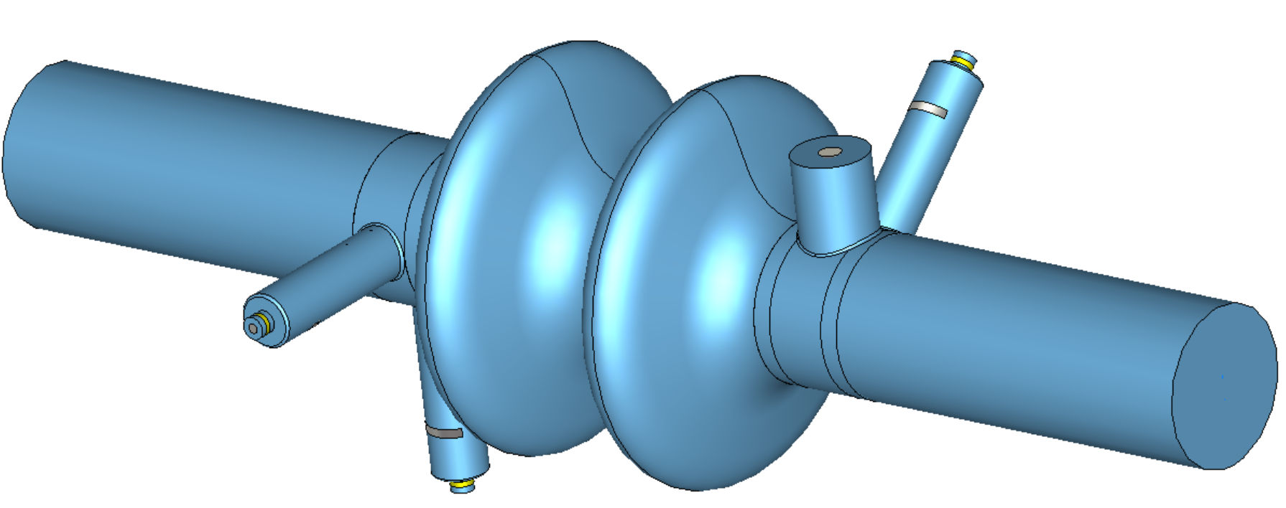
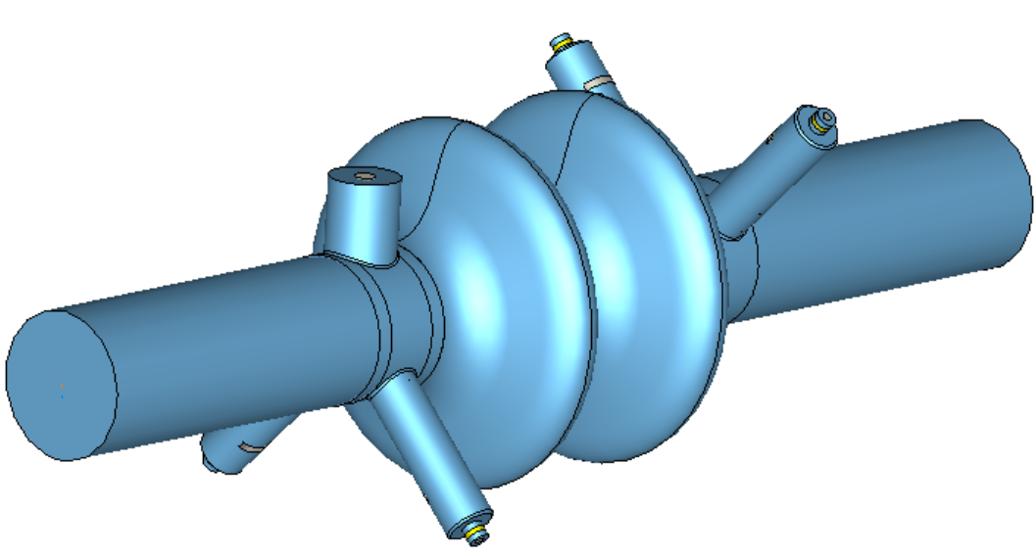
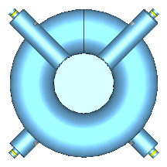
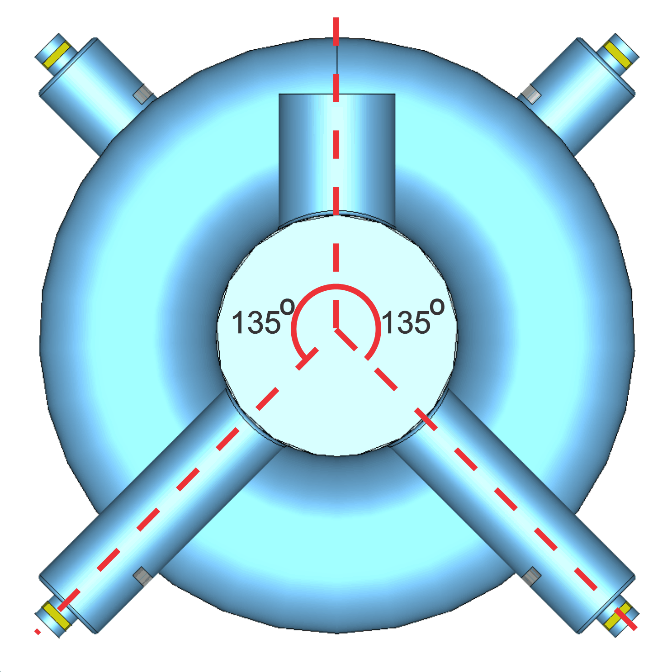
HOM Coupler Mounting – 2-, 3-, 4-Hook Coupler Systems
Result
2HC1FPC
3HC1FPC
4HC1FPC

Slide 8
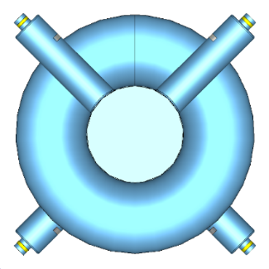
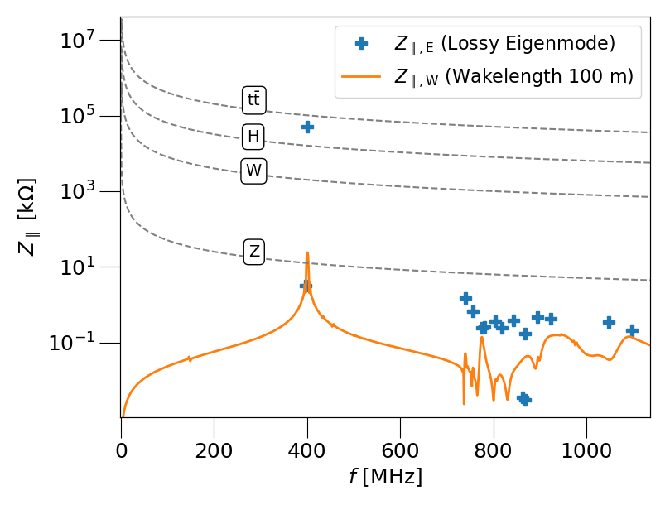
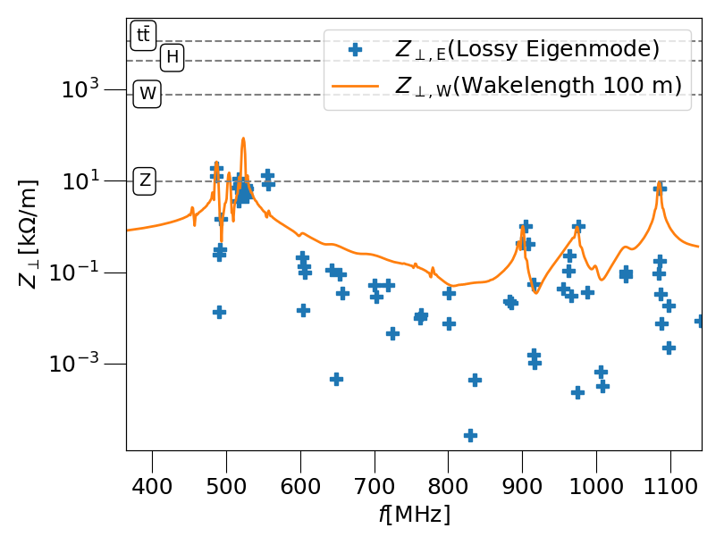
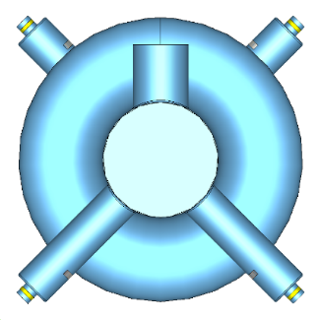
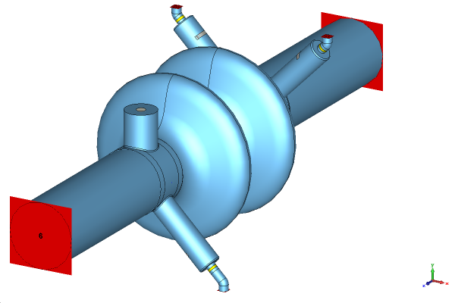
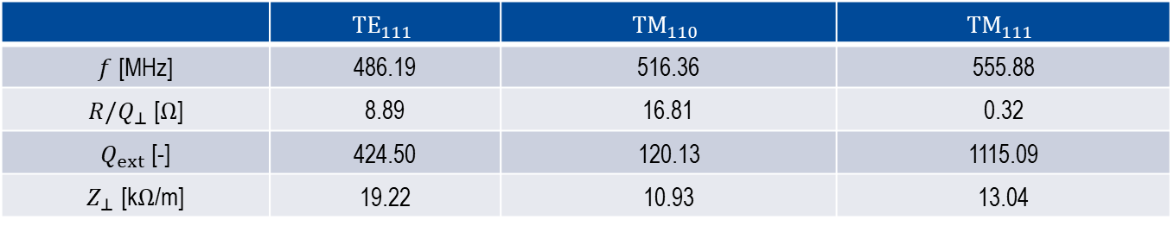
4-Hook Coupler System
Configuration
Result
Longitudinal wakefield and lossy eigenmode impedance plots C3794
Transverse wakefield and lossy eigenmode impedance plots C3794
 | $${TE}_{111}$$ | $${TM}_{110}$$ | $${TM}_{111}$$
$f$ [MHz] | 486.19 | 516.36 | 555.88
$R/Q_{⊥}$ [$Ω$] | 8.89 | 16.81 | 0.32
$Q_{ext}$ [-] | 424.50 | 120.13 | 1115.09
$Z_{⊥}$ [k$Ω$/m] | 19.22 | 10.93 | 13.04

Slide 9
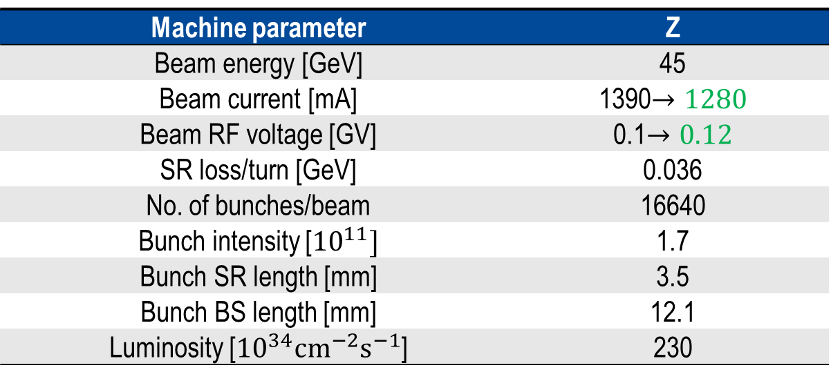
Z Working Point
Machine parameter | Z
Beam energy [GeV] | 45
Beam current [mA] | 1390$→1280$
Beam RF voltage [GV] | 0.1$→0.12$
SR loss/turn [GeV] | 0.036
No. of bunches/beam | 16640
Bunch intensity [${10}^{11}]$ | 1.7
Bunch SR length [mm] | 3.5
Bunch BS length [mm] | 12.1
Luminosity [${10}^{34}{cm}^{−2}s^{−1}$] | 230

Slide 10
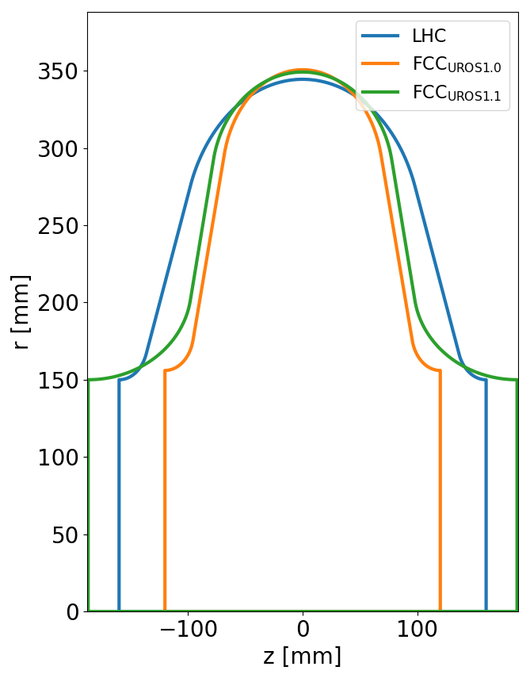
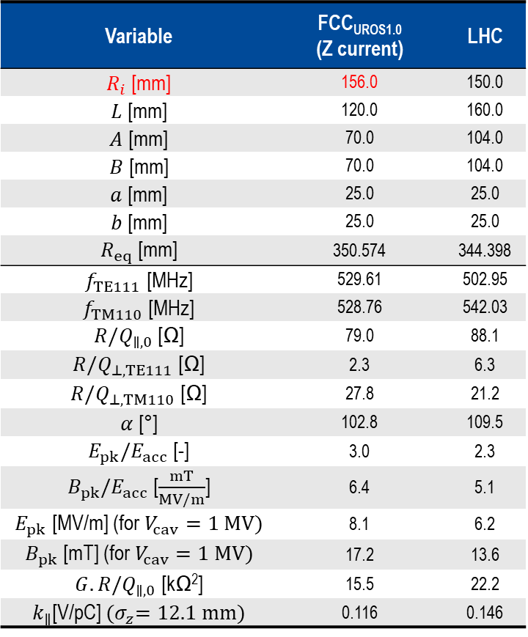
Z Working Point Cavity Design and Proposed Design Update
Slide courtesy of Shahnam Gorgi Zadeh
Variable | FCC_{UROS1.0} (Z current) | LHC
$R_{i}$ [mm] | 156.0 | 150.0
$L$ [mm] | 120.0 | 160.0
$A$ [mm] | 70.0 | 104.0
$B$ [mm] | 70.0 | 104.0
$a$ [mm] | 25.0 | 25.0
$b$ [mm] | 25.0 | 25.0
$R_{eq}$ [mm] | 350.574 | 344.398
$f_{TE111}$ [MHz] | 529.61 | 502.95
$f_{TM110}$ [MHz] | 528.76 | 542.03
$R/Q_{∥,0}$ [Ω] | 79.0 | 88.1
$R/Q_{⊥,TE111}$ [Ω] | 2.3 | 6.3
$R/Q_{⊥,TM110}$ [Ω] | 27.8 | 21.2
$α$ [°] | 102.8 | 109.5
$E_{pk}/E_{acc}$ [-] | 3.0 | 2.3
$B_{pk}/E_{acc}$ [$\frac{mT}{MV/m}$] | 6.4 | 5.1
$E_{pk}$ [MV/m] (for $V_{cav}=1 MV)$ | 8.1 | 6.2
$B_{pk}$ [mT] (for $V_{cav}=1 MV)$ | 17.2 | 13.6
$G.R/Q_{∥,0}$ [kΩ²] | 15.5 | 22.2
$k_{∥}$[V/pC] ${(σ}_{z}=12.1 mm)$ | 0.116 | 0.146
FCC_{UROS1.1} (Proposed update)
150
187
79.189
70
90
60
349.0943
518.89
531.98
81.25
4.77
24.81
-
2.36
5.99
6.3
12.74
17.47
0.117
FCC_{UROS1.0} : Single-cell cavity designed by Shahnam [1]
The cavity was designed with a 156 mm aperture radius for FCC_{UROS1.0} so as to have a uniform radius with the previous 4-cell 400 MHz cavity designed for the W and H working points
Update motivation:
  Replicating similar longitudinal impedance properties as with the cavity designed for the W working point.
  Uniform iris radius with the cavity for the W working point

Slide 11
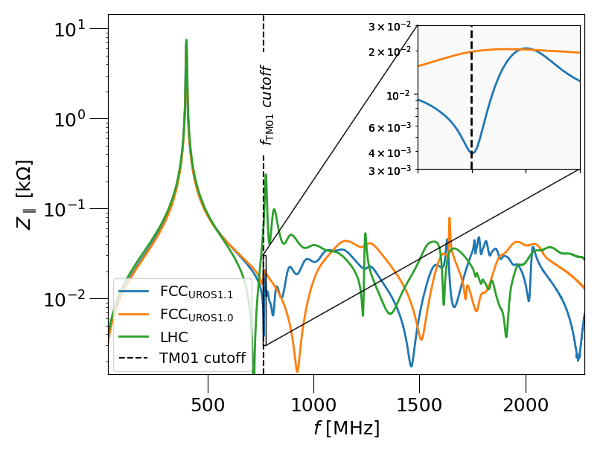
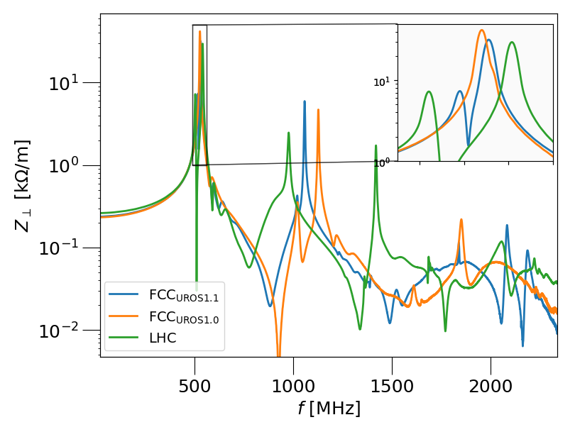
Proposed Design Update - $FCC_{UROS1.1}$
Highlights of the design update
Iris radius of 150 mm to match with the iris radius of the 2-cell cavity for the W working point
Absence of high-impedance longitudinal HOM
Having dipole modes closer to each other has two advantages:
  The design of coaxial HOM couplers is simpler
  The transmission curves of the coaxial HOM couplers can have a larger bandwidth around the resonances and are thus more robust against perturbations

Slide 12
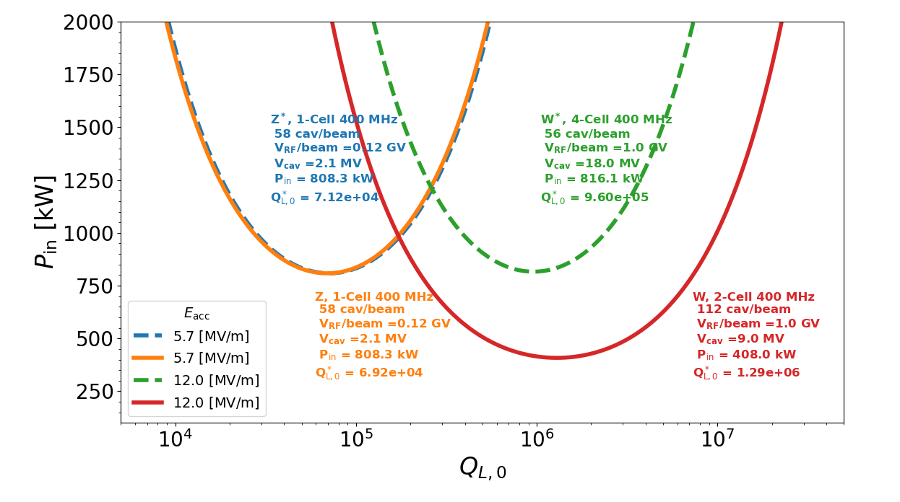
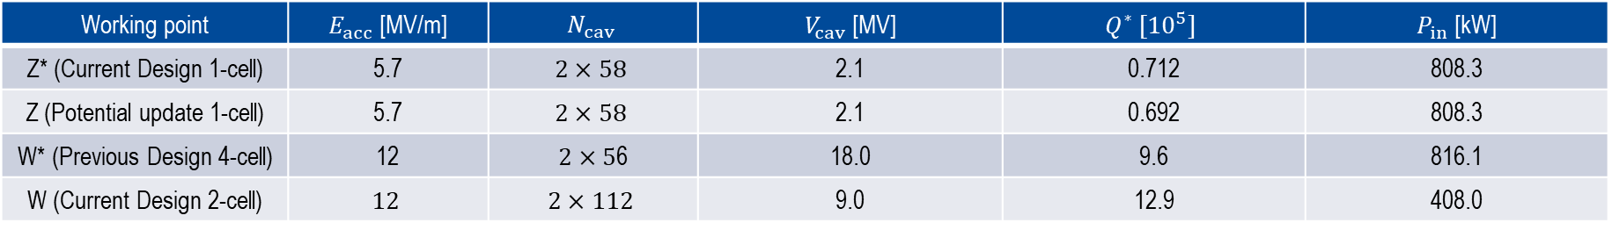
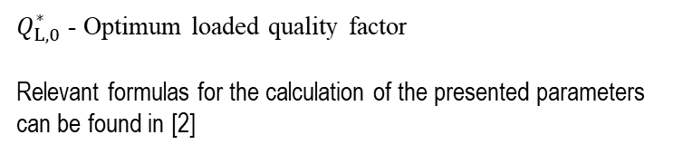
Power Requirement – Z and W Working Points
$Q_{L,0}^{∗}$ - Optimum loaded quality factor
Relevant formulas for the calculation of the presented parameters can be found in [2]
Working point | $E_{acc}$ [MV/m] | $$N_{cav}$$ | $V_{cav}$ [MV] | $$Q^{∗} [{10}^{5}]$$ | $P_{in}$ [kW]
Z* (Current Design 1-cell) | 5.7 | $$2×58$$ | 2.1 | 0.712 | 808.3
Z (Potential update 1-cell) | 5.7 | $$2×58$$ | 2.1 | 0.692 | 808.3
W* (Previous Design 4-cell) | 12 | $2×5$6 | 18.0 | 9.6 | 816.1
W (Current Design 2-cell) | $$12$$ | $$2×112$$ | 9.0 | 12.9 | 408.0
[2] S. Gorgi Zadeh, “Accelerating cavity and higher-order mode coupler design for the Future Circular Collider”, Ph.D. thesis, Theoretische Elektrotechnik, Universität Rostock, 2020;http://purl.uni-rostock.de/rosdok/id00003023

Slide 13
Summary
A new cavity has been designed for the W working point of the FCC-ee
The HOMs impedance of the designed cavity-hook-coupler system for the W working point fall below the impedance stability limit
A design update is proposed for the Z working point to have uniform cavity iris radius for the Z and W working points

