Slide 1








FCC Feasibility Study Overview
Michael Benedikt, CERN
on behalf of the FCC collaboration and FCCIS DS team
LHC
PS
SPS
FCC
http://cern.ch/fcc
Work supported by the European Commission under the HORIZON 2020 projects EuroCirCol, grant agreement 654305; EASITrain, grant agreement no. 764879; ARIES, grant agreement 730871, FCCIS, grant agreement 951754, and E-JADE, contract no. 645479
photo: J. Wenninger

Slide 2

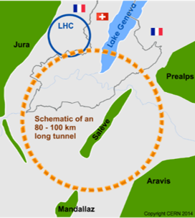
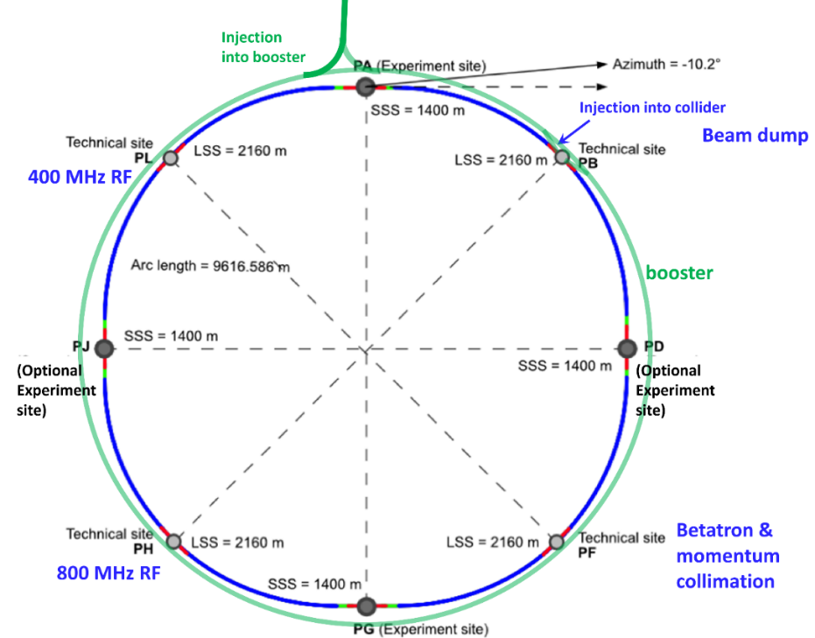
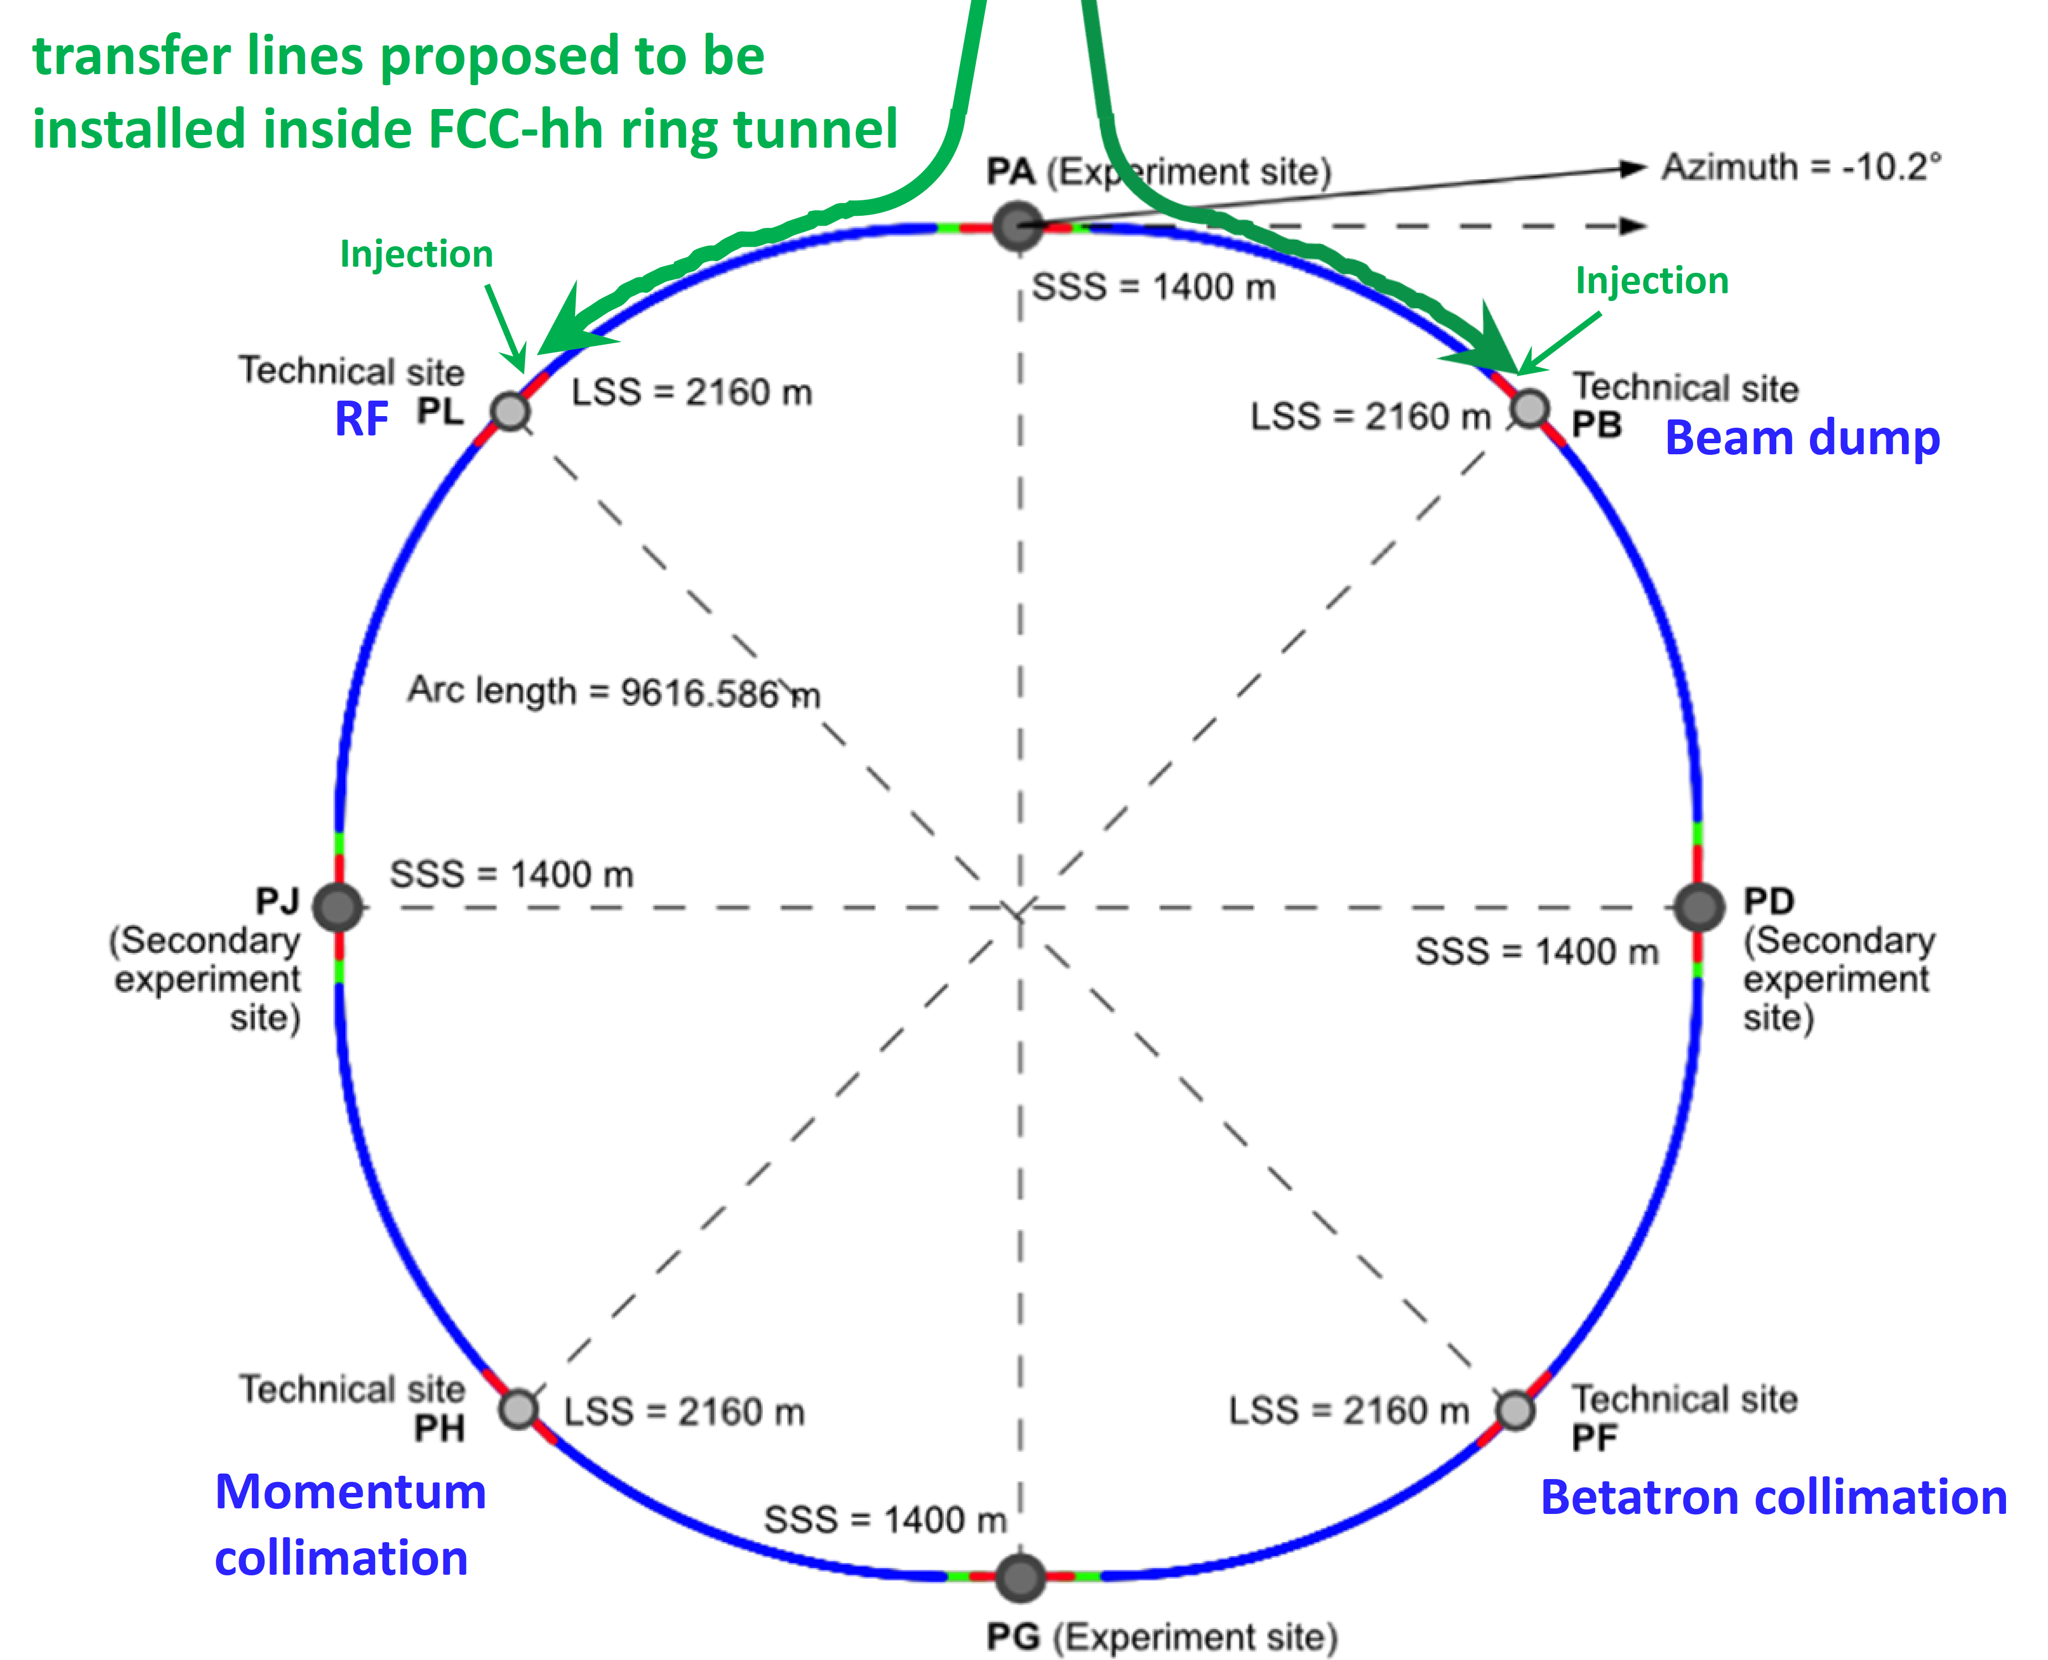
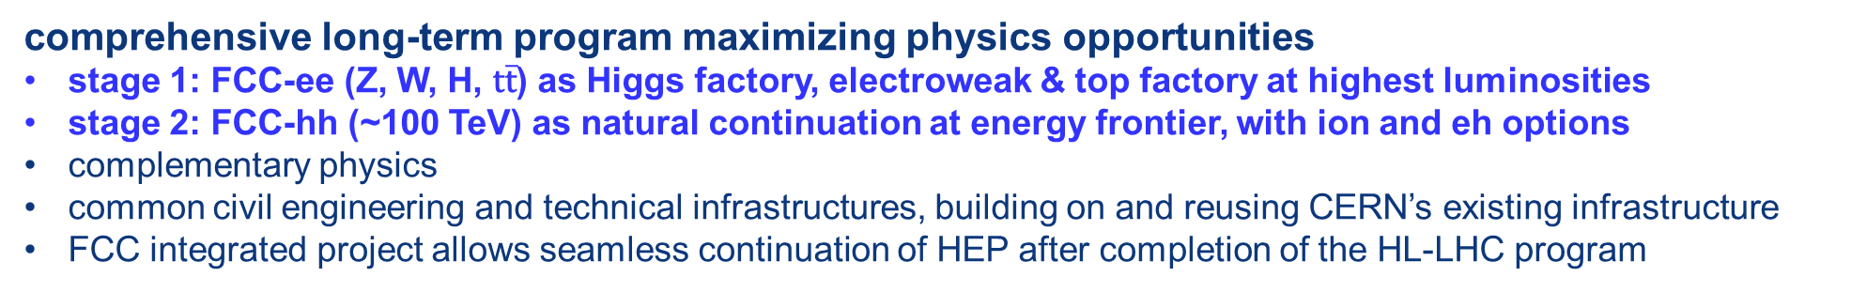
The FCC integrated program
inspired by successful LEP – LHC programs at CERN
comprehensive long-term program maximizing physics opportunities
stage 1: FCC-ee (Z, W, H, $\text{t}\overline{\text{t}}$) as Higgs factory, electroweak & top factory at highest luminosities
stage 2: FCC-hh (~100 TeV) as natural continuation at energy frontier, with ion and eh options
complementary physics
common civil engineering and technical infrastructures, building on and reusing CERN’s existing infrastructure
FCC integrated project allows seamless continuation of HEP after completion of the HL-LHC program
FCC-ee
FCC-hh
2020 - 2040
2045 - 2060
2070 - 2090++

Slide 3
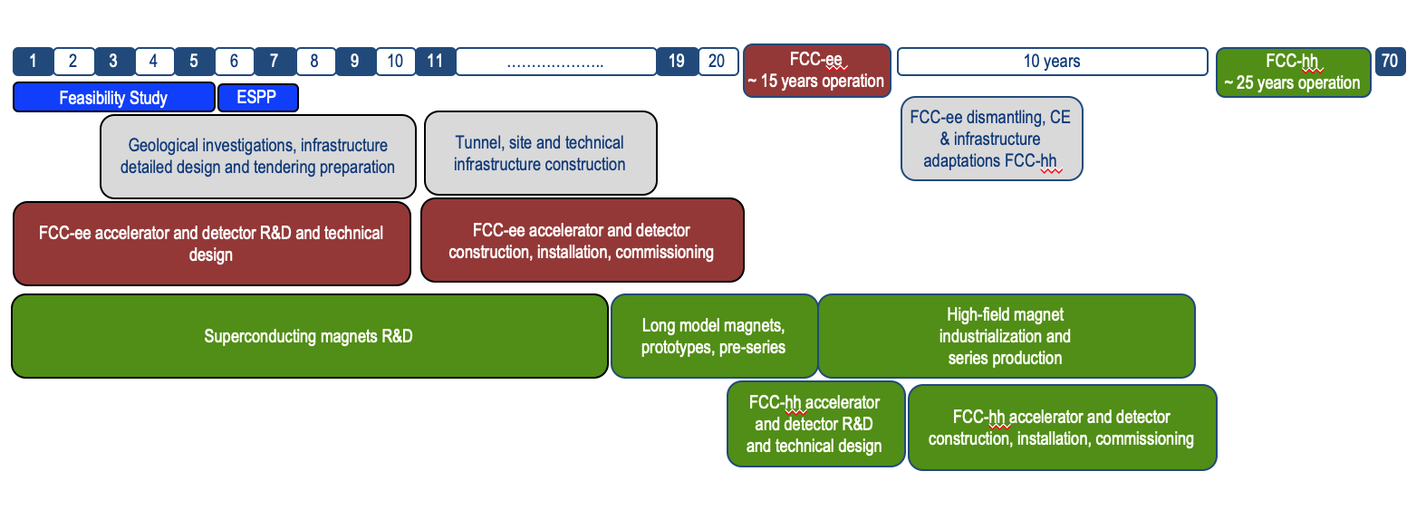
Timeline of the FCC integrated programme
Feasibility Study: 2021-2025
If project approved before end of
decade → construction can start
beginning 2030s
FCC-ee operation ~2045-2060
FCC-hh operation 2070-2090++
F. Gianotti

Slide 4
Feasiblity study goals and
roadmap towards first e⁺e⁻ collisions
Highest priority goals:
Financial feasibility
Technical and administrative feasibility of tunnel: no show-stopper for ~100 km tunnel
\
Technologies of machine and experiments: magnets; minimised environmental impact; energy efficiency & recovery
Gathering scientific, political, societal and other support
Fabiola Gianotti: “CERN vision and goals until next strategy update” FCCIS Kick-Off, 9 Nov. 2020
>2038
machine
installation
>2045 first
ee collisions
>2030
start tunnel
construction
~2028 approval
2026/7
ESPPU
>2030 - 37
element production
2025/26
Feasibility proof
>2026 - 30 full
technical design
2014 FCC
study kickoff
2020
ESPPU
2020 FCCIS
kickoff
2025/26
Financing model
Operation concept
2013
ESPPU
2018 FCC CDR
today
2020-25
FCC Feasibility Study
FCCIS H2020 DS
2012 Higgs discovery announced
2011 circular Higgs factory proposal

Slide 5
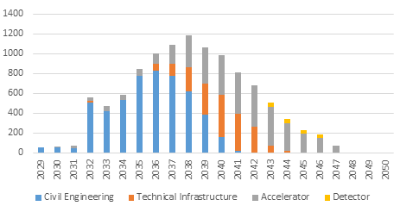
FCC stage 1: infrastructure and FCC-ee project cost estimate and spending profile
Construction cost estimate for FCC-ee
Machine configurations for Z, W, H working points included
Baseline configuration with 2 detectors
CERN contribution to 2 experiments incl.
Spending profile for FCC-ee
CE construction 2032 - 2040
Technical infrastructure 2037 - 2043
Accelerator and experiment 2032 – 2045
Commissioning and operation start 2045 -2048.
cost category | [MCHF] | %
civil engineering | 5.400 | 50
technical infrastructure | 2.000 | 18
accelerator | 3.300 | 30
detector | 200 | 2
total cost (2018 prices) | 10.900 | 100

Slide 6



Feasibility Study Timeline
2021 |  |  |  | 2022 |  |  |  | 2023 |  |  |  | 2024 |  |  |  | 2025
Q1 | Q2 | Q3 | Q4 | Q1 | Q2 | Q3 | Q4 | Q1 | Q2 | Q3 | Q4 | Q1 | Q2 | Q3 | Q4 | Q1 | Q2 | Q3 | Q4
CDR baseline design adaptations for
new implementation scenario
Status reports &
study planning ,
FCC Week & Review : implementation, baseline design, organisation, communication
high-risk areas site investigations, territorial integration & environmental initial state studies with host states
FCCW followed by mid-term review:
general coherency, cost update
Total CERN funding for the Feasibility Study 2021 - 2025: 100 MCHF material & personnel
H2020 FCCIS Design Study
Swiss CHART programme
FCC collaboration resources
detailed design towards FS report
FCC Week & Review: key technology R&D programs
FS Report
Release FSR
Project cost update

Slide 7
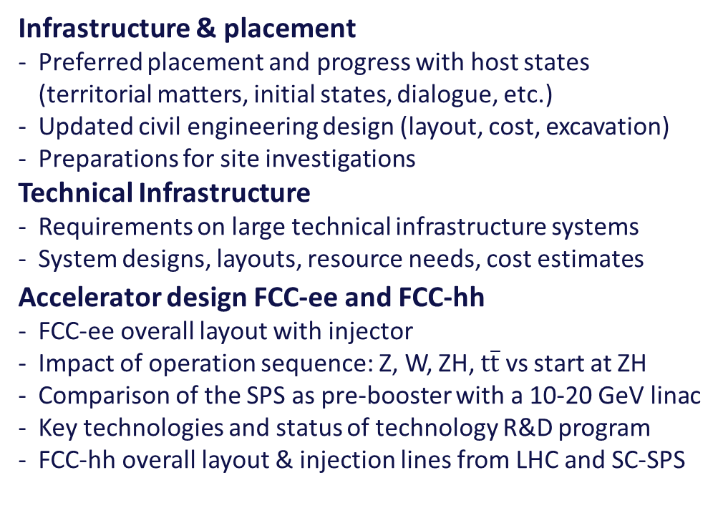
Mid-Term Review & Cost Review, autumn ‘23
A mid-term review report, supported by additional documentation on each of the deliverables, will be submitted to the review committees and to the Council and its subordinate bodies, as input for the review.
Results of both the general mid-term review and the cost review should indicate the main directions and areas of attention for the second part of the Feasibility Study
Infrastructure & placement
Preferred placement and progress with host states (territorial matters, initial states, dialogue, etc.)
Updated civil engineering design (layout, cost, excavation)
Preparations for site investigations
Technical Infrastructure
Requirements on large technical infrastructure systems
System designs, layouts, resource needs, cost estimates
Accelerator design FCC-ee and FCC-hh
FCC-ee overall layout with injector
Impact of operation sequence: Z, W, ZH, $\text{t}\overline{\text{t}}$ vs start at ZH
Comparison of the SPS as pre-booster with a 10-20 GeV linac
Key technologies and status of technology R&D program
FCC-hh overall layout & injection lines from LHC and SC-SPS
Physics, experiments, detectors:
Documentation of FCC-ee and FCC-hh physics cases
Plans for improved theoretical calculations needed to reduce the theoretical uncertainties towards matching the FCC-ee statistical precision for the most important measurements.
First documentation of the main detector requirements to fully exploit the FCC-ee physics opportunities
Organisation and financing:
Overall cost estimate and spending profile for stage 1 project.
Environmental impact, socio-economic impact:
Initial state analysis, excavation material management, etc.
Socio-economic impact and sustainability studies.

Slide 8
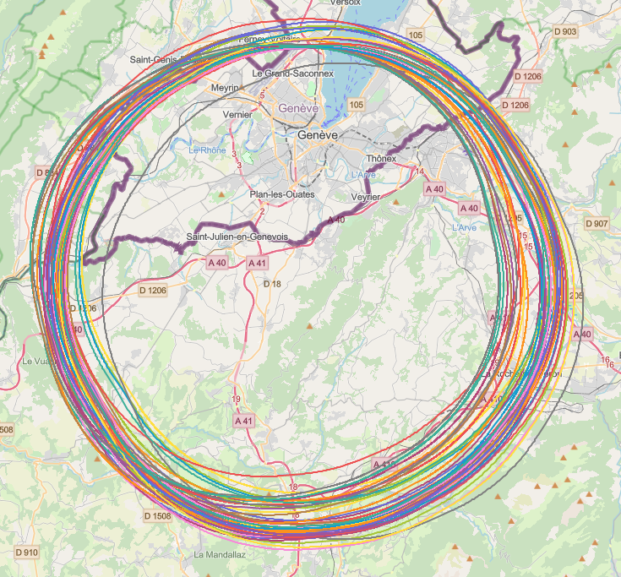
Implementation studies with host states
layout & placement optimisation across both host states, Switzerland and France;
following "avoid-reduce-compensate" directive of European & French regulatory frameworks;
diverse requirements and constraints:
  technical feasibility of civil engineering and subsurface geological constraints
  territorial constraints on surface and subsurface
  nature, accessibility, technical infrastructure, resource needs & constraints
  optimum machine performance and efficiency
  economic factors including benefits for, and synergies, with the regional developments
  …
collaborative effort: FCC technical experts, consulting companies, government-notified bodies

Slide 9
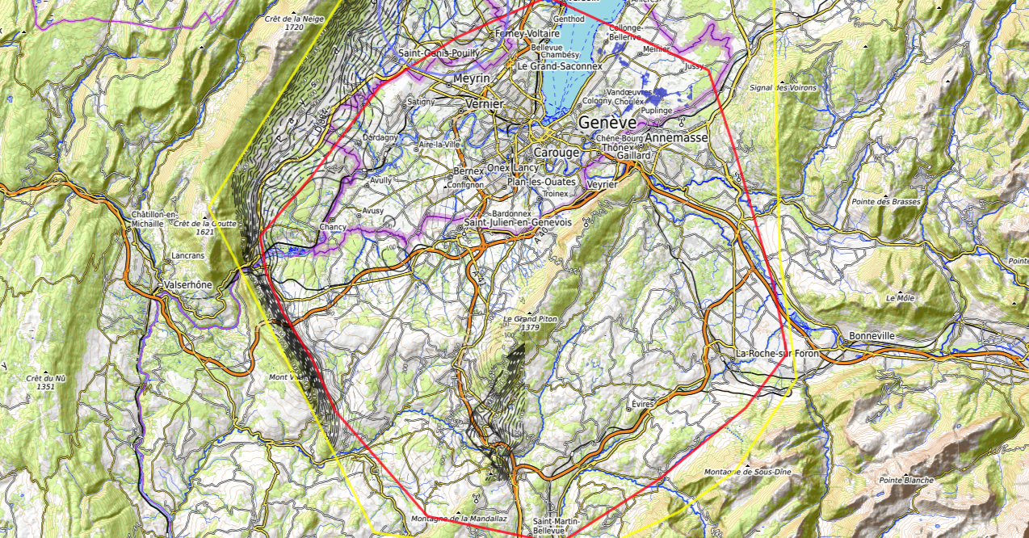
9
Discouraged due
to likely oppositions
Densely urbanized
and agriculture/nature
Strict landscape protection
and re-naturalization areas
Jura limestone
Protected forest
Densely urbanized
and emerging areas
Densely urbanized
Clustered residential
areas and farm areas
Terrain difficult to
access and water
reservoirs
Known water reservoirs and
protected nature in CH
(legal + technical reasons)
Water protection and
natural zones without
developed access
Densely urbanized
and emerging areas
(some spots possible)
Water protection zones,
landscape protection zones,
altitudes
High mountains (900 m)
north of Fillière river valley
Vuache limestone
and faults
Likely major opposition:
local urbanistic planning
for traffic calming &
nature protection
High altitudes
Densely populated
J. Gutleber, V. Mertens

Slide 10
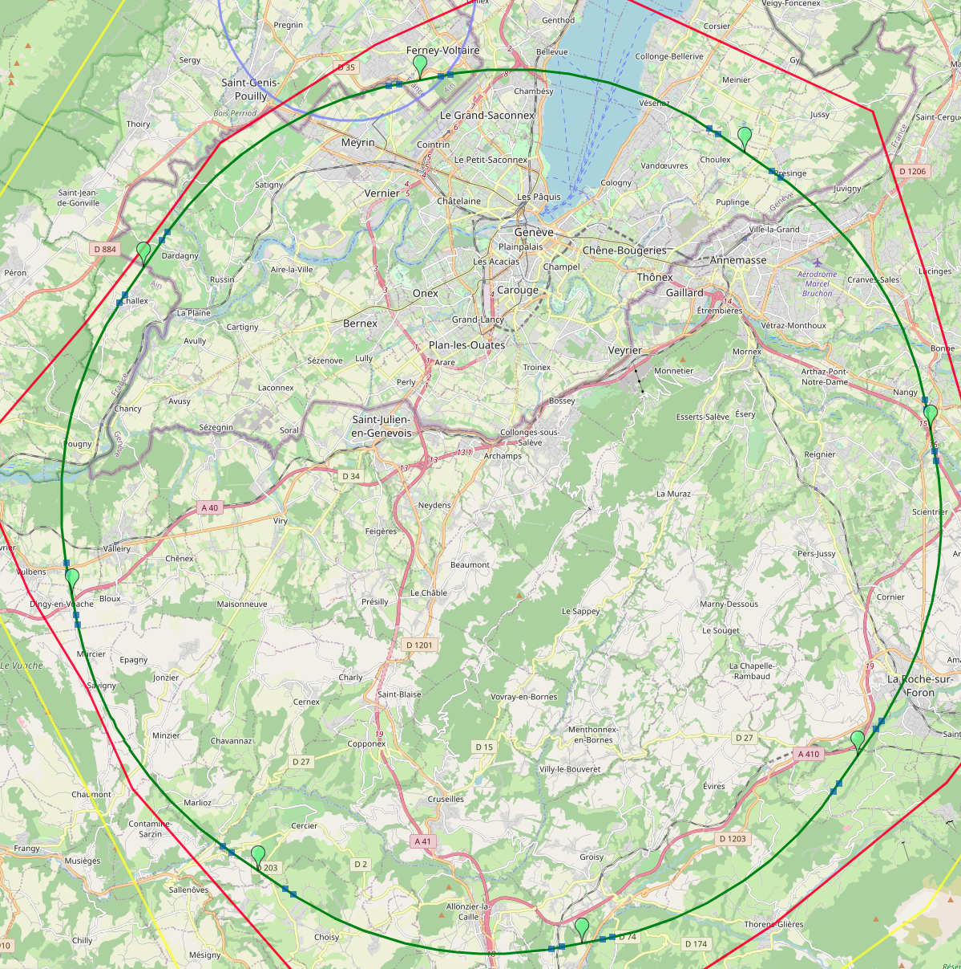
8-site baseline ”PA31”
PA: Experiment
Number of surface sites | 8
LSS@IP (PA, PD, PG, PJ) | 1400 m
LSS@TECH (PB, PF, PH, PL) | 2143 m
Arc length | 9.6 km
Sum of arc lengths | 76.9 m
Total length | 91.1 km
PB: technical
PL: technical
PD: experiment
8 sites – less use of land, <40 ha instead 62 ha
Possibility for 4 experiment sites in FCC-ee
All sites close to road infrastructures (< 5 km of new road constructions for all sites)
Vicinity of several sites to 400 kV grid lines
Good road connection of PD, PF, PG, PH suggest operation pole around Annecy/LAPP
PJ: experiment
PF: technical
PH: technical
PG: experiment
J. Gutleber

Slide 11
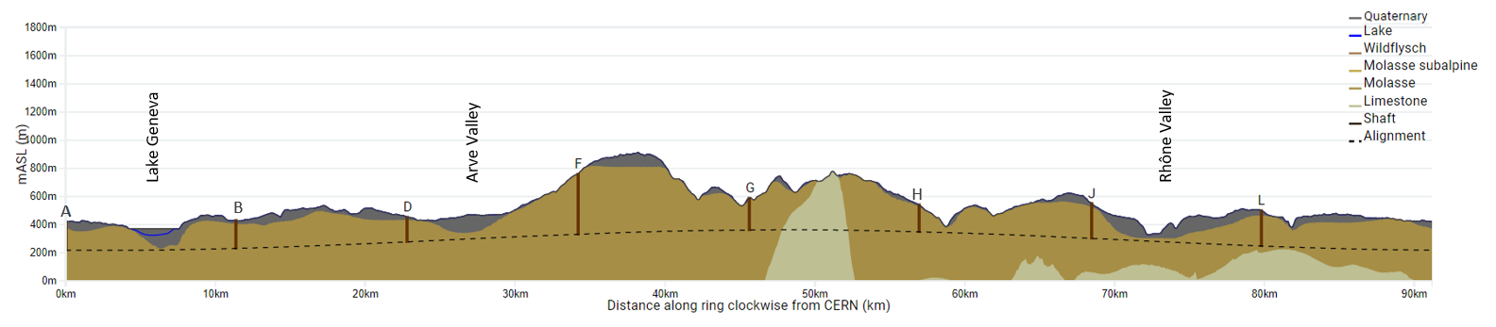
FCC Long Section – PA31-1.0
FCC inclined at 0.5% gradient to minimise depth of point F
Limestone unavoidable between G-H
FCC passes below Lake Geneva moraines
FCC passes above limestone
Shaft depth:
A: 202 m
B: 200 m
D: 177 m
F: 399 m
G: 228 m
H: 139 m
J: 251 m
L: 253 m
John Osborne

Slide 12
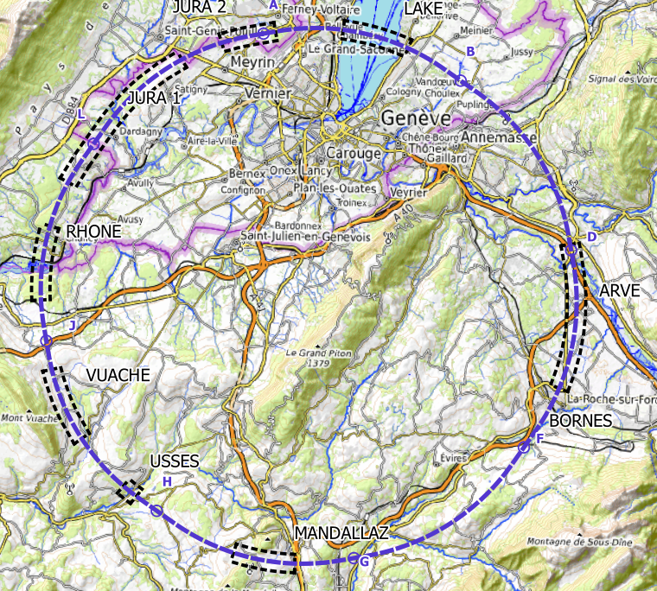
Plans for high-risk area site investigations
  Jura, Vuache (3 Areas)
  Top of limestone
  Karstification and filling-in at the tunnel depth
  Water pressure
  Lake, Rhône, Arve and Usses Valley (4 Areas)
  Top of the molasse
  Quaternary soft grounds, water bearing layers
  Mandallaz (1 Areas)
  Water pressure at the tunnel level
  Karstification
  Bornes (1 Area)
  High overburden molasse properties
  Thrust zones
  Site investigations planned for 2024 – 2025:
  ~40-50 drillings, 100 km of seismic lines

Slide 13

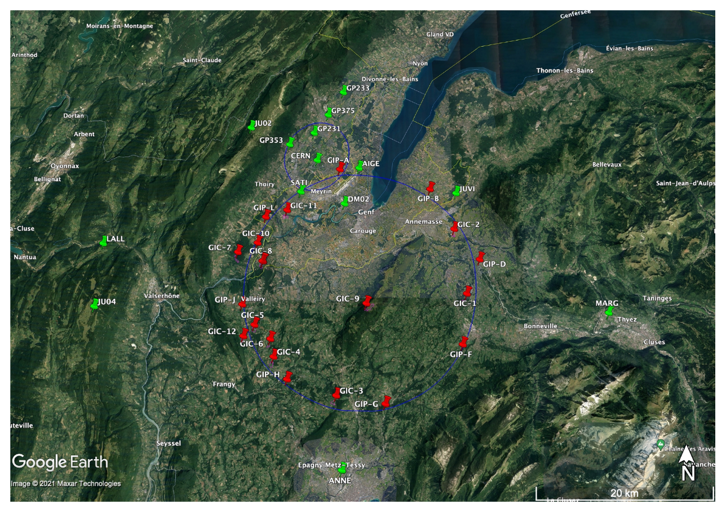
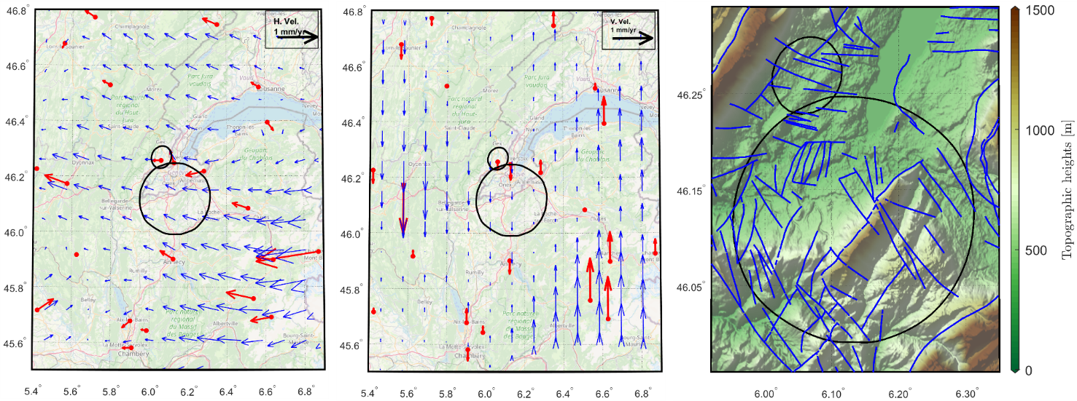
Geodesy Surface Reference Network
Surface geodetic network needs to be spatially extended
Realization of a coordinate reference frame (CTRF) for georeferencing of site investigation data and as basis for all geospatial works using global navigation satellite system (GNSS) and surveying instruments
GNSS-based monitoring of the geokinematic surface deformations (assure stable main geodetic points, quantify differential displacements which may affect later alignment)
EUREF surface velocity field
(differential displacements)
Faults
(potential discontinuities of displacements)
CTRF uses existing surface points and
8 pillars in vicinity of access shafts, 1 point near centroid
Geomonitoring requires early on
11 network points near faults and tunnel
CHART collaboration with ETH Zuerich
Notes:
Two plots on the left: show horizontal and vertical yearly displacement rates. Red vectors = resulting from long term GNSS measurements, data provided by European Reference Frame Velocity Working Group. BLUE vectors = interpolation, but likely not correct because of geological situation (e.g. faults, see 3rd picture). Discontinuities of displacement vector field to be expected. There could be differences of several tenths of mm / year – need to know the displacement rates when tunneling starts and need to know for planning alignment facility details => monitoring required
Plot on the right: red points: proposed new network points to be established soon after site investigation and to be monitored geodetically (campaigns, some points equipped continuously with GNSS receivers) during the feasibility study, possibly even longer. Green points: existing stations (continuously operating GNSS stations) whose GNSS data will be used jointly with data from the red stations.

Slide 14
Host state activities needed in 2022/2023
Feedback on in principle feasibility by directly engaging with local and regional stakeholders in France and in Switzerland that are affected by the placement scenario.
Launch of common work with federal agencies in Switzerland and with national serivces in France on topics to be delt with at national level (e.g. managemenet of exavated materials, access to water and electricity resources, road construction feasibility etc.).
Optimisation of the locations for geophysical and geotechnical investigations with locally affected stakeholders (e.g. plot owners, residents).
Launch of initial field studies to obtain a reference for environmental impact studies and estimation of the evolution of the territory without and FCC project.
Feasibility study of access to national railroard infrastructures in France and in Switzerland via existing, to be refurbished or to be created terminals.
Feasibility study of access ot French national highway system at selected locations for handover of exavated materials.
Interactions with local and regional development policy makers on potentials and priorities for synergies between FCC and the hosting regions.
Notes:
Two plots on the left: show horizontal and vertical yearly displacement rates. Red vectors = resulting from long term GNSS measurements, data provided by European Reference Frame Velocity Working Group. BLUE vectors = interpolation, but likely not correct because of geological situation (e.g. faults, see 3rd picture). Discontinuities of displacement vector field to be expected. There could be differences of several tenths of mm / year – need to know the displacement rates when tunneling starts and need to know for planning alignment facility details => monitoring required
Plot on the right: red points: proposed new network points to be established soon after site investigation and to be monitored geodetically (campaigns, some points equipped continuously with GNSS receivers) during the feasibility study, possibly even longer. Green points: existing stations (continuously operating GNSS stations) whose GNSS data will be used jointly with data from the red stations.

Slide 15

new layouts and assignments of straight sections
injection-tunnel near PA; 400 MHz RF in PL; 4 exp. caverns for both
FCC-ee
4-fold periodicity, synergies ee & hh
FCC-hh

Slide 16
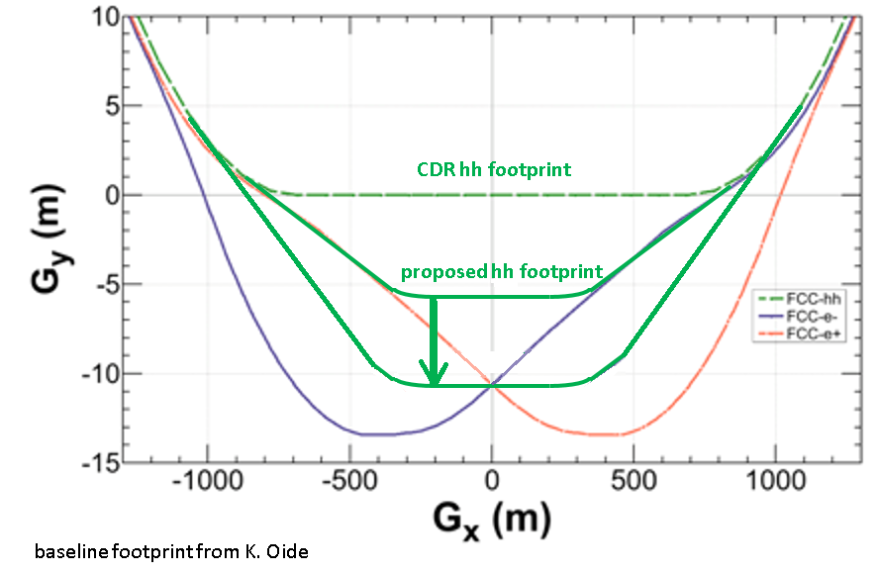
layout optimisation of high-luminosity insertions
From CDR
  Due to FCC-ee asymmetric IR layout, transverse displacement of IPs for FCC-ee and FCC-hh.
  FCC-hh footprint compatible with FCC-ee injector
F. Zimmermann
Massimo Giovannozzi & Thys Risselada
Implementation of an improved layout with FCC-ee & FCC-hh IPs with same transverse positions
Advantages:
  Transverse size of detector cavern reduced
  Tunnel width reduced over 2 x 500 m
  Potential to re-use FCC-ee detector magnets for FCC-hh
(m)
T. Risselada
(m)

Slide 17
Stage 1: updated parameters
K. Oide, D. Shatilov,
Parameter [4 IPs, 91.2 km,T_{rev}=0.3 ms] | Z | WW | H (ZH) | ttbar
beam energy [GeV] | 45 | 80 | 120 | 182.5
beam current [mA] | 1280 | 135 | 26.7 | 5.0
number bunches/beam | 10000 | 880 | 248 | 36
bunch intensity [10¹¹] | 2.43 | 2.91 | 2.04 | 2.64
SR energy loss / turn [GeV] | 0.0391 | 0.37 | 1.869 | 10.0
total RF voltage 400/800 MHz [GV] | 0.120/0 | 1.0/0 | 2.08/0 | 4.0/7.25
long. damping time [turns] | 1170 | 216 | 64.5 | 18.5
horizontal beta* [m] | 0.1 | 0.2 | 0.3 | 1
vertical beta* [mm] | 0.8 | 1 | 1 | 1.6
horizontal geometric emittance [nm] | 0.71 | 2.17 | 0.64 | 1.49
vertical geom. emittance [pm] | 1.42 | 4.34 | 1.29 | 2.98
horizontal rms IP spot size [μm] | 8 | 21 | 14 | 39
vertical rms IP spot size [nm] | 34 | 66 | 36 | 69
beam-beam parameter ξ_{x} / ξ_{y} | 0.004/ .159 | 0.011/0.111 | 0.0187/0.129 | 0.096/0.138
rms bunch length with SR / BS [mm] | 4.38 / 14.5 | 3.55 / 8.01 | 3.34 / 6.0 | 2.02 / 2.95
luminosity per IP [10³⁴ cm⁻²s⁻¹] | 182 | 19.4 | 7.3 | 1.33
total integrated luminosity / year [ab⁻¹/yr] | 87 | 9.3 | 3.5 | 0.65
beam lifetime rad Bhabha + BS [min] | 19 | 18 | 6 | 9
preliminary – example parameters
for present layout & with 4 IPs

Slide 18







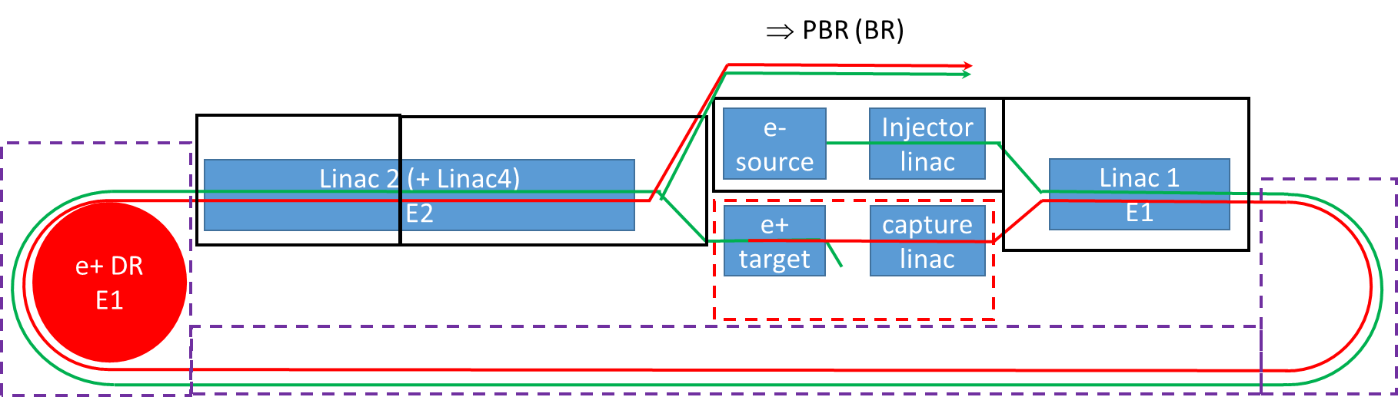
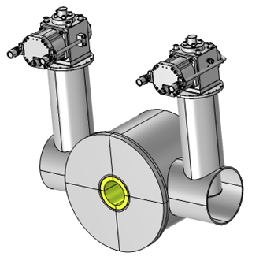
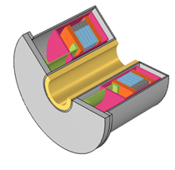
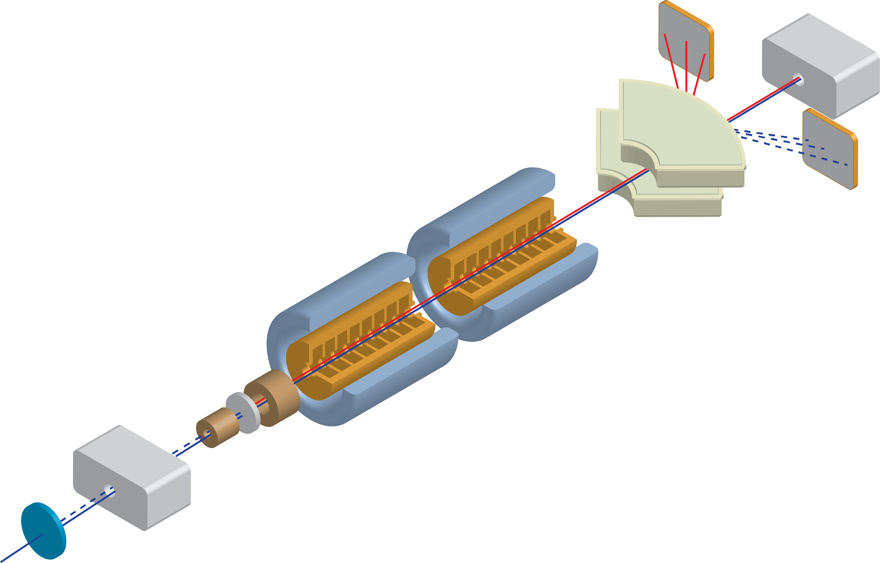
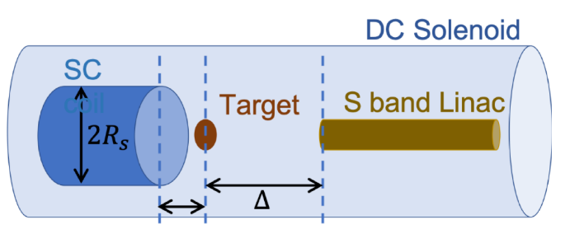
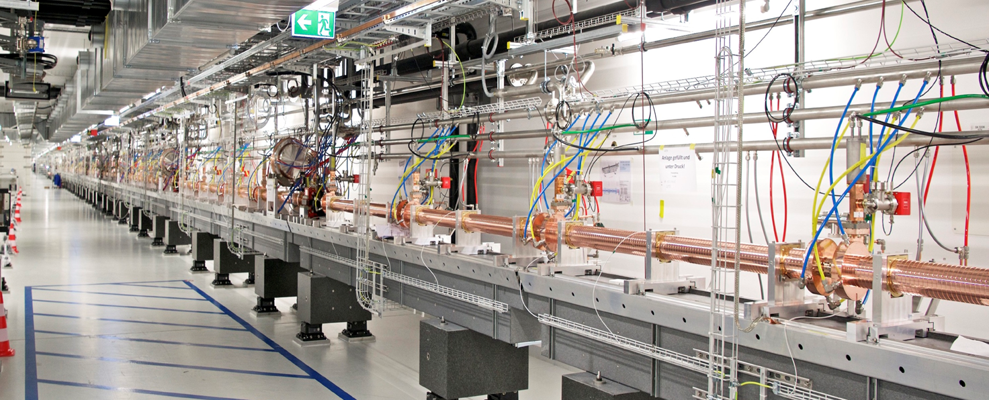
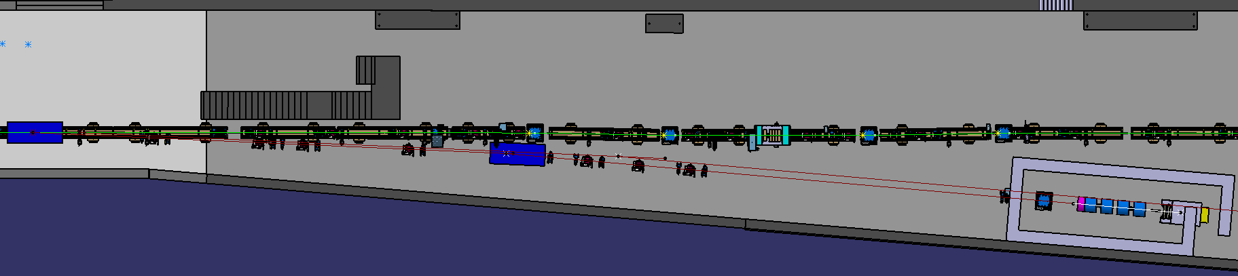
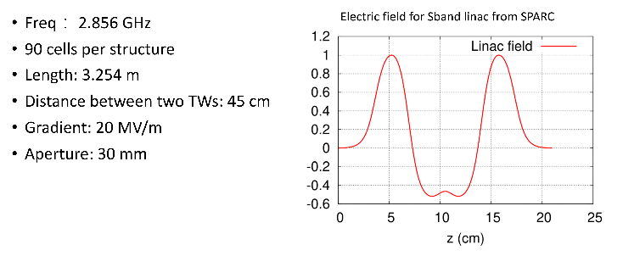
FCC-ee pre-injector complex
final energy 10 or 20 GeV
I. Chaikovska, B. Bai, A. Faus-Golfe et al.
200 MeV
FCC-ee demonstrator e⁺ source at SwissFEL for e⁻/e⁺ conversion & capture efficiency
high-yield positron source target with SC solenoid or flux concentrator
SwissFEL 6 GeV C-band linac

Slide 19
Stage 2: FCC-hh (pp) collider parameters
parameter | FCC-hh |  | HL-LHC | LHC
collision energy cms [TeV] | 100 |  | 14 | 14
dipole field [T] | ~17 (~16 comb.function) |  | 8.33 | 8.33
circumference [km] | 91.2 |  | 26.7 | 26.7
beam current [A] | 0.5 |  | 1.1 | 0.58
bunch intensity [10¹¹] | 1 | 1 | 2.2 | 1.15
bunch spacing [ns] | 25 | 25 | 25 | 25
synchr. rad. power / ring [kW] | 2700 |  | 7.3 | 3.6
SR power / length [W/m/ap.] | 32.1 |  | 0.33 | 0.17
long. emit. damping time [h] | 0.45 |  | 12.9 | 12.9
beta* [m] | 1.1 | 0.3 | 0.15 (min.) | 0.55
normalized emittance [μm] | 2.2 |  | 2.5 | 3.75
peak luminosity [10³⁴ cm⁻²s⁻¹] | 5 | 30 | 5 (lev.) | 1
events/bunch crossing | 170 | 1000 | 132 | 27
stored energy/beam [GJ] | 7.8 |  | 0.7 | 0.36

Slide 20
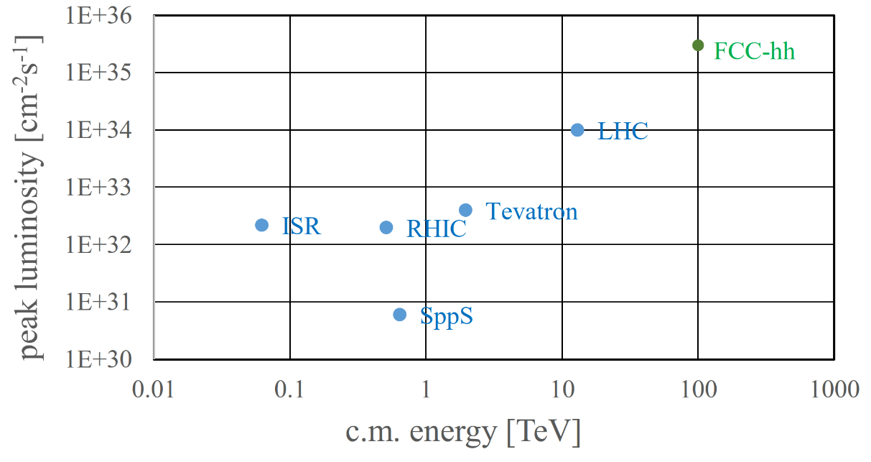
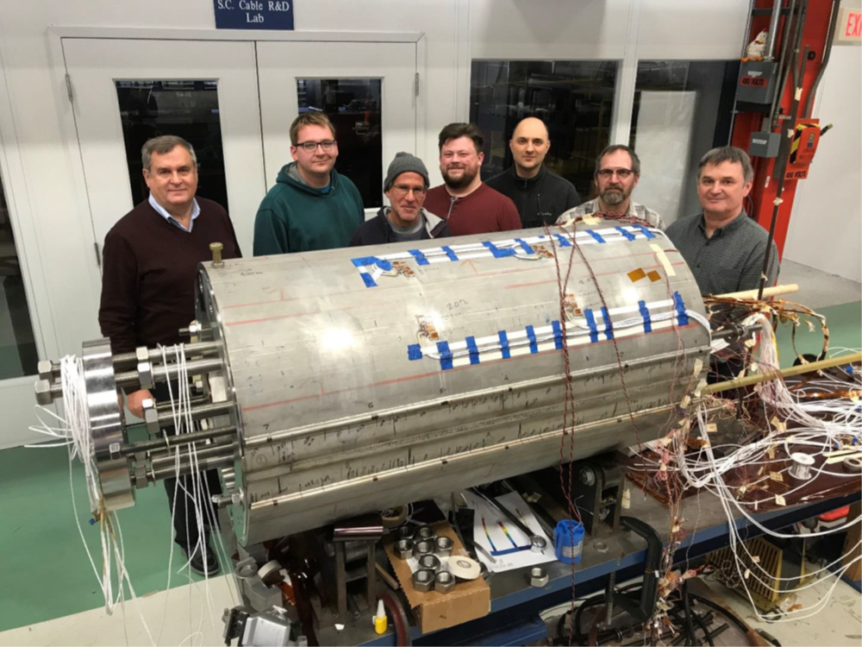
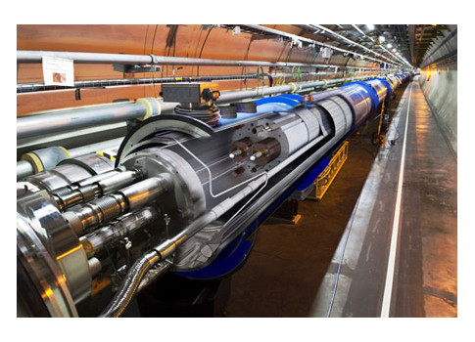
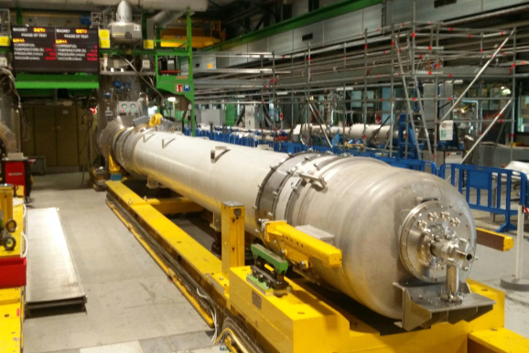
FCC-hh: highest collision energies
order of magnitude performance increase in both energy & luminosity
100 TeV cm collision energy (vs 14 TeV for LHC)
20 ab-1 per experiment collected over 25 years of operation (vs 3 ab⁻¹ for LHC)
similar performance increase as from Tevatron to LHC
key technology: high-field magnets
from
LHC technology
8.3 T NbTi dipole
via
HL-LHC technology
12 T Nb₃Sn quadrupole
FNAL dipole demonstrator
4-layer cosϑ
14.5 T Nb₃Sn in 2019

Slide 21
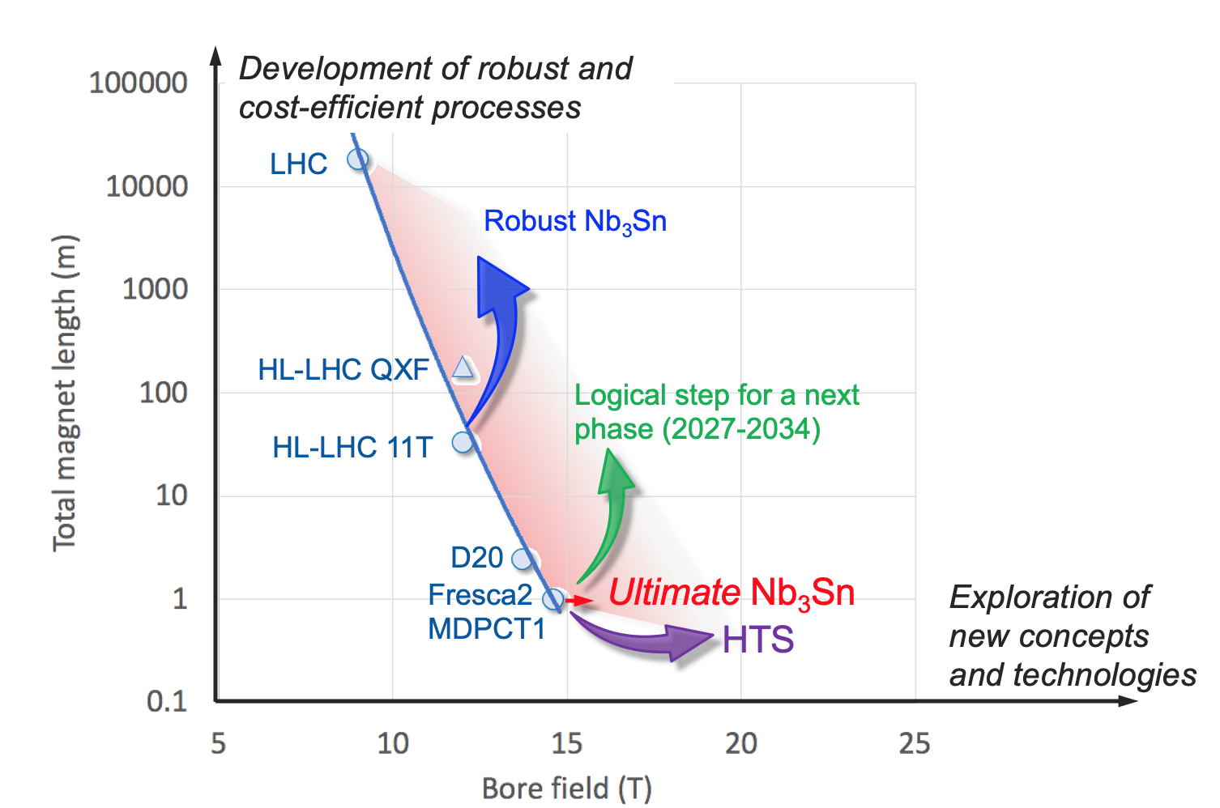
High-field magnets R&D: 1st steps towards FCC-hh
In parallel to FCC Study, HFM development program as long-term separate R&D project
Main R&D activities:
materials: goal is ~16 T for Nb₃Sn, at least ~20 T for HTS inserts
magnet technology: engineering, mechanical robustness, insulating materials, field quality
production of models and prototypes: to demonstrate material, design and engineering choices,
industrialisation and costs
infrastructure and test stations: for tests up to ~ 20 T and 20-50 kA
Global collaborations already established during FCC CDR phase.

Slide 22

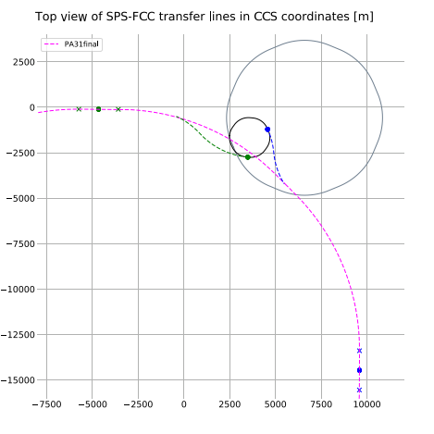
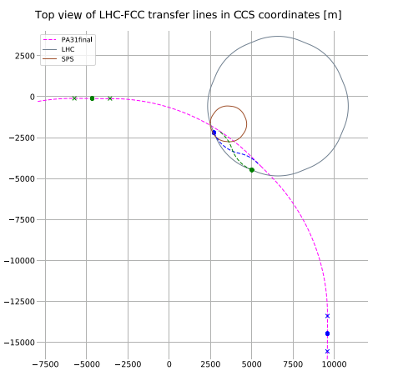

hadron injector lines for new layout
injection from LHC
injection from scSPS
NC (left) or
SC transfer lines (below)
IP1
Alternative:
scSPS @ 1.2 TeV
IP8
Baseline:
LHC @ 3.3 TeV
tunnel lengths:
• LHC, SC, 3.2/3.5 km
• SPS, NC, 4.6/3.2 km
• SPS, SC, 1.5/2.1 km

Slide 23
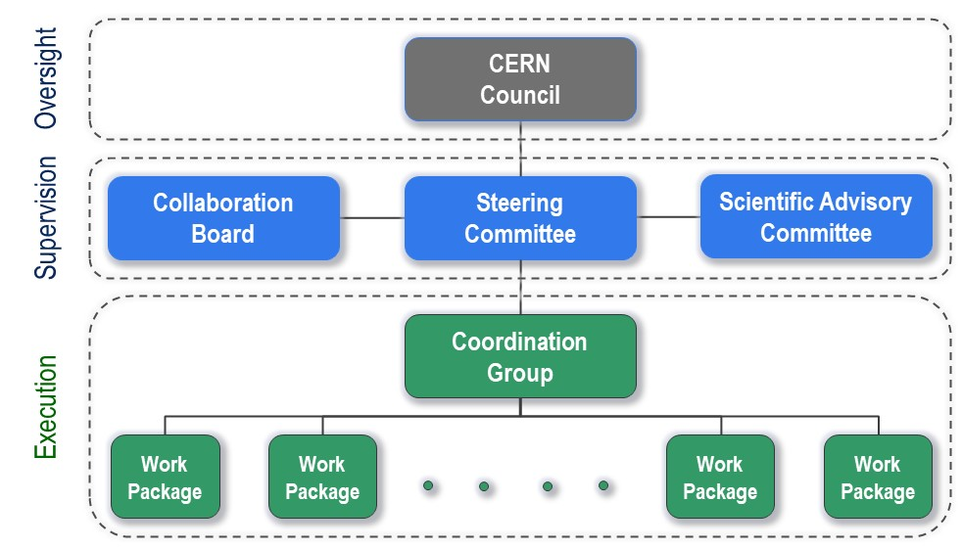
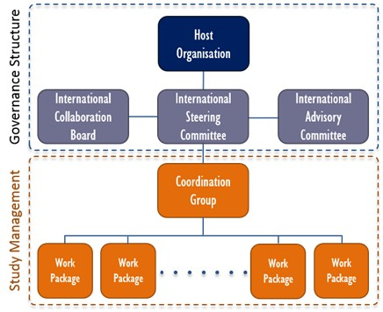
FCC Feasibility Study - organisational structure
  New structure very similar to the first phase of the FCC Study (2014-2020), leading to the Conceptual Design Report as input to the ESPPU.
  Classical structure common to CERN projects.

Slide 24

Status of Global FCC Collaboration
Increasing international collaboration as a prerequisite for success:
links with science, research & development and high-tech industry will be essential to further advance and prepare the implementation of FCC
147
Institutes
30
Companies
34
Countries
EC
H2020
FCC Feasibility Study: 58 fully-signed previous members, 17 new members, MoU renewal of remaining CDR participants in progress

Slide 25
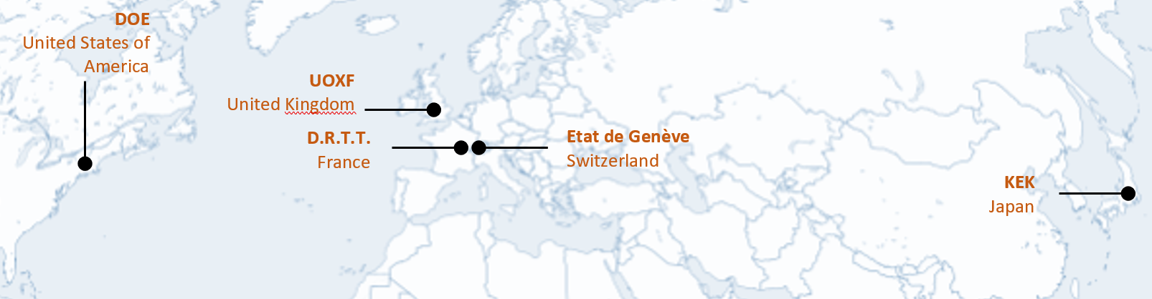
H2020 DS FCC Innovation Study 2020-24
Topic | INFRADEV-01-2019-2020
Grant Agreement | FCCIS 951754
Duration | 48 months
From-to | 2 Nov 2020 – 1 Nov 2024
Project cost | 7 435 865 €
EU contribution | 2 999 850 €
Beneficiaries | 16
Partners | 6
Beneficiaries
Partners

Slide 26
Objectives of FCCIS (Description of Action)
O1: Design a circular luminosity frontier particle collider with a research programme to remain at the forefront of research
O2: Demonstrate the technical and organizational feasibility of a 100 km long, circular particle collider
O3: Develop an innovation plan for a long-term sustainable research infrastructure that is seamlessly integrated in the European research landscape
O4: Engage stakeholders from different sectors of the society
O5: Demonstrate the role and impact of the research infrastructure in the innovation chain, focusing on responsible resource use and managing environmental impacts

Slide 27

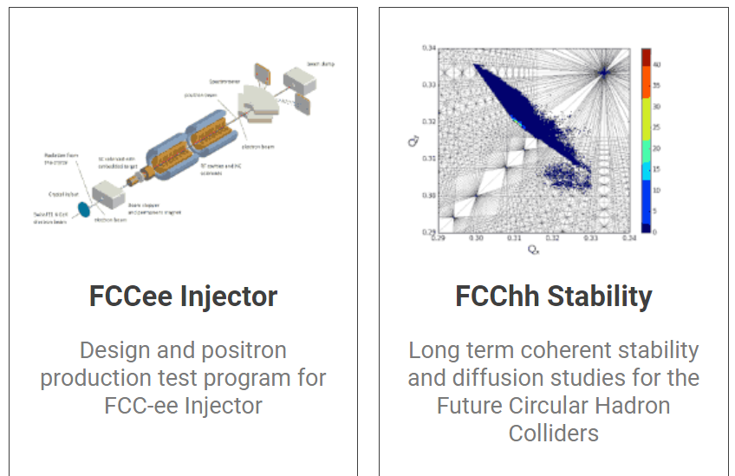
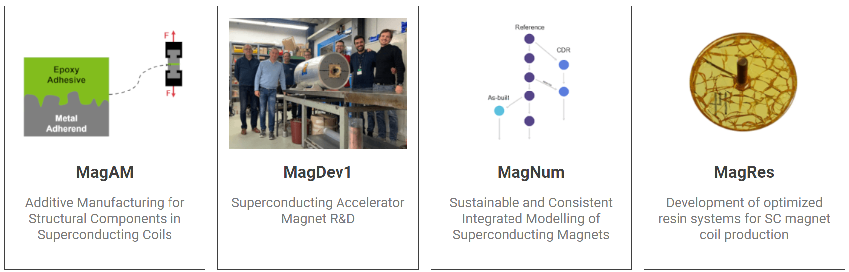
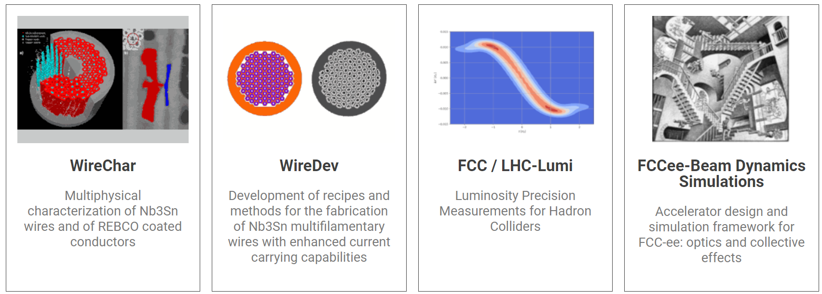
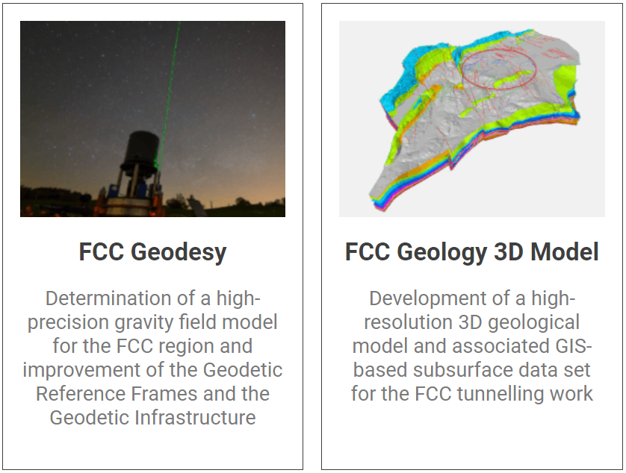
CHART – Switzerland
Founded in 2016 as umbrella organization for accelerator research and technology activities in Switzerland to support FCC via co-funded projects with CERN, PSI, ETHZ, EPFL and U Geneva. Dedicated CHART funding 10.5 MCHF for FCC FS

Slide 28
Summary
The European Strategy Update 2019/20 issued the request for a feasibility study of the FCC integrated programme to be delivered by end 2025.
The main activities of the FCC Feasibility Study are:
  concrete local/regional implementation scenario in collaboration with host state authorities,
  accompanied by machine optimization, physics studies and technology R&D,
  performed via global collaboration and supported by EC H2020 Design Study FCCIS,
  in parallel High Field Magnet R&D program as separate line, to prepare for FCC-hh.
Long term goal: world-leading HEP infrastructure for 21st century to push the particle-physics precision and energy frontiers far beyond present limits.
Next important milestone is the mid-term review planned for autumn 2023.
Success of FCC relies on strong global participation. Everybody interested is warmly welcome to join the effort!
Have an excellent FCC Week here in Paris!

