Slide 1
Wolfgang Lohmann
BTU, DESY and RWTH
on behalf of FCAL
R&D for lumionometers at e⁺e⁻ colliders

Slide 2
FCAL R&D Collaboration
FCAL was founded in 2002
The mission was R&D for the instrumentation of the very forward region of detectors at future e⁺e⁻ colliders, design, contruction and test of prototypes.
In its best times:
70 physicists
15 Institutes, from Americas, Asia, Europe
Contacts to ILD, SiD and CLICdp detector concepts

Slide 3
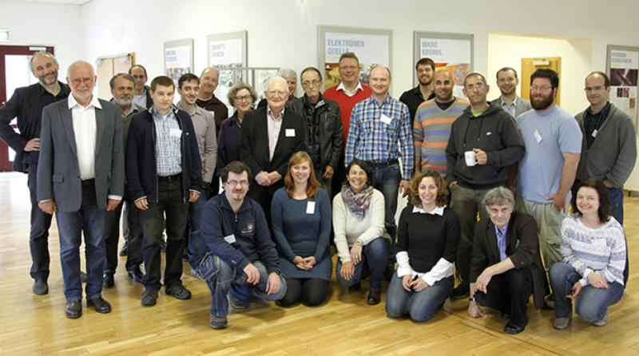
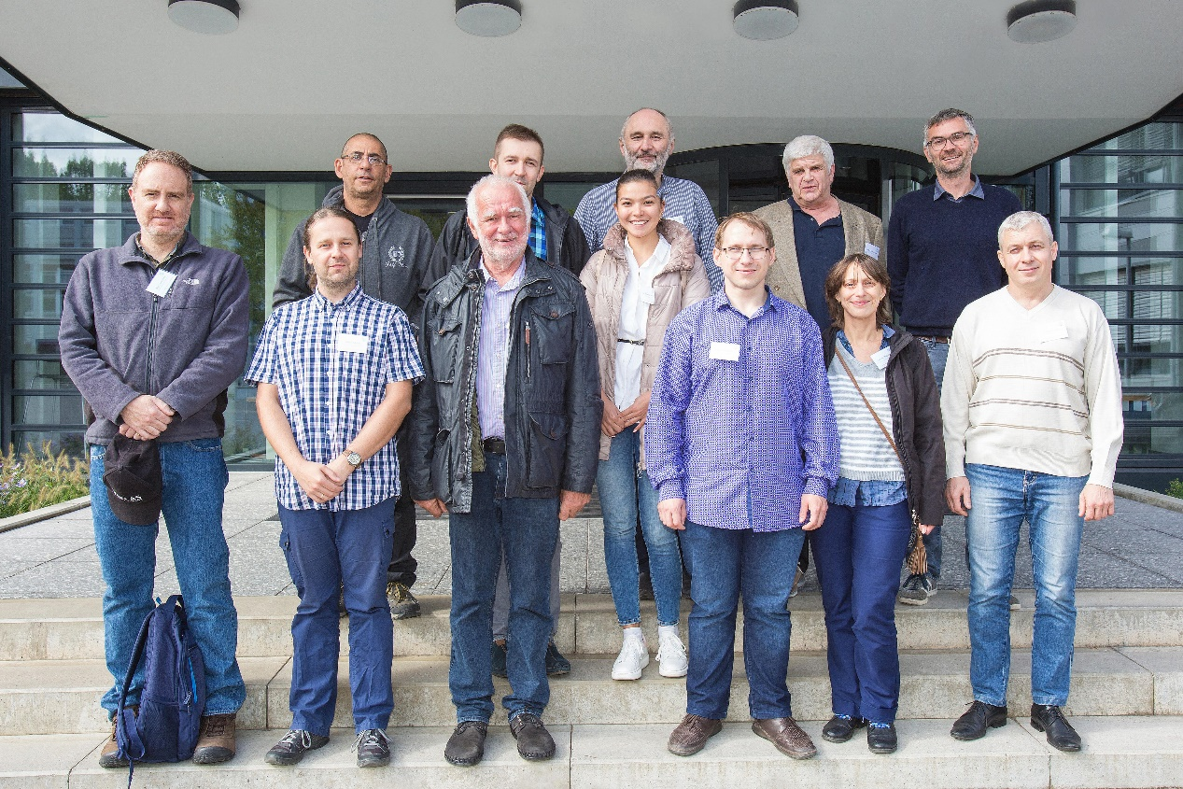
FCAL R&D Collaboration

Slide 4
Design of the very forward region
Forward region of an e⁺e⁻ collider detector
LumiCal for precise
luminosity measurement
(Counting Bhabhas)
BeamCal for fast luminosity
Measurement
(using beamstrahlung)
Both for large polar angle
coverage
(important for new particle
searches)
Technology choice: Si or GaAs/W sandwich calorimeters
1 X₀ absorber thickness, 20 (30) layers in ILC (CLIC)
Small Moliere radius
High granularity

Slide 5
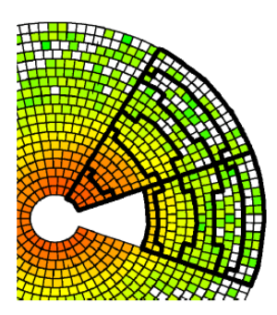
BeamCal Simulations
Fast readout of beamstrahlung pair depositions in areas after each bunch crossing
In addition energy of beamstrahlung photons (E_{γ} in GamCal)
Fast luminosity estimate using beamstrahlung depositions (bunch-by-bunch at ILC)
Beam parameter estimation
Fast feedback to the machine
JINST 3 (2008) P10004
Dedicated ASIC development with fast AND to be used in the feedback system
Fast response to separate incoming machine induced background from beamstrahlung
Design done, no prototypes

Slide 6
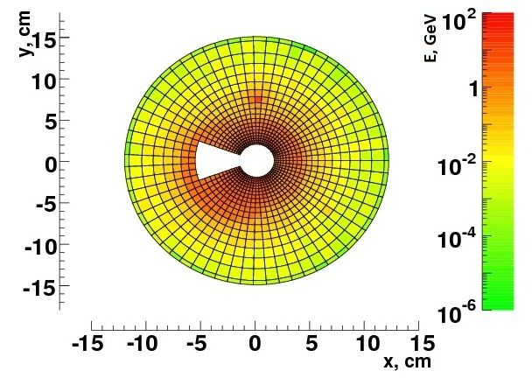
BeamCal simulations
Detection of low angle electrons
Average the background depositions for 10 BX per pad
Subtract them from a signal event
Search for a local shower in the remaining depositions
Local deposition of a single electron
E_{beam}=250 GeV
Efficiency of electron detection,
depends on the relative fraction of the depositions
▼50 GeV
100 GeV
250 GeV

Slide 7

LumiCal simulations
Luminosity is a key parameter in an experiment
$$N=σ⋅L$$
Number of events
Cross section
Luminosity
Precision requirements on L derived from physics, expected statistics of e⁺ e⁻ → f f (γ)
O (10⁻³) up to 500 GeV, e.g. ILC (few years of running, 500 fb⁻¹ )
O (10⁻²) up to 3 TeV, e.g. CLIC
Better O (10⁻⁴) for running at Z
The gauge process is low angle Bhabha scattering, e⁺e⁻ → e⁺e⁻(γ)
Strong requirements on the mechanical and position precision of LumiCal
JINST 5 (2010) P12002

Slide 8

LumiCal
$$L=\frac{N_{BH}}{σ_{BH}}$$
Number of Bhabha events in a certain θ range
Luminosity measurement
Bhabha cross section (from theory)
range
Challenge is the control of the inner acceptande limit, O (10μm)
Sharp edges
Small leakage
A small range is important in case limited space available
Bias on polar angle measurement
Requires small Moliere radius!

Slide 9
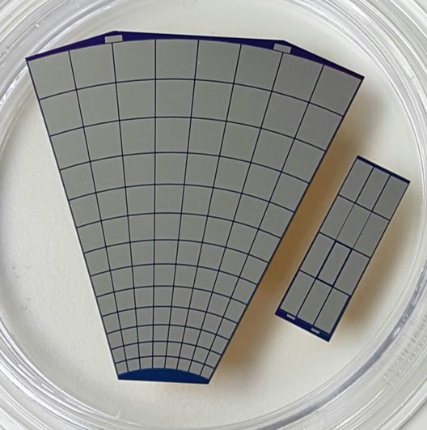
Sensor Technology BeamCal: GaAs
Development of high resistivity GaAs sensors with Tomsk State University
Test-beam
S/N ≈ 20
Sensor thickness 500 μm
Resistivity 10⁹ Ωm
Bias voltage 100 V
Leakage current O(100nA) per pad
Rad hard up to several MGy (electrons → beamstrahlung pairs)
JINST 7 (2012) P11022

Slide 10
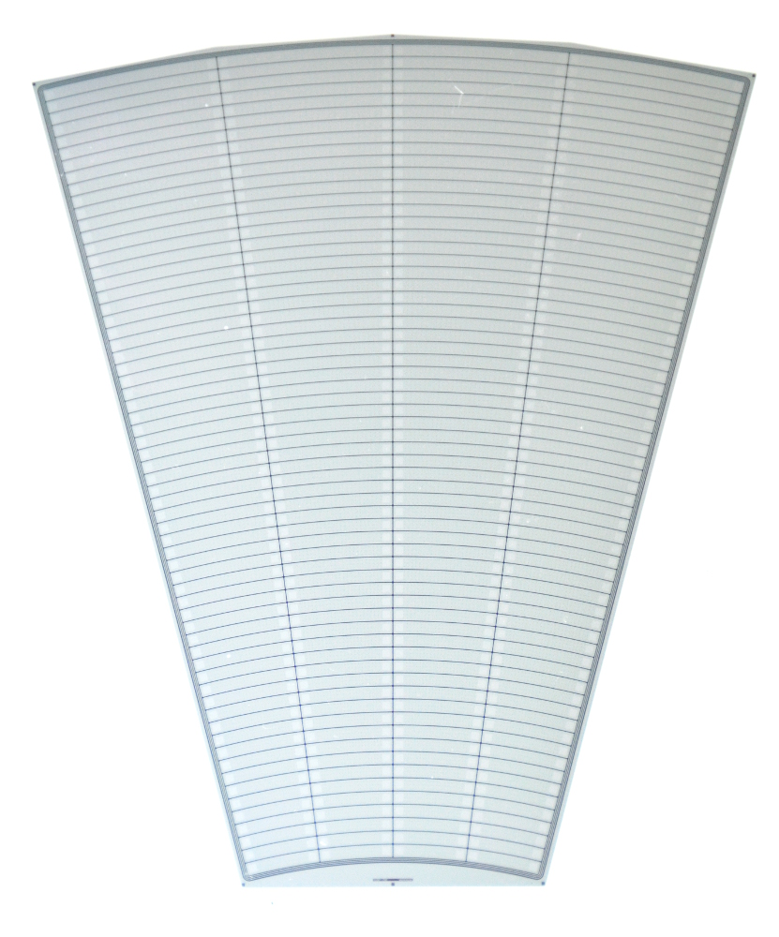
Sensor Technolgy LumiCal: Silicon
Developed with Hamamatsu
Thickness 320 μm
p⁺ in n
DC coupled to FE
Outer active radius R = 195.2 mm
Inner active radius R = 80.0 mm
Si sensor prototype
Full depletion at 60-70 V

Slide 11
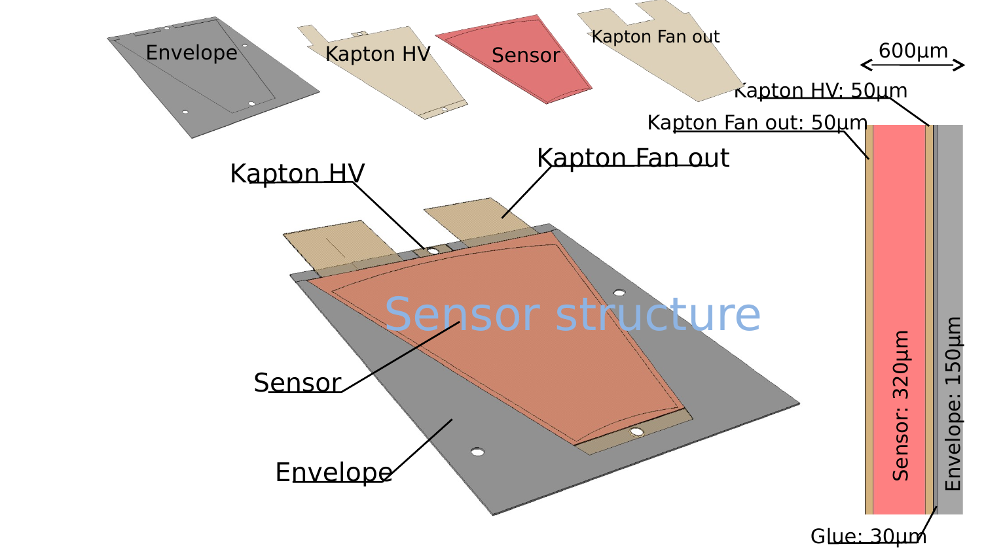
Technology detector planes
To keep the Moliere radius small:
Thin sensor planes (< 1mm)
Readout via copper traces on flexible Kapton PCB

Slide 12
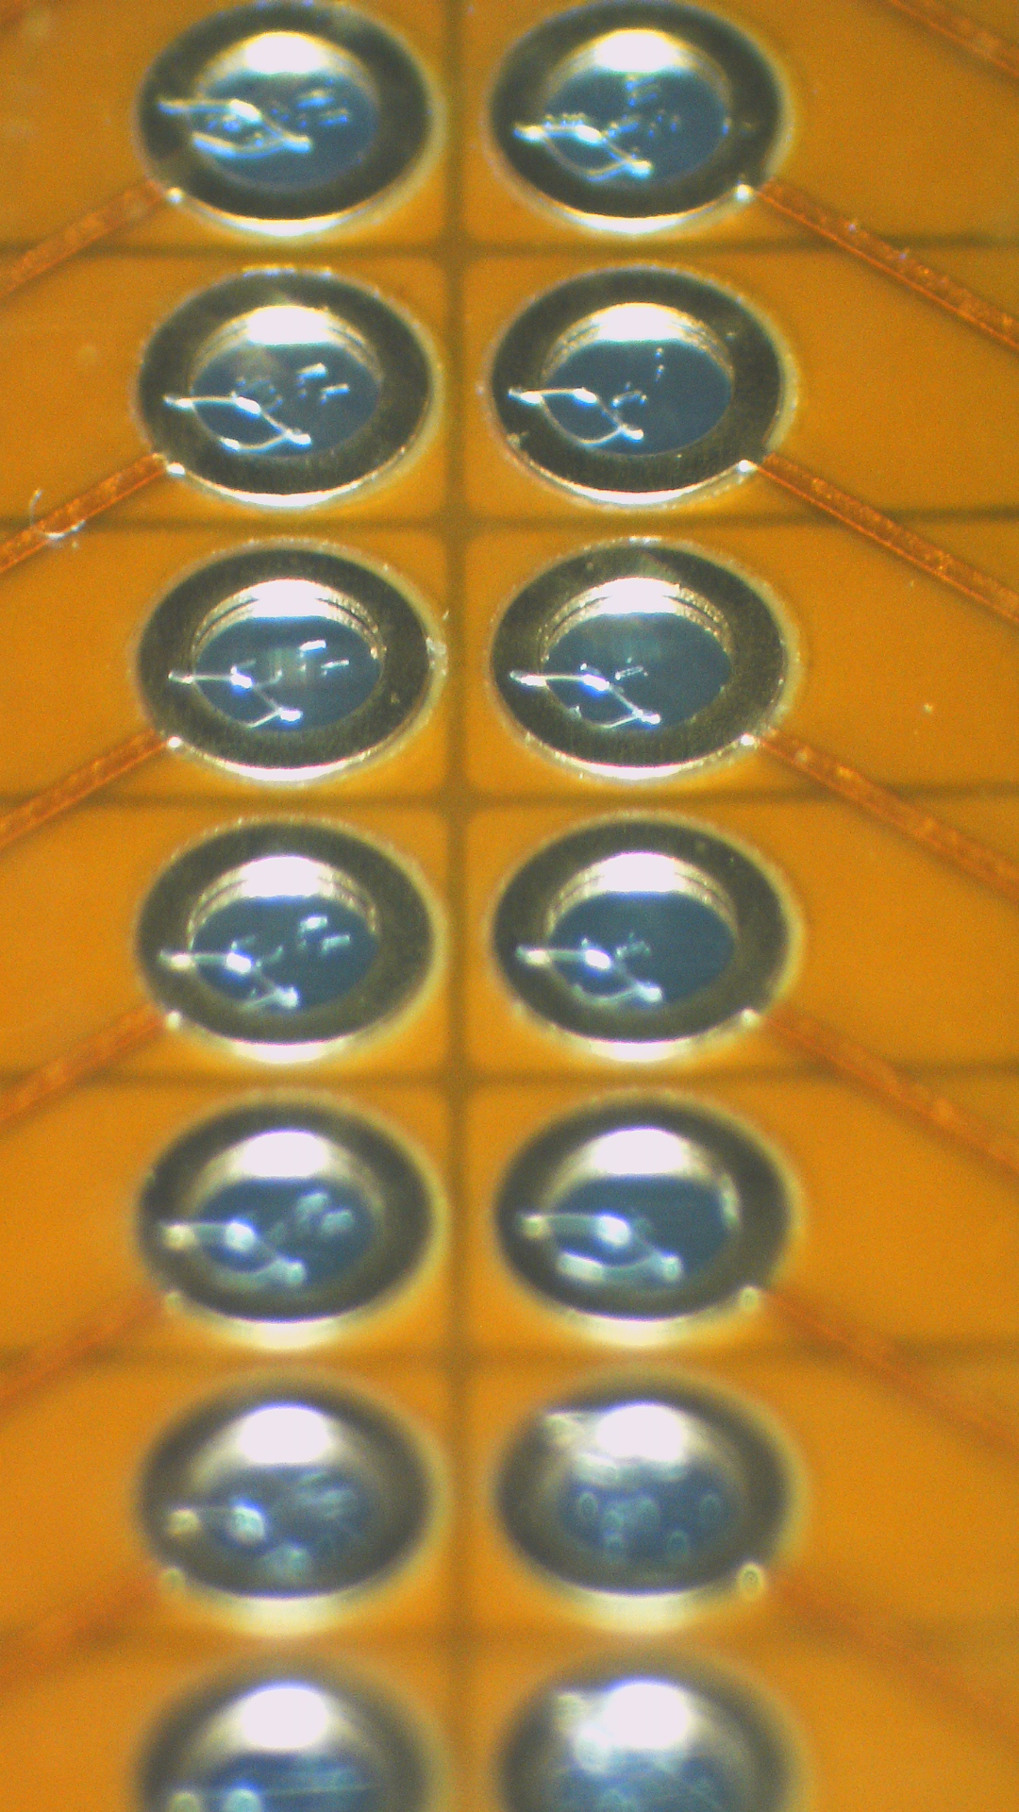
Technology detector planes
Connecting the sensor pads to copper traces on Kapton fan-out
Keep bond loops below 100 μm

Slide 13
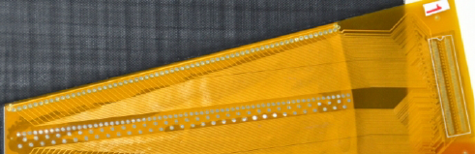
Technology detector planes
Connecting the sensor pads to copper traces on Kapton fan-out
Keep bond loops below 100 μm

Slide 14
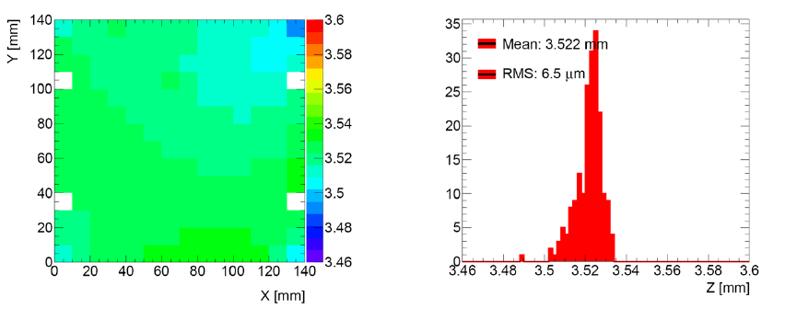
Technology W-Plates
W-plates of high planarity
Max. deviation O(10μm)
Alloy: W (92.5%) Ni (5.25%), Cu (2.25%)
Density: 18 gcm⁻³

Slide 15
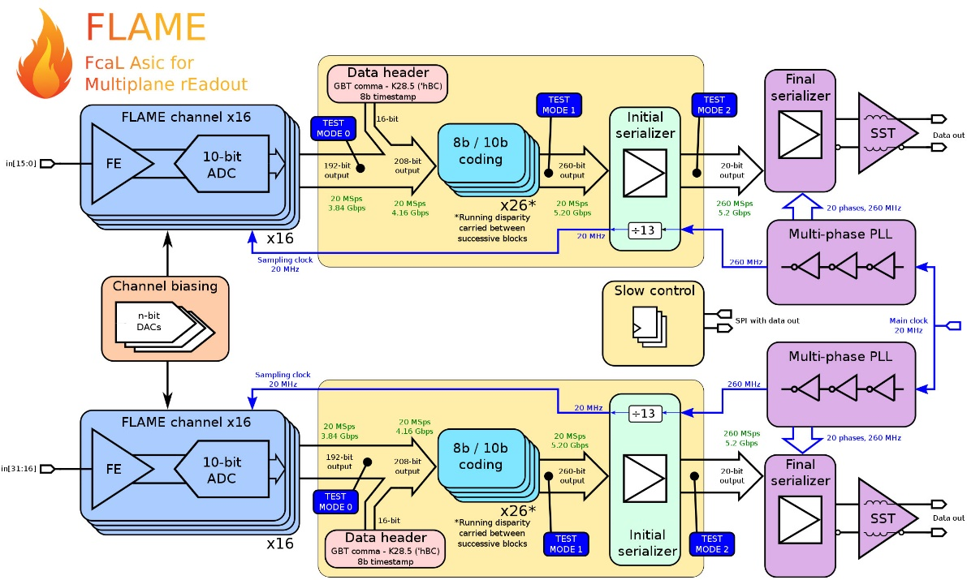
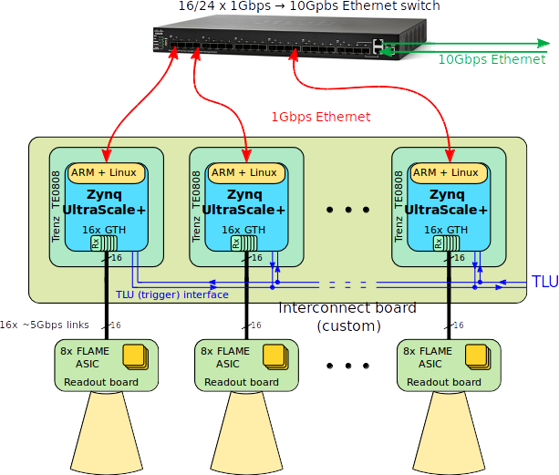
FE electronics
Variable gain (MiP sensitive)
10-bit SAR
Peaking time 55 ns
Power dissipation 2 mW per channel, power pulsing foreseen
Dedicated FE electronics in 130 nm TSMC
Signal processing using FPGA
JINST 10 C01018

Slide 16
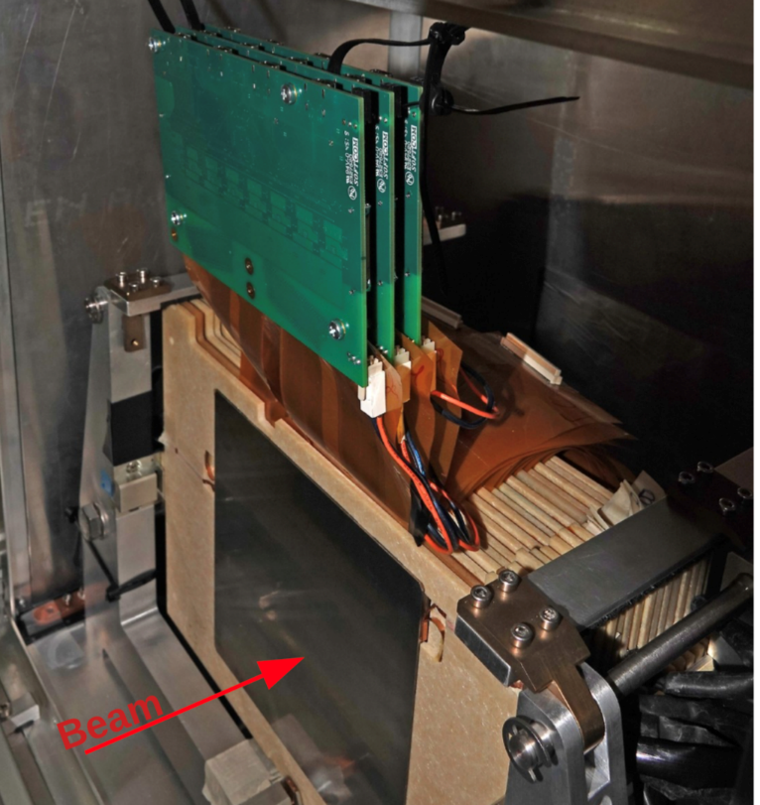
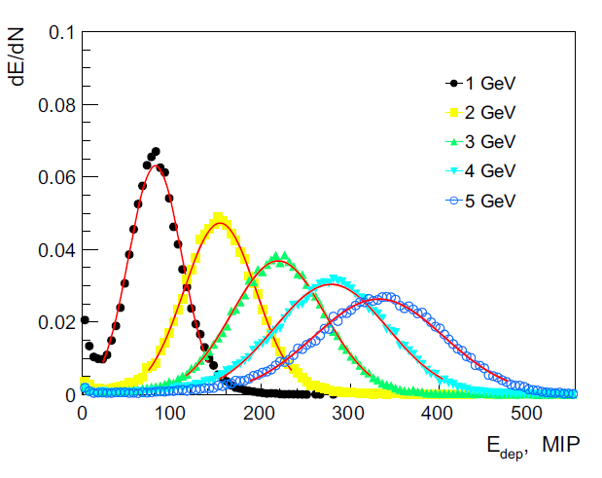
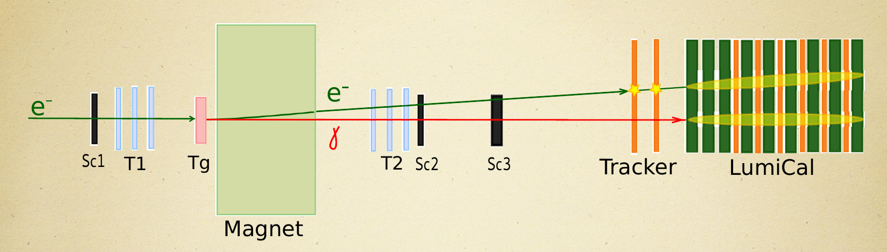
Prototype
LumiCal prototype
20 sensor/absorber planes available
Partly instrumented with FLAME ASICs
(remaining with APV25)
TLU trigger box, EUDAQ (SRS from RD51)
Energy deposited in the calorimeter
Test-beam scheme

Slide 17
Test-beam results
Longitudinal shower development, data/MC comparison
Shower position resolution 440 μm
Transverse shower development, data/MC comparison (a) shower core, (b) 2 pads away, (c) 5 pads away, 7 X₀ downstream

Slide 18
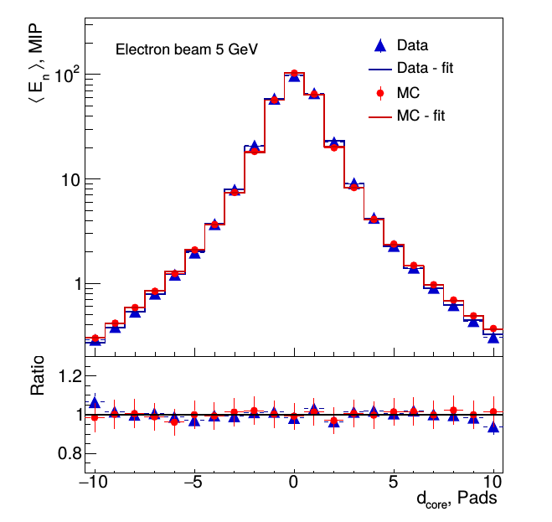
Moliere radius
Effective Moliere radius: ~ 8 mm (5GeV)
approaching the technological limit
Projection of the energy deposition on the transverse plane
Energy dependence of R_{M} due to limited number of instrumented sensor planes (6)
Published in: Eur.Phys.J.C 79 (2019) 7, 579

Slide 19
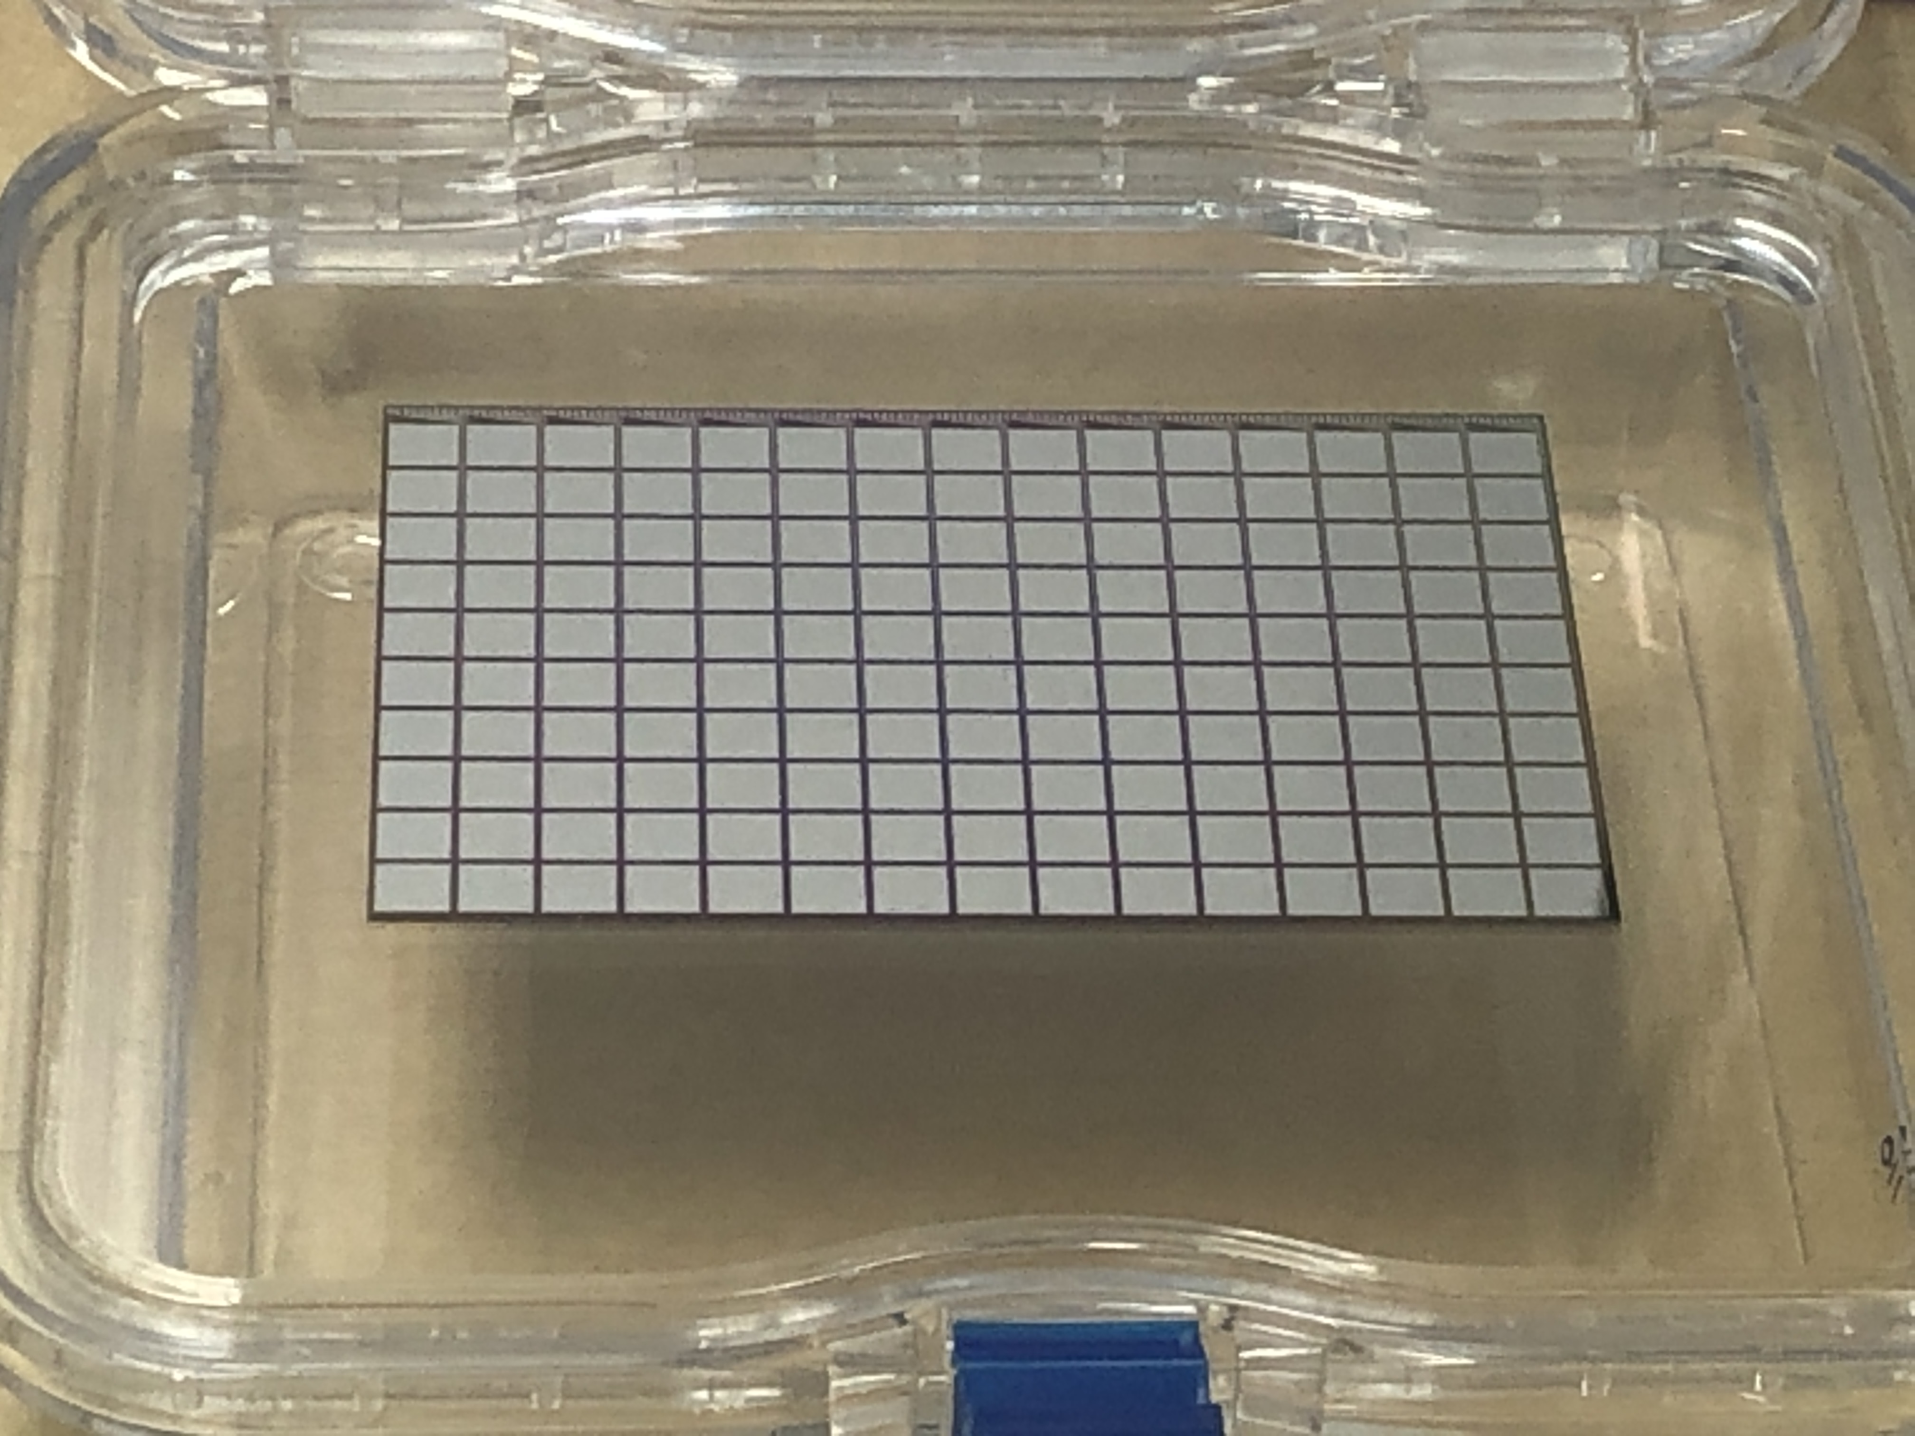
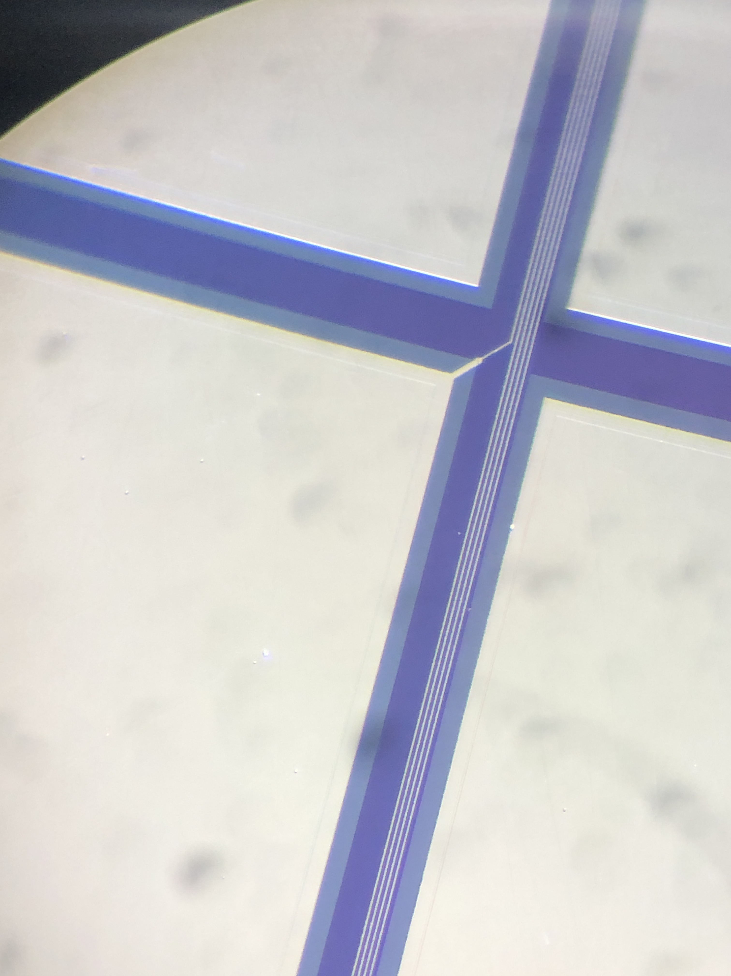
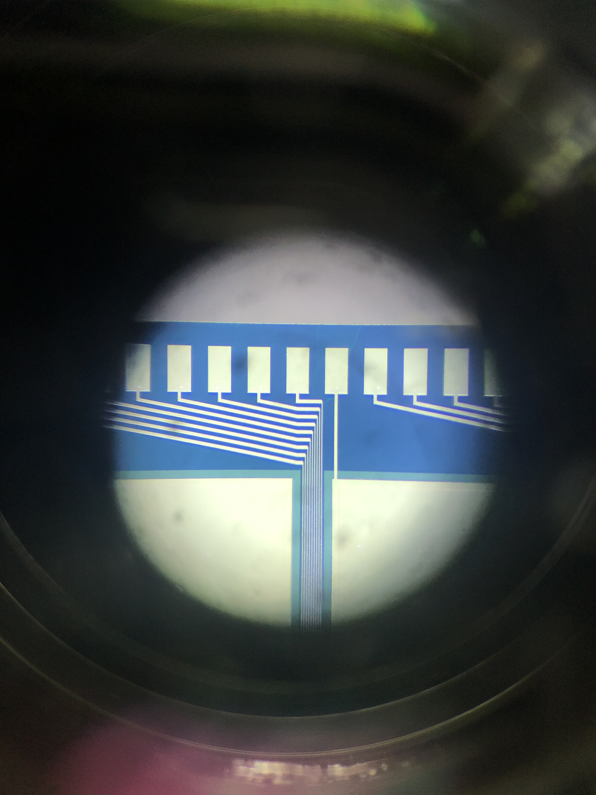
new technology GaAs sensors
New technology→Sensors, with signal routing integrated on the
sensor
15 x 10 pads
Pad connected to Al readout trace
Bond pads at the upper sensor edge,
To be connected to the FE ASIC

Slide 20
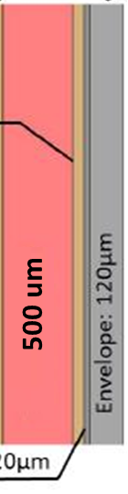
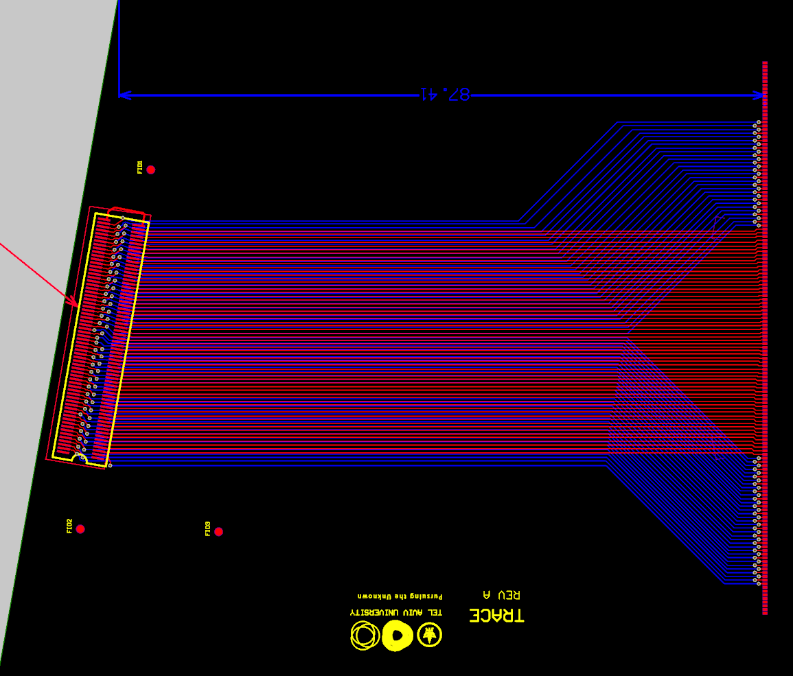


Read out connections
Assembled sensor plane
Sensor: 500um
Thickness 710 μm
Details still to be designed for a robust and reliable connectivity scheme,
Prototype below

Slide 21
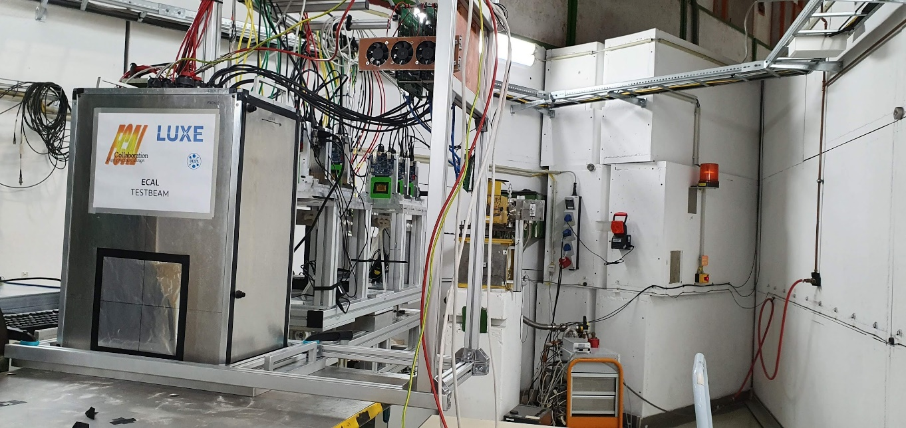
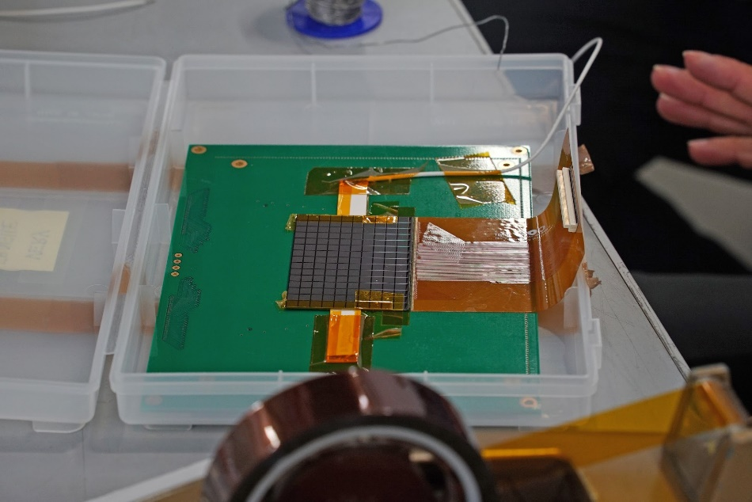
Testbeam
New signal routing technology on GaAs sensors
Beam test Nov. 8-14 2021 at T24 at DESY
Sensor box (DUT) downstream of the beam talescope
Two GaAs sensors (with new routing Al strips) and two Calice silicon sensors were prepared to be connected to FLAME readout

Slide 22
Test-beam results
Signal size for Si and GaAs similar (due to very low hole mobility in GaAs)
MPV values for several pads
Signal distribution

Slide 23
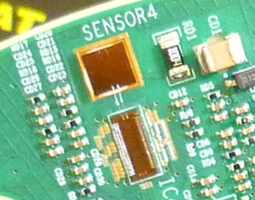
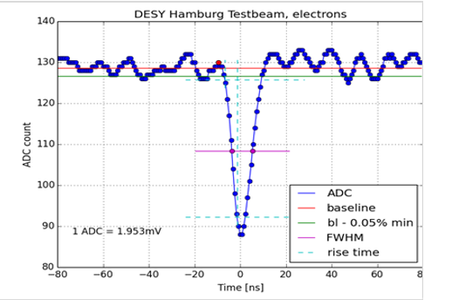
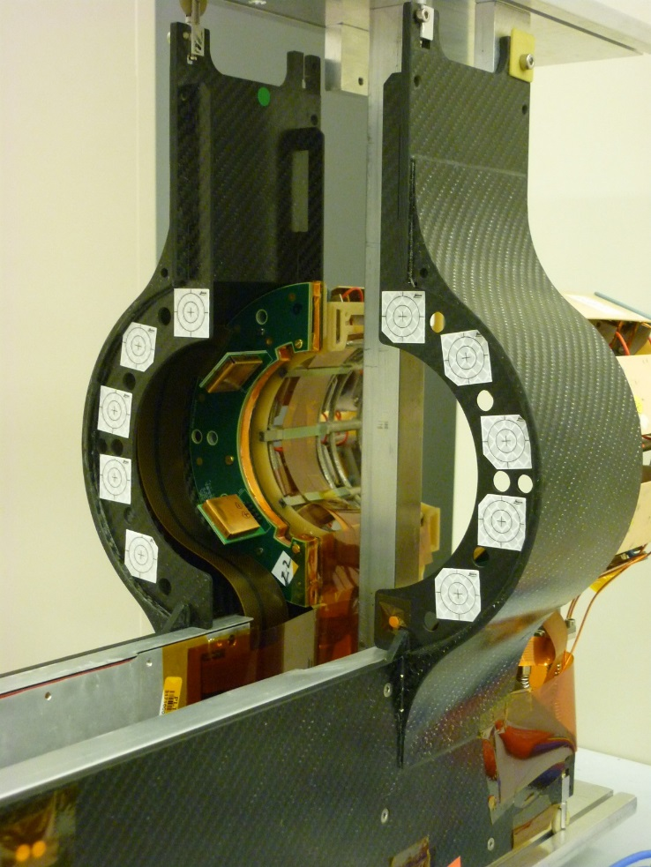
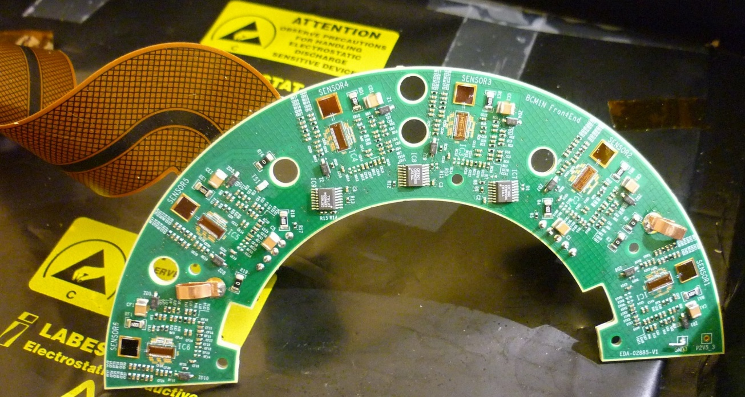
Spin-offs
Luminometer and Beam Condition Monitor for the CMS experiment
sensor pads (Si diodes or diamond)
Carbon fiber structure
Front-end ASIC, supers-fast (sub-Nanosecond time measurement)
Designed in UST Krakow & CERN
Half ring with flexible Kapton PCB
BCM1F
Beam-pipe
Components of FLAME are used in the upgrade of the CMS HGCAL

Slide 24
Summary
Two luminometers, BeamCal and LumiCal are designed for ILC or CLIC- like collider.
Fine-granular sensors and dedicated FE electronics were developed.
Assembled sensors planes of less than 1 mm thickness were build.
The transversal and longitudinal shower shape was measured in an electron beam up to 5 GeV, and compared with simulations, very good agreement found.
The effective Moliere radius was measured and approched the ‚technological limit‘.
GaAs sensors have been developed with signal routing traces integrated in the sensor.
Test-beam results show expected performance, signal size comparable to silicon.
The current political situation requires to reconsider the next steps.
FCAL has still millions of test-beam data from the fully instrumneted prototype. Person-power for analysis currently very small.

Slide 25
Lessons for other colliders
The polar angle range must be adapted to collect sufficient Bhabha event statistics
(depends on available space, energy)
Data flux to be adapted to expected rates
Background, beam-strahlung, bunch-charge density impact, polarisation to be considered
Flame peaking time of 55 ns was set for ILC. Use at CLIC was possible thanks to
low Bhabha rate per BX, and time resolution of a few ns.

Slide 26
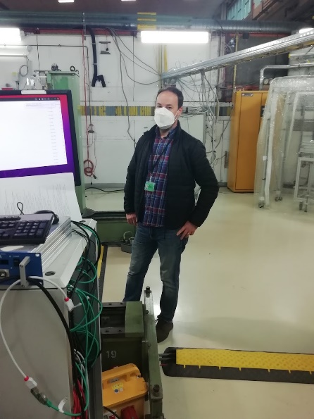
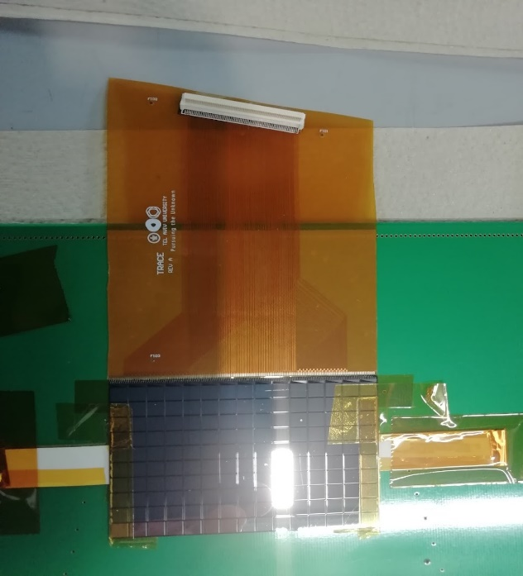
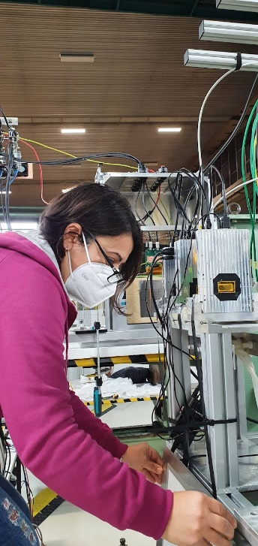
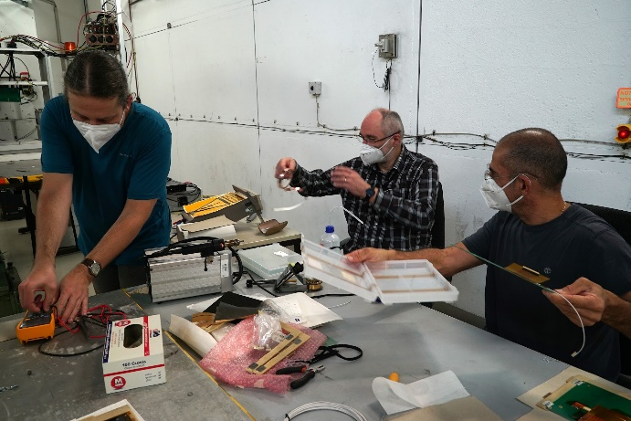
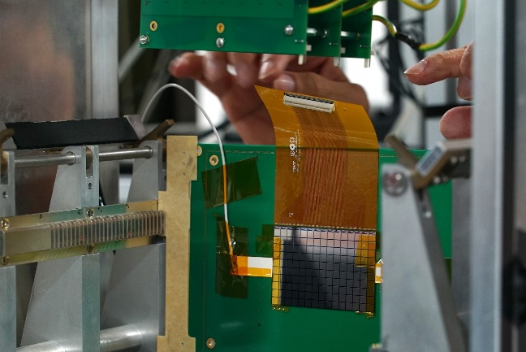
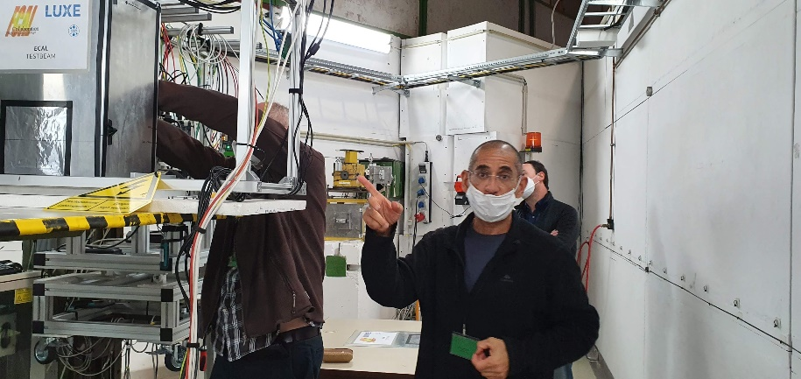
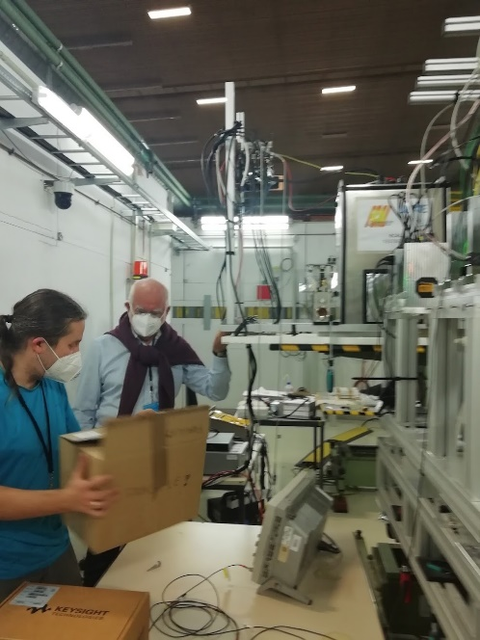
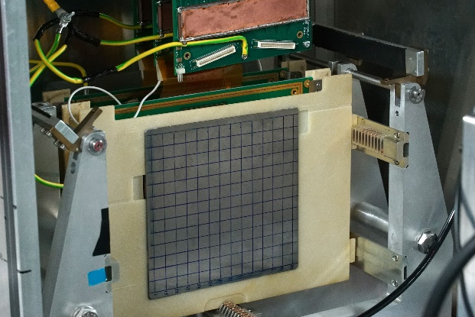
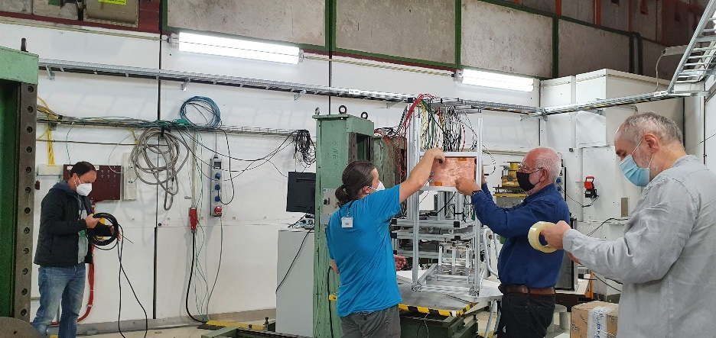
Beam-test campaign
Participants from AGH-UST, ISS TAU

Slide 27
backup

Slide 28
GaAs sensors
GaAs measurement results 2011
Response to a single electron
Using the information from the ZEUS beam telescope
Growing pad size

Slide 29
Test-beam results
MPV as a function of the pad number
Similar for GaAs and silicon sensors,
Assuming 5% calibration uncertainty of the FE ASIC channels -> response is independent of the pad number
Quantitative study in the next test-beam

