Slide 1
simulation of fcc-ee beam-beam effects with xsuite
P. Kicsiny, X. Buffat, D. Schulte, M. Seidel
Special thanks to:
F. Carlier, M. Hofer, G. Iadarola, K. Oide, D. Shatilov, T. Pieloni, D. Zhou
FCC-week
1st June 2022

Slide 2
Outline
Outline
Beam-beam effects and modeling
Benchmark highlights
Summary

Slide 3
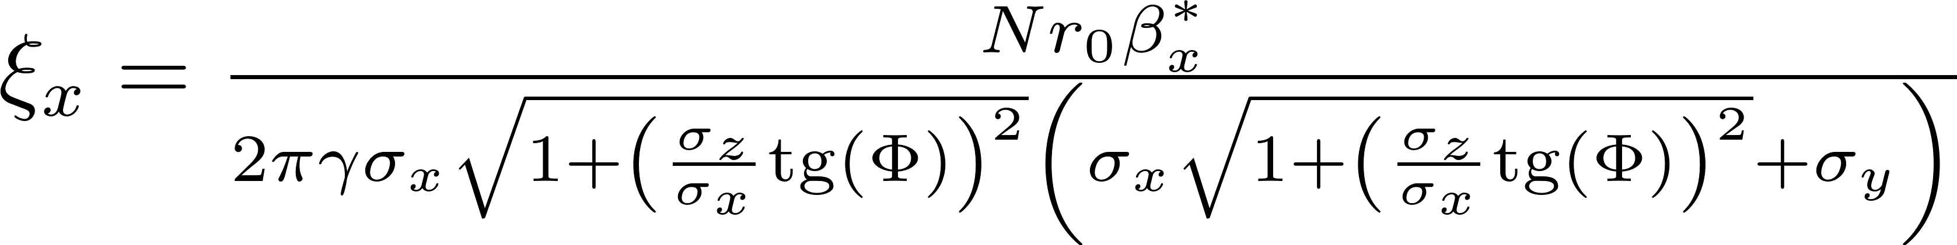
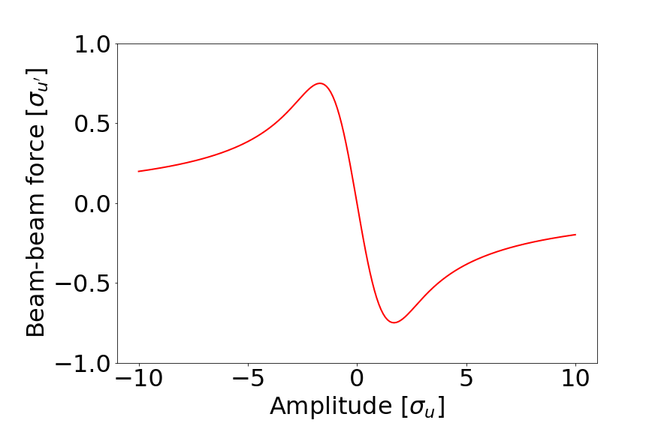

1) Beam-beam effects and modeling
Beam-beam interaction
A particle beam represents an electromagnetic
potential for other charges
Beam acts with a force on other beam
  Beam-beam kick: highly nonlinear
  Harmful consequences for beam dynamics
  Linear strength characterized by beam-beam parameter (ξ)
  No complete theory, simulations have to be used
Force of opposite bunch on a single test particle
u ∈ {x,y}

Slide 4
1) Beam-beam effects and modeling
Beam-beam models
N_{s}
...
2
1
Σ₂
Σ₁
  ~10⁴-10⁷ particles per bunch
  Longitudinal slicing (simplecticity)
  Interaction of slice pairs
    Compute kick using slice moments (Σ)
    Update dynamical variables
Σ₂
Σ₁
1
2
...
N_{s}
multi-turn effects
low disruption parameter
high disruption parameter
single particle effects
slow instabilities
fast instabilities, wakefield & lattice interplay
fastest & least accurate
slowest & most accurate
never
weak-strong [WS]
periodically
quasi strong-strong [QSS]
after each slice-slice
interaction
strong-strong [SS]
Frequency of recomputing slice moments

Slide 5
1) Beam-beam effects and modeling
Beam-beam models
N_{s}
...
2
1
Σ₂
Σ₁
  ~10⁴-10⁷ particles per bunch
  Longitudinal slicing (simplecticity)
  Interaction of slice pairs
    Compute kick using slice moments (Σ)
    Update dynamical variables
Σ₂
Σ₁
1
2
...
N_{s}
In xsuite:
Core algorithm: single slice-slice interaction
Choice between models done by user: specifying update frequency of slice moments
Force: soft-Gaussian kick by Bassetti-Erskine formula [1] (field solvers to be tested in future)
Extendible with features e.g. Beamstrahlung, Bhabha scattering
[1] https://cds.cern.ch/record/122227/files/198005132.pdf

Slide 6
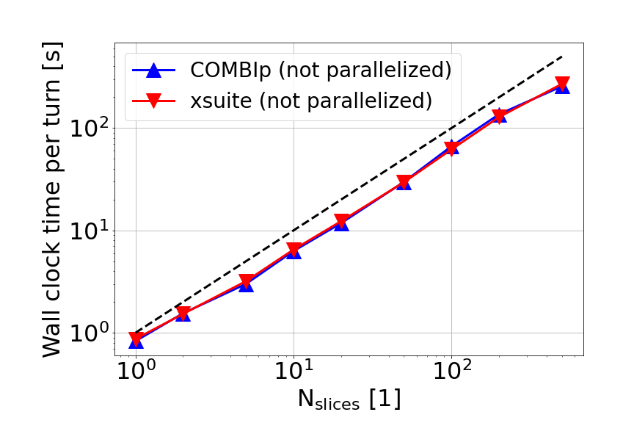

1) Beam-beam effects and modeling
Benchmark of computation (wall clock) time using reference code COMBIp [1]
  Beam-beam (strong-strong)
  Linear tracking
Avg. time per turn scales approximately with the number of longitudinal slices
xsuite runtimes comparable to state of the art
OpenMP and GPU acceleration are available in xsuite, to be tested in future
  Will be needed for full scale simulations
[1] https://twiki.cern.ch/twiki/bin/view/ABPComputing/COMBI

Slide 7
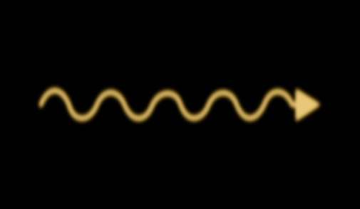

1) Beam-beam effects and modeling
Beamstrahlung
Radiation emitted at collision due to deflection in the collective EM field of the opposite bunch
Harmful effect
  Increases bunch length (σ_{z})
  & energy spread (σ_{δ})
  Decreases luminosity & beam lifetime
Proposed setup [1]:
  Large Piwinski angle + crab waist scheme
    Small beam size, crossing angle, crab sextupoles
  Top-up injection scheme: continuous injection of new bunches
    Maintains luminosity levels & compensates for decreased beam lifetime
At collision
2σ_{y}
2σ_{z}
Main limiting factor of FCC-ee luminosity
[1] https://cds.cern.ch/record/2651299/files/CERN-ACC-2018-0057.pdf

Slide 8
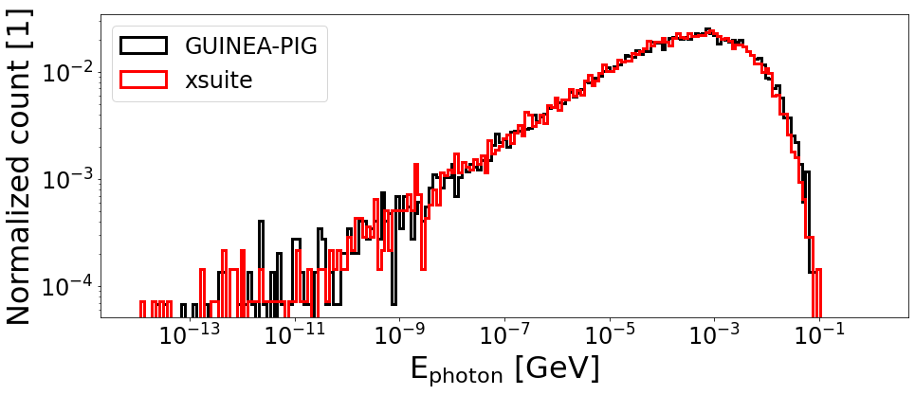
2) Benchmark highlights
Beamstrahlung benchmark
Benchmark against reference code GUINEA-PIG [1]
  FCC-ee Z
  Half crossing angle: 15e-3 [rad]
  Beamstrahlung model OK
  xsuite: weak-strong
  GUINEA-PIG: strong-strong
Possibility to generate photons for external use [2]
TODO: come up with an efficient model of Bhabha scattering
Beamstrahlung photon spectrum / coll.
[1] https://twiki.cern.ch/twiki/bin/view/ABPComputing/Guinea-Pig
[2] https://xsuite.readthedocs.io/en/latest/internal_record.html#internal-record-for-elements-used-in-standalone-mode

Slide 9
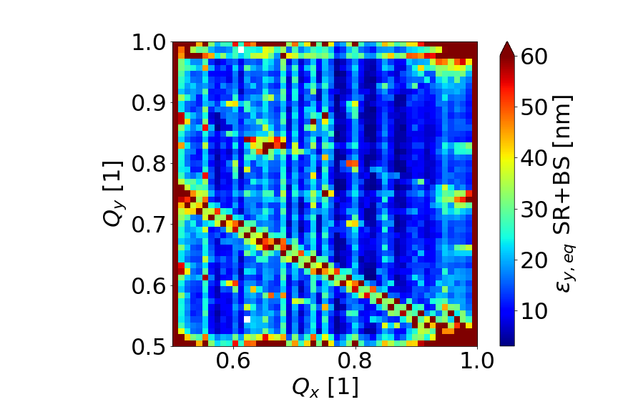
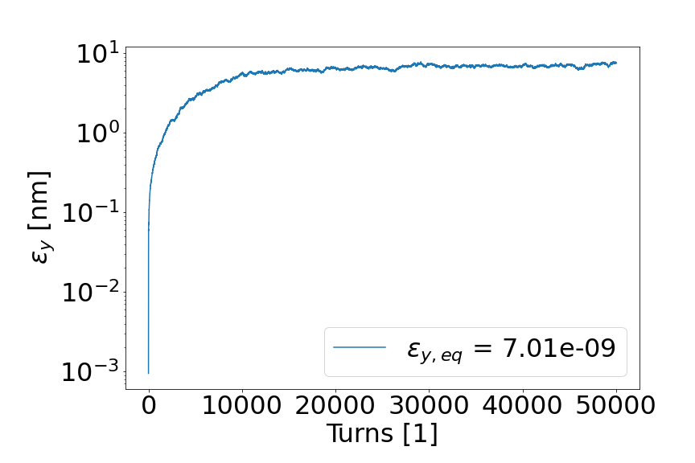
2) Benchmark highlights
Finding optimal working points:
  Tune scans: FCC-ee Z weak-strong tracking including synchrotron radiation + Beamstrahlung
Blowup of transversal emittances due to beam-beam (crab sextupole to be added)
(Q_{x}, Q_{y}) = (.57, .61)
ε_{y,0} = 1e-12
Work ongoing!

Slide 10
3) Summary
Summary
[1] https://github.com/xsuite
  Work so far
  Beam-beam model development & benchmarks
  Beamstrahlung: photon generation available
  Update github repository [1] expected in a few days
  Work ongoing
  Crab sextupoles
  Interplay with real lattice model
  Bhabha scattering
  Top-up injection
  3D flip-flop
  Other xsuite features targeted
  Impact of lattice imperfections (misalignment, orbit and optics corrections)
  Multiple IPs
  Monochromatization
  Wakefields
More on xsuite by T. Pieloni & F. Carlier @ this workshop
Thank you!

Slide 11
backup

Slide 12
Backup
Simulation parameters
 | Runtime benchmark (slide #5) | Beamstrahlung energy spectrum (slide #7) | Tune scan (slide #8)
N slices | scanned | 200 | 200
N macroparticles | 1e6 | 1e5 | 1e3
N turns | 10 | 1 | 5e4
Half crossing angle [rad] | 0 | 15e-3 | 15e-3
ε_{x}/ε_{y} [m] | 2.68e-10 / 2.68e-10 | 2.7e-10 / 2.7e-12 | 2.7e-10 / 1e-12
β_{x}/β_{y} [m] | 1 / 1 | 0.15 / 0.15 | 0.15 / 8e-4
Beamstrahlung | OFF | ON | ON
Beam profile | HL-LHC round Gaussian | FCC-ee flat Gaussian | FCC-ee flat Gaussian
xsuite beam-beam model | strong-strong | weak-strong | weak-strong

Slide 13
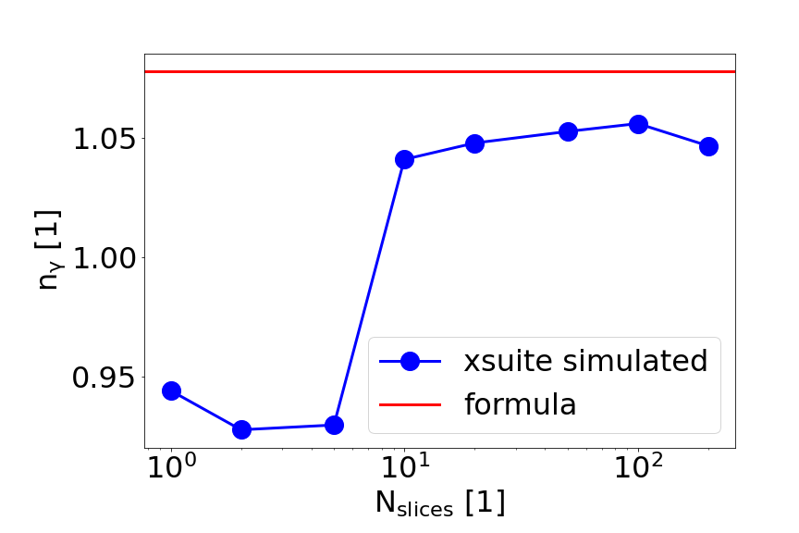
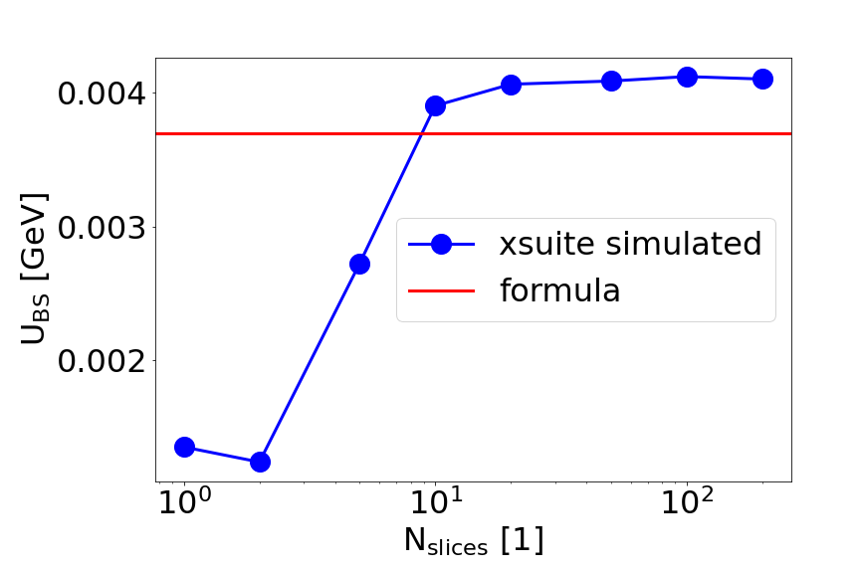
2) Benchmark highlights
Beamstrahlung benchmarks
Avg. num. of emitted BS photons / e⁻ / coll.
Avg. E loss / e⁻ / coll.
Valid for
weak-strong
case
Single weak-strong beam-beam collision; look at num. of emitted photons & E loss
xsuite simulated quantities converge (within 10%) to analytical estimates [1]
[1] https://accelconf.web.cern.ch/ipac2016/papers/wepmw010.pdf

