Slide 1
The Ell Cavities program at CERN: Atomic layer deposition
Thomas Proslier, Yasmine Kalboussi
FCC Week 2022
31th of May 2022

Slide 2
Contents
Atomic Layer deposition
Secondary electron yield
Multilayers
Perspectives

Slide 3
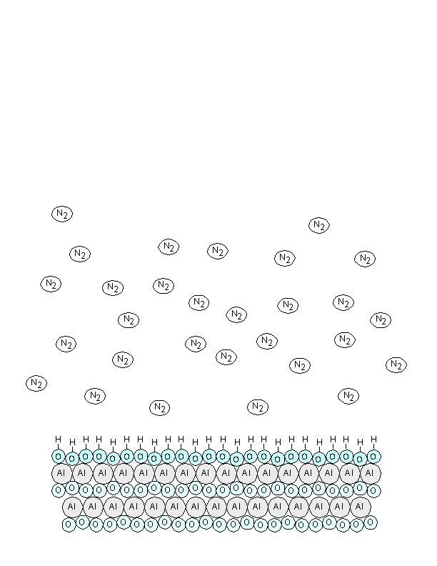
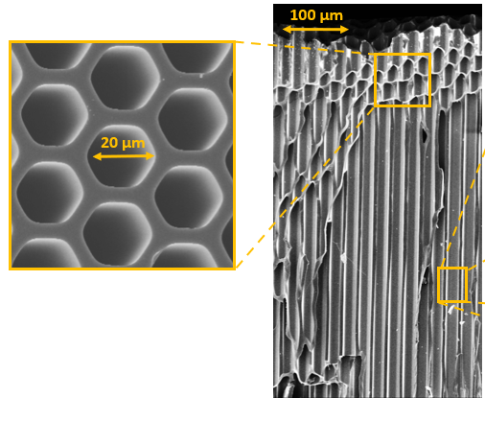
Atomic Layer Deposition
Al₂O₃ = TMA(Al(CH3)₃) + H₂O
Thin films (≤ 1 µm) synthesis technique based on self-limiting surface chemical reactions. Sequential injection of vapor phase precursors . Layer by layer growth. Cycles.
Advantages:
Thickness and composition control down to the atomic level.
Pin-hole free films.
Excellent conformality on complex-shaped and large area substrates.
Large palette of materials.
Low temperatures (RT-450°C)
Limits:
Slow deposition (0.3 to 10 Å/min).
New materials require new chemistry.
Applications:
Micro-electronic, Photovoltaic, Catalysis, Batteries, Detectors…
Electronique flexible

Slide 4
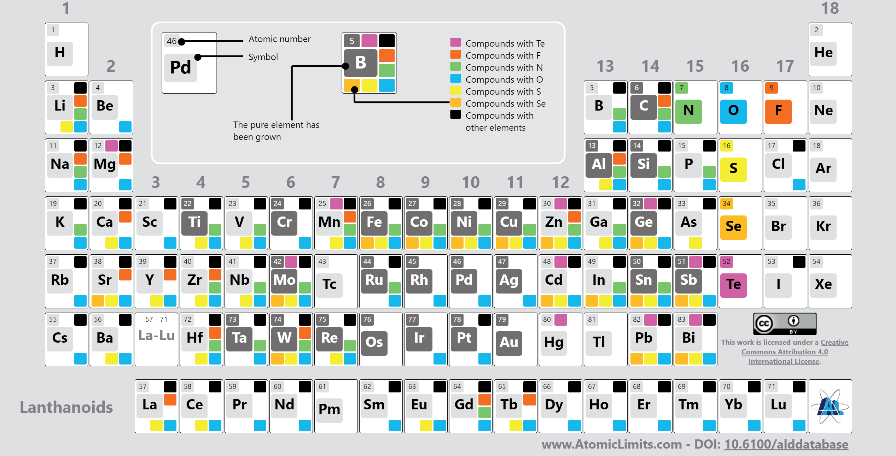
Atomic Layer Deposition – Materials

Slide 5
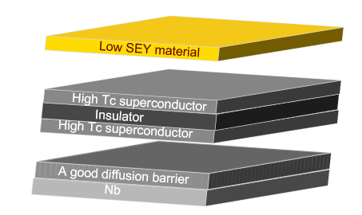
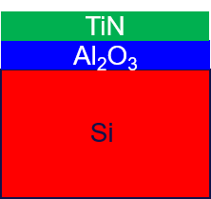
Secondary electron yield – Mitigate Multipacting
TiN on Al2O3 (10 nm)
SEY MAX
λ = 12 cy = 0.45 nm
Other dep. ~ 10 nm
R [Ω]
Control thickness and chemical composition – uniformity
Tune SEY and electrical conductivity
Wide variety of substrates (Nb, Cu…)
CEA-ONERA

Slide 6
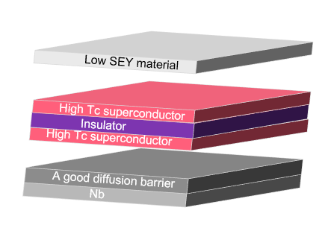
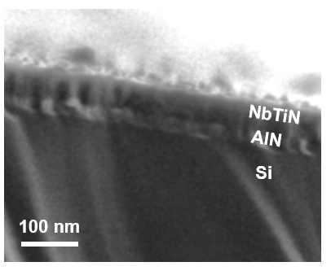
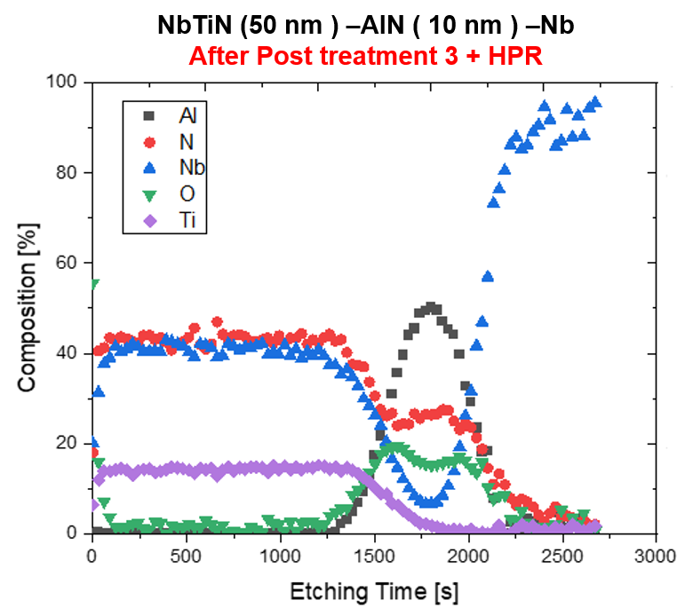
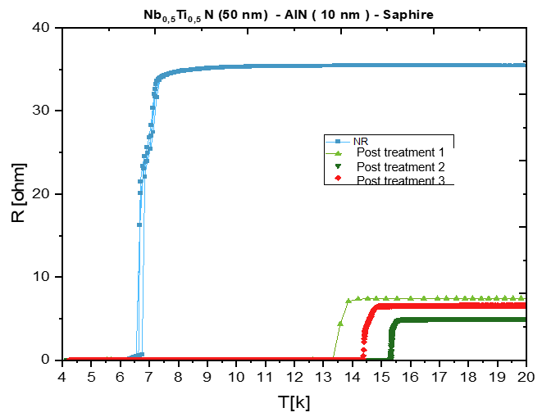
Multilayers – increase SRF cavities performances (Q and E_{max})
Superconducting alloys – NbTiN/AlN
Motivation: NbTiN has good superconducting performance (T_{c} = 17 K)
AlN as an insulating layer.
Chemistry: Combination of TiN and NbN cycles:
n (TiCl₄ + NH₃) + m (NbCl₅ +NH₃) = Nb_{1-x}Ti_{x}N
Tune chemical composition
Good superconducting properties
Compatible with SRF cavities treatments
All conditions are met to apply/test this theory on SRF cavities.

Slide 7
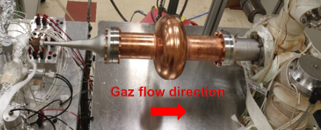
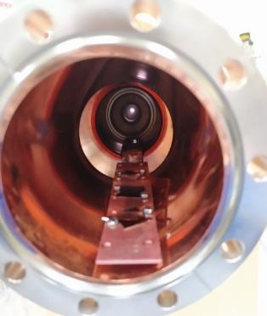
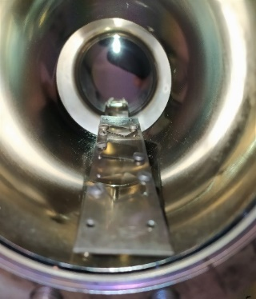
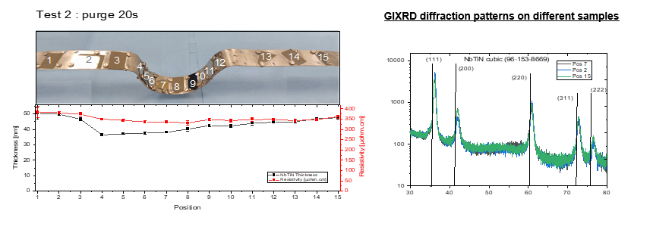
From coupons to Cavities…
Before
After
B
Optimized deposition parameters on RF cavities.
Homogeneous deposition (thickness, Tc and structure) over 1,3 GHz Nb and Cu test cavity.

Slide 8
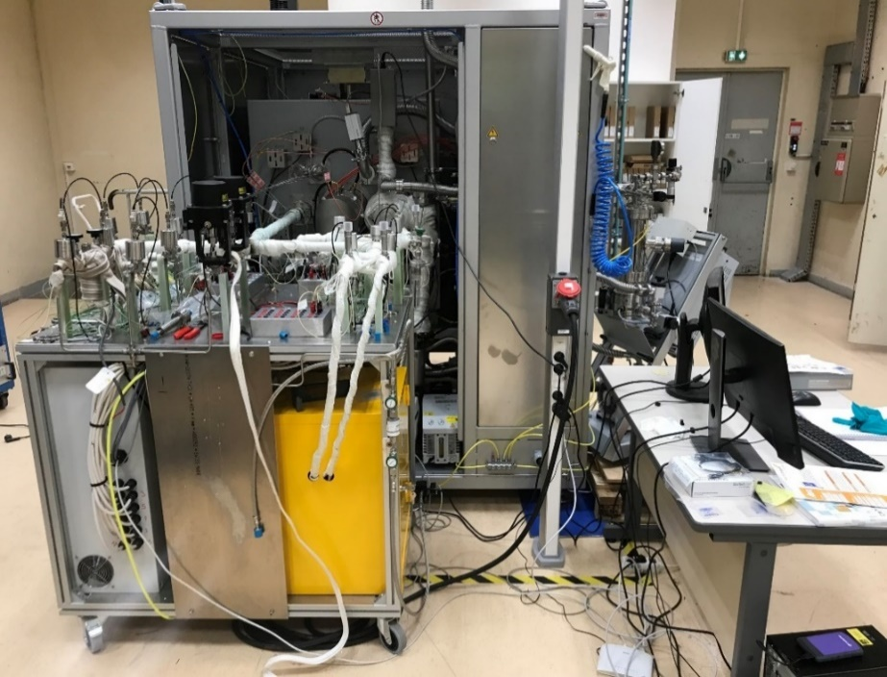
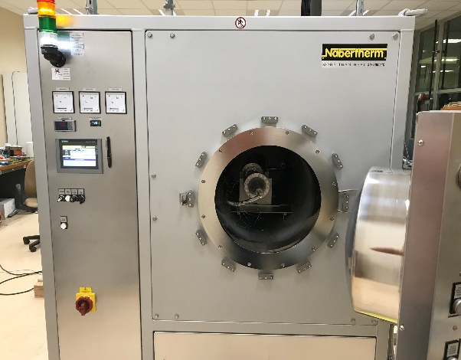
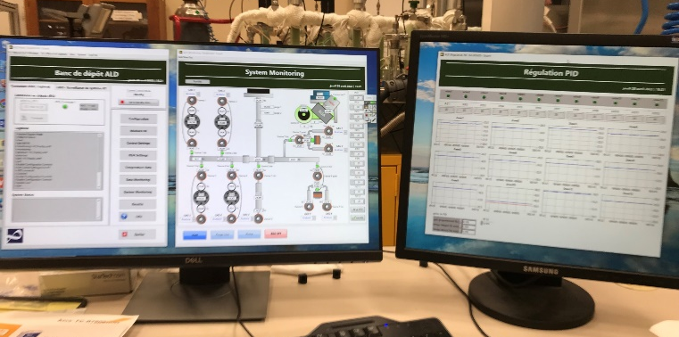
Cavity dedicated ALD apparatus
ALD system
High vacuum oven:
- 650°C – 10⁻⁶ mbar / 900°C 1bar N₂
- Volume retort: Φ = 49 cm, L= 110 cm
(Cavities sizes > 0.6 GHz)
ALD system:
- 9 precursor lines (2 gases, 2 liquids, 4 solids, 1 Ultra high temp.).
- RGA synthesis monitoring.
Interface and control:
- Labview program of ALD system and Oven.
- Automatic synthesis parameter
control and monitoring.
Status:
Deposition tests on samples
Future: Deposition on cavities
retort
Program interface
49 cm

Slide 9
Conclusion-Perspectives:
  SEY: ALD of TiN film is promising to reduce multipacting inside RF cavities.
  Growth of NbTiN and the multilayers AlN/NbTiN by ALD with good superconducting properties, homogeneous composition and thickness control over large surface areas (RF cavities).
  Control doping and surface engineering -> no post treatment chemistry.
  Future Goals :
  SEY: Test the Al₂O₃-TiN structure on Niobium RF cavities.
  Multilayer: Test the NbTiN-AlN structure on Niobium RF cavities.
  Doping: Test ALD doping procedure on SRF cavityies
  New directions:
  - ALD on Copper complementary to HIPIMS: insulating barrier - Nucleation and thermo- currents.
  - ALD for detectors/optics.

Slide 10
Thank you for your attention
Questions ?
Acknowledgements
Yasmine Kalboussi¹, Baptiste Delatte¹, Claire Antoine¹, David Longuevergne², Diana Dragoe³, Jocelyne Leroy⁴, Sandrine Tusseau-Nenez⁵, Aurélie Gentils², Stéphanie Jublot Leclerc², Fréderic Miserque⁶, Mohamed Belhaj⁷, Junling Zheng⁸, David Hrabovsky⁹, G. Rosaz¹⁰, Thomas Proslier¹.
¹IRFU, CEA Saclay, 91191 Gif-sur-Yvette Cedex, France ; ² Université Paris-Saclay, CNRS/IN2P3, IJCLab, 91405 Orsay, France ; ³ Plateforme ICMMO, Rue du doyen Georges Poitou, Bât 410 ,91400 Orsay France ; ⁴ Laboratoire d’Innovation en Chimie des Surfaces et Nanosciences, 91191 Gif sur Yvette, Cedex, France ; ⁵ Plateforme de Diffraction des Rayons X, Ecole Polytechnique, Route de Saclay, 91128 Palaiseau. ⁶ DEN, Service de la Corrosion et du Comportement des Matériaux dans leur Environnement (SCCME), CEA Saclay, 91191 Gif-sur-Yvette Cedex, France, ⁷ Physics instrumentation environnement space department, coupling of spacecraft and environnement unit, ONERA. ⁸ Institut des nanosciences de Paris, UPMC, Jussieu 75005 Paris, ⁹ Université Pierre et Marie Curie, Jussieu 75005 Paris. ¹⁰ CERN, Geneva, Switzerland.

