Slide 1




Overview of the FCC Software framework developments
F. Carlier and T. Pieloni
D. Di Croce, L. Sabato, G. Iadarola, X. Buffat, P. Kicsiny, D. Schulte, R. De Maria, A. Faus-Golfe, F. Schmidt, G. Simon, R. Tomas, W. Yi, M. Rakic, S. White, A. Abramov, R. Bruce, K. Oide, M. Seidel

Slide 2
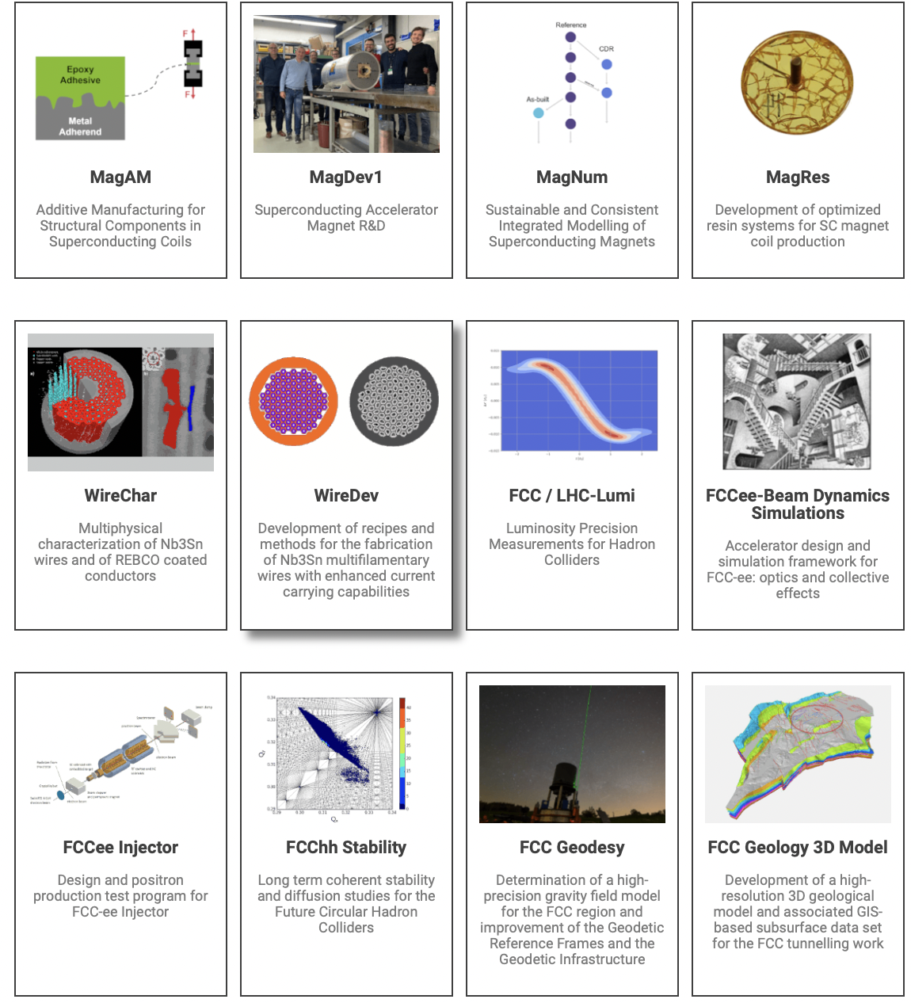
FCC Software Framework (SF) Project
Executive Abstract:
Develop a modular and expandable software framework for FCC-ee design and simulation work.
Includes a multi-turn, multiple interaction points model of a Future Circular Lepton Collider (FCC-ee) including a full lattice description with errors, beam-beam modules, beamstrahlung, radiative Bhabha scattering and strong damping for beam lifetime and particle losses studies in a self-consistent approach. Allow studies of collective effects interplay.
FCC stability project : electron cloud studies
ML4FCC project with Suisse Data Science Center (SDSC)
Recently approved polarization project
www.chart.ch

Slide 3
FCC Software Framework
Review of available tools: pyAT, Sixtrack/Xtrack, BMAD, GUINEAPIG, …
Identify key parts/components of the development fundamental for FCC-ee studies
  physics models (Beam-Beam, BS, lattice description, impedance, e-cloud…)
  technical needs and benefits (different codes, speed, computing resources)
Great synergies with CERN ABP Computing WG developments and modernization
→ develop a common, modern and robust tool for hadron and lepton community
→ maintenance, reproducibility of results, extensive testing and debugging
Define a general strategy for the developments to open tools to a larger community/collaboration i.e. FCC-ee, FCC-hh, muon, light sources…
GOAL: prepare for a simulation campaign where several effects interplay

Slide 4
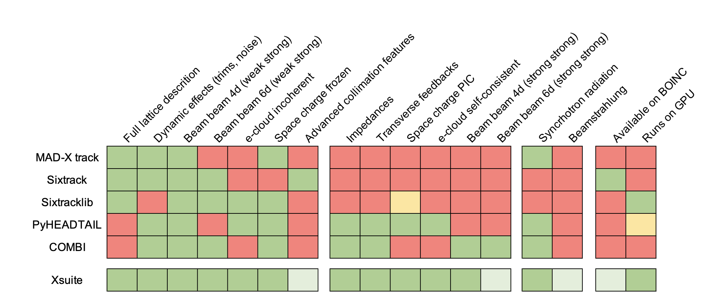
XSUITE for LHC, HL-LHC and Injectors
Project launched to rationalize and modernize software for multiparticle simulations
Moved from a heterogenous range of programs each with limited capabilities to an integrated modular toolkit (Xsuite)
  Covering with a single toolkit injectors, LHC, HL-LHC and design studies (FCC Framework)
  Exploitation of modern computing platforms (e.g. GPUs) for a wide range of applications
  Strong simplification of development and maintenance process (removes several duplications)
G. Iadarola
R. De Maria and BE/ABP

Slide 5

Synergies and new developments
ML for DA optimization
Polarization and SPIN tracking
Xsequence,
Xconverter
(F. Carlier)
SITROS
SAD
BMAD
PyAT
D. Di Croce,
G. Iadarola,
F. Vanderveken,
T. Pieloni,
SDSC
MADX
P. Kicsiny,
X. Buffat,
D. Schulte
Y. Wu,
F. Carlier,
T. Pieloni
EPOL team
P. Kicsiny, X. Buffat
L. Sabato, L. Mether
G. Simon, R. De Maria,
F. Schmidt, A. Faus-Golfe
P. Kicsiny, X. Buffat
Tapering
F. Carlier, M. Rakic, S. White

Slide 6
Lattice management and tapering
ML for DA optimization
Polarization and SPIN tracking
Xsequence,
Xconverter
(F. Carlier)
SITROS
SAD
BMAD
PyAT
D. Di Croce,
G. Iadarola,
F. Vanderveken,
T. Pieloni,
SDSC
MADX
P. Kicsiny,
X. Buffat,
D. Schulte
Y. Wu,
F. Carlier,
T. Pieloni
EPOL team
P. Kicsiny, X. Buffat
L. Sabato, L. Mether
G. Simon, R. De Maria,
F. Schmidt, A. Faus-Golfe
P. Kicsiny, X. Buffat
Tapering
F. Carlier, M. Rakic, S. White

Slide 7
Xsequence/Xconverter
Codes | Import | Export
MAD-X (cpymad)
SAD
pyAT
Xsuite
Bmad
Elegant
Xsequence package being developed in the framework of FCC-ee in order to:
Simplify lattice conversions to the different codes of interest
Offer an expandable platform for users to contribute tools for specific conversions
Simplify the creation of models for the large simulation campaigns by controlling errors and tuning knobs
Description of circuits using xdeps package (R. de Maria)
Ensure model consistency between platforms for comparative simulations
For more details:
https://indico.cern.ch/event/1085318/
7

Slide 8
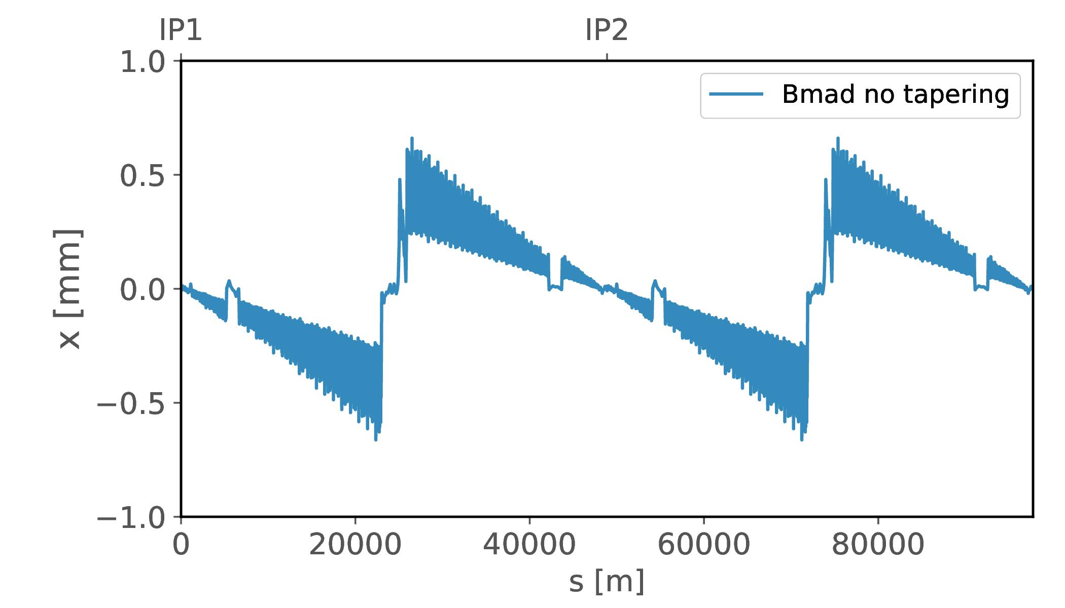
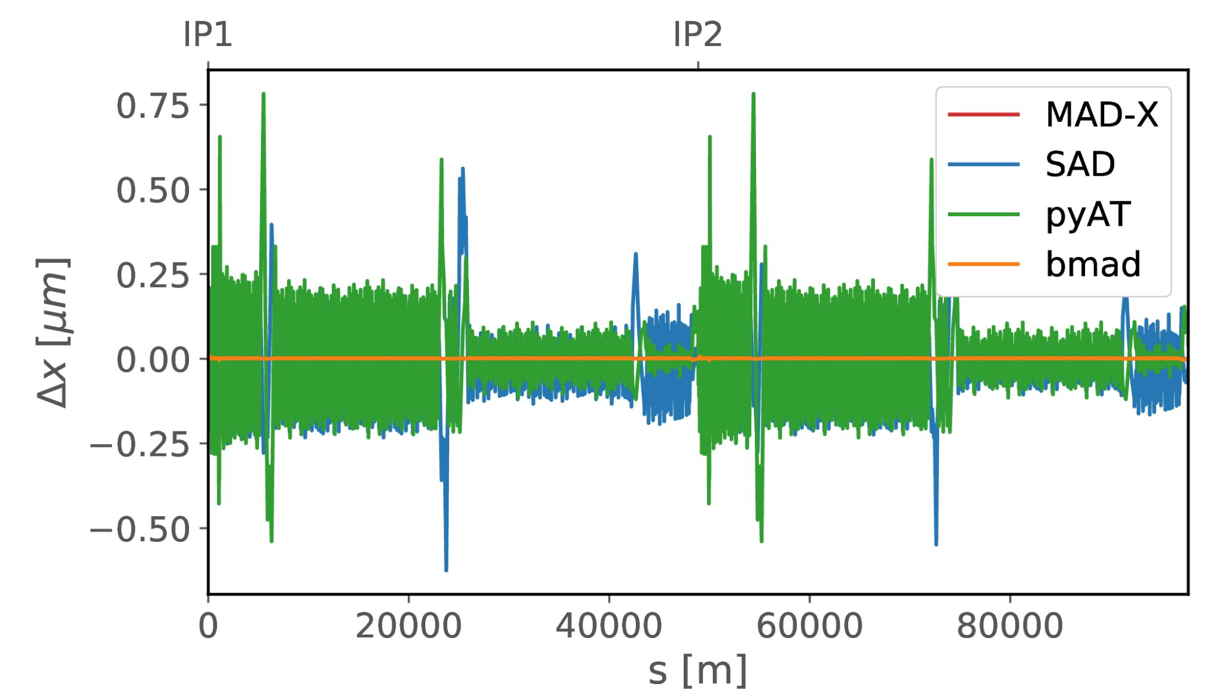
Tapering was developed for Bmad and pyAT
Loss of energy due to synchrotron radiation changes strength of:
Dipoles → Sawtooth orbit offsets throughout accelerator
Other magnets → Perturbation of optics
Tapering scheme: Adjusting magnetic strengths to compensate for energy loss and retrieve reference orbit and optical functions
SAD comparison (L. van Riesen-Haupt)
https://indico.cern.ch/event/923801/
Bmad (F. Carlier)
https://indico.cern.ch/event/1018475/
pyAT (S. White, M. Rakic, F. Carlier)
https://indico.cern.ch/event/1018475/
F. Carlier
https://indico.cern.ch/event/995850/
Tapering
A. Abramov ”FCC-ee Collimation Studies” at 16:45.

Slide 9
Beam-beam, Beamstrahlung, Synchrotron Radiation
ML for DA optimization
Polarization and SPIN tracking
Xsequence,
Xconverter
(F. Carlier)
SITROS
SAD
BMAD
PyAT
D. Di Croce,
G. Iadarola,
F. Vanderveken,
T. Pieloni,
SDSC
MADX
P. Kicsiny,
X. Buffat,
D. Schulte
Y. Wu,
F. Carlier,
T. Pieloni
EPOL team
P. Kicsiny, X. Buffat
L. Sabato, L. Mether
G. Simon, R. De Maria,
F. Schmidt, A. Faus-Golfe
P. Kicsiny, X. Buffat
Tapering
F. Carlier, M. Rakic, S. White

Slide 10
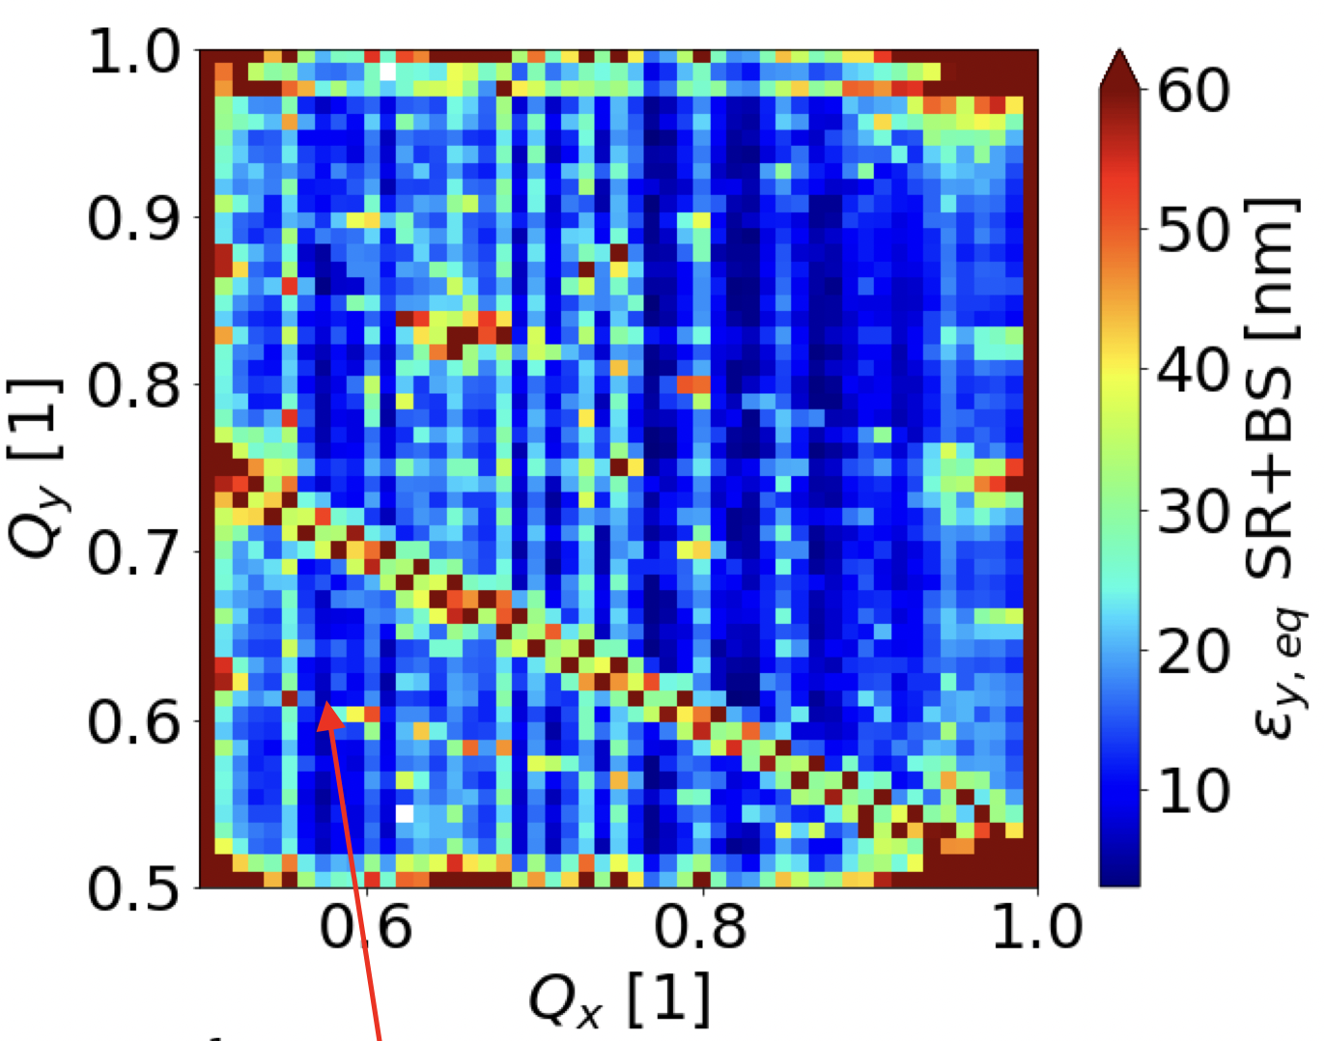
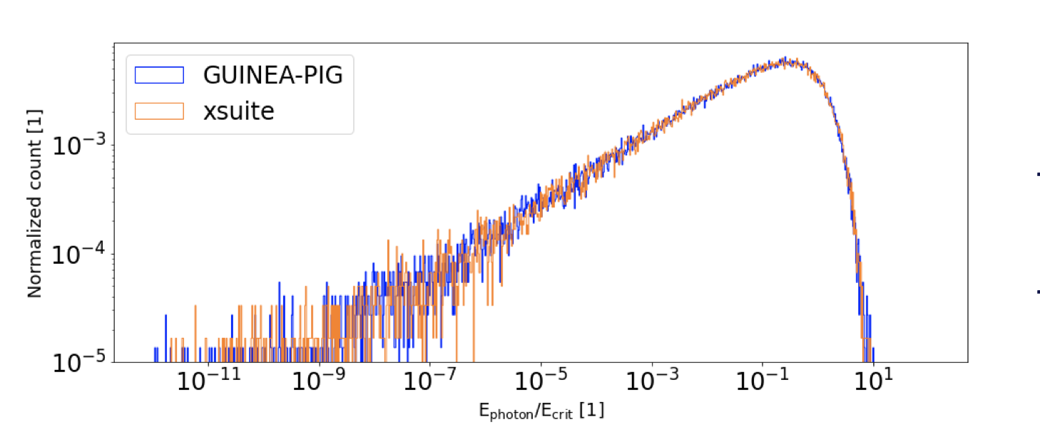
Beam-Beam, Beamstrahlung, Synchrotron Radiation
Beam-beam simulations: SS, WS, Quasi SS
Beamstrahlung effect implemented and benchmarked
First pilot studies for FCC-ee are ongoing including:
  Synchrotron radiation
  Strong-strong and Weak-strong 6D beam beam
  Beamstrahlung
Next steps:
Bhabha Scattering
Crab Waist scheme
P. Kicsiny “Simulations of FCC-ee beam-beam effects with xsuite” this session
Notes:
CHeck with Peter

Slide 11
Lattice, imperfections and radiation
ML for DA optimization
Polarization and SPIN tracking
Xsequence,
Xconverter
(F. Carlier)
SITROS
SAD
BMAD
PyAT
D. Di Croce,
G. Iadarola,
F. Vanderveken,
T. Pieloni,
SDSC
MADX
P. Kicsiny,
X. Buffat,
D. Schulte
Y. Wu,
F. Carlier,
T. Pieloni
EPOL team
P. Kicsiny, X. Buffat
L. Sabato, L. Mether
G. Simon, R. De Maria,
F. Schmidt, A. Faus-Golfe
P. Kicsiny, X. Buffat
Tapering
F. Carlier, M. Rakic, S. White

Slide 12
Lattice, imperfections and radiation
Invest on MAD-X code to create a solid platform for FCC-ee
  MAD-X already used for FCC-ee studies, has synergies with many other projects.
Radiation effects in MAD-X used in many FCC-ee studies:
  Few calculations have shown inconsistent results related to thin multipole elements and solenoid
  Some usability issues have been identified related to tapering in the last version
Stabilize radiation calculations in MAD-X
  Review and document radiation related physics applied to MAD-X
  Compare calculations on FCC-ee or other test lattices using different methods such as direct tracking, map formalism, radiation integral formalism
  Coordinate with optics studies for defining priorities such as interaction region modelling and vertical emittance studies
R. De Maria talk on MADX in this session

Slide 13
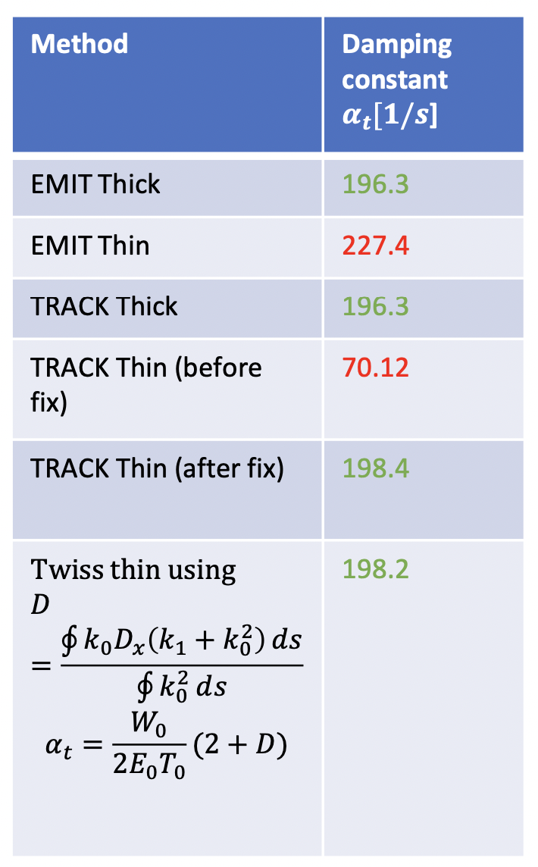
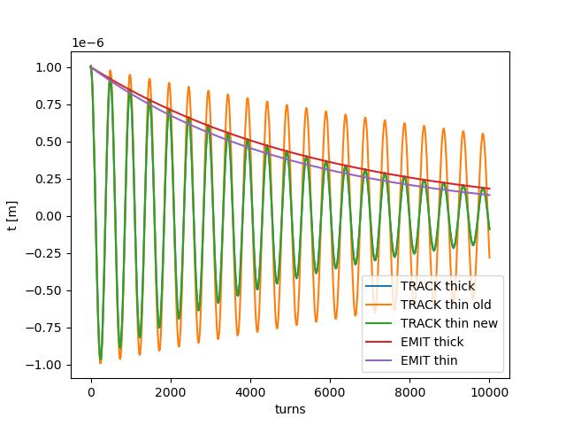

Lattice, imperfections and radiation
Investigating different tracking methods in MADX
Identified and corrected bug in TRACK for thin multipole resulting in incorrect damping times
Collected other issues that are under investigations:
  tapering introduces optics beating
  equilibrium emittance not correct for tilted solenoid
  twiss energy loss does not take the gamma of the closed orbit correctly into account
  issue with radiation of multipoles in track and emit
  adding ktap on additional elements
  synchrotron radiation integrals zero with zero length elements
Deterministic damping
G. Simon poster session Thursday 17:30: “Synchrotron radiation improvements in MAD-X for FCCee studies”

Slide 14
Polarization and spin tracking
ML for DA optimization
Polarization and SPIN tracking
Xsequence,
Xconverter
(F. Carlier)
SITROS
SAD
BMAD
PyAT
D. Di Croce,
G. Iadarola,
F. Vanderveken,
T. Pieloni,
SDSC
MADX
P. Kicsiny,
X. Buffat,
D. Schulte
Y. Wu,
F. Carlier,
T. Pieloni
EPOL team
P. Kicsiny, X. Buffat
L. Sabato, L. Mether
G. Simon, R. De Maria,
F. Schmidt, A. Faus-Golfe
P. Kicsiny, X. Buffat
Tapering
F. Carlier, M. Rakic, S. White

Slide 15
Polarization and Spin dynamics
First simulations of spin dynamics in Bmad for FCC-ee
  Allows full lattice description, errors, misalignments and corrections.
  Comparison of Bmad vs. SITROS in linear and nonlinear spin simulations
  Study the effects of machine errors on achievable polarization and the possible need of spin orbit matching.
Spin part of Madx-PTC has been compared to Bmad-PTC to good agreement.
  Calculation of linear polarization limits still need to be developed using Madx-PTC output. More details at link.
The goal is to use the developed codes to study resonant depolarization for energy calibration using full lattice descriptions. Project approved by CHART starting on 15th July.
Y. Wu EPOL2 session Thurs 9am: “Simulations of the Spin Polarization for the Future Circular Collider e+e− using Bmad”

Slide 16
Electron Cloud
ML for DA optimization
Polarization and SPIN tracking
Xsequence,
Xconverter
(F. Carlier)
SITROS
SAD
BMAD
PyAT
D. Di Croce,
G. Iadarola,
F. Vanderveken,
T. Pieloni,
SDSC
MADX
P. Kicsiny,
X. Buffat,
D. Schulte
Y. Wu,
F. Carlier,
T. Pieloni
EPOL team
P. Kicsiny, X. Buffat
L. Sabato, L. Mether
G. Simon, R. De Maria,
F. Schmidt, A. Faus-Golfe
P. Kicsiny, X. Buffat
Tapering
F. Carlier, M. Rakic, S. White

Slide 17
Electron Cloud studies and developments
Improve the model of the electron cloud formation based on the current state of knowledge (from both lab and the LHC experience): i.e. improvement of the energy spectrum model of the emitted electrons using lab measurements
Validate the existing numerical tools for electron cloud build-up based on the LHC RUN3 data set
Development code and benchmark of PyECLOUD for Xsuite in the software framework for FCC
By using the results of the model, propose modifications for the design of the vacuum chambers of the FCC in terms of shape, material, coating or surface treatment
Contribute to the development of a framework for comprehensive beam dynamics simulations on the combined effect of persisting electron cloud, beam-beam and impedance aiming at the prediction of stability limits and beam lifetime evolution during collisions
Details at link.

Slide 18
ML4FCC
ML for DA optimization
Polarization and SPIN tracking
Xsequence,
Xconverter
(F. Carlier)
SITROS
SAD
BMAD
PyAT
D. Di Croce,
G. Iadarola,
F. Vanderveken,
T. Pieloni,
SDSC
MADX
P. Kicsiny,
X. Buffat,
D. Schulte
Y. Wu,
F. Carlier,
T. Pieloni
EPOL team
P. Kicsiny, X. Buffat
L. Sabato, L. Mether
G. Simon, R. De Maria,
F. Schmidt, A. Faus-Golfe
P. Kicsiny, X. Buffat
Tapering
F. Carlier, M. Rakic, S. White

Slide 19
ML4FCC PROJECT
Higher computational complexity for FCC → Multiple effects; Synchrotron radiation, 6D beam-beam interactions, beamstrahlung, impedance, lattice, polarization… → need for computational resources, automatized simulation submissions, analysis and optimization of parameters → possible use of ML details at link
BOINC system ideal to submit jobs for FCC tracking simulations!
  An improved tracking simulation tool has been developed Xtrack (part of Xsuite)
  BOINC app for FCC simulation is being developed to involve worldwide volunteers to the global effort of designing a Future Circular Collider vis the LHC BOINC system “FCC@home”
  Possible to develop GPU support for BOINC app
Develop an active learning framework to continuous update the DA model with new simulated data in order to explore new parameter space
  Provide FCC (DA) model and tuning knobs for machine design and optimization.

Slide 20
Summary
Simulating the beam dynamics for the FCC-ee is a challenging goal!
Multiple effects will need to be studied together for a final and robust understanding and design
Design and Optimization of the machine parameters can profit of novel technologies for speed, reproducibility and automatization of tuning
Developments should be done profiting from different communities: lepton colliders, light sources, hadron colliders
Simulations tools are fundamental to permit reproducibility, good practise, involve younger generations
Synergies with the CERN Computing WG are fundamental to guarantee maintainability of tools in a long term prospective, profit of expertise in modelling and constant testing

Slide 21
Many developments are on-going and first results presented:
P. Kicsiny “Simulations of FCC-ee beam-beam effects with xsuite”
R. De Maria talk on MADX developments in this session
A. Abramov ”FCC-ee Collimation Studies”
Y. Wu EPOL2 session Thurs 9am: “Simulations of the Spin Polarization for the Future Circular Collider e+e− using Bmad”
G. Simon poster session Thursday 17:30: “Synchrotron radiation improvements in MAD-X for FCCee studies”
Comments, ideas, contributions are very welcome!
EPFL-LPAP FCC-ee Software Framework Meetings: https://indico.cern.ch/category/9606/

Slide 22
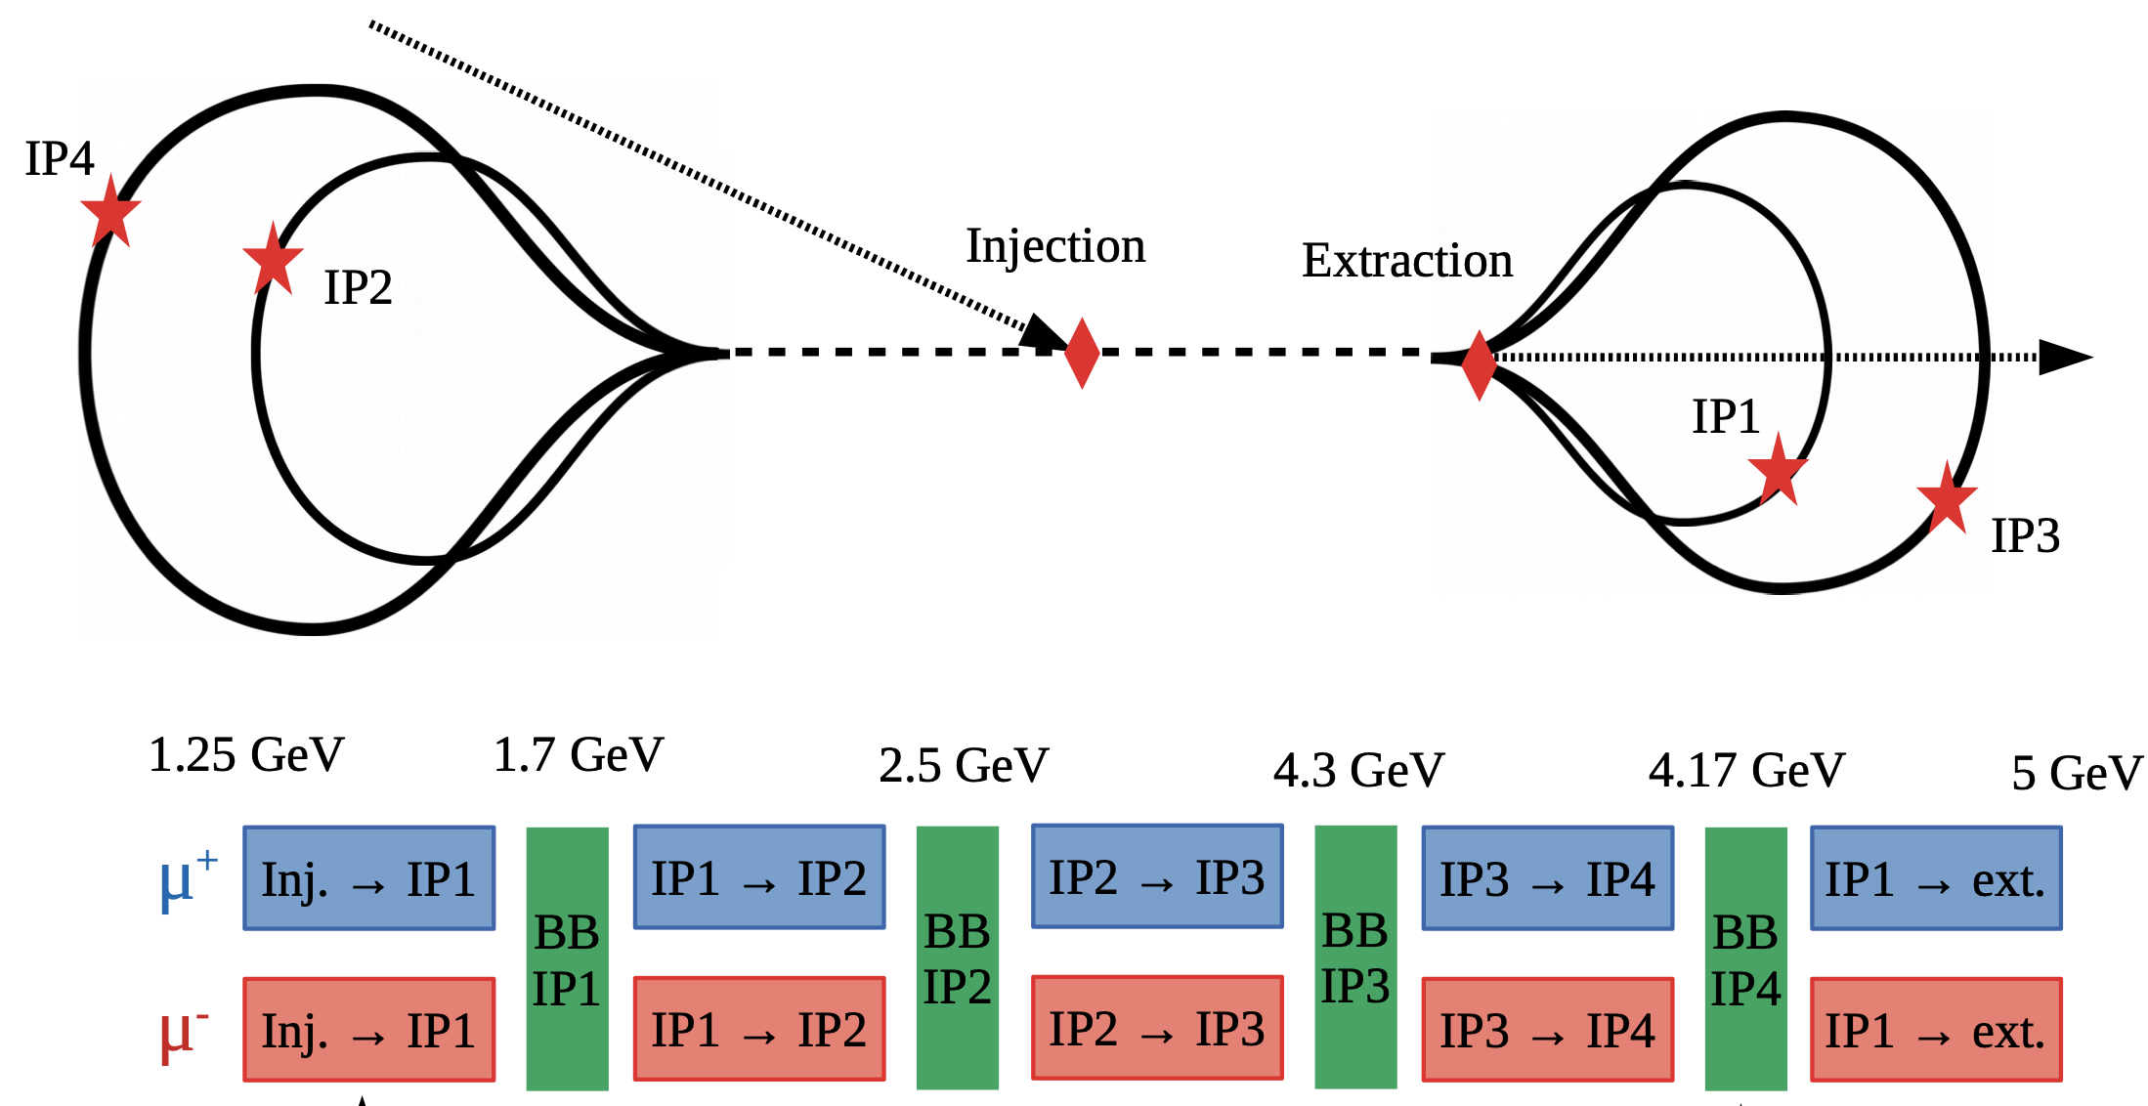
Beam-beam interactions for muon collider
X. Buffat
Xsuite used for first studies on beam-beam effects in recirculating linac for muon collider

Slide 23
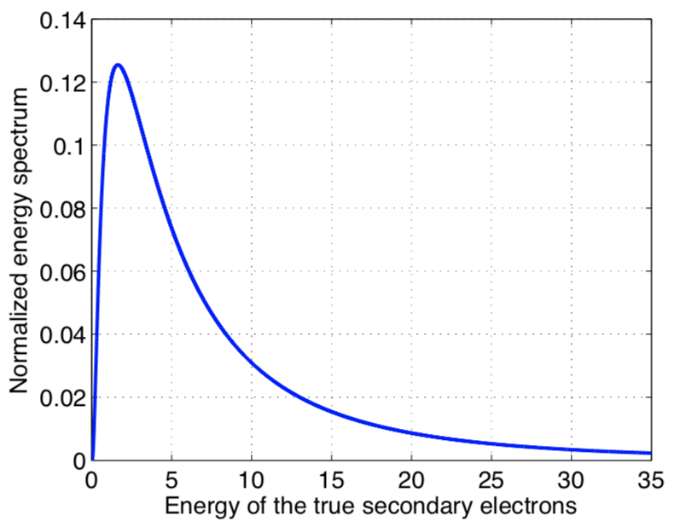
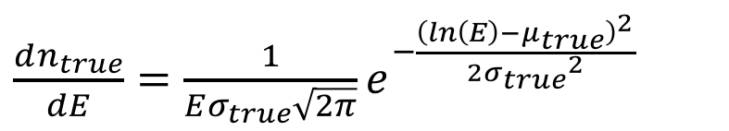
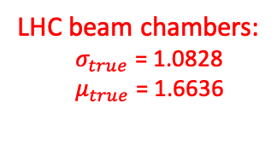
Electron Cloud studies and developments
Improve the model of the electron cloud formation based on the current state of knowledge (from both lab and the LHC experience)
Improvement of the energy spectrum model of the emitted electrons, using lab measurements
[] B. Henrist et al., “Secondary Electron Emission Data for the Simulation of Electron Cloud”, cds 2002.

Slide 24
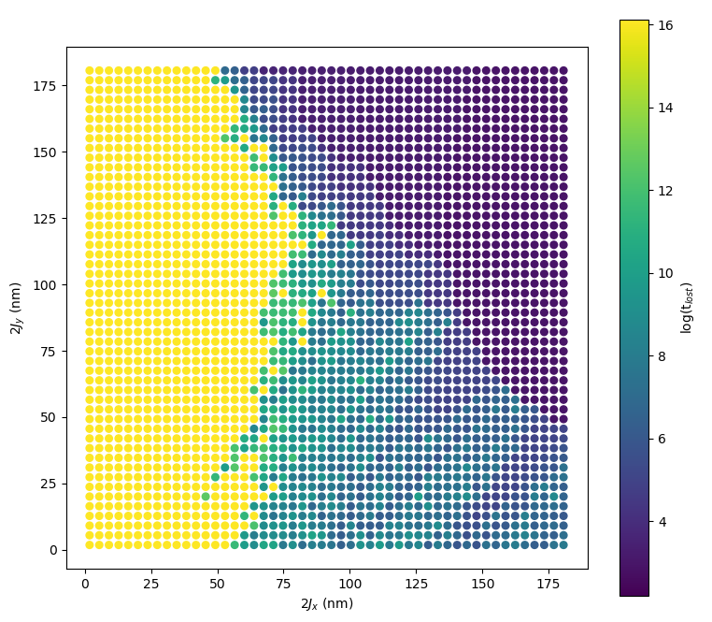
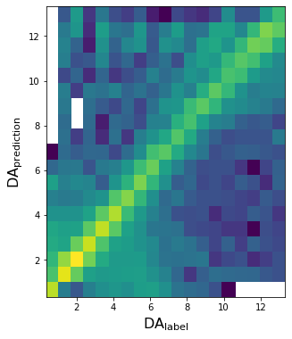
ML4FCC PROJECT
Dead after
N turns
GNN for 3D/4D DA border detection
  producing synthetic data
Xtrack BOINC app development
  standalone binary available for Windows and Linux + test server and test application ready to test BOINC API
DA regressor and particle loss GAN for various configurations of accelerator
  DA regressor developed using existing Sixtrack data while preparing to produce FCC-ee Xtrack simulation
Test MAE = 6%

