Slide 1


Slide 2


IR chamber & Calculations
02/06/2022 / FCC week 2022
Francesco Fransesini
Speaker: Francesco Fransesini
Working group: Stefano Lauciani, Luigi Pellegrino, Manuela Boscolo, Alexander Novokhatski, Giancarlo Sensolini, Francesco Fransesini
This project has received funding from the European Union's Horizon 2020 research and innovation programme under the European Union's Horizon 2020 research and innovation programme under grant agreement No 951754

Slide 3
Table of contents
02/06/2022 / FCC week 2022
Francesco Fransesini
Introduction 4
Central chamber
  Main aspects 5
  Technical details 6
Trapezoidal chamber
  Main aspects 7
  Technical details 8
  Thickness of the chamber 9
Thermal analysis
  Characteristics 10
  Results 11
CAD integration
  Main aspects 13
  Integration with the chamber 14
  Study of the interference between cooling and luminometer acceptance 15
Bellow
  Main aspects 16
Prototypes
  Characteristics 17
Conclusion and future steps 18

Slide 4
Introduction
02/06/2022 / FCC week 2022
Francesco Fransesini
Since the FCC week 2021 some steps have been taken; some discussions were held during the MDI session.
We started a progressive change from a conceptual design of the chamber to an engineered design:
Central chamber
Trapezoidal chamber
Bellow
We performed a Finite Element Analysis to consider every thermo-structural aspect using a detailed model
We updated the assembly using the new version of the magnet system proposed by Michael Koratzinos

Slide 5
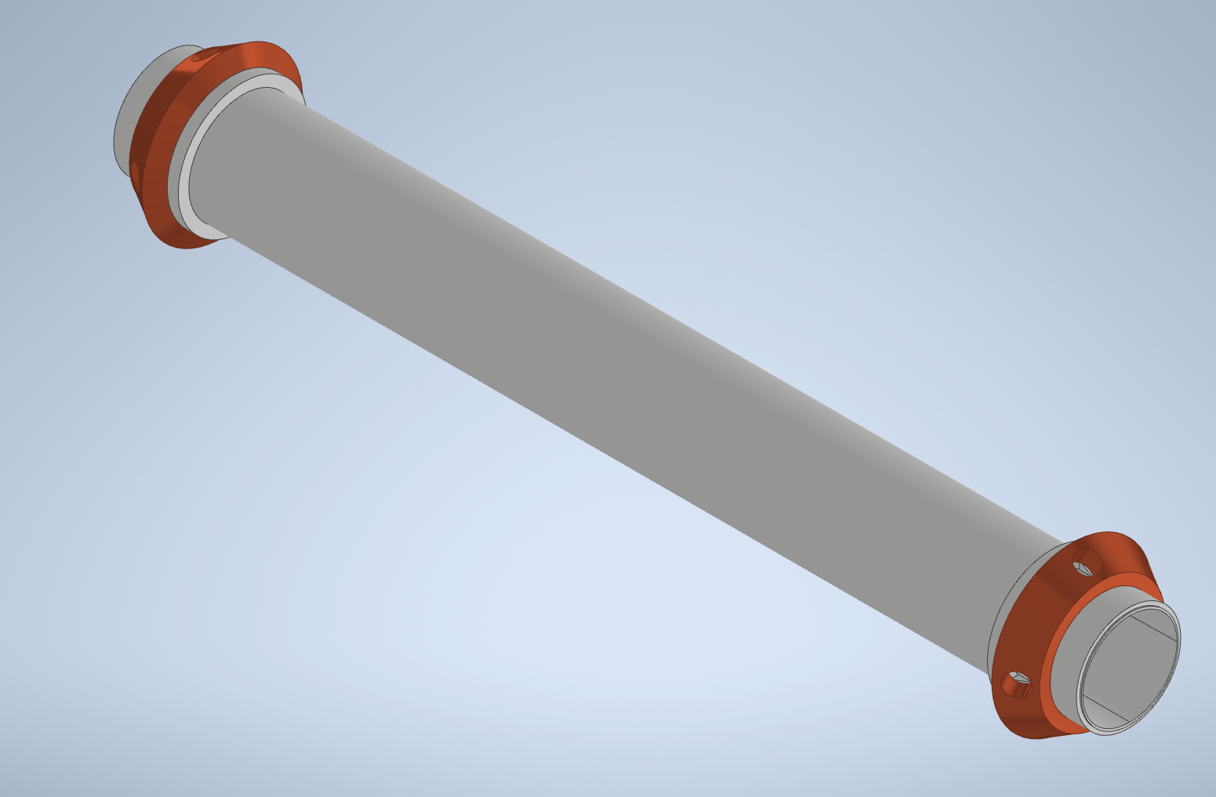
Central chamber
02/06/2022 / FCC week 2022
Francesco Fransesini
The main aspects of the central chamber are:
Thin wall
Annular gap for paraffin flow
AlBeMet162 as main material
To create an innovative design, we are evaluating the possibility to use the “thick copper deposition”, a technique that allows to create a copper deposition over a built part. In this way is possible to create complex geometry and to assure the hydraulic tightness.
AlBeMet
Copper
(thick copper deposition)

Slide 6
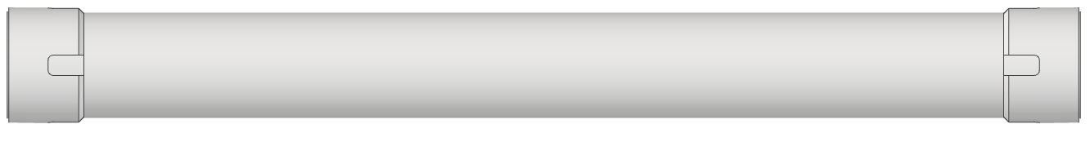
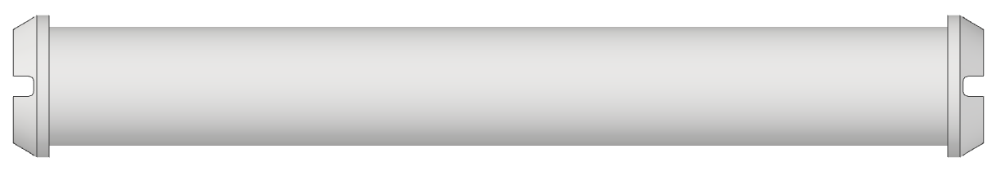
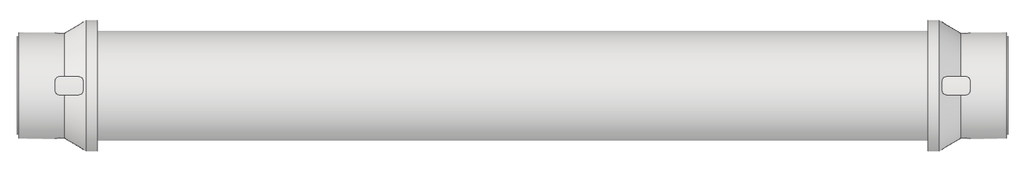
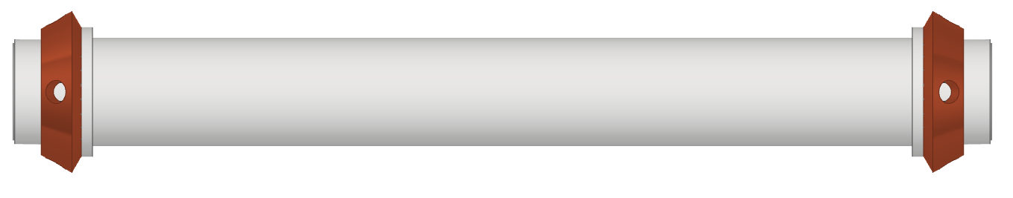
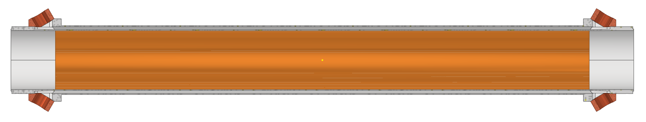
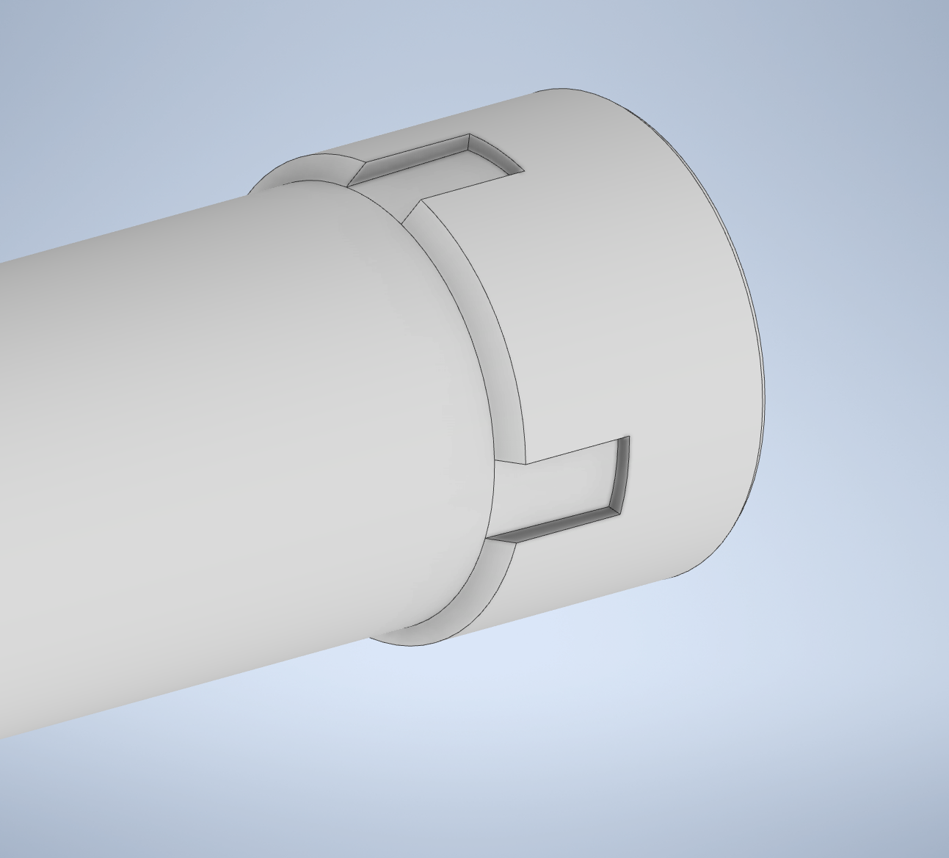
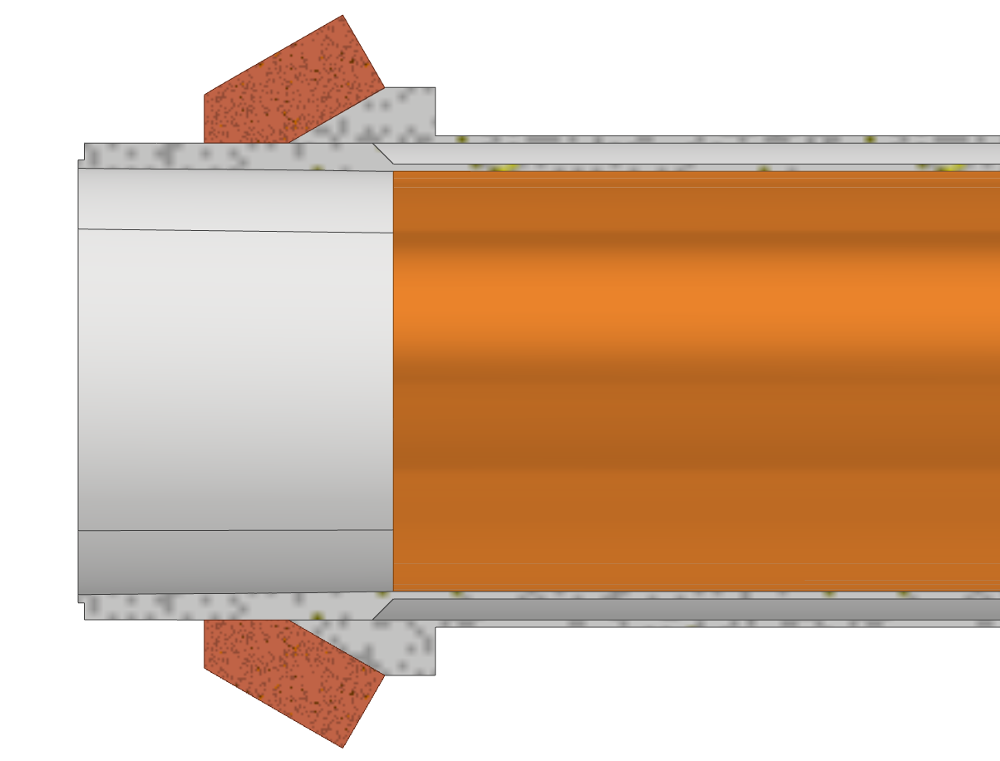
Central chamber
02/06/2022 / FCC week 2022
Francesco Fransesini
Insertion of the internal part
Thick copper deposition to create the cooling inlet and outlet
Section with cavities for the paraffin flow
The channel for paraffin is opened only in the part where the internal central chamber has cavities.
Using the “thick copper deposition” the
hydraulic tightness is assured in the parts in contact with AlBeMet
Hydraulic tightness

Slide 7
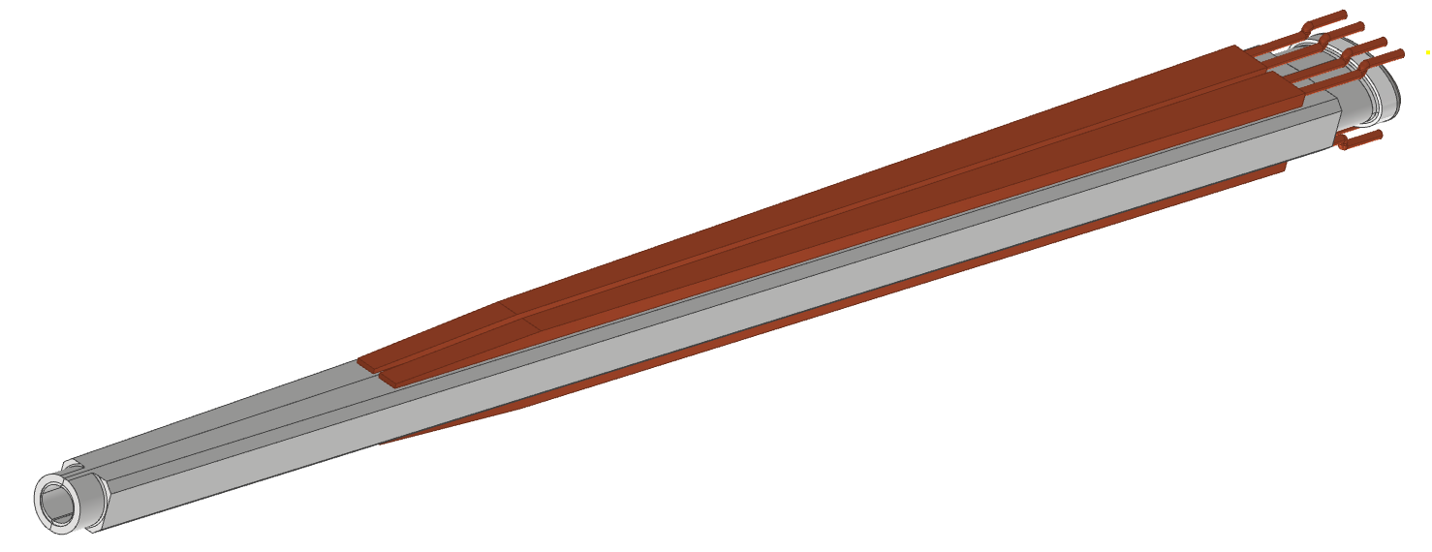
Trapezoidal chamber
02/06/2022 / FCC week 2022
Francesco Fransesini
The main aspects of the trapezoidal chamber are:
Structural thickness
Cooling channel for water flow
AlBeMet162 as main material
The cooling channels could be built using the same “thick copper deposition” technology as the central part. This additive technique could allow creating a strong adhesion between AlBeMet162 and copper, increasing the efficiency of the thermal exchange.
Different cooling system material is in study to reduce the radiation length

Slide 8
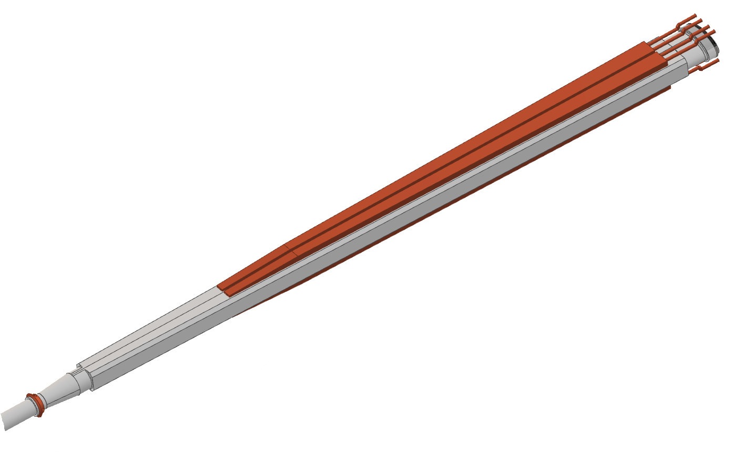
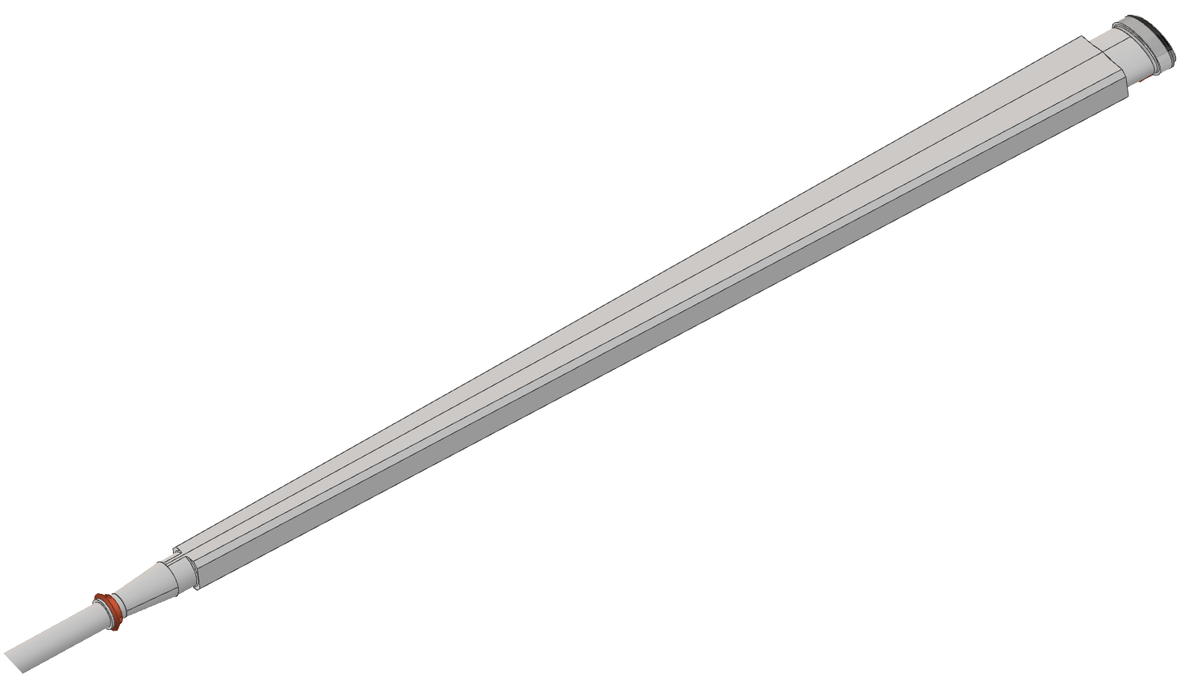
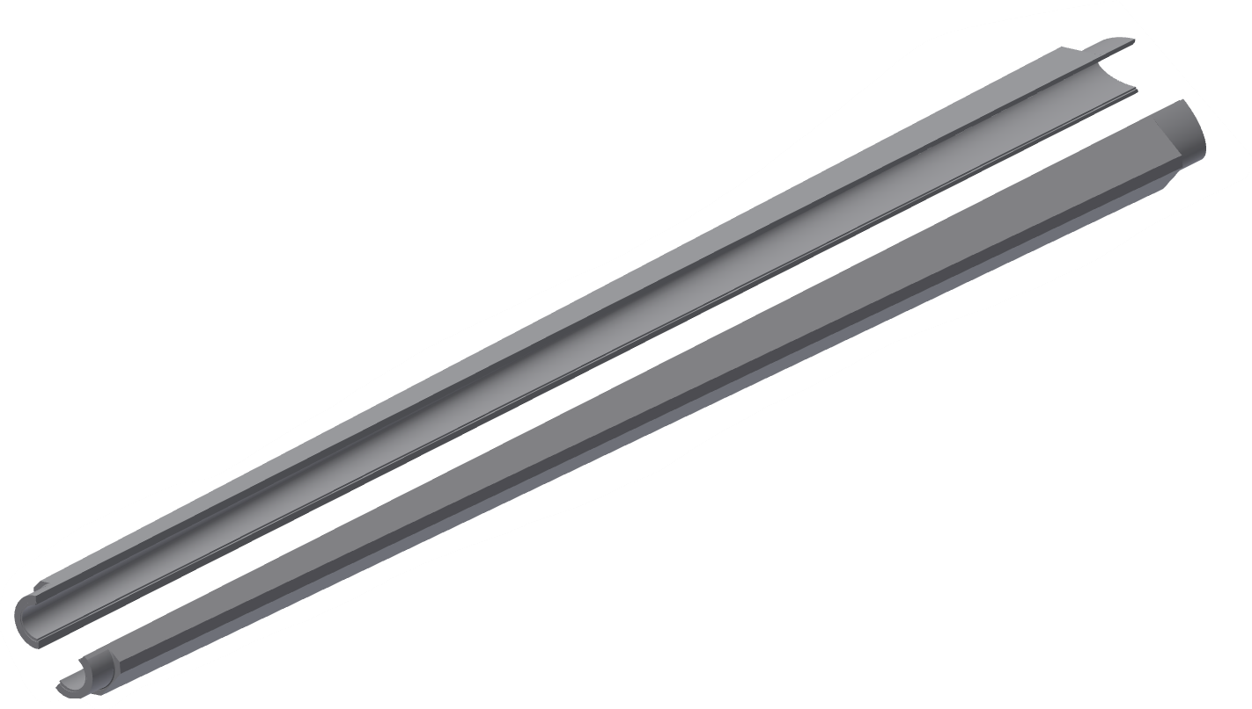
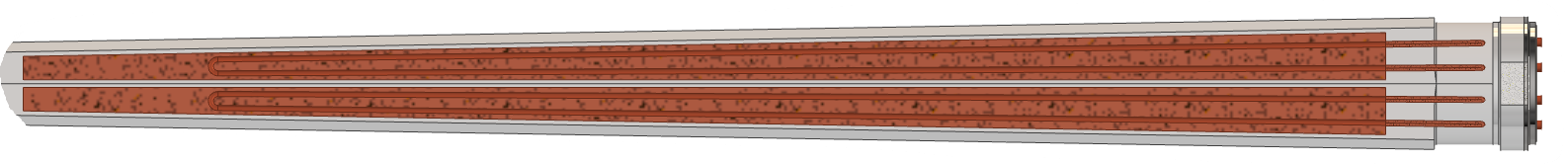
Trapezoidal chamber
02/06/2022 / FCC week 2022
Francesco Fransesini
Copper pipes
EBW¹
Assembly sequence
Shell 1
Flange (explosion bonding transition)
Shell 2
EBW
Thick copper deposition cooling channels
Water flow
Transition to the central chamber
1=electron beam welding

Slide 9

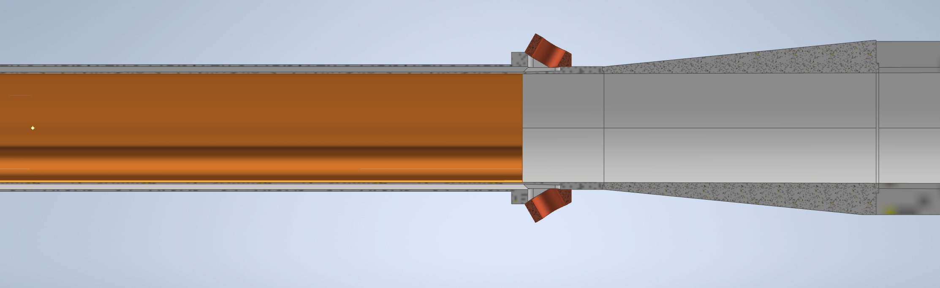
02/06/2022 / FCC week 2022
Francesco Fransesini
Thickness of the chamber
Currently the trapezoidal chamber maximum thickness is around 6 mm, due to the circular-elliptical transition; its reduction is under study
0,35 mm
1 mm
0,35 mm
5,8 mm
1,5 mm
90 mm
105 mm
155 mm

Slide 10
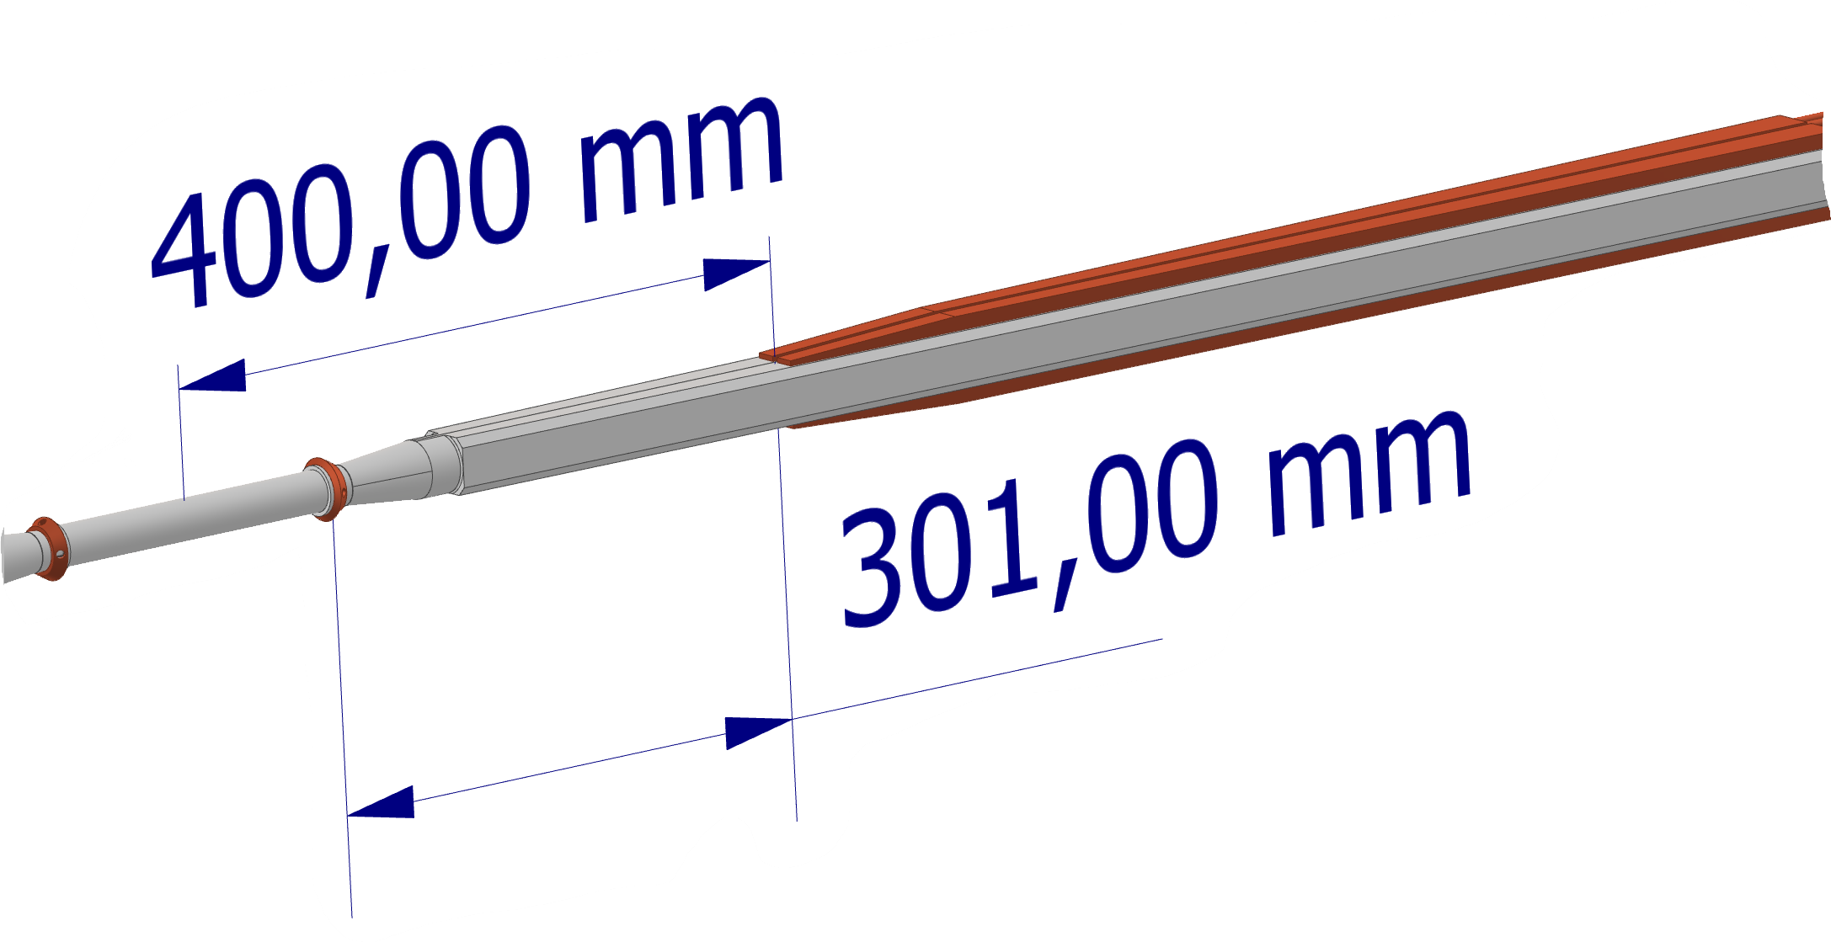
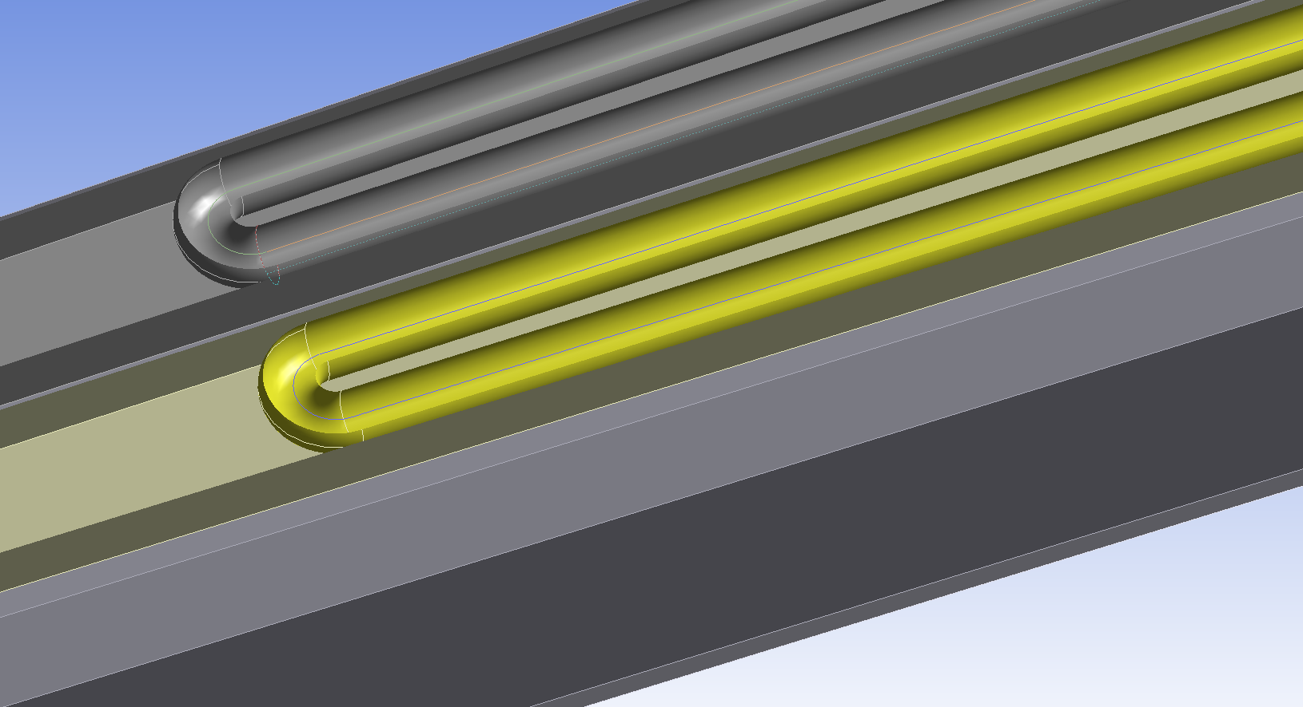
Thermal analysis
02/06/2022 / FCC week 2022
Francesco Fransesini
It is necessary to consider every thermo-structural aspect using a detailed model
FEA (Ansys)
Temperature distribution along the pipe
Start of the cooling over the trapezoidal chamber
Paraffin flow
Flow rate: 0,015 kg/s
Section: 68,17 mm²
Velocity: 0,3 m/s
Inlet temperature: 18°C
Convective coefficient: 900 W/m²K
Water flow (8 different channel)
Flow rate: 0,0196 kg/s
Section: 19,64 mm²
Velocity: 1 m/s
Inlet temperature: 18°C
Convective coefficient: 1200 W/m²K

Slide 11
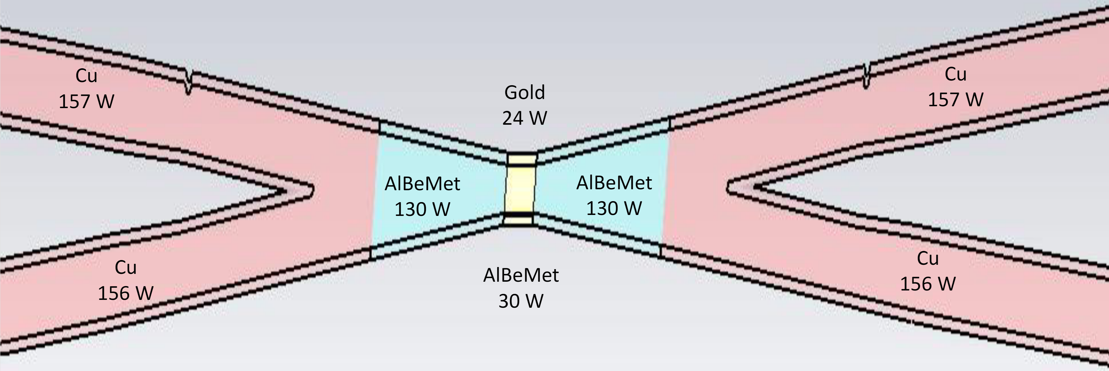
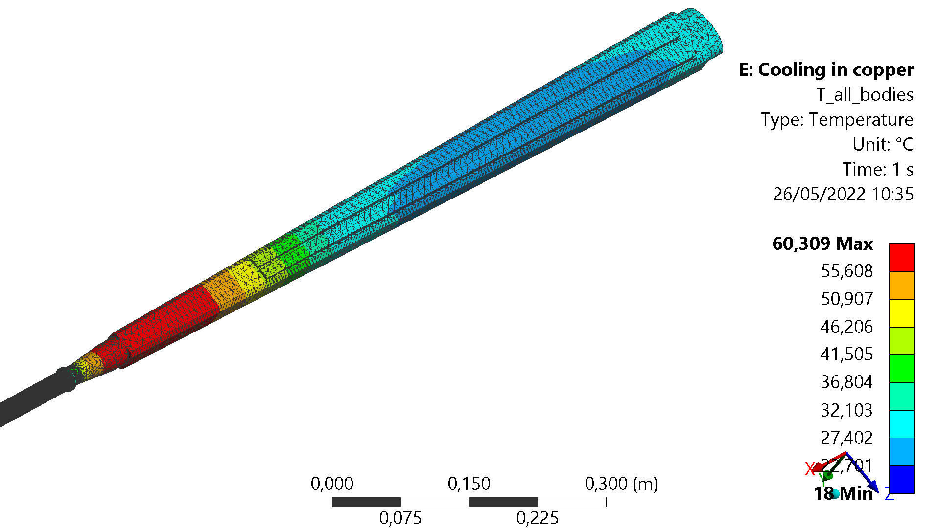
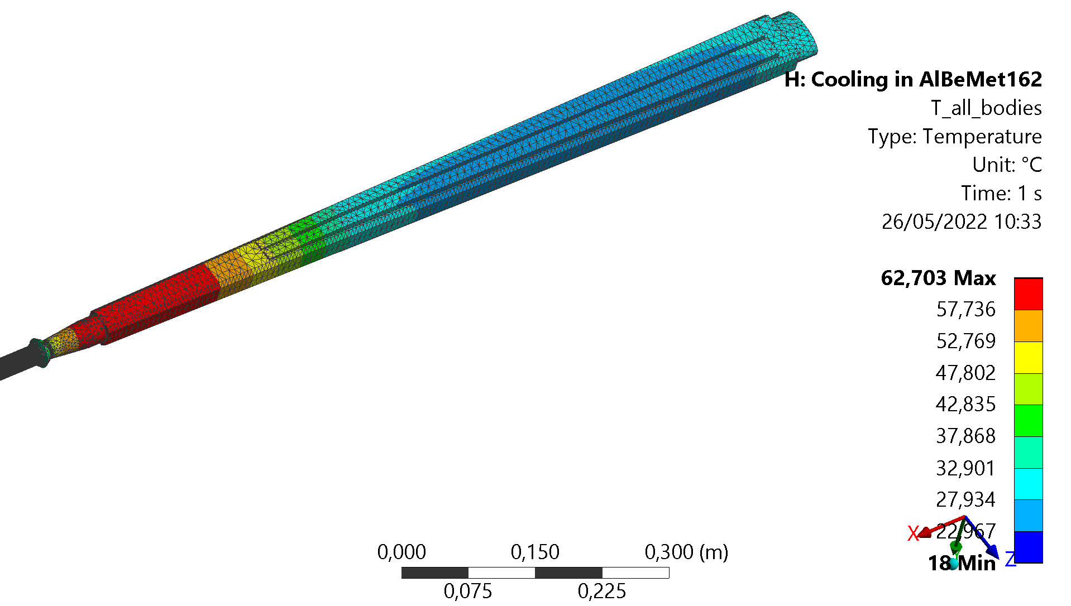
Thermal analysis - results
02/06/2022 / FCC week 2022
Francesco Fransesini
A. Novokhatski 04/11/22
Thanks to Alexander Novokhatski
Heat load :
54 W central
130 W AlBeMet162 for each part
Hypothesis:
Perfect thermal contact between the materials
Two cases have been analyzed:
 | Trapezoidal cooling in copper | Trapezoidal cooling in AlBeMet162
Maximum temperature [°C] | 60,309 | 62,703
T_out paraffin [°C] | 19,22 | 19,27
T_out water [°C] | 33,04 | 33,98

Slide 12
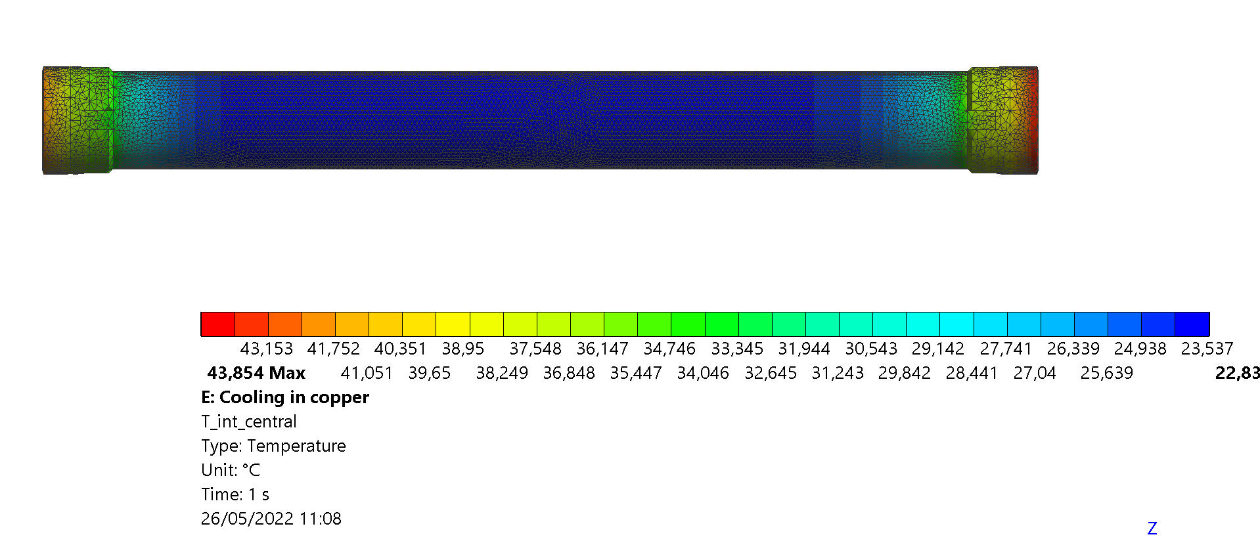
Thermal analysis - consideration
02/06/2022 / FCC week 2022
Francesco Fransesini
Temperature distribution in the central part
The solution using the trapezoidal cooling channel in AlBeMet162 is quite similar in term of maximum temperature reached, but the construction of the channel is more complicated than the tick copper deposition; in fact, is not possible to create the channel embedded into a single piece.
The thermal contact between two plates of AlBeMet is worse than the thermal contact between AlBeMet162 and the copper deposition.

Slide 13
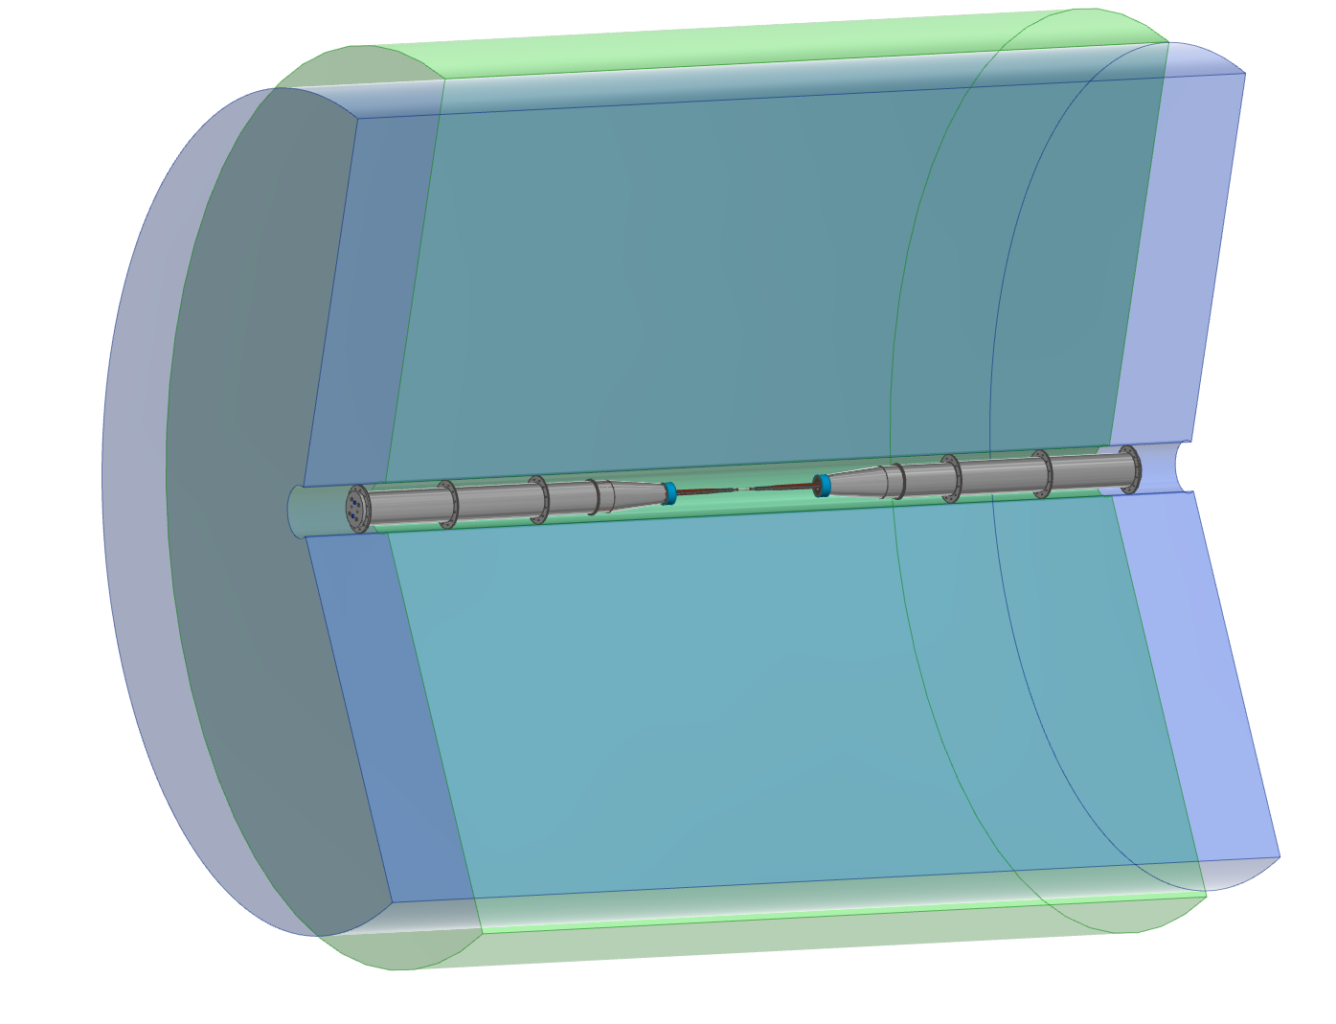
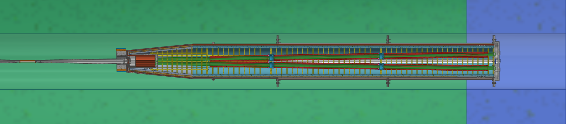
CAD Integration
02/06/2022 / FCC week 2022
Francesco Fransesini
Along with the design work, we take care of including the new versions of each component of the MDI. Recently we integrated the IR magnets and cryostat updated model into the general assembly.
Their compatibility with the vacuum chamber and the Luminometer is under check.
Michael Koratzinos
Cedric Martin Ormond

Slide 14
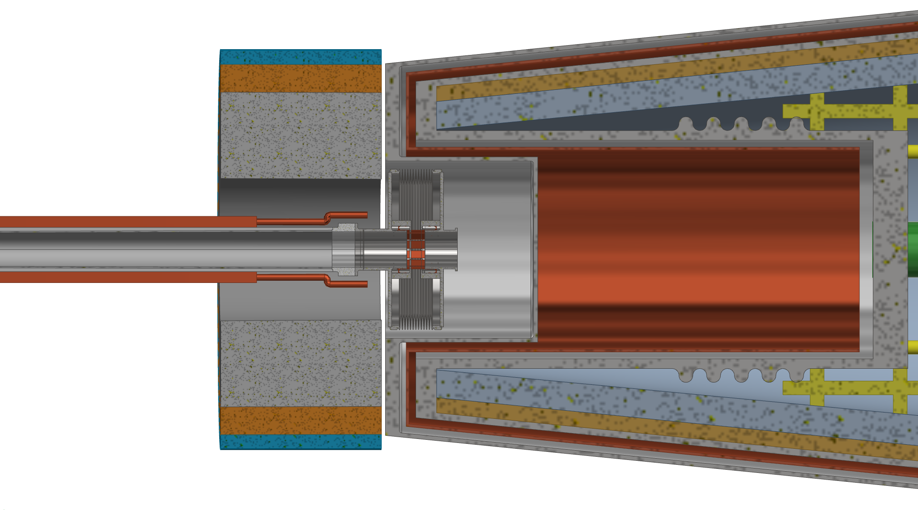
CAD Integration– integration with the chamber
02/06/2022 / FCC week 2022
Francesco Fransesini
It is necessary more study to:
Increase the current little space between LumiCal and Criomagnets
Arrange the cooling pipes to use the space between the LumiCal and the bellow
evaluate the space to include the remote vacuum connection
Need to know if tungsten shieldings are needed and the space required

Slide 15
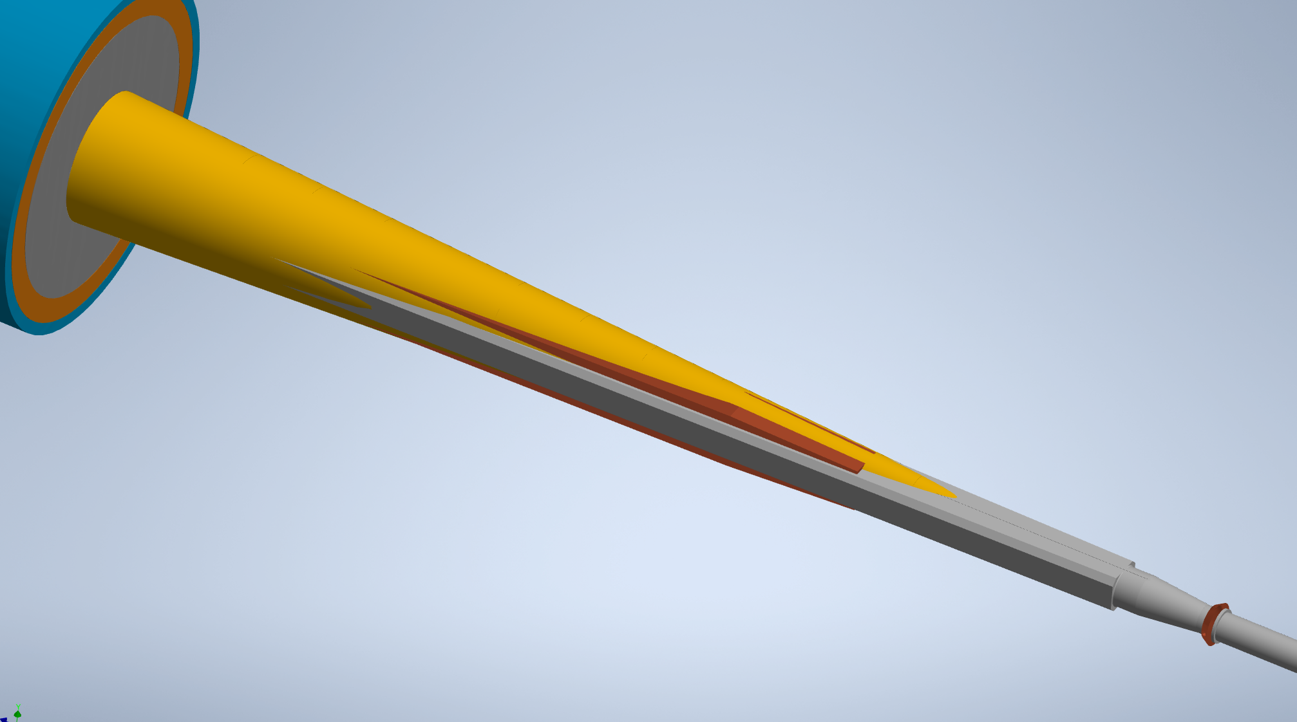
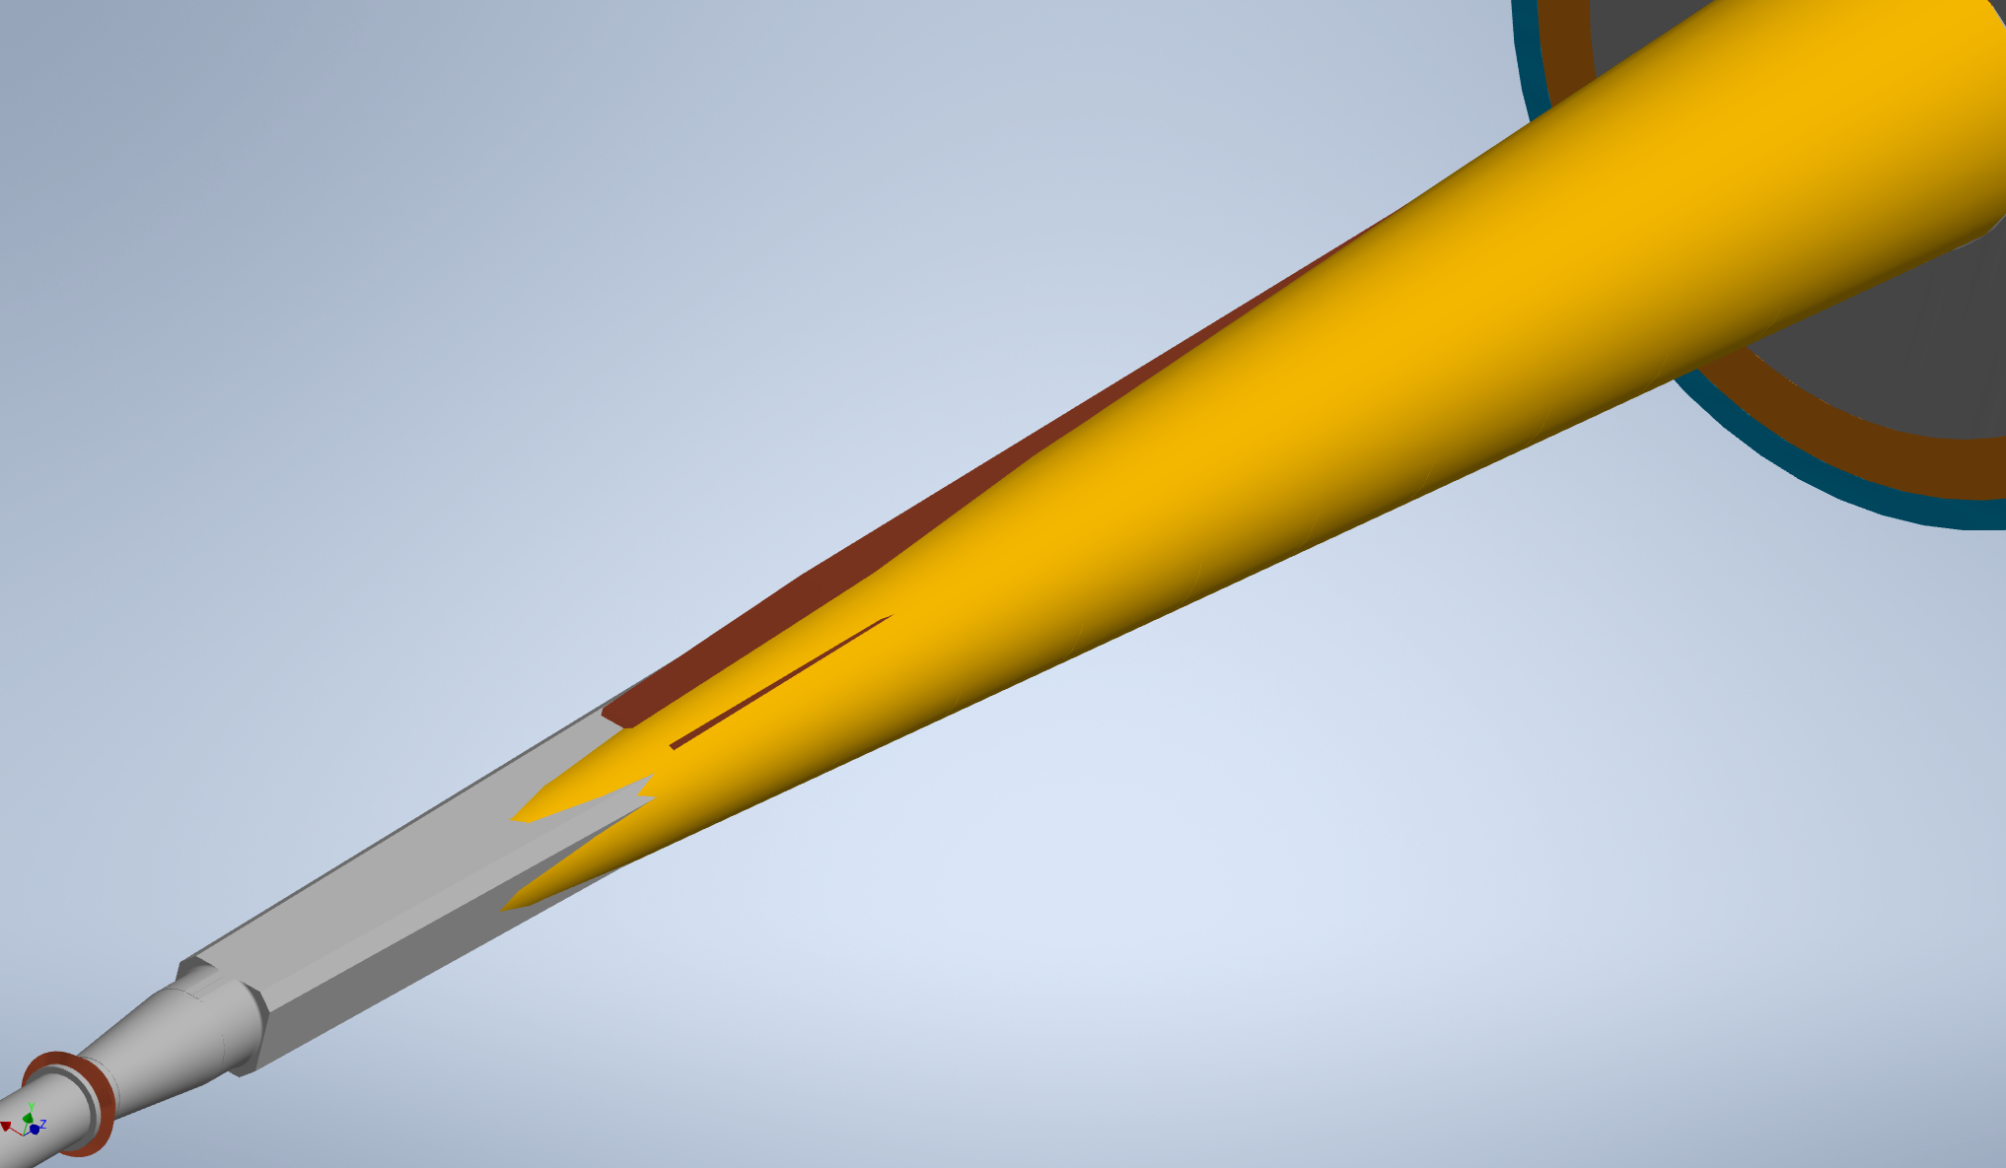
02/06/2022 / FCC week 2022
Francesco Fransesini
Study of the interference between cooling and luminometer acceptance
There is an asymmetric interference between the cooling and the cone.
We are waiting the evaluation of the influence that the material has over the measurement, before evaluating different cooling position.
Cooling out of cone
50 mrad cone centered on the outgoing beam
Cooling out of cone
Geant4 simulation for the impact of the material budget of engineered beam pipes model has recently started.
(A. Ciarma)

Slide 16
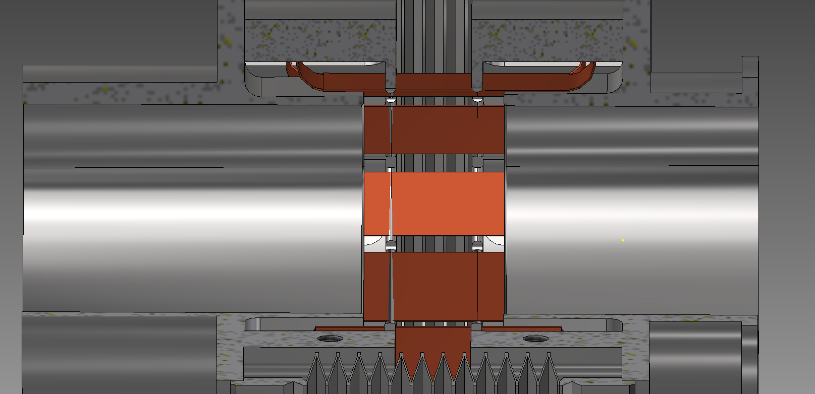
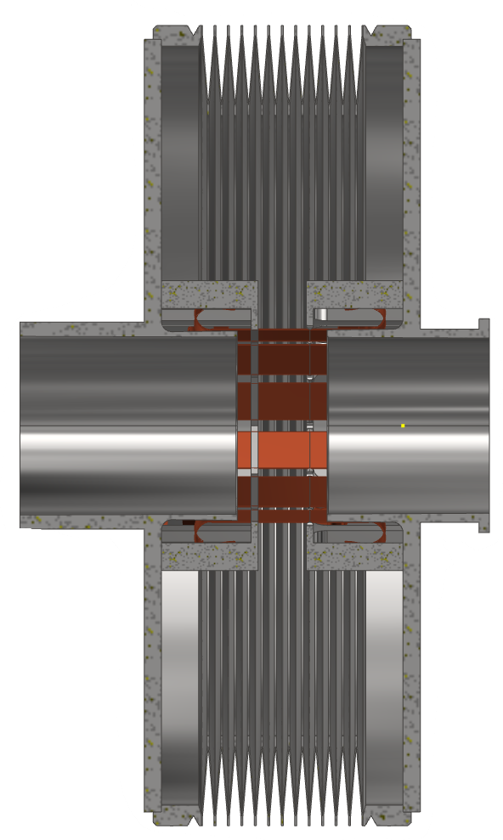
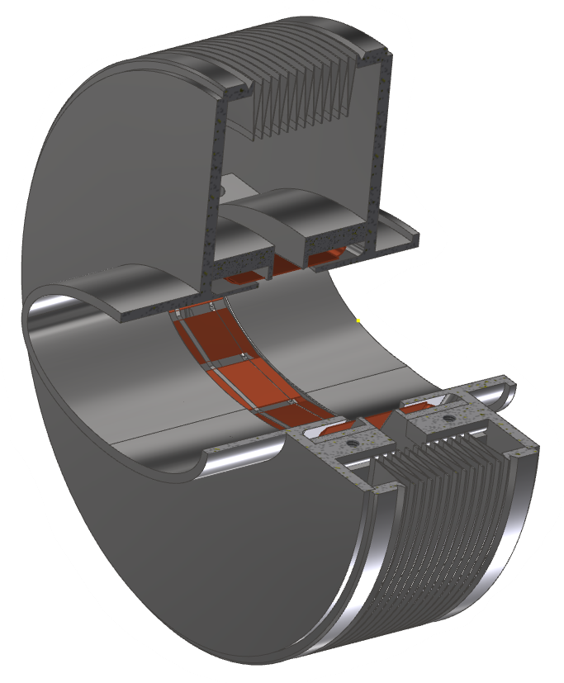
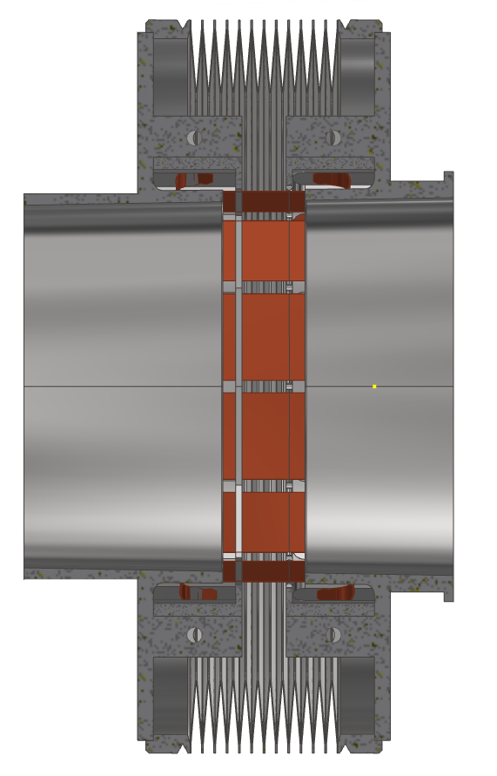
Bellow
02/06/2022 / FCC week 2022
Francesco Fransesini
12 RF copper springs (can be increased to 16)
Compact size in length
8mm stroke (-5mm +3mm)
Finger to ensure contact between RF-spring to bellow (like ESRF bellow)
Future steps for the bellow:
Simulation to validate the design from thermal point of view
Optimization of the size and the convolutions number
Inclusion of cooling
Evaluation of different designs
Notes:
A preliminary design of the bellow is under investigation in order to stay in the space contraints

Slide 17
Prototypes
02/06/2022 / FCC week 2022
Francesco Fransesini
Prototype of:
Central IP chamber in order to:
set and test the paraffin cooling system with temperature control
verify the assembly procedure from a vacuum point of view
study and test the thick copper deposition of the inlet and outlet
AlBeMet162- steel transition in order to:
study the shape of the transition
optimize the EBW process according to our design
Bellow in order to:
study the manufacturing and assembly process
test the behavior in terms of displacement allowable
test from vacuum and thermal point of view
Welding in order to:
study the EBW process for an elliptical geometry
Some prototypes are foreseen to study the real behavior of some components and manufacturing processes

Slide 18
Conclusion and future steps
02/06/2022 / FCC week 2022
Francesco Fransesini
The main assembly has been updating
A preliminary thermal analysis has been done to understand the temperature distribution
The engineered chamber design is in progress (central chamber, trapezoidal chamber, bellow)
Future steps:
Continue the CAD integration in order to develop a conceptual proposal for assembly and supports (chamber support, LumiCal support, etc.)
Structural analysis of the chamber according to the constraint configuration

Slide 19
Thank you for your attention.
02/06/2022 / FCC week 2022
Francesco Fransesini
19
Contact: francesco.fransesini@lnf.infn.it

