Slide 1


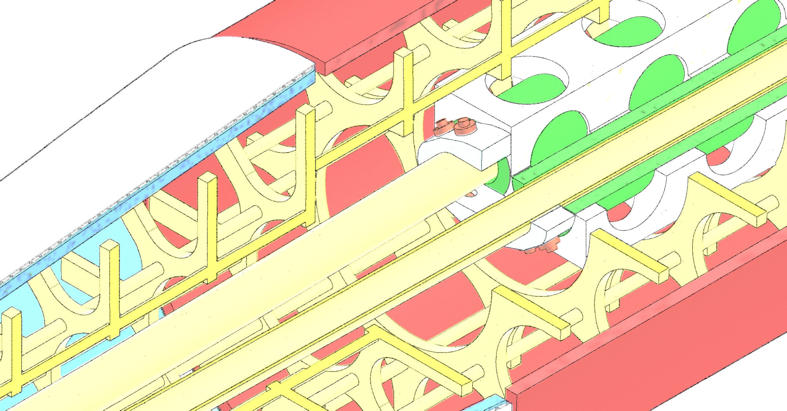


FCC-ee interaction region concepts
M. Koratzinos, C. Ormond
FCC week
02/06/2022

Slide 2
Introduction
We do have (and we are happy with) a conceptual design for all elements of the interaction region
We are now proceeding to a more detailed engineering design
We need to make sure no important detail is overlooked
The following is an ad-hoc mixture of established facts and “my vision” on how I see engineering solutions
All engineering drawings I will show here exist in our CAD design area

Slide 3
The systems
Final focus quadrupoles: QC1L1, QC1L2, QC1L3
Final focus correctors
Beam instrumentation (BPMs)
Compensation scheme solenoids (shielding solenoid, compensation solenoid)
(Luminometer) – will not talk about it today
Cryostat
The mechanical structure
Beam pipe
Alignment system
Assembly scheme

Slide 4
Overview of conceptual design
Cantilevered, 4.3m long
Connected rigidly on one side (away from the IP)
Some mechanical coupling also close to the center of gravity
QC1 magnets coupled with each other and to a strong skeleton
Skeleton also holds in place the two solenoids
BPMs linked to the beampipe with laser position monitoring
There is an extra, thin, Helium vessel (welded together)
Thin and non-structural cryostat for insulation vacuum

Slide 5
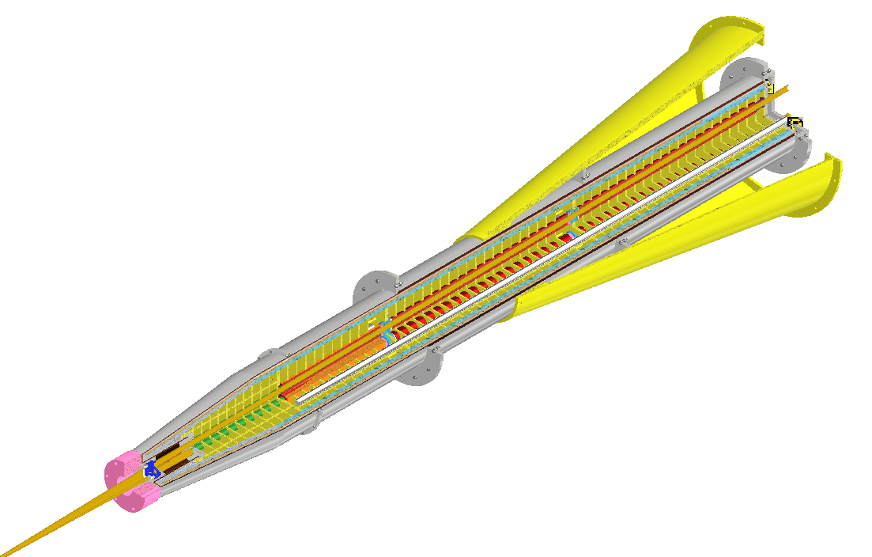
The FCC-ee MDI region
Screening solenoid
Luminometer
Final Focus Quadrupoles (QC1L1, QC1L2, QC1L3)
Interaction point
Compensating solenoid

Slide 6
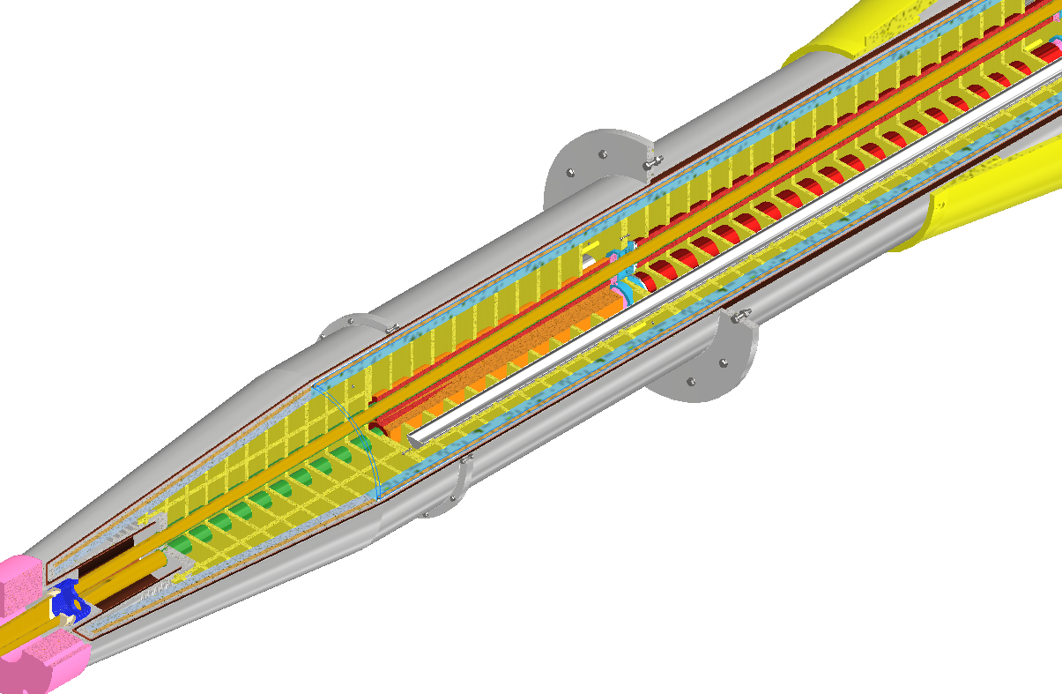
The FCC-ee MDI region
Screening solenoid
Luminometer
QC1L1
Compensating solenoid

Slide 7
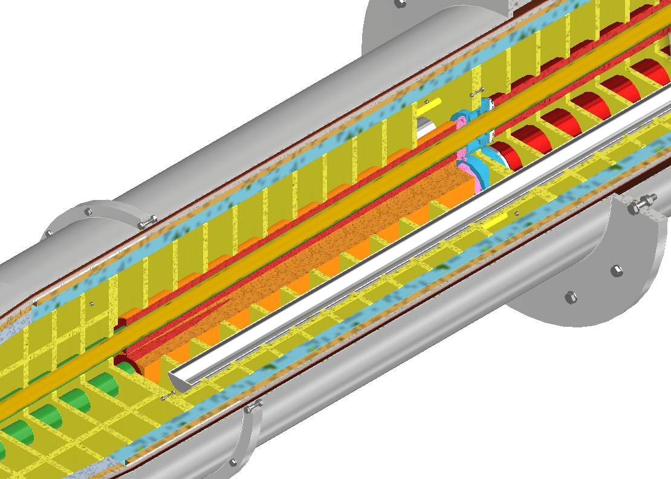
The FCC-ee MDI region
Screening solenoid
QC1L1 for positrons
Compensating solenoid
QC1L1 for electrons

Slide 8
Magnetic element design

Slide 9
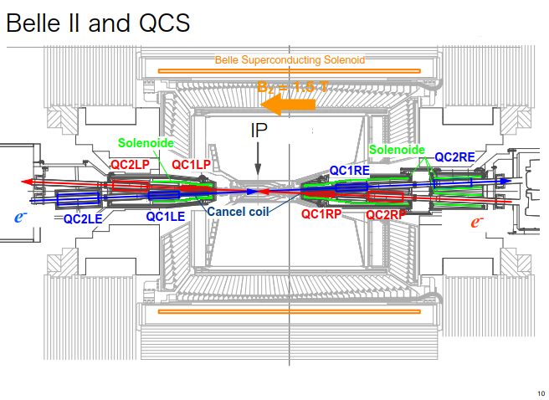
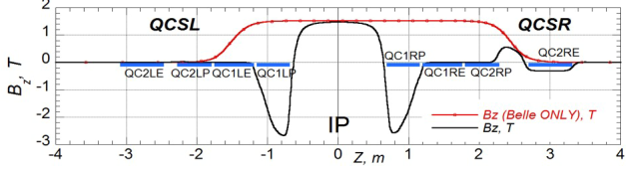
Prior art
55 individually powered magnetic elements!
4 FF quadrupoles per beam line
35 corrector coils
8 cancel coils
4 compensation solenoids
Detector solenoid 1.5T
We do not want to re-invent the wheel, but can we simplify / improve?
Note that first FF quad sits in a high magnetic field

Slide 10
From SuperKEKB to FCC
Can we improve on the SuperKEKB design?
The answer is YES. FCC has one considerable advantage: (almost) identical energies for the two beams
This simplifies the design considerably
Instead of “cancel coils” and “correction coils” we incorporate the correction inside the quadrupoles
We also make sure that the FF quads sit in a zero magnetic field
SuperKEKB | FCC-ee
4 FF quads per beam line | 6 FF quads per beam line
35 corrector coils | 12 corrector coils
8 cancel coils | 0 cancel coils
4 compensation solenoids | 4 compensation solenoids
Detector solenoid at 1.5t | Detector solenoid at 2T

Slide 11
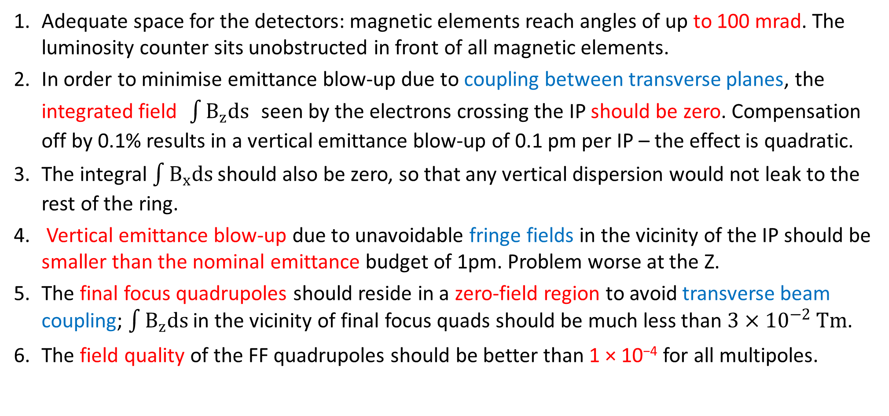
FCC-ee: six requirements at the IP related to magnet design
Adequate space for the detectors: magnetic elements reach angles of up to 100 mrad. The luminosity counter sits unobstructed in front of all magnetic elements.
In order to minimise emittance blow-up due to coupling between transverse planes, the integrated field $\int{B_{z}ds}$ seen by the electrons crossing the IP should be zero. Compensation off by 0.1% results in a vertical emittance blow-up of 0.1 pm per IP – the effect is quadratic.
The integral $\int{B_{x}ds}$ should also be zero, so that any vertical dispersion would not leak to the rest of the ring.
Vertical emittance blow-up due to unavoidable fringe fields in the vicinity of the IP should be smaller than the nominal emittance budget of 1pm. Problem worse at the Z.
The final focus quadrupoles should reside in a zero-field region to avoid transverse beam coupling; $\int{B_{z}ds}$ in the vicinity of final focus quads should be much less than $3×{10}^{−2} Tm$.
The field quality of the FF quadrupoles should be better than 1 × 10⁻⁴ for all multipoles.

Slide 12
Design considerations to satisfy all requirements
Requirement 4 (Zero field @ quads) means that screening solenoids are needed.
Requirement 3 (emittance blow up) necessitates the use of a compensating solenoid.
We have managed to fit the compensating solenoids in the region upstream of the screening solenoids, whereas the area of ±1.23 m from the IP is completely free of magnetic elements, and therefore the luminometer and other technical elements can reside.
Requirement 5 (field quality) is demanding due to the close proximity of the two final focus quadrupoles for the two beams.
Finally, requirements 2 and 3 (integrated fields zero) can be approximately satisfied by tuning the overall design (not trivial)

Slide 13
Compensation scheme

Slide 14
Compensation scheme design
Please refer to our paper “The magnetic compensation scheme of the FCC-ee detectors”, M. Koratzinos and K. Oide, https://doi.org/10.18429/JACoW-IPAC2021-THPAB012
Scheme with two magnetic elements (solenoids) per side [the minimum possible]
Use of LHC-technology: LHC Rutherford cable, super-fluid Helium operation.
By the time of FCC construction, HTS conductors might be a viable alternative

Slide 15
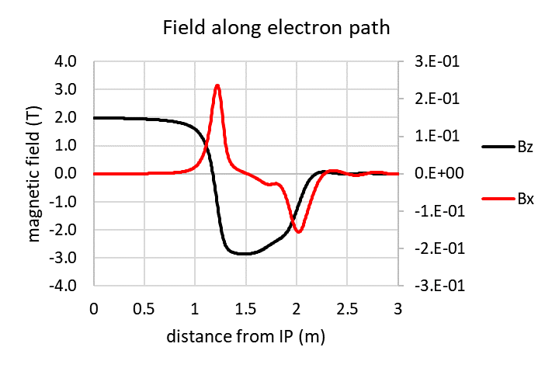
Field profiles

Slide 16
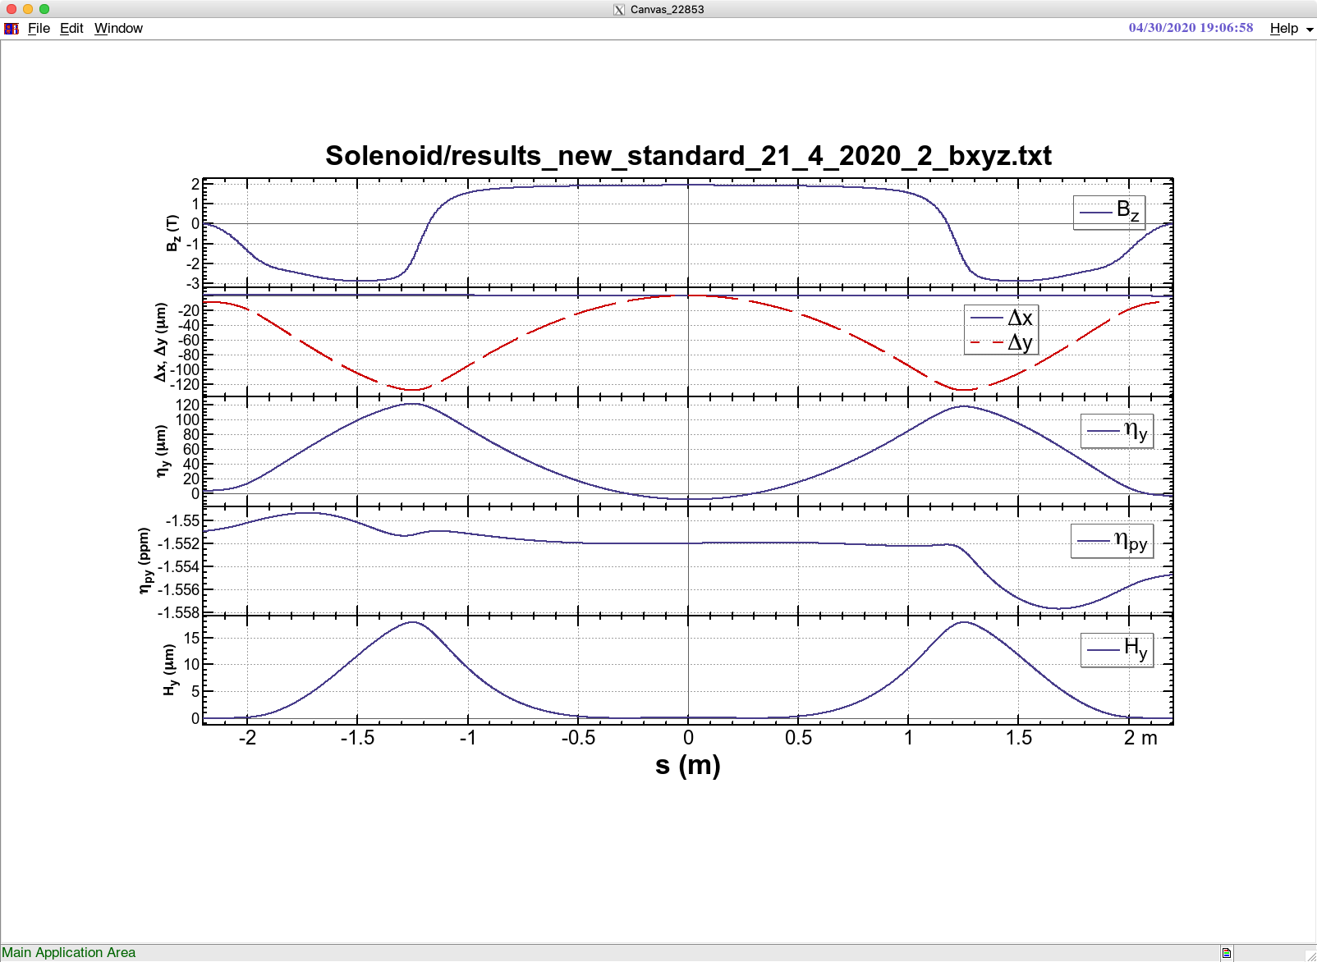
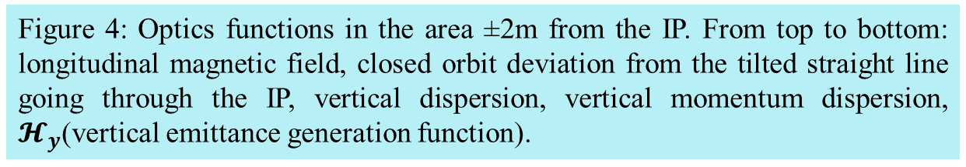
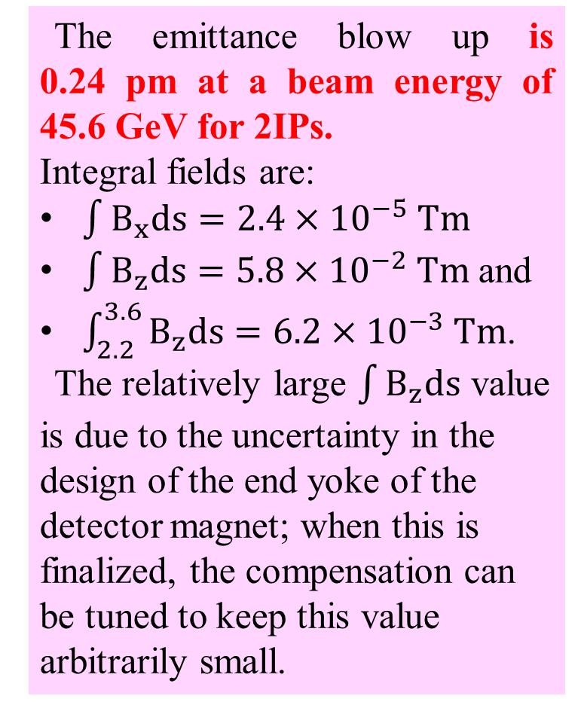
Results
The emittance blow up is 0.24 pm at a beam energy of 45.6 GeV for 2IPs.
Integral fields are:
$\int{B_{x}ds=2.4×{10}^{−5} Tm}$
$\int{B_{z}ds=5.8×{10}^{−2} Tm}$ and
$\int_{2.2}^{3.6}{B_{z}ds=6.2×{10}^{−3} Tm}$.
The relatively large $\int{B_{z}ds}$ value is due to the uncertainty in the design of the end yoke of the detector magnet; when this is finalized, the compensation can be tuned to keep this value arbitrarily small.
Figure 4: Optics functions in the area ±2m from the IP. From top to bottom: longitudinal magnetic field, closed orbit deviation from the tilted straight line going through the IP, vertical dispersion, vertical momentum dispersion, $𝓗_{y}$(vertical emittance generation function).

Slide 17
Ff quads and prototype

Slide 18
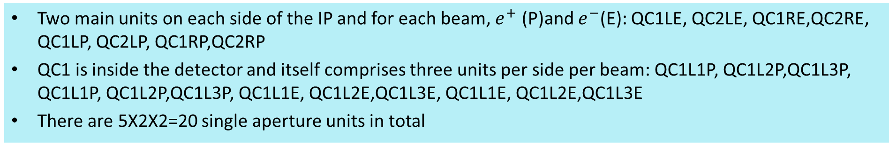
Final focus quadrupoles
Two main units on each side of the IP and for each beam, $e^{+}$ (P)and $e^{−}$(E): QC1LE, QC2LE, QC1RE,QC2RE, QC1LP, QC2LP, QC1RP,QC2RP
QC1 is inside the detector and itself comprises three units per side per beam: QC1L1P, QC1L2P,QC1L3P, QC1L1P, QC1L2P,QC1L3P, QC1L1E, QC1L2E,QC1L3E, QC1L1E, QC1L2E,QC1L3E
There are 5X2X2=20 single aperture units in total
From the FCC CDR update 13/12/2019, Katsunobu Oide
Optics design is such that E and P quads have the same strength
Maximum strength is 100T/m
The most difficult element is QC1L1, the closest to the beam and where the E and P quads are closer together
 | Start position (m) | Length (m) | B’ @Z (T/m) | B’ @W (T/m) | B’ @ H (T/m) | B’ @ tt (T/m)
QC2L2 | -8.44 | 1.25 | 25.05 | 43.82 | 61.30 | 69.50
QC2L1 | -7.11 | 1.25 | -0.18 | 0.00 | 7.32 | 56.85
QC1L3 | -5.56 | 1.25 | -19.35 | -34.38 | -53.08 | -99.98
QC1L2 | -4.23 | 1.25 | -18.57 | -32.94 | -53.07 | -99.98
QC1L1.1 | -2.9 | 0.7 | -40.95 | -70.00 | -99.71 | -95.39
QC1L1.2 | 2.2 | 0.7 | -40.95 | -70.00 | -99.71 | -95.39
QC1R2 | 2.98 | 1.25 | -25.44 | -37.25 | -51.94 | -100.00
QC1R3 | 4.31 | 1.25 | -19.54 | -39.51 | -53.65 | -91.87
QC2R1 | 5.86 | 1.25 | 14.64 | 16.85 | -2.65 | 37.19
QC2R2 | 7.19 | 1.25 | 19.50 | 44.32 | 67.52 | 94.43
The updated parameters are rather different for QC1L1: its length is now 70cm from 120cm

Slide 19
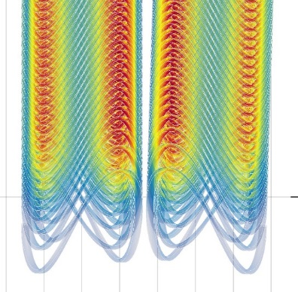
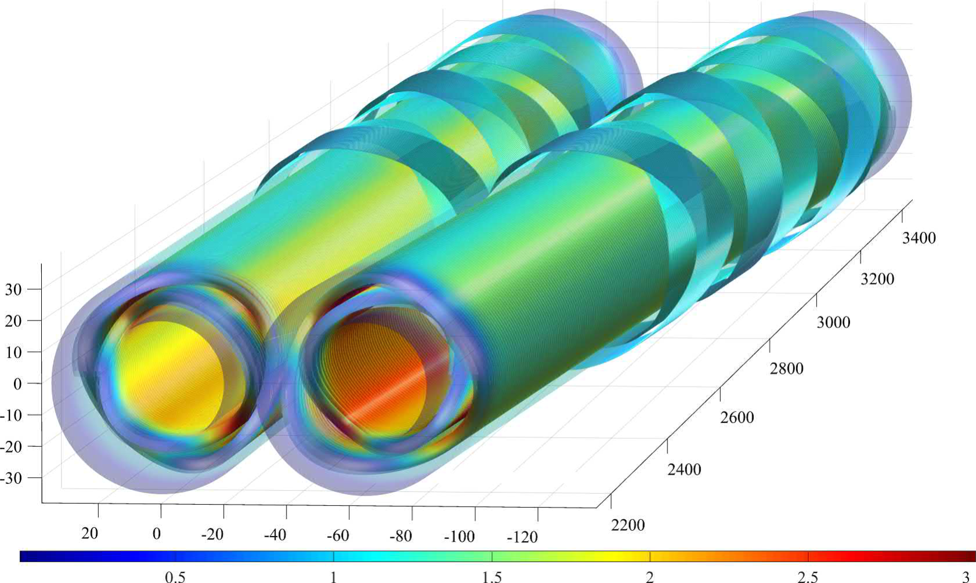
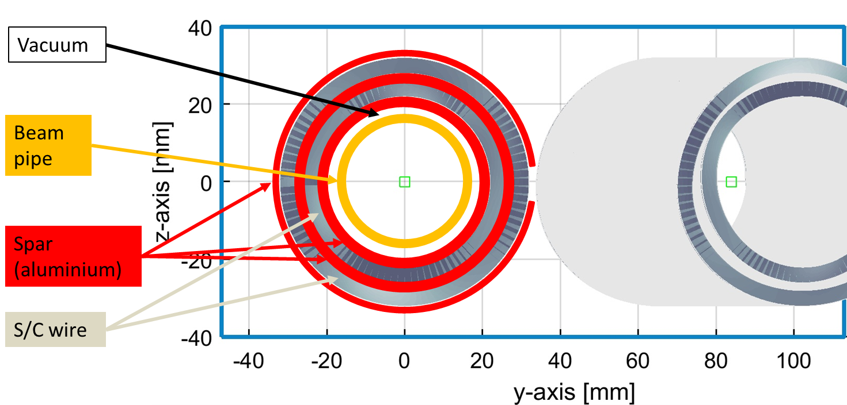
QC1L1
QC1L1 is the first and most demanding pair of quadrupoles of the final focus system of FCC-ee
Correctors have also been designed
Iron-free design
Inner bore: 40mm (diameter)
Fits outside the warm water-cooled beam pipe of inner diameter 30mm

Slide 20
Main challenges for QC1L1
Lack of space: 66mm between the two beams at QC1L1. Quads are at an angle so crosstalk varies along the length
Required field quality: better than 10⁻⁴ and of O(10⁻⁵)
Need to eliminate crosstalk between the two quadrupoles
  The beam pipe inner diameter is 30mm
  The beam pipe is warm, so we need vacuum insulation and cooling/heating for the beam pipe
  The minimum size of the thickness of the double layer beam-pipe with the cooling liquid flowing in-between is 3mm
  We are then leaving 2mm for vacuum and a heat shield
  ➔ aperture of FF quads is 40mm
  ➔ space left for former, conductor, yoke = 13mm
  ➔ it would be very difficult to fit an iron yoke with reasonable thickness to eliminate crosstalk

Slide 21
Choice of technology for QC1L1
There is only one technology we have identified that can tackle those challenges: a CCT iron-free design
A CCT design can compensate for the crosstalk between quadrupoles even in the case that crosstalk changes every centimetre: see M. Koratzinos et al.1709.08444 [physics.acc-ph] Published in: IEEE Trans.Appl.Supercond. 28 (2018) 3, 4007305
A CCT design can also compensate for edge effects ensuring excellent field quality locally at every point of the magnet. This is important since the optics functions vary wildly close to the IP

Slide 22
CCT accelerator magnets
A CCT (Canted Cosine Theta) is a type of accelerator magnet where the multipole mix is a local attribute of a magnet. (One can trivially design a magnet which is a dipole on one side and a quadrupole in the other.)
The QC1L1 magnets are NOT quadrupoles. They are quads minus the field due to the other aperture. But together they make two nearly perfect quadrupoles
Other important advantages of CCTs:
  Cheap to make – from the magnet design program to CAD to CNC machine with no manual interventions
  Easy to make – no pre-stress! Stress management is trivial in CCTs
  Fast to make – few steps, no expensive equipment
  Excellent field quality – please see further
Conventional
CCT

Slide 23
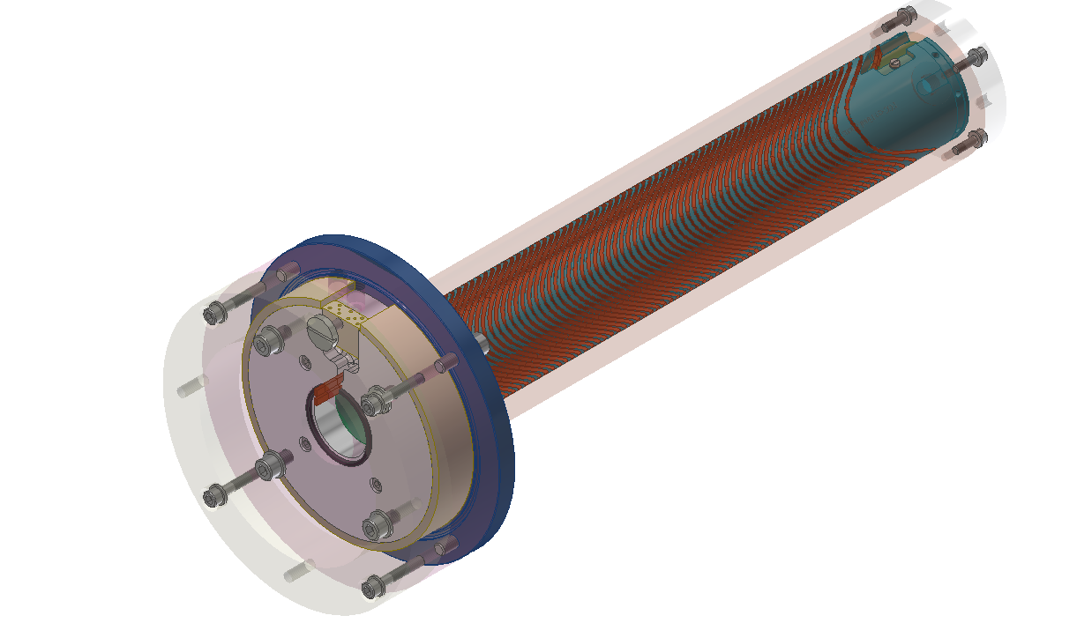
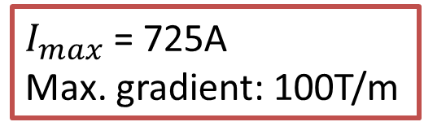
The FCC-ee Final Focus Quadrupole prototype
Single aperture
43cm long
With edge correction on one side
$I_{max}$ = 725A
Max. gradient: 100T/m

Slide 24
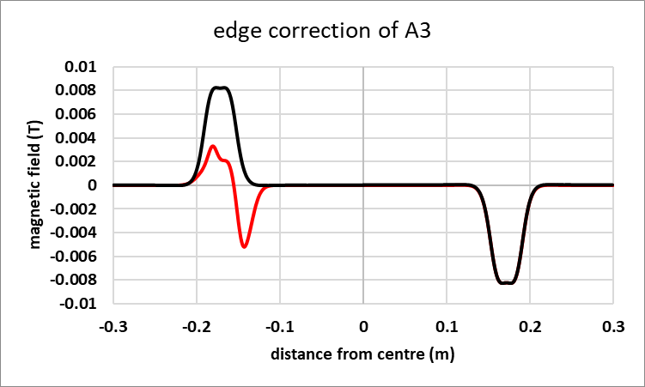
Local edge correction
By design, a CCT magnet has all integral multipoles vanish (with the exception of the main one).
However, the skew (A) components of the magnetic field compensate only because they have opposite signs at the entry and exit of the magnet.
QC1L1 sits in an area of rapidly-changing optics functions: the change of beam size between the entry and exit of the magnet is a factor of ~2. ➔ a local correction is needed
Example: correction of A3 component, one side only. In red: corrected; in black: uncorrected
M. Koratzinos et al.1709.08444 [physics.acc-ph]

Slide 25
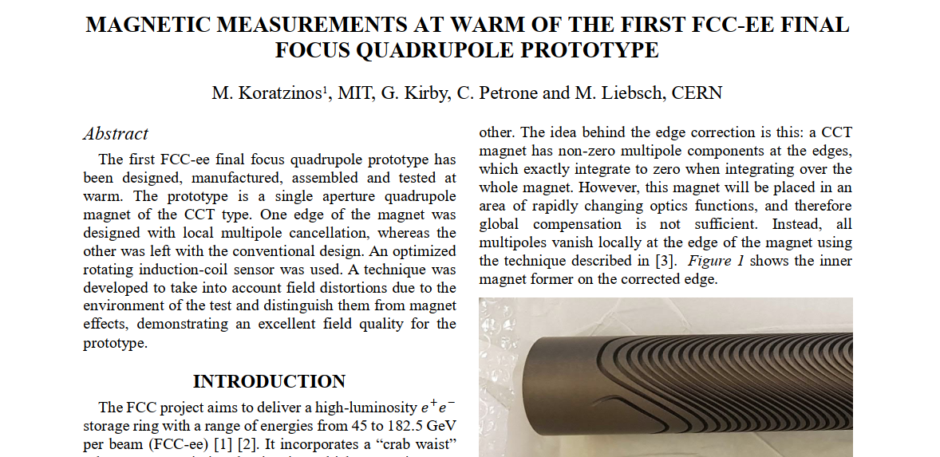
IPAC21 paper
arXiv:2105.13230 [physics.acc-ph]

Slide 26
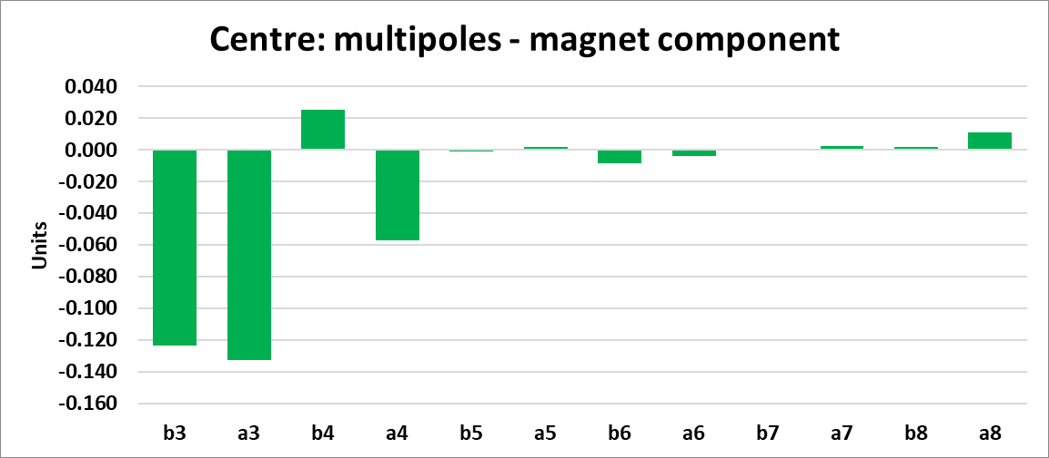
Results - centre
All multipoles are below 0.15 units and only b3, a3 is above 0.10 units. (this is barely above the sensitivity of the method)

Slide 27
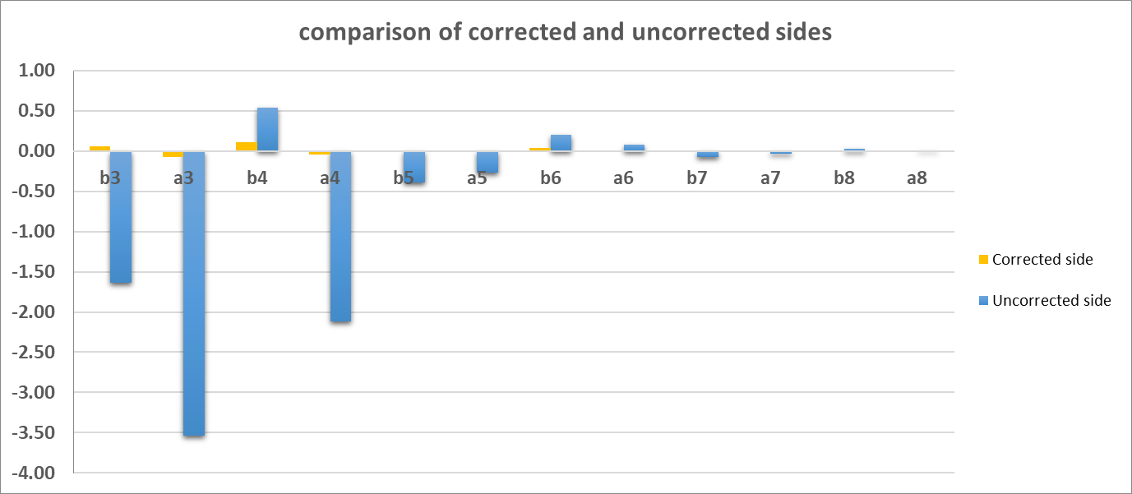
Field quality at the edge, comparison
Corrected side has edge effects that are 0.1 units or less
Reduction by a factor ~50!
For both plots, the normalization is to the full length of QC1L1 (1200mm)
Carlo Petrone
Edge correction really works!

Slide 28
Conclusions FF quad prototype
The first FCC-ee final focus prototype has been designed, manufactured and the first tests at warm are available (IPAC paper arXiv:2105.13230 ).
Field quality is excellent.
All multipoles in the middle of the magnet are 0.15 units or less, approaching the accuracy of the method. These are real measurements, not simulation!
The novel technique of locally correcting each edge for edge effects is working beautifully → this gives us confidence that the crosstalk compensation will also work.
All multipoles of the corrected edge contribute 0.1 units or less. ➔ this is a “perfect edge” magnet.
The CCT technique is very well suited for the final focus quadrupoles of FCC-ee (and also CEPC…).
Hope to be able to test the magnet at cold also

Slide 29
Engineering concepts

Slide 30
Engineering concepts
We will now talk about the most important engineering concepts of the cantilevered assembly and the solutions we envisage
Cedric Ormond has done most of the detailed CAD design
This is arguably the most complicated and expensive part of the machine: space is very tight, there are conflicting requirements and the assembly procedure is very complex.

Slide 31
Progress since last presentation
We have now moved towards an engineering design of all elements:
  Mechanical coupling between magnets to ensure alignment
  Mechanical structure (skeleton)
  Helium vessel (welded)
  Insulation vacuum vessel
  Thermal screen (new element)
We have failed to keep the 100mrad cone. We now are at 113mrad. We prefer to press on with the design, then find ways to improve.

Slide 32
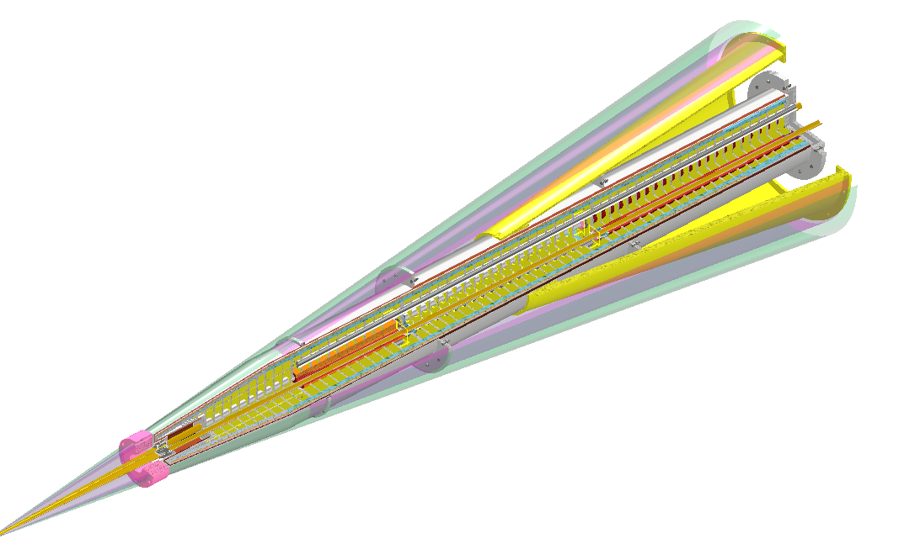
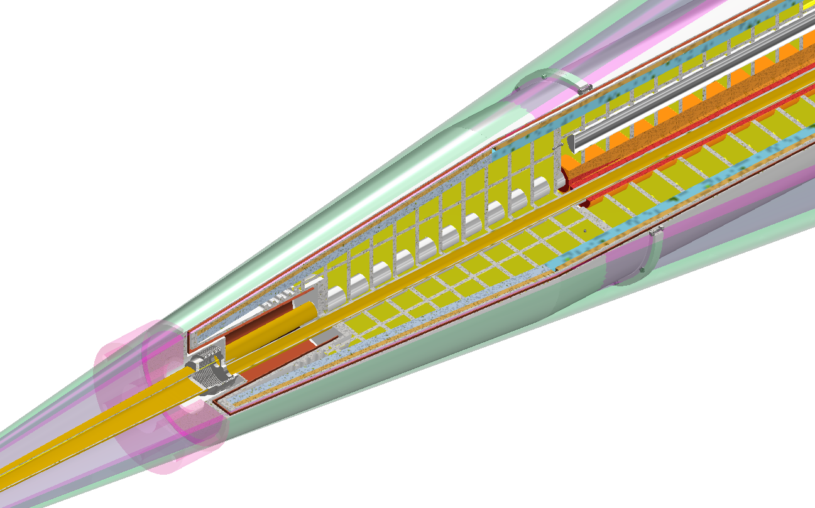
New, more complete, design
Pink: 100mrad cone
Green: 113mrad cone
Cedric Ormond

Slide 33
Beam pipe

Slide 34
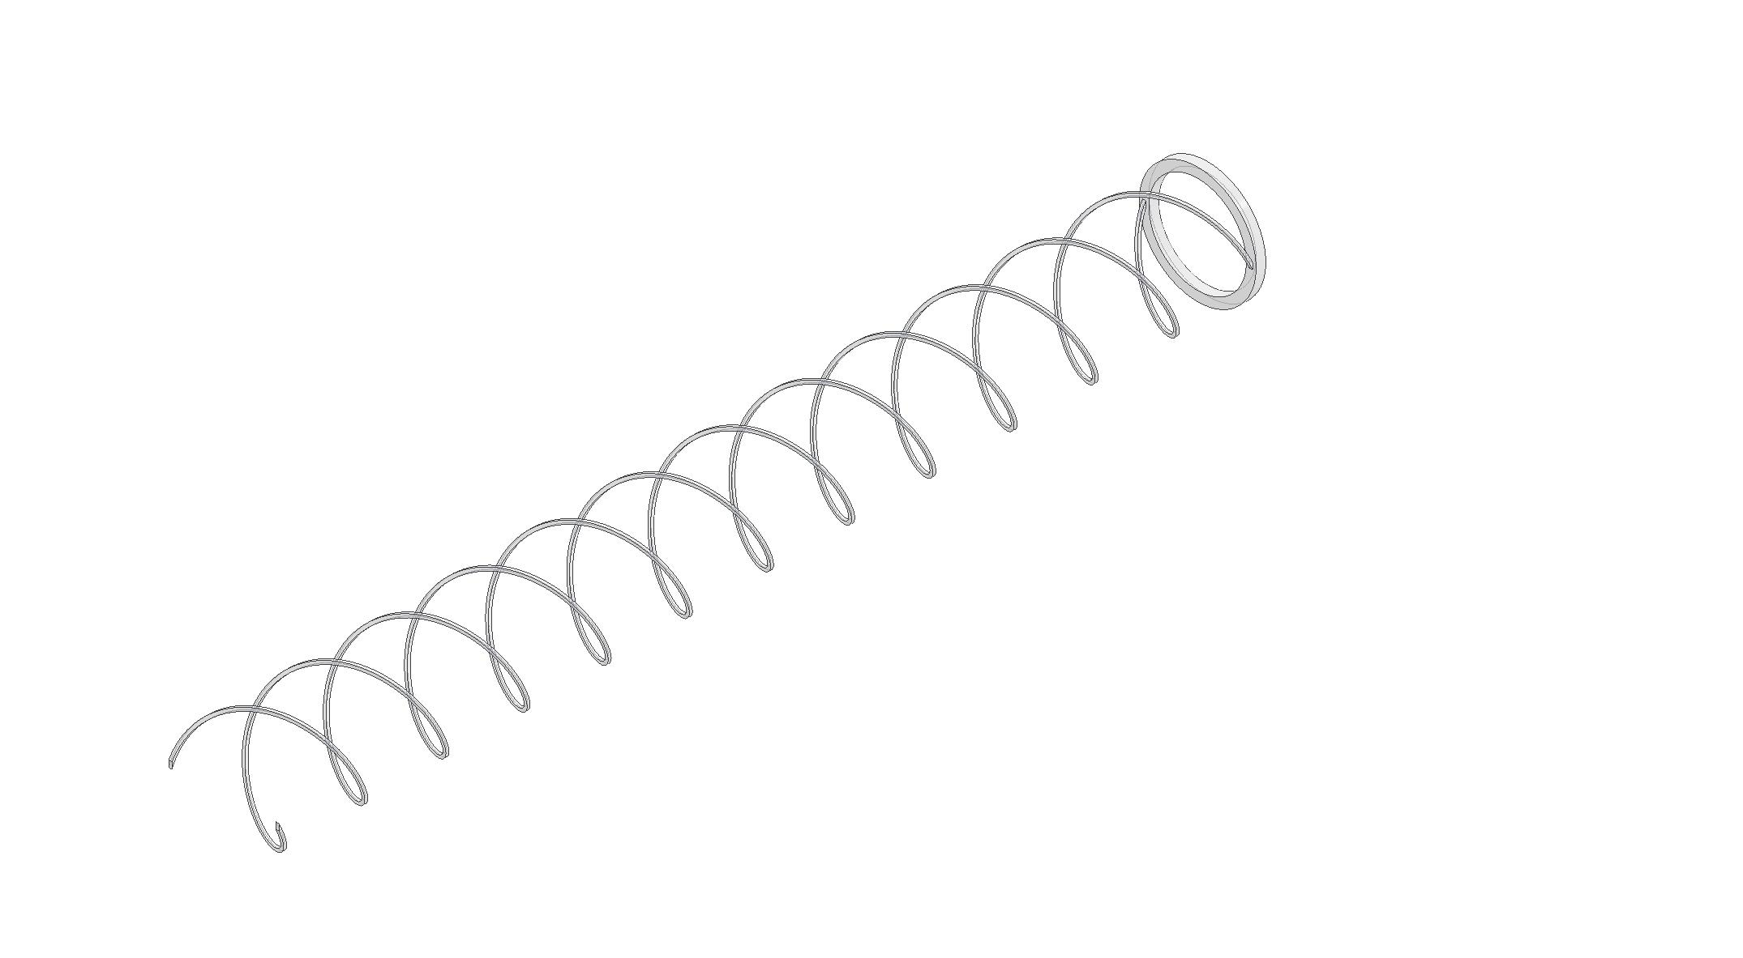
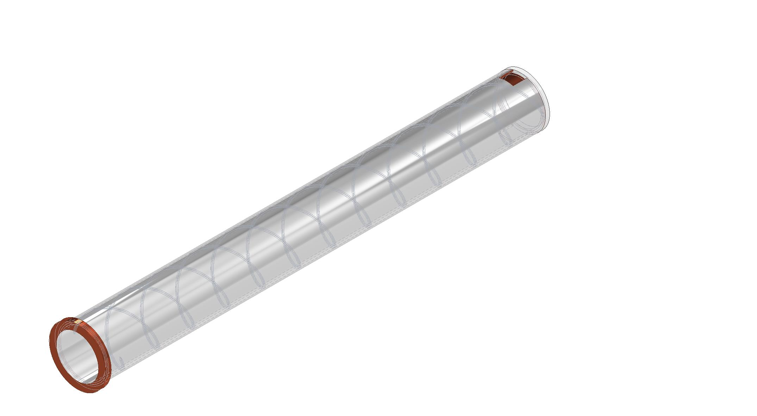
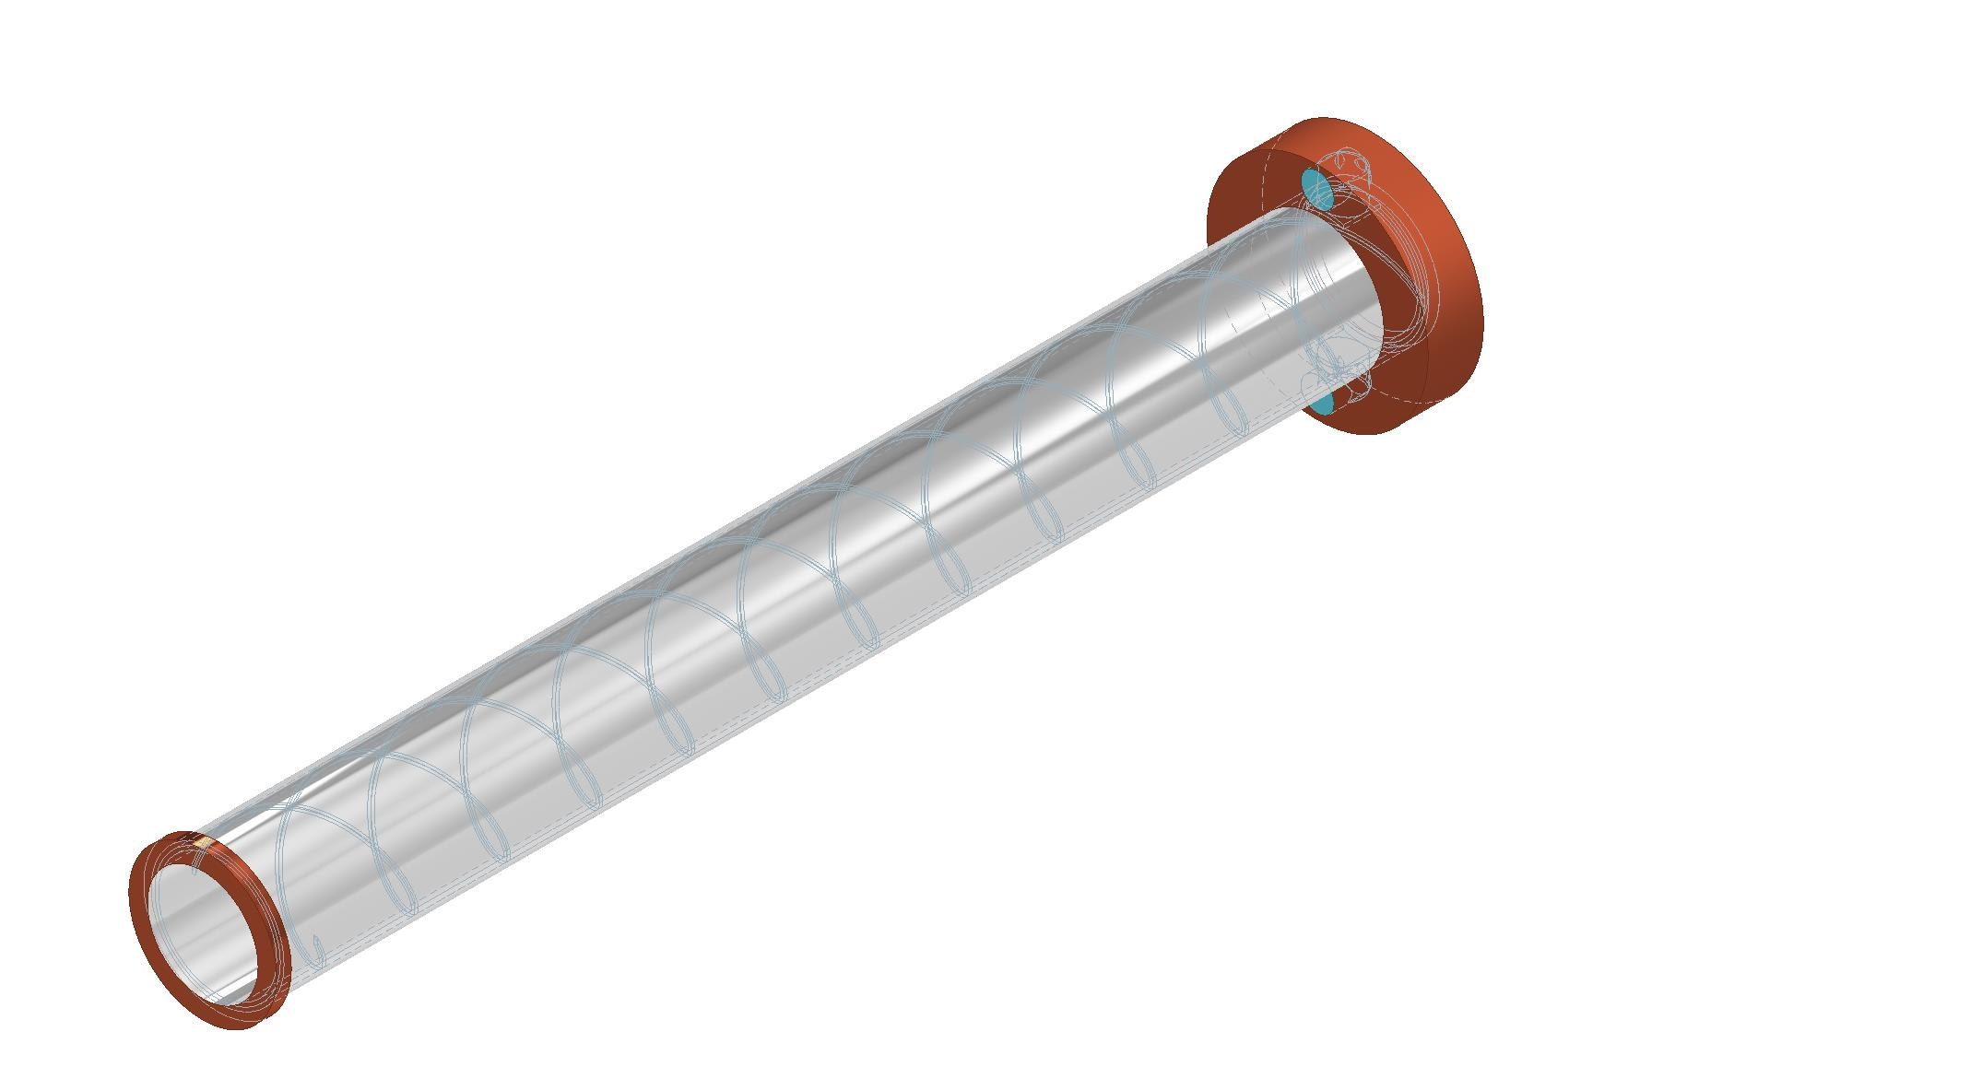
Water-cooled beam pipe

Slide 35
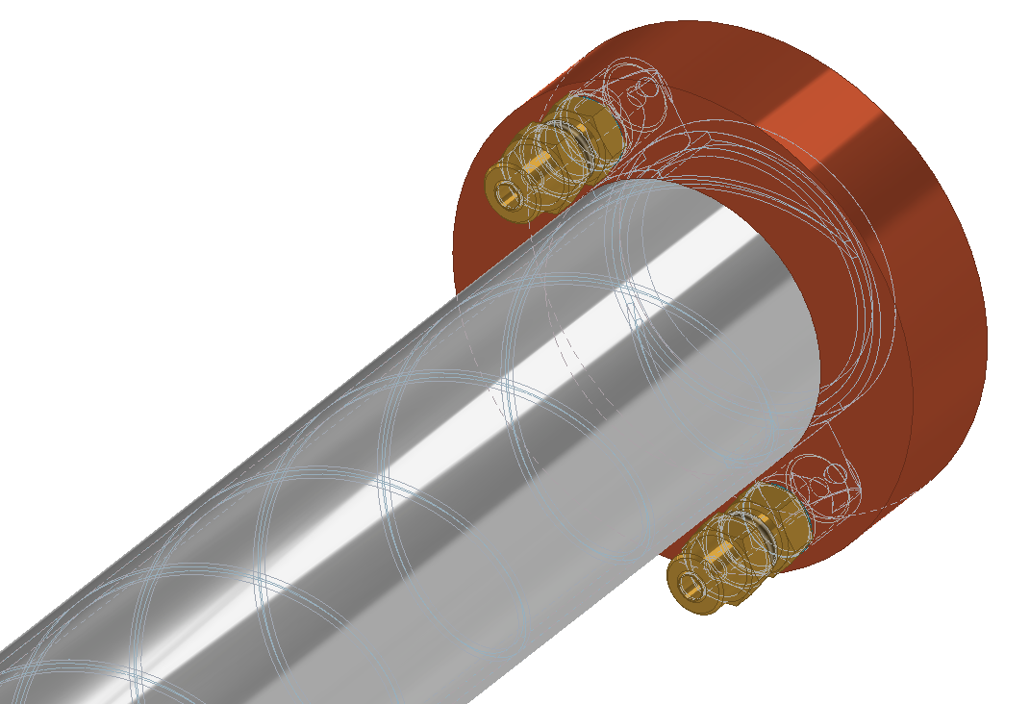
Water-cooled beam pipe
Two-skin design
Spiral spacer that channels water
Inlet/outlet on the same side
Water xsection in the beampipe: inlet: 50mm2, outlet 50mm2
Length: 4300mm
Heat: 140W/m or 600W per pipe
Water inlet/outlet tubes: 8mm
For a water flow rate of 0.5m/sec ➔ Delta_theta = 6K
This is not challenging
Excellent R&D topic

Slide 36
beam position monitors

Slide 37
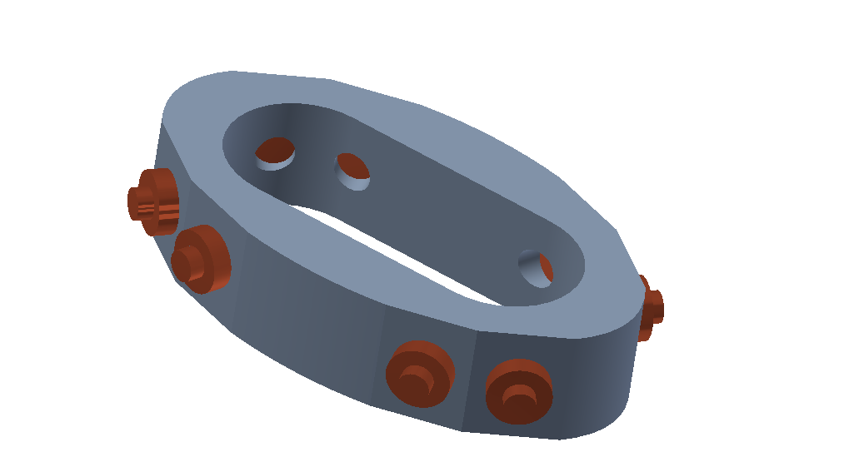
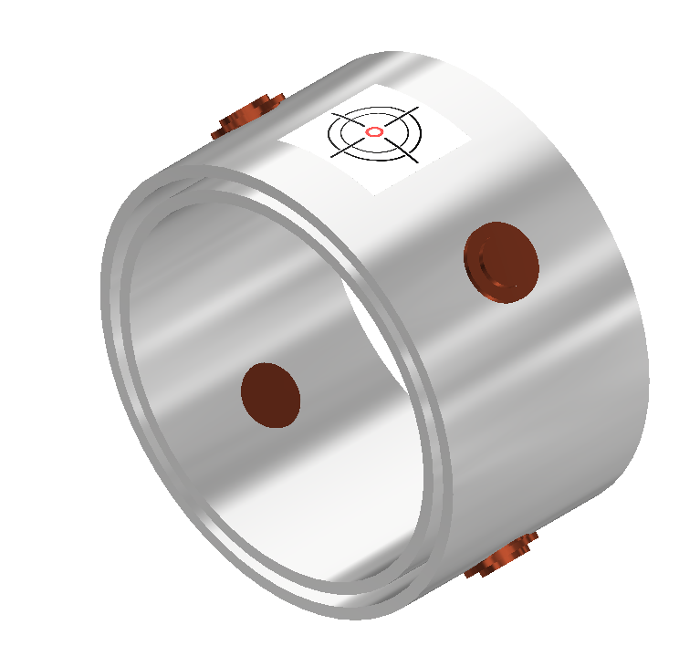
BPM design
Ideally, BPMs need to be mechanically coupled to the magnets, but the beam pipe is in the way. One could envisage a system with flanges and bellows for the BPMs, but this will not work in our case.
Our solution: BPMs are rigidly connected to the beam pipe, which is free to move inside the magnet aperture.
There is a laser system that continuously monitors the position of the beam pipe with respect to the (final focus) magnets
New design
Old design
we need one BPM per QC1 quad
Cedric Ormond

Slide 38
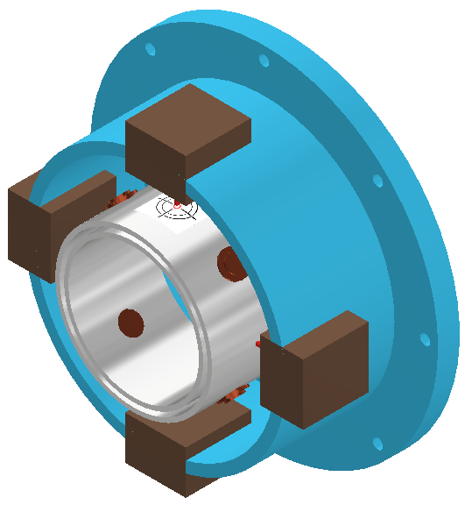
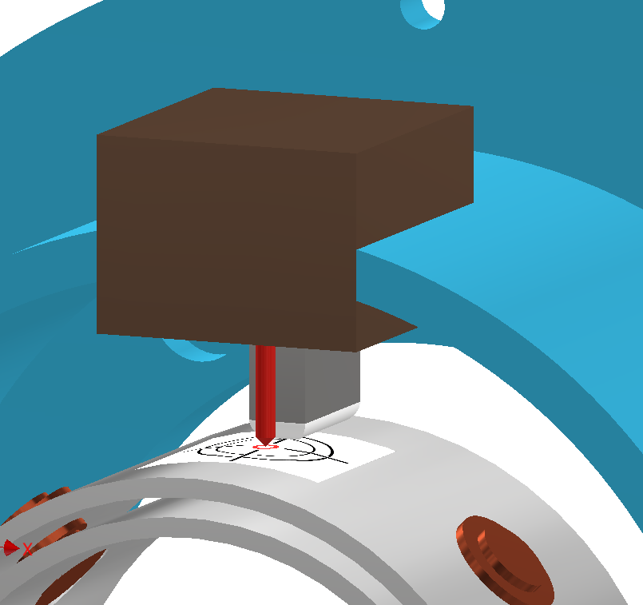
Beampipe alignment using a (cold) laser system
Excellent R&D topic
Cold laser alignment system
Cold stepper motor
Teflon-tipped spring
Cedric Ormond
Added complication: insulation vacuum

Slide 39
Remote flange

Slide 40
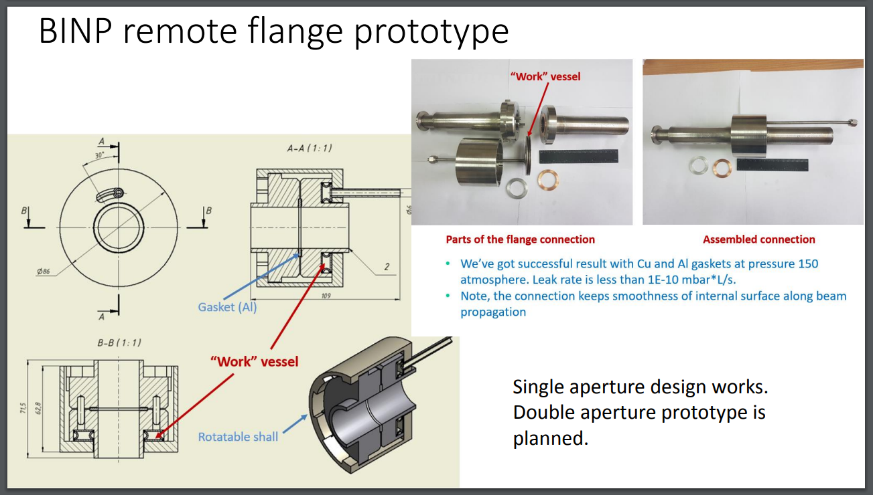
Remote flange
To be able to assemble/disassemble the structure, we need a disassembly flange.
This flange sits at the intersection of the trapezoidal pipe to the two separate pipes, close to the luminometer
Due to space requirements, this flange needs to be remotely operated: once to lock the beam vacuum at the end of assembly, and once to unlock after a run for disassembly.
Already discussed by our BINP colleagues in 2019

Slide 41
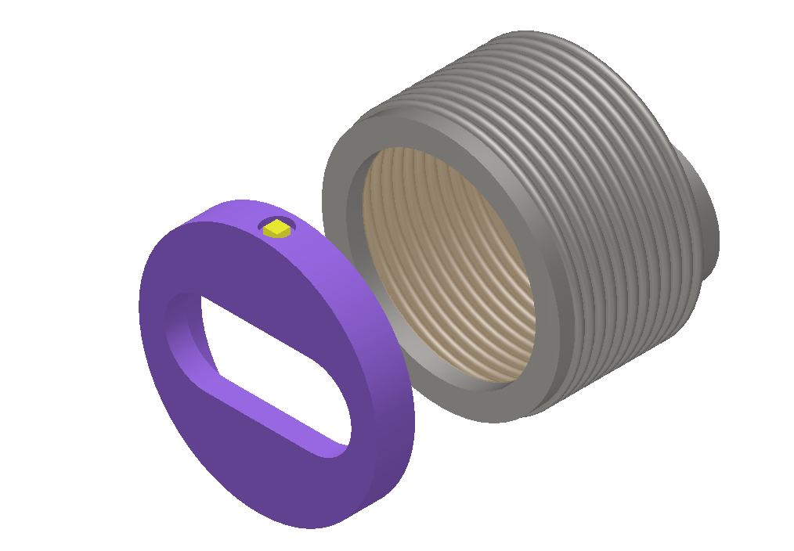
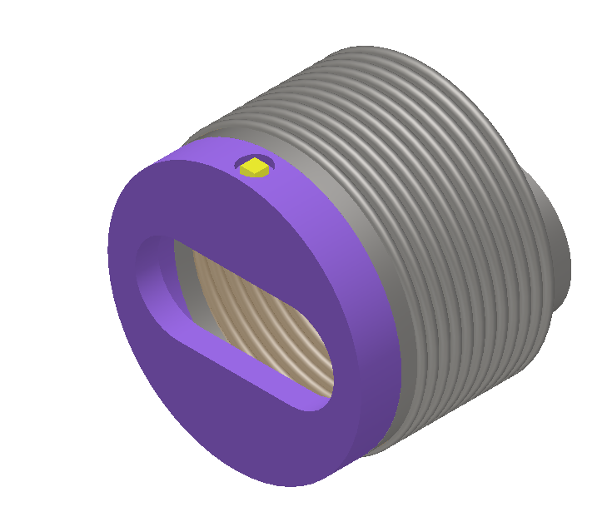
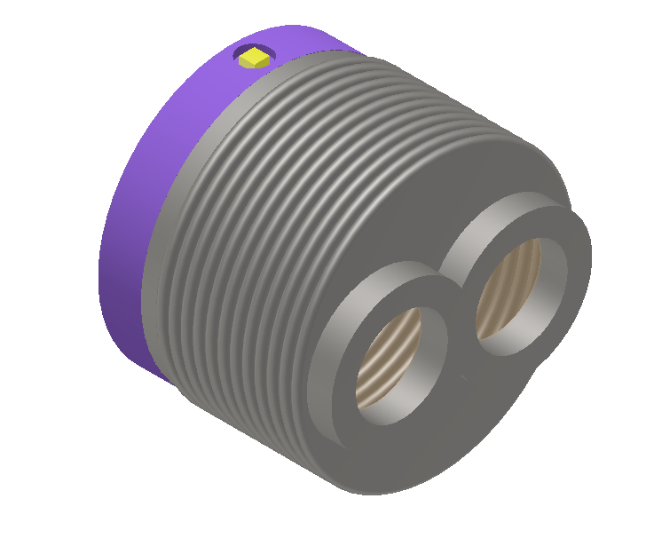
Remote flange – functional description
Excellent R&D topic
Rotate to separate

Slide 42
Heat management

Slide 43
Heat management- superfluid He
The current design uses super-fluid helium for cooling (like the LHC main magnets)
Superfluid helium has excellent heat removing properties…
…but also there are points of extra caution:
Superfluid helium has zero viscosity, so will find the smallest of holes to seep out.
This necessitate the use of a welded (and inspected) helium vessel, which could be thin

Slide 44
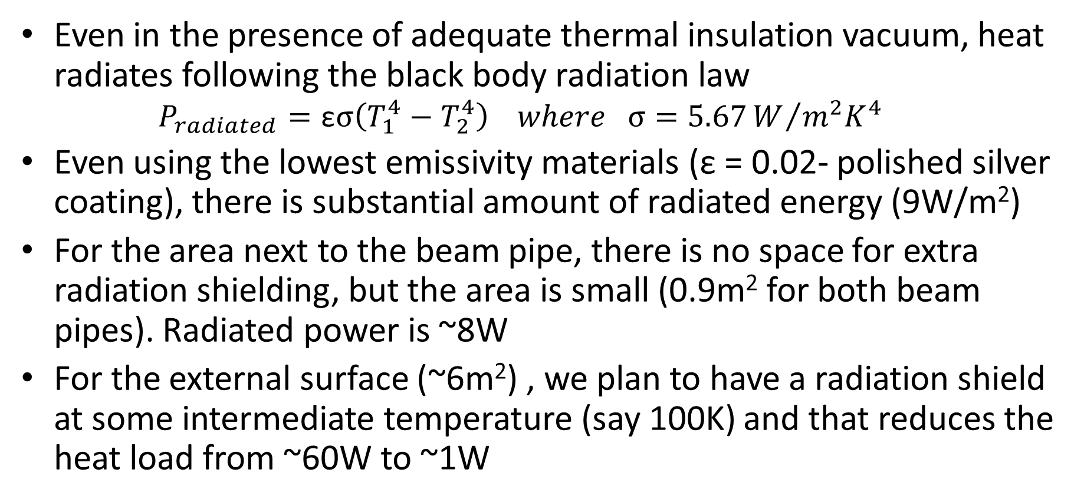
Heat management – black body radiation
Even in the presence of adequate thermal insulation vacuum, heat radiates following the black body radiation law
  $$P_{radiated}=\text{ε}σ\left(T_{1}^{4}−T_{2}^{4}\right) where σ=5.67W/{m^{2}K^{4}}$$
Even using the lowest emissivity materials (ε = 0.02- polished silver coating), there is substantial amount of radiated energy (9W/m²)
For the area next to the beam pipe, there is no space for extra radiation shielding, but the area is small (0.9m² for both beam pipes). Radiated power is ~8W
For the external surface (~6m²) , we plan to have a radiation shield at some intermediate temperature (say 100K) and that reduces the heat load from ~60W to ~1W

Slide 45
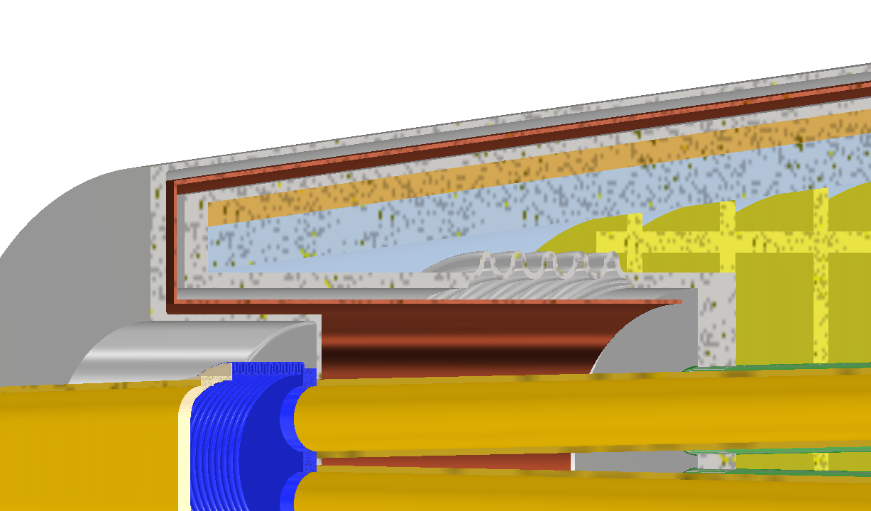
Contraction management
Compensation solenoid
Outer insulation vacuum vessel
Thermal screen
Helium vessel
The cold part of the system will contract by ~1cm w.r.t. the hot part
(Pivoting support – not shown – to be designed)
Cedric Ormond

Slide 46
Mechanical structure

Slide 47
Mechanical structure – towards an engineering design
We have started work to go from the conceptual to a more engineering design
The mechanical support is a (stainless steel) backbone skeleton, cantilevered,
  from l=1220mm to l=5600mm
  length=4380mm
  Weight ~1700 kg per side
Part of the design is cold, the other part hot
Magnets are aligned with respect to each other using spacers
Cedric Ormond

Slide 48
Mechanical support of the cantilever structure
This is a very complex system.
Mechanical support will rely on supporting the bulk of the cantilever design at the point far away from the IP. This is because space is not an issue there, and we can use longer and stronger supports to reduce heat creeping in the cryostat.
The secondary supports close to the centre of gravity of the system need to have a pivot design due to the shrinkage of the system at low temperatures.
Vibration control

Slide 49
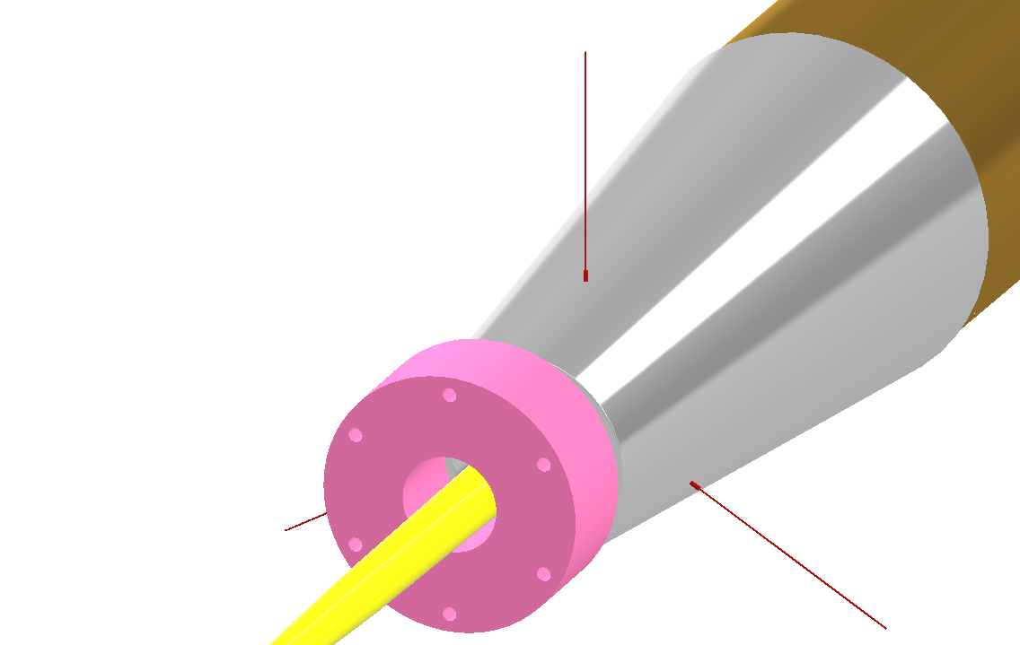
Extra support
If needed we can also have a “Mercedes star” (left, in red) structure at the front of the structure with piano wires going through the detector (if the detector people allow us!
This can help primarily for the vibration mitigation

Slide 50
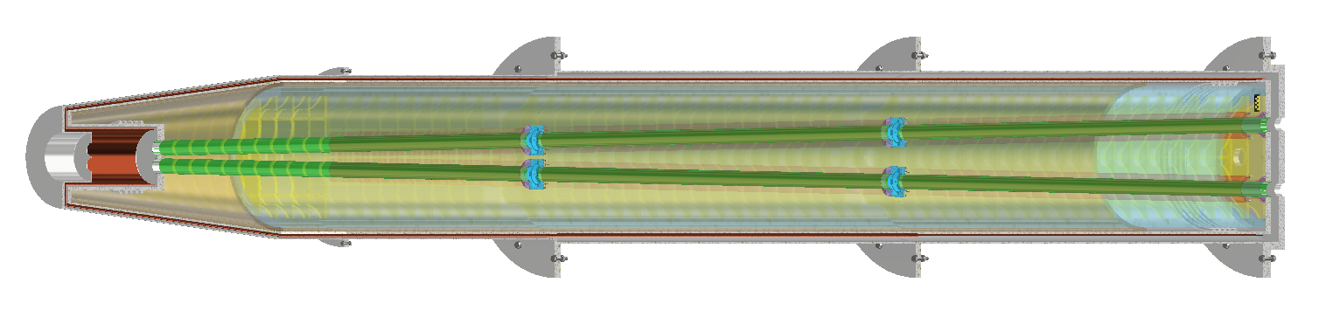
Helium vessel
Helium II operation necessitates the use of a dedicated helium vessel (which can be thin) which is welded together.
Below we can see the helium vessel (in green) between the insulation vacuum and the magnet aperture
On the outside the helium vessel is a bit thicker.
A big relief valve is envisaged to make sure that helium gas has an escape route in case of a quench
Cedric Ormond

Slide 51
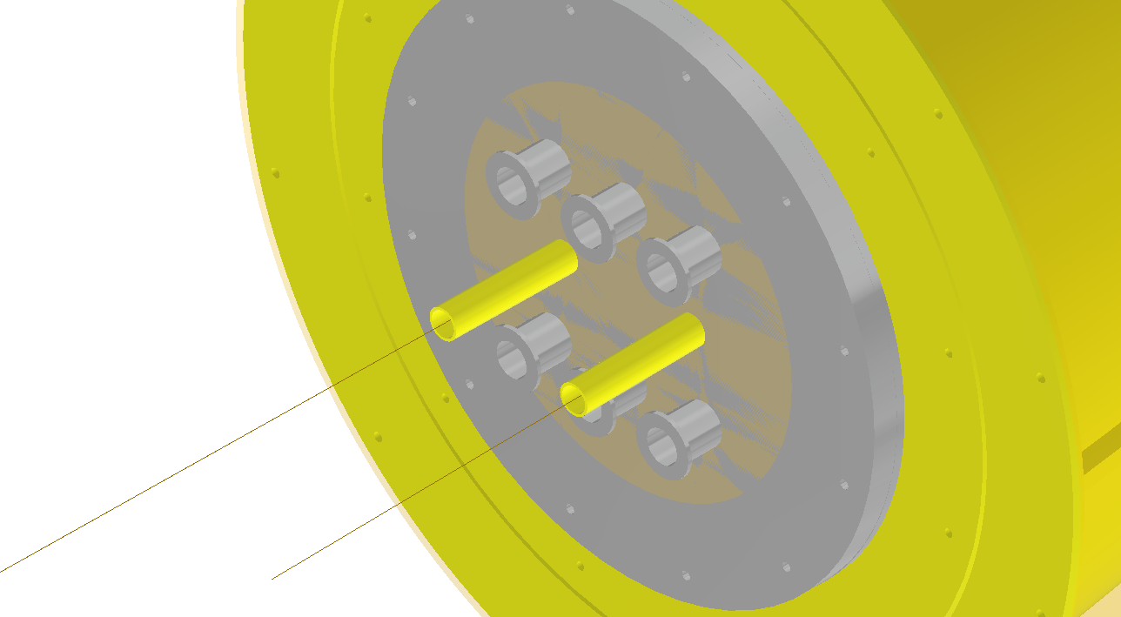
Services
The system will need a number of services:
Liquid helium
Low-pressure helium line for the heat exchanger (two lines)
Insulation vacuum pumps
Beam vacuum pumps
He gas relief valve
High current systems:
  Compensation solenoid
  Screening solenoid
  QC1L1
  QC1L2
  QC1L3
Medium current systems:
  Correctors (dipole x, dipole y, skew quadrupole per beam per side)

Slide 52
assembly

Slide 53
Assembly
Assembly is not straightforward, but we think we have a working assumption.
Assembly starts from the end away from the IP
The beam pipes are some of the final elements to be assembled
Still a lot of work to be done here
A video is the best way to explain this

Slide 54
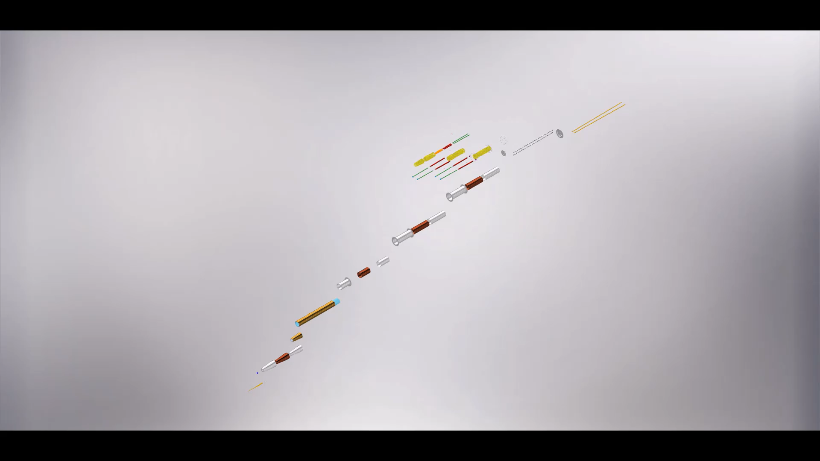
Cedric Ormond

Slide 55
Final word
This is an exciting project!
Since this system is (arguably) the most complicated of the whole FCC-ee machine, let’s make it truly state-of-the-art

Slide 56
Thank you

Slide 57
Extra slides

Slide 58
Discussion on s/c choices
This system has been designed using NbTi as conductor and superfluid helium as coolant.
The reasoning was that the alternative, HTS, was largely unproven when we started the project, especially regarding field quality of the final focus quadrupoles.
However, HTS has performance advantages over LTS NbTi.
The uncertainty about HTS should change by the time we need to construct FCC (2040+)
We need a roadmap on this possible transition to HTS

