Slide 1
Challenges of high-power beam dumps – general considerations on beamstrahlung absorbers
A. Lechner, T. Lefevre, A. Perillo-Marcone, M. Calviani
2nd June 2022

Slide 2
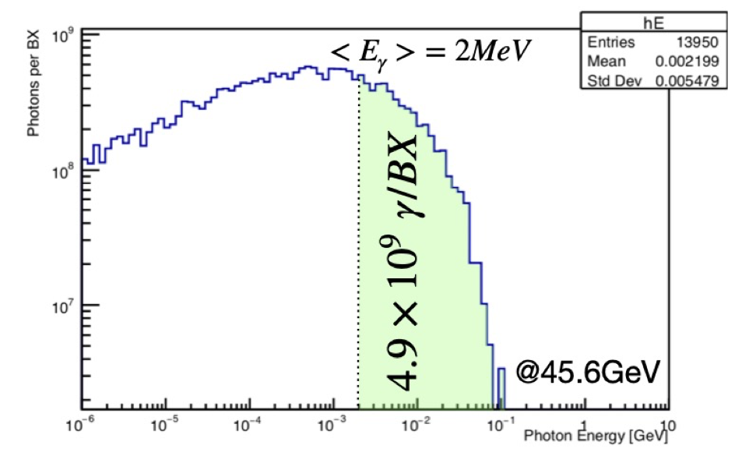
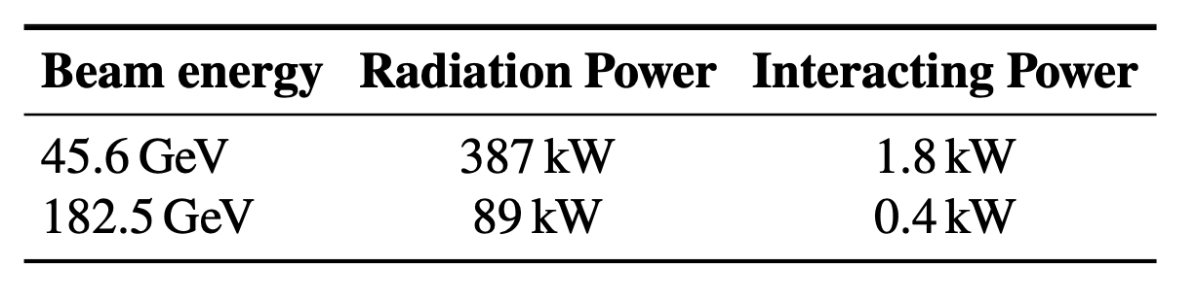
Setting the scene / requirements
A significant fluence of photons is generated at the IPs in the very forward direction by different mechanisms (beamstrahlung, radiative Bhabha, etc.)
  ±2 MeV average, extending up to 100 MeV
  Almost O(400 kW) in few cm²
To be absorbed reliably and safely
A. Ciarma
doi:10.18429/JACoW-IPAC2021-WEPAB029
Interesting of monitoring the incoming photon fluence for physics

Slide 3

Setting the scene / requirements
With 4 IPs, we would need 8 dumps, each of them of 0.5 MW class
This is a big challenge for a beam intercepting device and monitoring

Slide 4

What type of challenges need to be faced?
Must be able to withstand operation and accident scenarios & protect delicate equipment
“Last line of defence” against component damage
Dependable components, whose failure often leads to long period of downtime
Radioactive components in an accelerator complex (cool down, ALARA)
https://cerncourier.com/a/intercepting-the-beams/

Slide 5
What type of challenges need to be faced?
Ultra High Vacuum requirements (if internal)
High energy and power densities (several kW/cm³)
High average deposited power (hundreds of kW)
Radiation damage and TID (hence shielding) in neighbouring areas
Impedance optimisation
Several independent units to be installed in the complex

Slide 6

BIDs lifecycle
Functional requirements
Conceptual design
R&D + prototype + testing
Advanced design
Procurement and construction
Operation / maintenance
Disposal
Commissioning
Lifecycle for the successful construction & operation of BIDs/Target Systems
Lessons learnt at every step …

Slide 7
Boundary conditions & constraints
Integration and localisation constraints (tunnels, alcoves, etc.)
Energy deposition & thermo-mechanical stability
Material damage (lifetime & reliability)
Operational availability
Safety for personnel and for machine
Handling, accessibility & maintenance considerations
Design is a complex and iterative process, which must satisfy multiple requirements with – in most cases – incomplete data to start with

Slide 8
Internal vs. external dumps
Dumps are designed to withstand all potential beam scenarios, safety devices for machine components
They can be located internally or externally to the machine vacuum depending on the geometry and external requirements
Internal dumps have the extra challenge of having to comply with the strict UHV requirements despite the high T (& strict impedance requirements!)
External dumps usually requires dedicated caverns or line components

Slide 9
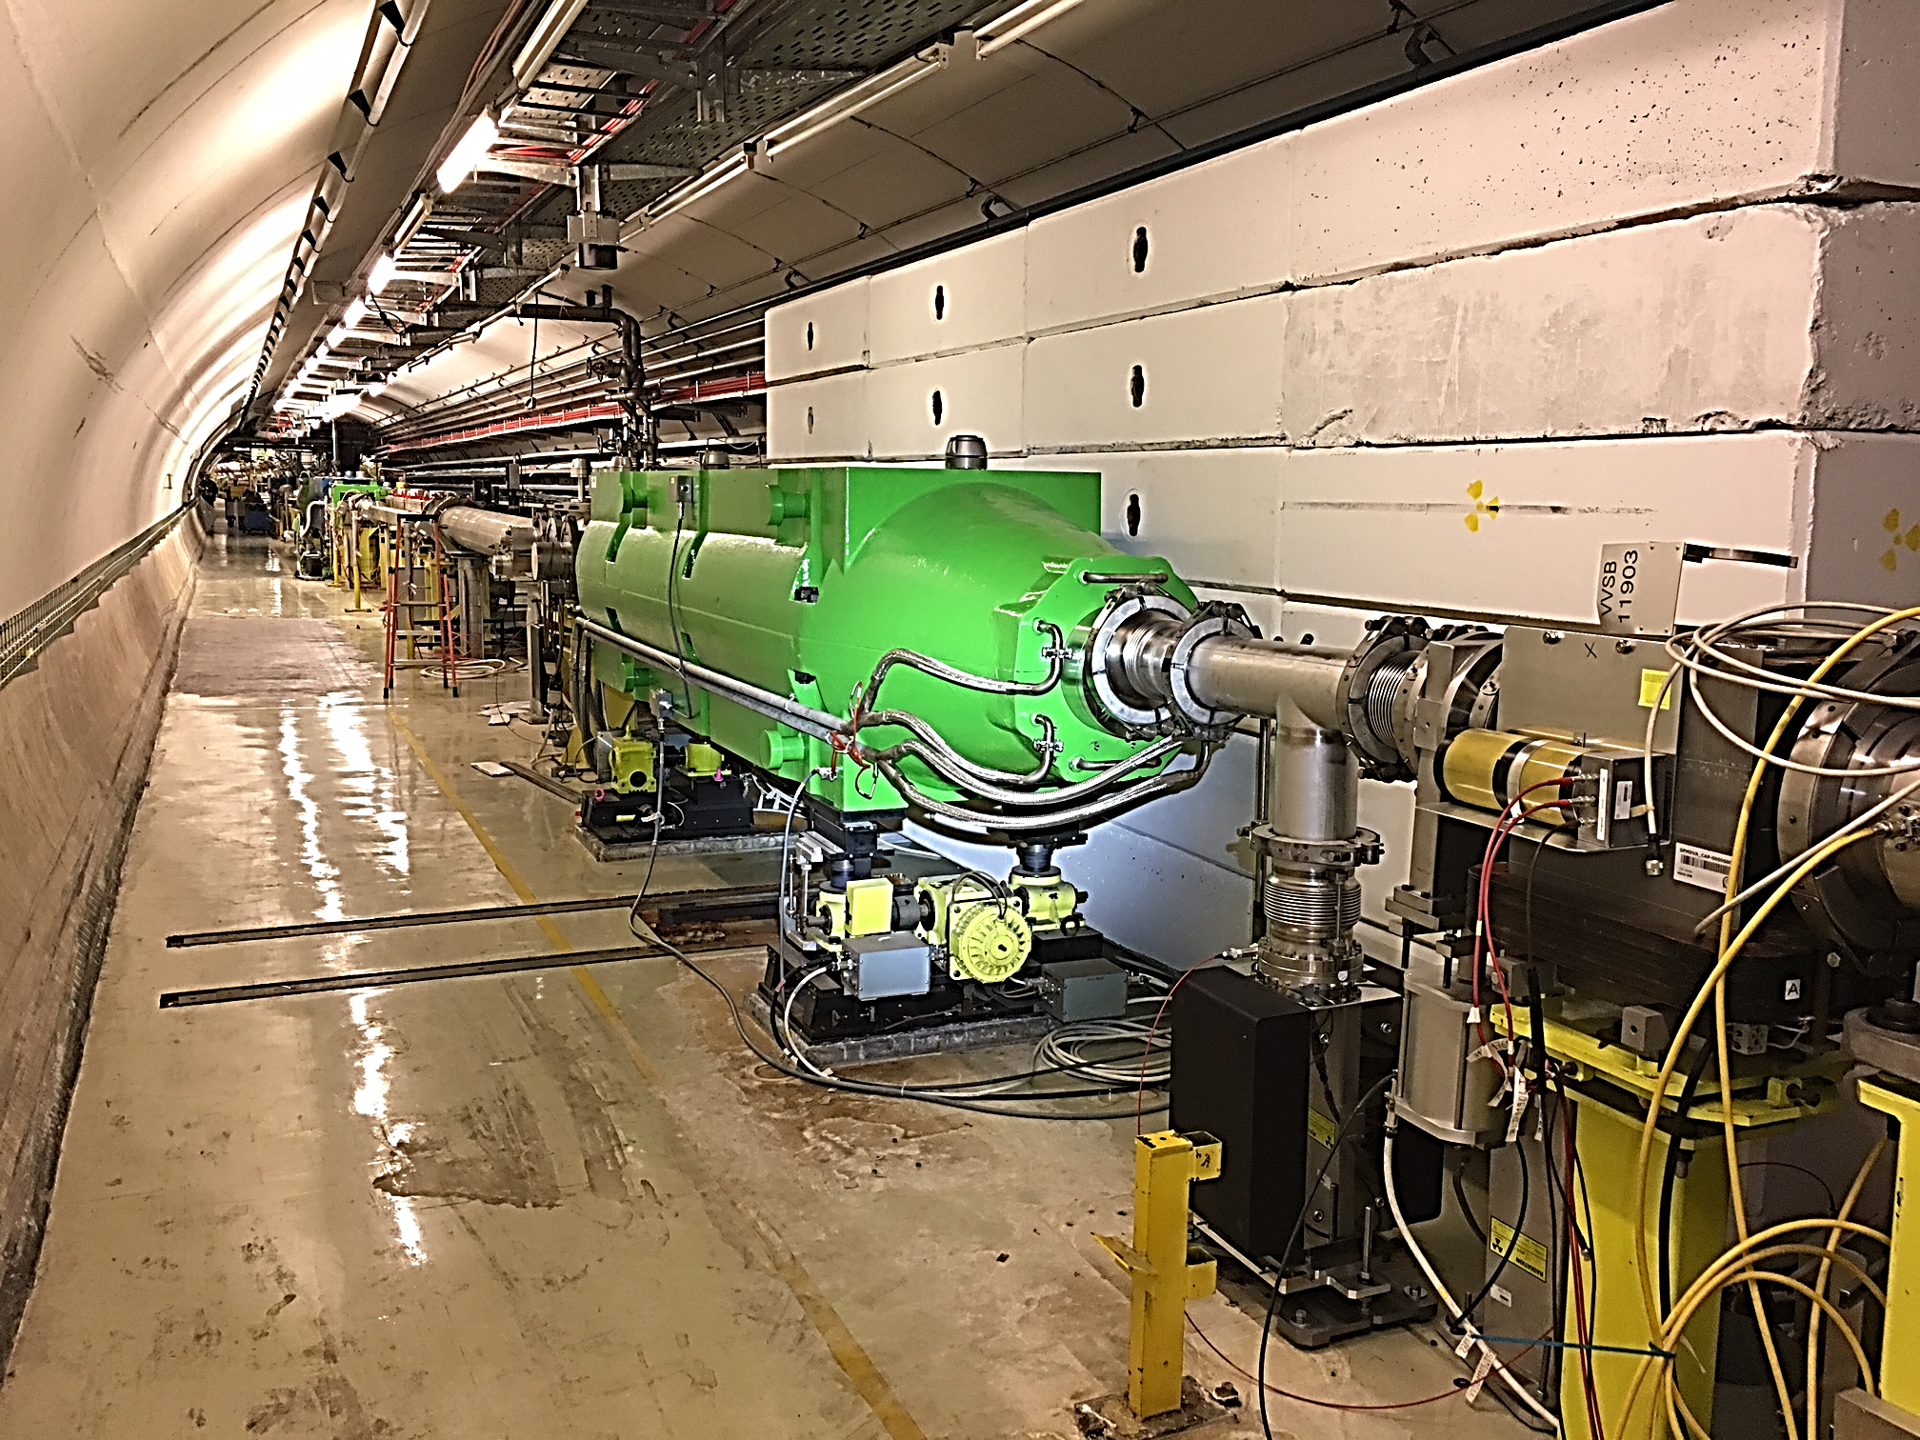
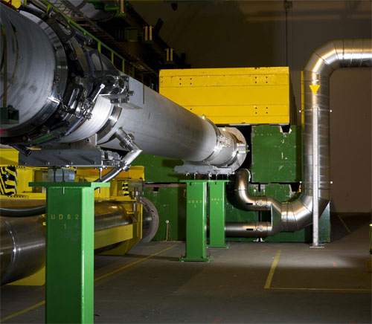
Internal vs. external dumps
Internal dumps
  Extra challenge of having to comply with the strict UHV requirements despite the high T
  Plus, highly radioactive devices in the middle of the accelerator
External dumps
  Usually requires dedicated caverns or line components (CE complexity)
Pre-LS2 SPS internal dump
Pre-LS2 LHC external dump

Slide 10
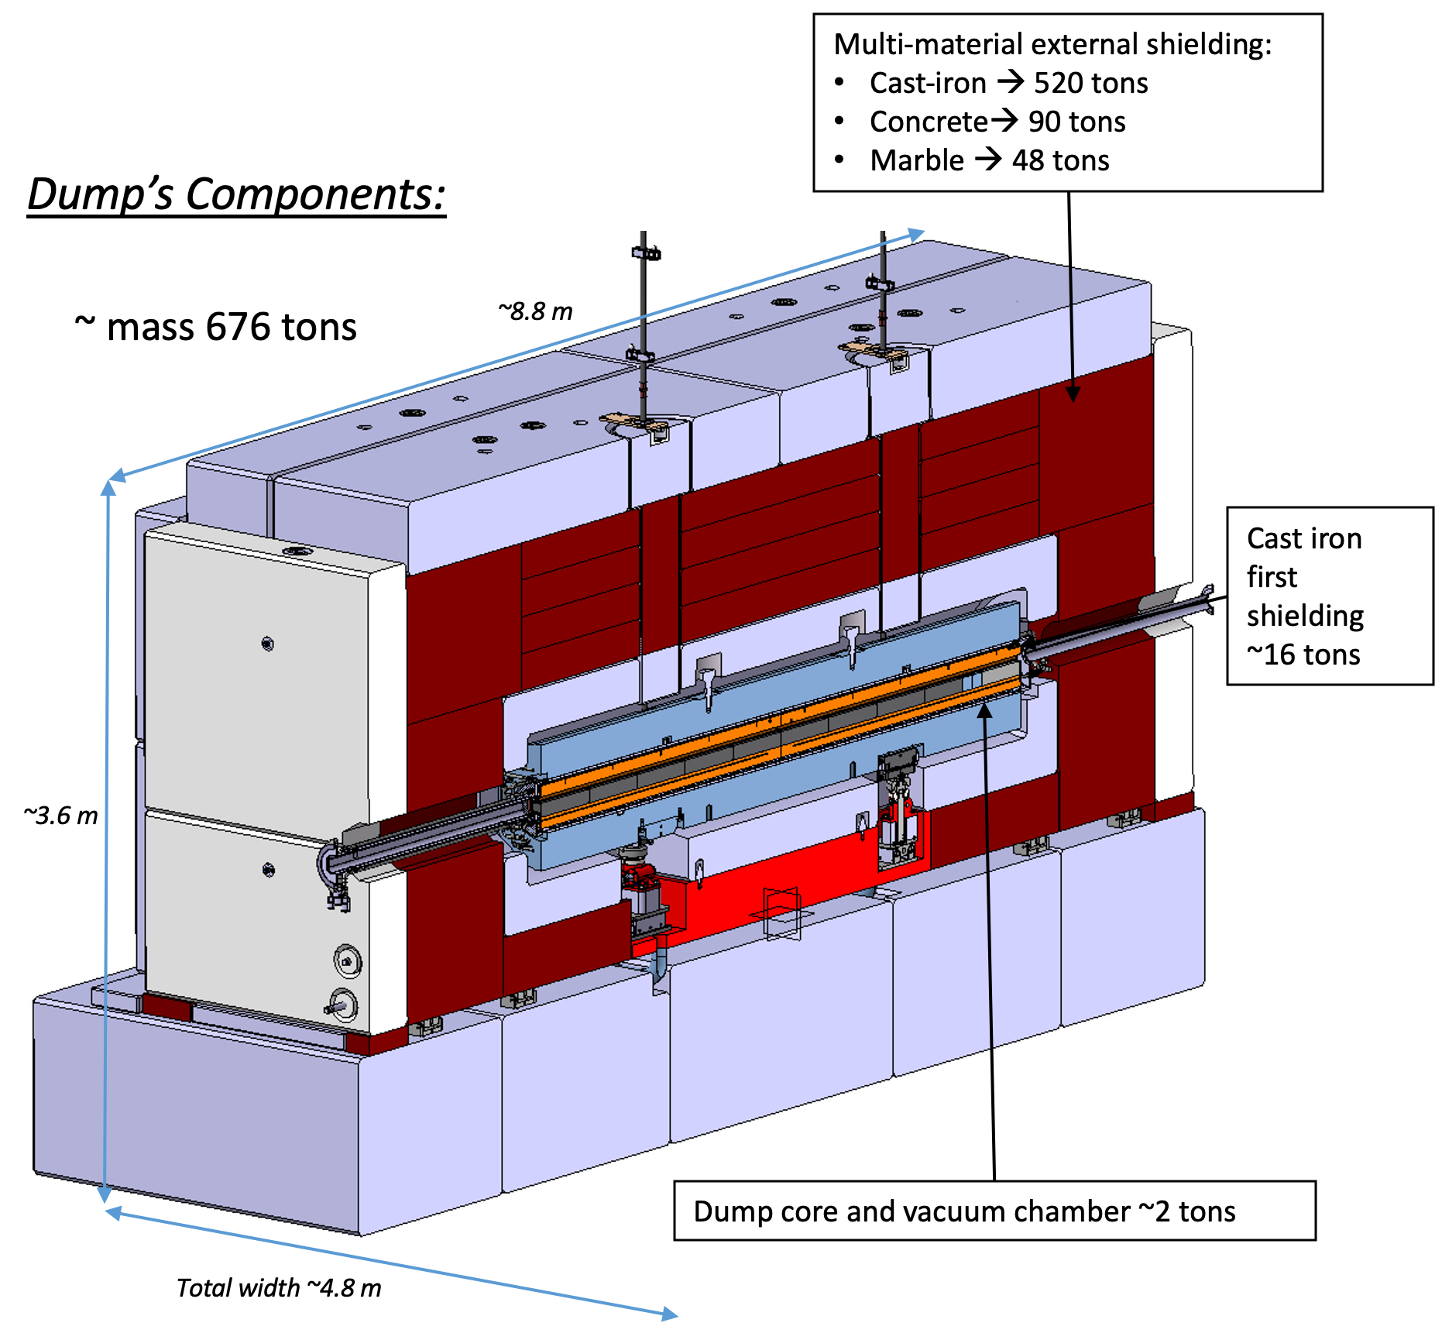
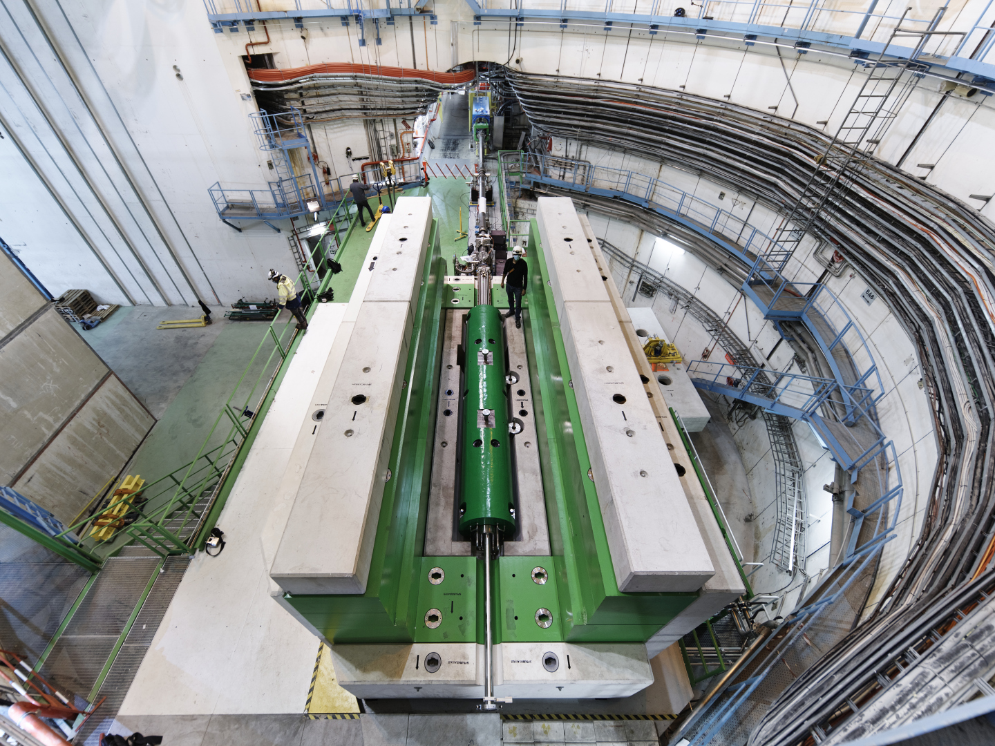
SPS TIDVG5 (internal dump)
Designed for about 300 kW in the most demanding scenario

Slide 11
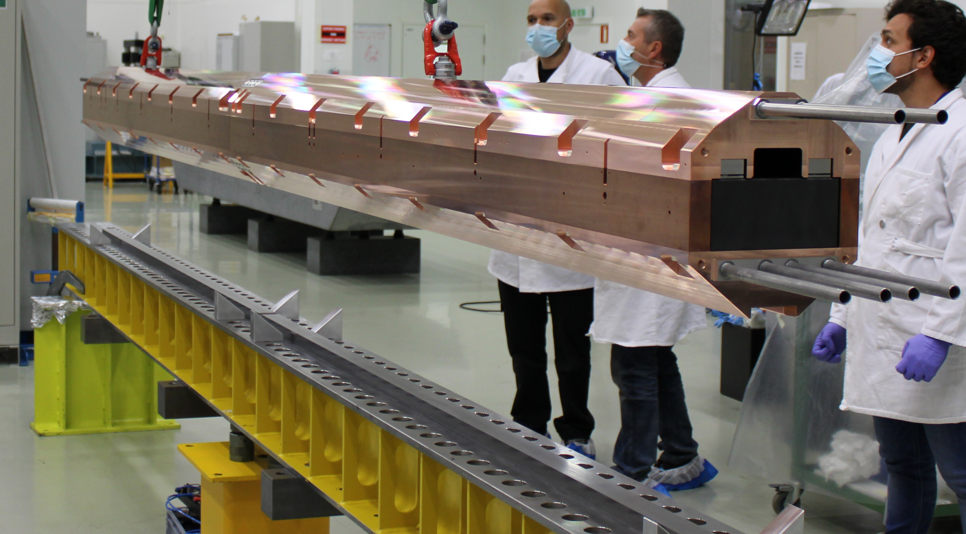
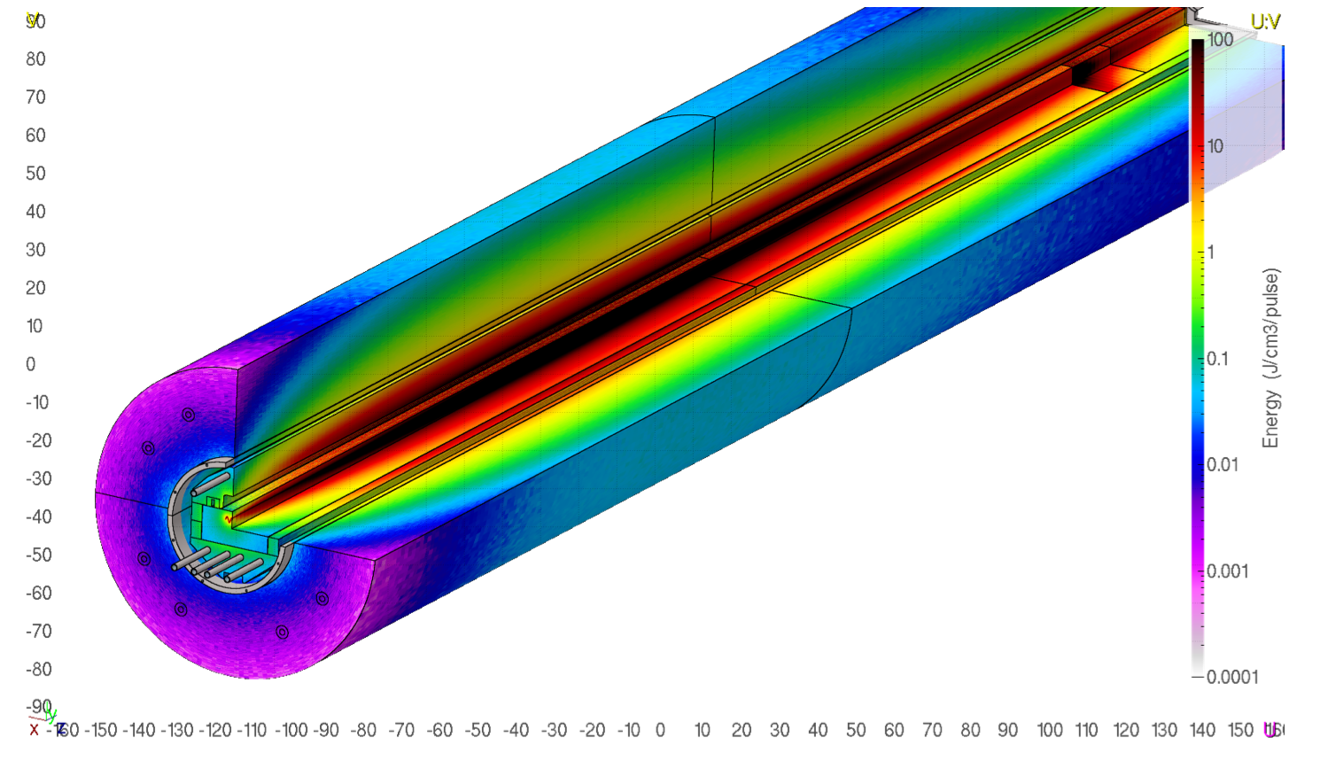
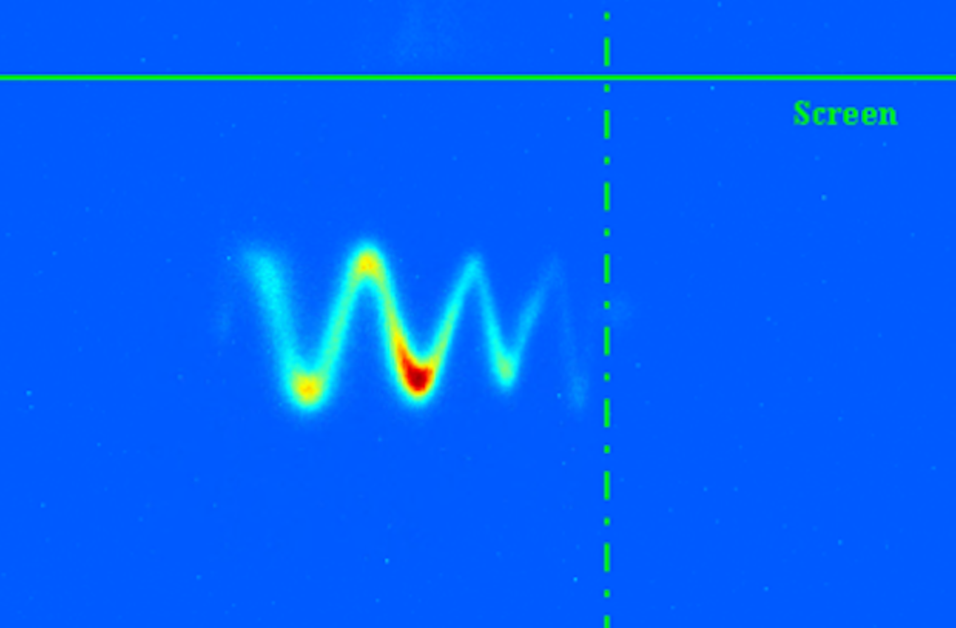
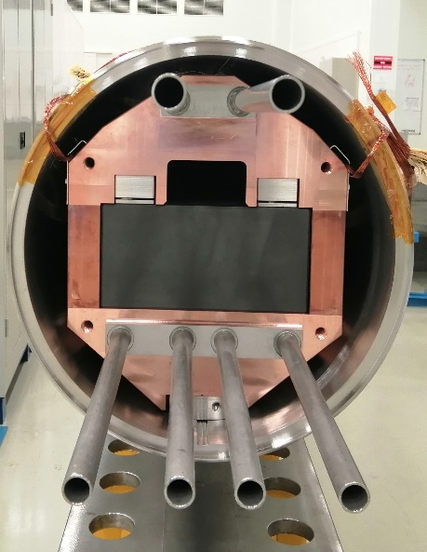


Slide 12
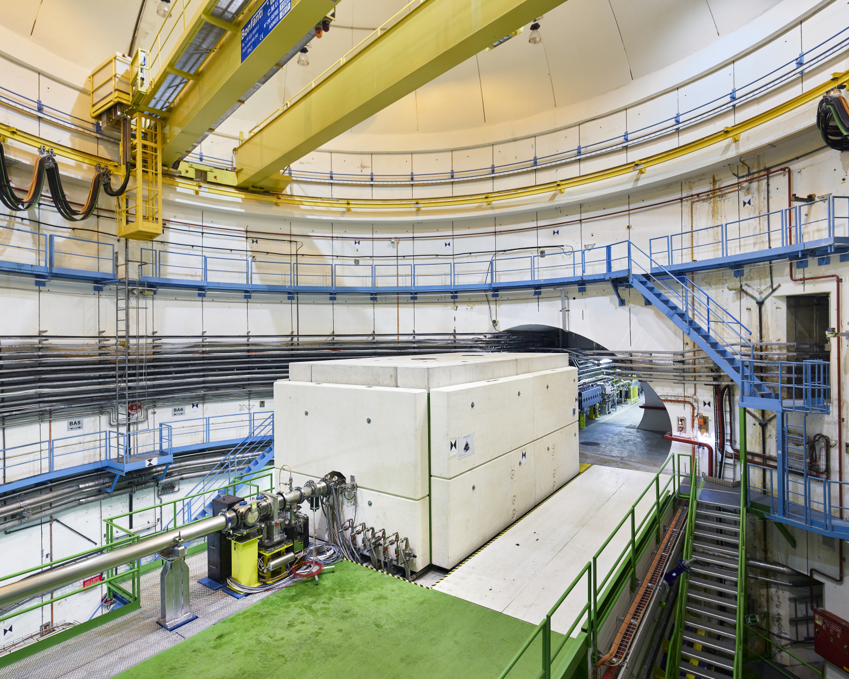

Slide 13
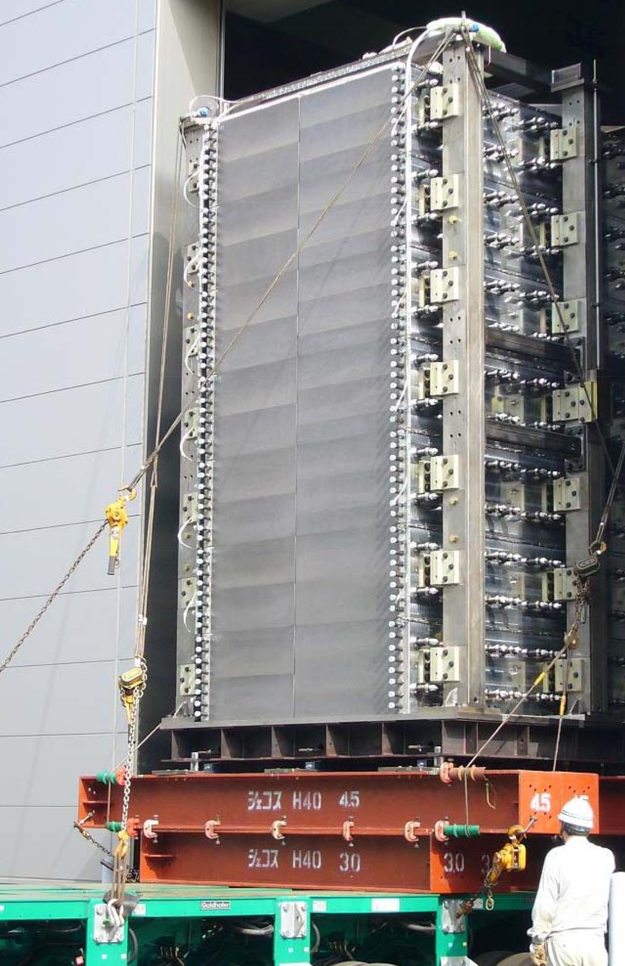
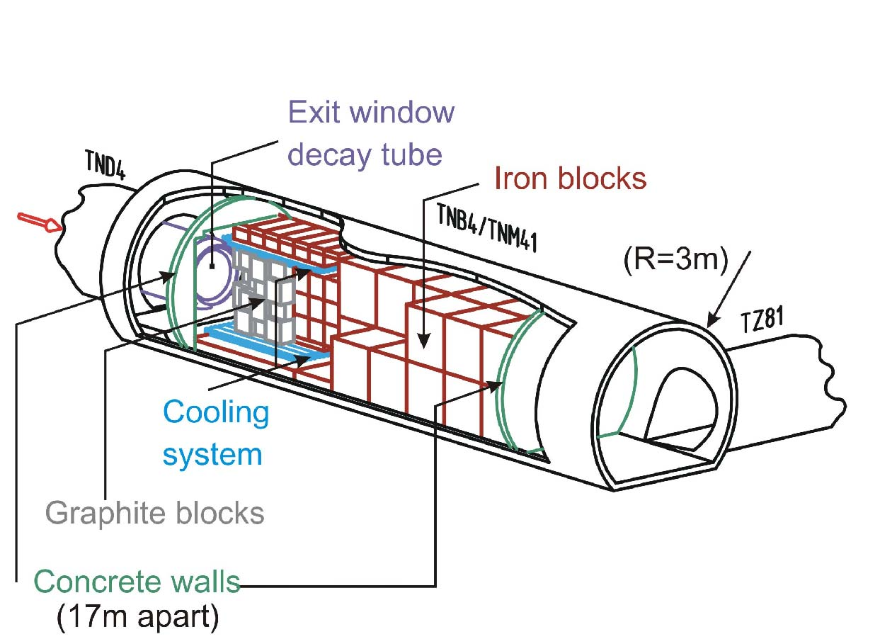
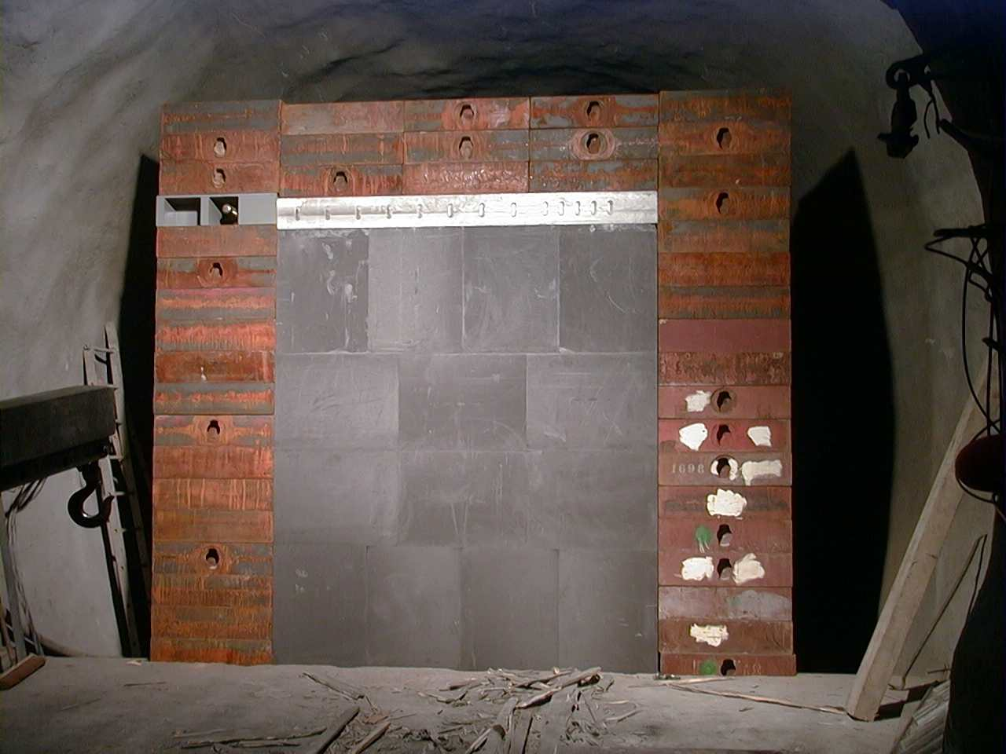
Hadron absorbers for neutrino beams
High average power absorbers exists also in neutrino beam lines, namely, to absorb the large hadron fluence and the remaining proton beam
5 m
e.g. T2K absorber, courtesy T. Ishida (JPARC)
4 m
5 m
e.g. CNGS@CERN absorber

Slide 14
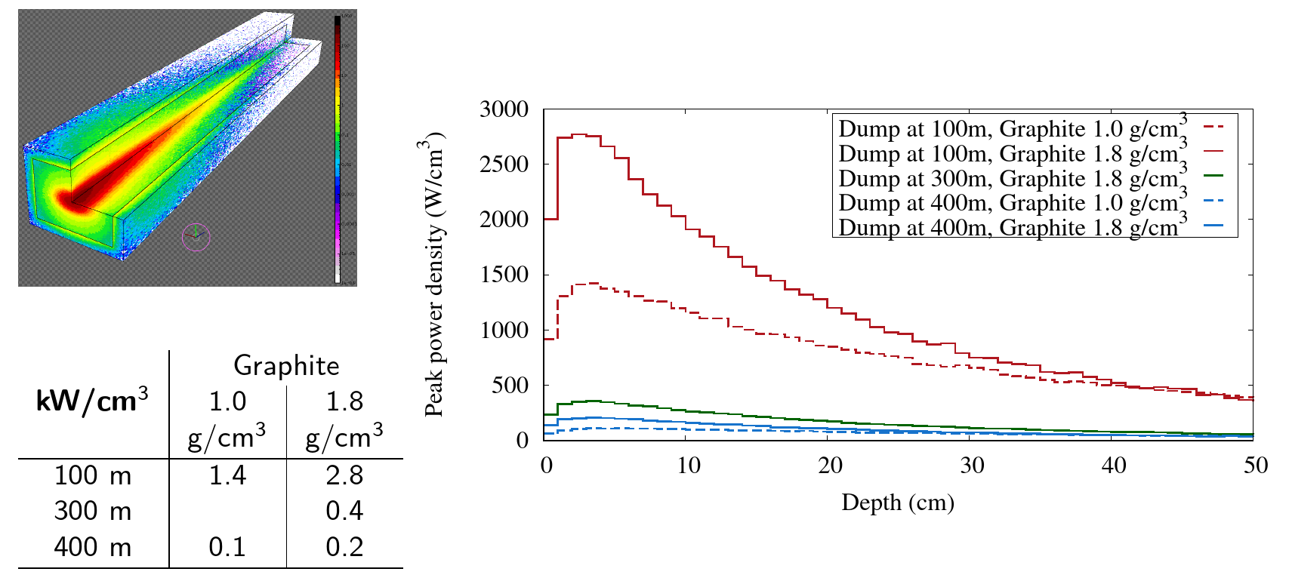
Power density in a tentative graphite core (Z pole)
Typical HD and LD graphite densities for different distances from IP
Based on beamstrahlung distribution from A. Ciarma

Slide 15
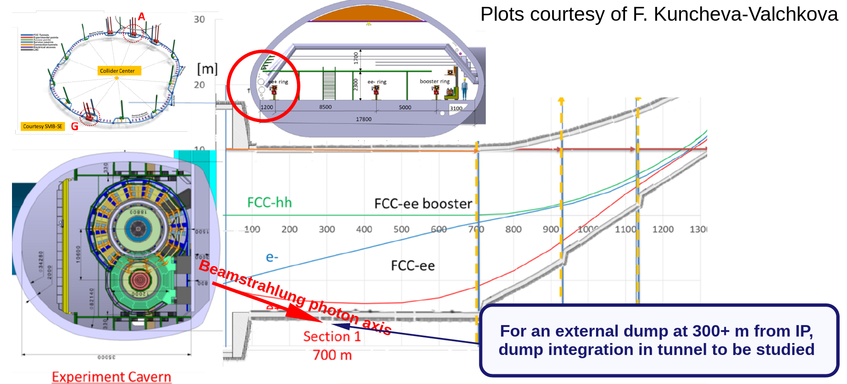
Beamstrahlung dump integration in tunnel

Slide 16
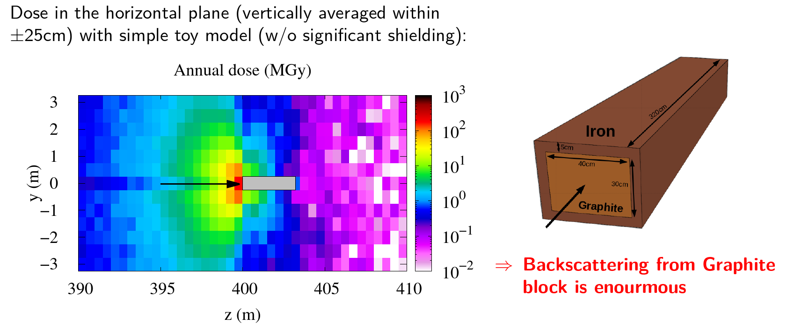
Radiation environment around dump (Z pole)
Neutrons are also produced due to the tail of higher energy photons

Slide 17
Options for the FCCee beamstrahlung absorber
Graphite core (monolithic or tilted to dissipate energy) is a primary option given the robustness (but thermal conductance is not the best)
Water absorber could also be a possibility (à-la ILC photon dump)
Liquid metal (e.g. Pb or PbBi) could also be an opportunity for a very compact design (line of R&D joint with other activities at CERN)
Integration constraints (example of questions):
  Can we put the dump at 300/400 m from the IP?
  Vacuum line design – impacted, vacuum criteria?
  Do we need a window, or can we move to a window-less absorber?

Slide 18
Measuring beamstrahlung photons at FCCee
Challenge: Measuring the intensity, position and size of high-power densities beamstrahlung photon beams
Proposal: Use a two-steps approach with different diagnostics
  Fully characterising the photon beams at low power using, e.g., scintillating screens and cameras (to be studied) that will only be inserted in the photon beam extraction line during single bunch or few bunch operation
  Measure the transverse tails of beamstrahlung photon distribution using intercepting sensors (i.e., scintillators, gaseous detectors, pixel detectors..) or developing fully non-invasive methods (e.g., using ionisation or fluorescence of gas jets) that would be able to withstand the full photon beam power
Studies priority to be clarified with project (and possibly launched if resources made available)

Slide 19
How to go ahead?
The definition of a working plan is essential for priorities & resources
Definition of the source and boundary conditions
Integration constraints and possibilities is a major boundary in the definition of the design parameter space
Beam monitoring opportunities
Early conceptual design for the assembly & cooling & R&D (!)
Lots of challenges ahead !

Slide 20
Conclusions
Hundreds of kW of photons to be safely absorbed – and potentially measures – out of the FCCee IPs is a major challenge
Integration constraints must be carefully addressed and included in the conceptual design, as the potential primary boundary limitation
It is a challenging multi-physics/dimensional problem, that needs attention & adequate resources to be properly assigned
The BS dump/instrumentation line is a challenging part of the collider as well requiring a thorough study (that can only be started when resources are available)
Lessons can be derived from other high-power absorbers built worldwide and at CERN

