Slide 1


Summary of the Infrastructure Sessions
K Hanke, CERN
FCC week 2022, Paris

Slide 2
Summary of the infrastructure sessions
K Hanke, CERN
FCC week 2022, Paris

Slide 3
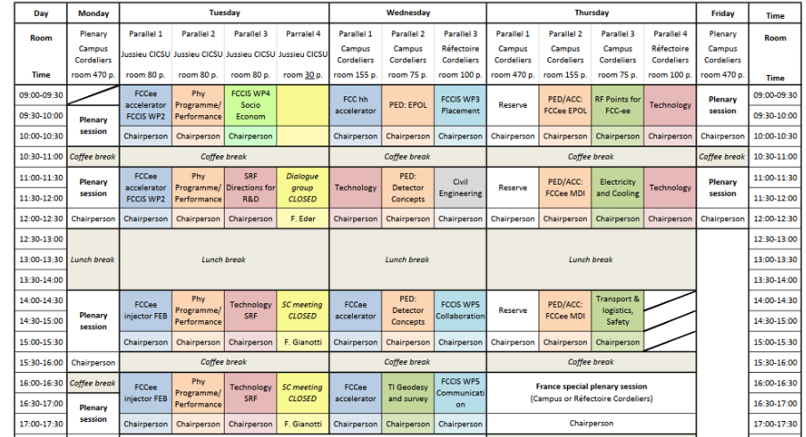
K Hanke
FCC week 2022
Infrastructure Sessions

Slide 4
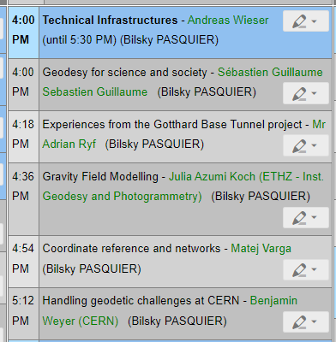
K Hanke
FCC week 2022
Geodesy and Survey

Slide 5
K Hanke
FCC week 2022
S Guilleaume, Geodesy for Science and Society (remote)
Introduction to problematic and concepts of geodesy
Determination of position of objects
Determination of gravity field and its geometry
Density variations can perturb measurement
Choice of coordinate system is essential
Different techniques how to determine the gravity field

Slide 6
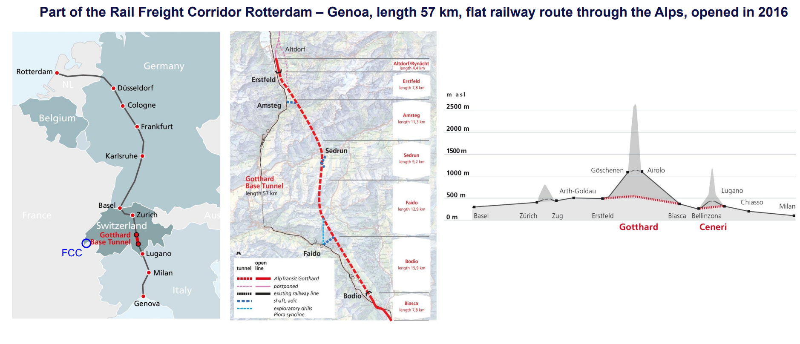
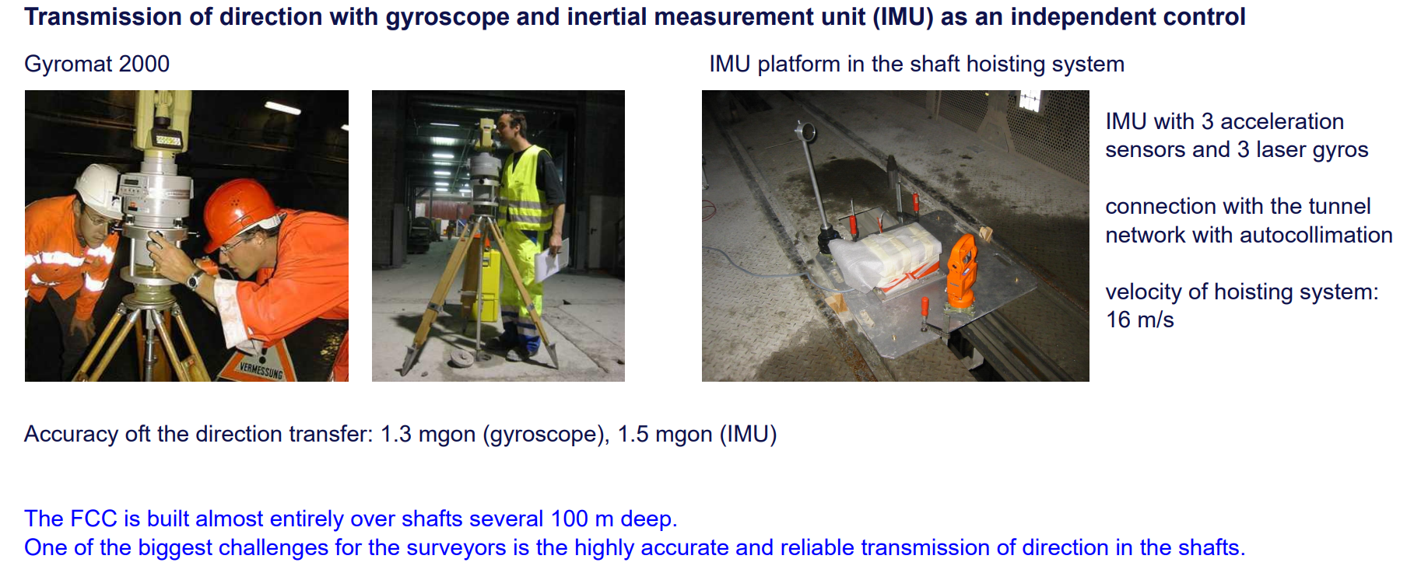
K Hanke
FCC week 2022
A Ryf, Experience from the Gotthard Base Project (remote)
Longest railway tunnel in the world 57 km
Tolerance 25 cm for position and direction, 12 cm for height (achieved 8 cm in direction, 1 cm height)
Survey at the surface (e.g. dams) is needed
FCC monitoring will be necessary

Slide 7
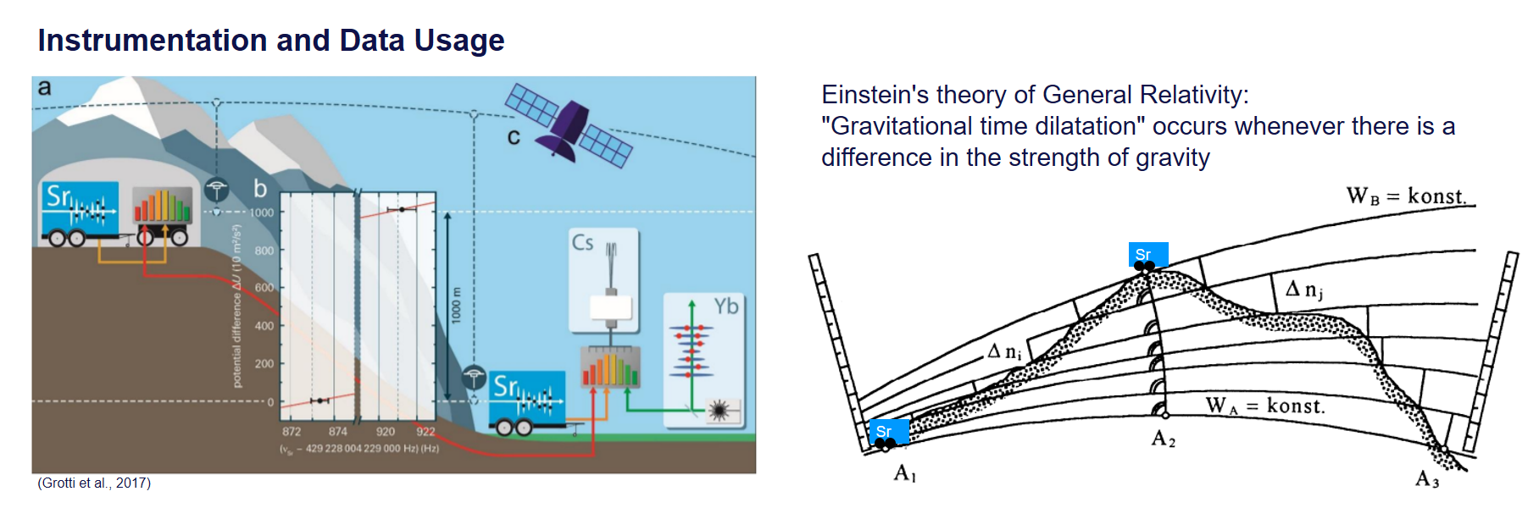
K Hanke
FCC week 2022
J A Koch, Gravity Field Modelling (remote)
A gravity field model allows the computation of the
Gravity potential (Geoid)
Gravity acceleration g
Deflection of the Vertical
Available model is insufficient!
Instrument absolute gravimeter
Gravity corrected height differences
Is an issue for FCC
Available gravity field model

Slide 8
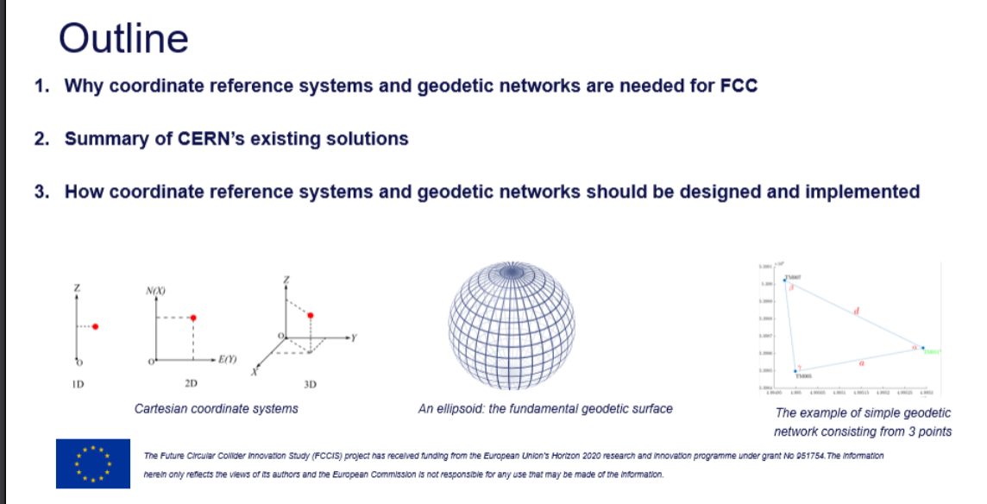
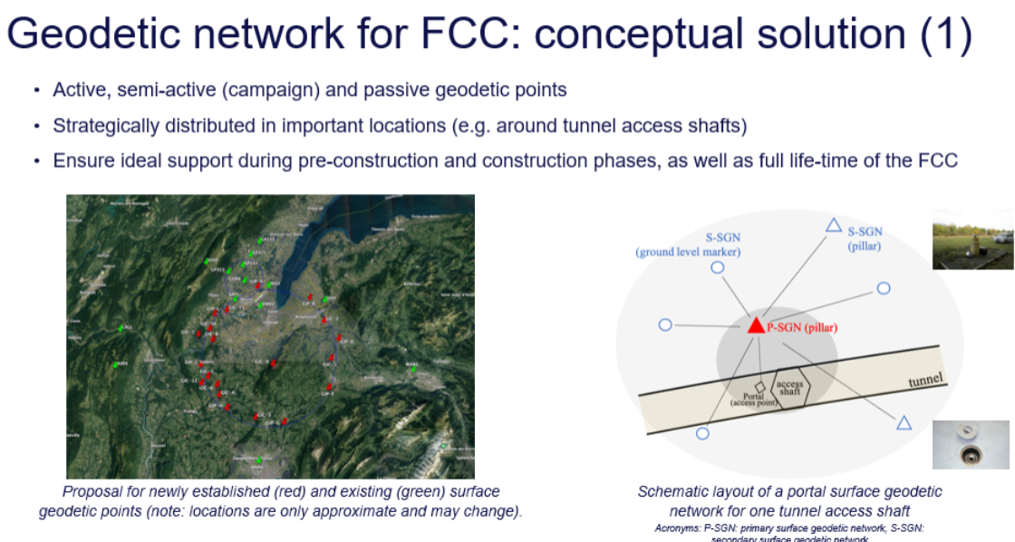
K Hanke
FCC week 2022
M Varga, Coordinate Reference and Networks
CRS Coordinate Reference System
Existing situation at CERN needs clarification
Proposed conceptual solution for FCC
Geodetic networks
Taking into account local constraints

Slide 9
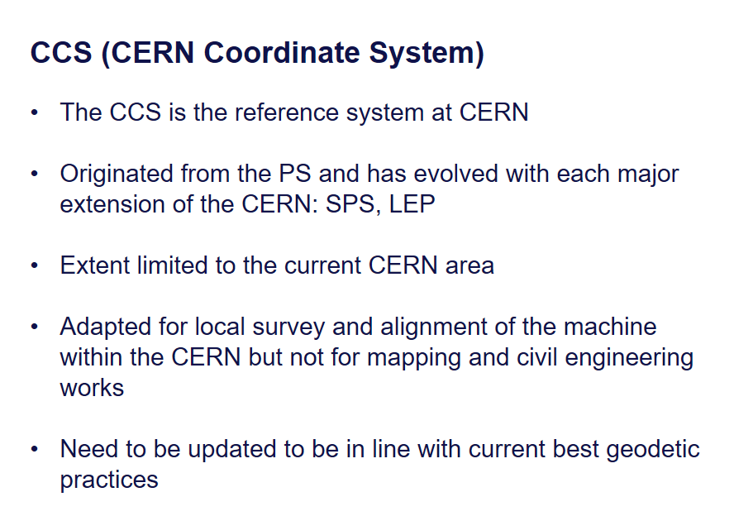
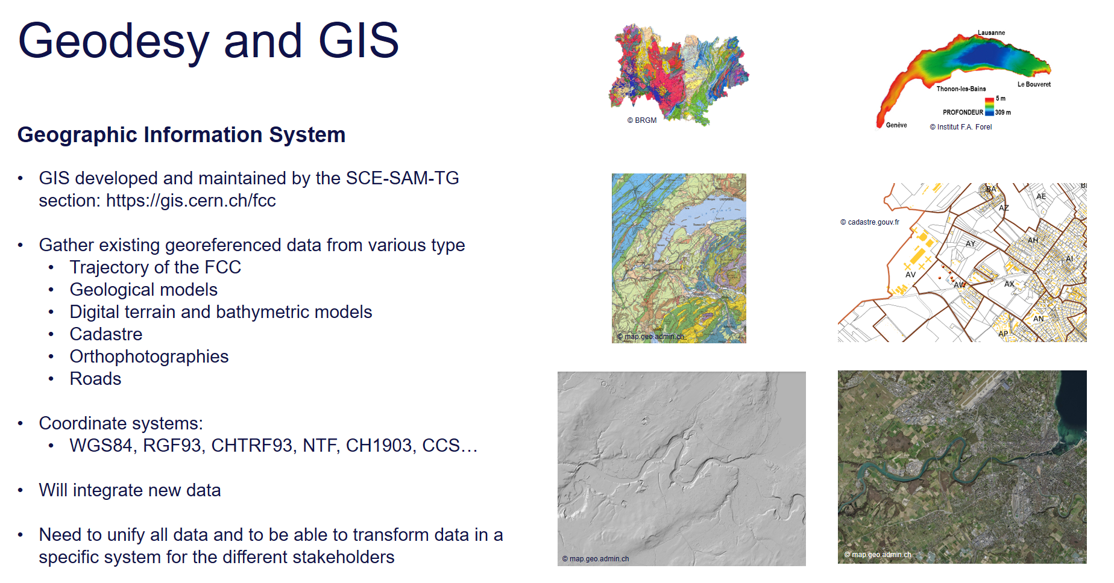
K Hanke
FCC week 2022
B Weyer, Handling Geodetic Challenges at CERN
Historic origin, coordinate system center in the PS
MAD coordinates vs coordinate system
From MAD-X to real world
Geographic Information System
Accuracy is key
Adapting prodecures for FCC in collaboration with ETHZ

Slide 10
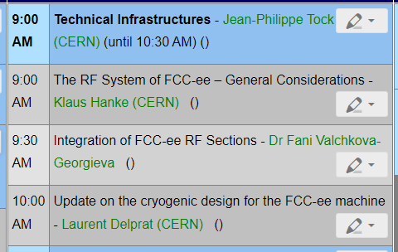
K Hanke
FCC week 2022
RF Points for FCC-ee

Slide 11
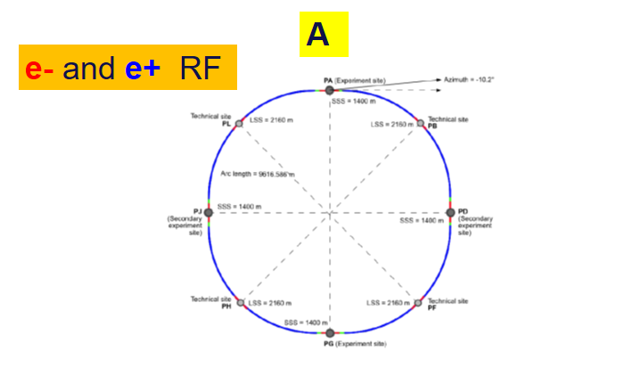
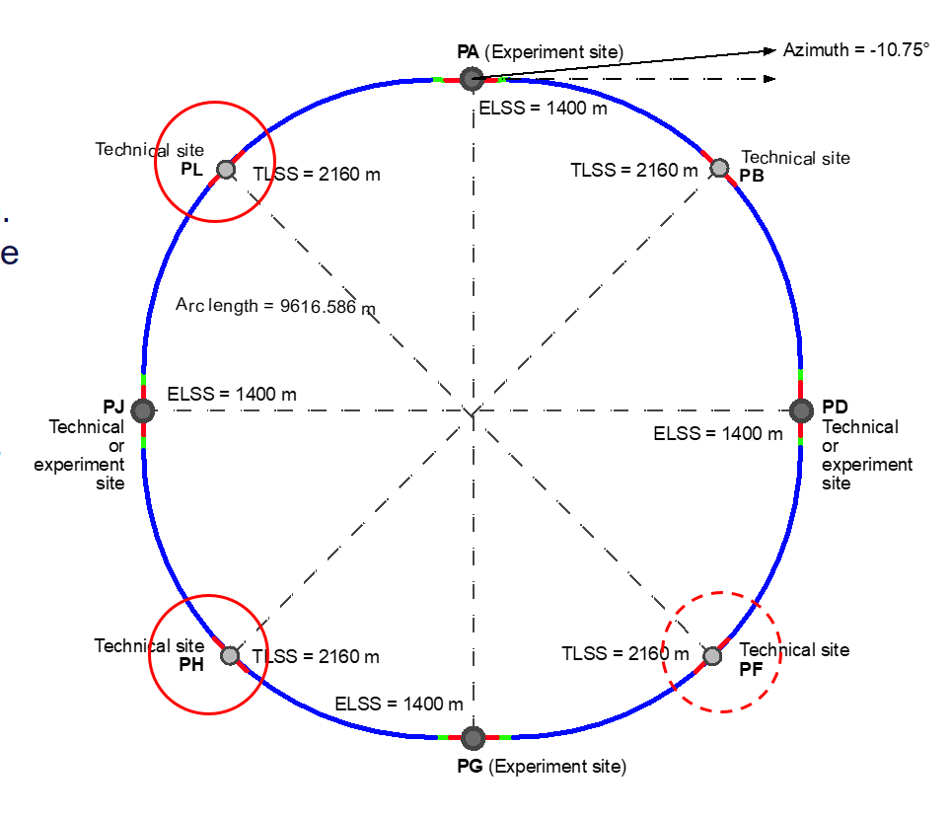
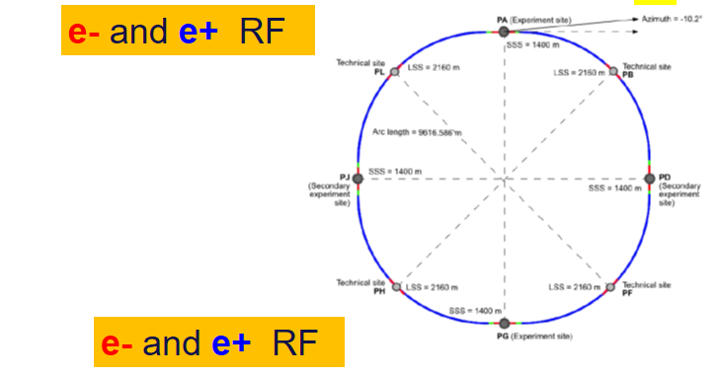
K Hanke
FCC week 2022
K Hanke, The RF System for FCC-ee – General Considerations
Physics Constraints
Infrastructure Constraints
W, Z, H: Single RF point
ttbar: two RF points, do not need to be opposite points
Exclude experimental points and point B
L and H fit nicely integration wise, accessibility and infrastructure
F is not preferred (large lateral displacement of access shaft)

Slide 12
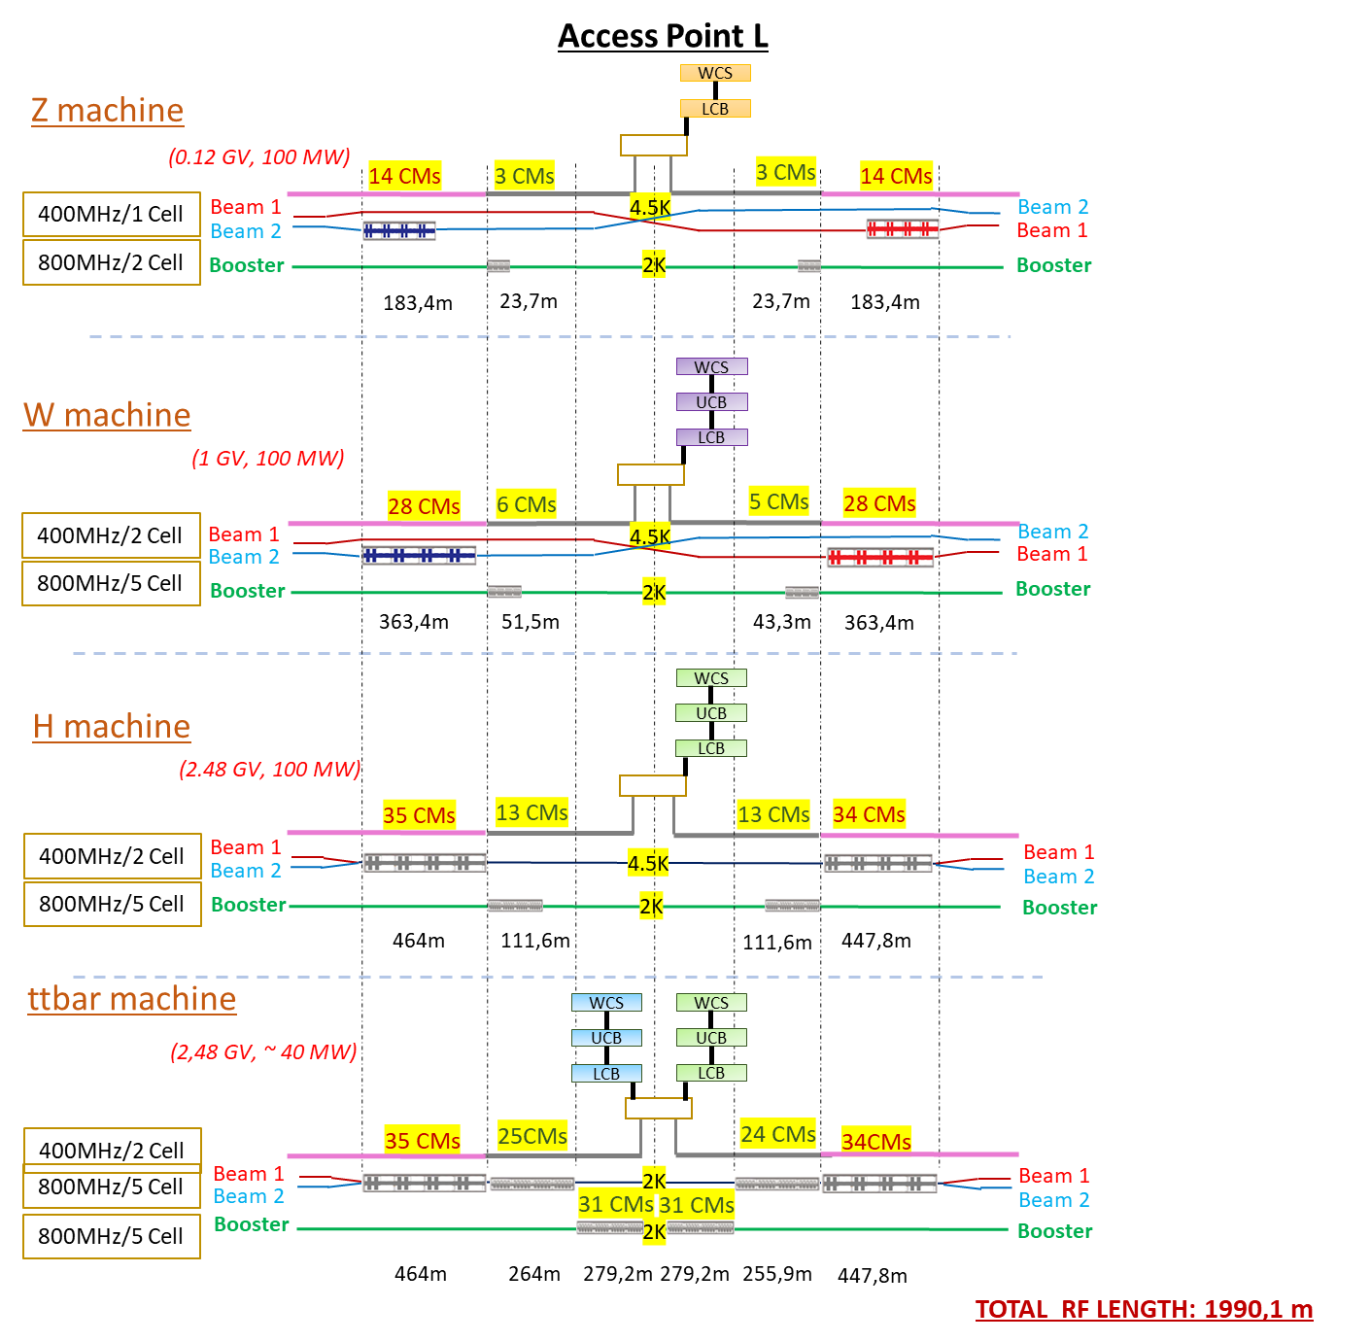
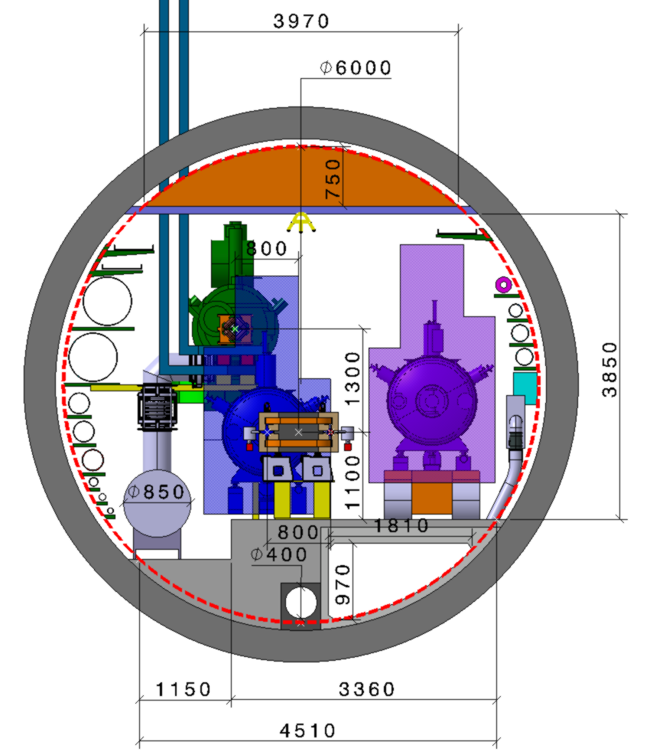
K Hanke
FCC week 2022
F Valchkova-Georgieva, Integration of FCC-ee RF Sections
TLSS length: 2160 m
RF Section tunnel integration

Slide 13
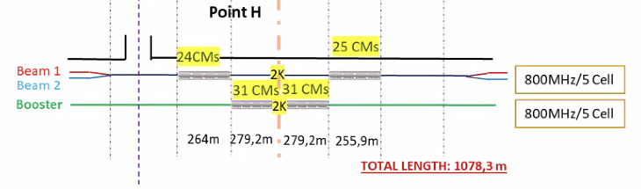
K Hanke
FCC week 2022
L Delprat, Update on the cryogenic design for the FCC-ee machine
Updated inventory of cryo needs and architecture (has much evolved since CDR)
Point L settled, point H options under investigation
RF point L
RF point H
3 different options studied due to access pit location geographical constraints
Option 1: all cryo installed in a dedicated cavern at the LSS center
Option 2: half of cryo installed in a dedicated cavern at the LSS center
Option 3: all cryo installed in the usual service cavern

Slide 14
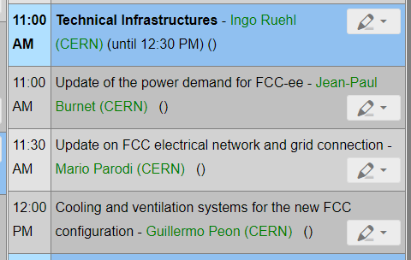
K Hanke
FCC week 2022
Electricity and Cooling

Slide 15
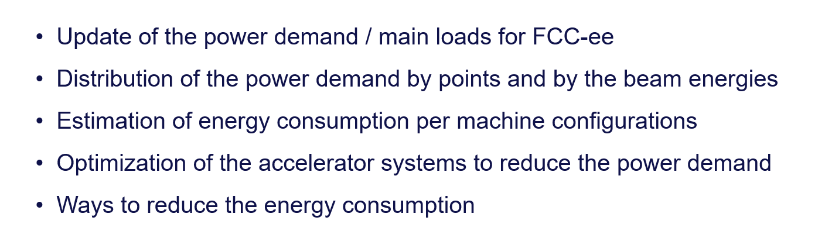
K Hanke
FCC week 2022
J P Burnet, Update of the Power Demand for FCC-ee
Updated power demand for FCC-ee per working point
 |  | Z | W | H | TT
Beam energy (GeV) |  | 45.6 | 80 | 120 | 182.5
Magnet current |  | 25% | 44% | 66% | 100%
Power ratio |  | 6% | 19% | 43% | 100%
PRF EL (MW) | Storage | 146 | 146 | 146 | 146
PRFb EL (MW) | Booster | 2 | 2 | 2 | 2
Pcryo (MW) | Storage | 1 | 7 | 17 | 50
Pcryo (MW) | Booster | 0.01 | 0.08 | 0.19 | 0.56
Pcv (MW) | all | 33 | 34 | 36 | 40.2
PEL magnets (MW) | Stroage | 6 | 17 | 39 | 89
PEL magnets (MW) | Booster | 1 | 3 | 5 | 11
Experiments (MW) | Pt A & G | 8 | 8 | 8 | 8
Data centers (MW) | Pt A & G | 4 | 4 | 4 | 4
General services (MW) |  | 36 | 36 | 36 | 36
Power during beam operation (MW) |  | 237 | 257 | 293 | 387
Average power / year (MW) |  | 143 | 154 | 174 | 225
Big Five:
RF
Cryo
Booster Magnets
Collider Magnets
Cooling & Ventilation
Plus others: general services, computing, …

Slide 16
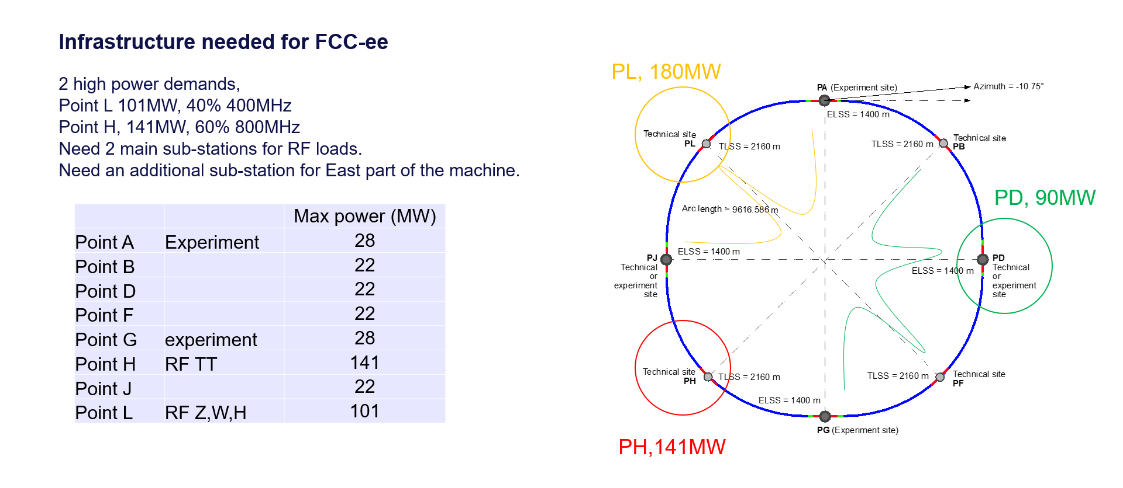
K Hanke
FCC week 2022
J P Burnet, Update of the Power Demand for FCC-ee
Lots of ideas how to reduce power consumption being explored!

Slide 17
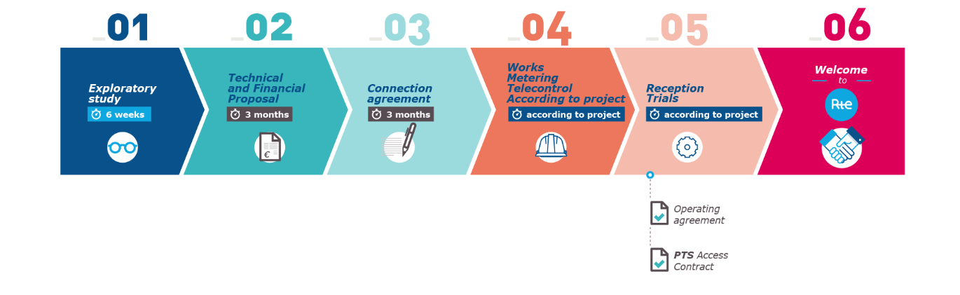
K Hanke
FCC week 2022
M Parodi, Update on FCC Electrical Network and Grid Connection
Updated load estimate (has much evolved since CDR)
Adaptation to the 8-points new layout
Confirmation of n. 3 connection points to RTE grid:
  n. 2 HV connections at RF points
  n. 1 HV connection at point D (preferred) or point F (possible)
Internal closed 132 kV transmission loop
  Balanced power flow
  High reliability
  Existing control and protection technologies suitable for the topology
  Adapt to move towards FCC-hh
  Cost of investment Vs. FCC RAMS requirement: analysis to be performed
Collaboration with French electricity provider RTE
The overall power demands justifies a connection to RTE 400 kV (or alternatively 225 kV) grid
The first step (exploratory study) is free of charge and not binding. Data Collection Sheet available online.
The further study and execution phases need investment and commitment from both parties
The technical solutions include upgraded to RTE upstream infrastructure where required

Slide 18
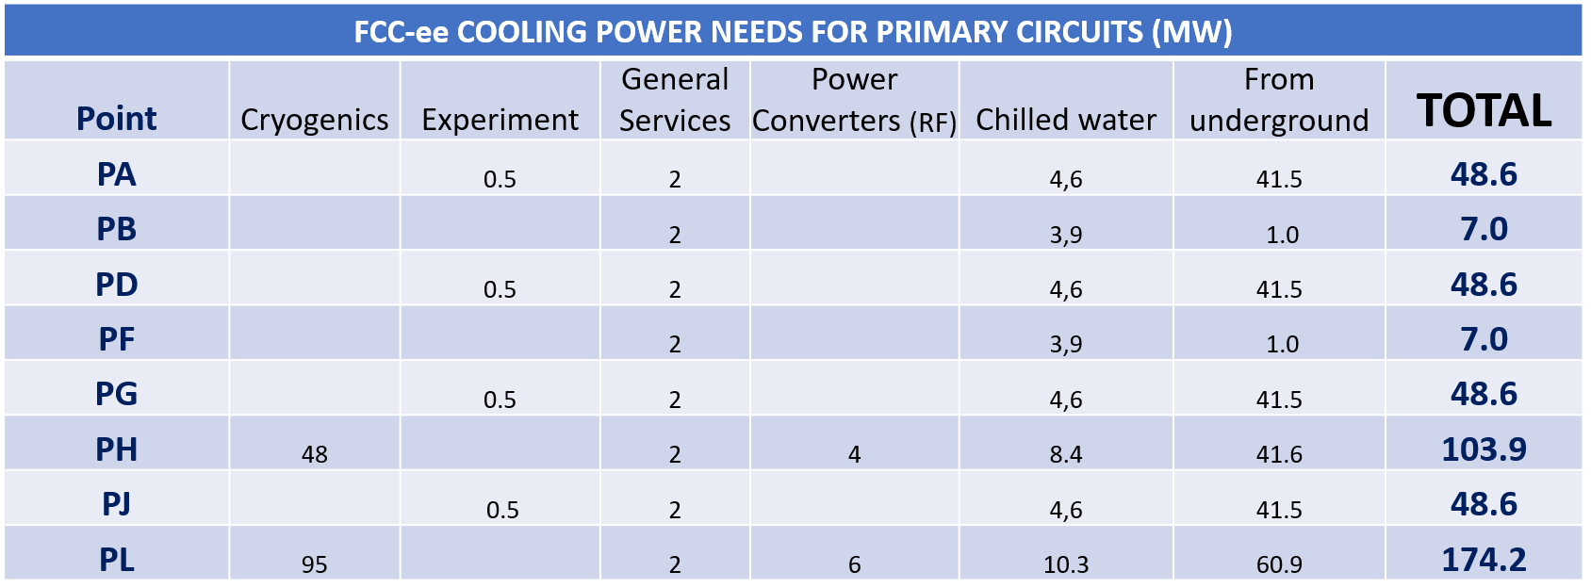
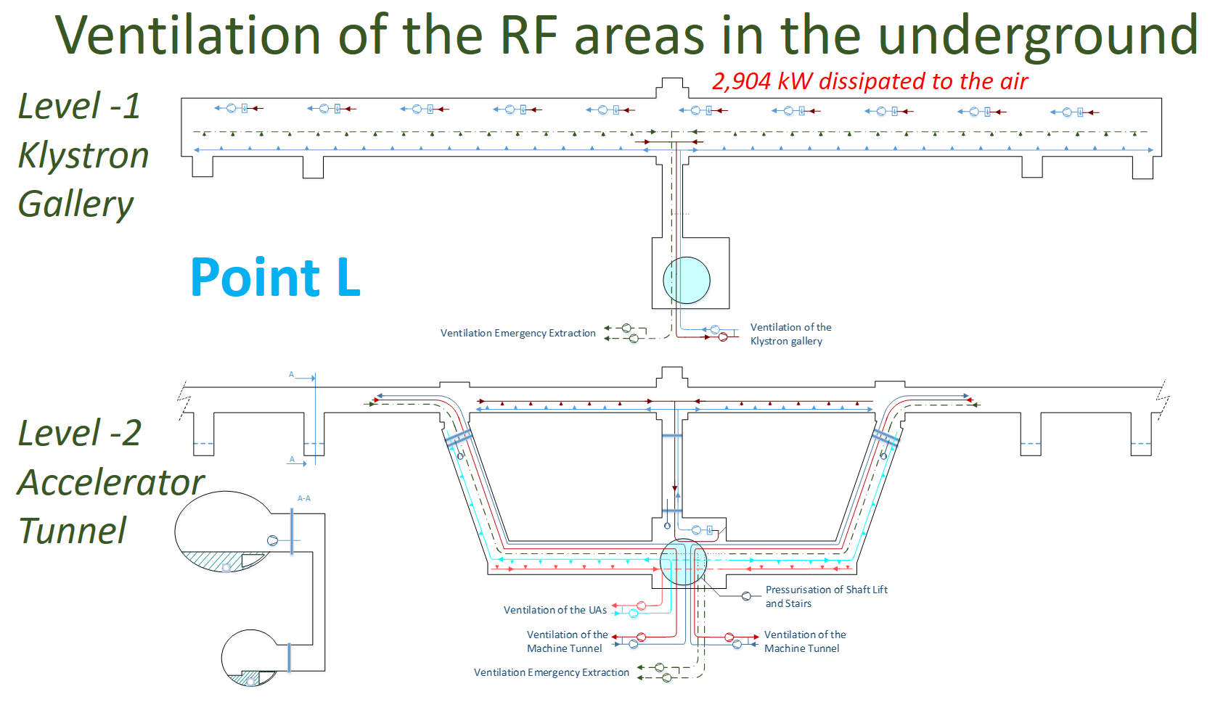
K Hanke
FCC week 2022
G Peon, Cooling and Ventilation Systems for the new FCC-ee Configuration
Updated inventory of water cooling power needs
Ventilation:
Heat loads in air collected (surface and underground)

Slide 19
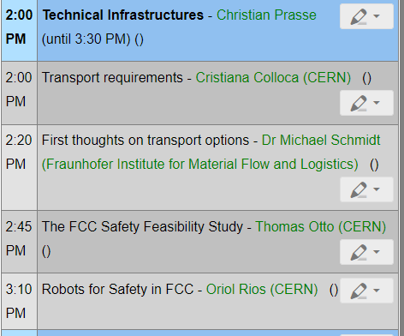
K Hanke
FCC week 2022
Transport and Safety

Slide 20
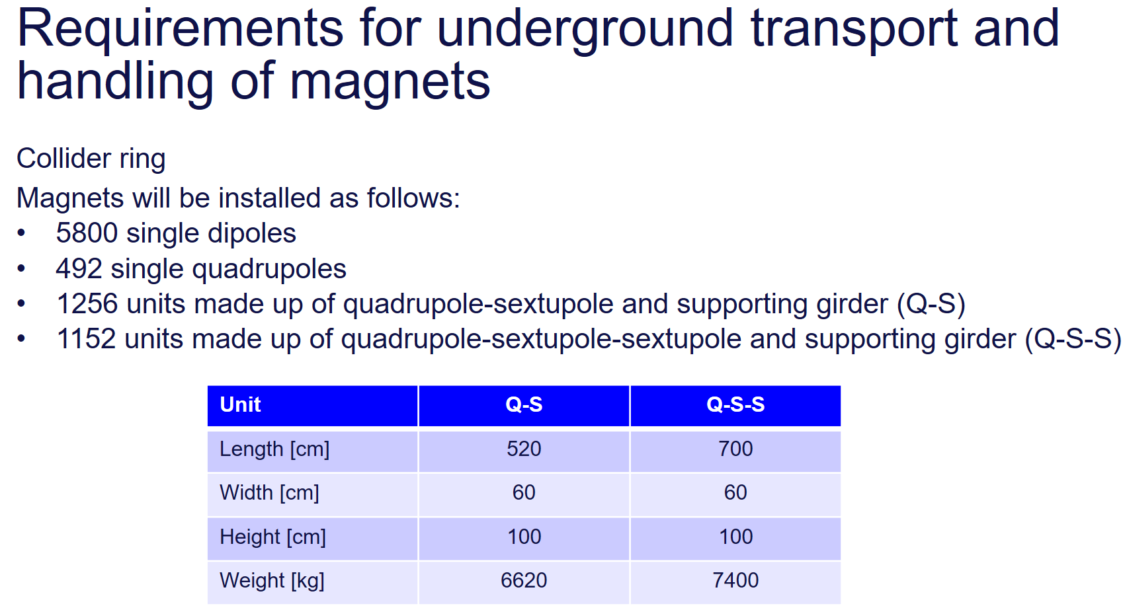
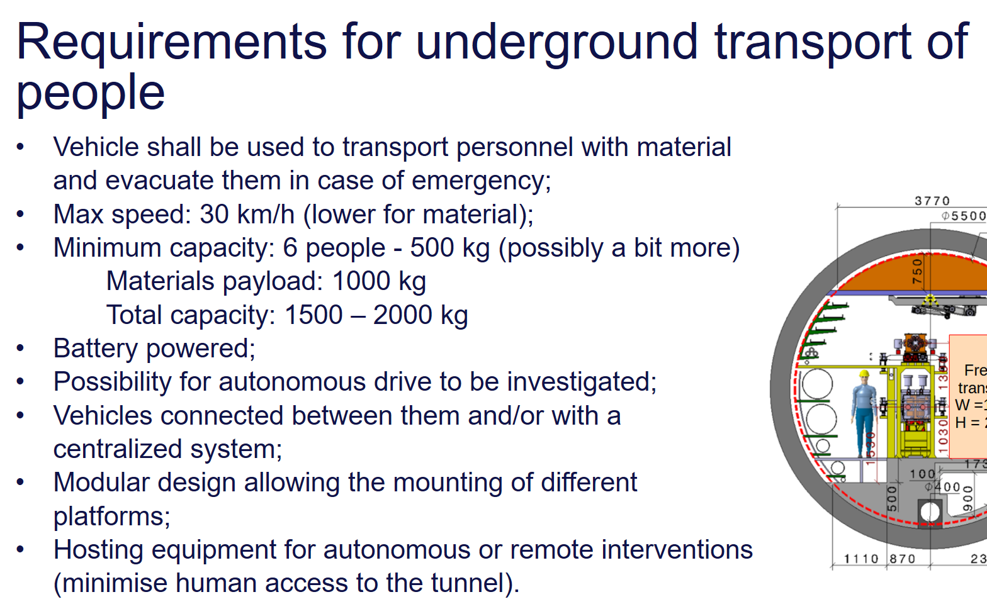
K Hanke
FCC week 2022
C Colloca, Transport Requirements
Updated inventory considering FCC-ee (Booster and collider) magnets!

Slide 21
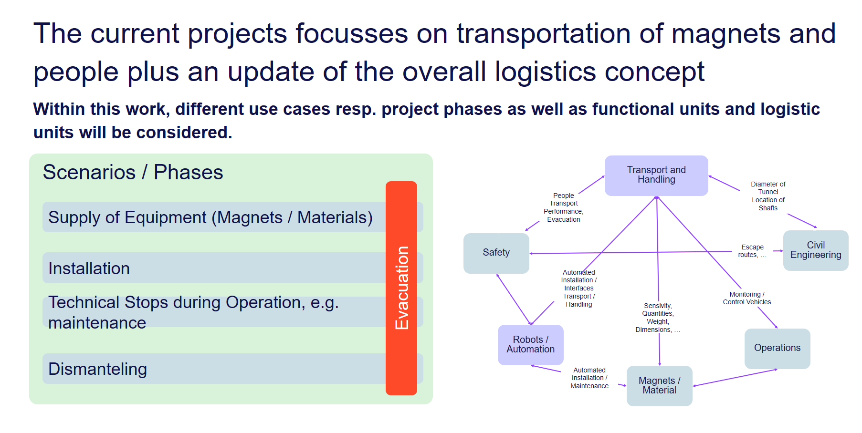

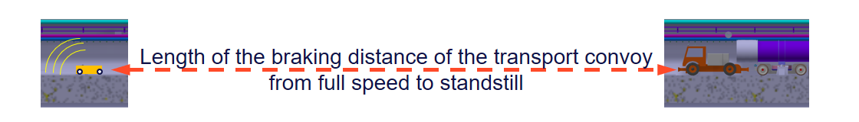
K Hanke
FCC week 2022
M Schmidt, First Thoughts on Transport Options

Slide 22
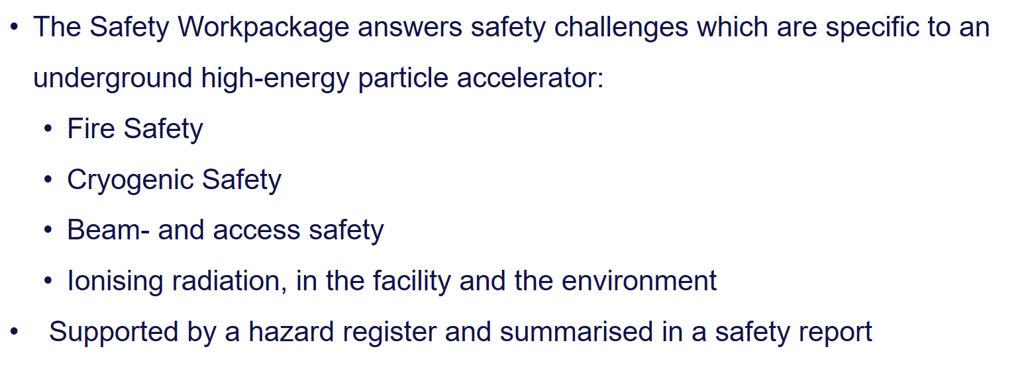
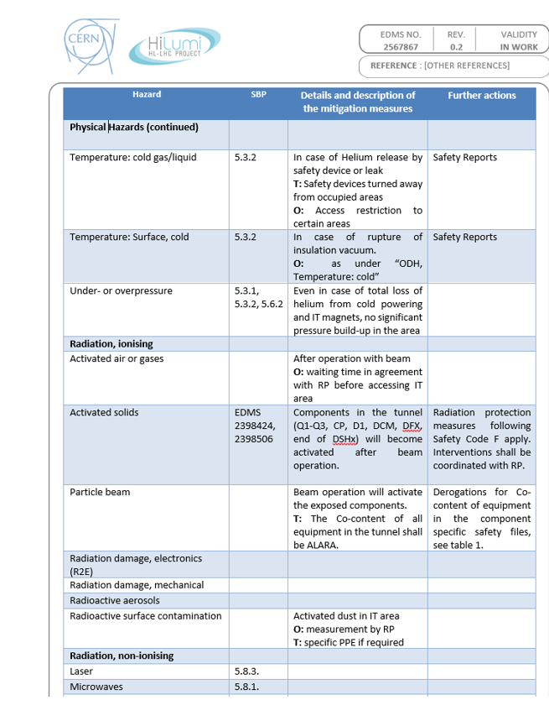
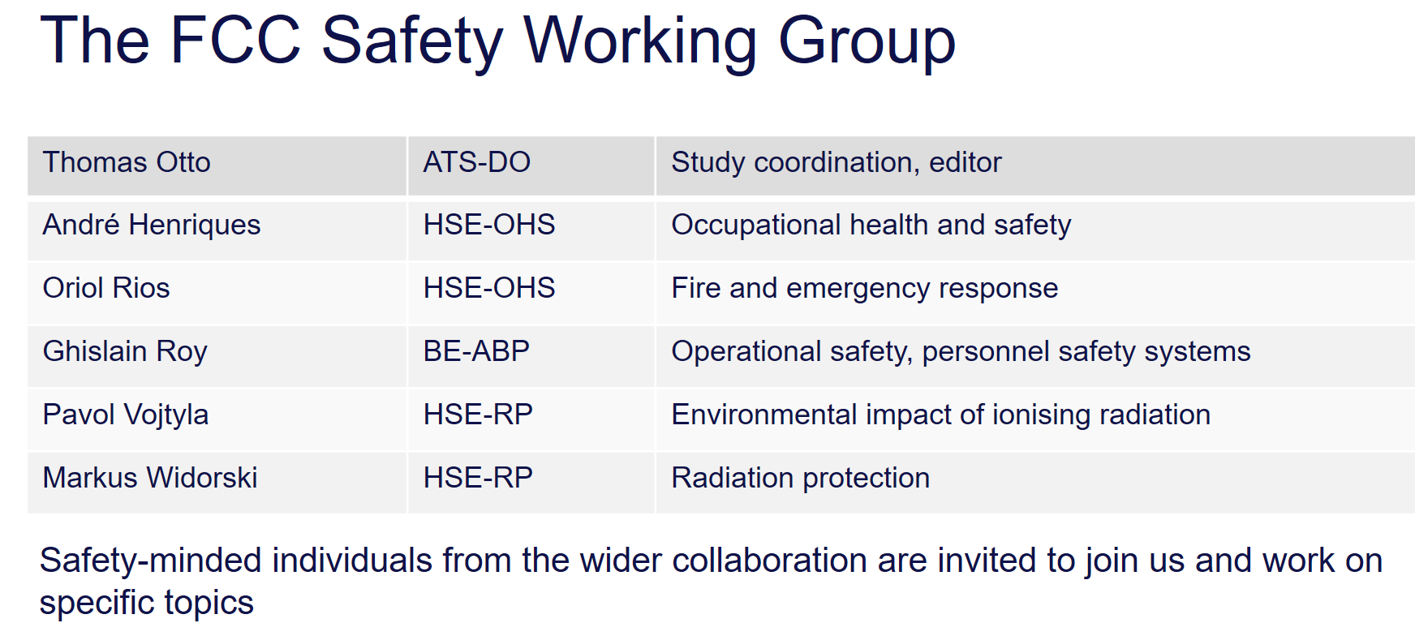
K Hanke
FCC week 2022
T Otto, The FCC Safety Feasibility Study
Hazard Register for HL-LHC

Slide 23
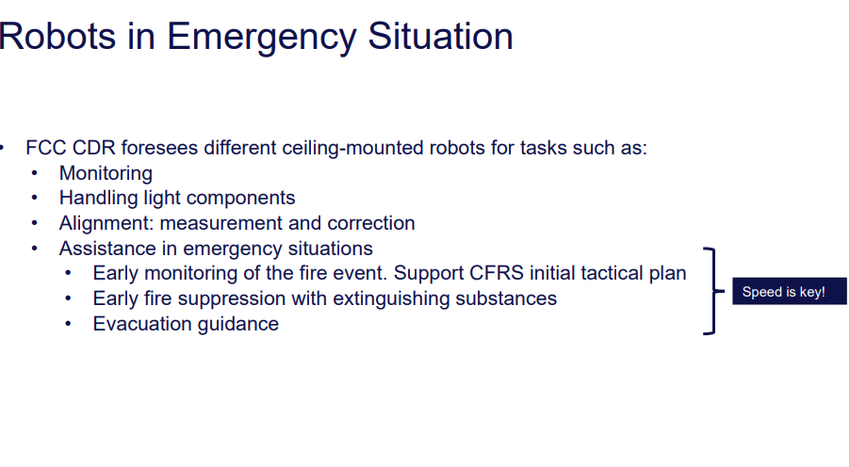
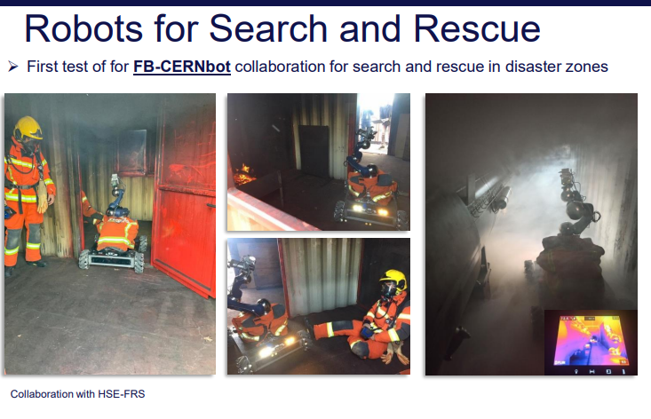
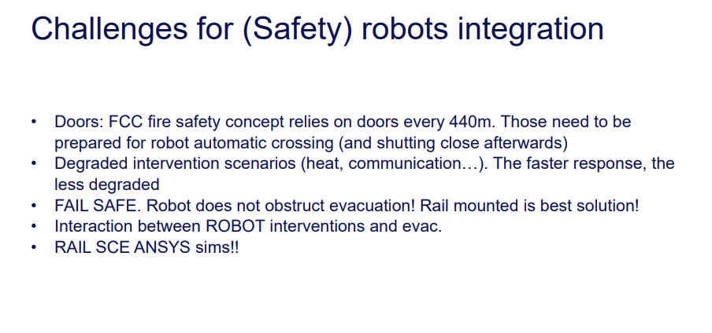
K Hanke
FCC week 2022
O Rios, Robots for Safety in FCC

Slide 24
Thanks to all speakers and chairpersons!

