Slide 1
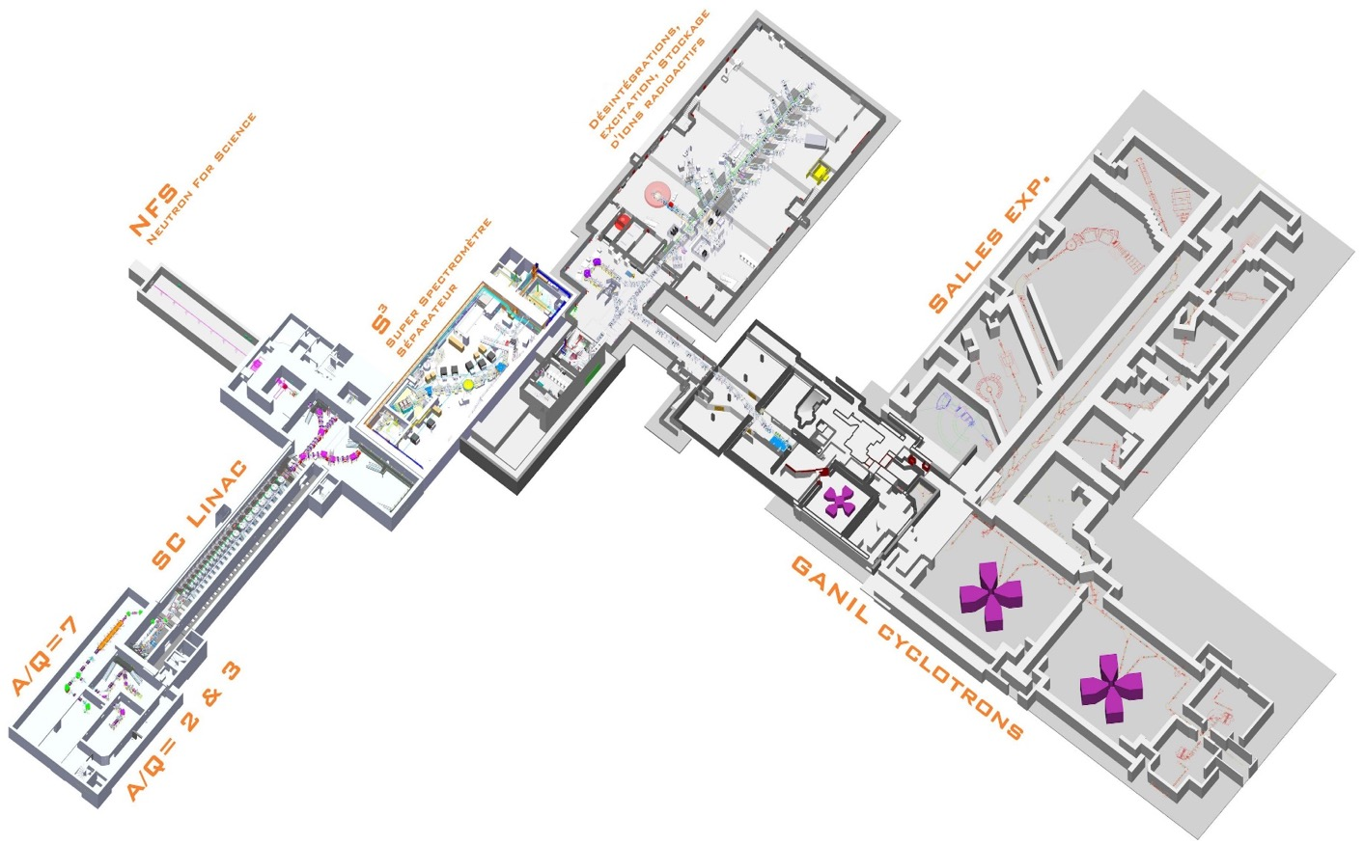
Programs and projects
at GANIL-SPIRAL2

Slide 2


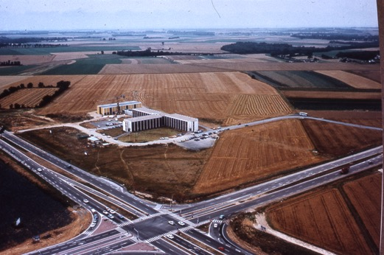
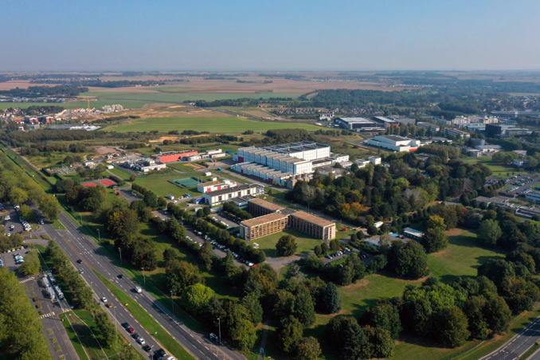
A brief history of GANIL
1976 Creation of GANIL
(Grand Accélérateur national d’ions lourds)
1983 First experiment
2001 SPIRAL1 exotic beams
2006 SPIRAL2 Project signature of convention for construction Inclusion on European Strategy Forum for
Research Infrastructures (ESFRI) roadmap
  2016 SPIRAL2 ESFRI Landmark
  2019 Start of the commissioning of SPIRAL2
  2020 First neutron beams
  2021 First NFS experiments (Neutron For Science)
GANIL 1980
GANIL 2020

Slide 3
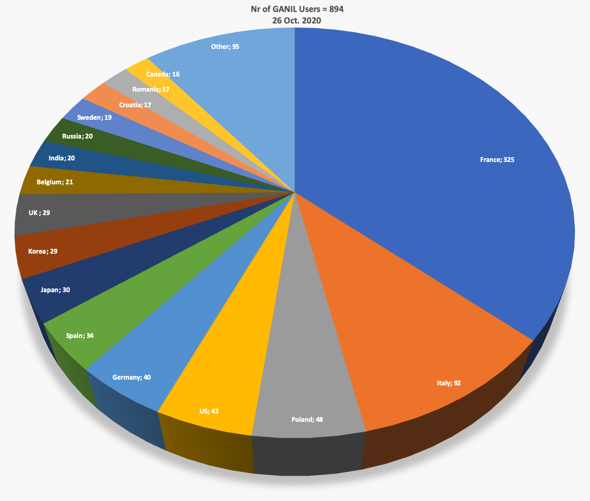
Some numbers
• 230 permanent staff members (CEA and CNRS researchers, engineers, technicians) + 40 temporary staff (15 PhD, 5 postdocs)
+ CIMAP = 24 permanent staff + 15 PhD + 8 postdocs
• An international scientific community of ≈ 1000 members
France
Italie
Pologne
USA
Allemagne
Espagne
Japon
Corée
Royaume Uni
Belgique
Inde
Russie
Suède
Roumanie
Canada
A major facility for heavy ions in the world
with GSI/FAIR (Germany), RIBF/RIKEN (Japan), FRIB/MSU (USA), ISOLDE (CERN)…

Slide 4
Programs
at GANIL-SPIRAL2

Slide 5
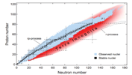
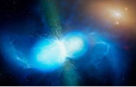

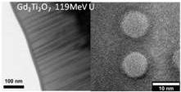


GANIL: a multidisciplinary and multi-users laboratory
Nuclear Physics
Nuclear Physics@GANIL: study of exotic nuclei
Main questions to be answered :
What are the limits of existence of nuclei ?
What are the underlying fundamental interactions ?
How regular patterns emerge in the intrinsic structure of complex many body nuclei ?
Nuclear Astrohysics
Astrochemistry
Materials under irradiation
~ 3000 more predicted by nuclear models (produced in reactions in stars)
Nanostructuration
~ 3300 radioactive isotopes produced and studied at accelerator facilities
Z=8
Radiobiology
Z=2
Notes:
288 noyaux stables

Slide 6
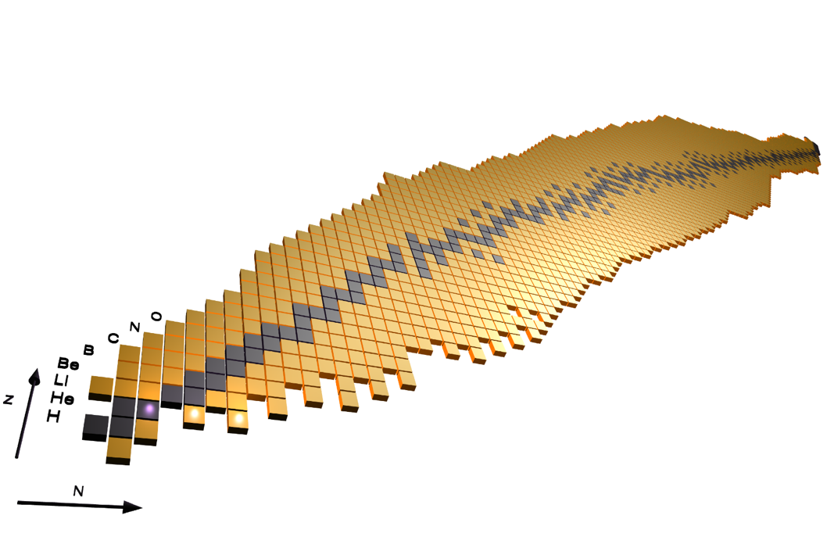

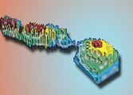
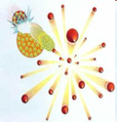


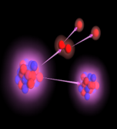
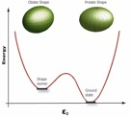
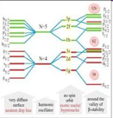


GANIL: a multidisciplinary and multi-users laboratory
Nuclear Physics@GANIL: study of exotic nuclei
Are there more unexpected new phenomena to be discovered ?
  Shell structure modification and new magic numbers
  Halo nuclei
  New radioactivities
  ????
Nuclear Physics
Nuclear Astrohysics
Fission dynamics
Superheavy
nuclei
Nuclear matter
Equation of State
Pairing Correlations
Astrochemistry
2p
radioactivity
Coupling to continuum
Fundamental interactions
Materials under irradiation
Nuclear shapes and coexistences
Nanostructuration
Shell effects
Nuclear astrophysics
Radiobiology
Clusters
Halo nuclei

Slide 7
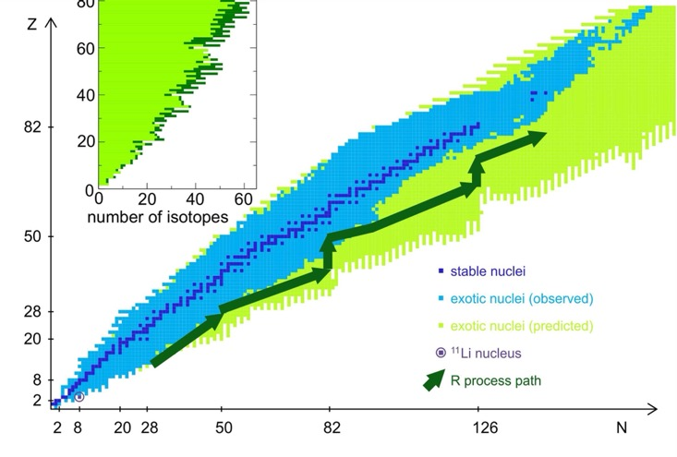
GANIL: a multidisciplinary and multi-users laboratory
Nuclear astrophysics:
How nuclei have participated and still participate in the creation of elements in the universe?
Renewed interest since the discovery of gravitational waves : EM counterpart of GW170817 is the strongest evidence of heavy elements nucleosynthesis through the r-process.
Nuclear Physics
Nuclear Astrohysics
Astrochemistry
r-process
Materials under irradiation
r-abundance curve
Nanostructuration
Observations
Strong shell closure
Shell quenching
Radiobiology
Arnould et al,
Physics Reports 2007
A
B. Pfeiffer, et al., NPA 693 (2001) 282
Notes:
288 noyaux stables

Slide 8
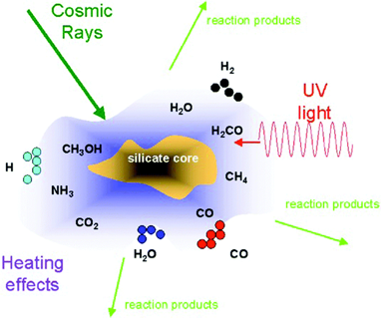
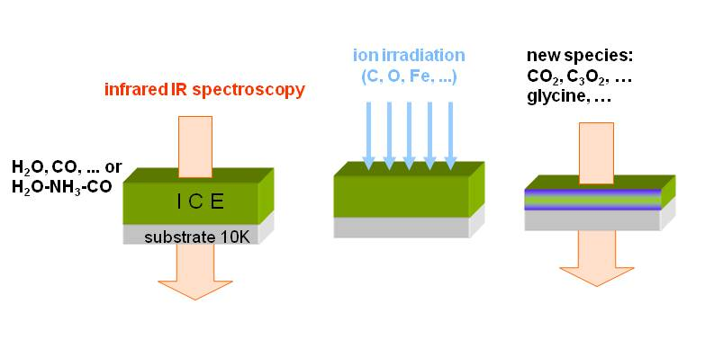
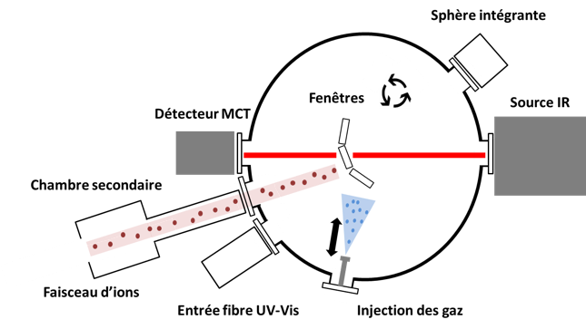
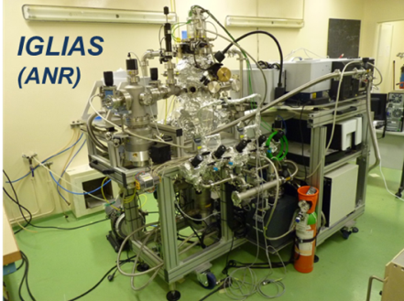
GANIL: a multidisciplinary and multi-users laboratory
Astrochemistry:
Role of cosmic rays and stellar winds on ices for the appearance of
molecules in the universe
Nuclear Physics
fragmentation/destruction
formation of molecules
Desorption / Sputtering /implantation
Nuclear Astrohysics
Astrochemistry
IGLIAS setup to mimic interstellar ices exposed to radiation
Materials under irradiation
Nanostructuration
Radiobiology
In-situ gas deposition
3 spectrometers (UV-visible, FTIR, QMS)
Notes:
une partie importante des demandes de faisceaux lors de l’IPAC est l’irradiation de glaces d’intérêt astrophysique.
Les glaces sont présentes partout dans l’espace que ce soit sur les lunes, les poussiéres, les cométes, les nuages moléculaires, les objet transneptuniens, ….et elles sont soumis à des flux de particules ionisantes. Cela peut induire des transitions de phases, de la radiolyse et donc la destruction de certaines molécules., D’&utres au contraire peuvent se former par réaction entre radicaux et voir ainsi former des molécuiles plus complexes.
On a développé pour cela un dispositif sous ultra vide permettant le dépôt de mélange gazeux pour former des glaces, leur irradiation et le suivi in-situ des modifications chimiques par spectroscopie IR ou UV visible.
What is the role of cosmic rays and stellar wind on ices and silicates for the appearance of molecules in the universe? To answer this question, GANIL is a precious and unique tool to perform laboratory experiments in particular to understand the production and the radio-resistance of newly formed molecules during ice irradiation, an important topic for the understanding of emergence of life.
Ices are ubiquitous in space. They can be found on dust grain in dense molecular clouds in the interstellar medium (ISM), on comets and on the Jovian moons like Europa in the solar system for example. These icy mantles are mostly composed of small molecules (H₂O, CO, CO₂, NH₃, ...) and are permanently irradiated by cosmic rays or stellar wind. Irradiation leads to radiolysis: mother molecules are broken and radicals are formed. These radicals may then react inside the ice with neighboring molecules and produce new molecules leading to the chemical modification of the initial ices. More complex organic molecules can thus be produced which is in agreement with the fact that amino acids, as glycine, have been observed in space (Rosetta mission 2014-2015) on the 67P/Tchourioumov-Guérassimenko also know as “Tchouri”.
On the other, more than 200 molecules have been identified in the interstellar medium and organic complex molecules have been observed in planetary atmospheres such as Saturn moons. Many experiments are devoted to the ion collision induced molecular complexification inside carbonated molecules clusters and compared to theoretical calculations. These studies show the particular role played by ion collisions in the molecular synthesis in space due to the specific interaction of heavy particles with matter. GANIL is specially well adapted to tackle this important topic of understanding the building up of complex molecules in space.
Dans les parties denses de l’espace (comètes, planètes) Molecules se condensent dessus la glace. Implantation des ions dans les glaces, ou inverse sputtering, radiolyse,
Reproduire ce qui se passe dans l’espace: substrat à 10 K; in situ buse injection gaz, on dépose, puis on irradie puis on tourne fait spectro IR => évolution des liaisons chimiques
QMS,
iGLIAS soit IRRSUD, ARIBE
MCT= détecteur IR

Slide 9

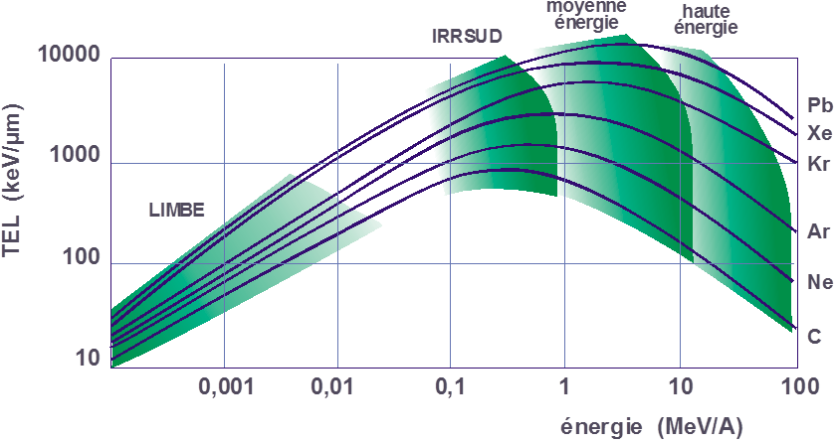
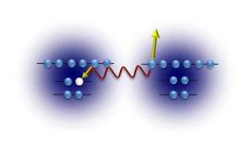
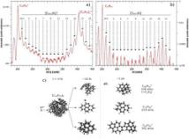
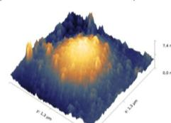
GANIL: a multidisciplinary and multi-users laboratory
Nuclear Physics
Materials under irradiation/Nanostructuration
- Materials study
- Contribution to improving the
nuclear power plants safety
(fuel tubes, nuclear packaging)
Nuclear Astrohysics
Astrochemistry
ARIBE
Materials under irradiation
Nanostructuration
surface
5 µm
100 µm
1500 µm
Radiobiology
Studies perfomed by scientific community related to CIMAP/CIRIL
9
Notes:
Explication complète qu’il faudra bien sur simplifier: IRRSUD= produite de fission, HE= permet radiobio et simuler les alpha, SME = maximum de TEL
Grâce à la variété d’ions disponibles, ces différentes gammes d’énergie donnent accès à un grand domaine de pouvoir d’arrêt. Ce graphique représente le transfert d’énergie linéique en keV/µm en fonction de l’énergie de ions en MeV/A. Ce TEL dépend de la masse de l’ion projectile. Le carbone, élément léger, aura un TEL beaucoup plus faible que le plomb. Les zones vertes représentent les gammes d’énergie couvertes par nos 4 lignes de faisceaux. Il y a une zone énergétique non couverte par les lignes disponibles à Caen. Cette zone est couverte par la plateforme JANNUS à Saclay. Le pouvoir d’arrêt nucléaire domine le pouvoir d’arrêt électronique. A basse énergie, les mécanismes dominants étant l’excitation et la capture électronique, les systèmes les plus étudiés ont été, pendant les 20 dernières années, des atomes, molécules et agrégats en phase gazeuse. Depuis quelques années, grâce à l’amélioration des performances des sources ECR, les ions de basses énergies sont également un outil pour étudier la surface des matériaux (glace, métaux, semiconducteurs). Sur IRRSUD, l’énergie des ions est en moyenne de 1 MeV/A. Le dépôt d’énergie se fera essentiellement à gauche du pic de Bragg. La gamme d’énergie disponible en SME correspond au pic de Bragg alors qu’à haute énergie, la perte d’énergie se fait après le pic de Bragg. La profondeur atteignable dans le cas d’IRRSUD est de 5 à 10 µm alors que pour la HE elle est de l’ordre que 0.1 mm a plus d’1 mm. Selon les contraintes imposées par les méthodes de caractérisation des matériaux il sera plus judicieux de choisir telle ou telle ligne

Slide 10
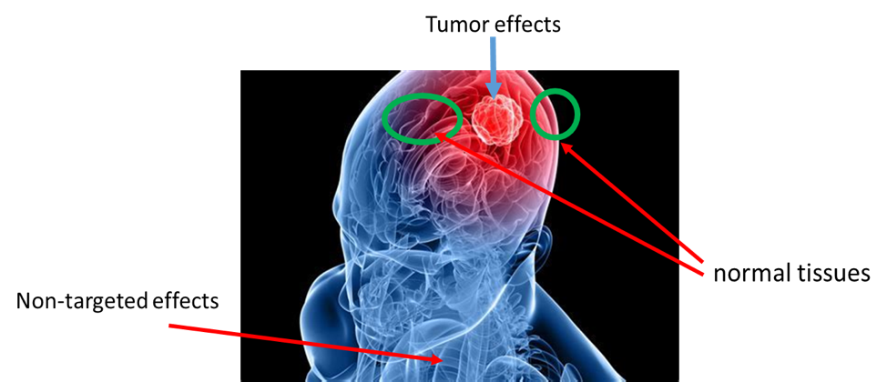
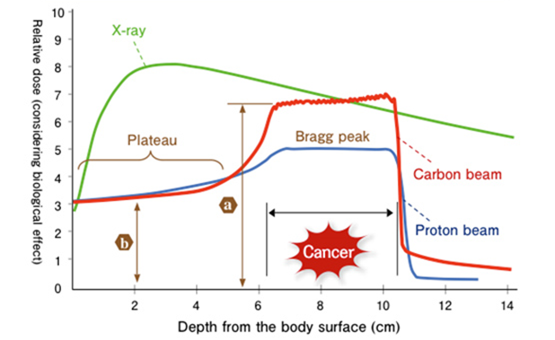

GANIL: a multidisciplinary and multi-users laboratory
Nuclear Physics
Radiobiology
- New radioisotopes for medicine (²¹¹At)
- pre-clinical studies and
innovative methods for
hadrontherapy
Nuclear Astrohysics
Astrochemistry
Materials under irradiation
Nanostructuration
New hadrontherapy center nearby GANIL
Radiobiology

Slide 11
GANIL-SPIRAL2
Facility

Slide 12

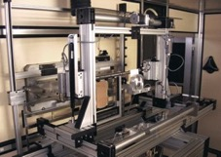
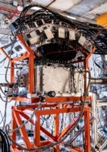
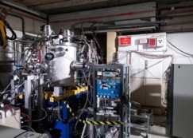
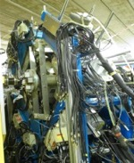
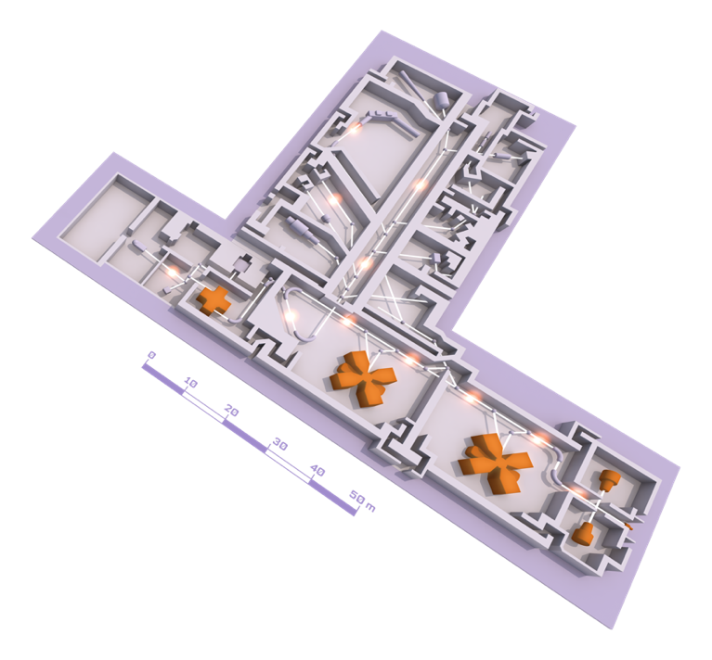
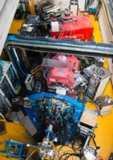
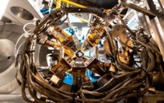
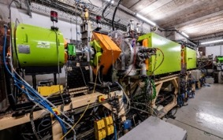
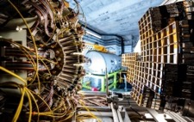
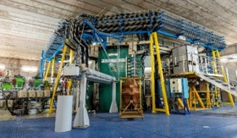
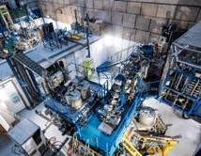
GANIL Cyclotrons and experimental equipment
EXOGAM
ACTAR TPC
Sample holder for irradiation
MUGAST
Experimental rooms
AGATA
LISE SPECTROMETER
VAMOS
Beams : ¹²C to U
Energy : from <1 MeV up to 95MeV/nucleon
Up to 4 experiments in parallel
GANIL CYCLOTRONS
INDRA + FAZIA
CYCLOTRON
SOURCES

Slide 13
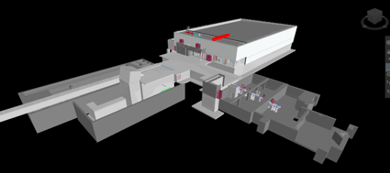
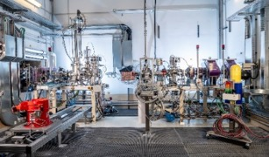
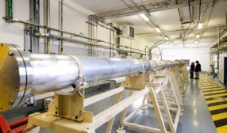
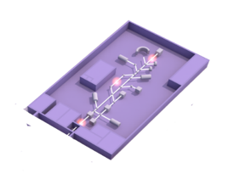
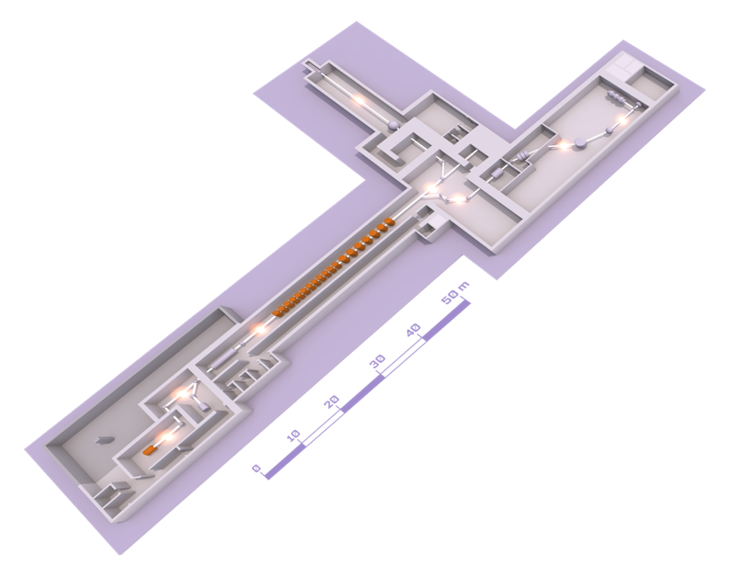

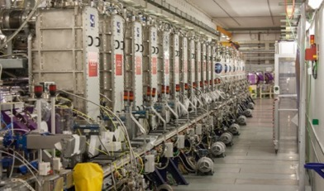
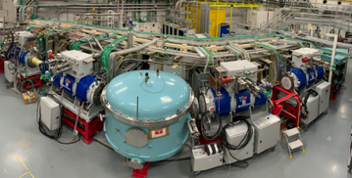
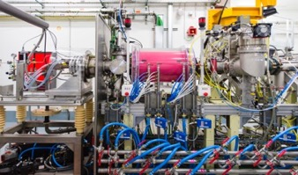
SPIRAL2 and the new experimental rooms
EXPERIMENTAL ROOM DESIR
(Desintegration,
Excitation and Storage of Radioactive Ions)
EXPERIMENTAL ROOM NFS (NEUTRONS FOR SCIENCE)
Convertor room
Time of Flight room
LINEAR accelerator (LINAC)
EXPERIMENTAL ROOM S3 (SUPER SEPARATOR SPECTROMETER)
Beams :
33 MeV protons
40 MeV deutons
<14,5 MeV/A heavy ions
ION SOURCE

Slide 14
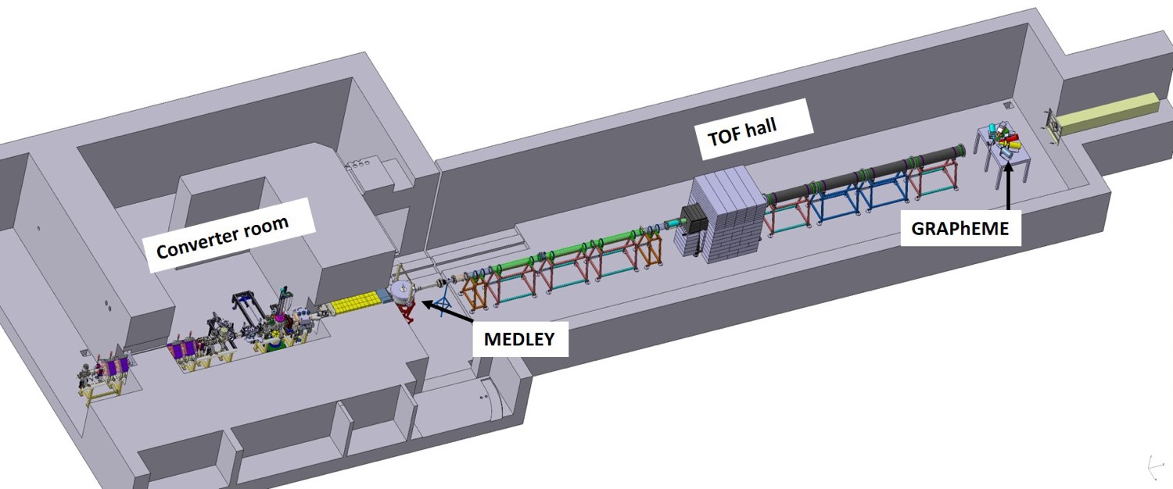
New experimental room : Neutron for Science
Collimator
● Ion and neutron induced reactions
● Irradiation station (n, p, d)
LINAC
Beam
Physics case
Fundamental physics
Astrophysics
New generation of reactor
Fusion technology
Radioisotopes production for medical applications
Biology (cells irradiation..)
Development and characterization of new detectors
Study of the single-event upsets
● Neutron Beam at 0°
● Collimator beam quality
● Size (Lⅹl) ≃ (28m ⅹ 6m)
- TOF measurements
- free flight path

Slide 15
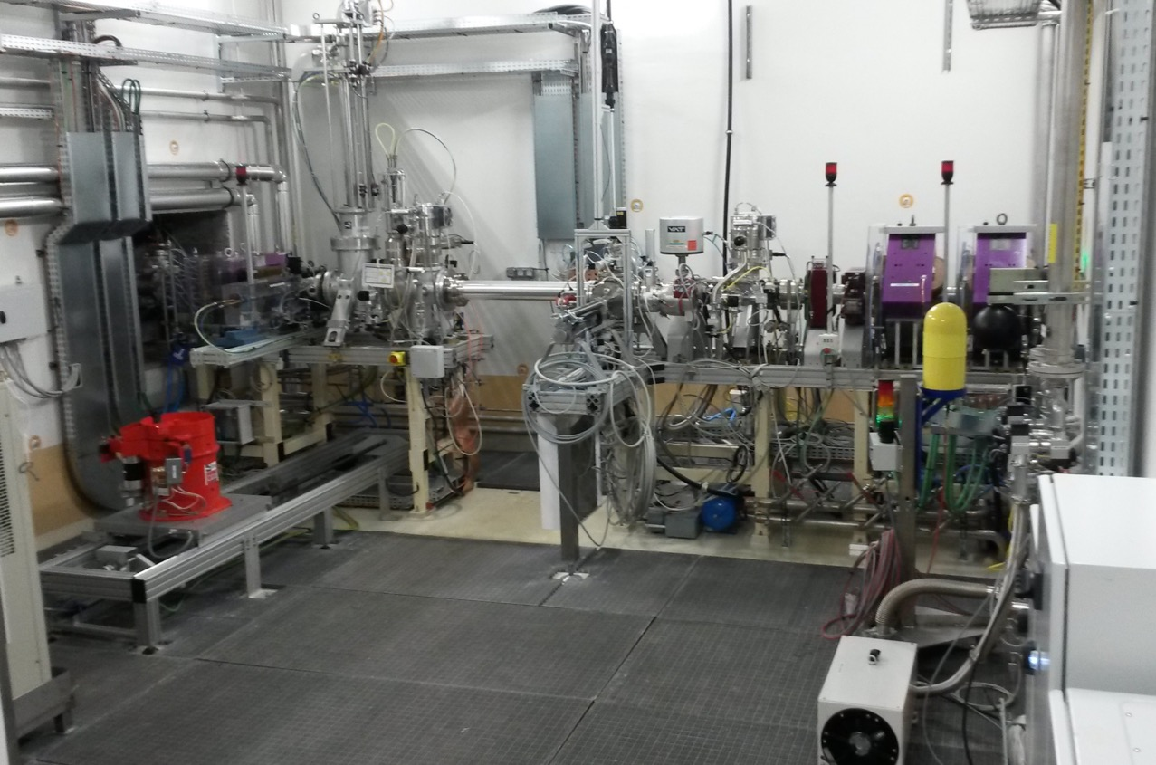
New experimental room : Neutron for Science
● Ion and neutron induced reactions
● Beam line extension
● Irradiation station (n, p, d)
Collimator
Rotating
converter
Pneumatic transfer system
LINAC
Beam
Li converter
Irradiation station
Physics case
Fundamental physics
Astrophysics
New generation of reactor
Fusion technology
Radioisotopes production for medical applications
Biology (cells irradiation..)
Development and characterization of new detectors
Study of the single-event upsets
● Neutron Beam at 0°
● Collimator beam quality
● Size (Lⅹl) ≃ (28m ⅹ 6m)
- TOF measurements
- free flight path

Slide 16
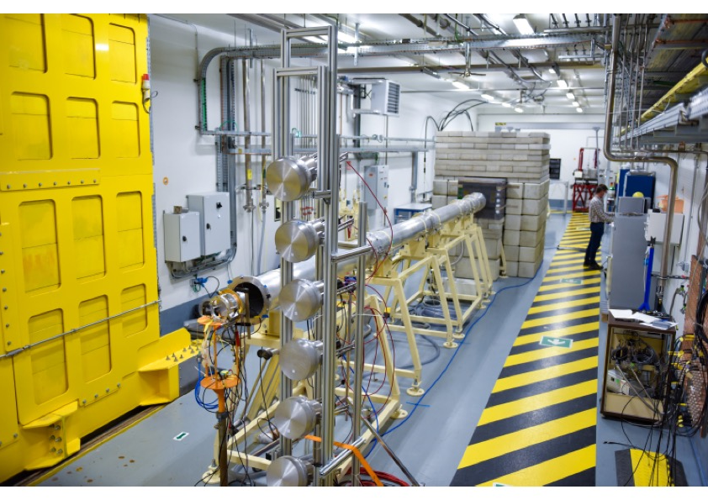
New experimental room : Neutron for Science
● Ion and neutron induced reactions
● Beam line extension
● Irradiation station (n, p, d)
Collimator
LINAC
Beam
Physics case
Fundamental physics
Astrophysics
New generation of reactor
Fusion technology
Radioisotopes production for medical applications
Biology (cells irradiation..)
Development and characterization of new detectors
Study of the single-event upsets
● Neutron Beam at 0°
● Collimator beam quality
● Size (Lⅹl) ≃ (28m ⅹ 6m)
- TOF measurements
- free flight path

Slide 17
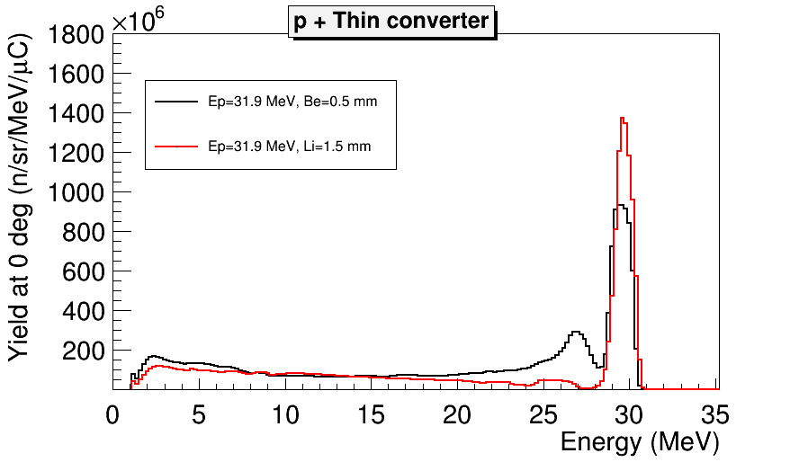
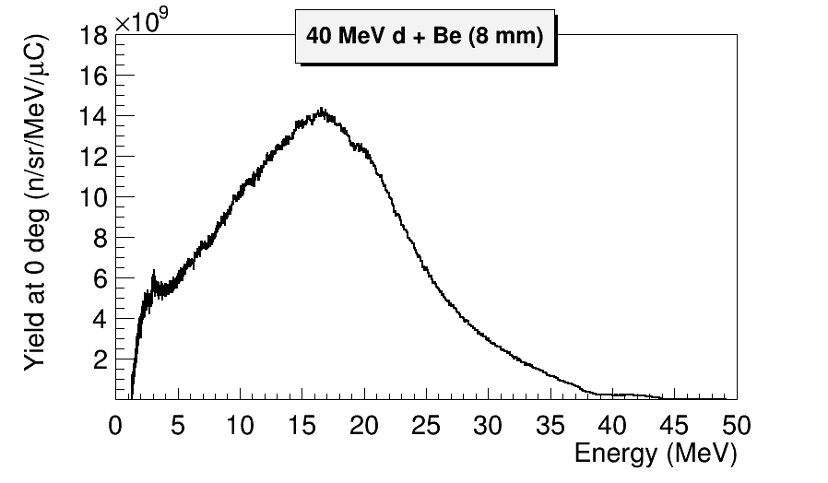
Neutrons beams
Flux at 5 meters :
8.10⁷ n/s/cm²
at 15 MeV : 5.10⁶ n/s/cm²/MeV
at 30 MeV : 6.10⁵ n/s/cm²/MeV

Slide 18



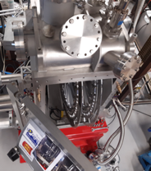
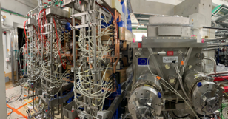

















: the Super Separator Spectrometer
Fundamental research in Nuclear & Atomic physics
High selectivity > 10¹³ beam rejection
High efficiency 50%
Mass resolution > 350
Versatility : high resolution, high transmission, high beam rejection modes…
Unique instrumentation : SIRIUS for p, α, electron and γ spectroscopy, and S3-LEB with gas catcher, RFQ and MR-ToF-MS
Open RT magnet & beam dump & Movable fingers
Cooling system, Laser room …
Dispersive zone
Infra / Interface
Target system
LEB @ LPC & GISELE Laser Lab
High power rotating targets
LEB
3 × M-dipoles
Large H & V gaps
DSSD, SSD, FEE/BEE, DAQ & Diagbox
SMT, PSS, Coldbox & LTC
E-Dipole
SIRIUS
SC Multipoles
20 cm gap & +/- 300 kV
Open slit in the anode
Notes:
MR-ToF-MS: multi reflection ToF mass separator

Slide 19


S³-SIRIUS day 1 pre-proposals
SIRIUS: Spectroscopy and Identification of Rare Isotopes Using S3
tracking detector
Si detector box
Ge detectors
  K-isomers
  Single particle states
  New isotopes – limits of stability
  Odd-Z nuclei
  Reaction mechanism
  N=152, 162
Very heavy and super heavy nuclei
Limit of the nuclear existence
Shell correction effects
Reaction mechanisms
152
162
184
Isomers
²⁵⁴Rf, ²⁶⁰Sg
120
beyond
with NEWGAIN
2028
+ SC source
$≥$ 2030
Search for new isotopes
²⁵²Rf
114
Limits of stability / isomers
^{250,249,…}No
108
Odd Z isotopes – nuclear structure
fermium region
E_{shell}
“day 1”
with injector1
2024
1 particle μA
= 6.2 x10¹² particles/s
Calc.: A. Sobiszewski

Slide 20




S³-LEB day 1 pre-proposals
REGLIS³
Observables :
Nuclear magnetic
dipole moment
Nuclear Electric
quadrupole moment
Mean charge radii
Spin
PILGRIM
(MR-Tof-MS)
Observables :
Mass (100keV)
Spectroscopic information on the heaviest nuclei ?
Fm (isomers, shapes, moments)
How relativistic effects affect the
architecture of the periodic table?
Measure IP in Rf and Db ?
Nucleon-Nucleon interaction around ¹⁰⁰Sn?
Effective Single particle energy levels: ¹⁰¹Sn, ⁹⁹In
T = 0 T = 1 Pairing interaction: ⁹⁸In
Spin-aligned coupling scheme: ⁹⁴Ag, ⁹⁰Rh
How deformation emerge from microscopic
configuration ?
Q in Sn chain
Evolution of deformation around ⁸⁰Zr
Binding energies and Wigner term ?
From ⁸⁰Zr-¹⁰⁰Sn
rp-process
Tape station
Observables :
Decay
spectroscopy
Half-life
Octupole deformation
in U region ?
Evolution of N=126 shell closure with increasing Z ?
Laser spectroscopy
Mass measurement
Decay spectroscopy
N=Z region: shell evolution, nucleosynthesis, symmetries
Heavy neutron-deficient refractory elements: shapes/shape coexistence, exotic decay modes
Heavy and Super Heavy Element region: single-particle versus deformation, atomic physics
Notes:
REGLIS3: Rare Elements in Gas-Laser Ion Source and spectrocopy at S3
The physics cases for the S3 LEB experimental program have been updated in 2018 and 11 pre-proposals have been submitted by the collaboration. They cover experiment campain studying systems with extreme proton to neutron balance on the N=Z line including the doubly magic 100Sn, and systems with extreme masses in the actinide and super heavy region.

Slide 21


Experimental room under project:
HRS
Ion trapping
DETRAP
Precise mass measurements
In-trap decay spectroscopy
β-n angular correlations
S³-LEB beam
Collinear laser spectroscopy
Laser polarization (decay spectroscopy, β-NMR, …)
Laser
Spectroscopy
LUMIERE
UHRS
Decay
Spectroscopy
BESTIOL
Beam purification
and preparation
(Cooling/Bunching/Trapping)
SPIRAL1 beam
β-delayed charge part.
Full absorption spectroscopy
(Trap/Laser-assisted) decay spectroscopy
Low-energy radioactive-ion-beam facility
Beams from SPIRAL1 and S³
Important beam preparation and purification capabilities
High resolution/precision experiments
Colloque GANIL 2021
Construction will start after « Modification autorisation » procedure (ASN, MSNR) and public inquiry => Spring-summer 2023
First beams: 2027

Slide 22


Scientific Program
Collinear laser spectroscopy
β-delayed γ spectroscopy
β-n angular correlation
Mass measurement
β-delayed charge part., β-n emission
(Trap-assisted) β-decay, full absorption spectroscopy
LUMIERE
Very (super)-heavy
DETRAP
BESTIOL
A~150
Deformation
Decay properties
N~Z
Nuclear structure
near closed shells
S³-LEB
  Fusion-evaporation
  (Multi-)nucleon Transfer
Fundamental
interactions
SPIRAL 1 Upgrade
b-n
  Beam & target fragmentation

Slide 23










New injector for SPIRAL2: NEWGAIN
Floorplan, design intensities and time line
beam injector1 (injector2)
intensities 2023 2028 $≥$ 2030
Ions | Intensity (pµA) Phoenix V3 RFQ A/Q≤3 | Intensity (pµA) Phoenix V3 RFQ A/Q≤7 | Intensity (pµA) SC Ion Source RFQ A/Q≤7
¹⁸O | 80 | * | 375
¹⁹F | >15 | >40 | >40
³⁶Ar | 16 | 70 | 45
⁴⁰Ar | 3.6 | 70 | 45
³⁶S | 2.3 | * | *
⁴⁰Ca | 2.9 | 10 | 20
⁴⁸Ca | 1.2 | 10 | 20
⁵⁸Ni | 1.1 | 4 | 8
⁸⁴Kr | 0.1 | 10 | 20
¹³⁹Xe | 0.001 | 7 | >10
²³⁸U | <<0.001 | 0.1 | 6
Measured
Estimated
* -> no estimation
White Book
https://www.ganil-spiral2.eu/scientists/ganil-spiral-2-facilities/accelerators/newgain/
time line
2020 | 2021 | 2022 | 2023 | 2024 | 2025 | 2026 | 2027 | 2028
Study Phase
Construction Phase
first
beam

Slide 24
GANIL-SPIRAL2
medium/long term perspectives

Slide 25

Vision for the future of GANIL: Expert Committee report
Expert committtee Chair : Michel Spiro
Members: Maria Jose Garcia Borge (CSIC), Paolo Giubellino (FAIR), Ulli Köster(ILL), Hiroyushi Sakurai (RIKEN),
Boris Sharkov (JINR), Brad Sherill (MSU), Johanna Stachel (Univ. Heidelberg)
Three steps for the future of GANIL
Until 2030:
-finalisation of ongoing projets : S3, DESIR, NEWGAIN
-cyclotrons and LINAC operation, refurbishing of cyclotrons
-new target station for test of radioisotopes production
-test gas cell for fragment production via MNT (multi-nucleon transfer)
2) Until 2035
-renovation or replacement of CIME cyclotron
to reach 100 MeV/nucleon
-building for production of n-rich exotic nuclei by fission of UCx target.
-Dedicated target station for radioisotopes production
-Dedicated beam line for pluridisciplinary research
3) Until 2040
-Construction of an electron accelerator (synchrotron or ERL) for a new generation of experiments : electron-exotic nuclei scattering
« Vision to keep GANIL at the forefront of nuclear
science globally for many decades to come »

Slide 26

Vision for the future of GANIL: Expert Committee report
GANIL 2040 ????

Slide 27
Thank you for your attention

Slide 28
Back up slides

Slide 29
Nuclear Physics :
Some examples of latest results

Slide 30





Study of very neutron rich light nuclei : ⁷H
ACTAR active target : the detector gas constitutes the target material
  Thick target to compensate for low beam intensity
  Vertex and energy measurement
  Low particle thresholds
  Large range of center of mass angles
  Very high efficiency
  Excitation function
Application to ⁷H ground state properties investigation by missing mass method M. Caamano et al, Phys. Lett B829 (2022)
E_{R}=
Γ_{R}=
½+ ground state

Slide 31
















The AGATA project : THE ultimate spectrometer
180 (60 triple-clusters) 36-fold
segmented crystals
Amount of germanium: 362 kg
Solid angle coverage: 82 %
Singles rate >50 kHz
Efficiency: 43% (M_{γ}=1) , 28% (M _{γ} = 30)
Peak/Total: 58% (M _{γ} =1), 49% (M _{γ} = 30)
Angular Resolution: ~1º
The project timeline is to complete the 4π
by 2030
Combination of:
segmented detector
pulse-shape analysis
tracking the γ rays
digital electronics
AGATA@GANIL
S. Akkoyun et al., Nucl. Instrum. Methods Phys. Res., Sect. A 668, 26 (2012).
E. Clément et al., Nucl. Instrum. Methods Phys. Res., Sect. A 855, 1 (2017).

Slide 32




AGATA@GANIL: many sub-campaigns
2015-2017
2018
2019-2021
2021
AGATA coupled with VAMOS, FATIMA, PARIS
AGATA coupled with NEDA- DIAMANT
AGATA coupled with VAMOS MUGAST
AGATA coupled with VAMOS, EXOGAM,
2nd Arm, LEPS

Slide 33



N=Z isotopes: study p-n (iso-scalar) pairing correlations
Nucleons can form strongly correlated pairs which impact strongly on nuclear structure.
Only in N=Z nuclei will the p-n (isoscalar) pairing be important, as protons and neutrons occupy the same orbit.
⁸⁸Ru: 44 protons and 44 neutrons (near proton dripline)
Rotating deformed nucleus with strong
ISO-SCALAR
p-n pairing !
Z
→
→ N
B. Cederwall et al., PRL 124, 062501 (2020)

Slide 34










Fission Studies in inverse kinematics @ VAMOS
  Inverse Kinematics using beams of ²³⁸U around Coulomb Barrier
Access to « exotic » fissionning systems
heavier than ²³⁸U
VAMOS
A,Z
evaporation
transfer
reaction
fission
²³⁸U @ 6 AMeV
  VAMOS Magnetic Spectrometer
Direct and Complete
isotopic fission fragment yields
target
PISTA
recoil
SPIDER:
Recoil
A, Z, E, angle
²³⁹U
  Surrogate reactions
  (transfer induced fission)
Selection of the fissionning system
Measurement of the excitation energy
D. Ramos et al PRL (2019)​​

Slide 35
Nuclear Physics
and dark matter

Slide 36



The neutron lifetime puzzle
τ_{n}(s)
Counting emitted protons :
W. Pattie et al, Science 360 (2018) 6389
$$τ_{n}^{beam}=888.0±2.1 s$$
Counting remaining neutrons :
$$τ_{n}^{bottle}=879.3±0.75 s$$
Discrepancy
$$\frac{∆τ_{n}}{τ_{n}}≈1\%$$
Year of experiment
How could the remaining 1% be explained ?
Decay of neutron into particles of Standard Model (other than p) : excluded
n → dark matter : Fornal and Grinstein, PRL120(2018)191801 -> shortening of the apparent lifetime in the bottle
  n → dark particle(s) to be searched for
  Neutrons loosely bound in nuclei may also decay by the dark channel, if allowed by energy conditions
Notes:
Voir les manipes UCNA et UCN

Slide 37




Search for dark decay of neutrons in ⁶He
(H. Savajols et al. June 2021)
TETRA
Branching ratio estimate from bottle/inflight decays Bχ = 1.2 × 10⁻⁵
Allowed energy window : Mχ < Mn - 975.45 keV
Combining other results 937.992 MeV < Mχ < 938.589 MeV
Pfutzner and Riisager, PRC 97, 042501(R) (2018)
Standard decay
Dark decay ?
3x T_{1/2}
⁶He¹⁺ SPIRAL1 world-record intensity (2×10⁸ pps)
Neutron multidetector TETRA with 50% efficiency
Search of an excess of neutrons in the decay of ⁶He
➔ The final analysis provides a stringent
upper limit for this dark decay
Time (10μs)
Time (10μs)

Slide 38
Nuclear Physics and
Physics beyond the Standard Model

Slide 39


Nuclear beta decay as a laboratory for weak interaction
Two complementary approaches:
High energy frontier
« Direct » observation of new particles at high energy colliders (LHC)
Precision/intensity frontier
Look for tiny deviations from SM predictions
  Non zero EDMs
  ν oscillations
  Search for WIMPs
  Dark decay of neutron
  …
  Correlation measurements in nuclear beta decay
  → exotic couplings
  of electroweak interaction
Linked through EFT
b: Search for Tensor Interactions in nucLear bEta Decay (bSTILED)
  Searching for exotic tensor currents via a b correlation measurement to the 10⁻⁴ level
Matter’s Origin from RadioActivity (MORA)
  searching for CP violation in nuclear β-decay via a D correlation measurement to the 10⁻⁵ level
Measurement of Ft values (half-lifes, branching ratios) of superallowed decays for tests of CVC to the 10⁻⁴ level and the search for exotic scalar currents

Slide 40
Materials under irradiation

Slide 41


Graphene/polymer nanoporous membranes
Simulation
Pore diameter as a function of stopping power
Collaboration:
Universities of
Helsinki and Aalto, Finland
Nottingham, UK
Duisburg-Essen, Germany
Wien, Austria
Science and Technology MISiS, Russian Federation
CIMAP, France
Ruder Boskovic Inst., Croatia
Helmholtz-Zentrum Dresden-Rossendorf, Germany
Experiment
Application:
Desalination of sea water
Project NU TEGRAM
Flagship Graphene
Pores diameter as a function of time
H. Vázquez et al.
Carbon 114 (2017) 511
L. Madauß et al.
Nanoscale 9 (2017) 10487
Notes:
Les ions font trou de petite taille dans le graphene (dépendant du pouvoir d’arret des ions) et comme le graphene est sur un polymere on peux ensuite faire attaque chimique pour révéler les trou dans polymeres
Sur image le « flou » est la zone avec graphene. On voir les trous dans polymere mais en regardant de plus pres on peut voir trou dans graphene. Et taille trou simulé marche bien avec observation
Sel tout petit donc trou très petit, qq couches de graphnèe sur polymère, puis trou sur polymère . Eau passe, sel reste sur graphène

Slide 42
Radiobiology

Slide 43



Chondrosarcoma / pre-clinical experiments
Chondrosarcoma
malignant tumor of cartilage with bad prognostic - highly radio-resistant => use of hadrontherapy ?
Clonogenic assays: comparison between X-rays and C-ions (+/- PARPi)
Cell survival (%) is a mean +/- SD of 3 independent experiments performed in triplicate
Comparison of C-ions and X-rays:
Relative Biological Effectiveness 2,95
M. Cesaire, J. of bone oncology 17 (2019) 100246
Notes:
Comparaison des courbes en bleu: montre que ions C plus efficace que X rays (pas de cellules survivante à 6 Gy alors qu,’il en reste aux RX). Si on rajoute des agent radiosensibilisant (ici des inhibiteur de PARP pour limiter la réparation) on augmente encore l’efficacité des ions carbone.
Cartilage, résistante aux rayonsX, une indication hadronthérapie
PARPi: inhibiteur de PARP, protéine qui permet réparation ADN. Injection au patient, empêche que l’aDN se répare avant radiothérapie
Ions C 3 fois plus efficaces que X, et plus localisé.
Intérêt d’avoir labo de bio juste à côté + nécessité d’avoir planning qui ne bouge pas (ajout de PARPI 2 heures avant irradiation)

Slide 44
Astrochemistry

Slide 45

Role of cosmic rays and stellar winds on ices for the
appearance of molecules in the universe
IGLIAS setup to mimic interstellar ices exposed to radiation
fragmentation/destruction
formation of molecules
Desorption / Sputtering /implantation
Compactation / Amorphization
In-situ gas deposition
3 spectrometers (UV-visible, FTIR, QMS)
Notes:
une partie importante des demandes de faisceaux lors de l’IPAC est l’irradiation de glaces d’intérêt astrophysique.
Les glaces sont présentes partout dans l’espace que ce soit sur les lunes, les poussiéres, les cométes, les nuages moléculaires, les objet transneptuniens, ….et elles sont soumis à des flux de particules ionisantes. Cela peut induire des transitions de phases, de la radiolyse et donc la destruction de certaines molécules., D’&utres au contraire peuvent se former par réaction entre radicaux et voir ainsi former des molécuiles plus complexes.
On a développé pour cela un dispositif sous ultra vide permettant le dépôt de mélange gazeux pour former des glaces, leur irradiation et le suivi in-situ des modifications chimiques par spectroscopie IR ou UV visible.
What is the role of cosmic rays and stellar wind on ices and silicates for the appearance of molecules in the universe? To answer this question, GANIL is a precious and unique tool to perform laboratory experiments in particular to understand the production and the radio-resistance of newly formed molecules during ice irradiation, an important topic for the understanding of emergence of life.
Ices are ubiquitous in space. They can be found on dust grain in dense molecular clouds in the interstellar medium (ISM), on comets and on the Jovian moons like Europa in the solar system for example. These icy mantles are mostly composed of small molecules (H₂O, CO, CO₂, NH₃, ...) and are permanently irradiated by cosmic rays or stellar wind. Irradiation leads to radiolysis: mother molecules are broken and radicals are formed. These radicals may then react inside the ice with neighboring molecules and produce new molecules leading to the chemical modification of the initial ices. More complex organic molecules can thus be produced which is in agreement with the fact that amino acids, as glycine, have been observed in space (Rosetta mission 2014-2015) on the 67P/Tchourioumov-Guérassimenko also know as “Tchouri”.
On the other, more than 200 molecules have been identified in the interstellar medium and organic complex molecules have been observed in planetary atmospheres such as Saturn moons. Many experiments are devoted to the ion collision induced molecular complexification inside carbonated molecules clusters and compared to theoretical calculations. These studies show the particular role played by ion collisions in the molecular synthesis in space due to the specific interaction of heavy particles with matter. GANIL is specially well adapted to tackle this important topic of understanding the building up of complex molecules in space.
Dans les parties denses de l’espace (comètes, planètes) Molecules se condensent dessus la glace. Implantation des ions dans les glaces, ou inverse sputtering, radiolyse,
Reproduire ce qui se passe dans l’espace: substrat à 10 K; in situ buse injection gaz, on dépose, puis on irradie puis on tourne fait spectro IR => évolution des liaisons chimiques
QMS,
iGLIAS soit IRRSUD, ARIBE
MCT= détecteur IR

