Slide 1
FCC local communication Strategy
Andrea Perez Fernandez
Andrea Perez Fernandez
Local Communications Officer - CERN

Slide 2
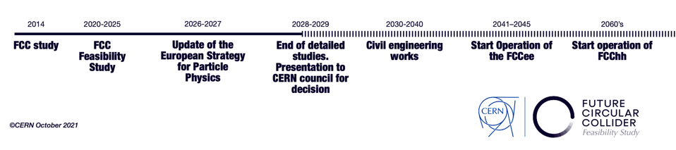
Timeline
2020 Update European Strategy for Particle Physics
Investigate the technical and financial feasibility of a new generation of particle colliders at CERN
There is a very fine line between communicating too soon and communicating too late

Slide 3
Communication strategy
FCC Communication Strategy
CERN Communication Strategy

Slide 4
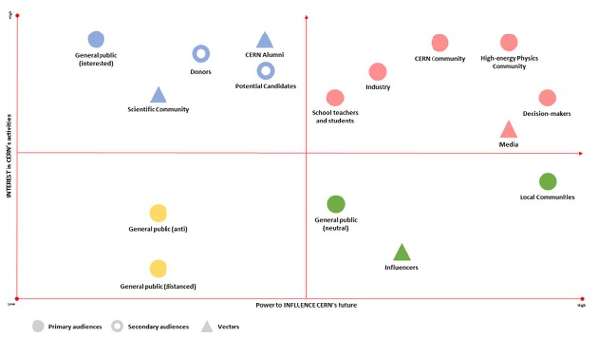
Stratégie de communication CERN: Public Ciblé
Interest in CERN activities
Power to influence the future of CERN

Slide 5
Communication strategy CERN: Messages for local public 2020-2025
Region Reputation
Economic
Development
Education
Sustainability
CERN works closely with neighboring institutions being a driving force for economic and cultural development in the local area.
CERN is contributing to the region’s reputation as a leader in science and technology through operating the LHC and exploring the potential for future colliders.
All CERN activities in the local area follow CERN’s highest standards of transparency, environmental responsibility and sustainability.

Slide 6
Communication strategy FCC: Messages
CERN has a nearly 70-year track record of success. (Credibility-trust)
The cost of FCC is reasonable when put into the perspective of its time span as well as the cost of other major endeavors
FCC brings a global project to Europe. (Collaboration)
FCC is a science mission for the 21st century.
FCC is a training ground for generations of global researchers. (Inspiration)
Contracts with a long-term project like FCC provides security for European industry.
FCC is the first major global project subject to the strict guidelines of the United Nations Sustainability Goals. (Sustainability)
FCC Feasibility Study is exactly that – a study – not construction or implementation phase.
Inspiration
Collaboration
Credibilité
Durabilité

Slide 7
Communication strategy
FCCfs Local Communication strategy
FCC Communication Strategy
CERN Communication Strategy

Slide 8
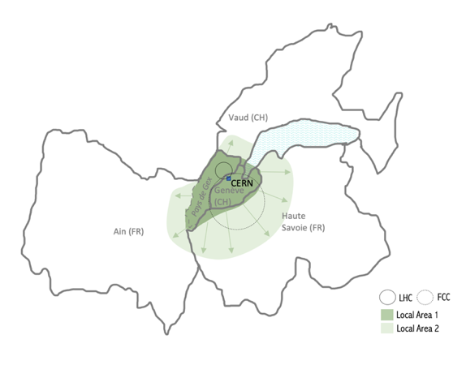
Complexity of the local area:
Previous knowledge
Canton de Genève /
Pays de Gex
CERN FCC
2. Haute Savoie / Ain / Canton de Vaud
CERN + FCC

Slide 9
Complexity of the local area:
Opposition
Local Area 1: CERN FCC
Local Area 2: CERN FCC

Slide 10
Complexity of the local area: Diversity
2 countries
CH: 2 cantons
FR: 2 departments
Different regulations
20 Municipalities for the feasibility study
Urban/Peri urban/Rural

Slide 11
Communication strategy
Take the pulse of stakeholders
FCCfs Local Communication strategy
FCC Communication Strategy
CERN Communication Strategy
Territorial dialogue
Stablish guidelines for FCC Communication at local level
A guideline for FCC communication at national and international level
Framework for all strategies

Slide 12
Target public
Desired outcomes
Outputs
Direct outcomes
Channels
Indirect outcomes
Main messages

Slide 13
Identifying target public:
Industry
General public
Local Media
Community-based associations
Local authorities
Landowners
Environmental associations
CERN community
Teachers and students
Universities
Research Centers

Slide 14
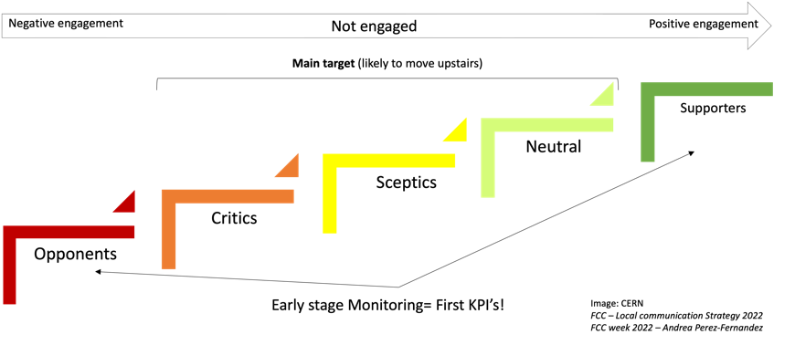
Identifying target public:

Slide 15
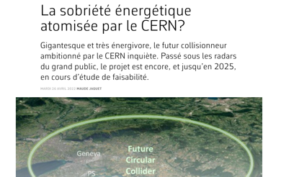
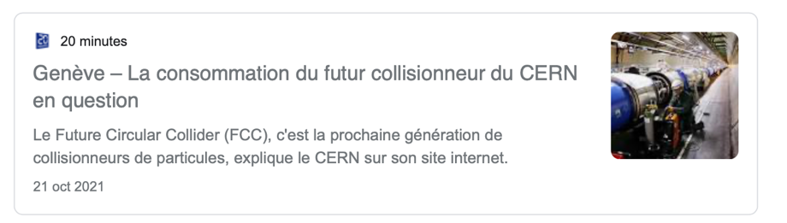

Slide 16
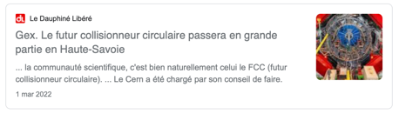
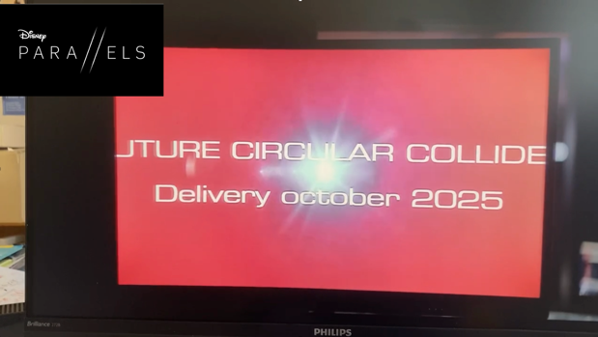

Slide 17
Identifying concerns
Geological risks
Local environmental impact
  Costs
  Future land Value
Disturbances during construction
Power consumption
Radiation
Water management
Catastrophic ideas
  Conspiracy theories
  Impact vs. local benefits
  Land Value
Excavation waste management
  NIMBY effect
  Landscape impact
Investment vs. Benefits for society
AN ONGOING STUDY

Slide 18

Feasibility study
FCC might Extend CERN Benefits for the region
Environmental Responsibility Commitment
Developing main messages
Timescale
Layout?
International collaboration
2022-2025
What’s the plan B?
20 communes
Infrastructures
Education
Our region a candidate?
Industry
Tourism
CERN as an asset
Prestige
LHC example
FCCee Power consumption = LHC
Avoid Reduce Compensate

Slide 19
Local Expert in Territorial Dialogue
FCC-CERN
Local communication and engagement group
Territorial dialogue coordination group

Slide 20
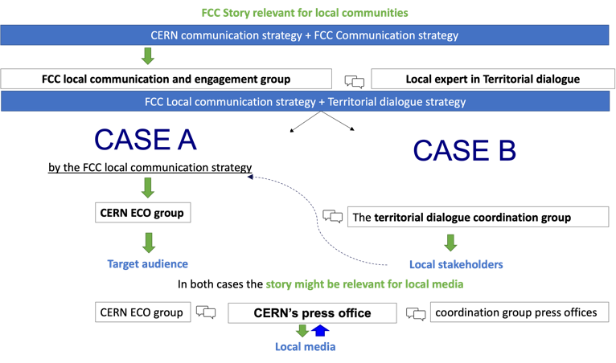

Slide 21
Taking action…

Slide 22


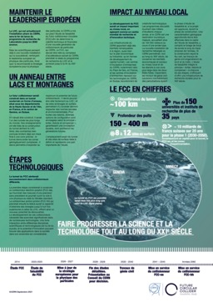


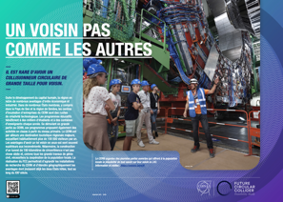
Communication supports

Slide 23
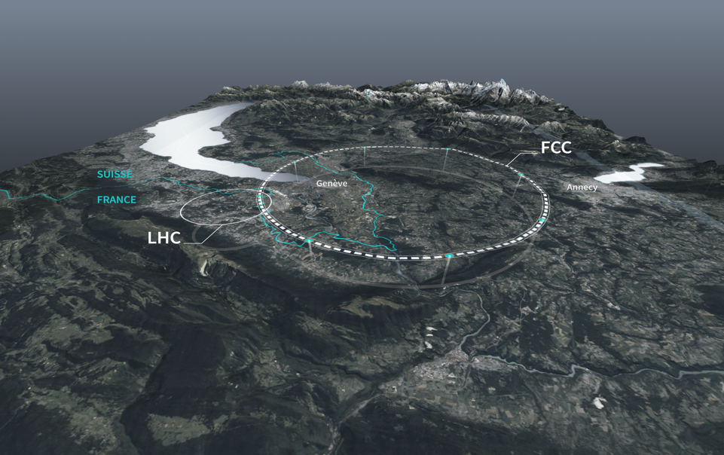
FCCfs

Slide 24
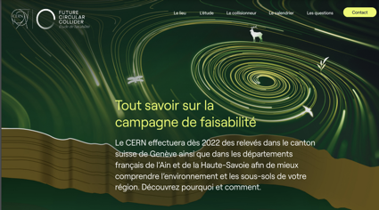
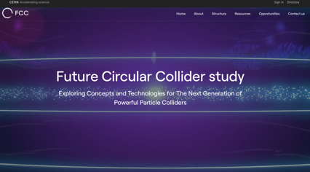

https://fcc.web.cern.ch
Q&A

Slide 25

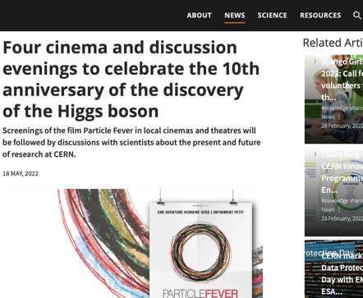
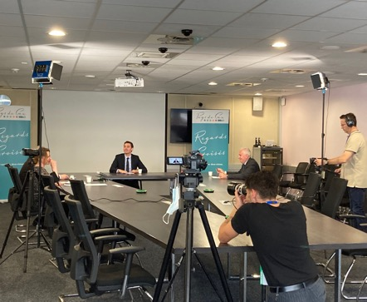

Slide 26
Thank you

