Slide 1

RF Frequency Options at H
D. Shatilov (BINP)
143rd FCC-ee Optics Design Meeting
CERN, 26 Aug 2021

Slide 2
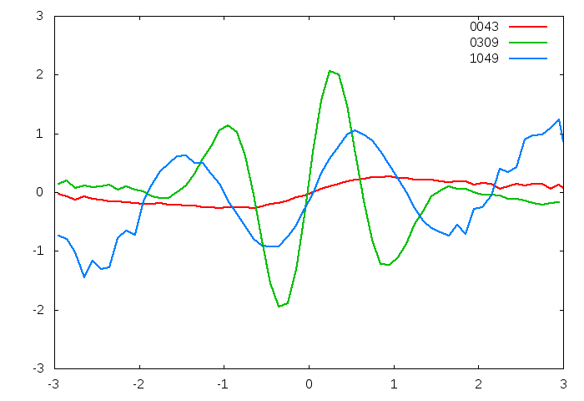
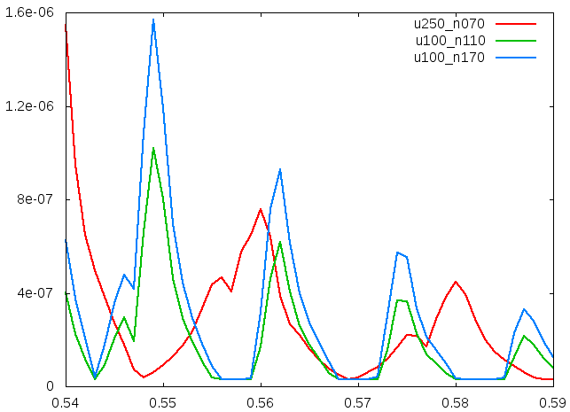
Mitigation of Coherent Beam-Beam Instability
x
Bunch shape at some turns
Excited coherent modes are associated with synchrotron satellites of half-integer resonance:
Since the wavelength cannot be less than 2L_{i}, we get the condition:
If φ is not too large, we can solve the problem by choosing
+
-
e
L_{i}
e
θ
φ ∙σ_{x}
z
x /σ_{x}
2σ_{z}
2σ_{x}
Sketch of collision with large Piwinski angle
z /σ_{z}
RF voltage at low energy (Z)
U_{RF} = 250 MV (red) and 100 MV (green, blue).
RF voltage [MV] | 100 | 250
RF frequency [MHz] | 400 | 400
Synchrotron tune [ν_{z}] | 0.0125 | 0.02
Bunch length (bs) [mm] | 12.1 | 7.6
Bunch population [10¹¹] | 1.7 | 1.08
Piwinski angle | 28.5 | 18
ν_{x}* | 0.86 | 0.86
ν_{x}* is too big and it does not depend on U_{rf}. So, we have to work with ν_{x} < ν_{x}*. The main reason is a very large Piwinski angle.
Reducing ν_{z} we increase the order of resonances near the working point, that makes them weaker.
2ν_{x} - 8ν_{z} = 1
ε_{x} (cm)
2ν_{x} - 10ν_{z} = 1
ν_{x}
D. Shatilov 143rd Optics design meeting, CERN, 26 Aug 2021 2

Slide 3
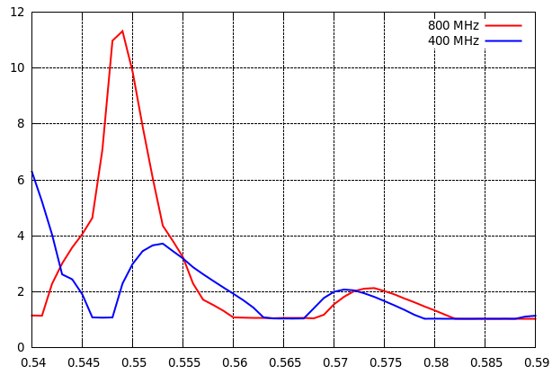
800 MHz vs. 400 MHz at H
RF frequency [MHz] | 400 | 800
RF voltage [GV] | 2.0 | 2.0
RF acceptance [%] | 2.3 | 1.66
Momentum accept. [%] | ±1.7
Synchrotron tune [ν_{z}] | 0.018 | 0.025
Bunch length (bs) [mm] | 5.3 | 3.7
Bunch population [10¹¹] | 1.8 | 1.25
Number of bunches [N_{b}] | 328 | 472
Piwinski angle | 5.8 | 4.1
ν_{x}* | 0.6 | 0.6
2ν_{x} - 4ν_{z} = 1
ε_{x} /ε_{x0}
2ν_{x} - 6ν_{z} = 1
ν_{x}
Piwinski angle at high energy is not very big, so we are close to ν_{x}*.
The resonances (coherent beam-beam instability) are mainly suppressed by this factor.
We can safely increase RF frequency and find a good working point.
D. Shatilov 143rd Optics design meeting, CERN, 26 Aug 2021 3

