Slide 1

The lpGBT: from concept to a radiation-tolerant high-speed communication ASIC for the HL-LHC upgrade
Adithya Pulli, CERN
Pedro Vicente Leitao, CERN
Stefan Biereigel, CERN
on behalf of the lpGBT team
EP-ESE Seminar, https://indico.cern.ch/event/1065136
28th June 2022

Slide 2
Outline
Introduction [Pedro]
UVM Verification [Adi]
Testing / Validation [Stefan]
Conclusions [Stefan]

Slide 3
The lpGBT Collaboration
The lpGBT wouldn’t have been possible without our collaborators!
CERN
Coordination
AGH UST
Poland
Marek
Idzik
5 engineers
CTU
Czech Republic
Miroslav Havranek
2 engineers
CERN
Switzerland
Paulo
Moreira
15 engineers
1 technician
KU Leuven
Belgium
Paul
Leroux
3 Engineers
UNL
Portugal
Nuno
Paulino
2 Engineers
SMU EE/PH
USA
Ping Gui /
Jingbo Ye
8 engineers
3

Slide 4
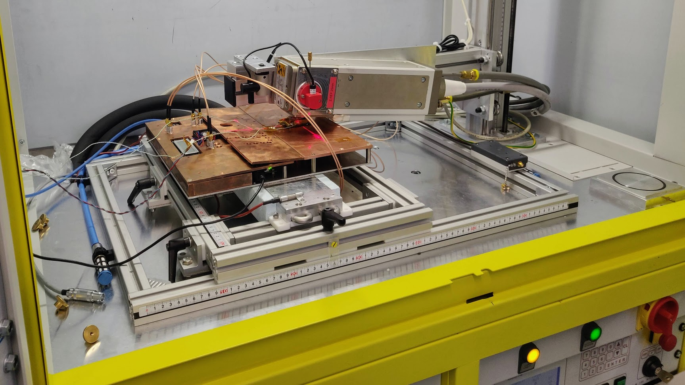

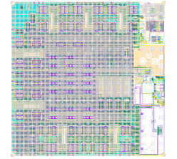
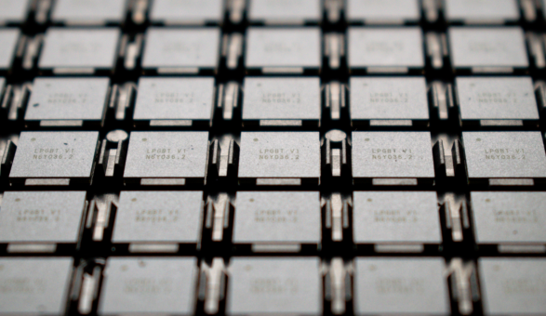
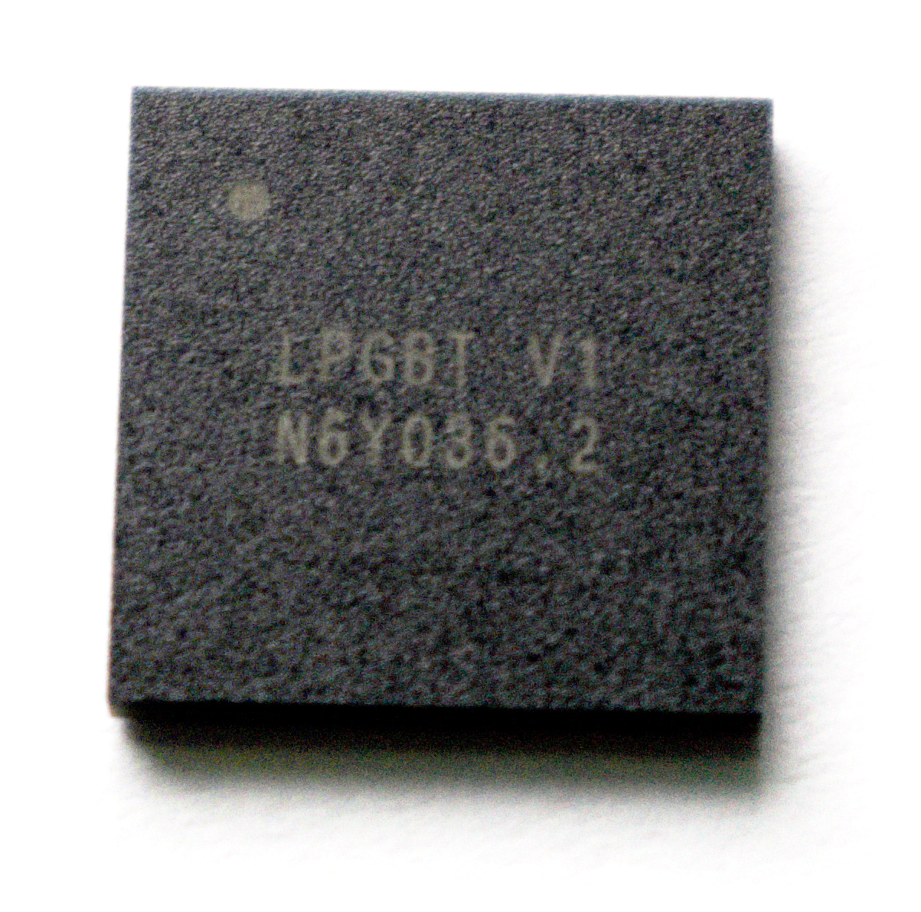
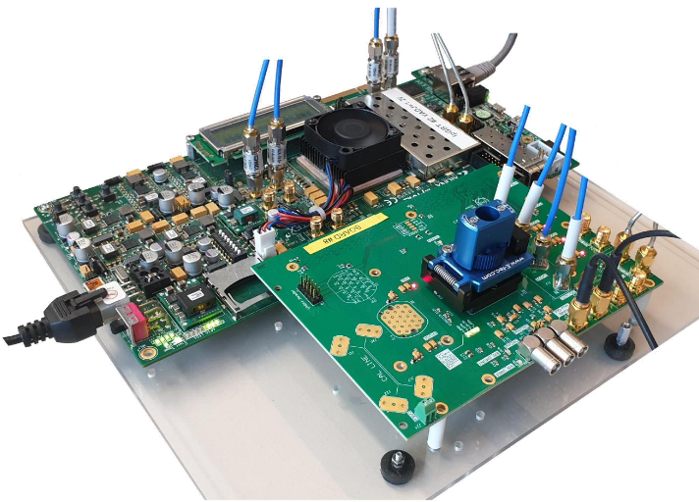
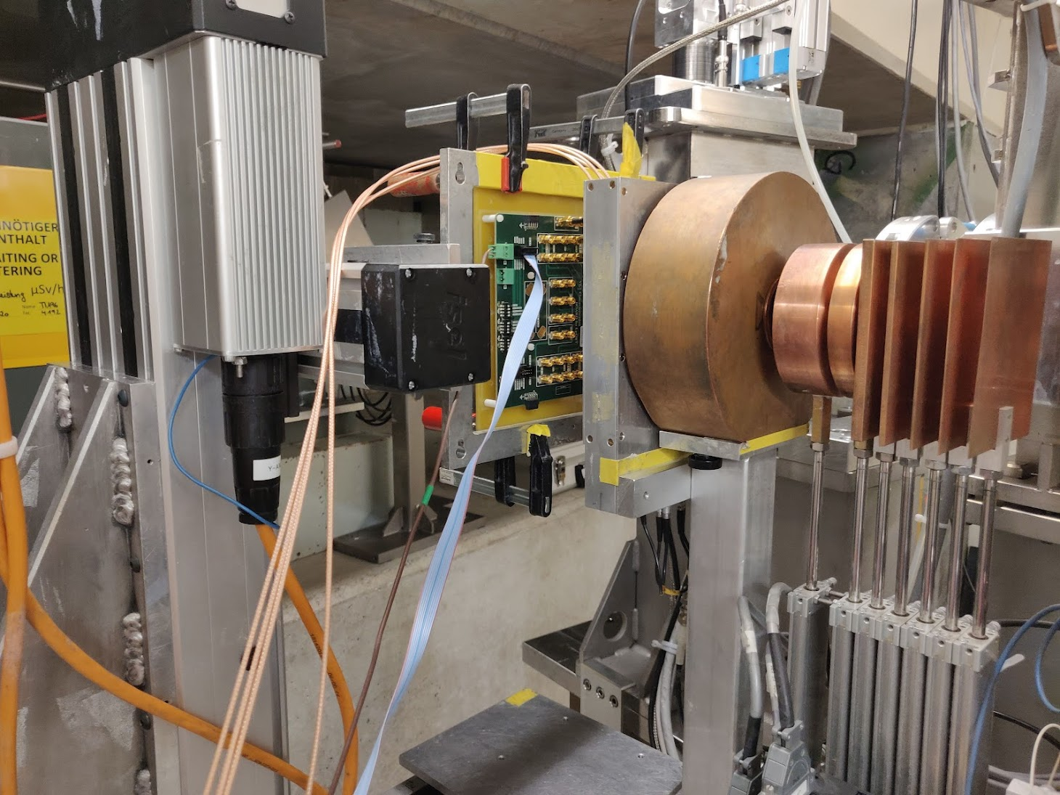
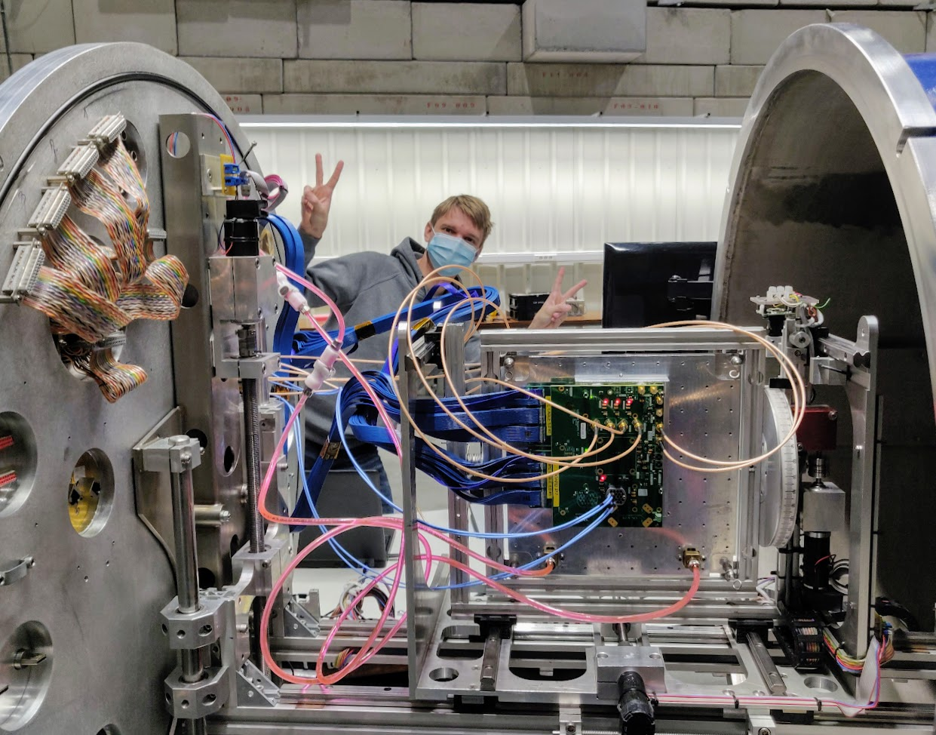
lpGBTv1 Timeline
In house testing
&
deliveries to the users
TID @ CERN
Neutron irradiation VLDB (VTRX+)
Target: 1014 n/cm-2
Start large scale testing
03/2021
lpGBT v1 submission
Start large scale
packaging
In house testing
2000 ASICs (reserved)
27/Sept/2021
TWEPP 2021
Public presentation
Industrial testing
8k ASICs
End of Production
2021
Mar
Apr
May
June
July
Aug
Sept
Oct
Nov
Dec
Jan
Feb
Mar
Apr
May
June
July
Aug
Sept
Oct
Nov
Dec
Jan
Feb
Mar
2022
02/2022
63 Wafer Ordered
3089 die/wafer
194k devices
2023
09/2021
Prototypes @ CERN
Dates of interest:
Specs frozen: 2015
lpGBT V0 submission: 07/2018
lpGBT V0 prototypes: 11/2018
lpGBT V0 extensive testing: Q4/18 - Q3/19
Proton irradiation @ PSI
Heavy Ion @ UCL
ESE seminar on the lpGBT
28 June 2022
Today!
Wafers on their way to CERN!
Functional validation
and
characterization started

Slide 5
lpGBT Link Architecture
High radiation doses
No or small radiation doses
LHC: up to 100 Mrad (10¹⁴ 1MeV n/cm²)
HL – LHC: up to 1 Grad (10¹⁶ 1MeV n/cm²)
Short distance optical links: 50 to 300 m
FPGA
Timing & Trigger
lpGBT
PD
Timing & Trigger
TIA
DAQ
DAQ
LD
LD
Slow Control
Slow Control
Custom ASICs
On-Detector
Radiation Hard Electronics
Off-Detector
Commercial Off-The-Shelf (COTS)
Electrical links to the frontend
modules. Lengths: cm to few m
Custom optoelectronics

Slide 6
What’s the lpGBT? [user point of view]
Data transceiver with fixed and “deterministic” latency for both up and down links
  Clocks and Data
Downlink
  2.56 Gbps
  FEC12
  eLinks
    Bandwidth: 80/160/320 Mbps
    Count: 16/8/4
Uplink
  5.12 Gbps or 10.24 Gbps
  FEC5 or FEC12
  eLinks
    Data rates: 160 /320 / 640 / 1280 Mbps
    Count:
      FEC5
        Up to 28 @ 160 Mbps
        Up to 7 @ 1.28 Gbps
      FEC12
        Up to 24 @ 160 Mbps
        Up to 6 @ 1.28 Gbps
ROC
Data rate: 160 Mbps to 1.28 Gbps
Length: cm to meters
Data rate:
Rx: 2.56 Gbps
Tx: 5.12 and 10.24 Gbps
Length: <200 m
ROC
lpGBT
ROC
Experiment control/monitoring functions
  10-bit ADC
  12-bit voltage DAC
  8-bit current DAC
  Temperature sensor
  Three I2C masters
  Programmable parallel port: 16 x GPIO
Package
  9 mm x 9 mm x 1.25 mm (pitch: 0.5 mm)
  Pin count: 289 (17 x 17)
Notes:
Update the footer
Add disclaimer for temperature sensor and mention that

Slide 7
LpGBT System Block Diagram (Simplified)
FE
Module
E – Port
Phase – Shifter
Clocks
lpGBT
eLink
2.56 Gbps
EOM
LpGBTIA
FE
Module
E – Port
DSCR
DEC
DeSER
LR
E – Port
E – Port
CLK Manager
CDR/PLL
Ref CLK
(optional)
data-down
data-up
5.12 Gbps
or
10.24 Gbps
clock
Phase – Aligners + Ser/Des for E – Ports
LpGBLD
160 Mbps
to
1.28 Gbps ports
SCR
ENC
SER
LD
FE
Module
E – Port
E – Port
PUSM
BOD/POR
E – Port
Control Logic
Configuration
(e-Fuses + reg-Bank)
One 80 Mbps port
GBT – SCA
ADC
PIO
I2C Slave
I2C Masters
E – Port
aIn[7:0]
IO[15:0]
I2C
Port
I2C
Ports
data
control
clocks
Notes:
lpGBT is communication hub on hybrid – mention to introduce PUSM, brownout, POR

Slide 8
Specifications summary [radiation]
The lpGBT is designed in 65 nm CMOS process
Targets [not only] the innermost layers of the HL-LHC detectors
  Total Ionizing Dose (TID)
    200 Mrad (two times safety factor)
  Non Ionizing Energy Loss (NIEL) radiation
    ~ 10¹⁵ 1 MeV n_{eq}/cm² (mainly a concern for the optoelectronics components)
  [Over a 10 years lifetime]
Operation robust to Total Ionizing Dose
  Designed with ELT (enclosed-layout-transistor) whenever possible
Operation robust to Single Events Upsets
  Triple Modular Redundancy (TMR) used in the State Machines and the “low-frequency” section of the Data Path
  Forward Error Correction used in the “high-frequency” section of the data path and over the optical links
  Use of an LC-VCO architecture for increased SEU-Tolerance and low jitter.
  Clock triplication at the output of the PLL
Notes:
Move last bullet about ELT to TID section
Align TID spec between Stefan and Pedro

Slide 9
lpGBT - Verification
Adithya Pulli, CERN
on behalf of the lpGBT team
EP-ESE Seminar
28 June 2022 – CERN

Slide 10
Verification - Introduction
What?
  ASIC verification is one of the crucial steps of ASIC design process which ensures that the design specification is preserved in the actual design implementation
  It can consume as much as 70-80% of the total ASIC design time
Why?
  Humans tend to make mistakes
  Cost of finding and fixing a mistake (AKA bug) increases significantly over project lifetime
How?
  Build a realistic world (AKA verification environment) around a design (AKA Design Under Test - DUT)
  Exercise the DUT in all possible ways* using the verification environment
  Check all the outcomes of the DUT are as expected

Slide 11
Verification - Introduction
*Catch
  It is impossible to exercise DUT in all possible ways in a reasonable amount of time
  Algorithmically, verification is a PSPACE-complete problem
What now?
  Rely on constrained random stimulus to maximize the design space exercised
  Use a methodology which supports efficient implementation of constrained random tests
  Use metrics to gain confidence in the verification effort
    Quis custodiet ipsos custodes? (Who will guard the guards themselves?)
    Coverage, regression testing, bug-rate etc.
Verification reduces the risk of finding a bug after fabrication. It cannot assure absence of any bugs

Slide 12
lpGBT Verification
lpGBT verification landscape
  Unit-level directed (and random) tests written in System Verilog and cocotb which mainly served as design sanity tests
  Top-level directed tests written in System Verilog which mainly exercised debug features
  Top-level highly random tests written in System Verilog following UVM methodology
lpGBT UVM environment
  The verification infrastructure built around lpGBT DUT to drive its inputs and observe its outputs
lpGBT UVM tests
  11 tests were defined for lpGBT. 8 tests are very simple tests which mainly focus on checking the sanity of the environment
  lpgbt_reg_rw_test exhaustively verifies register instantiation and connectivity from all configuration ports of lpGBT
  lpgbt_fuse_burning_test exercises and verifies fuse burning process
  lpgbt_rand_test randomly exercises most of the features of lpGBT

Slide 13
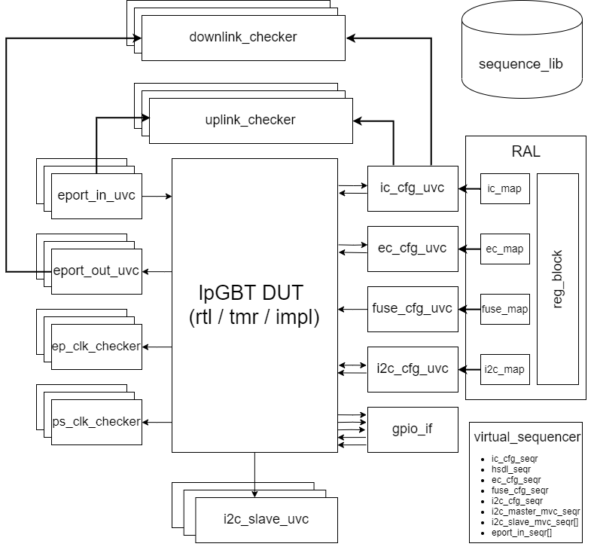
lpGBT UVM Environment
Key design considerations
  Modularity
  Ease of randomization
Supports RTL, triplicated RTL (tmr) and netlist (impl) versions of DUT
Partially synthesizable drivers which are reused in post-si test setup
SEE aware checkers
Register Access Layer (RAL) with support for accesses through different interfaces

Slide 14
lpGBT Rand Test
Program PLL and datapath
Trigger lpGBT to boot and get to a ready state
Reports an error if the chip doesn’t get to ready state in expected duration
Continuous uplink/downlink data
I2C masters
Programmable IO
Random register accesses with error injection
Induce correctible FEC errors
Simulate a catastrophic event by injecting a sequence of operations which trigger frame-aligner/lock-filter/PLL/DLL/channel to unlock
Sequence blocks until chip recovers and reaches ready state
Data integrity checkers are disabled during this phase
Random variables:
Number of operations and their order
Config access mechanisms
Configuration values
clock phase and jitter
boot up
regular actions
regular actions
catastrophic events
regular actions
Mode: simplex_rx, simplex_tx, transceiver
Boot config: fuses, ROM, none
TX datarate: 5.12Gbps, 10.24Gbps
TX FEC modes: FEC5, FEC12
E-groups configuration: datarates, channels enabled etc
CRC error injection in fuses
config_mechanism: fuses, ROM, IC, EC, I2C
Number of operations and their order
Thresholds for filters and timeout actions
Enable/disable of watchdog actions
Operations include:
  Lock-filter unlock
  Frame-aligner unlock
  PLL timeout
  PLL watchdog
  DLL watchdog
  DLL timeout
  Channel timeout
  Brownout
  State machine force override through configuration
Data integrity checks
Clock frequency and phase checks
Reset out check
I2C master transaction check
Dedicated checks for each operation
  Data checks for I2CM
  IO values for PIO tests
  Expected register values after random reg access with error injection
Check status registers values of critical state machines
Action counter values
Status of state machines
Action counter values
Legend
Description
Random variables
Checks

Slide 15
lpGBT Rand Test
boot up
regular actions
regular actions
catastrophic events
regular actions
boot up
regular actions
regular actions
catastrophic events
regular actions
boot up
catastrophic events
regular actions
regular actions
regular actions
 | Full injection | Partial injection | No injection
Fault injection scope | All nodes | Only triplicated modules | No faults injected
Checkers | Relaxed (allow up to 8 consecutive bits of data corruption in downlink and up to 3 consecutive frames corruption in uplink) | Strict (doesn’t tolerate any corruption of uplink and downlink data) | Strict (doesn’t tolerate any corruption of uplink and downlink data)
Fault injection frequency | F_{clk}/2 | F_{clk}/2 | -

Slide 16
lpGBT Signoff
Tools and techniques
  Massive parallel regression testing using Oracle Grid Engine (OGE) batch system
  Gitlab for content and project management using issues and merge requests
  tmake based build system
  vManager for regression management and metrics tracking
Metrics
  Regression pass-rate (98.24%)
    10k simulations on the final netlist
  Code coverage (94.35%)
  Functional coverage (100%)
  Fault coverage (100%)
    >2k SEU/node, 200 SET/node

Slide 17
lpGBT verification timeline
Oct-2020
Catastrophic events test phase
added to lpgbt_rand_test
Dec-2020
SEE tolerance built into checkers
early August 2020:
Setting up verification flow
(vmanager, fault simulations)
~21-Aug-2020
First version of
lpgbt_rand_test
Mostly SEE vulnerabilities
01-Jun-2020:
Start of verification
framework development
June/July-2020:
Verification environment bring-up
Configuration sequences
First functional tests
Jan-2020 to Mar-2020:
Fault campaigns and netlist simulations

Slide 18
lpGBT Verification – Key takeaways
Verification can only show presence of bugs, but cannot prove their absence
Start early! Verification is a resource intensive activity
Before embarking on verification, define a verification strategy which considers
  Functional verification
  SEE verification
  Netlist verification
Use constrained random verification approaches. Randomize as much as possible
Benefit from already existing verification IPs and verification productivity tools. Don’t reinvent the wheel

Slide 19
lpGBT - Validation and Testing
Stefan Biereigel, CERN
on behalf of the lpGBT team
EP-ESE Seminar
28 June 2022 – CERN

Slide 20
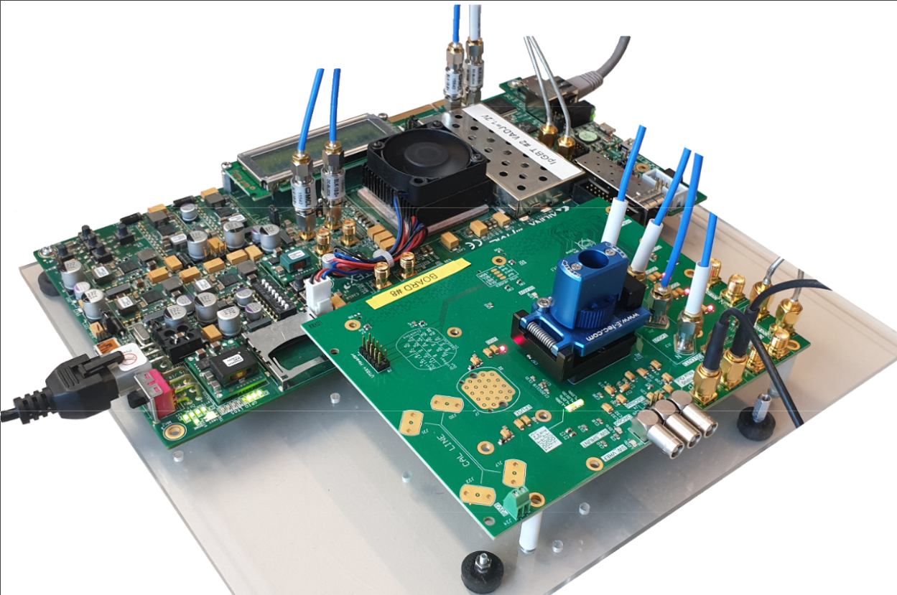
lpGBT - Testing Ecosystem
Complex, rad-hard mixed-signal ASICs require extensive silicon validation efforts
The „lpGBT tester“: dedicated, FPGA-based test system [1], enabling:
  Lab characterization (functional tests & electrical characteristics)
  Environmental testing (temperature)
  Heavy Ion / Laser SEE testing
  X-ray total ionizing dose testing
  Automated volume production testing
Based on high performance Xilinx Virtex 7 FPGA Reference Board (Xilinx VC707)
Supplemented by further testing hardware (VLDB+ Demo Board, lpGBT characterization PCB)
[1] J. Mendes et al: "lpGBT Tester: an FPGA based test system for
the lpGBT ASIC", TWEPP2019

Slide 21
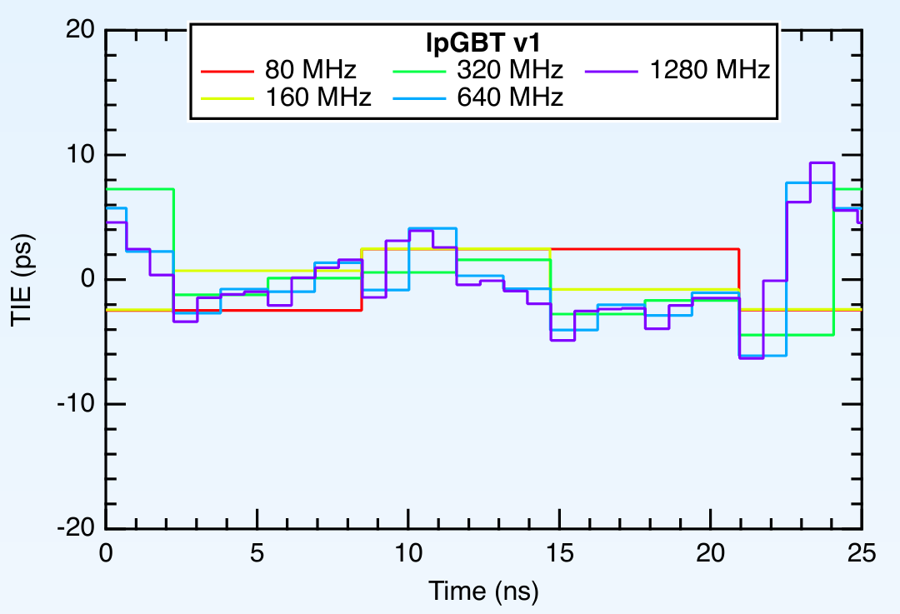
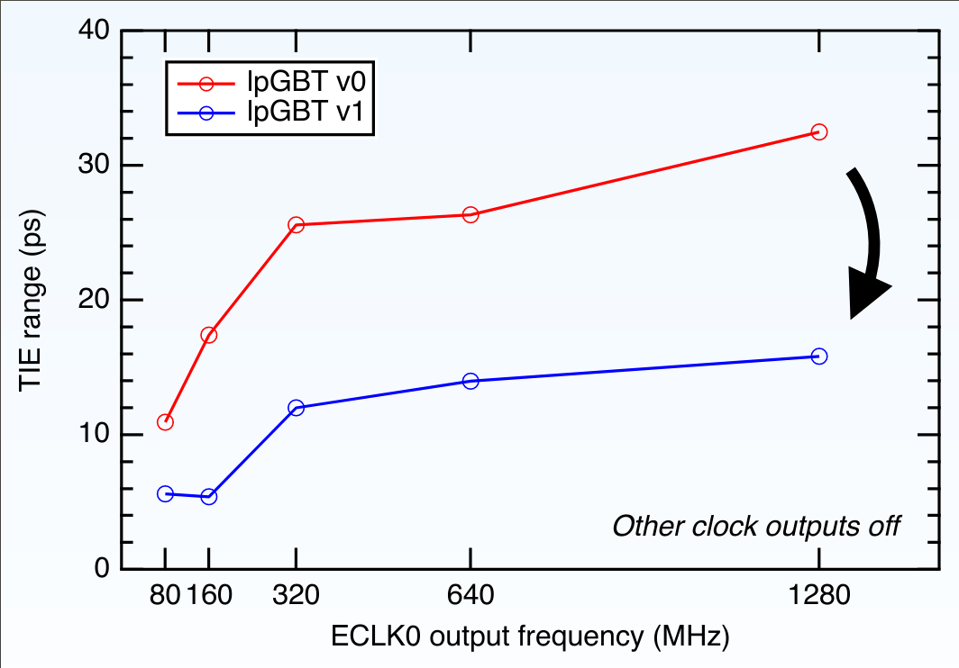
lpGBT – Functional & Performance Characterization
Extensive validation performed on lpGBTv0, functionality & performance OK for most features
Remaining functional & performance issues identified successfully addressed in lpGBTv1
  I²C Master yield issue fixed
  Clock & data latency determinism now at ps-level
  Phase shifter performance improved
    Two channels had degraded performance: fixed
    Improved low-voltage + TID performance
  Deterministic jitter significantly reduced
    Improvement about 2x
Remaining issue: Reliability of eFuses
  eFuses are foundry IP blocks
  Fuse burning process unreliable in lpGBTv0 + v1
  Fuses also degrade with TID (discussed later)
  General advisory: Do not use eFuses, baseline other configuration mechanisms (ROM, I²C, IC, EC)
  Mitigations
    Chip ID will be stored redundantly for mass production chips
    Per-chip calibration data will be delivered through online database
Deterministic Jitter Performance of lpGBTv0 and lpGBTv1 (Credit J. Troska)

Slide 22
Single-Event Effects Testing

Slide 23
Single-Event Effects Testing – General Information
High complexity makes SEE testing challenging
  Limited test time available
    Exercise & monitor all modes/subsystems
  Capture a-priori unknown chip failure behavior
Testing of lpGBTv0 revealed several issues
  Systematic design issue in configuration memory
    Corruption of ASIC configuration
  Critical part of clock distribution not TMR-protected
    Bursts of errors on high speed link
  SEE sensitivity of LC-VCO inductor
    Transients of clock phase in PLL mode
Known issues were addressed in lpGBTv1 design
Qualification HI campaign in 2021 @ CRC HIF (Louvain-la-Neuve, Belgium)

Slide 24
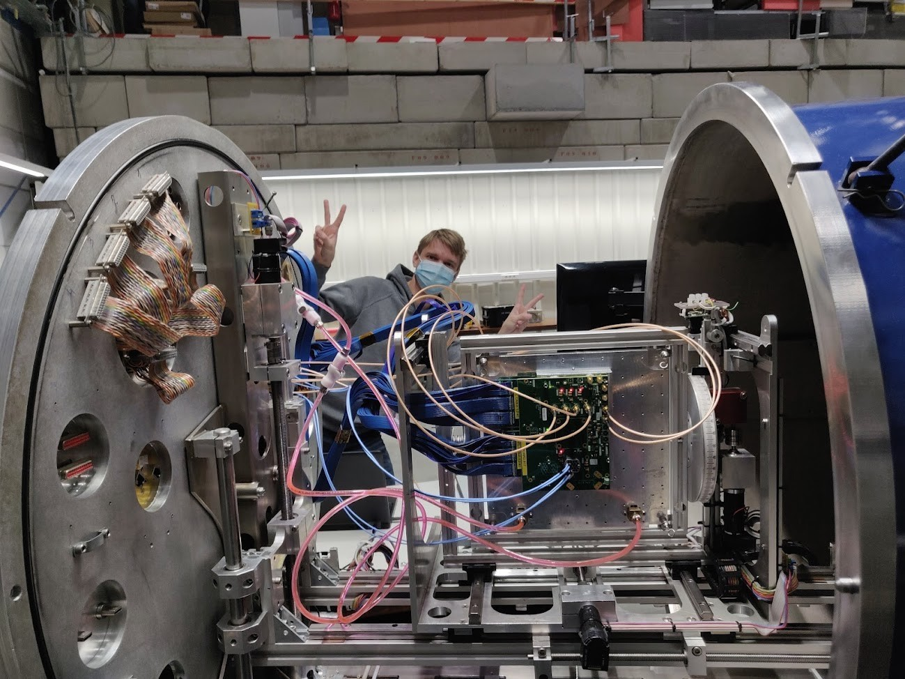
Single-Event Effects Testing – General Information
Scope of lpGBTv1 SEE qualification
  Key modes of operation
  (Simplex RX, TRX modes)
  Key high speed link modes
  (5 Gbps, 10 Gbps, FEC5, FEC12)
  Different ePort/eLink configurations (data rate & group combinations)
  Clock phase stability (eClock + Phase Shifters)
  Slow-Control, power-up state machine
  (Configuration Memory, I²C Slave, I²C Master, IC, EC, config ROM, ...)
Analog peripherals out of scope
  Glitches & single conversion errors in ADCs & DACs to be expected, presence or magnitude not studied
Similar expectations for all digital I/Os (Data, Clock, GPIOs, …)
  Part of their signal path is necessarily unprotected
lpGBTv1 installed in HIF Louvain, BE

Slide 25
Single-Event Effects Testing – General Information
Dedicated Slow Control Testing
Exercised with single ion at UCL HIF CRC: LET = 32.4 MeV cm²/mg
Power-up + configuration sequence w/ beam over 1 hour: no issues
Exercised I²C Masters over 1 hour: no issues
Saturation HI cross section for both subsystems < 2x10⁻⁸ cm²
Power consumption
Monitored throughout all tests
No latch-up sensitivity found
Data path testing
Some data errors expected, since part of data path is not fully redundant
  Some correctable: HS link protected by FEC
  Some uncorrectable: eLink and associated logic cannot be fully protected
Goal: Enable conservative estimates of in-experiment error rates
  Using LET between 1.3 and 32.4 MeV cm²/mg - constrain threshold LET and saturation cross section
  1 hour per ion, 11 minutes per mode (TRX 5G FEC5, TRX 5G FEC12, TRX 10G FEC5, TRX 10G FEC12, TX 10G FEC12)

Slide 26
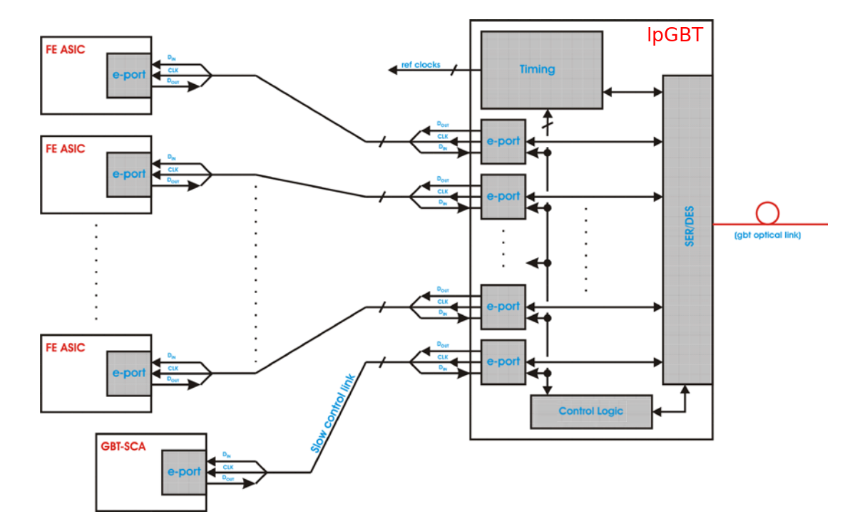
Single-Event Effects Testing – Data Path
Data Path Reliability
Key observation: Improved clock generator now fully robust against unlocks
  In GBTX, BER is dominated by PLL unlocks producing long bursts of errors
Link errors now dominated by single- and multi-bit errors
  Originating in different parts of the data path
lpGBT data path architecture

Slide 27
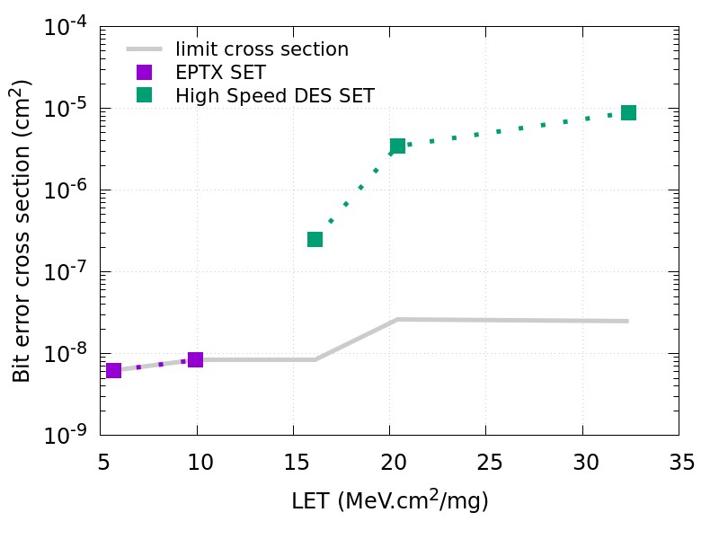
Single-Event Effects Testing – Data Path
Downlink Data Path
Only small amount of downlink bit errors observed during 16 hours of testing
Three main SEE signatures
  FEC-correctable link errors: no impact
  SET in eLink output driver: Single bit errors affecting one eLink
  SET in deserializer: Frame corruption, simultaneous single errors in multiple groups
Conservative estimate for high-fluence regions (e.g. CMS tracker): BER < 4x10⁻¹⁴ @ 1.28 Gbps
Heavy ion cross section for data errors on high-speed downlink

Slide 28
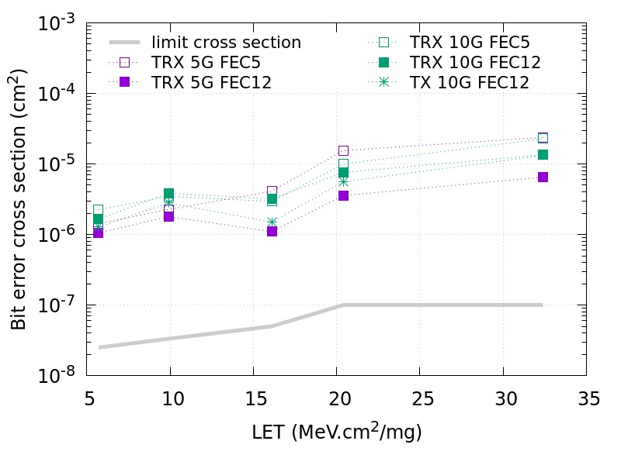
Single-Event Effects Testing – Data Path
Uplink Data Path
BER cross section depending on link data rate and FEC mode
Similar SEE signatures
  FEC-correctable link errors: no impact
  Single-bit errors: affecting non-TMR'd parts of ePortRxGroup, scale with data rate
  Frame errors: corrupt data of multiple links/groups in a single frame
Conservative estimate for high-fluence regions (e.g. CMS tracker): BER < 1x10⁻¹⁴ @ 8.92 Gbps
Heavy ion cross section for data errors on high-speed uplink

Slide 29
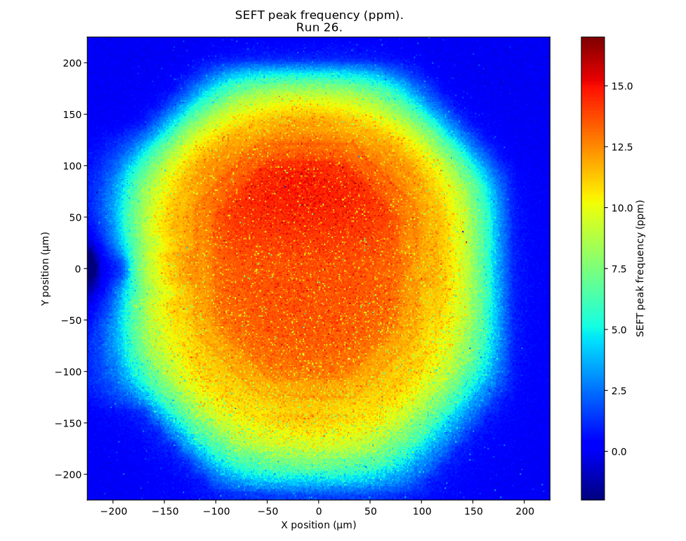
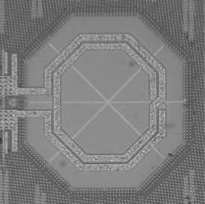
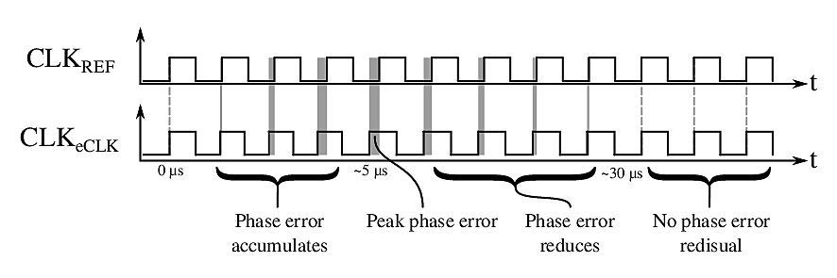
Single-Event Effects Testing – Inductor SEE Sensitivity
Inductor SEE Sensitivity (1/2)
New type of radiation sensitivity, discovered during tests of lpGBTv0
  Not reported in literature before
Affects inductor used in 5.12 GHz VCO of lpGBT clock generator
  Long-lived frequency shift (up to 100 ppm, depending on LET) of oscillator
  Stimulates temporary phase shift of lpGBT clock generator in PLL mode
  Large sensitive area (approaching 10⁻³ cm²)
Mechanism not yet fully understood (various studies underway), so only system-level mitigations available
Inductor
Micrograph
Heavy Ion
Sensitivity Map
Qualitative visualization of transient phase errors

Slide 30
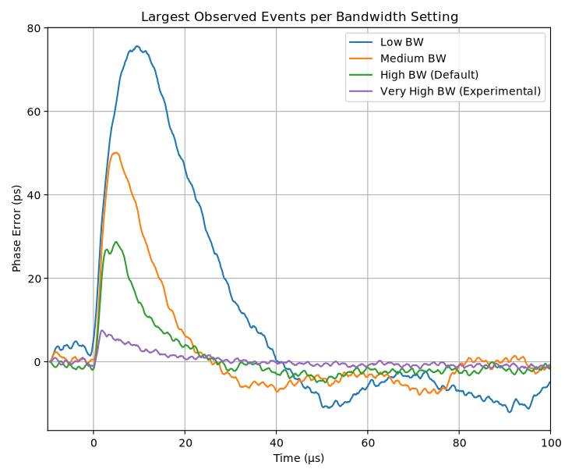
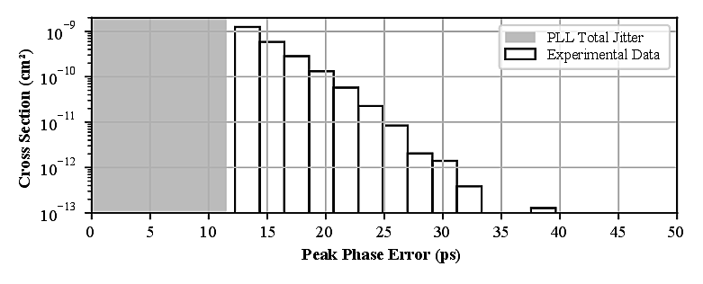
Single-Event Effects Testing – Inductor SEE Sensitivity
Inductor SEE Sensitivity (2/2)
Impact assessment performed
  Dedicated 200 MeV proton test @ PSI
  No danger to data transmission in any mode of operation
  Concern only for timing derived from lpGBT clocks when in simplex TX mode
  Effect suppressed in RX/TRX mode by higher CDR bandwidth
Mitigation strategy
  New default clock generator settings, minimize magnitude of effect
  Recommendation: prefer clocks from transceiver-mode-lpGBTs for precision timing
200 MeV p+ cross section characterized for recommended settings
Results & recommendations published in Application Note [2]
[2] lpGBT team: "Application Note: Single-Event Effect Clock Phase Transients in Simplex Transmitter Mode", 2021

Slide 31
Total Ionizing Dose Testing

Slide 32
lpGBT X-ray TID Testing - Introduction
TID design spec for lpGBT: 100 Mrad (200 Mrad with safety factor)
Common development makes qualification difficult
  Large variability of use cases: expected lifetime dose, operational chip temperature
  TID degradation highly dependent on dose rate, die temperature, bias conditions
  Annealing behavior another important aspect
Chosen approach
  Small user survey carried out to identify application environments
  Irradiation of 7 samples performed in different conditions (temperature, ultimate dose)
  Dose rate: approx. 3 Mrad/h to limit the test time
Caveat for data presented here
  Due to high dose rate used, optimistic by 2x - 4x compared to in-experiment dose rates
  Extrapolating the data to different temperatures is not straight forward

Slide 33
lpGBT X-ray TID Testing - Introduction
Extensive X-ray campaign
  Total test time: 4 weeks
  Chips 1-6 irradiated deeply into failure in different conditions, to study TID margins of various blocks
  Chip 7 irradiated up to 50 Mrad at room temperature, to study annealing behavior after low doses
Main goals
  Identify key failure mode and dose
  Characterize degradation behavior of analog peripherals
 | Mode | Die Temp (°C) | TID (Mrad) | Annealing with bias
CHIP1 | 10G FEC5 | 30 | 340 | -
CHIP2 | 10G FEC5 | 30 | 400 | 1 week
CHIP3 | 5G FEC12 | 30 | 350 | -
CHIP4 | 5G FEC12 | 30 | 400 | 1 week
CHIP5 | 10G FEC5 | -5 | 560 | -
CHIP6 | 10G FEC5 | 0 | 620 | -
CHIP7 | 10G FEC5 | 30 | 50 | 3+ weeks
TID test samples & test conditions

Slide 34
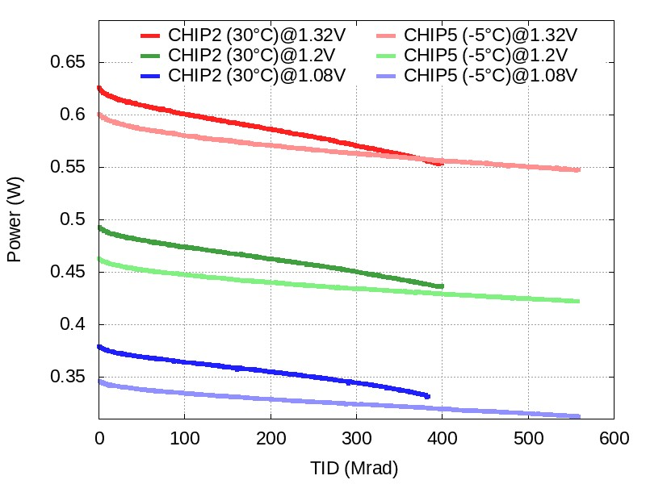
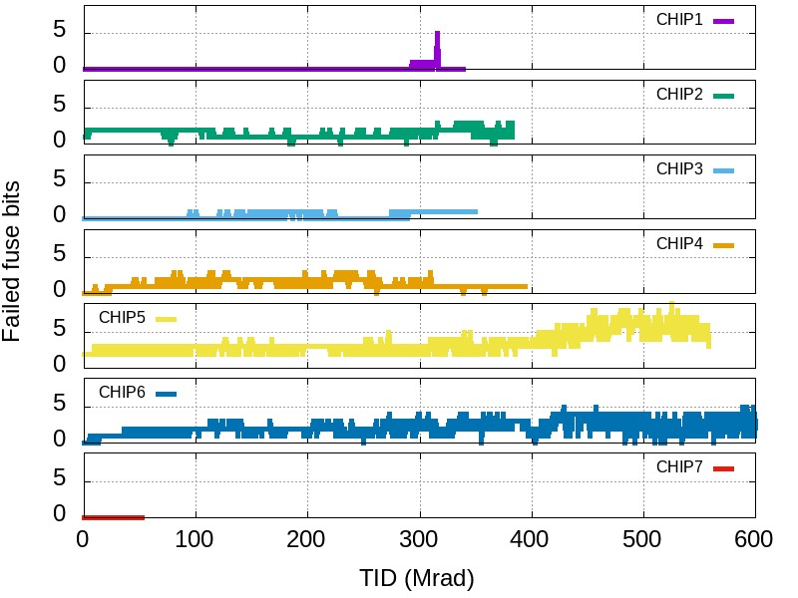
lpGBT X-ray TID Testing – General Information
Configuration (Config Memory, EC, IC, I²C, ROM, CRC, PUSM)
No problems found during testing
Power Consumption
Degrades gracefully, reducing during irradiation
Changes in P_{tot} smaller than variation over supply voltage range
eFuses
Tend to lose information with TID
High variability from chip to chip
Once again: Strong advisory against using the eFuses!

Slide 35
lpGBT X-ray TID Testing – Data Path
TID failure mode in all tested chips: Data transmission
Uplink datapath is critical component
  High speed serializer
    Initially introduces correctable errors, gradually reducing link margin
    At some point, too many errors are produced → user data corruption
  Uplink eLinks (ePortRxGroup)
    Fail to sample/forward data through uplink data path → user data corruption
First failures always observed at low supply voltage
  100 Mrad difference between failures at 1.08 V and 1.20 V
  No failures observed at 1.32 V
  ASIC specification: 10% supply voltage variation → failures reported at 1.08 V
Downlink data path did not experience any failures during testing
 | Temp | UL Errors (Correctable) | Data Errors @ 160 Mbps | Data Errors @ 320 Mbps | Data Errors @ 640 Mbps
CHIP3 | 30 °C | 270 Mrad | 335 Mrad | 310 Mrad | 310 Mrad
CHIP4 | 30 °C | 285 Mrad | 355 Mrad | 320 Mrad | 320 Mrad
Uplink data path failure (5 Gbps, VDD = 1.08 V)
 | Temp | UL Errors (Correctable) | Data Errors @ 320 Mbps | Data Errors @ 640 Mbps | Data Errors @ 1280 Mbps
CHIP1 | 30 °C | 140 Mrad | 210 Mrad | 220 Mrad | 210 Mrad
CHIP2 | 30 °C | 200 Mrad | 285 Mrad | 285 Mrad | 190 Mrad
CHIP5 | -5 °C | 385 Mrad | 455 Mrad | 470 Mrad | 320 Mrad
CHIP6 | 0 °C | 415 Mrad | 520 Mrad | 500 Mrad | 325 Mrad
Uplink data path failure (10 Gbps, VDD = 1.08 V)

Slide 36
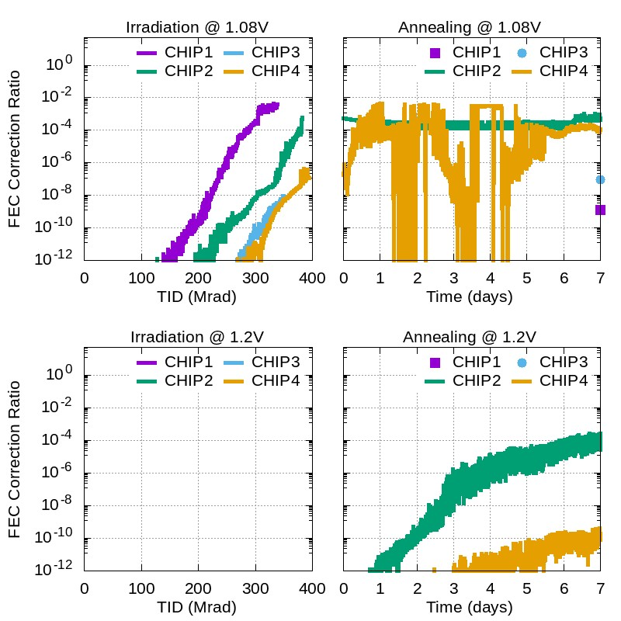
lpGBT X-ray TID Testing – Data Path
Room temperature annealing after large TID
  Chip 1/3 without bias
  Chip 2/4 with bias
Degradation observed when annealing with bias
  Data path failures occur during annealing even at 1.2 V
  Not seen for samples without bias
Operational recommendation: Do not power lpGBTs when detectors are warmed up
For low-dose sample, no failures observed during long-term annealing with bias
Uplink data path failures during annealing

Slide 37
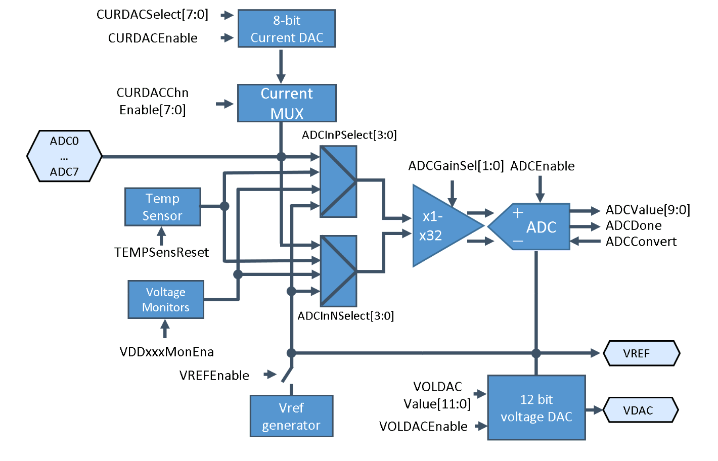
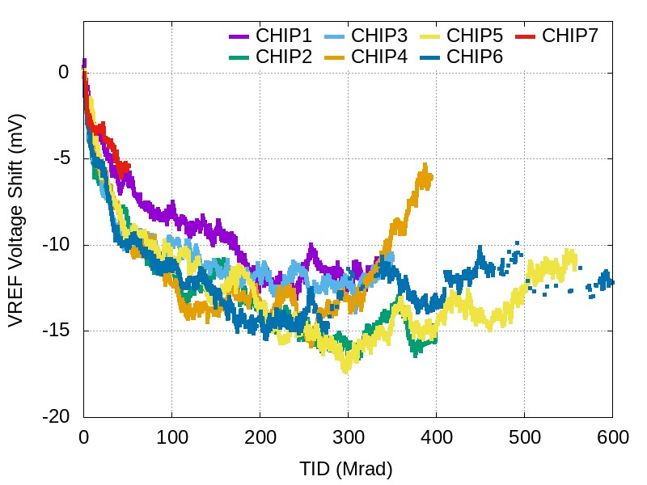
lpGBT X-ray TID Testing – Analog Peripherals
Bandgap Reference Generator
Reference for all analog peripherals (V_{Ref} = 1 V)
Drift over TID larger than calibration accuracy
(ΔV_{Ref} ~ -15 mV)
Results obtained with X-ray irradiation, i.e. no DD effects
Degradation observed during neutron testing:
ΔV_{Ref} ~ -4 mV at 2.8 x 10¹⁴ n/cm^2

Slide 38
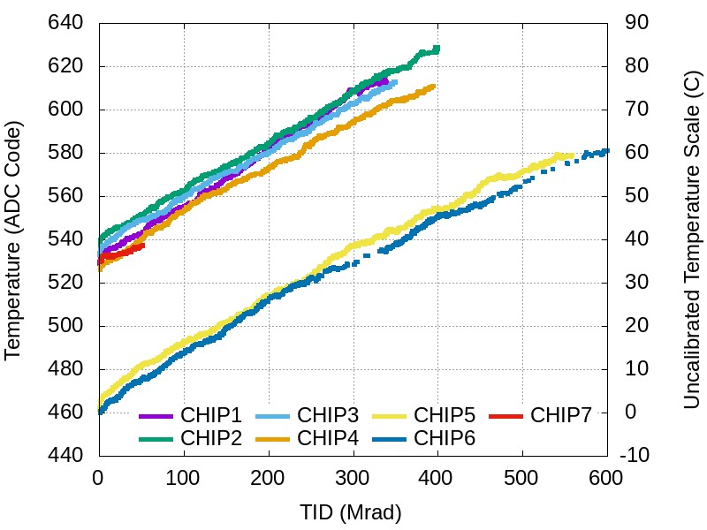
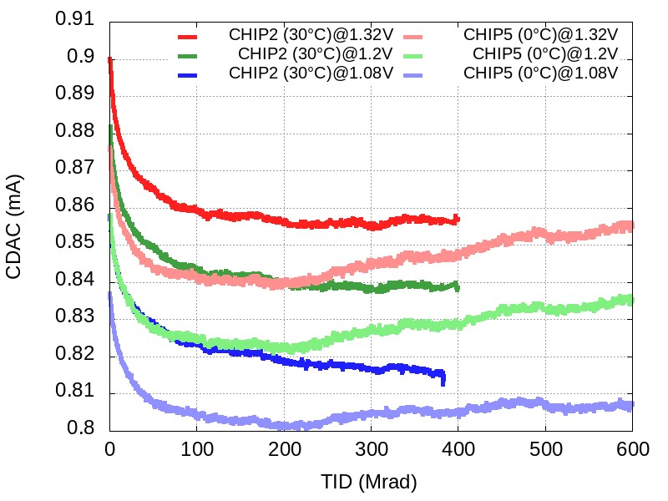
lpGBT X-ray TID Testing – Analog Peripherals
On-Chip Temperature Sensor
Sensor is based on bandgap-like circuit structure
Output voltage is affected by TID
Leads to uncertainty of up to 30 K across 200 Mrad TID spec
Not useful for absolute measurements, but valuable for detecting transient changes
Current DAC
Foreseen for PT1000-based temperature measurements
Output current sensitive to VDD and TID
Combined uncertainty of 20-30 K across 200 Mrad TID+VDD spec
Similar performance as on-chip T-sensor

Slide 39
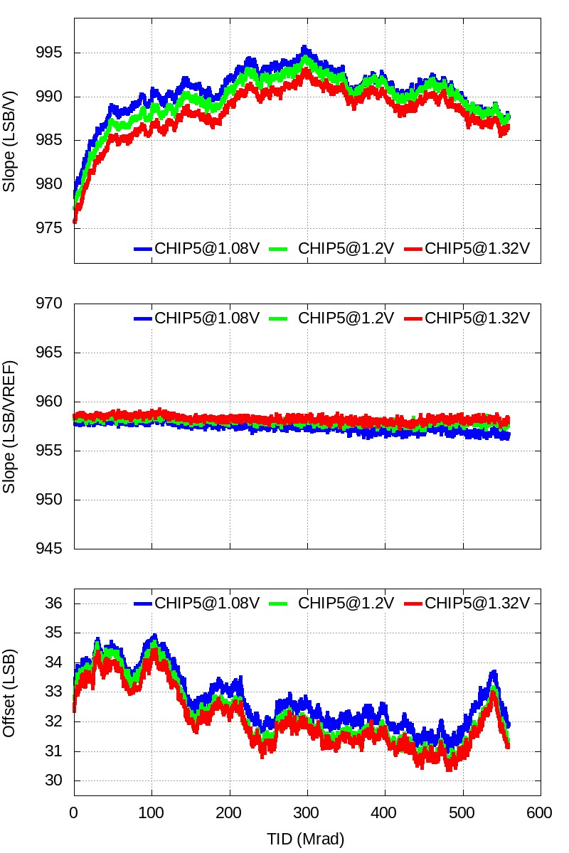
lpGBT X-ray TID Testing – Analog Peripherals
ADC/DAC
Continuously characterized during X-ray irradiation
Both very well-behaved
When accounting for V_{Ref} drift
  Offset/slope changes limited to a few LSBs
Performance limited by reference voltage drift

Slide 40
Conclusions
Silicon validation of lpGBTv1 successful
All critical issues identified in lpGBTv0 successfully mitigated
  Includes performance, SEE, TID issues
SEE qualification campaign
  Big leap in reliability compared to previous generation of high speed links
  Extensive SEE verification one of the keys to success
  Novel radiation sensitivity of inductor characterized and mitigated to possible extent
Very reassuring TID response
  High confidence of meeting demands of experimental environments
  Provided operational recommendations to experiments to maximize device lifetime
Volume testing commencing this year
  Awaiting arrival of production wafers at CERN
  Next steps: packaging and testing at the contractor

Slide 41
Finding Information
Official schedule
  https://ep-ese.web.cern.ch/content/lpgbt-vl-dcdc-schedule
lpGBT user manual
  https://lpgbt.web.cern.ch/lpgbt
LpGBT-FPGA core
  https://gitlab.cern.ch/gbt-fpga/lpgbt-fpga
Contact and support
  lpgbt-support@cern.ch
  https://lpgbt-support.web.cern.ch

Slide 42
Backup

Slide 43
lpGBT team and contributors
lpGBT Design team
CERN, Geneva: Sophie Baron, Stefan Biereigel, Jose Fonseca, Rui Francisco, Iraklis Kremastiotis, Thanushan Kugathasan, Szymon Kulis, Pedro Leitao, Paulo Moreira, David Porret, Adithya Pulli, Ken Wyllie
AGH-UST, Cracow: Jakub Moroń, Krzysztof Swientek, Marek Idzik, Miroslaw Firlej, Tomasz Fiutowski
KU, Leuven: Bram Faes, Jeffrey Prinzie, Paul Leroux
FCT/UNL, Lisbon: João Carvalho, Nuno Paulino
SMU Physics, Dallas: Datao Gong, Di Guo, Dongxu Yang, Jingbo Ye, Quan Sun, Wei Zhou
SMU Electrical Engineering, Dallas: Ping Gui, Tao Zhang
lpGBT Test team
CERN, Geneva: Sophie Baron, Stefan Biereigel, Eduardo Brandao De Souza Mendes, Jose Fonseca, Nour Guettouche, Daniel Hernandez, Szymon Kulis, Pedro Leitao, Julian Mendez, Paulo Moreira, David Porret
Macrocell contributors
Czech Technical University, Prague: Miroslav Havranek, Tomas Benka
CERN, Geneva: Alessandro Caratelli, Iraklis Kremastiotis, Stefano Michelis

Slide 44
Configuration
FE
Module
E – Port
Phase - Shifter
LpGBT
eLink
2.56 Gbps
EOM
LpGBTIA
FE
Module
E – Port
DSCR
DEC
DeSER
LR
E – Port
E – Port
CLK Manager
CDR/PLL
Ref CLK
(optional)
data-down
data-up
5.12 Gbps
or
10.24 Gbps
Phase – Aligners + Ser/Des for E – Ports
LpGBLD
clock
160 Mbps
to
1.28 Gbps ports
SCR
ENC
SER
LD
FE
Module
E – Port
E – Port
E – Port
Control Logic
Configuration
(e-Fuses + reg-Bank)
One 80 Mbps port
GBT – SCA
ADC
PIO
I2C Slave
I2C Masters
E – Port
aIn[7:0]
IO[15:0]
I2C
Port
I2C
Ports
data
control
clocks

Slide 45
Programming the lpGBT (1/2)
The lpGBT is a highly flexible device:
  Transceiver modes / Locking modes / Uplink data rate / FEC coding / Clock frequencies / Clock phases / Number of active eLinks / Phase-aligner modes / Pre-emphasis / Equalization / Driving strengths / … / …
It won't simply work by just having it installed in your system…!
It needs to be configured!
There are:
  11 configuration pins to be “hardwired”;
  320 registers to be programed (240 R/W/F + 80 R/W + 142 R (status));
Configuration pins define the “basic” operation mode;
Configuration registers “customize” for the user application:
  Some of them also affect the basic operation (e.g. PLLs, DLLs, startup procedure, etc.);

Slide 46
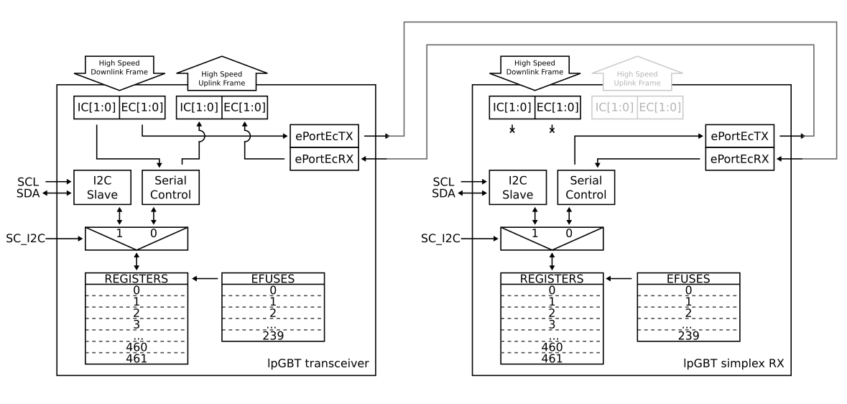
Programming the lpGBT (2/2)
Several options are available to read / write the configuration registers:
  I2C port, always possible;
  IC channel, only possible in Transceiver mode;
  EC port, only possible in simplex TX or RX modes;
  Access mode needs to be configured [pin “SC_I2C”].
Optionally, the user’s configuration can be “burned into” the ASIC on a bank of “eFuses” and copied at startup into the configuration registers
  Requires additional 2.5 V supply voltage during the programming cycle.

Slide 47
Electrically Interfacing with the Frontends
FE
Module
E – Port
Phase - Shifter
LpGBT
eLink
2.56 Gbps
EOM
LpGBTIA
FE
Module
E – Port
DSCR
DEC
DeSER
LR
E – Port
E – Port
CLK Manager
CDR/PLL
Ref CLK
(optional)
data-down
data-up
5.12 Gbps
or
10.24 Gbps
Phase – Aligners + Ser/Des for E – Ports
LpGBLD
clock
160 Mbps
to
1.28 Gbps ports
SCR
ENC
SER
LD
FE
Module
E – Port
E – Port
E – Port
Control Logic
Configuration
(e-Fuses + reg-Bank)
One 80 Mbps port
GBT – SCA
ADC
PIO
I2C Slave
I2C Masters
E – Port
aIn[7:0]
IO[15:0]
I2C
Port
I2C
Ports
data
control
clocks

Slide 48
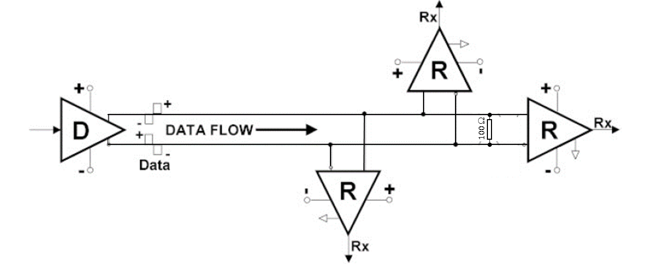
eLinks Electrical “Standard”
CLPS “CERN Low Power Signalling”
  [This should] avoid any confusion with LVDS or SLVS;
Link type:
  Point – to – point
  Multi – drop transmitter
Max data rate:
  1.28 Gbps (NRZ)
Max clock frequency:
  1.28 GHz
Programmable signalling level:
  100 mV to 400 mV (single-ended PP amplitude)
  200 mV to 800 mV (differential PP amplitude)
Common mode voltage:
  600 mV (nominal)
Load impedance:
  100 Ω
V_{out}+
V_{out}-
V_{cm}:
Single-ended PP amplitude:
  max(V_{out}+) – min(V_{out}+)
Differential PP amplitude:
  max(V_{out}+ - V_{out}-) – min(V_{out}+ - V_{out}-)
100 Ω transmission line,
twisted pair, etc.
Termination load close to the last
receiver in the transmission line
Common mode in the middle of the
supply (Vdd/2) for best tolerance to
ground fluctuations between modules;

Slide 49
eLink Line Receiver (eRx)
Off chip capacitors if AC coupling needed!
Macro cell, available for front-end designers (upon request)
C_{c}
in+
C_{c}
V_{CM}
Rail-to-Rail
Receiver
Remember: AC coupling introduces a zero at f = 1/(2π × Cc × 100 Ω) reducing the number of consecutive zero and ones that can be sent over the line reliably (DC base wander).
An external termination can be used to improve this but will certainly complicate your layout.
100 Ω
in-
invertData
enableTermination
enableRx
eq[1:0]
setCommonMode
Specs
  Data rate:
    Up to 1.28 Gbps
  Common mode voltage range:
    70 mV – 1.13V
  Differential input voltage:
    140 mV – 450 mV
Programmable
  ON/OFF receiver (for power saving)
  Data polarity (to simplify routing)
  ON/OFF termination (100 Ω)
  ON/OFF common mode setting (for AC coupling, V_{dd}/2)
  Programmable equalization:
    Optimized for cables with bandwidths of “infinite” (equalization off), 448, 299 and 224 MHz

Slide 50
Using the eRx(s)
Equalization:
Should only be used if needed (low bandwidth transmission line)
Only effective for the high bit rates
Equalization has (only) three coarse settings
User must choose the most appropriate!
This requires a verification / scanning procedure from the user:
  Ideally the front-end designer implements a PRBS7 that the lpGBT can automatically verify;
  The user verifies the transmitted data at the counting room;
  A detailed scan procedure will also be proposed by the lpGBT team…
eRx Check list:
Turn ON the receivers corresponding to the eLinks in use.
  Obviously the others should be OFF
Choose the polarity (non-invert / invert)
Turn on the termination:
  Most likely the case (unless the chip in a multiple drop configuration – unlikely, or AC coupling to be optimized)
Enable the internal bias, if using AC coupling
Choose the appropriate equalization setting

Slide 51
eLink Data Sampling and “Deserialization”
FE
Module
E – Port
Phase - Shifter
LpGBT
eLink
2.56 Gbps
EOM
LpGBTIA
FE
Module
E – Port
DSCR
DEC
DeSER
LR
E – Port
E – Port
CLK Manager
CDR/PLL
Ref CLK
(optional)
data-down
data-up
5.12 Gbps
or
10.24 Gbps
Phase – Aligners + Ser/Des for E – Ports
LpGBLD
clock
160 Mbps
to
1.28 Gbps ports
SCR
ENC
SER
LD
FE
Module
E – Port
E – Port
E – Port
Control Logic
Configuration
(e-Fuses + reg-Bank)
One 80 Mbps port
GBT – SCA
ADC
PIO
I2C Slave
I2C Masters
E – Port
aIn[7:0]
IO[15:0]
I2C
Port
I2C
Ports
data
control
clocks

Slide 52
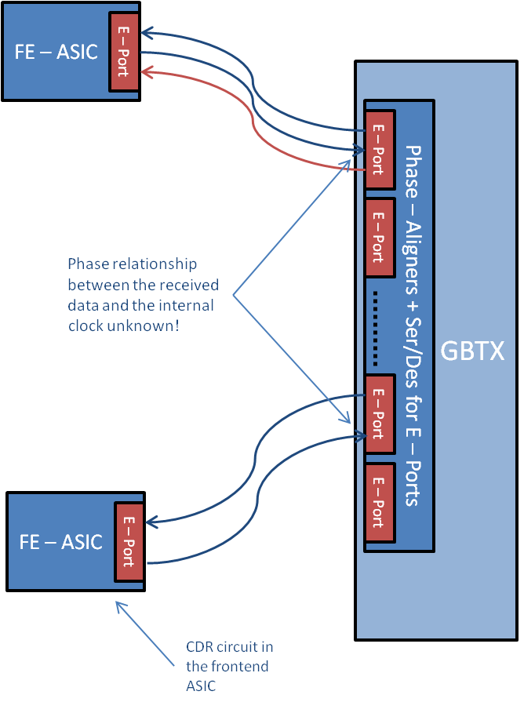
Up eLink – Phase Alignment
Good sampling instants
eLink “i”
Clock (explicitly) provided to the
front-end by an eLink clock.
Phase relationship
between the received
data and the internal
clock unknown!
LpGBT internal clock
Bad sampling instants
LpGBT
eLink “j”
Clock embedded in the data,
CDR needed at the front-end
The phase of the incoming data signals is “unknown” in relation to the internal sampling clock!
There are up to 28 eLinks inputs (potentially) all with random phase offsets
The solution:
  “Measure” the phase offset of each eLink input
  Delay individually each incoming bit stream to phase align it with the internal sampling clock

Slide 53
Phase-Aligner Block Diagram
Q D
CK
(x4)
Resampled Data
MUX
Phase Selection Logic
trackMode [2:0]
enableChannel
trainChannel
Input Data
(unknown phase)
Delay Line (replica)
resetChannel
phaseSelectChannel [3:0]
(x1)
PD
CP
LPF
dataRate[2:0]
dllConfig [3:0]
bitRateClock
Delay Line (reference)
dllReset
Reference DLL

Slide 54
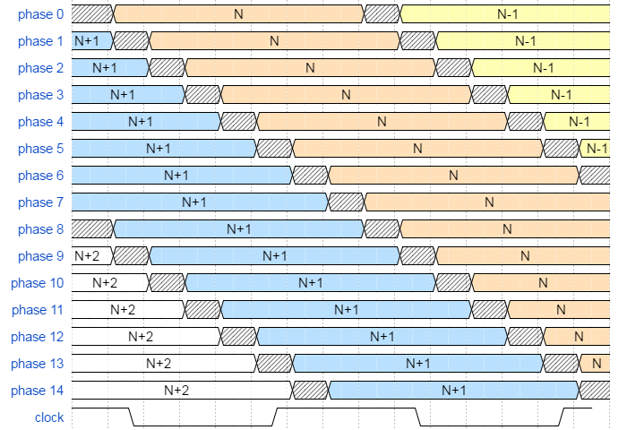
Phase - Selection
Automatic, semi-automatic or or user driven procedures:
“Examine” all the eLink phases
Detect where the data “edges” are in relation to the clock;
Choose the phase that has the edges better centred around the clock
In automatic mode:
  Once aligned, the PA can track the data phase wanders that cover virtually a full clock cycle:
  To allow for this, the delay line covers more than one bit period: 1.75 × T_{bit}
  And, during initialization only phases 4 to 11 are allowed
T/8
-3/8 T
+3/8 T

Slide 55
Using the Phase-Aligner(s)
There are 8 phase-aligners in the lpGBT:
  7 serve 28 data eLinks;
  1 serves the EC eLink.
A phase-aligner serves 4 eLink channels:
  Called an eLink Group.
The four channels in a Group share a calibration DLL;
User must setup:
  The calibration DLL
  The individual phase-aligner channels corresponding to the eLinks in use.
Phase Aligner Check list:
Set the group data rate;
  This sets the maximum number of eLinks per group (see next slides);
Configure the DLL parameters;
Reset the DLL;
Set the phase alignment mode:
  Static phase selection:
    User intervention needed.
  Initial training with learned static phase selection:
    User intervention needed
  Automatic phase tracking;
Enable and reset the channels in use;

Slide 56
eLink Rx Groups
eLinks are “clustered” in groups of 4:
  Simply called groups.
The number of available groups is determined by the FEC uplink code in use;
The number of available eLinks within a group is determined by the Group data rate;
The possible data rates depend on the uplink bandwidth (5.12 or 10.24 Gbps)
The data rate of each group can be set independently:
  A couple of [over complicated] examples:
    uplink 5.12 Gbps & FEC12: 8 eLinks x 160 Mbps + 4 eLinks x 320 Mbps + 2 eLinks x 640 Mbps
    uplink 10.24 Gbps & FEC5: 8 eLinks x 320 Mbps + 4 eLinks x 640 Mbps + 3 eLinks x 1.28 Gbps
Input eLinks (uplink)
uplink bandwidth [Gbps] | 5.12 |  |  |  |  |  | 10.24
FEC coding | FEC5 |  |  | FEC12 |  |  | FEC5 |  |  | FEC12
Bandwidth [Mbps] | 160 | 320 | 640 | 160 | 320 | 640 | 320 | 640 | 1280 | 320 | 640 | 1280
Maximum number | 28 | 14 | 7 | 24 | 12 | 6 | 28 | 14 | 7 | 24 | 12 | 6

Slide 57
Note about eLink Input Pin Names
Input to the lpGBT
eLink
Group number: 0, 1,… 6 (there are 7 groups)
EDINGCP
Pin Polarity: P – Positive, N – Negative
(Remember: polarity can be inverted
at the output of the corresponding eRx)
Data
Channel number within a group: 0, 1, 2 or 3 (there
are 4 eLinks associated with every group)
Example: EDIN32N – eLink data input group 3 channel 2 negative polarity pin

Slide 58
The EC “Group”
The EC “group” is a special case!
It is composed of a single eLink!
It only works at 80 Mbps!
EC channel eLink Functionality is only available in Transceiver mode;
In transceiver mode it is always available independently of the other Groups activity;
Its mission is to implement an “experiment control” link, however it can be used as a general purpose link;
[As seen before, this input can be used to control the ASIC in the simplex modes (TX / RX) but not in transceiver mode]
Pins:
  EDINECP (eLink Data In EC channel Positive pin)
  EDINECN (eLink Data In EC channel Negative pin)

Slide 59
eLink Deserialization
eLink inputs receive serial data from the frontend devices;
These data is de-serialized and inserted in the uplink frame to be transmitted to the counting room (more on this soon):
  The frame is processed in parallel in the chip before it is itself serialized for uplink transmission.
In the case of transmission at 5.12 Gbps an eLink Group is always associated with the same 16-bits in the frame, the group bits.
The same is true for 10.24 Gbps but in this case the group bits are 32 (the uplink frame is twice as long)
The user knows from the position of the bits in the frame from which eLink group the data belongs to!
Moreover, depending on the data rate, a specific eLink is identified by the position of the corresponding bits within the “group bits” (or simply, the position within the frame).
After the eLinks input data is de-serialized, scrambling, FEC coding, interleaving header insertion and high-speed serialization takes place in the uplink data path…

Slide 60
Uplink Data Path
FE
Module
E – Port
Phase - Shifter
LpGBT
eLink
2.56 Gbps
EOM
LpGBTIA
FE
Module
E – Port
DSCR
DEC
DeSER
LR
E – Port
E – Port
CLK Manager
CDR/PLL
Ref CLK
(optional)
data-down
data-up
5.12 Gbps
or
10.24 Gbps
Phase – Aligners + Ser/Des for E – Ports
LpGBLD
clock
160 Mbps
to
1.28 Gbps ports
SCR
ENC
SER
LD
FE
Module
E – Port
E – Port
E – Port
Control Logic
Configuration
(e-Fuses + reg-Bank)
One 80 Mbps port
GBT – SCA
ADC
PIO
I2C Slave
I2C Masters
E – Port
aIn[7:0]
IO[15:0]
I2C
Port
I2C
Ports
data
control
clocks

Slide 61
High – Speed Uplink Frame
The LpGBT supports the following uplink data rates:
  5.12 / 10.24 Gbps
Data is transmitted as a frame composed of:
  Header
  The data field
  A forward error correction field:
  FEC5 / FEC12
The data field is scrambled to allow for CDR operation at no [additional] bandwidth penalty
Efficiency = # data bits/# frame bits
Data
(User data payload)
H
Message
FEC
Header
(Delimits the frame boundaries)
Forward Error Correction
(Allows to correct transmission errors)
 | uplink
 | 5.12 Gbps |  | 10.24 Gbps
 | FEC5 | FEC12 | FEC5 | FEC12
Frame [bits] | 128 |  | 256
Header [bits] | 2 |  | 2
Data [bits] | 116 | 102 | 232 | 204
FEC [bits] | 10 | 24 | 20 | 48
Correction [bits] | 5 | 12 | 10 | 24
Efficiency | 91% | 80% | 91% | 80%

Slide 62
Example: 5.12 Gbps FEC5 Uplink Frame
128 bits
2 bits
2 bits
2 bits
112 bits
10 bits
G6
G5
G4
G3
G2
G1
G0
H[1:0) = 2’b10
IC[1:0]
EC[1:0]
D[111:96]
D[95:80]
D[79:64]
D[63:48]
D[47:32]
D[31:16]
D[15:0]
FEC[9:0]
7 groups of 4 input e-Ports
Number of data ports:
28 eLinks @ 160 Mbps
14 eLinks @ 320 Mbps
7 eLinks @ 640 Mbps
Frame | Function | I/O Group
FRMUP[9:0] | FEC[9:0]
FRMUP[25:10] | Data[15:0] | 0
FRMUP[41:26] | Data[31:16] | 1
FRMUP[57:42] | Data[47:32] | 2
FRMUP[73:58] | Data[63:48] | 3
FRMUP[89:74] | Data[79:64] | 4
FRMUP[105:90] | Data[95:80] | 5
FRMUP[121:106] | Data[111:96] | 6
FRMUP[123:122] | EC[1:0] | EC
FRMUP[125:124] | IC[1:0]
FRMUP[127:126] | H[1:0] = 2'b10 | HFH[1:0] = 2'b10
Note: This is how you will see the uplink frame after it has been processed by the lpGBT-FPGA receiver but not how it is actually transmitted by the lpGBT …

Slide 63
Uplink data path
data[N:0]
Scrambler
Interleaving
Serializer
FEC
Coding
serialData
header
The order of operations is important
128-to-1 @ 5.12 Gbps
Or
512-to-1 @ 10.24 Gbps
We avoid the details here since you will not have to worry with them, they will be “handled” by lpGBT-FPGA

Slide 64
High-Speed Line Driver
FE
Module
E – Port
Phase - Shifter
LpGBT
eLink
2.56 Gbps
EOM
LpGBTIA
FE
Module
E – Port
DSCR
DEC
DeSER
LR
E – Port
E – Port
CLK Manager
CDR/PLL
Ref CLK
(optional)
data-down
data-up
5.12 Gbps
or
10.24 Gbps
Phase – Aligners + Ser/Des for E – Ports
LpGBLD
clock
160 Mbps
to
1.28 Gbps ports
SCR
ENC
SER
LD
FE
Module
E – Port
E – Port
E – Port
Control Logic
Configuration
(e-Fuses + reg-Bank)
One 80 Mbps port
GBT – SCA
ADC
PIO
I2C Slave
I2C Masters
E – Port
aIn[7:0]
IO[15:0]
I2C
Port
I2C
Ports
data
control
clocks

Slide 65
Line – Driver Topology
Accommodate the
large capacitive load
On-chip 100 Ω matching
I_{max} = 12 mA
Buffer Stage
I_{max} = 8 mA
RC delay to generate
the pre-emphasis pulse
Pre-emphasis
current driver

Slide 66

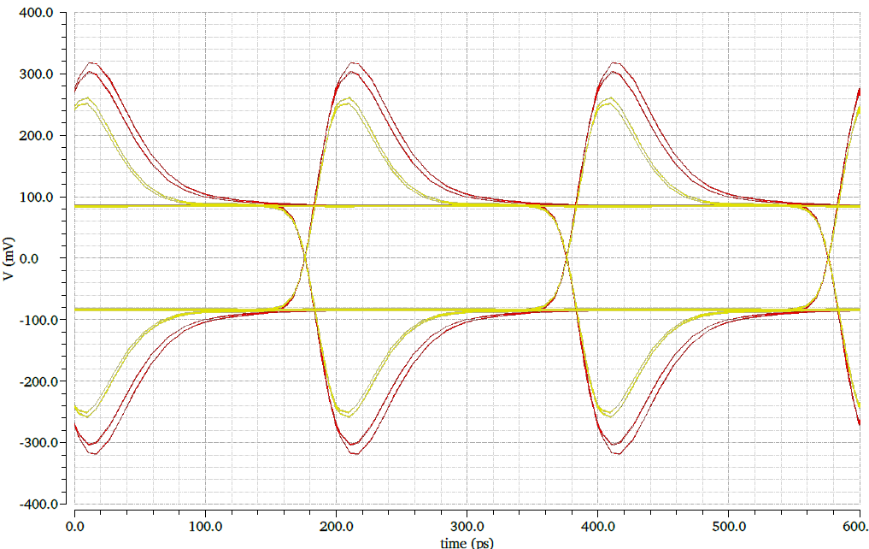
Line driver simulations (@5.12Gbps)
I_{cc} = 40 mA
I_{mod} = 12 mA
I_{pre} = 8 mA
C_{out} = 500 fF
Process: SS_100C_1.2V
“long” delay
$$I_{m}\left(t\right)$$
I_{m}
“short” delay
$$I_{pre}\left(t\right)={−α∙I}_{m}\left(t−∆t\right)$$
I_{pre}
= +
Advantage:
Pre-emphasis is made by subtracting the “bit stream” to itself after inversion and scaling!
No narrow pulses required (as needed for the eTx scheme)
Disadvantage:
The pre-emphasis is done by reducing the amplitude rather than peaking the signal during the pre-emphasis phase.
The driver consumes in permanence I_{m} + I_{pre}.
I_{out}

Slide 67
Using the Line Driver
The user must:
Enable the line driver for Transceiver and Simplex Transmitter modes:
Enable the pre-emphasis if needed;
Set the amplitude of the:
  Modulation current;
  Pre-emphasis current.
Set the pre-emphasis pulse duration;
It is possible to invert HS output polarity to simplify the PCB design:
  The inversion is done @40M (before the Serializer) at the frame level.

Slide 68
High-Speed Line Receiver / Equalizer
FE
Module
E – Port
Phase - Shifter
LpGBT
eLink
2.56 Gbps
EOM
LpGBTIA
FE
Module
E – Port
DSCR
DEC
DeSER
LR
E – Port
E – Port
CLK Manager
CDR/PLL
Ref CLK
(optional)
data-down
data-up
5.12 Gbps
or
10.24 Gbps
Phase – Aligners + Ser/Des for E – Ports
LpGBLD
clock
160 Mbps
to
1.28 Gbps ports
SCR
ENC
SER
LD
FE
Module
E – Port
E – Port
E – Port
Control Logic
Configuration
(e-Fuses + reg-Bank)
One 80 Mbps port
GBT – SCA
ADC
PIO
I2C Slave
I2C Masters
E – Port
aIn[7:0]
IO[15:0]
I2C
Port
I2C
Ports
data
control
clocks

Slide 69
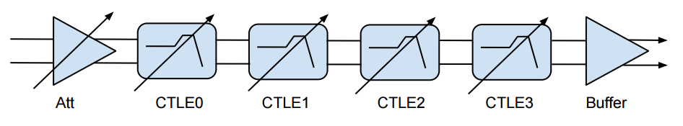
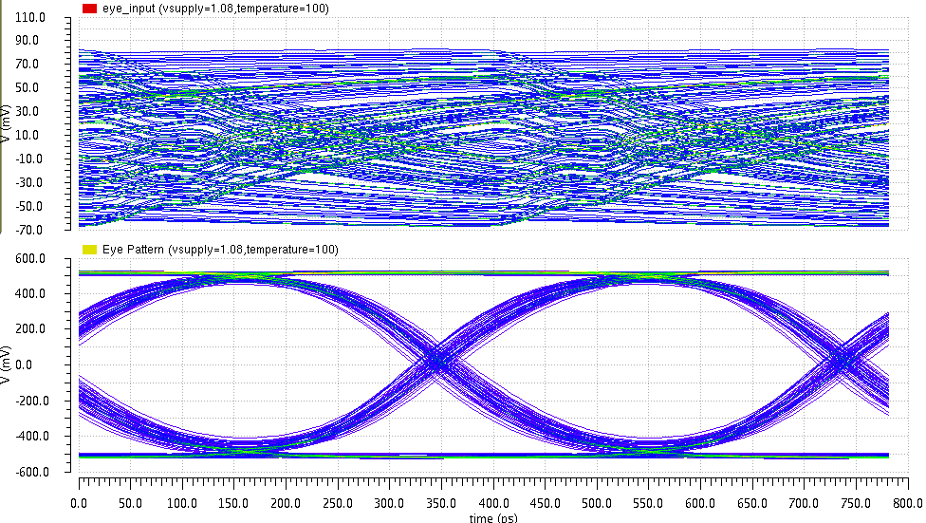
The Equalizer in the LpGBT
Passive attenuator: allows
to handle signals as high as 1 V
Attenuation: 0, -3.5 and -9.5 dB
Four equalizing stages allow
to flexibly control the shape
of the transfer function.
75 cm of Low Bandwidth Coaxial Cable
To be used in case of “low bandwidth” downlink
  “Bypassed” by default.
If needed, user programs the positions of the zeros of the four CTLE stages (and the 1st stage attenuation)
It is an iterative process in a “case-by-case” basis

Slide 70
Eye Opening Monitor
FE
Module
E – Port
Phase - Shifter
LpGBT
eLink
2.56 Gbps
EOM
LpGBTIA
FE
Module
E – Port
DSCR
DEC
DeSER
LR
E – Port
E – Port
CLK Manager
CDR/PLL
Ref CLK
(optional)
data-down
data-up
5.12 Gbps
or
10.24 Gbps
Phase – Aligners + Ser/Des for E – Ports
LpGBLD
clock
160 Mbps
to
1.28 Gbps ports
SCR
ENC
SER
LD
FE
Module
E – Port
E – Port
E – Port
Control Logic
Configuration
(e-Fuses + reg-Bank)
One 80 Mbps port
GBT – SCA
ADC
PIO
I2C Slave
I2C Masters
E – Port
aIn[7:0]
IO[15:0]
I2C
Port
I2C
Ports
data
control
clocks

Slide 71
Eye Opening Monitor
Y-axis:
  31 points, step = ~20 mV (covers from V_{DD}/2 up to V_{DD})
X-axis:
  64 points, step = ~6.1 ps in typical
Operation:
  Controlled through the I2C interface
  Eye reconstruction at the "backend”
data+
DFF
CML
data-
comp
compQ
CMOS
toCounter
V_{of}+
V_{of}-
clk2G56pi
polarity
DAC
V_{of}+
vSel[3:0]
V_{of}-
Phase
Interpolator
clk5G12
selPhase[5:0]
Notes:
The DAC is designed with a resistive network plus passgates

Slide 72
PLL / CDR and Clock Manager
FE
Module
E – Port
Phase - Shifter
LpGBT
eLink
2.56 Gbps
EOM
LpGBTIA
FE
Module
E – Port
DSCR
DEC
DeSER
LR
E – Port
E – Port
CLK Manager
CDR/PLL
Ref CLK
(optional)
data-down
data-up
5.12 Gbps
or
10.24 Gbps
Phase – Aligners + Ser/Des for E – Ports
LpGBLD
clock
160 Mbps
to
1.28 Gbps ports
SCR
ENC
SER
LD
FE
Module
E – Port
E – Port
E – Port
Control Logic
Configuration
(e-Fuses + reg-Bank)
One 80 Mbps port
GBT – SCA
ADC
PIO
I2C Slave
I2C Masters
E – Port
aIn[7:0]
IO[15:0]
I2C
Port
I2C
Ports
data
control
clocks

Slide 73
Clock Syntheses
This circuit generates all the clocks needed by the ASIC:
  40 MHz, 80 MHz, …, 5.12 GHz
  The 10.24 Gbps Serializer uses a DDR scheme
Simplex TX:
  A 40 MHz external reference is needed
Simplex RX and Transceiver:
  The downlink serial stream is used as a clock reference
CDR Locking modes:
  External reference aided
  Reference-Less Locking
5.12 GHz
320 MHz
40 MHz
PLL / CDR
+
Clock Manager
160 MHz
80 MHz
40 MHz
2.56 Gbps

Slide 74
Down Link Data Path
FE
Module
E – Port
Phase - Shifter
LpGBT
eLink
2.56 Gbps
EOM
LpGBTIA
FE
Module
E – Port
DSCR
DEC
DeSER
LR
E – Port
E – Port
CLK Manager
CDR/PLL
Ref CLK
(optional)
data-down
data-up
5.12 Gbps
or
10.24 Gbps
Phase – Aligners + Ser/Des for E – Ports
LpGBLD
clock
160 Mbps
to
1.28 Gbps ports
SCR
ENC
SER
LD
FE
Module
E – Port
E – Port
E – Port
Control Logic
Configuration
(e-Fuses + reg-Bank)
One 80 Mbps port
GBT – SCA
ADC
PIO
I2C Slave
I2C Masters
E – Port
aIn[7:0]
IO[15:0]
I2C
Port
I2C
Ports
data
control
clocks

Slide 75
Downlink Data Path
2.56 Gbps CDR circuit
data[N:0]
DeScrambler
FEC
DeCoding
(error detection
/correction)
DeInterleaving
CDR &
DeSerializer
serialData
header
The order of operations is important
[Once again] We avoid the details here since you will not have to worry with them, they will be “handled” by lpGBT-FPGA

Slide 76
eLink Groups and Serialization
FE
Module
E – Port
Phase - Shifter
LpGBT
eLink
2.56 Gbps
EOM
LpGBTIA
FE
Module
E – Port
DSCR
DEC
DeSER
LR
E – Port
E – Port
CLK Manager
CDR/PLL
Ref CLK
(optional)
data-down
data-up
5.12 Gbps
or
10.24 Gbps
Phase – Aligners + Ser/Des for E – Ports
LpGBLD
clock
160 Mbps
to
1.28 Gbps ports
SCR
ENC
SER
LD
FE
Module
E – Port
E – Port
E – Port
Control Logic
Configuration
(e-Fuses + reg-Bank)
One 80 Mbps port
GBT – SCA
ADC
PIO
I2C Slave
I2C Masters
E – Port
aIn[7:0]
IO[15:0]
I2C
Port
I2C
Ports
data
control
clocks

Slide 77
eLink Tx Groups & Serialization
Tx eLinks are “clustered” in groups of 4 (similar to RX eLinks):
The data rate of each group can be set independently:
80 / 160 or 320 Mbps
The number of available eLinks within a group is determined by the Group data rate;
[Similar to the uplink] Tx eLinks are associated with specific bits within the downlink frame (geographical addressing):
  The user knows, from the position of the bits (and the selected data rate) in the frame, to which eLink the data will be serialized to.
EC outputs (pins: EOUTECP / EOUTECP) are fixed data rate (80 Mbps) that can be used for Experiment Control in Transceiver mode or participate in the control of the ASIC itself in Simplex TX or RX modes
Output eLinks (down-link)
Bandwidth [Mb/s] | 80 | 160 | 320
Maximum number | 16 | 8 | 4

Slide 78
eLink Tx “Mirror” function
To help implementing broadcast of data to the frontends, a “mirror” function is implemented for the Tx eLinks:
  Call it “buffering” if you prefer!
Since the number of active Tx eLinks depends on the selected data rate, “unused” transmitters can be used to “repeat” the data of the active channels
This called “mirror” function
The possibilities are:
  80 Mbps:
    No mirroring
  160 Mbps:
    Each channel is [can be] available on 2 outputs
  320 Mbps:
    Each channel is [can be] available on 4 outputs

Slide 79
eLink Line Transmitter (eTx)
FE
Module
E – Port
Phase - Shifter
LpGBT
eLink
2.56 Gbps
EOM
LpGBTIA
FE
Module
E – Port
DSCR
DEC
DeSER
LR
E – Port
E – Port
CLK Manager
CDR/PLL
Ref CLK
(optional)
data-down
data-up
5.12 Gbps
or
10.24 Gbps
Phase – Aligners + Ser/Des for E – Ports
LpGBLD
clock
160 Mbps
to
1.28 Gbps ports
SCR
ENC
SER
LD
FE
Module
E – Port
E – Port
E – Port
Control Logic
Configuration
(e-Fuses + reg-Bank)
One 80 Mbps port
GBT – SCA
ADC
PIO
I2C Slave
I2C Masters
E – Port
aIn[7:0]
IO[15:0]
I2C
Port
I2C
Ports
data
control
clocks

Slide 80
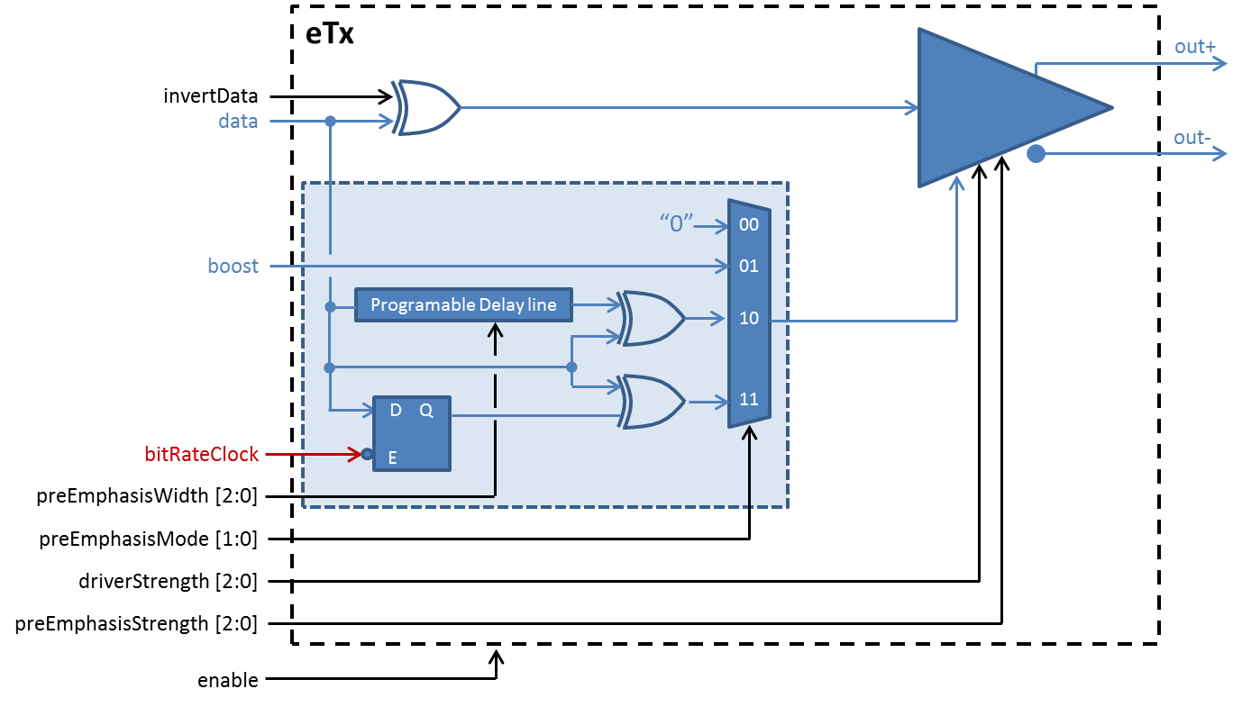
eLink Driver
Data rate:
  Up to 1.28 Gbps
Clock frequency:
  Up to 1.28 GHz
Driving current:
  Programmable: 1 to 4 mA in 0.5 mA steps
Receiving end termination:
  100 Ω
Voltage amplitude in 100 Ω:
  100 mV to 400 mV (SE PP amplitude)
  200 mV to 800 mV (DIFF PP amplitude)
Common mode voltage:
  600 mV
Selectable polarity
Pre-emphasis:
  Driving current: 1 to 4 mA in 0.5 mA steps
  Pulse width:
    Externally timed
    Self timed: 120 ps to 960 ps in steps of 120 ps
    Clock timed: T _{bit} / 2
Pre-emphasis logic
Macro cell, available for front-end designers (upon request)

Slide 81
eTx Functionality
Controls the polarity
of the driver
Programmable delay line allows to
generate pre-emphasis pulse widths
between 120 and 960 ps
Half bit period
pre-emphasis pulse width
Pre-emphasis
self-timed pulse
width selectable
Pre-emphasis pulse
Pre-emphasis
mode selectable
Pre-emphasis
amplitude
programmable

Slide 82
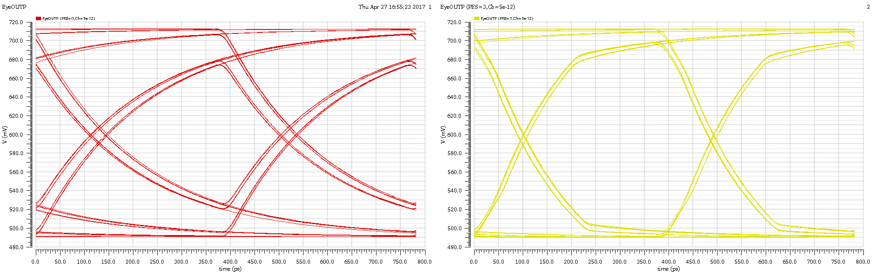
eTx – Pre-Emphasis
Data: PRBS 7
Data rate: 2.56 Gb/s
C_{L} = 2 x 5 pF
No Pre-Emphasis
Driver Strength = 2 mA
Pre-Emphasis Strength = 0 mA
Pulse width = n.a.
With Pre-Emphasis
Driver Strength = 2 mA
Pre-Emphasis Strength = 2 mA
Pulse width = T/2

Slide 83
Note about eLink Output Pin Names
Output from the lpGBT
eLink
Group number: 0, 1, 2 and 3 (there are 4 groups)
EDOUTGCP
Pin Polarity: P – Positive, N – Negative
(Remember: polarity can be inverted
at the output of the corresponding eTx)
Data
Channel number within a group: 0, 1, 2 or 3 (there
are 4 eLinks associated with every group)
Example: EDOUT32N – eLink data output group 3 channel 2 negative polarity pin

Slide 84
eLink Clocks
FE
Module
E – Port
Phase - Shifter
LpGBT
eLink
2.56 Gbps
EOM
LpGBTIA
FE
Module
E – Port
DSCR
DEC
DeSER
LR
E – Port
E – Port
CLK Manager
CDR/PLL
Ref CLK
(optional)
data-down
data-up
5.12 Gbps
or
10.24 Gbps
Phase – Aligners + Ser/Des for E – Ports
LpGBLD
clock
160 Mbps
to
1.28 Gbps ports
SCR
ENC
SER
LD
FE
Module
E – Port
E – Port
E – Port
Control Logic
Configuration
(e-Fuses + reg-Bank)
One 80 Mbps port
GBT – SCA
ADC
PIO
I2C Slave
I2C Masters
E – Port
aIn[7:0]
IO[15:0]
I2C
Port
I2C
Ports
data
control
clocks

Slide 85
eLink Clocks
Same drivers as for the Tx data eLinks, thus:
  Programmable: polarity, driving strength and pre-emphasis
4 programmable Phase/Frequency clocks:
  4 independent
  Phase resolution: 50 ps
  Frequencies: 40 / 80 / 160 / 320 / 640 / 1280 MHz
eLink Clocks:
  28 independent
  Fixed phase
  Frequency programmable
  Frequencies: 40 / 80 / 160 / 320 / 640 / 1280 MHz

Slide 86
Experiment Control and Environment Monitoring
FE
Module
E – Port
Phase - Shifter
LpGBT
eLink
2.56 Gbps
EOM
LpGBTIA
FE
Module
E – Port
DSCR
DEC
DeSER
LR
E – Port
E – Port
CLK Manager
CDR/PLL
Ref CLK
(optional)
data-down
data-up
5.12 Gbps
or
10.24 Gbps
Phase – Aligners + Ser/Des for E – Ports
LpGBLD
clock
160 Mbps
to
1.28 Gbps ports
SCR
ENC
SER
LD
FE
Module
E – Port
E – Port
E – Port
Control Logic
Configuration
(e-Fuses + reg-Bank)
One 80 Mbps port
GBT – SCA
ADC
PIO
I2C Slave
I2C Masters
E – Port
aIn[7:0]
IO[15:0]
I2C
Port
I2C
Ports
data
control
clocks

Slide 87
Digital
Three I2C Masters:
  Three general purpose masters
    But one typically dedicated to control the laser driver (LDQ10)
  Transfer rates: 100 KHz, 200 KHz, 400 KHz, 1 MHz
  7-bit and 10-bit addressing standards
  Single-byte and multi-byte I2C read/write bus operations
  Masters themselves controlled by:
    The I2C slave port (always possible)
    The IC – channel (only possible in transceiver mode)
    The EC – port (Only possible in Simplex RX or TX mode)
General Purpose I/O
  16-bit I/O port
  Optional internal pull-up / pull-down resistors
  Controlled by the same means as the I2C masters
Output reset pin
  Active low
  Programmable pulse duration

Slide 88
Analogue Peripherals
10 bit ADC
  Core: fully differential SAR
  8 channels (single ended or differential)
  Voltage amplifier (x1 .. x32)
  Sampling rate up to ~ 1MSps
  (limited by the control channel)
  Monitoring of internal signals (like VDD)
12 bit voltage DAC
8 bit current DAC
  can be attached to any analog input
  range: 0-1mA (8bit)
Temperature sensor
Current MUX
8-bit
Current DAC
InPSel[3:0]
Input[7:0]
GainSel[1:0]
Vref/2
x1-x32
ADC
dataOut[9:0]
InNSel[3:0]
Vref/2
Vref generator
Vref
12 bit
voltage DAC
DACout
Temp
Sensor

Slide 89
Example: Using an External Temperature Sensor
Current MUX
8-bit
Current DAC
X = 0, 1, … 7
InPSel[3:0]
ADCX
GainSel[1:0]
Vref/2
x1-x32
ADC
dataOut[9:0]
ΔV
InNSel[3:0]
PT100
I
Vref/2
Vref generator
Vref
12 bit
voltage DAC
DACout
Temp
Sensor

Slide 90
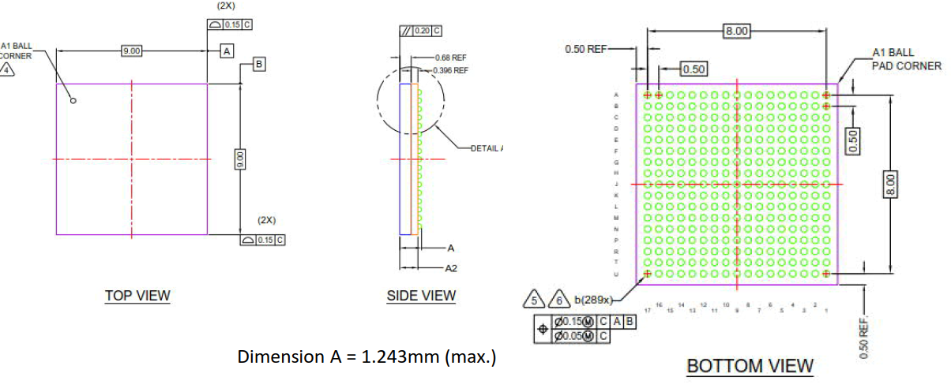
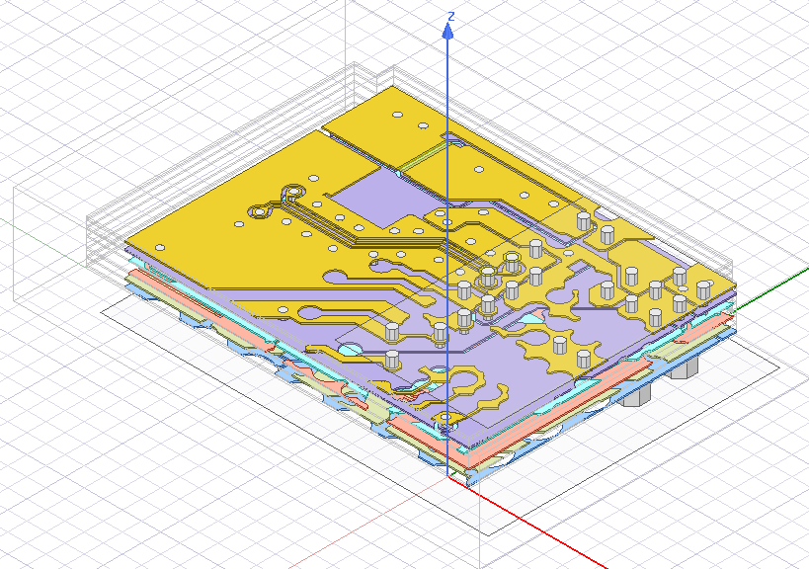
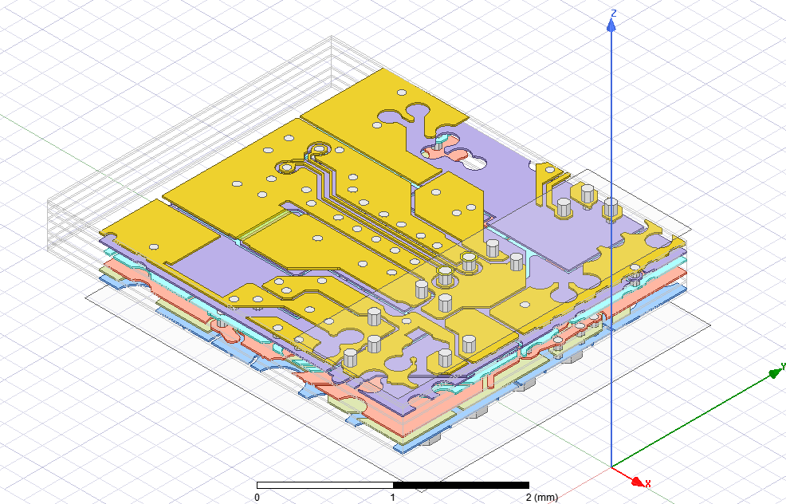
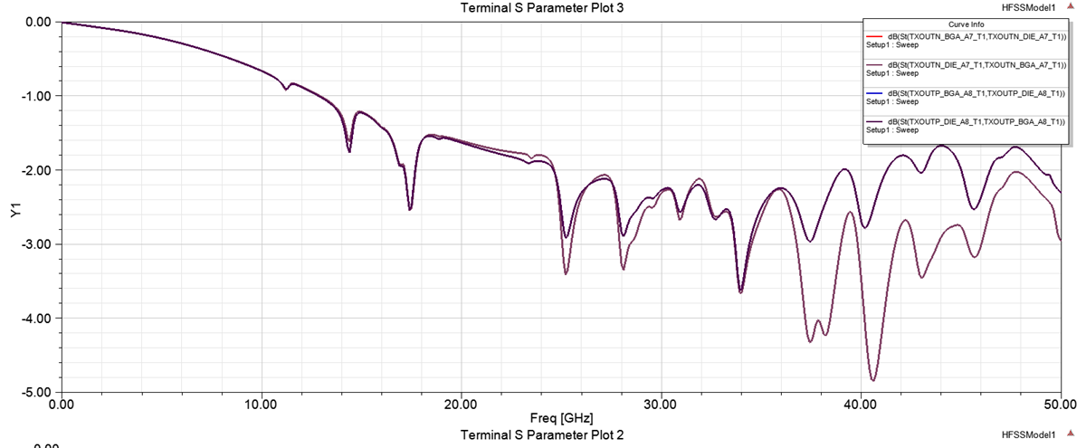
Package
Small Footprint BGA package:
  Size: 9 mm x 9 mm x 1.25 mm
  Fine Pitch: 0.5 mm
  Pin count: 289 (17 x 17)
Routing of high speed signals optimized and simulated
  Very small loss @ 10GHz
  Models used for line driver simulations

Slide 91
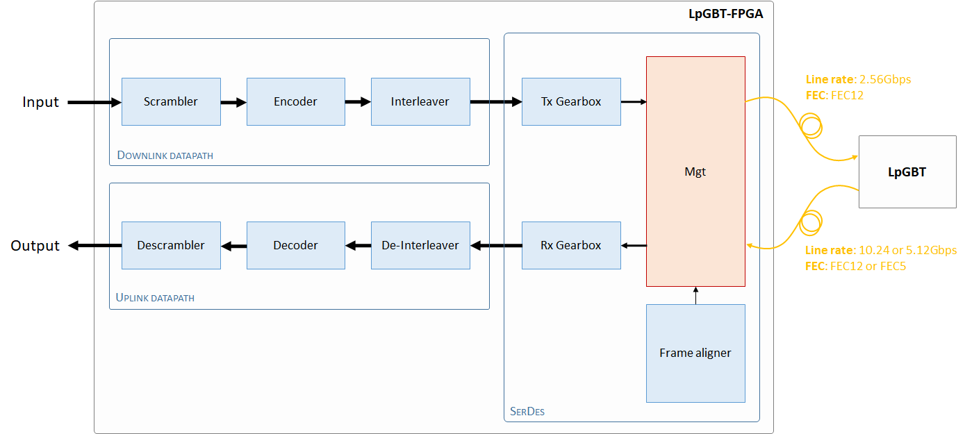
lpGBT FPGA
The lpGBT-FPGA provides a back-end counterpart to the lpGBT ASIC
Warning:
  “Strategy” departures from that used for the GBT-FPGA
  Not a single generic “block”;
  But a set:
    Of modules;
    Of implementation examples;
    Of reference notes.
  To help the user designing its own system!

Slide 92
lpGBT Simulation Model
The lpGBT model (will be) available to the users:
  To simplify the design and verification of front-end (ASIC) and back-end (FPGA) systems
Contains all essential features related to the data transition and slow control interfaces:
  Some of the chip’s analogue features are not modelled:
    e.g.: pre-emphasis, equalization, analogue I/O (ADC,DAC), pull up/down resistors;
“Distributed” as one System Verilog file, compatible with:
  Cadence Incisive
  Mentor Questa
  Synopsys VCS

Slide 93
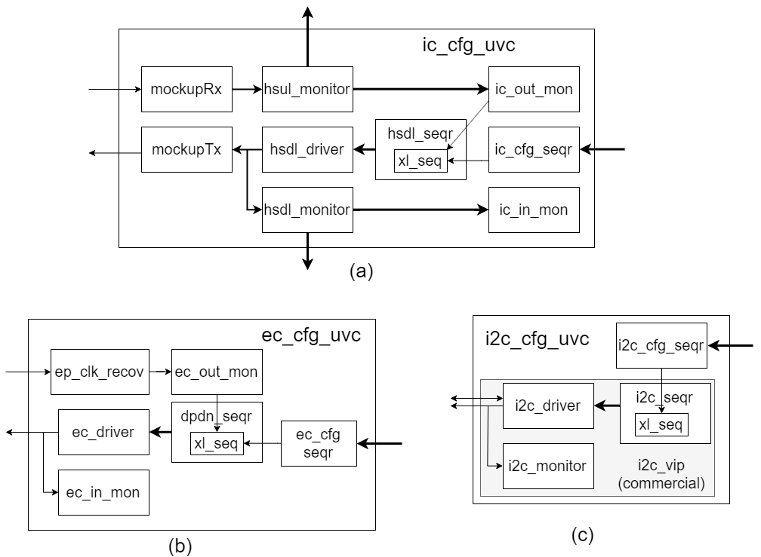
lpGBT UVM Agents

Slide 94
lpGBT tests
AliveTest
EcAliveTest
IcAliveTest
I2cAliveTest
FuseAliveTest
RalTest
I2cMastersTest
RegRandRwTest
PioTest
FuseBurningTest
RandTest

Slide 95
lpGBT – Functional & Performance Characterization
Data path validation
  High speed links (5G/10G, FEC5/FEC12)
  RX / TX ePort characterization (BER testing, phase aligners, data jitter, ...)
  Equalization / pre-emphasis on high-speed optical link and eLinks
Clock performance testing
  PLL and CDR clock quality, deterministic and random jitter, clock latency
  High-Resolution clock phase shifter
Analog peripheral characterization
  Bandgap reference
  Voltage ADC
  Current DAC
  Voltage DAC (linearity, noise, stability, temperature)
Configuration/Start-Up/Watchdog Testing
  Power-Up state machine
  Configuration flows: I²C, EC, IC, ROM, eFuses, CRC, …
  I²C Master, GPIOs
List not exhaustive!

Slide 96
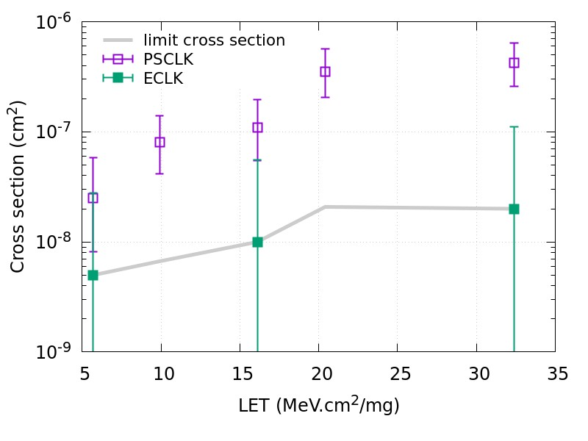
Single-Event Effects Testing – Clock Glitches
Glitches on Clock Signals
eClocks are not fully redundant all the way through the chain
  Short (100s of ps) SETs might appear on the clock outputs
eClock and PSclock were monitored during irradiation
  Sensitive to pulses longer than 100 ps
Frequency of occurrence characterized
  No further data collected (typical length of individual pulses unknown)
Heavy ion cross section for glitches on eClocks and phase programmable clocks

Slide 97
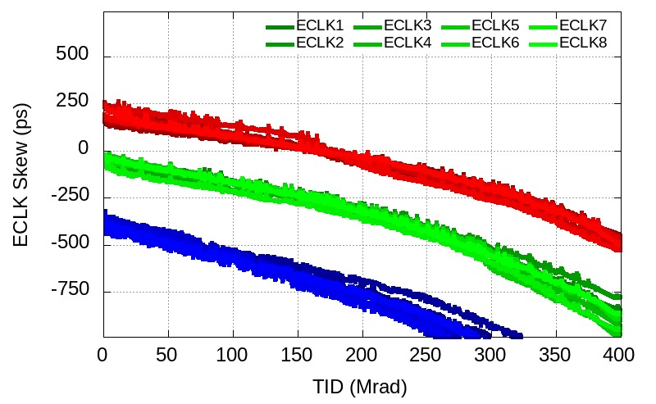
lpGBT X-ray TID Testing – eClock and eLink Delay
Clock and Data Delay
Clock and data delay through chip varies with VDD and TID
  Variations across supply range on the same level as drift over TID
Achieves excellent repeatability across power cycles
  Only long-term drift needs to be accounted for
Degradation of different eClocks is consistent
Evolution of eClock delay with TID

Slide 98
lpGBT – Functional & Performance Characterization
Data path validation
  High speed links (5G/10G, FEC5/FEC12)
  RX / TX ePort characterization (BER testing, phase aligners, data jitter, ...)
  Equalization / pre-emphasis on high-speed optical link and eLinks
Clock performance testing
  PLL and CDR clock quality, deterministic and random jitter, clock latency
  High-Resolution clock phase shifter
Analog peripheral characterization
  Bandgap reference
  Voltage ADC
  Current DAC
  Voltage DAC (linearity, noise, stability, temperature)
Configuration/Start-Up/Watchdog Testing
  Power-Up state machine
  Configuration flows: I²C, EC, IC, ROM, eFuses, CRC, …
  I²C Master, GPIOs
List not exhaustive!

Slide 99
Single-Event Effects Testing – Clock Glitches
Glitches on Clock Signals
eClocks are not fully redundant all the way through the chain
  Short (100s of ps) SETs might appear on the clock outputs
eClock and PSclock were monitored during irradiation
  Sensitive to pulses longer than 100 ps
Frequency of occurrence characterized
  No further data collected (typical length of individual pulses unknown)
Heavy ion cross section for glitches on eClocks and phase programmable clocks

Slide 100
lpGBT X-ray TID Testing – eClock and eLink Delay
Clock and Data Delay
Clock and data delay through chip varies with VDD and TID
  Variations across supply range on the same level as drift over TID
Achieves excellent repeatability across power cycles
  Only long-term drift needs to be accounted for
Degradation of different eClocks is consistent
Evolution of eClock delay with TID

