Slide 1
CLEAR planning
CLEAR in shutdown, machine commissioning started. Operations expected to resume in September
Tests ready for September?
  ChDR theory validation
  cBPMs
  continuation of BL via EOSD
  X-rays ChR
  …any other?

Slide 2
Vacuum test stand
location for in-vacuum tests identified: 730 mm long, 40 mm dia straight after cBPMs. Target location of Xrays ChR test
MME will update the layout.
Need to produce support
  compatible with different vacuum chambers
  transverse / vertical mover needed?

Slide 3
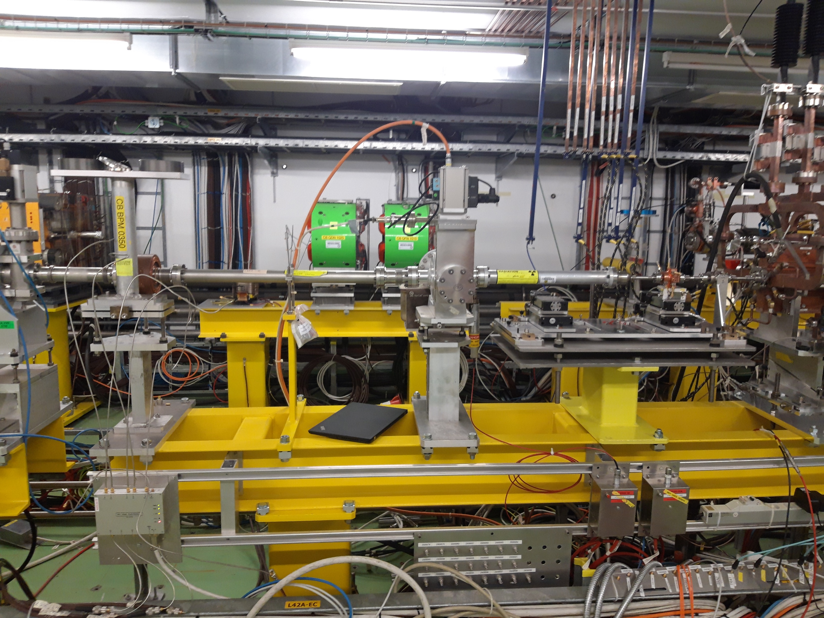

Slide 4
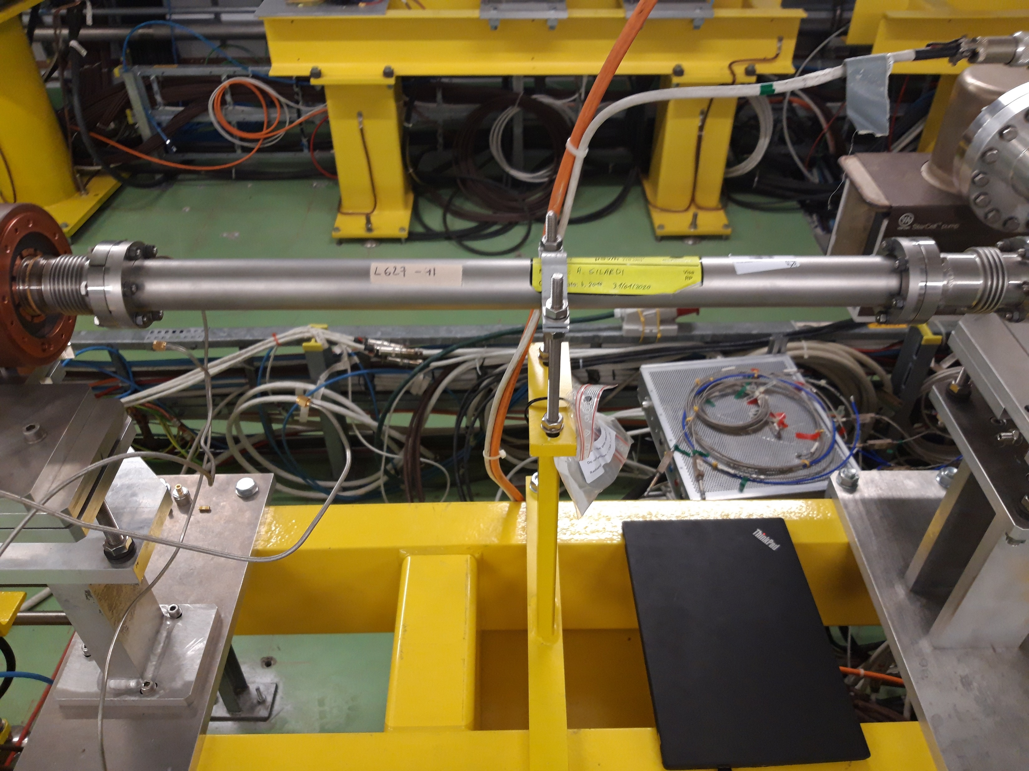

Slide 5
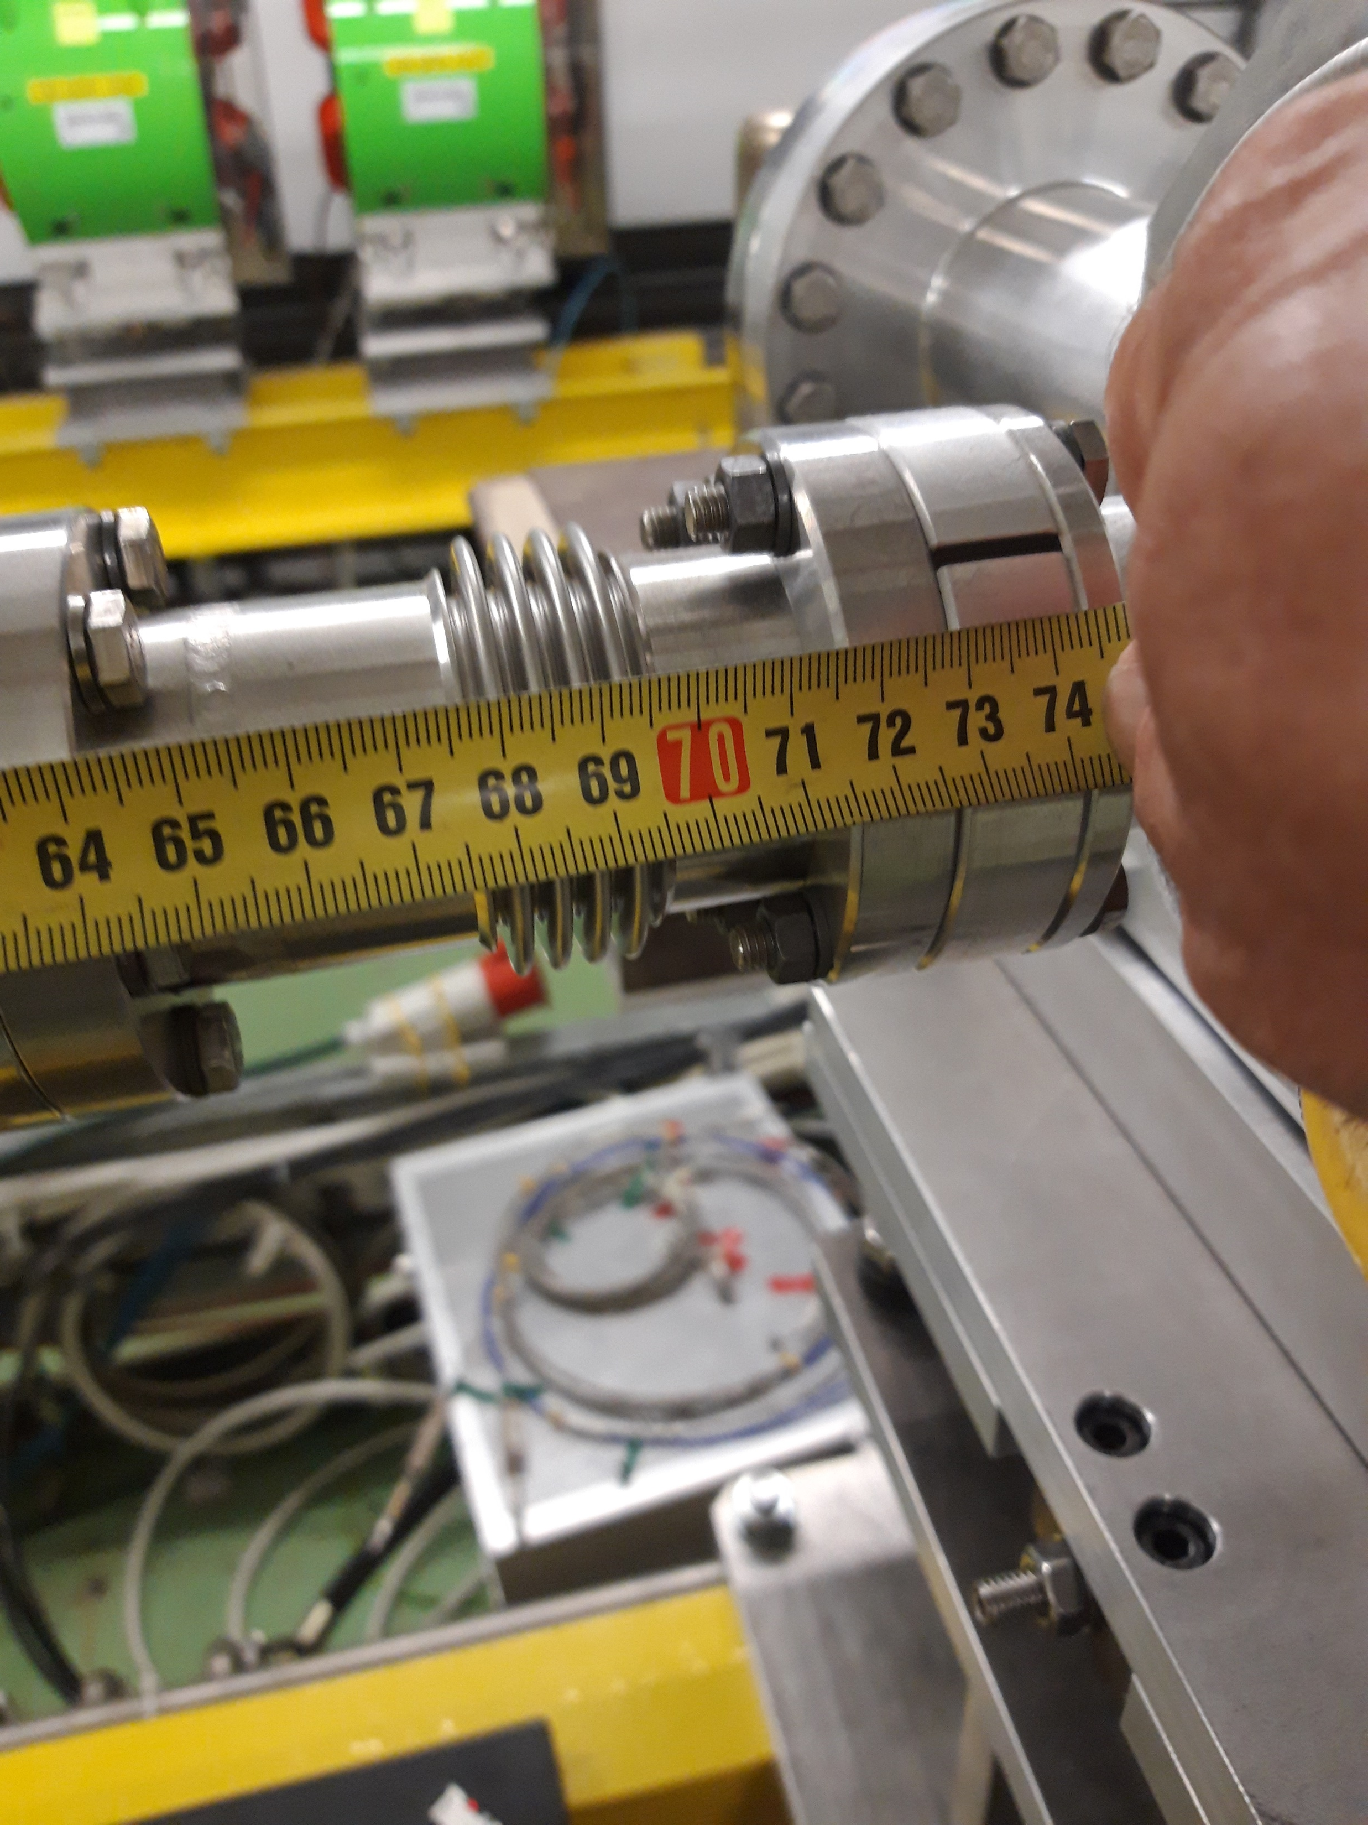

Slide 6
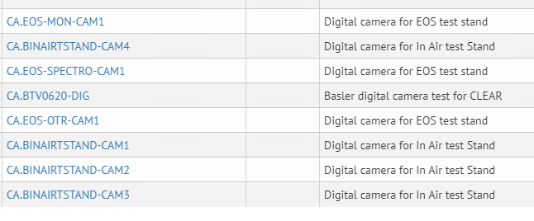
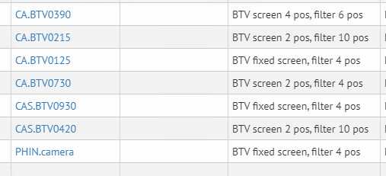
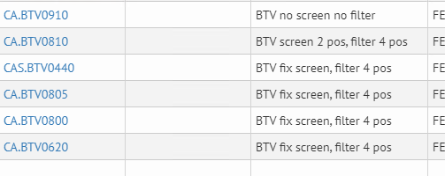
Digital camera upgrade
8 digital cameras (cfv-2010-btvclear)
At present we have
7 analog cameras (cfv-2010-btvclex1)
6 analog cameras (cfv-2010-btvclex2)

Slide 7
Digital camera upgrade
8 digital cameras (cfv-2010-btvclear)
At present we have
7 analog cameras (cfv-2010-btvclex1)
6 analog cameras (cfv-2010-btvclex2)

Slide 8
Digital camera upgrade
SW:
  FESA Class “BTVDC” available, but GUI missing.
  Preliminary version should be ready 1st half of August, final version will be developed by new member of SW team starting 1st Sept (Until then: PyBasler)
HW:
  started procurement of equipment. PoE switch located in KG connected to FEC
  Cables (eth + coax): need to be pulled
  Two additional positions for new injector in PHIN

